Slide 1
Accelerating with Torchy, a tracing JIT compiler
Nuno Lopes
MSR Cambridge

Slide 2
Eager-mode frameworks are amazing!
x = torch.tensor(((1.,2.), (3.,4.))) y = torch.tensor(((5.,6.), (7.,8.)))
z = x.mul(y) z = z.add(y) x.add_(z)
print(x)
tensor([[11., 20.],
[31., 44.]])

Slide 3
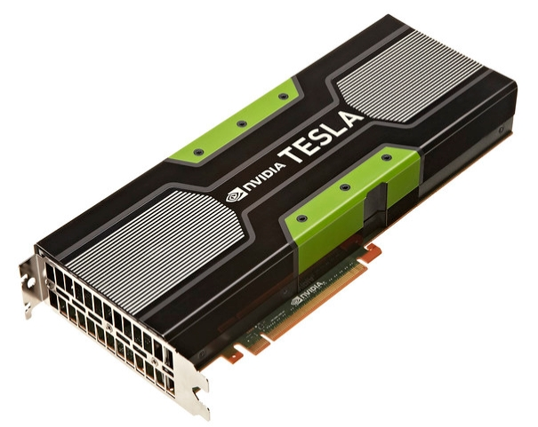
Eager-mode frameworks are slow! 🙄
x = torch.tensor(((1.,2.), (3.,4.))) y = torch.tensor(((5.,6.), (7.,8.)))
z = x.mul(y) z = z.add(y) x.add_(z)
print(x)
tensor([[ 5., 12.],
[21., 32.]])
tensor([[10., 18.],
[28., 40.]])
tensor([[11., 20.],
[31., 44.]])
tensor([[11., 20.],
[31., 44.]])

Slide 4
Eager-frameworks “hacks”
x = torch.tensor(((1.,2.), (3.,4.)))
y = x.transpose(0, 1)
y[0,0] = 42
print(y) print(x)
tensor([[42., 3.],
[ 2., 4.]])
tensor([[42., 2.],
[ 3., 4.]])
+ ever-increasing list of fused ops that users need to call manually
Transpose fuses marvelously with matmul!

Slide 5
What’s a Tensor?
Multiple tensor implementations:
Dense
Sparse
Batched
…
Python Tensor
PyTorch Tensor
Ref counted
TensorImpl
Storage
Ref counted
StorageImpl
Interpretation of the data (aka view)
The data
Other Languages
pybind / C Python API
PyTorch C++’14 code

Slide 6
Tensor creation
Python Tensor
PyTorch Tensor
Ref counted
TensorImpl
Storage
Ref counted
StorageImpl
New Tensor/TensorImpl/Storage/StorageImpl w/ default type & placed on default device
x = torch.tensor(((1.,2.), (3.,4.))) y = torch.tensor(((5.,6.), (7.,8.)))
z = x.mul(y) x.add_(z)
w = x.to(torch.float, copy=False)
z = x.transpose(0, 1)
New Tensor/TensorImpl/Storage/StorageImpl w/ same type & device as inputs
Nothing new; override StorageImpl’s data
Bump Tensor ref count if types match; new Tensor/Storage otherwise
New Tensor/TensorImpl; bump Storage ref count

Slide 7
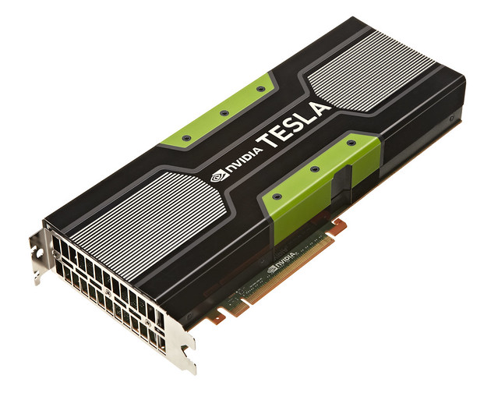
Life of a PyTorch function call
z = x.add(y)
Waterfall dispatcher
Dispatch:
Operation = Add.Tensor
Op0 = Tensor, CPU, Float
Op1 = Tensor, CPU, Float
Global dispatcher state:
Default device = CPU
Default type = Float
Include dispatch key = None
VMap
Batched
Autocast
Tracer
Autograd
Backend Select
Devices (CPU, CUDA, etc)

Slide 8
Speeding up PyTorch today (single device)
TorchScript Tracing (torch.jit.trace)
TorchScript Compilation (torch.jit.script)
ORT Module
Autocast / apex (fp32 -> fp16)

Slide 9
TorchScript Tracing
Function/module is executed (twice) with concrete inputs & operations recorded
def f(x, y):
z = x.add(y)
z.add_(x)
return x.mul(z)
w = torch.tensor(…)
z = torch.tensor(…)
torch.jit.trace(f, (w, z))
SSA-based IR:
def f(x: Tensor, y: Tensor) -> Tensor:
z = torch.add(x, y, alpha=1)
z0 = torch.add_(z, x, alpha=1)
return torch.mul(x, z0)

Slide 10
Tracing input-dependent code
def RAdam(wd, N_sma, …):
if wd != 0:
p_data_fp32.add_(p_data_fp32, alpha=-wd * lr)
# more conservative since it's an approximated value
if N_sma >= 5:
denom = exp_avg_sq.sqrt().add_(eps)
p_data_fp32.addcdiv_(exp_avg, denom, value=-step_size)
else:
p_data_fp32.add_(exp_avg, alpha=-step_size)
There are 4 possible different traces depending on the input!
But TorchScript Tracing only supports single-trace functions.

Slide 11
TorchScript Compilation
Compiler from Python AST to an SSA-based IR (the same used by tracing)
Supports functions with control-flow
But no support for too many Python features (only tensor inputs, no lambdas, no union types, etc, etc)
Many real-world codebases are too pythonic. Will never work with TorchScript!

Slide 12
Is PyTorch inherently inefficient?

Slide 13
All problems in computer science can be solved by another level of indirection, except performance.

Slide 14
All problems in computer science can be solved by another level of indirection, except performance.
including

Slide 15
Torchy A tracing JIT compiler for PyTorch

Slide 16
Most Tensors are not observed
w = x.mul(y) w = w.add(y) w.add_(x)
print(w)
Tensors are only observed:
Data access, e.g., for branching on data-dependent models
Printing
Some PyTorch functions query layout, size, etc for pre-dispatch optimization (a hack)
Function from 2 tensors to another tensor
Intermediate values of w not observed

Slide 17
Idea: delay execution until observation
x = torch.tensor(((1.,2.), (3.,4.))) y = torch.tensor(((5.,6.), (7.,8.)))
w = x.mul(y) w = w.add(y) x.add_(w)
print(x)
Tracing JIT Compiler
w0 = x.mul(y)
w1 = w0.add(y)
x1 = x.add_(w1)
tensor([[11., 20.],
[31., 44.]])
Observation event! Stop tracing and compute

Slide 18
Tracing JIT compilers
A tremendous success for JavaScript in the past decade
Batch operations as execution is delayed
Detect which tensors are temporaries to help optimization
Traces can be optimized before execution, or in background
Traces repeat; optimization cost amortized
Work with any codebase unmodified!

Slide 19
Intercepting PyTorch function calls
z = x.add(y)
Waterfall dispatcher
Dispatch:
Operation = Add.Tensor
Op0 = Tensor, CPU, Float
Op1 = Tensor, CPU, Float
Global dispatcher state:
Default device = CPU
Default type = Float
Include dispatch key = Torchy
VMap
Batched
Alternative backends:
Glow
LLVM/MLIR
ONNX Runtime (ORT)
TorchScript
XLA
…
Autocast
Tracer
Torchy
Autograd
Backend Select
Trace
z = add(x, y)
Devices (CPU, CUDA, etc)
import torchy
torchy.enable()

Slide 20
Intercepting non-dispatched events
print(x)
x.storage()
x.storage()
Python Tensor
PyTorch Tensor
Torchy Tensor
TensorImpl
Storage
StorageImpl
Is tensor materialized?
- Yes: behave like a normal tensor
- No: flush trace & act normally

Slide 21
Early experiments
Benchmarks:
TorchVision: ResNet-18, ResNeXt, MobileNet v3 large
Hungging Face: sentiment analysis (Bert)
PyTorch 1.9+

Slide 22
Bert from the compiler’s perspective
Weight initialization
Model

Slide 23
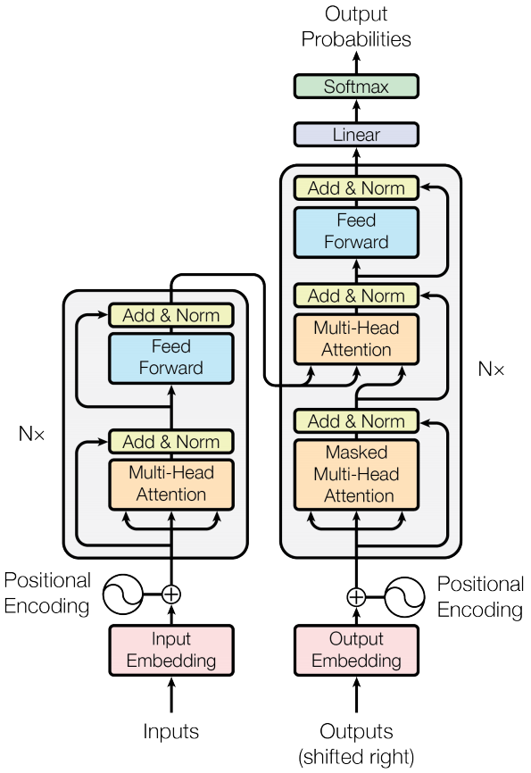
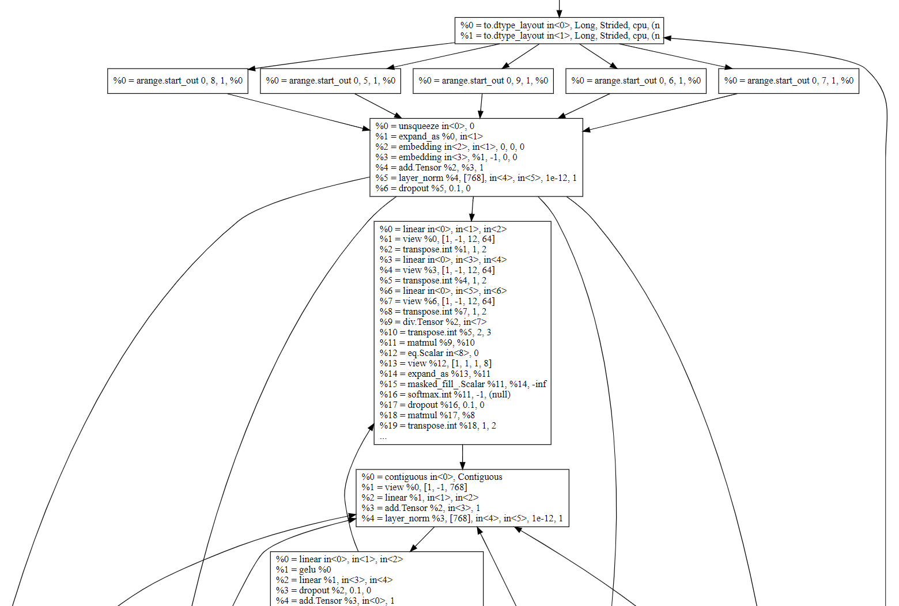
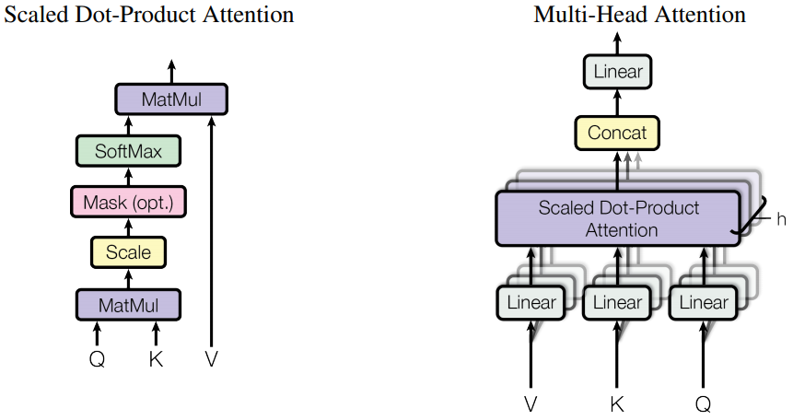
Embedding
Attention Head
Normalization
Feed Forward

Slide 24
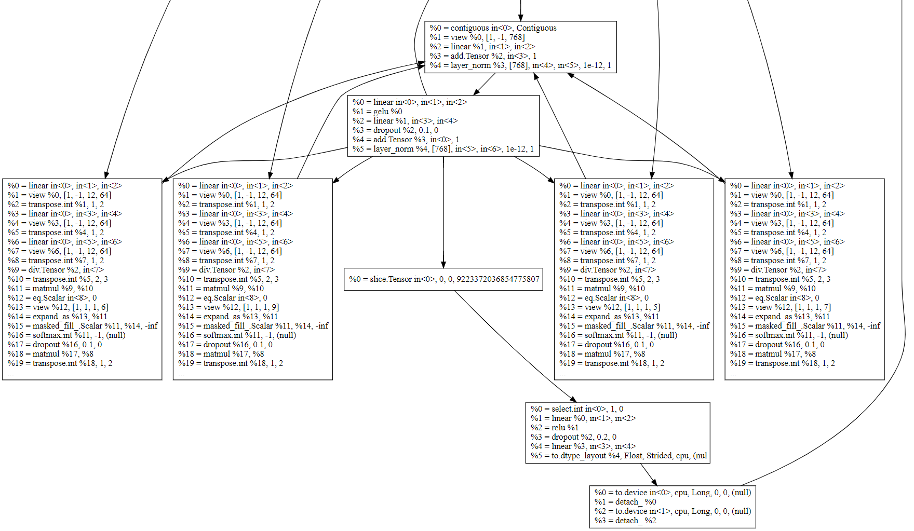
Normalization
Feedforward
Attention
Output result

Slide 25
Summary: Torchy
Acceleration for dynamic PyTorch programs
Converts programs into small-ish straight-line programs (traces)
Optimizes and runs each trace with the best backend
Zero code changes! Just ‘pip install torchy’

