Slide 2
Automatic Software Verification with SMT
Nuno Lopes

Slide 3
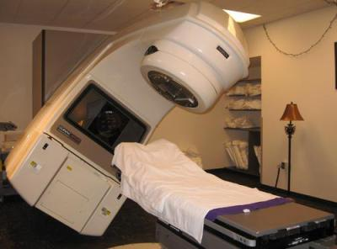
Deadly Software Bugs
Therac-25
Ariane 5

Slide 4
Compiler bugs
New trend to exploit compiler bugs to introduce backdoors
Major projects to verify compilers (LLVM, Visual Studio C++)

Slide 5
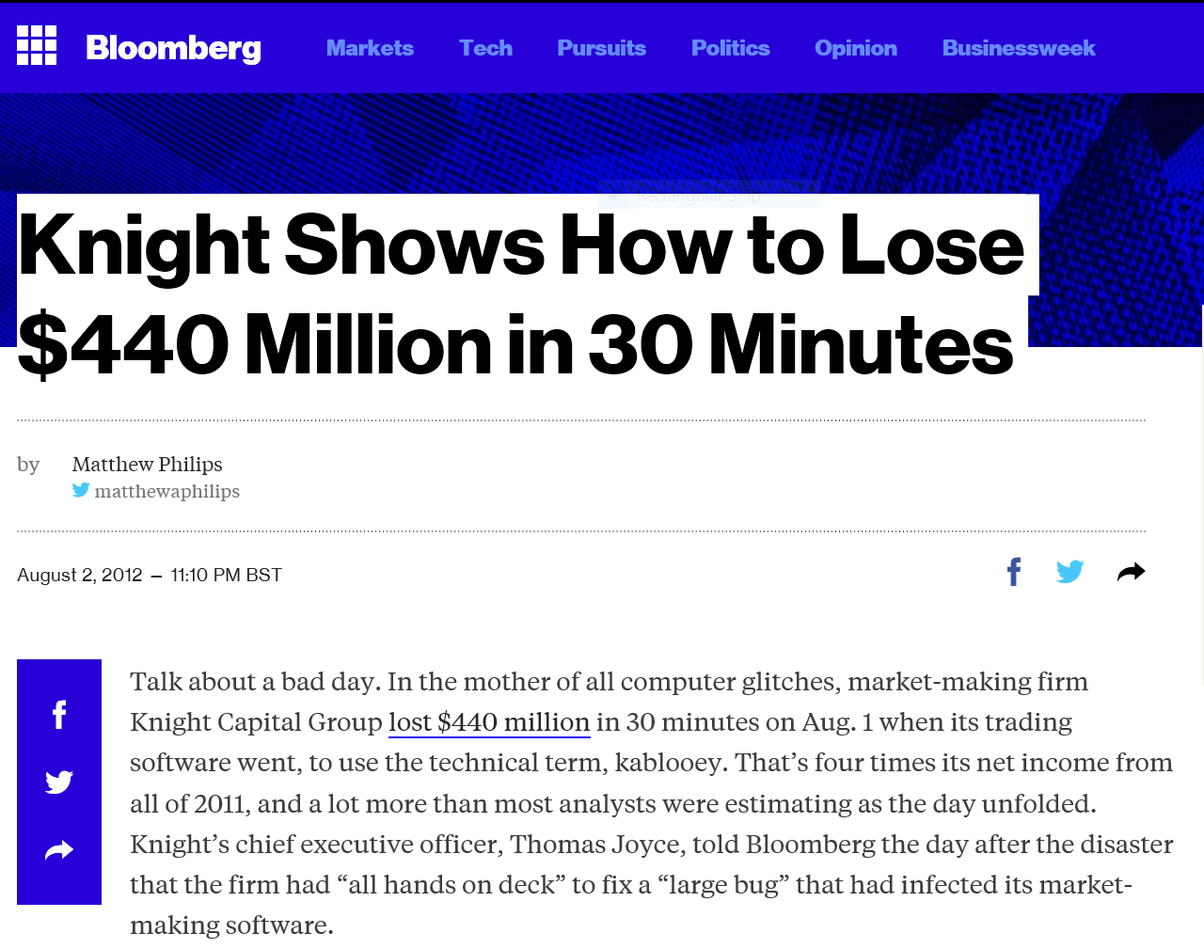

Slide 7
Bugs are Annoying too..

Slide 8
Why should YOU care?
Be the hero: save lives and/or money
Be the hero: save us from hackers
Be the hero: save us from blue screens
All major companies hiring in this area

Slide 9
Can this assert() crash?
void f(int n) {
int j = 0;
for (int i = 0; i < n; ++i) {
j += 1;
}
assert(j >= n);
}
n = 0, j = 0 ✓
n = 1, j = 1 ✓
…
n = -1, j = 0 ✓
n = -2, j = 0 ✓

Slide 10
Today
Applying SMT to software verification
SMT: learning from program analysis

Slide 11
Program Analysis
Abstract interpretation / static analysis
Symbolic execution
Bounded model checking (BMC)
Model checking
Different clients: program verification, bug finding, compiler optimization, refactoring, code metrics, …

Slide 12
Verification
Error states
Reachable abstract states
Reachable states
Notes:
State: valuation of program variables

Slide 13
Abstract Interpretation (AI)
Execute program with abstract values (e.g., intervals)
Widening: converge faster (loses completeness)
Abstraction: forget (potentially) irrelevant information

Slide 14
AI: example
void f() {
int i = 0;
while (i < 100) {
++i;
}
assert(i == 100);
}
i₀ = 0
i = ϕ(i₀, i₁)
i < 100
i ≥100
i₁ = i + 1
i₂ = i
i₂ ≠100
i₂ =100
error
return

Slide 15
Interval domain
Interval:
$$\left\{\left[l,h\right] \right| l≤h, l∈ℤ∪\{−∞\}, h∈ℤ∪\{+∞\}\}$$
Abstraction function α:
α(s) = [min(s), max(s)]
Example:
α({1, 3}) = [1, 3]

Slide 16
AI with intervals
i₀ = 0
$$i_{0}=\left[0,0\right] \\ i′=\left(i_{0}∪i_{1}\right)∩\left[−∞,99\right] \\ i_{1}=i′+\left[1,1\right] \\ i_{2}=\left(i_{0}∪i_{1}\right)∩\left[100,+∞\right]$$
i = ϕ(i₀, i₁)
i < 100
i ≥100
i₁ = i + 1
i₂ = i
Does this always hold?
$$i_{2}∩(i_{2}≠100)=∅$$
i₂ ≠100
i₂ =100
error
return

Slide 17
AI: least fixed-point (lfp)
$$i_{0}=\left[0,0\right] \\ i′=\left(i_{0}∪i_{1}\right)∩\left[−∞,99\right] \\ i_{1}=i′+\left[1,1\right] \\ i_{2}=\left(i_{0}∪i_{1}\right)∩\left[100,+∞\right]$$
$$i_{0}=\left[0,0\right] \\ i′ =∅ \\ i_{1}=∅ \\ i_{2}=∅$$
$$i_{0}=\left[0,0\right] \\ i′ =\left[0,0\right] \\ i_{1}=∅ \\ i_{2}=∅$$
$$i_{0}=\left[0,0\right] \\ i′ =\left[0,0\right] \\ i_{1}=[1,1] \\ i_{2}=∅$$
$$i_{0}=\left[0,0\right] \\ i′ =\left[0,1\right] \\ i_{1}=[1,1] \\ i_{2}=∅$$
$$i_{0}=\left[0,0\right] \\ i′ =\left[0,1\right] \\ i_{1}=[1,2] \\ i_{2}=∅$$
1st iteration
2nd
3rd
4th
5th

Slide 18
AI: least fixed-point (lfp)
$$i_{0}=\left[0,0\right] \\ i′=\left(i_{0}∪i_{1}\right)∩\left[−∞,99\right] \\ i_{1}=i′+\left[1,1\right] \\ i_{2}=\left(i_{0}∪i_{1}\right)∩\left[100,+∞\right]$$
$$i_{0}=\left[0,0\right] \\ i′ =∅ \\ i_{1}=∅ \\ i_{2}=∅$$
$$i_{0}=\left[0,0\right] \\ i′ =\left[0,99\right] \\ i_{1}=[1,100] \\ i_{2}=[100,100]$$
…
1st iteration
last iteration

Slide 19
AI: least fixed-point (lfp)
i₀ = 0
$$i_{0}=\left[0,0\right] \\ i′=\left(i_{0}∪i_{1}\right)∩\left[−∞,99\right] \\ i_{1}=i′+\left[1,1\right] \\ i_{2}=\left(i_{0}∪i_{1}\right)∩\left[100,+∞\right]$$
i = ϕ(i₀, i₁)
i < 100
i ≥100
i₁ = i + 1
i₂ = i
$$i_{0}=\left[0,0\right] \\ i′ =\left[0,99\right] \\ i_{1}=[1,100] \\ i_{2}=[100,100]$$
i₂ ≠100
i₂ =100
error
return
Does this always hold?
$$i_{2}∩{(i}_{2}≠100)=∅$$

Slide 20
AI: Widening
What we just did was super slow!
Faster to execute program
Widening: converge lfp faster:
$$\left[l,h\right] ∇ \left[l^{′},h^{′}\right]=[if l^{′}<l then −∞ else l,$$ $if h^{′}>h then+∞ else h]$

Slide 21
AI: lfp with widening
$$i_{0}=\left[0,0\right] \\ i′=({i′}_{ }∇\left(i_{0}∪i_{1}\right))∩\left[−∞,99\right] \\ i_{1}=i′+\left[1,1\right] \\ i_{2}=\left(i_{0}∪i_{1}\right)∩\left[100,+∞\right]$$
$$i_{0}=\left[0,0\right] \\ i =\left[0,99\right] \\ i_{1}=[1,100] \\ i_{2}=[100,100]$$
$$i_{0}=\left[0,0\right] \\ i′ =∅ \\ i_{1}=∅ \\ i_{2}=∅$$
$$i_{0}=\left[0,0\right] \\ i′ =\left[0,0\right] \\ i_{1}=∅ \\ i_{2}=∅$$
$$i_{0}=\left[0,0\right] \\ i′ =\left[0,0\right] \\ i_{1}=[1,1] \\ i_{2}=∅$$
$$i_{0}=\left[0,0\right] \\ i′ =\left[0,99\right] \\ i_{1}=[1,1] \\ i_{2}=∅$$
$$i_{0}=\left[0,0\right] \\ i′ =\left[0,99\right] \\ i_{1}=[1,100] \\ i_{2}=∅$$
1st iteration
2nd
3rd
4th
5th

Slide 22
Abstract Interpretation
Least fixed-point over equations
Each iteration: multiple abstract domain operations
Arithmetic operations, union, conjunction, etc
Usually not implemented with SMT
SMT can be used to compute optimal results

Slide 23
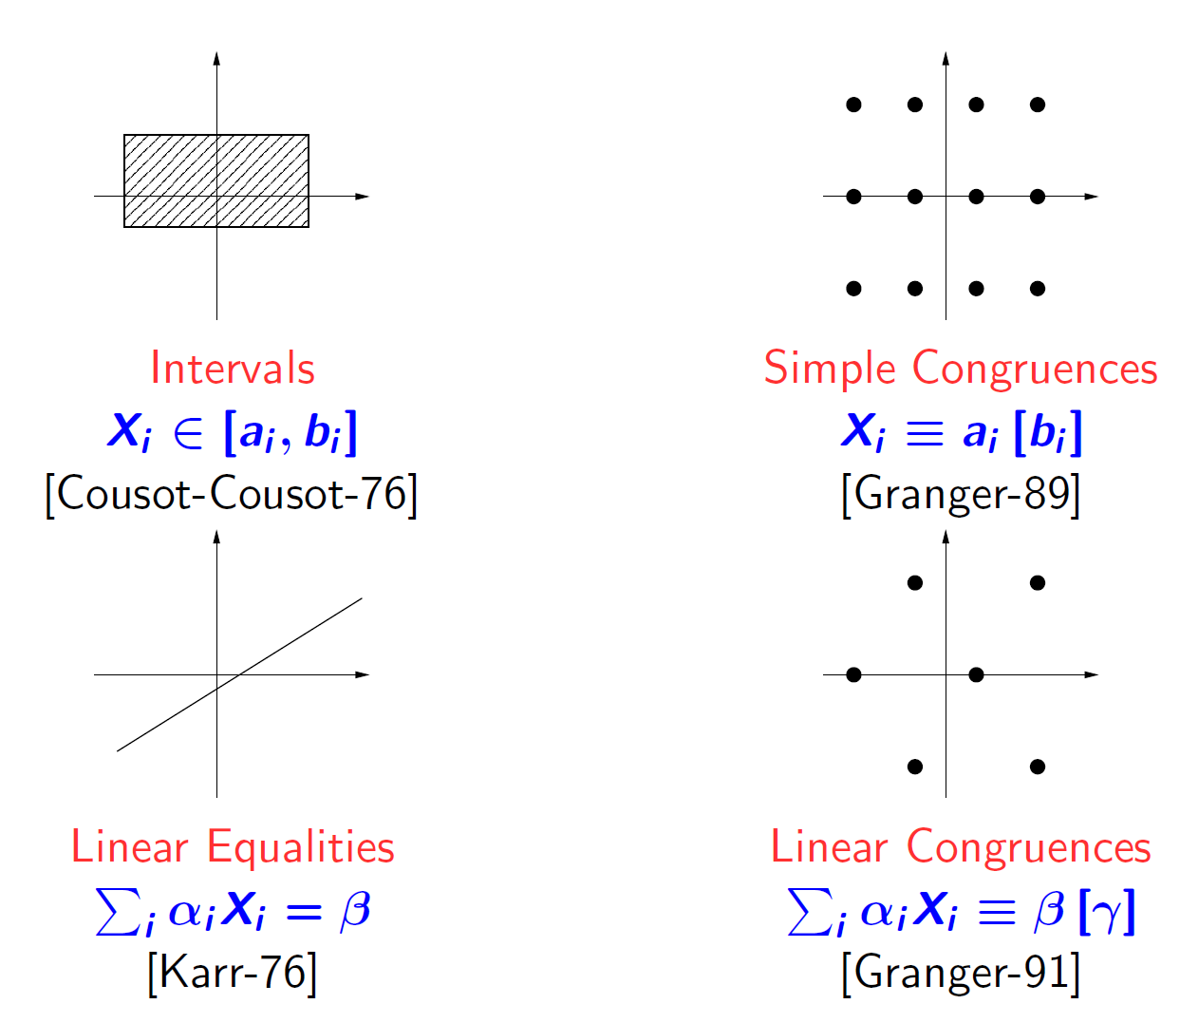
AI: Many domains
Bertrand Jeannet, Antoine Miné [CAV’09]

Slide 24
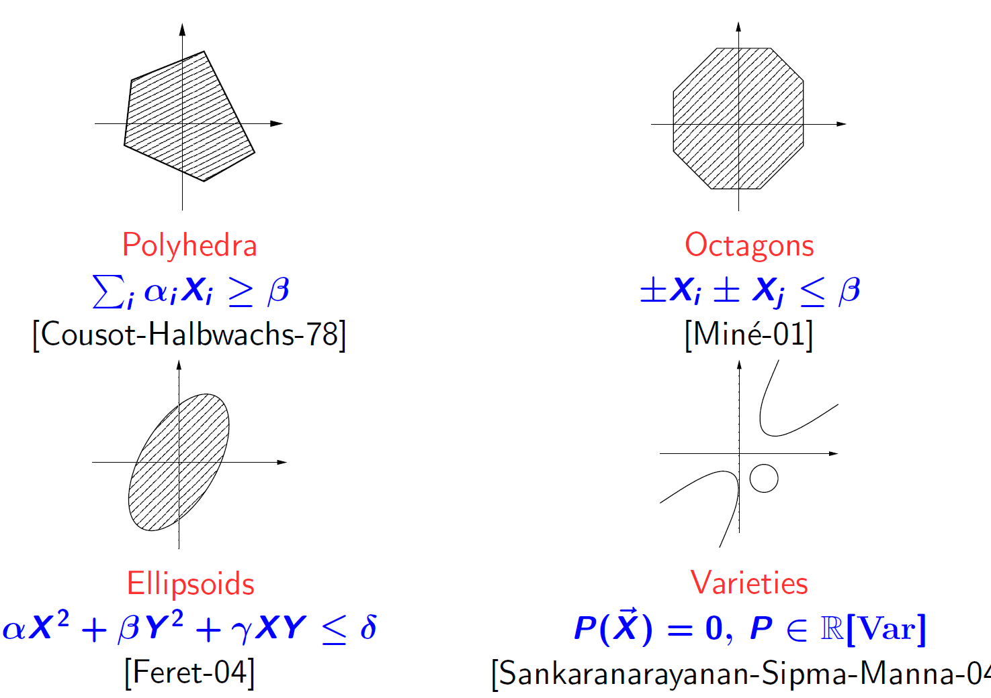
AI: Many domains
Bertrand Jeannet, Antoine Miné [CAV’09]

Slide 25
Symbolic execution
Execute program with an SMT solver
Mostly for bug finding; usually doesn’t terminate
Usually 1 query per branch

Slide 26
SE: example
void f(int n) {
int j = 0;
for (int i = 0; i < n; ++i) {
j += 1;
}
assert(j >= n);
}
j₀ = 0 i₀ = 0
i < n
i ≥n
i₁ = i + 1
j₁ = j + 1
skip
j < n
j ≥n
i < n
i ≥n
error
return
…
…

Slide 27
SE: example
SMT queries
j₀ = 0 i₀ = 0
$$j_{0}=0 ⋀{ i}_{0}=0 ⋀{ i}_{0}<n$$
$$j_{0}=0 ⋀{ i}_{0}=0 ⋀{ i}_{0}≥n ⋀ j_{0}<n$$
i < n
i ≥n
i₁ = i + 1
j₁ = j + 1
skip
j < n
j ≥n
i < n
i ≥n
error
return
…
…

Slide 28
SE: implementation
Incremental queries along a path
fork() to copy SMT solver state (on branching)
Usually BFS, easily parallelizable
Mixed SAT/UNSAT queries

Slide 29
BMC: Bounded Model Checking
Similar to symbolic execution
But usually encodes whole program in single query
1 query per unfolding

Slide 30
BMC: example
void f(int n) {
int j = 0;
for (int i = 0; i < n; ++i) {
j += 1;
}
assert(j >= n);
}
1 unfolding
void f(int n) {
int j = 0;
int i = 0;
assume(i < n);
j += 1;
++i;
assume(i >= n);
assert(j >= n);
}
0 unfoldings
void f(int n) {
int j = 0;
int i = 0;
assume(i >= n);
assert(j >= n);
}

Slide 31
BMC: SMT queries
0 unfoldings
1 unfolding
void f(int n) {
int j = 0;
int i = 0;
assume(i >= n);
assert(j >= n);
}
void f(int n) {
int j = 0;
int i = 0;
assume(i < n);
j += 1;
++i;
assume(i >= n);
assert(j >= n);
}
$$j_{0}=0∧ i_{0}=0∧i_{0}≥n∧j_{0}<n$$
$$j_{0}=0∧ i_{0}=0∧{i_{0}<n∧i_{1}=i_{0}+1∧j_{1}=j_{0}+1∧i}_{1}≥n∧j_{1}<n$$

Slide 32
BMC: implementation
Mostly UNSAT queries (SAT = bug in program)
Not incremental
Advanced: termination with k-induction (not covered)

Slide 33
Model Checking
Abstract Interpretation, but abstraction is built as needed
CEGAR loop to refine abstraction (counterexample-guided abstraction refinement)
Abstraction: as coarse as possible, precise when needed

Slide 34
SMC: Cartesian predicate abstraction
Set of predicates, e.g., $P=\{x≥0,x+y<2, x=3\}$
$α\left(x=0∧y<1\right)=\{0,1\}$
Entailment can be approximated syntactically:
If $a⊆b$ then $b→a$
E.g. $\left\{1\right\}⊆\{1,3\}$ so $x≥0∧ x+y<2→x≥0$

Slide 35
SMC: Example
void f(int n) {
int j = 0;
for (int i = 0; i < n; ++i) {
j += 1;
}
assert(j >= n);
}
j₀ = 0 i₀ = 0
j = ϕ(j₀, j₁) i = ϕ(i₀, i₁)
i < n
i ≥n
j₁ = j + 1 i₁ = i + 1
i₂ = i
j₂ < n
j₂ ≥ n
error
return

Slide 36
SMC: Example
j₀ = 0 i₀ = 0
$$P=\{\}$$
$$\{\}$$
$$j_{0}=0∧i_{0}=0∧i_{0}≥n∧j_{0}<n$$
j = ϕ(j₀, j₁) i = ϕ(i₀, i₁)
UNSAT = abstraction too coarse
$$\{\}$$
i < n
i ≥n
j₁ = j + 1 i₁ = i + 1
i₂ = i
$$\{\}$$
j₂ < n
j₂ ≥ n
error
return

Slide 37
SMC: Example Refinement
j₀ = 0 i₀ = 0
$$P=\{i=j,i≥n\}$$
$$\{0\}$$
$$j=0∧i=0→p_{0}(i,j)$$
$$p_{0}\left(i,j\right)→p_{1}\left(i,j\right)$$
j = ϕ(j₀, j₁) i = ϕ(i₀, i₁)
$$\{0\}$$
$$p_{1}\left(i,j\right)∧i≥n→p_{2}\left(i,j,n\right)$$
$$p_{2}\left(i,j,n\right)∧j<n→⊥$$
i < n
i ≥n
j₁ = j + 1 i₁ = i + 1
i₂ = i
$$p_{0}\left(i,j\right)≔i=j \\ p_{1}\left(i,j\right)≔i=j \\ p_{2}\left(i,j,n\right)≔i≥n$$
$$\{0\}$$
$$\{0,1\}$$
j₂ < n
j₂ ≥ n
error
return
unreachable

Slide 38
SMC: Refinement
Many algorithms: interpolants from SMT proof of UNSAT, algebra equations (Farkas lemma), polynomial rings, etc
Predicate list: global, per “line”, per function, etc

Slide 39
SMC: Implementation
Either discard all state across iterations, maintain partial state or whole sub-trees
BFS vs DFS: no clear choice
1 query per predicate per “line” per iteration

Slide 40
Comparison
 | Abstraction | # SMT queries | Query result | Incremental?
Abstract Interp | Fixed | 1 per “line” per iteration | SAT | No
Symbolic Exec | No | 1 per path | mixed | Yes
BMC | No | 1 per unfolding | UNSAT | No
Model Checking | Adaptive | 1 per “line” per predicate per iteration | UNSAT | No

Slide 41
Though clients
Variety of theories: integers, rationals, reals, bit-vectors, floats
Plus arrays and UFs
Plus: incremental, copy SMT state, small queries and huge queries
Resource bounds (time, memory)
Sometimes w/ quantifiers

Slide 42
Preprocessing is awesome
 | QARMC | QARMC -nopreprocess
cdaudio.bug | 7s | 70s (10x)
diskperf | 88s | > 600s (> 7x)
summ_mccarthy | 0.5s | > 50s (> 100x)
qrdcmp | 1s | > 100s (> 100x)
tridag | 0.7s | 1.4s (2x)

Slide 43
QARMC: preprocessing
C frontend:
Alias analysis
Trim read/write variable sets per function
….
At horn clause level:
Simplify formulas
Bottom-up / top-down symbol reachability
Inline clauses
Equality propagation
Subsumed clause elimination
Acceleration (compute simple loops)
Inter-clause transformations, like: constant/equality propagation, …

Slide 44
What does this mean for SMT?
Program analysis properties are often shallow
Most stuff is irrelevant
Cheap preprocessing pays off
Compilers have cheap constraint solvers
SMT solvers are already awesome; Can we aim for even more awesomeness?

Slide 45
API Experiments: queries/sec
 | Z3 BV | SICStus Prolog CLPQ | LLVM ConstantRange
True/False | 3,657 | 264,550 (72x)
$$a≥b$$ | 2,886 | 14,682 (5x)
$$a≥b∧b≥c$$ | 883 | 4,996 (6x)
$$f(a)≥b$$ | 1,748
$$f(a)≥b∧f(b)≥c$$ | 1,091
$$\left[0,42\right]∩[5,99]$$ |  |  | 20 Million
5,000x potential
All latest versions, Intel x64

Slide 46
API Experiments: take away
Small queries are too slow
Everything must be lazy, and only used when needed
With ~4k SMT queries/sec, can only visit 40 states/sec if predicate list size = 100
2 to 4 orders of magnitude slower than specialized abstract domains

Slide 47
Drawing ideas from Compilers
Efficient algorithms for program analysis
Super cheap (and imprecise) constraint solvers
Can they be used in SMT solvers specialized for program analysis?

Slide 48
WARNING
I’m no SMT expert.
What follows is a list of ideas that could potentially maybe work in SMT. Mostly not new; some tried and failed
But: compiler algorithms did wonders in software verification tools
Use at your own risk.

Slide 49
Alias analysis
int f(int *a, int k) {
int b[5];
for (unsigned i = 0; i < 5; ++i) {
b[i] = a[i] + i;
}
return b[k];
}
Can’t alias (i.e., don’t overlap)

Slide 50
Alias analysis
int f(int *a, int k) {
int b[5];
for (unsigned i = 0; i < 5; ++i) {
b[i] = a[i] + i;
}
return b[k];
}
Straightforward encoding: $$mem^{′}=(store \left(+ b 0\right) \left(+ \left(select \left(+ a 0\right) mem\right) 0\right) mem) \\ mem^{′′}=(store \left(+ b 1\right) \left(+ \left(select \left(+ a 1\right) mem^{′}\right) 1\right) mem^{′}) \\ …$$
Equivalent to: $$mem^{′}=(store \left(+ b 0\right) \left(+ \left(select \left(+ a 0\right) mem\right) 0\right) mem) \\ mem^{′′}=(store \left(+ b 1\right) \left(+ \left(select \left(+ a 1\right) mem\right) 1\right) mem^{′}) \\ …$$

Slide 51
Alias analysis: Expand 2 unfoldings
Straightforward encoding: $$mem^{′′}=(store \left(+ b 1\right) (+ (select \left(+ a 1\right) \\ (store \left(+ b 0\right) \left(+ \left(select \left(+ a 0\right) mem\right) 0\right) mem) 1) \\ (store \left(+ b 0\right) \left(+ \left(select \left(+ a 0\right) mem\right) 0\right) mem))$$
Equivalent to: $$mem^{′′}=(store \left(+ b 1\right) \left(+ \left(select \left(+ a 1\right) mem\right) 1\right) \\ (store \left(+ b 0\right) \left(+ \left(select \left(+ a 0\right) mem\right) 0\right) mem))$$

Slide 52
Alias Analysis in SMT
Propagate aliasing constraints cheaply and simplify array formulas
E.g.: $(a+sizeof(a)≥b∨$ $b+sizeof(b)≥a)∧$ $(=\left(select …\right)…)$

Slide 53
Array Theory in Z3
Translation Validation for MSVC++
Array theory vs encoding with (ite ..) and UFs
Performance comparable with light alias analysis in vcgen
Arrays slower if no analysis

Slide 54
Data-flow analysis
Abstract interpretation
Bottom-up vs top-down
Varied domains: reachable definitions, live variables, signs, known bits, etc…
Path sensitive vs path insensitive

Slide 55
DFA: Known bits
char f(char x) {
char y = 0;
if (x < 0)
y = 3;
if (x >= 3 && (y & 1) != 0)
return 0;
return 1;
}
y = 00000000
y = 00000011
y = 000000xx
?

Slide 56
DFA: Known bits (path-sensitive)
char f(char x) {
char y = 0;
if (x < 0)
y = 3;
if (x >= 3 && (y & 1) != 0)
return 0;
return 1;
}
y = 00000000
y = 00000011 / x = 1xxxxxxx
false!
/ false!

Slide 57
Data-flow: propagate bounds
Context-sensitive propagation (left-right and right-left): $a∧b∧c$
Wrapping interval domain [l,h]
$l≤h:[l,h]$
$l>h:\left[l, max\right]∪[0,h]$
$$x≥2∧…∧ite \left(x<0,a,b\right)=0$$
$$x≥2∧…∧b=0$$

Slide 58
Propagate bounds: Example
Example: Proof of correctness of automatic vectorization by MSVC++:
Vanilla Z3: > 300s
Z3+bounds: 0.05s
However: not always profitable (too slow)
What if “path-insensitive” (less precise)?

Slide 59
Tracing JIT / Profile-guided optimization (PGO)
JavaScript
function fn(a, b) {
return a + b;
}
The compiler may not know in advance the type of a and b
Solution? Measure

Slide 60
Tracing JIT / Profile-guided optimization (PGO)
JavaScript
function fn(a, b) {
return a + b;
}
function fn(a, b) {
if (typeof a === 'number' && typeof b === 'number')
return Number.add(a, b);
if (typeof a === 'string' && typeof b === 'string')
return String.concat(a, b);
return a + b;
}
Top 2 types at runtime

Slide 61
Profile-guided optimization (PGO)
If can’t be predicted statically, measure at runtime and adapt
SMT: can we specialize formulas where conflicts are more frequent?
Can we specialize formulas for “simplifying” values? (e.g., zero)

Slide 62
Bit-blasting
Brute-force approach
Assume no overflow and use reals/integers (or case-split formulas)?
Fallback only when needed (and only for the sub-formulas that need it)

Slide 64
Conclusion
SMT solvers are awesome: they allowed complex program analysis to develop
Know your client: adapt algorithms and APIs
SMT solvers can should learn from program analysis

