Slide 1
Towards Efficient Execution of Smart Contracts
Nuno P. Lopes, IST – U Lisbon
Joint work with Aptos Labs: George Mitenkov, Rati Gelashvili, Alexander Spiegelman, Zekun Li, Igor Kabiljo, Satyanarayana Vusirikala, Zhuolun Xiang, Aleksandar Zlateski

Slide 2
Efficient Smart Contract Execution
Metering of Smart Contracts
Parallel Execution of Smart Contracts

Slide 3
Smart contracts
module aptos_framework::coin {
use std::error;
struct Wallet<phantom T> has key {
balance: u64,
}
public fun balance<T>(a: address): u64 acquires Wallet {
assert!(exists<Wallet<T>>(a), error::not_found(404));
borrow_global<Wallet<T>>(a).balance
}
public entry fun transfer<T>(
from: &signer,
to: address,
amount: u64,
) acquires Wallet {
deposit(to, withdraw<T>(from, amount));
}
}
Programs stored on the blockchain
1. Written in a high-level language
2. Compiled to bytecode
3. Executed in a virtual machine

Slide 4
Gas metering
public balance<Ty>(Arg: address): u64
B0: // GAS
0: CopyLoc[0](Arg: address) // 1
1: ExistsGeneric[0](Wallet<Ty>) // 5
2: BrFalse(4) // 2
B1:
3: Branch(7) // 2
B2:
4: LdConst[6](U64: 404) // 10
5: Call error::not_found(u64): u64 // 20
6: Abort // 3
B3:
7: MoveLoc[0](Arg: address) // 1
8: ImmBorrowGlobalGeneric[0](Wallet<Ty>) // 5
9: ImmBorrowFieldGeneric[0](Wallet.balance: u64) // 1
10: ReadRef // 3
11: Ret // 1
Gas: a fundamental unit of computation which represents the cost of resources used when a smart contract is executed.
1. Executing instructions costs gas
2. User defines a gas limit
3. Gas costs summed up
4. Execution halted if not enough gas

Slide 5
Cost Model
Over-approximation of the costs incurred when executing a contract
Load the contract, VM start-up time, …
Execution: CPU, RAM, network
Storage
Protocol costs
Deterministic and equal on all platforms
Enforces limits on execution: transaction/block size, latency
DoS protection

Slide 6
Different Cost Models
Division is 30x slower than addition; it’s easy/cheap to harm some networks!

Slide 7
Metering
An implementation of the cost model
Cost models must be efficiently implementable
pseudo-instruction
bytecode, e.g., WebAssembly
native code, e.g., x86
B2:
3: ChargeGas(U64: 10)
4: LdConst[6](U64: 404)
5: ChargeGas(U64: 20)
6: Call error::not_found(u64): u64
7: ChargeGas(U64: 1)
8: Abort
(block
(call $meter(i64.const 10))
(local.set $t6 404)
(call $meter(i64.const 20))
(call $not_found((local.get $t6))
(call $meter(i64.const 1))
(unreachable)
1: ; meter instruction gas cost
2: sub rax, 10
3: jb .out_of_gas
4: ; continue execution
…
100: .out_of_gas
101: ; handle out of gas

Slide 8
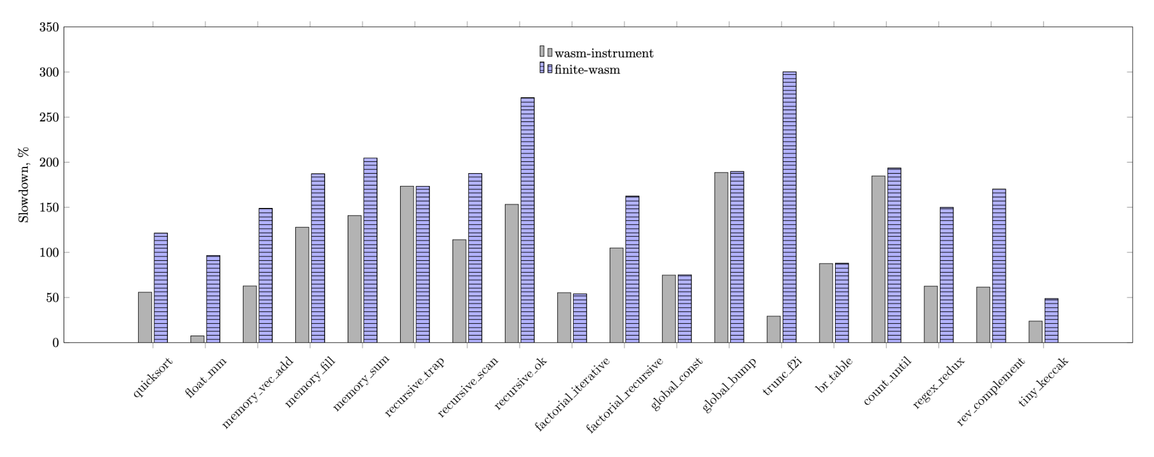
Metering in fast interpreters (WebAssembly)

Slide 9
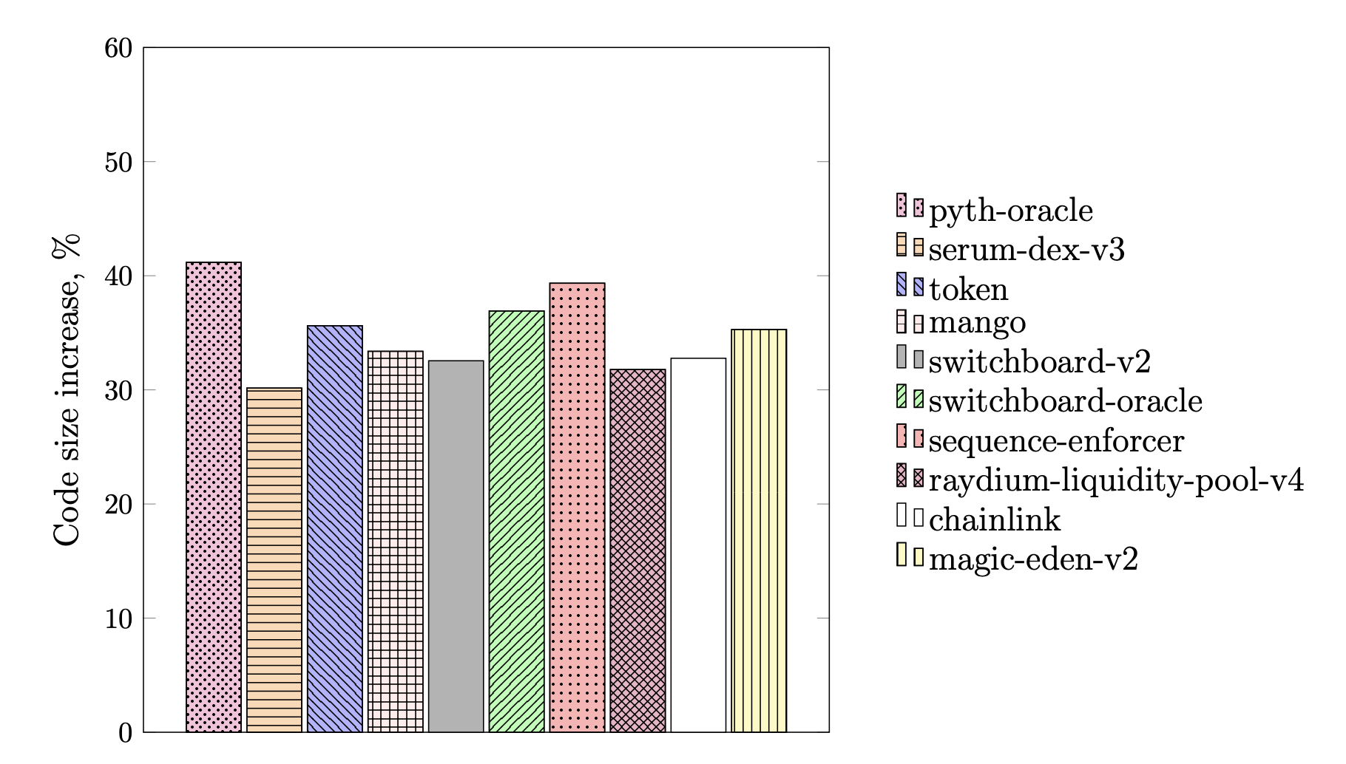
Metering in JIT compilers (Solana)
Contract is compiled from eBPF into x86, metering on every instruction is not feasible!
Solana uses a smart algorithm (~per each basic block)

Slide 10
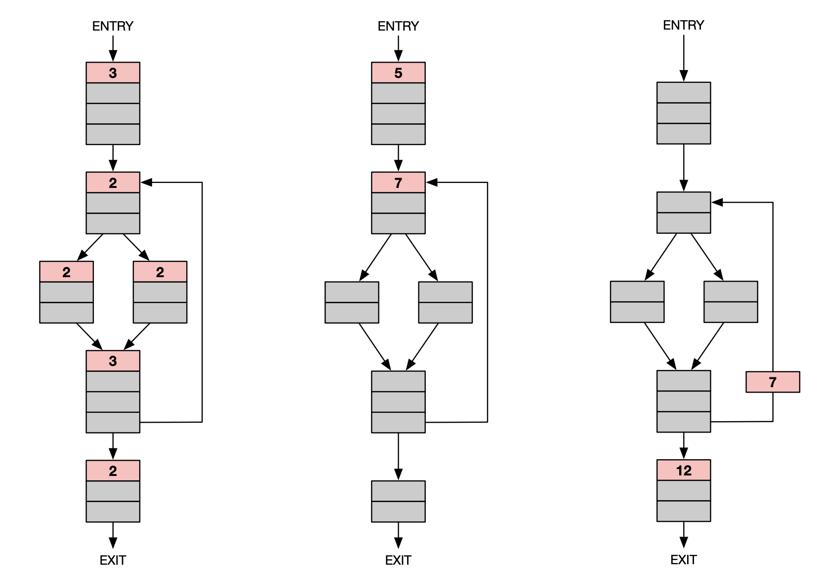
Example Metering
State of the art

Slide 11
Minimal metering instrumentation problem
Find a minimal set of metering instrumentation points in the program so that:
Execution is metered online,
The sum of metered amounts is equal to the execution cost,
At most k gas executed for free (k-safe).
If k=0, nothing goes uncharged! (we say the metering is safe)

Slide 12
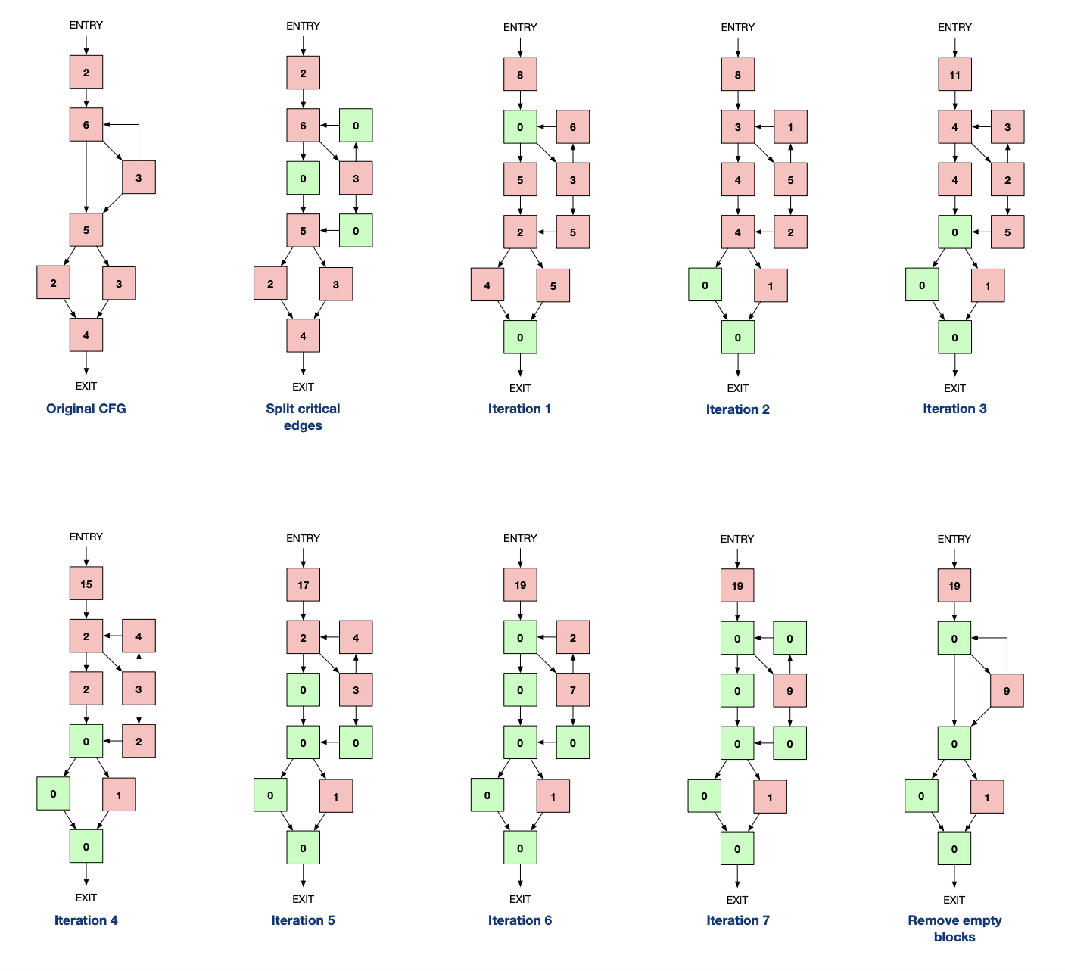
Algorithm

Slide 13
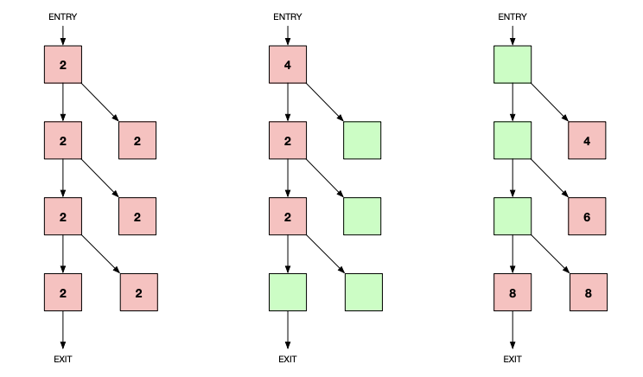
K-Safe Instrumentation examples

Slide 14
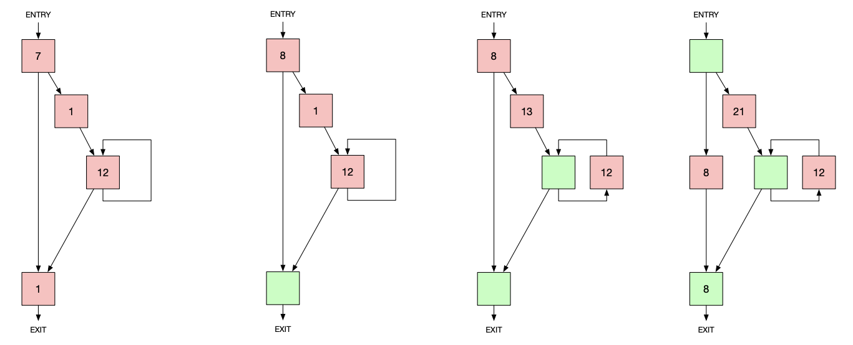
K-Safe Instrumentation examples

Slide 15
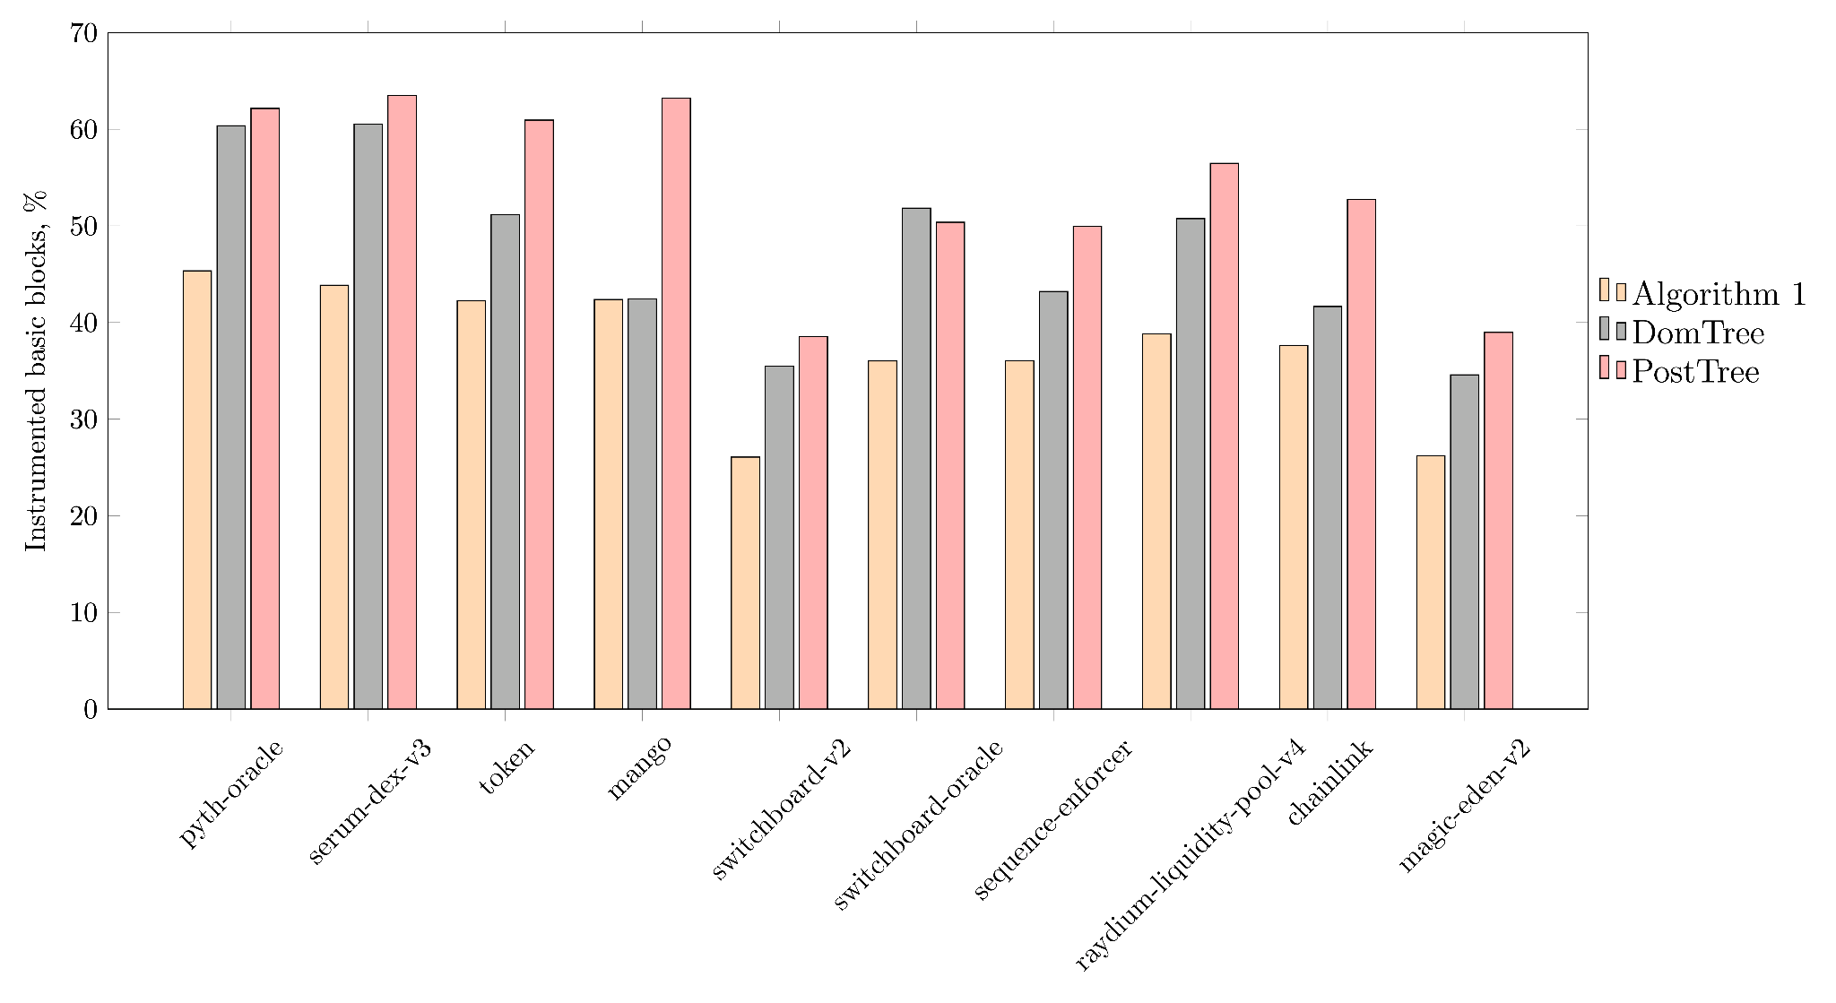
Real contracts
Number of instrumented blocks for different real contracts deployed on Solana blockchain.

Slide 16
Problems with per-block instruction gas cost metering
charge 1
status:
out-of-gas
charge 4
charge 1
status:
charge 1
x / 0
error
x / 0
charge 1
gas_used:
3
limit:
3
gas_used:
3
limit:
3

Slide 17
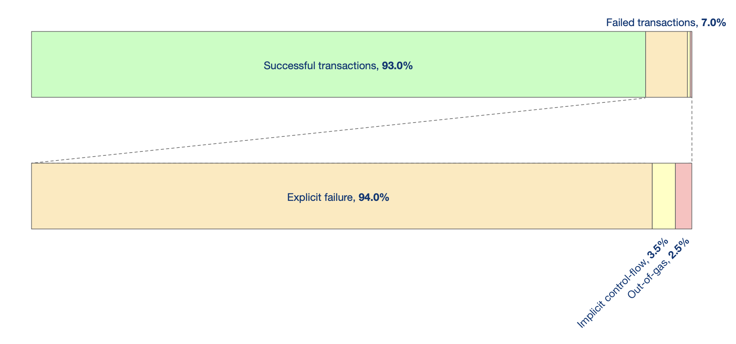
Do errors matter?

Slide 18
Recovery Mechanism
Enable movement of charges across implicit control flow
E.g., division by zero traps in Move
Traps and out-of-gas are rare (< 1%)
Switch to a slower recovery mechanism

Slide 19
Metering Wrap-up
Existing cost models don’t give the right incentives
Metering can introduce high overhead
Being optimistic is a good tradeoff

Slide 20
Open Questions
Can we give economic incentives to contract developers & compilers to make metering more efficient?
E.g., branches with same cost, no implicit control flow
Can metering be computed at compile time?
Validated at run time (a la proof carrying code)

Slide 21
Efficient Smart Contract Execution
Metering of Smart Contracts
Parallel Execution of Smart Contracts

Slide 22
Aptos runs on Block-STM
Executes transactions in parallel
Optimistic concurrency control
Writes recorded in a multi-versioned data-structure
Rolling commits: prefix of transactions committed on the fly
Txn 1
Txn 2
Txn 3
Txn 4
Txn 5
Txn 6
Storage
write B
write D
Versions
write D’

Slide 23
Inherently sequential workloads
Sequentiality is mostly due to counters:
total supply tracking
user balance updates
sequence numbers
NFT collection size tracking and indexing

Slide 24
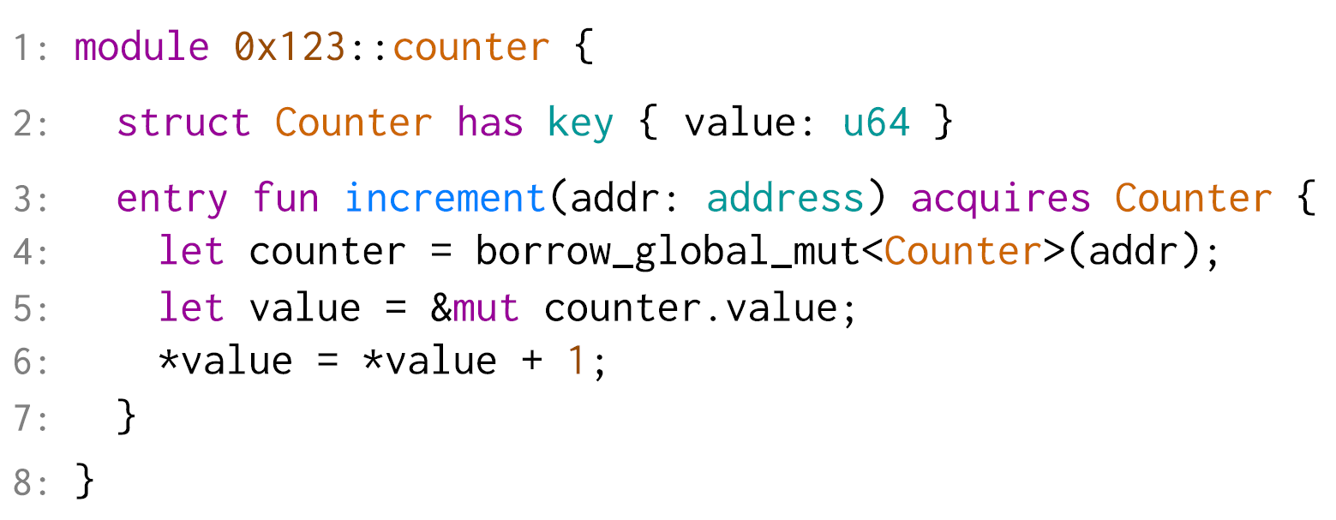
Simple counter in Move

Slide 25
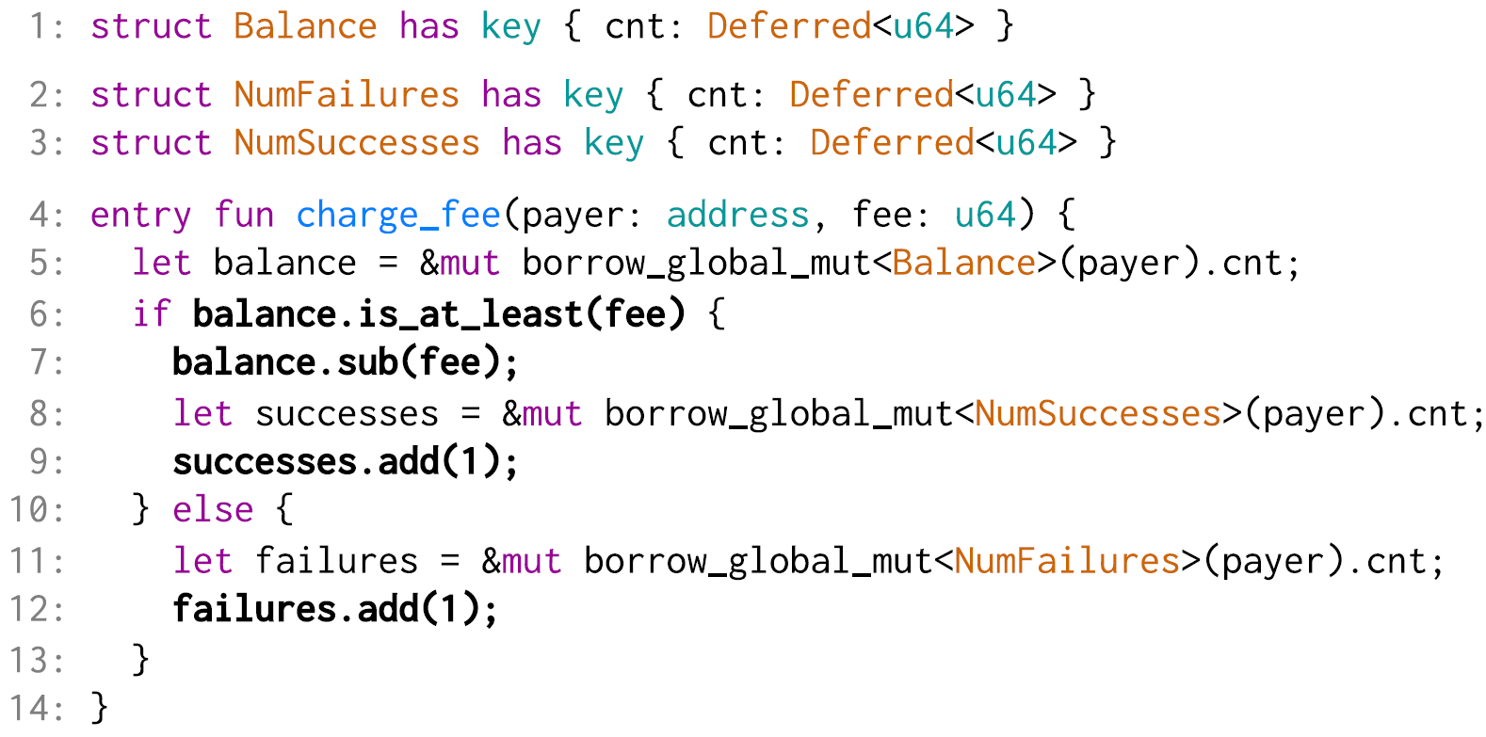
Language extension: deferred objects
Language support for updates with pre/post-conditions
Effectively removes read-write conflicts
STM write log collects deltas
Updates are delayed until commit time

Slide 26
No-op workload

Slide 27
Sponsored workload

Slide 28
Transfer workload

Slide 29
Deferred objects wrap-up
Deployed at
Economic incentives for parallel-friendly workloads?
Can we automate usage during compilation?

Slide 30
Efficient Smart Contract Execution
Metering of Smart Contracts
Parallel Execution of Smart Contracts

