Slide 1
Procedural Modeling of Architectonic Shapes: An Approach Focused on Structural and Ornamental Variations
MSc. Computer Science and Engineering
Instituto Superior Técnico, Universidade de Lisboa
Lourenço Isidro do Carmo Neiva Mourão – 102122
Supervisor: Prof. Dr. António Paulo Teles de Menezes Correia Leitão

Slide 2
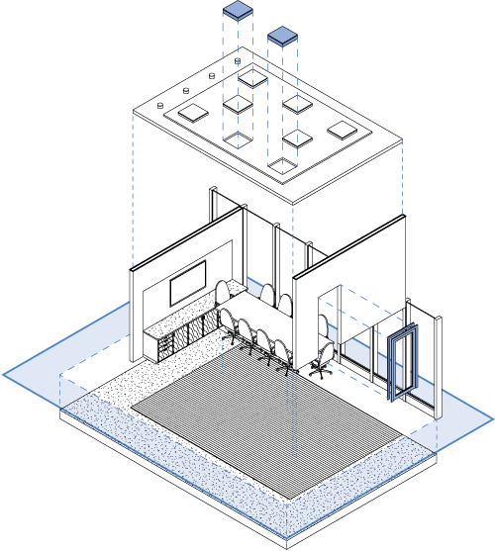
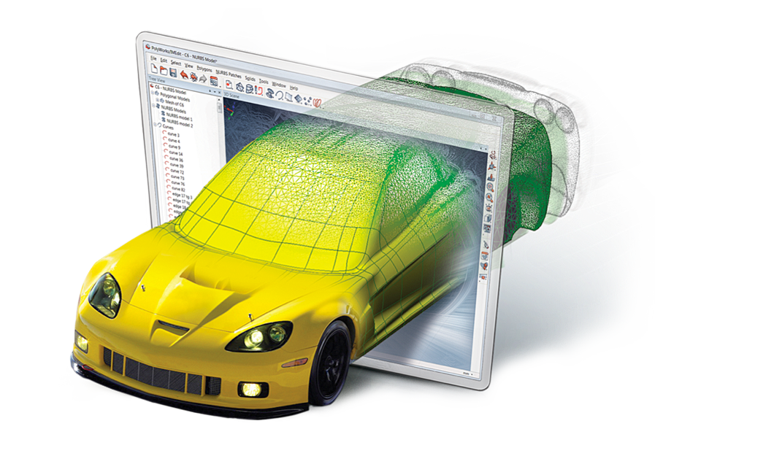
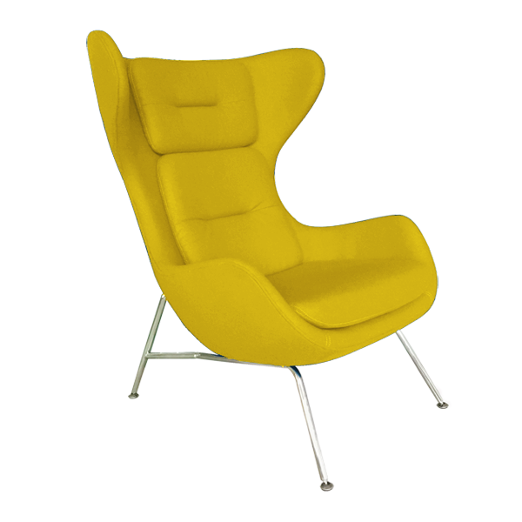
COMPUTER-AIDED DRAFTING (CAD)
Architecture
Engineering
Design
Accessibility (GUIs)
Automation
Increase in productivity
Burdensome
Time-consuming
Scaling insufficiency

Slide 3
MOTIVATION
Practical Breadth
Architecture
Video Games
Virtual Environments
Case Study
Complex Modeling
Important Factors
Complex interdependencies
Structural & ornamental variations
Well-established conventions
Flexibility
Scalability

Slide 4
ALGORITHMIC DESIGN
Procedural Modeling
Parametric Design
Shape generation
Parameters
Identification
Definition
Procedures (rules / instructions)

Slide 5
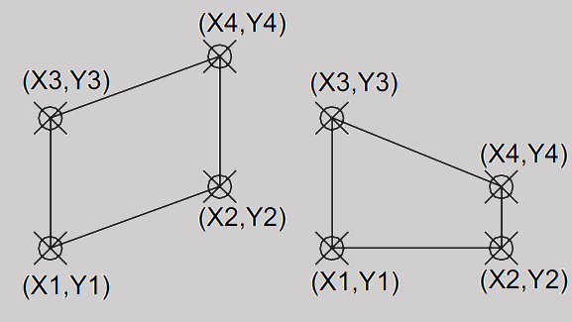
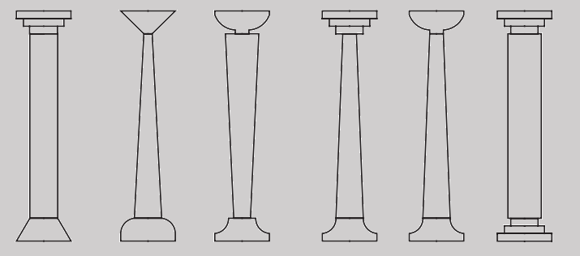
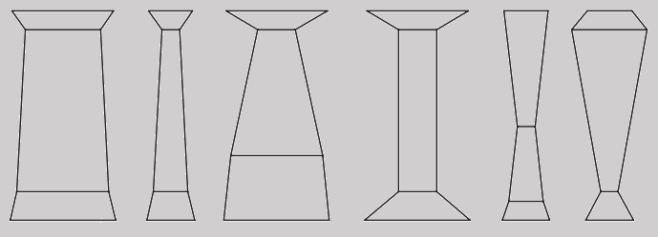
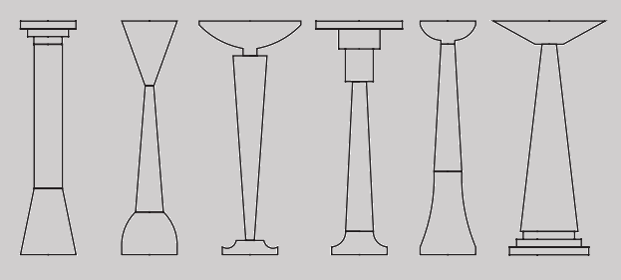
PARAMETRIC DESIGN
Parametric Variations
Parametric Combinations
Parametric Hybridizations
Graphics source: Hernandez 2006, “Thinking Parametric Design: Introducing Parametric Gaudi”

Slide 6
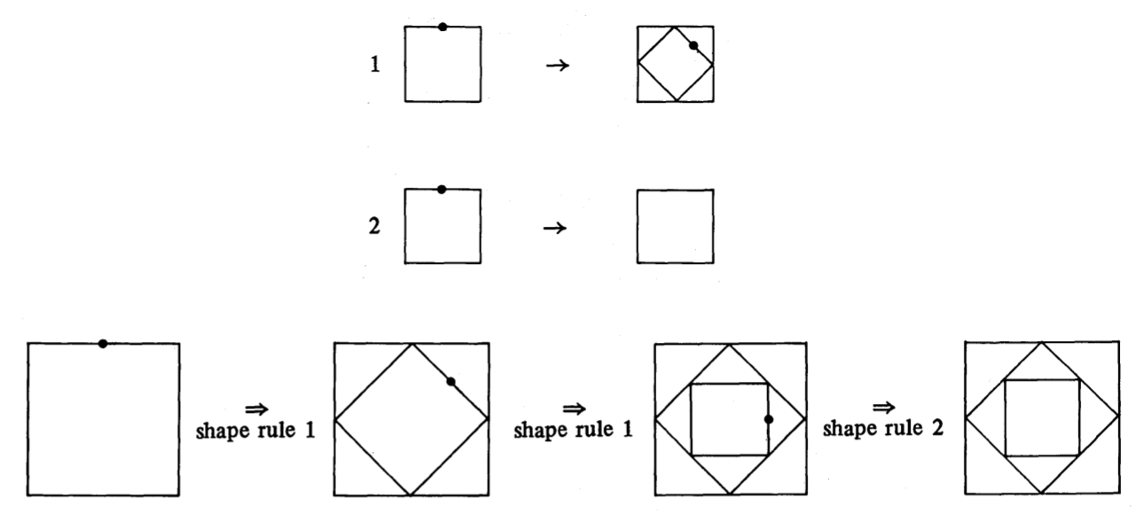
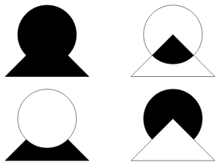
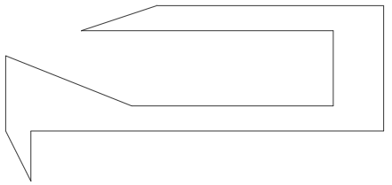
PROCEDURAL MODELING
Rule-Based Approaches
Scripting-Based Approaches
Modeling
Modeling
States
Rule derivations
Instantiations
Boolean operations
Deformations & Manipulations
Frameworks
Frameworks
Shape Grammars
L-Systems
Programming environment
Geometry libraries
Graphics source: Stiny 1980, “Introduction to Shape and Shape Grammars”
Graphics source: https://web.ist.utl.pt/~antonio.menezes.leitao/Docs/Books/BookJulia/index.html

Slide 7
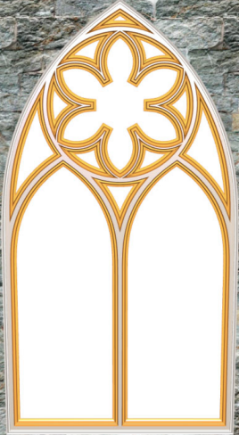
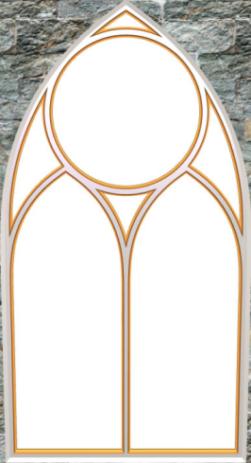
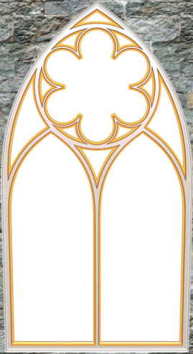
STRUCTURE VS ORNAMENT
Structure
Ornament
Topological
Sustaining
Embellishments
Aesthetic
Cathedral
Window
Structure
Ornament
Structure
Ornament
Pillars
Walls
Pillar styles
Arc styles
Window styles
3D aspect
Rosette styles
Arc styles
Tracery
Graphics source: Havemann 2005, “Generative Mesh Modeling”

Slide 8
GENERATIVE MODELING LANGUAGE (GML)
Architecture
Stack-Based DSL
GML
Euler operators & macros
Convoluted syntax
Rigid
Outdated
Combined boundary representations
Abstraction level
Subdivision surfaces
Graphics hardware
Basic Example
/a 5 7 add 8 mul def
Low–level operations still present
Static backend environment

Slide 9
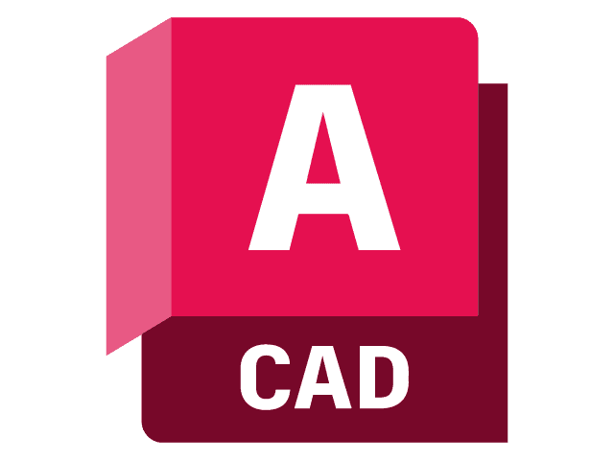
KHEPRI
Architecture
Programming Language
Frontend Environment
Backend Environment
Friendly syntax
Flexible
In vogue
Basic Example
a = (5 + 7) * 8
Higher-level of abstraction
Versatility & Portability

Slide 10
SOLUTION
Static structural representations
Dynamic ornamental representations

Slide 11
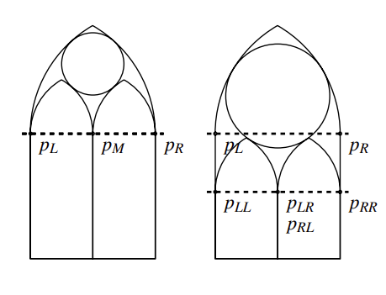
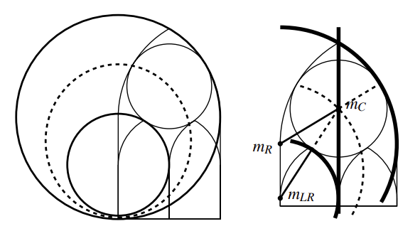
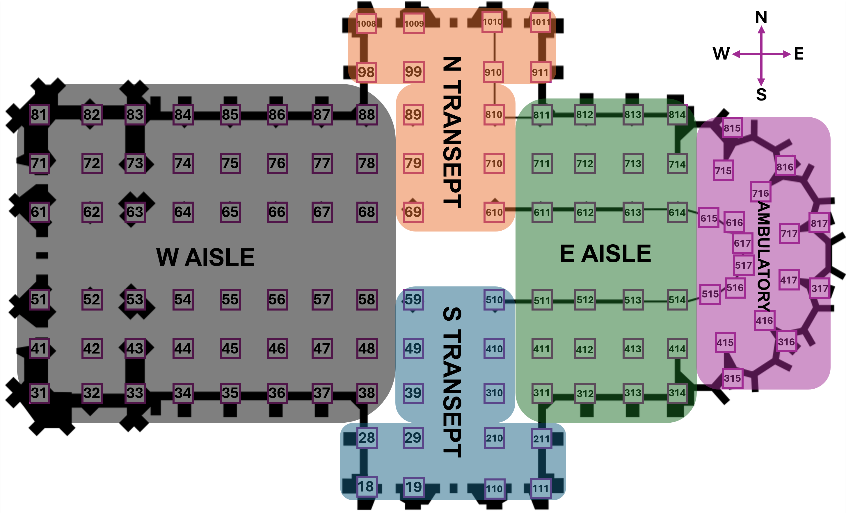
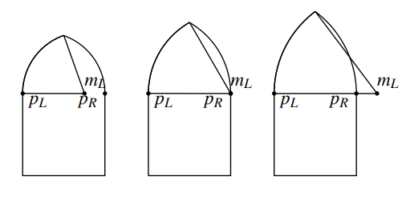
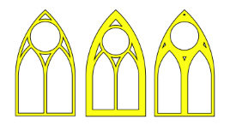
PARAMETRIC REPRESENTATIONS
Gothic Window
Gothic Cathedral
Excess
Vertical distance
Inner offset
Outer offset
Graphics source: Havemann 2005, “Generative Mesh Modeling”
Graphics source: https://commons.wikimedia.org/wiki/Category:Plans_of_Cologne_Cathedral (modified)

Slide 12
WINDOW STRUCTURE
GothicWindow
Cartesian positioning
bottom_left_corner
upper_right_corner
excess
vertical_distance_to_sub_arch
outer_offset
inner_offset
window_profile
rosette_style
left_sub_arch_style
right_sub_arch_style
Ornamental parameters

Slide 13
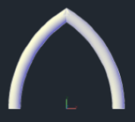
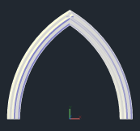
WINDOW ORNAMENT
Generative Functions
3D embellishments
Ornamental refinement

Slide 14
COMBINING STRUCTURE AND ORNAMENT
Constructors
Gothic_Window
Sub_Gothic_Window
gothic_window
Intermediate calculations for Cartesian positioning
Structural and ornamental attachment
Populate sub-hierarchical elements of input data structure
Recursive application to sub-hierarchical elements

Slide 15
CATHEDRAL STRUCTURE
Pillar
Ornamental parameter
model
row
column
center
orientation
width
depth
height
north_wall
south_wall
west_wall
east_wall
Directional Axis Conformance
NORTH = vy(1)
SOUTH = – NORTH
WEST = vx(-1)
EAST = – WEST
GROWING_HEIGHT = vz(1)
DECREASING_HEIGHT = - GROWING_HEIGHT
Pointer data
Global Initializers
Measurements & delimiters
Pillar info
Wall info
Wall
model
left_pillar
right_pillar

Slide 16
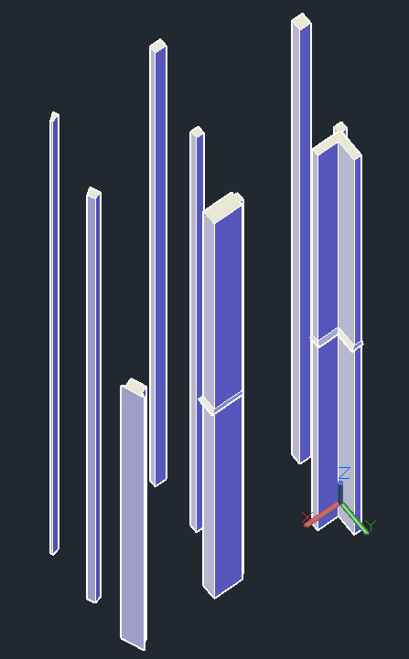
CATHEDRAL ORNAMENT
Pillars
Walls
Generative Functions
Generative Functions
Buttresses
Inner pillars
Outer pillars
Flying buttresses
Wall blocks
Arch blocks
Window blocks

Slide 17
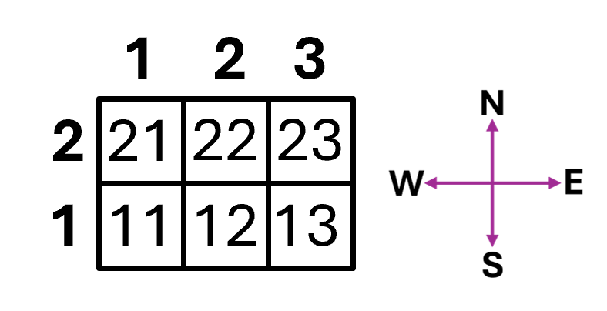
COMBINING STRUCTURE AND ORNAMENT
Global Instantiators
Pillars instantiator
Walls instantiator
Asset collection section range
asset_range_instantiator(pillars, asset_info_collection, asset_type_instantiator)
2D array
S-N / W-E order
Asset generative function
2 x 3 matrix

Slide 18
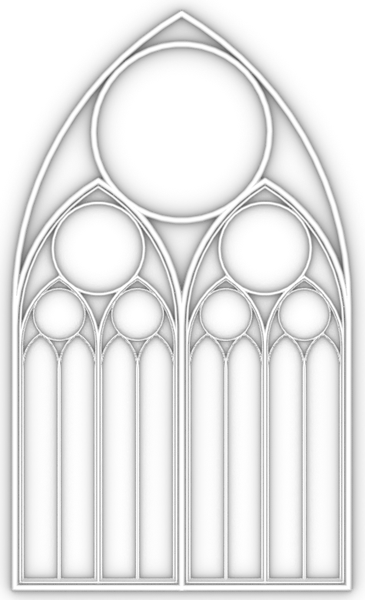
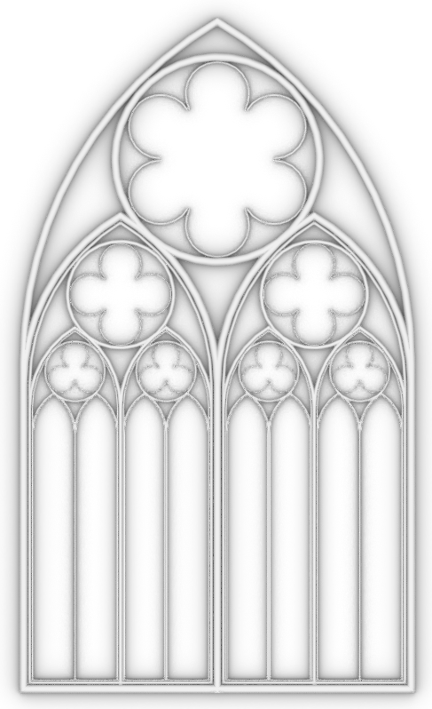
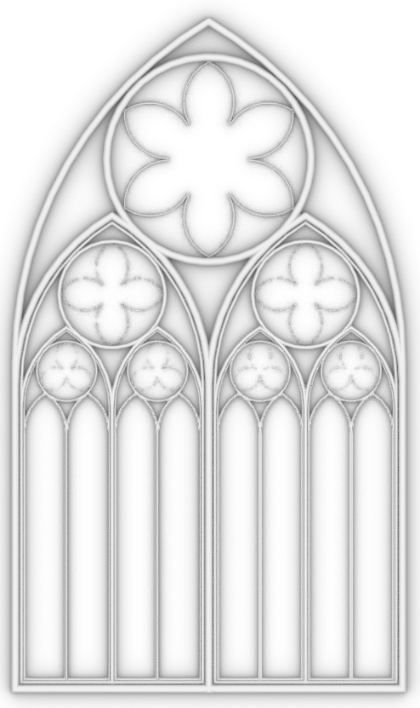
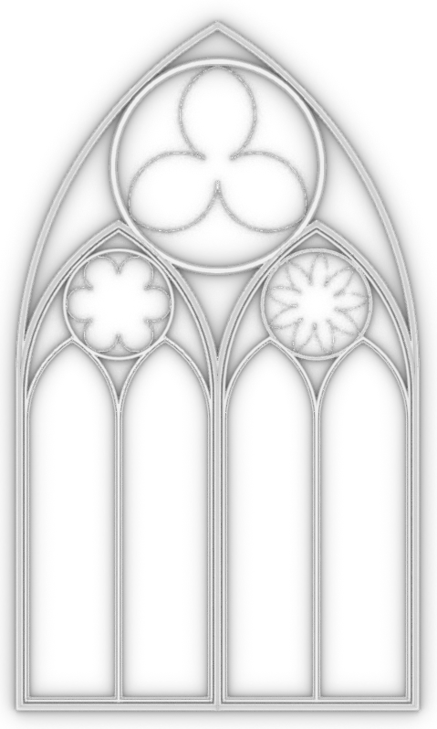
EVALUATION
GothicWindow
bottom_left_corner
upper_right_corner
excess
vertical_distance_to_sub_arch
outer_offset
inner_offset
window_profile
rosette_style
left_sub_arch_style
right_sub_arch_style
Rosette
Rosette_Empty_Style
Rosette_Rounded_Style
Rosette_Pointed_Style

Slide 19
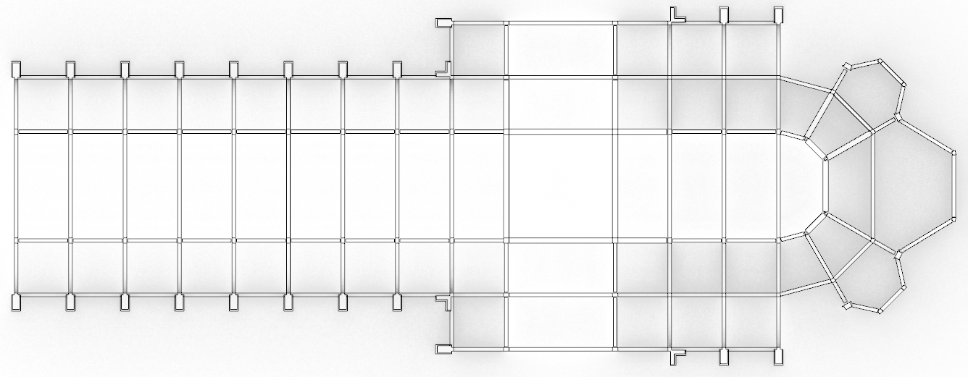
EVALUATION
Cathedral Instantiators
instantiate_measurements_and_delimiters
Distance between pillars
Cathedral sections (min_bound : max_bound)
pillars
2D array
instantiate_pillars_info
Default basic pillar dimensions
instantiate_walls_info
Pillar matrix
instantiate_all_walls
Pillar matrix

Slide 20
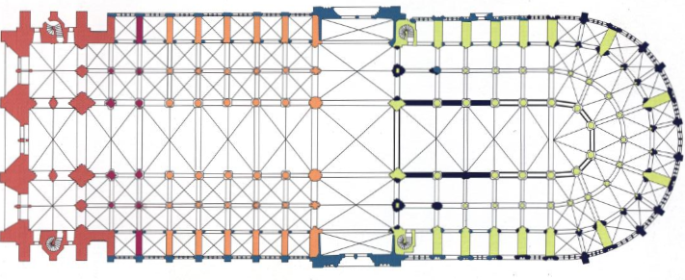
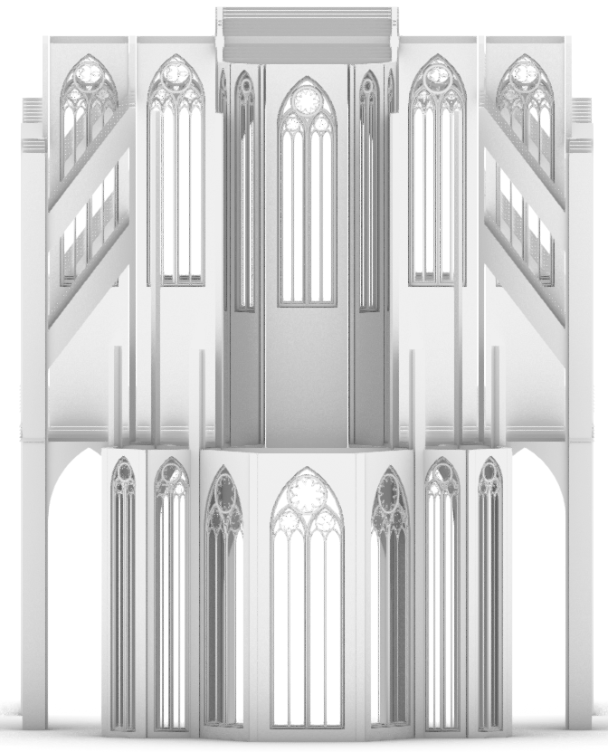
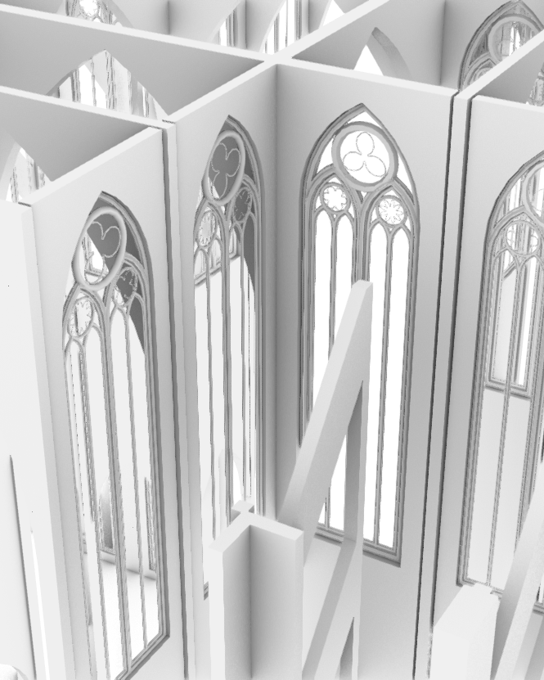
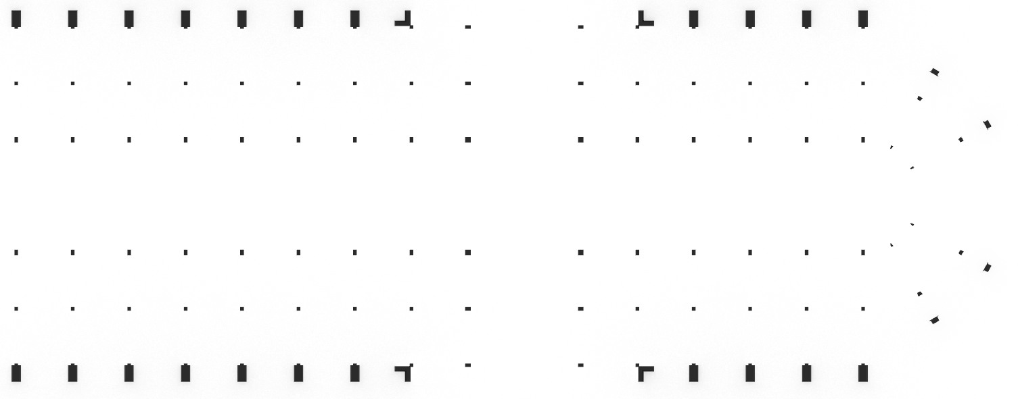
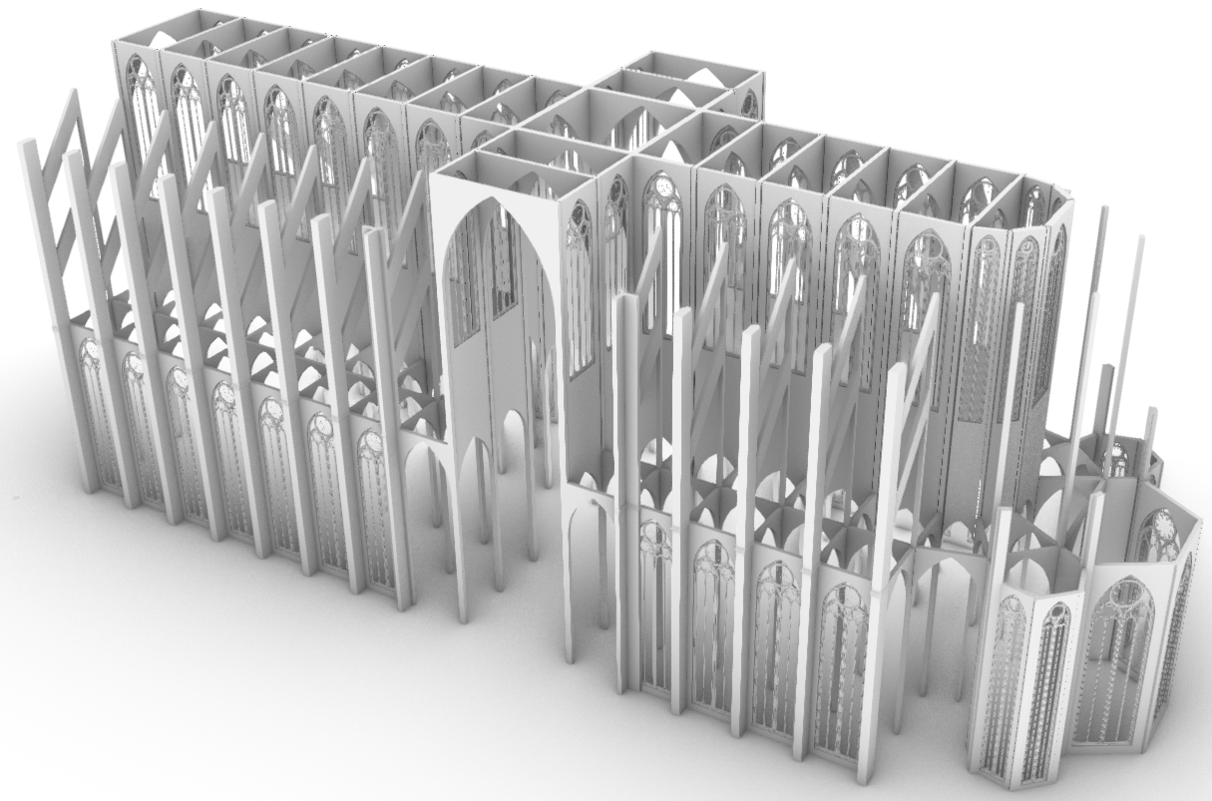
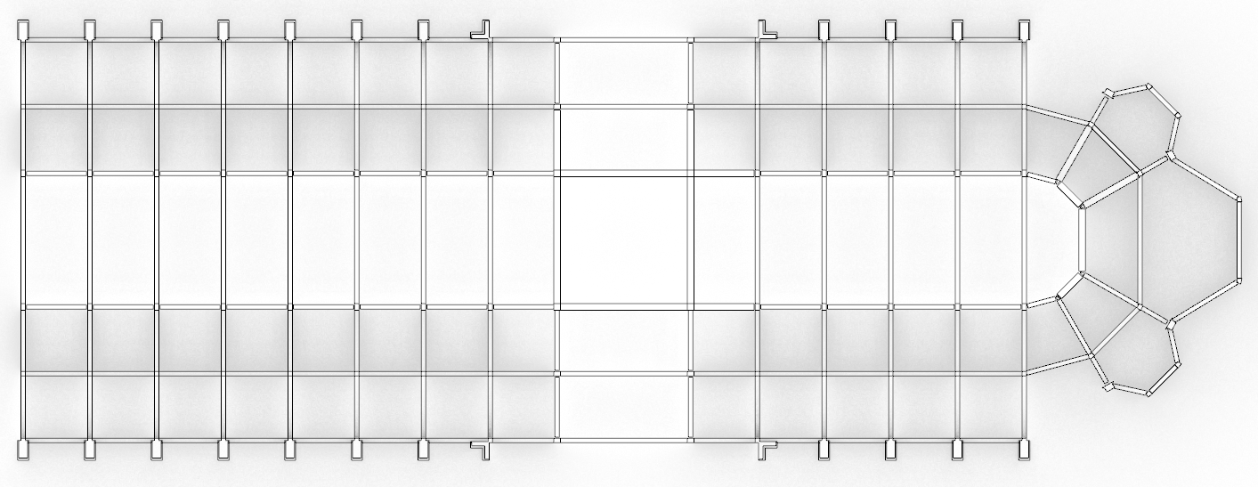
EVALUATION
Official floorplan source: https://mcid.mcah.columbia.edu/art-atlas/mapping-gothic/paris-cathedrale-notre-dame

Slide 21
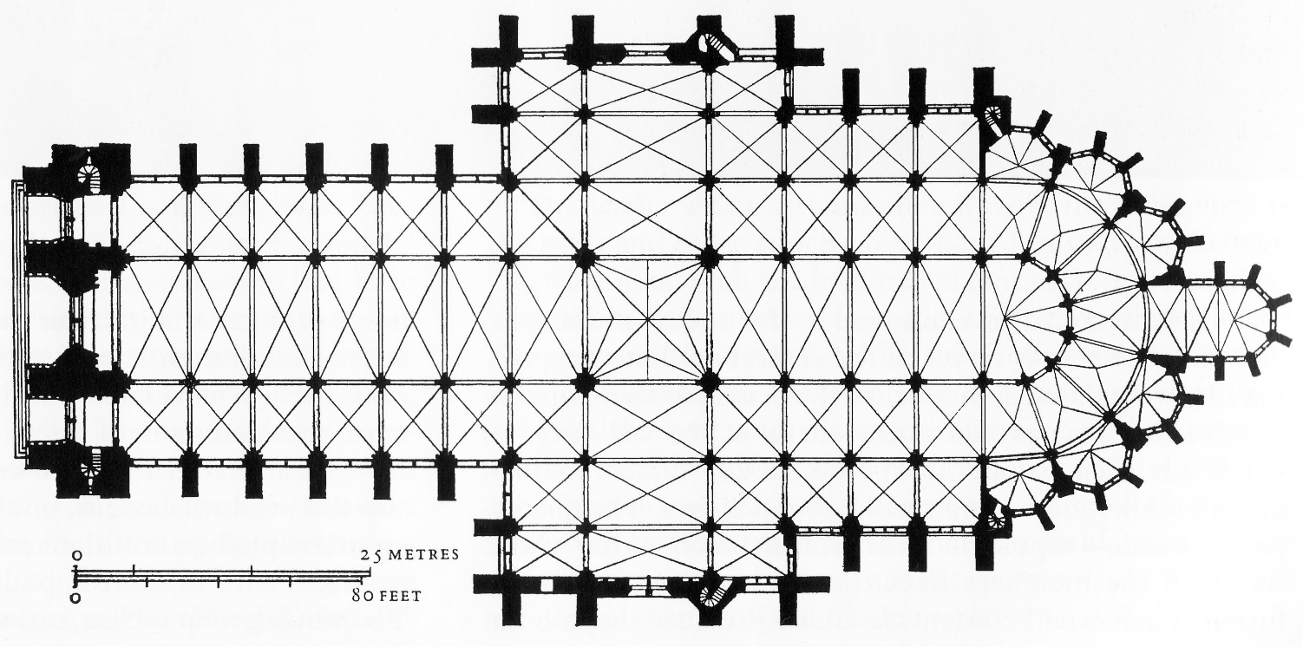
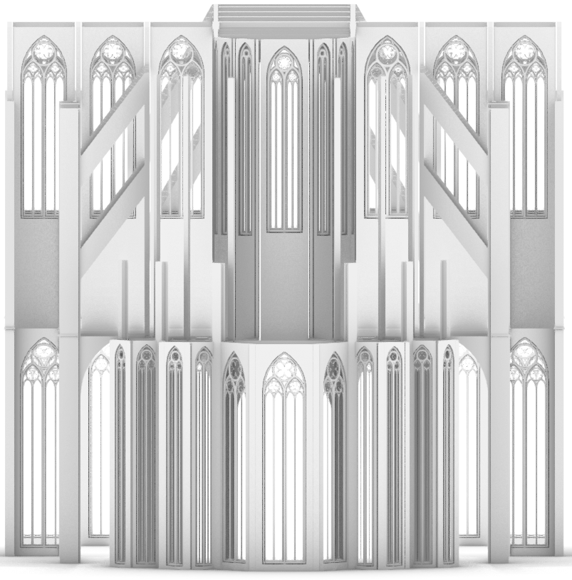
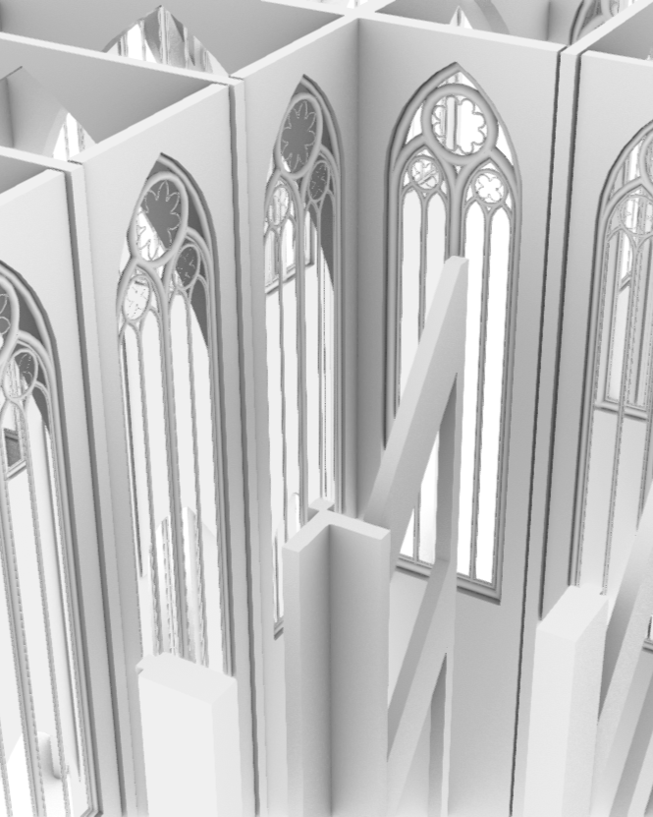
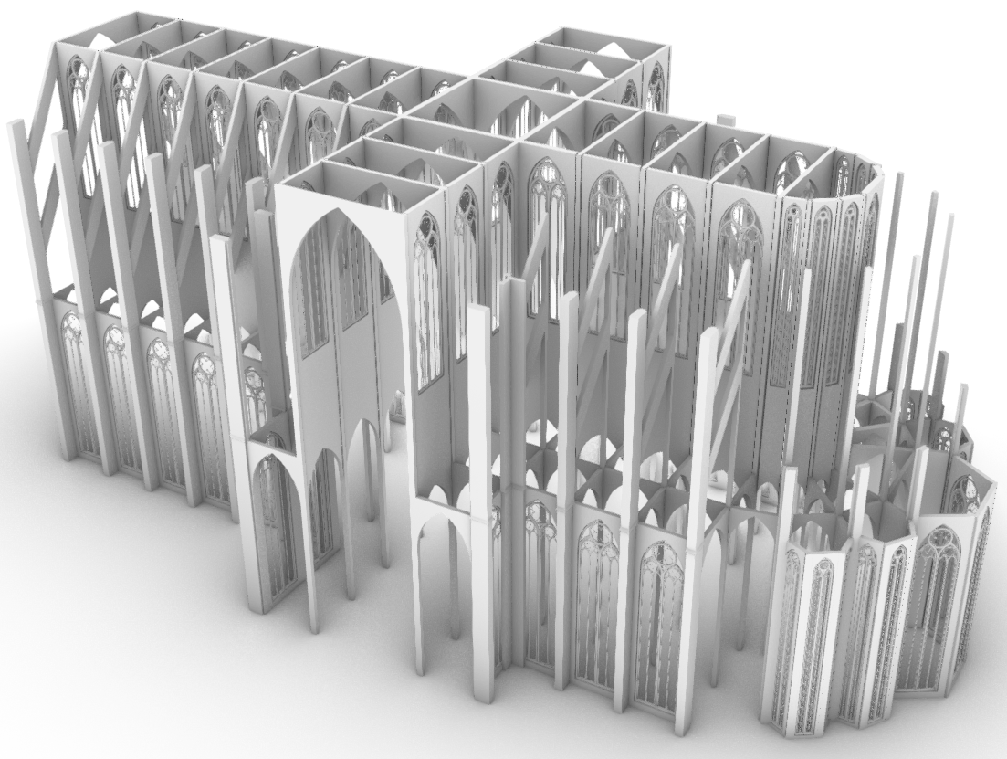
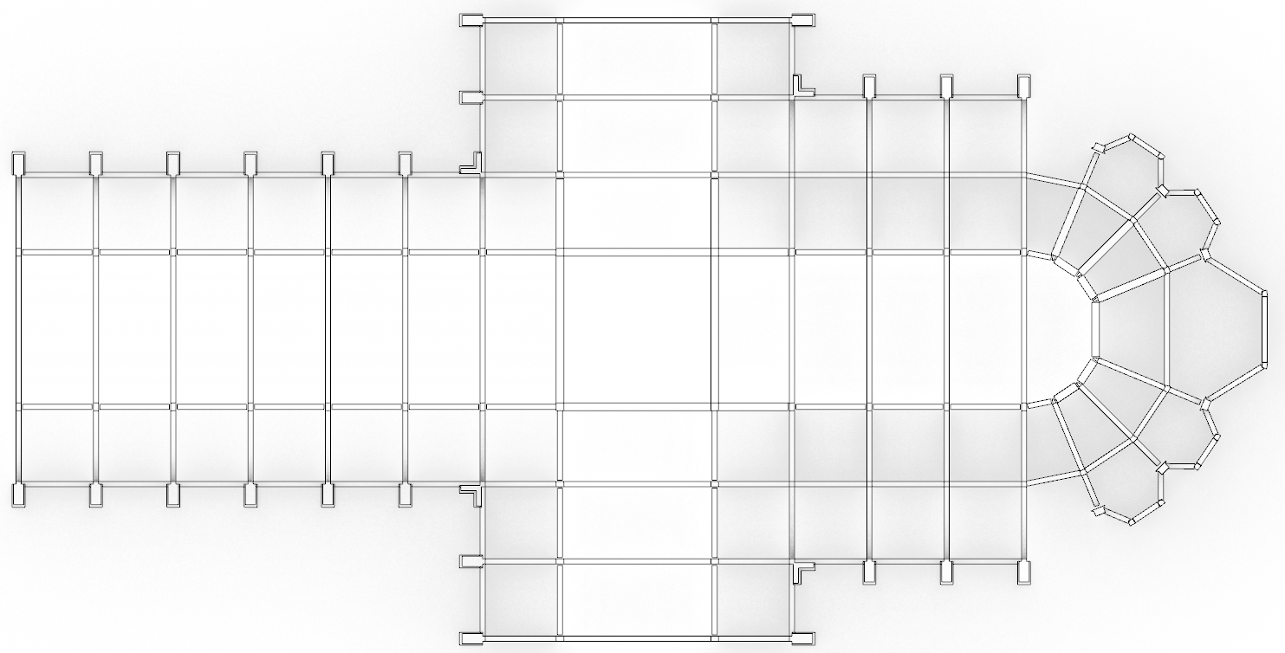
EVALUATION
Official floorplan source: https://mcid.mcah.columbia.edu/art-atlas/mapping-gothic/amiens-cathedrale-notre-dame

Slide 22
CONCLUSION
Contributions
Future Work
AD as a means of reducing modeling workloads
Flexible and scalable approach
Static structural representations
Dynamic ornamental representations
Modernization of previous AD approaches
Complex case study
Analytic geometry vs constructive geometry
Geometric constraints for conflicting geometry
Amend Khepri’s portability issues

Slide 23
ACTA EST FABULA
(Está concluída a apresentação)
OBRIGADO!
ANY QUESTIONS?

