Slide 1
Liberalitas
A Metaobject Protocol for
by Eduardo Espadeiro
supervised by Prof. António Menezes Leitão

Slide 2
Julia
High level and dynamic programming language
Just-In-Time (JIT) compilation
Features multiple dispatch
Limited data structuring features

Slide 3
Julia’s Limitations
Animal
subclass of
Cannot derive from concrete types
Multiple subtyping is not supported
Dog
Wolf
instance of
Laika
Labrador

Slide 4
Julia’s Limitations
Animal
Cannot derive from concrete types
Multiple subtyping is not supported
Dog
Wolf
Wolfdog
Notes:
Porque é que não fazemos apenas features de Java?
Não pretendemos implementar funcionalidades e forçar utilizadores
O meu papel é dar as ferramentas

Slide 5
Metaobject Protocols
How methods are invoked.
How classes are instantiated.
How fields are accessed.
How behavior is inherited.
…

Slide 6
What are metaobjects?
Metaobjects are objects that represent a part of a program:
Classes
Methods
…
Their classes are called metaclasses.
Notes:
Introduzir problema counted class antes de mudar

Slide 7
Example: Counted Class
new instance of class
Start
Imagine defining a metaclass CountedClass, which adds a counter property to class metaobjects.
yes
class instance of CountedClass
increment class’s counter
no
End

Slide 8
Related Work: CLOS & Swindle
Object system features a MOP.
Protocols defined with generic functions.
Data and behavior separated (classes & generics).
Notes:
O CLOS foi o que inspirou
DAR AO JULIA as capacidades do CLOS

Slide 9
Liberalitas
Similar to CLOS, consists of 3 types of metaobjects:
Classes
Methods
Generic Functions

Slide 10
Liberalitas: Representing Instances
We define structures to represent instances and operations to handle them, such as:
Accessing its class.
Retrieving the value of a slot.
Updating the value of a slot.
Class
Class
Slots
Methods
Method Combination
Cache

Slide 11
Liberalitas: Initializing instances
Class
Initargs
When make is invoked:
allocate_instance is passed the class and returns a new instance.
initialize receives the new instance and the initargs.
julia> make(Rectangle, width=10, height=8) Rectangle(height=8, width=10)

Slide 12
Liberalitas: Classes
These contain the following information:
Name
Direct superclasses
Slots
Constructor arguments
Default slot values
Class precedence list
@class Person() [ name [age :initform => 0 :noinitarg] ]

Slide 13
Liberalitas: Inheritance
Animal
Dog
Wolf
Wolfdog, Dog, Wolf, Animal
Class Precedence List
Wolfdog

Slide 14
Liberalitas: Generic Functions
These contain the following information:
Methods
Method Combination
Cache for Effective Methods
@generic paint

Slide 15
Liberalitas: Methods
These contain the following information:
Types specialized by the args
Method body (anonymous function)
Qualifier used for method combination
@method paint[around](cm::ColorMixin) =
begin set_brush_color(cm.cyan,
cm.magenta,
cm.yellow) next()
end

Slide 16
Liberalitas: Method Dispatch
Get the arguments classes
Filter the applicable methods
Compute the effective method
Invoke the effective method
Retrieve the classes of the arguments with classof.
Filter the methods applicable to the classes of the arguments.
Apply the method combination to compute the effective method.
Invoke the resulting effective method with the arguments passed.
Notes:
fala da class precedence list na parte sobre filtrar
falar sobre ordenação na combinação de métodos

Slide 17
Liberalitas: Bootstrapping
Top
Liberalitas contains many circularities:
Classes are objects, instances of a class.
Objects are created with the generic function make.
How can we create the first class when there are none yet?
How can we define this object?
subclass of
Object
Class
instance of

Slide 18
Liberalitas: Bootstrapping
How do we tackle these circularities?
We create a class metaobject by hand, setting its class to itself.
We define early versions of the needed generic functions.
With these defined, we can take care of the remaining metaobjects.
Lastly, we replace the early versions.

Slide 19
Evaluation
How flexible is it?
How well does it perform?

Slide 20
Evaluation: Flexibility
How easy it is to:
represent common OOP patterns
simplified by dynamic features (Strategy, Factory, …)
introduce new mechanisms
Notes:
Strategy (first class citizen class metaobjects)
Visitor (maybe not idk)
definir metaclasses e override
(dizer ainda aqui) não foi feito para ser rapido logo

Slide 21
Liberalitas: Method Dispatch
Get the arguments classes
Filter the applicable methods
Compute the effective method
Invoke the effective method
Retrieve the classes of the arguments with classof.
Filter the methods applicable to the classes of the arguments.
Apply the method combination to compute the effective method.
Invoke the resulting effective method with the arguments passed.
Notes:
fala da class precedence list na parte sobre filtrar
falar sobre ordenação na combinação de métodos

Slide 22
Optimization: Effective Method Cache
Get the arguments classes
Get effective method from the cache
Invoke the effective method
Filter the applicable methods
Compute and store the effective method

Slide 23
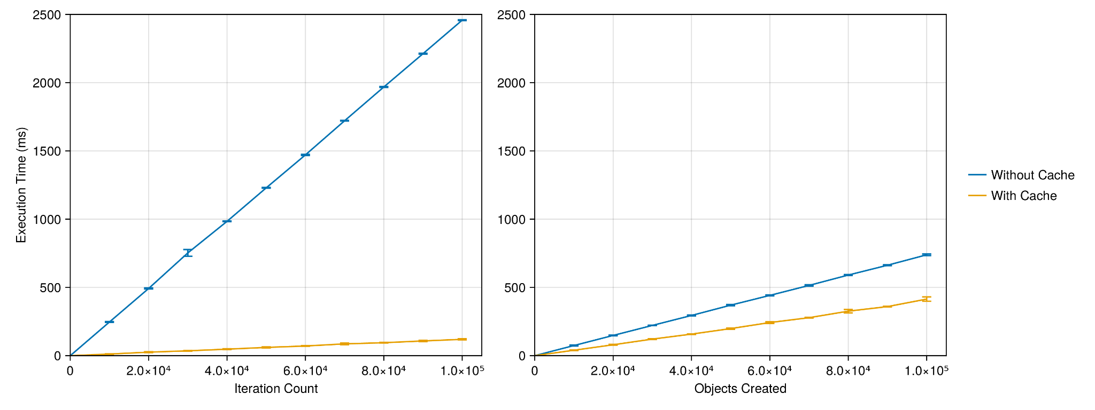
Optimization: Effective Method Cache

Slide 24
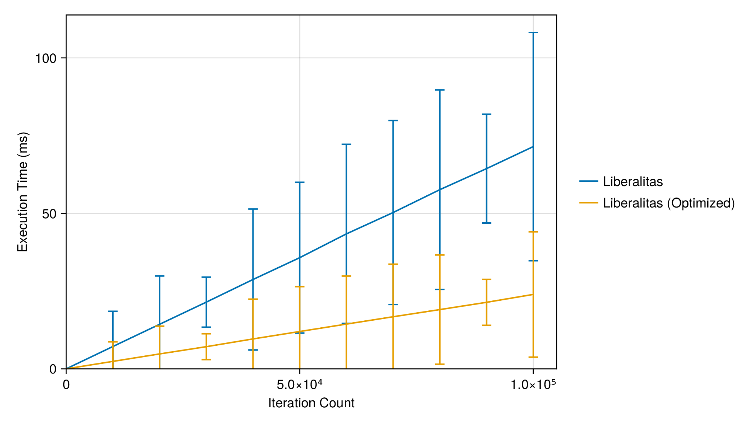
Optimization: Profiling

Slide 25
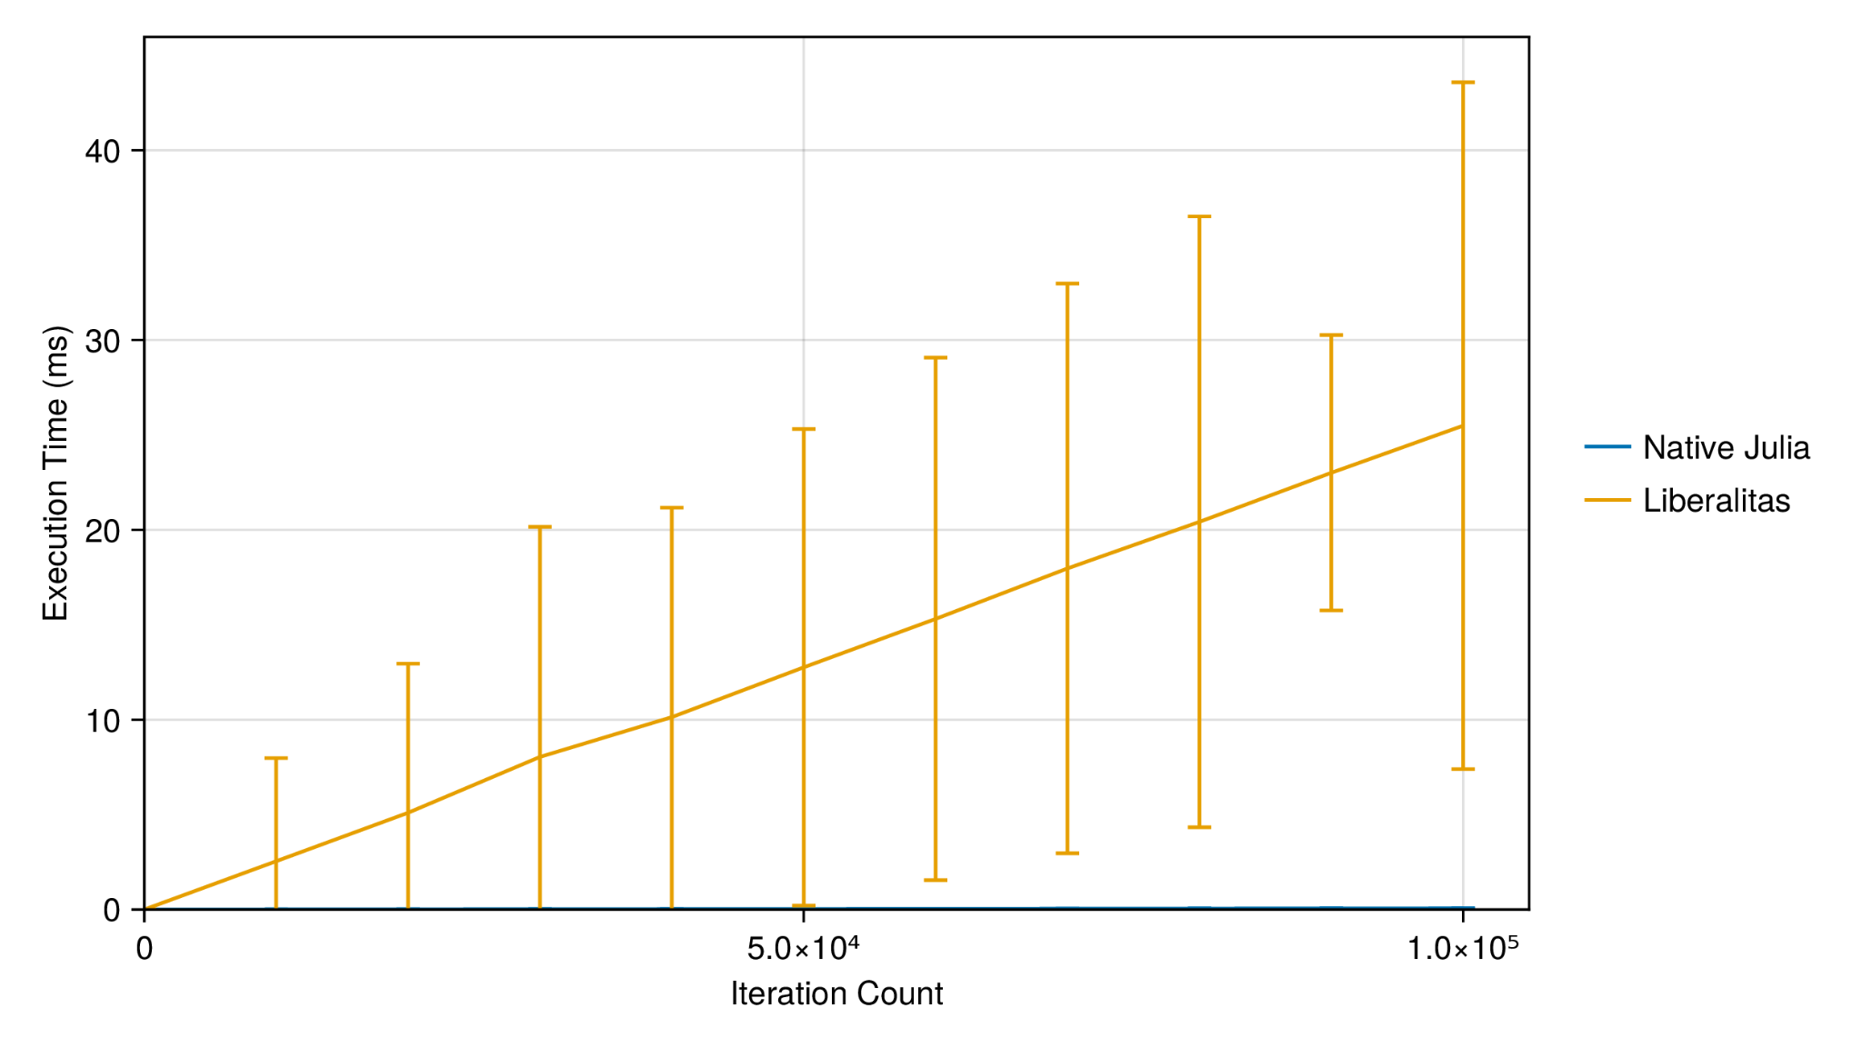
Evaluation: Comparison with Julia

Slide 26
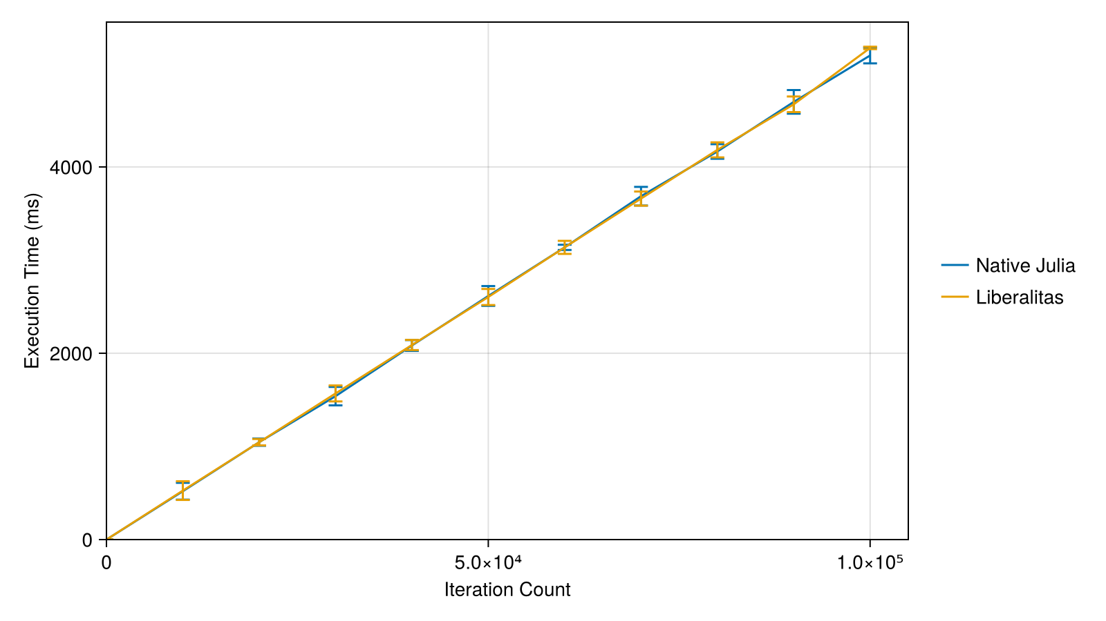
Evaluation: Comparison with Julia

Slide 27
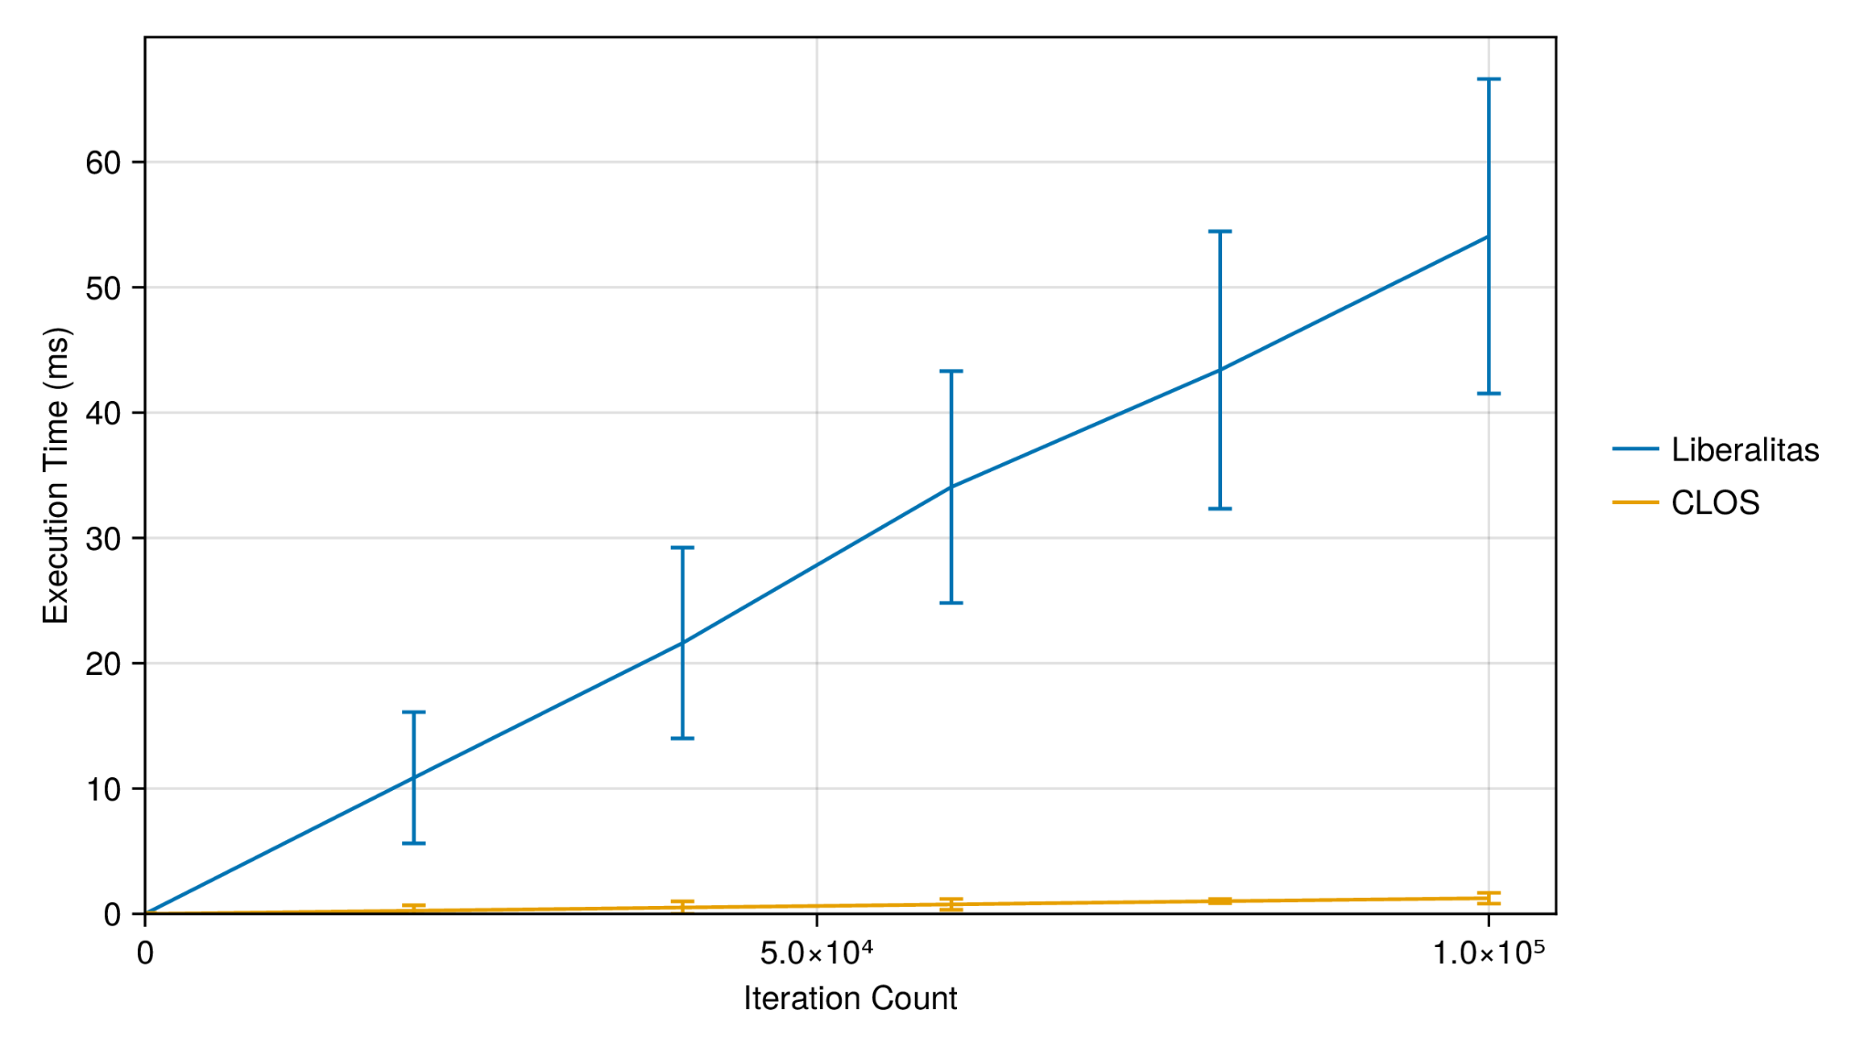
Evaluation: Comparison with CLOS (SBCL)

Slide 28
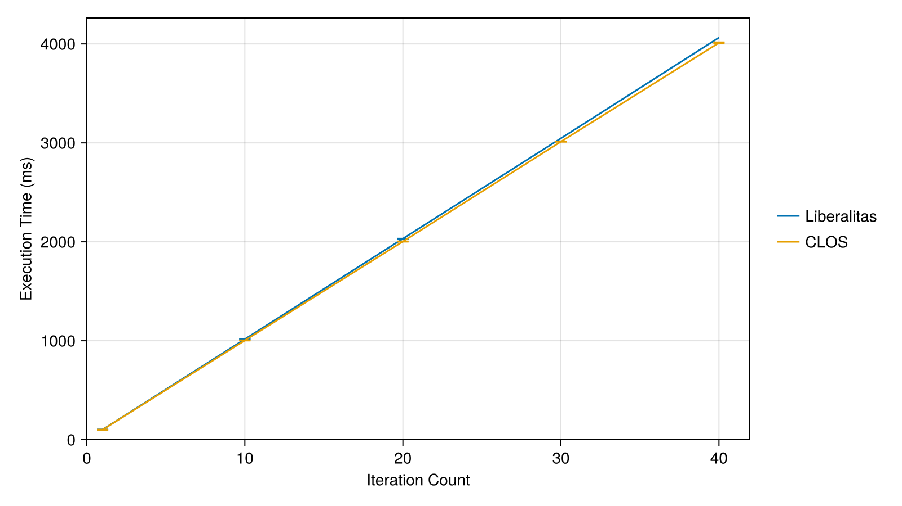
Evaluation: Comparison with CLOS (SBCL)

Slide 29
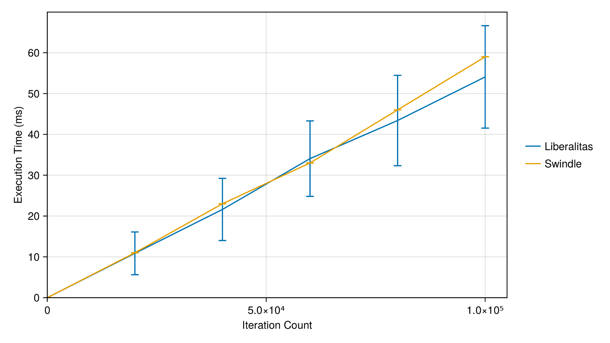
Evaluation: Comparison with Swindle

Slide 30
Summary
We propose Liberalitas, a MOP for Julia, allowing users to freely override its behavior to their liking.
Liberalitas’s performance penalty isn’t noticeable in typical cases.
What are the next steps?
Expand the existing protocols (Inheritance, Slot accessing, Generic functions).
Further optimize Liberalitas.
Notes:
Não só resolver as limitações

Slide 31
Obrigado!
Any questions?

Slide 32
Liberalitas: Inheritance
@method compatible_metaclasses(class::Class, super::Class) = issubclass(classof(class), classof(super))
MetaA
MetaB
instance of
A
B
inherits from

