Slide 1
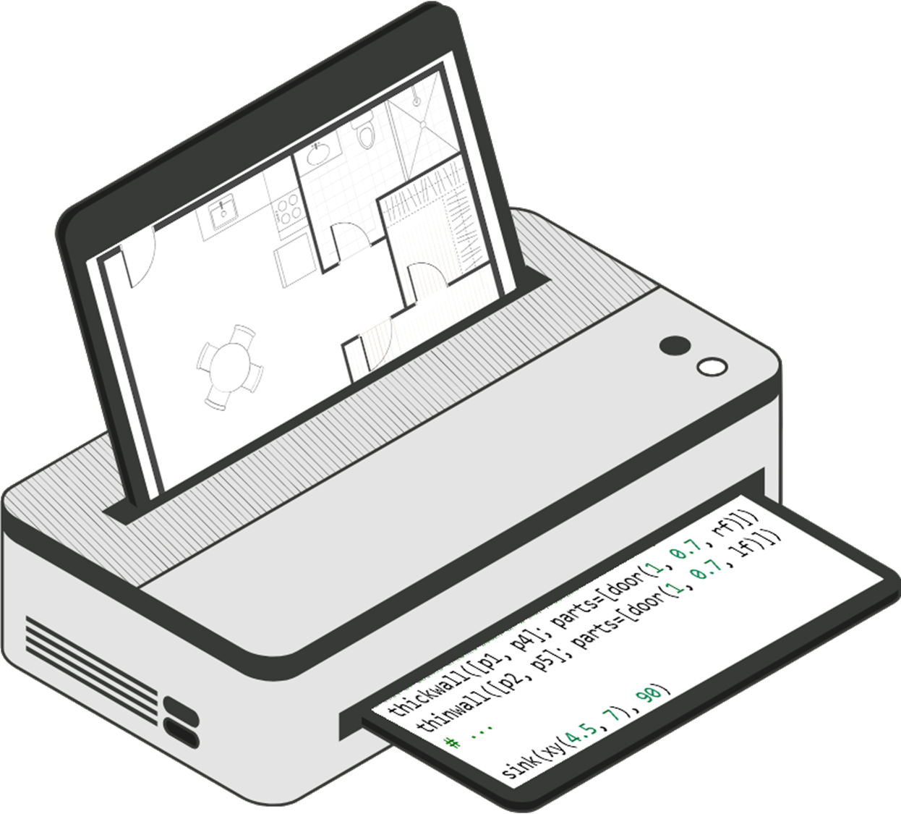
Inverse Algorithmic Design
Automatic Conversion of Floor Plan Images into Computer Programs
João Carlos Morgado David

Slide 2
Background
Technical drawings
Computer-Aided Design (CAD)
Building Information Modeling (BIM)

Slide 3
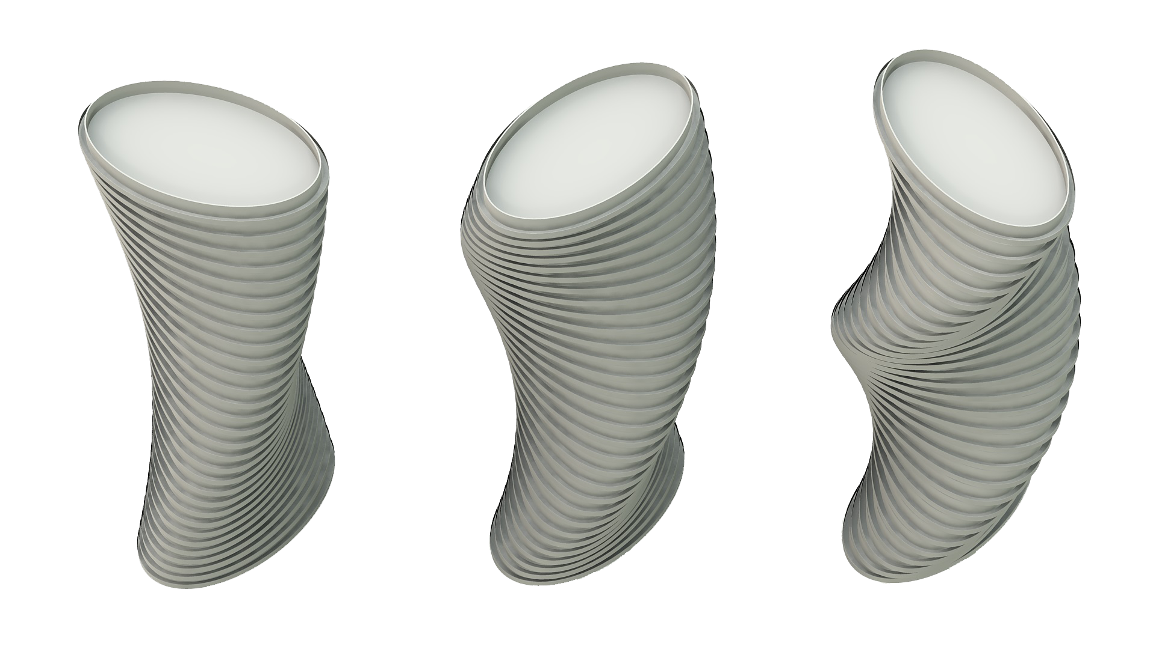
Algorithmic Design
Algorithms are parametric
Parameters control variations
Steep learning curve
Costly conversion

Slide 4
Inverse Algorithmic Design

Slide 5
Inverse Algorithmic Design
Interpretation
Representation
Reconstruction
Detecting relevant symbols
Creating the algorithm
Converting to a structured representation

Slide 6
Objectives
Parametric output
Intuitive floor plan description
Inverse Algorithmic Design

Slide 7
Related Work

Slide 8
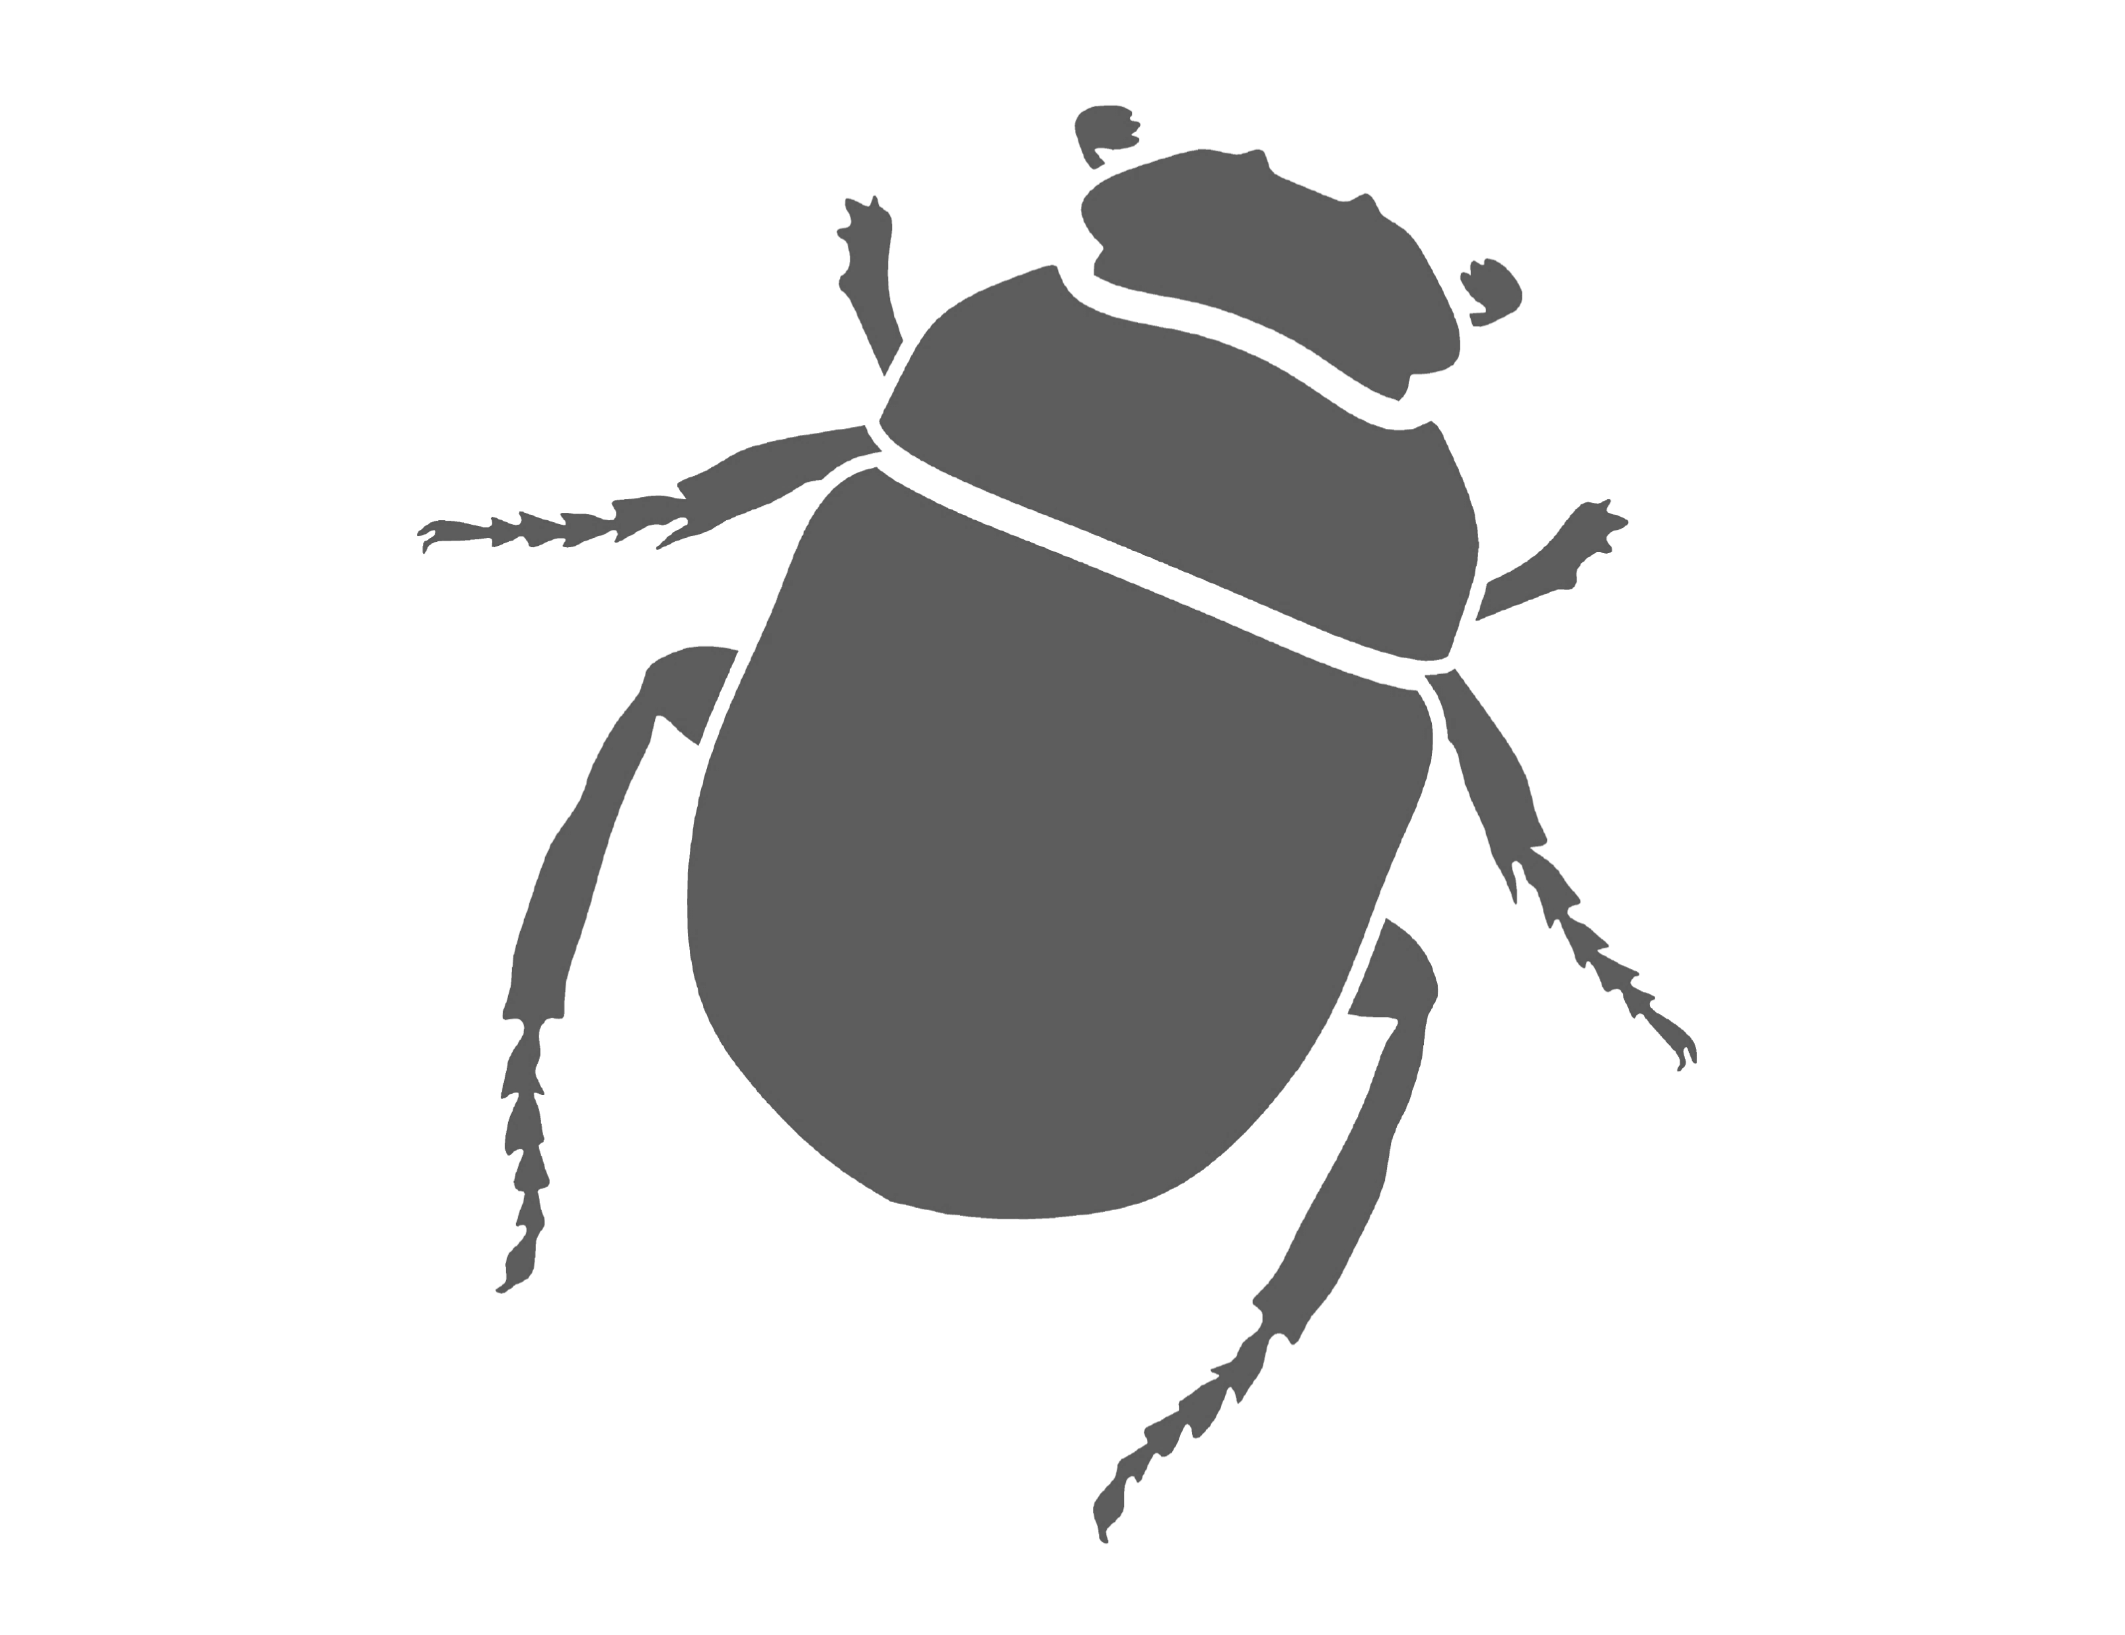
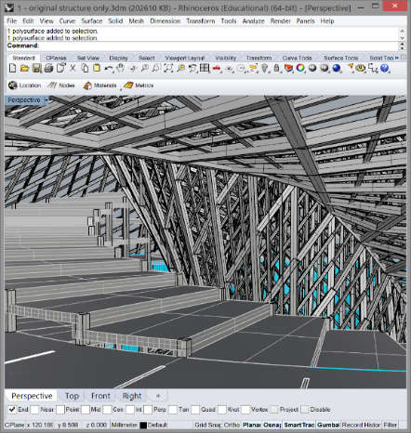
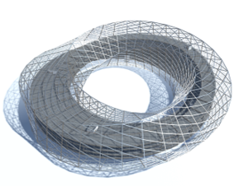
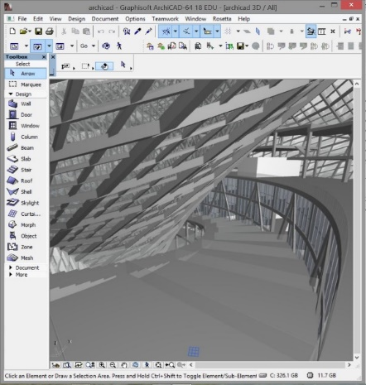
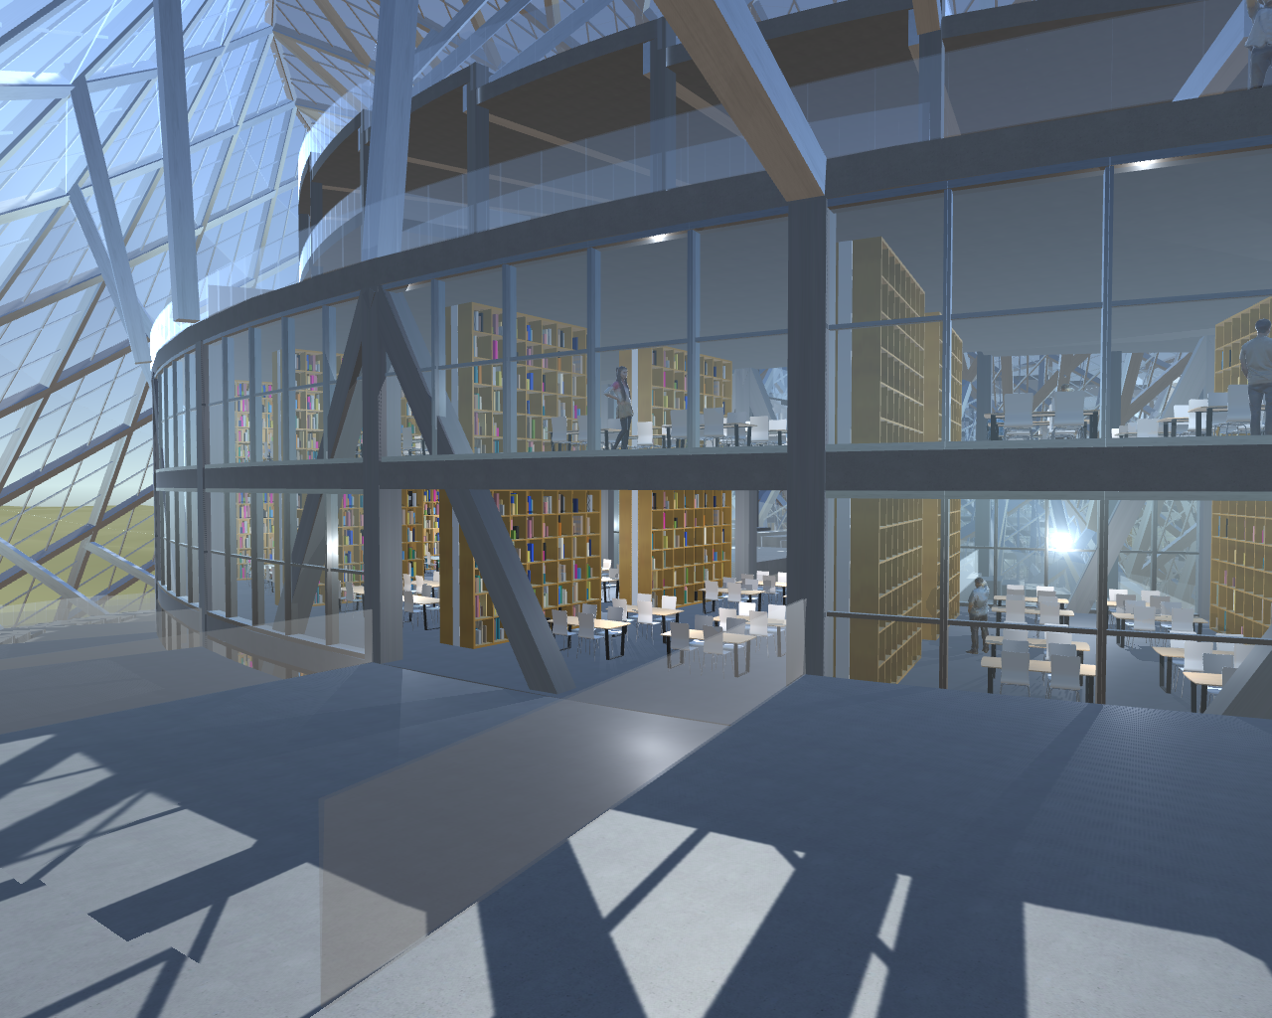
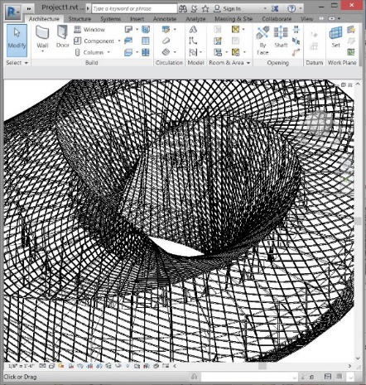
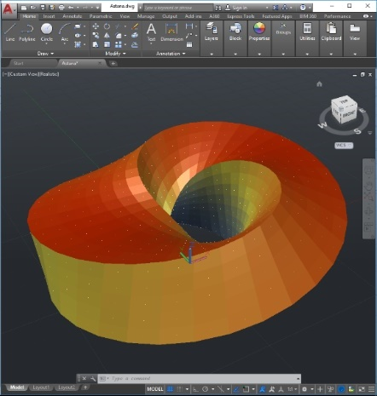
Algorithmic Design
book_wall(p, fi, z) =
let (p1, p2, p3, p4, pa, pb) = (
p + vpol(mid_block_r() + library_door, fi),
p + vpol(mid_block_r() + block_l/2 + -(library_door/2), fi),
p + vpol(mid_block_r() + block_l/2 + library_door/2, fi),
p + vpol(mid_block_r() + block_l + -library_door, fi),
u0() + vx(-(wall_thickness/2)),
u0() + vxy(wall_thickness/2, block_h/4))
with(default_level_to_level_height, block_h/4) do
with(default_level, level(z)) do
wall([p1, p2])
wall([p3, p4])
end
end
end
torch_set(p, fi, z) =
let (p1, p2, p3, p4) = (
p + vz(man_h) + vpol(mid_block_r() + library_door, fi),
p + vz(man_h) + vpol(mid_block_r() + block_l/2 -library_door/2, fi),
p + vz(man_h) + vpol(mid_block_r() + block_l/2 + library_door/2, fi),
p + vz(man_h) + vpol(mid_block_r() + block_l + -library_door, fi))
(v2, v3) = (normal(p, p2, p2+vz(1), p+vz(1)),
normal(p, p3, p3+vz(1), p+vz(1)))
rotate(block_instance(astana_torch, loc_from_o_phi(add_z(p2, z), fi), 1),
-pi/8, p2+vz(z), v2)
rotate(block_instance(astana_torch, loc_from_o_phi(add_z(p3, z), fi), 1),
pi/8, p3+vz(z), v3)
end
KHEPRI

Slide 9
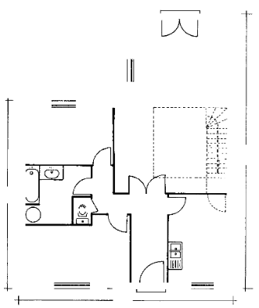
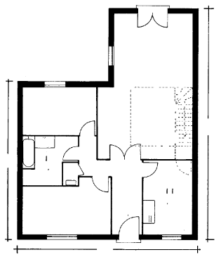
Floor Plan Parsing — Before
Constraint Network (Dosch et al., 2000)
Altered Hough Transform (Macé et al., 2010)
SURF & OCR (Ahmed et al., 2012)
Dosch et al., 2000 — A complete system for the analysis of architectural drawings

Slide 10
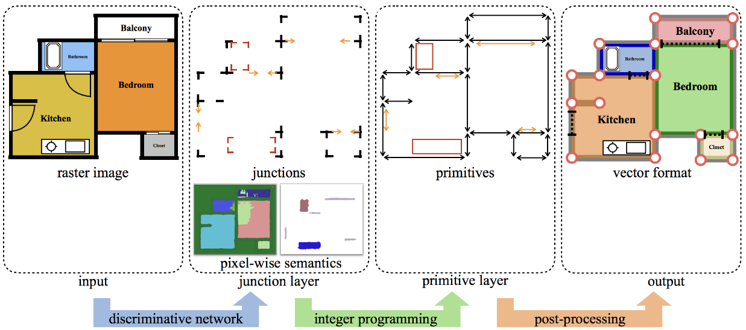
Floor Plan Parsing — Now
Liu et al., 2017 — Raster-to-Vector: revisiting floorplan transformation

Slide 11
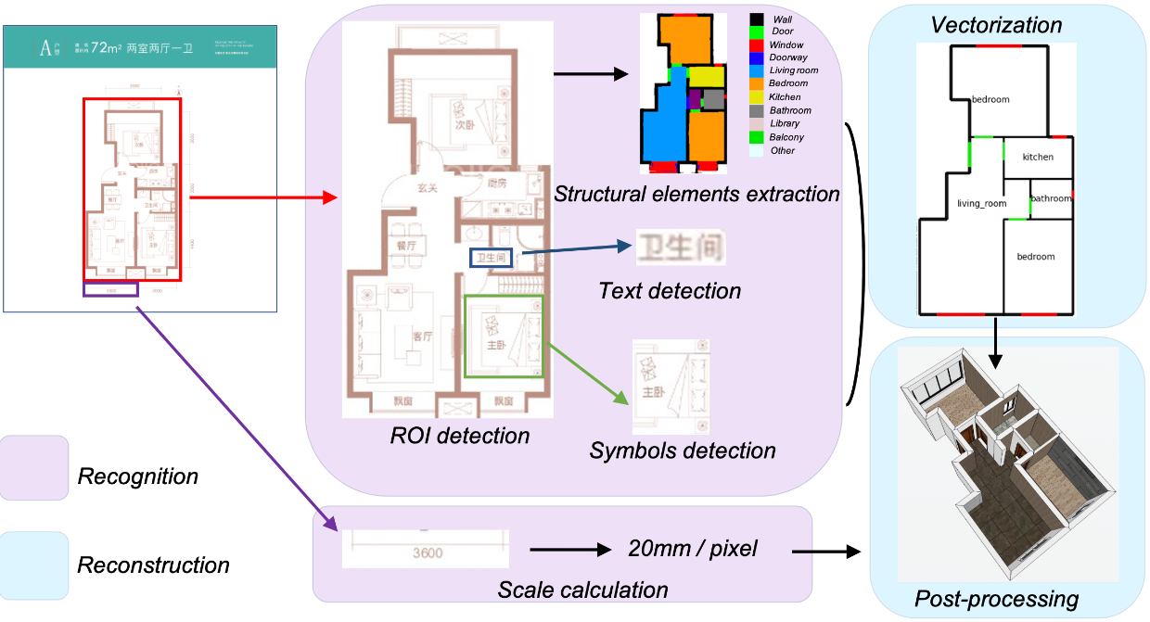
Floor Plan Parsing — Now
Lv et al., 2021 — Residential floor plan recognition and reconstruction

Slide 12
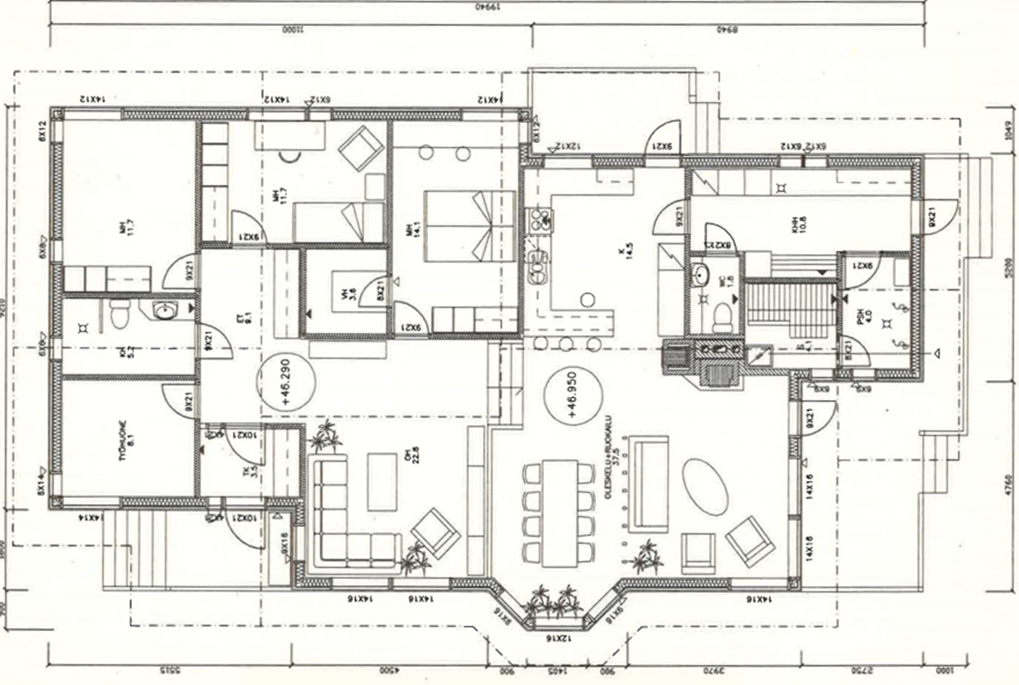
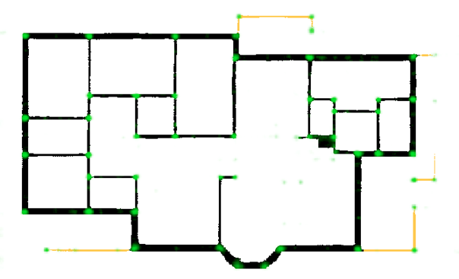
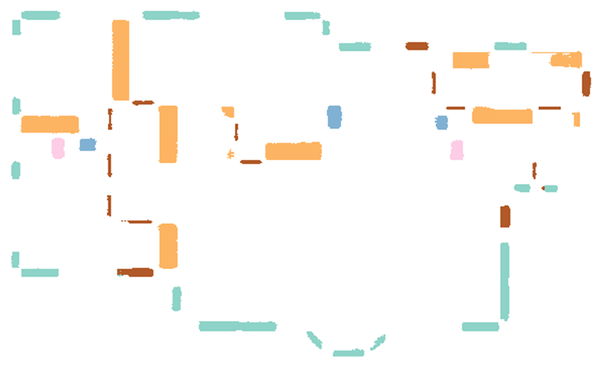
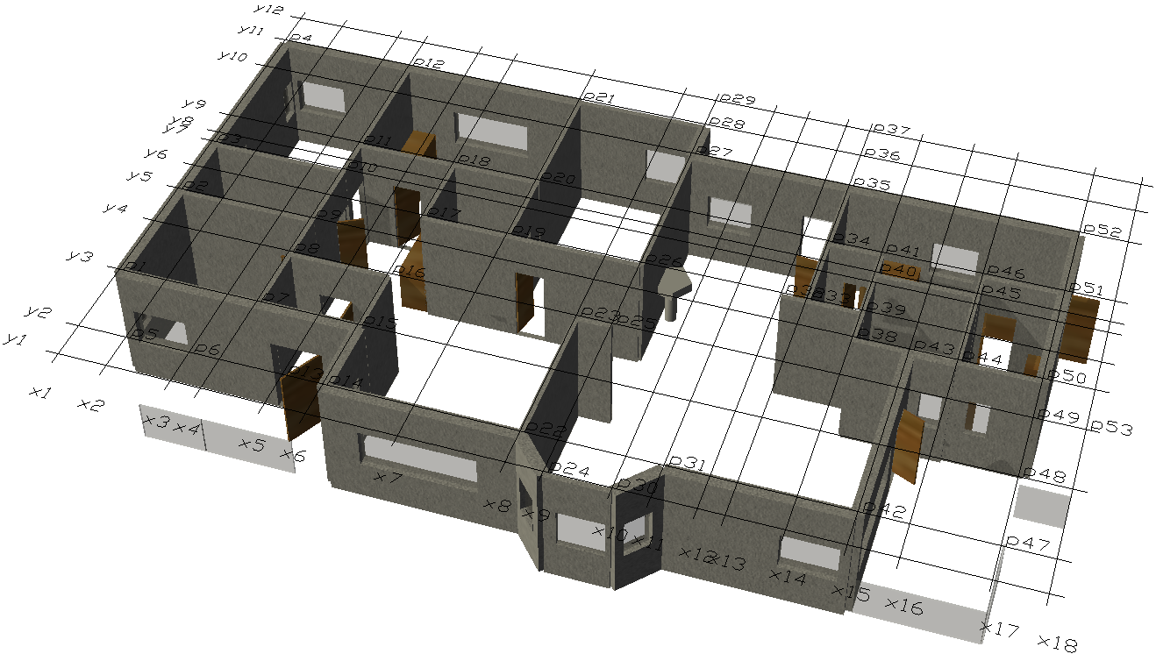
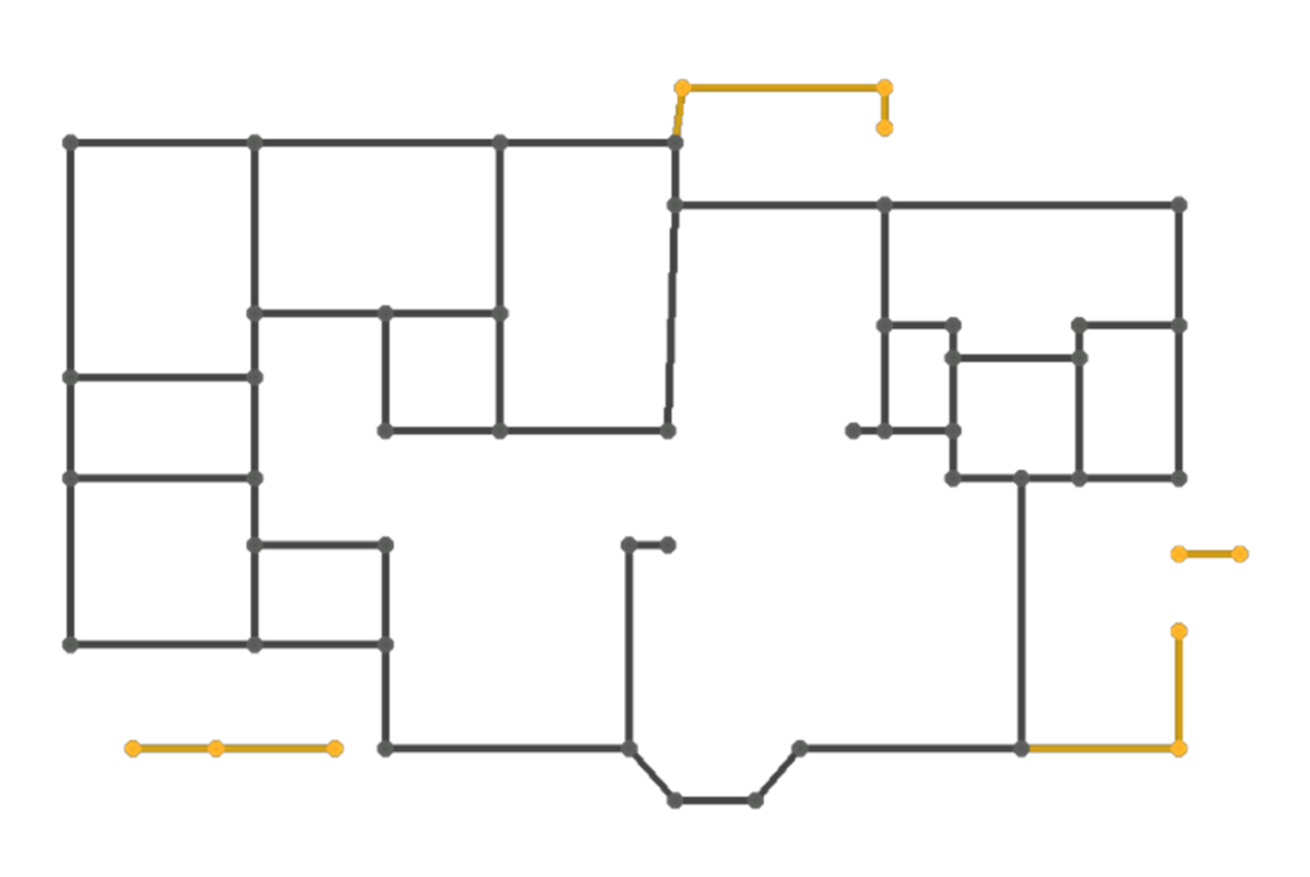
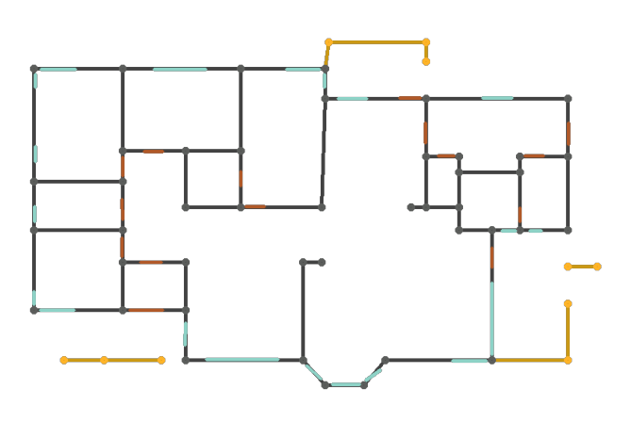
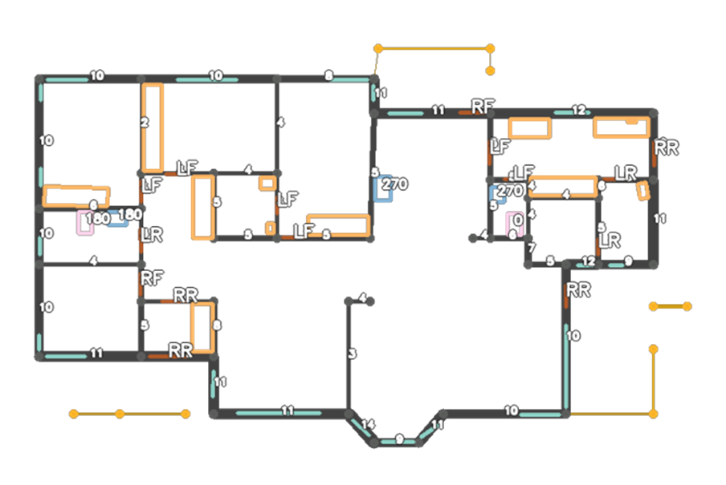
Proposed Solution
Input image
Recognition
Reconstruction
Segmentation
Defining parameters
Program writing
Walls & Junctions
Symbols
using Khepri
x1 = 1.41
... y1 = 1.56
... wall(p1, p2; parts=door(1, .5))
sink(xy(10, 15), 270)
...
Vectorization
Attaching wall elements
Semantics Recovery
Backend rendering

Slide 13
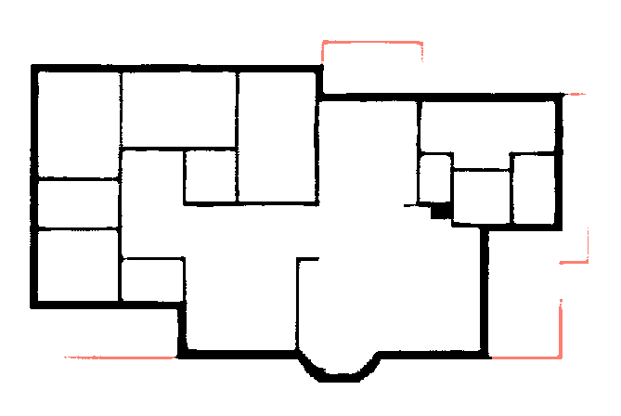
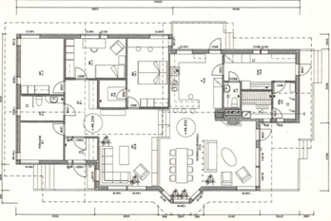
Segmentation
Walls and Railings
Input Image
Symbols
Junctions
Kalervo et al., 2019 — CubiCasa5K: A dataset and an Improved multi-task model for floorplan image analysis

Slide 14
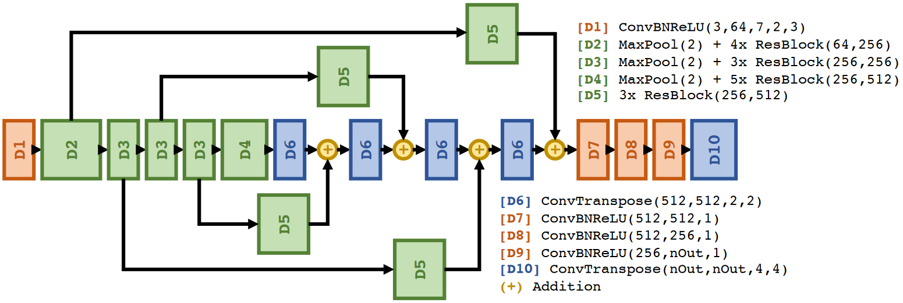
Segmentation Network
Kalervo et al., 2019 — CubiCasa5K: A dataset and an Improved multi-task model for floorplan image analysis

Slide 15
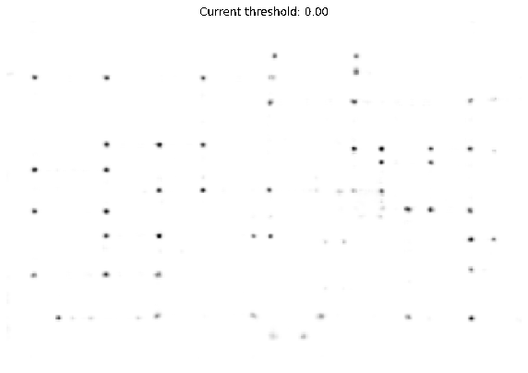
Junction Heatmap Threshold

Slide 16
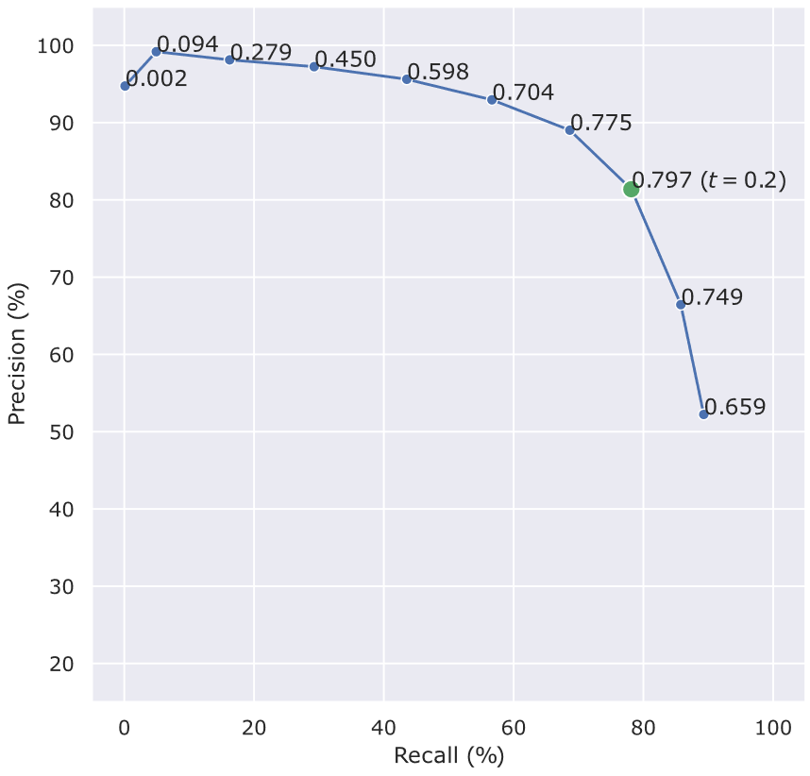
Junction Heatmap Threshold

Slide 17
Vectorization

Slide 18
Wall Thickness Calculation
1
2

Slide 19
Wall Thickness Calculation
1
2

Slide 20
Choosing a Metric

Slide 21
Choosing a Metric
$$fitness=1∗True Positives −1.1 ∗False Positives$$

Slide 22
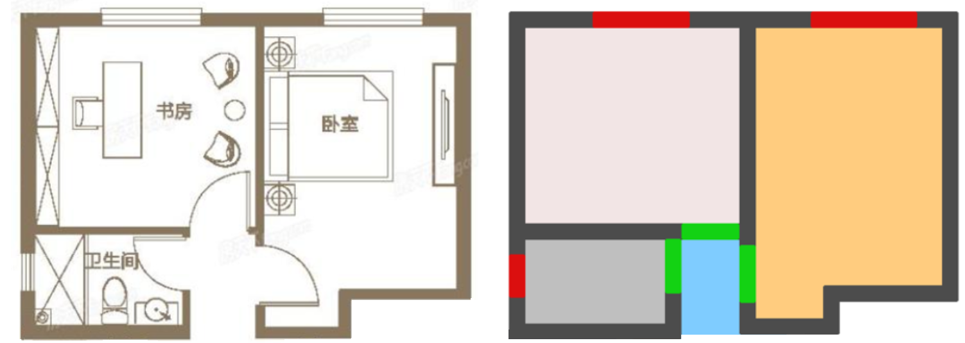
Semantics Recovery
Adapted from: Lv et al., 2021 — Residential floor plan recognition and reconstruction

Slide 23
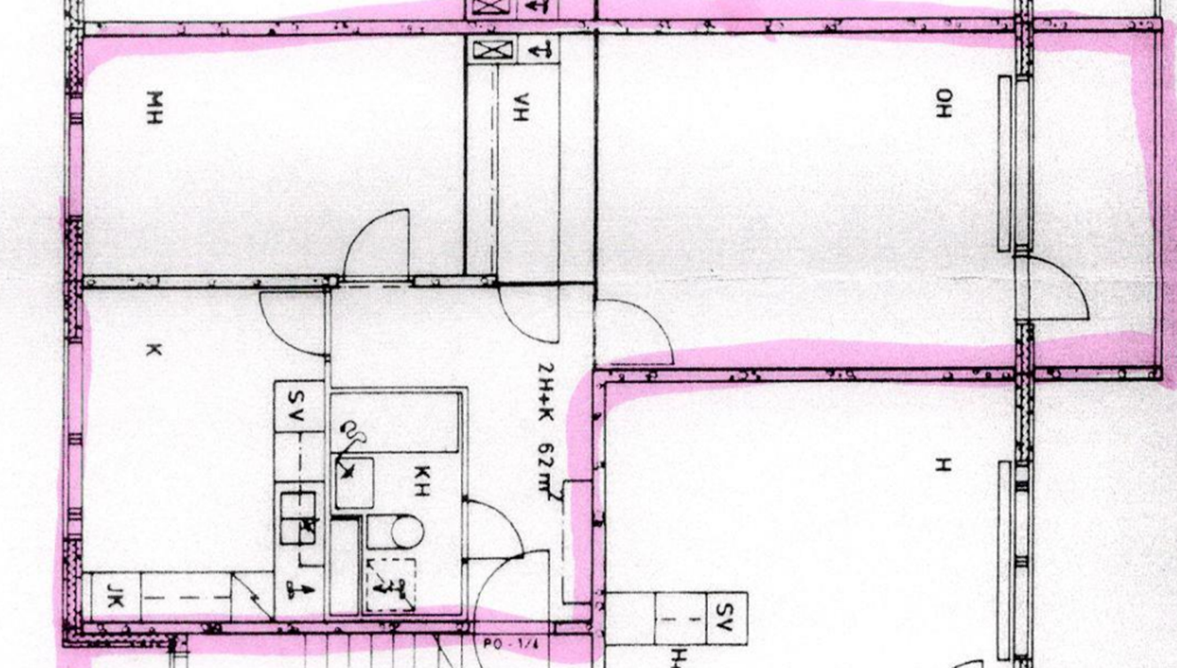
Example Image
Kalervo et al., 2019 — CubiCasa5K: A dataset and an improved multi-task model for floorplan image analysis

Slide 24
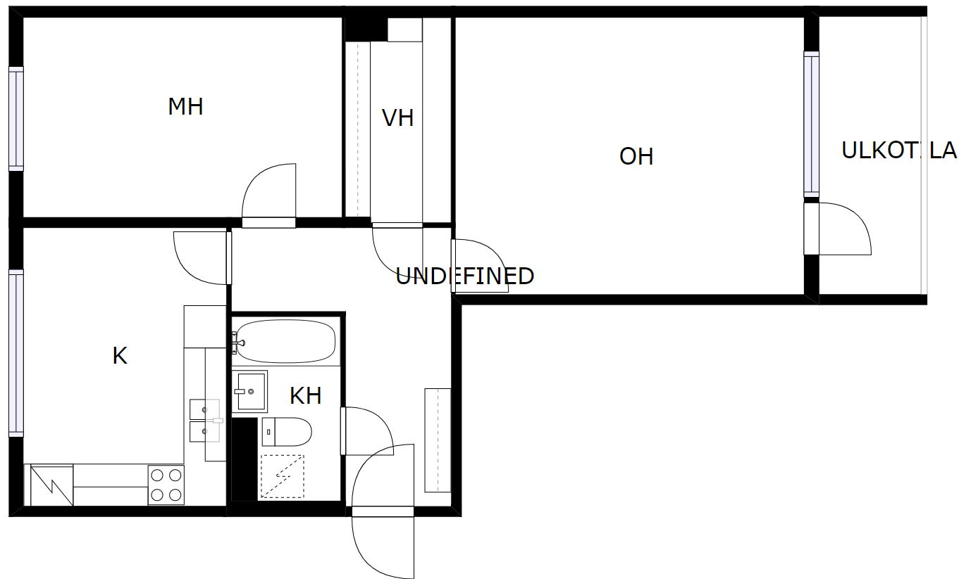
Door Extraction
E
S

Slide 25
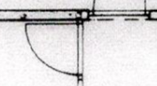
Door Classification
O
S
E
New example
Right
Forward

Slide 26
Other Examples

Slide 27
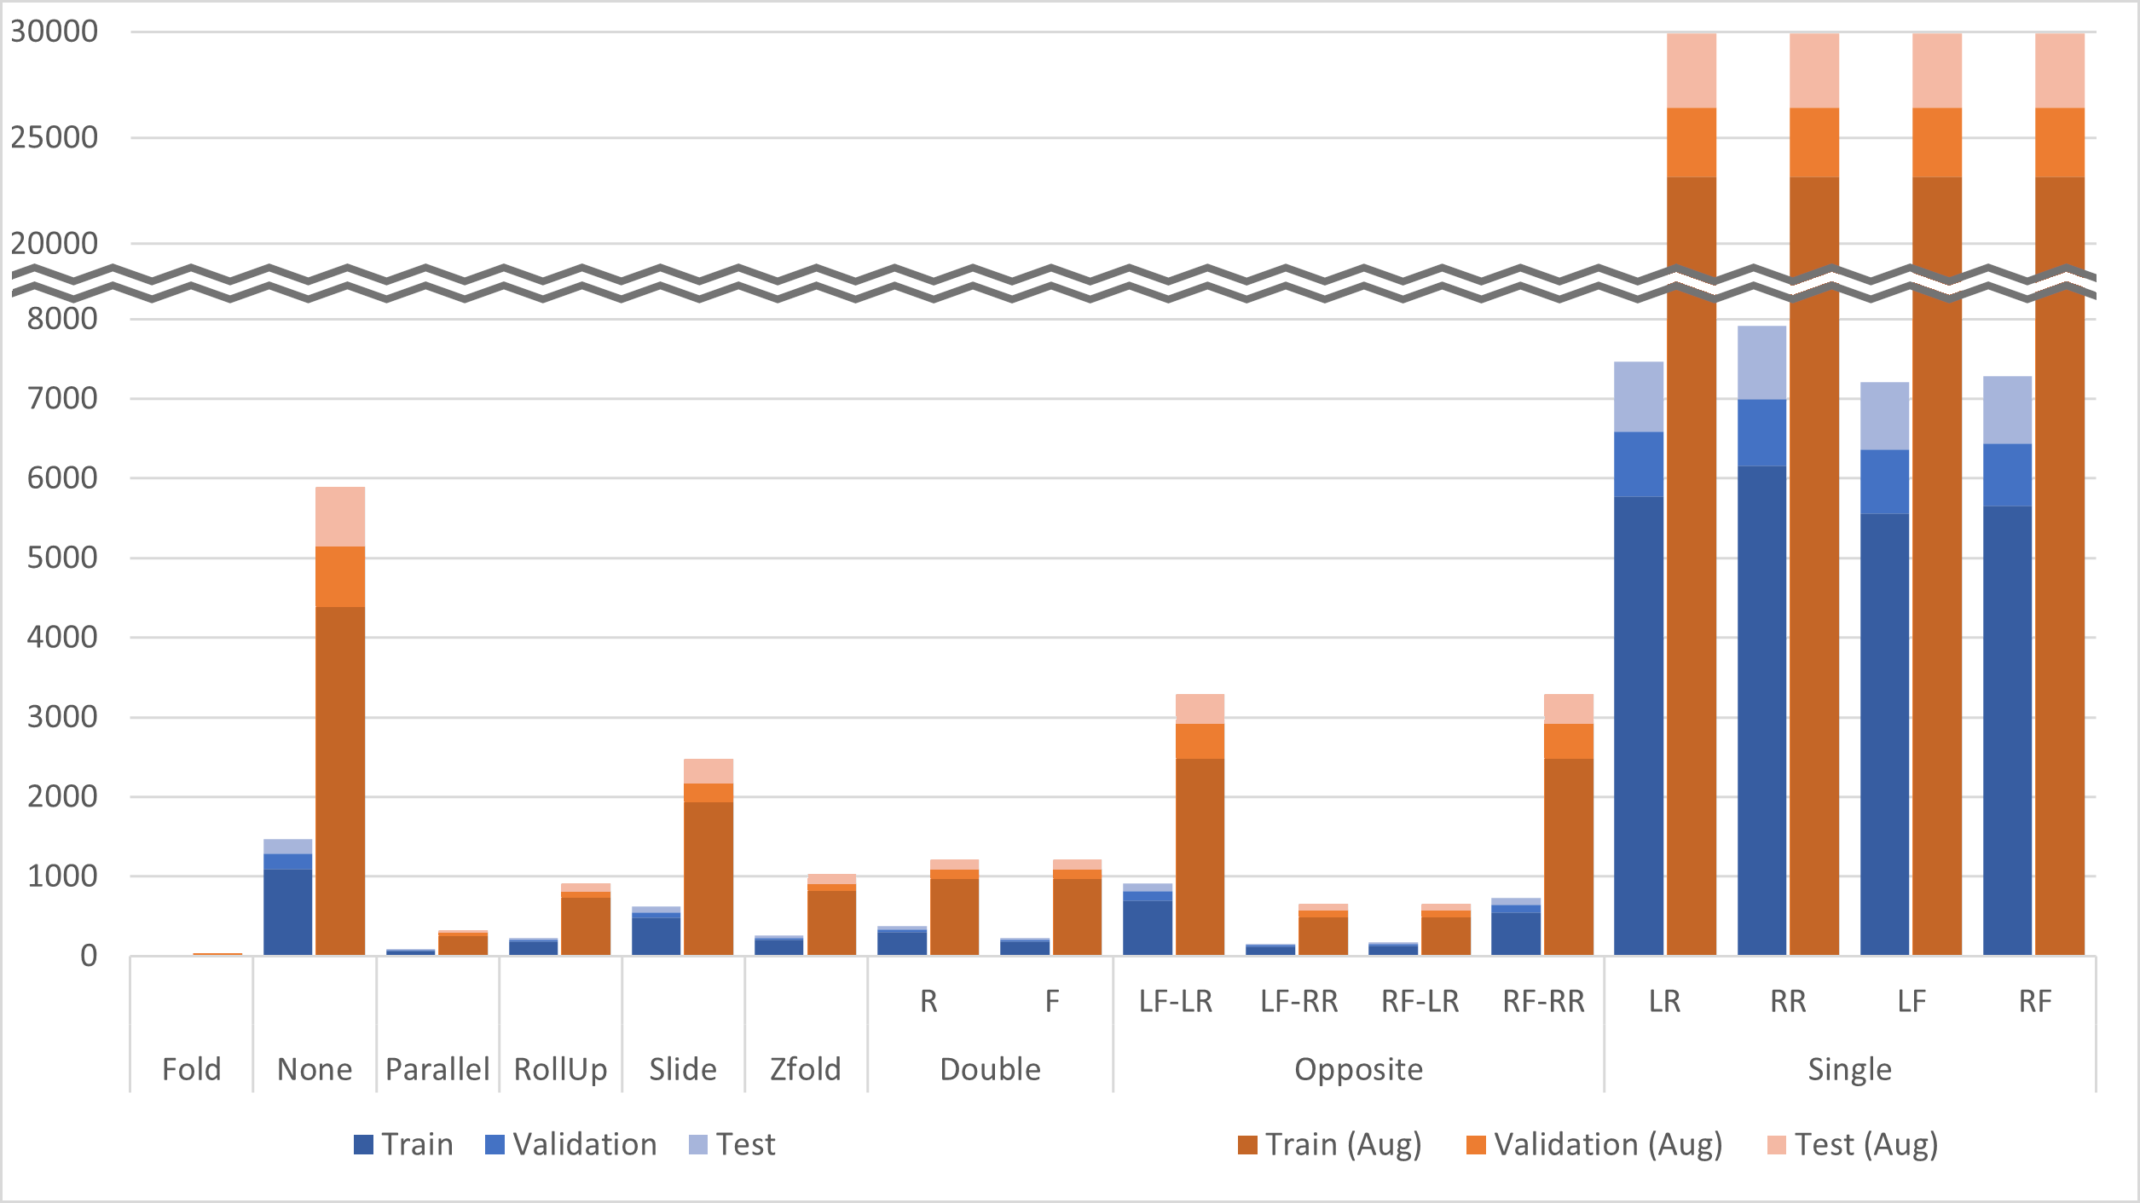
Dataset Statistics

Slide 28
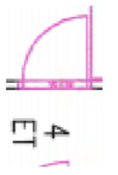
Data Augmentation

Slide 29
Toilets, Sinks, and Others
Kalervo et al., 2019 — CubiCasa5K: A dataset and an improved multi-task model for floorplan image analysis

Slide 30
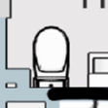
Toilets
Class: 0º

Slide 31
Toilets
Class: 45º

Slide 32
Toilets
Class: 180º

Slide 33
Sinks
Class: 0º
Class: 0º (?)
Class: 315º (?)
CornerSink

Slide 34
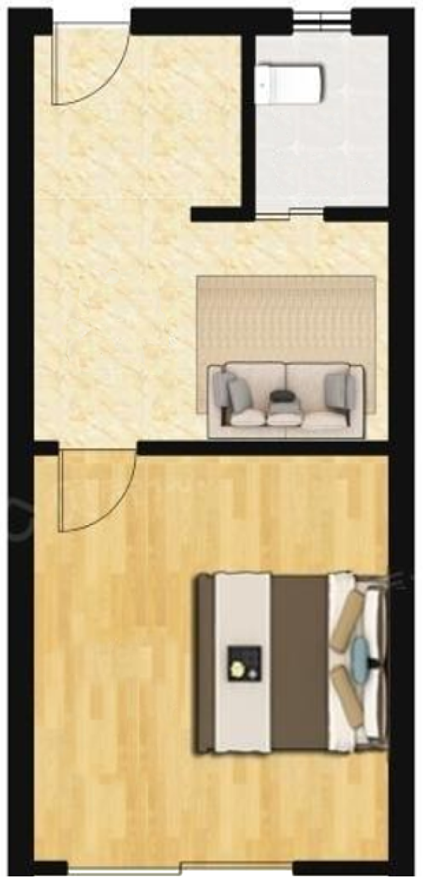
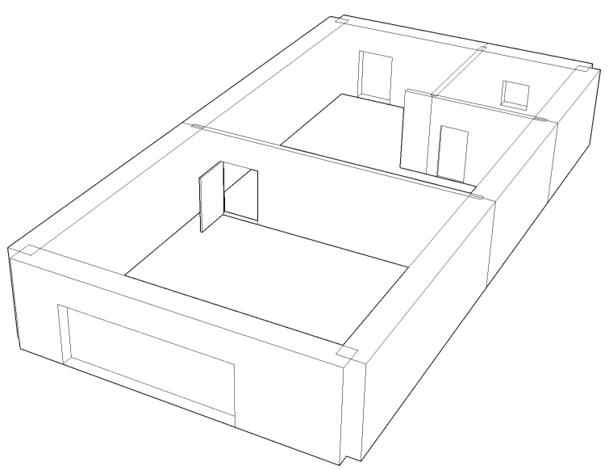
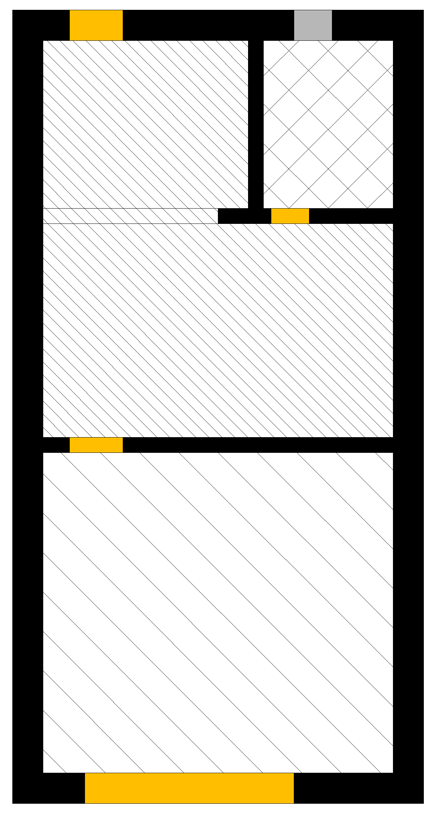
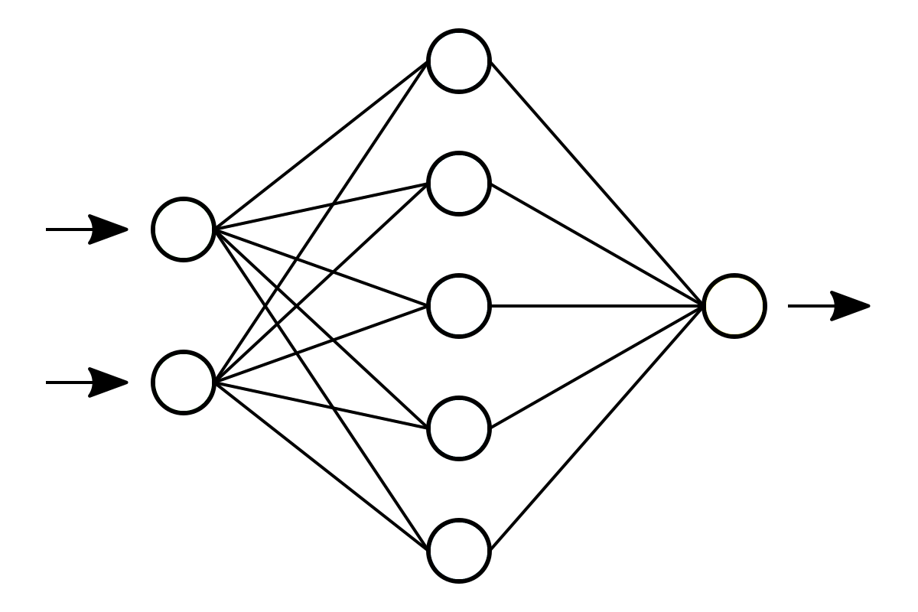
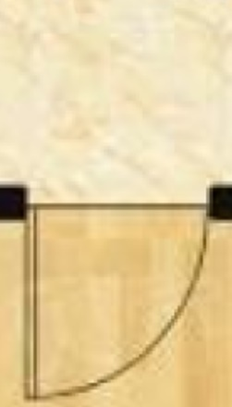
Integration
Liu et al., 2022 — A ConvNet for the 2020s

Slide 35
Proposed Solution
Input image
Recognition
Reconstruction
Segmentation
Defining parameters
Program writing
Walls & Junctions
Symbols
using Khepri
x1 = 1.41
... y1 = 1.56
... wall(p1, p2; parts=door(1, .5))
sink(xy(10, 15), 270)
...
Vectorization
Attaching wall elements
Semantics Recovery
Backend rendering

Slide 36
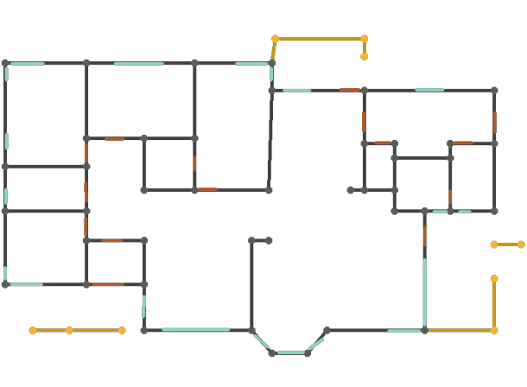
Defining Parameters

Slide 37
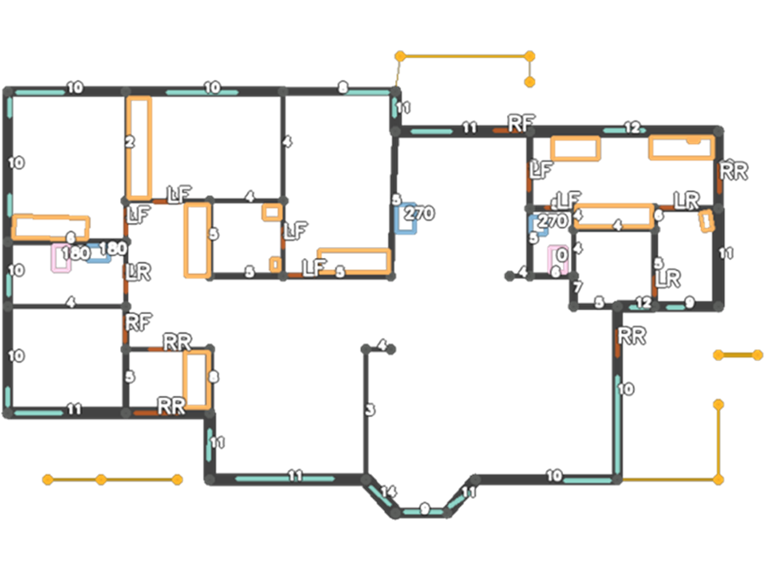
Estimating Distances

Slide 38
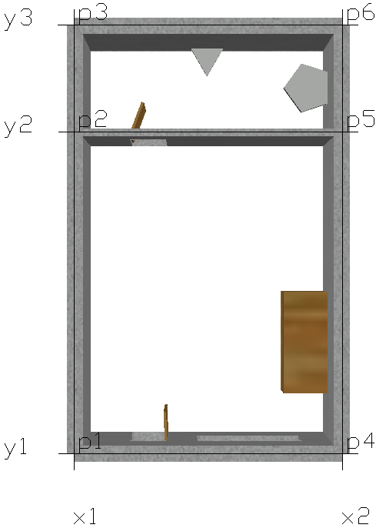
include("OutAux.jl")
delete_all_shapes()
thinwall(wallpath; parts=[]) = wall(wallpath, 0.15; parts=parts)
thickwall(wallpath; parts=[]) = wall(wallpath, 0.3; parts=parts)
# List of X and Y values. Alternatively, this part could be
# skipped and the points would use these values directly. x1 = 0
x2 = 5
y1 = 0
y2 = 6
y3 = 8
# List of points created based on X and Y values.
p1 = xy(x1, y1)
p2 = xy(x1, y2)
p3 = xy(x1, y3)
# ...
# Definition of the walls based on the created points
thickwall([p1, p2])
thickwall([p1, p4]; parts=[door(1, 0.7, rf), window(2.3, 2)])
thinwall([p2, p5]; parts=[door(1, 0.7, lf)])
# ...
sink(xy(4.5, 7), 90)
toilet(xy(2.5, 7.7), 180)
closet(xy(4, 1), xy(5, 3))
show_auxiliary_labels(labels_only=false)
Program Execution

Slide 39
include("OutAux.jl")
delete_all_shapes()
thinwall(wallpath; parts=[]) = wall(wallpath, 0.15; parts=parts)
thickwall(wallpath; parts=[]) = wall(wallpath, 0.3; parts=parts)
# List of X and Y values. Alternatively, this part could be
# skipped and the points would use these values directly. x1 = 0
x2 = 5
y1 = 0
y2 = 6
y3 = 8
# List of points created based on X and Y values.
p1 = xy(x1, y1)
p2 = xy(x1, y2)
p3 = xy(x1, y3)
# ...
# Definition of the walls based on the created points
thickwall([p1, p2])
thickwall([p1, p4]; parts=[door(1, 0.7, rf), window(2.3, 2)])
thinwall([p2, p5]; parts=[door(1, 0.7, lf)])
# ...
sink(xy(4.5, 7), 90)
toilet(xy(2.5, 7.7), 180)
closet(xy(4, 1), xy(5, 3))
show_auxiliary_labels(labels_only=false)
Program Execution

Slide 40
include("OutAux.jl")
delete_all_shapes()
thinwall(wallpath; parts=[]) = wall(wallpath, 0.15; parts=parts)
thickwall(wallpath; parts=[]) = wall(wallpath, 0.3; parts=parts)
# List of X and Y values. Alternatively, this part could be
# skipped and the points would use these values directly. x1 = 0
x2 = 5
y1 = 0
y2 = 6
y3 = 8
# List of points created based on X and Y values.
p1 = xy(x1, y1)
p2 = xy(x1, y2)
p3 = xy(x1, y3)
# ...
# Definition of the walls based on the created points
thickwall([p1, p2])
thickwall([p1, p4]; parts=[door(1, 0.7, rf), window(2.3, 2)])
thinwall([p2, p5]; parts=[door(1, 0.7, lf)])
# ...
sink(xy(4.5, 7), 90)
toilet(xy(2.5, 7.7), 180)
closet(xy(4, 1), xy(5, 3))
show_auxiliary_labels(labels_only=false)
Program Execution

Slide 41
include("OutAux.jl")
delete_all_shapes()
thinwall(wallpath; parts=[]) = wall(wallpath, 0.15; parts=parts)
thickwall(wallpath; parts=[]) = wall(wallpath, 0.3; parts=parts)
# List of X and Y values. Alternatively, this part could be
# skipped and the points would use these values directly. x1 = 0
x2 = 5
y1 = 0
y2 = 6
y3 = 8
# List of points created based on X and Y values.
p1 = xy(x1, y1)
p2 = xy(x1, y2)
p3 = xy(x1, y3)
# ...
# Definition of the walls based on the created points
thickwall([p1, p2])
thickwall([p1, p4]; parts=[door(1, 0.7, rf), window(2.3, 2)])
thinwall([p2, p5]; parts=[door(1, 0.7, lf)])
# ...
sink(xy(4.5, 7), 90)
toilet(xy(2.5, 7.7), 180)
closet(xy(4, 1), xy(5, 3))
show_auxiliary_labels(labels_only=false)
Program Execution

Slide 42
include("OutAux.jl")
delete_all_shapes()
thinwall(wallpath; parts=[]) = wall(wallpath, 0.15; parts=parts)
thickwall(wallpath; parts=[]) = wall(wallpath, 0.3; parts=parts)
# List of X and Y values. Alternatively, this part could be
# skipped and the points would use these values directly. x1 = 0
x2 = 5
y1 = 0
y2 = 6
y3 = 8
# List of points created based on X and Y values.
p1 = xy(x1, y1)
p2 = xy(x1, y2)
p3 = xy(x1, y3)
# ...
# Definition of the walls based on the created points
thickwall([p1, p2])
thickwall([p1, p4]; parts=[door(1, 0.7, rf), window(2.3, 2)])
thinwall([p2, p5]; parts=[door(1, 0.7, lf)])
# ...
sink(xy(4.5, 7), 90)
toilet(xy(2.5, 7.7), 180)
closet(xy(4, 1), xy(5, 3))
show_auxiliary_labels(labels_only=false)
Program Execution

Slide 43
Results

Slide 44
Segmentation Model
 | Rooms |  |  | Icons
 | Wall | Railing | Rest | Door | Window | Toilet | Sink | Closet | Rest
Acc (%) | 83.3 | 27.4 | 98.4 | 57.0 | 71.4 | 66.4 | 64.3 | 76.2 | 99.5
IoU (%) | 72.2 | 22.9 | 96.5 | 52.0 | 65.4 | 61.5 | 54.7 | 68.4 | 98.1

Slide 45
Segmentation Model
 | Rooms |  |  | Icons
 | Wall | Railing | Rest | Door | Window | Toilet | Sink | Closet | Rest
Acc (%) | 83.3 | 27.4 | 98.4 | 57.0 | 71.4 | 66.4 | 64.3 | 76.2 | 99.5
IoU (%) | 72.2 | 22.9 | 96.5 | 52.0 | 65.4 | 61.5 | 54.7 | 68.4 | 98.1

Slide 46
Segmentation Model
 | Rooms |  |  | Icons
 | Wall | Railing | Rest | Door | Window | Toilet | Sink | Closet | Rest
Acc (%) | 83.3 | 27.4 | 98.4 | 57.0 | 71.4 | 66.4 | 64.3 | 76.2 | 99.5
IoU (%) | 72.2 | 22.9 | 96.5 | 52.0 | 65.4 | 61.5 | 54.7 | 68.4 | 98.1

Slide 47
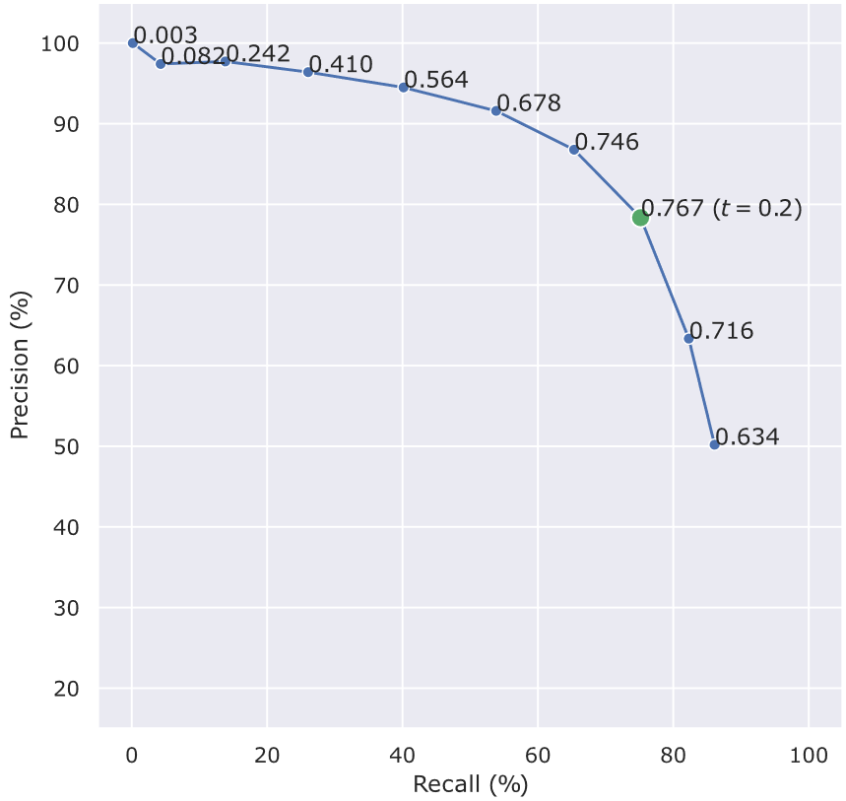
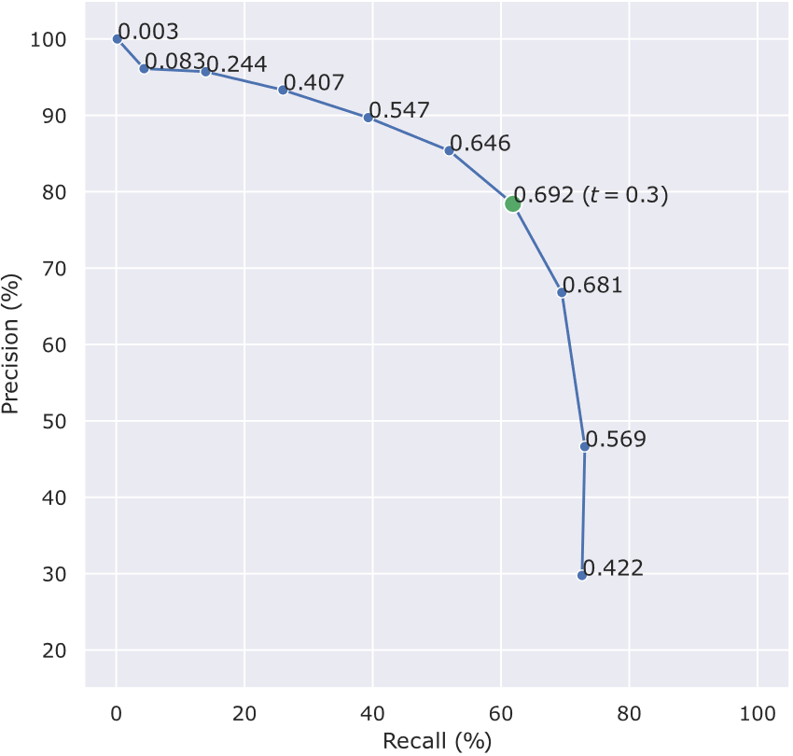
Junction Detection
Class-agnostic detection
Class-dependent detection

Slide 48
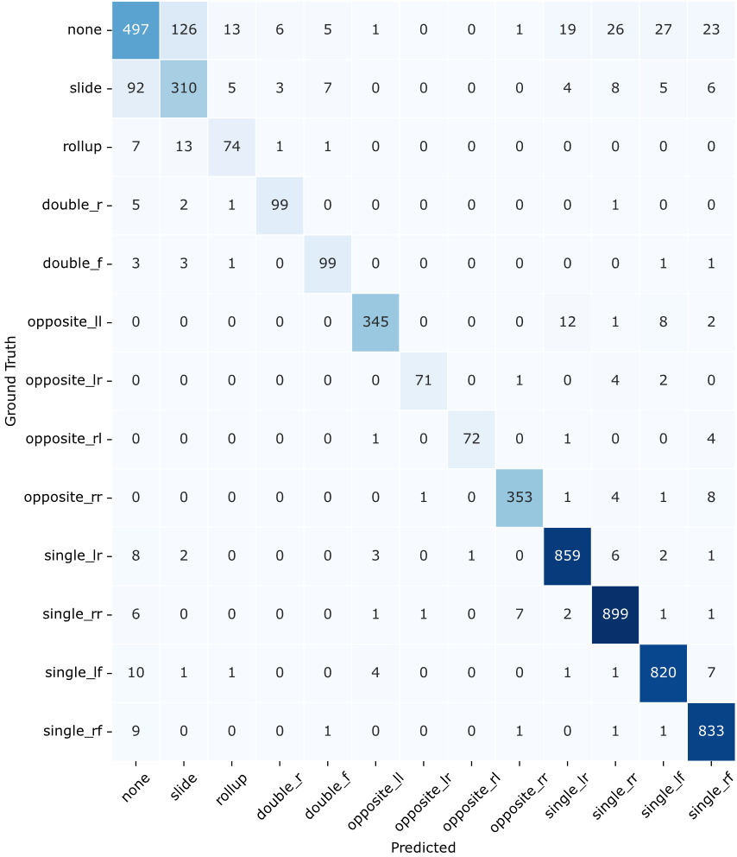
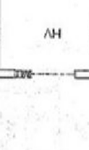
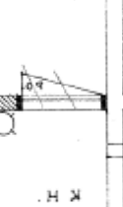
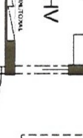
none
slide

Slide 49
Orientation Classification
Toilets test set
Sinks test set
 | 0º-360º
Recall (%) | 98.9
Precision (%) | 98.9
 | 0º-360º | Corner | Weighted Avg.
Recall (%) | 98.6 | 95.8 | 98.5
Precision (%) | 98.6 | 93.9 | 98.5

Slide 50
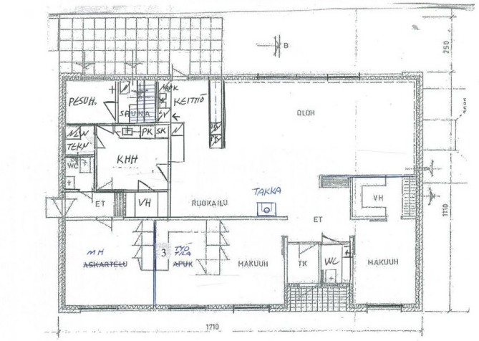
Example Results
Kalervo et al., 2019 — CubiCasa5K: A dataset and an improved multi-task model for floorplan image analysis

Slide 51
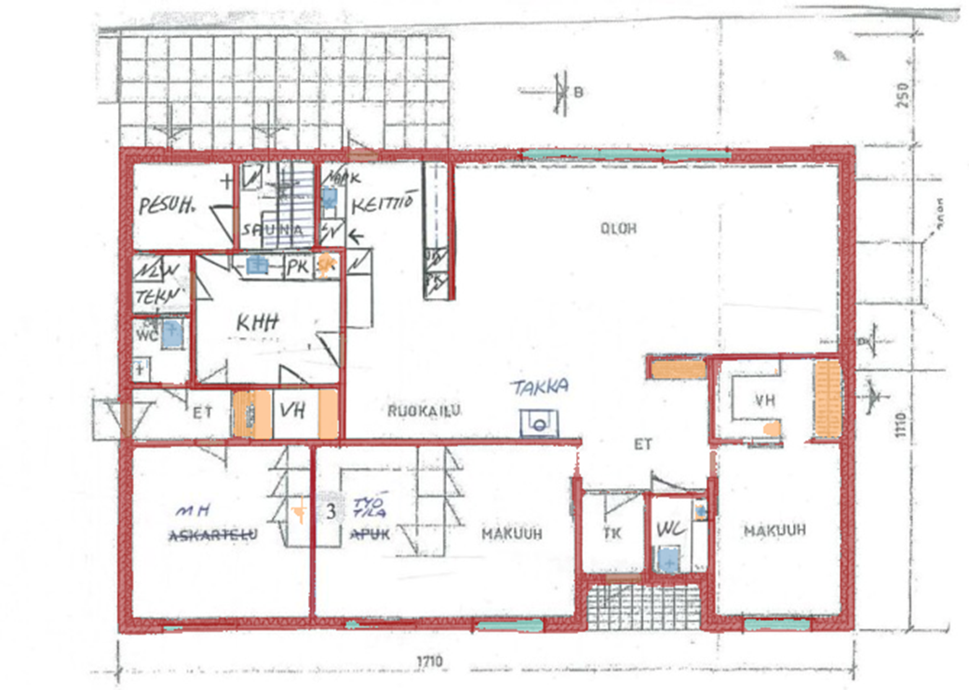
Example Results

Slide 52
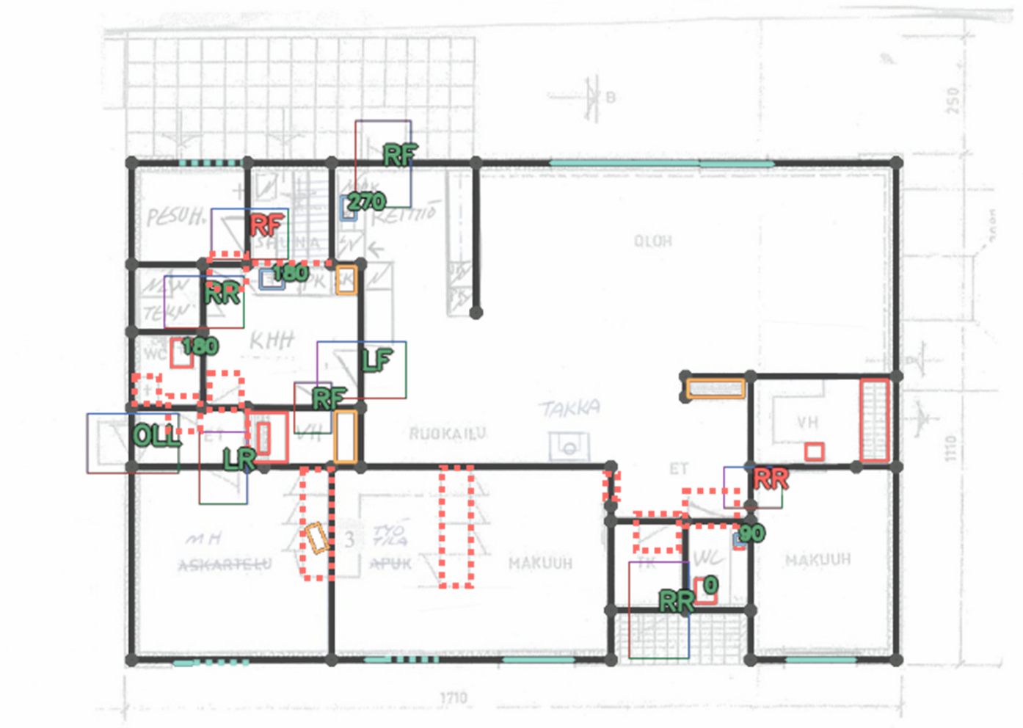
Example Results

Slide 53
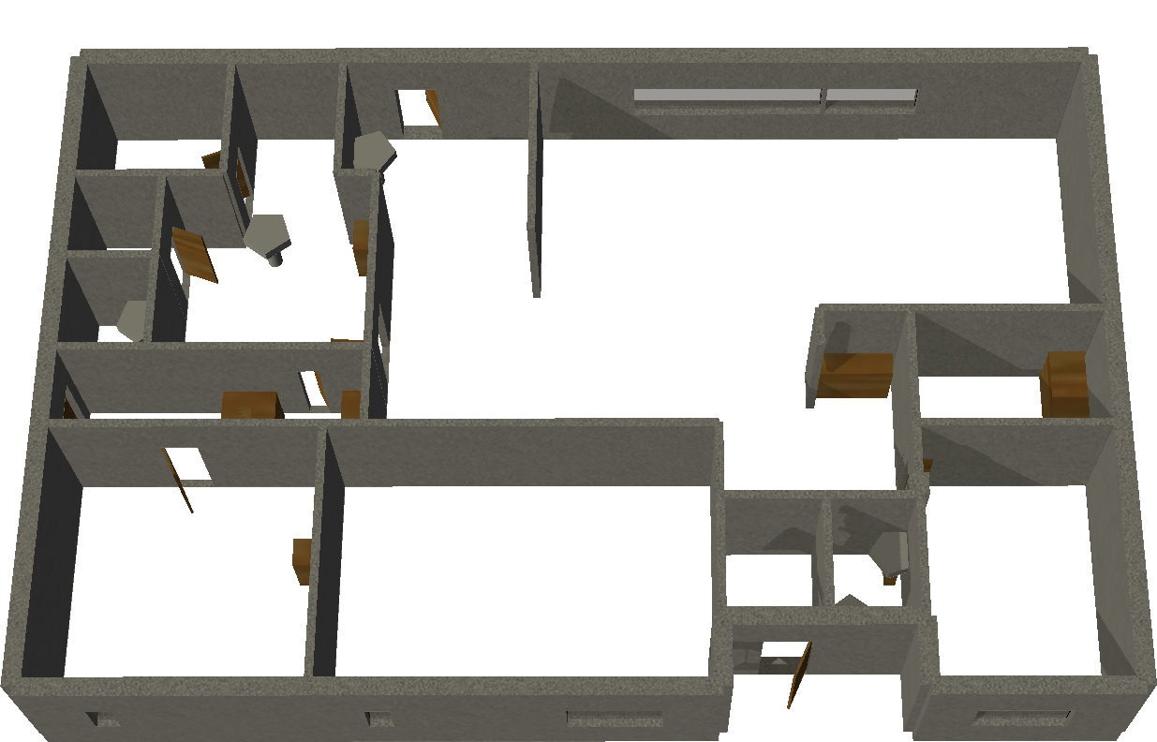
Example Results

Slide 55
Conclusions
Traditional design methods
Contributions
Are hard to parameterize and optimize, which is a requirement nowadays.
J. David and A. Leitão, “Getting a handle on floor plan analysis: door classification in floor plan images and a survey on existing datasets”, in Proceedings of the 10th International Conference of the Arab Society for Computation in Architecture, Art, and Design (2022): Hybrid Spaces of the Metaverse, Oct. 2022, pp. 22–235.
J. David, C. Belém, and A. Leitão, “Inverse algorithmic design: automatic conversion of floor plan images into computer programs”, in INTERCONNECTIONS: Co-computing beyond boundaries — Proceedings of the CAAD Futures conference, 2023, TU Delft Netherlands (submitted).
Algorithmic design
Easy to iterate over but there is no easy conversion method, and it has a steep learning curve.
Inverse algorithmic design
We automatically create AD programs from floor plan images:
New reconstruction method;
Semantic recovery process;
Output in the form of parametric AD programs.

Slide 56
Conclusions
Traditional design methods
Contributions
Are hard to parameterize and optimize, which is a requirement nowadays.
J. David and A. Leitão, “Getting a handle on floor plan analysis: door classification in floor plan images and a survey on existing datasets”, in Proceedings of the 10th International Conference of the Arab Society for Computation in Architecture, Art, and Design (2022): Hybrid Spaces of the Metaverse, Oct. 2022, pp. 22–235.
J. David, C. Belém, and A. Leitão, “Inverse algorithmic design: automatic conversion of floor plan images into computer programs”, in INTERCONNECTIONS: Co-computing beyond boundaries — Proceedings of the CAAD Futures conference, 2023, TU Delft Netherlands (submitted).
Algorithmic design
Easy to iterate over but there is no easy conversion method, and it has a steep learning curve.
Inverse algorithmic design
We automatically create AD programs from floor plan images:
New reconstruction method;
Semantic recovery process;
Output in the form of parametric AD programs.
joaodavid@tecnico.ulisboa.pt

Slide 57
Inverse Algorithmic Design
wall(xy(7.584039, 3.842963), xy(2.398200, 3.853195))
beam(xy(0.502686, 2.703664), xy(8.244835, 10.961915))
wall(xy(14.693588, 11.768203), xy(14.054853, 0.192584))
wall(xy(7.370911, 6.716919), xy(11.943345, 14.120184))
wall(xy(1.747752, 7.537068), xy(2.703668, 7.131730))
beam(xy(11.581883, 9.683602), xy(0.151352, 0.410725))
beam(xy(7.426873, 9.021476), xy(6.926079, 12.398898))
wall(xy(12.493763, 4.756162), xy(1.159009, 1.971081))
beam(xy(3.490791, 7.604907), xy(3.204002, 0.474994))
beam(xy(14.497536, 13.006465), xy(8.799677, 6.278438))
block(xy(10.517310, 9.367753))
block(xy(3.341927, 14.129803))
block(xy(5.478417, 8.914325))
block(xy(7.269629, 3.172376))
block(xy(13.184670, 13.796445))
block(xy(6.753180, 10.633837))
block(xy(1.574608, 0.533216))
block(xy(10.986766, 12.291348))
block(xy(13.317139, 1.794746))
block(xy(1.989959, 5.523614))
block(xy(3.171852, 8.748131))
beam(xy(4.102901, 7.008103), xy(0.064639, 5.828904))
beam(xy(0.379541, 5.330805), xy(11.256828, 2.661589))
wall(xy(2.084056, 13.388036), xy(13.611340, 9.179749))
beam(xy(3.847304, 3.357306), xy(0.132002, 10.896384))
wall(xy(1.692626, 11.254379), xy(10.204213, 1.378933))
wall(xy(10.563378, 10.510916), xy(8.537150, 11.153845))
beam(xy(2.467427, 11.791093), xy(10.066387, 6.674029))
wall(xy(10.481891, 1.151805), xy(1.071189, 8.043461))
beam(xy(6.657314, 7.561724), xy(1.523147, 0.549411))
beam(xy(8.167366, 12.537342), xy(3.505036, 2.041586))
KHEPRI

Slide 58
Recovering Accurate Orientation

Slide 59
Ellis, K., et al. (2018)

Slide 60
Scale-Invariant Feature Transform (SIFT)
Lowe, 2004 - Distinctive Image Features from Scale-Invariant Keypoints

Slide 61
Scale-Invariant Feature Transform (SIFT)

Slide 62
Structural Symbol Recognition
Rezvanifar et al., 2019 - Symbol spotting for architectural drawings: state-of-the-art and new industry-driven developments

Slide 63
Subgraph Isomorphism

Slide 64
Constraint Network
Ah-Soon & Tombre, 2001 - Architectural symbol recognition using a network of constraints

Slide 65
Convolutional Neural Networks
A Comprehensive Guide to Convolutional Neural Networks — the ELI5 Way (Towards Data Science)

Slide 66
Attention and the Transformer
Dosovitskiy et al., 2021 - An image is worth 16x16 words: Transformers for image recognition at scale

Slide 67
EfficientNetV2

Slide 68
Graph Neural Networks
Song & Yu, 2021 - Framework for indoor elements classification via inductive learning on floor plan graphs

Slide 69
Rotation Invariance
Objects can be detected in any orientation
Their rotation is discarded
Find image rotation and scale using automated feature matching (MathWorks)

Slide 70
Floor Plan Parsing — Now
Zeng et al., 2019 — Deep floor plan recognition using a multi-task network with room-boundary-guided attention

Slide 71
Floor Plan Parsing — Now
Zeng et al., 2019 — Deep floor plan recognition using a multi-task network with room-boundary-guided attention

Slide 72
Floor Plan Parsing — Now
Zeng et al., 2019 — Deep floor plan recognition using a multi-task network with room-boundary-guided attention

Slide 73
Residential Floor Plan Vectorization

Slide 74
Avoid Placing Walls Over Junctions
1
2
3

Slide 75
Avoid Placing Walls Over Junctions
1
3
2

Slide 76
Used Loss Function

Slide 77
CubiCasa5K Loss Function

Slide 78
CubiCasa5K Loss Function

Slide 79
CubiCasa5K Loss Function

Slide 80
CubiCasa5K Loss Function

Slide 81
Segmentation Network
 | Mean Room Type IoU (%) | Mean Icon IoU (%) | Heatmap MAE
Baseline (CubiCasa5K) | 60.72 | 55.73 | 0.00117
DFP-VGG-16 | 47.83 | 41.25 | 0.00141
DFP-ResNet34 | 47.88 | 38.36 | 0.00142
DFP-ResNet50 | 45.26 | 34.33 | 0.00147
DeepLabv3-ResNet50 | 58.72 | 57.25 | 0.00123

Slide 82
Validation Loss Curves

Slide 83
ConvNeXt Architecture

Slide 84
EfficientNetV2

Slide 85
ConvNeXt Architecture

Slide 86
Door Description

Slide 87
Why Extract Individual Images?

Slide 88
Generating Parameters
p1 = (2.5, 8.0)
p2 = (2.6, 7.2)
p3 = (8.0, 7.3)

Slide 89
Generating Parameters
x1 = 2.55
x2 = 8.0
y1 = 7.25
y2 = 8.0
p1 = (x1, y1)
p2 = (x1, y2)
p3 = (x2, y1)
p1 = (2.5, 8.0)
p2 = (2.6, 7.2)
p3 = (8.0, 7.3)
p1 = (1, 2)
p2 = (1, 1)
p3 = (2, 1)
Coordinate clustering
Generation

Slide 90
Execution Time Analysis

Slide 91
Failed Scale Estimation

Slide 92
F-signatures
(Tabbone et al., 2003)

Slide 93
Faster R-CNN
(Ren et al., 2017)

Slide 94
Taking context into account
(Macé et al., 2010)

