Slide 1
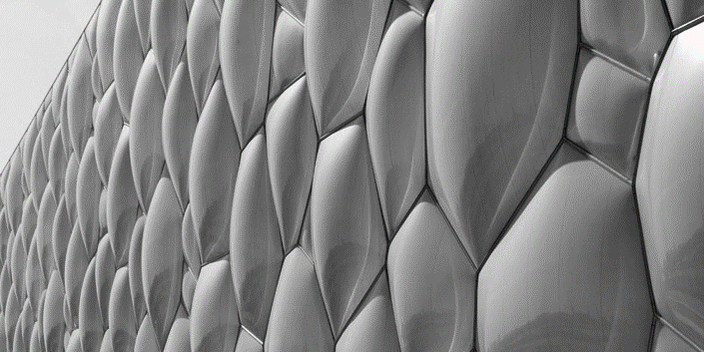
THE EXPRESSIVE POWER OF PROGRAMMING LANGUAGES IN ARCHITECTURE
Maria João Sammer
Supervisor
Prof. Dr. António Menezes Leitão
Co-supervisor
Prof. Dr. Miguel Amado
18th June 2019
PTW Architects, Beijing National Aquatics Center/Watercube (2007), Beijing, China [1]

Slide 2
INTRODUCTION
Objectives
ALGORITHMIC DESIGN
PROGRAMMING LANGUAGES
Fundamental Concepts
EVALUATION
Theory
Practice
GUIDELINES
The Approach
Implementations
CONCLUSIONS
Reflections
Future Work
Zaha Hadid Architects, Morpheus Hotel (2018), City of Dreams, Macau [2]

Slide 3
INTRODUCTION
Objectives
ALGORITHMIC DESIGN
PROGRAMMING LANGUAGES
Fundamental Concepts
EVALUATION
Theory
Practice
GUIDELINES
The Approach
Implementations
CONCLUSIONS
Reflections
Future Work
3

Slide 4
INTRODUCTION
Objectives
ALGORITHMIC DESIGN
PROGRAMMING LANGUAGES
Fundamental Concepts
EVALUATION
Theory
Practice
GUIDELINES
The Approach
Implementations
CONCLUSIONS
Reflections
Future Work
3

Slide 5
INTRODUCTION
Objectives
ALGORITHMIC DESIGN
PROGRAMMING LANGUAGES
Fundamental Concepts
EVALUATION
Theory
Comparative study of Programming Languages
Practice
GUIDELINES
The Approach
Implementations
CONCLUSIONS
Reflections
Future Work
4

Slide 6
INTRODUCTION
Objectives
ALGORITHMIC DESIGN
PROGRAMMING LANGUAGES
Fundamental Concepts
EVALUATION
Theory
Comparative study of Programming Languages
Practice
GUIDELINES
Framework for the use of different Programming Languages
The Approach
Implementations
CONCLUSIONS
Reflections
Future Work
4

Slide 7
INTRODUCTION
Objectives
ALGORITHMIC DESIGN
PROGRAMMING LANGUAGES
Fundamental Concepts
EVALUATION
Theory
Comparative study of Programming Languages
Practice
GUIDELINES
Framework for the use of different Programming Languages
The Approach
Implementations
Proposal of Algorithmic Design as a representation method
CONCLUSIONS
Reflections
Future Work
4

Slide 8
INTRODUCTION
Objectives
ALGORITHMIC DESIGN
PROGRAMMING LANGUAGES
Fundamental Concepts
EVALUATION
Theory
Practice
GUIDELINES
The Approach
Implementations
CONCLUSIONS
Reflections
Future Work
BIG, Serpentine Pavilion (2016), London, UK [3]

Slide 9
INTRODUCTION
Objectives
ALGORITHMIC DESIGN
PROGRAMMING LANGUAGES
Fundamental Concepts
EVALUATION
Theory
Practice
GEOMETRY
GUIDELINES
The Approach
Implementations
CONCLUSIONS
Reflections
Future Work
6

Slide 10
INTRODUCTION
Objectives
ALGORITHMIC DESIGN
PROGRAMMING LANGUAGES
Fundamental Concepts
EVALUATION
Theory
Practice
GEOMETRY
GUIDELINES
The Approach
Implementations
CONCLUSIONS
Reflections
Future Work
6

Slide 11
INTRODUCTION
Objectives
ALGORITHMIC DESIGN
PROGRAMMING LANGUAGES
Fundamental Concepts
EVALUATION
Theory
Practice
GUIDELINES
The Approach
Implementations
CONCLUSIONS
Reflections
Future Work
Fernando Romero Enterprise, Museum Soumaya (2010), Mexico City, Mexico [4]

Slide 12
INTRODUCTION
Objectives
ALGORITHMIC DESIGN
PROGRAMMING LANGUAGES
Fundamental Concepts
EVALUATION
Theory
Practice
GUIDELINES
The Approach
Implementations
CONCLUSIONS
Reflections
Future Work
VPLs
8

Slide 13
INTRODUCTION
Objectives
ALGORITHMIC DESIGN
PROGRAMMING LANGUAGES
Fundamental Concepts
EVALUATION
Theory
Practice
GUIDELINES
The Approach
Implementations
CONCLUSIONS
Reflections
Future Work
VPLs
TPLs
8

Slide 14
INTRODUCTION
Objectives
ALGORITHMIC DESIGN
PROGRAMMING LANGUAGES
Fundamental Concepts
EVALUATION
Theory
Practice
GUIDELINES
The Approach
Implementations
CONCLUSIONS
Reflections
Future Work
VPLs
TPLs
9

Slide 15
INTRODUCTION
Objectives
ALGORITHMIC DESIGN
PROGRAMMING LANGUAGES
Fundamental Concepts
EVALUATION
Theory
Practice
GUIDELINES
The Approach
Implementations
CONCLUSIONS
Reflections
Future Work
VPLs
TPLs
9

Slide 16
INTRODUCTION
Objectives
ALGORITHMIC DESIGN
PROGRAMMING LANGUAGES
Fundamental Concepts
EVALUATION
Theory
Practice
GUIDELINES
The Approach
Implementations
CONCLUSIONS
Reflections
Future Work
VPLs
TPLs
9

Slide 17
INTRODUCTION
Objectives
ALGORITHMIC DESIGN
PROGRAMMING LANGUAGES
Fundamental Concepts
EVALUATION
Theory
Practice
GUIDELINES
The Approach
Implementations
CONCLUSIONS
Reflections
Future Work
VPLs
TPLs
9

Slide 18
INTRODUCTION
Objectives
ALGORITHMIC DESIGN
PROGRAMMING LANGUAGES
Fundamental Concepts
EVALUATION
Theory
Practice
GUIDELINES
The Approach
Implementations
CONCLUSIONS
Reflections
Future Work
VPLs
TPLs
9

Slide 19
INTRODUCTION
Objectives
ALGORITHMIC DESIGN
PROGRAMMING LANGUAGES
Fundamental Concepts
EVALUATION
Theory
Practice
GUIDELINES
The Approach
Implementations
CONCLUSIONS
Reflections
Future Work
TPLs
10

Slide 20
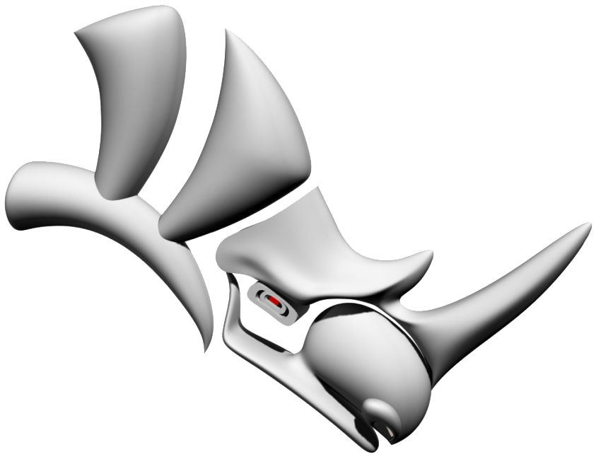
INTRODUCTION
Objectives
ALGORITHMIC DESIGN
PROGRAMMING LANGUAGES
Fundamental Concepts
EVALUATION
Theory
Practice
GUIDELINES
The Approach
Implementations
CONCLUSIONS
Reflections
Future Work
TPLs
11

Slide 21
INTRODUCTION
Objectives
ALGORITHMIC DESIGN
PROGRAMMING LANGUAGES
Fundamental Concepts
EVALUATION
Theory
Practice
GUIDELINES
The Approach
Implementations
CONCLUSIONS
Reflections
Future Work
TPLs
12

Slide 22
INTRODUCTION
Objectives
ALGORITHMIC DESIGN
PROGRAMMING LANGUAGES
Fundamental Concepts
EVALUATION
Theory
Practice
GUIDELINES
The Approach
Implementations
CONCLUSIONS
Reflections
Future Work
VPLs
13

Slide 23
INTRODUCTION
Objectives
ALGORITHMIC DESIGN
PROGRAMMING LANGUAGES
Fundamental Concepts
EVALUATION
Theory
Practice
GUIDELINES
The Approach
Implementations
CONCLUSIONS
Reflections
Future Work
VPLs
13

Slide 24
INTRODUCTION
Objectives
ALGORITHMIC DESIGN
PROGRAMMING LANGUAGES
Fundamental Concepts
EVALUATION
Theory
Practice
GUIDELINES
The Approach
Implementations
CONCLUSIONS
Reflections
Future Work
VPLs
13

Slide 25
INTRODUCTION
Objectives
Morpheus Hotel
ALGORITHMIC DESIGN
PROGRAMMING LANGUAGES
Water
Cube
Fundamental Concepts
EVALUATION
Theory
Practice
GUIDELINES
The Approach
Implementations
CONCLUSIONS
Reflections
Future Work
Hangzhou Tennis
Center
Rhythmic Gymnastics
Center in Luzhniki
14

Slide 26
INTRODUCTION
Objectives
ALGORITHMIC DESIGN
TPLs
PROGRAMMING LANGUAGES
Fundamental Concepts
EVALUATION
Theory
Practice
GUIDELINES
The Approach
Implementations
CONCLUSIONS
Reflections
Future Work
VPLs
14

Slide 27
INTRODUCTION
Objectives
ALGORITHMIC DESIGN
PROGRAMMING LANGUAGES
Fundamental Concepts
Computational Power
EVALUATION
Theory
Practice
GUIDELINES
The Approach
Implementations
CONCLUSIONS
Reflections
Future Work
15

Slide 28
INTRODUCTION
Objectives
ALGORITHMIC DESIGN
PROGRAMMING LANGUAGES
Fundamental Concepts
Computational Power
EVALUATION
Theory
Performance
Practice
GUIDELINES
The Approach
Implementations
CONCLUSIONS
Reflections
Future Work
15

Slide 29
INTRODUCTION
Objectives
ALGORITHMIC DESIGN
PROGRAMMING LANGUAGES
Fundamental Concepts
Computational Power
EVALUATION
Theory
Performance
Practice
GUIDELINES
Expressive Power
The Approach
Implementations
CONCLUSIONS
Reflections
Future Work
15

Slide 30
INTRODUCTION
Objectives
ALGORITHMIC DESIGN
PROGRAMMING LANGUAGES
Fundamental Concepts
Computational Power
EVALUATION
Theory
Performance
Practice
GUIDELINES
Expressive Power
The Approach
Implementations
CONCLUSIONS
User Interface
Reflections
Future Work
15

Slide 31
INTRODUCTION
Objectives
ALGORITHMIC DESIGN
PROGRAMMING LANGUAGES
Fundamental Concepts
Computational Power
EVALUATION
Theory
Performance
Practice
GUIDELINES
Expressive Power
The Approach
Implementations
CONCLUSIONS
User Interface
Reflections
Future Work
Limit of Complexity
15

Slide 32
INTRODUCTION
Objectives
ALGORITHMIC DESIGN
PROGRAMMING LANGUAGES
Fundamental Concepts
EVALUATION
Theory
Practice
GUIDELINES
The Approach
Implementations
CONCLUSIONS
Reflections
Future Work
Woods Bagot, South Australian Health and Medical Research Institute (2013), Adelaide, Australia [5]

Slide 33
INTRODUCTION
Objectives
ALGORITHMIC DESIGN
PROGRAMMING LANGUAGES
Number Sliders
and Boolean Toggles
Fundamental Concepts
EVALUATION
Theory
Practice
GUIDELINES
The Approach
Implementations
CONCLUSIONS
Reflections
Future Work
17

Slide 34
INTRODUCTION
Objectives
ALGORITHMIC DESIGN
PROGRAMMING LANGUAGES
Number Sliders
and Boolean Toggles
Fundamental Concepts
EVALUATION
Theory
Practice
Immediate Feedback
GUIDELINES
The Approach
Implementations
CONCLUSIONS
Reflections
Future Work
17

Slide 35
INTRODUCTION
Objectives
ALGORITHMIC DESIGN
PROGRAMMING LANGUAGES
Number Sliders
and Boolean Toggles
Fundamental Concepts
EVALUATION
Theory
Practice
Immediate Feedback
GUIDELINES
The Approach
Implementations
Traceability
CONCLUSIONS
Reflections
Future Work
17

Slide 36
INTRODUCTION
Objectives
ALGORITHMIC DESIGN
PROGRAMMING LANGUAGES
Number Sliders
and Boolean Toggles
Fundamental Concepts
EVALUATION
Theory
Practice
Immediate Feedback
GUIDELINES
The Approach
Implementations
Traceability
CONCLUSIONS
Reflections
Future Work
Visual Input Mechanisms
17

Slide 37
INTRODUCTION
Objectives
ALGORITHMIC DESIGN
PROGRAMMING LANGUAGES
Number Sliders
and Boolean Toggles
Processing
Reas and Fry, MIT Press, 2007
Fundamental Concepts
EVALUATION
Theory
Luna Moth
Alfaiate et al., ACADIA, 2017
Practice
Immediate Feedback
GUIDELINES
The Approach
Implementations
Traceability
CONCLUSIONS
Reflections
Future Work
Visual Input Mechanisms
17

Slide 38
INTRODUCTION
Objectives
ALGORITHMIC DESIGN
PROGRAMMING LANGUAGES
Number Sliders
and Boolean Toggles
Processing
Reas and Fry, MIT Press, 2007
Fundamental Concepts
EVALUATION
Theory
Luna Moth
Alfaiate et al., ACADIA, 2017
Practice
Immediate Feedback
GUIDELINES
The Approach
Rosetta
Leitão, A., Lopes, J. and Santos, L., ACADIA, 2014
Implementations
Traceability
CONCLUSIONS
Reflections
From Visual Input to Visual Output
in Textual Programming
Sammer, M. J., Leitão, A., Caetano, I. CAADRIA, 2019
Future Work
Visual Input Mechanisms
17

Slide 39
INTRODUCTION
Objectives
ALGORITHMIC DESIGN
PROGRAMMING LANGUAGES
Number Sliders
and Boolean Toggles
Processing
Reas and Fry, MIT Press, 2007
Fundamental Concepts
EVALUATION
Theory
Luna Moth
Alfaiate et al., ACADIA, 2017
Practice
Immediate Feedback
GUIDELINES
The Approach
Rosetta
Leitão, A., Lopes, J. and Santos, L., ACADIA, 2014
Implementations
Traceability
CONCLUSIONS
Reflections
From Visual Input to Visual Output
in Textual Programming
Sammer, M. J., Leitão, A., Caetano, I. CAADRIA, 2019
Future Work
Visual Input Mechanisms
17

Slide 40
INTRODUCTION
Objectives
ALGORITHMIC DESIGN
PROGRAMMING LANGUAGES
Grasshopper
Julia within Khepri
Fundamental Concepts
EVALUATION
Theory
Practice
GUIDELINES
The Approach
Implementations
CONCLUSIONS
Reflections
Future Work
VPLs
TPLs
18

Slide 41
INTRODUCTION
Objectives
ALGORITHMIC DESIGN
PROGRAMMING LANGUAGES
Grasshopper
Julia within Khepri
Fundamental Concepts
EVALUATION
Theory
Practice
GUIDELINES
The Approach
Implementations
CONCLUSIONS
Reflections
Future Work
VPLs
TPLs
18

Slide 42
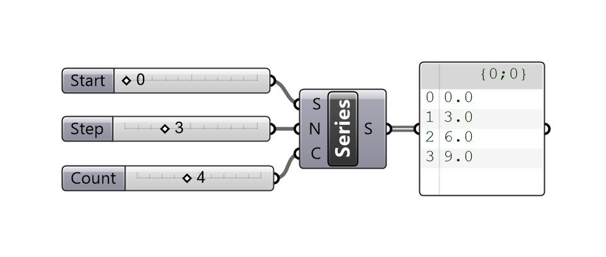
INTRODUCTION
Objectives
ALGORITHMIC DESIGN
Grasshopper
PROGRAMMING LANGUAGES
Fundamental Concepts
EVALUATION
Theory
Practice
GUIDELINES
The Approach
series(start, step, count) =
count == 0 ?
[] :
[start, series(start + step, step, count - 1)...]
julia> series(0, 3, 4)
0
3
6
9
Khepri
Implementations
CONCLUSIONS
Reflections
Future Work
19

Slide 43
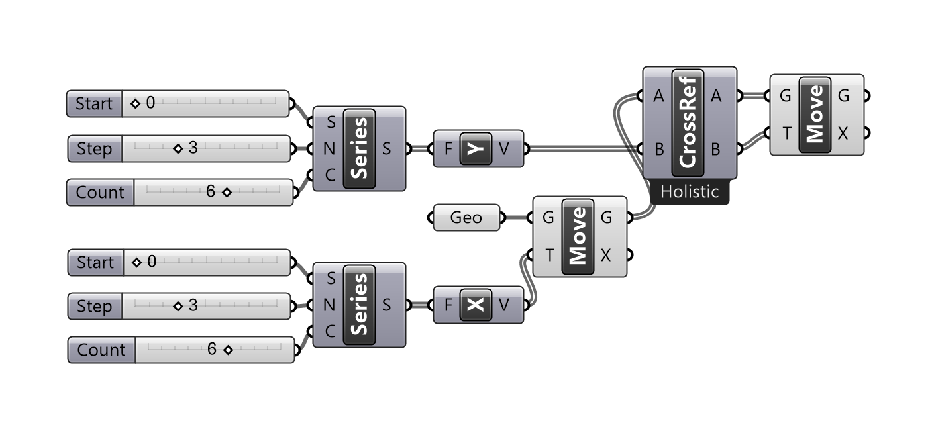
INTRODUCTION
Objectives
ALGORITHMIC DESIGN
Grasshopper
PROGRAMMING LANGUAGES
Fundamental Concepts
EVALUATION
Theory
Practice
GUIDELINES
The Approach
Khepri
Implementations
CONCLUSIONS
template = select_shape()
for x in series(0,3,6), y in series(0,3,6)
move(template, vxy(x,y))
end
Reflections
Future Work
20

Slide 44
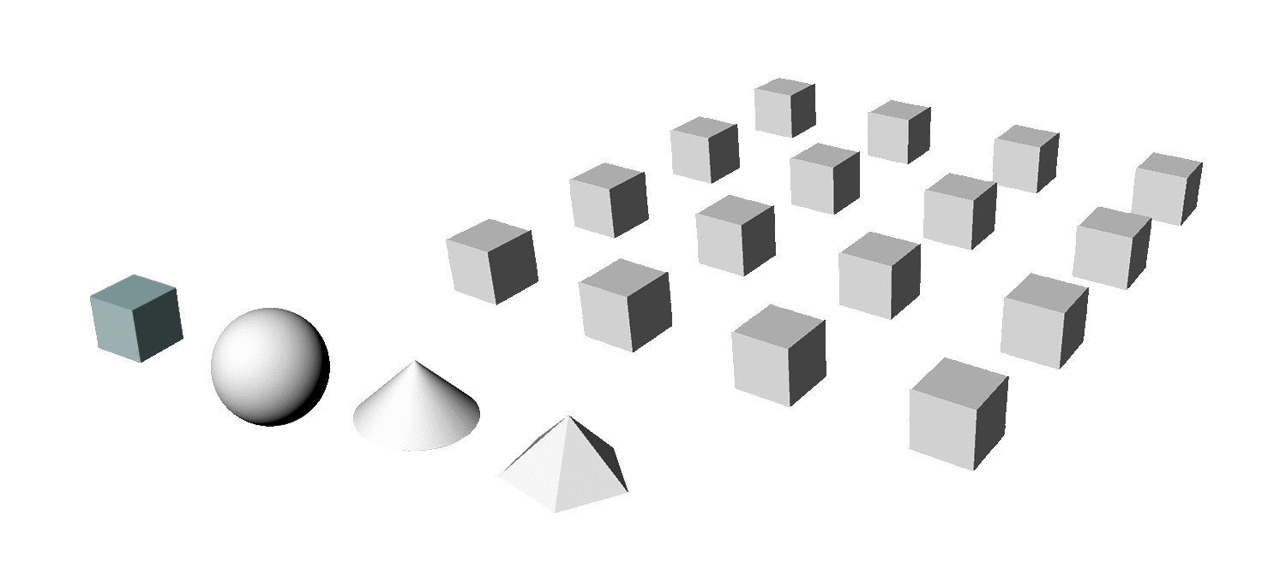
INTRODUCTION
Objectives
ALGORITHMIC DESIGN
Grasshopper
PROGRAMMING LANGUAGES
Fundamental Concepts
EVALUATION
Theory
Practice
GUIDELINES
The Approach
Khepri
Implementations
CONCLUSIONS
template = select_shape()
for x in series(0,3,6), y in series(0,3,6)
move(template, vxy(x,y))
end
template = select_shape()
for x in series(0,3,6), y in series(0,3,6)
move(template, vxy(x,y))
end
Reflections
Future Work
20

Slide 45
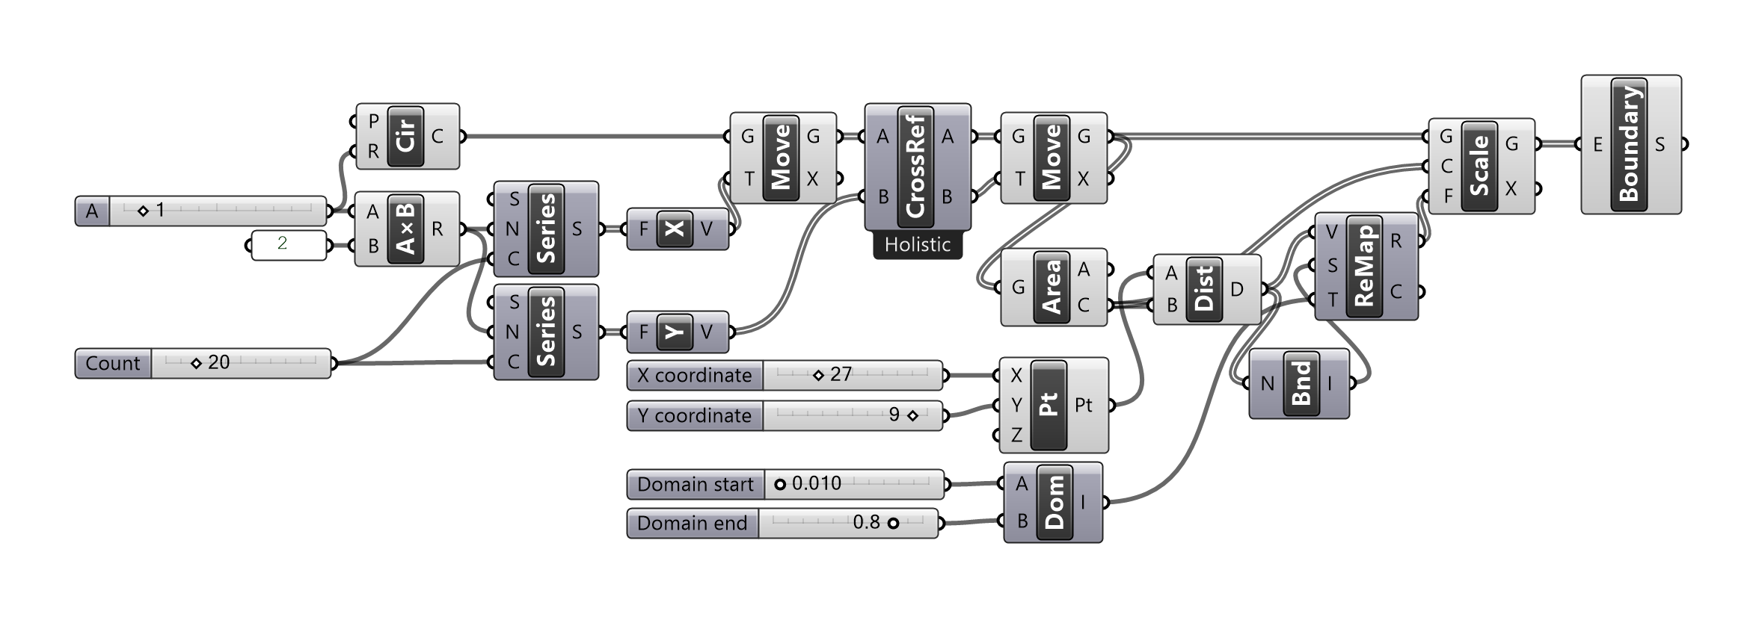
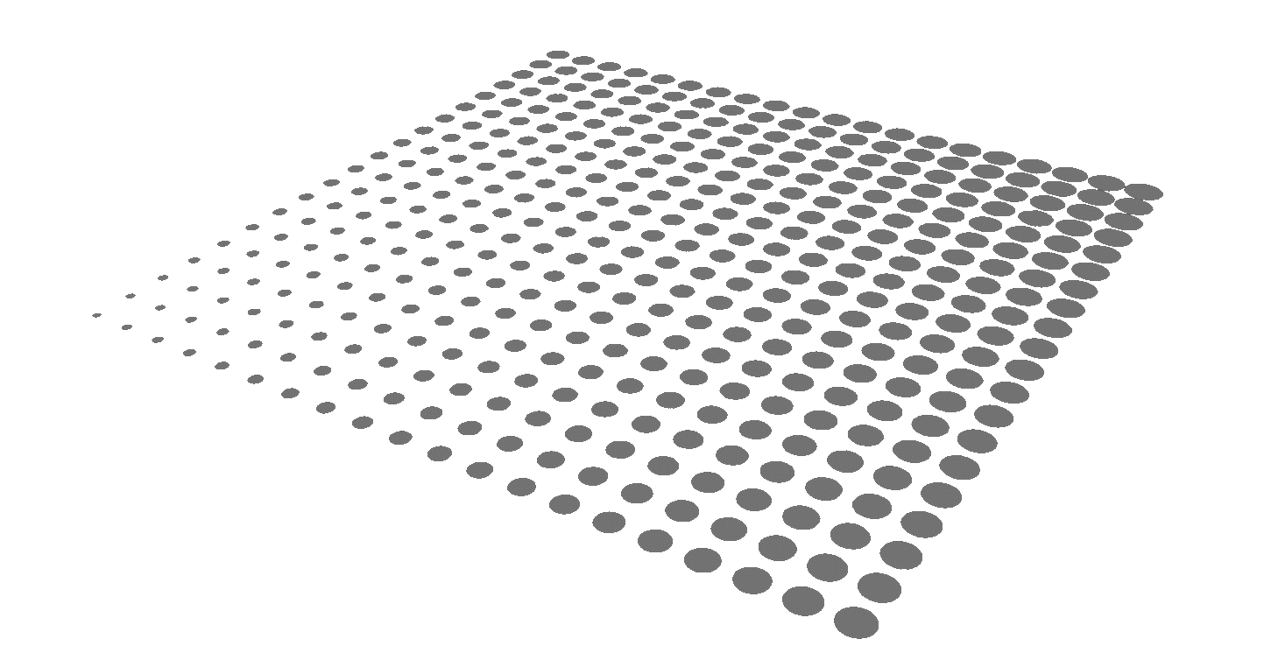
INTRODUCTION
Objectives
ALGORITHMIC DESIGN
Grasshopper
PROGRAMMING LANGUAGES
Fundamental Concepts
EVALUATION
Theory
Practice
GUIDELINES
The Approach
Khepri
Implementations
attractor_circles(p, r, count, q, r_min, r_max) =
let ps = [p+vxy(x, y)
for x in series(0, 2*r, count),
y in series(0, 2*r, count)],
dists = [distance(p, q) for p in ps],
domain = extrema(dists)
[circle(p, remap(d, domain, (r_min, r_max)))
for (p, d) in zip(ps, dists)]
end
attractor_circles(xy(1,2), 1, 20, xy(8, 14), 0.01, 0.8)
CONCLUSIONS
Reflections
Future Work
21

Slide 46
INTRODUCTION
Objectives
ALGORITHMIC DESIGN
Grasshopper
PROGRAMMING LANGUAGES
Fundamental Concepts
EVALUATION
Theory
Practice
GUIDELINES
The Approach
Khepri
Implementations
attractor_circles(p, r, count, q, r_min, r_max) =
let ps = [p+vxy(x, y)
for x in series(0, 2*r, count),
y in series(0, 2*r, count)],
dists = [distance(p, q) for p in ps],
domain = extrema(dists)
[circle(p, remap(d, domain, (r_min, r_max)))
for (p, d) in zip(ps, dists)]
end
attractor_circles(xy(1,2), 1, 20, xy(8, 14), 0.01, 0.8)
CONCLUSIONS
Reflections
Future Work
21

Slide 47
INTRODUCTION
Objectives
ALGORITHMIC DESIGN
Grasshopper
PROGRAMMING LANGUAGES
Fundamental Concepts
EVALUATION
Theory
Practice
GUIDELINES
The Approach
Khepri
Implementations
attractor_circles(p, r, count, q, r_min, r_max) =
let ps = [p+vxy(x, y)
for x in series(0, 2*r, count),
y in series(0, 2*r, count)],
dists = [distance(p, q) for p in ps],
domain = extrema(dists)
[circle(p, remap(d, domain, (r_min, r_max)))
for (p, d) in zip(ps, dists)]
end
attractor_circles(xy(1,2), 1, 20, xy(8, 14), 0.01, 0.8)
CONCLUSIONS
Reflections
Future Work
21

Slide 48
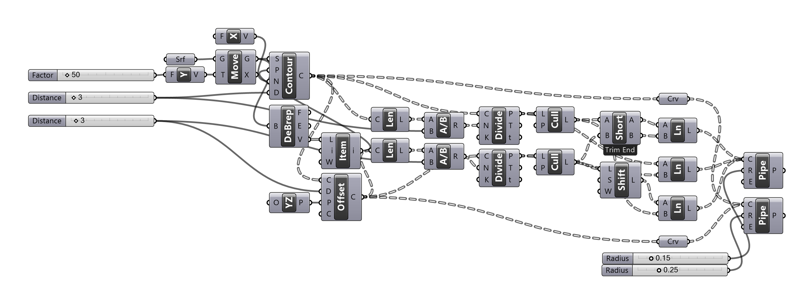
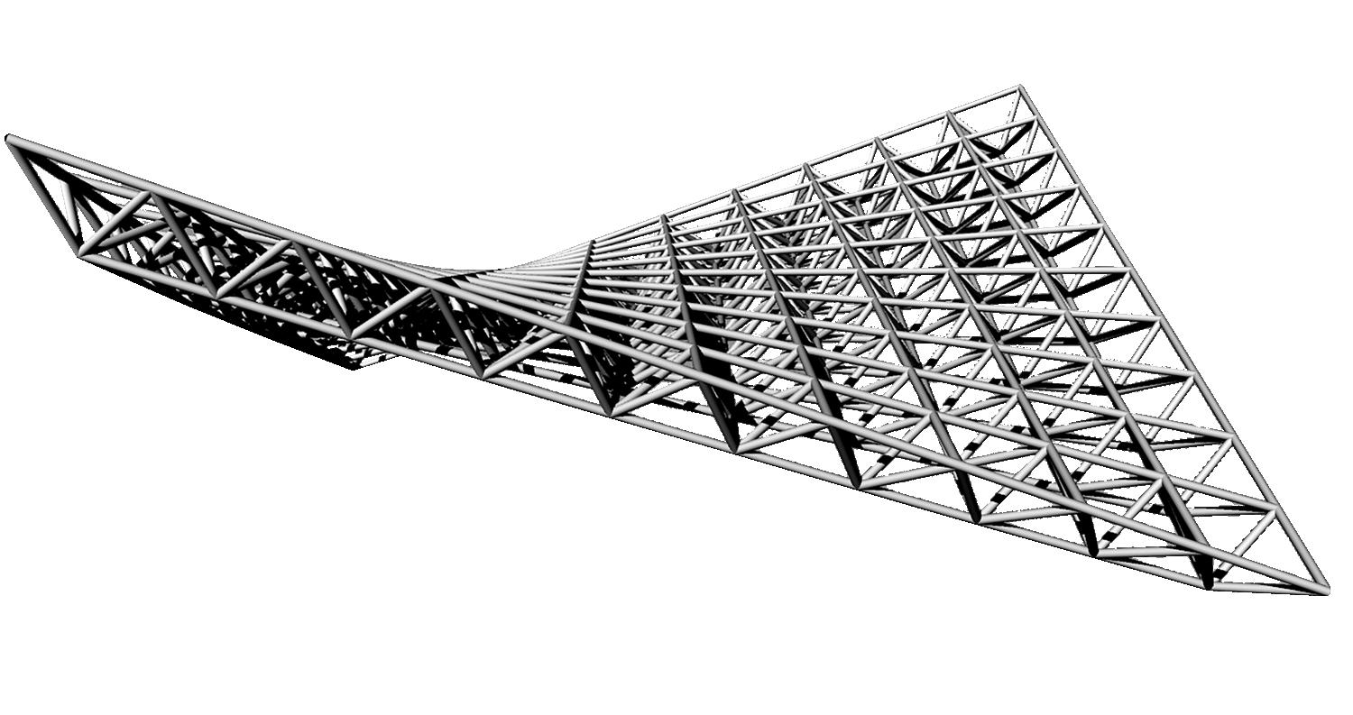
INTRODUCTION
Objectives
ALGORITHMIC DESIGN
Grasshopper
PROGRAMMING LANGUAGES
Fundamental Concepts
EVALUATION
Theory
Practice
GUIDELINES
The Approach
Implementations
CONCLUSIONS
Reflections
Future Work
22

Slide 49
INTRODUCTION
Objectives
ALGORITHMIC DESIGN
spaceframe(ptss) =
let ais = ptss[1]
bis = ptss[2]
cis = ptss[3]
spaceframe_nodes(ais)
spaceframe_nodes(bis)
spaceframe_struts(ais, cis)
spaceframe_struts(bis, ais)
spaceframe_struts(bis, cis)
spaceframe_struts(bis, ais[2:end])
spaceframe_struts(bis, cis[2:end])
spaceframe_struts(ais, ais[2:end])
spaceframe_struts(bis, bis[2:end])
if length(ptss) == 3 # no nodes left?
spaceframe_nodes(cis)
spaceframe_struts(cis[2:end], cis)
else
spaceframe(ptss[3:end])
spaceframe_struts(bis, ptss[4])
end
end
spaceframe(spaceframe_pts(map_division(
in_world, select_surface(),
10, 10)))
PROGRAMMING LANGUAGES
Fundamental Concepts
EVALUATION
Theory
Practice
GUIDELINES
The Approach
Khepri
Implementations
CONCLUSIONS
Reflections
Future Work
23

Slide 50
INTRODUCTION
Objectives
ALGORITHMIC DESIGN
spaceframe(ptss) =
let ais = ptss[1]
bis = ptss[2]
cis = ptss[3]
spaceframe_nodes(ais)
spaceframe_nodes(bis)
spaceframe_struts(ais, cis)
spaceframe_struts(bis, ais)
spaceframe_struts(bis, cis)
spaceframe_struts(bis, ais[2:end])
spaceframe_struts(bis, cis[2:end])
spaceframe_struts(ais, ais[2:end])
spaceframe_struts(bis, bis[2:end])
if length(ptss) == 3 # no nodes left?
spaceframe_nodes(cis)
spaceframe_struts(cis[2:end], cis)
else
spaceframe(ptss[3:end])
spaceframe_struts(bis, ptss[4])
end
end
spaceframe(spaceframe_pts(map_division(
in_world, select_surface(),
10, 10)))
PROGRAMMING LANGUAGES
Fundamental Concepts
EVALUATION
Theory
Practice
GUIDELINES
The Approach
Khepri
Implementations
CONCLUSIONS
Reflections
Future Work
23

Slide 51
INTRODUCTION
Objectives
ALGORITHMIC DESIGN
spaceframe(spaceframe_pts(map_division(
in_world, select_surface(),
10, 10)))
PROGRAMMING LANGUAGES
Fundamental Concepts
EVALUATION
Theory
Practice
GUIDELINES
The Approach
Khepri
Implementations
CONCLUSIONS
Reflections
Future Work
23

Slide 52
INTRODUCTION
Objectives
ALGORITHMIC DESIGN
Grasshopper
PROGRAMMING LANGUAGES
Fundamental Concepts
EVALUATION
Theory
Practice
GUIDELINES
The Approach
Khepri
Implementations
CONCLUSIONS
Reflections
backend(revit) backend(robot) backend(radiance)
Future Work
24

Slide 53
INTRODUCTION
Objectives
ALGORITHMIC DESIGN
Grasshopper
PROGRAMMING LANGUAGES
Fundamental Concepts
EVALUATION
Theory
Practice
GUIDELINES
The Approach
Khepri
Implementations
CONCLUSIONS
Reflections
backend(revit) backend(robot) backend(radiance)
Future Work
24

Slide 54
INTRODUCTION
Objectives
ALGORITHMIC DESIGN
VPLs
TPLs
PROGRAMMING LANGUAGES
Fundamental Concepts
Less background knowledge
More demanding learning process
EVALUATION
Theory
Practice
GUIDELINES
The Approach
Implementations
CONCLUSIONS
Reflections
Future Work
25

Slide 55
INTRODUCTION
Objectives
ALGORITHMIC DESIGN
VPLs
TPLs
PROGRAMMING LANGUAGES
Fundamental Concepts
Less background knowledge
More demanding learning process
EVALUATION
Theory
Visual features and mechanisms
No inherent visual features and mechanisms
Practice
GUIDELINES
The Approach
Implementations
CONCLUSIONS
Reflections
Future Work
25

Slide 56
INTRODUCTION
Objectives
ALGORITHMIC DESIGN
VPLs
TPLs
PROGRAMMING LANGUAGES
Fundamental Concepts
Less background knowledge
More demanding learning process
EVALUATION
Theory
Visual features and mechanisms
Possibility of implementing visual features and mechanisms
Practice
GUIDELINES
The Approach
Implementations
CONCLUSIONS
Reflections
Future Work
25

Slide 57
INTRODUCTION
Objectives
ALGORITHMIC DESIGN
VPLs
TPLs
PROGRAMMING LANGUAGES
Fundamental Concepts
Less background knowledge
More demanding learning process
EVALUATION
Theory
Visual features and mechanisms
Possibility of implementing visual features and mechanisms
Practice
GUIDELINES
The Approach
Pre-defined abstractions
Pre- and user-defined abstractions
Implementations
CONCLUSIONS
Reflections
Future Work
25

Slide 58
INTRODUCTION
Objectives
ALGORITHMIC DESIGN
VPLs
TPLs
PROGRAMMING LANGUAGES
Fundamental Concepts
Less background knowledge
More demanding learning process
EVALUATION
Theory
Visual features and mechanisms
Possibility of implementing visual features and mechanisms
Practice
GUIDELINES
The Approach
Pre-defined abstractions
Pre- and user-defined abstractions
Implementations
CONCLUSIONS
Reflections
Future Work
25

Slide 59
INTRODUCTION
Objectives
ALGORITHMIC DESIGN
VPLs
TPLs
PROGRAMMING LANGUAGES
Fundamental Concepts
Less background knowledge
More demanding learning process
EVALUATION
Theory
Visual features and mechanisms
Possibility of implementing visual features and mechanisms
Practice
GUIDELINES
The Approach
Pre-defined abstractions
Pre- and user-defined abstractions
Implementations
CONCLUSIONS
Plug-ins
Portability
Reflections
Future Work
25

Slide 60
INTRODUCTION
Objectives
ALGORITHMIC DESIGN
VPLs
TPLs
PROGRAMMING LANGUAGES
Fundamental Concepts
Less background knowledge
More demanding learning process
EVALUATION
Theory
Visual features and mechanisms
Possibility of implementing visual features and mechanisms
Practice
GUIDELINES
The Approach
Pre-defined abstractions
Pre- and user-defined abstractions
Implementations
CONCLUSIONS
Plug-ins
Portability
Reflections
Future Work
25

Slide 61
INTRODUCTION
Objectives
ALGORITHMIC DESIGN
VPLs
TPLs
PROGRAMMING LANGUAGES
Fundamental Concepts
Less background knowledge
More demanding learning process
EVALUATION
Theory
Visual features and mechanisms
Possibility of implementing visual features and mechanisms
Practice
GUIDELINES
The Approach
Pre-defined abstractions
Pre- and user-defined abstractions
Implementations
CONCLUSIONS
Plug-ins
Portability
Reflections
Scalability problems
Scales for complex programs integrating different phases of the project
Future Work
25

Slide 62
INTRODUCTION
Objectives
ALGORITHMIC DESIGN
PROGRAMMING LANGUAGES
Fundamental Concepts
EVALUATION
Theory
Practice
GUIDELINES
The Approach
Implementations
CONCLUSIONS
Reflections
Future Work
Asymptote Architecture, Viceroy Yas Hotel (2010), Abu Dhabi, United Arab Emirates [6]

Slide 63
INTRODUCTION
Objectives
ALGORITHMIC DESIGN
PROGRAMMING LANGUAGES
Fundamental Concepts
EVALUATION
Theory
TPLs
Practice
VPLs
GUIDELINES
Manual
Approach
increasing
program
complexity
The Approach
Implementations
CONCLUSIONS
Drawing Board
Reflections
Future Work
CAD
BIM
27

Slide 64
INTRODUCTION
Objectives
ALGORITHMIC DESIGN
PROGRAMMING LANGUAGES
Fundamental Concepts
EVALUATION
Theory
TPLs
Practice
VPLs
GUIDELINES
Manual
Approach
increasing
program
complexity
The Approach
Khepri
Implementations
Drawings and Sketches
Grasshopper
Khepri
CONCLUSIONS
Drawing Board
AutoCAD
Dynamo
Reflections
Future Work
CAD
Revit
BIM
27

Slide 65
INTRODUCTION
Objectives
ALGORITHMIC DESIGN
PROGRAMMING LANGUAGES
increasing
project
complexity
Khepri
Fundamental Concepts
+ Analysis
EVALUATION
Grasshopper + Ladybug
Theory
TPLs
Khepri
DIVA for Rhino
Practice
VPLs
EnergyAnalysisForDynamo
GUIDELINES
Manual
Approach
The Approach
Khepri
Green Building Studio
Implementations
Drawings and Sketches
Grasshopper
Khepri
CONCLUSIONS
Drawing Board
AutoCAD
Dynamo
Reflections
Future Work
CAD
Revit
BIM
27

Slide 66
INTRODUCTION
Objectives
ALGORITHMIC DESIGN
PROGRAMMING LANGUAGES
increasing
project
complexity
Khepri
Fundamental Concepts
+ Analysis
EVALUATION
Grasshopper + Ladybug
Theory
TPLs
Khepri
DIVA for Rhino
Practice
VPLs
EnergyAnalysisForDynamo
GUIDELINES
Manual
Approach
The Approach
Khepri
Green Building Studio
Implementations
Drawings and Sketches
Grasshopper
Khepri
CONCLUSIONS
Drawing Board
AutoCAD
Dynamo
Reflections
Future Work
CAD
Revit
BIM
27

Slide 67
INTRODUCTION
Objectives
ALGORITHMIC DESIGN
PROGRAMMING LANGUAGES
Fundamental Concepts
Error detection and debugging mechanisms
EVALUATION
Theory
Practice
GUIDELINES
The Approach
Implementations
CONCLUSIONS
Reflections
Future Work
28

Slide 68
INTRODUCTION
Objectives
ALGORITHMIC DESIGN
PROGRAMMING LANGUAGES
Fundamental Concepts
Error detection and debugging mechanisms
EVALUATION
Theory
Control Flow visualization mechanisms
Practice
GUIDELINES
The Approach
Implementations
CONCLUSIONS
Reflections
Future Work
28

Slide 69
INTRODUCTION
Objectives
ALGORITHMIC DESIGN
PROGRAMMING LANGUAGES
Fundamental Concepts
Error detection and debugging mechanisms
EVALUATION
Theory
Control Flow visualization mechanisms
Practice
GUIDELINES
Documentation mechanisms
The Approach
Implementations
CONCLUSIONS
Reflections
Future Work
28

Slide 70
INTRODUCTION
Objectives
ALGORITHMIC DESIGN
PROGRAMMING LANGUAGES
Fundamental Concepts
Error detection and debugging mechanisms
EVALUATION
Theory
Control Flow visualization mechanisms
Practice
GUIDELINES
Documentation mechanisms
The Approach
Implementations
CONCLUSIONS
Traceability
Reflections
Future Work
28

Slide 71
INTRODUCTION
Objectives
ALGORITHMIC DESIGN
PROGRAMMING LANGUAGES
Fundamental Concepts
Error detection and debugging mechanisms
EVALUATION
Theory
Control Flow visualization mechanisms
Practice
GUIDELINES
Documentation mechanisms
The Approach
Implementations
CONCLUSIONS
Traceability
Reflections
Future Work
Predefined abstractions
28

Slide 72
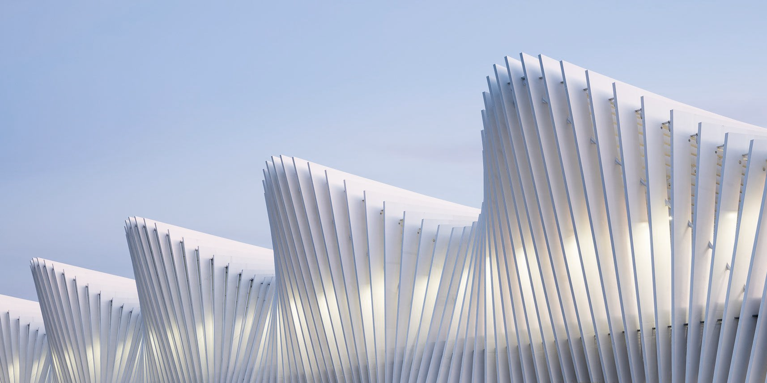
INTRODUCTION
Objectives
ALGORITHMIC DESIGN
PROGRAMMING LANGUAGES
Fundamental Concepts
EVALUATION
Theory
Practice
GUIDELINES
The Approach
Implementations
CONCLUSIONS
Reflections
Future Work
Santiago Calatrava, Reggio Emilia Railway Station (2013), Reggio Emilia, Italy [7]

Slide 73
INTRODUCTION
Objectives
ALGORITHMIC DESIGN
PROGRAMMING LANGUAGES
Fundamental Concepts
Algorithmic Design as representation method
EVALUATION
Theory
Practice
GUIDELINES
The Approach
Implementations
CONCLUSIONS
Reflections
Future Work
30

Slide 74
INTRODUCTION
Objectives
ALGORITHMIC DESIGN
PROGRAMMING LANGUAGES
Fundamental Concepts
Algorithmic Design as representation method
EVALUATION
Theory
Algorithmic Design in the architectural workflow
Practice
GUIDELINES
The Approach
Implementations
CONCLUSIONS
Reflections
Future Work
30

Slide 75
INTRODUCTION
Objectives
ALGORITHMIC DESIGN
PROGRAMMING LANGUAGES
Fundamental Concepts
Algorithmic Design as representation method
EVALUATION
Theory
Algorithmic Design in the architectural workflow
Practice
GUIDELINES
Algorithmic Design as architectural reasoning
The Approach
Implementations
CONCLUSIONS
Reflections
Future Work
30

Slide 76
INTRODUCTION
Objectives
ALGORITHMIC DESIGN
PROGRAMMING LANGUAGES
Fundamental Concepts
Algorithmic Design as representation method
EVALUATION
Theory
Algorithmic Design in the architectural workflow
Practice
GUIDELINES
Algorithmic Design as architectural reasoning
The Approach
Implementations
CONCLUSIONS
Visual or Textual Programming Languages?
Reflections
Future Work
30

Slide 77
INTRODUCTION
Objectives
ALGORITHMIC DESIGN
PROGRAMMING LANGUAGES
Fundamental Concepts
Algorithmic Design as representation method
EVALUATION
Theory
Algorithmic Design in the architectural workflow
Practice
GUIDELINES
Algorithmic Design as architectural reasoning
The Approach
Implementations
CONCLUSIONS
Visual or Textual Programming Languages?
Reflections
Future Work
Barriers
30

Slide 78
INTRODUCTION
Objectives
ALGORITHMIC DESIGN
PROGRAMMING LANGUAGES
Fundamental Concepts
EVALUATION
Implementation of visual features and mechanisms
Theory
Practice
GUIDELINES
The Approach
Implementations
CONCLUSIONS
Reflections
Future Work
31

Slide 79
INTRODUCTION
Objectives
ALGORITHMIC DESIGN
PROGRAMMING LANGUAGES
Fundamental Concepts
EVALUATION
Implementation of visual features and mechanisms
Theory
Practice
Implementation of more back-ends
GUIDELINES
The Approach
Implementations
CONCLUSIONS
Reflections
Future Work
31

Slide 80
INTRODUCTION
Objectives
ALGORITHMIC DESIGN
PROGRAMMING LANGUAGES
Fundamental Concepts
EVALUATION
Implementation of visual features and mechanisms
Theory
Practice
Implementation of more back-ends
GUIDELINES
The Approach
Integration of AD in the conceptual process of design
Implementations
CONCLUSIONS
Reflections
Future Work
31

Slide 81
INTRODUCTION
Objectives
ALGORITHMIC DESIGN
PROGRAMMING LANGUAGES
Fundamental Concepts
EVALUATION
Implementation of visual features and mechanisms
Theory
Practice
Implementation of more back-ends
GUIDELINES
The Approach
Integration of AD in the conceptual process of design
Implementations
CONCLUSIONS
Assessment of the power of algorithms as representation methods
Reflections
Future Work
31

Slide 82
INTRODUCTION
Objectives
ALGORITHMIC DESIGN
PROGRAMMING LANGUAGES
Fundamental Concepts
EVALUATION
Theory
Practice
GUIDELINES
The Approach
Implementations
CONCLUSIONS
Reflections
Future Work
31

Slide 83
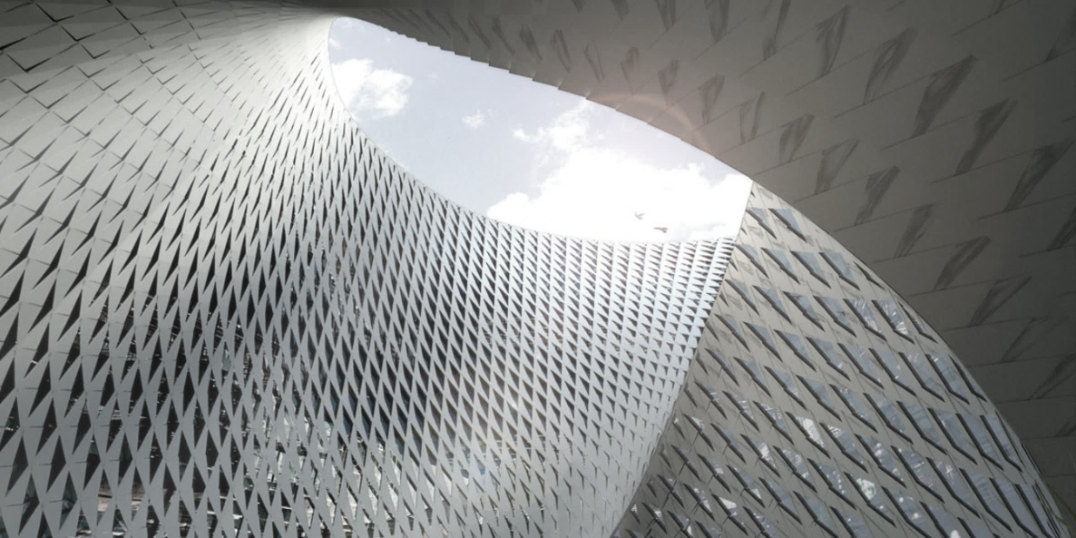
CONTRIBUTIONS
CAADRIA 2019
From Visual Input to Visual Output in Textual Programming
Sammer, M. J., Leitão, A. & Caetano, I.
Best Paper Award
eCAADe 2019
Visual Input Mechanisms in Textual Programming
Sammer, M. J., Leitão, A.
BIG, Astana National Library (unbuilt), Astana, Kazakhstan [8]

Slide 84
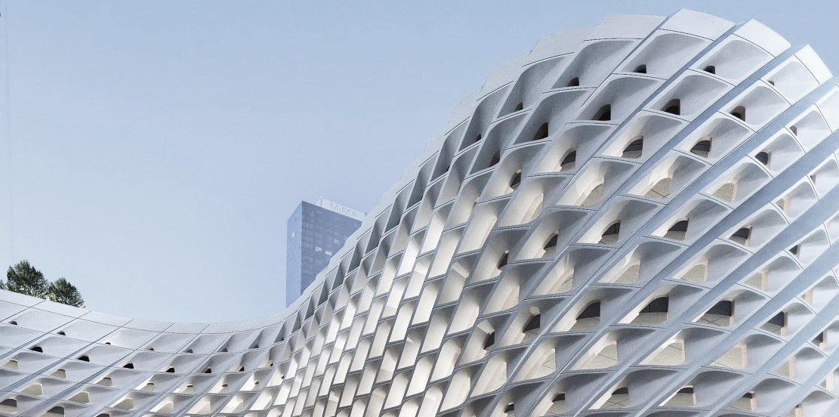
QUESTIONS?
THANK YOU.
Archilier Architecture, Port Authority Bus Terminal (competition), New York City, USA [9]

Slide 85
[1] http://www.l-a-v-a.net/assets/Uploads/_resampled/croppedimage755510-0802-watercube-opening-8931.jpg
[2] http://www.zaha-hadid.com/wp-content/files_mf/cache/th_65d1300db123ce22f6e2569fb36764f8_17_zha_morpheus_photoivandupont_lowres.jpg
[3] https://www.big.dk/layouts/default/css/images/blank.gif
[4] https://www.fosterandpartners.com/media/2636286/1960_fp627911.jpg?width=1920&quality=85
[5] https://d2um9prq37tvxi.cloudfront.net/store/uploads/15fbf6db36ab79e634b4-xl.png
[6] https://images.adsttc.com/media/images/56c7/28a9/e58e/ce8f/8100/0024/slideshow/YAS_rendering_2.jpg?1455892627
[7] https://i.pinimg.com/originals/8a/e3/36/8ae336cb3a184d0bf790a6c5a1003dc2.jpg
[8] https://www.big.dk/layouts/default/css/images/blank.gif
[9] http://archilier.com/wp-content/uploads/2016/09/Tenth-Av-inter-city-e1473802321396-0x1000.jpg
IMAGE SOURCES

