Slide 1
Reverse Algorithmic Design of Buildings
Daniel Fermoselle - 78207
Advisor: Prof. Doutor António Menezes Leitão

Slide 2
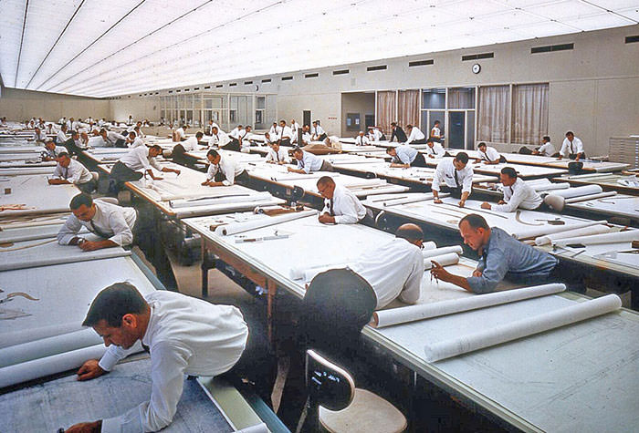
Introduction
From paper-based to computers

Slide 3
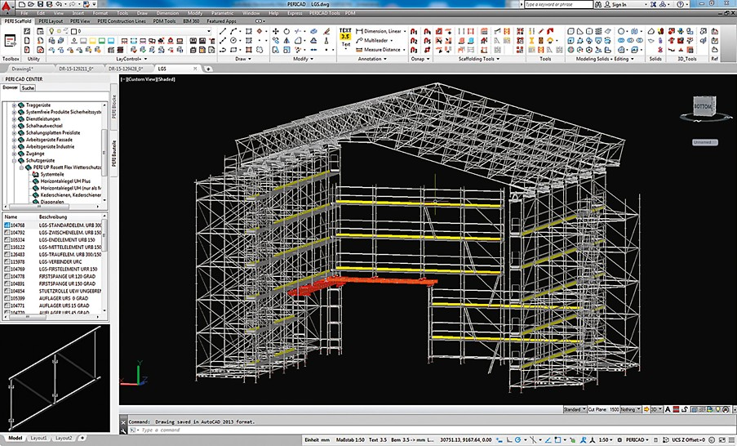
Introduction
From paper-based to computers

Slide 4
Introduction
Less repetitive methods

Slide 5
Introduction
Less repetitive methods
Procedural Modelling (PM)
Procedural Model
(Eg: Grammars)
PM
Content
(Eg: Digital Model)

Slide 6
Introduction
Inverse Procedural Modelling (IPM)
PM
Procedural Model
(Eg: Grammars)
Content
(Eg: Digital Model)
IPM

Slide 7
Introduction
PM & IPM approaches have problems

Slide 8
Introduction
PM & IPM approaches have problems
Algorithmic Design (AD)
AD
Procedural Model
(Algorithms)
Content
(Digital Model)

Slide 9
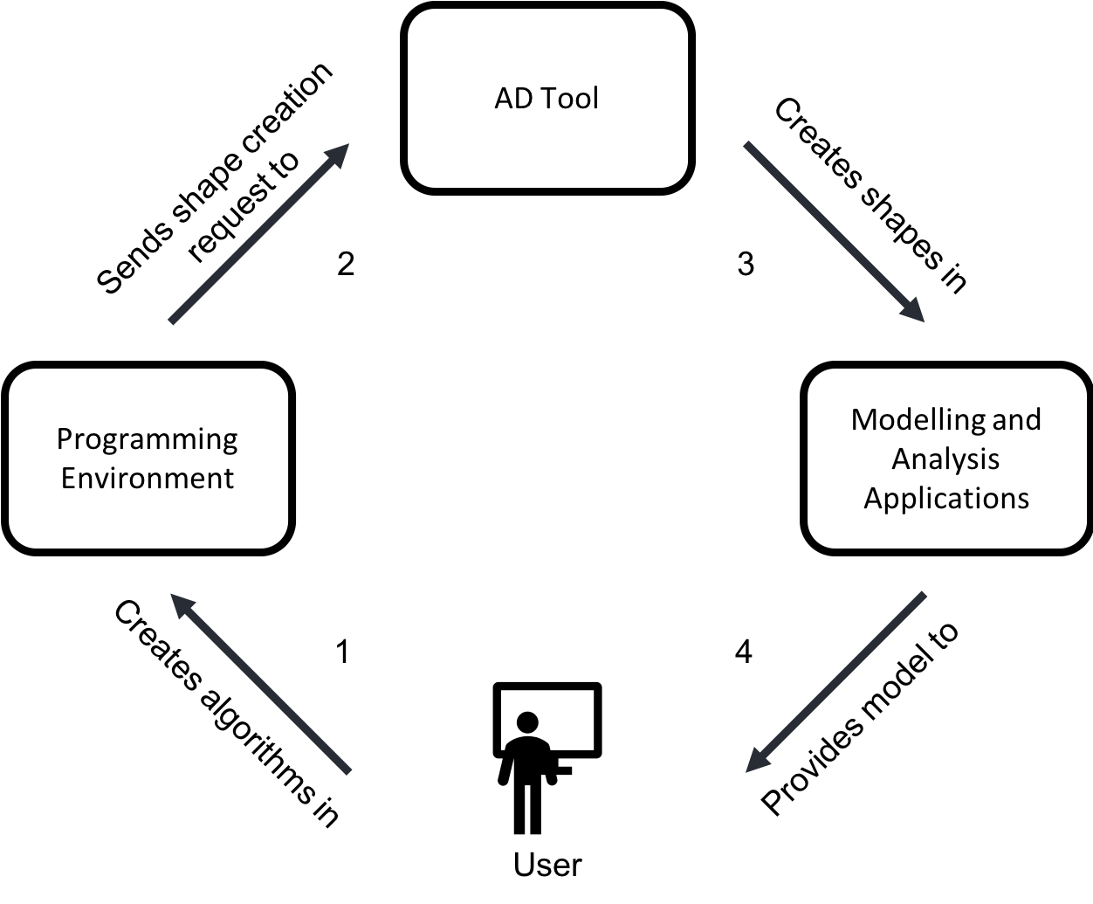
Algorithmic Design

Slide 10
Goal
Ease conversion of models to AD representation
AD
Procedural Model
(Algorithms)
Content
(Digital Model)
?

Slide 11
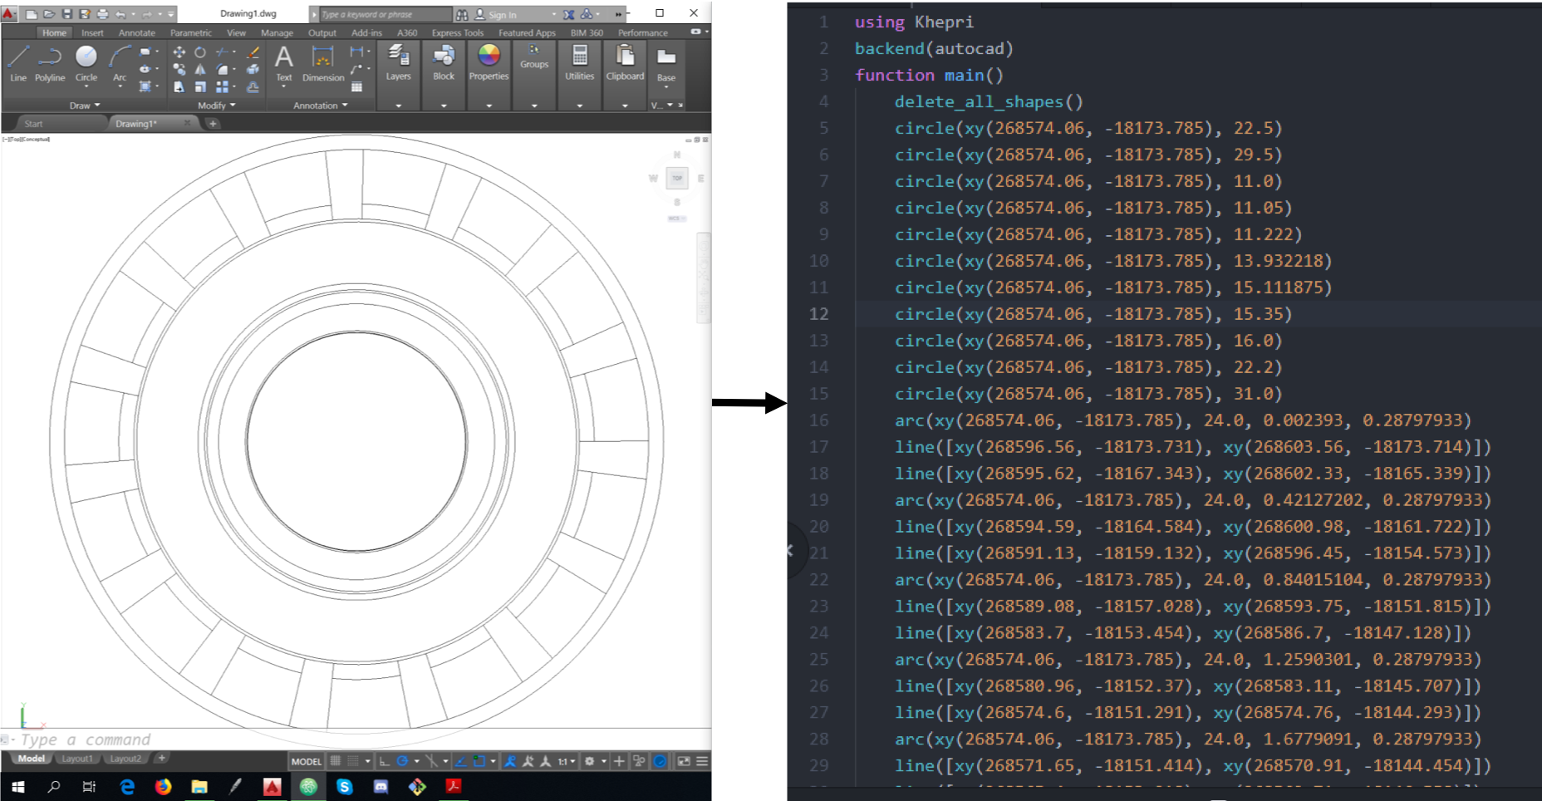
Goal
Ease conversion of models to AD representation

Slide 12
Goal
Ease conversion of models to AD representation
Digital Model
Non Intelligible Algorithm

Slide 13
Goal
Ease conversion of models to AD representation
Digital Model
Non Intelligible Algorithm
Intelligible
Algorithm

Slide 14
Goal
Ease conversion of models to AD representation
Help from Refactoring
Digital Model
Non Intelligible Algorithm
Intelligible
Algorithm

Slide 15
Goal
Ease conversion of models to AD representation
Help from Refactoring
Difficult to refactor non intelligible algorithm
Digital Model
Non Intelligible Algorithm
Intelligible
Algorithm

Slide 16
Goal
Ease conversion of models to AD representation
Help from Refactoring
Difficult to refactor non intelligible algorithm
Help from Traceability
Digital Model
Non Intelligible Algorithm
Intelligible
Algorithm

Slide 17
Refactoring
What is Refactoring?
circle(xy(0, 0), 1)
circle(xy(0, 0), 2)
circle(xy(0, 0), 3)
circle(xy(0, 0), 4)
for radius in 1:4
circle(xy(0, 0), radius)
end

Slide 18
Traceability
What is Traceability?
Program Comprehension
Example

Slide 19
Traceability
What is Traceability?
Program Comprehension
Example

Slide 20
Traceability
What is Traceability?
Program Comprehension
Example

Slide 21
Traceability
Luna Moth
From code to result

Slide 22
Traceability
Luna Moth
From result to code

Slide 23
Solution
What is the problem?
Reverse Algorithmic Design (RAD)
Required Tools
Traceability

Slide 24
Solution
What is the problem?
Reverse Algorithmic Design (RAD)
Required Tools
Traceability

Slide 25
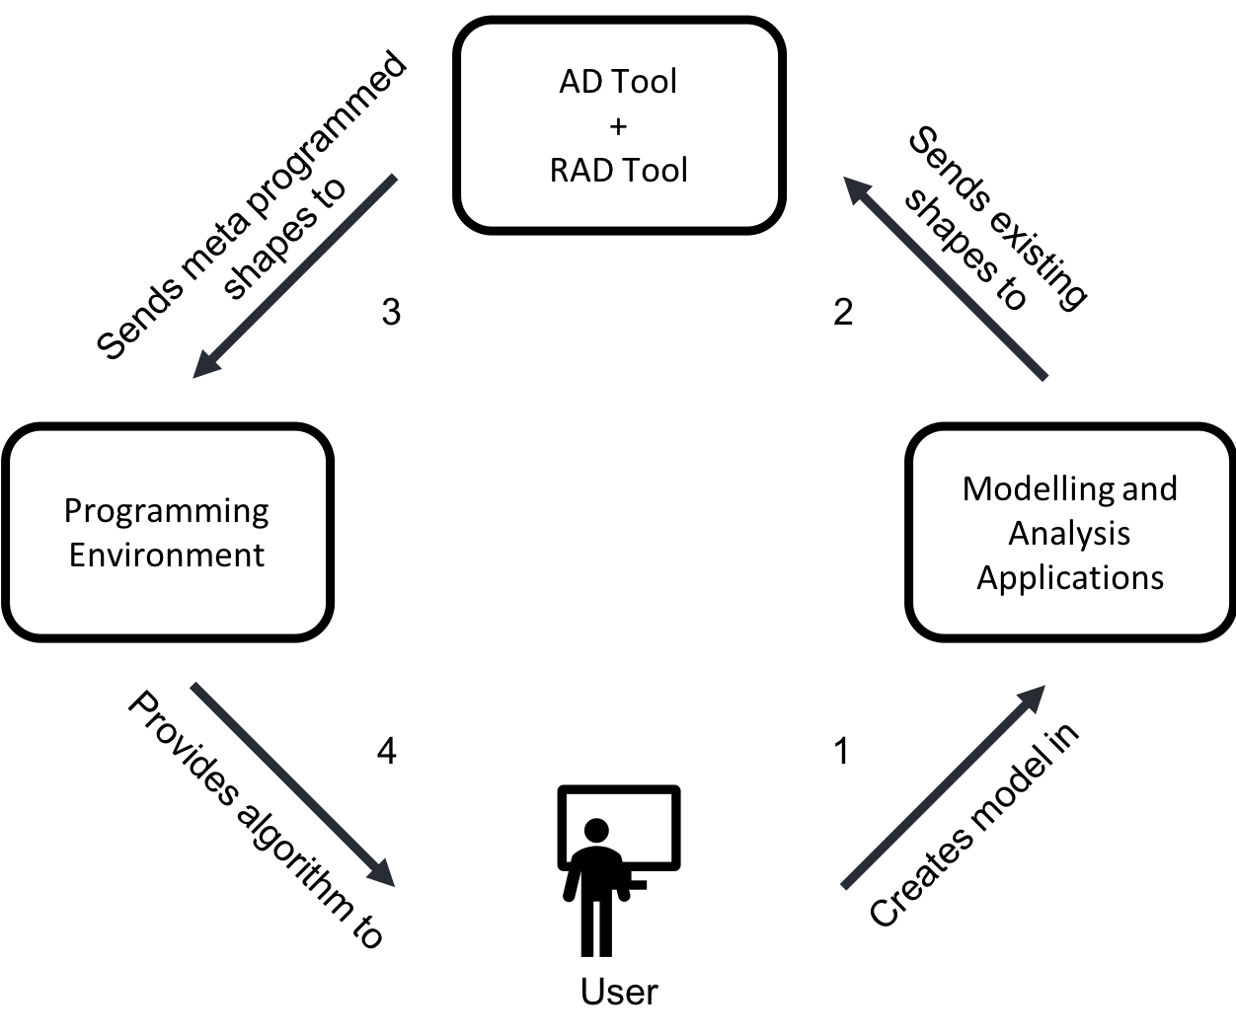
Reverse Algorithmic Design

Slide 26
Solution
What is the problem?
Reverse Algorithmic Design (RAD)
Required Tools
Traceability

Slide 27
Required Tools
AD tool
Programming Environment
Digital modelling tool

Slide 28
Khepri

Slide 29
Required Tools
Khepri
Programming Environment
Digital modelling tool

Slide 30
Required Tools
Khepri
Atom
Digital modelling tool

Slide 31
Required Tools
Khepri
Atom
AutoCAD

Slide 32
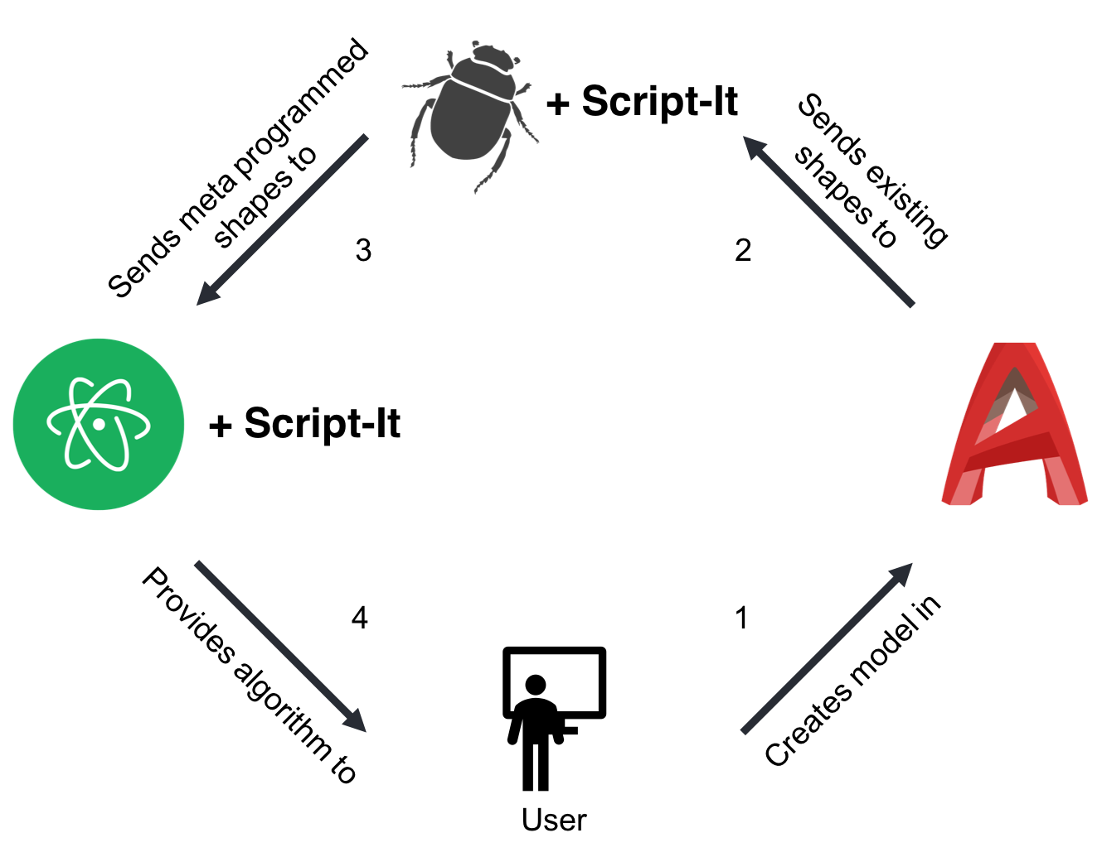
RAD Implementation: Script-It

Slide 33
Solution
Reverse Algorithmic Design (RAD)
What will it do?
Required Tools
Traceability

Slide 34
Traceability
Code Redefinition
Code Injection
Interpreter
Stack Inspection

Slide 35
Traceability
Code Redefinition
Code Injection
Interpreter
Stack Inspection

Slide 36
Implementation
Differences and limitations

Slide 37
Implementation
Differences and limitations
Packages
Atom
Julia

Slide 38
Implementation
Differences and limitations
Packages
Atom
Julia
Data Structures

Slide 39
Implementation
Differences and limitations
Packages
Atom
Julia
Data Structures
How does each approach work

Slide 40
Features
Algorithm Extraction
Algorithm Execution
Refactoring
Function Extraction
Free-Refactoring mode

Slide 41
Algorithm Extraction

Slide 42
Algorithm Extraction

Slide 43
Algorithm Extraction

Slide 44
Algorithm Execution

Slide 45
Algorithm Execution

Slide 46
Algorithm Execution

Slide 47
Function Extraction

Slide 48
Free-Refactoring mode

Slide 49
Implementation Comparison

Slide 50
Implementation Comparison

Slide 51
Implementation Comparison

Slide 52
Workflow
2
1
box(…)
box(…)
box(…)
box(…)
pyramid(…)
pyramid(…)
pyramid(…)
pyramid(…)
makeCity(…){
makeBuild(…)
…
…
}
makeCity(…)
3
makeAnglBuild(…){
pyramid(…)
…
…
}
makeAnglBuild(…)
makeAnglBuild(…){
pyramid(…)
…
…
} makeAnglBuild(…)
1
2

Slide 53
Extraction and Traceability
2
1
box(…)
box(…)
box(…)
box(…)
pyramid(…)
pyramid(…)
pyramid(…)
pyramid(…)
makeCity(…){
makeBuild(…)
…
…
}
makeCity(…)
3
makeAnglBuild(…){
pyramid(…)
…
…
}
makeAnglBuild(…)
makeAnglBuild(…){
pyramid(…)
…
…
} makeAnglBuild(…)
1
2

Slide 54
Refactoring
2
1
box(…)
box(…)
box(…)
box(…)
pyramid(…)
pyramid(…)
pyramid(…)
pyramid(…)
makeCity(…){
makeBuild(…)
…
…
}
makeCity(…)
3
makeAnglBuild(…){
pyramid(…)
…
…
}
makeAnglBuild(…)
makeAnglBuild(…){
pyramid(…)
…
…
} makeAnglBuild(…)
1
2

Slide 55
Test Model Variations
2
1
box(…)
box(…)
box(…)
box(…)
pyramid(…)
pyramid(…)
pyramid(…)
pyramid(…)
makeCity(…){
makeBuild(…)
…
…
}
makeCity(…)
3
makeAnglBuild(…){
pyramid(…)
…
…
}
makeAnglBuild(…)
makeAnglBuild(…){
pyramid(…)
…
…
} makeAnglBuild(…)
1
2

Slide 56
Metrics
Evaluation
Time
Accuracy

Slide 57
Metrics
Evaluation
Time
Accuracy

Slide 58
Metrics
Evaluation
Time
Accuracy

Slide 59
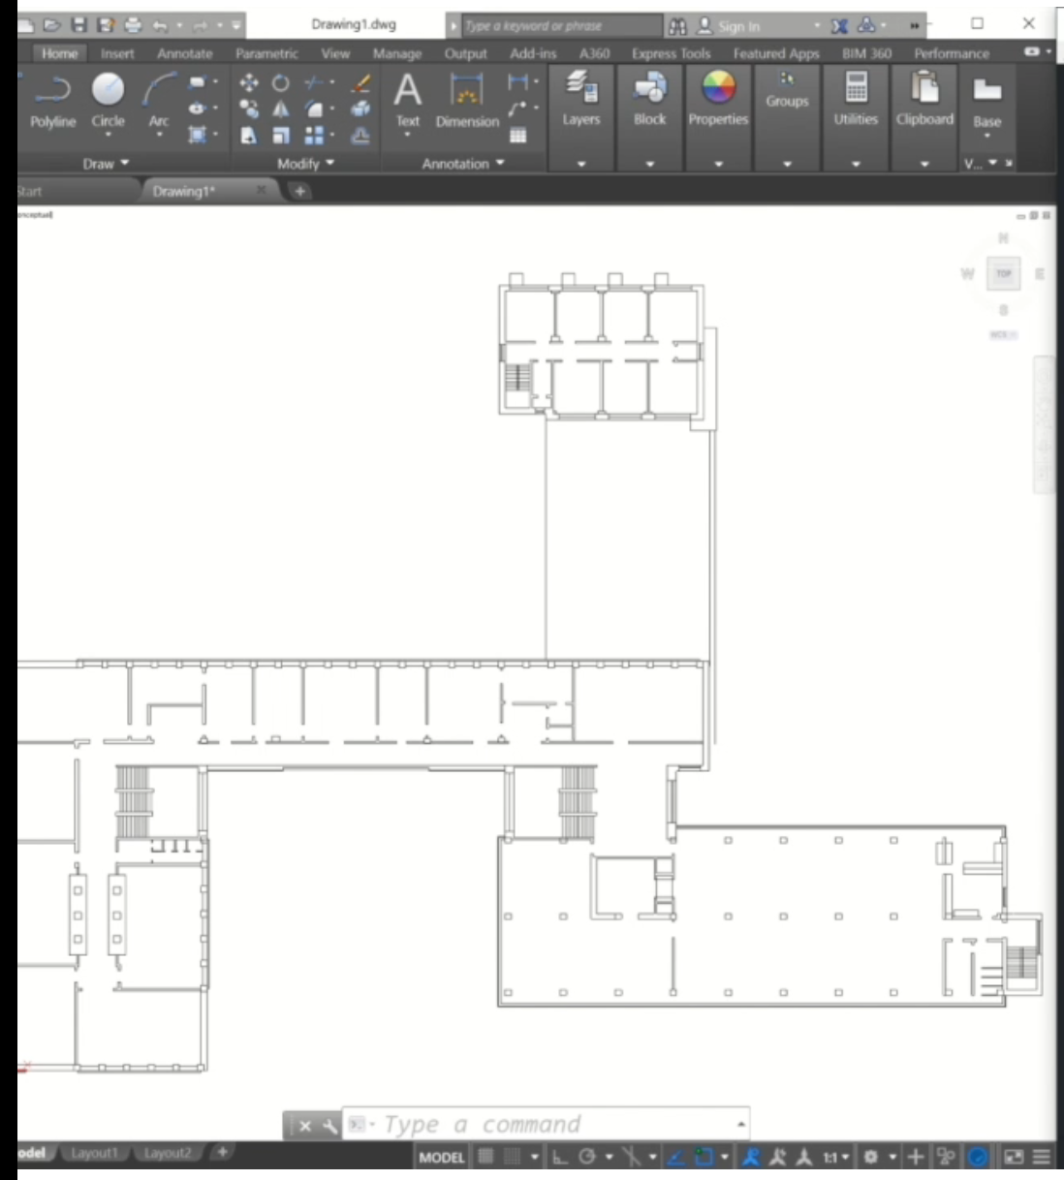
Evaluation

Slide 60
Evaluation
Manual Extraction
Script-It Extraction
Subject | Extraction + Refactorization (MM:SS) | Accuracy (%)
#1 | 07:50 | 100
#2 | 12:30 | 100
#3 | 14:36 | 100
#4 | 12:21 | 100
#5 | 08:19 | 100
AVG | 11:07 | 100
Subject | Extraction + Refactorization (MM:SS) | Accuracy (%)
#1 | 07:26 | 100
#2 | 09:44 | 100
#3 | 10:17 | 80
#4 | 11:50 | 100
#5 | 06:00 | 100
AVG | 09:03 | 96

Slide 61
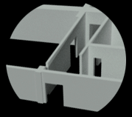
Large Scale

Slide 62
Conclusions

Slide 63
Conclusions
Pen & Paper

Slide 64
Conclusions
Pen & Paper
CAD & BIM

Slide 65
Conclusions
Pen & Paper
CAD & BIM
PM & IPM

Slide 66
Conclusions
Pen & Paper
CAD & BIM
PM & IPM
AD

Slide 67
Conclusions
Pen & Paper
CAD & BIM
PM & IPM
AD & RAD

Slide 68
Conclusions
Pen & Paper
CAD & BIM
PM & IPM
AD & RAD
Future Work

Slide 69
One more thing…

Slide 70
Questions?
Thank you!

