Slide 1
An Enhanced Programming Environment for
Generative Design
Guilherme Ferreira
Instituto Superior Técnico

Slide 2
Problem
Solution
Conclusions

Slide 3
1 Problem

Slide 4
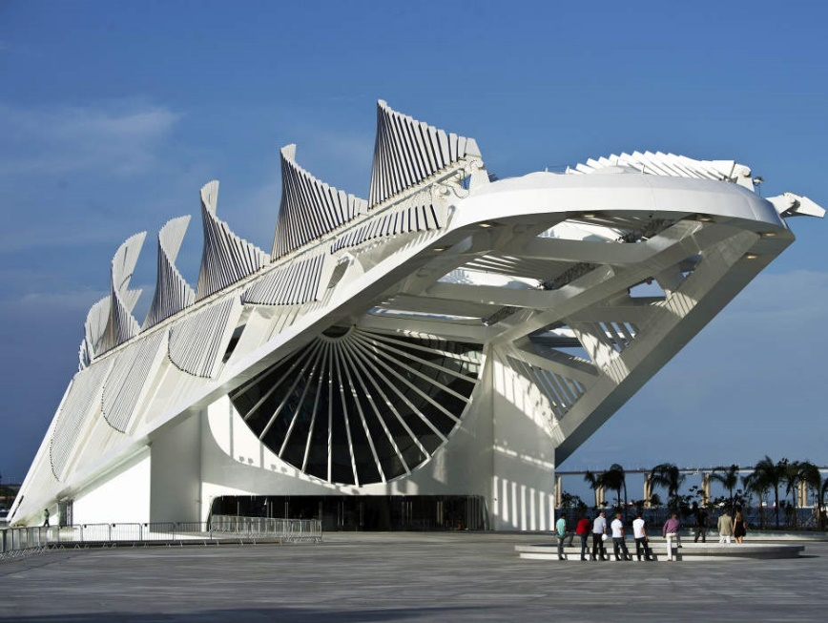
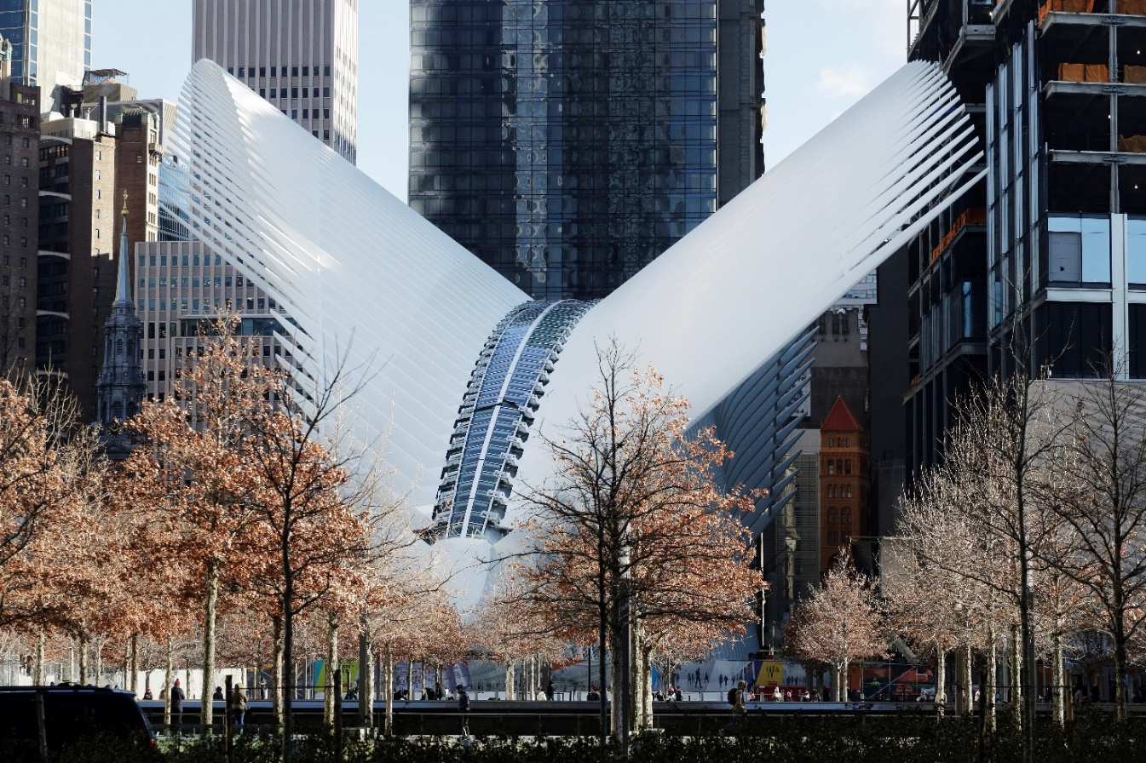
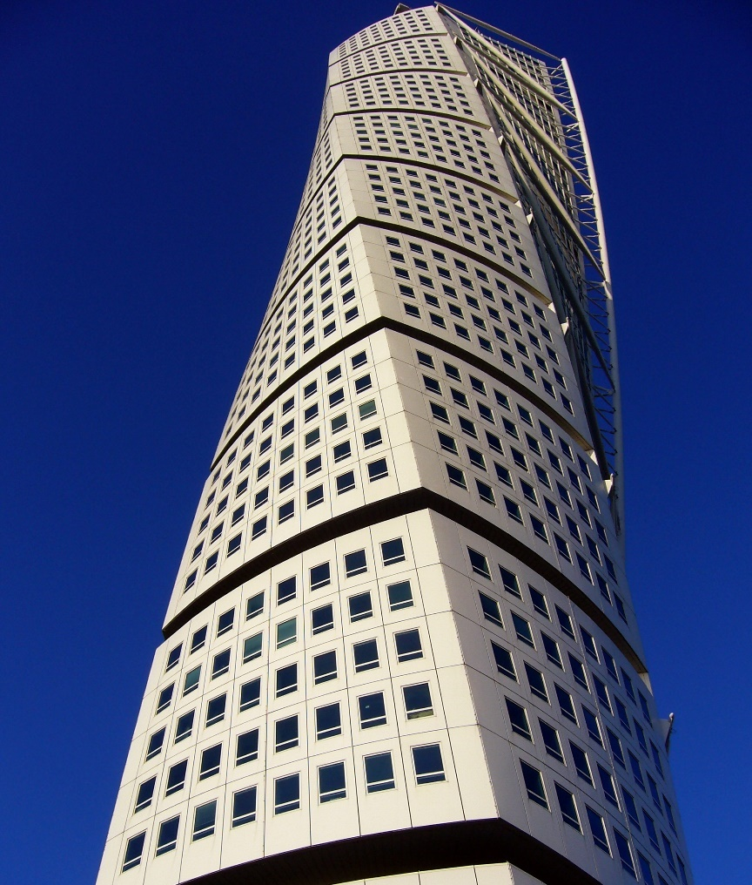
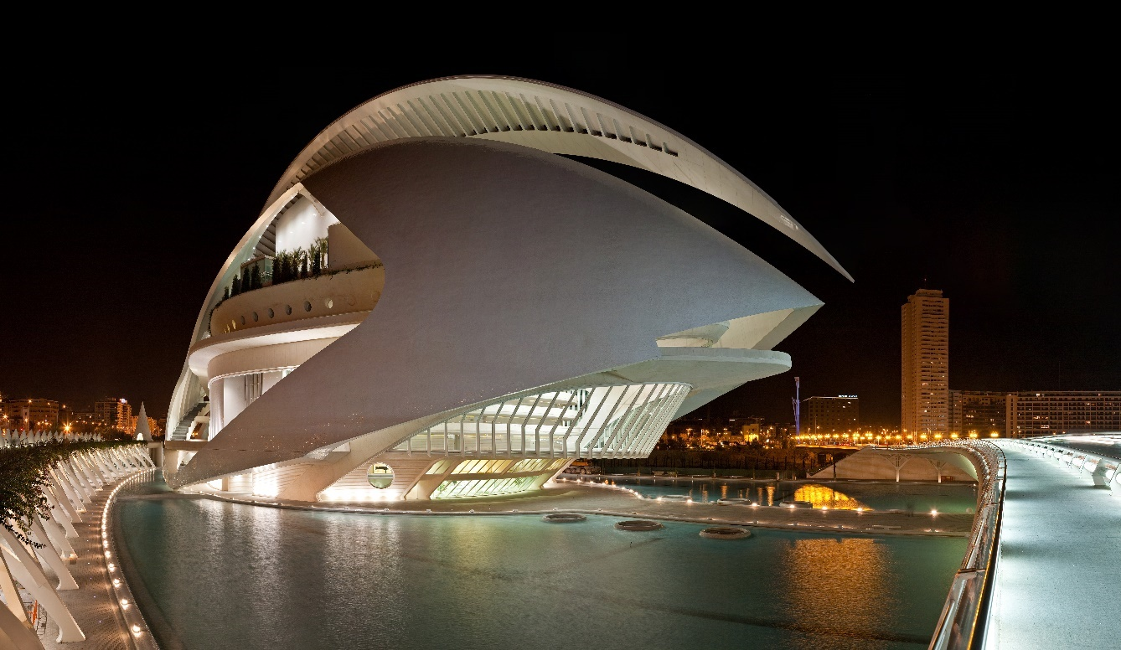
Museum of Tomorrow Rio de Janeiro, Brazil
Turning Torso Malmö, Sweden (2005)
World Trade Center Transit Hub New York, USA (2016)
Queen Sofia Palace of the Arts Valencia, Spain (2005)
© Architect Santiago Calatrava

Slide 8
How can I change this program?
© Nathan Miller

Slide 10
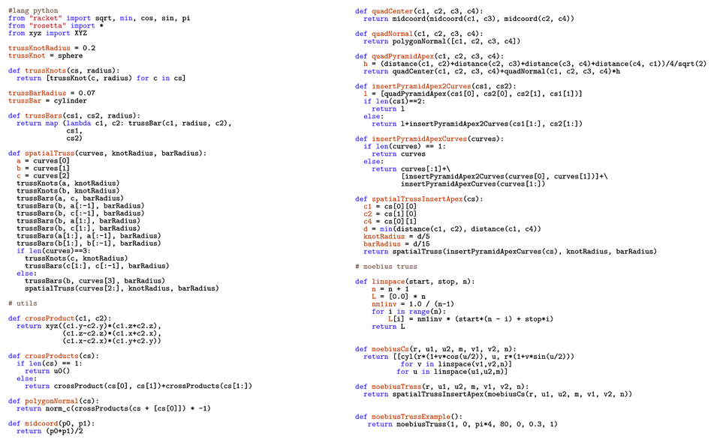
What is this program doing?

Slide 11
2 Solution

Slide 12
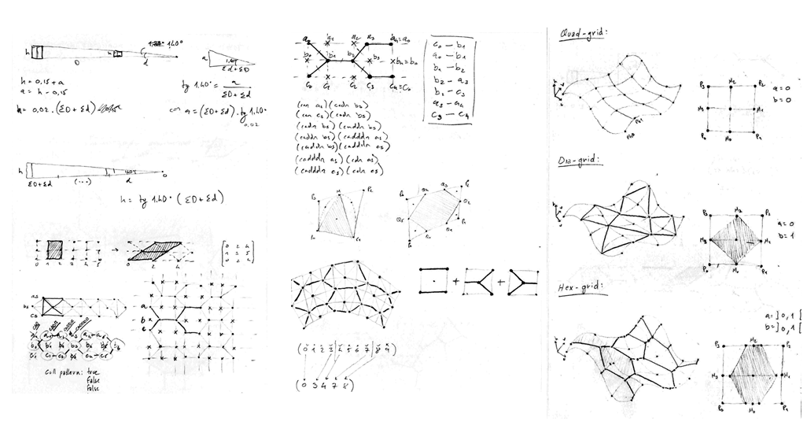
Sketches
CONCEPT
SCRIPT
DESIGN
Diagrams

Slide 13
Sketches
CONCEPT
SCRIPT
DESIGN
Diagrams
(define (skin-open-srf srf panel panel-f panel-h att)
(sphere att 0.03)
(iterate-quads
(lambda (h0 h1 h2 h3)
(panel (list-ref h0 4)
(list-ref h0 3)
(list-ref h1 4)
(list-ref h2 1)
(list-ref h2 0)
(list-ref h3 1)
panel-f panel-h att))
(iterate-quads
(lambda (p0 p1 p2 p3)
(let* ((a (ptf p0 p3 0.17))
(b (ptf p0 p1 1/2))
(f (ptf p0 p3 1/2))
(j (ptf p3 p2 1/2))
(e (ptf b j 2/3))
(k p1)
(l p2)
(c (ptf k l 0.17))
(d (ptf k l 1/2))
(w (ptf k l 2/3))
(g (ptf (ptf p0 p3 2/3) (ptf p1 p2 2/3) 3/2))
(h (ptf p3 p2 3/2))
(i (ptf k l 1.17)))
(panel a b c d e f panel-f panel-h att)
(list a b c d e f)))
(transpose-matrix srf))))
(define (hex-panel-1 p0 p1 p2 p3 p4 p5 f h att)
(let* ((c (quad-center p0 p1 p2 p3))
(n (quad-normal p0 p1 p2 p3))
(d (* f (distance att c))))
(loft (list
(closed-line p0 p1 p2 p3 p4 p5)
(move
(scale
(closed-line p0 p1 p2 p3 p4 p5) d c)
(*c n (- h)))))))
(define (hex-panel-2 p0 p1 p2 p3 p4 p5 f h att)
(let* ((c (quad-center p0 p1 p2 p3))
(n (quad-normal p0 p1 p2 p3))
(d (* f (distance att c))))
(loft (list
(closed-line p0 p1 p2 p3 p4 p5)
(move
(scale
(closed-line p0 p1 p2 p3 p4 p5)
(/ d 1.3) c)
(*c n (/ (- h) 2.0)))
(move
(scale
(closed-line p0 p1 p2 p3 p4 p5) d c)
(*c n (- h)))))))

Slide 14
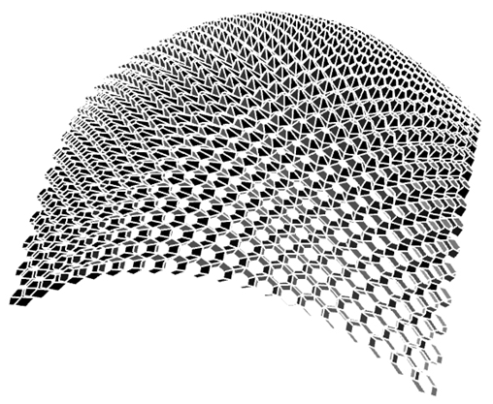
Sketches
CONCEPT
SCRIPT
DESIGN
Diagrams

Slide 15
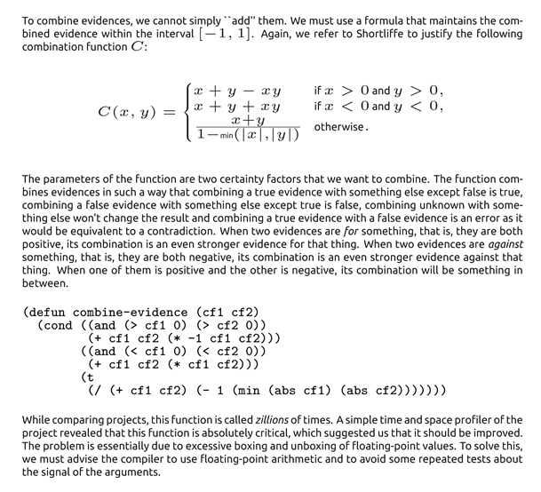
Literate Programming
Documentation
Program
Documentation

Slide 16
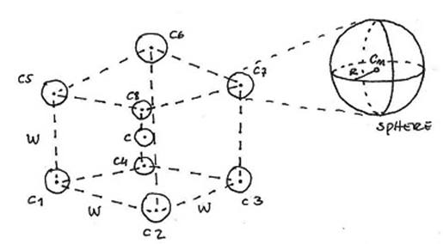
Program-sketch Correlation
def cubeSpheres(c, w, r):
c1 = c+xyz(-w,-w,-w)
c2 = c+xyz(+w,-w,-w)
c3 = c+xyz(+w,+w,-w)
c4 = c+xyz(-w,+w,-w)
c5 = c+xyz(-w,-w,+w)
c6 = c+xyz(+w,-w,+w)
c7 = c+xyz(+w,+w,+w)
c8 = c+xyz(-w,+w,+w)
for p in [c1,c2,c3,c4,c5,c6,c7,c8]:
sphere(p, r)
Documentation
Program

Slide 17
Program-sketch Correlation
def cubeSpheres(c, w, r):
c1 = c+xyz(-w,-w,-w)
c2 = c+xyz(+w,-w,-w)
c3 = c+xyz(+w,+w,-w)
c4 = c+xyz(-w,+w,-w)
c5 = c+xyz(-w,-w,+w)
c6 = c+xyz(+w,-w,+w)
c7 = c+xyz(+w,+w,+w)
c8 = c+xyz(-w,+w,+w)
for p in [c1,c2,c3,c4,c5,c6,c7,c8]:
sphere(p, r)
Documentation
Program

Slide 19
Immediate feedback

Slide 20
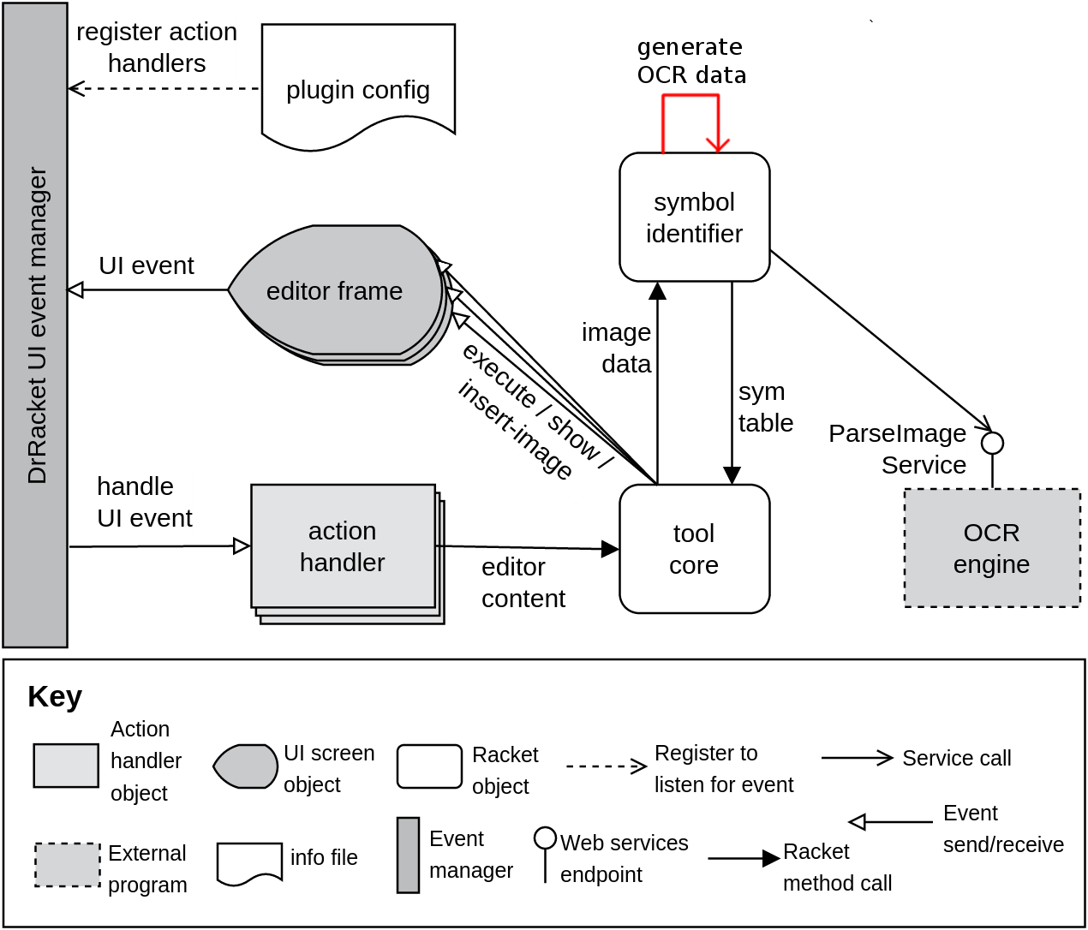
How to implement these tools?

Slide 21
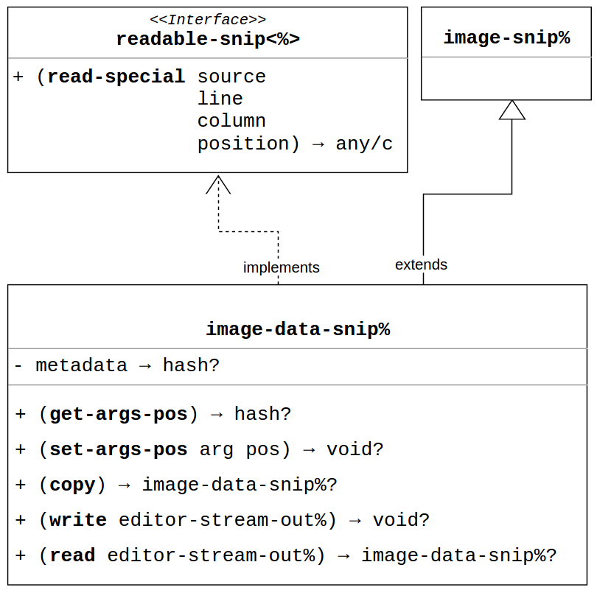
How to implement these tools?

Slide 22
Evaluation
Users feedback
Awkward shortcuts
Resize images
Adaptive sliders
Limitations
No resize operation for bitmaps
DrRacket slider GUI has fixed range
DrRacket stores code and metadata as binary

Slide 23
3 Conclusions

Slide 24
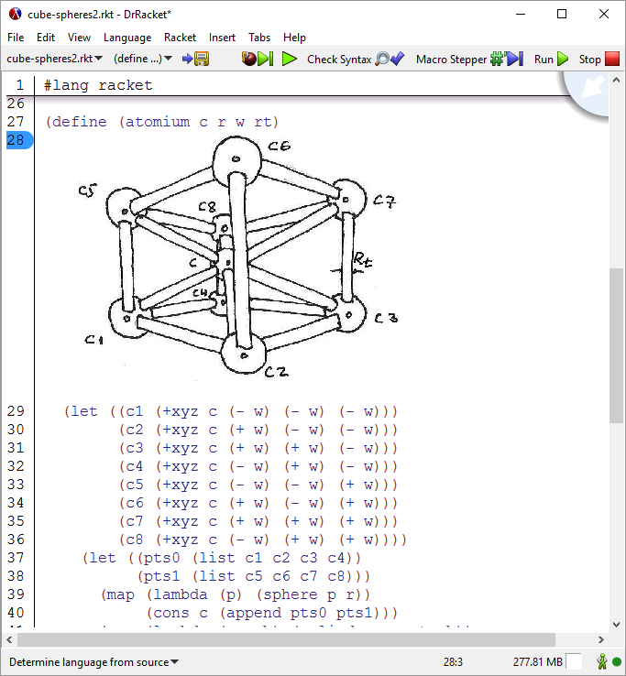
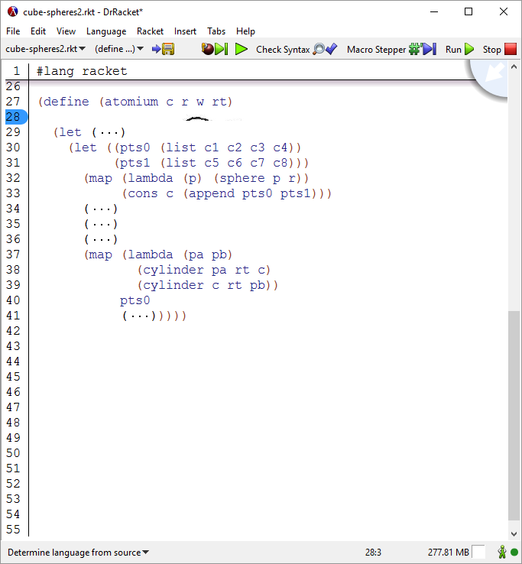
Program-sketch Correlation Tool
Current Work
Correlates code with program artifacts
Saves image and its metadata
Provides useful operations over images
Future Work
New correlation strategies
OCR integration
Support for image editing

Slide 25
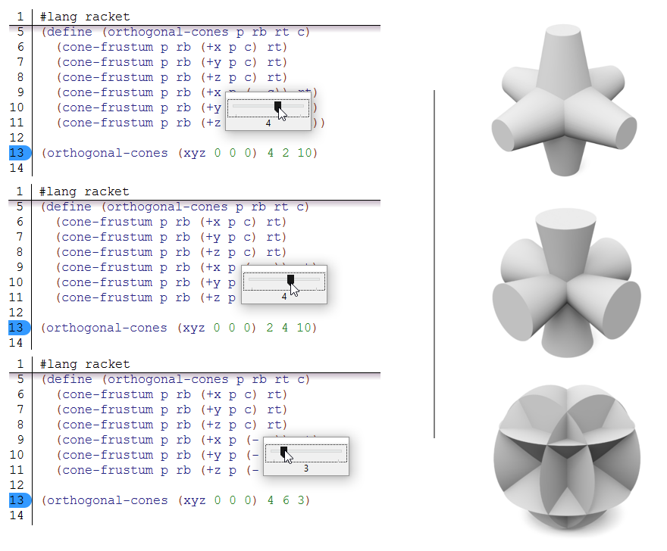
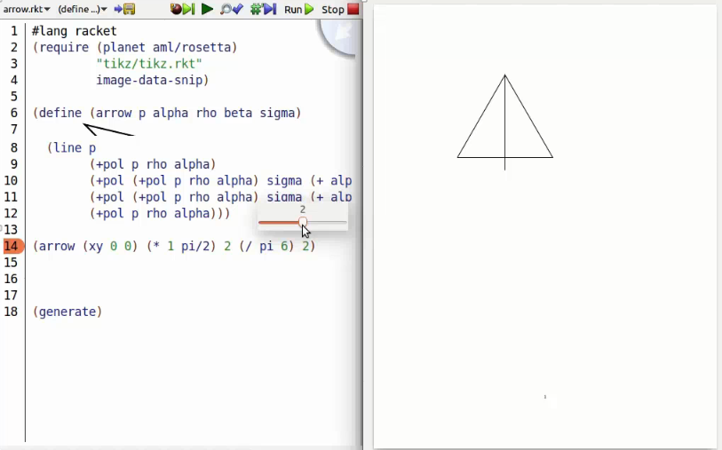
Immediate Feedback Tool
Current Work
Processes immediately the code change
Provides inline slider
Supports change in any literal
Future Work
Partial code execution
Adaptive sliders
Show model change

Slide 26
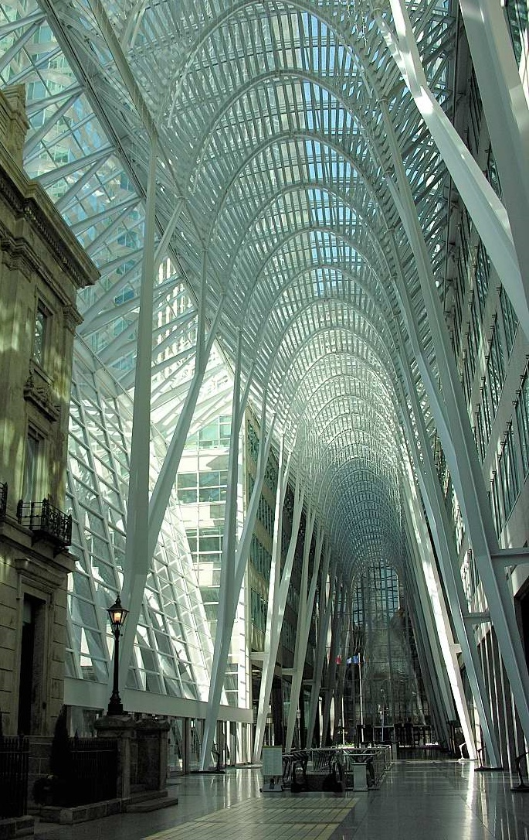
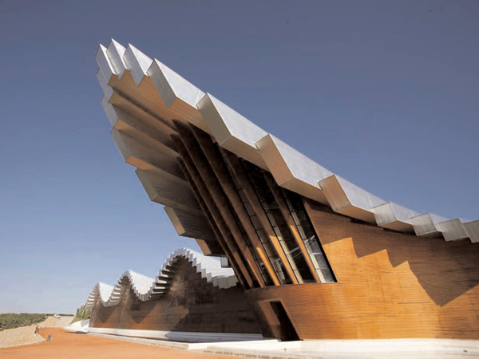
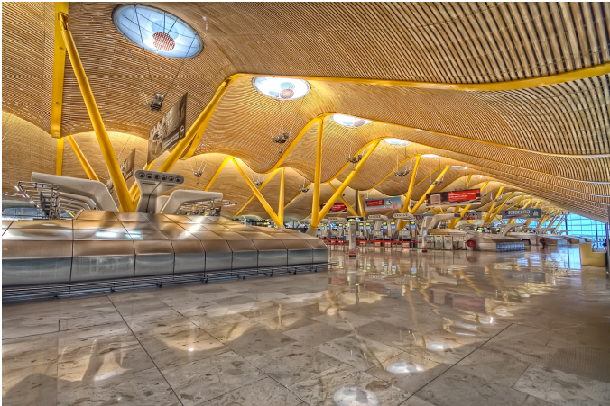
Ysios Winery
Laguardia, Spain (2001)
Thank you. Questions?
Barajas Airport
Madrid, Spain
Atrium of Brookfield Place
Toronto, Canada (1992)

