Slide 1
PyonR: A Python Implementation for Racket
Thesis to obtain the Master of Science Degree in
Information Systems and Computer Engineering
Pedro Alexandre Henriques Palma Ramos

Slide 2
Contents
Motivation
Related Work
Solution
Compilation
Runtime Environment
Interoperability
DrRacket Integration
Performance
Conclusions
Pedro Alexandre Henriques Palma Ramos | PyonR: A Python Implementation for Racket

Slide 3
Racket + DrRacket
Pedro Alexandre Henriques Palma Ramos | PyonR: A Python Implementation for Racket

Slide 4
Why Python?
GitHub repositories (September 2013 – October 2014)
 | Python: | 214 000 repositories
 | Racket: | 1 200 repositories
Pedro Alexandre Henriques Palma Ramos | PyonR: A Python Implementation for Racket

Slide 5
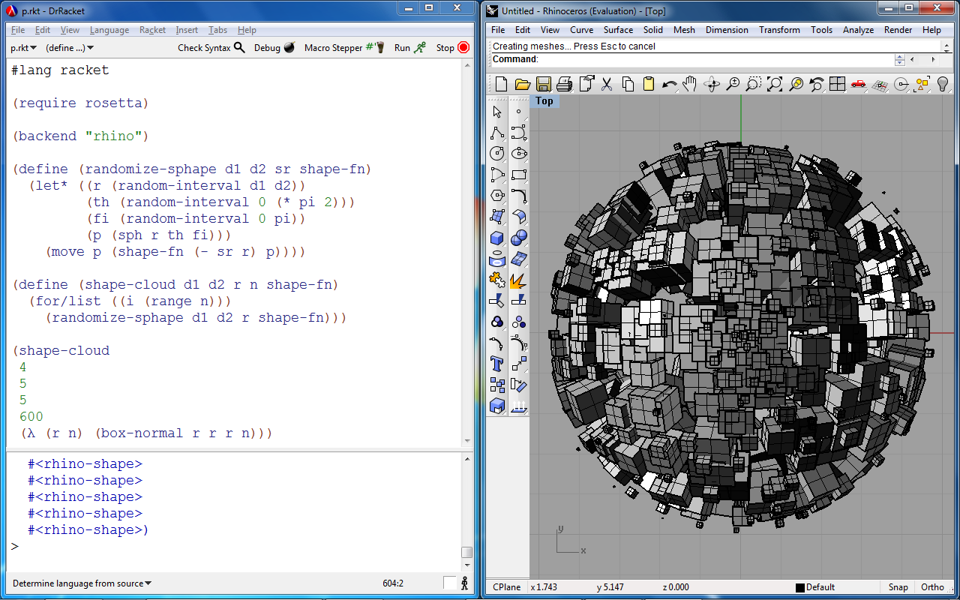
Rosetta IDE
Pedro Alexandre Henriques Palma Ramos | PyonR: A Python Implementation for Racket

Slide 6
Goals
Correctness + Completeness
Performance
DrRacket Integration
Interoperability with Racket
Pedro Alexandre Henriques Palma Ramos | PyonR: A Python Implementation for Racket

Slide 7
Related Work – Implementations
Pedro Alexandre Henriques Palma Ramos | PyonR: A Python Implementation for Racket

Slide 8
Related Work – Implementations
 | Language(s) Written | Platform(s) targetted | Speedup (vs. CPython) | Std. library support
CPython (1994-) | C | CPython’s VM | 1x | Full
Pedro Alexandre Henriques Palma Ramos | PyonR: A Python Implementation for Racket

Slide 9
Related Work – Implementations
 | Language(s) Written | Platform(s) targetted | Speedup (vs. CPython) | Std. library support
CPython (1994-) | C | CPython’s VM | 1x | Full
Jython (2000-) | Java | JVM | ~1x | Most
IronPython (2006-) | C# | CLI (.NET) | ~1.8x | Most
Pedro Alexandre Henriques Palma Ramos | PyonR: A Python Implementation for Racket

Slide 10
Related Work – Implementations
 | Language(s) Written | Platform(s) targetted | Speedup (vs. CPython) | Std. library support
CPython (1994-) | C | CPython’s VM | 1x | Full
Jython (2000-) | Java | JVM | ~1x | Most
IronPython (2006-) | C# | CLI (.NET) | ~1.8x | Most
PyPy (2007-) | RPython | C, JVM, CLI | ~6x | Most
Pedro Alexandre Henriques Palma Ramos | PyonR: A Python Implementation for Racket

Slide 11
Related Work – Implementations
 | Language(s) Written | Platform(s) targetted | Speedup (vs. CPython) | Std. library support
CPython (1994-) | C | CPython’s VM | 1x | Full
Jython (2000-) | Java | JVM | ~1x | Most
IronPython (2006-) | C# | CLI (.NET) | ~1.8x | Most
PyPy (2007-) | RPython | C, JVM, CLI | ~6x | Most
CLPython (2006-2013) | Common Lisp | Common Lisp | ~0.5x | Most
Pedro Alexandre Henriques Palma Ramos | PyonR: A Python Implementation for Racket

Slide 12
Related Work – Implementations
 | Language(s) Written | Platform(s) targetted | Speedup (vs. CPython) | Std. library support
CPython (1994-) | C | CPython’s VM | 1x | Full
Jython (2000-) | Java | JVM | ~1x | Most
IronPython (2006-) | C# | CLI (.NET) | ~1.8x | Most
PyPy (2007-) | RPython | C, JVM, CLI | ~6x | Most
CLPython (2006-2013) | Common Lisp | Common Lisp | ~0.5x | Most
PLT Spy (2003-2005) | Scheme, C | Scheme | ~0.001x | Full
Pedro Alexandre Henriques Palma Ramos | PyonR: A Python Implementation for Racket

Slide 13
Compilation Pipeline
(1)
(2)
lexical
analysis
TOKENS
syntactic
analysis
AST
(3)
(4)
code generation
macro expansion
(5)
(6)
Racket bytecode
compiler
Racket VM
Pedro Alexandre Henriques Palma Ramos | PyonR: A Python Implementation for Racket

Slide 14
Compilation example
def fib(n):
if n == 0: return 0
elif n == 1: return 1
else: return fib(n-1) + fib(n-2)
print fib(30)
(define-py-function :fib (n)
(lambda (:n)
(cond
((py-truth (py-eq :n 0)) 0)
((py-truth (py-eq :n 1)) 1)
(else (py-add (:fib (py-sub :n 1)) (:fib (py-sub :n 2)))))))
(py-print (:fib 10))
Pedro Alexandre Henriques Palma Ramos | PyonR: A Python Implementation for Racket

Slide 15
Alternative for Code Generation
def fib(n):
if n == 0: return 0
elif n == 1: return 1
else: return fib(n-1) + fib(n-2)
print fib(30)
(define (fib n)
(cond
((= n 0) 0)
((= n 1) 1)
(else (+ (fib (- n 1)) (fib (- n 2))))))
(displayln (fib 10))
Pedro Alexandre Henriques Palma Ramos | PyonR: A Python Implementation for Racket

Slide 16
Runtime Environment
Mapping to Python/C API
(via Racket Foreign Function Interface)
Racket reimplementation
Two alternatives:
Pedro Alexandre Henriques Palma Ramos | PyonR: A Python Implementation for Racket

Slide 17
Runtime Environment
Strategy A
Racket
CPython VM
foreign calls
on C pointers
Racket FFI
(Foreign Function Interface)
Python/C API
Pedro Alexandre Henriques Palma Ramos | PyonR: A Python Implementation for Racket

Slide 18
Runtime Environment
Strategy B
Racket
CPython VM
Standard
Racket calls
Pedro Alexandre Henriques Palma Ramos | PyonR: A Python Implementation for Racket

Slide 19
Comparison
Strategy A
(foreign values)
+ Completeness
– Performance
– Interoperability
Strategy B
(Racket values)
– Completeness
+ Performance
+ Interoperability
Pedro Alexandre Henriques Palma Ramos | PyonR: A Python Implementation for Racket

Slide 20
Strategy B – Datatype Mappings
int, long, float, complex → Racket numbers
bool → Racket booleans
tuple → Racket vectors
dict → Racket custom hash tables
...
Pedro Alexandre Henriques Palma Ramos | PyonR: A Python Implementation for Racket

Slide 21
Strategy B – Datatype Mappings
Some Python types do not have an equivalent in Racket
e.g. module
python-object
- type
module-object
- name
- contents
Pedro Alexandre Henriques Palma Ramos | PyonR: A Python Implementation for Racket

Slide 22
Optimizations
Early Dispatch
Faster dispatch for operators on common types
Sequence Iteration
Convert collections to Racket sequences for faster iteration
Attribute Getting and Setting
Descriptor caching and simplified logic
Pedro Alexandre Henriques Palma Ramos | PyonR: A Python Implementation for Racket

Slide 23
Interoperability
source code
modules
Pedro Alexandre Henriques Palma Ramos | PyonR: A Python Implementation for Racket

Slide 24
Interoperability
source code
modules
source code
modules
(Python source files)
Pedro Alexandre Henriques Palma Ramos | PyonR: A Python Implementation for Racket

Slide 25
Interoperability
source code
modules
source code
modules
(Python source files)
Pedro Alexandre Henriques Palma Ramos | PyonR: A Python Implementation for Racket

Slide 26
Interoperability – Racket source code
Name mangling
e.g. 2+3 imported as _2_PLUS_3
Predicate dispatching
map: Racket predicates → Python types
allows using Python operators with Racket datatypes
Pedro Alexandre Henriques Palma Ramos | PyonR: A Python Implementation for Racket

Slide 27
Interoperability
source code
modules
source code
modules
(Python source files)
modules
(any library available
to CPython)
Pedro Alexandre Henriques Palma Ramos | PyonR: A Python Implementation for Racket

Slide 28
Interoperability – CPython libraries
Basic types (int, string, bool, ...)
direct conversion
Composite types (type, module, ...)
recursively converted
Unknown types, functions, collections
proxy objects
Pedro Alexandre Henriques Palma Ramos | PyonR: A Python Implementation for Racket

Slide 29
cpyimport Example
#lang python
cpyimport numpy as np
def add_arrays(n):
result = np.zeros((100,100))
for i in range(n):
result += np.random.randint(0, 100000, (100,100))
return result
print add_arrays(10000)
Pedro Alexandre Henriques Palma Ramos | PyonR: A Python Implementation for Racket

Slide 30
cpyimport Example
Pedro Alexandre Henriques Palma Ramos | PyonR: A Python Implementation for Racket

Slide 31
cpyimport Example
#lang python
from arrays_example cpyimport add_arrays
print add_arrays(10000)
Pedro Alexandre Henriques Palma Ramos | PyonR: A Python Implementation for Racket

Slide 32
cpyimport Example
Pedro Alexandre Henriques Palma Ramos | PyonR: A Python Implementation for Racket

Slide 33
Integration with DrRacket
Source-code location
Syntax highlighting
Read-Eval-Print-Loop (REPL)
Error Display Handler
Pedro Alexandre Henriques Palma Ramos | PyonR: A Python Implementation for Racket

Slide 34
DrRacket – Source-code location
Pedro Alexandre Henriques Palma Ramos | PyonR: A Python Implementation for Racket

Slide 35
DrRacket – Source-code location
Pedro Alexandre Henriques Palma Ramos | PyonR: A Python Implementation for Racket

Slide 36
DrRacket – Syntax highlighting
Pedro Alexandre Henriques Palma Ramos | PyonR: A Python Implementation for Racket

Slide 37
DrRacket – Read-Eval-Print-Loop
Pedro Alexandre Henriques Palma Ramos | PyonR: A Python Implementation for Racket

Slide 38
DrRacket – Error Display Handler
Pedro Alexandre Henriques Palma Ramos | PyonR: A Python Implementation for Racket

Slide 39
Pystone Benchmark
...
...
Pedro Alexandre Henriques Palma Ramos | PyonR: A Python Implementation for Racket

Slide 40
PyonR Benchmark
Pedro Alexandre Henriques Palma Ramos | PyonR: A Python Implementation for Racket

Slide 41
Conclusions
Correctness + Completeness
Performance
DrRacket Integration
Interoperability with Racket
Pedro Alexandre Henriques Palma Ramos | PyonR: A Python Implementation for Racket

Slide 42
Conclusions
 | Language(s) Written | Platform(s) targetted | Speedup (vs. CPython) | Std. library support
CPython (1994-) | C | CPython’s VM | 1x | Full
Jython (2000-) | Java | JVM | ~1x | Most
IronPython (2006-) | C# | CLI (.NET) | ~1.8x | Most
PyPy (2007-) | RPython | C, JVM, CLI | ~6x | Most
CLPython (2006-2013) | Common Lisp | Common Lisp | ~0.5x | Most
PLT Spy (2003-2005) | Scheme, C | Scheme | ~0.001x | Full
Pedro Alexandre Henriques Palma Ramos | PyonR: A Python Implementation for Racket

Slide 43
Conclusions
 | Language(s) Written | Platform(s) targetted | Speedup (vs. CPython) | Std. library support
CPython (1994-) | C | CPython’s VM | 1x | Full
Jython (2000-) | Java | JVM | ~1x | Most
IronPython (2006-) | C# | CLI (.NET) | ~1.8x | Most
PyPy (2007-) | RPython | C, JVM, CLI | ~6x | Most
CLPython (2006-2013) | Common Lisp | Common Lisp | ~0.5x | Most
PLT Spy (2003-2005) | Scheme, C | Scheme | ~0.001x | Full
PyonR (2014-) | Racket | Racket | ~0.3x | Full
Pedro Alexandre Henriques Palma Ramos | PyonR: A Python Implementation for Racket

Slide 44
Conclusions - Rosetta
Pedro Alexandre Henriques Palma Ramos | PyonR: A Python Implementation for Racket

Slide 45
Future Work
Implementing remaining language elements
Unit testing
Enhancing performance
Profiling and optimizing common codepaths
Rewrite modules in Typed Racket
Source-code translation backend
Migration from Python 2.x to Python 3.x
Pedro Alexandre Henriques Palma Ramos | PyonR: A Python Implementation for Racket

Slide 46
Contributions
An Implementation of Python for Racket
7th European Lisp Symposium
Implementing Python for DrRacket
3rd Symposium on Languages, Applications and Technologies
Reaching Python from Racket
8th International Lisp Conference
Pedro Alexandre Henriques Palma Ramos | PyonR: A Python Implementation for Racket

Slide 47
Availability
https://github.com/pedropramos/PyonR
Pedro Alexandre Henriques Palma Ramos | PyonR: A Python Implementation for Racket

Slide 48
Thank you!
Pedro Alexandre Henriques Palma Ramos | PyonR: A Python Implementation for Racket

Slide 49
Thank you!
Pedro Alexandre Henriques Palma Ramos | PyonR: A Python Implementation for Racket

Slide 50
Thank you!
Pedro Alexandre Henriques Palma Ramos | PyonR: A Python Implementation for Racket

Slide 51
High level, dynamically typed, GC’d
Focus on code readability
Multiple paradigms
Huge standard library + third-party libraries
Pedro Alexandre Henriques Palma Ramos | PyonR: A Python Implementation for Racket

Slide 52
‘s Data Model
Source files define module objects
Classes define type objects
Every value has an associated type object
Type objects hold a dictionary for each method
method name → function object
Operator behaviour is stored at the type object
e.g. the + operator is implemented by the method “__add__”
Pedro Alexandre Henriques Palma Ramos | PyonR: A Python Implementation for Racket

Slide 53
Compilation - Example
tokenization
[
PRINT
line 3, cols 0-5
,
NAME: "arr"
line 3, cols 6-9
,
OPEN-BRACKET
line 3, cols 9-10
,
]
INT: 6
line 3, cols 10-11
,
CLOSE-BRACKET
line 3, cols 11-12
Pedro Alexandre Henriques Palma Ramos | PyonR: A Python Implementation for Racket

Slide 54
Compilation - Example
parsing
line 3, cols 0-12
print-statement
expression
line 3, cols 6-12
subscript-expression
line 3, cols 6-9
primary
sub
line 3, cols 10-11
identifier
literal
name
value
print
arr
[
6
]
Pedro Alexandre Henriques Palma Ramos | PyonR: A Python Implementation for Racket

Slide 55
Compilation - Example
code generation
(to-racket )
print-statement
(py-print (to-racket ))
subscript-expression
(py-print (py-get-index (to-racket )
(to-racket ))
identifier
literal
(py-print (py-get-index arr 6))
Pedro Alexandre Henriques Palma Ramos | PyonR: A Python Implementation for Racket

Slide 56
Compilation - Example
code generation
(py-print (py-get-index arr 6))
py-print
line: 3, cols: 0-12
(py-get-index arr 6)
py-get-index
line 3, cols 6-12
arr
line 3, cols 6-9
6
line 3, cols 10-11
Pedro Alexandre Henriques Palma Ramos | PyonR: A Python Implementation for Racket

Slide 57
Ackermann
(define (ackermann m n)
(cond
[(= m 0) (+ n 1)]
[(and (> m 0) (= n 0)) (ackermann (- m 1) 1)]
[else (ackermann (- m 1) (ackermann m (- n 1)))]))
(ackermann 3 9)
def ackermann(m,n):
if m == 0: return n+1
elif m > 0 and n == 0: return ackermann(m-1,1)
else: return ackermann(m-1, ackermann(m,n-1))
print ackermann(3,9)
Pedro Alexandre Henriques Palma Ramos | PyonR: A Python Implementation for Racket

Slide 58
Ackermann
Pedro Alexandre Henriques Palma Ramos | PyonR: A Python Implementation for Racket

Slide 59
Mandelbrot
(define (mandelbrot limit c)
(let loop ([i 0] [z 0+0i])
(cond
[(> i limit) i]
[(> (magnitude z) 2) i]
[else (loop (add1 i)
(+ (* z z) c))])))
(mandelbrot 1000000 .2+.3i)
def mandelbrot(limit, c):
z = 0+0j
for i in range(limit+1):
if abs(z) > 2: return i
z = z*z + c
return i+1
print mandelbrot(1000000, .2+.3j)
Pedro Alexandre Henriques Palma Ramos | PyonR: A Python Implementation for Racket

Slide 60
Mandelbrot
Pedro Alexandre Henriques Palma Ramos | PyonR: A Python Implementation for Racket

Slide 61
Mandelbrot using classes
class MandelbrotComplex:
def __init__(self):
self.z = 0+0j
def mandelbrot(limit, c):
mc = MandelbrotComplex()
for i in range(limit+1):
if abs(mc.z) > 2: return i
mc.z = mc.z * mc.z + c
return i+1
print mandelbrot(1000000, .2+.3j)
Pedro Alexandre Henriques Palma Ramos | PyonR: A Python Implementation for Racket

Slide 62
Mandelbrot using classes
Pedro Alexandre Henriques Palma Ramos | PyonR: A Python Implementation for Racket

