Slide 1




Inverse Algorithm Design
of Floor Plans
João David Inês Pereira Catarina Belém António Leitão

Slide 2
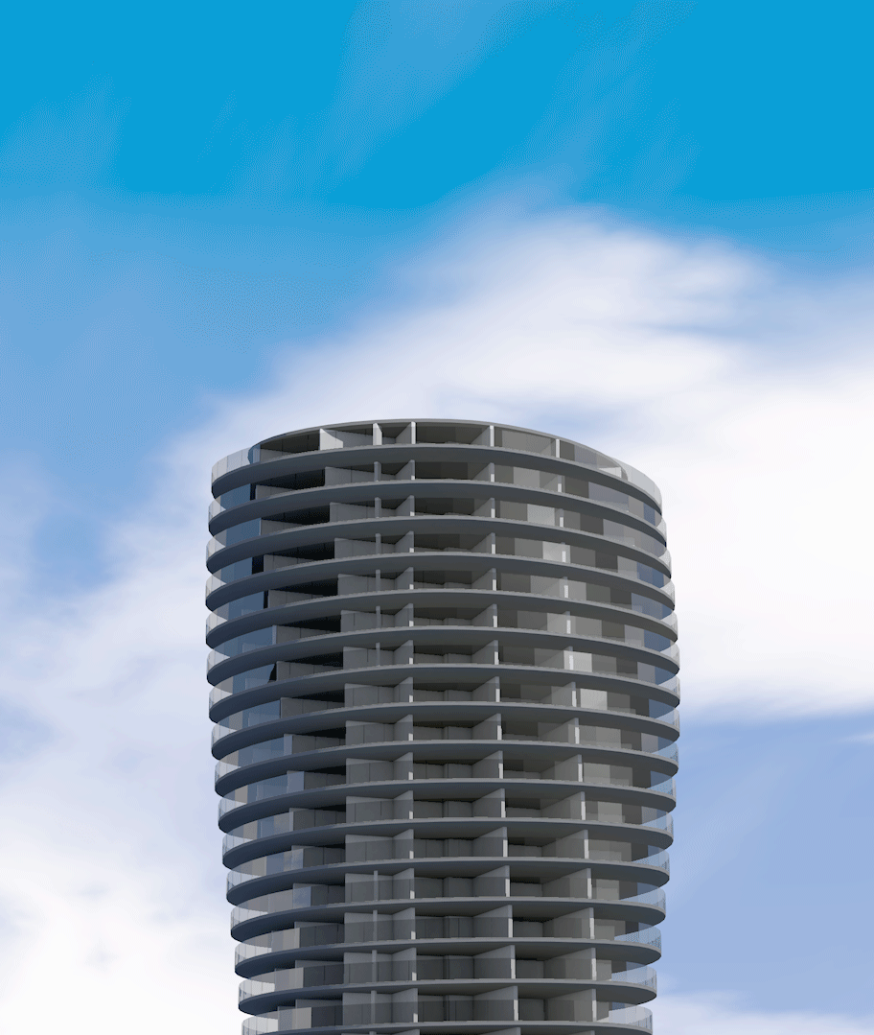
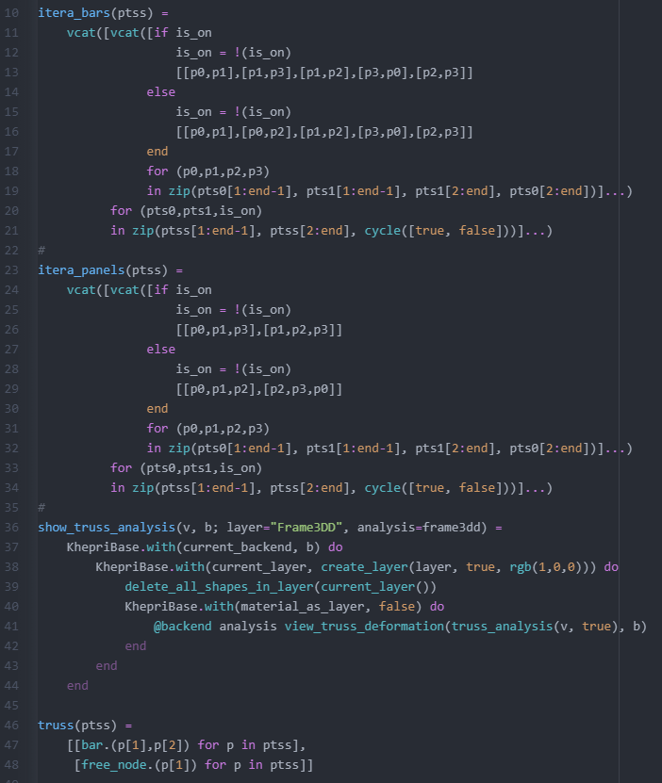
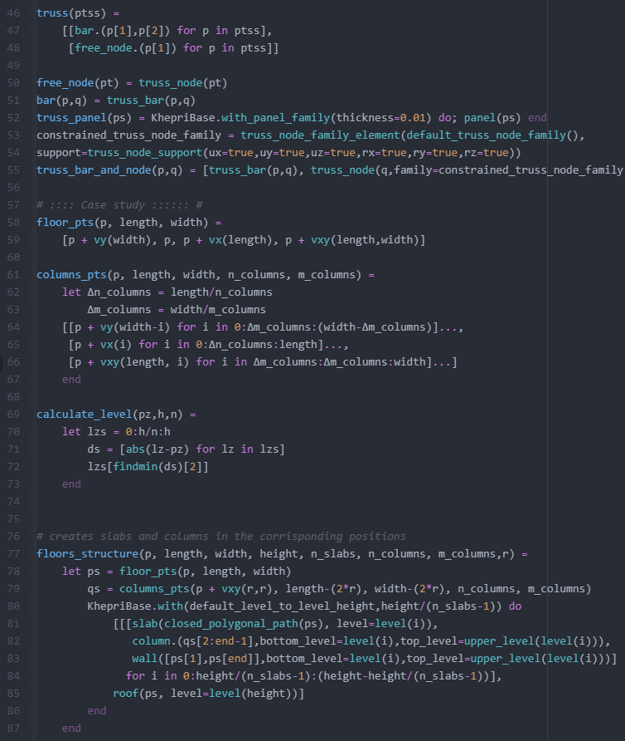
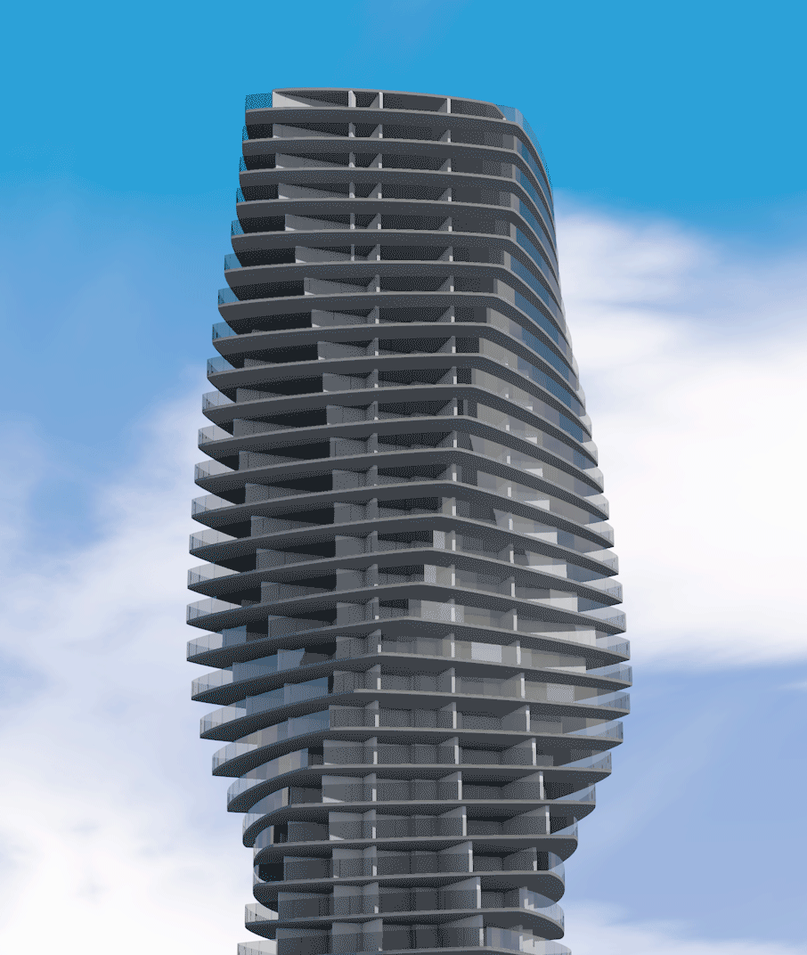
Algorithmic Design

Slide 3



Algorithmic Design
Parametric models
Automatic optimization
Steep learning curve
Costly
conversion

Slide 4
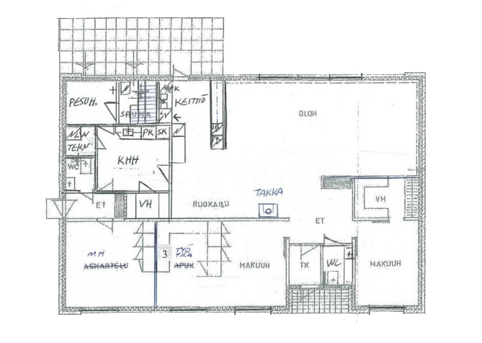



Inverse Algorithmic Design
wall([p1, p2])
wall([p1, p4]
parts=[door(1, 0.7, rf),
window(2.3, 2)])
sink(xy(4.5, 7), 90)
ML
algorithms
Floor plan images
Algorithmic description

Slide 5
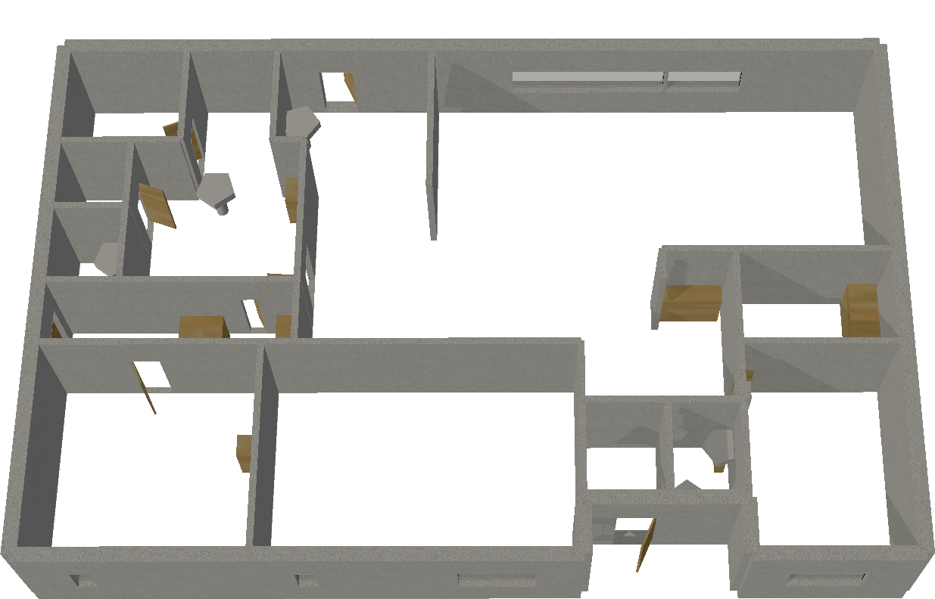

Inverse Algorithmic Design
ML
algorithms
Floor plan images
Model visualization

Slide 6
Inverse Algorithmic Design
Interpretation
Representation
Reconstruction
Detect relevant symbols
Convert to a structured representation
Create algorithmic description

Slide 7
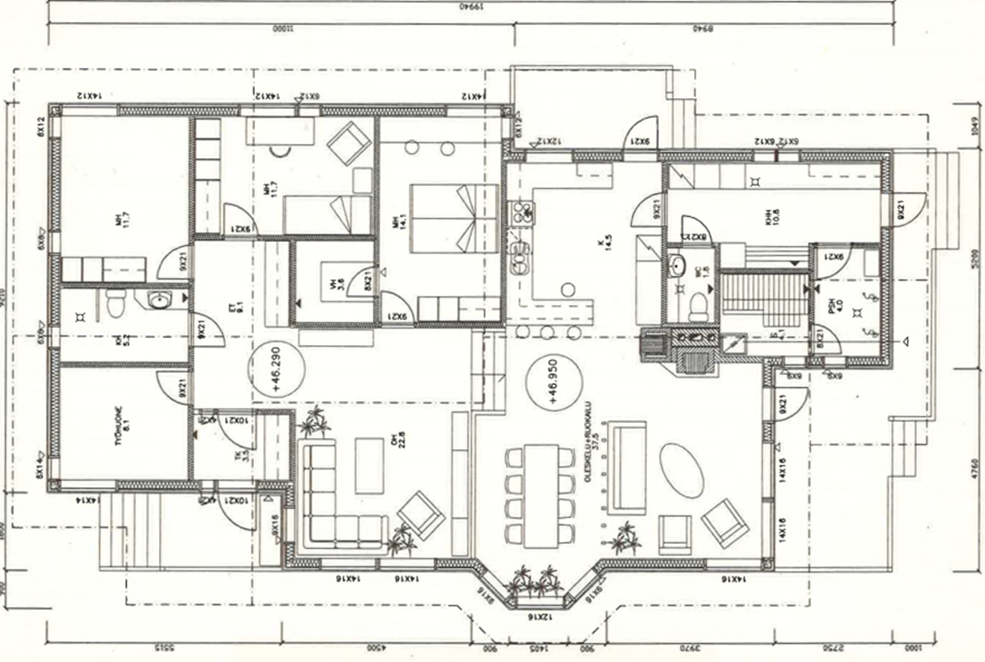
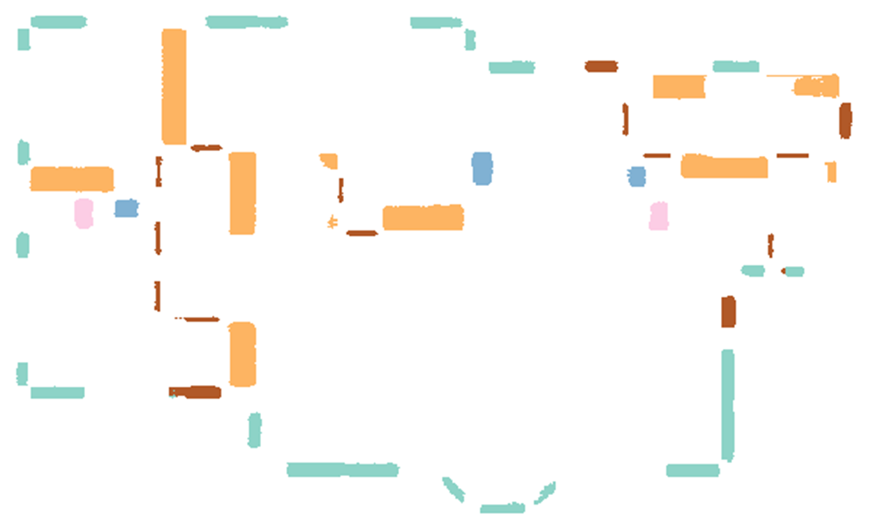
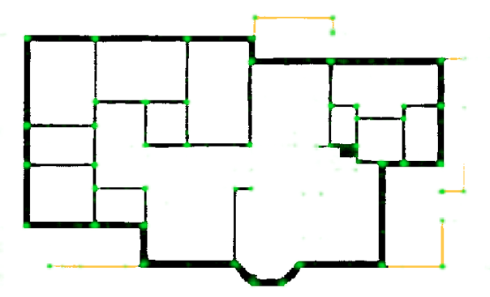
Inverse Algorithmic Design
Input image
from CubiCasa5K
Recognition
Segmentation
Vectorization

Slide 8
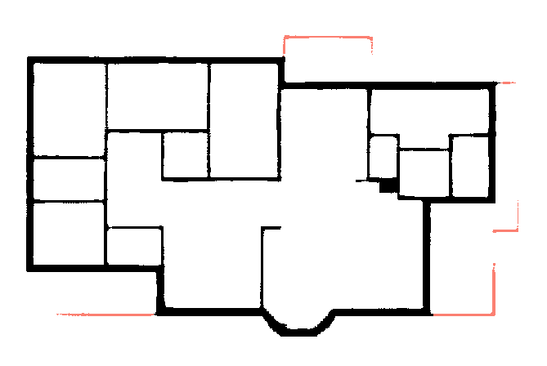
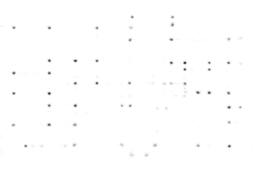
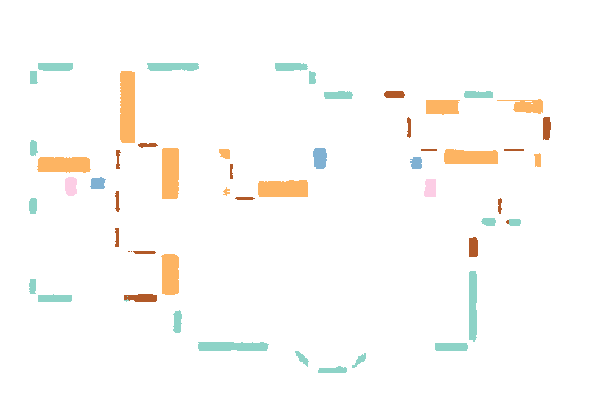
Inverse Algorithmic Design
Recognition
Segmentation allows us to identify:
Walls and Railings
Junctions
Symbols

Slide 9
Inverse Algorithmic Design
Recognition
Segmentation results :
Accuracy (%) | Rooms | Icons
 |  | Overall | Toilet | Sink
Our results | 82.5 | 97.5 | 98.9 | 98.5
CubiCasa5K | 82.7 | 97.6 | 72.5 | 67.4

Slide 10
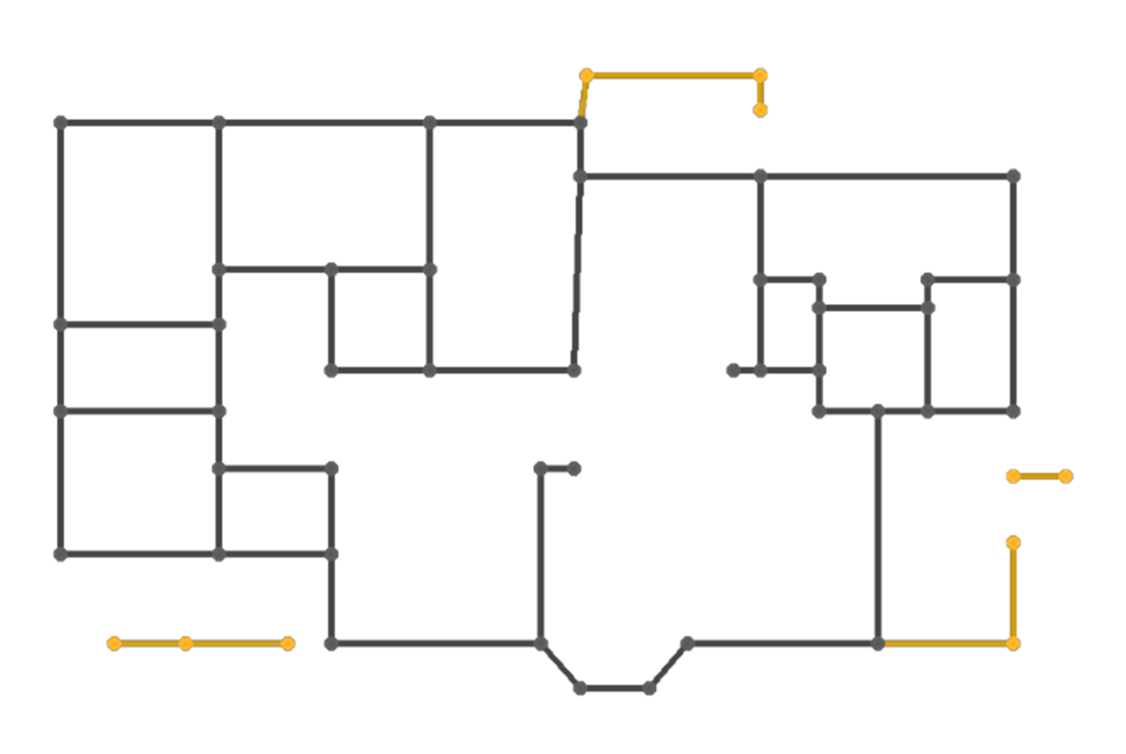
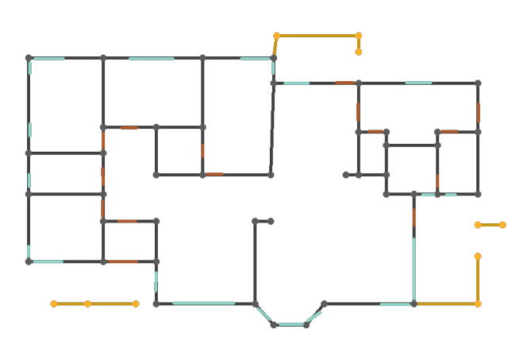
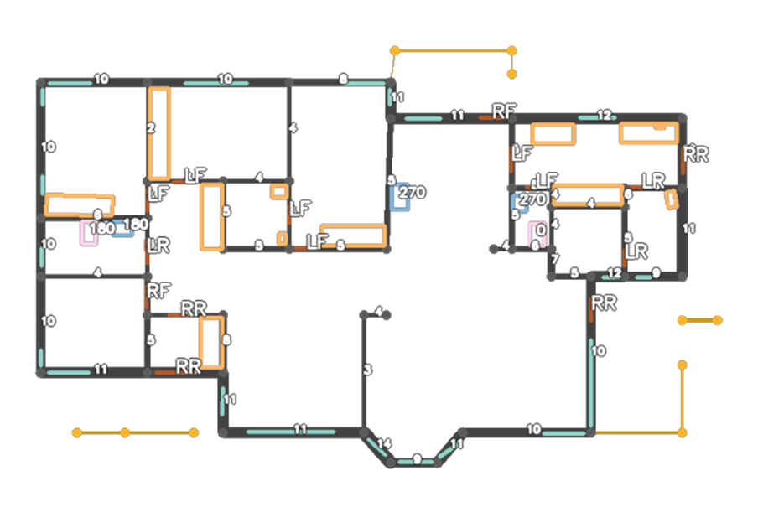
Inverse Algorithmic Design
Recognition
We then use that information to:
Vectorize structural elements
Attach windows and doors to walls
Recover semantics

Slide 11
Inverse Algorithmic Design
Input image
Recognition
Reconstruction
Segmentation
Vectorization
Define parameters
Write program
using Khepri
x1 = 1.41
y1 = 1.56
wall(p1, p2; parts=door(1, .5))
sink(xy(10, 15), 270)
...

Slide 12
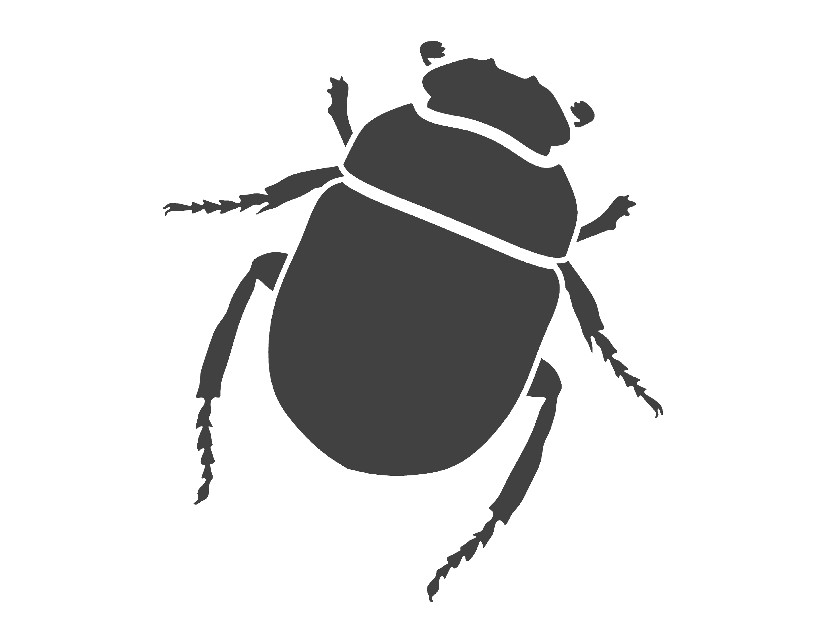
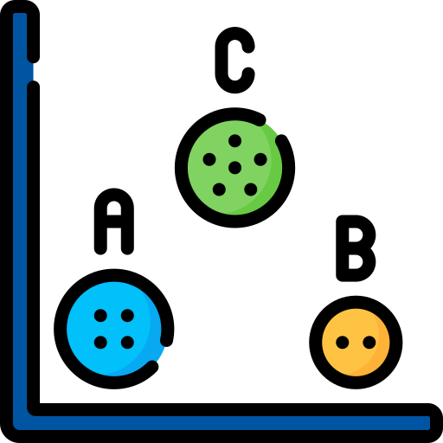

Inverse Algorithmic Design
Reconstruction
Khepri as the chosen AD tool
Clustering to define certain values
Refactoring to improve readability and parametricity

Slide 13
Inverse Algorithmic Design
Input image
Recognition
Reconstruction
Segmentation
Vectorization
Define parameters
Write program
using Khepri
x1 = 1.41
y1 = 1.56
wall(p1, p2; parts=door(1, .5))
sink(xy(10, 15), 270)
...

Slide 14
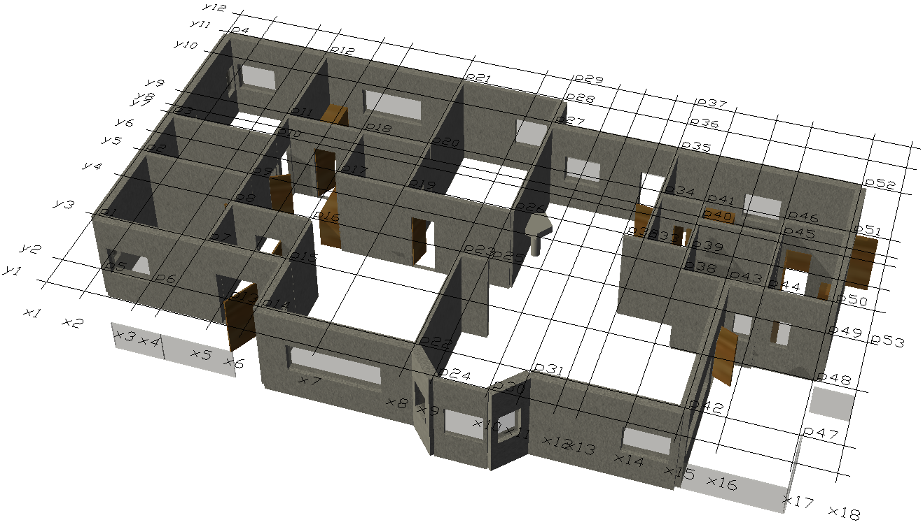
Inverse Algorithmic Design
Recognition
Reconstruction
Segmentation
Vectorization
Define parameters
Write program
using Khepri
x1 = 1.41
y1 = 1.56
wall(p1, p2; parts=door(1, .5))
sink(xy(10, 15), 270)
...

Slide 15
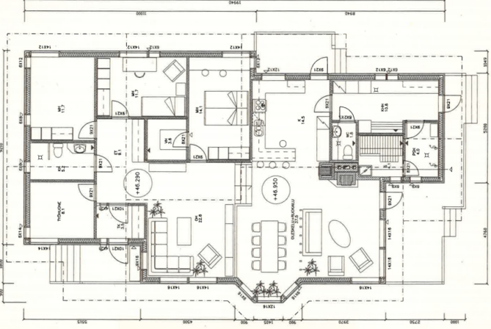
Examples

Slide 16
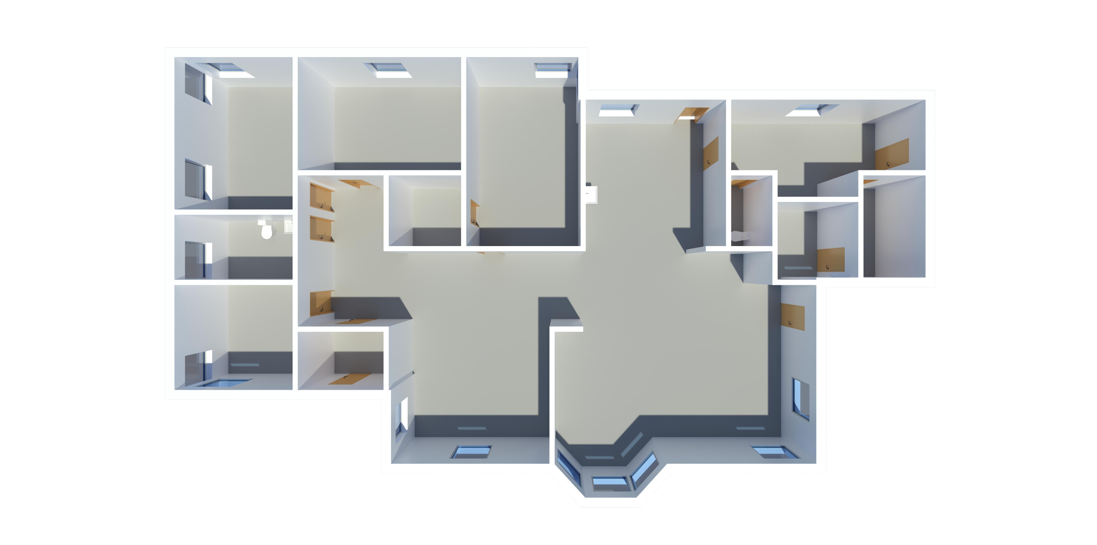
Examples

Slide 17
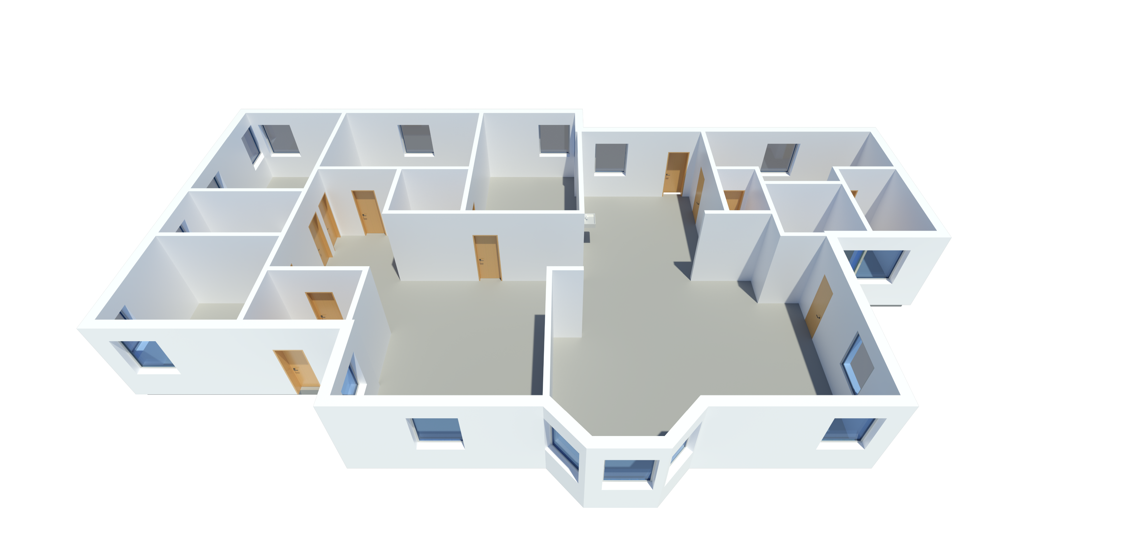
Examples

Slide 18
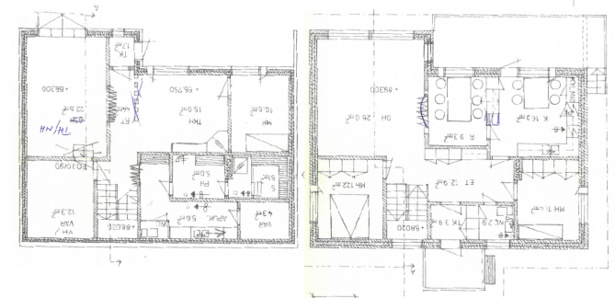
Examples

Slide 19
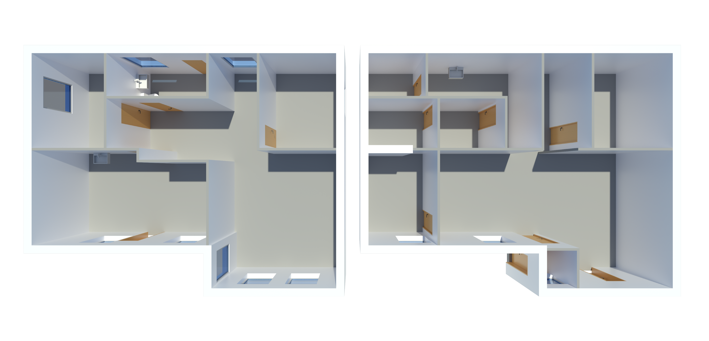
Examples

Slide 20
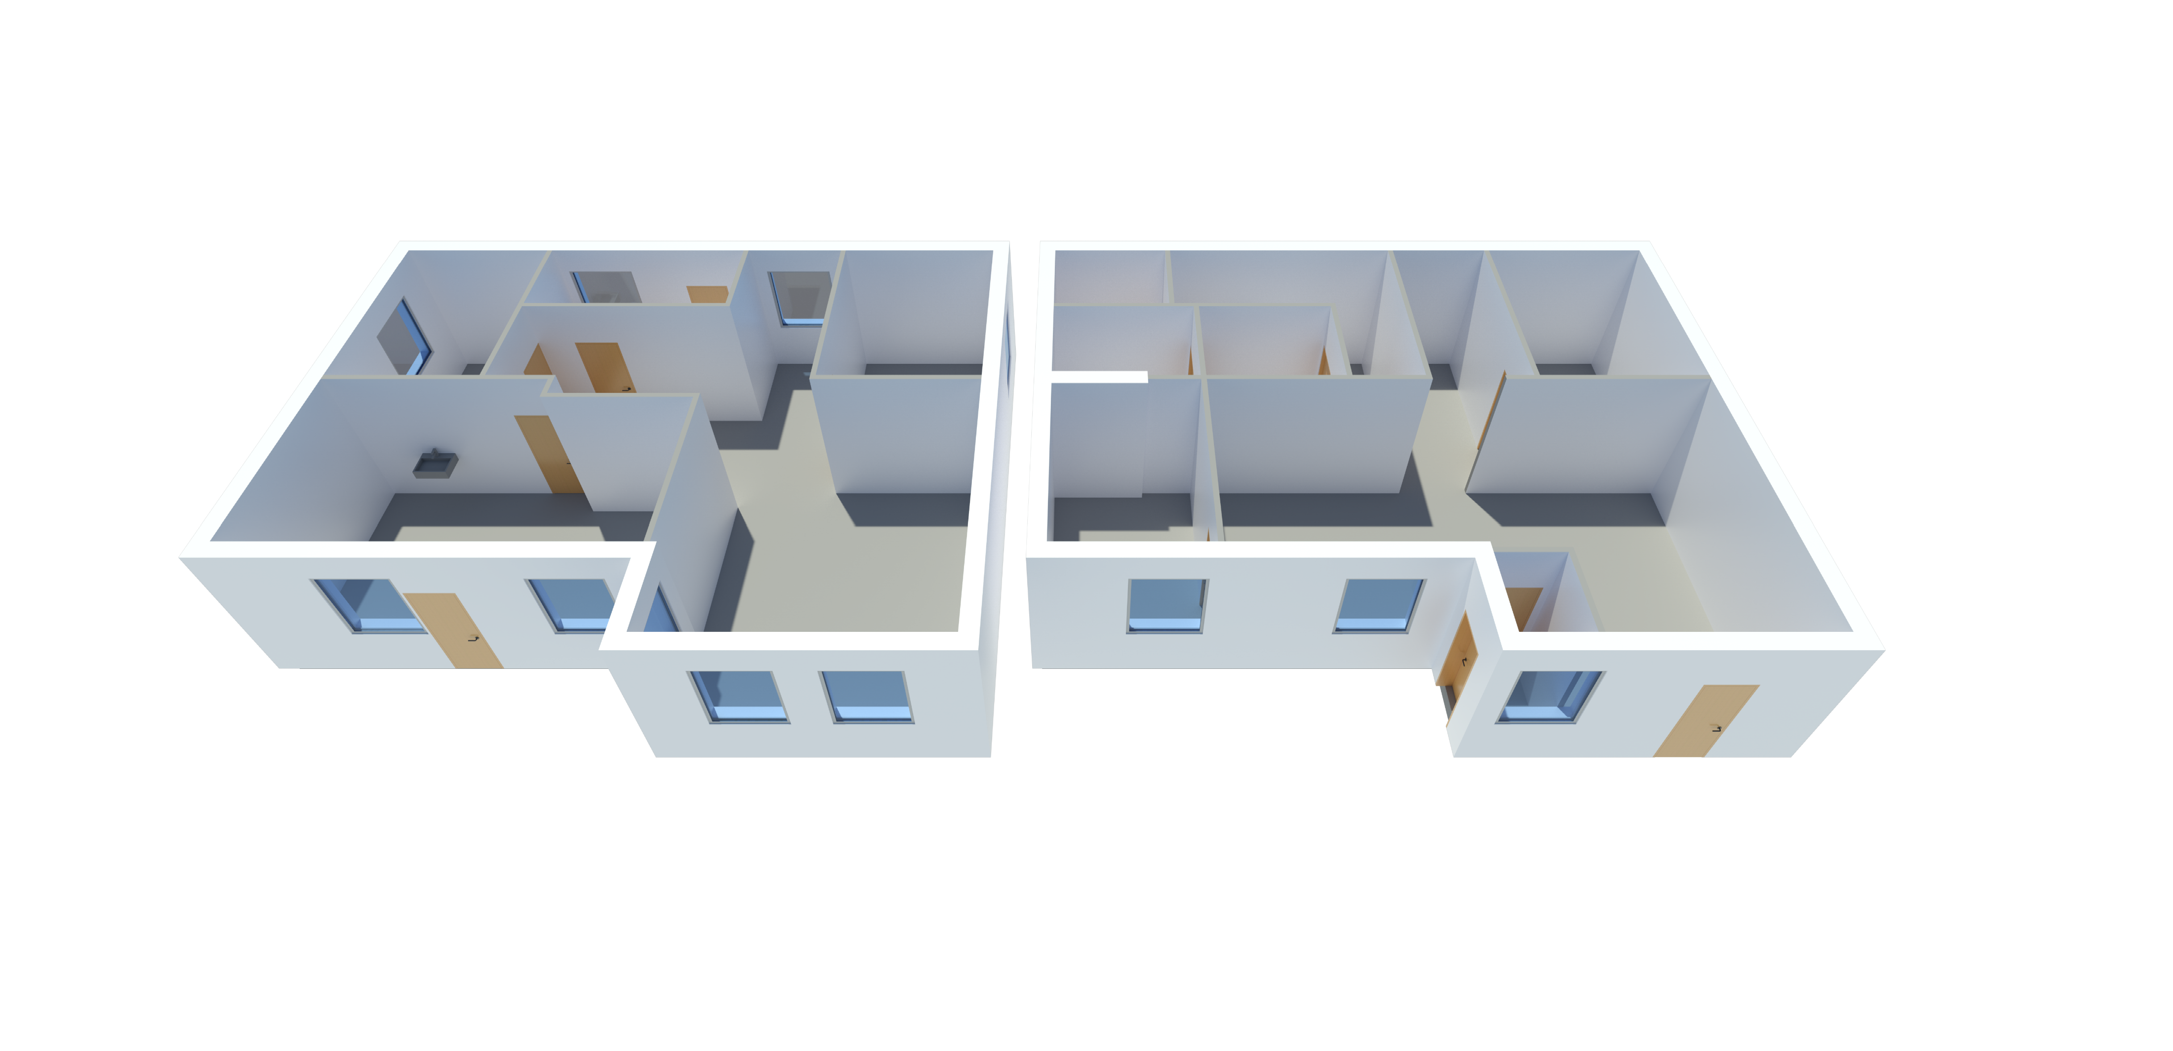
Examples

Slide 21
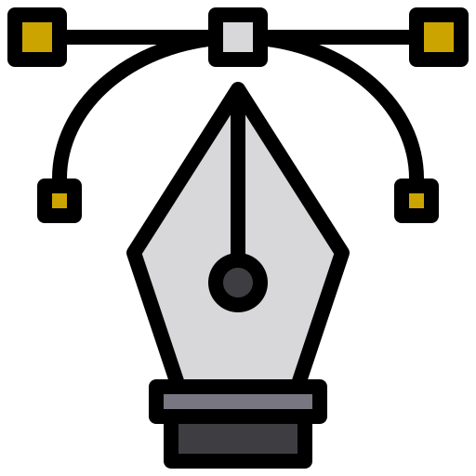


Reverse Algorithmic Design
Two-step method
Extraction
Refactoring
Explores vectorial information
Generates low-level program
Improves abstraction

Slide 22
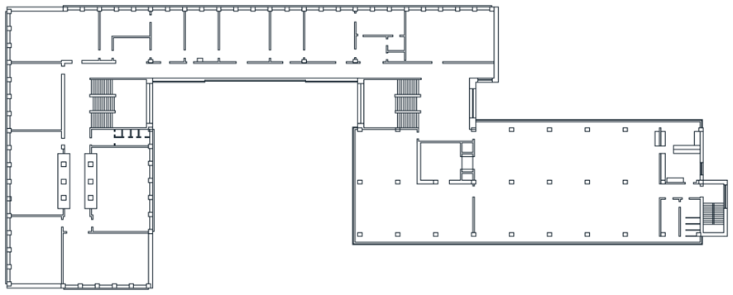
Reverse Algorithmic Design
polygon(xy(45, 7), xy(46, 7), xy(46, 6), xy(45, 6))
polygon(xy(51, 21), xy(51, 20), xy(50, 20), xy(50, 21))
polygon(xy(50, 14), xy(51, 14), xy(51, 13), xy(50, 13))
polygon(xy(50, 7), xy(51, 7), xy(51, 6), xy(50, 6))
polygon(xy(55, 7), xy(56, 7), xy(56, 6), xy(55, 6))
polygon(xy(60, 7.01), xy(61, 7), xy(61, 6), xy(60, 6))
polygon(xy(65, 21), xy(66, 21), xy(66, 20), xy(65, 20))
polygon(xy(65, 14), xy(66, 14), xy(66, 13), xy(65, 13))
polygon(xy(65, 7), xy(66, 7), xy(66, 6), xy(65, 6))
polygon(xy(70, 7), xy(71, 7), xy(71, 6), xy(70, 6))
polygon(xy(75, 21), xy(76, 21), xy(76, 20), xy(75, 20))
polygon(xy(75, 14), xy(76, 14), xy(76, 13), xy(75, 13))
polygon(xy(75, 7), xy(76, 7), xy(76, 6), xy(75, 6))
polygon(xy(80, 14), xy(81, 14), xy(81, 13), xy(80, 13))
polygon(xy(80, 7), xy(81, 7), xy(81, 6), xy(80, 6))
…

Slide 23
Reverse Algorithmic Design
polygon(xy(45, 7), xy(46, 7), xy(46, 6), xy(45, 6))
polygon(xy(51, 21), xy(51, 20), xy(50, 20), xy(50, 21))
polygon(xy(50, 14), xy(51, 14), xy(51, 13), xy(50, 13))
polygon(xy(50, 7), xy(51, 7), xy(51, 6), xy(50, 6))
polygon(xy(55, 7), xy(56, 7), xy(56, 6), xy(55, 6))
polygon(xy(60, 7.01), xy(61, 7), xy(61, 6), xy(60, 6))
polygon(xy(65, 21), xy(66, 21), xy(66, 20), xy(65, 20))
polygon(xy(65, 14), xy(66, 14), xy(66, 13), xy(65, 13))
polygon(xy(65, 7), xy(66, 7), xy(66, 6), xy(65, 6))
polygon(xy(70, 7), xy(71, 7), xy(71, 6), xy(70, 6))
polygon(xy(75, 21), xy(76, 21), xy(76, 20), xy(75, 20))
polygon(xy(75, 14), xy(76, 14), xy(76, 13), xy(75, 13))
polygon(xy(75, 7), xy(76, 7), xy(76, 6), xy(75, 6))
polygon(xy(80, 14), xy(81, 14), xy(81, 13), xy(80, 13))
polygon(xy(80, 7), xy(81, 7), xy(81, 6), xy(80, 6))
…

Slide 24
Reverse Algorithmic Design
p = xy(45, 6)
length = 1
for i ∈ 0:7
square(p+vx(5*i), length)
end

Slide 25
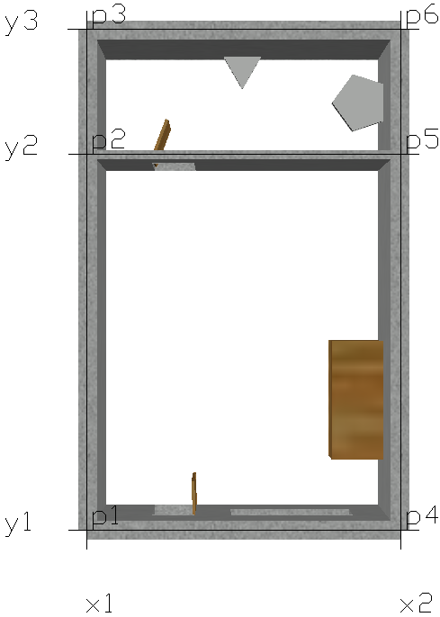
Inverse Algorithmic Design
using KhepriAutoCAD
x1 = 0
x2 = 5
y1 = 0
y2 = 6
y3 = 8
# List of points created based on X and Y values.
p1 = xy(x1, y1)
p2 = xy(x1, y2)
p3 = xy(x1, y3)
# ...
# Definition of the walls based on the created points
thickwall([p1, p2])
thickwall([p1, p4]; parts=[door(1, 0.7, rf),window(2.3, 2)])
thinwall([p2, p5]; parts=[door(1, 0.7, lf)])
# ...
sink(xy(4.5, 7), π)
toilet(xy(2.5, 7.7), 3π/2)
closet(xy(4, 1), xy(5, 3))
show_auxiliary_labels(labels_only=true)

Slide 26
Inverse Algorithmic Design
using KhepriAutoCAD
x1 = 0
x2 = 5
y1 = 0
y2 = 6
y3 = 8
# List of points created based on X and Y values.
p1 = xy(x1, y1)
p2 = xy(x1, y2)
p3 = xy(x1, y3)
# ...
# Definition of the walls based on the created points
thickwall([p1, p2])
thickwall([p1, p4]; parts=[door(1, 0.7, rf),window(2.3, 2)])
thinwall([p2, p5]; parts=[door(1, 0.7, lf)])
# ...
sink(xy(4.5, 7), π)
toilet(xy(2.5, 7.7), 3π/2)
closet(xy(4, 1), xy(5, 3))
show_auxiliary_labels(labels_only=true)

Slide 27
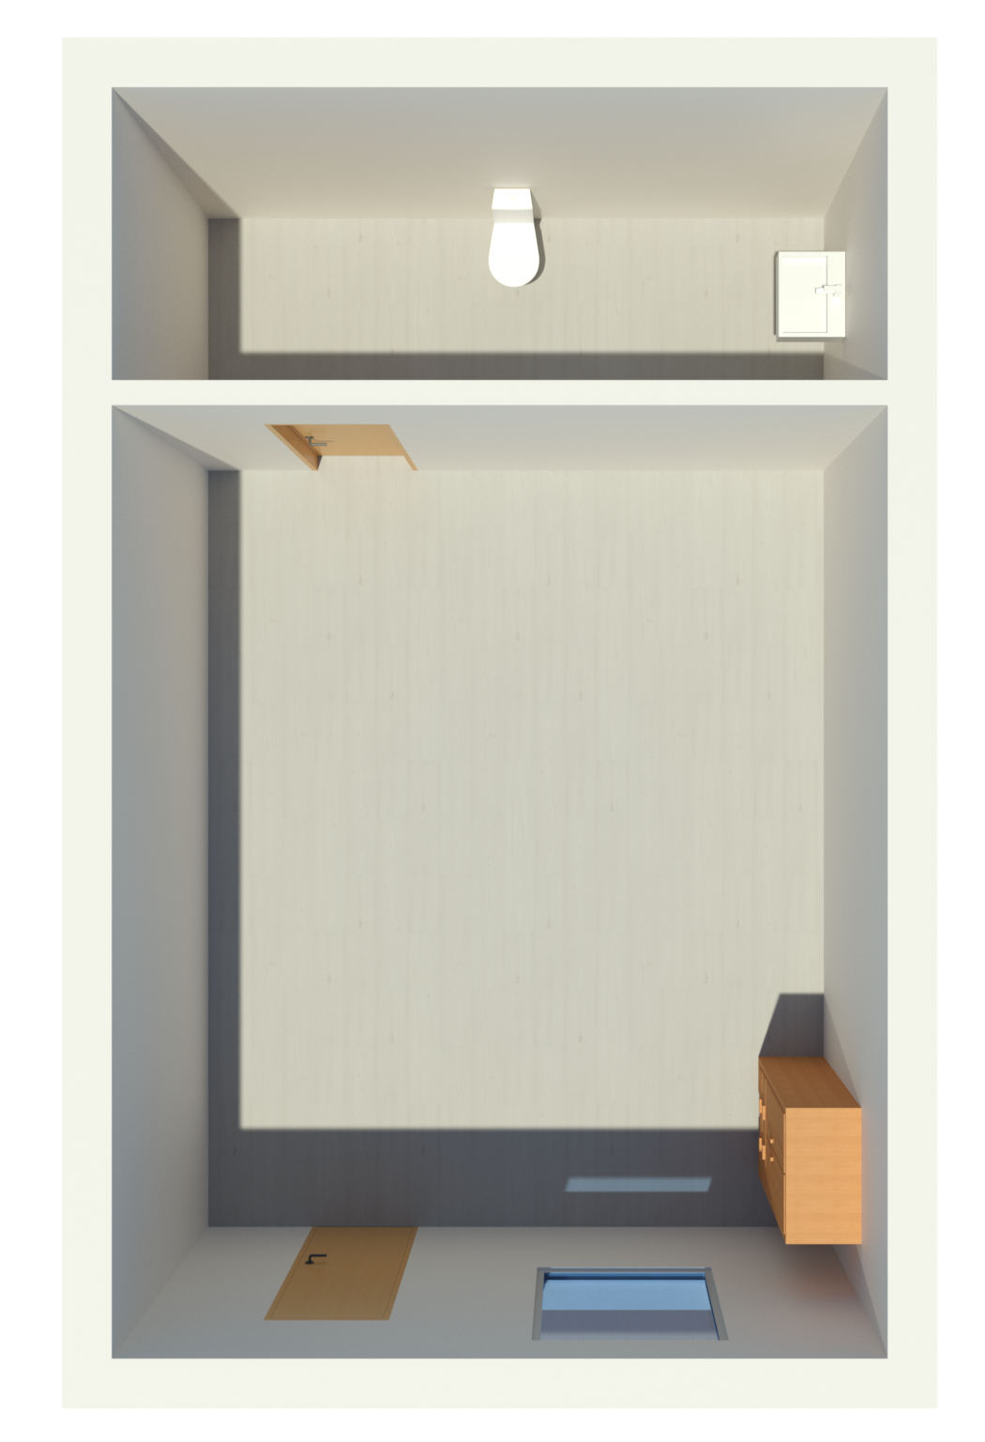
Inverse Algorithmic Design
using KhepriRevit
x1 = 0
x2 = 5
y1 = 0
y2 = 6
y3 = 8
# List of points created based on X and Y values.
p1 = xy(x1, y1)
p2 = xy(x1, y2)
p3 = xy(x1, y3)
# ...
# Definition of the walls based on the created points
thickwall([p1, p2])
thickwall([p1, p4]; parts=[door(1, 0.7, rf),window(2.3, 2)])
thinwall([p2, p5]; parts=[door(1, 0.7, lf)])
# ...
sink(xy(4.5, 7), π)
toilet(xy(2.5, 7.7), 3π/2)
closet(xy(4, 1), xy(5, 3))
show_auxiliary_labels(labels_only=false)

Slide 28


Inverse vs Reverse Algorithmic Design
Uses only raster images
Improves program readability
Adds semantics

Slide 29


Conclusions
Automatically creates an AD program
Extracts relevant floor plan elements
Generates parametric programs

Slide 30

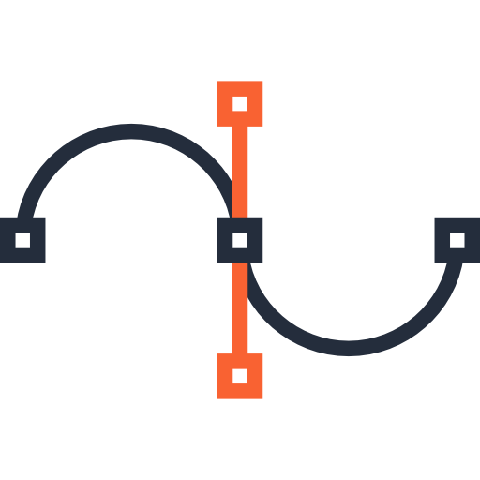
Future Work
Training with more data
Exploring vectorial information
Using Bézier curves to approximate curve walls

Slide 31
Thank You!
João David Inês Pereira Catarina Belém António Leitão

