Slide 1


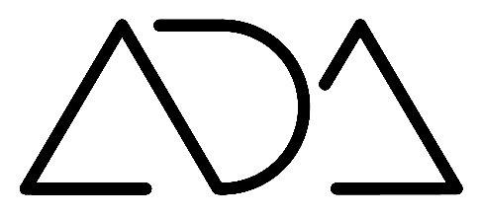

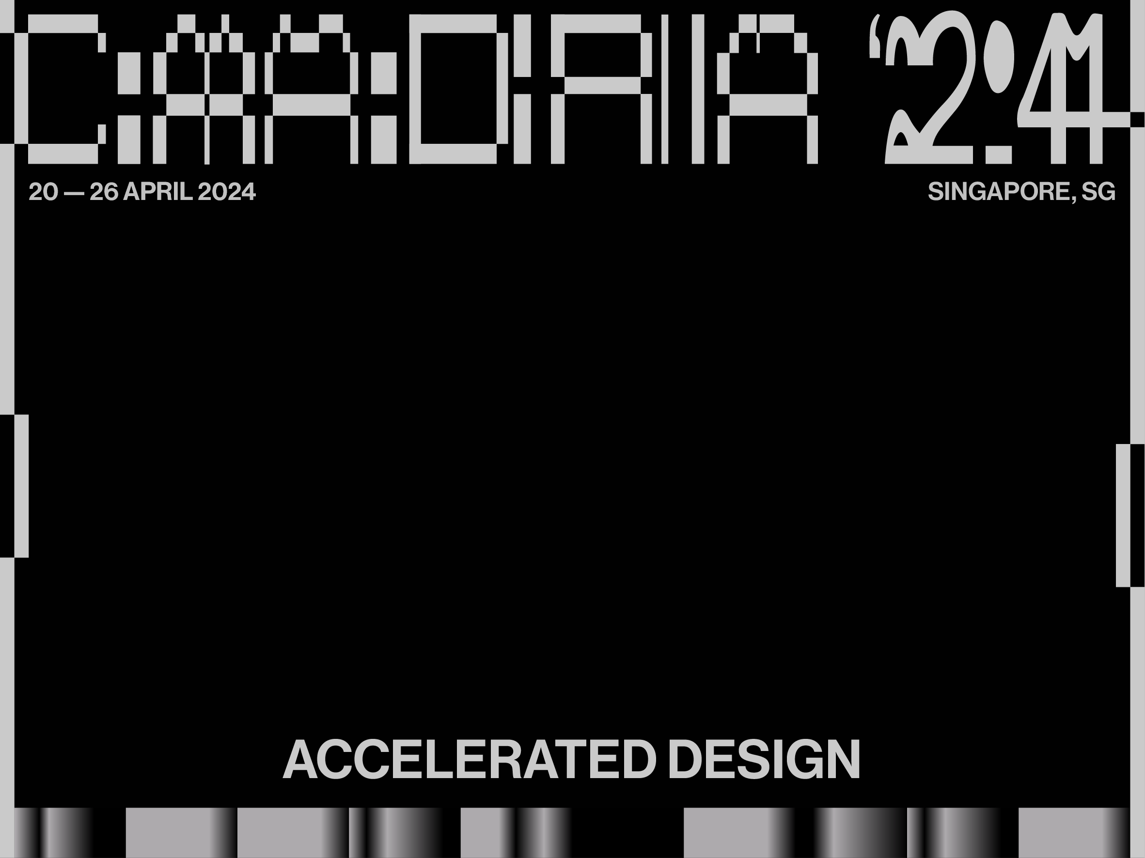
20 — 26 APRIL 2024
SINGAPORE, SG
ALGORITHMIC DESIGN
EXPLAINED
Renata Castelo-Branco
Inês Caetano
António Leitão
ACCELERATED DESIGN

Slide 2
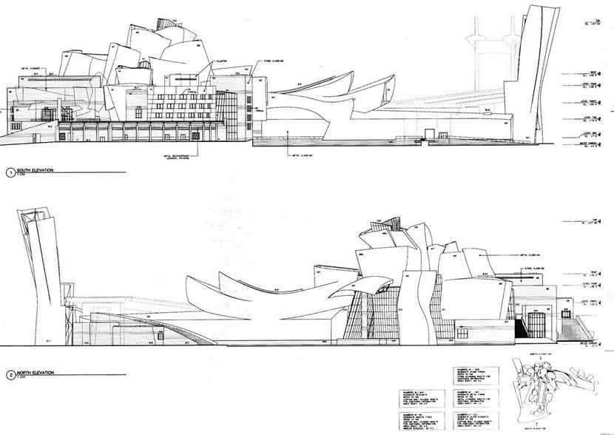



http://www.freepik.com
https://www.flaticon.com/search?word=contractor

Slide 3

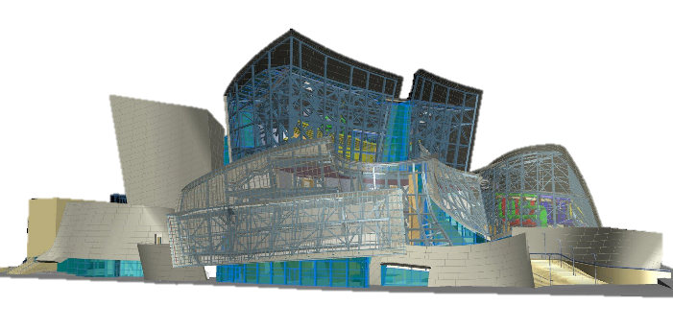

http://www.freepik.com
https://www.flaticon.com/search?word=contractor

Slide 4
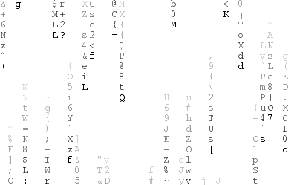
http://www.freepik.com
https://www.flaticon.com/search?word=contractor

Slide 5
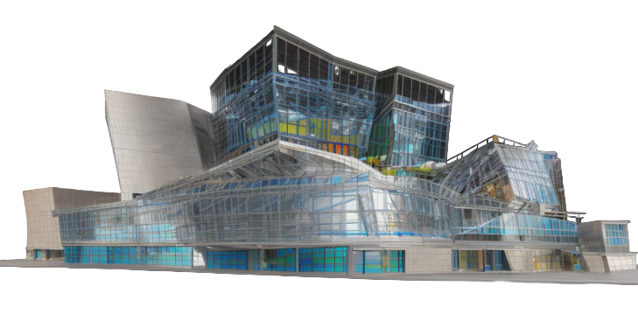
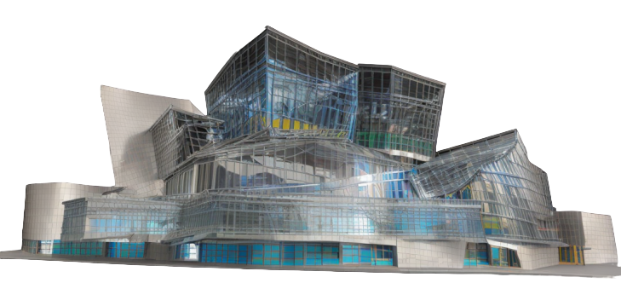
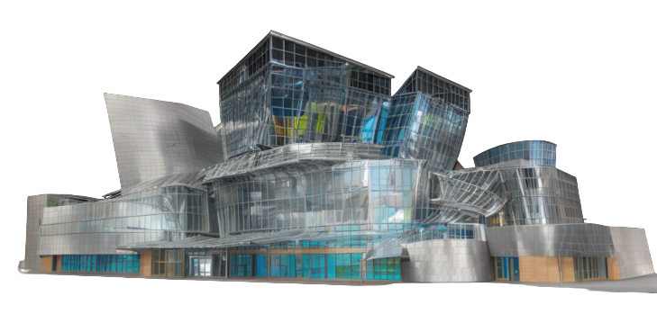
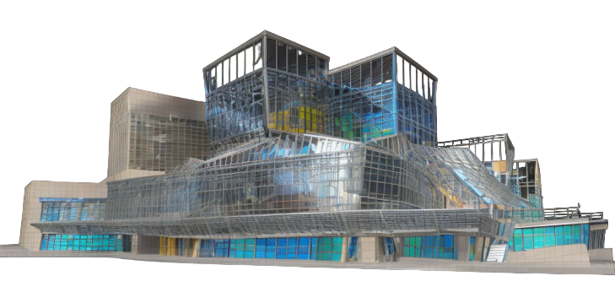

Slide 6


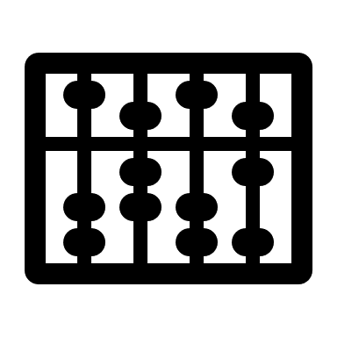





Slide 7
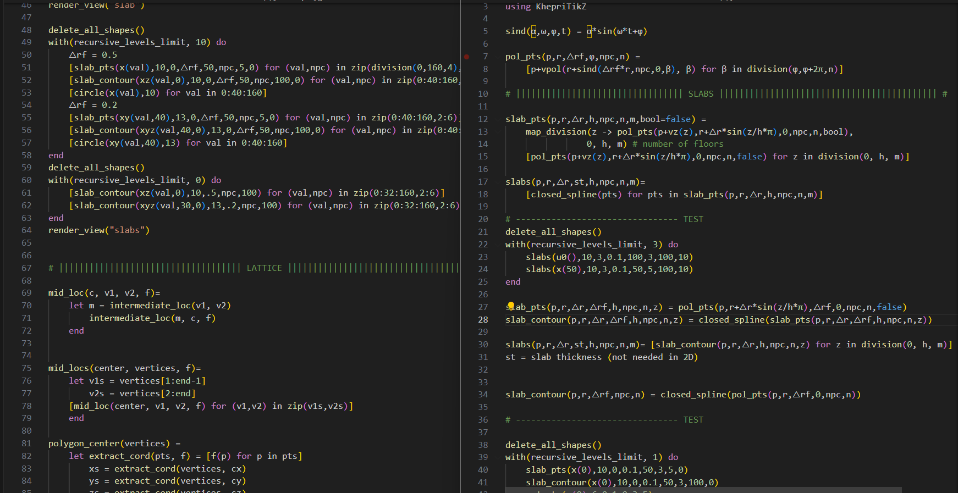

Slide 8



Slide 9
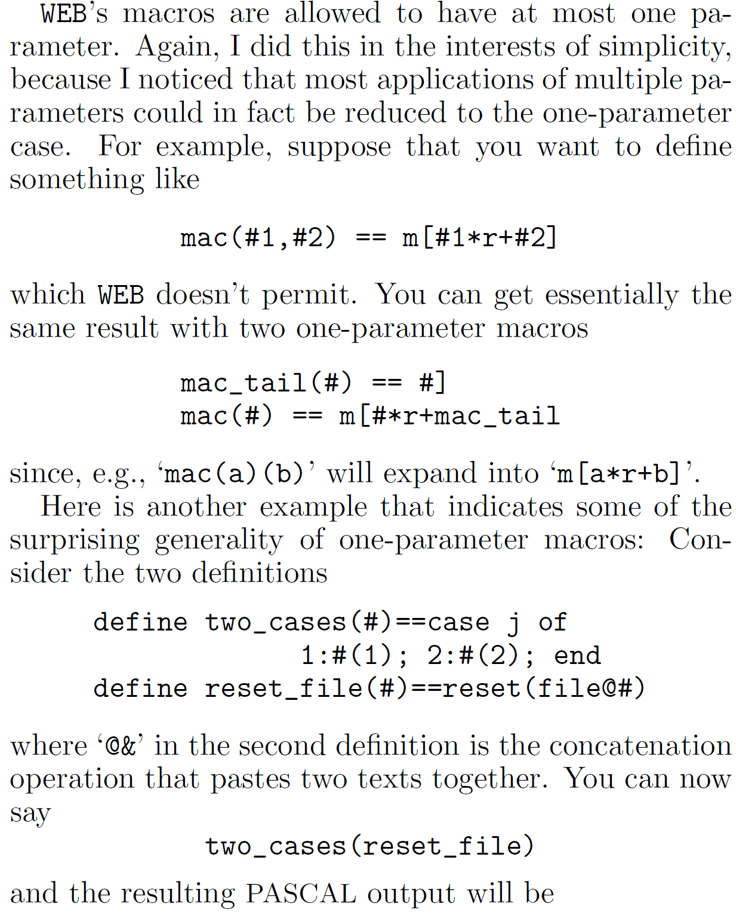
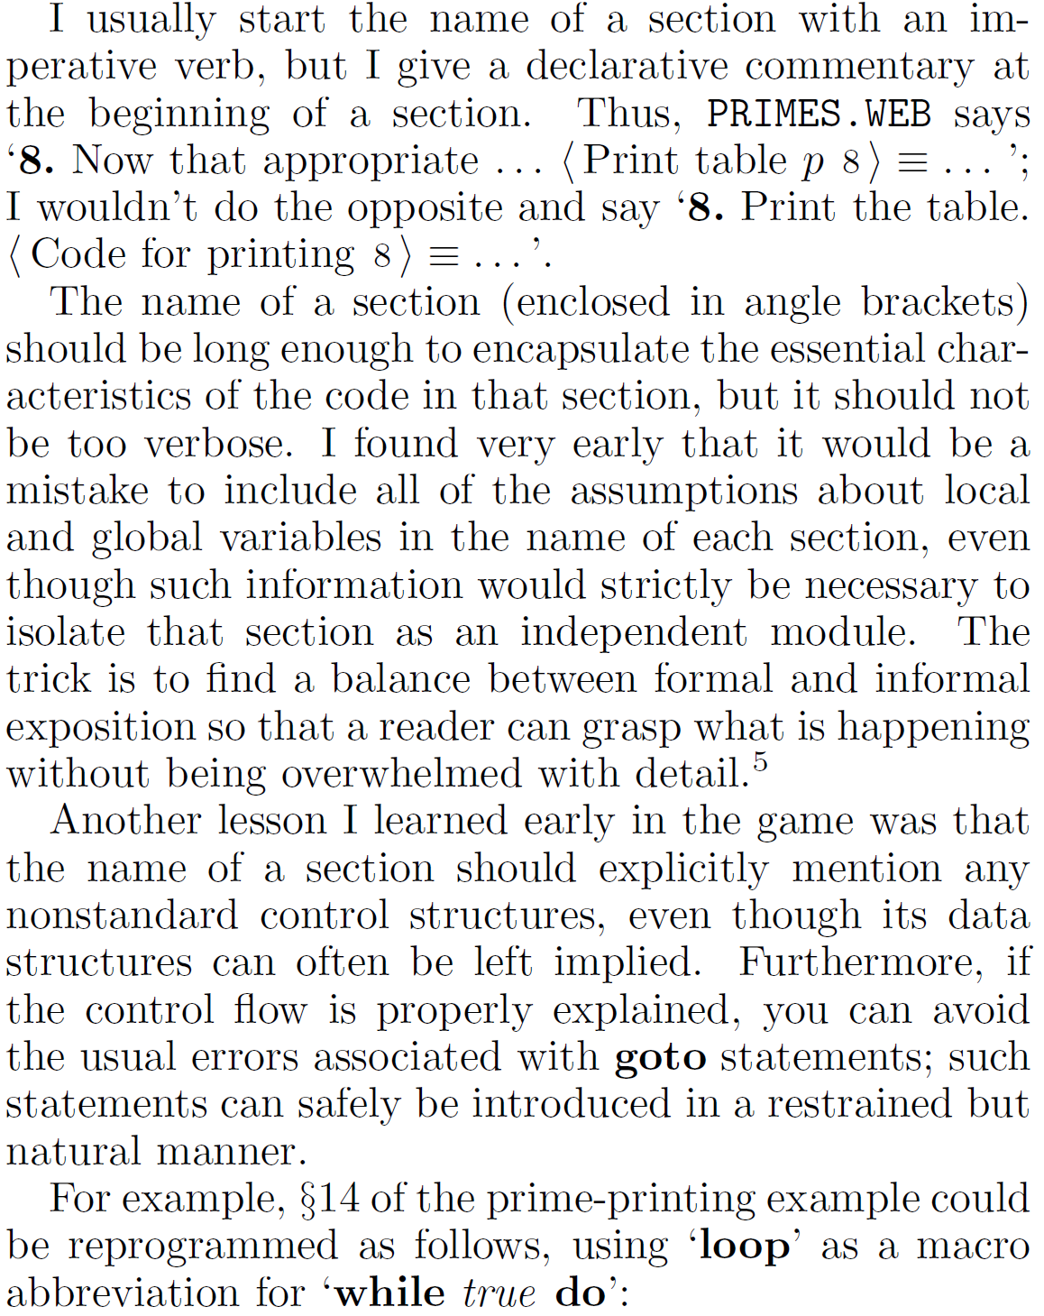
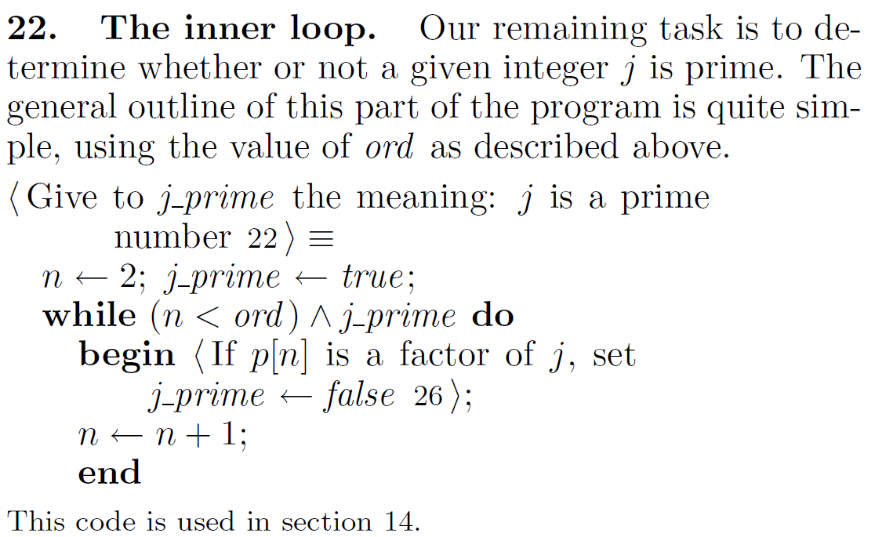
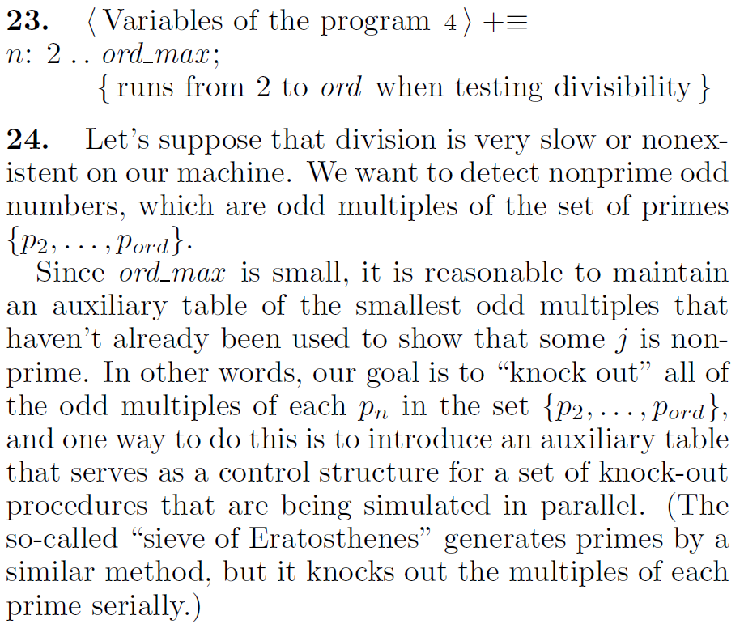
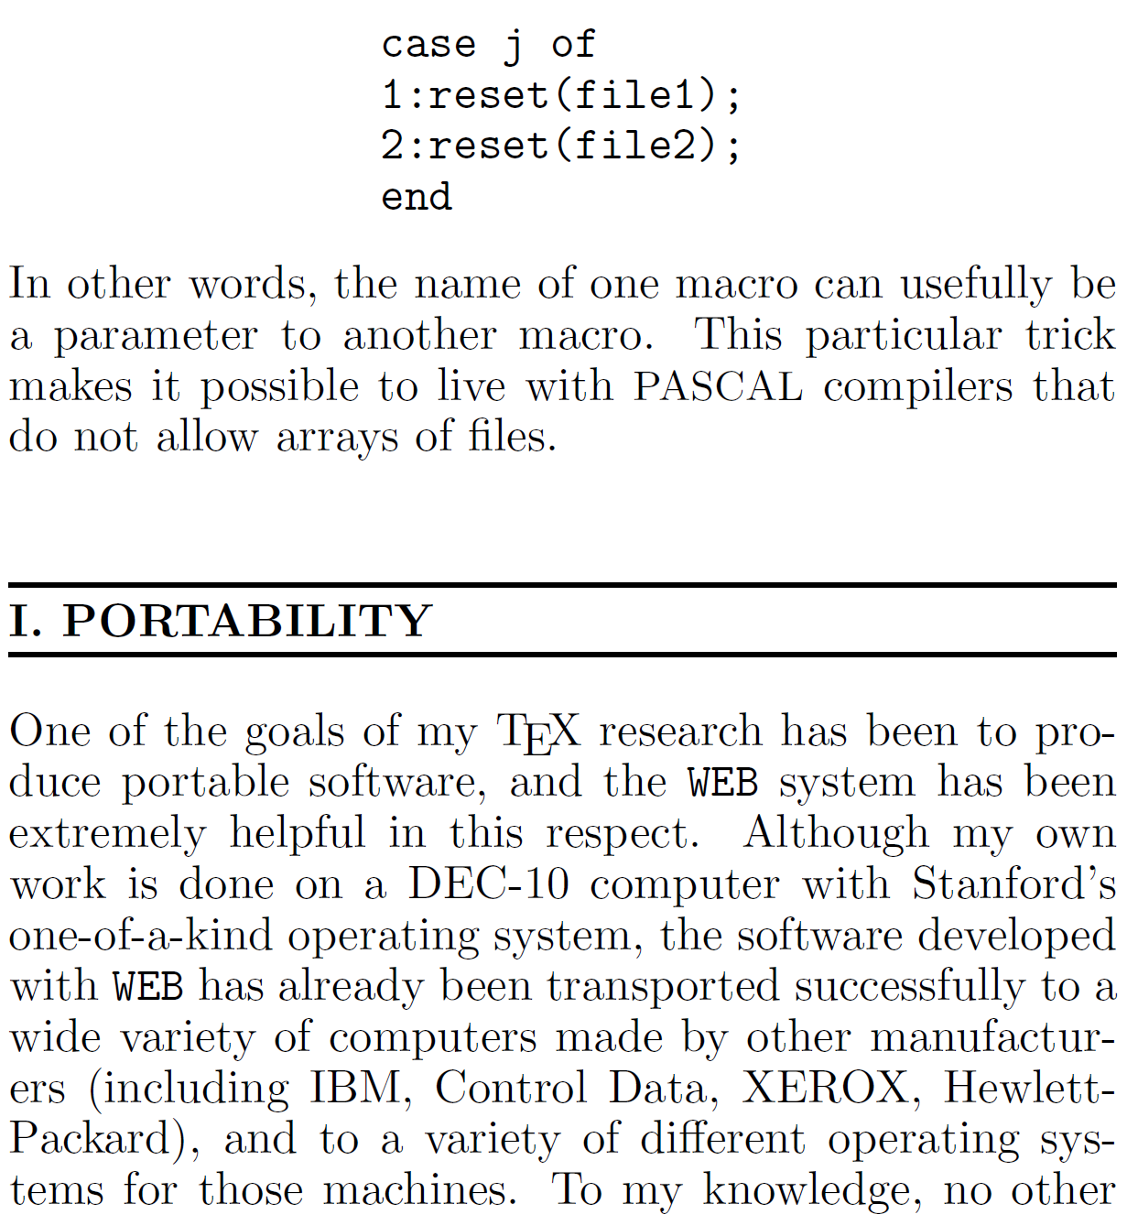
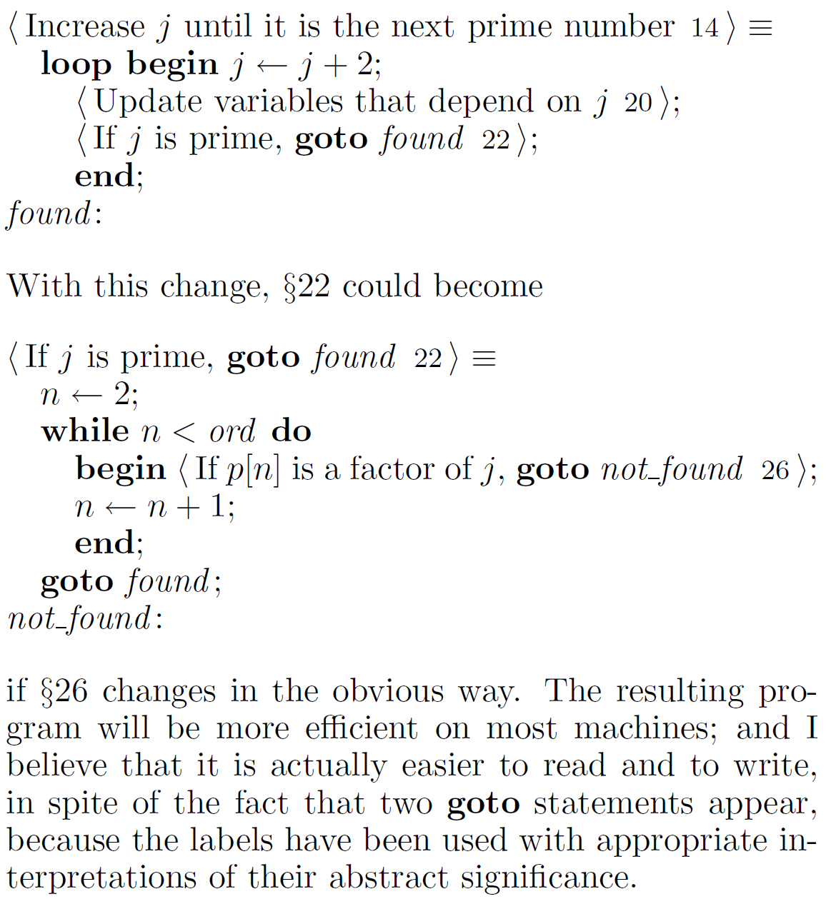
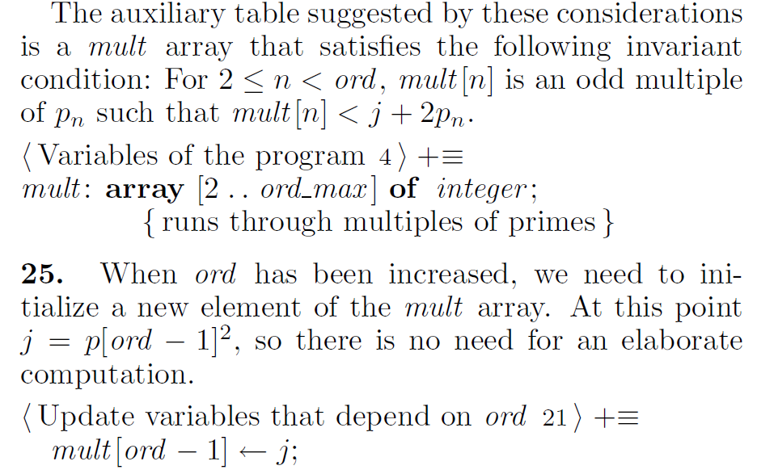
Donald E. Knuth (1984)
Literate Programming

Slide 10
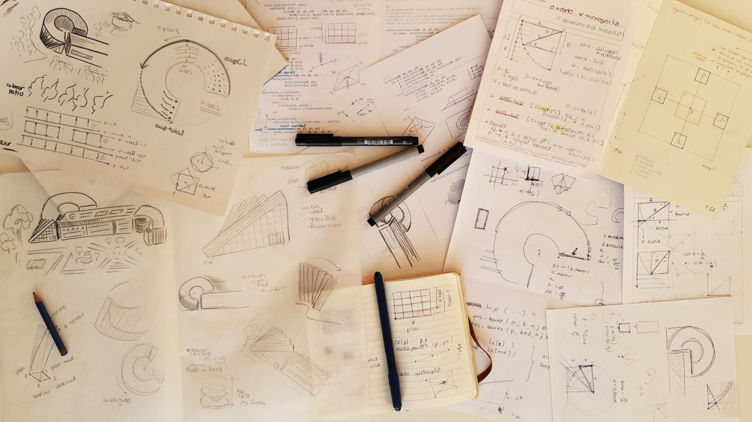

Slide 11
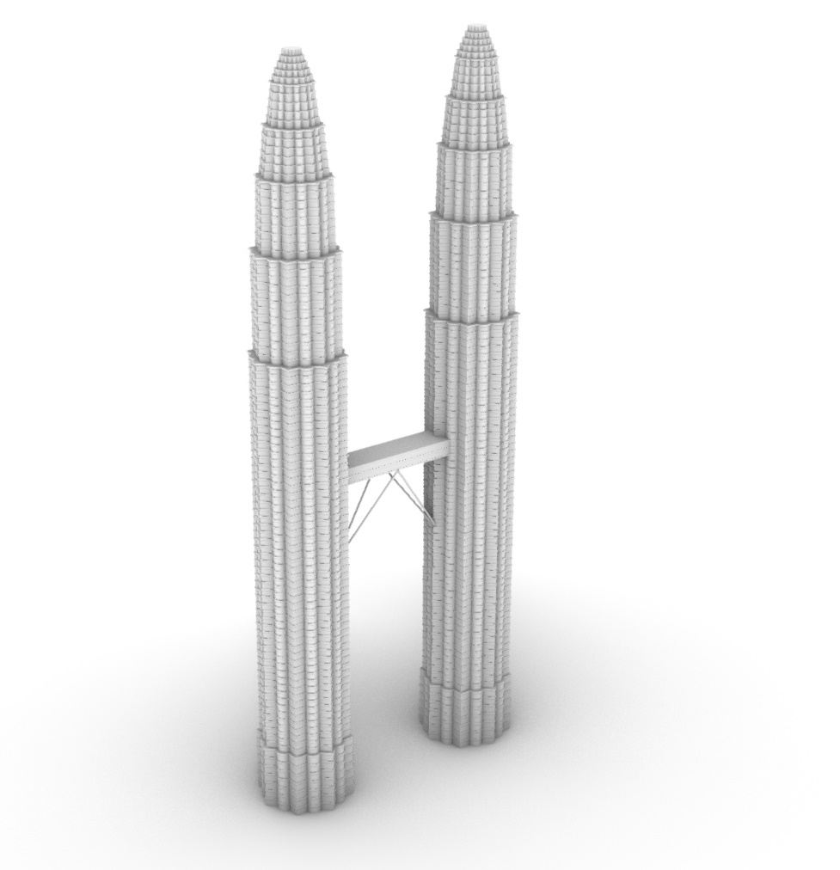
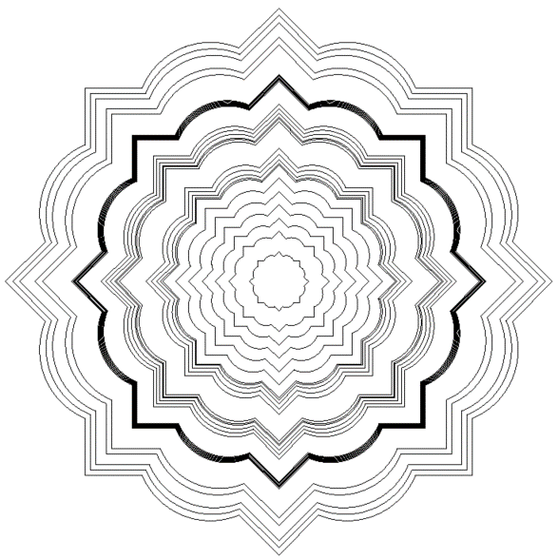
Illustrating Algorithmic Design
Castelo-Branco & Leitão (2023)

Slide 12
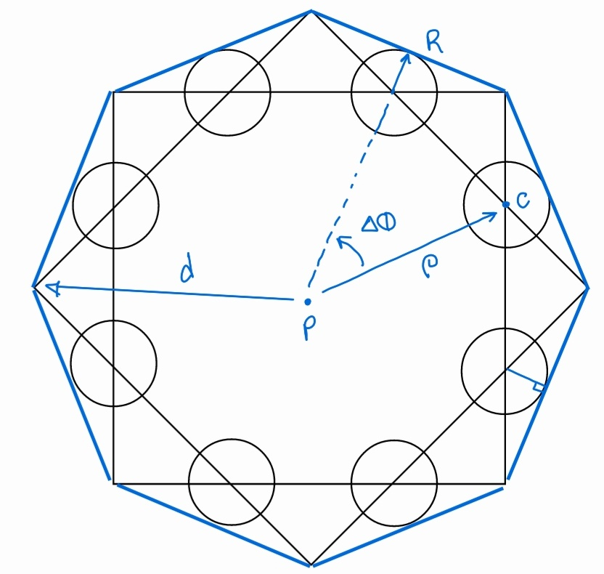
Illustrating Algorithmic Design
Castelo-Branco & Leitão (2023)
circle_union(p, ρ, ϕ, △ϕ, r, n) =
if n == 0
nothing
else
c = p + vpol(ρ, ϕ)
circle(c, r)
circle_union(p, ρ, ϕ+△ϕ, △ϕ, r, n-1)
end
petronas_base(p, l) =
let d = l/sqrt(2),
cos_a = cos(π/8),
r0 = l/(2*cos_a),
r1 = l*(cos_a/sqrt(2)-1/(2*cos_a))
regular_polygon(4, p, d, 0)
regular_polygon(4, p, d, -π/4)
circle_union(p, r0, π/8, π/4, r1, 8)
end

Slide 13
Illustrating Algorithmic Design
Castelo-Branco & Leitão (2023)
circle_union(p, ρ, ϕ, △ϕ, r, n) =
if n == 0
nothing
else
c = p + vpol(ρ, ϕ)
circle(c, r)
circle_union(p, ρ, ϕ+△ϕ, △ϕ, r, n-1)
end
petronas_base(p, l) =
let d = l/sqrt(2),
cos_a = cos(π/8),
r0 = l/(2*cos_a),
r1 = l*(cos_a/sqrt(2)-1/(2*cos_a))
regular_polygon(4, p, d, 0)
regular_polygon(4, p, d, -π/4)
circle_union(p, r0, π/8, π/4, r1, 8)
end

Slide 14
Illustrating Algorithmic Design
Castelo-Branco & Leitão (2023)
circle_union(p, ρ, ϕ, △ϕ, r, n) =
if n == 0
nothing
else
c = p + vpol(ρ, ϕ)
circle(c, r)
circle_union(p, ρ, ϕ+△ϕ, △ϕ, r, n-1)
end
petronas_base(p, l) =
let d = l/sqrt(2),
cos_a = cos(π/8),
r0 = l/(2*cos_a),
r1 = l*(cos_a/sqrt(2)-1/(2*cos_a))
regular_polygon(4, p, d, 0)
regular_polygon(4, p, d, -π/4)
circle_union(p, r0, π/8, π/4, r1, 8)
end

Slide 15
Illustrating Algorithmic Design
Castelo-Branco & Leitão (2023)
circle_union(p, ρ, ϕ, △ϕ, r, n) =
if n == 0
nothing
else
c = p + vpol(ρ, ϕ)
circle(c, r)
circle_union(p, ρ, ϕ+△ϕ, △ϕ, r, n-1)
end
petronas_base(p, l) =
let d = l/sqrt(2),
cos_a = cos(π/8),
r0 = l/(2*cos_a),
r1 = l*(cos_a/sqrt(2)-1/(2*cos_a))
regular_polygon(4, p, d, 0)
regular_polygon(4, p, d, -π/4)
circle_union(p, r0, π/8, π/4, r1, 8)
end

Slide 16
Illustrating Algorithmic Design
Castelo-Branco & Leitão (2023)
circle_union(p, ρ, ϕ, △ϕ, r, n) =
if n == 0
nothing
else
c = p + vpol(ρ, ϕ)
circle(c, r)
circle_union(p, ρ, ϕ+△ϕ, △ϕ, r, n-1)
end
petronas_base(p, l) =
let d = l/sqrt(2),
cos_a = cos(π/8),
r0 = l/(2*cos_a),
r1 = l*(cos_a/sqrt(2)-1/(2*cos_a))
regular_polygon(4, p, d, 0)
regular_polygon(4, p, d, -π/4)
circle_union(p, r0, π/8, π/4, r1, 8)
end

Slide 17
Illustrating Algorithmic Design
Castelo-Branco & Leitão (2023)
circle_union(p, ρ, ϕ, △ϕ, r, n) =
if n == 0
nothing
else
c = p + vpol(ρ, ϕ)
circle(c, r)
circle_union(p, ρ, ϕ+△ϕ, △ϕ, r, n-1)
end
petronas_base(p, l) =
let d = l/sqrt(2),
cos_a = cos(π/8),
r0 = l/(2*cos_a),
r1 = l*(cos_a/sqrt(2)-1/(2*cos_a))
regular_polygon(4, p, d, 0)
regular_polygon(4, p, d, -π/4)
circle_union(p, r0, π/8, π/4, r1, 8)
end

Slide 18
Illustrating Algorithmic Design
Castelo-Branco & Leitão (2023)
circle_union(p, ρ, ϕ, △ϕ, r, n) =
if n == 0
nothing
else
c = p + vpol(ρ, ϕ)
circle(c, r)
circle_union(p, ρ, ϕ+△ϕ, △ϕ, r, n-1)
end
petronas_base(p, l) =
let d = l/sqrt(2),
cos_a = cos(π/8),
r0 = l/(2*cos_a),
r1 = l*(cos_a/sqrt(2)-1/(2*cos_a))
regular_polygon(4, p, d, 0)
regular_polygon(4, p, d, -π/4)
circle_union(p, r0, π/8, π/4, r1, 8)
end

Slide 19
Illustrating Algorithmic Design
Castelo-Branco & Leitão (2023)
circle_union(p, ρ, ϕ, △ϕ, r, n) =
if n == 0
nothing
else
c = p + vpol(ρ, ϕ)
circle(c, r)
circle_union(p, ρ, ϕ+△ϕ, △ϕ, r, n-1)
end
petronas_base(p, l) =
let d = l/sqrt(2),
cos_a = cos(π/8),
r0 = l/(2*cos_a),
r1 = l*(cos_a/sqrt(2)-1/(2*cos_a))
regular_polygon(4, p, d, 0)
regular_polygon(4, p, d, -π/4)
circle_union(p, r0, π/8, π/4, r1, 8)
end

Slide 20
Illustrating Algorithmic Design
Castelo-Branco & Leitão (2023)
circle_union(p, ρ, ϕ, △ϕ, r, n) =
if n == 0
nothing
else
c = p + vpol(ρ, ϕ)
circle(c, r)
circle_union(p, ρ, ϕ+△ϕ, △ϕ, r, n-1)
end
petronas_base(p, l) =
let d = l/sqrt(2),
cos_a = cos(π/8),
r0 = l/(2*cos_a),
r1 = l*(cos_a/sqrt(2)-1/(2*cos_a))
regular_polygon(4, p, d, 0)
regular_polygon(4, p, d, -π/4)
circle_union(p, r0, π/8, π/4, r1, 8)
end

Slide 21
Illustrating Algorithmic Design
Castelo-Branco & Leitão (2023)
circle_union(p, ρ, ϕ, △ϕ, r, n) =
if n == 0
nothing
else
c = p + vpol(ρ, ϕ)
circle(c, r)
circle_union(p, ρ, ϕ+△ϕ, △ϕ, r, n-1)
end
petronas_base(p, l) =
let d = l/sqrt(2),
cos_a = cos(π/8),
r0 = l/(2*cos_a),
r1 = l*(cos_a/sqrt(2)-1/(2*cos_a))
regular_polygon(4, p, d, 0)
regular_polygon(4, p, d, -π/4)
circle_union(p, r0, π/8, π/4, r1, 8)
end

Slide 22
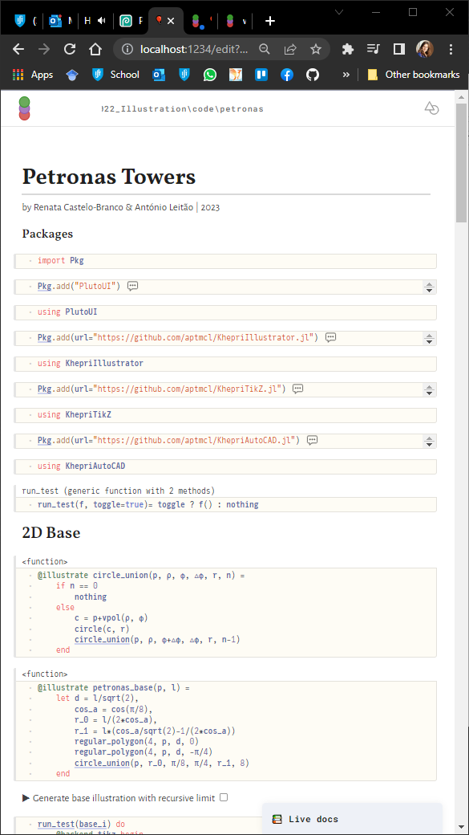

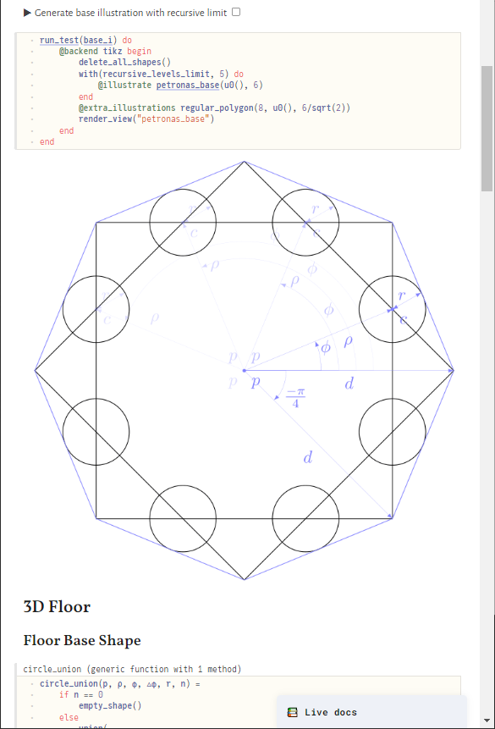
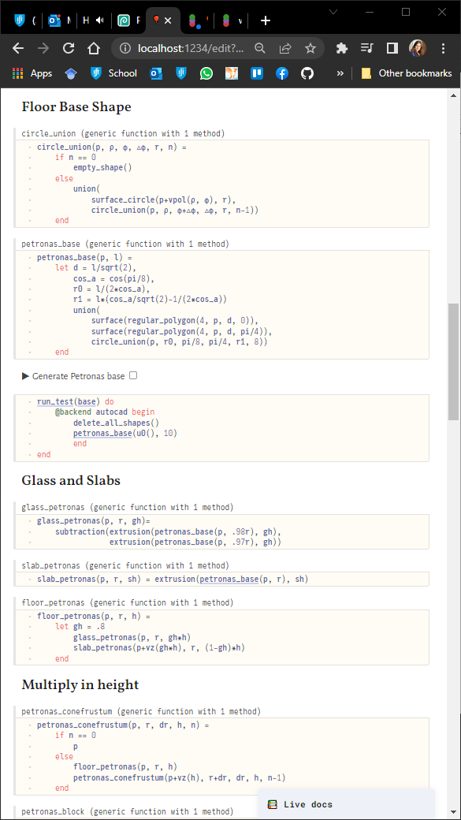
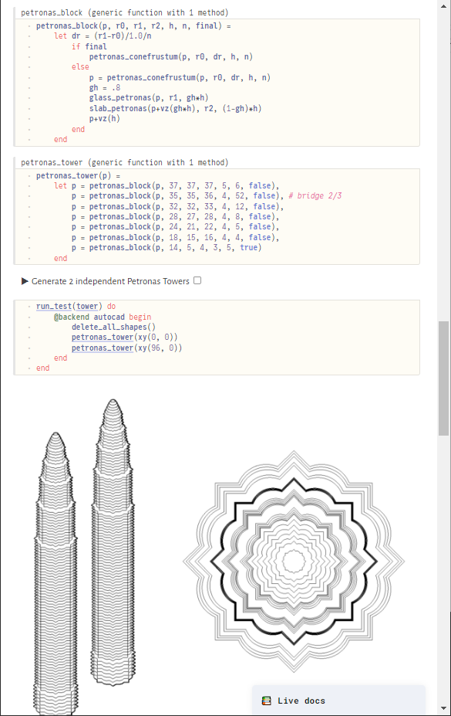
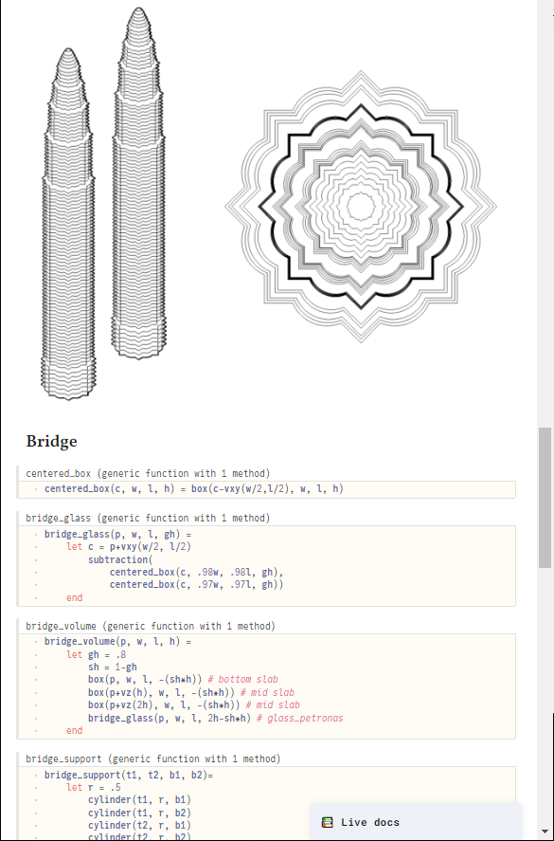
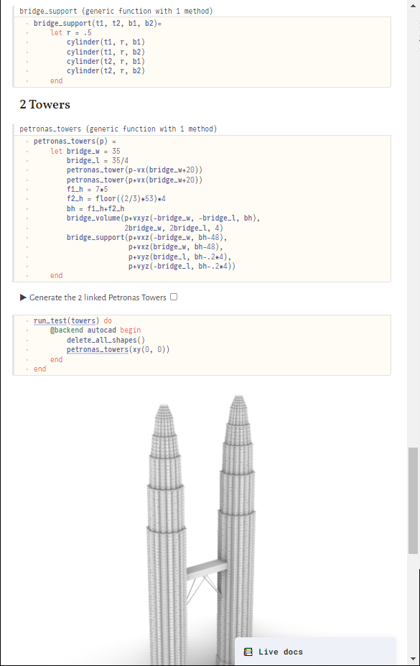
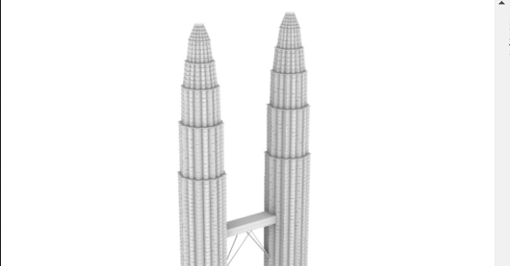
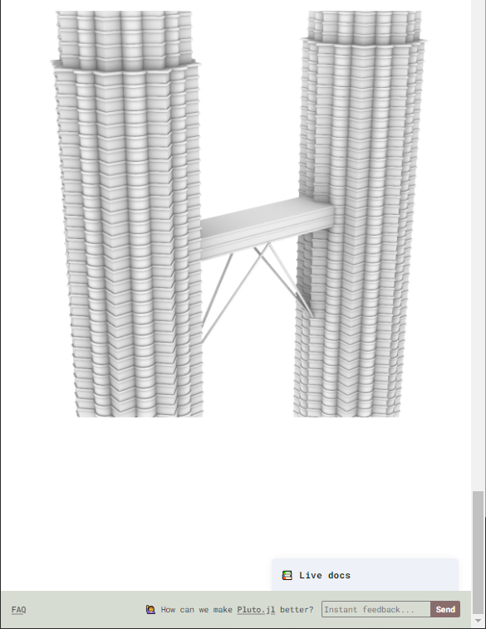

Slide 23
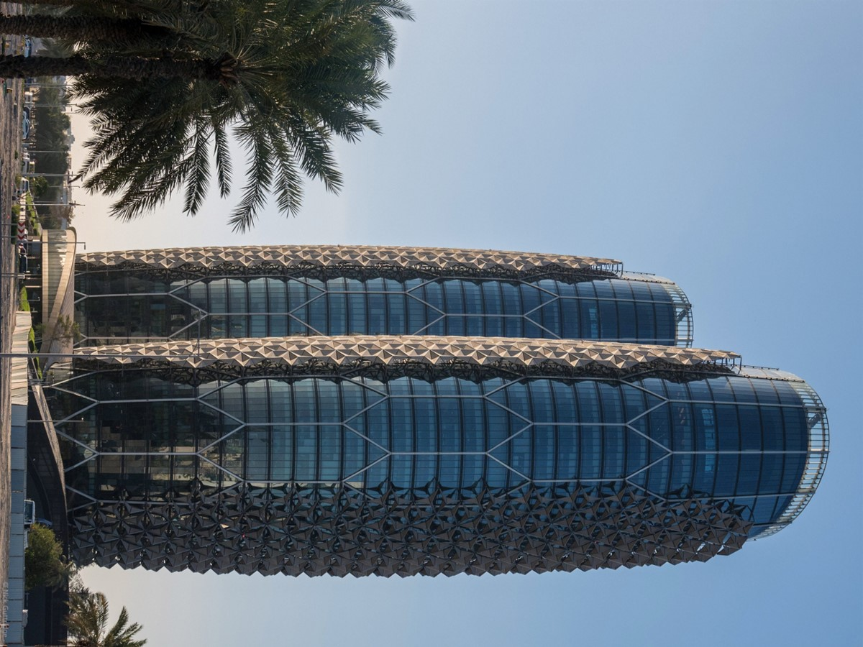
https://cdn.myportfolio.com/9c1723a8aef5f3fb9a63c76c690654b2/86da2f87-4ec3-4fad-a169-3b536e370b66_rw_1920.jpg?h=2d1ffdbf2af386aea53b4257a3080a17 ,
Al-Bahar Towers
-------
Abu Dhabi
Aedas studio

Slide 24
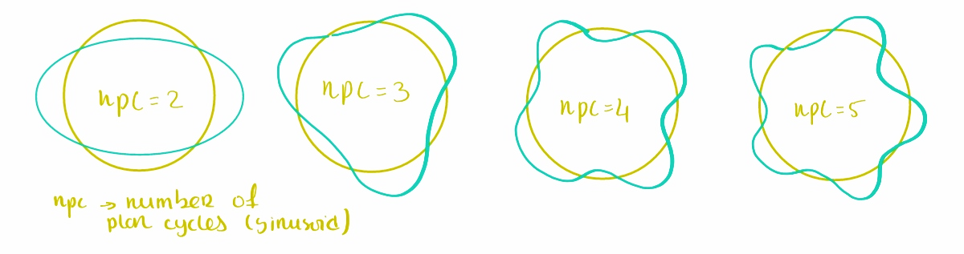
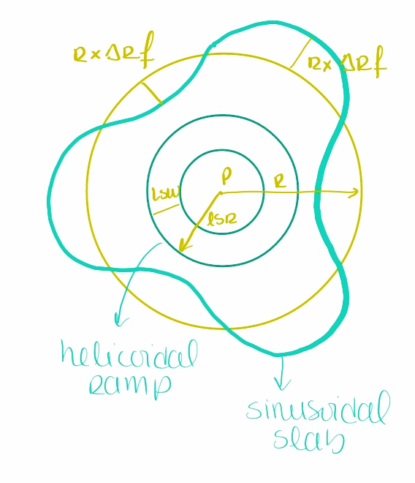
Al-Bahar Towers
Slabs
Abu Dhabi
Aedas studio

Slide 25
Al-Bahar Towers
Slabs
Abu Dhabi
Aedas studio

Slide 26
Al-Bahar Towers
Slabs
Abu Dhabi
Aedas studio

Slide 27
Al-Bahar Towers
Slabs
Abu Dhabi
Aedas studio

Slide 28
Al-Bahar Towers
Slabs
Abu Dhabi
Aedas studio

Slide 29
Al-Bahar Towers
Slabs
Abu Dhabi
Aedas studio

Slide 30
Al-Bahar Towers
Slabs
Abu Dhabi
Aedas studio
@illustrator begin
sind(α,ω,ϕ,t) = α*sin(ω*t+ϕ)
pol_pts(p,r,△rf,ϕ,npc,n) =
[p+vpol(r+sind(△rf*r,npc,0,β), β)
for β in division(ϕ,ϕ+2π,n)]
pol_pts(x(0),6,0.1,0,3,5)
end

Slide 31
Al-Bahar Towers
Slabs
Abu Dhabi
Aedas studio
@illustrator begin
sind(α,ω,ϕ,t) = α*sin(ω*t+ϕ)
pol_pts(p,r,△rf,ϕ,npc,n) =
[p+vpol(r+sind(△rf*r,npc,0,β), β)
for β in division(ϕ,ϕ+2π,n)]
pol_pts(x(0),6,0.1,0,3,5)
end

Slide 32
Al-Bahar Towers
Slabs
Abu Dhabi
Aedas studio
@illustrator begin
sind(α,ω,ϕ,t) = α*sin(ω*t+ϕ)
pol_pts(p,r,△rf,ϕ,npc,n) =
[p+vpol(r+sind(△rf*r,npc,0,β), β)
for β in division(ϕ,ϕ+2π,n)]
pol_pts(x(0),6,0.1,0,3,5)
end

Slide 33
Al-Bahar Towers
Slabs
Abu Dhabi
Aedas studio
@illustrator begin
sind(α,ω,ϕ,t) = α*sin(ω*t+ϕ)
pol_pts(p,r,△rf,ϕ,npc,n) =
[p+vpol(r+sind(△rf*r,npc,0,β), β)
for β in division(ϕ,ϕ+2π,n)]
pol_pts(x(0),6,0.1,0,3,5)
end

Slide 34
Al-Bahar Towers
Slabs
Abu Dhabi
Aedas studio
@illustrator begin
sind(α,ω,ϕ,t) = α*sin(ω*t+ϕ)
pol_pts(p,r,△rf,ϕ,npc,n) =
[p+vpol(r+sind(△rf*r,npc,0,β), β)
for β in division(ϕ,ϕ+2π,n)]
pol_pts(x(0),6,0.1,0,3,5)
end

Slide 35
Al-Bahar Towers
Slabs
Abu Dhabi
Aedas studio
@illustrator begin
sind(α,ω,ϕ,t) = α*sin(ω*t+ϕ)
pol_pts(p,r,△rf,ϕ,npc,n) =
[p+vpol(r+sind(△rf*r,npc,0,β), β)
for β in division(ϕ,ϕ+2π,n)]
pol_pts(x(0),6,0.1,0,3,5)
end

Slide 36
Al-Bahar Towers
Slabs
Abu Dhabi
Aedas studio
@illustrator begin
sind(α,ω,ϕ,t) = α*sin(ω*t+ϕ)
pol_pts(p,r,△rf,ϕ,npc,n) =
[p+vpol(r+sind(△rf*r,npc,0,β), β)
for β in division(ϕ,ϕ+2π,n)]
pol_pts(x(0),6,0.1,0,3,5)
end

Slide 37
Al-Bahar Towers
Slabs
Abu Dhabi
Aedas studio
@illustrator begin
sind(α,ω,ϕ,t) = α*sin(ω*t+ϕ)
pol_pts(p,r,△rf,ϕ,npc,n) =
[p+vpol(r+sind(△rf*r,npc,0,β), β)
for β in division(ϕ,ϕ+2π,n)]
pol_pts(x(0),6,0.1,0,3,5)
end

Slide 38
Al-Bahar Towers
Slabs
Abu Dhabi
Aedas studio
@illustrator begin
sind(α,ω,ϕ,t) = α*sin(ω*t+ϕ)
pol_pts(p,r,△rf,ϕ,npc,n) =
[p+vpol(r+sind(△rf*r,npc,0,β), β)
for β in division(ϕ,ϕ+2π,n)]
pol_pts(x(0),6,0.1,0,3,5)
end

Slide 39
Al-Bahar Towers
Slabs
Abu Dhabi
Aedas studio
@illustrator begin
sind(α,ω,ϕ,t) = α*sin(ω*t+ϕ)
pol_pts(p,r,△rf,ϕ,npc,n) =
[p+vpol(r+sind(△rf*r,npc,0,β), β)
for β in division(ϕ,ϕ+2π,n)]
pol_pts(x(0),6,0.1,0,3,5)
end
@illustrator_plus circle(x(0),6)

Slide 40
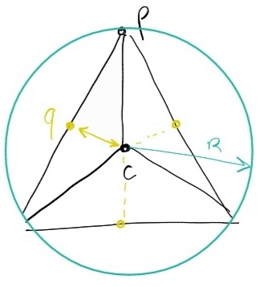
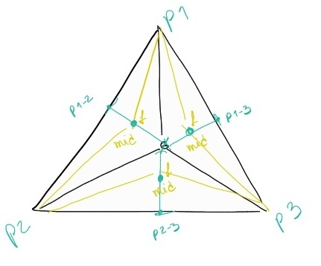
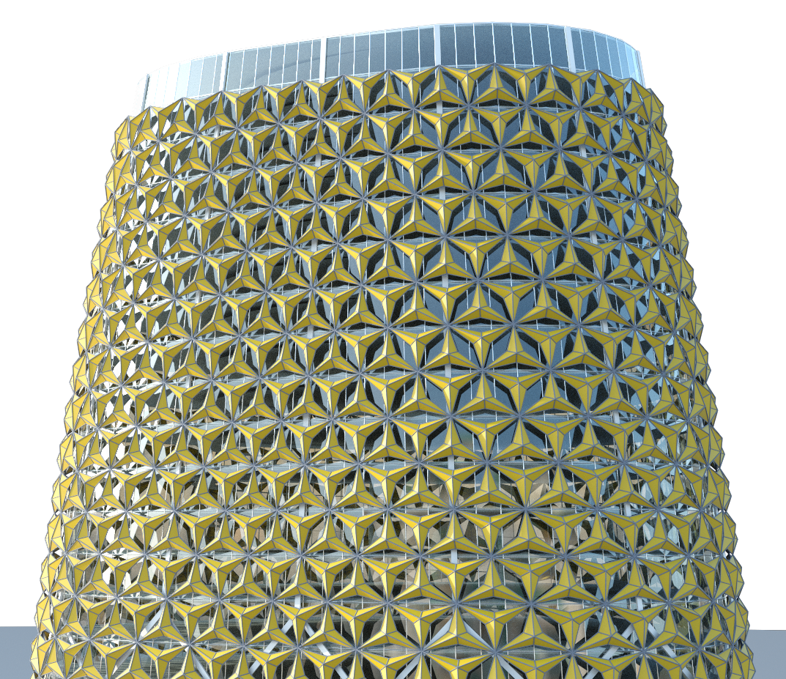
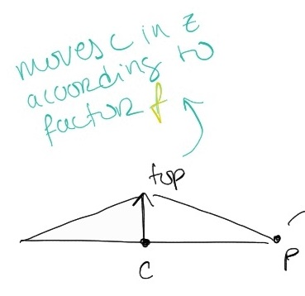
Al-Bahar Towers
Façade Lattices
Abu Dhabi
Aedas studio

Slide 41
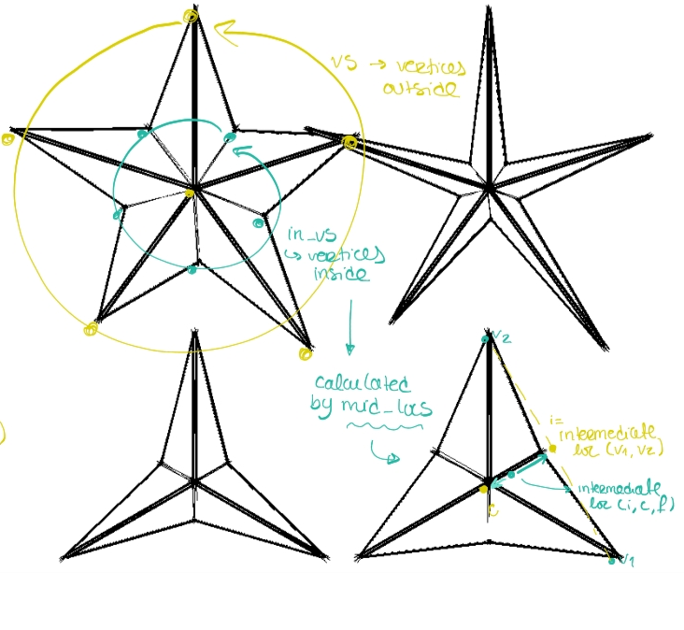
Al-Bahar Towers
Façade Lattices
Abu Dhabi
Aedas studio

Slide 42
Al-Bahar Towers
Façade Lattices
Abu Dhabi
Aedas studio

Slide 43
Al-Bahar Towers
Façade Lattices
Abu Dhabi
Aedas studio

Slide 44
Al-Bahar Towers
Façade Lattices
Abu Dhabi
Aedas studio

Slide 45
Al-Bahar Towers
Façade Lattices
Abu Dhabi
Aedas studio

Slide 46
Al-Bahar Towers
Façade Lattices
Abu Dhabi
Aedas studio
@illustrator begin
mid_loc(c, v1, v2, f)=
let m = intermediate_loc(v1, v2)
intermediate_loc(m, c, f)
end
mid_locs(center, vertices, f)=
let v1s = vertices[1:end-1]
v2s = vertices[2:end]
[mid_loc(center, v1, v2, f)
for (v1,v2) in zip(v1s,v2s)]
end
lattice(vs, f) =
let c = polygon_center(vs)
in_vs = mid_locs(c, vs, f)
[polygon(c, out, in) for (out,in) in zip(vs, in_vs)]
[polygon(c, in, out) for (in,out) in zip(in_vs, [vs[2:end]...,vs[1]])]
end
end

Slide 47
Al-Bahar Towers
Façade Lattices
Abu Dhabi
Aedas studio
@illustrator begin
mid_loc(c, v1, v2, f)=
let m = intermediate_loc(v1, v2)
intermediate_loc(m, c, f)
end
mid_locs(center, vertices, f)=
let v1s = vertices[1:end-1]
v2s = vertices[2:end]
[mid_loc(center, v1, v2, f)
for (v1,v2) in zip(v1s,v2s)]
end
lattice(vs, f) =
let c = polygon_center(vs)
in_vs = mid_locs(c, vs, f)
[polygon(c, out, in) for (out,in) in zip(vs, in_vs)]
[polygon(c, in, out) for (in,out) in zip(in_vs, [vs[2:end]...,vs[1]])]
end
end

Slide 48
Al-Bahar Towers
Façade Lattices
Abu Dhabi
Aedas studio
@illustrator begin
mid_loc(c, v1, v2, f)=
let m = intermediate_loc(v1, v2)
intermediate_loc(m, c, f)
end
mid_locs(center, vertices, f)=
let v1s = vertices[1:end-1]
v2s = vertices[2:end]
[mid_loc(center, v1, v2, f)
for (v1,v2) in zip(v1s,v2s)]
end
lattice(vs, f) =
let c = polygon_center(vs)
in_vs = mid_locs(c, vs, f)
[polygon(c, out, in) for (out,in) in zip(vs, in_vs)]
[polygon(c, in, out) for (in,out) in zip(in_vs, [vs[2:end]...,vs[1]])]
end
end

Slide 49
Al-Bahar Towers
Façade Lattices
v
Abu Dhabi
Aedas studio
1
v
2
@illustrator begin
mid_loc(c, v1, v2, f)=
let m = intermediate_loc(v1, v2)
intermediate_loc(m, c, f)
end
mid_locs(center, vertices, f)=
let v1s = vertices[1:end-1]
v2s = vertices[2:end]
[mid_loc(center, v1, v2, f)
for (v1,v2) in zip(v1s,v2s)]
end
lattice(vs, f) =
let c = polygon_center(vs)
in_vs = mid_locs(c, vs, f)
[polygon(c, out, in) for (out,in) in zip(vs, in_vs)]
[polygon(c, in, out) for (in,out) in zip(in_vs, [vs[2:end]...,vs[1]])]
end
end
v
2
v
1
v
1
v
2

Slide 50
Al-Bahar Towers
Façade Lattices
v
Abu Dhabi
Aedas studio
1
v
2
@illustrator begin
mid_loc(c, v1, v2, f)=
let m = intermediate_loc(v1, v2)
intermediate_loc(m, c, f)
end
mid_locs(center, vertices, f)=
let v1s = vertices[1:end-1]
v2s = vertices[2:end]
[mid_loc(center, v1, v2, f)
for (v1,v2) in zip(v1s,v2s)]
end
lattice(vs, f) =
let c = polygon_center(vs)
in_vs = mid_locs(c, vs, f)
[polygon(c, out, in) for (out,in) in zip(vs, in_vs)]
[polygon(c, in, out) for (in,out) in zip(in_vs, [vs[2:end]...,vs[1]])]
end
end
m
v
2
v
m
1
m
v
1
v
2

Slide 51
Al-Bahar Towers
Façade Lattices
v
Abu Dhabi
Aedas studio
1
v
2
@illustrator begin
mid_loc(c, v1, v2, f)=
let m = intermediate_loc(v1, v2)
intermediate_loc(m, c, f)
end
mid_locs(center, vertices, f)=
let v1s = vertices[1:end-1]
v2s = vertices[2:end]
[mid_loc(center, v1, v2, f)
for (v1,v2) in zip(v1s,v2s)]
end
lattice(vs, f) =
let c = polygon_center(vs)
in_vs = mid_locs(c, vs, f)
[polygon(c, out, in) for (out,in) in zip(vs, in_vs)]
[polygon(c, in, out) for (in,out) in zip(in_vs, [vs[2:end]...,vs[1]])]
end
end
m
v
2
v
c
m
1
m
v
1
v
2

Slide 52
Al-Bahar Towers
Façade Lattices
v
Abu Dhabi
Aedas studio
1
v
2
@illustrator begin
mid_loc(c, v1, v2, f)=
let m = intermediate_loc(v1, v2)
intermediate_loc(m, c, f)
end
mid_locs(center, vertices, f)=
let v1s = vertices[1:end-1]
v2s = vertices[2:end]
[mid_loc(center, v1, v2, f)
for (v1,v2) in zip(v1s,v2s)]
end
lattice(vs, f) =
let c = polygon_center(vs)
in_vs = mid_locs(c, vs, f)
[polygon(c, out, in) for (out,in) in zip(vs, in_vs)]
[polygon(c, in, out) for (in,out) in zip(in_vs, [vs[2:end]...,vs[1]])]
end
end
m
f
=
0
.
6
f
=
0
.
v
6
2
v
c
m
1
f
=
0
.
6
m
v
1
v
2

Slide 53
Al-Bahar Towers
Façade Lattices
v
1
v
v
2
Abu Dhabi
Aedas studio
1
v
2
@illustrator begin
mid_loc(c, v1, v2, f)=
let m = intermediate_loc(v1, v2)
intermediate_loc(m, c, f)
end
mid_locs(center, vertices, f)=
let v1s = vertices[1:end-1]
v2s = vertices[2:end]
[mid_loc(center, v1, v2, f)
for (v1,v2) in zip(v1s,v2s)]
end
lattice(vs, f) =
let c = polygon_center(vs)
in_vs = mid_locs(c, vs, f)
[polygon(c, out, in) for (out,in) in zip(vs, in_vs)]
[polygon(c, in, out) for (in,out) in zip(in_vs, [vs[2:end]...,vs[1]])]
end
end
m
f
=
0
.
6
v
2
f
=
0
.
v
6
v
1
2
v
c
m
1
f
=
0
.
6
m
v
1
v
v
2
1
v
2

Slide 54
Al-Bahar Towers
Façade Lattices
v
1
v
v
2
Abu Dhabi
Aedas studio
1
v
2
@illustrator begin
mid_loc(c, v1, v2, f)=
let m = intermediate_loc(v1, v2)
intermediate_loc(m, c, f)
end
mid_locs(center, vertices, f)=
let v1s = vertices[1:end-1]
v2s = vertices[2:end]
[mid_loc(center, v1, v2, f)
for (v1,v2) in zip(v1s,v2s)]
end
lattice(vs, f) =
let c = polygon_center(vs)
in_vs = mid_locs(c, vs, f)
[polygon(c, out, in) for (out,in) in zip(vs, in_vs)]
[polygon(c, in, out) for (in,out) in zip(in_vs, [vs[2:end]...,vs[1]])]
end
end
m
f
=
0
.
6
v
2
f
=
0
.
v
6
v
1
2
v
c
m
1
f
=
0
.
6
m
v
1
v
v
2
1
v
2

Slide 55
Al-Bahar Towers
Façade Lattices
v
1
v
v
2
Abu Dhabi
Aedas studio
1
o
u
t
v
2
@illustrator begin
mid_loc(c, v1, v2, f)=
let m = intermediate_loc(v1, v2)
intermediate_loc(m, c, f)
end
mid_locs(center, vertices, f)=
let v1s = vertices[1:end-1]
v2s = vertices[2:end]
[mid_loc(center, v1, v2, f)
for (v1,v2) in zip(v1s,v2s)]
end
lattice(vs, f) =
let c = polygon_center(vs)
in_vs = mid_locs(c, vs, f)
[polygon(c, out, in) for (out,in) in zip(vs, in_vs)]
[polygon(c, in, out) for (in,out) in zip(in_vs, [vs[2:end]...,vs[1]])]
end
end
m
f
=
0
.
6
i
n
v
2
f
=
0
.
v
6
v
1
2
c
o
c
m
u
t
v
1
i
n
i
n
f
=
0
.
6
m
v
1
v
v
2
1
o
u
t
v
2

Slide 56
Al-Bahar Towers
Façade Lattices
v
1
v
v
2
Abu Dhabi
Aedas studio
1
o
u
t
v
2
@illustrator begin
mid_loc(c, v1, v2, f)=
let m = intermediate_loc(v1, v2)
intermediate_loc(m, c, f)
end
mid_locs(center, vertices, f)=
let v1s = vertices[1:end-1]
v2s = vertices[2:end]
[mid_loc(center, v1, v2, f)
for (v1,v2) in zip(v1s,v2s)]
end
lattice(vs, f) =
let c = polygon_center(vs)
in_vs = mid_locs(c, vs, f)
[polygon(c, out, in) for (out,in) in zip(vs, in_vs)]
[polygon(c, in, out) for (in,out) in zip(in_vs, [vs[2:end]...,vs[1]])]
end
end
m
f
=
0
.
6
i
n
v
2
f
=
0
.
v
6
v
1
2
c
o
c
m
u
t
v
1
i
n
i
n
f
=
0
.
6
m
v
1
v
v
2
1
o
u
t
v
2

Slide 57
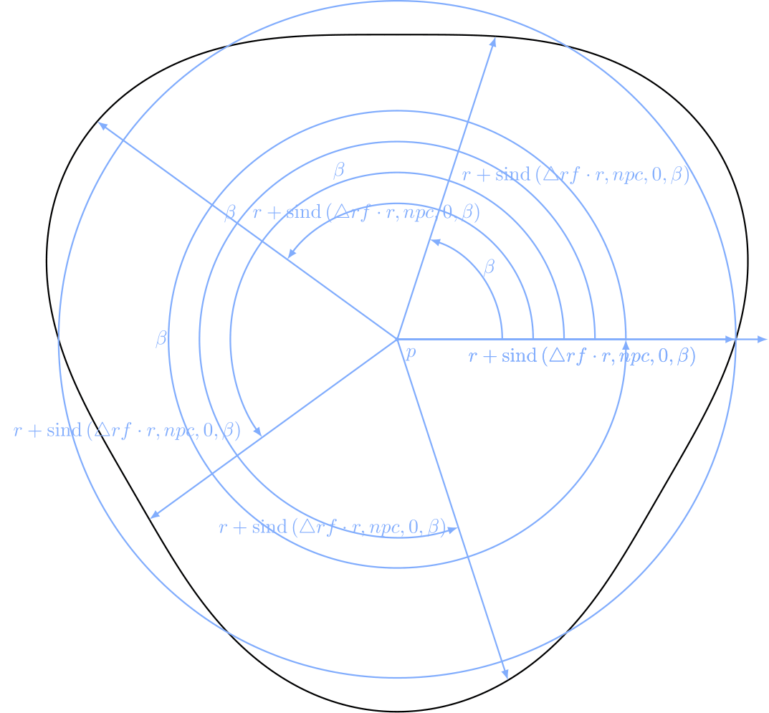
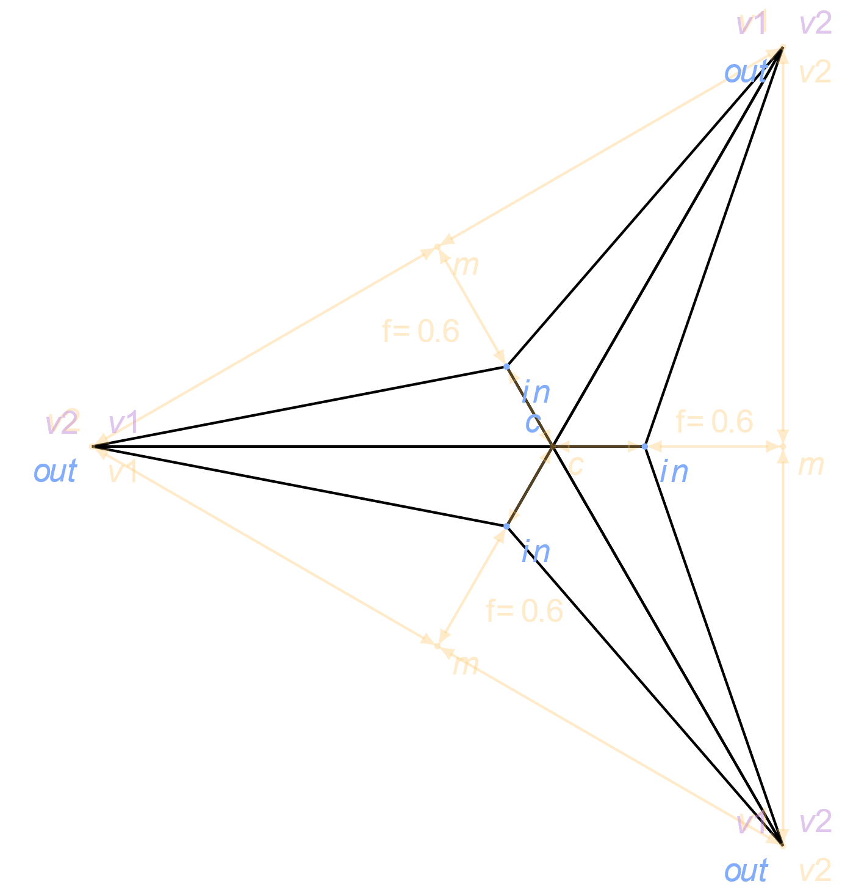
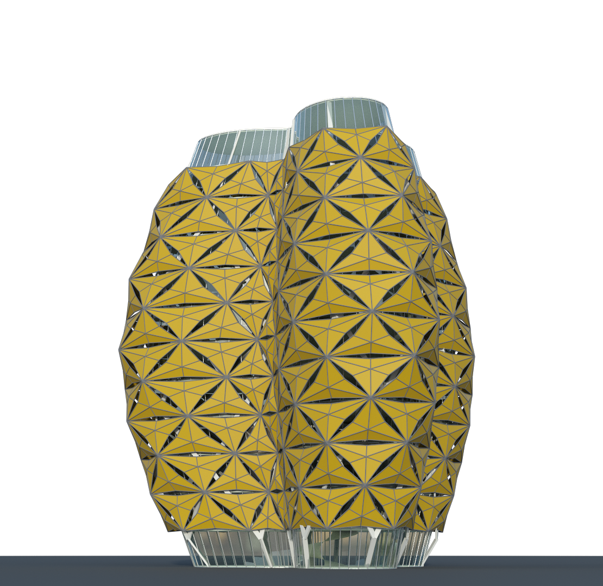
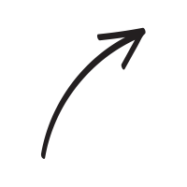
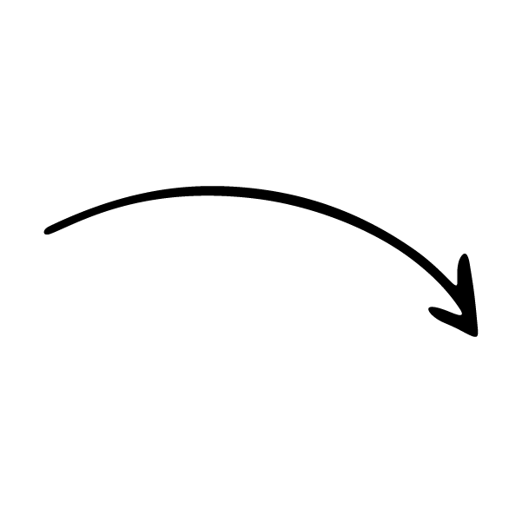

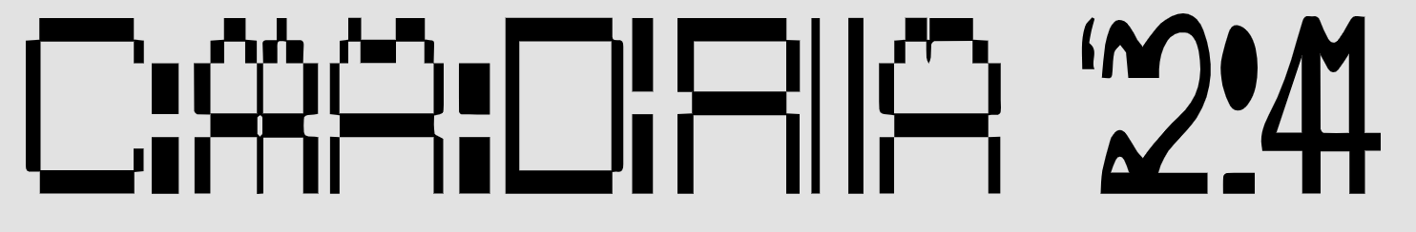
Conclusion

Slide 58
20 — 26 APRIL 2024
SINGAPORE, SG
THANK YOU
renata.castelo.branco@tecnico.ulisboa.pt
ines.caetano@tecnico.ulisboa.pt
antonio.menezes.leitao@tecnico.ulisboa.pt
ACCELERATED DESIGN

