Slide 1
Transpiling Python to Julia using PyJL
15th European Lisp Symposium
Miguel Marcelino
INESC-ID/Instituto Superior Técnico
University of Lisbon
António Menezes Leitão
INESC-ID/Instituto Superior Técnico
University of Lisbon

Slide 2
1. Motivation

Slide 3
Julia and Lisp
Metaprogramming
Multiple Dispatch
Macros
Dynamic Typing

Slide 4
Julia and Lisp
miguel@desktop:~$

Slide 5
Julia and Lisp
miguel@desktop:~$
; _ ; |_ _ _ |_ _ | . _ _ ; | (-||||_(_)|__|_)|_) ;-------------------|--------------------------------------------
> (+ 1 2)
3
julia --lisp

Slide 6
Motivation
“
There’s a subtle reason that programmers always want to throw away the code and start over. The reason is that they think the old code is a mess. And here is the interesting observation: they are probably wrong.
”

Slide 7
Julia vs. Python
Python
Julia
Popularity: 28.52%
High-Performance
PyPI: 352,008 projects
Simple Syntax
Python is slow
Popularity: 0.28%
Two Language Problem
Packages: 4,000 +
7

Slide 8
Why Use Transpilers?
Commonwealth Bank of Australia
Translate Python Libraries
COBOL → Java
$750 million over 5 years
Abundance of resources
Translate Software Requirements
8

Slide 9
Jnil: Java to Common Lisp
On Paper
In Practice
Common Lisp Libraries
Semantic Differences
Preserves Pragmatics
Impedence Mismatch

Slide 10
2. Proposed Solution

Slide 11
PyJL
Py2Many
Framework
PyJL

Slide 12
PyJL Architecture
Rewriters
Core
Transformers
Transformers
Python Source Code
Python AST Module
Post
Rewriters
Configuration Rewriters
Core Transformers
Transpiler
Julia
Source Code

Slide 13
3. Dynamic Behaviour

Slide 14
Generic Operations - Python
def get_first(container): return container[0]
>>> get_first([1, 2, 3]) 1
>>> get_first(["1", 2, 3]) '1'
>>> get_first("123") '1'
def sum_two(x, y): return x + y
>>> sum_two(1, 2) 3
>>> sum_two(1, 2.0) 3.0
>>> sum_two("1", "2") '12'
str

Slide 15
Generic Operations - Julia
function get_first(container) return container[1] end
julia> get_first([1, 2, 3]) 1
julia> get_first(["1", 2, 3]) "1"
julia> get_first("123") '1': ASCII/Unicode U+0031 (category Nd: Number, decimal digit)
function sum_two(x, y) return x + y end
julia> sum_two(1, 2) 3
julia> sum_two(1, 2.0) 3.0
julia> sum_two("1", "2") LoadError: MethodError: no method matching +(::String, ::String)

Slide 16
Generic Operations - Annotations
def get_first(container): return container[0]
def sum_two(x, y): return x + y
def get_first(container:List[int])->Int: return container[0]
def sum_two(x: int, y: int)->int: return x + y
function get_first(container
::Vector{Int64})::Int64 return container[1] end
function sum_two(x::Int64,
y::Int64)::Int64 return x + y end

Slide 17
Inference in Python
pytype
Gradual Typing
Variables have fixed types
Misuse is an error
Intra-Procedural
Type Inference
Types are allowed to change
Conforms to Python usage
Inter-Procedural

Slide 18
Inference in Python
def bar(input:str): if input == "baz": z = input else: z = -1
...
Inference
MyPy: Error
Pytype: z: Union[int, str]

Slide 19
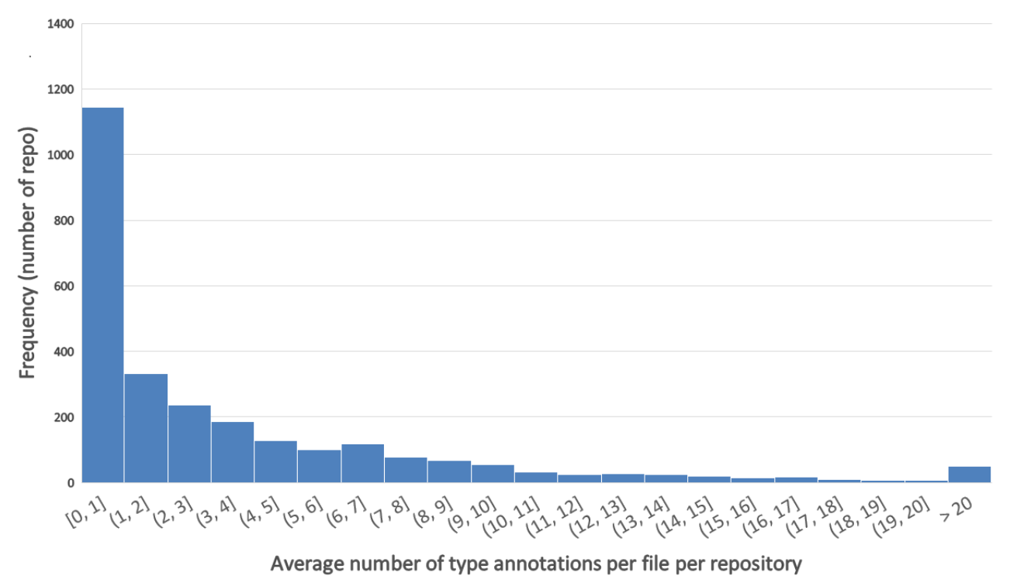
Annotated Repositories
Total: 2678
1144 with [0,1]
50 with >20

Slide 20
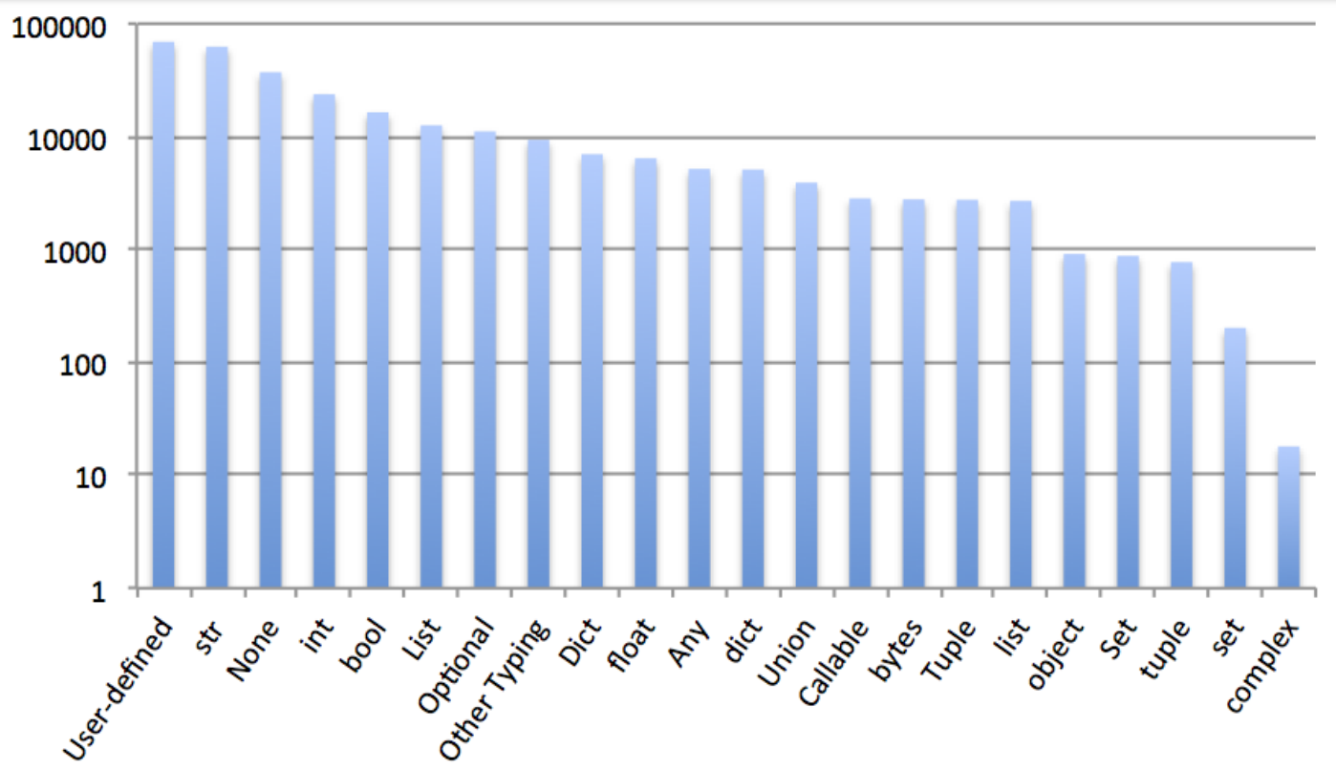
Annotated Repositories

Slide 21
4. Conversion Subset

Slide 22
Data Types
Numbers
$$int→Int$$
$$bool→Bool$$
$$float→Float64$$
$$complex→Complex$$
Immutable Sequences
$$str→String$$
$$tuple→Tuple$$
$$bytes→CodeUnits\{UInt8, String\}$$
Mutable Sequences
$$list→Vector$$
$$bytearray→Vector\{UInt8\}$$
Set Types
$$set→Set$$
Mappings
$$dict→Dict$$

Slide 23
Semantics – with Statement
with open(file_path, "w") as f: f.write("hello world")
with (open(file_path_1, "w") as f1, open(file_path_2, "w") as f2): f1.write("foo") f2.write("bar")
open(file_path, "w") do f write(f, "hello world") end

Slide 24
Semantics – With Statement
$$with_stmt∷=\text{with}\left("\text{("}with_stmt_contents ","?\text{ ")" } | with_stmt_contents\right)\text{ ":"} suite$$
$$with_stmt_contents∷=with_item\left(\text{,}with_item\right)∗$$
$$with_item∷=expression["as" target]$$
$$do_block∷=expr\text{("; "}\text{expr}\text{)∗ "}\text{do}\text{"} target\text{(","}target\text{)∗ }\text{suite}\text{ "}\text{end}"$$
with open(file_path, "w") as f: f.write("hello world")
open(file_path, "w") do f write(f, "hello world") end

Slide 25
Semantics – With Statement
with open(file_path, "w") as f: f.write("hello world")
class FileOp(): def __enter__(self): ... def __exit__(self, type=None, value=None, traceback=None): ...
with FileOp(file_path, "w") as f: f.write("hello world")
open(file_path, "w") do f write(f, "hello world") end

Slide 26
Semantics – yield Statement
def fib(): a = 0 b = 1 while True: yield a a, b = b, a+b
function fib() Channel() do ch a = 0 b = 1 while true put!(ch, a) a, b = b, a+b end end end

Slide 27
Semantics – yield Statement
def fib(): a = 0 b = 1 while True: yield a a, b = b, a+b
@resumable function fib(n::Int) :: Int a = 0 b = 1 for i in 1:n @yield a a, b = b, a+b end end

Slide 28
5. Classes

Slide 29
OO Paradigm
Python
Julia
Inheritance
Objects
Single Dispatch
Composition
Structs + Functions
Multiple Dispatch
+ Abstract
Types

Slide 30
Classes - 1
class Person: def __init__(self, name:str): self.name = name
def get_id(self) -> str: return self.name
abstract type AbstractPerson end
mutable struct Person <: AbstractPerson name::String end
function get_id(self::AbstractPerson) return self.name end

Slide 31
Classes - 1
class Student(Person): def __init__(self, name:str, student_num:int): super().__init__(name) self.student_num = student_num def get_id(self) -> str: return f"{self.student_num} - {self.name}"
Person
abstract type AbstractStudent <: AbstractPerson end
mutable struct Student <: AbstractStudent name::String student_num::Int64 end
function get_id(self::AbstractStudent) return "$(self.student_num) - $(self.name)" end
Student

Slide 32
Classes - 2
class Person: def __init__(self, name:str): self.name = name
def get_id(self) -> str: return self.name
@class mutable Person begin name::String end
function get_id(self::AbstractPerson) return self.name end

Slide 33
Classes - 2
class Student(Person): def __init__(self, name:str, student_num:int): super().__init__(name) self. student_num = student_num def get_id(self) -> str: return f"{self.student_num} - {self.name}"
Person
@class mutable Student <: Person begin student_num::Int64 end
function get_id(self::AbstractStudent) return "$(self.student_num) - $(self.name)" end
Student

Slide 34
Classes
class Student(Person): def __init__(self, name:str, student_num:int): super().__init__(name) self. student_num = student_num def get_id(self) -> str: return f"{self.student_num} - {self.name}"

Slide 35
Classes
class Student(Person): def __init__(self, name:str, student_number:int): …

Slide 36
Classes – Default Values
class Student(Person): def __init__(self, name:str, student_number:int, domain:str = "school.student.pt"): …
mutable struct Student <: Person name::String student_number::Int64
domain::String
Student(name, student_number, domain::String = "school.student.pt") =
new(name, student_number, domain) end

Slide 37
Classes – Default Values
class Student(Person): def __init__(self, name:str, student_number:int, domain:str = "school.student.pt"):
if student_number < 0: raise ValueError(“Student_number must be a positive number")
...
mutable struct Student <: Person name::String student_number::Int64
domain::String
Student(name::String, student_number::Int64, domain::String = "school.student.pt") =
begin if student_number < 0 throw(ArgumentError("Student number must be a positive number")) end new(name, student_number, domain) end end

Slide 38
Classes – Default Values
class Student(Person): def __init__(self, name:str, student_number:int, domain:str = "school.student.pt"): … def get_name(self): …
@with_kw mutable struct Student <: Person name::String student_number::Int64
domain::String = "school.student.pt" end

Slide 39
Classes – Special Methods
class Student(Person): def __init__(self, name:str, student_number:int, domain:str = "school.student.pt"): … def get_name(self): …
def __repr__(self): …
def __bytes__ (self): …
…
function __repr__(self::AstractStudent)
… end
function __bytes__(self::AstractStudent)
… end

Slide 40
Classes – PyClass
class Student(Person): def __init__(self, name:str, student_number:int, domain:str = "school.student.pt"): … def get_name(self): …
def __repr__(self): …
def __bytes__ (self): …
…
@pyclass mutable struct Student <: Person name::String student_number::Int64
domain::String = "school.student.pt" end

Slide 41
OO Paradigm
Python
Julia
Inheritance
Objects
Single Dispatch
Composition
Structs + Functions
Multiple Dispatch
+ Abstract
Types

Slide 42
OO Paradigm
Python
Julia
Inheritance
Multiple Inheritance
C3 for MRO
Composition
Single Inheritance
(for now)

Slide 43
Classes – Special Methods
class Student(Person): domain = "school.student.pt" def __init__(self, name:str, student_number:int): … def get_name(self): …
def __repr__: …
def __bytes__: …
…
@pyclass mutable struct Student <: Person name::String student_number::Int64
domain::String = "school.student.pt" end
No Multiple Inheritance
Single Inheritance
No C3 for MRO
(for now)

Slide 44
6. Performance

Slide 45
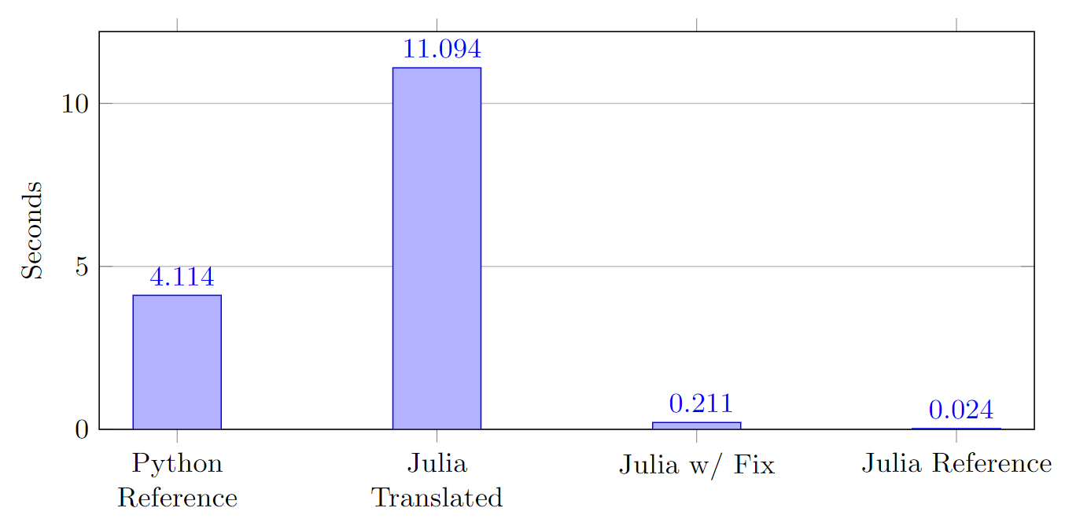
N-Body Translation
Performance of N-Body Implementations
Setup: Intel Core i7 4790k @4GHz w/ 16GB of RAM under Windows 10; Input 500000; 10 runs

Slide 46
N-Body Translation
List = Vector{Any}
def combinations(l): result = [] for x in range(len(l) - 1): ls = l[x+1:] for y in ls: result.append((l[x],y)) return result
function combinations(l)::Vector result = [] for x in (0:length(l)-1-1) ls = l[(x+1+1):end] for y in ls push!(result, (l[x+1], y)) end end return result end

Slide 47
N-Body Translation - Julia
CodeInfo( 1 ── %1 = $(Expr(:foreigncall, :(:jl_alloc_array_1d), Vector{Any}, svec(Any, Int64), 0, :(:ccall), Vector{Any}, 0, 0))::Vector{Any} │ %2 = Base.arraylen(l)::Int64 │ %3 = Base.sub_int(%2, 1)::Int64 │ %4 = Base.sub_int(%3, 1)::Int64
…

Slide 48
N-Body Translation
function combinations(l)::Vector result::Tuple{eltype(l), eltype(l)} = [] for x in (0:length(l)-1-1) ls = l[(x+1+1):end] for y in ls push!(result, (l[x+1], y)) end end return result end

Slide 49
N-Body Translation
52.6 Speedup
Performance of N-Body Implementations
Setup: Intel Core i7 4790k @4GHz w/ 16GB of RAM under Windows 10; Input 500000; 10 runs

Slide 50
N-Body Translation
19.5x Faster than Python
Performance of N-Body Implementations
Setup: Intel Core i7 4790k @4GHz w/ 16GB of RAM under Windows 10; Input 500000; 10 runs

Slide 51
N-Body Translation
Performance of N-Body Implementations
Setup: Intel Core i7 4790k @4GHz w/ 16GB of RAM under Windows 10; Input 500000; 10 runs

Slide 52
Transpiling Python to Julia using PyJL
15th European Lisp Symposium
Miguel Marcelino
INESC-ID/Instituto Superior Técnico
University of Lisbon
António Menezes Leitão
INESC-ID/Instituto Superior Técnico
University of Lisbon

Slide 53
References
Adsharma. (2020). py2many: Python to many CLike languages transpiler.
Van Rossum, G., & Drake, F. L., Jr. (1995). Python reference manual. Centrum voor Wiskunde en Informatica Amsterdam.
Hugunin, J. (1997). Python and Java: The Best of Both Worlds. in Proceedings of the 6th International Python Conference. CNRI, 1997–1910.
Hugunin, J. (n.d.). IronPython Home Page.
Foundation, P. S. (3 2010). typing - Support for type hints.
Bysiek, M., Drozd, A., & Matsuoka, S. (2016). Migrating Legacy Fortran to Python While Retaining Fortran-Level Performance through Transpilation and Type Hints. 2016 6th Workshop on Python for High-Performance and Scientific Computing (PyHPC), 9–18. doi:10.1109/PyHPC.2016.006

Slide 54
References
Leitao, A. M. (2007). Migration of Common Lisp Programs to the Java Platform - The Linj Approach. 11th European Conference on Software Maintenance and Reengineering (CSMR’07), 243–251. doi:10.1109/CSMR.2007.34
Leitão, A. M. (2007). The next 700 programming libraries. Proceedings of the 2007 International Lisp Conference. Presented at the Cambridge, United Kingdom. doi:10.1145/1622123.1622147
Bezanson, J., Chen, J., Chung, B., Karpinski, S., Shah, V. B., Vitek, J., & Zoubritzky, L. (2018). Julia: Dynamism and Performance Reconciled by Design. Proc. ACM Program. Lang., 2(OOPSLA). doi:10.1145/3276490
Pcarbonn. (2019, Maart). PYPL: PopularitY of Programming Language index.
Bezanson, J., Karpinski, S., Shah, V., Edelman, A., & Others. (2014). Julia Language Documentation - Performance Tips. The Julia Manual. http://docs. julialang. org/en/release-0. 2/manual.
Plevin, R. (2021, November). Classes.jl. Carson, K., Johansson, F., Tupteq, & Nanz, D. (2021, Maart). N-Body Problem, Python Implementation.

Slide 55
References
van Rossum, G., Lehtosalo, J., Levkivskyi, I., & Sullivan, M. J. (2014). MyPy.
Barrett, K., Cassels, B., Haahr, P., Moon, D. A., Playford, K., & Withington, P. T. (1996). A Monotonic Superclass Linearization for Dylan. Proceedings of the 11th ACM SIGPLAN Conference on Object-Oriented Programming, Systems, Languages, and Applications, 69–82. Presented at the San Jose, California, USA. doi:10.1145/236337.236343
Google. (2015, Maart). Pytype: A static type analyzer for Python code.
Fomiga, A., Karpinski, S., Shah, V. B., Bezanson, J., Smallnamespaces, Beckmeyer, A., & Yu, V. (2021, April). N-Body Problem, Julia Implementation.

