Slide 1
Theme 1: Artificial Intelligence
Getting a Handle on Floor Plan Analysis
Door classification in floor plans and a survey on existing datasets
J. DAVID¹ and A. LEITÃO²
¹ INESC-ID/IST / joaodavid@tecnico.ulisboa.pt
² INESC-ID/IST / antonio.menezes.leitao@tecnico.ulisboa.pt

Slide 2
Why Analyze Floor Plans?
Liu, C., Wu, J., Kohli, P., & Furukawa, Y. (2017). Raster-to-Vector: Revisiting floorplan transformation.

Slide 3
https://metaverse.exclusible.com/

Slide 4
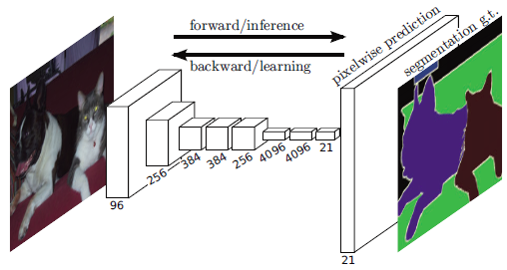
How Can We Analyze Floor Plans?
Before
Now
Heuristics
Low-level image processing
Hough transform
Canny edge detector
Feature extraction
Long, J., Shelhamer, E., & Darrell, T. (2015). Fully convolutional networks for semantic segmentation.

Slide 5
Machine Learning
Pros
Cons
Better results
More generalizable
other
Require large amount of data
Data must be correctly annotated
Lack of annotation conventions

Slide 6
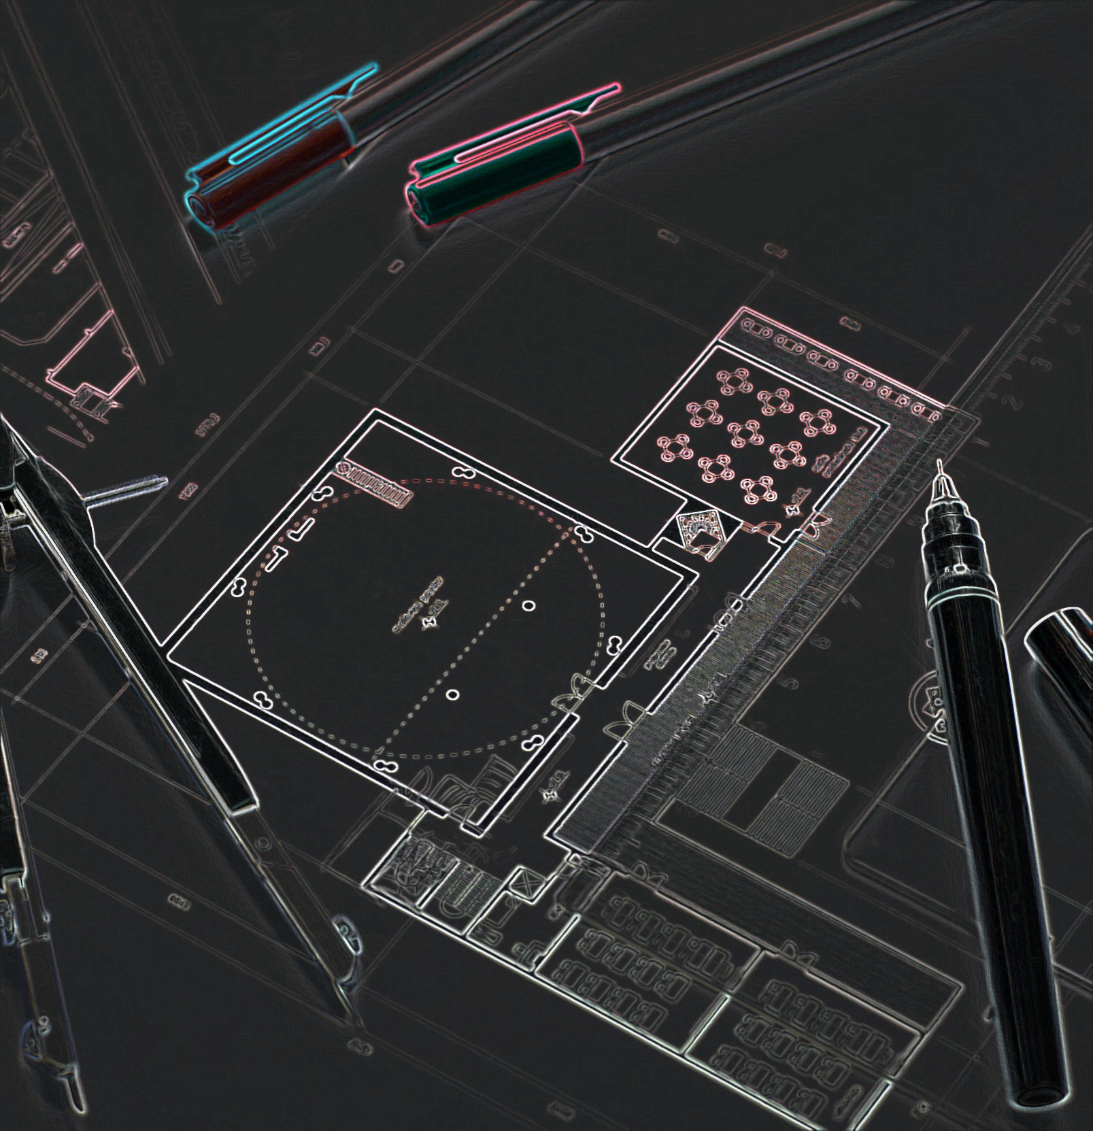
Our Focus
Survey on floor plan datasets
A method to recover door semantics

Slide 7
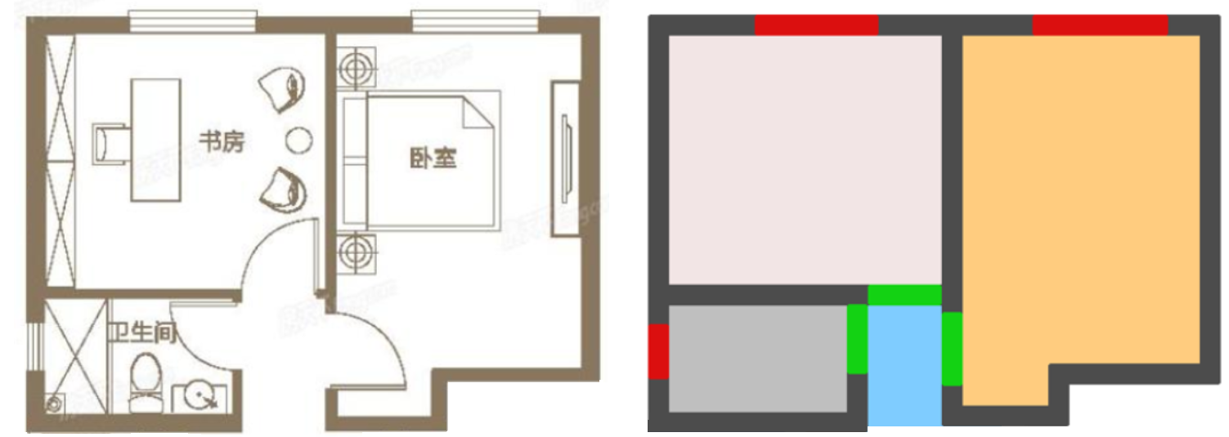
Example Annotation
Adapted from: Lv, X., Zhao, S., Yu, X., & Zhao, B. (2021). Residential floor plan recognition and reconstruction.

Slide 8
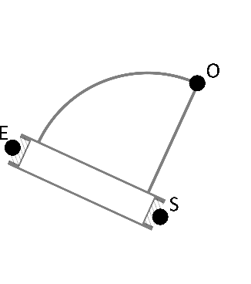
Describing Doors

Slide 9
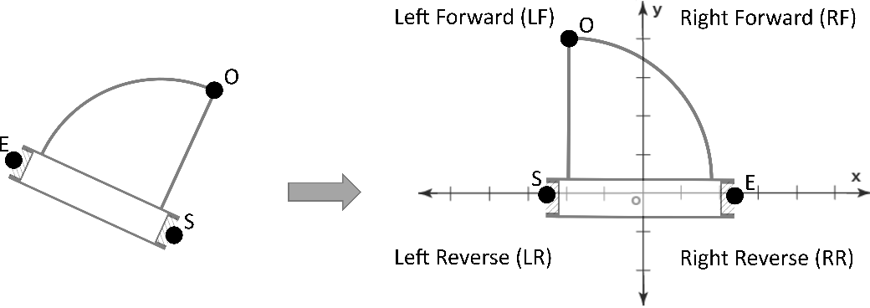
Describing Doors

Slide 10
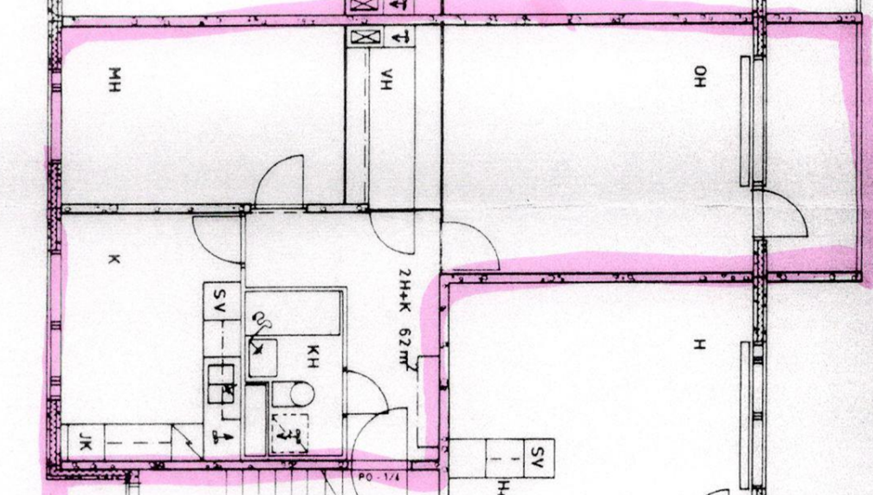
Data Extraction
Kalervo, A., Ylioinas, J., Häikiö, M., Karhu, A., & Kannala, J. (2019, June). CubiCasa5K: A dataset and an improved multi-task model for floorplan image analysis. In Scandinavian Conference on Image Analysis (pp. 28-40).

Slide 11
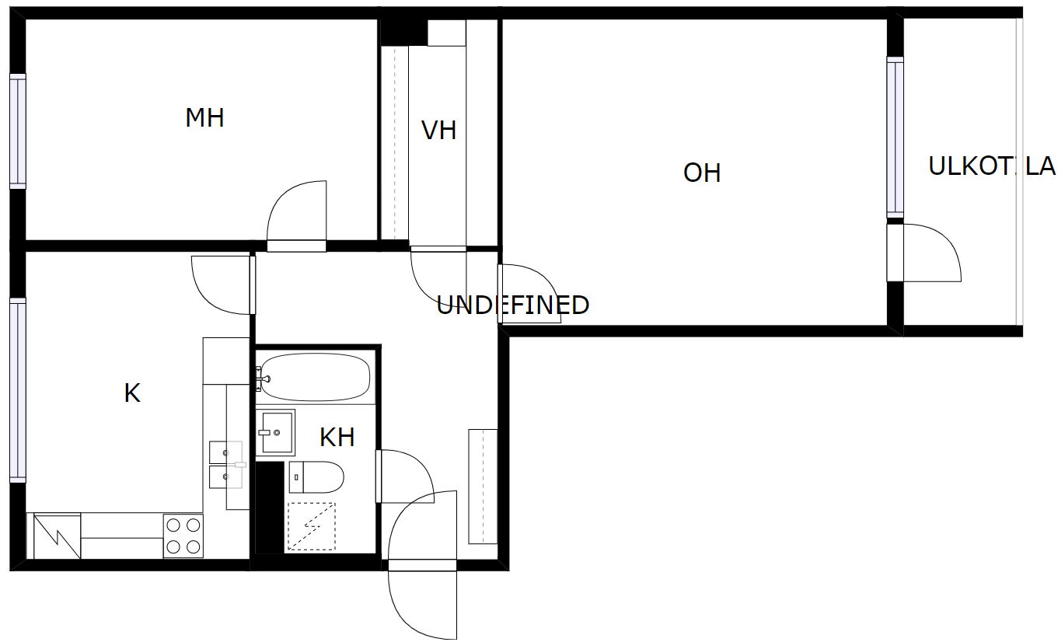
Example Annotation

Slide 12
Door Extraction
E
S

Slide 13
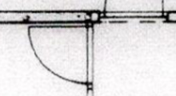
Door Classification
O
S
E
New example
Right
Forward

Slide 14
Other Examples

Slide 15
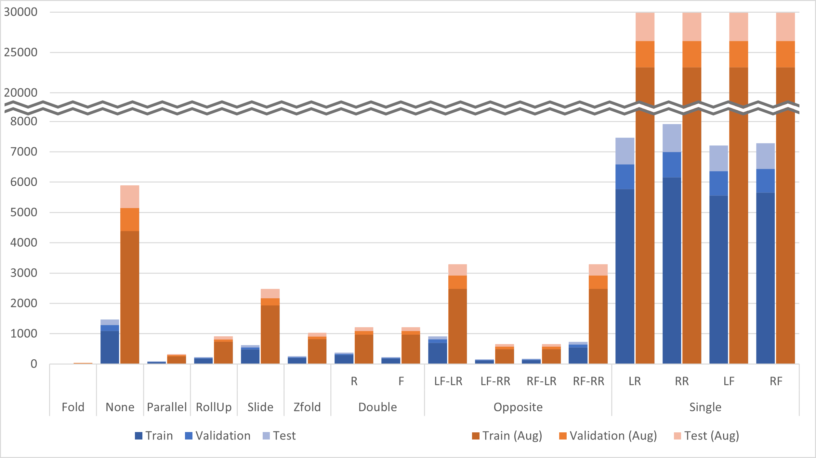
Dataset Statistics

Slide 16
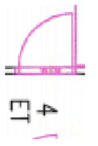
Dataset Statistics

Slide 17
Dataset Statistics

Slide 18
Dataset Statistics

Slide 19
Dataset Statistics

Slide 20
Why Extract Individual Images?
Kalervo, A., Ylioinas, J., Häikiö, M., Karhu, A., & Kannala, J. (2019, June). CubiCasa5K: A dataset and an improved multi-task model for floorplan image analysis. In Scandinavian Conference on Image Analysis (pp. 28-40).

Slide 21
Why Extract Individual Images?

Slide 22
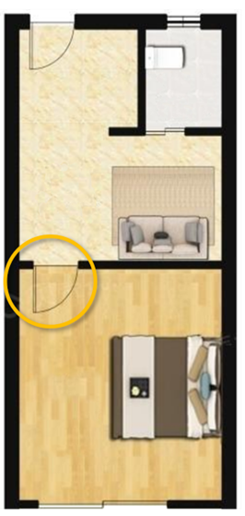
Application

Slide 23
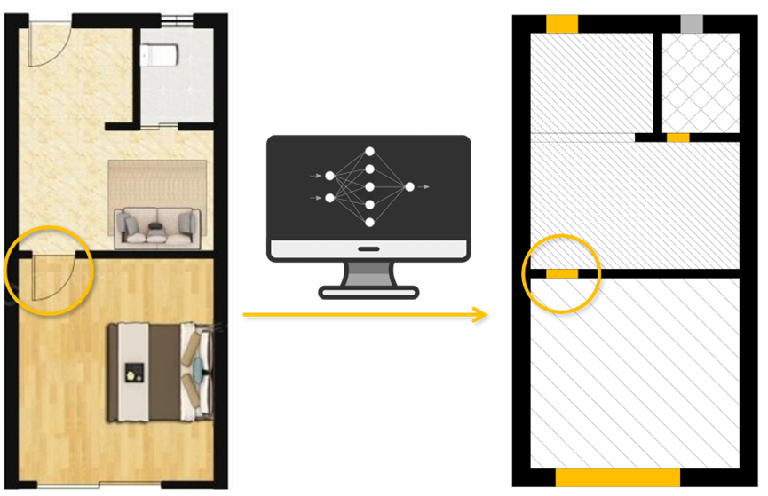
Application

Slide 24
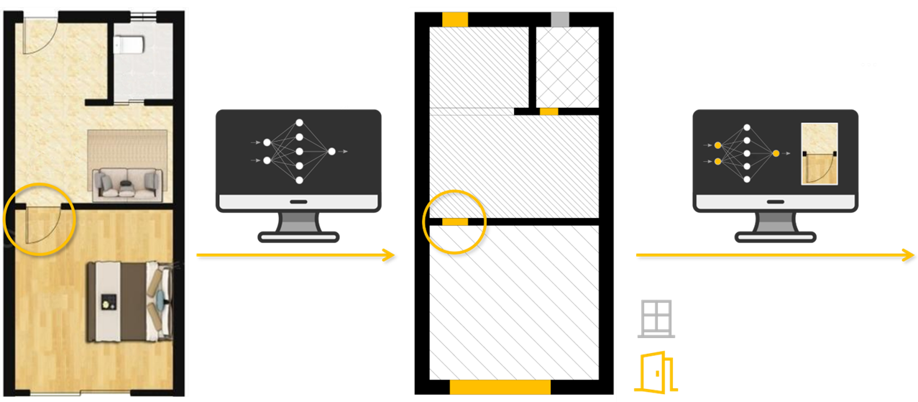
Application

Slide 25
Application

Slide 26
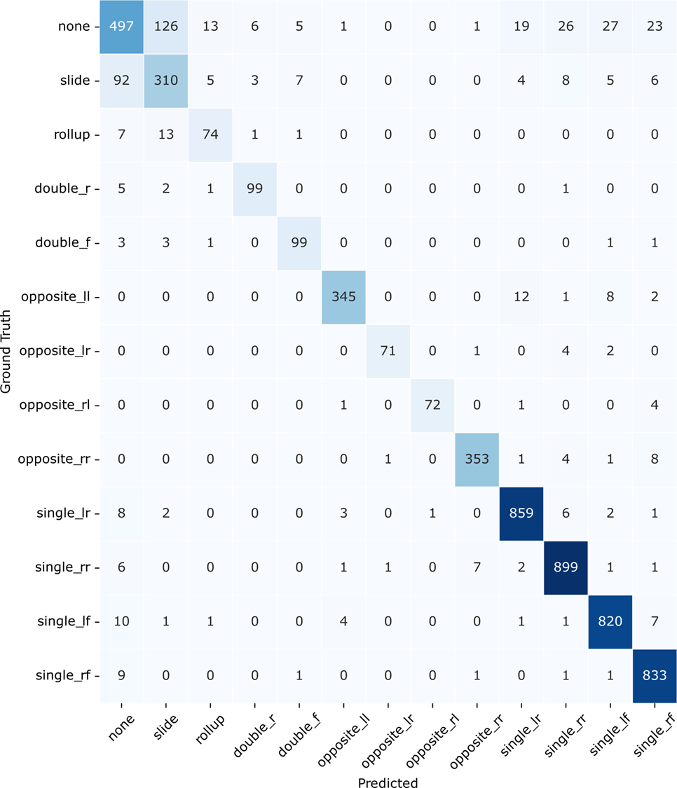

Slide 27
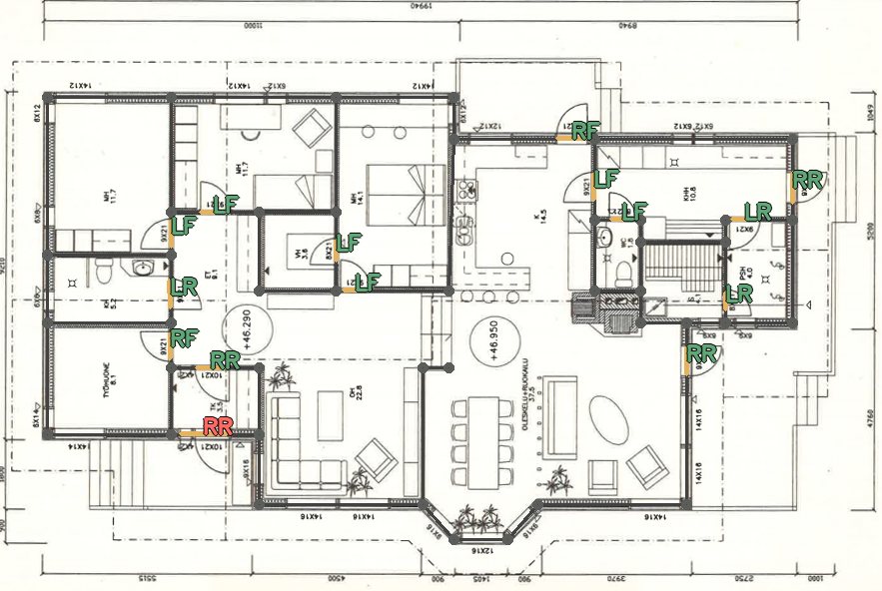
Floor plan from: Kalervo, A., Ylioinas, J., Häikiö, M., Karhu, A., & Kannala, J. (2019, June). CubiCasa5K: A dataset and an improved multi-task model for floorplan image analysis. In Scandinavian Conference on Image Analysis (pp. 28-40).

Slide 28
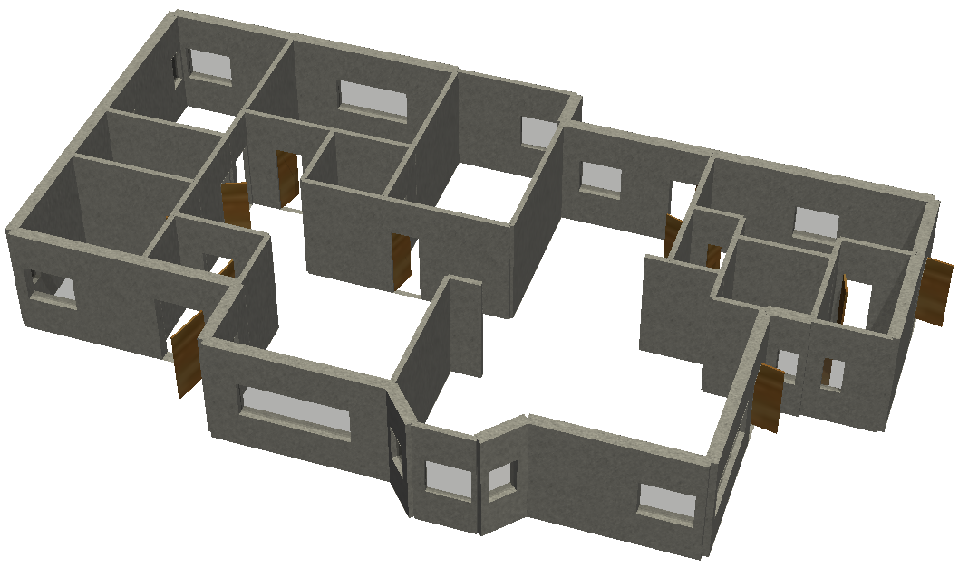

Slide 29
Thank You
João Carlos Morgado David
INESC-ID/IST
joadavid@tecnico.ulisboa.pt

