Slide 1
AD-based Surrogate Models for Simulation And Optimization of Large Urban Areas.
Gonçalo Araújo - goncalo.r.araujo@tecnico.ulisboa.pt;
Luís Santos - lfds@create.aau.dk
António Leitão - antonio.menezes.leitao@tecnico.ulisboa.pt; Ricardo Gomes - ricardo.a.gomes@tecnico.ulisboa.pt

Slide 2
INTRODUCTION
UN Sustainable Development Goals

Slide 3
INTRODUCTION
UN Sustainable Development Goals

Slide 4
INTRODUCTION
UN Sustainable Development Goals

Slide 5
INTRODUCTION
UN Sustainable Development Goals

Slide 6
INTRODUCTION
UN Sustainable Development Goals

Slide 7
INTRODUCTION
UN Sustainable Development Goals

Slide 8
INTRODUCTION
UN Sustainable Development Goals

Slide 9
INTRODUCTION
Renovate

Slide 10
INTRODUCTION
Renovate

Slide 11
INTRODUCTION
Renovate

Slide 12
INTRODUCTION
Renovate

Slide 13
INTRODUCTION
Practice

Slide 14
INTRODUCTION
Practice
Ownership

Slide 15
INTRODUCTION
Practice
Ownership

Slide 16
INTRODUCTION
Simulation Tools

Slide 17
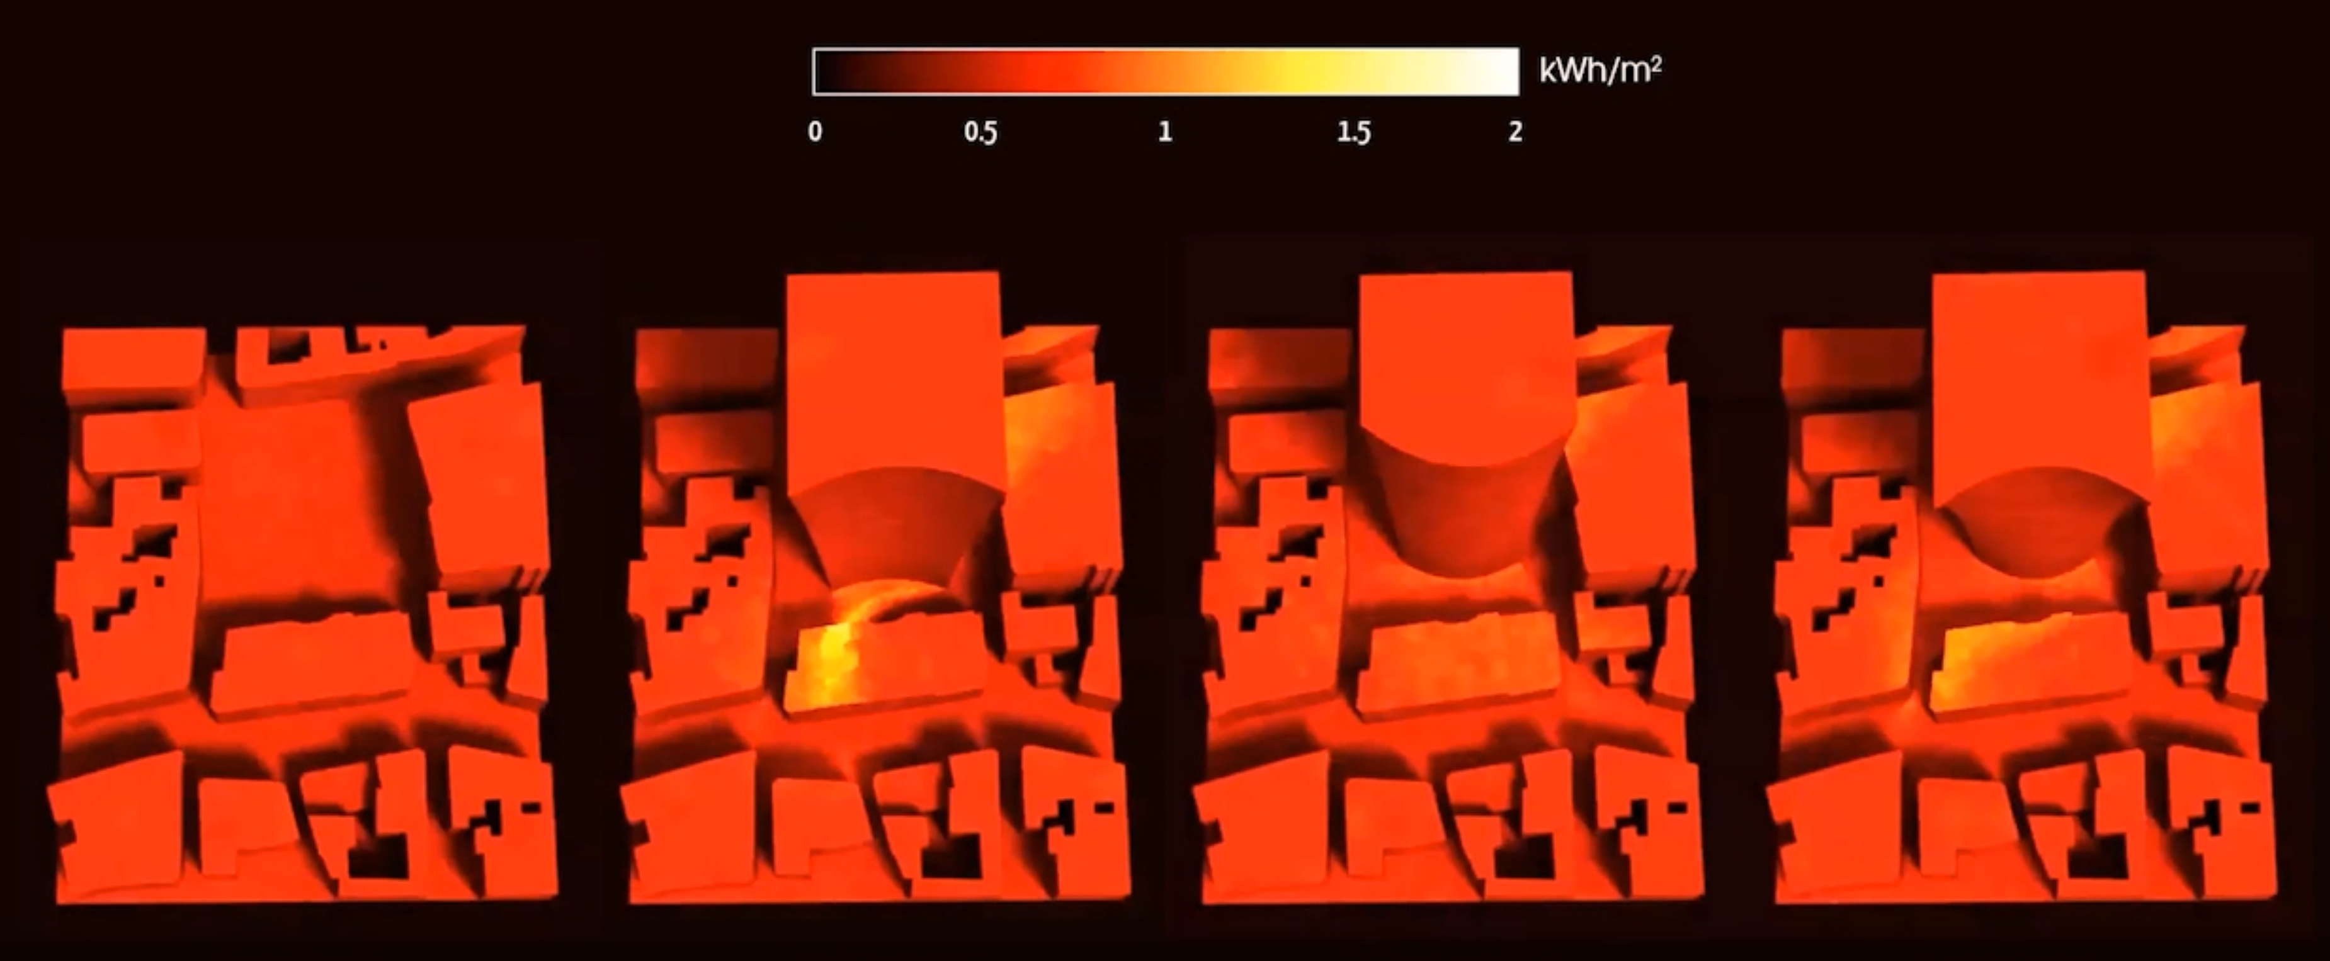
INTRODUCTION
Simulation Tools

Slide 18
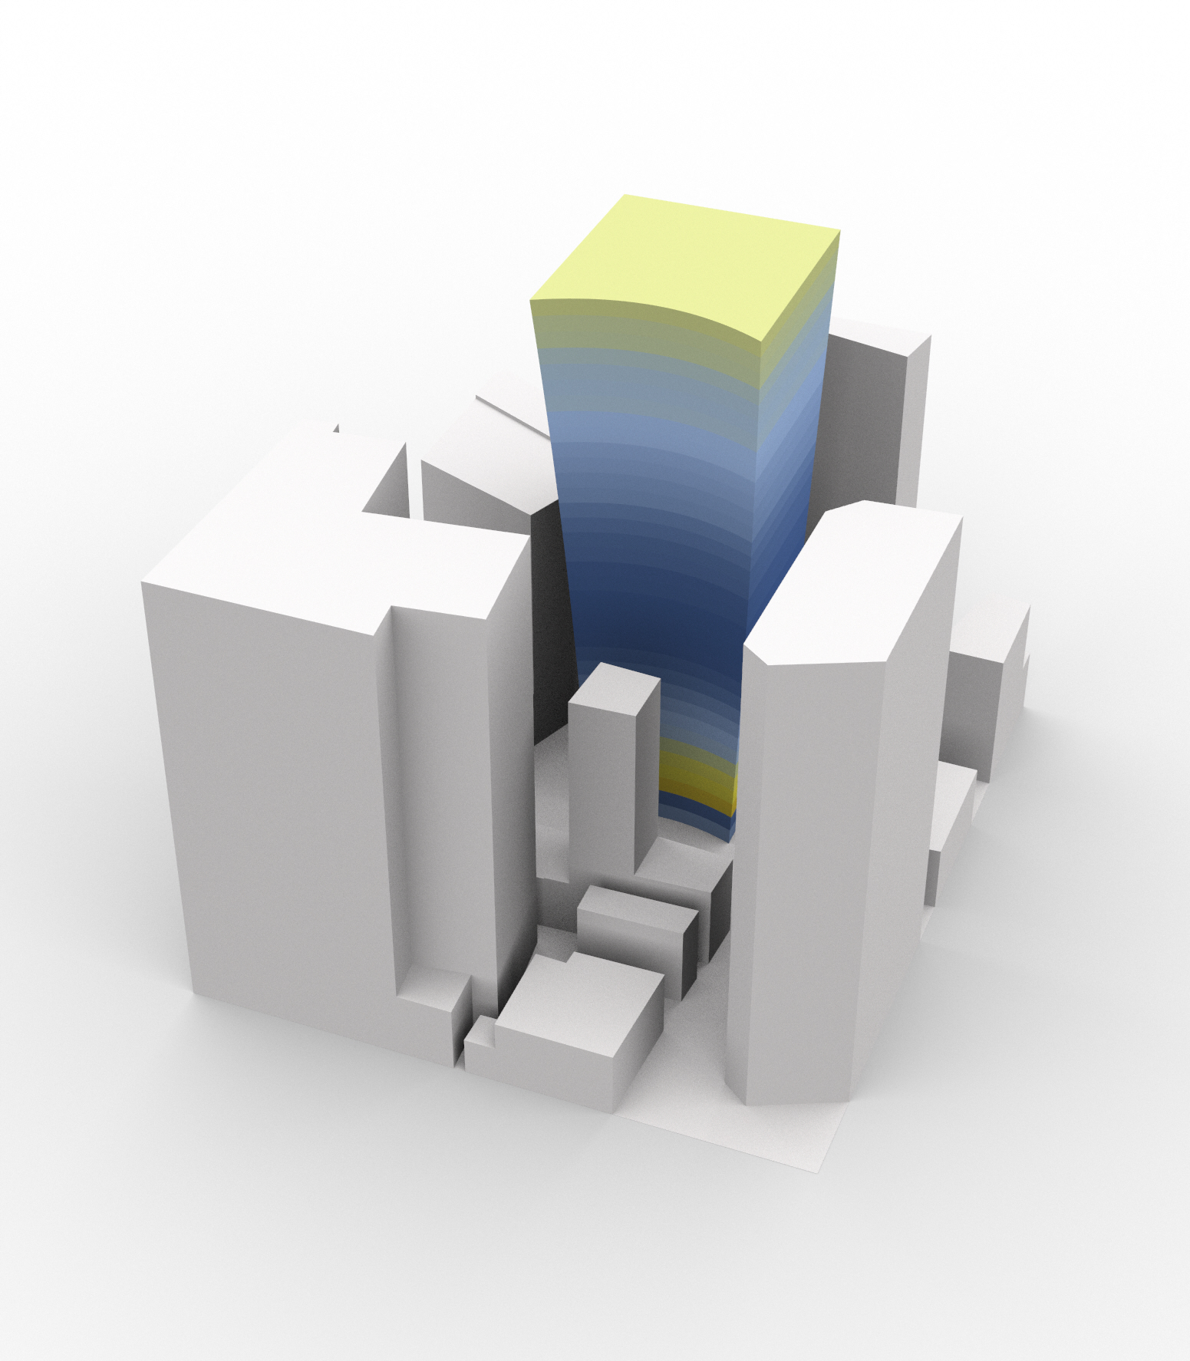
INTRODUCTION
Simulation Tools

Slide 19
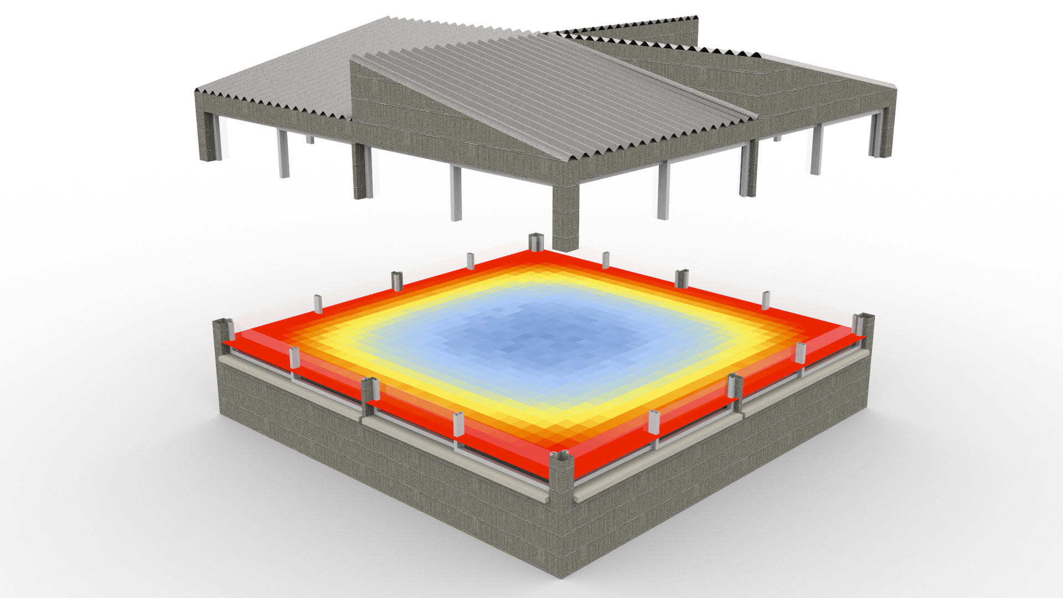
INTRODUCTION
Simulation Tools

Slide 20
INTRODUCTION
Simulation Tools

Slide 21
INTRODUCTION
Simulation Tools

Slide 22
INTRODUCTION
Simulation Tools

Slide 23
INTRODUCTION
Simulation Tools

Slide 24
INTRODUCTION
Simulation Tools

Slide 25
INTRODUCTION
Simulation Tools

Slide 26
INTRODUCTION
Simulation Tools

Slide 27
INTRODUCTION
Simulation Tools

Slide 28
INTRODUCTION
Simulation Tools

Slide 29
INTRODUCTION
Simulation Tools

Slide 30
INTRODUCTION
Simulation Tools
Machine Learning

Slide 31
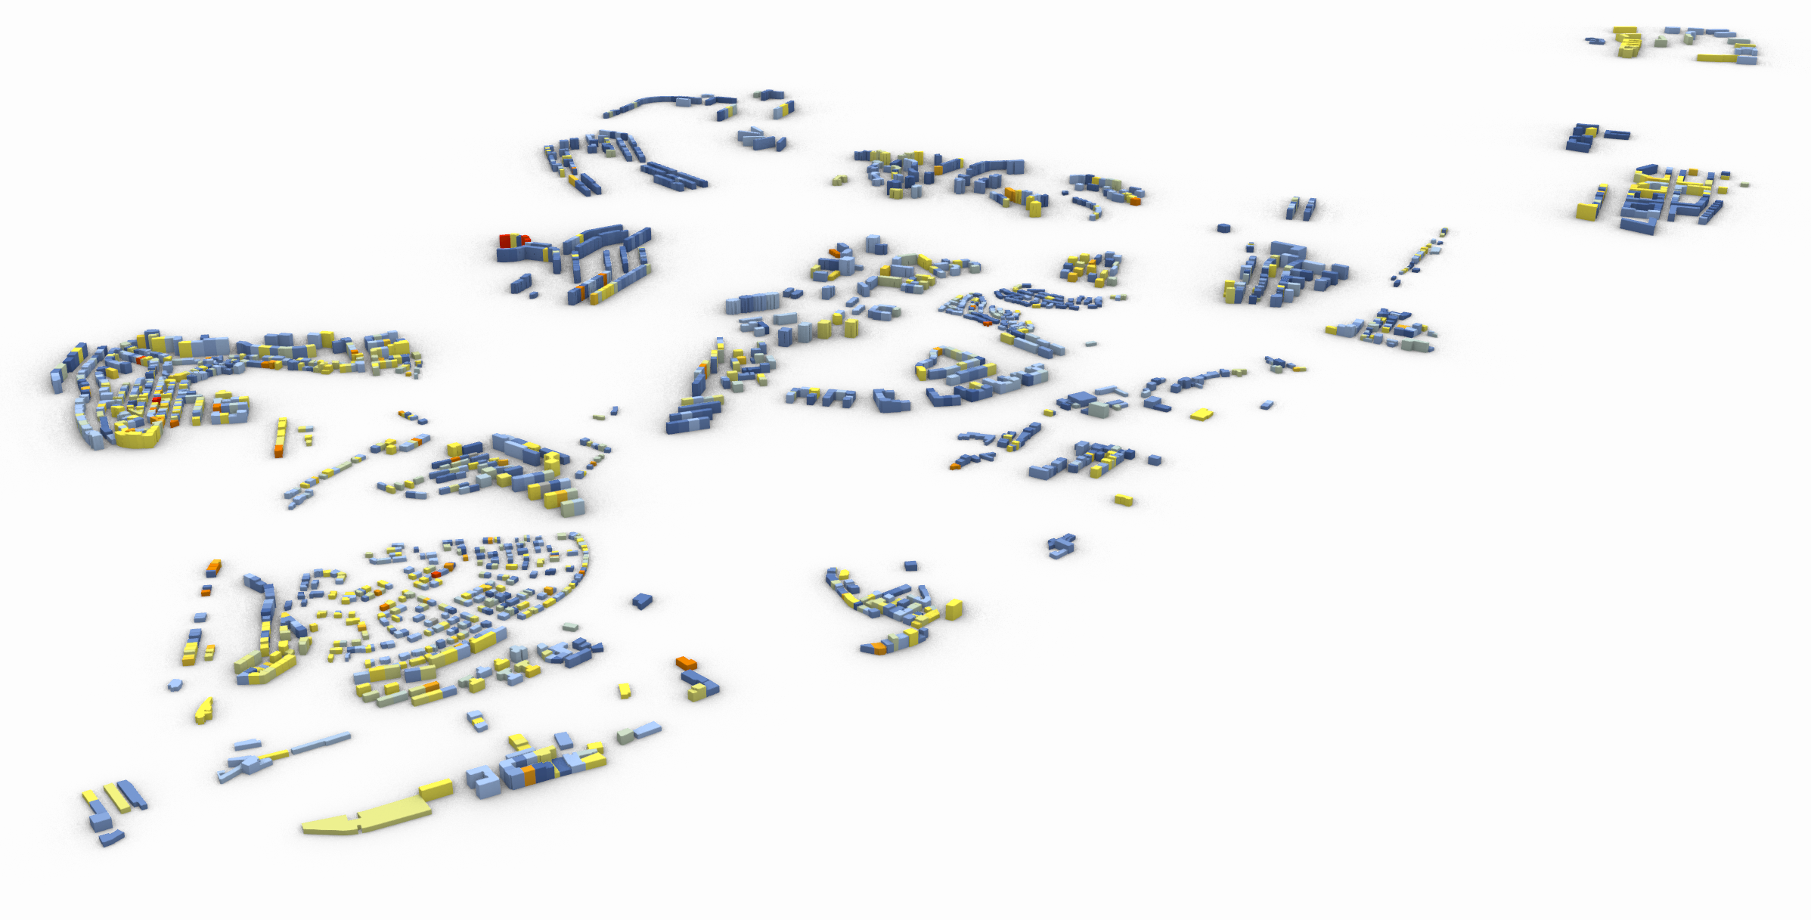
INTRODUCTION
Machine Learning

Slide 32
INTRODUCTION
Machine Learning

Slide 33
INTRODUCTION
Machine Learning

Slide 34
INTRODUCTION
Machine Learning

Slide 35
INTRODUCTION
Machine Learning

Slide 36
WORKFLOW
Simulation Tools
Algorithmic Design
Machine Learning

Slide 37
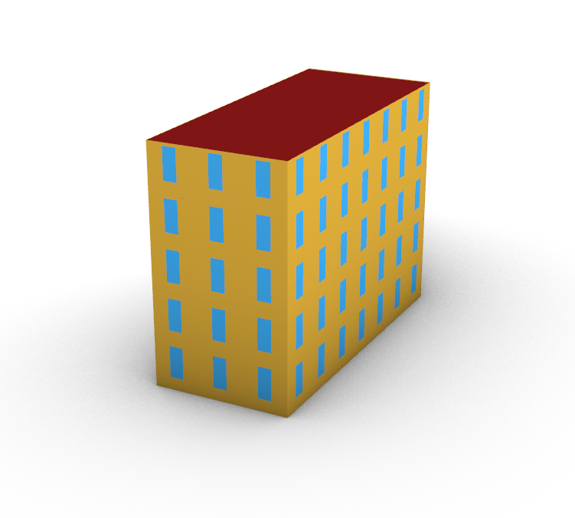
WORKFLOW
Algorithmic Design

Slide 38
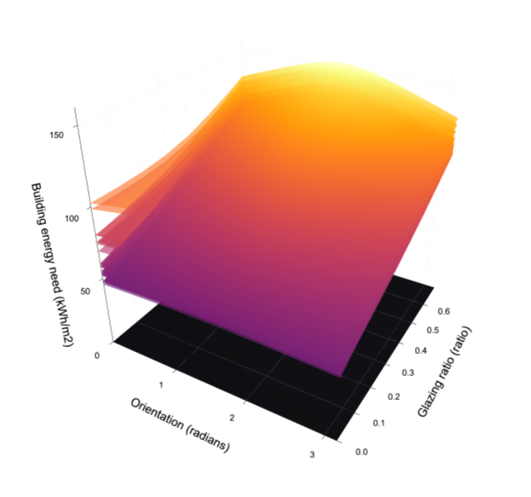
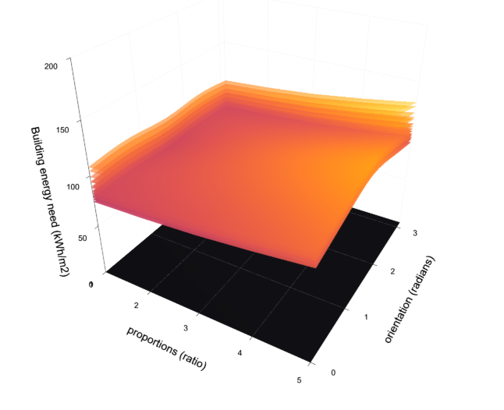
WORKFLOW
Algorithmic Design

Slide 39
WORKFLOW
Database

Slide 40
WORKFLOW
Database

Slide 41
WORKFLOW
AD-based Surrogate models

Slide 42
WORKFLOW
AD-based Surrogate models
Allow us to obtain results for any building within specific geometrical boundaries

Slide 43
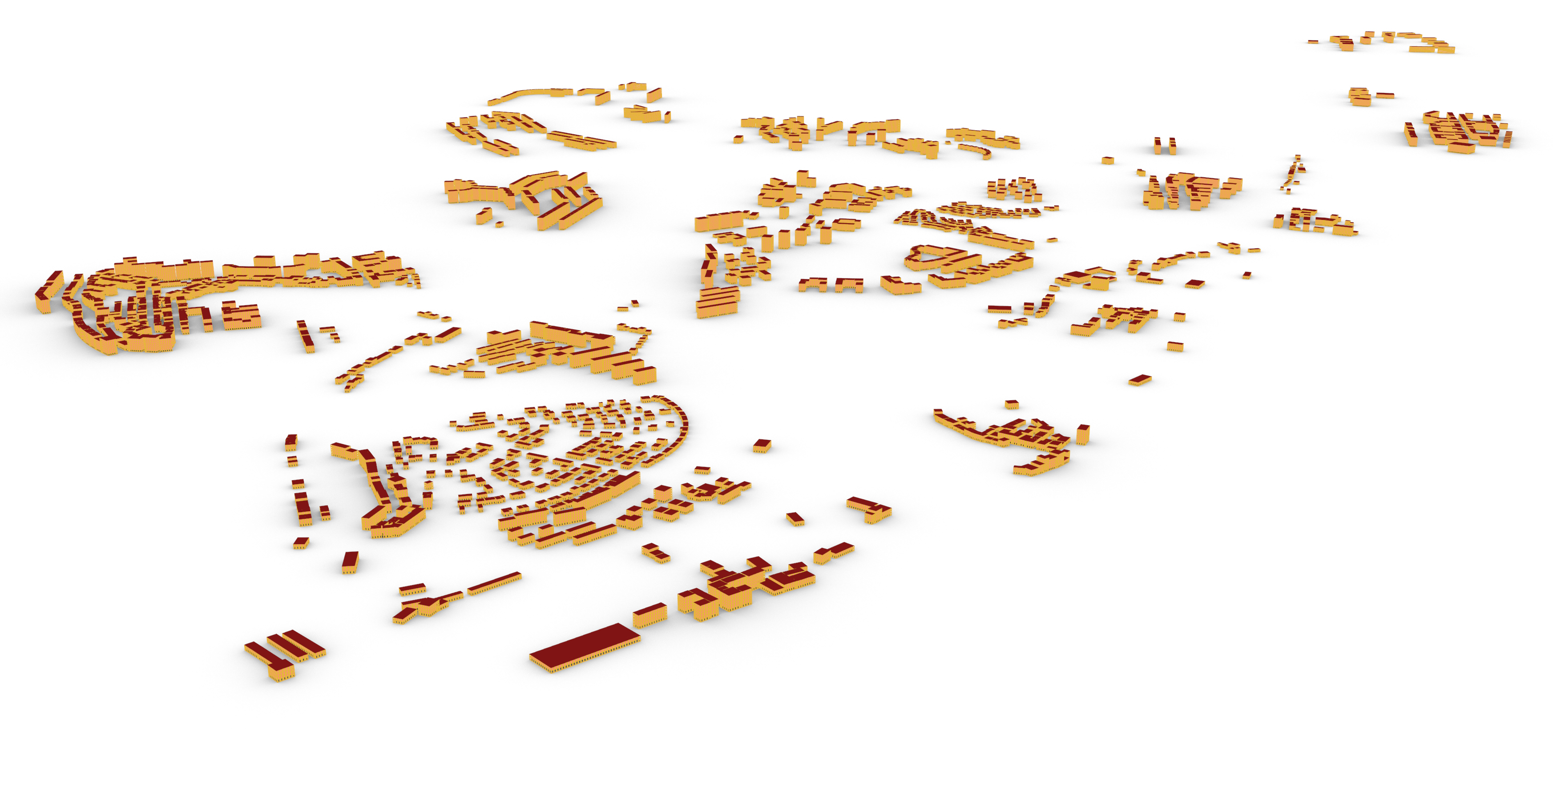
WORKFLOW
AD-based Surrogate models
Surrogate models
Allow us to obtain results for any building within specific geometrical boundaries

Slide 44
WORKFLOW
AD-based Surrogate models
Surrogate models
Allow us to obtain results for any building within specific geometrical boundaries
Case-specific buildings and results

Slide 45
WORKFLOW
Khepri AD Tool

Slide 46
WORKFLOW
1. Data Gathering
Khepri AD Tool

Slide 47
WORKFLOW
1. Data Gathering
Khepri AD Tool

Slide 48
WORKFLOW
1. Data Gathering
2. Simulation
Khepri AD Tool

Slide 49
WORKFLOW
1. Data Gathering
2. Simulation
Khepri AD Tool

Slide 50
WORKFLOW
1. Data Gathering
2. Simulation
Khepri AD Tool
3. Regression Models

Slide 51
WORKFLOW
1. Data Gathering
4. Validation
2. Simulation
Khepri AD Tool
3. Regression Models

Slide 52
WORKFLOW
1. Data Gathering
4. Validation
2. Simulation
5. Optimization
Khepri AD Tool
3. Regression Models

Slide 53
WORKFLOW
1. Data Gathering
4. Validation
2. Simulation
5. Optimization
Khepri AD Tool
3. Regression Models

Slide 54
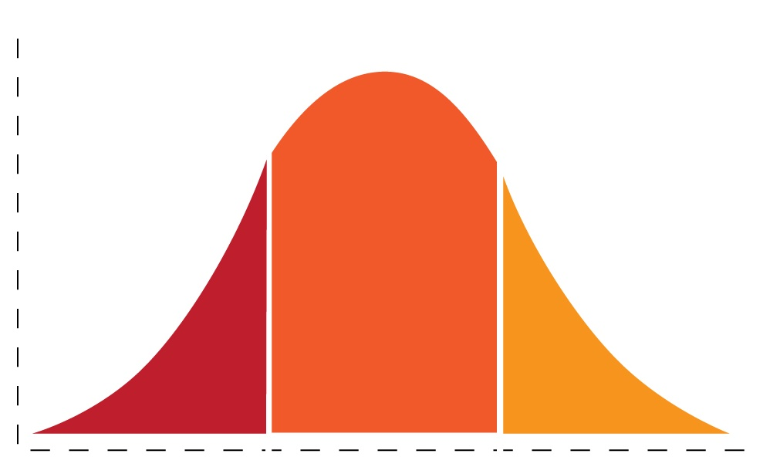
WORKFLOW
1. Data Gathering
4. Validation
2. Simulation
5. Optimization
Khepri AD Tool
3. Regression Models

Slide 55
WORKFLOW
1. Data Gathering
4. Validation
2. Simulation
5. Optimization
Khepri AD Tool
3. Regression Models

Slide 56
RESULTS
1. Data Gathering
4. Validation
2. Simulation
5. Optimization
Khepri AD Tool
3. Regression Models

Slide 57
RESULTS
Construction period | Construction ID | Wall U_Value (kWh/m²) | Roof U_Value (W/m²⋅ºC) | Floor U_Value (W/m²⋅ºC) | Window U_Value (W/m²⋅ºC) | Wall retrofit U-value (W/m²⋅ºC) | Roof retrofit U-value (W/m²⋅ºC)
<1919 | 1 | 2.78 | 1.99 | 1.80 | 2.69 | 0.61 | 0.63
1919-1945 | 2 | 2.78 | 1.99 | 1.80 | 2.69 | 0.61 | 0.63
1946-1960 | 3 | 1.49 | 1.99 | 1.80 | 2.69 | 0.57 | 0.63
1961-1970 | 4 | 1.08 | 1.99 | 3.03 | 2.69 | 0.49 | 0.63
1971-1980 | 5 | 1.26 | 1.99 | 3.03 | 2.69 | 0.53 | 0.63
1981-1990 | 6 | 0.50 | 1.99 | 3.03 | 2.69 | 0.32 | 0.63
1991-1995 | 7 | 0.49 | 1.99 | 3.03 | 2.69 | 0.32 | 0.63
1996-2000 | 8 | 0.46 | 1.99 | 2.31 | 2.69 | 0.29 | 0.63
2001-2005 | 9 | 0.25 | 1.99 | 2.31 | 2.69 | 0.19 | 0.63
>2006 | 10 | 0.25 | 1.99 | 2.31 | 2.69 | 0.19 | 0.63
1. Data Gathering
4. Validation
2. Simulation
5. Optimization
Khepri AD Tool
3. Regression Models

Slide 58
RESULTS
Construction period | Construction ID | Wall U_Value (kWh/m²) | Roof U_Value (W/m²⋅ºC) | Floor U_Value (W/m²⋅ºC) | Window U_Value (W/m²⋅ºC) | Wall retrofit U-value (W/m²⋅ºC) | Roof retrofit U-value (W/m²⋅ºC)
<1919 | 1 | 2.78 | 1.99 | 1.80 | 2.69 | 0.61 | 0.63
1919-1945 | 2 | 2.78 | 1.99 | 1.80 | 2.69 | 0.61 | 0.63
1946-1960 | 3 | 1.49 | 1.99 | 1.80 | 2.69 | 0.57 | 0.63
1961-1970 | 4 | 1.08 | 1.99 | 3.03 | 2.69 | 0.49 | 0.63
1971-1980 | 5 | 1.26 | 1.99 | 3.03 | 2.69 | 0.53 | 0.63
1981-1990 | 6 | 0.50 | 1.99 | 3.03 | 2.69 | 0.32 | 0.63
1991-1995 | 7 | 0.49 | 1.99 | 3.03 | 2.69 | 0.32 | 0.63
1996-2000 | 8 | 0.46 | 1.99 | 2.31 | 2.69 | 0.29 | 0.63
2001-2005 | 9 | 0.25 | 1.99 | 2.31 | 2.69 | 0.19 | 0.63
>2006 | 10 | 0.25 | 1.99 | 2.31 | 2.69 | 0.19 | 0.63
1. Data Gathering
4. Validation
2. Simulation
5. Optimization
Khepri AD Tool
3. Regression Models

Slide 59
RESULTS
Construction period | Construction ID | Wall U_Value (kWh/m²) | Roof U_Value (W/m²⋅ºC) | Floor U_Value (W/m²⋅ºC) | Window U_Value (W/m²⋅ºC) | Wall retrofit U-value (W/m²⋅ºC) | Roof retrofit U-value (W/m²⋅ºC)
<1919 | 1 | 2.78 | 1.99 | 1.80 | 2.69 | 0.61 | 0.63
1919-1945 | 2 | 2.78 | 1.99 | 1.80 | 2.69 | 0.61 | 0.63
1946-1960 | 3 | 1.49 | 1.99 | 1.80 | 2.69 | 0.57 | 0.63
1961-1970 | 4 | 1.08 | 1.99 | 3.03 | 2.69 | 0.49 | 0.63
1971-1980 | 5 | 1.26 | 1.99 | 3.03 | 2.69 | 0.53 | 0.63
1981-1990 | 6 | 0.50 | 1.99 | 3.03 | 2.69 | 0.32 | 0.63
1991-1995 | 7 | 0.49 | 1.99 | 3.03 | 2.69 | 0.32 | 0.63
1996-2000 | 8 | 0.46 | 1.99 | 2.31 | 2.69 | 0.29 | 0.63
2001-2005 | 9 | 0.25 | 1.99 | 2.31 | 2.69 | 0.19 | 0.63
>2006 | 10 | 0.25 | 1.99 | 2.31 | 2.69 | 0.19 | 0.63
1. Data Gathering
4. Validation
2. Simulation
5. Optimization
Khepri AD Tool
3. Regression Models

Slide 60
RESULTS
Construction period | Construction ID | Wall U_Value (kWh/m²) | Roof U_Value (W/m²⋅ºC) | Floor U_Value (W/m²⋅ºC) | Window U_Value (W/m²⋅ºC) | Wall retrofit U-value (W/m²⋅ºC) | Roof retrofit U-value (W/m²⋅ºC)
<1919 | 1 | 2.78 | 1.99 | 1.80 | 2.69 | 0.61 | 0.63
1919-1945 | 2 | 2.78 | 1.99 | 1.80 | 2.69 | 0.61 | 0.63
1946-1960 | 3 | 1.49 | 1.99 | 1.80 | 2.69 | 0.57 | 0.63
1961-1970 | 4 | 1.08 | 1.99 | 3.03 | 2.69 | 0.49 | 0.63
1971-1980 | 5 | 1.26 | 1.99 | 3.03 | 2.69 | 0.53 | 0.63
1981-1990 | 6 | 0.50 | 1.99 | 3.03 | 2.69 | 0.32 | 0.63
1991-1995 | 7 | 0.49 | 1.99 | 3.03 | 2.69 | 0.32 | 0.63
1996-2000 | 8 | 0.46 | 1.99 | 2.31 | 2.69 | 0.29 | 0.63
2001-2005 | 9 | 0.25 | 1.99 | 2.31 | 2.69 | 0.19 | 0.63
>2006 | 10 | 0.25 | 1.99 | 2.31 | 2.69 | 0.19 | 0.63
1. Data Gathering
4. Validation
25 kWh/m²
175 kWh/m²
2. Simulation
5. Optimization
Khepri AD Tool
3. Regression Models

Slide 61
RESULTS
Construction period | Construction ID | Wall U_Value (kWh/m²) | Roof U_Value (W/m²⋅ºC) | Floor U_Value (W/m²⋅ºC) | Window U_Value (W/m²⋅ºC) | Wall retrofit U-value (W/m²⋅ºC) | Roof retrofit U-value (W/m²⋅ºC)
<1919 | 1 | 2.78 | 1.99 | 1.80 | 2.69 | 0.61 | 0.63
1919-1945 | 2 | 2.78 | 1.99 | 1.80 | 2.69 | 0.61 | 0.63
1946-1960 | 3 | 1.49 | 1.99 | 1.80 | 2.69 | 0.57 | 0.63
1961-1970 | 4 | 1.08 | 1.99 | 3.03 | 2.69 | 0.49 | 0.63
1971-1980 | 5 | 1.26 | 1.99 | 3.03 | 2.69 | 0.53 | 0.63
1981-1990 | 6 | 0.50 | 1.99 | 3.03 | 2.69 | 0.32 | 0.63
1991-1995 | 7 | 0.49 | 1.99 | 3.03 | 2.69 | 0.32 | 0.63
1996-2000 | 8 | 0.46 | 1.99 | 2.31 | 2.69 | 0.29 | 0.63
2001-2005 | 9 | 0.25 | 1.99 | 2.31 | 2.69 | 0.19 | 0.63
>2006 | 10 | 0.25 | 1.99 | 2.31 | 2.69 | 0.19 | 0.63
1. Data Gathering
4. Validation
25 kWh/m²
175 kWh/m²
2. Simulation
5. Optimization
Khepri AD Tool
3. Regression Models

Slide 62
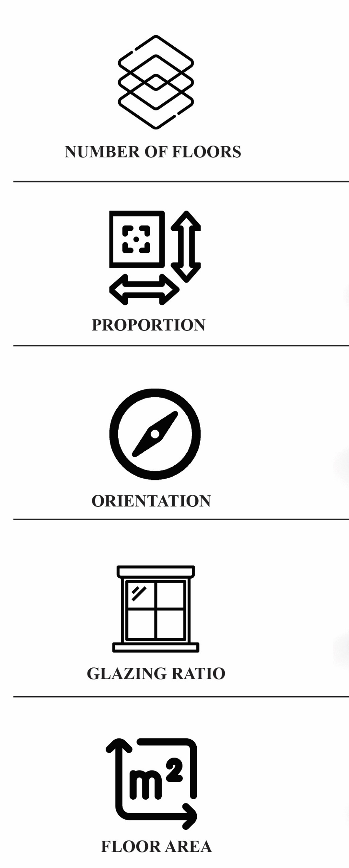
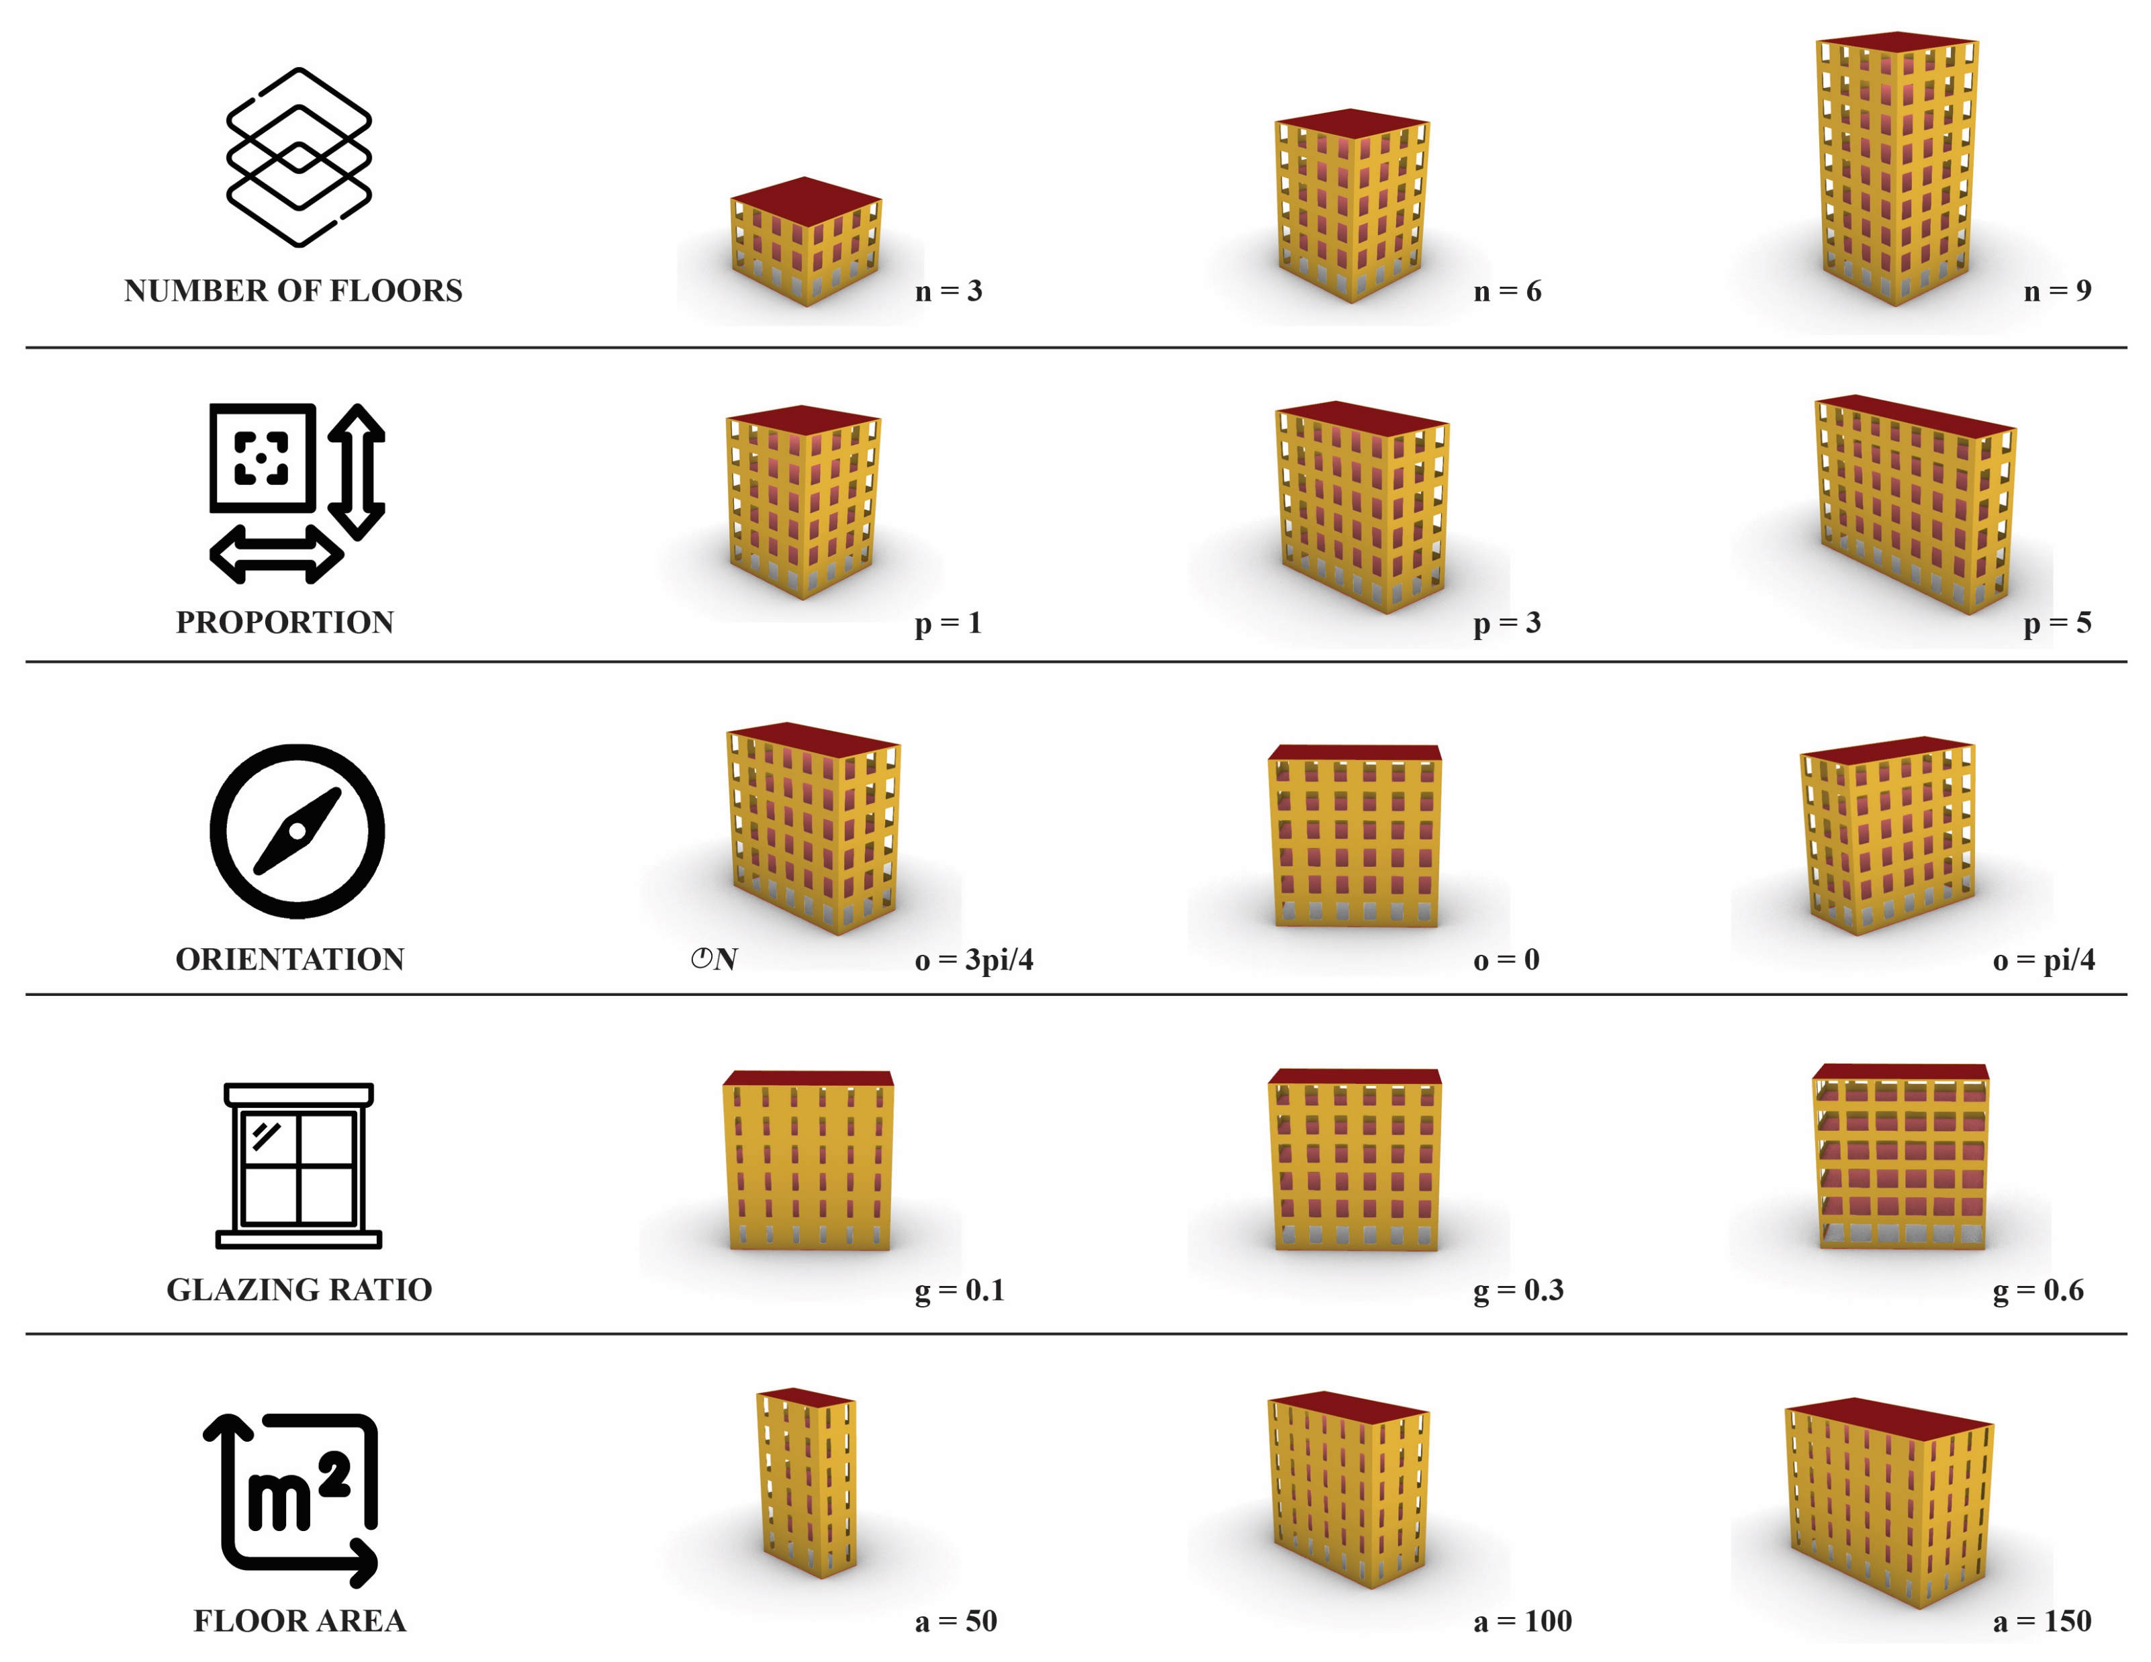
RESULTS
Construction period | Construction ID | Wall U_Value (kWh/m²) | Roof U_Value (W/m²⋅ºC) | Floor U_Value (W/m²⋅ºC) | Window U_Value (W/m²⋅ºC) | Wall retrofit U-value (W/m²⋅ºC) | Roof retrofit U-value (W/m²⋅ºC)
<1919 | 1 | 2.78 | 1.99 | 1.80 | 2.69 | 0.61 | 0.63
1919-1945 | 2 | 2.78 | 1.99 | 1.80 | 2.69 | 0.61 | 0.63
1946-1960 | 3 | 1.49 | 1.99 | 1.80 | 2.69 | 0.57 | 0.63
1961-1970 | 4 | 1.08 | 1.99 | 3.03 | 2.69 | 0.49 | 0.63
1971-1980 | 5 | 1.26 | 1.99 | 3.03 | 2.69 | 0.53 | 0.63
1981-1990 | 6 | 0.50 | 1.99 | 3.03 | 2.69 | 0.32 | 0.63
1991-1995 | 7 | 0.49 | 1.99 | 3.03 | 2.69 | 0.32 | 0.63
1996-2000 | 8 | 0.46 | 1.99 | 2.31 | 2.69 | 0.29 | 0.63
2001-2005 | 9 | 0.25 | 1.99 | 2.31 | 2.69 | 0.19 | 0.63
>2006 | 10 | 0.25 | 1.99 | 2.31 | 2.69 | 0.19 | 0.63
1. Data Gathering
4. Validation
2. Simulation
5. Optimization
Khepri AD Tool
3. Regression Models

Slide 63
RESULTS
Construction period | Construction ID | Wall U_Value (kWh/m²) | Roof U_Value (W/m²⋅ºC) | Floor U_Value (W/m²⋅ºC) | Window U_Value (W/m²⋅ºC) | Wall retrofit U-value (W/m²⋅ºC) | Roof retrofit U-value (W/m²⋅ºC)
<1919 | 1 | 2.78 | 1.99 | 1.80 | 2.69 | 0.61 | 0.63
1919-1945 | 2 | 2.78 | 1.99 | 1.80 | 2.69 | 0.61 | 0.63
1946-1960 | 3 | 1.49 | 1.99 | 1.80 | 2.69 | 0.57 | 0.63
1961-1970 | 4 | 1.08 | 1.99 | 3.03 | 2.69 | 0.49 | 0.63
1971-1980 | 5 | 1.26 | 1.99 | 3.03 | 2.69 | 0.53 | 0.63
1981-1990 | 6 | 0.50 | 1.99 | 3.03 | 2.69 | 0.32 | 0.63
1991-1995 | 7 | 0.49 | 1.99 | 3.03 | 2.69 | 0.32 | 0.63
1996-2000 | 8 | 0.46 | 1.99 | 2.31 | 2.69 | 0.29 | 0.63
2001-2005 | 9 | 0.25 | 1.99 | 2.31 | 2.69 | 0.19 | 0.63
>2006 | 10 | 0.25 | 1.99 | 2.31 | 2.69 | 0.19 | 0.63
Min = 2
Max = 11
1. Data Gathering
4. Validation
2. Simulation
5. Optimization
Khepri AD Tool
3. Regression Models

Slide 64
RESULTS
Construction period | Construction ID | Wall U_Value (kWh/m²) | Roof U_Value (W/m²⋅ºC) | Floor U_Value (W/m²⋅ºC) | Window U_Value (W/m²⋅ºC) | Wall retrofit U-value (W/m²⋅ºC) | Roof retrofit U-value (W/m²⋅ºC)
<1919 | 1 | 2.78 | 1.99 | 1.80 | 2.69 | 0.61 | 0.63
1919-1945 | 2 | 2.78 | 1.99 | 1.80 | 2.69 | 0.61 | 0.63
1946-1960 | 3 | 1.49 | 1.99 | 1.80 | 2.69 | 0.57 | 0.63
1961-1970 | 4 | 1.08 | 1.99 | 3.03 | 2.69 | 0.49 | 0.63
1971-1980 | 5 | 1.26 | 1.99 | 3.03 | 2.69 | 0.53 | 0.63
1981-1990 | 6 | 0.50 | 1.99 | 3.03 | 2.69 | 0.32 | 0.63
1991-1995 | 7 | 0.49 | 1.99 | 3.03 | 2.69 | 0.32 | 0.63
1996-2000 | 8 | 0.46 | 1.99 | 2.31 | 2.69 | 0.29 | 0.63
2001-2005 | 9 | 0.25 | 1.99 | 2.31 | 2.69 | 0.19 | 0.63
>2006 | 10 | 0.25 | 1.99 | 2.31 | 2.69 | 0.19 | 0.63
Min = 2
Max = 11
Min = 1
Max = 5
1. Data Gathering
4. Validation
2. Simulation
5. Optimization
Khepri AD Tool
3. Regression Models

Slide 65
RESULTS
Construction period | Construction ID | Wall U_Value (kWh/m²) | Roof U_Value (W/m²⋅ºC) | Floor U_Value (W/m²⋅ºC) | Window U_Value (W/m²⋅ºC) | Wall retrofit U-value (W/m²⋅ºC) | Roof retrofit U-value (W/m²⋅ºC)
<1919 | 1 | 2.78 | 1.99 | 1.80 | 2.69 | 0.61 | 0.63
1919-1945 | 2 | 2.78 | 1.99 | 1.80 | 2.69 | 0.61 | 0.63
1946-1960 | 3 | 1.49 | 1.99 | 1.80 | 2.69 | 0.57 | 0.63
1961-1970 | 4 | 1.08 | 1.99 | 3.03 | 2.69 | 0.49 | 0.63
1971-1980 | 5 | 1.26 | 1.99 | 3.03 | 2.69 | 0.53 | 0.63
1981-1990 | 6 | 0.50 | 1.99 | 3.03 | 2.69 | 0.32 | 0.63
1991-1995 | 7 | 0.49 | 1.99 | 3.03 | 2.69 | 0.32 | 0.63
1996-2000 | 8 | 0.46 | 1.99 | 2.31 | 2.69 | 0.29 | 0.63
2001-2005 | 9 | 0.25 | 1.99 | 2.31 | 2.69 | 0.19 | 0.63
>2006 | 10 | 0.25 | 1.99 | 2.31 | 2.69 | 0.19 | 0.63
Min = 2
Max = 11
Min = 1
Max = 5
Min = 0
Max = pi
1. Data Gathering
4. Validation
2. Simulation
5. Optimization
Khepri AD Tool
3. Regression Models

Slide 66
RESULTS
Construction period | Construction ID | Wall U_Value (kWh/m²) | Roof U_Value (W/m²⋅ºC) | Floor U_Value (W/m²⋅ºC) | Window U_Value (W/m²⋅ºC) | Wall retrofit U-value (W/m²⋅ºC) | Roof retrofit U-value (W/m²⋅ºC)
<1919 | 1 | 2.78 | 1.99 | 1.80 | 2.69 | 0.61 | 0.63
1919-1945 | 2 | 2.78 | 1.99 | 1.80 | 2.69 | 0.61 | 0.63
1946-1960 | 3 | 1.49 | 1.99 | 1.80 | 2.69 | 0.57 | 0.63
1961-1970 | 4 | 1.08 | 1.99 | 3.03 | 2.69 | 0.49 | 0.63
1971-1980 | 5 | 1.26 | 1.99 | 3.03 | 2.69 | 0.53 | 0.63
1981-1990 | 6 | 0.50 | 1.99 | 3.03 | 2.69 | 0.32 | 0.63
1991-1995 | 7 | 0.49 | 1.99 | 3.03 | 2.69 | 0.32 | 0.63
1996-2000 | 8 | 0.46 | 1.99 | 2.31 | 2.69 | 0.29 | 0.63
2001-2005 | 9 | 0.25 | 1.99 | 2.31 | 2.69 | 0.19 | 0.63
>2006 | 10 | 0.25 | 1.99 | 2.31 | 2.69 | 0.19 | 0.63
Min = 2
Max = 11
Min = 1
Max = 5
Min = 0
Max = pi
Min = 0
Max = 0.7
1. Data Gathering
4. Validation
2. Simulation
5. Optimization
Khepri AD Tool
3. Regression Models

Slide 67
RESULTS
Construction period | Construction ID | Wall U_Value (kWh/m²) | Roof U_Value (W/m²⋅ºC) | Floor U_Value (W/m²⋅ºC) | Window U_Value (W/m²⋅ºC) | Wall retrofit U-value (W/m²⋅ºC) | Roof retrofit U-value (W/m²⋅ºC)
<1919 | 1 | 2.78 | 1.99 | 1.80 | 2.69 | 0.61 | 0.63
1919-1945 | 2 | 2.78 | 1.99 | 1.80 | 2.69 | 0.61 | 0.63
1946-1960 | 3 | 1.49 | 1.99 | 1.80 | 2.69 | 0.57 | 0.63
1961-1970 | 4 | 1.08 | 1.99 | 3.03 | 2.69 | 0.49 | 0.63
1971-1980 | 5 | 1.26 | 1.99 | 3.03 | 2.69 | 0.53 | 0.63
1981-1990 | 6 | 0.50 | 1.99 | 3.03 | 2.69 | 0.32 | 0.63
1991-1995 | 7 | 0.49 | 1.99 | 3.03 | 2.69 | 0.32 | 0.63
1996-2000 | 8 | 0.46 | 1.99 | 2.31 | 2.69 | 0.29 | 0.63
2001-2005 | 9 | 0.25 | 1.99 | 2.31 | 2.69 | 0.19 | 0.63
>2006 | 10 | 0.25 | 1.99 | 2.31 | 2.69 | 0.19 | 0.63
Min = 2
Max = 11
Min = 1
Max = 5
Min = 0
Max = pi
Min = 0
Max = 0.7
1. Data Gathering
4. Validation
Min = 50
Max = 300
2. Simulation
5. Optimization
Khepri AD Tool
3. Regression Models

Slide 68
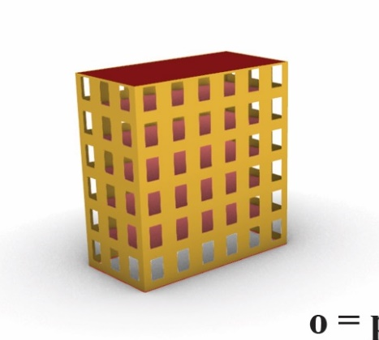
RESULTS
Min = 2
Max = 11
Min = 1
Max = 5
Min = 0
Max = pi
Min = 0
Max = 0.7
1. Data Gathering
4. Validation
Min = 50
Max = 300
2. Simulation
5. Optimization
Khepri AD Tool
3. Regression Models

Slide 69
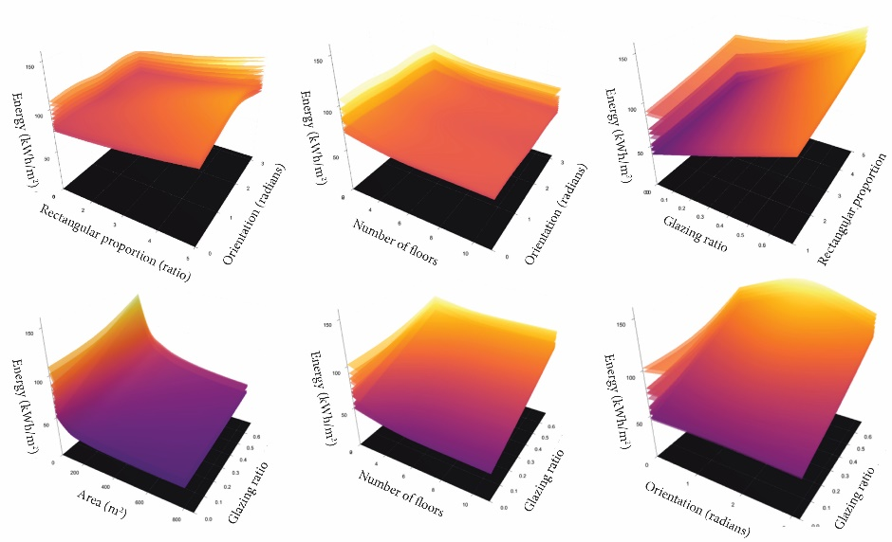
RESULTS
Min = 2
Max = 11
Min = 1
Max = 5
Min = 0
Max = pi
Min = 0
Max = 0.7
1. Data Gathering
4. Validation
Min = 50
Max = 300
2. Simulation
5. Optimization
Khepri AD Tool
3. Regression Models

Slide 70
RESULTS
1. Data Gathering
4. Validation
2. Simulation
5. Optimization
Khepri AD Tool
3. Regression Models

Slide 71
RESULTS
 | Linear Regression | Ridge | Random Forest | Extra Trees
1. Data Gathering
4. Validation
2. Simulation
5. Optimization
Khepri AD Tool
3. Regression Models

Slide 72
RESULTS
 | Linear Regression | Ridge | Random Forest | Extra Trees
1. Data Gathering
4. Validation
2. Simulation
5. Optimization
Khepri AD Tool
3. Regression Models
25 kWh/m²
175 kWh/m²

Slide 73
RESULTS
 | Linear Regression | Ridge | Random Forest | Extra Trees
Mean Error (kWh/m²)
Root Mean Squared Error (kWh/m²)
R2 score
1. Data Gathering
4. Validation
2. Simulation
5. Optimization
Khepri AD Tool
3. Regression Models
25 kWh/m²
175 kWh/m²

Slide 74
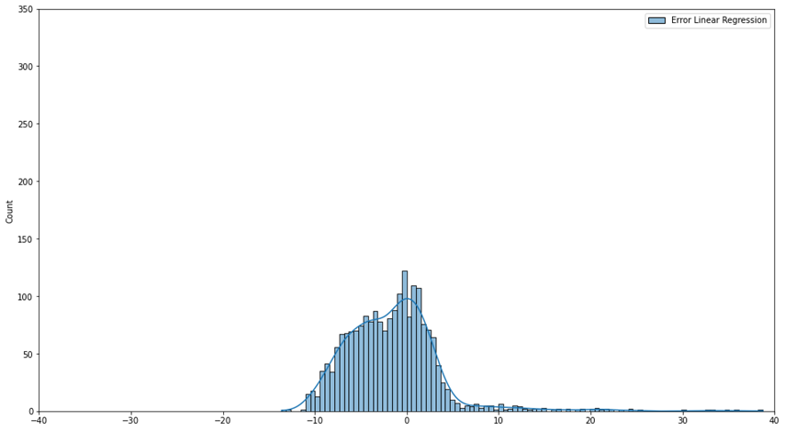
RESULTS
 | Linear Regression | Ridge | Random Forest | Extra Trees
Mean Error (kWh/m²)
Root Mean Squared Error (kWh/m²)
R2 score
Count
kWh/m²
1. Data Gathering
4. Validation
2. Simulation
5. Optimization
Khepri AD Tool
3. Regression Models
25 kWh/m²
175 kWh/m²

Slide 75
RESULTS
 | Linear Regression | Ridge | Random Forest | Extra Trees
Mean Error (kWh/m²) | 15.85
Root Mean Squared Error (kWh/m²) | 15.40
R2 score | 0.64
Count
kWh/m²
1. Data Gathering
4. Validation
2. Simulation
5. Optimization
Khepri AD Tool
3. Regression Models
25 kWh/m²
175 kWh/m²

Slide 76
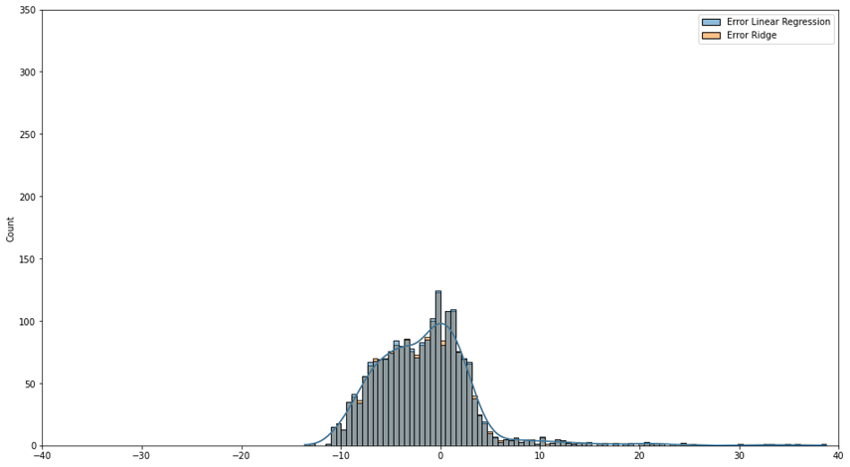
RESULTS
 | Linear Regression | Ridge | Random Forest | Extra Trees
Mean Error (kWh/m²) | 15.85 | 15.79
Root Mean Squared Error (kWh/m²) | 15.40 | 15.40
R2 score | 0.64 | 0.64
Count
kWh/m²
1. Data Gathering
4. Validation
2. Simulation
5. Optimization
Khepri AD Tool
3. Regression Models
25 kWh/m²
175 kWh/m²

Slide 77
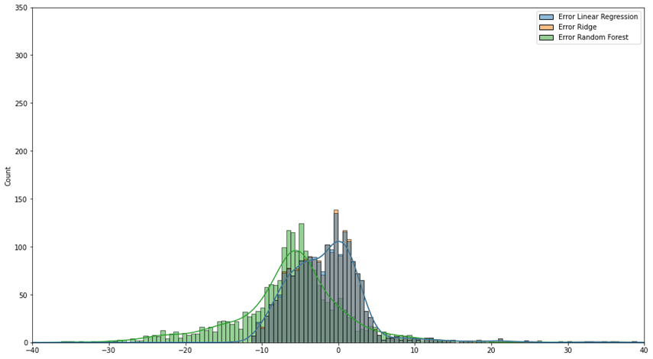
RESULTS
 | Linear Regression | Ridge | Random Forest | Extra Trees
Mean Error (kWh/m²) | 15.85 | 15.79 | -6.06
Root Mean Squared Error (kWh/m²) | 15.40 | 15.40 | 9.88
R2 score | 0.64 | 0.64 | 0.85
Count
kWh/m²
1. Data Gathering
4. Validation
2. Simulation
5. Optimization
Khepri AD Tool
3. Regression Models
25 kWh/m²
175 kWh/m²

Slide 78
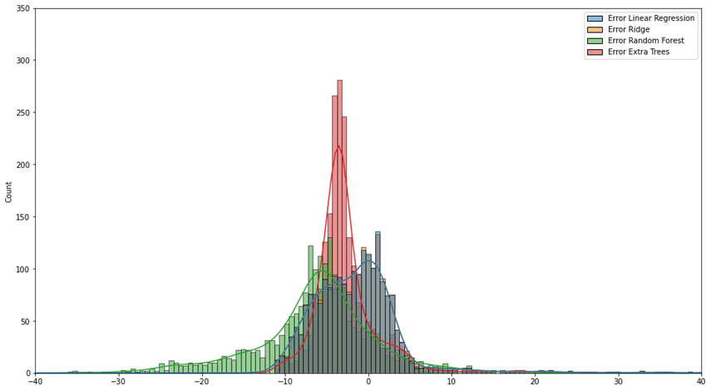
RESULTS
 | Linear Regression | Ridge | Random Forest | Extra Trees
Mean Error (kWh/m²) | 15.85 | 15.79 | -6.06 | -2.21
Root Mean Squared Error (kWh/m²) | 15.40 | 15.40 | 9.88 | 5.44
R2 score | 0.64 | 0.64 | 0.85 | 0.95
Count
kWh/m²
1. Data Gathering
4. Validation
2. Simulation
5. Optimization
Khepri AD Tool
3. Regression Models
25 kWh/m²
175 kWh/m²

Slide 79
RESULTS
 | Linear Regression | Ridge | Random Forest | Extra Trees
Mean Error (kWh/m²) | 15.85 | 15.79 | -6.06 | -2.21
Root Mean Squared Error (kWh/m²) | 15.40 | 15.40 | 9.88 | 5.44
R2 score | 0.64 | 0.64 | 0.85 | 0.95
Count
kWh/m²
1. Data Gathering
4. Validation
2. Simulation
5. Optimization
Khepri AD Tool
3. Regression Models
25 kWh/m²
175 kWh/m²

Slide 80
RESULTS
1. Data Gathering
4. Validation
2. Simulation
5. Optimization
Khepri AD Tool
3. Regression Models

Slide 81
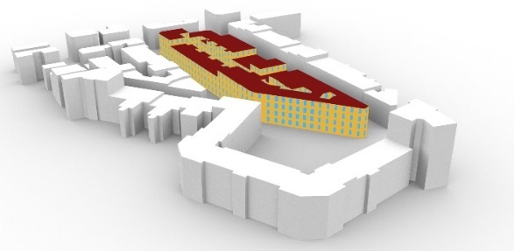
RESULTS
1. Data Gathering
4. Validation
2. Simulation
5. Optimization
Khepri AD Tool
3. Regression Models

Slide 82
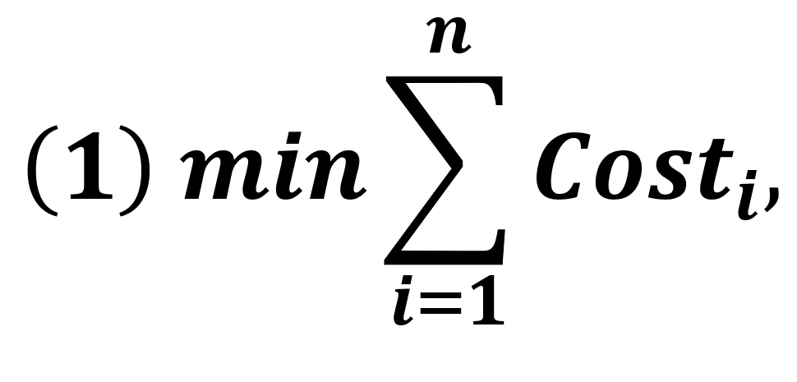
RESULTS
1. Data Gathering
4. Validation
2. Simulation
5. Optimization
Khepri AD Tool
3. Regression Models

Slide 83
RESULTS
1. Data Gathering
4. Validation
2. Simulation
5. Optimization
Khepri AD Tool
3. Regression Models

Slide 84
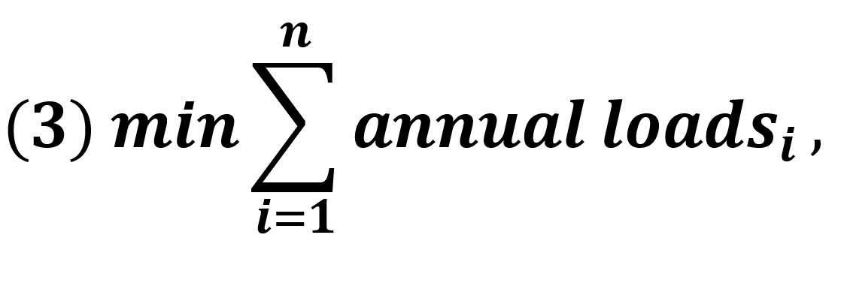
RESULTS
1. Data Gathering
4. Validation
2. Simulation
5. Optimization
Khepri AD Tool
3. Regression Models

Slide 85
RESULTS
1. Data Gathering
4. Validation
NSGAII – 800 evals
2. Simulation
5. Optimization
Khepri AD Tool
3. Regression Models

Slide 86
RESULTS
 | Elapsed Time (s)
 | Dataset simulation | Optimization
Model-Based | 5820.00 | 67516.70
1. Data Gathering
4. Validation
NSGAII – 800 evals
2. Simulation
5. Optimization
Khepri AD Tool
3. Regression Models

Slide 87
RESULTS
 | Elapsed Time (s)
 | Dataset simulation | Optimization
Model-Based | 5820.00 | 67516.70
AD-based | 0.08 | 791.99
1. Data Gathering
4. Validation
NSGAII – 800 evals
2. Simulation
5. Optimization
Khepri AD Tool
3. Regression Models

Slide 88
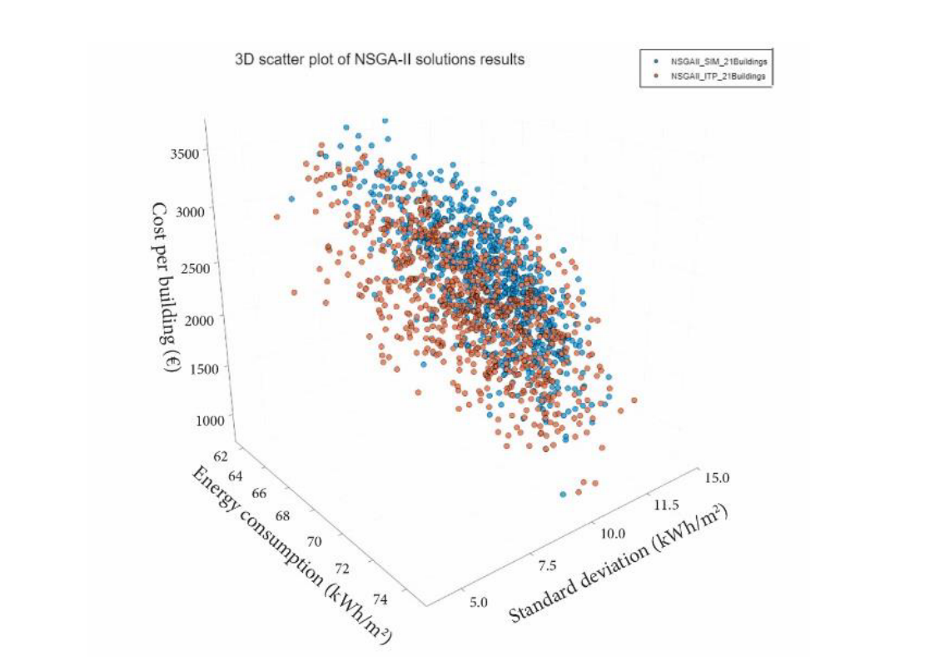
RESULTS
 | Elapsed Time (s)
 | Dataset simulation | Optimization
Model-Based | 5820.00 | 67516.70
AD-based | 0.08 | 791.99
1. Data Gathering
4. Validation
NSGAII – 800 evals
2. Simulation
5. Optimization
Khepri AD Tool
3. Regression Models

Slide 89
RESULTS
 | Elapsed Time (s)
 | Dataset simulation | Optimization
Model-Based | 5820.00 | 67516.70
AD-based | 0.08 | 791.99
1. Data Gathering
4. Validation
NSGAII – 800 evals
2. Simulation
5. Optimization
Khepri AD Tool
3. Regression Models

Slide 90
DISCUSSION
 | Elapsed Time (s)
 | Dataset simulation | Optimization
Model-Based | 5820.00 | 67516.70
AD-based | 0.08 | 791.99
NSGAII – 800 evals

Slide 91
DISCUSSION
Model-based approach
Set up
Simulation
 | Elapsed Time (s)
 | Dataset simulation | Optimization
Model-Based | 5820.00 | 67516.70
AD-based | 0.08 | 791.99
NSGAII – 800 evals

Slide 92
DISCUSSION
Model-based approach
Set up
Simulation
 | Elapsed Time (s)
 | Dataset simulation | Optimization
Model-Based | 5820.00 | 67516.70
AD-based | 0.08 | 791.99
NSGAII – 800 evals

Slide 93
DISCUSSION
Surrogate model approach
Set up
Simulation
 | Elapsed Time (s)
 | Dataset simulation | Optimization
Model-Based | 5820.00 | 67516.70
AD-based | 0.08 | 791.99
NSGAII – 800 evals

Slide 94
DISCUSSION
Surrogate model approach
Set up
Simulation
 | Elapsed Time (s)
 | Dataset simulation | Optimization
Model-Based | 5820.00 | 67516.70
AD-based | 0.08 | 791.99
NSGAII – 800 evals

Slide 95
CONCLUSION

Slide 96
CONCLUSION
RMSE – 5.44 kWh/m²

Slide 97
CONCLUSION
RMSE – 5.44 kWh/m²
R2 Score – 0.95

Slide 98
CONCLUSION
RMSE – 5.44 kWh/m²
R2 Score – 0.95
Easily applicable to other urban settings

Slide 99
CONCLUSION
RMSE – 5.44 kWh/m²
R2 Score – 0.95
Easily applicable to other urban settings
Increased speed

Slide 100
CONCLUSION
RMSE – 5.44 kWh/m²
R2 Score – 0.95
Easily applicable to other urban settings
Increased speed
Model training time

Slide 101
CONCLUSION
RMSE – 5.44 kWh/m²
R2 Score – 0.95
Easily applicable to other urban settings
Increased speed
Model training time

Slide 102
CONCLUSION
RMSE – 5.44 kWh/m²
R2 Score – 0.95
Easily applicable to other urban settings
No shading and context geometry
Increased speed
Model training time

Slide 103
CONCLUSION
RMSE – 5.44 kWh/m²
R2 Score – 0.95
Easily applicable to other urban settings
No shading and context geometry
Increased speed
Low number of retrofit variables
Model training time

Slide 104
CONCLUSION
RMSE – 5.44 kWh/m²
R2 Score – 0.95
Easily applicable to other urban settings
No shading and context geometry
Increased speed
Low number of retrofit variables
Model training time
Still highly time-consuming for a high number of construction solutions

Slide 105
CONCLUSION
RMSE – 5.44 kWh/m²
R2 Score – 0.95
Easily applicable to other urban settings
No shading and context geometry
Increased speed
Low number of retrofit variables
Model training time
Still highly time-consuming for a high number of construction solutions

Slide 106
FUTURE WORK
Outputs

Slide 107
FUTURE WORK
Outputs
Performance

Slide 108
FUTURE WORK
Outputs
Performance
User-Experience

Slide 109
FUTURE WORK
Outputs
Performance
User-Experience
Daylighting

Slide 110
FUTURE WORK
Outputs
Performance
User-Experience
Daylighting
Thermal Comfort

Slide 111
FUTURE WORK
Outputs
Performance
User-Experience
Daylighting
Parallelization Techniques
Thermal Comfort

Slide 112
FUTURE WORK
Outputs
Performance
User-Experience
Daylighting
Parallelization Techniques
Thermal Comfort
Context shading, building constructions, typologies, windows and more.

Slide 113
FUTURE WORK
Outputs
Performance
User-Experience
Daylighting
Parallelization Techniques
GUI
Thermal Comfort
Context shading, building constructions, typologies, windows and more.

Slide 114
FUTURE WORK
Outputs
Performance
User-Experience
Daylighting
Parallelization Techniques
GUI
Thermal Comfort
Context shading, building constructions, typologies, windows and more.
Benchmark analyses and optimizations

Slide 115
AD-based Surrogate Models for Simulation and Optimization of Large Urban Areas
Gonçalo Araújo - goncalo.r.araujo@tecnico.ulisboa.pt;
Luís Santos - lfds@create.aau.dk
António Leitão - antonio.menezes.leitao@tecnico.ulisboa.pt; Ricardo Gomes - ricardo.a.gomes@tecnico.ulisboa.pt

