Slide 1






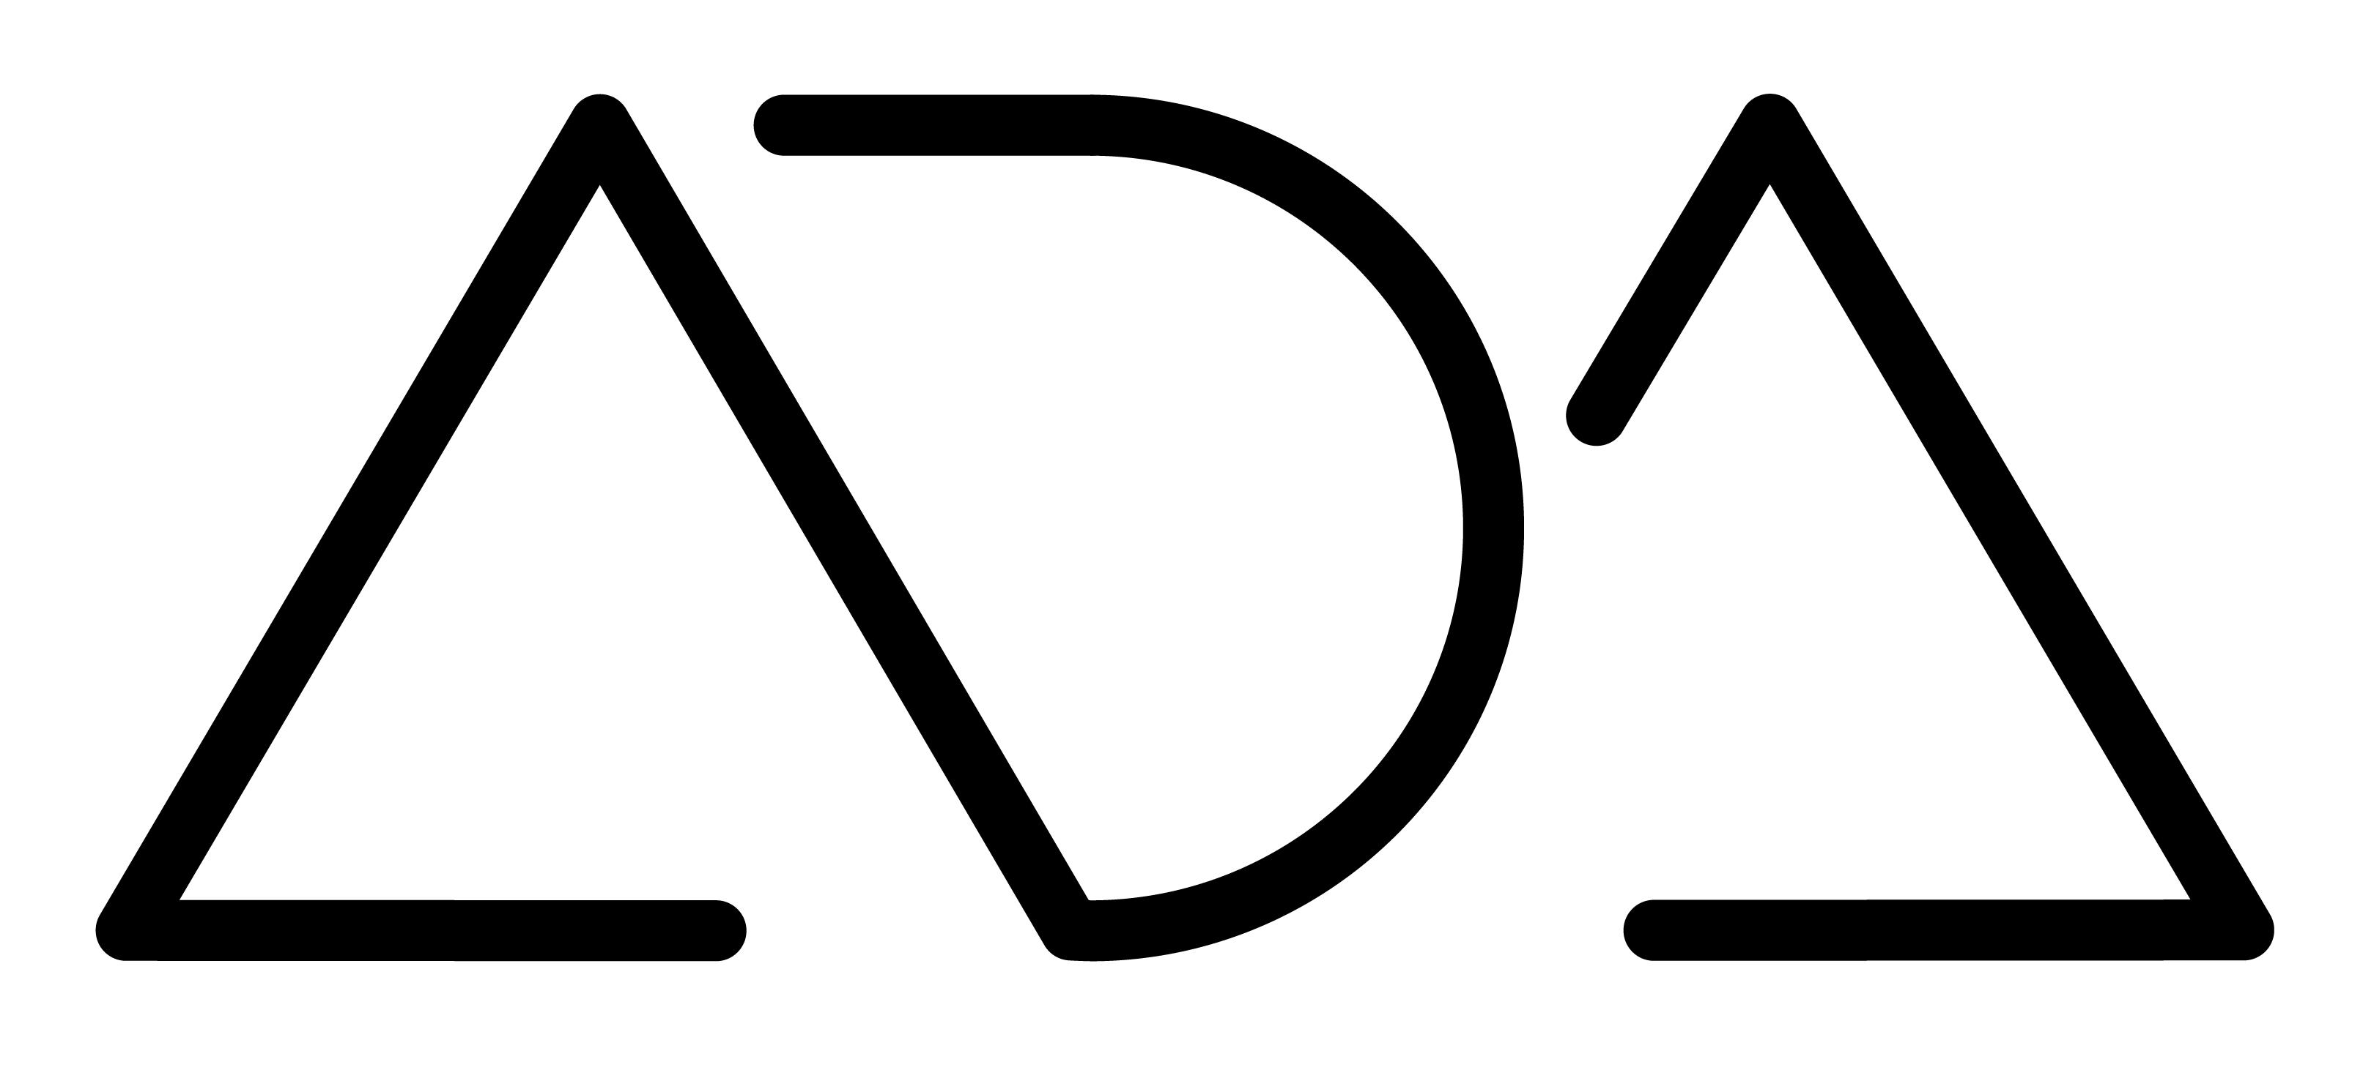
R
everse Algorithmic Design
António Leitão | Sara Garcia

Slide 2


Algorithmic Design
R

Slide 3
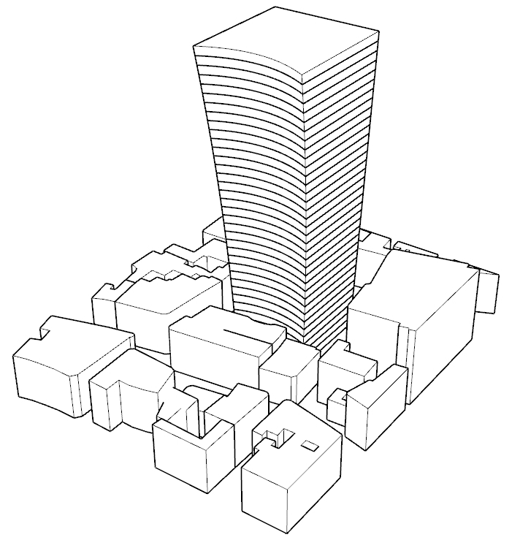
Algorithmic Design
The Walkie-Talkie building
From Macro to Micro: An integrated algorithmic approach towards sustainable cities, H. Martinho, G. Araújo, A. Leitão, CAADRIA 2020

Slide 4
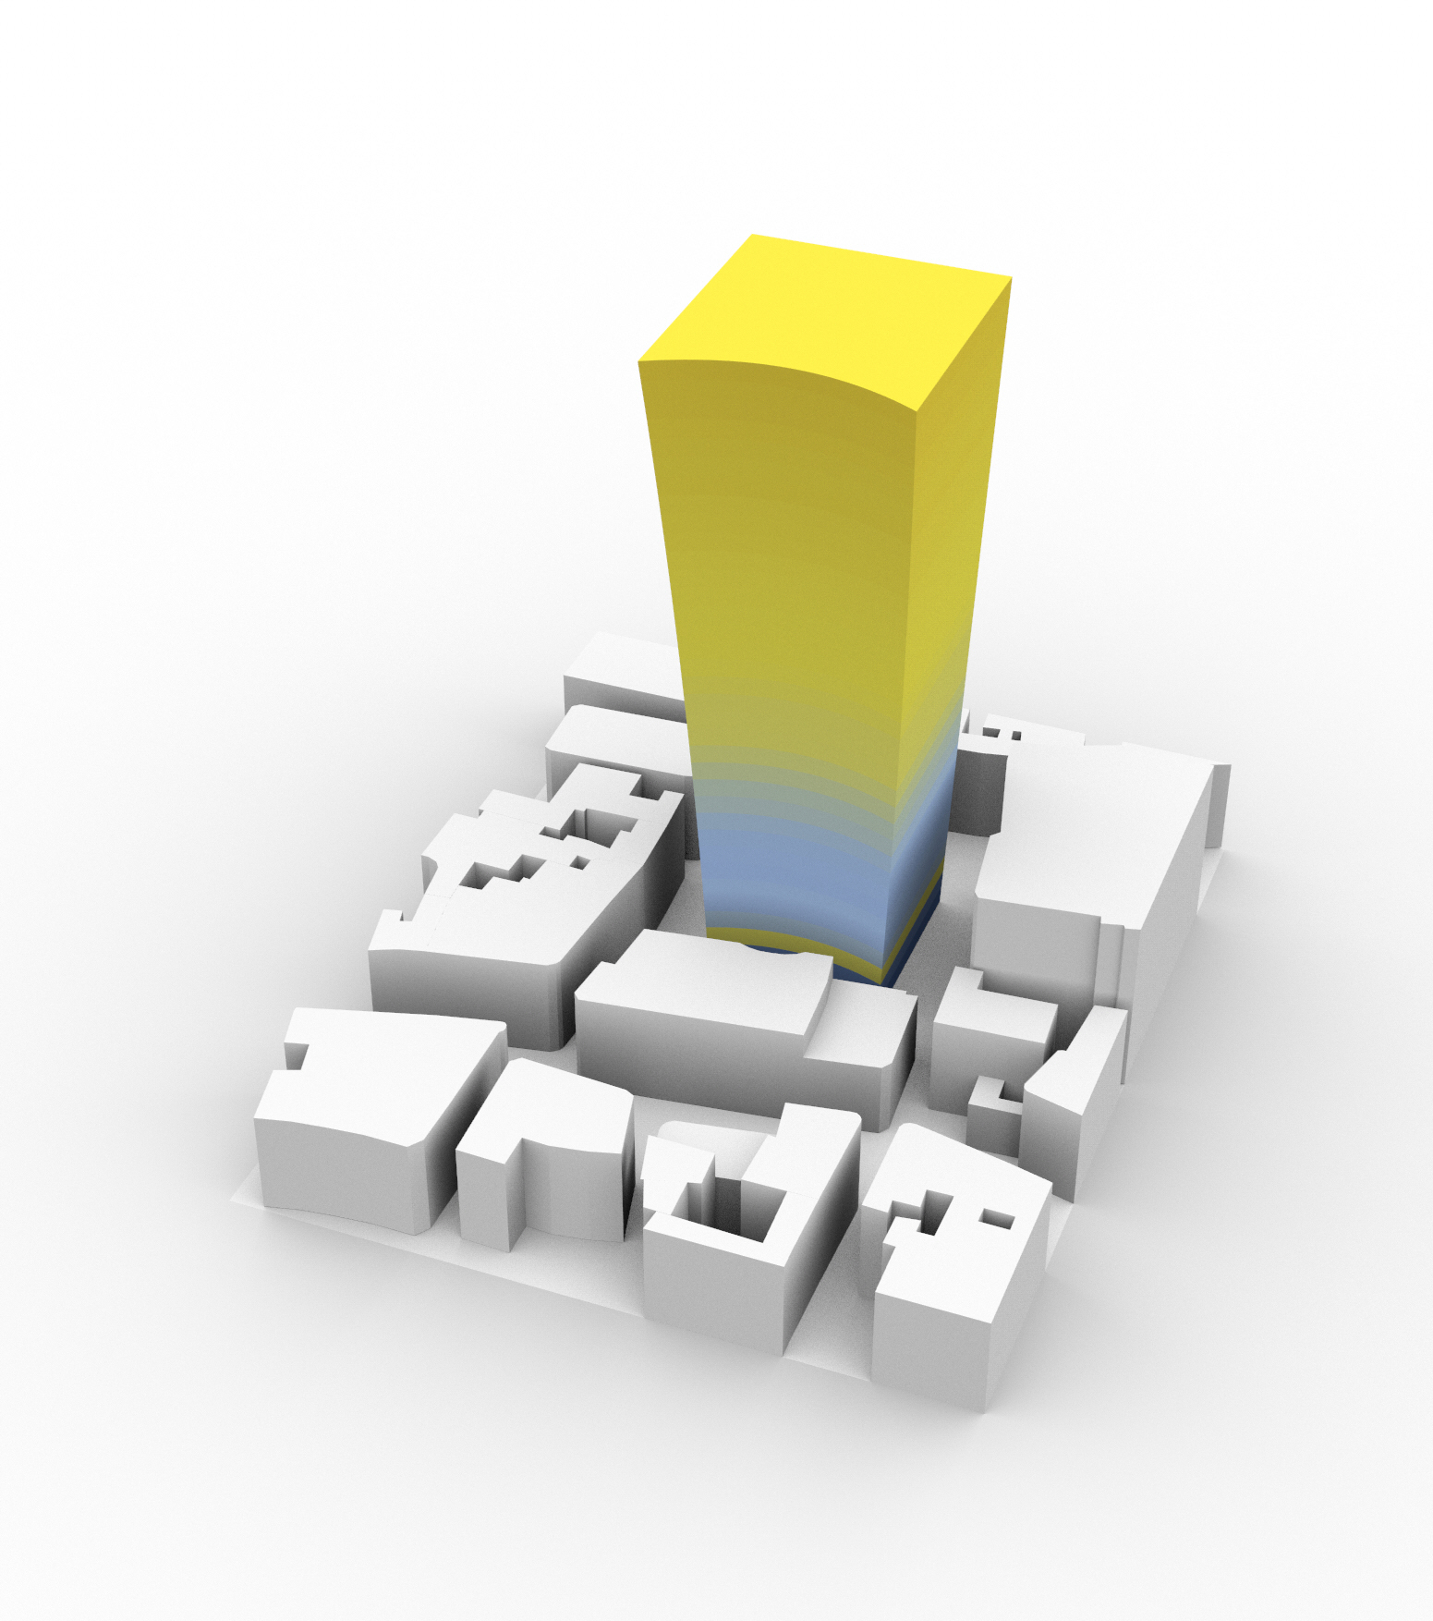
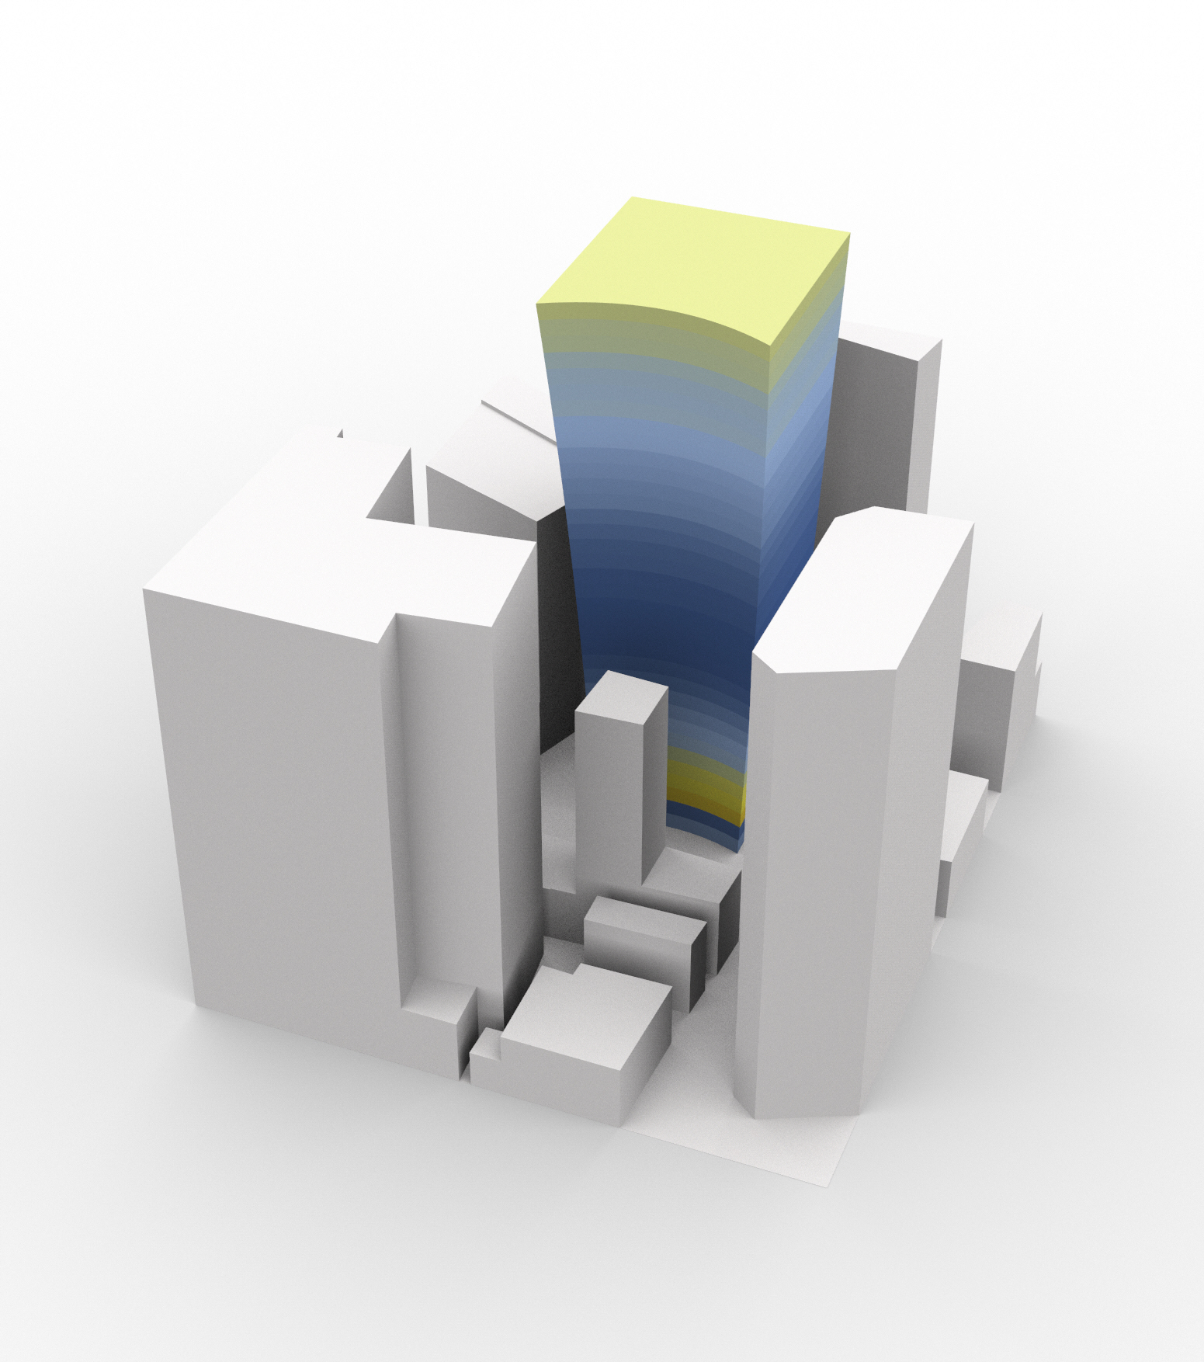
Algorithmic Design
Thermal Analysis in London (left) and NY (right)
From Macro to Micro: An integrated algorithmic approach towards sustainable cities, H. Martinho, G. Araújo, A. Leitão, CAADRIA 2020

Slide 5
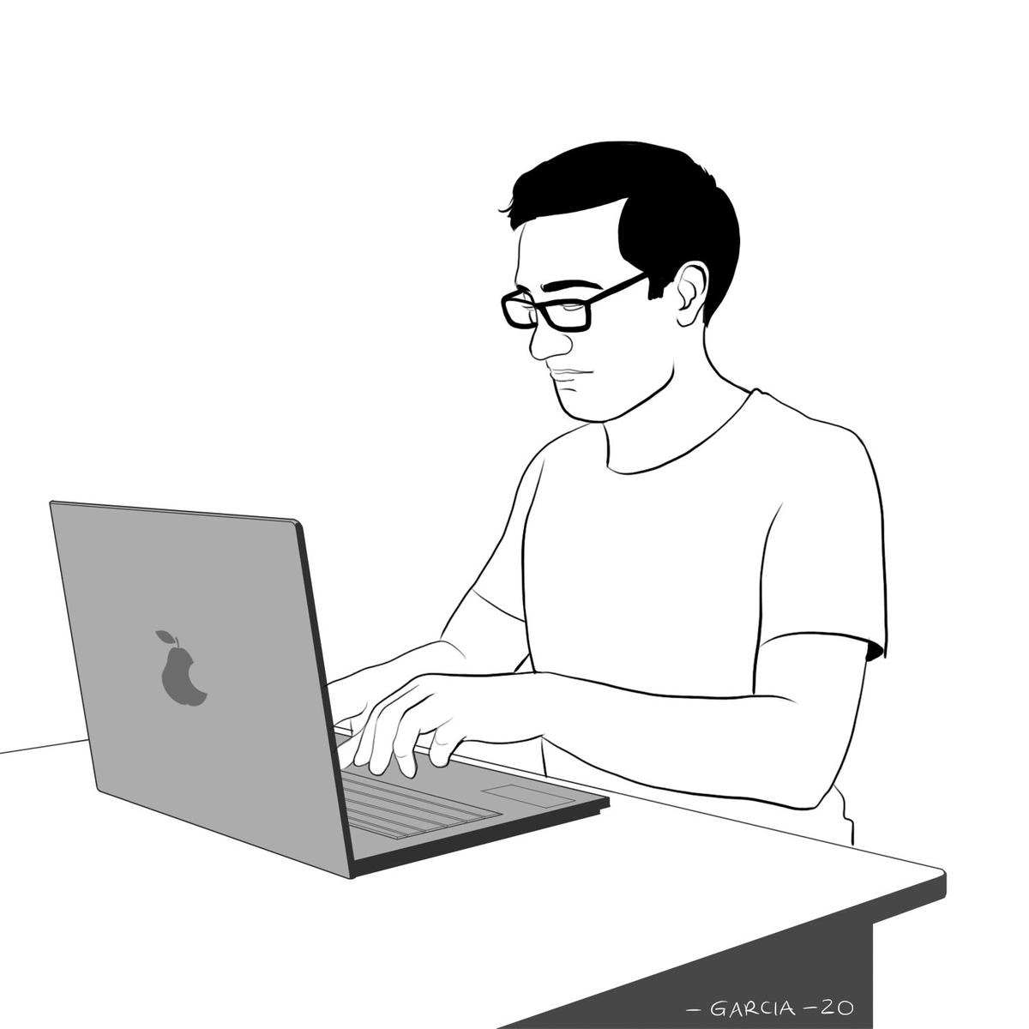
Algorithmic Design
Illustration by Daniel Garcia

Slide 6
Reverse
Algorithmic Design

Slide 7
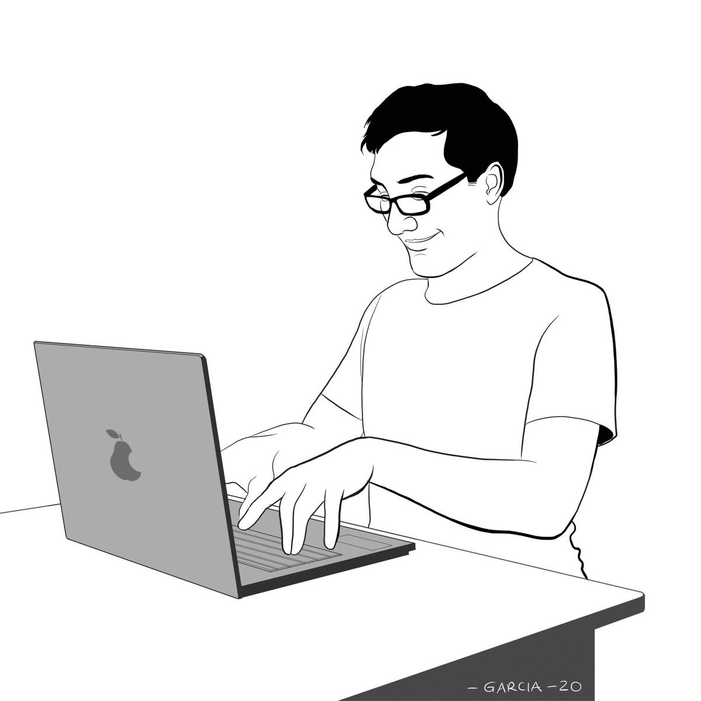
Reverse
Algorithmic Design
Illustration by Daniel Garcia

Slide 8
Workflow

Slide 10

Extraction
line(xy(-25.0, -5.0), xyz(-24.5, -5.0, 9.0))
line(xy(-25.0, -6.7), xyz(-24.1, -6.7, 9.0))
line(xy(-25.0, -8.3), xyz(-23.6, -8.3, 9.0))
line(xy(-25.0, -10.0), xyz(-22.9, -10.0, 9.0))
line(xy(-25.0, -11.7), xyz(-22.1, -11.7, 9.0))
line(xy(-25.0, -13.3), xyz(-21.1, -13.3, 9.0))
line(xy(-25.0, -15.0), xyz(-20.0, -15.0, 9.0))
line(xy(-25.0, -16.7), xyz(-18.6, -16.7, 9.0))
line(xy(-25.0, -18.3), xyz(-17.0, -18.3, 9.0))
line(xy(-25.0, -20.0), xyz(-15.0, -20.0, 9.0))
line(xy(-25.0, -21.7), xyz(-12.5, -21.7, 9.0))
line(xy(-25.0, -23.3), xyz(-9.0, -23.3, 9.0))
line(xy(-25.0, -25.0), xyz(0.0, -25.0, 9.0))

Slide 11

Extraction
Refactoring
line(xy(-25.0, -5.0), xyz(-24.5, -5.0, 9.0))
line(xy(-25.0, -6.7), xyz(-24.1, -6.7, 9.0))
line(xy(-25.0, -8.3), xyz(-23.6, -8.3, 9.0))
line(xy(-25.0, -10.0), xyz(-22.9, -10.0, 9.0))
line(xy(-25.0, -11.7), xyz(-22.1, -11.7, 9.0))
line(xy(-25.0, -13.3), xyz(-21.1, -13.3, 9.0))
line(xy(-25.0, -15.0), xyz(-20.0, -15.0, 9.0))
line(xy(-25.0, -16.7), xyz(-18.6, -16.7, 9.0))
line(xy(-25.0, -18.3), xyz(-17.0, -18.3, 9.0))
line(xy(-25.0, -20.0), xyz(-15.0, -20.0, 9.0))
line(xy(-25.0, -21.7), xyz(-12.5, -21.7, 9.0))
line(xy(-25.0, -23.3), xyz(-9.0, -23.3, 9.0))
line(xy(-25.0, -25.0), xyz(0.0, -25.0, 9.0))
beams(r, a, h, n_beams, t) =
for i ∈ 1:n_beams
let d = r/n_beams*i
α = arcsin(d/r)
P1 = per(pol(r, a), d)
P2 = cyl(r, a+α, h)
prism(P1, P2, vy(d*0.1), t)
end
end

Slide 12

+
Extraction
Refactoring
Traceability
line(xy(-25.0, -5.0), xyz(-24.5, -5.0, 9.0))
line(xy(-25.0, -6.7), xyz(-24.1, -6.7, 9.0))
line(xy(-25.0, -8.3), xyz(-23.6, -8.3, 9.0))
line(xy(-25.0, -10.0), xyz(-22.9, -10.0, 9.0))
line(xy(-25.0, -11.7), xyz(-22.1, -11.7, 9.0))
line(xy(-25.0, -25.0), xyz(0.0, -25.0, 9.0)))
line(xy(-25.0, -13.3), xyz(-21.1, -13.3, 9.0))
line(xy(-25.0, -15.0), xyz(-20.0, -15.0, 9.0))
line(xy(-25.0, -16.7), xyz(-18.6, -16.7, 9.0))
line(xy(-25.0, -18.3), xyz(-17.0, -18.3, 9.0)
line(xy(-25.0, -20.0), xyz(-15.0, -20.0, 9.0))
line(xy(-25.0, -21.7), xyz(-12.5, -21.7, 9.0))
line(xy(-25.0, -23.3), xyz(-9.0, -23.3, 9.0))
beams(r, a, h, n_beams, t) =
for i ∈ 1:n_beams
let d = r/n_beams*i
α = arcsin(d/r)
P1 = per(pol(r, a), d)
P2 = cyl(r, a+α, h)
prism(P1, P2, vy(d*0.1), t)
end
end

Slide 13
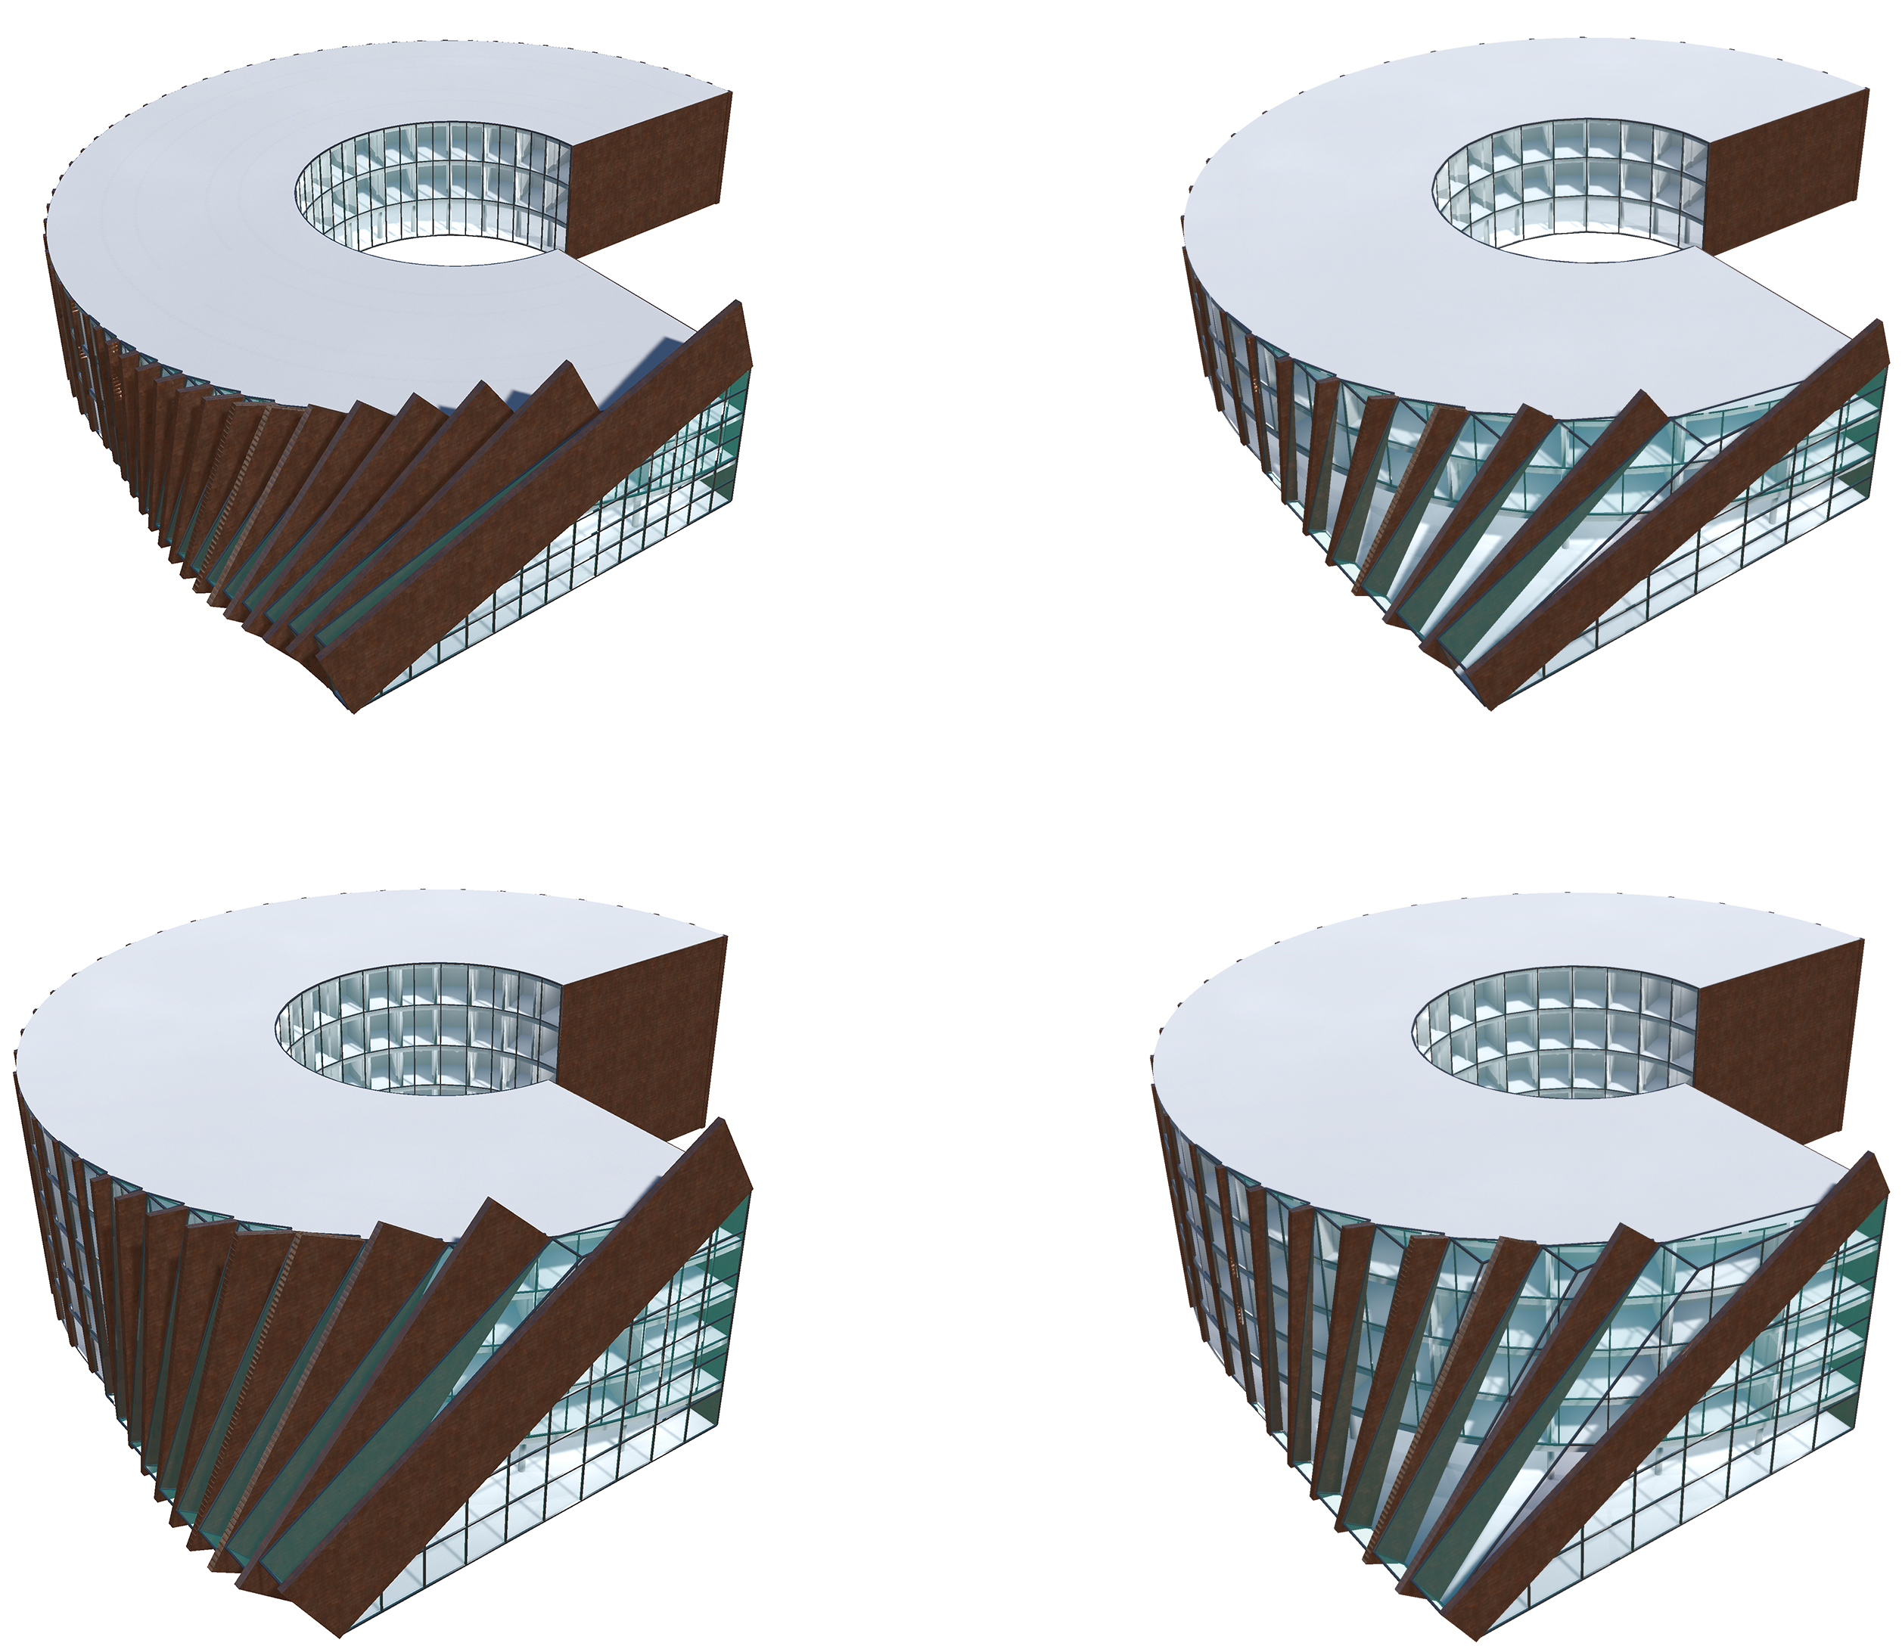
+
Extraction
Refactoring
Traceability
line(xy(-25.0, -5.0), xyz(-24.5, -5.0, 9.0))
line(xy(-25.0, -6.7), xyz(-24.1, -6.7, 9.0))
line(xy(-25.0, -8.3), xyz(-23.6, -8.3, 9.0))
line(xy(-25.0, -10.0), xyz(-22.9, -10.0, 9.0))
line(xy(-25.0, -11.7), xyz(-22.1, -11.7, 9.0))
line(xy(-25.0, -25.0), xyz(0.0, -25.0, 9.0)))
line(xy(-25.0, -13.3), xyz(-21.1, -13.3, 9.0))
line(xy(-25.0, -15.0), xyz(-20.0, -15.0, 9.0))
line(xy(-25.0, -16.7), xyz(-18.6, -16.7, 9.0))
line(xy(-25.0, -18.3), xyz(-17.0, -18.3, 9.0)
line(xy(-25.0, -20.0), xyz(-15.0, -20.0, 9.0))
line(xy(-25.0, -21.7), xyz(-12.5, -21.7, 9.0))
line(xy(-25.0, -23.3), xyz(-9.0, -23.3, 9.0))
beams(r, a, h, n_beams, t) =
for i ∈ 1:n_beams
let d = r/n_beams*i
α = arcsin(d/r)
P1 = per(pol(r, a), d)
P2 = cyl(r, a+α, h)
prism(P1, P2, vy(d*0.1), t)
end
end
Isenberg Innovation Hub building
Modeling by Retana Castelo-Branco

Slide 14
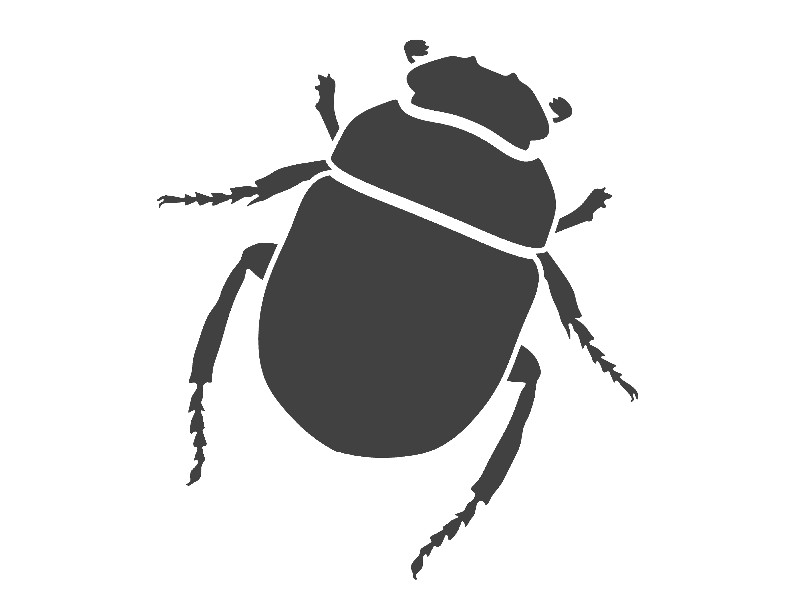
+
g
Extraction
Refactoring
Traceability
line(xy(-25.0, -5.0), xyz(-24.5, -5.0, 9.0))
line(xy(-25.0, -6.7), xyz(-24.1, -6.7, 9.0))
line(xy(-25.0, -8.3), xyz(-23.6, -8.3, 9.0))
line(xy(-25.0, -10.0), xyz(-22.9, -10.0, 9.0))
line(xy(-25.0, -11.7), xyz(-22.1, -11.7, 9.0))
line(xy(-25.0, -25.0), xyz(0.0, -25.0, 9.0)))
line(xy(-25.0, -13.3), xyz(-21.1, -13.3, 9.0))
line(xy(-25.0, -15.0), xyz(-20.0, -15.0, 9.0))
line(xy(-25.0, -16.7), xyz(-18.6, -16.7, 9.0))
line(xy(-25.0, -18.3), xyz(-17.0, -18.3, 9.0)
line(xy(-25.0, -20.0), xyz(-15.0, -20.0, 9.0))
line(xy(-25.0, -21.7), xyz(-12.5, -21.7, 9.0))
line(xy(-25.0, -23.3), xyz(-9.0, -23.3, 9.0))
beams(r, a, h, n_beams, t) =
for i ∈ 1:n_beams
let d = r/n_beams*i
α = arcsin(d/r)
P1 = per(pol(r, a), d)
P2 = cyl(r, a+α, h)
prism(P1, P2, vy(d*0.1), t)
end
end
Isenberg Innovation Hub building
Modeling by Retana Castelo-Branco

Slide 15
Evaluation

Slide 16
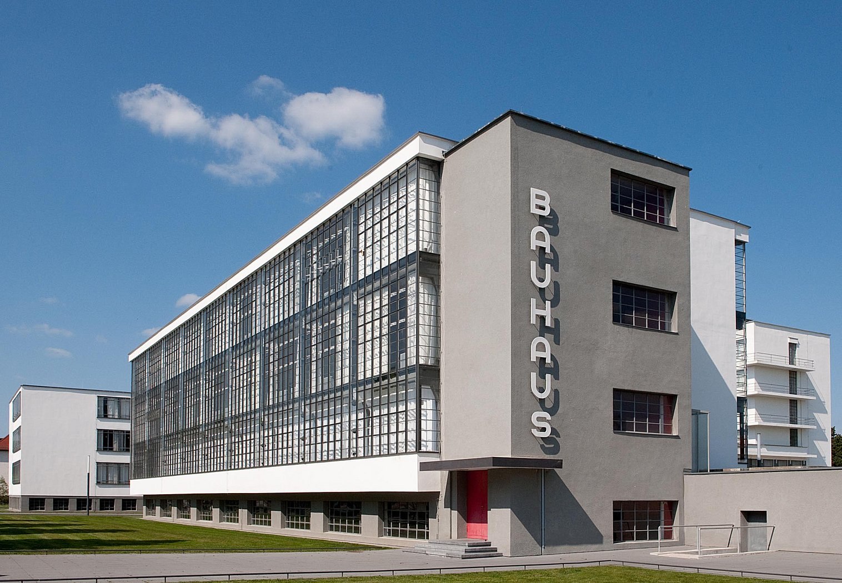
Building Renovation
Bauhaus Building (Dessau, Germany)
www.bauhaus-dessau.de

Slide 17

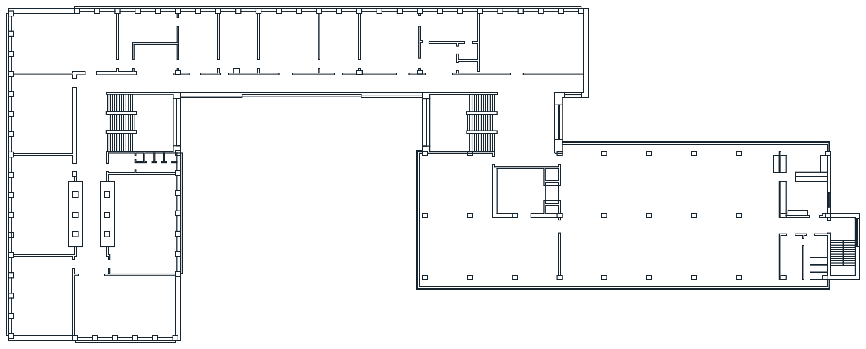

Slide 18
polygon(xy(45, 7), xy(46, 7), xy(46, 6), xy(45, 6))
polygon(xy(51, 21), xy(51, 20), xy(50, 20), xy(50, 21))
polygon(xy(50, 14), xy(51, 14), xy(51, 13), xy(50, 13))
polygon(xy(50, 7), xy(51, 7), xy(51, 6), xy(50, 6))
polygon(xy(55, 14), xy(56, 14), xy(56, 13), xy(55, 13))
polygon(xy(55, 7), xy(56, 7), xy(56, 6), xy(55, 6))
polygon(xy(60, 14), xy(61, 14), xy(61, 13), xy(60, 13))
polygon(xy(60, 7.01), xy(61, 7), xy(61, 6), xy(60, 6))
polygon(xy(65, 21), xy(66, 21), xy(66, 20), xy(65, 20))
polygon(xy(65, 14), xy(66, 14), xy(66, 13), xy(65, 13))
polygon(xy(65, 7), xy(66, 7), xy(66, 6), xy(65, 6))
polygon(xy(70, 21), xy(71, 21), xy(71, 20), xy(70, 20))
polygon(xy(70, 14), xy(71, 14), xy(71, 13), xy(70, 13))
polygon(xy(70, 7), xy(71, 7), xy(71, 6), xy(70, 6))
polygon(xy(75, 21), xy(76, 21), xy(76, 20), xy(75, 20))
polygon(xy(75, 14), xy(76, 14), xy(76, 13), xy(75, 13))
polygon(xy(75, 7), xy(76, 7), xy(76, 6), xy(75, 6))
polygon(xy(80, 21), xy(81, 21), xy(81, 20), xy(80, 20))
polygon(xy(80, 14), xy(81, 14), xy(81, 13), xy(80, 13))
polygon(xy(80, 7), xy(81, 7), xy(81, 6), xy(80, 6))
polygon(xy(91, 20), xy(90, 20), xy(90, 21), xy(91, 21))
polygon(xy(85, 7), xy(86, 7), xy(86, 6), xy(85, 6))
…

Slide 19
polygon(xy(45, 7), xy(46, 7), xy(46, 6), xy(45, 6))
polygon(xy(51, 21), xy(51, 20), xy(50, 20), xy(50, 21))
polygon(xy(50, 14), xy(51, 14), xy(51, 13), xy(50, 13))
polygon(xy(50, 7), xy(51, 7), xy(51, 6), xy(50, 6))
polygon(xy(55, 14), xy(56, 14), xy(56, 13), xy(55, 13))
polygon(xy(55, 7), xy(56, 7), xy(56, 6), xy(55, 6))
polygon(xy(60, 14), xy(61, 14), xy(61, 13), xy(60, 13))
polygon(xy(60, 7.01), xy(61, 7), xy(61, 6), xy(60, 6))
polygon(xy(65, 21), xy(66, 21), xy(66, 20), xy(65, 20))
polygon(xy(65, 14), xy(66, 14), xy(66, 13), xy(65, 13))
polygon(xy(65, 7), xy(66, 7), xy(66, 6), xy(65, 6))
polygon(xy(70, 21), xy(71, 21), xy(71, 20), xy(70, 20))
polygon(xy(70, 14), xy(71, 14), xy(71, 13), xy(70, 13))
polygon(xy(70, 7), xy(71, 7), xy(71, 6), xy(70, 6))
polygon(xy(75, 21), xy(76, 21), xy(76, 20), xy(75, 20))
polygon(xy(75, 14), xy(76, 14), xy(76, 13), xy(75, 13))
polygon(xy(75, 7), xy(76, 7), xy(76, 6), xy(75, 6))
polygon(xy(80, 21), xy(81, 21), xy(81, 20), xy(80, 20))
polygon(xy(80, 14), xy(81, 14), xy(81, 13), xy(80, 13))
polygon(xy(80, 7), xy(81, 7), xy(81, 6), xy(80, 6))
polygon(xy(91, 20), xy(90, 20), xy(90, 21), xy(91, 21))
polygon(xy(85, 7), xy(86, 7), xy(86, 6), xy(85, 6))
…

Slide 20
polygon(xy(45, 7), xy(46, 7), xy(46, 6), xy(45, 6))
polygon(xy(51, 21), xy(51, 20), xy(50, 20), xy(50, 21))
polygon(xy(50, 14), xy(51, 14), xy(51, 13), xy(50, 13))
polygon(xy(50, 7), xy(51, 7), xy(51, 6), xy(50, 6))
polygon(xy(55, 14), xy(56, 14), xy(56, 13), xy(55, 13))
polygon(xy(55, 7), xy(56, 7), xy(56, 6), xy(55, 6))
polygon(xy(60, 14), xy(61, 14), xy(61, 13), xy(60, 13))
polygon(xy(60, 7.01), xy(61, 7), xy(61, 6), xy(60, 6))
polygon(xy(65, 21), xy(66, 21), xy(66, 20), xy(65, 20))
polygon(xy(65, 14), xy(66, 14), xy(66, 13), xy(65, 13))
polygon(xy(65, 7), xy(66, 7), xy(66, 6), xy(65, 6))
polygon(xy(70, 21), xy(71, 21), xy(71, 20), xy(70, 20))
polygon(xy(70, 14), xy(71, 14), xy(71, 13), xy(70, 13))
polygon(xy(70, 7), xy(71, 7), xy(71, 6), xy(70, 6))
polygon(xy(75, 21), xy(76, 21), xy(76, 20), xy(75, 20))
polygon(xy(75, 14), xy(76, 14), xy(76, 13), xy(75, 13))
polygon(xy(75, 7), xy(76, 7), xy(76, 6), xy(75, 6))
polygon(xy(80, 21), xy(81, 21), xy(81, 20), xy(80, 20))
polygon(xy(80, 14), xy(81, 14), xy(81, 13), xy(80, 13))
polygon(xy(80, 7), xy(81, 7), xy(81, 6), xy(80, 6))
polygon(xy(91, 20), xy(90, 20), xy(90, 21), xy(91, 21))
polygon(xy(85, 7), xy(86, 7), xy(86, 6), xy(85, 6))
…

Slide 21
polygon(xy(50, 7), xy(51, 7), xy(51, 6), xy(50, 6))
polygon(xy(45, 7), xy(46, 7), xy(46, 6), xy(45, 6))
polygon(xy(60, 7.01), xy(61, 7), xy(61, 6), xy(60, 6))
polygon(xy(65, 7), xy(66, 7), xy(66, 6), xy(65, 6))
polygon(xy(70, 7), xy(71, 7), xy(71, 6), xy(70, 6))
polygon(xy(75, 7), xy(76, 7), xy(76, 6), xy(75, 6))
polygon(xy(55, 7), xy(56, 7), xy(56, 6), xy(55, 6))
polygon(xy(80, 7), xy(81, 7), xy(81, 6), xy(80, 6))

Slide 22
polygon(xy(50, 7), xy(51, 7), xy(51, 6), xy(50, 6))
polygon(xy(45, 7), xy(46, 7), xy(46, 6), xy(45, 6))
polygon(xy(60, 7.01), xy(61, 7), xy(61, 6), xy(60, 6))
polygon(xy(65, 7), xy(66, 7), xy(66, 6), xy(65, 6))
polygon(xy(70, 7), xy(71, 7), xy(71, 6), xy(70, 6))
polygon(xy(75, 7), xy(76, 7), xy(76, 6), xy(75, 6))
polygon(xy(55, 7), xy(56, 7), xy(56, 6), xy(55, 6))
polygon(xy(80, 7), xy(81, 7), xy(81, 6), xy(80, 6))

Slide 23
polygon(xy(50, 7), xy(51, 7), xy(51, 6), xy(50, 6))
polygon(xy(45, 7), xy(46, 7), xy(46, 6), xy(45, 6))
polygon(xy(60, 7), xy(61, 7), xy(61, 6), xy(60, 6))
polygon(xy(65, 7), xy(66, 7), xy(66, 6), xy(65, 6))
polygon(xy(70, 7), xy(71, 7), xy(71, 6), xy(70, 6))
polygon(xy(75, 7), xy(76, 7), xy(76, 6), xy(75, 6))
polygon(xy(55, 7), xy(56, 7), xy(56, 6), xy(55, 6))
polygon(xy(80, 7), xy(81, 7), xy(81, 6), xy(80, 6))

Slide 24
polygon(xy(50, 7), xy(51, 7), xy(51, 6), xy(50, 6))
polygon(xy(60, 7), xy(61, 7), xy(61, 6), xy(60, 6))
polygon(xy(65, 7), xy(66, 7), xy(66, 6), xy(65, 6))
polygon(xy(70, 7), xy(71, 7), xy(71, 6), xy(70, 6))
polygon(xy(75, 7), xy(76, 7), xy(76, 6), xy(75, 6))
polygon(xy(45, 7), xy(46, 7), xy(46, 6), xy(45, 6))
polygon(xy(55, 7), xy(56, 7), xy(56, 6), xy(55, 6))
polygon(xy(80, 7), xy(81, 7), xy(81, 6), xy(80, 6))

Slide 25
polygon(xy(45, 7), xy(46, 7), xy(46, 6), xy(45, 6))
polygon(xy(50, 7), xy(51, 7), xy(51, 6), xy(50, 6))
polygon(xy(55, 7), xy(56, 7), xy(56, 6), xy(55, 6))
polygon(xy(60, 7), xy(61, 7), xy(61, 6), xy(60, 6))
polygon(xy(65, 7), xy(66, 7), xy(66, 6), xy(65, 6))
polygon(xy(70, 7), xy(71, 7), xy(71, 6), xy(70, 6))
polygon(xy(75, 7), xy(76, 7), xy(76, 6), xy(75, 6))
polygon(xy(80, 7), xy(81, 7), xy(81, 6), xy(80, 6))

Slide 26
square(xy(45, 6), 1)
square(xy(50, 6), 1)
square(xy(55, 6), 1)
square(xy(60, 6), 1)
square(xy(65, 6), 1)
square(xy(70, 6), 1)
square(xy(75, 6), 1)
square(xy(80, 6), 1)

Slide 27
square(xy(45, 6), 1)
square(xy(50, 6), 1)
square(xy(55, 6), 1)
square(xy(60, 6), 1)
square(xy(65, 6), 1)
square(xy(70, 6), 1)
square(xy(75, 6), 1)
square(xy(80, 6), 1)

Slide 28
length = 1
square(xy(45, 6), length)
square(xy(50, 6), length)
square(xy(55, 6), length)
square(xy(60, 6), length)
square(xy(65, 6), length)
square(xy(70, 6), length)
square(xy(75, 6), length)
square(xy(80, 6), length)

Slide 29
length = 1
square(xy(45, 6), length)
square(xy(50, 6), length)
square(xy(55, 6), length)
square(xy(60, 6), length)
square(xy(65, 6), length)
square(xy(70, 6), length)
square(xy(75, 6), length)
square(xy(80, 6), length)

Slide 30
length = 1
square(xy(45, 6), length)
square(xy(45, 6)+vx(5), length)
square(xy(45, 6)+vx(10), length)
square(xy(45, 6)+vx(15), length)
square(xy(45, 6)+vx(20), length)
square(xy(45, 6)+vx(25), length)
square(xy(45, 6)+vx(30), length)
square(xy(45, 6)+vx(35), length)

Slide 31
p = xy(45, 6)
length = 1
square(p, length)
square(p+vx(5), length)
square(p+vx(10), length)
square(p+vx(15), length)
square(p+vx(20), length)
square(p+vx(25), length)
square(p+vx(30), length)
square(p+vx(35), length)

Slide 32
p = xy(45, 6)
length = 1
square(p, length)
square(p+vx(5), length)
square(p+vx(10), length)
square(p+vx(15), length)
square(p+vx(20), length)
square(p+vx(25), length)
square(p+vx(30), length)
square(p+vx(35), length)

Slide 33
p = xy(45, 6)
length = 1
for i ∈ 0:7
square(p+vx(5*i), length)
end

Slide 34
p = xy(45, 6)
length = 1
spacing = 5
number = 8
for i ∈ 0:number-1
square(p+vx(spacing*i), length)
end

Slide 35
p = xy(45, 6)
length = 1
spacing = 5
number = 8
columns(p, length, spacing, number) =
for i ∈ 0:number-1
square(p+vx(spacing*i), length)
end
columns(p, length, spacing, number)

Slide 36
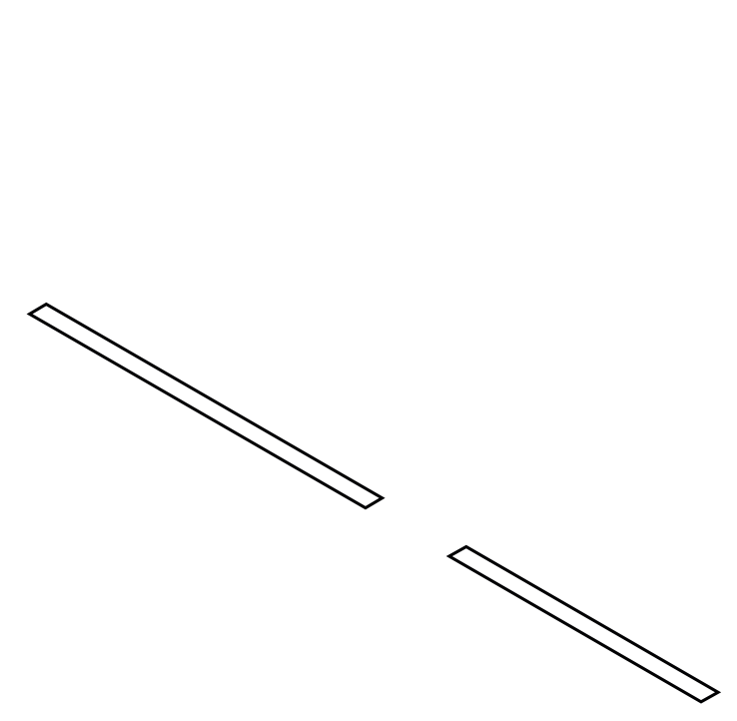
polygon(xy(0, 0), xy(4, 0), xy(4, 0.3), xy(0, 0.3))
polygon(xy(5, 0), xy(8, 0), xy(8, 0.3), xy(5, 0.3))

Slide 37
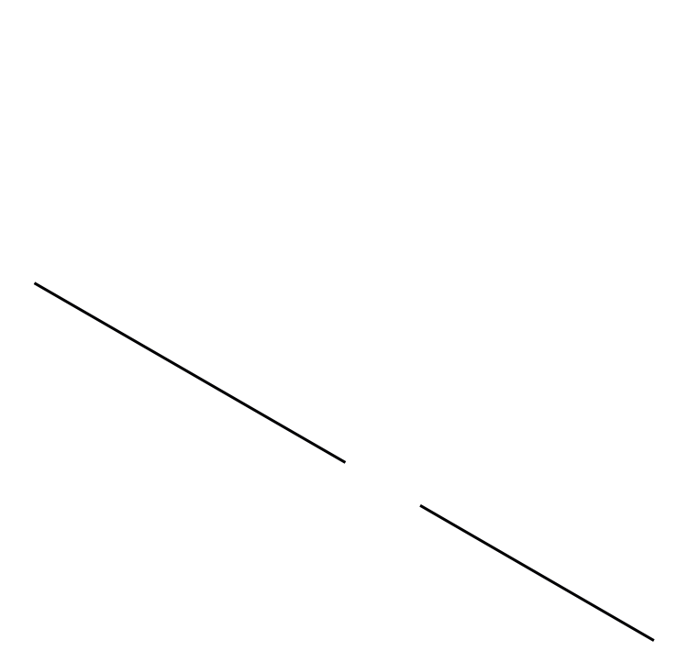
line(xy(0, 0.15), xy(4, 0.15))
line(xy(5, 0.15), xy(8, 0.15))

Slide 38
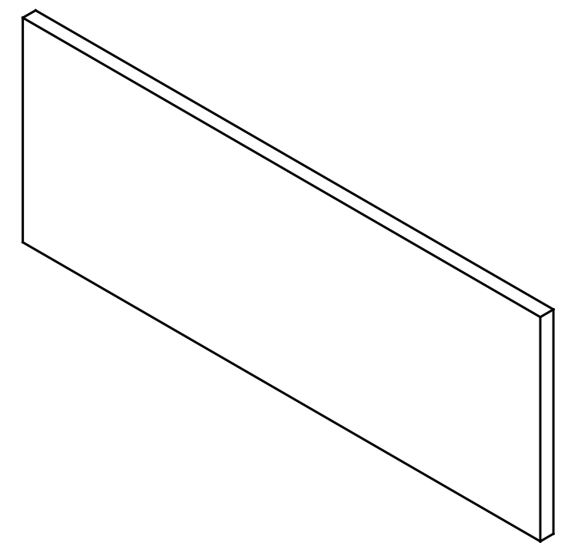
wall([xy(0, 0.15), xy(8, 0.15)])

Slide 39
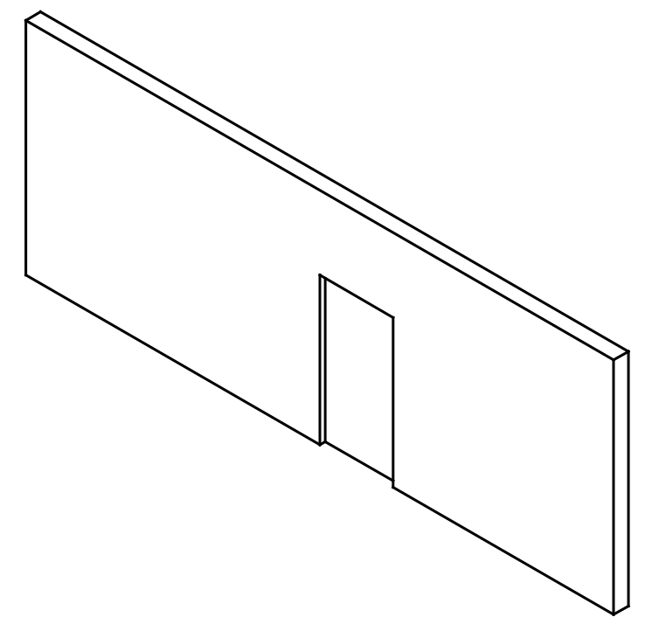
door(wall([xy(0, 0.15), xy(8, 0.15)]), xy(4, 0))

Slide 40

bauhaus(doors_width) =
let door_f = (w, h, t) -> door_family(w*f, h, t)
door_f_a = door_f(750.0, 2000.0, 100.0)
door_f_b = door_f(900, 2000, 100)
door_f_c = door_f(1000.0, 2000.0, 100.0)
door_f_d = door_f(1640.0, 2000.0, 100.0)
wall_rectangle = (p, dx, dy) ->
wall([add_x(p, dx/2), add_xy(p, dx/2, dy)],
family = wall_family(thickness=dx))
door = (w, p, fam) ->
add_door(w, add_x(p, fam.width*(1-f)*0.5), fam)
…
for x in division(45925.77, 90280.0, 9)
for y in division(6788.276, 20534.028, 2)
wall_rectangle(xy(x, y), 574.425, 479.232)
end
end
for x in division(7120.0, 10640.0, 1)
for y in division(11530.768, 15930.768, 2)
wall_rectangle(xy(x, y), 620.0, 620.0)
end
end
…

Slide 41
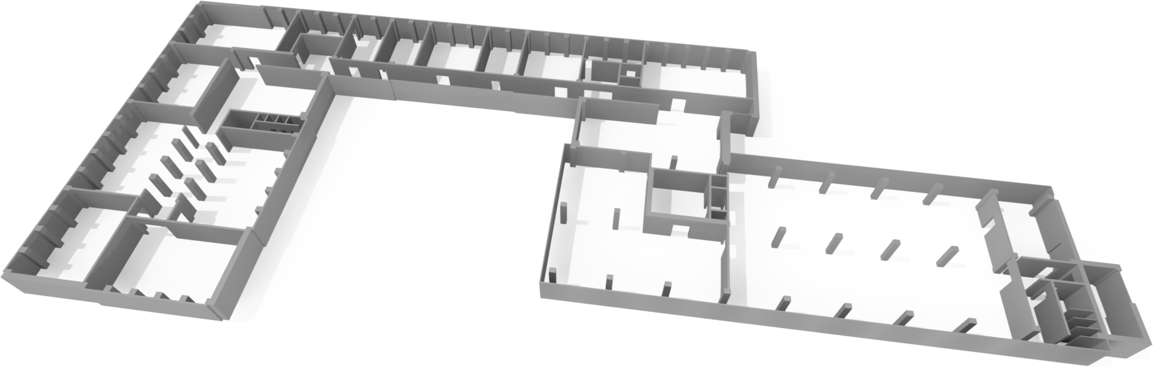
bauhaus(doors_width) =
let door_f = (w, h, t) -> door_family(w*f, h, t)
door_f_a = door_f(750.0, 2000.0, 100.0)
door_f_b = door_f(900, 2000, 100)
door_f_c = door_f(1000.0, 2000.0, 100.0)
door_f_d = door_f(1640.0, 2000.0, 100.0)
wall_rectangle = (p, dx, dy) ->
wall([add_x(p, dx/2), add_xy(p, dx/2, dy)],
family = wall_family(thickness=dx))
door = (w, p, fam) ->
add_door(w, add_x(p, fam.width*(1-f)*0.5), fam)
…
for x in division(45925.77, 90280.0, 9)
for y in division(6788.276, 20534.028, 2)
wall_rectangle(xy(x, y), 574.425, 479.232)
end
end
for x in division(7120.0, 10640.0, 1)
for y in division(11530.768, 15930.768, 2)
wall_rectangle(xy(x, y), 620.0, 620.0)
end
end
…

Slide 42
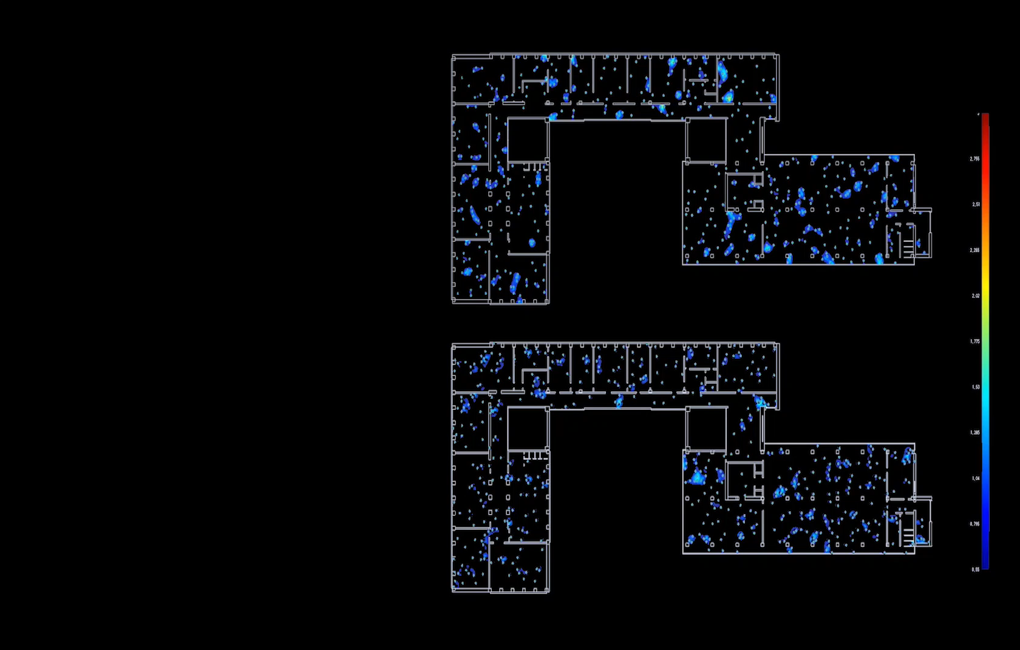
g
Door width +5%
Evacuation time -20%
Bauhaus Building Evacuation Performance
Safe Path: An Agent-Based Framework to Simulate Crowd Behaviours, A. Leitão, S. Sousa, F. Loio, eCAADe 2018

Slide 43
Conclusion

Slide 44
Algorithmic Design

Slide 45
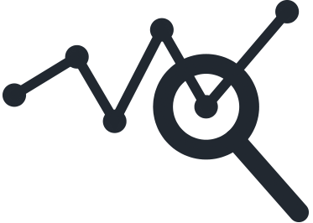
✓
Easy exploration of designs
Algorithmic Design

Slide 46
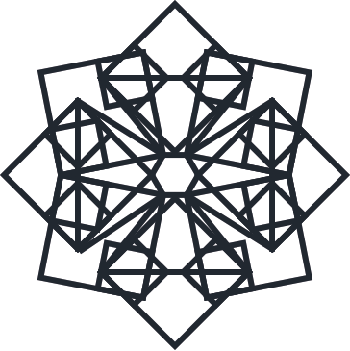
✓
Easy exploration of designs
Algorithmic Design
✓
Generation of complex geometry

Slide 47
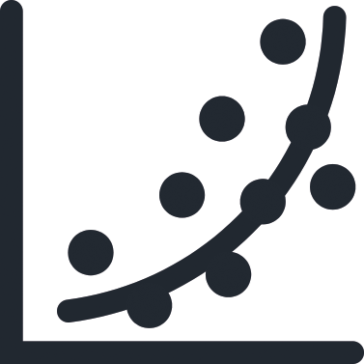
✓
Easy exploration of designs
Algorithmic Design
✓
Generation of complex geometry
✓
Automation of design optimization

Slide 48

✓
Easy exploration of designs
Algorithmic Design
✓
Generation of complex geometry
✓
Automation of design optimization
✗
Program development is time-consuming

Slide 49
Reverse
Algorithmic Design

Slide 50

✓
Reduce time and effort
Reverse
Algorithmic Design

Slide 51
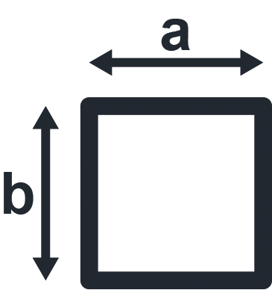
✓
Reduce time and effort
Reverse
Algorithmic Design
✓
Suggest parametric models

Slide 52

✓
Reduce time and effort
Reverse
Algorithmic Design
✓
Suggest parametric models
✓
Convert 2D CAD to 3D BIM

Slide 53

✓
Reduce time and effort
Reverse
Algorithmic Design
✓
Suggest parametric models
✓
Convert 2D CAD to 3D BIM
✓
Detect errors in existing models

Slide 54

✓
Input: 2D CAD
Reverse
Algorithmic Design

Slide 55

✓
Input: 2D CAD
Reverse
Algorithmic Design
Input: 3D CAD/BIM

Slide 56
✓
Input: 2D CAD
Reverse
Algorithmic Design
Input: 3D CAD/BIM
Convert CAD to BIM automatically

Slide 57

✓
Input: 2D CAD
Reverse
Algorithmic Design
Input: 3D CAD/BIM
Convert CAD to BIM automatically
User Studies

Slide 58
Thank you
http://algorithmicdesign.github.io
antonio.menezes.leitao@tecnico.ulisboa.pt
sara.garcia@inesc-id.pt

