Slide 1
Inês Caetano António Leitão
When the Geometry Informs the Algorithm
a hybrid visual/textual programming framework for facade design

Slide 3
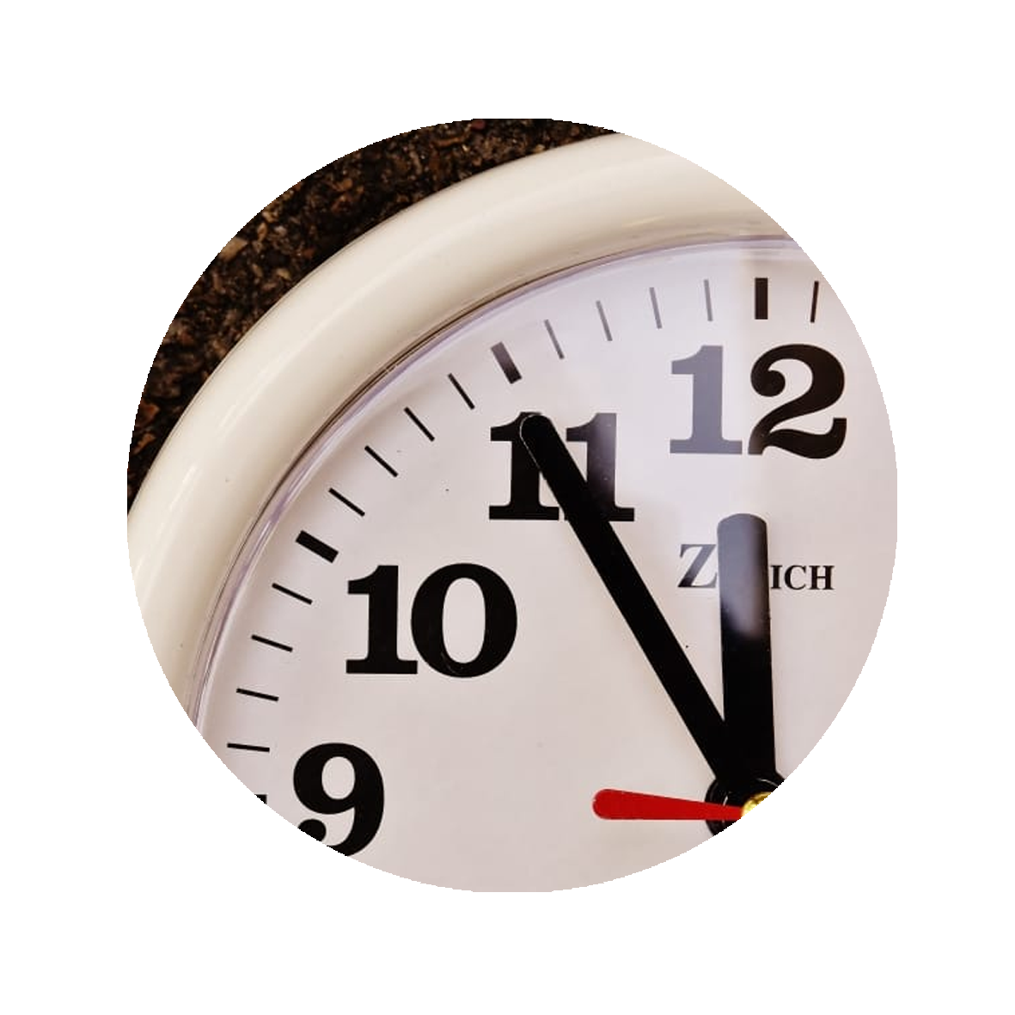
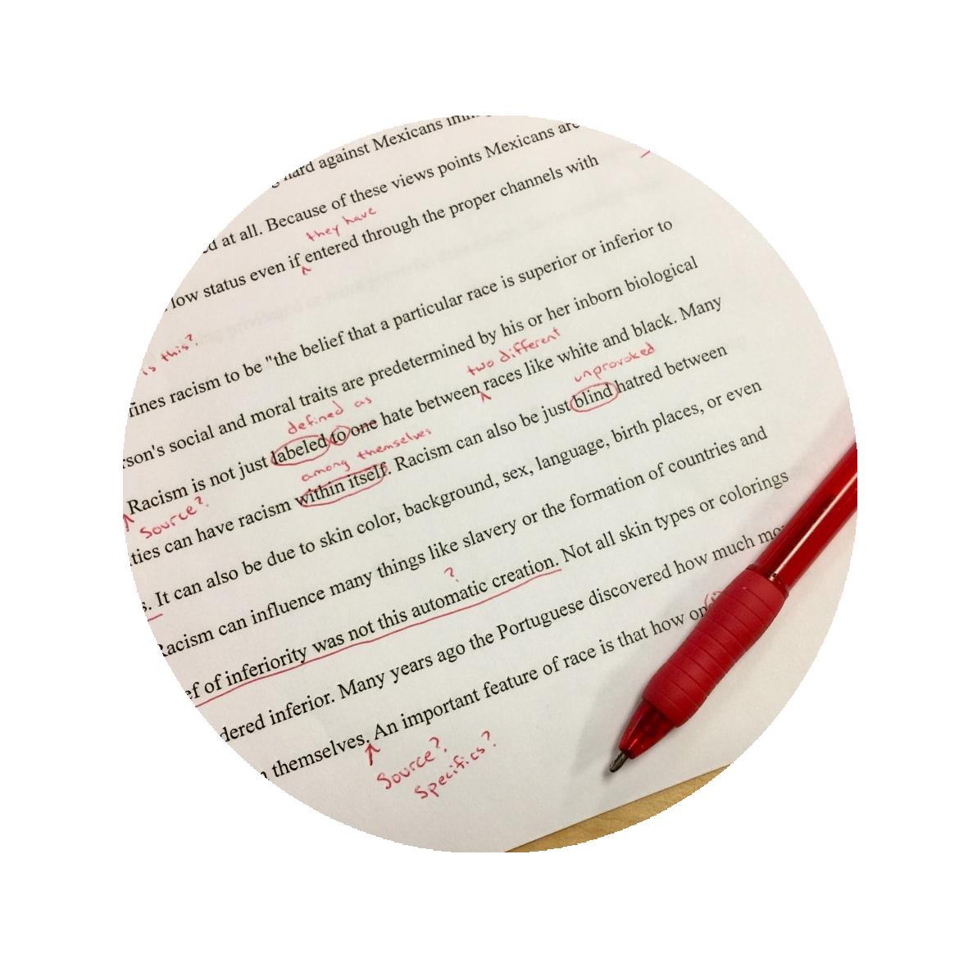

Slide 4
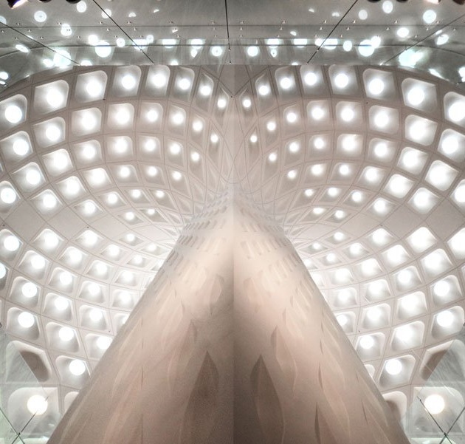
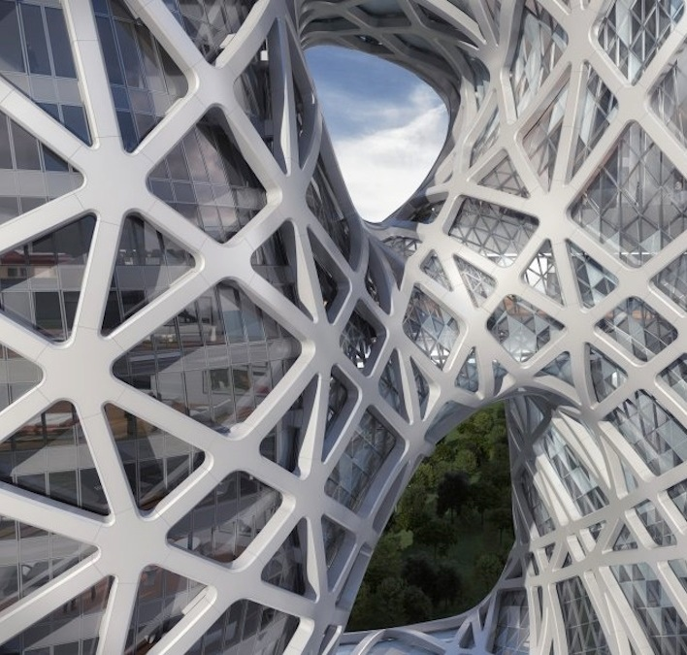
Mumbai Airport Terminal
Morpheus Hotel

Slide 5
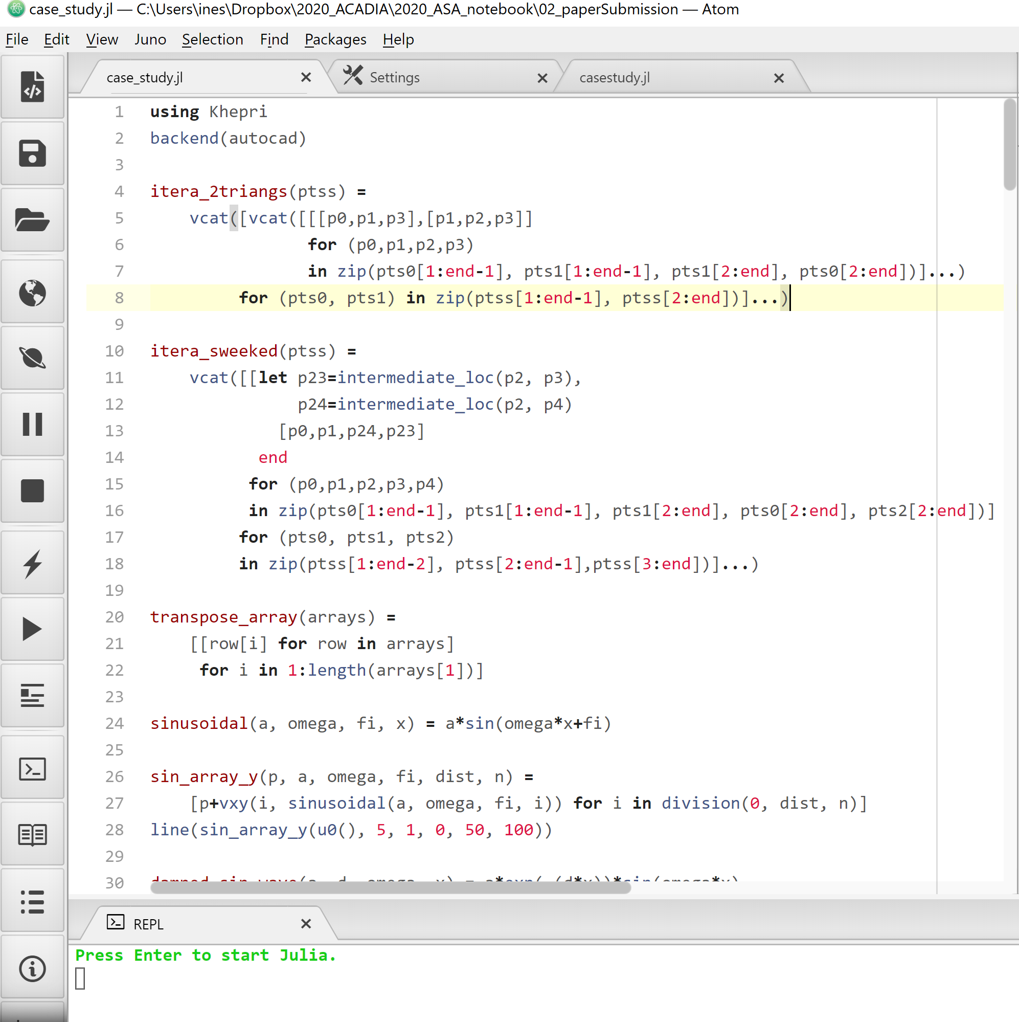
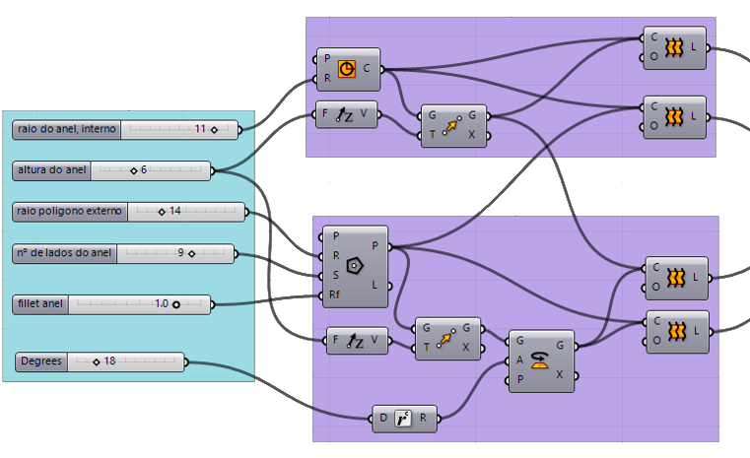

Slide 7
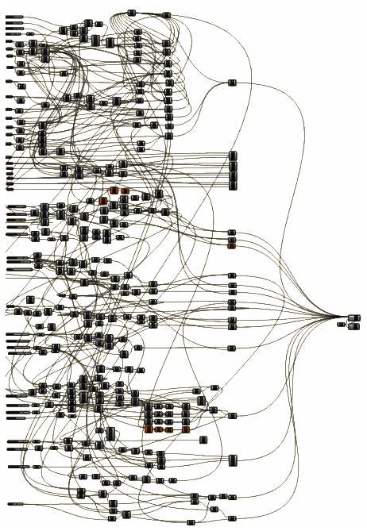

Slide 9
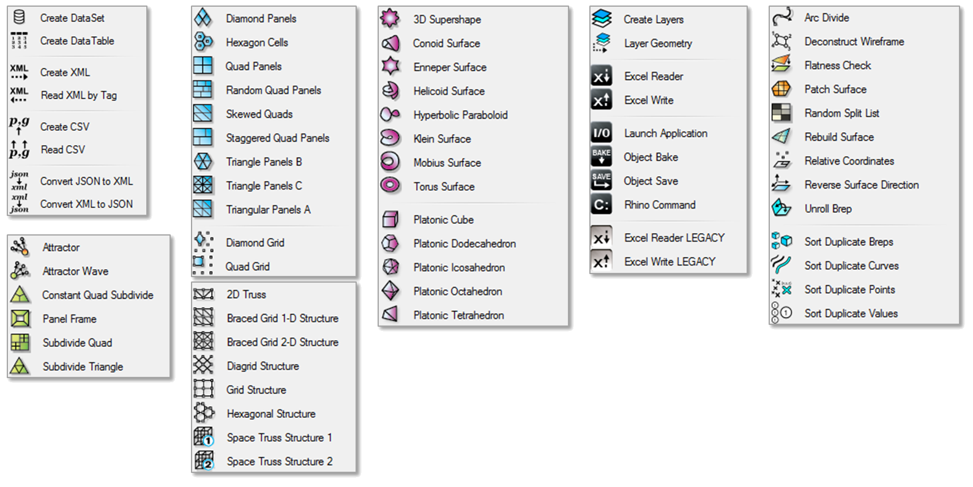

Slide 11
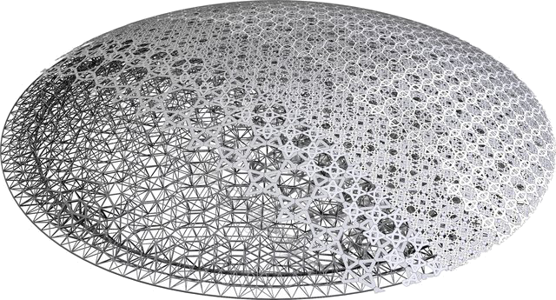
Top:©Goswin Rothenthal, Waagner Biro;

Slide 12
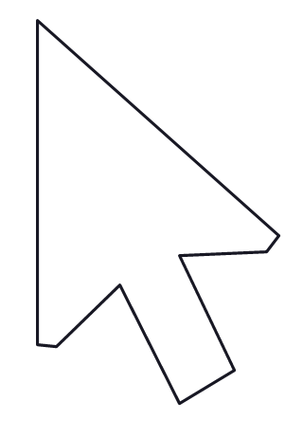
Top:©Goswin Rothenthal, Waagner Biro; Bottom: © Erik Arndt, ©Austin Condiff,

Slide 14
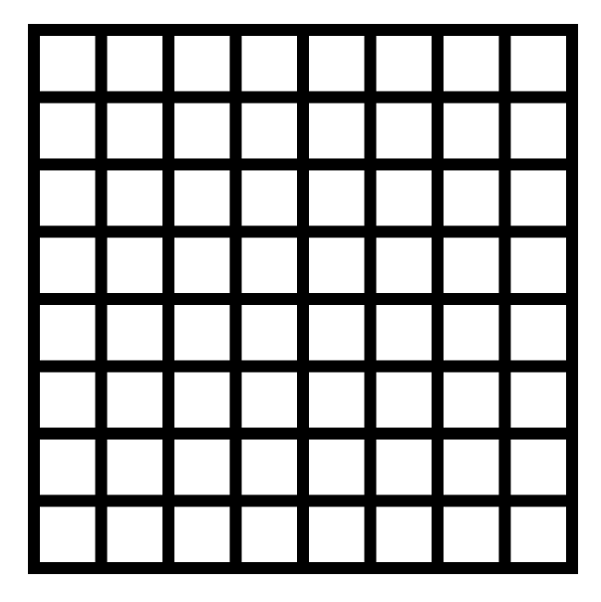
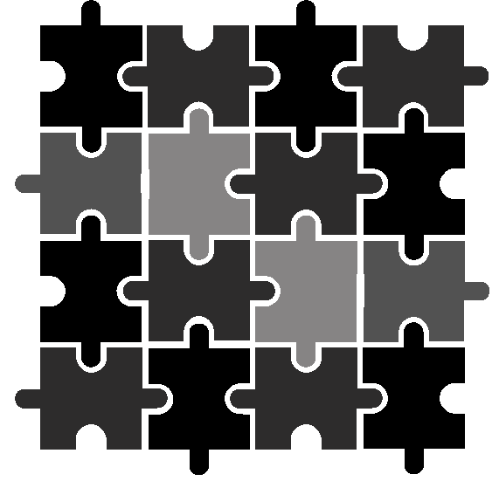
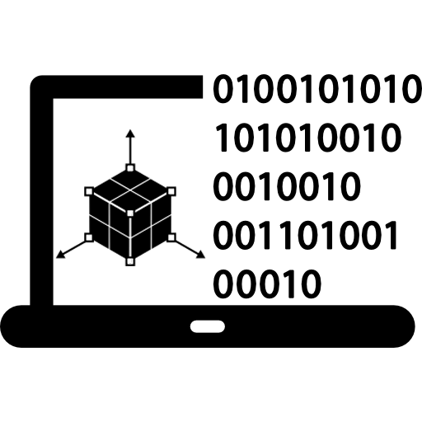

Slide 22
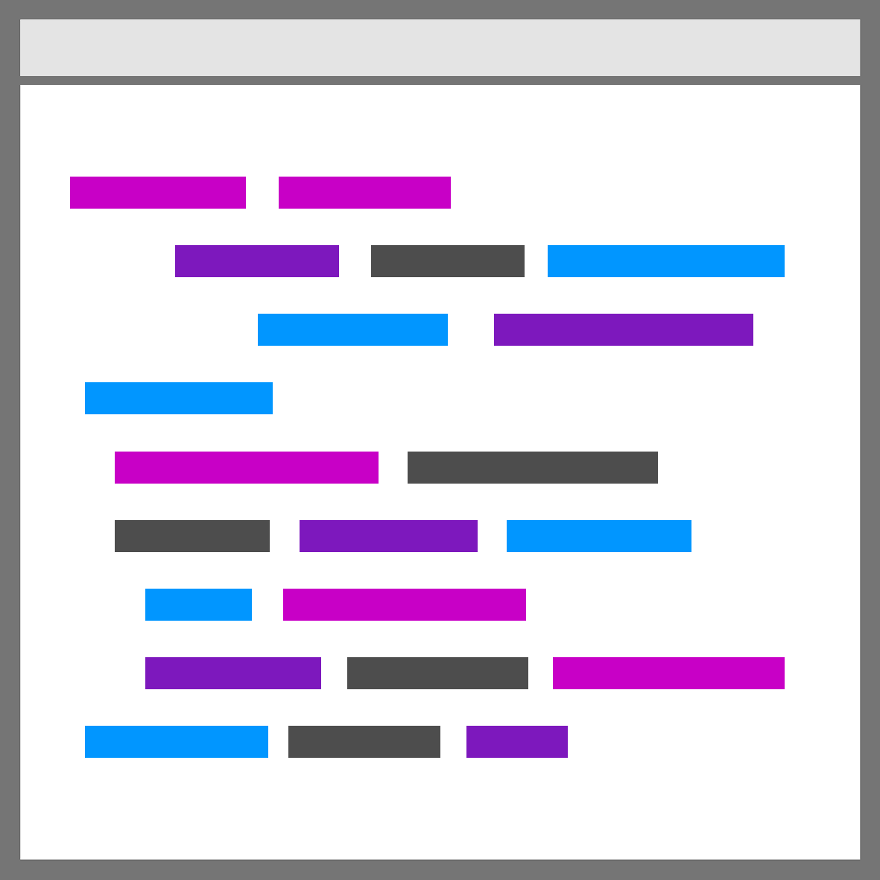
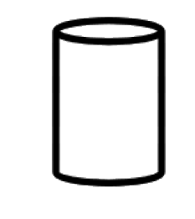
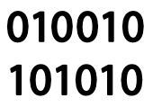

Slide 24
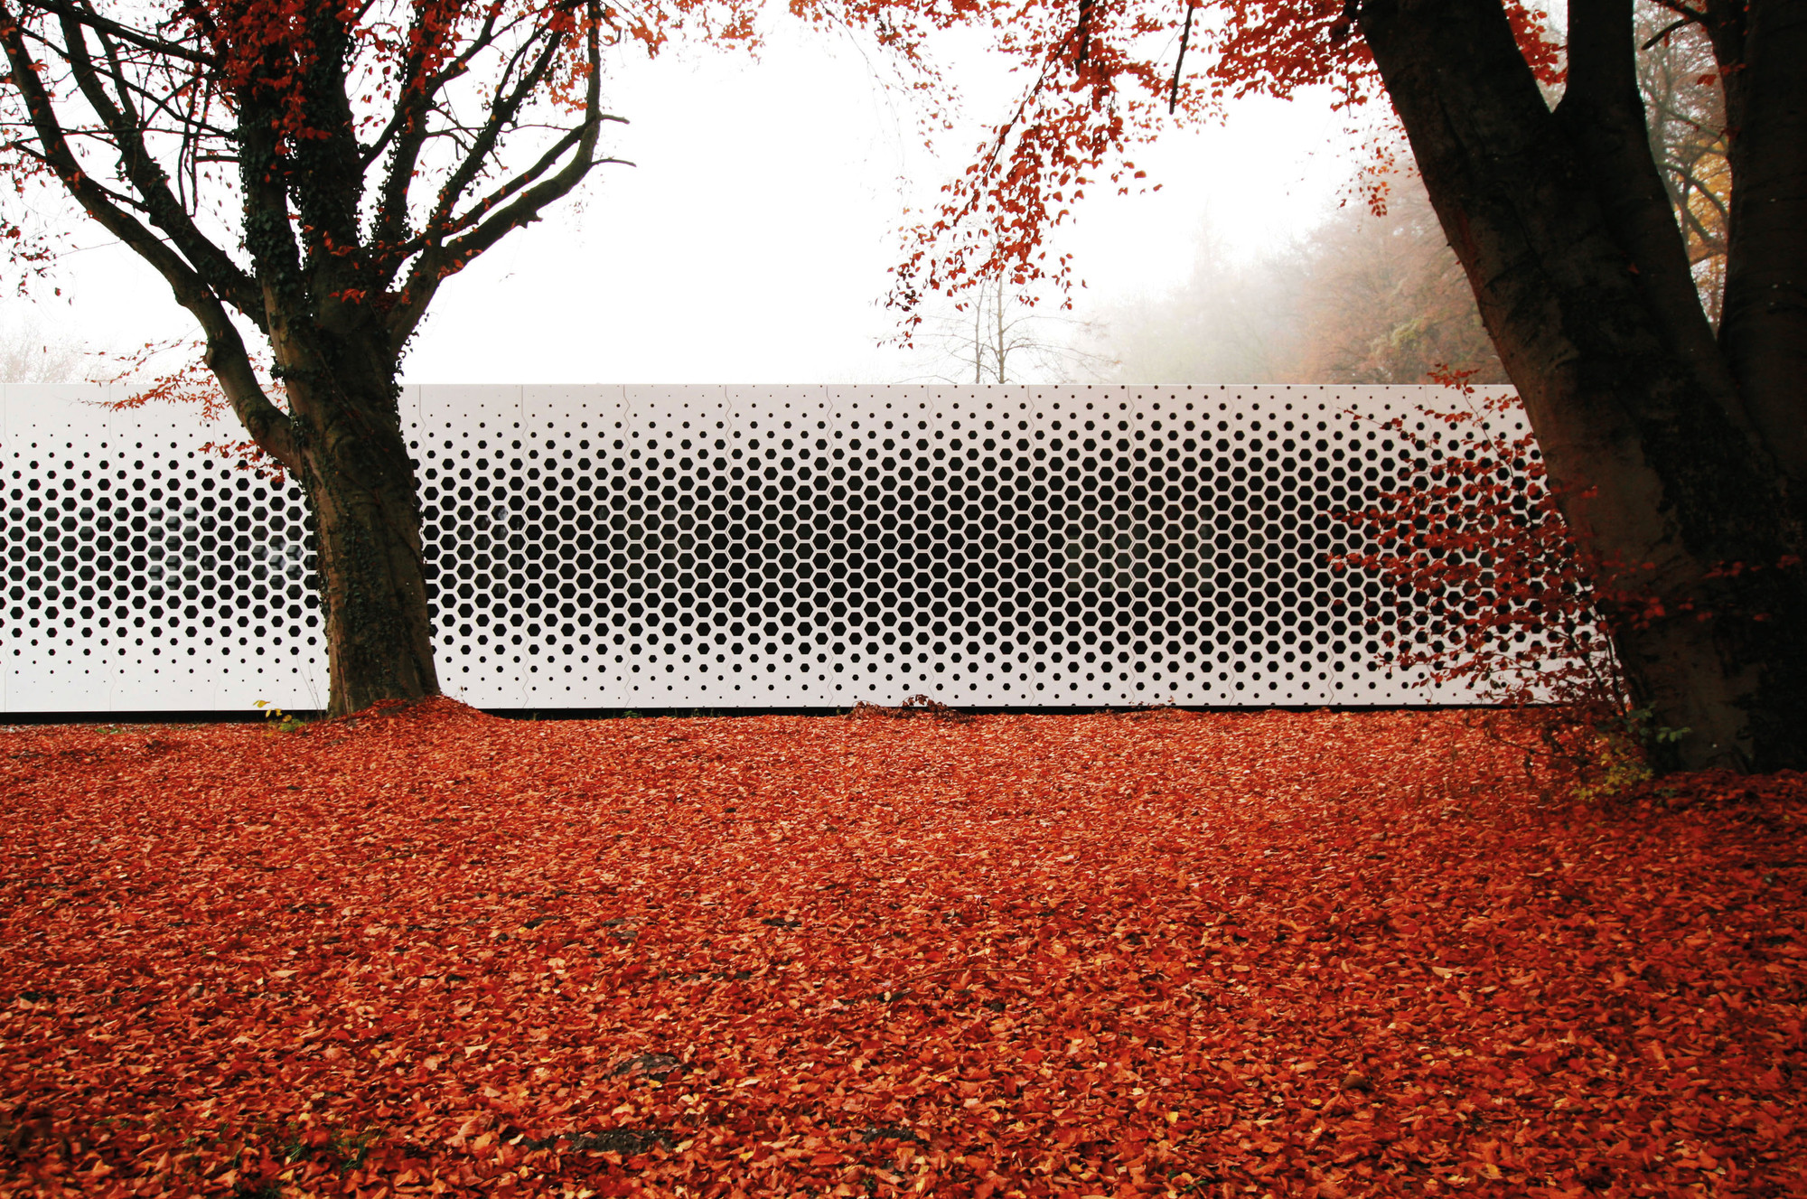
©Format Elf Architekten

Slide 25
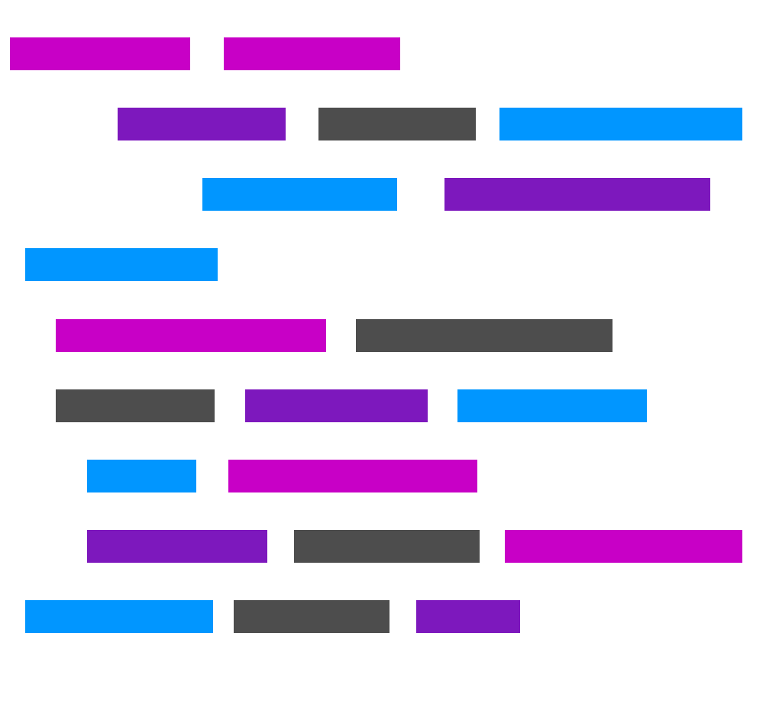
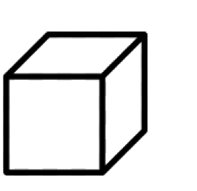

Slide 48
Textual Inputs VS Visual Inputs

Slide 49
Portability
Textual Input
Visual Input

Slide 50
Portability
Textual Input
Visual Input

Slide 51
Portability
Textual Input
Visual Input

Slide 52
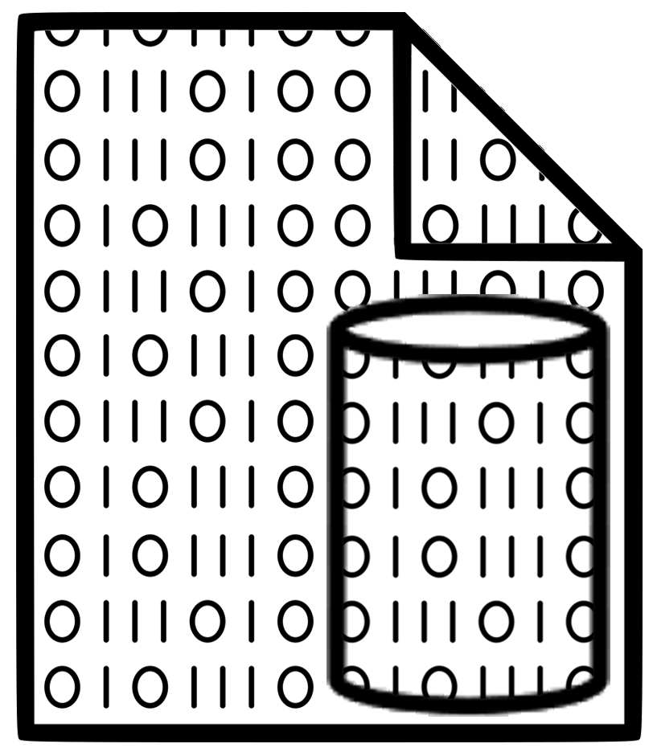
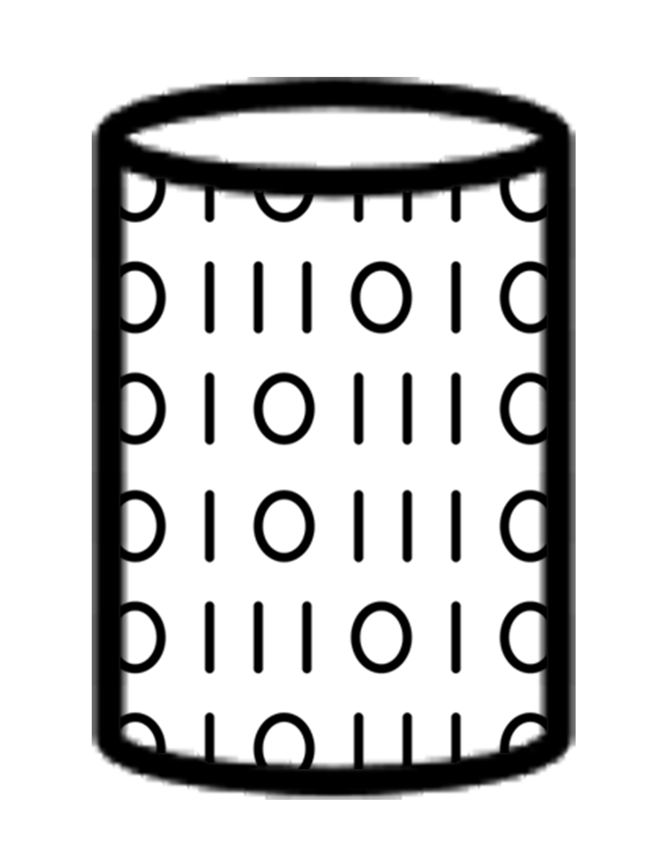
Portability
Textual Input
Visual Input

Slide 53
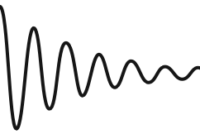
Geometries Supported
Textual Input

Slide 54
Geometries Supported
Textual Input
Visual Input

Slide 55
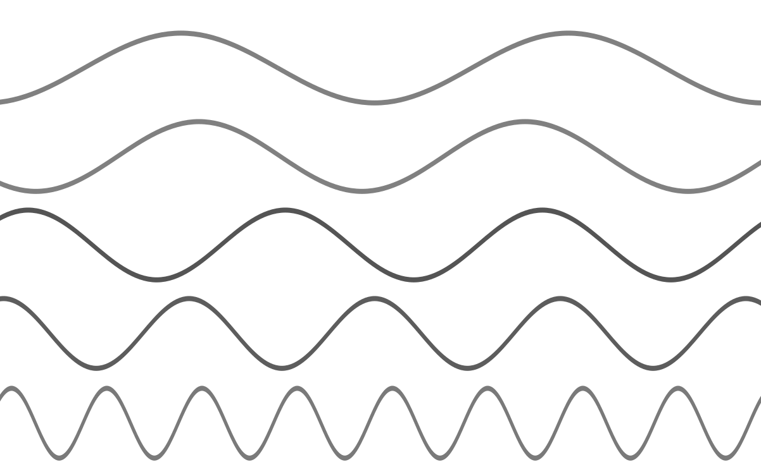
Flexibility
Textual Input
Visual Input

Slide 56
Flexibility
Textual Input
Visual Input
ω
ϕ
A

Slide 58
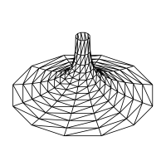
©LluisaIborra

Slide 59
Thank You
Inês Caetano ines.caetano@tecnico.ulisboa.pt
António Leitão antonio.menezes.leitao@tecnico.ulisboa.pt

