Slide 1
MORE
IS
MORE
The No Free Lunch Theorem in Architecture
Inês Pereira António Leitão

Slide 2
Architectural
optimization

Slide 3
Single-Objective
One optimal solution
Multi-Objective
Compromise between goals

Slide 4
OPTIMIZATION
ALGORITHMS

Slide 5
METAHEURISTIC Algorithms
INSPIRED BY NATURE
model-based Algorithms
Create surrogate models

Slide 6
No Free
Lunch
Theorem

Slide 7
solution
Test different algorithms
Problem
Different optimization tools
Time-consuming

Slide 8
Methods

Slide 9
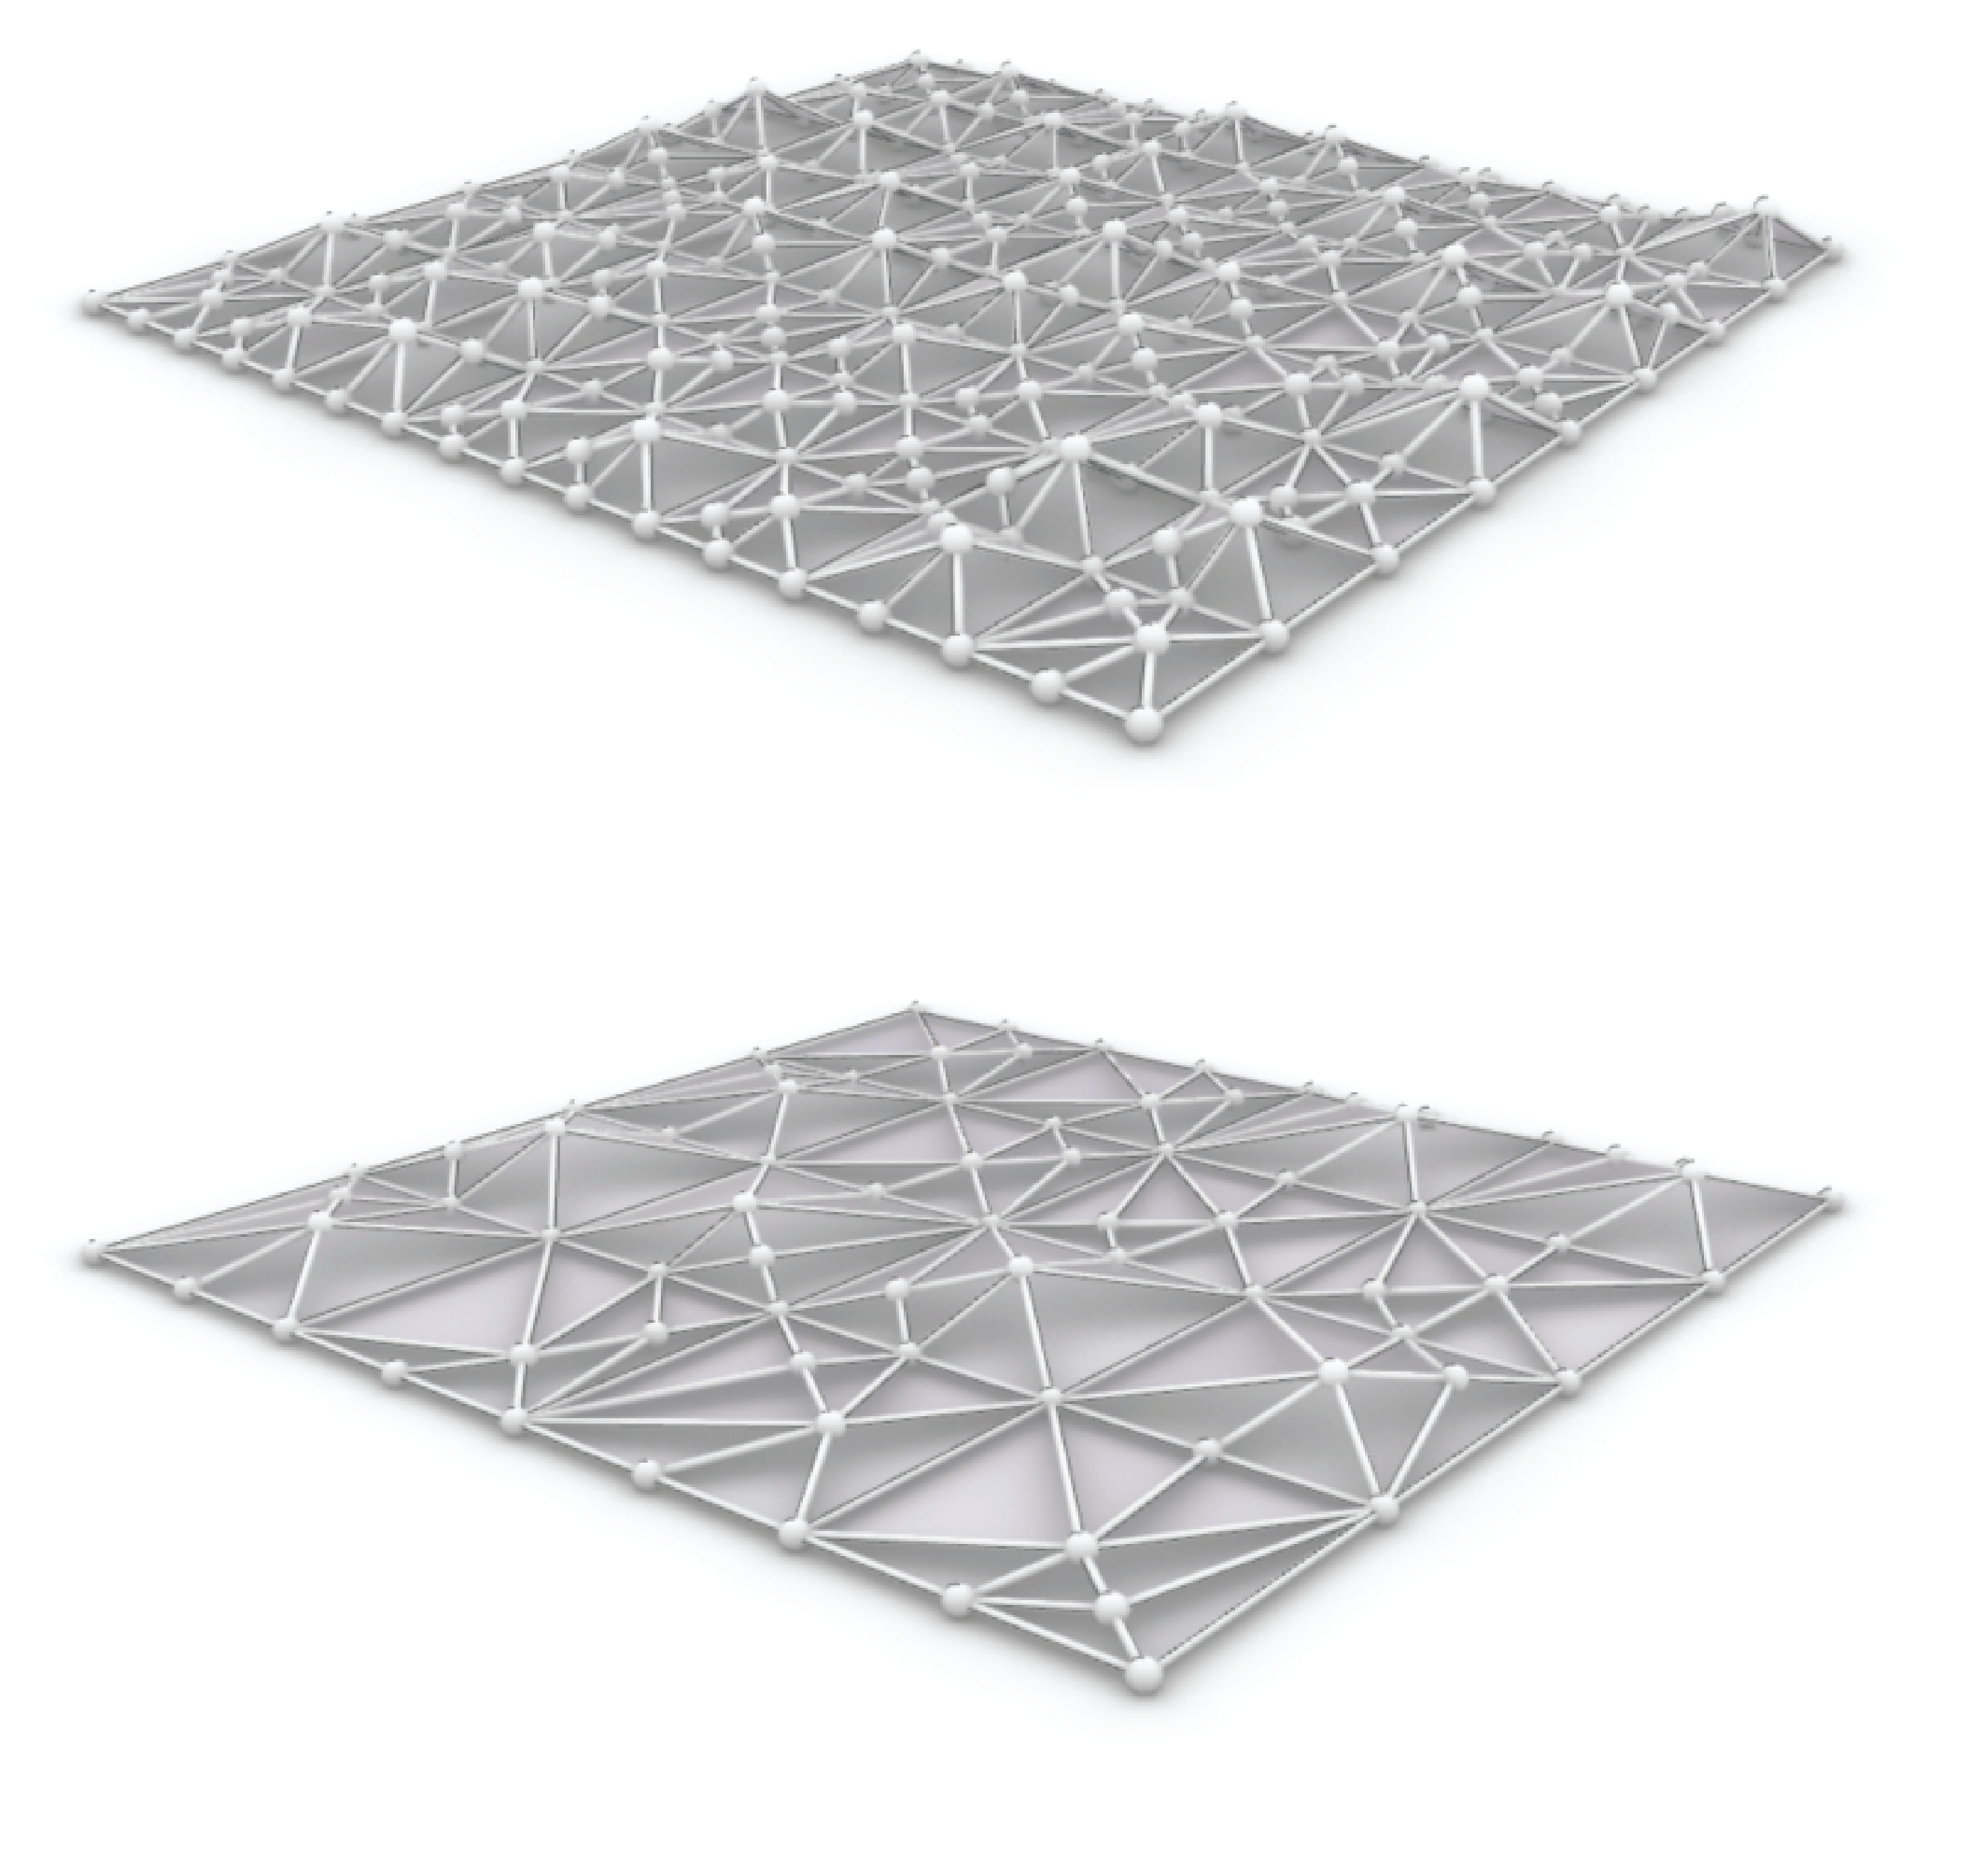
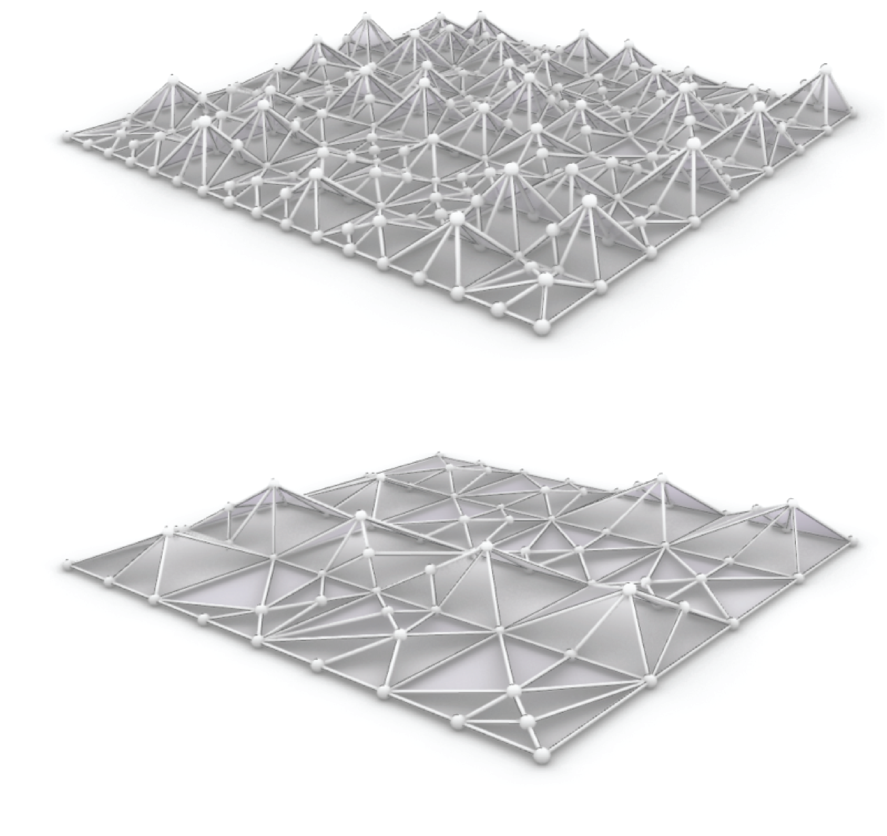
case
study
Truss

Slide 10
objectives
Minimize
Maximum displacement
Minimize
Material cost

Slide 11
results
optimization

Slide 12
9 optimization algorithms
6 metaheuristics
3 model-base
600 evaluations
3 runs

Slide 13
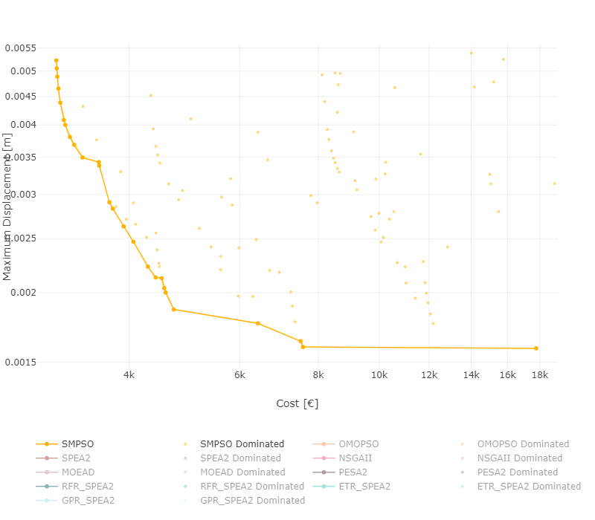
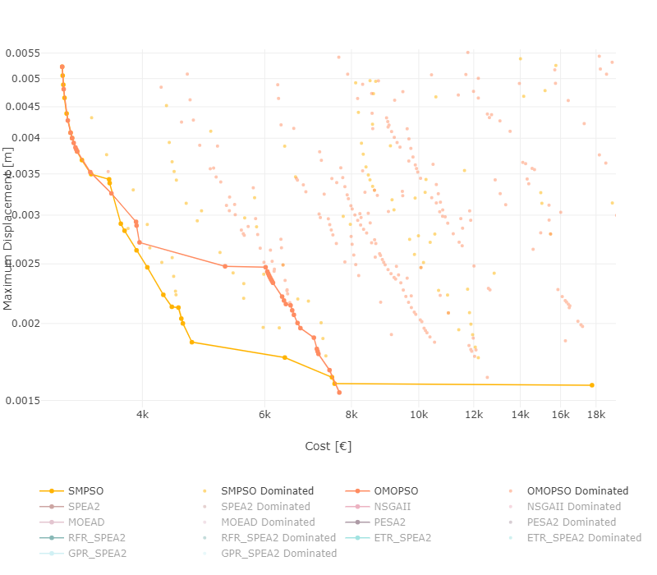
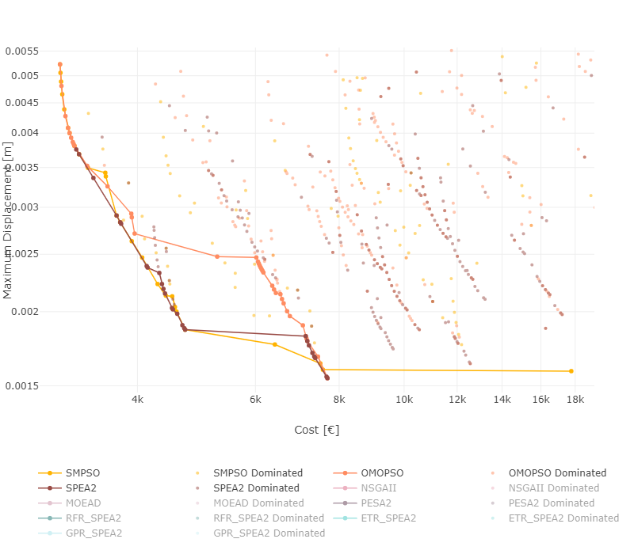
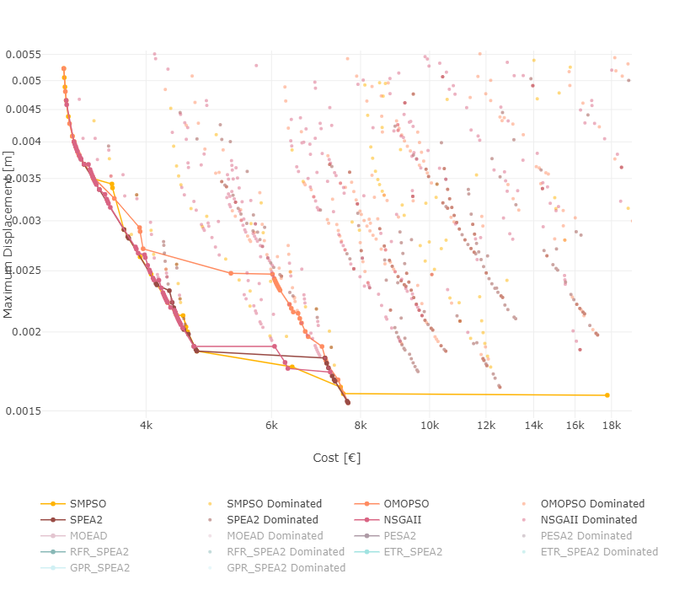
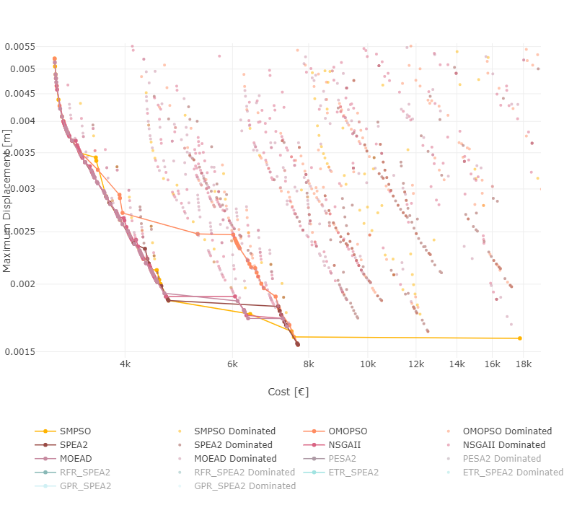
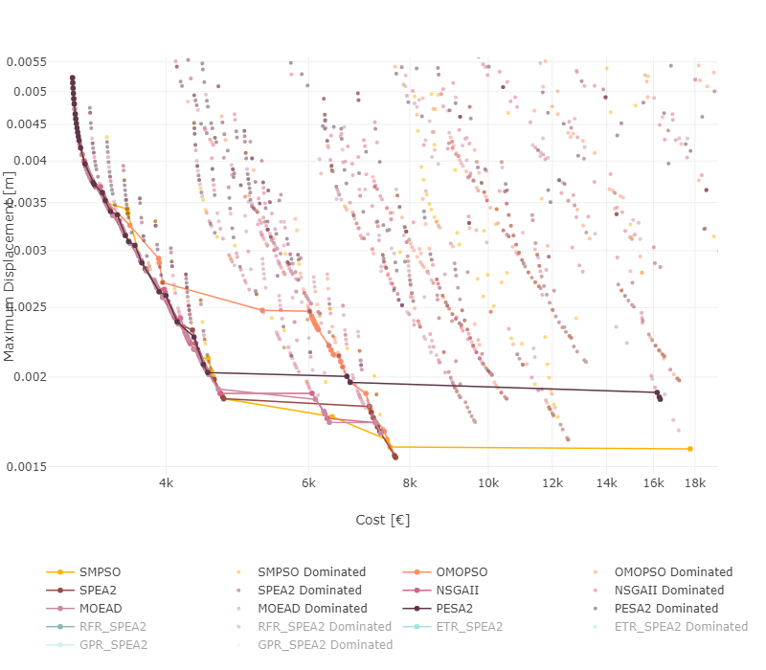
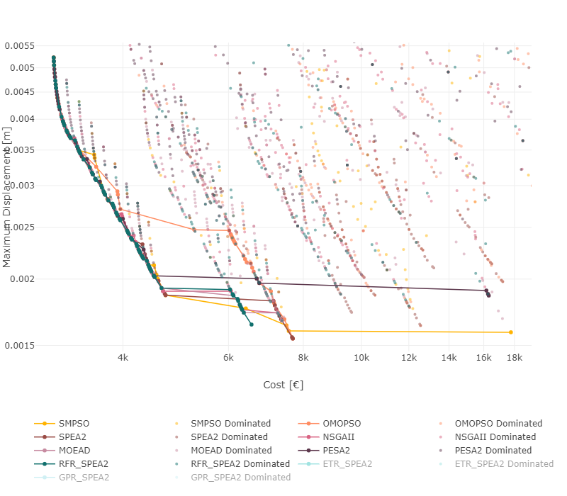
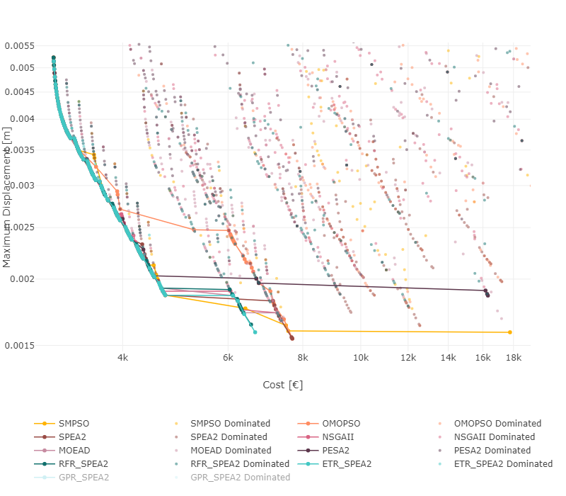
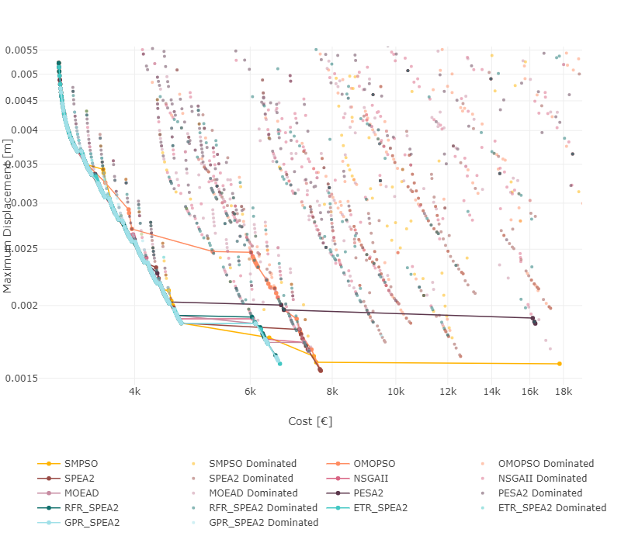
Pareto fronts
SMPSO
0.0055
OMPSO
0.0050
0.0045
SPEA2
metaheuristics
0.0040
NSGA-II
0.0035
MOEAD
0.0030
Maximum Displacement [m]
PESA2
0.0025
RANDOM FOREST
REGRESSOR + SPEA2
0.0020
EXTRA TREE
REGRESSOR + SPEA2
Model-based
GAUSSIAN PROCESS
REGRESSOR + SPEA2
0.0015

Slide 14
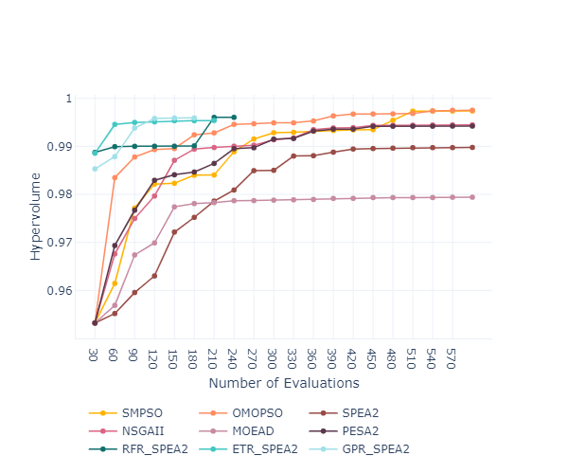
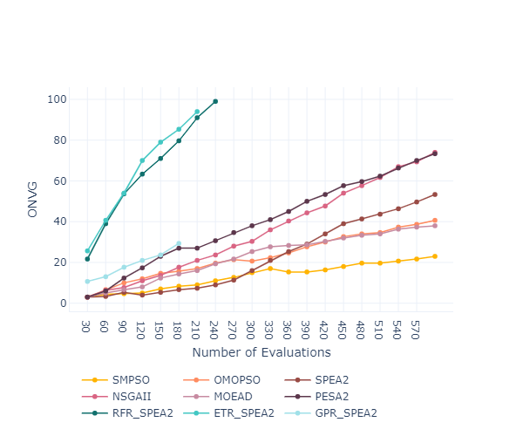
Other performance indicators
SMPSO
OMPSO
HYPERVOLUME
ONGV
SPEA2
metaheuristics
NSGA-II
MOEAD
PESA2
RANDOM FOREST
REGRESSOR + SPEA2
Model-based
EXTRA TREE
REGRESSOR + SPEA2
GAUSSIAN PROCESS
REGRESSOR + SPEA2

Slide 15
results
parallelization

Slide 16
Parallelization Problem
Laptop
8 CPU cores
16 threads
32 GB ram
24
27 parallel processes

Slide 17
SPEEDUP RESULTS
Sequential: 401 minutes
Parallel: 60 minutes
Speedup factor: 6.7

Slide 18
Conclusion

Slide 19
Future
work

Slide 20
Thank
You!
Inês Pereira
Ines.pereira@tecnico.ulisboa.pt
António Leitão
antonio.menezes.leitao @tecnico.ulisboa.pt

