Slide 1
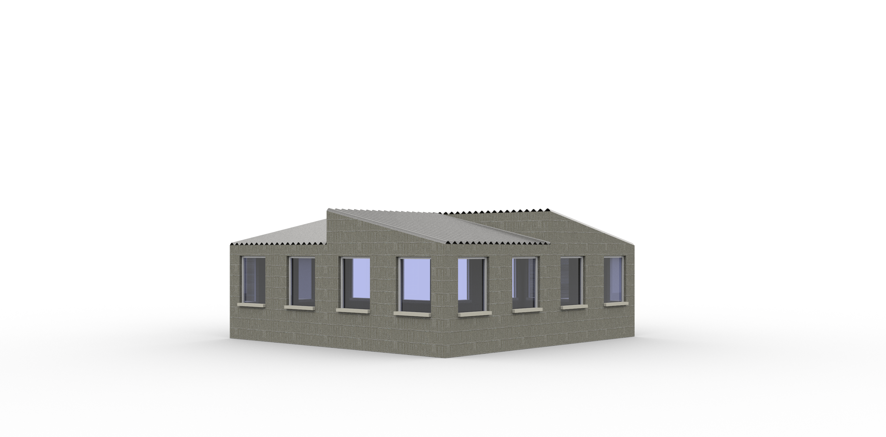
Integrating algorithmic processes in informal urban and architectural planning
A case study of a Maputo’s neighborhood
Gonçalo Araújo
Manuel Correia Guedes
António Leitão

Slide 2
Urban development

Slide 3
2050
Urban development

Slide 4
2050
Urban development
66% World population in cities

Slide 5
2050
Urban development
90% in Africa and Asia

Slide 6
Urban Growth

Slide 7
Urban Growth
Underdeveloped Countries

Slide 8
Informal Housing

Slide 9
Informal Housing

Slide 10
Informal Housing

Slide 11
Informal Housing

Slide 12
Algorithmic Processes

Slide 13
Algorithmic Processes

Slide 14
Algorithmic Processes

Slide 15
WORKFLOW
Data Gathering

Slide 16
WORKFLOW
Data Gathering
Algorithmic Processes

Slide 17
WORKFLOW
Data Gathering
Algorithmic Processes
Analysis

Slide 18
WORKFLOW
Case Study
Data Gathering
Algorithmic Processes
Analysis

Slide 19
WORKFLOW
Case Study
Data Gathering
Algorithmic Processes
Analysis

Slide 20
WORKFLOW
Case Study
Data Gathering
Algorithmic Processes
Analysis

Slide 21
WORKFLOW
Case Study
Data Gathering
Algorithmic Processes
Analysis

Slide 22
WORKFLOW
Algorithmic Design
Case Study
Data Gathering
Algorithmic Processes
Analysis

Slide 23
WORKFLOW
Algorithmic Design
Case Study
Integrated Building Performance Simulation
Data Gathering
Algorithmic Processes
Analysis

Slide 24
WORKFLOW
Algorithmic Design
Case Study
Integrated Building Performance Simulation
Data Gathering
Algorithmic Processes
Analysis

Slide 25
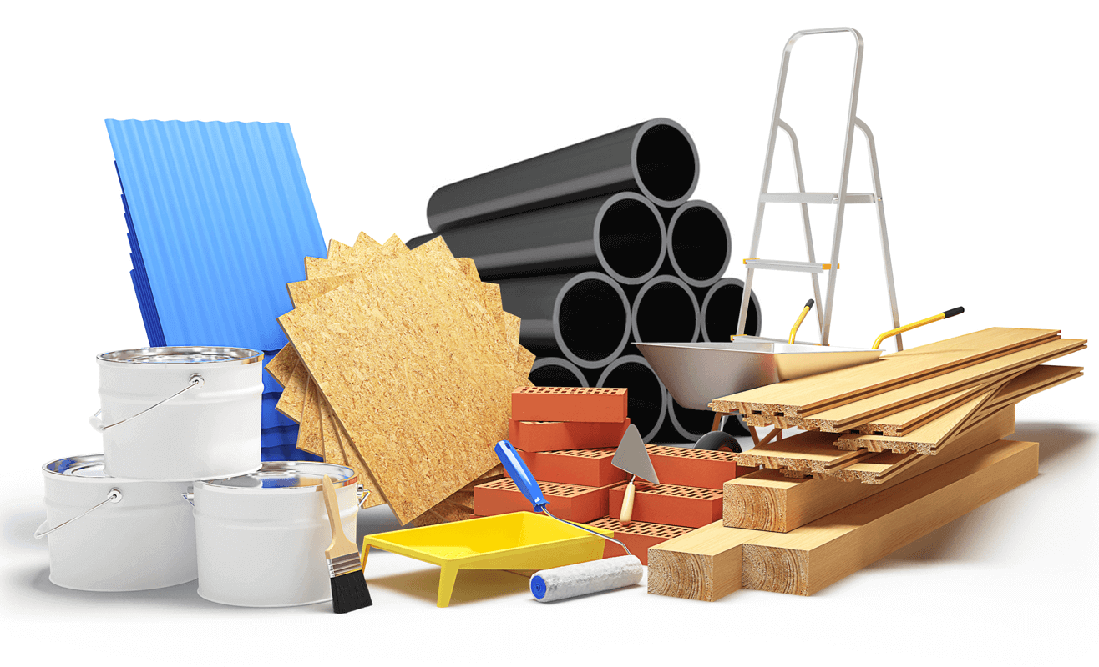
WORKFLOW
Algorithmic Design
Case Study
Integrated Building Performance Simulation
Data Gathering
Algorithmic Processes
Analysis

Slide 26
WORKFLOW
INPUTS
Algorithmic Design
Case Study
Integrated Building Performance Simulation
Data Gathering
Algorithmic Processes
Analysis

Slide 27
WORKFLOW
INPUTS
Algorithmic Design
Case Study
Integrated Building Performance Simulation
Data Gathering
Algorithmic Processes
Analysis

Slide 28
WORKFLOW
INPUTS
Algorithmic Design
Thermal Comfort
Case Study
Integrated Building Performance Simulation
Data Gathering
Algorithmic Processes
Analysis

Slide 29
WORKFLOW
INPUTS
Algorithmic Design
Thermal Comfort
Case Study
Integrated Building Performance Simulation
Construction Costs
Data Gathering
Algorithmic Processes
Analysis

Slide 30
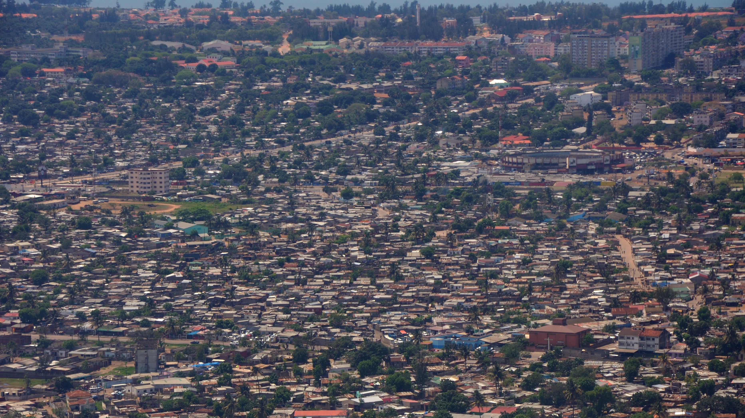
Chamanculo C - Mozambique
https://upload.wikimedia.org/wikipedia/commons/6/69/2010-10-18_10-55-38_Mozambique_Maputo_Chamanculo_%E2%80%9DB%E2%80%9D.jpg

Slide 31
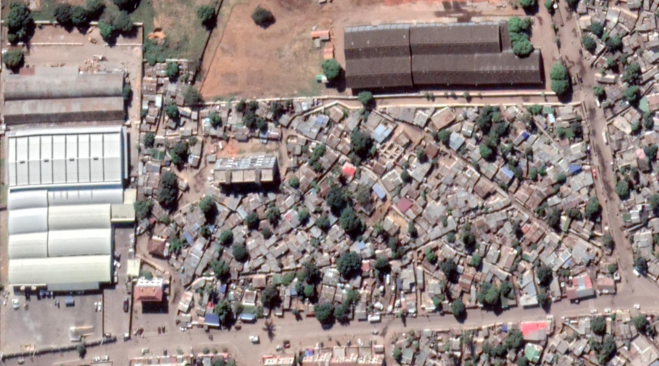

Slide 33
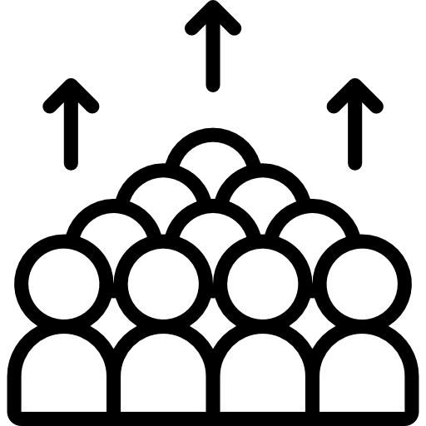

Slide 35
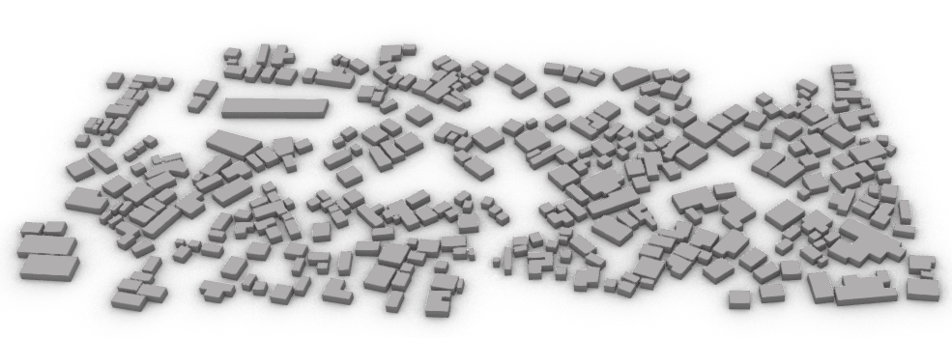

Slide 36
334 building units

Slide 37
5 wall solutions
334 building units

Slide 38
5 wall solutions
334 building units
2 roof solutions

Slide 39
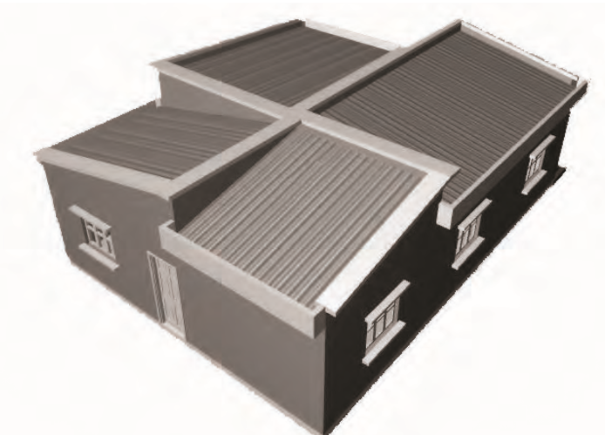
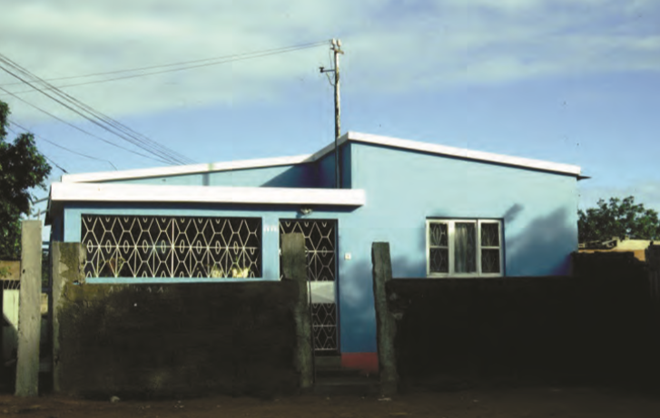
‘Ventoinha’ house

Slide 40
‘Ventoinha’ house

Slide 41
‘Ventoinha’ house

Slide 42
‘Ventoinha’ house

Slide 43
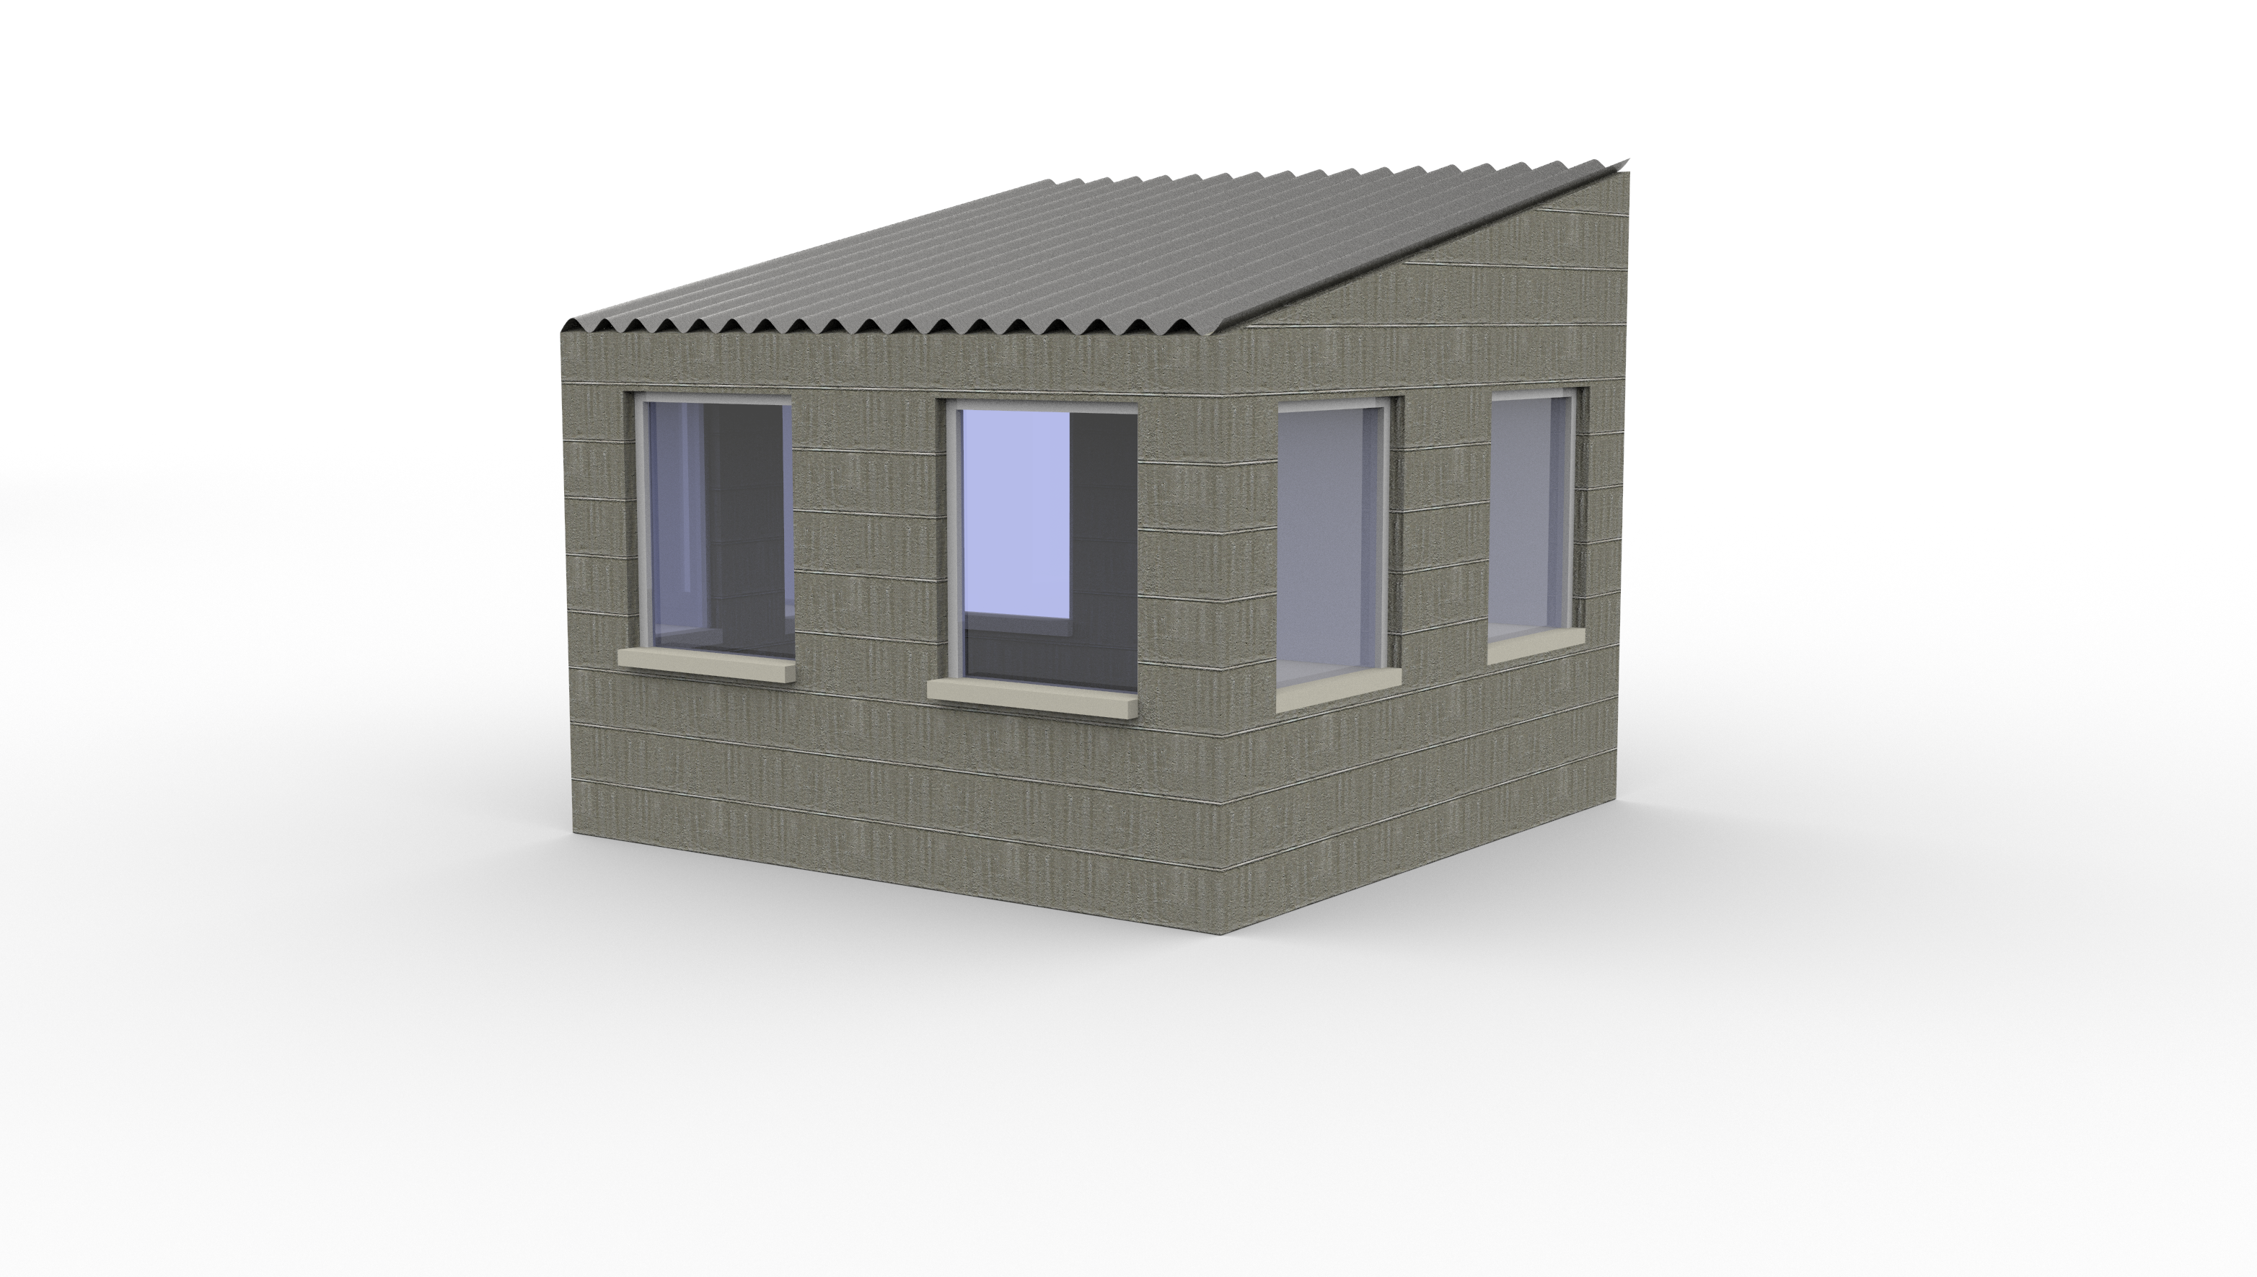

Slide 44
Length

Slide 45
Width
Length

Slide 46
Height
Width
Length

Slide 47
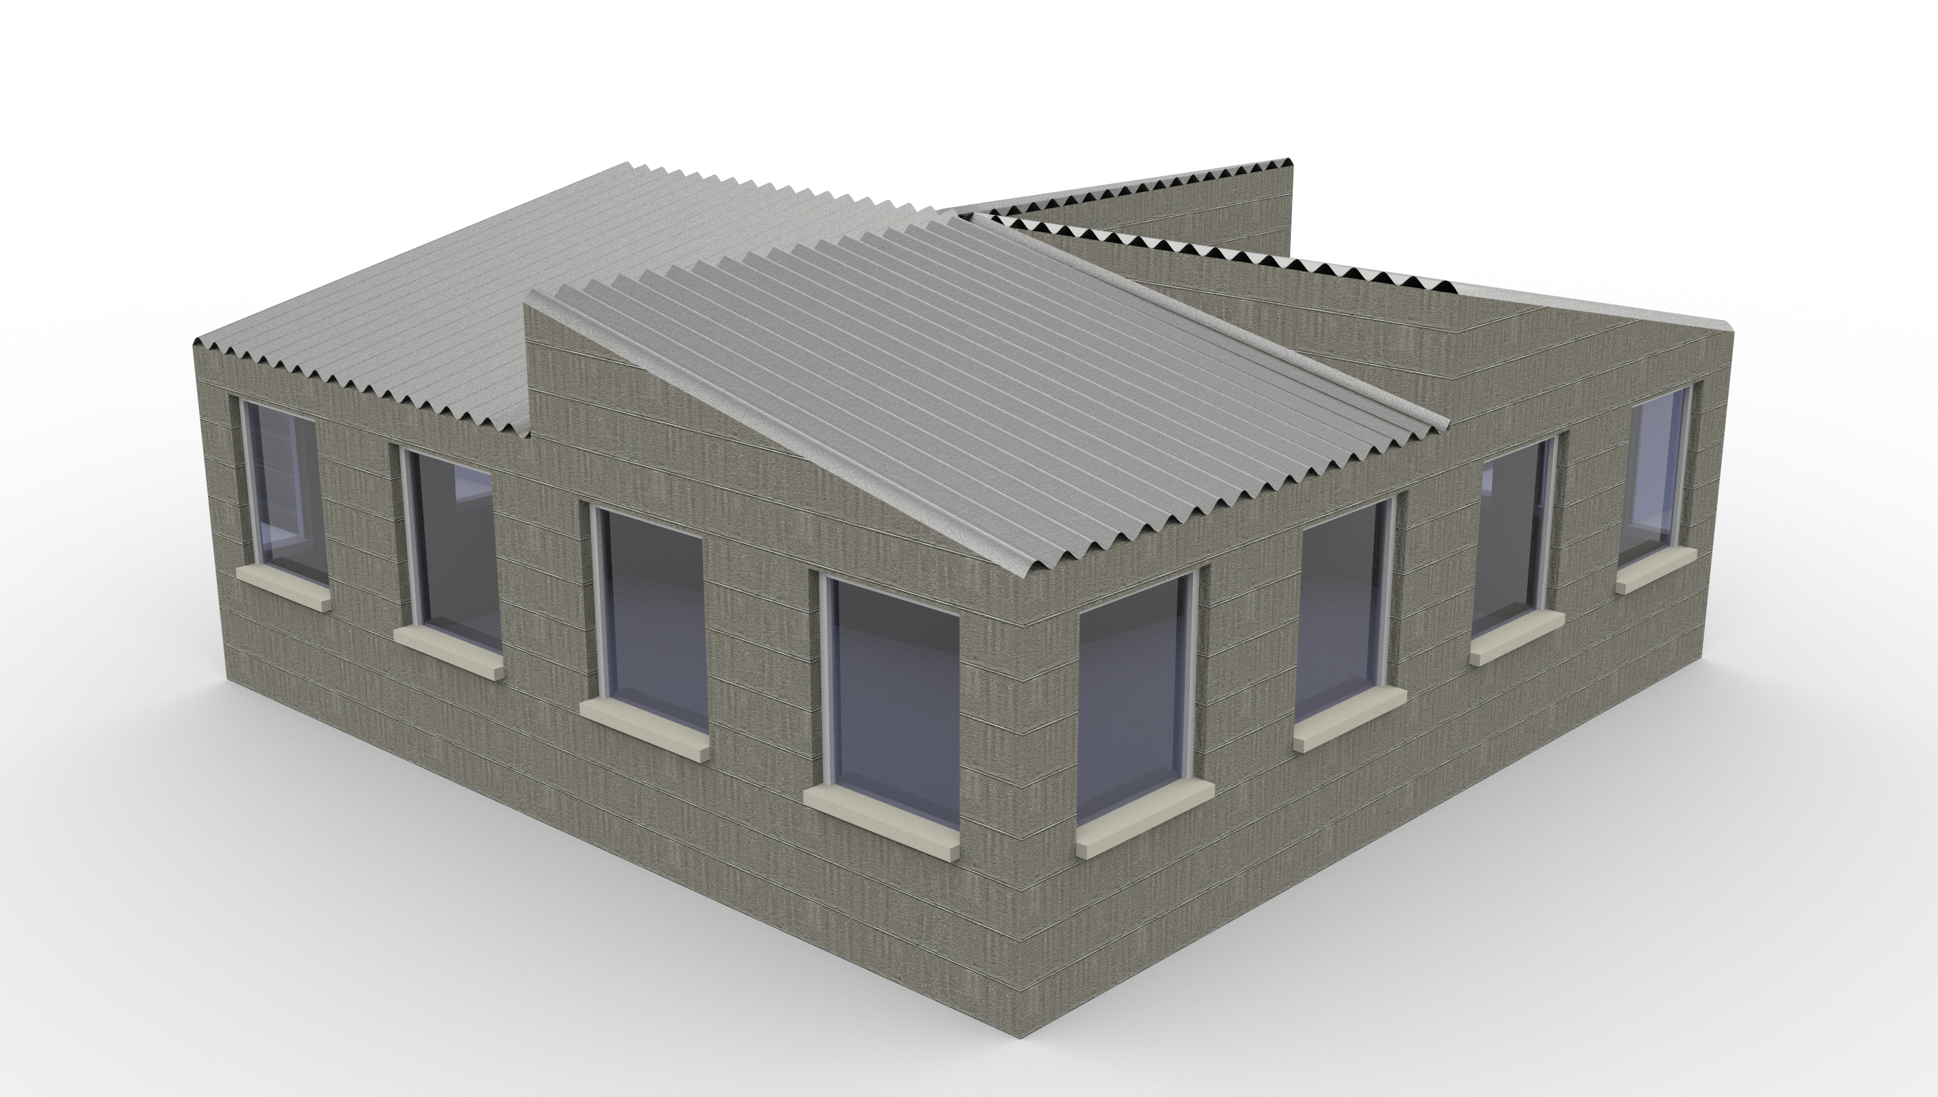

Slide 48
Results and Discussion
Thermal Comfort

Slide 49
Results and Discussion
Thermal Comfort
Summer period
10 to 20 pm

Slide 50
Results and Discussion
Thermal Comfort
Summer period
10 to 20 pm

Slide 51
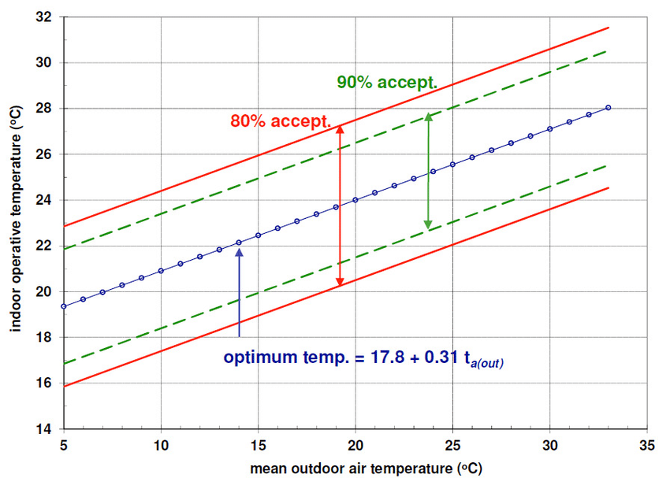
Results and Discussion
Thermal Comfort
Summer period
10 to 20 pm

Slide 52
Results and Discussion
Thermal Autonomy (TA)
Thermal Comfort
Summer period
10 to 20 pm

Slide 53
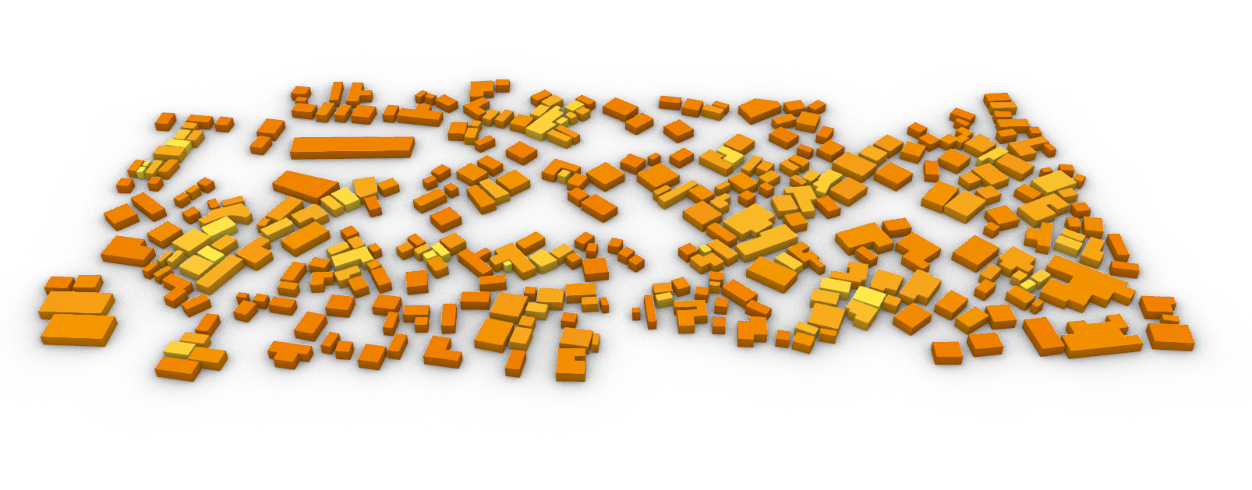
Results and Discussion
1

Slide 54
Results and Discussion
1
2

Slide 55
Results and Discussion
1
Zinc
2

Slide 56
Results and Discussion
1
Zinc
2
Walls

Slide 57
Results and Discussion
1
Zinc
2
Walls
Roof

Slide 58
Results and Discussion
1
Zinc
30% < TA < 40%
2
Walls
Roof

Slide 59
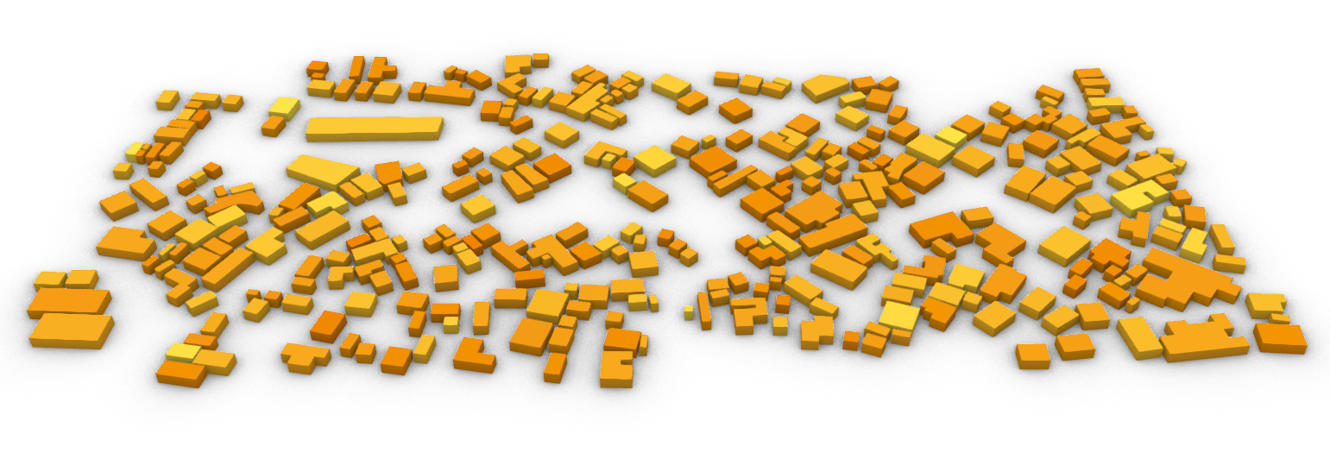
Results and Discussion
3

Slide 60
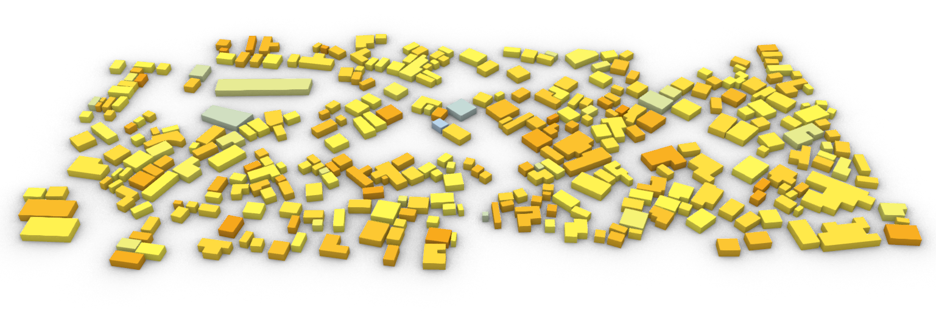
Results and Discussion
3
4

Slide 61
Results and Discussion
3
Walls
4

Slide 62
Results and Discussion
3
Walls
4
Walls

Slide 63
Results and Discussion
3
Walls
Roof
4
Walls
Roof

Slide 64
Results and Discussion
3
27% < TA < 43%
Average 34%
4

Slide 65
Results and Discussion
3
27% < TA < 43%
Average 34%
4
33% < TA < 69%
Average 44%

Slide 66
Results and Discussion
5
4
33% < TA < 69%
Average 44%

Slide 67
Results and Discussion
5
Walls
4
33% < TA < 69%
Average 44%

Slide 68
Results and Discussion
5
29% < TA < 54%
Average 38%
4
33% < TA < 69%
Average 44%

Slide 69
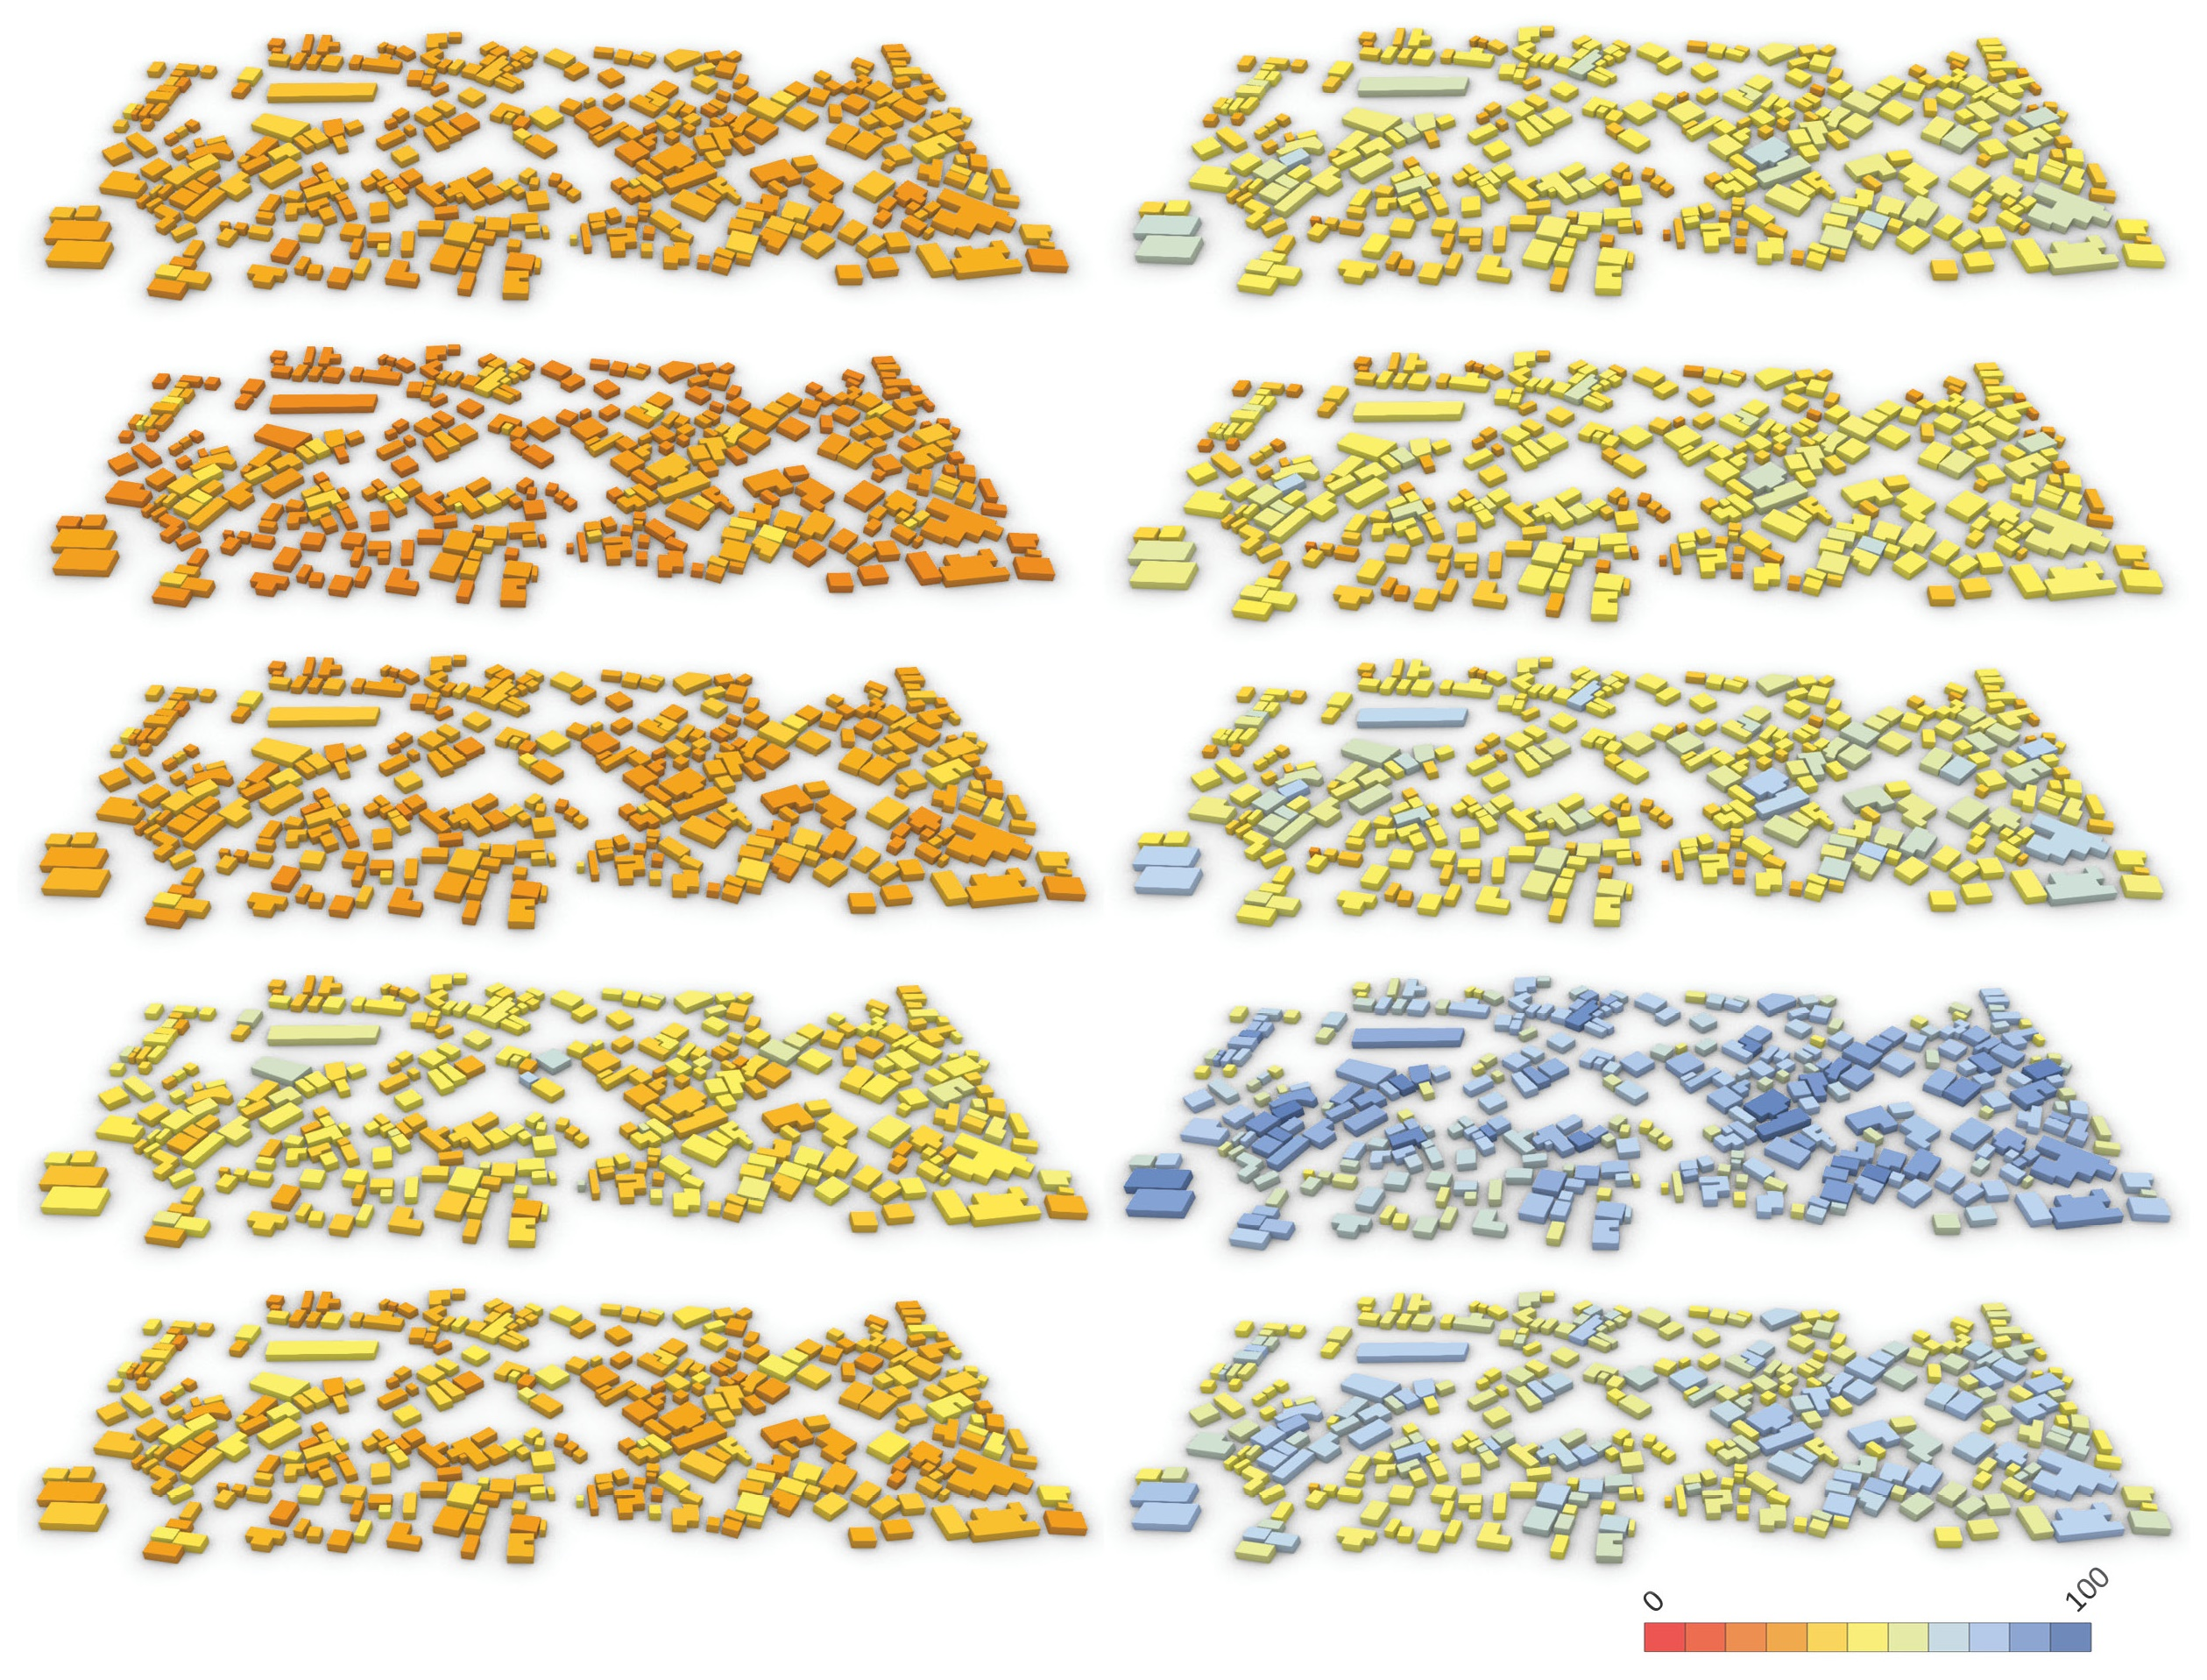
Results and Discussion
Roof type 1
Roof type 2
Wall type 1
Wall type 2
Wall type 3
Wall type 4
Wall type 5

Slide 70
Results and Discussion
Roof type 1
Roof type 2
Wall type 1
Wall type 2
Wall type 3
Wall type 4
Wall type 5

Slide 71
Results and Discussion
Roof type 1
Roof type 2
Wall type 1
Wall type 2
Roof upgrade
Wall type 3
Wall type 4
Wall type 5

Slide 72
Results and Discussion
Roof type 1
Roof type 2
Wall type 1
Wall type 2
Roof upgrade
Wall type 3
High TA variation
Wall type 4
Wall type 5

Slide 73
Results and Discussion
Roof type 1
Roof type 2
Wall type 1
Wall type 2
Roof upgrade
Wall type 3
High TA variation
Wall type 4
Area
Wall type 5

Slide 74
Results and Discussion
Roof type 1
Roof type 2
Wall type 1
Wall type 2
Roof upgrade
Wall type 3
High TA variation
Wall type 4
Area
Context
Wall type 5

Slide 75
Results and Discussion
Roof type 1
Roof type 2
Wall type 1
Wall type 2
Roof upgrade
Wall type 3
High TA variation
Wall type 4
Area
Context
Wall type 5
Var(ThermalAutonomy)

Slide 76
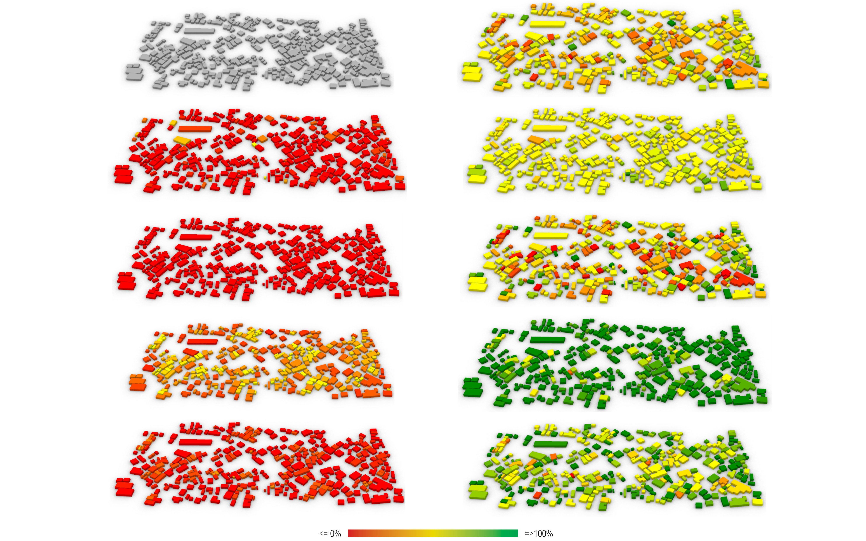
Results and Discussion

Slide 77
Results and Discussion

Slide 78
Results and Discussion

Slide 79
Results and Discussion

Slide 80
Results and Discussion

Slide 81
Results and Discussion

Slide 82
Results and Discussion

Slide 83
Results and Discussion

Slide 84
Results and Discussion

Slide 85
Results and Discussion

Slide 86
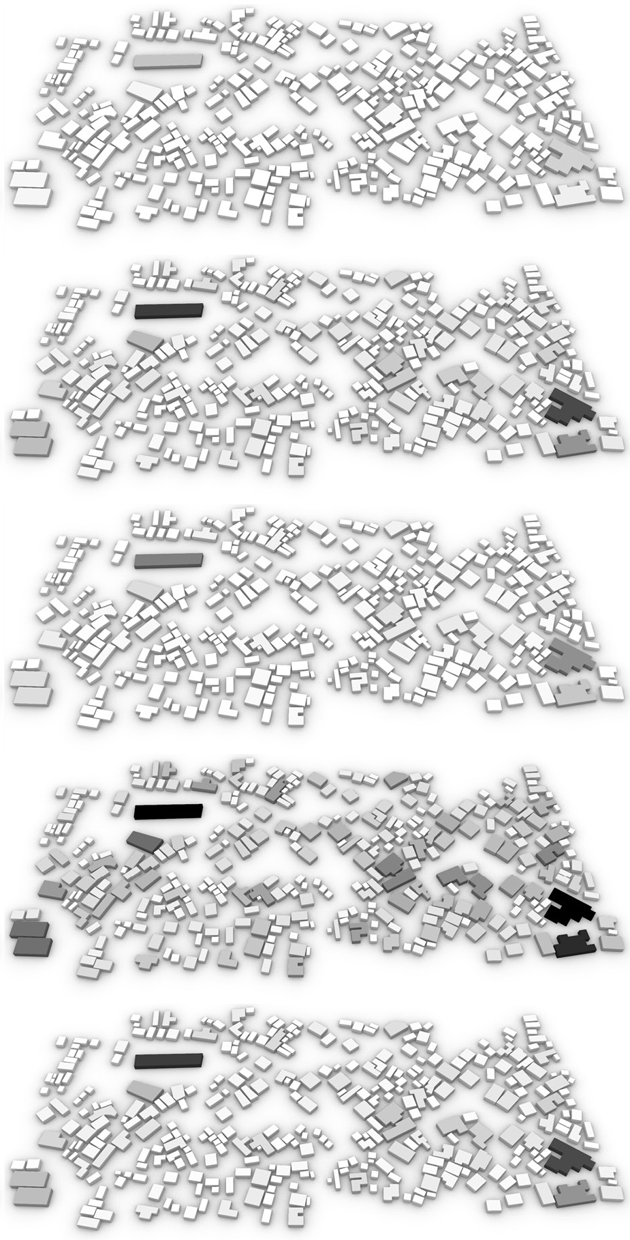
Results and Discussion

Slide 87
Results and Discussion

Slide 88
Results and Discussion
TA

Slide 89
Results and Discussion
TA
Costs

Slide 90
Results and Discussion
TA
Costs

Slide 91
Results and Discussion
TA
Costs

Slide 92
Results and Discussion
TA
Costs

Slide 93
Results and Discussion
‘Ventoinha’ house

Slide 94
Results and Discussion
‘Ventoinha’ house
Scenario 5 + Roof 2

Slide 95
Results and Discussion
‘Ventoinha’ house
Scenario 5 + Roof 2
2.25m < h < 3.5m

Slide 96
Results and Discussion
‘Ventoinha’ house
Scenario 5 + Roof 2
2.25m < h < 3.5m
6.25 m² < area < 16m²

Slide 97
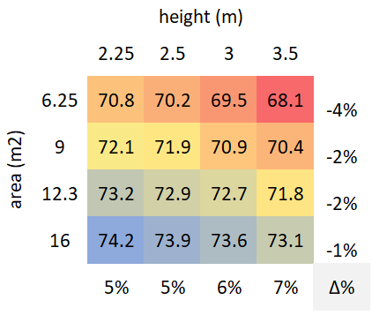
Results and Discussion
‘Ventoinha’ house
Scenario 5 + Roof 2
2.25m < h < 3.5m
6.25 m² < area < 16m²

Slide 98
Results and Discussion
‘Ventoinha’ house
All Scenarios + Roof 2

Slide 99
Results and Discussion
‘Ventoinha’ house
All Scenarios + Roof 2
6.25 m² < area < 400m²

Slide 100
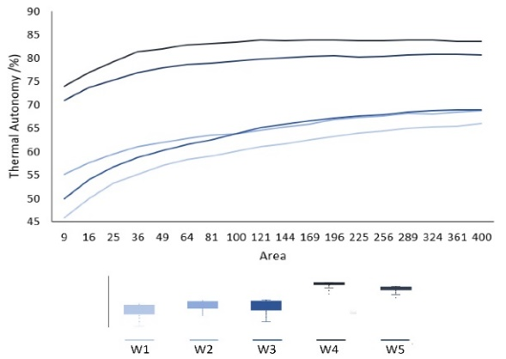
Results and Discussion
‘Ventoinha’ house
All Scenarios + Roof 2
6.25 m² < area < 400m²

Slide 101
Conclusion
Methodology

Slide 102
Conclusion
Methodology
Integrated Algorithmic processes

Slide 103
Conclusion
Urban Planning
Methodology
Integrated Algorithmic processes

Slide 104
Conclusion
Urban Planning
Methodology
Integrated Algorithmic processes
Architectural Planning

Slide 105
Conclusion
Urban Planning
Integrated Algorithmic processes
Architectural Planning

Slide 106
Conclusion
Urban Planning
Integrated Algorithmic processes
Architectural Planning

Slide 107
Conclusion
Urban Planning
Architectural Planning

Slide 108
Conclusion
Thermal Comfort

Slide 109
Conclusion
Thermal Comfort
Materials

Slide 110
Conclusion
Thermal Comfort
Materials
Cost

Slide 111
Conclusion
Thermal Comfort
Materials
Cost
Design dimensions

Slide 112
Future Work

Slide 113
Future Work

Slide 114
Future Work

Slide 115
Future Work

Slide 116
Future Work

Slide 117
Future Work

Slide 118
Thank you for watching
Gonçalo Araújo
Manuel Correia Guedes
António Leitão

