Slide 1
escaping
evolution
a study on multi-objective optimization
Inês Pereira
Catarina Belém
António Leitão

Slide 2
a shift towards sustainability

Slide 3
a shift towards sustainability
source: https://www.2030districts.org/

Slide 4
a shift towards sustainability
- 50%
source: https://www.2030districts.org/

Slide 5
a shift towards sustainability
performance-based design

Slide 6
performance-based design and optimization

Slide 7
performance-based design and optimization
b
a

Slide 8
performance-based design and optimization

Slide 9
performance-based design and optimization

Slide 10
can we escape evolution?

Slide 11
methods

Slide 12
methods
multiple algorithms

Slide 13
methods | optimization algorithms
metaheuristics

Slide 14
methods | optimization algorithms
evolutionary algorithms
particle swarm algorithms
metaheuristics

Slide 15
methods | optimization algorithms
model-based algorithms

Slide 16
methods | optimization algorithms
gaussian processes
random
forests
model-based algorithms

Slide 17
methods
multiple algorithms
multiple
runs

Slide 18
methods
multiple algorithms
multiple
runs
hypervolume

Slide 19
methods | hypervolume
evaluated solutions

Slide 20
methods | hypervolume
optimal solutions

Slide 21
methods | hypervolume
r
reference point

Slide 22
methods | hypervolume
r
area between
reference point and
optimal solutions

Slide 23
methods | hypervolume
r
area between
reference point and
optimal solutions

Slide 24
methods | hypervolume
r
total area
=
hypervolume

Slide 25
methods
multiple algorithms
multiple
runs
different
case studies
hypervolume

Slide 26
results

Slide 27
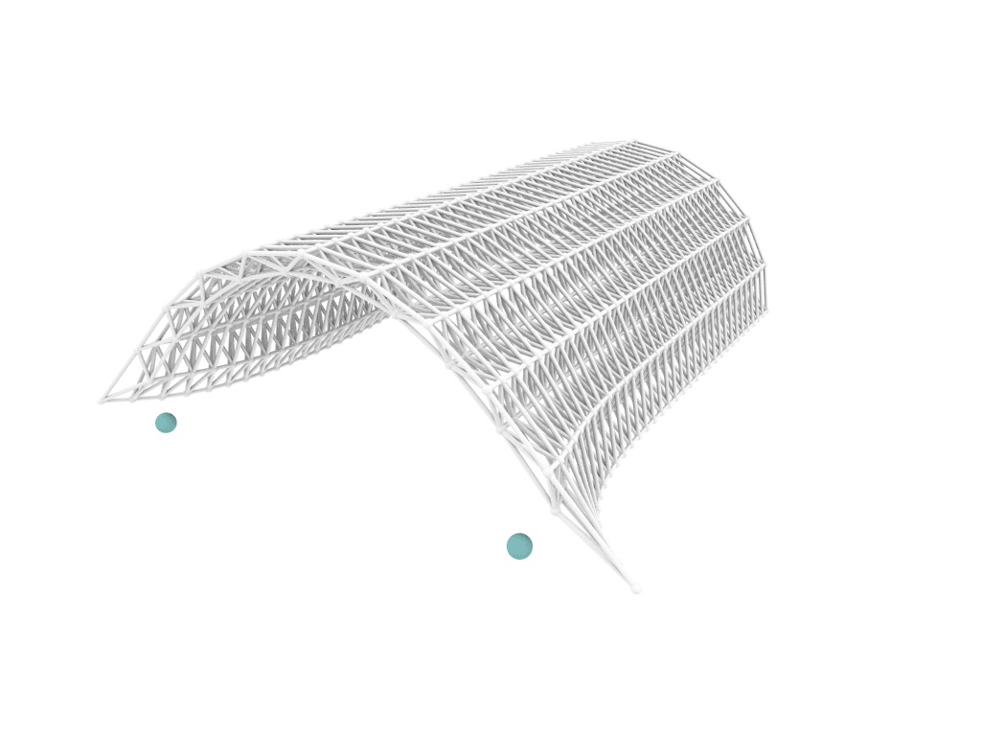
case study | arc-shaped truss
objectives
maximize
Euclidean distances
minimize
maximum displacement

Slide 28
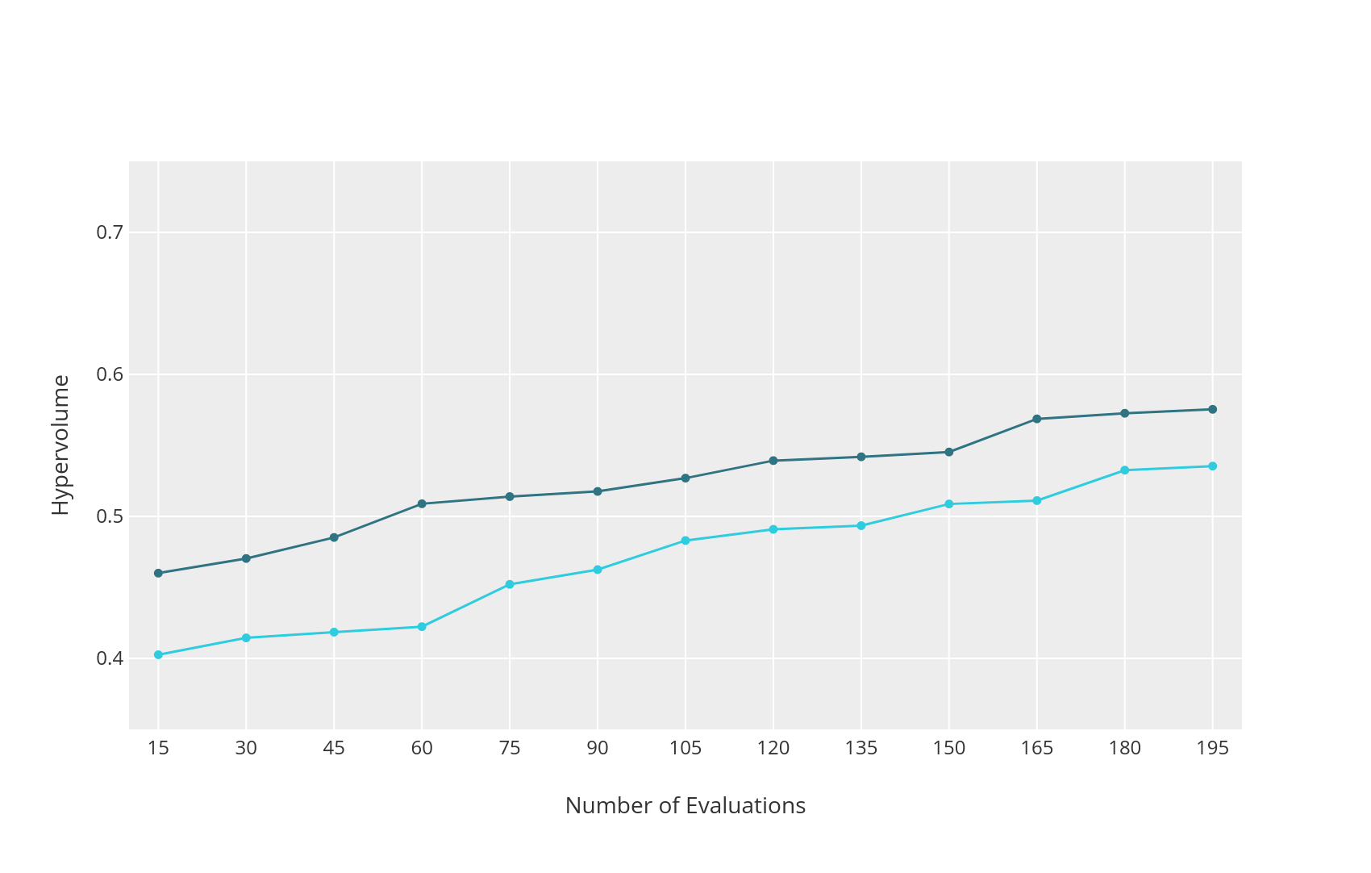
hypervolume per iteration
evolutionary
SPEA2
NSGAII
metaheuristics
0.7
0.6
hypervolume
0.5
0.4
model-based
1
2
3
4
5
6
7
8
9
10
11
12
13
iteration

Slide 29
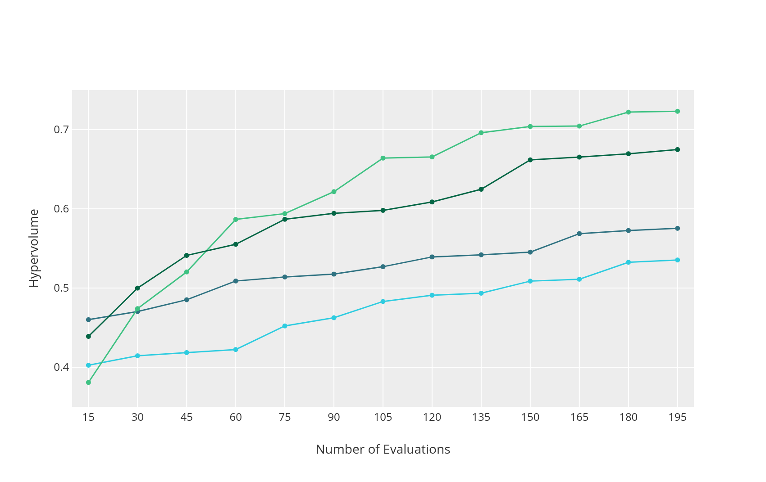
hypervolume per iteration
evolutionary
SPEA2
NSGAII
metaheuristics
0.7
particle swarm
SMPSO
OMOPSO
0.6
hypervolume
0.5
0.4
model-based
1
2
3
4
5
6
7
8
9
10
11
12
13
iteration

Slide 30
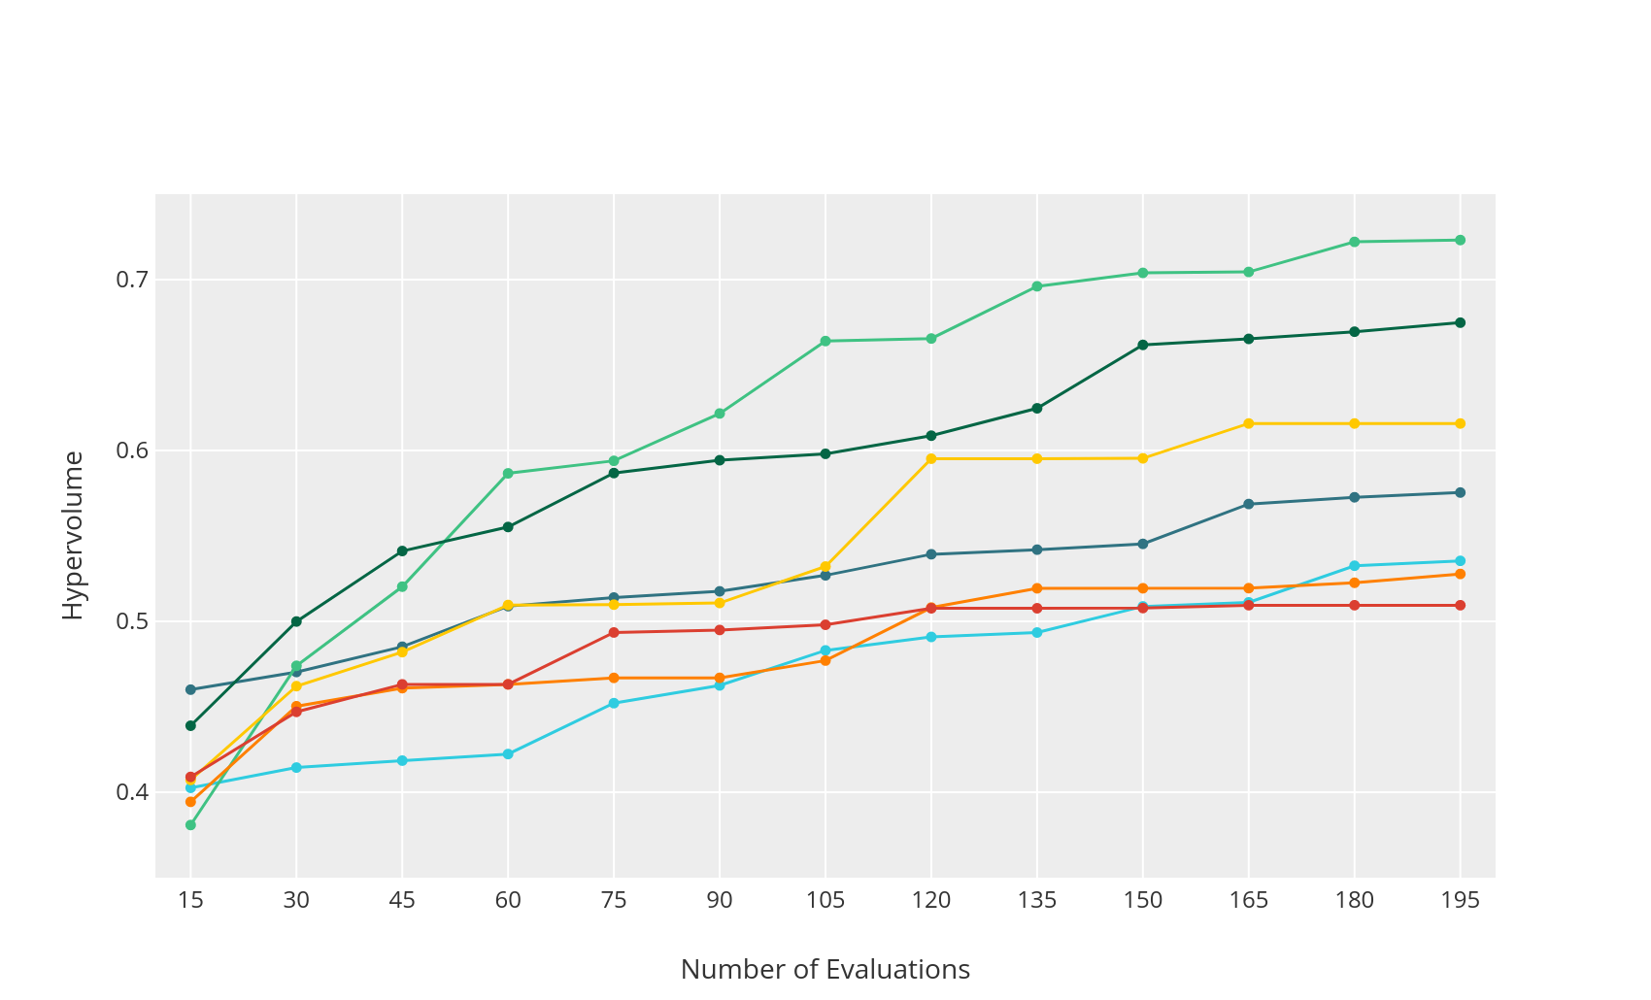
hypervolume per iteration
evolutionary
SPEA2
NSGAII
metaheuristics
0.7
particle swarm
SMPSO
OMOPSO
0.6
hypervolume
gaussian processes
0.5
GPR SMPSO
GPR NSGAII
GPR Random
0.4
model-based
1
2
3
4
5
6
7
8
9
10
11
12
13
iteration

Slide 31
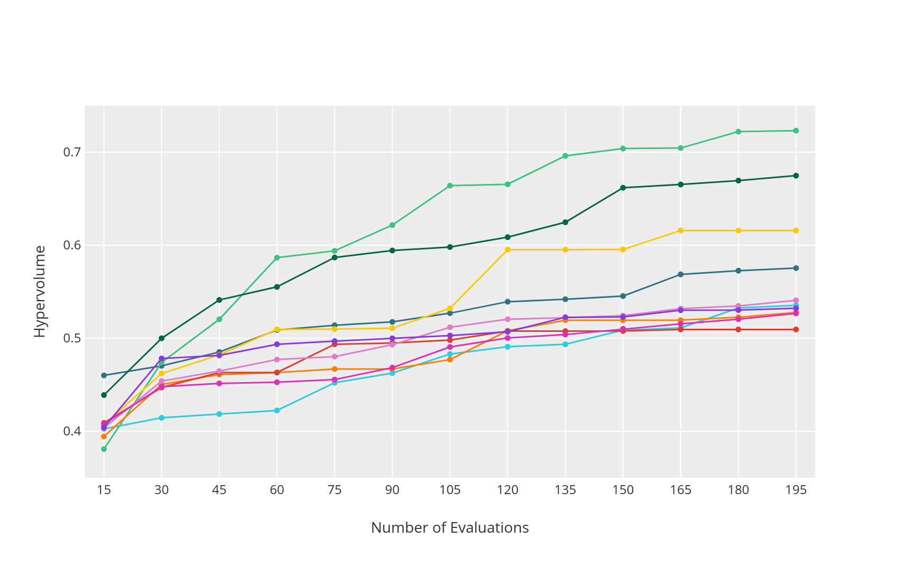
hypervolume per iteration
evolutionary
SPEA2
NSGAII
metaheuristics
0.7
particle swarm
SMPSO
OMOPSO
0.6
hypervolume
gaussian processes
0.5
GPR SMPSO
GPR NSGAII
GPR Random
0.4
model-based
random forests
1
2
3
4
5
6
7
8
9
10
11
12
13
RF SMPSO
iteration
RF NSGAII
RF Random

Slide 32
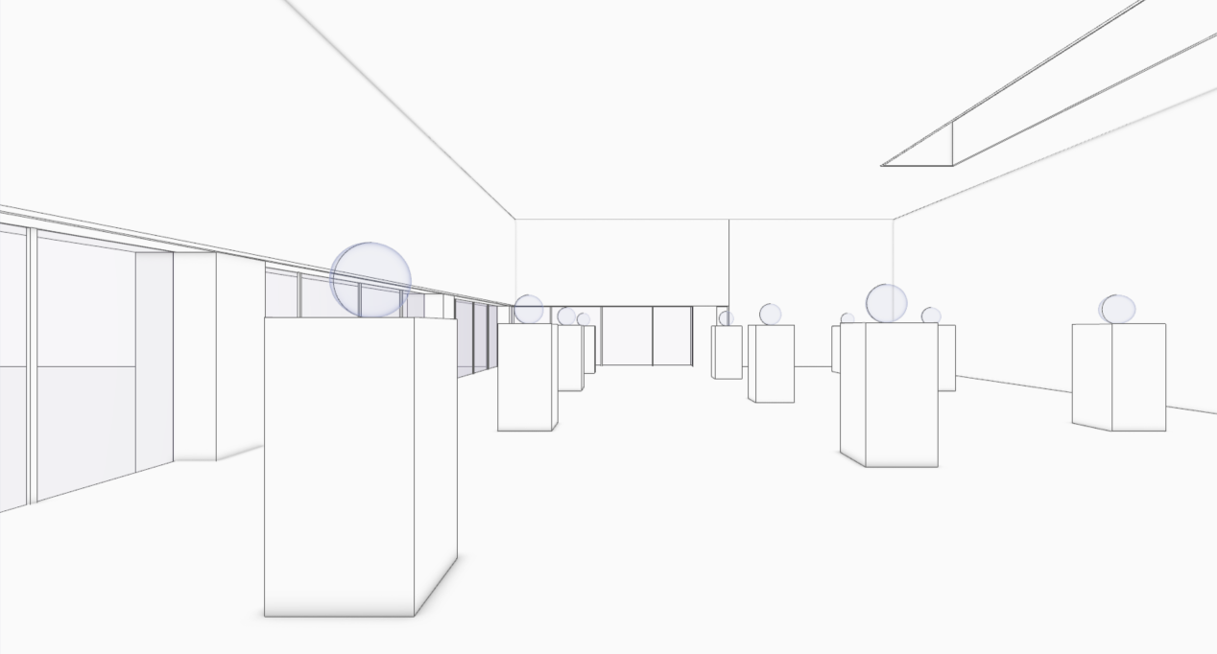
case study | exhibition space

Slide 33
case study | renovation of an exhibition space
objectives
maximize
spatial useful daylight illuminance
minimize
material cost

Slide 34
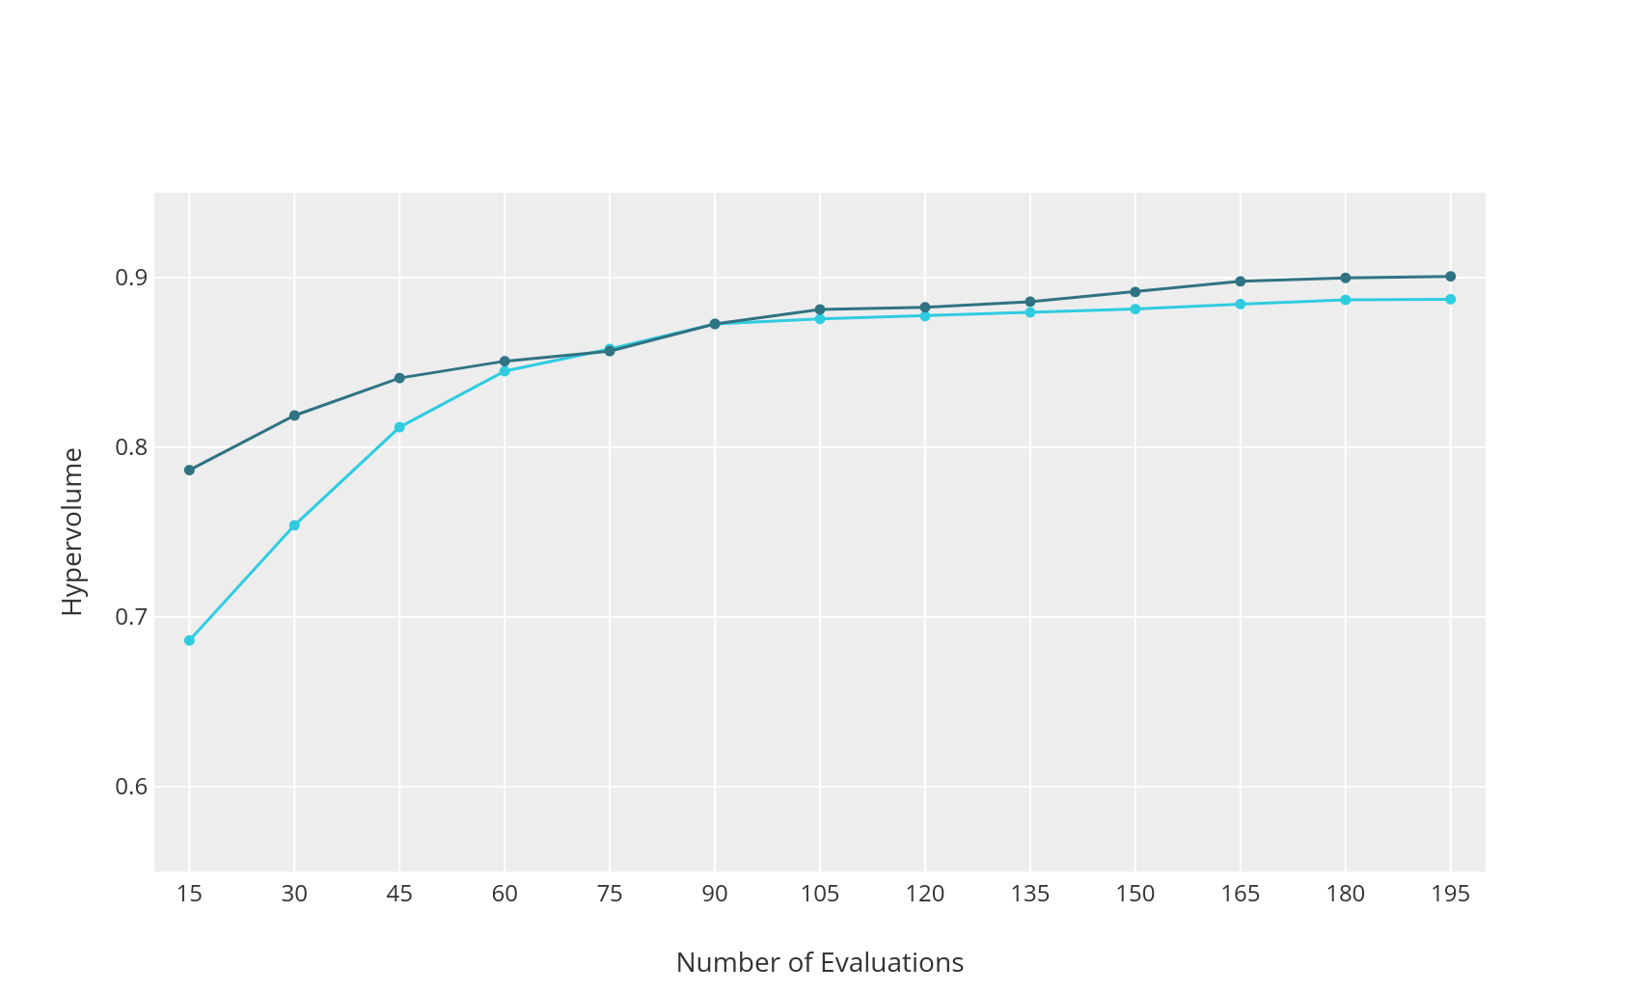
hypervolume per iteration
evolutionary
SPEA2
NSGAII
metaheuristics
0.9
0.8
hypervolume
0.7
0.6
model-based
1
2
3
4
5
6
7
8
9
10
11
12
13
iteration

Slide 35
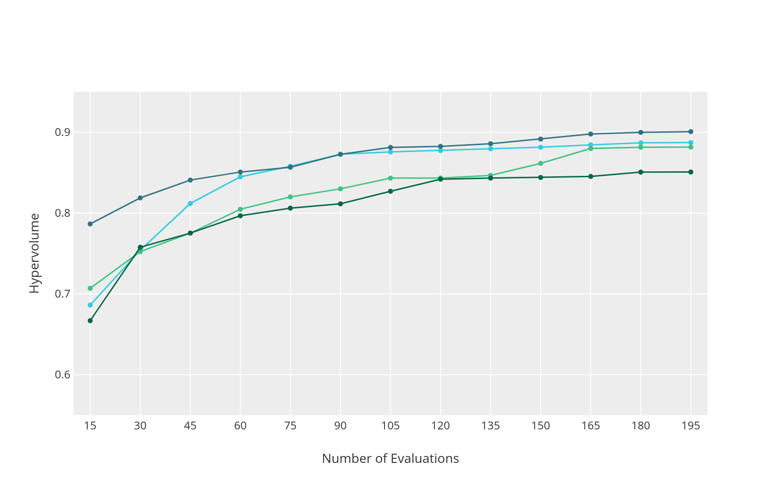
hypervolume per iteration
evolutionary
SPEA2
NSGAII
metaheuristics
0.9
particle swarm
SMPSO
OMOPSO
0.8
hypervolume
0.7
0.6
model-based
1
2
3
4
5
6
7
8
9
10
11
12
13
iteration

Slide 36
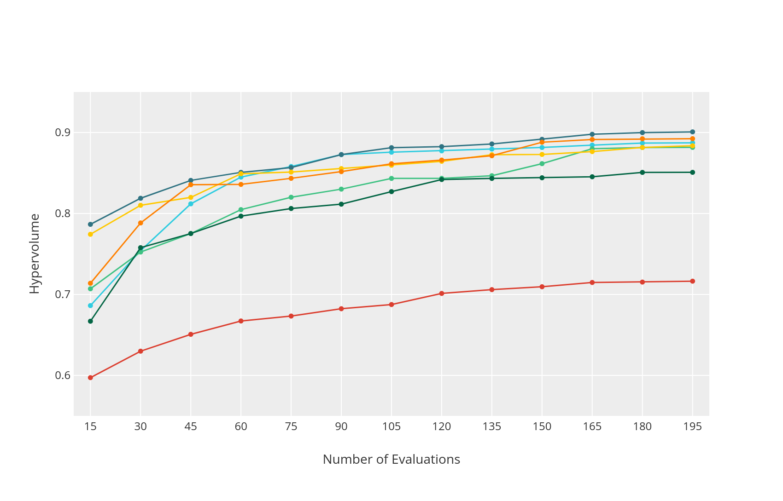
hypervolume per iteration
evolutionary
SPEA2
NSGAII
metaheuristics
0.9
particle swarm
SMPSO
OMOPSO
0.8
hypervolume
gaussian processes
0.7
GPR SPEA2
GPR NSGAII
GPR Random
0.6
model-based
1
2
3
4
5
6
7
8
9
10
11
12
13
iteration

Slide 37
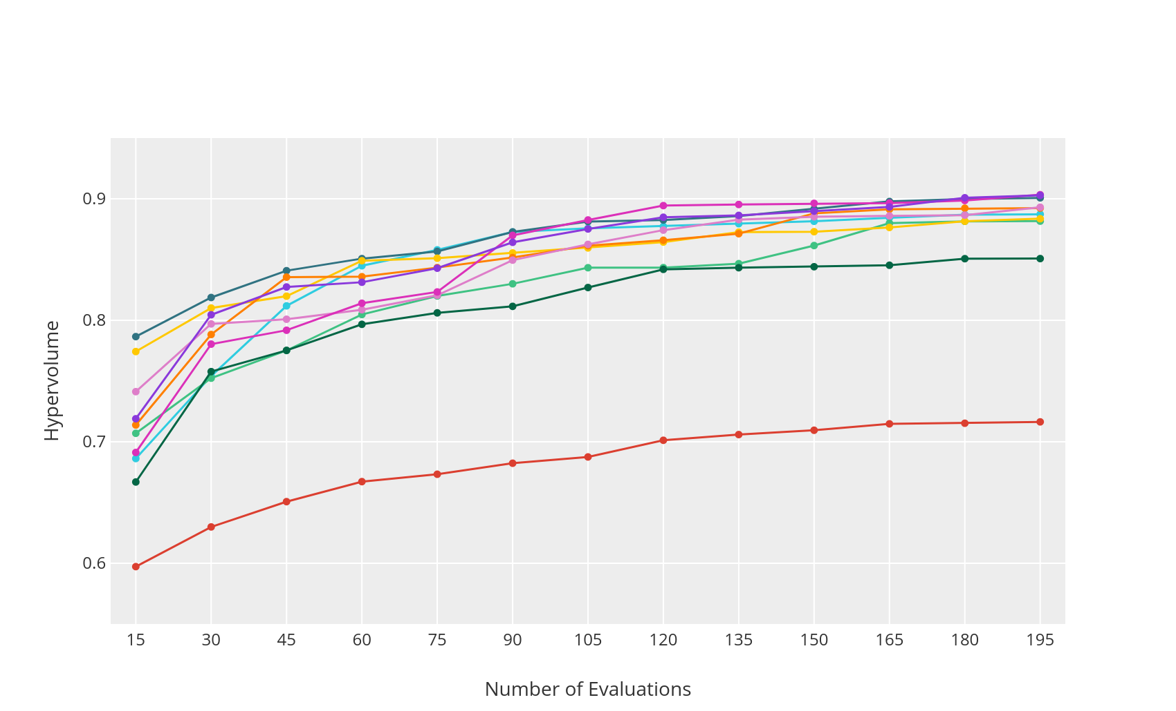
hypervolume per iteration
evolutionary
SPEA2
NSGAII
metaheuristics
0.9
particle swarm
SMPSO
OMOPSO
0.8
hypervolume
gaussian processes
0.7
GPR SPEA2
GPR NSGAII
GPR Random
0.6
model-based
random forests
1
2
3
4
5
6
7
8
9
10
11
12
13
RF SPEA2
iteration
RF NSGAII
RF Random

Slide 38
conclusions

Slide 39
conclusions
no free lunch theorem

Slide 40
conclusions
no free lunch theorem
test different algorithms

Slide 41
conclusions
no free lunch theorem
test different algorithms
improve
performance

Slide 42
future work
real-time evaluation

Slide 43
future work
real-time evaluation
complex problems

Slide 44
future work
real-time evaluation
complex problems
hyperparameter
optimization

Slide 45
Inês Pereira
ines.pereira@tecnico.ulisboa.pt
thank
Catarina Belém
catarina.belem@tecnico.ulisboa.pt
you
António Leitão
antonio.menezes.leitao@tecnico.ulisboa.pt
ADA Website
https://algorithmicdesign.github.io/

