Slide 1
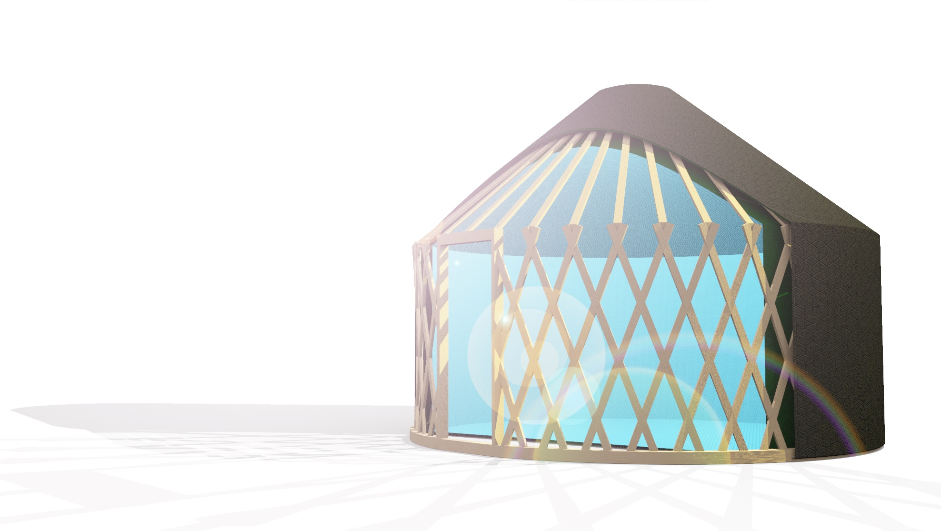
Back to the Future
Reverse-designing a shelter for extreme weather in Antarctica
Gonçalo Araújo
Sue Roaf
Manuel Correia Guedes
António Leitão
João Pinelo

Slide 2
Introduction

Slide 3
Introduction

Slide 4
Introduction

Slide 5
Introduction

Slide 6
Introduction

Slide 7
Introduction

Slide 8
Introduction

Slide 9
Introduction

Slide 10
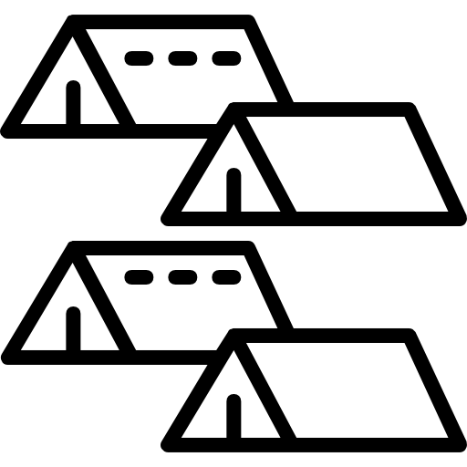
Introduction

Slide 11
Introduction

Slide 12
Introduction

Slide 13
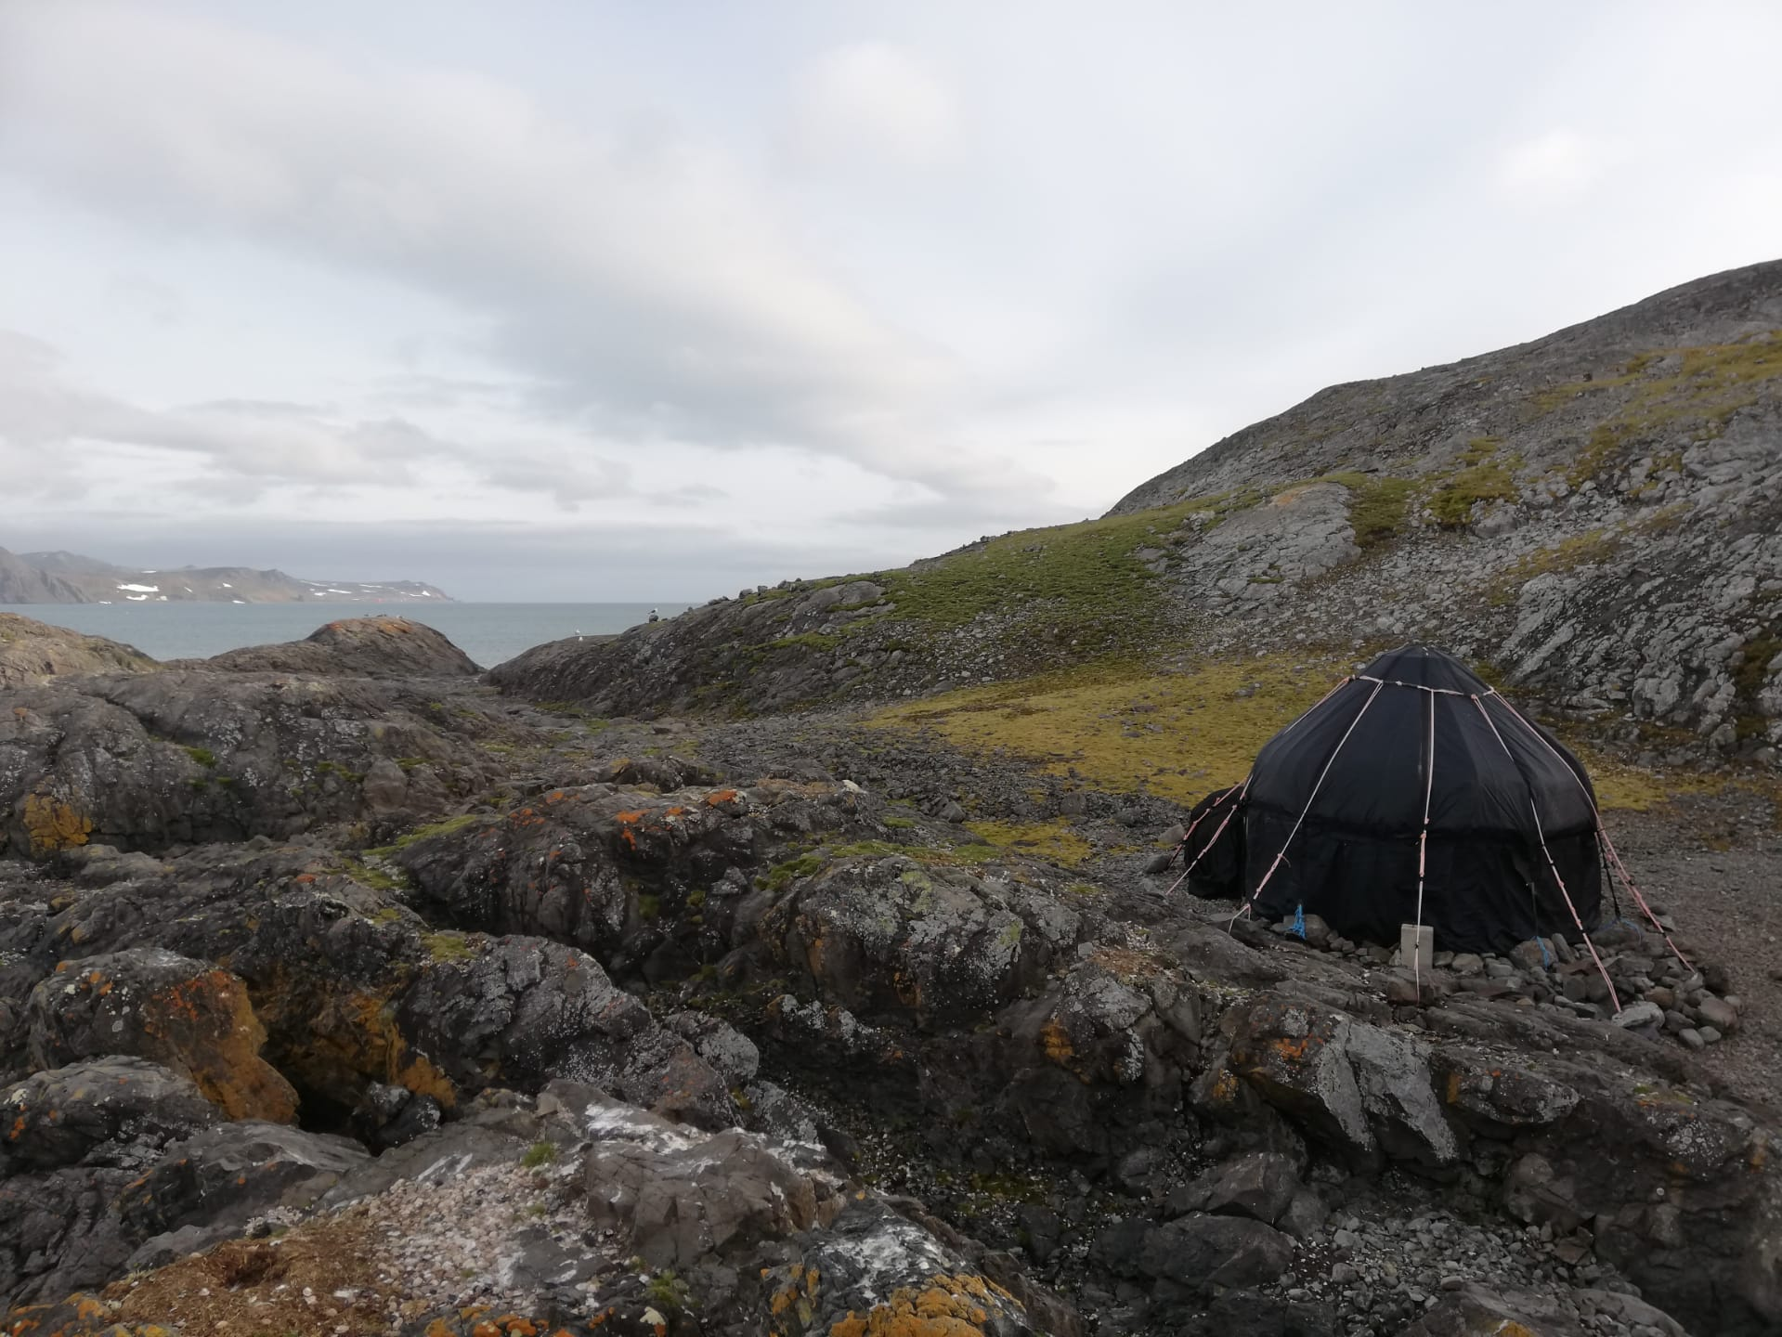
Introduction

Slide 14
Introduction
Collins Bay,King George Island, Antarctica

Slide 15
Introduction
Collins Bay,King George Island, Antarctica
12 months

Slide 16
Introduction
Collins Bay,King George Island, Antarctica
12 months
Structure

Slide 17
Introduction
Collins Bay,King George Island, Antarctica
12 months
Structure
Fabric

Slide 18
Workflow

Slide 19
Workflow
Theoretical Data

Slide 20
Workflow
Theoretical Data
Field Data

Slide 21
Workflow
Theoretical Data
Field Data
Algorithmic Design

Slide 22
Workflow
Theoretical Data
Field Data
Algorithmic Design

Slide 23
Workflow
Theoretical Data
Field Data
Algorithmic Design
Building Performance Simulation

Slide 24
Workflow
Theoretical Data
Field Data
Algorithmic Design
Building Performance Simulation

Slide 25
Workflow
Algorithmic Design
Building Performance Simulation

Slide 26
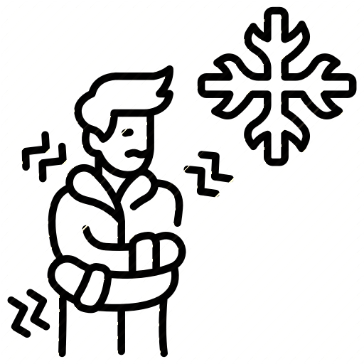
Workflow
Algorithmic Design
Building Performance Simulation

Slide 27
Workflow
Algorithmic Design
Building Performance Simulation
Permanent Structures

Slide 28
Workflow
Local data
Algorithmic Design

Slide 29
Workflow
Local data
Algorithmic Design

Slide 30
Workflow
Local data
Algorithmic Design

Slide 31
Workflow
Local data
Data loggers
Algorithmic Design

Slide 32
Workflow
Local data
Data loggers
Algorithmic Design

Slide 33
Workflow
Local data
Data loggers
Algorithmic Design

Slide 34
Workflow
Local data
Data loggers
Algorithmic Design

Slide 35
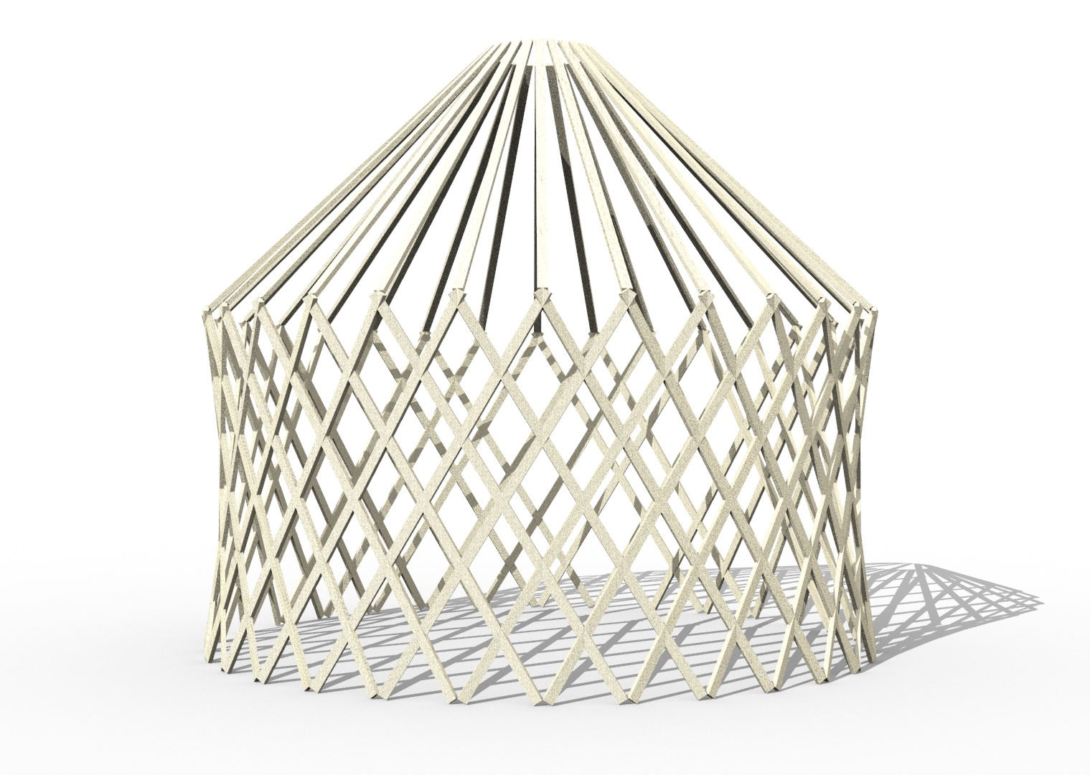
Workflow
Algorithmic Design

Slide 36
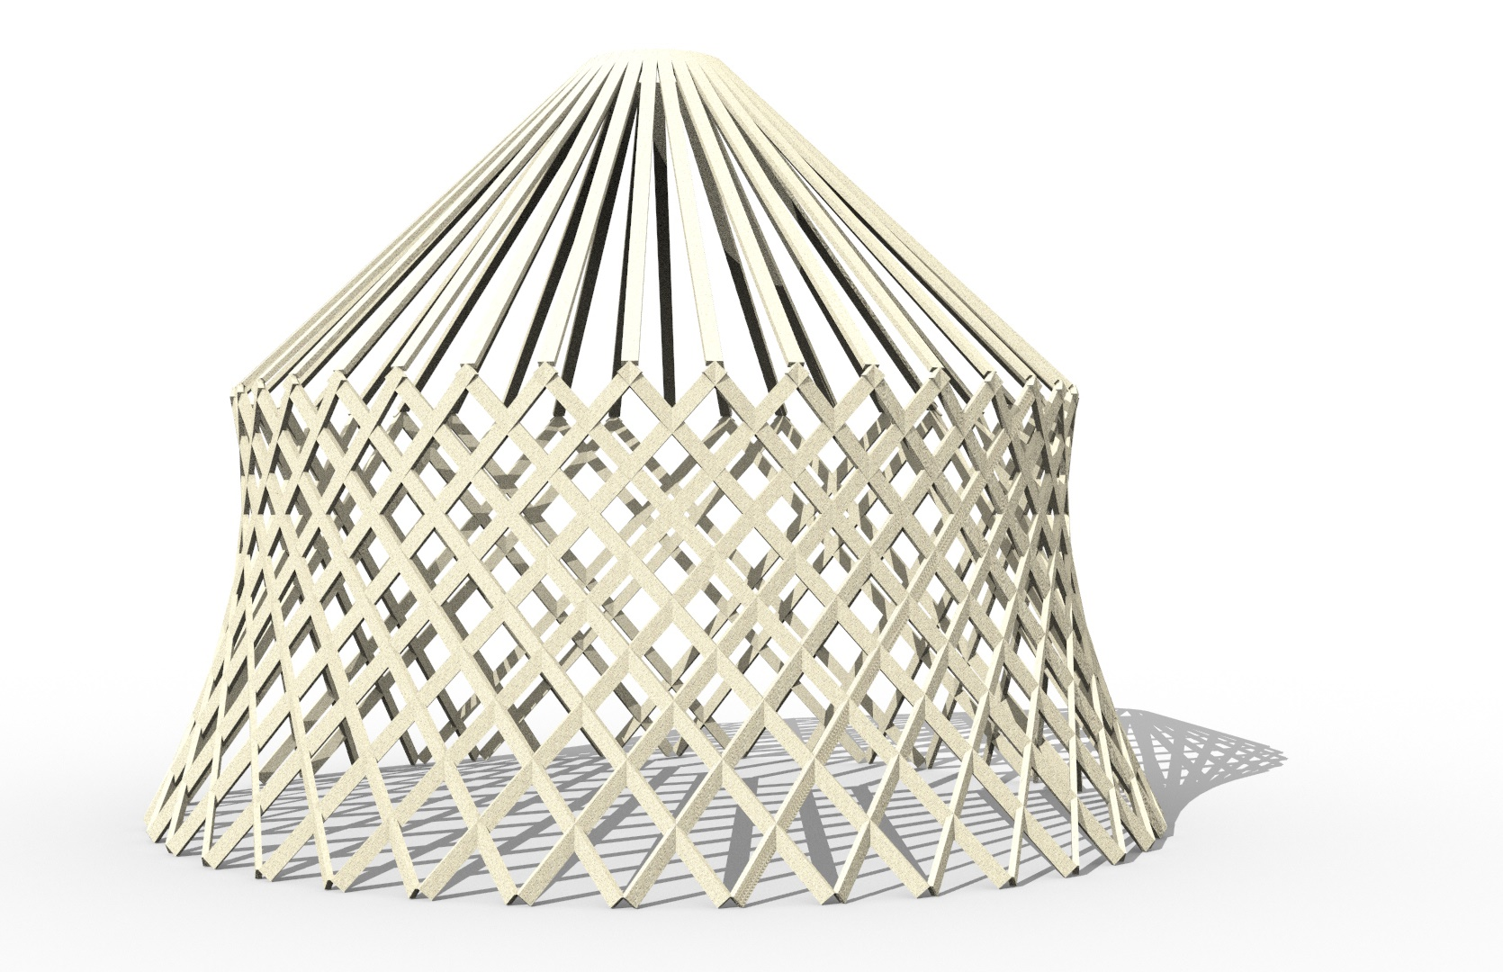
Workflow
Algorithmic Design

Slide 37
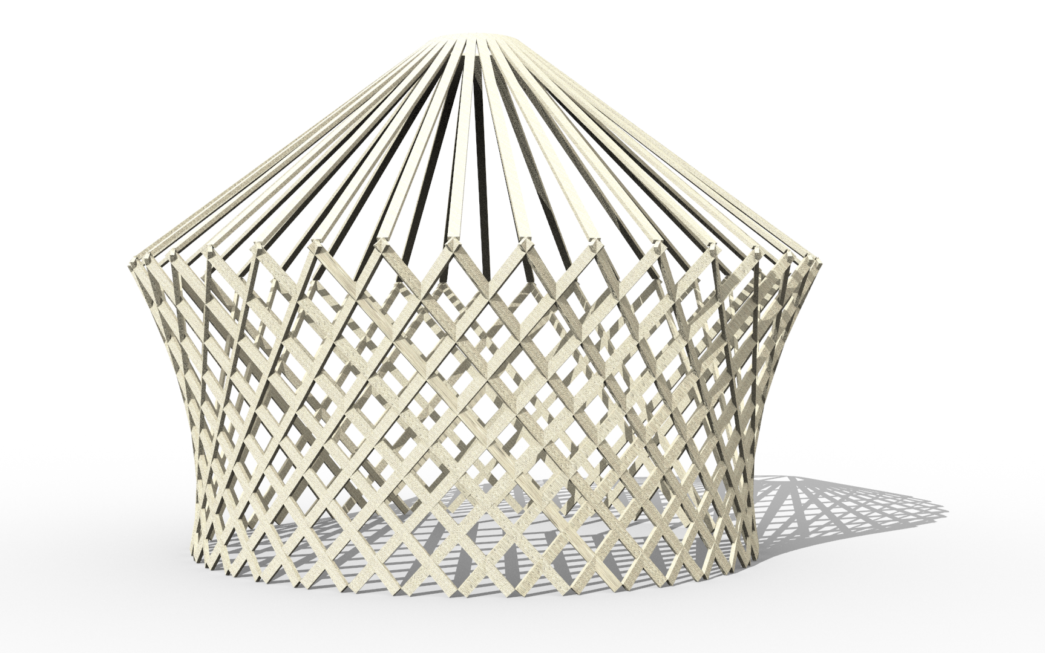
Workflow
Algorithmic Design

Slide 38
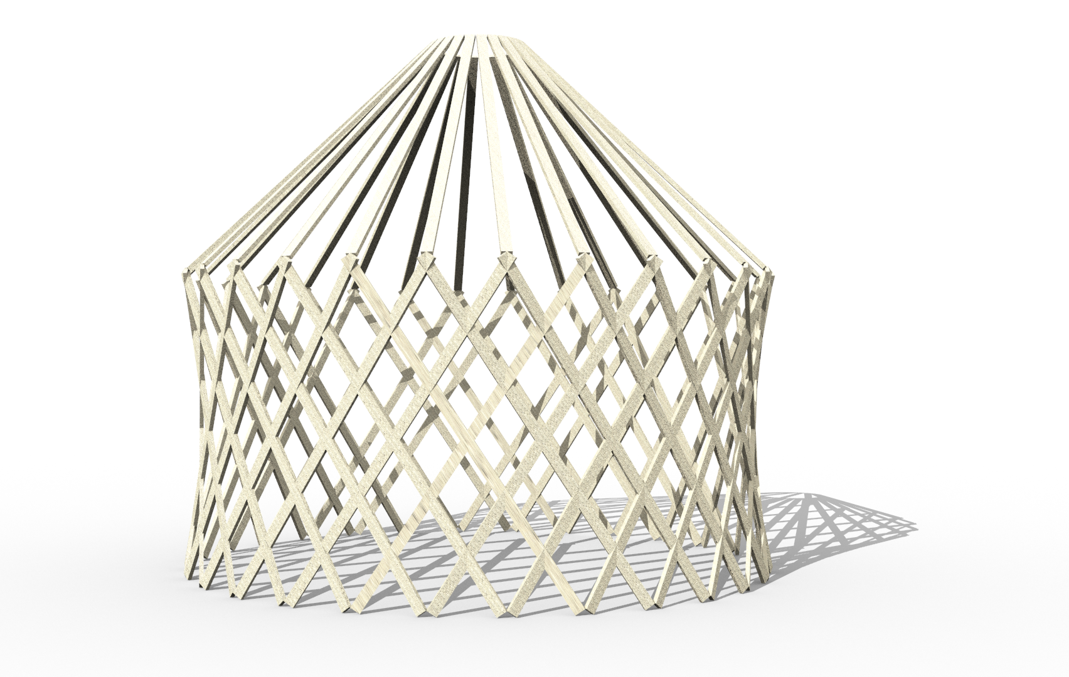
Workflow
Algorithmic Design

Slide 39
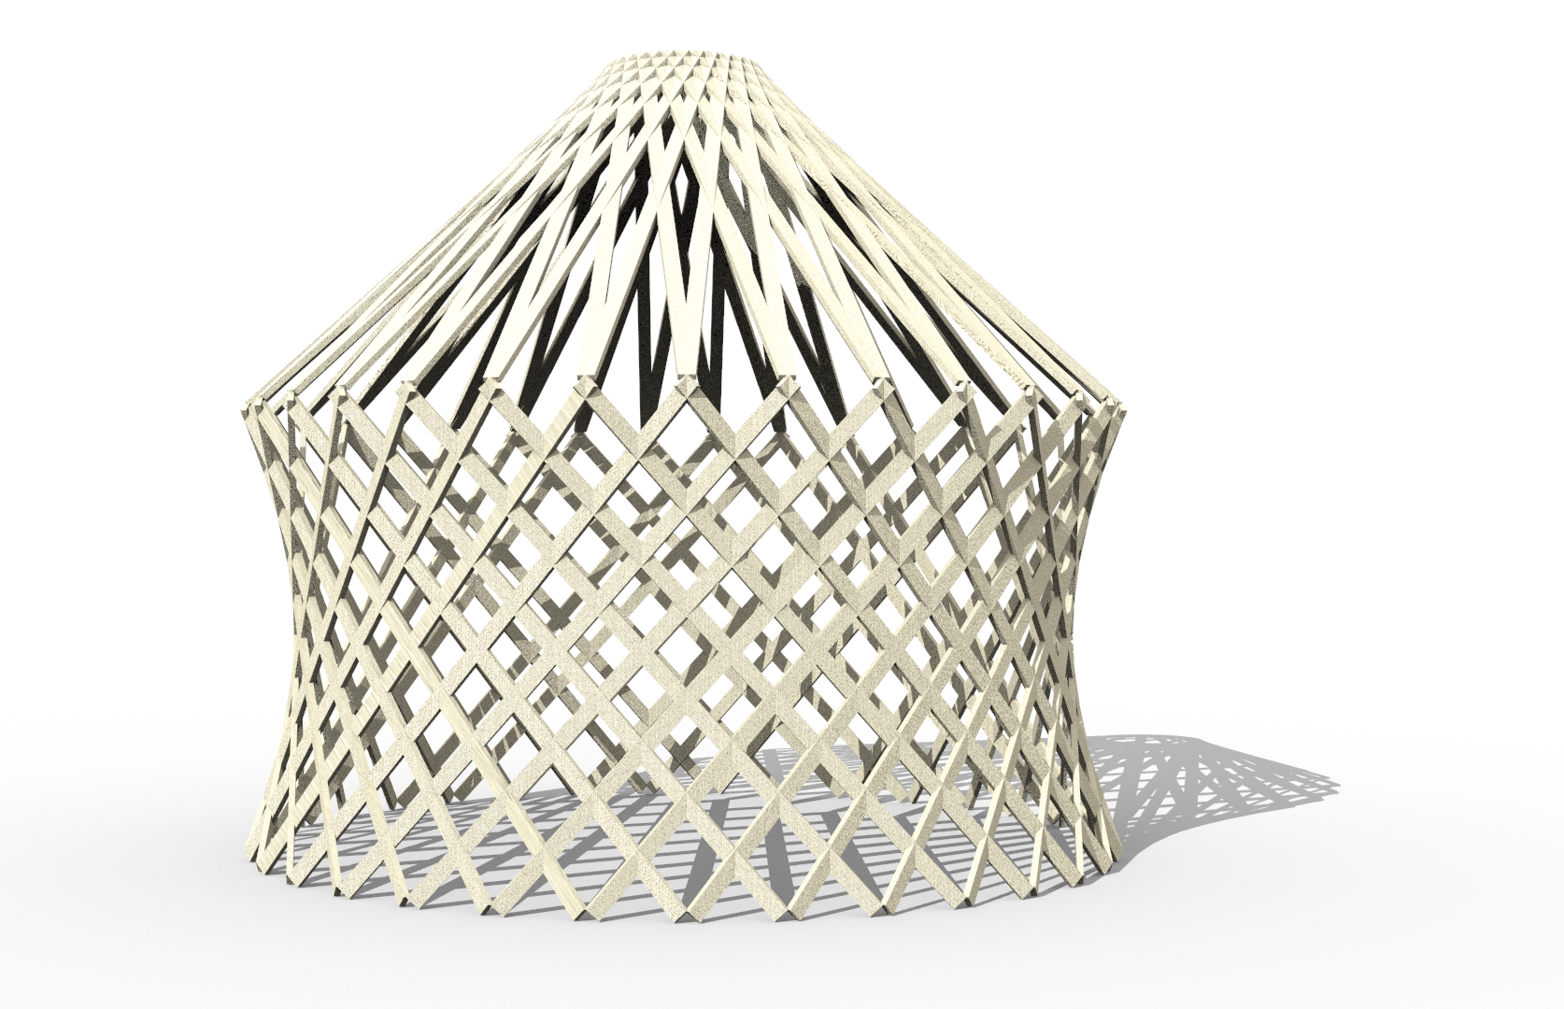
Workflow
Algorithmic Design

Slide 40
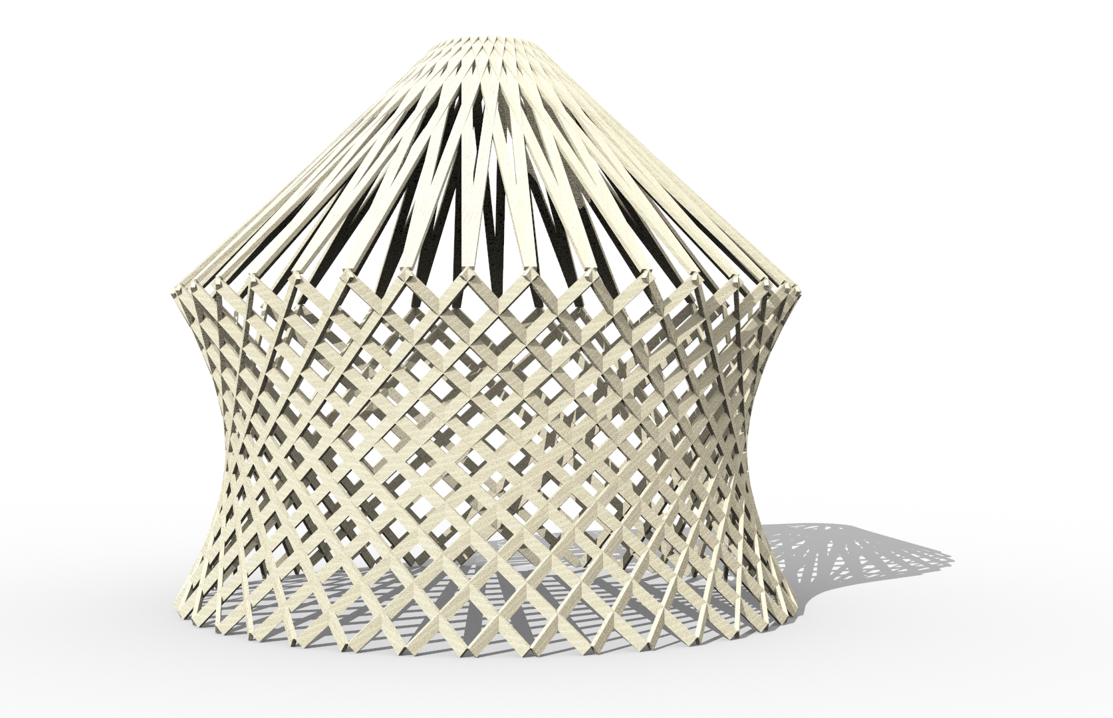
Workflow
Algorithmic Design

Slide 41
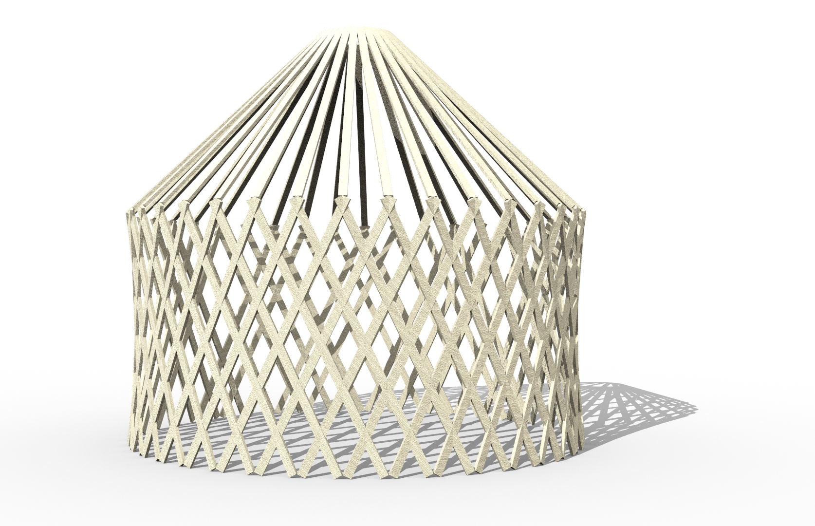
Workflow
Algorithmic Design

Slide 42
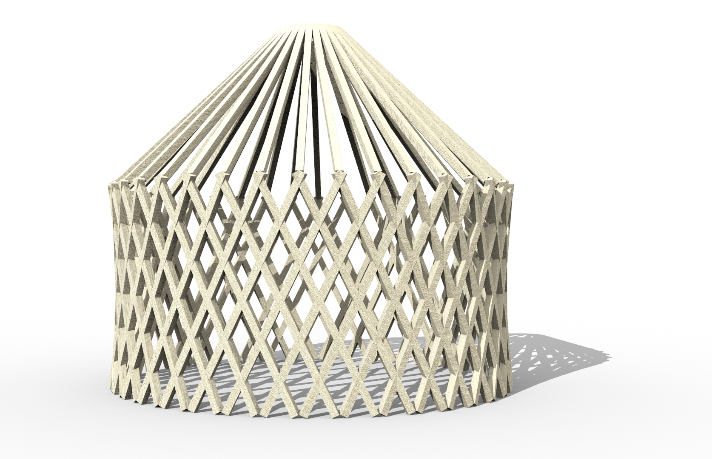
Workflow
Algorithmic Design

Slide 43
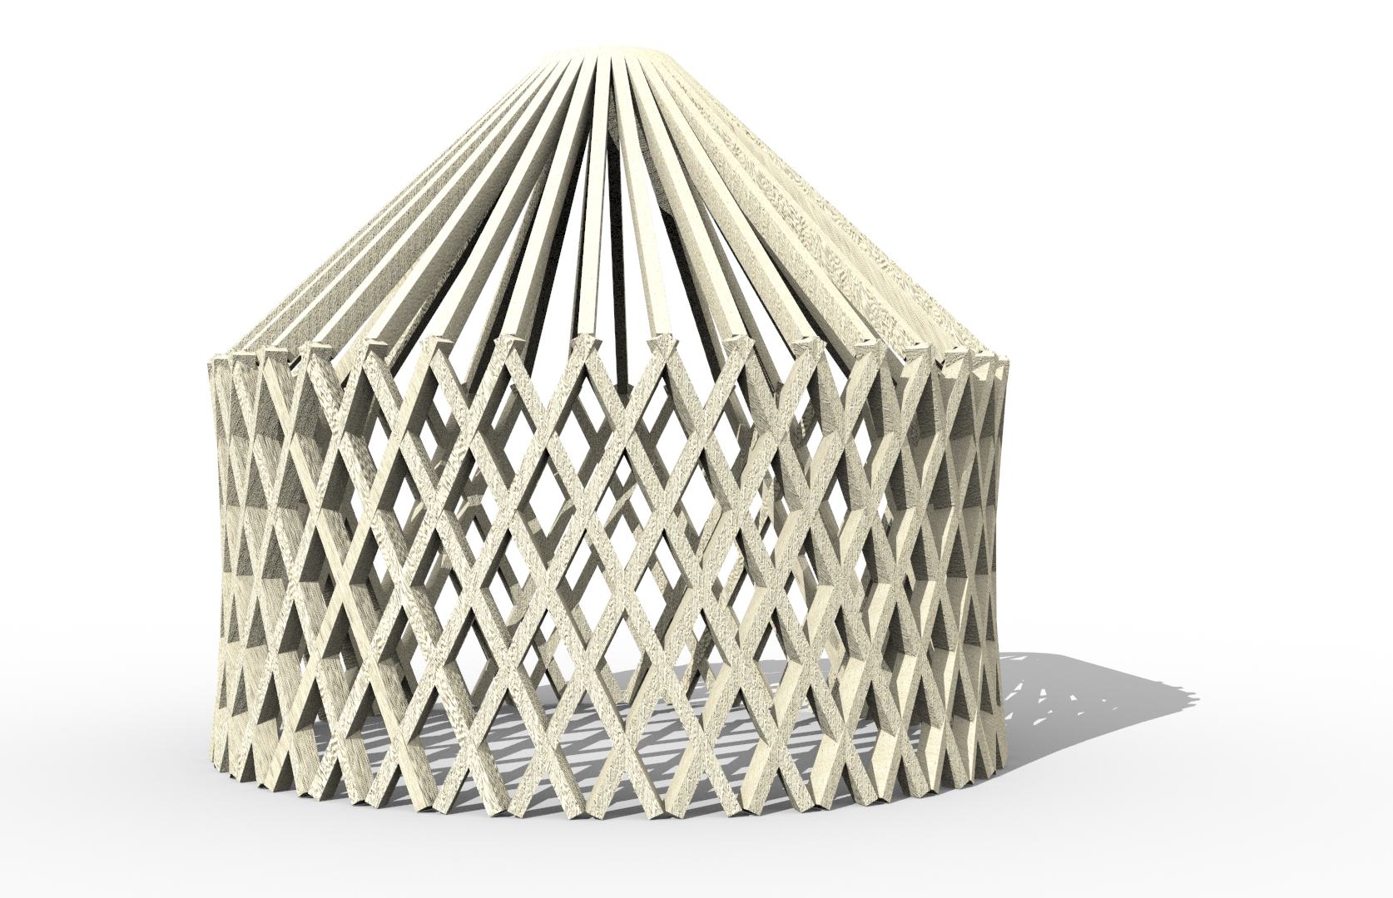
Workflow
Algorithmic Design

Slide 44
Workflow
Algorithmic Design

Slide 45
Workflow
Algorithmic Design

Slide 46
Workflow
Algorithmic Design

Slide 47
Workflow
Algorithmic Design

Slide 48
Workflow
Inputs
Algorithmic Design

Slide 49
Workflow
70 Knots
Inputs
Algorithmic Design

Slide 50
Workflow
70 Knots
N, W and E
Inputs
Algorithmic Design

Slide 51
Workflow
Algorithmic Design

Slide 52
Workflow
Algorithmic Design

Slide 53
Workflow
Inputs
Algorithmic Design

Slide 54
Workflow
Inputs
Algorithmic Design

Slide 55
Workflow
Inputs
Algorithmic Design

Slide 56
Workflow
Inputs
Algorithmic Design

Slide 57
Results and discussion | Damage Report and Airflow

Slide 58
Results and discussion | Damage Report and Airflow

Slide 59
Results and discussion | Damage Report and Airflow

Slide 60
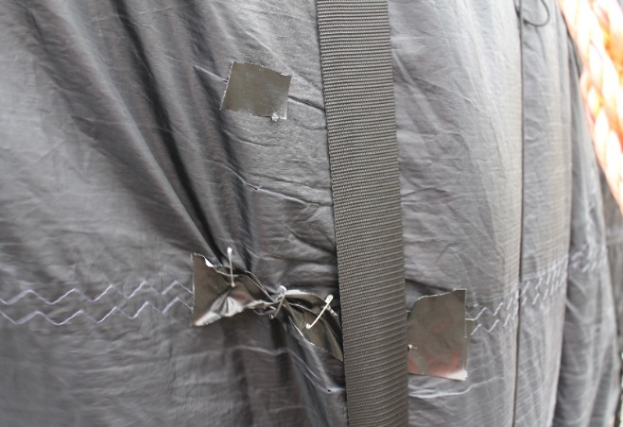
Results and discussion | Damage Report and Airflow

Slide 61
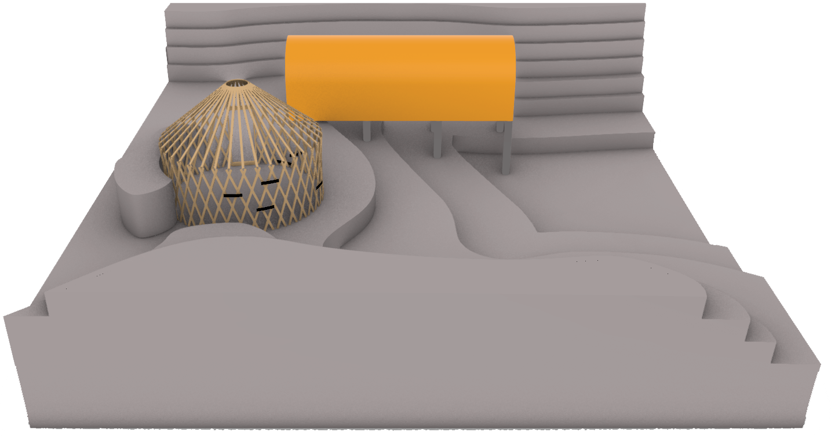
Results and discussion | Damage Report and Airflow

Slide 62
Results and discussion | Damage Report and Airflow
3 Wind tunnel tests

Slide 63
Results and discussion | Damage Report and Airflow
3 Wind tunnel tests
45 Seconds

Slide 64
Results and discussion | Damage Report and Airflow
3 Wind tunnel tests
45 Seconds
North

Slide 65
Results and discussion | Damage Report and Airflow
3 Wind tunnel tests
45 Seconds
North
East

Slide 66
Results and discussion | Damage Report and Airflow
3 Wind tunnel tests
45 Seconds
North
East
West

Slide 67
Results and discussion | Damage Report and Airflow
3 Wind tunnel tests
45 Seconds
North
East
West

Slide 68
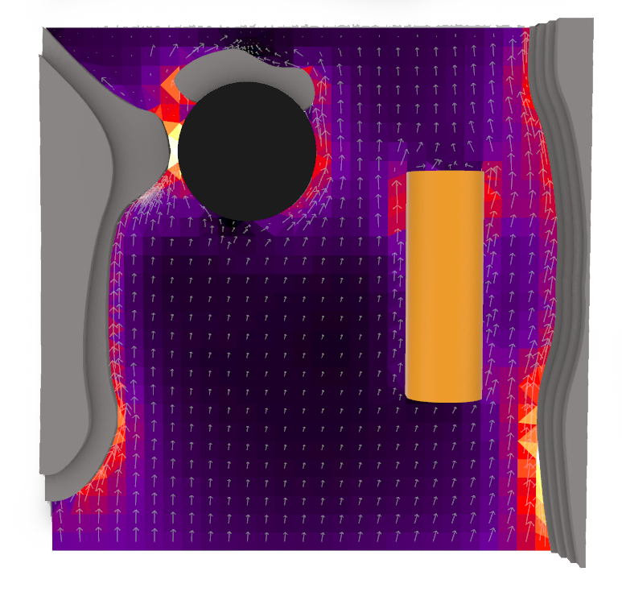
Results and discussion | Damage Report and Airflow
45 Seconds
North
East
West
0 Knots
23 Knots

Slide 69
Results and discussion | Damage Report and Airflow
> 23 Knots in the Eastern side
45 Seconds
North
East
West
0 Knots
23 Knots

Slide 70
Results and discussion | Damage Report and Airflow
> 23 Knots in the Eastern side
> 12 Knots in the Western side
45 Seconds
North
East
West
0 Knots
23 Knots

Slide 71
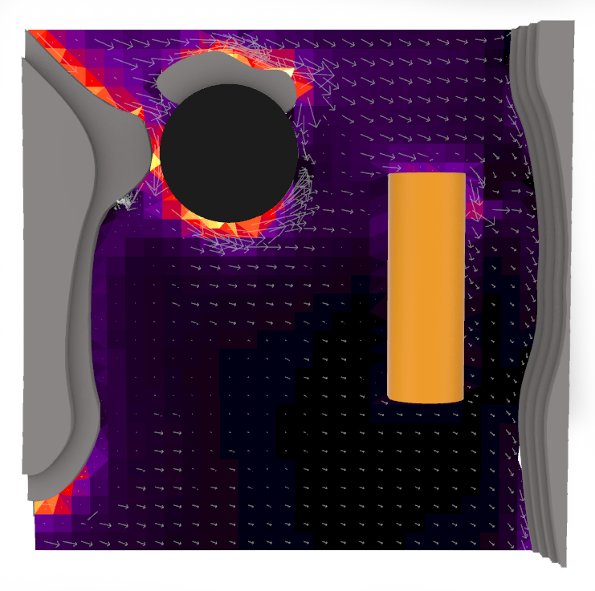
Results and discussion | Damage Report and Airflow
> 20 Knots in the northern side
> 18 Knots in the Eastern side
45 Seconds
North
East
West
0 knots
23 Knots

Slide 72
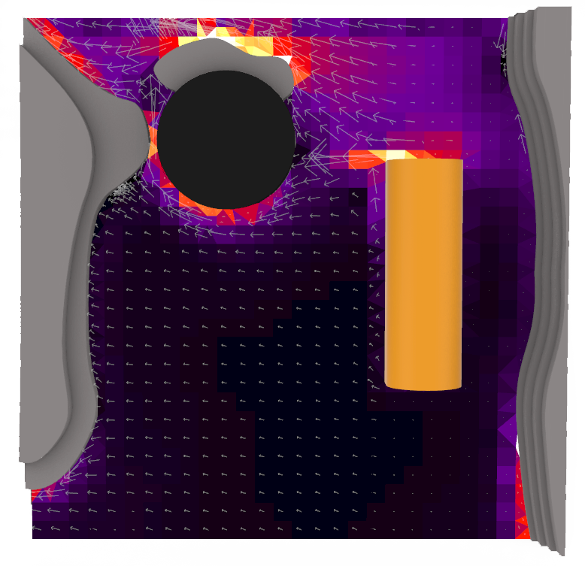
Results and discussion | Damage Report and Airflow
> 23 Knots in the Southern side
> 15 Knots in the Northern side side
45 Seconds
North
East
West
0 knots
23 Knots

Slide 73
Results and discussion | Damage Report and Airflow
> 23 Knots in the Southern side
> 15 Knots in the Northern side side
45 Seconds
North
East
West
0 knots
23 Knots

Slide 74
Results and discussion | Damage Report and Airflow
North
East

Slide 75
Results and discussion | Damage Report and Airflow

Slide 76
Results and discussion | Damage Report and Airflow
Damaged areas

Slide 77
Results and discussion | Damage Report and Airflow
Constricted sections
North
East
Damaged areas

Slide 78
Results and discussion | Damage Report and Airflow
Constricted sections
North
East
Damaged areas

Slide 79
Results and discussion | Damage Report and Airflow
Constricted sections
North
East
Damaged areas

Slide 80
Results and discussion | Damage Report and Airflow
Damage

Slide 81
Results and discussion | Damage Report and Airflow
Damage
Prevention

Slide 82
Results and discussion | Damage Report and Airflow
Damage
Prevention
Displacement

Slide 83
Results and discussion | Damage Report and Airflow
Damage
Prevention
Displacement

Slide 84
Results and discussion | Comfort performance and comparison

Slide 85
Results and discussion | Comfort performance and comparison

Slide 86
Results and discussion | Comfort performance and comparison

Slide 87
Results and discussion | Comfort performance and comparison

Slide 88
Results and discussion | Comfort performance and comparison
ºC
Indoor recorded Temperature

Slide 89
Results and discussion | Comfort performance and comparison
ºC
Indoor recorded Temperature
Outdoor recorded Temperature

Slide 90
Results and discussion | Comfort performance and comparison
ºC
Indoor recorded Temperature
Outdoor recorded Temperature

Slide 91
Results and discussion | Comfort performance and comparison
ºC
Indoor recorded Temperature
Outdoor recorded Temperature
Max

Slide 92
Results and discussion | Comfort performance and comparison
ºC
Indoor recorded Temperature
Outdoor recorded Temperature
Max

Slide 93
Results and discussion | Comfort performance and comparison
ºC
Indoor recorded Temperature
Outdoor recorded Temperature
Max

Slide 94
Results and discussion | Comfort performance and comparison
ºC
Indoor recorded Temperature
Outdoor recorded Temperature
Min
Min

Slide 95
Results and discussion | Comfort performance and comparison
%
Indoor Relative Humidity (%)
Outdoor Relative Humidity (%)

Slide 96
Results and discussion | Comfort performance and comparison
%
Indoor Relative Humidity (%)
Outdoor Relative Humidity (%)

Slide 97
Results and discussion | Comfort performance and comparison
ºC
Simulated indoor Temperature

Slide 98
Results and discussion | Comfort performance and comparison
ºC
Indoor recorded Temeprature
Simulated indoor Temperature

Slide 99
Results and discussion | Comfort performance and comparison
ºC
Indoor recorded Temeprature
Simulated indoor Temperature

Slide 100
Results and discussion | Comfort performance and comparison
ºC
Indoor recorded Temeprature
Simulated indoor Temperature
σ = ±3 ºc

Slide 101
Results and discussion | Comfort performance and comparison
ºC
Indoor recorded Temeprature
Simulated indoor Temperature
σ = ±10 ºc
σ = ±3 ºc

Slide 102
Results and discussion | Comfort performance and comparison
ºC
Indoor recorded Temeprature
Simulated indoor Temperature

Slide 103
Results and discussion | Comfort performance and comparison
ºC
Indoor recorded Temeprature
Simulated indoor Temperature
σ = ±5.5 ºc

Slide 104
Results and discussion | Comfort performance and comparison
ºC
Indoor recorded Temeprature
Simulated indoor Temperature

Slide 105
Results and discussion | Comfort performance and comparison
-14 ºC
22 ºC

Slide 106
Results and discussion | Comfort performance and comparison
-14 ºC
22 ºC

Slide 107
Results and discussion | Comfort performance and comparison
-14 ºC
22 ºC

Slide 108
Results and discussion | Comfort performance and comparison
-14 ºC
22 ºC

Slide 109
Results and discussion | Comfort performance and comparison
-14 ºC
22 ºC

Slide 110
Conclusions | Shelter Performance

Slide 111
Conclusions | Shelter Performance
Good Heat Storage

Slide 112
Conclusions | Shelter Performance
Good Heat Storage
High Thermal Amplitude

Slide 113
Conclusions | Shelter Performance
Good Heat Storage
High Thermal Amplitude
Humidity Damage

Slide 114
Conclusions | Shelter Performance
Good Heat Storage
High Thermal Amplitude
Adequate for Summer
Humidity Damage

Slide 115
Conclusions | Shelter Performance
Good Heat Storage
High Thermal Amplitude
Adequate for Summer
Humidity Damage
Inadequate for Winter

Slide 116
Conclusions | Shelter Performance
Good Heat Storage
High Thermal Amplitude
Adequate for Summer
Humidity Damage
Inadequate for Winter

Slide 117
Conclusions | Methodology

Slide 118
Conclusions | Methodology
Reliable data

Slide 119
Conclusions | Methodology
Reliable data
Further improvements

Slide 120
Conclusions | Methodology
Reliable data
Occupancy Schedules
Further improvements

Slide 121
Conclusions | Methodology
Reliable data
Occupancy Schedules
Further improvements
Material properties

Slide 122
Conclusions | Methodology
Reliable data
Occupancy Schedules
Further improvements
Material properties

Slide 123
Future Work
Design Parameters

Slide 124
Future Work
Design Parameters
Structural Analysis

Slide 125
Future Work
Design Parameters
Structural Analysis
Optimization

Slide 126
Future Work
Wind Loads
Design Parameters
Structural Analysis
Optimization

Slide 127
Future Work
Deformation
Wind Loads
Design Parameters
Structural Analysis
Optimization

Slide 128
Future Work
Deformation
Wind Loads
Cost
Design Parameters
Structural Analysis
Optimization

Slide 129
Future Work
Deformation
Wind Loads
Cost
Design Parameters
Structural Analysis
Optimization

Slide 130
Thank you for watching
Gonçalo Araújo
Sue Roaf
Manuel Correia Guedes
António Leitão
João Pinelo

