Slide 1
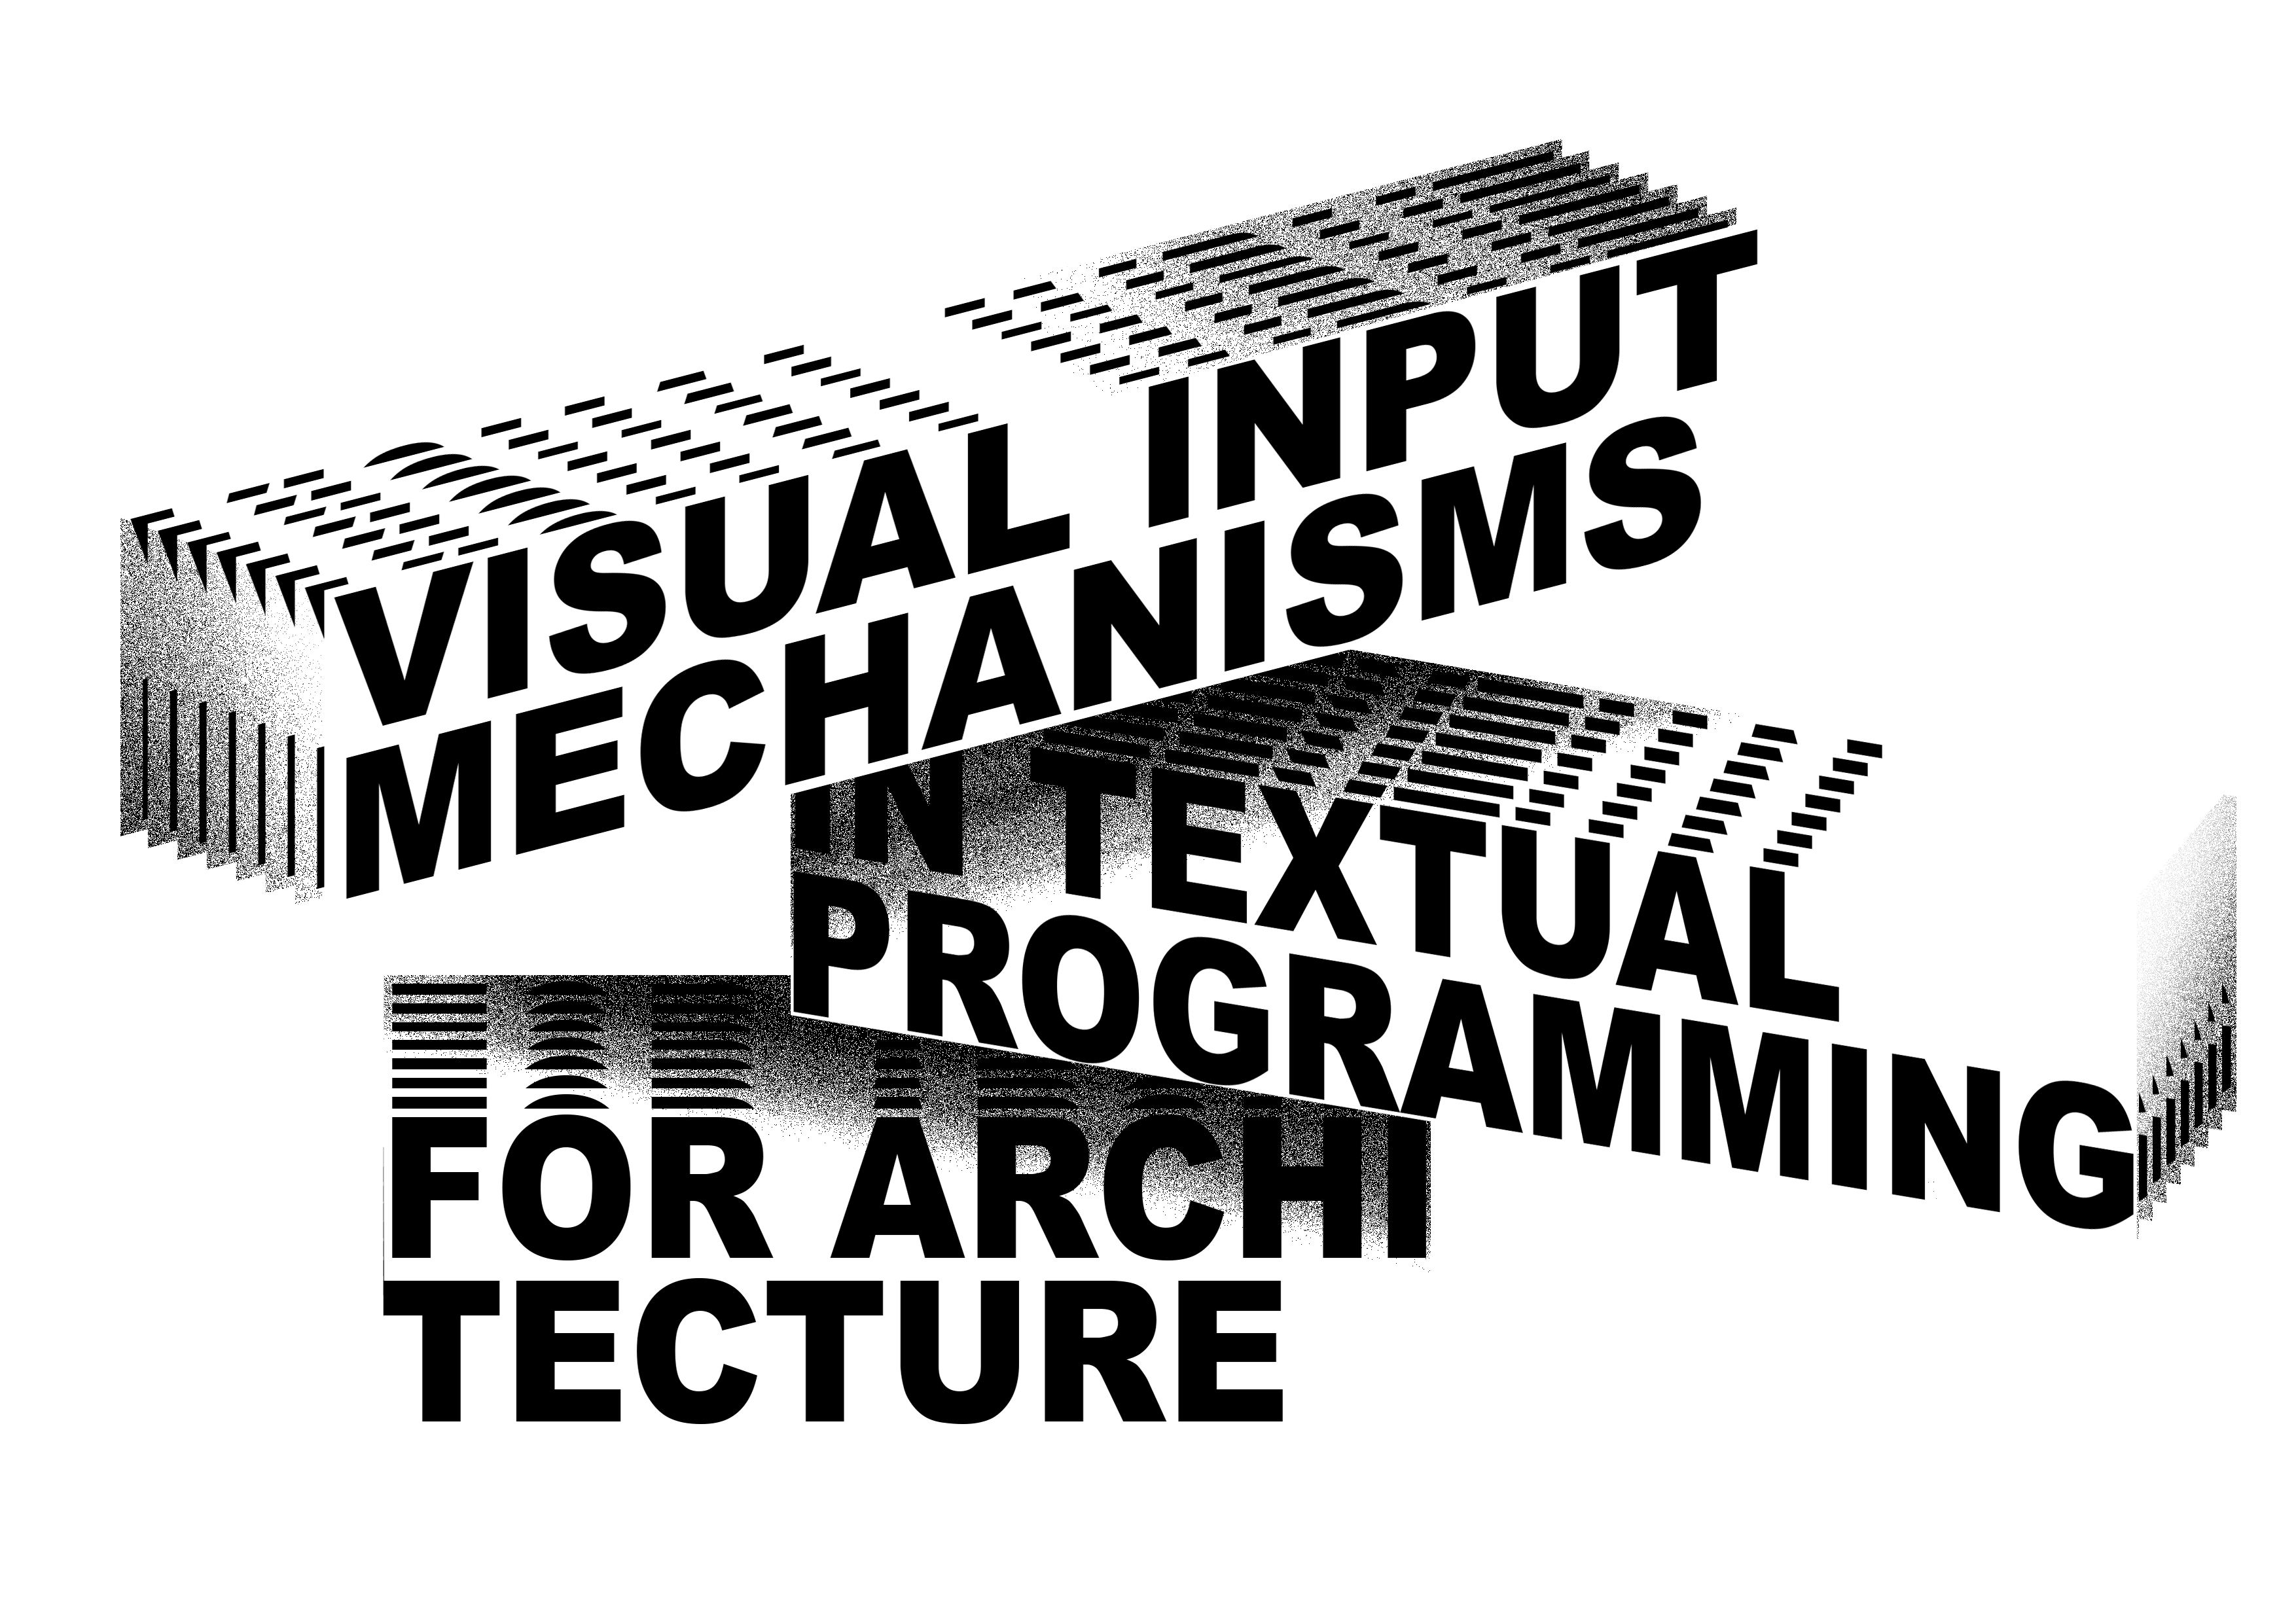
MARIA JOÃO SAMMER & ANTÓNIO LEITÃO
ECAADE SIGRADI 2019

Slide 2
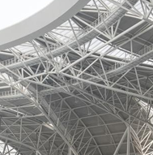
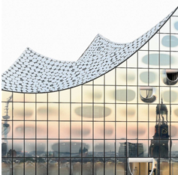
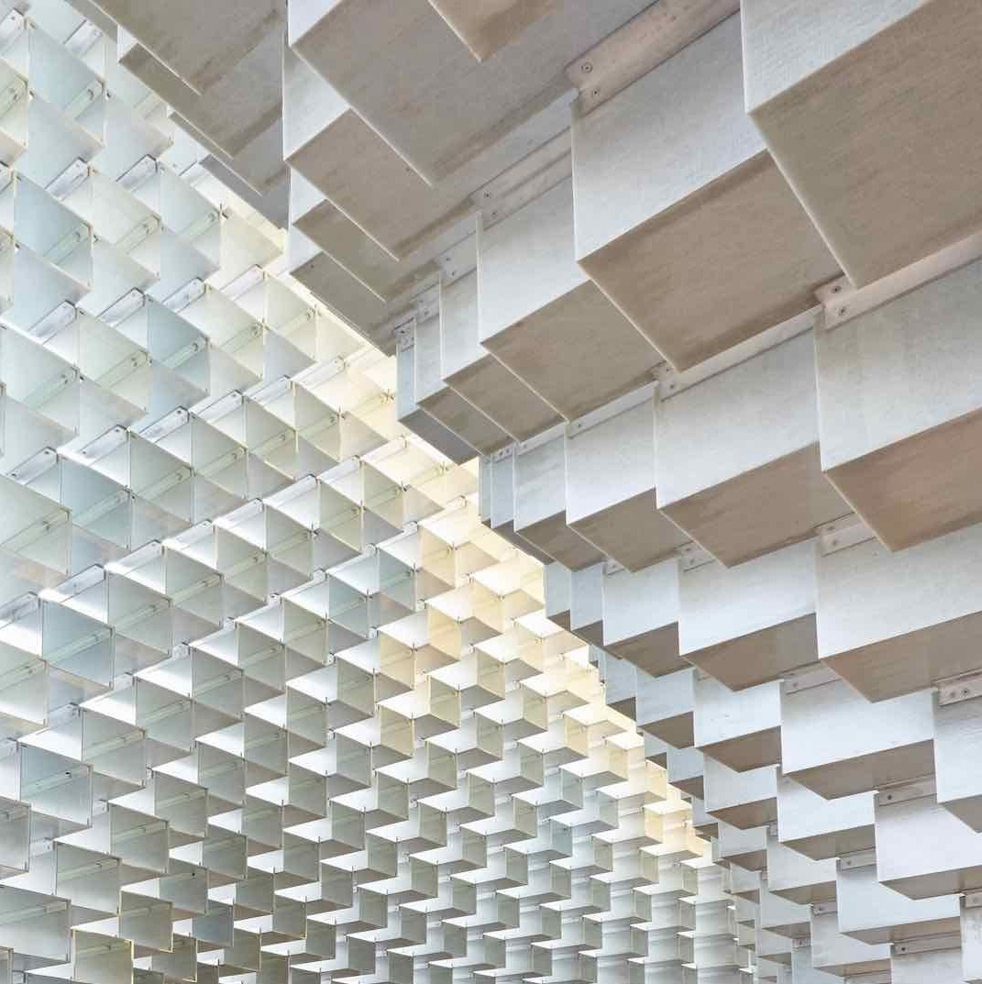
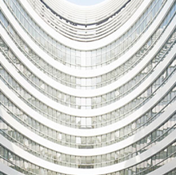
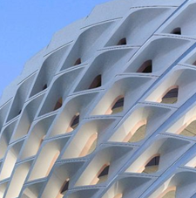
INTRODUCTION VIMS EVALUATION KHEPRI CONCLUSIONS
Architecture in the age of the 4th INDUSTRIAL revolution
1
Visual Input Mechanisms in Textual Programming for Architecture
ECAADE SIGRADI 2019

Slide 3
INTRODUCTION VIMS EVALUATION KHEPRI CONCLUSIONS
Algorithmic Design
2
GEOMETRY
Visual Input Mechanisms in Textual Programming for Architecture
ECAADE SIGRADI 2019

Slide 4
INTRODUCTION VIMS EVALUATION KHEPRI CONCLUSIONS
Algorithmic Design
2
<algorithm/>
GEOMETRY
Visual Input Mechanisms in Textual Programming for Architecture
ECAADE SIGRADI 2019

Slide 5
INTRODUCTION VIMS EVALUATION KHEPRI CONCLUSIONS
Programming Languages
3
<algorithm/>
Visual Input Mechanisms in Textual Programming for Architecture
ECAADE SIGRADI 2019

Slide 6
INTRODUCTION VIMS EVALUATION KHEPRI CONCLUSIONS
Programming Languages
3
<algorithm/>
VPL
Visual Input Mechanisms in Textual Programming for Architecture
ECAADE SIGRADI 2019

Slide 7
INTRODUCTION VIMS EVALUATION KHEPRI CONCLUSIONS
Programming Languages
3
<algorithm/>
VPL
TPL
Visual Input Mechanisms in Textual Programming for Architecture
ECAADE SIGRADI 2019

Slide 8
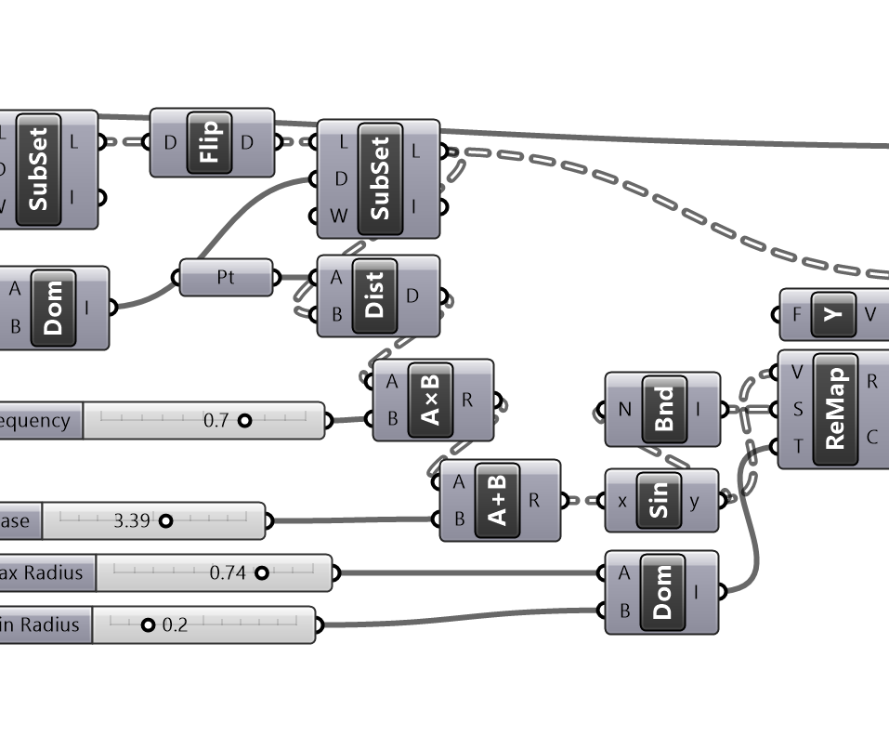
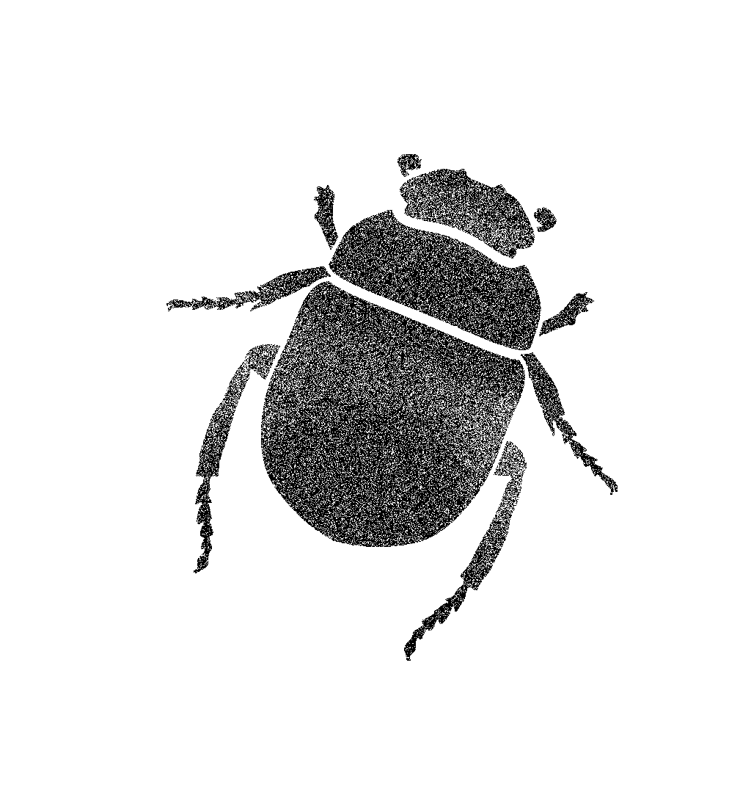
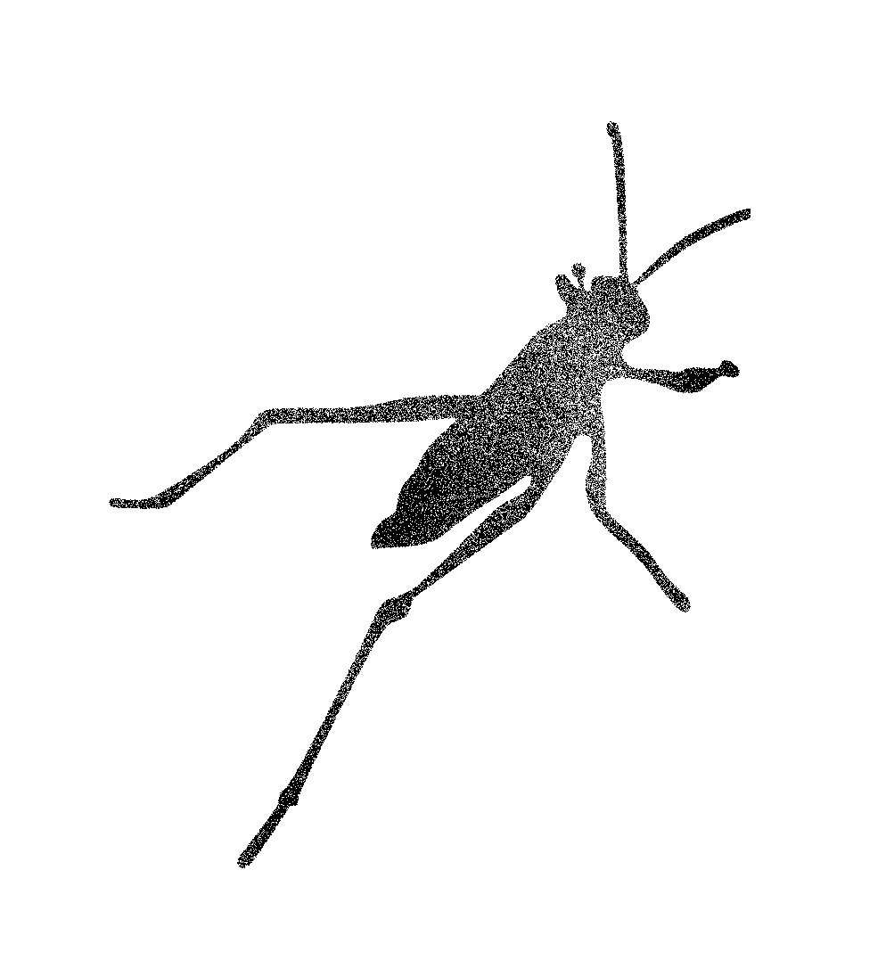
INTRODUCTION VIMS EVALUATION KHEPRI CONCLUSIONS
Programming Languages
3
# 1st phase: loop until final choice
while (new_p = select_position()) != nothing
p = new_p
delete_shapes(output)
with(current_layer, output) do
# quick visualization
create_windows(
facade_surface,p)
end
end
<algorithm/>
GRASSHOPPER
khepri
Visual Input Mechanisms in Textual Programming for Architecture
ECAADE SIGRADI 2019

Slide 9
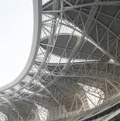
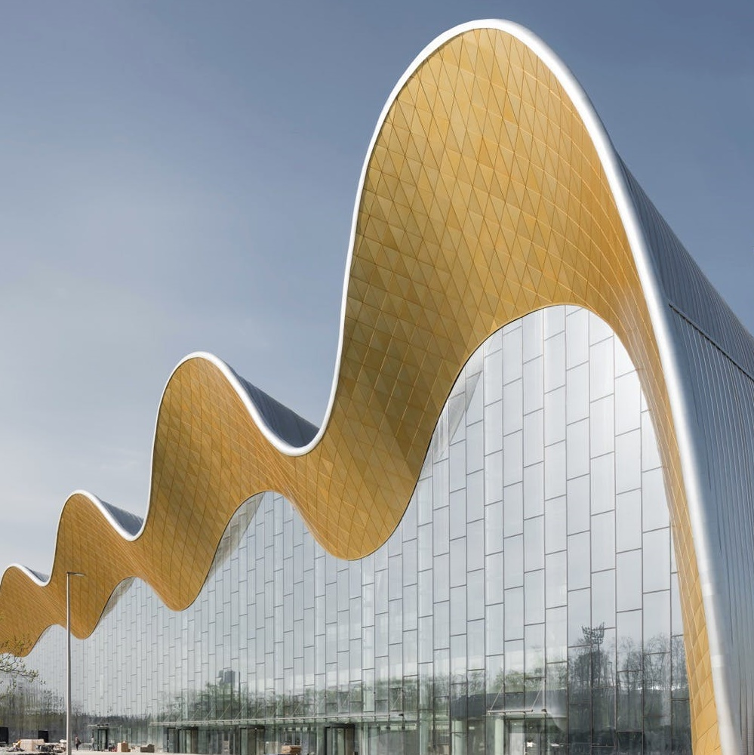
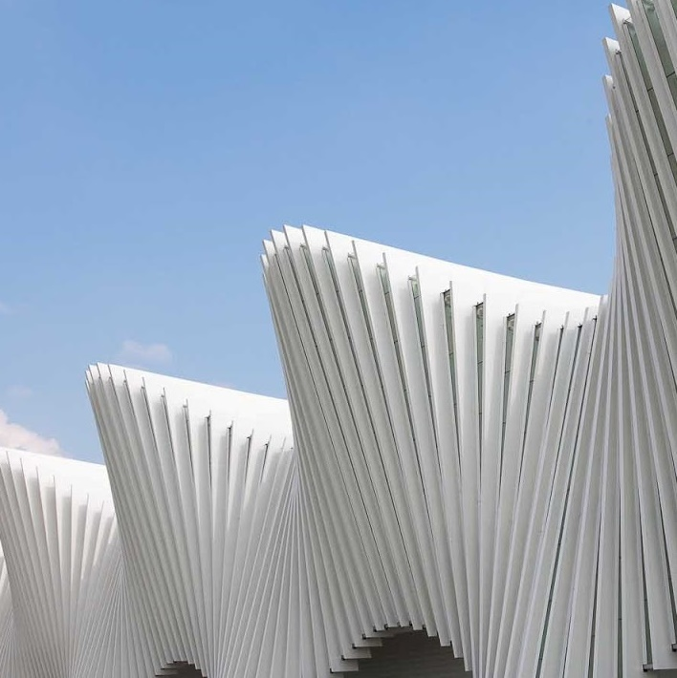
INTRODUCTION VIMS EVALUATION KHEPRI CONCLUSIONS
Programming Languages
4
Visual Input Mechanisms in Textual Programming for Architecture
ECAADE SIGRADI 2019

Slide 10
INTRODUCTION VIMS EVALUATION KHEPRI CONCLUSIONS
Programming Languages
4
TPL
TPL
Visual Input Mechanisms in Textual Programming for Architecture
ECAADE SIGRADI 2019

Slide 11
INTRODUCTION VIMS EVALUATION KHEPRI CONCLUSIONS
Programming Languages
4
TPL
TPL
Visual Input Mechanisms in Textual Programming for Architecture
ECAADE SIGRADI 2019

Slide 12
INTRODUCTION VIMS EVALUATION KHEPRI CONCLUSIONS
Programming Languages
5
NUMBER SLIDERS & BOOLEAN TOGGLES
Visual Input Mechanisms in Textual Programming for Architecture
ECAADE SIGRADI 2019

Slide 13
INTRODUCTION VIMS EVALUATION KHEPRI CONCLUSIONS
Programming Languages
5
NUMBER SLIDERS & BOOLEAN TOGGLES
LUNA MOTH
Visual Input Mechanisms in Textual Programming for Architecture
ECAADE SIGRADI 2019

Slide 14
INTRODUCTION VIMS EVALUATION KHEPRI CONCLUSIONS
Programming Languages
5
NUMBER SLIDERS & BOOLEAN TOGGLES
Immediate feedback
Visual Input Mechanisms in Textual Programming for Architecture
ECAADE SIGRADI 2019

Slide 15
INTRODUCTION VIMS EVALUATION KHEPRI CONCLUSIONS
Programming Languages
5
NUMBER SLIDERS & BOOLEAN TOGGLES
LUNA MOTH
Immediate feedback
processing
Visual Input Mechanisms in Textual Programming for Architecture
ECAADE SIGRADI 2019

Slide 16
INTRODUCTION VIMS EVALUATION KHEPRI CONCLUSIONS
Programming Languages
5
NUMBER SLIDERS & BOOLEAN TOGGLES
Immediate feedback
Traceability
Visual Input Mechanisms in Textual Programming for Architecture
ECAADE SIGRADI 2019

Slide 17
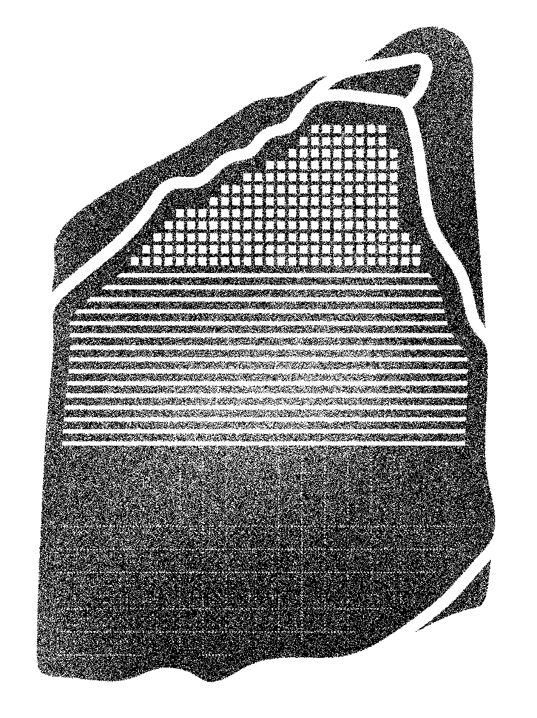
INTRODUCTION VIMS EVALUATION KHEPRI CONCLUSIONS
Programming Languages
5
NUMBER SLIDERS & BOOLEAN TOGGLES
LUNA MOTH
Immediate feedback
processing
Traceability
ROSETTA
Visual Input Mechanisms in Textual Programming for Architecture
ECAADE SIGRADI 2019

Slide 18
INTRODUCTION VIMS EVALUATION KHEPRI CONCLUSIONS
Programming Languages
5
NUMBER SLIDERS & BOOLEAN TOGGLES
LUNA MOTH
Immediate feedback
processing
Traceability
ROSETTA
VISUAL INPUT MECHANISMS
KHEPRI
Visual Input Mechanisms in Textual Programming for Architecture
ECAADE SIGRADI 2019

Slide 19
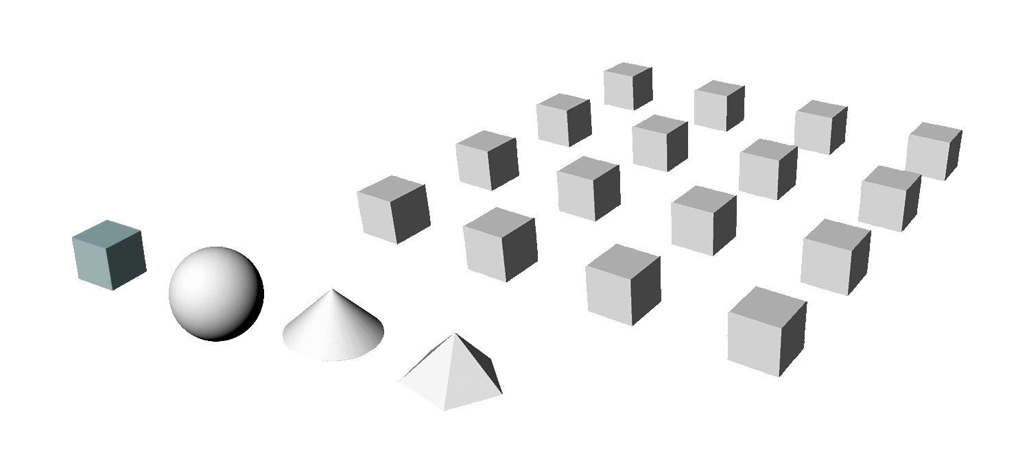
INTRODUCTION VIMS EVALUATION KHEPRI CONCLUSIONS
Visual input Mechanisms
6
<algorithm/>
inPUT
OUTPUT
Visual Input Mechanisms in Textual Programming for Architecture
ECAADE SIGRADI 2019

Slide 20
INTRODUCTION VIMS EVALUATION KHEPRI CONCLUSIONS
Visual input Mechanisms
6
<algorithm/>
GEOMETRY EASIER
TO PRODUCE BY HAND
inPUT
OUTPUT
Visual Input Mechanisms in Textual Programming for Architecture
ECAADE SIGRADI 2019

Slide 21
INTRODUCTION VIMS EVALUATION KHEPRI CONCLUSIONS
Visual input Mechanisms
6
<algorithm/>
GEOMETRY EASIER
TO PRODUCE BY HAND
inPUT
OUTPUT
EXISTING GEOMETRY
Visual Input Mechanisms in Textual Programming for Architecture
ECAADE SIGRADI 2019

Slide 22
INTRODUCTION VIMS EVALUATION KHEPRI CONCLUSIONS
Visual input Mechanisms
6
<algorithm/>
GEOMETRY EASIER
TO PRODUCE BY HAND
inPUT
OUTPUT
EXISTING GEOMETRY
OUTPUT GEOMETRY OF A PROGRAM AS AN INPUT TO OTHER PROGRAM
Visual Input Mechanisms in Textual Programming for Architecture
ECAADE SIGRADI 2019

Slide 23
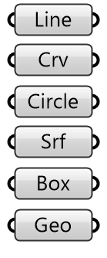
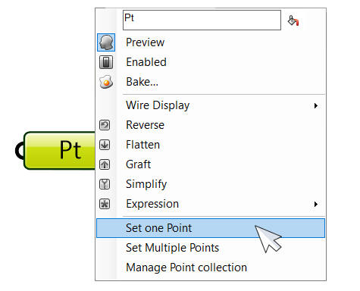
INTRODUCTION VIMS EVALUATION KHEPRI CONCLUSIONS
Visual input Mechanisms
7
In Grasshopper
Visual Input Mechanisms in Textual Programming for Architecture
ECAADE SIGRADI 2019

Slide 24
INTRODUCTION VIMS EVALUATION KHEPRI CONCLUSIONS
Visual input Mechanisms
7
In Grasshopper
SELECT
GEOMETRY
IN RHINO
Visual Input Mechanisms in Textual Programming for Architecture
ECAADE SIGRADI 2019

Slide 25
INTRODUCTION VIMS EVALUATION KHEPRI CONCLUSIONS
Visual input Mechanisms
7
In Grasshopper
SELECT
GEOMETRY
IN RHINO
DEPENDENCy
Visual Input Mechanisms in Textual Programming for Architecture
ECAADE SIGRADI 2019

Slide 26
INTRODUCTION VIMS EVALUATION KHEPRI CONCLUSIONS
Visual input Mechanisms
7
In Grasshopper
SELECT
GEOMETRY
IN RHINO
Change
geometry
Visual Input Mechanisms in Textual Programming for Architecture
ECAADE SIGRADI 2019

Slide 27
INTRODUCTION VIMS EVALUATION KHEPRI CONCLUSIONS
Visual input Mechanisms
7
In Grasshopper
Changes
PROPAGATED
IN THE PROGRAM
SELECT
GEOMETRY
IN RHINO
Change
geometry
NEW RESULTS
GENERATED
Visual Input Mechanisms in Textual Programming for Architecture
ECAADE SIGRADI 2019

Slide 28
INTRODUCTION VIMS EVALUATION KHEPRI CONCLUSIONS
Visual input Mechanisms
7
In Grasshopper
SELECT
GEOMETRY
IN RHINO
INDEPENDENCy
Visual Input Mechanisms in Textual Programming for Architecture
ECAADE SIGRADI 2019

Slide 29
INTRODUCTION VIMS EVALUATION KHEPRI CONCLUSIONS
Visual input Mechanisms
7
In Grasshopper
SELECT
GEOMETRY
IN RHINO
INTERNALIZE
DATA
Visual Input Mechanisms in Textual Programming for Architecture
ECAADE SIGRADI 2019

Slide 30
INTRODUCTION VIMS EVALUATION KHEPRI CONCLUSIONS
Visual input Mechanisms
8
In Khepri
Visual Input Mechanisms in Textual Programming for Architecture
ECAADE SIGRADI 2019

Slide 31
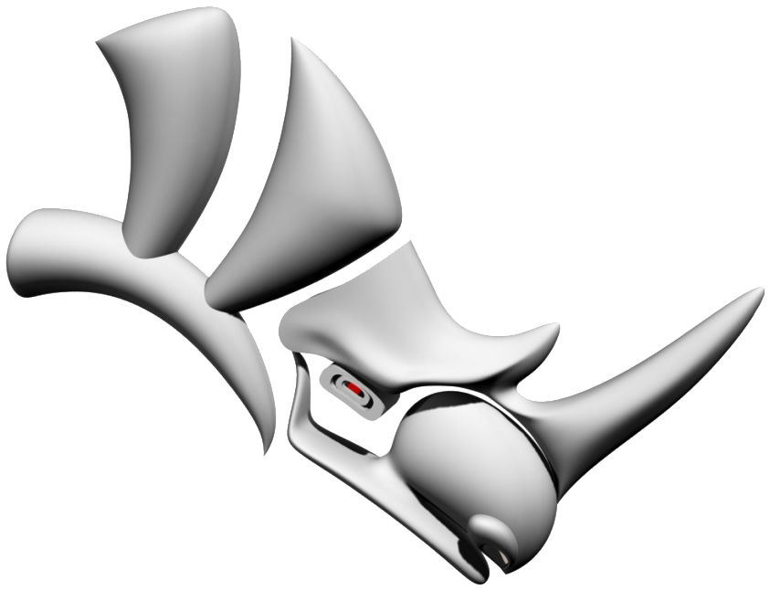
INTRODUCTION VIMS EVALUATION KHEPRI CONCLUSIONS
Visual input Mechanisms
8
In Khepri
Visual Input Mechanisms in Textual Programming for Architecture
ECAADE SIGRADI 2019

Slide 32
INTRODUCTION VIMS EVALUATION KHEPRI CONCLUSIONS
Visual input Mechanisms
9
In Khepri
select_position()
select_point()
select_curve()
select_surface()
...
SELECT
GEOMETRY
IN RHINO
Visual Input Mechanisms in Textual Programming for Architecture
ECAADE SIGRADI 2019

Slide 33
INTRODUCTION VIMS EVALUATION KHEPRI CONCLUSIONS
Visual input Mechanisms
9
In Khepri
select_position()
select_point()
select_curve()
select_surface()
...
SELECT
GEOMETRY
IN RHINO
INDEPENDENCy
Visual Input Mechanisms in Textual Programming for Architecture
ECAADE SIGRADI 2019

Slide 34
INTRODUCTION VIMS EVALUATION KHEPRI CONCLUSIONS
Visual input Mechanisms
9
In Khepri
Change
geometry
select_position()
select_point()
select_curve()
select_surface()
...
SELECT
GEOMETRY
IN RHINO
RESELECT
geometry
Visual Input Mechanisms in Textual Programming for Architecture
ECAADE SIGRADI 2019

Slide 35
INTRODUCTION VIMS EVALUATION KHEPRI CONCLUSIONS
Visual input Mechanisms
9
In Khepri
Change
geometry
select_position()
select_point()
select_curve()
select_surface()
...
SELECT
GEOMETRY
IN RHINO
NEW RESULTS
GENERATED
RESELECT
geometry
Visual Input Mechanisms in Textual Programming for Architecture
ECAADE SIGRADI 2019

Slide 36
INTRODUCTION VIMS EVALUATION KHEPRI CONCLUSIONS
Visual input Mechanisms
9
In Khepri
select_position()
select_point()
select_curve()
select_surface()
...
SELECT
GEOMETRY
IN RHINO
DEPENDENCy
Visual Input Mechanisms in Textual Programming for Architecture
ECAADE SIGRADI 2019

Slide 37
INTRODUCTION VIMS EVALUATION KHEPRI CONCLUSIONS
Visual input Mechanisms
9
In Khepri
with_shape_dependency()
select_position()
select_point()
select_curve()
select_surface()
...
SELECT
GEOMETRY
IN RHINO
DEPENDENCy
METAPROGRAMMING
Visual Input Mechanisms in Textual Programming for Architecture
ECAADE SIGRADI 2019

Slide 38
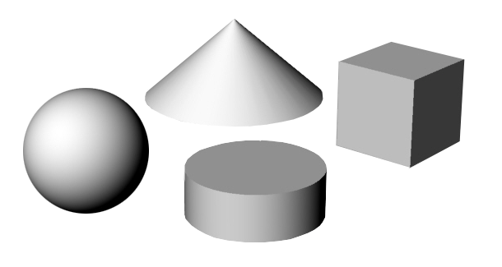
INTRODUCTION VIMS EVALUATION KHEPRI CONCLUSIONS
Visual input Mechanisms
10
In Khepri
sphere(…)
cone(…)
cylinder(…)
box(…)
METAPROGRAMMING
Visual Input Mechanisms in Textual Programming for Architecture
ECAADE SIGRADI 2019

Slide 39
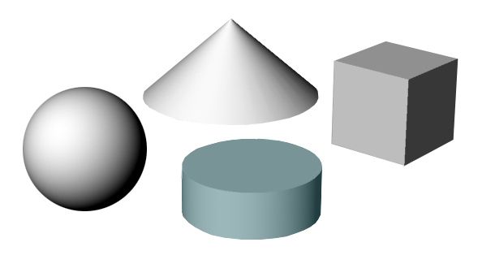
INTRODUCTION VIMS EVALUATION KHEPRI CONCLUSIONS
Visual input Mechanisms
10
In Khepri
sphere(…)
cone(…)
METAPROGRAMMING
cylinder(…)
box(…)
Visual Input Mechanisms in Textual Programming for Architecture
ECAADE SIGRADI 2019

Slide 40
INTRODUCTION VIMS EVALUATION KHEPRI CONCLUSIONS
Visual input Mechanisms
10
In Khepri
METAPROGRAMMING
Visual Input Mechanisms in Textual Programming for Architecture
ECAADE SIGRADI 2019

Slide 41
INTRODUCTION VIMS EVALUATION KHEPRI CONCLUSIONS
Visual input Mechanisms
10
In Khepri
captured_shape(autocad,
49675)
METAPROGRAMMING
capture_shape()
captured_shape(rhino,
30967)
captured_shape(revit,
22038)
Visual Input Mechanisms in Textual Programming for Architecture
ECAADE SIGRADI 2019

Slide 42
INTRODUCTION VIMS EVALUATION KHEPRI CONCLUSIONS
Visual input Mechanisms
10
In Khepri
circle(center = xyz(1, 2, 3),
radius = 4)
METAPROGRAMMING
internalize_shape()
sphere(center = xyz(5, 6, 7),
radius = 8)
box(corner0 = xyz(0, 0, 0),
corner1 = xyz(9, 19, 3))
Visual Input Mechanisms in Textual Programming for Architecture
ECAADE SIGRADI 2019

Slide 43
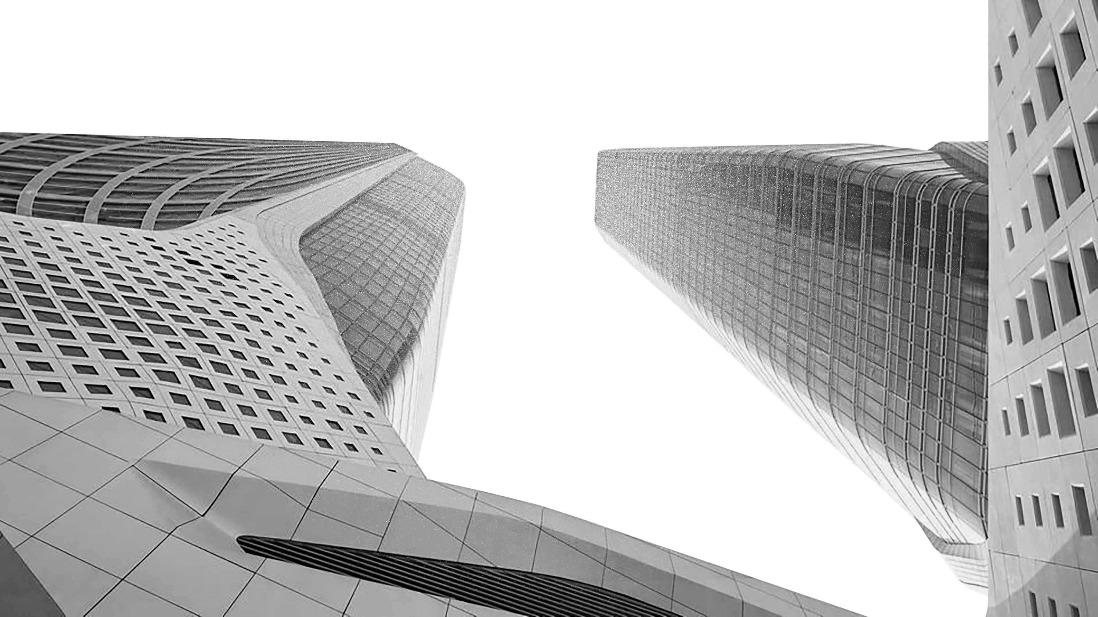
INTRODUCTION VIMS EVALUATION KHEPRI CONCLUSIONS
Evaluation
11
Visual Input Mechanisms in Textual Programming for Architecture
ECAADE SIGRADI 2019

Slide 44
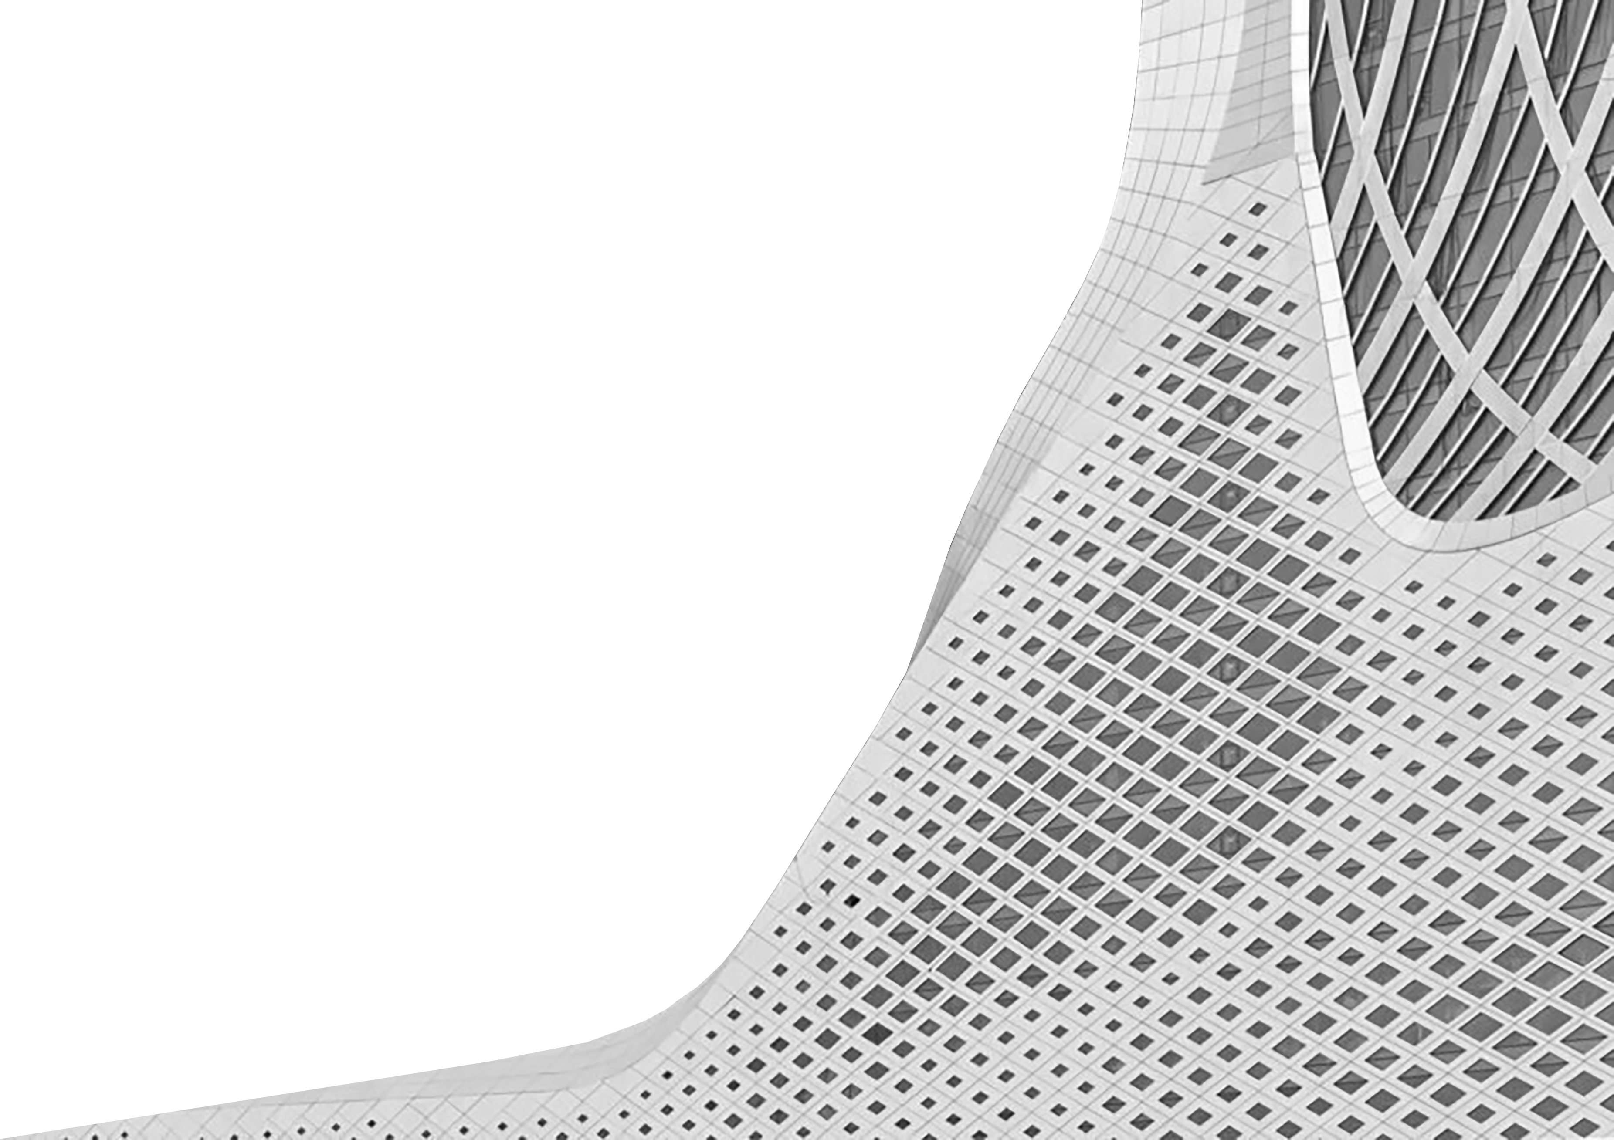
INTRODUCTION VIMS EVALUATION KHEPRI CONCLUSIONS
Evaluation
12
Nanjing International Youth Cultural Center
Zaha Hadid architects
2018
Visual Input Mechanisms in Textual Programming for Architecture
ECAADE SIGRADI 2019

Slide 45
INTRODUCTION VIMS EVALUATION KHEPRI CONCLUSIONS
Evaluation
12
Nanjing International Youth Cultural Center
Zaha Hadid architects
2018
SURFACE OF THE FAÇADE
Visual Input Mechanisms in Textual Programming for Architecture
ECAADE SIGRADI 2019

Slide 46
INTRODUCTION VIMS EVALUATION KHEPRI CONCLUSIONS
Evaluation
12
Nanjing International Youth Cultural Center
Zaha Hadid architects
2018
SURFACE OF THE FAÇADE
LINE OF THE THICKNESS
Visual Input Mechanisms in Textual Programming for Architecture
ECAADE SIGRADI 2019

Slide 47
INTRODUCTION VIMS EVALUATION KHEPRI CONCLUSIONS
Evaluation
12
Nanjing International Youth Cultural Center
Zaha Hadid architects
2018
SURFACE OF THE FAÇADE
LINE OF THE THICKNESS
SHAPE OF THE WINDOW
Visual Input Mechanisms in Textual Programming for Architecture
ECAADE SIGRADI 2019

Slide 48
INTRODUCTION VIMS EVALUATION KHEPRI CONCLUSIONS
Evaluation
12
Nanjing International Youth Cultural Center
Zaha Hadid architects
2018
SURFACE OF THE FAÇADE
LINE OF THE THICKNESS
SHAPE OF THE WINDOW
ATTRACTOR POINT
Visual Input Mechanisms in Textual Programming for Architecture
ECAADE SIGRADI 2019

Slide 49
INTRODUCTION VIMS EVALUATION KHEPRI CONCLUSIONS
Evaluation
12
Nanjing International Youth Cultural Center
Zaha Hadid architects
2018
SURFACE OF THE FAÇADE
LINE for THICKNESS
SHAPE OF THE WINDOW
ATTRACTOR POINT
ATTRACTOR MECHANISM
Visual Input Mechanisms in Textual Programming for Architecture
ECAADE SIGRADI 2019

Slide 50
INTRODUCTION VIMS EVALUATION KHEPRI CONCLUSIONS
Evaluation
13
Visual Input Mechanisms in Textual Programming for Architecture
ECAADE SIGRADI 2019

Slide 51
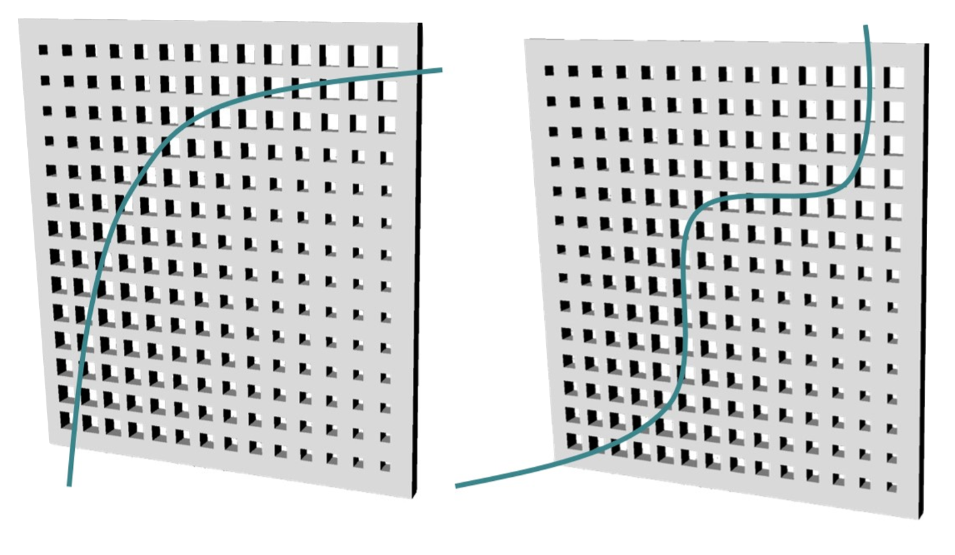
INTRODUCTION VIMS EVALUATION KHEPRI CONCLUSIONS
Evaluation
13
Visual Input Mechanisms in Textual Programming for Architecture
ECAADE SIGRADI 2019

Slide 52
INTRODUCTION VIMS EVALUATION KHEPRI CONCLUSIONS
Evaluation
14
Visual Input Mechanisms in Textual Programming for Architecture
ECAADE SIGRADI 2019

Slide 53
INTRODUCTION VIMS EVALUATION KHEPRI CONCLUSIONS
Evaluation
14
attracted_radius(p, attractor) =
min_radius+(max_radius-min_radius)*(sin(frequency*
min_distance(p,attractor) + phase)+1)/2
Visual Input Mechanisms in Textual Programming for Architecture
ECAADE SIGRADI 2019

Slide 54
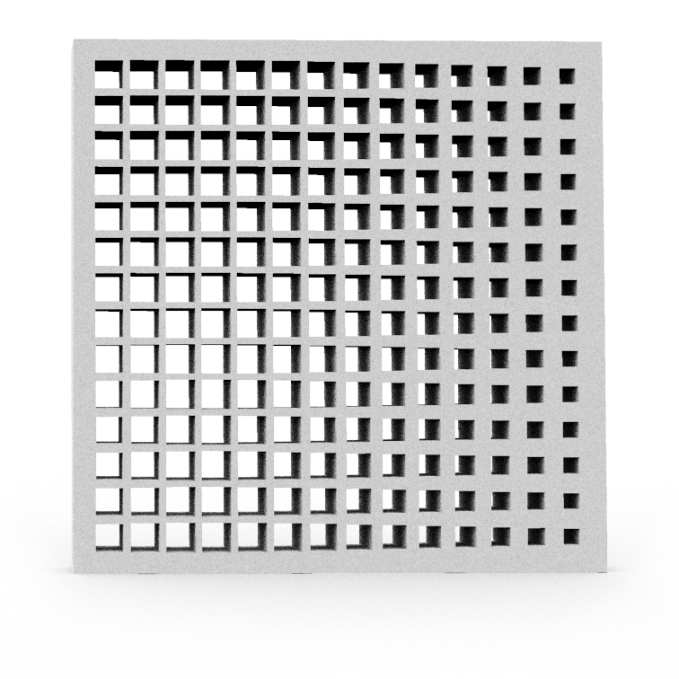
INTRODUCTION VIMS EVALUATION KHEPRI CONCLUSIONS
Evaluation
14
attracted_radius(p, attractor) =
min_radius+(max_radius-min_radius)*(sin(frequency*
min_distance(p,attractor) + phase)+1)/2
min_distance(p, p1::Loc) = distance(p, p1)
Visual Input Mechanisms in Textual Programming for Architecture
ECAADE SIGRADI 2019

Slide 55
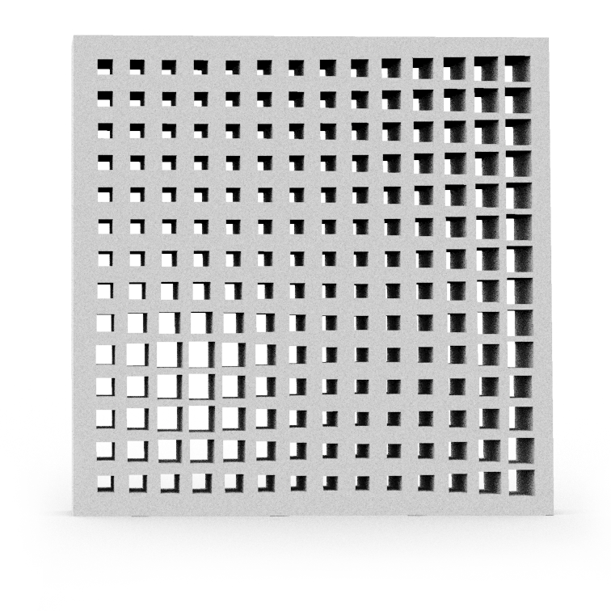
INTRODUCTION VIMS EVALUATION KHEPRI CONCLUSIONS
Evaluation
14
attracted_radius(p, attractor) =
min_radius+(max_radius-min_radius)*(sin(frequency*
min_distance(p,attractor) + phase)+1)/2
min_distance(p, p1::Loc) = distance(p, p1)
min_distance(p, pts::Locs) = minimum(map(p1 -> distance(p, p1), pts))
Visual Input Mechanisms in Textual Programming for Architecture
ECAADE SIGRADI 2019

Slide 56
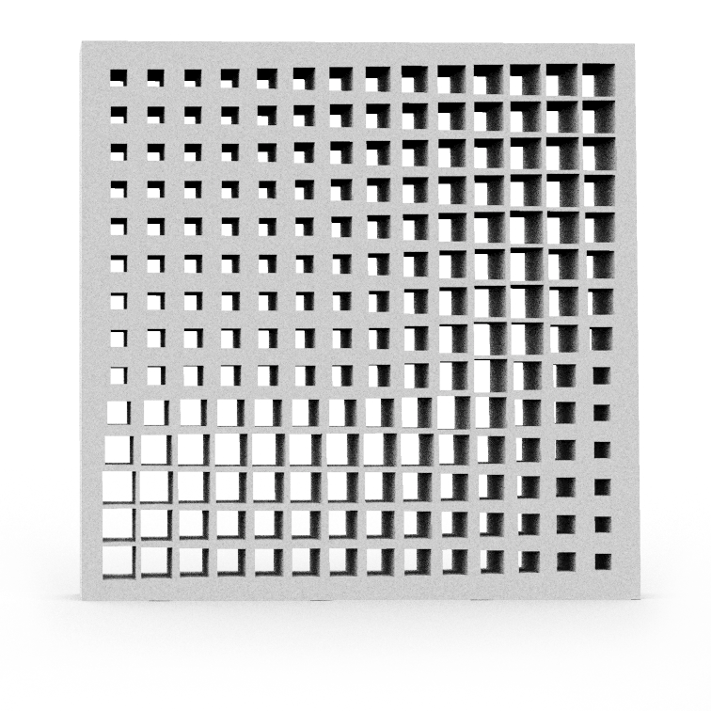
INTRODUCTION VIMS EVALUATION KHEPRI CONCLUSIONS
Evaluation
14
attracted_radius(p, attractor) =
min_radius+(max_radius-min_radius)*(sin(frequency*
min_distance(p,attractor) + phase)+1)/2
min_distance(p, p1::Loc) = distance(p, p1)
min_distance(p, pts::Locs) = minimum(map(p1 -> distance(p, p1), pts))
min_distance(p, c::Spline) = min_distance(p, map_division(p->p, c, 20))
Visual Input Mechanisms in Textual Programming for Architecture
ECAADE SIGRADI 2019

Slide 57
INTRODUCTION VIMS EVALUATION KHEPRI CONCLUSIONS
Evaluation
15
select_attractor_position(length, height, nx, ny) =
let attractor = nothing,
p = nothing
rectangle(u0(), length, height)
while (p = select_position()) != nothing
attractor = p
delete_all_shapes()
rectangle(u0(), length, height)
attractor_windows(surface_circle, attractor,
length, height, nx, ny)
end
attractor
end
Visual Input Mechanisms in Textual Programming for Architecture
ECAADE SIGRADI 2019

Slide 58
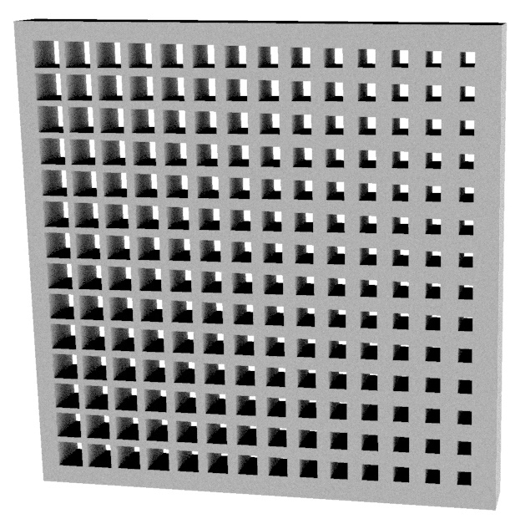
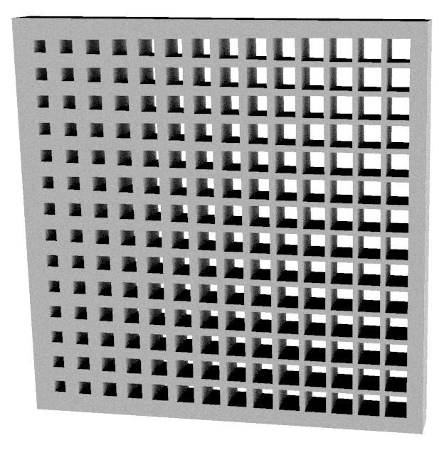
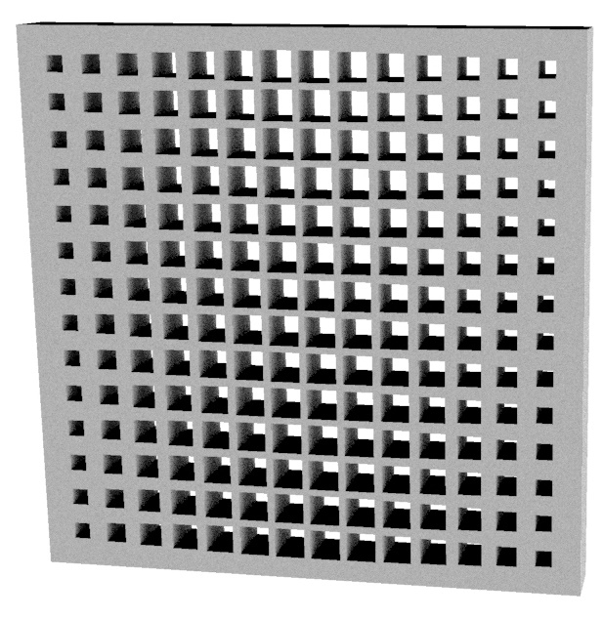
INTRODUCTION VIMS EVALUATION KHEPRI CONCLUSIONS
Evaluation
15
select_attractor_position(length, height, nx, ny) =
let attractor = nothing,
p = nothing
rectangle(u0(), length, height)
while (p = select_position()) != nothing
attractor = p
delete_all_shapes()
rectangle(u0(), length, height)
attractor_windows(surface_circle, attractor,
length, height, nx, ny)
end
attractor
end
Visual Input Mechanisms in Textual Programming for Architecture
ECAADE SIGRADI 2019

Slide 59
INTRODUCTION VIMS EVALUATION KHEPRI CONCLUSIONS
KHEPRI AND THE TEXTUAL APPROACH
16
Flexible abstractions
SOPHISTICATED ABSTRACTIONS
IMMEDIATE INTERACTIVITY
INTERACTION PHASES
Visual Input Mechanisms in Textual Programming for Architecture
ECAADE SIGRADI 2019

Slide 60
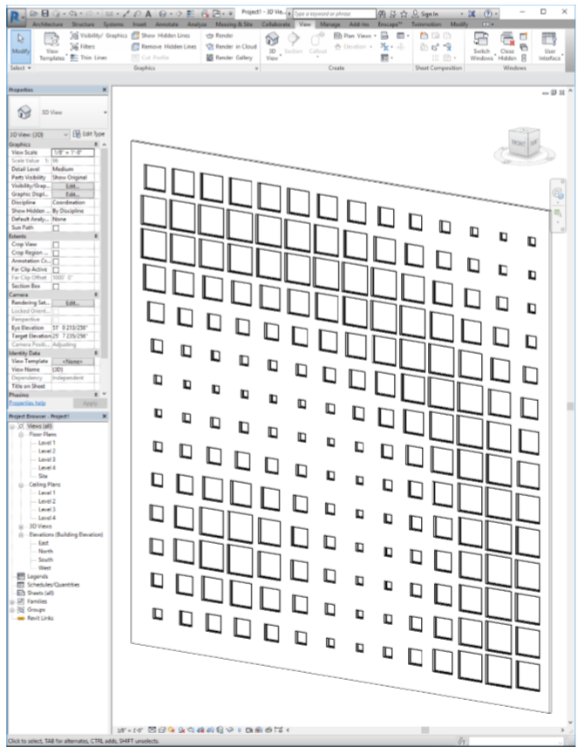
INTRODUCTION VIMS EVALUATION KHEPRI CONCLUSIONS
KHEPRI AND THE TEXTUAL APPROACH
16
Flexible abstractions
SOPHISTICATED ABSTRACTIONS
IMMEDIATE INTERACTIVITY
INTERACTION PHASES
portability
Visual Input Mechanisms in Textual Programming for Architecture
ECAADE SIGRADI 2019

Slide 61
INTRODUCTION VIMS EVALUATION KHEPRI CONCLUSIONS
KHEPRI AND THE TEXTUAL APPROACH
16
Flexible abstractions
SOPHISTICATED ABSTRACTIONS
IMMEDIATE INTERACTIVITY
INTERACTION PHASES
portability
Visual Input Mechanisms in Textual Programming for Architecture
ECAADE SIGRADI 2019

Slide 62
INTRODUCTION VIMS EVALUATION KHEPRI CONCLUSIONS
Conclusions
17
No impediment to implement visual features in a tpl
Visual Input Mechanisms in Textual Programming for Architecture
ECAADE SIGRADI 2019

Slide 63
INTRODUCTION VIMS EVALUATION KHEPRI CONCLUSIONS
Conclusions
17
No impediment to implement visual features in a tpl
GREATER DESIGN COMPLEXITY
Visual Input Mechanisms in Textual Programming for Architecture
ECAADE SIGRADI 2019

Slide 64
INTRODUCTION VIMS EVALUATION KHEPRI CONCLUSIONS
Conclusions
17
No impediment to implement visual features in a tpl
GREATER DESIGN COMPLEXITY
IMPROVED PROGRAM PERFORMANCE
Visual Input Mechanisms in Textual Programming for Architecture
ECAADE SIGRADI 2019

Slide 65
INTRODUCTION VIMS EVALUATION KHEPRI CONCLUSIONS
Conclusions
17
No impediment to implement visual features in a tpl
GREATER DESIGN COMPLEXITY
IMPROVED PROGRAM PERFORMANCE
WIDE RANGE OF ABSTRACTION COMBINATIONS
Visual Input Mechanisms in Textual Programming for Architecture
ECAADE SIGRADI 2019

Slide 66
INTRODUCTION VIMS EVALUATION KHEPRI CONCLUSIONS
Conclusions
17
No impediment to implement visual features in a tpl
GREATER DESIGN COMPLEXITY
IMPROVED PROGRAM PERFORMANCE
WIDE RANGE OF ABSTRACTION COMBINATIONS
FLEXIBLE DATA INTEGRATION AND MANIPULATION
Visual Input Mechanisms in Textual Programming for Architecture
ECAADE SIGRADI 2019

Slide 67
INTRODUCTION VIMS EVALUATION KHEPRI CONCLUSIONS
Conclusions
17
No impediment to implement visual features in a tpl
GREATER DESIGN COMPLEXITY
IMPROVED PROGRAM PERFORMANCE
WIDE RANGE OF ABSTRACTION COMBINATIONS
FLEXIBLE DATA INTEGRATION AND MANIPULATION
MULTIPLE BACK-ENDS
Visual Input Mechanisms in Textual Programming for Architecture
ECAADE SIGRADI 2019

Slide 68
Visual Input Mechanisms in Textual Programming for Architecture
ECAADE SIGRADI 2019

