Slide 1
SafePath - An Agent-Based Framework to Simulate Crowd Behaviors
António Leitão, Sofia Sousa, Francisco Loio

Slide 2
Building Evacuation Performance
Full Scale Evacuation Drills vs Simulation Models

Slide 3
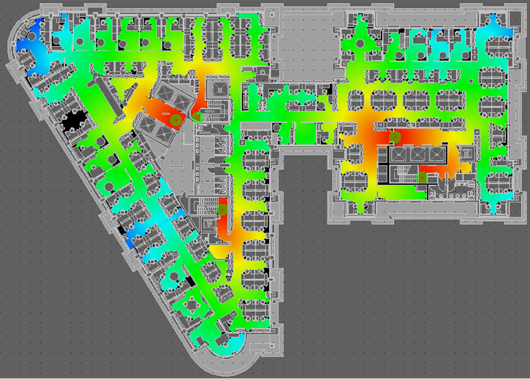
Performance-Based Design

Slide 4
Algorithmic Design
Absolute Towers © Jason Zytynsky

Slide 5
Performance-Based Design Cycle For Evacuation
DESIGN SYNTHESIS
DESIGN
ANALYSIS
DESIGN EVALUATION

Slide 6
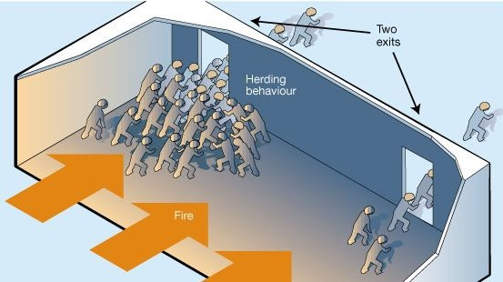
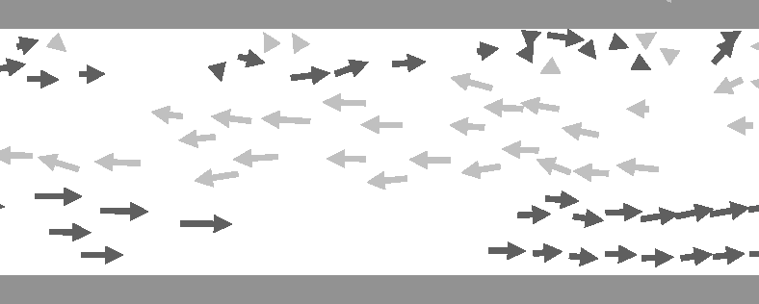
Crowd Behavior Study
Results from Helbing’s Experiences in: Helbing, D., Farkas, I., & Vicsek, T. (2000). Simulating dynamical features of escape panic. Nature, 407(6803), 487.

Slide 7
Agent-Based Modeling

Slide 8
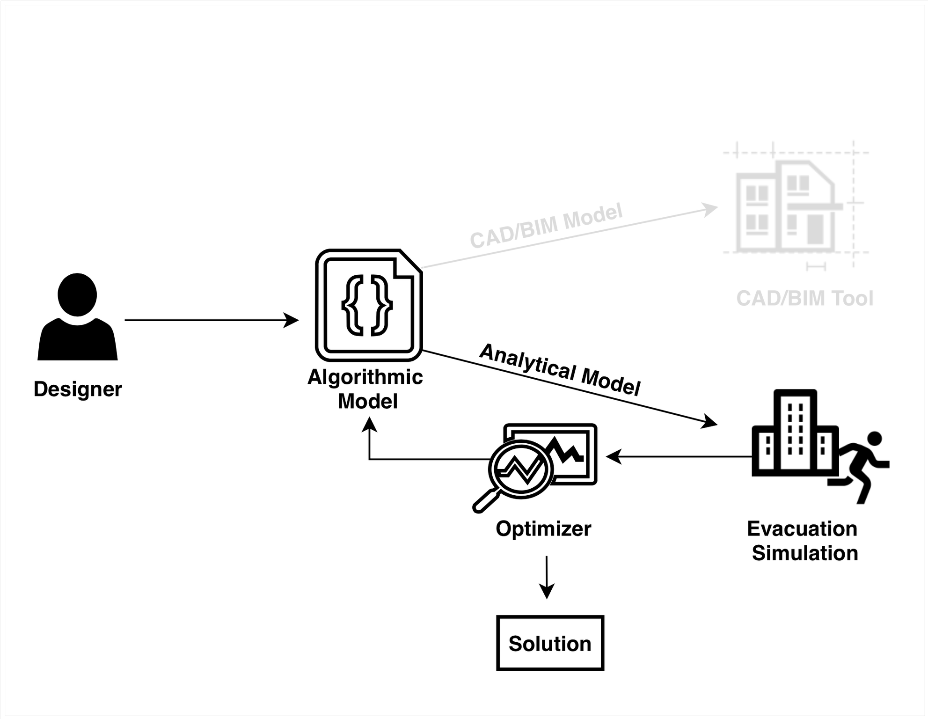
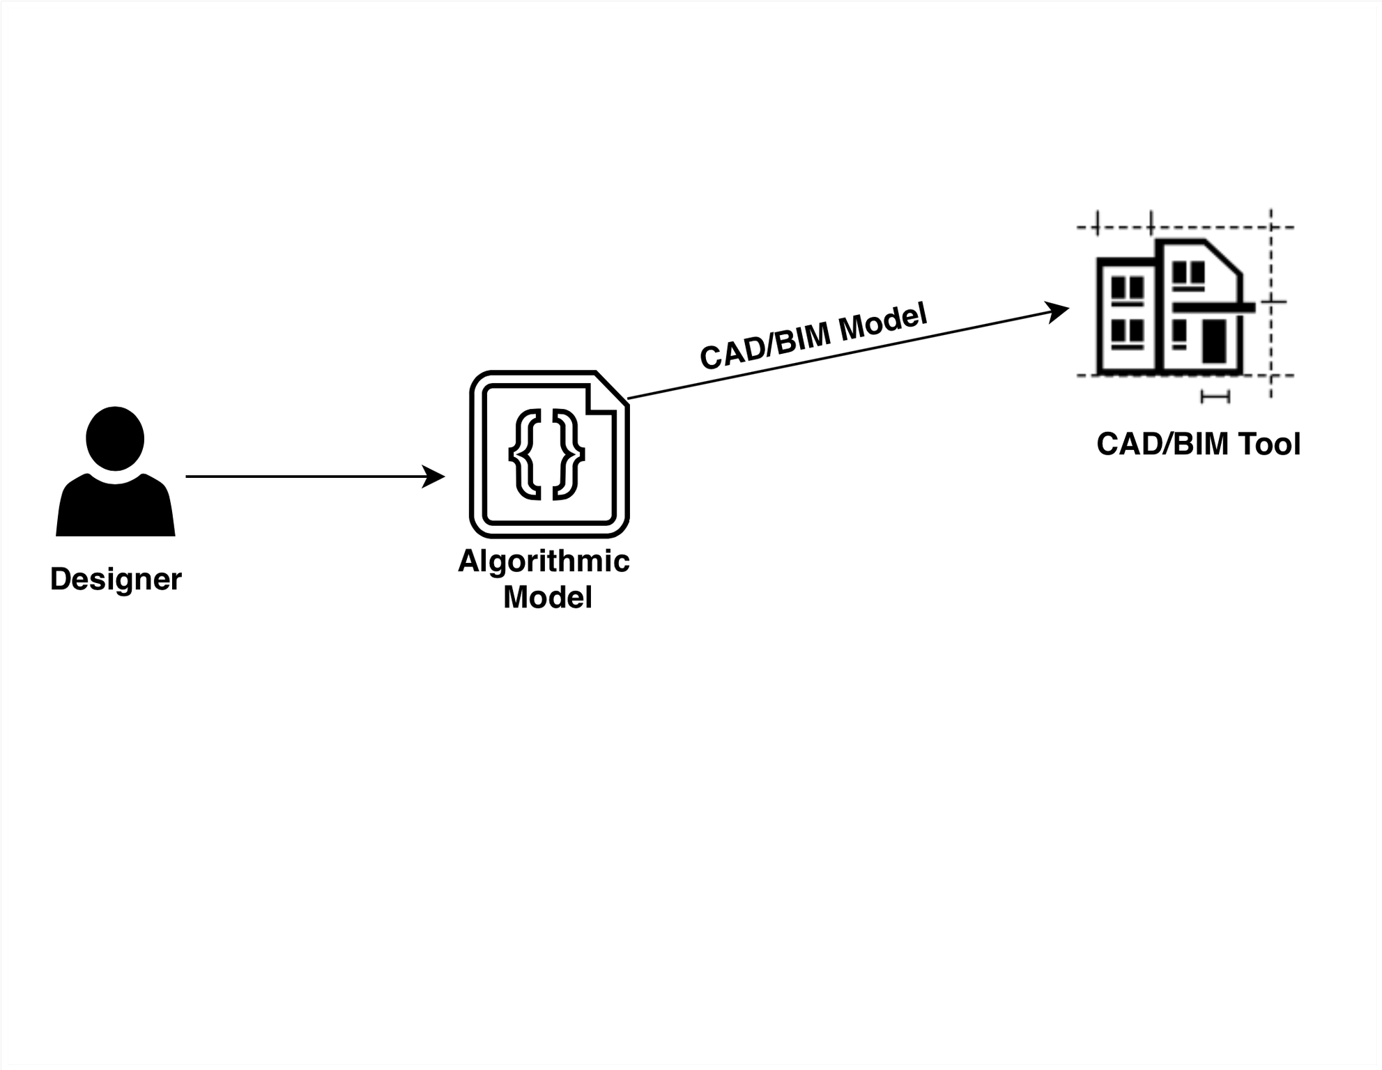
Framework

Slide 9
Case Study: Bauhaus School, 1st floor

Slide 10
Simulation

Slide 11
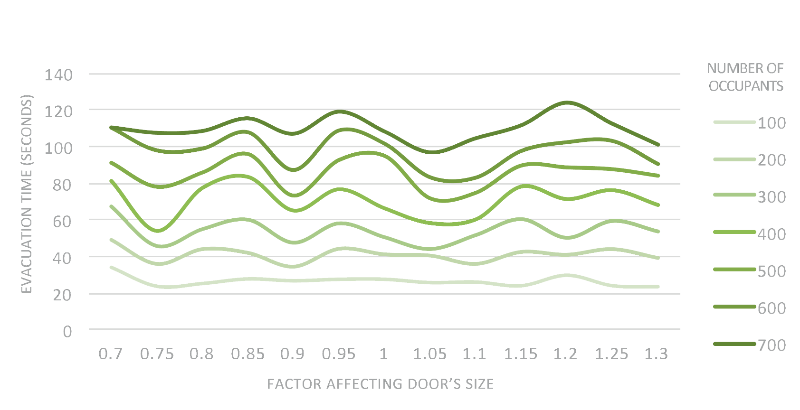
Results

Slide 12
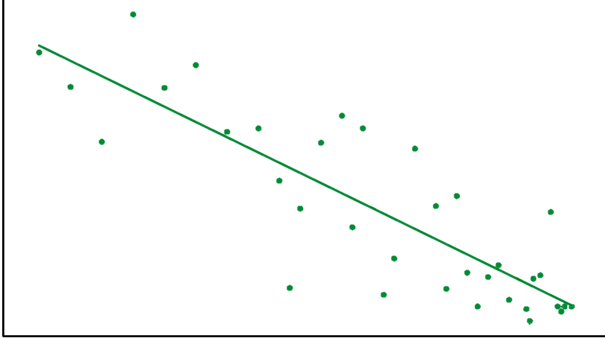
Results
105
100
95
90
TOTAL EVACUATION TIME (SECONDS)
85
80
75
70
0.80
0.85
0.90
0.95
1.00
1.05
1.10
1.15
1.20
FACTOR AFFECTING DOOR SIZE
500 OCCUPANTS

Slide 13
Conclusions
Recent crowd disasters related with design flaws
Development of larger buildings
Study evacuation performance is critical
Current tools:
Require manually produced analytic models
Focus on non-emergency conditions.

Slide 14
Future Work
Test and validate the results for emergency evacuations
Multi-objective optimization

Slide 15
Thank You

