Slide 1
From Design to Optimized Design An algorithmic-based approach
September, 2018
Catarina Garcia Belém
António Menezes Leitão

Slide 2
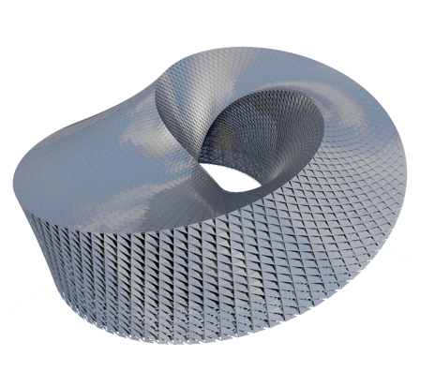
Introduction
An algorithmic approach

Slide 3
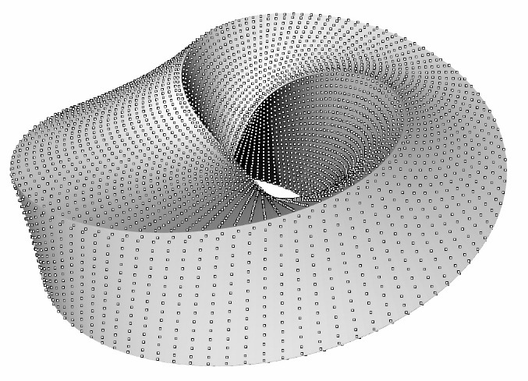
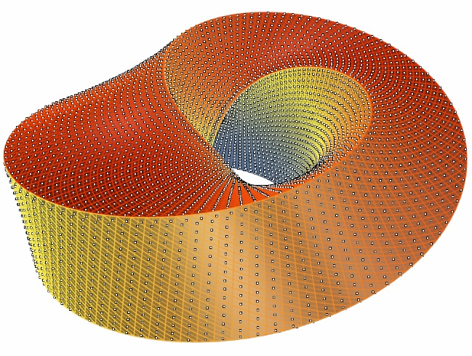
Building Performance Tools
Analytical Model
Performance Score
Simulator

Slide 4
Building Performance – Costly Modifications
Branco, R. C., & Leitão, A. (2017). Integrated Algorithmic Design: A single-script approach for multiple design tasks. (35th eCAADe)

Slide 5
Algorithmic Design (AD)
Branco, R. C., & Leitão, A. (2017). Integrated Algorithmic Design: A single-script approach for multiple design tasks. (35th eCAADe)

Slide 6
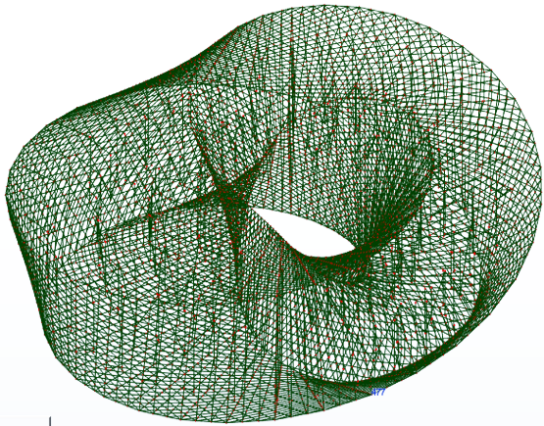
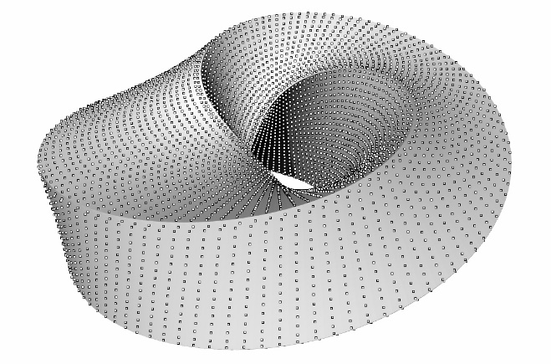
Algorithmic Analysis (aA)
Branco, R. C., & Leitão, A. (2017). Integrated Algorithmic Design: A single-script approach for multiple design tasks. (35th eCAADe)

Slide 7
AD and AA Methodology
3D Modeling Tool
</>
Architect
Algorithmic Design
Tool
Analysis Tool 1
Analysis Tool 2
Aguiar, R., Cardoso, C., & Leitão, A. (2017). Algorithmic Design and Analysis Fusing Disciplines. (37th ACADIA)

Slide 8
Algorithmic OPtimization
3D Modeling Tool
</>
Architect
Algorithmic Design
Tool
Analysis Tool 1
Analysis Tool 2
Optimization Tool

Slide 9
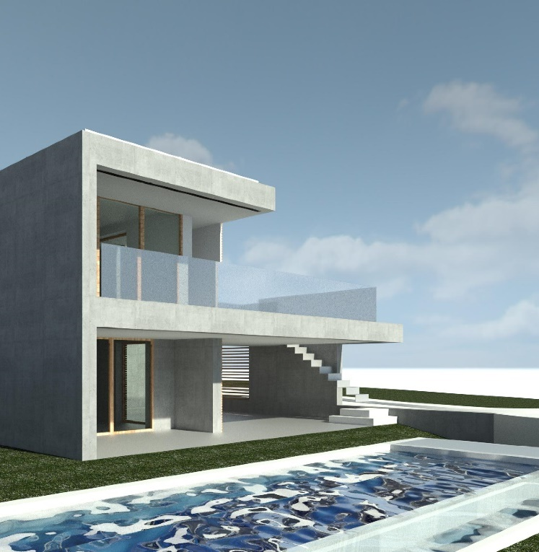
Case Study
Case Studies on the Integration of Algorithmic Design Processes in Traditional Design Workflows
Caetano, I., Ilunga, G., Belém, C., Aguiar, R., Feist, S., Bastos, F., & Leitão, A. (2018) (23rd CAADRIA)

Slide 10
Case Study

Slide 11
Case Study
Distance between bars

Slide 12
Case Study
Distance between bars
Maximum Size

Slide 13
Case Study
Distance between bars
Maximum Size
Minimum Size

Slide 14
Case Study
Distance between bars
Maximum Size
Minimum Size
Number of different bars

Slide 15
Case Study - Benchmarks
Phase 1. Global vs Local Methods
Phase 2. Hot-Start Local Methods

Slide 16
Phase 1. Global vs Local Methods
Solution Space
Initial Evaluation
Evaluations

Slide 17
Phase 1. Global vs Local Methods
Solution Space
Initial Evaluation
Evaluations

Slide 18
Phase 1. Global vs Local Methods
Metaheuristics | Direct Search | Model-based
CSR2 | DIRECT | COBYLA*
ISRES | DIRECT-L* | BOBYQA*
ESCH | NMS* | GPR
 | SUBPLEX* | RBF-CC
 | PRAXIS* | RBF-CL
* Local methods

Slide 19
Phase 1. Metaheuristics Methods
CRS2
ESCH
ISRES
0 5 10 15 20 25 30 35 40 45 50 55

Slide 20
Phase 1. Direct search Methods
DIRECT
DIRECT-L
NMS
PRAXIS
SUBPLEX
0 5 10 15 20 25 30 35 40 45 50 55

Slide 21
Phase 1. Model-Based Methods
BOBYQA
COBYLA
GPR
RBF-CC
RBF-CL
0 5 10 15 20 25 30 35 40 45 50 55

Slide 22
Phase 1. Best performing Methods
CRS2
DIRECT
NMS
GPR
RBF-CC
0 5 10 15 20 25 30 35 40 45 50 55

Slide 23
Phase 1. Global vs Local Methods
Increasing sUDI (%)

Slide 24
Phase 2. Hot-start local methods
Direct Search | Model-based
NMS | COBYLA
SUBPLEX | BOBYQA
PRAXIS

Slide 25
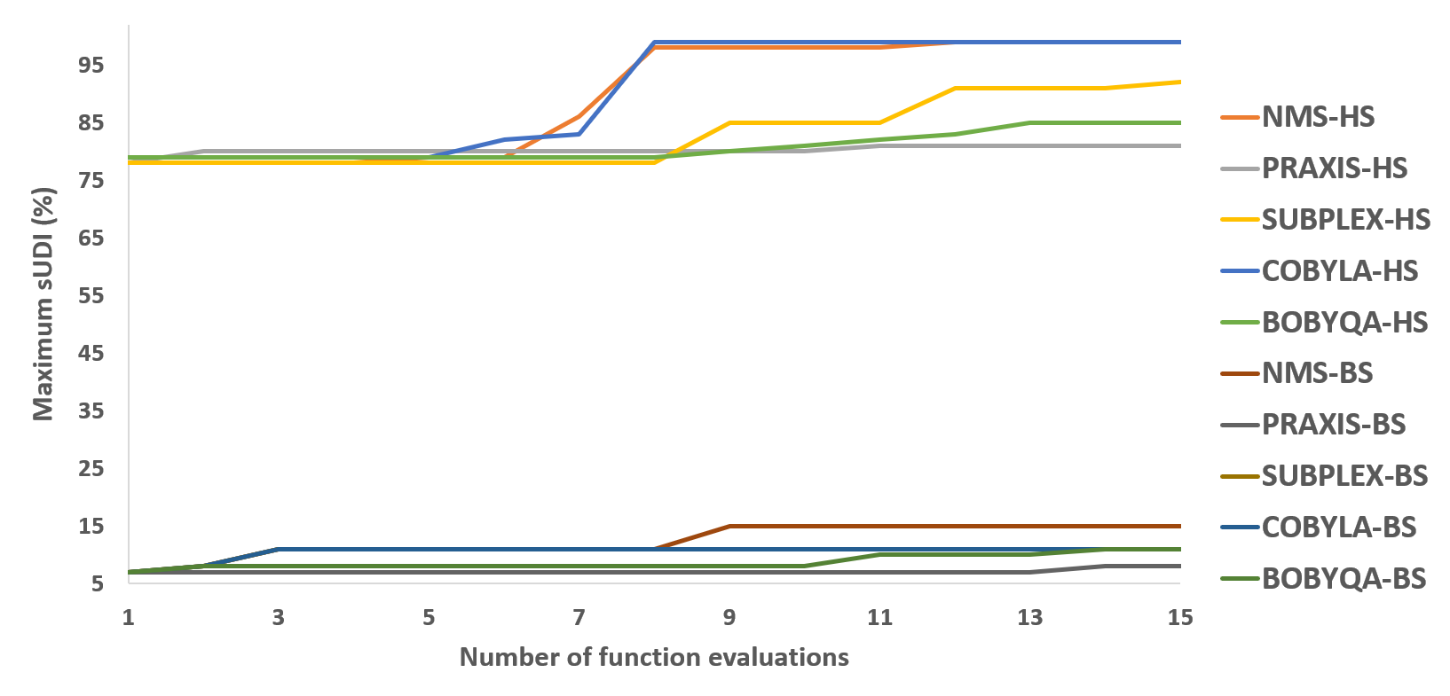
Phase 2. Hot-start local methods

Slide 26
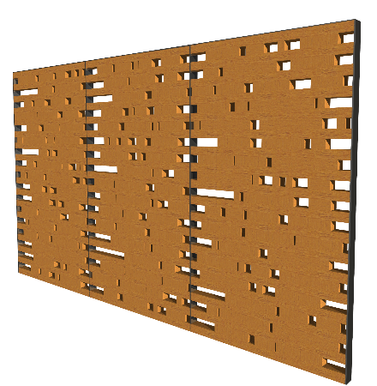
Phase 2. Hot-start local methods

Slide 27
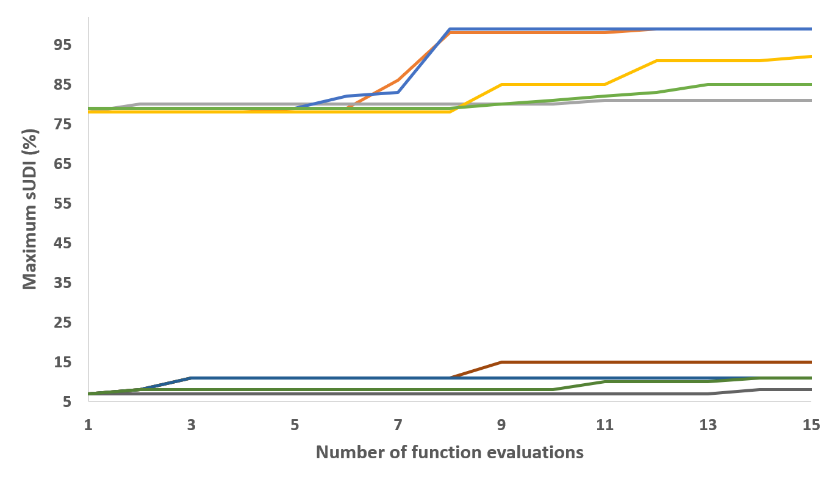
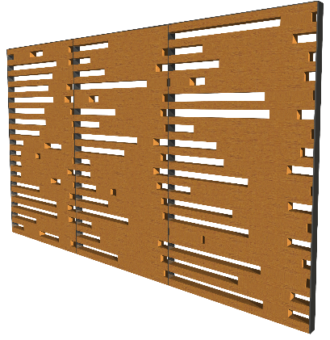
Phase 2. Hot-start local methods

Slide 28
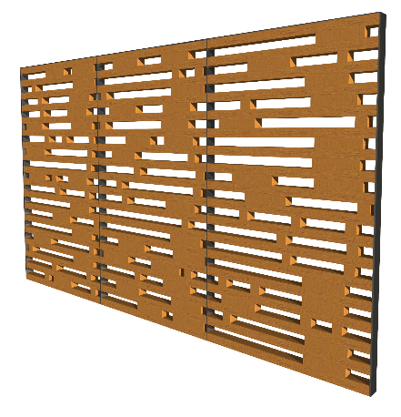
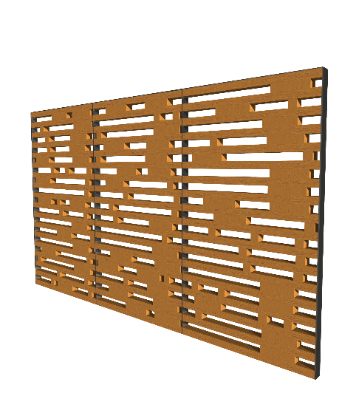
Phase 2. Hot-start local methods

Slide 29
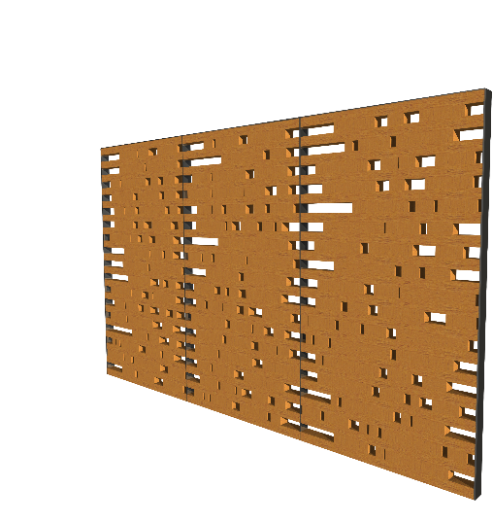
Phase 2. Hot-start local methods

Slide 30
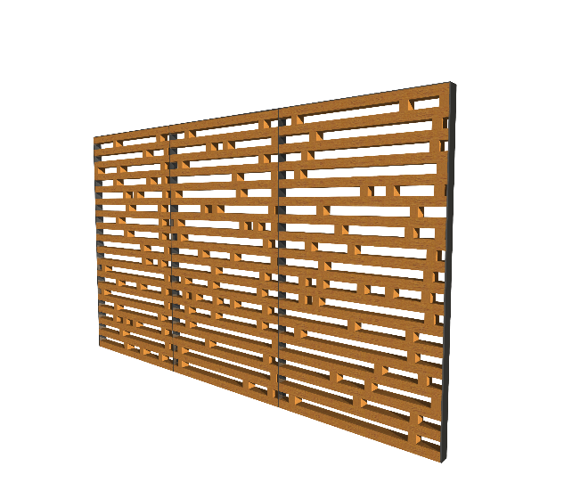
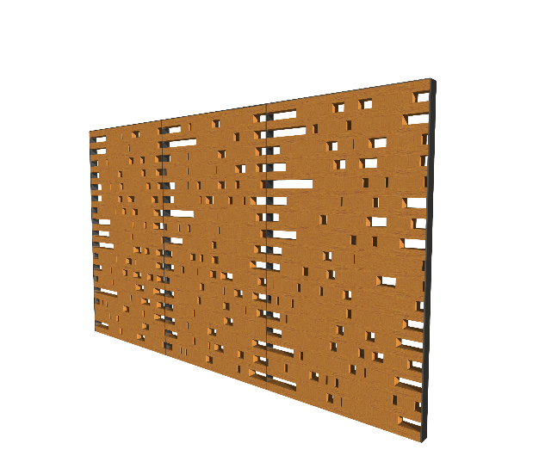
Phase 2. Hot-start local methods

Slide 31
Conclusion
Larger exploration in less time
Sensitivity of optimization processes
Tests are relevant for algorithm selection
Flexibility

Slide 32
Future Work
Input variables
Criteria Analysis
Optimization Algorithms
Multi-Objective Optimization (Pareto-based)

Slide 33
Thank you!
Catarina Garcia Belém catarina.belem@tecnico.ulisboa.pt
António Menezes Leitão antonio.menezes.leitao@tecnico.ulisboa.pt

