Slide 1
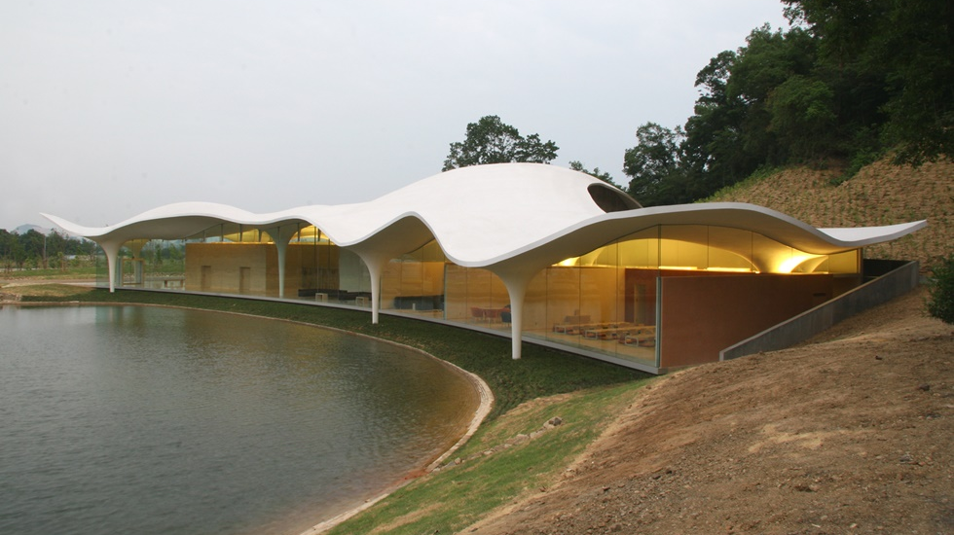
Derivative-free Methods for Structural Optimization
Guilherme Ilunga, António Leitão
INESC-ID/Instituto Superior Técnico, Universidade de Lisboa

Slide 2
Algorithms for Structural Optimization
Guilherme Ilunga, António Leitão
INESC-ID/Instituto Superior Técnico, Universidade de Lisboa

Slide 3
What is Optimization?

Slide 4
What is Optimization?
Finding the parameters which give the best value of a given metric

Slide 5
What is Optimization?
Finding the parameters which give the best value of a given metric
Example:
Parameters: position and height of each pillar

Slide 6
What is Optimization?
Finding the parameters which give the best value of a given metric
Example:
Parameters: position and height of each pillar
Metric: maximum displacement of the roof

Slide 7
Why do we want optimization?

Slide 8
Why do we want optimization?
It can help with building code restrictions

Slide 9
Why do we want optimization?
It can help with building code restrictions
It can help reduce costs

Slide 10
Why do we want optimization?
It can help with building code restrictions
It can help reduce costs
It can help the creative stage

Slide 11
Why do we want optimization?
It can help with building code restrictions
It can help reduce costs
It can help the creative stage
This process can be automated

Slide 12
Why do we want optimization?
It can help with building code restrictions
It can help reduce costs
It can help the creative stage
This process can be automated

Slide 13
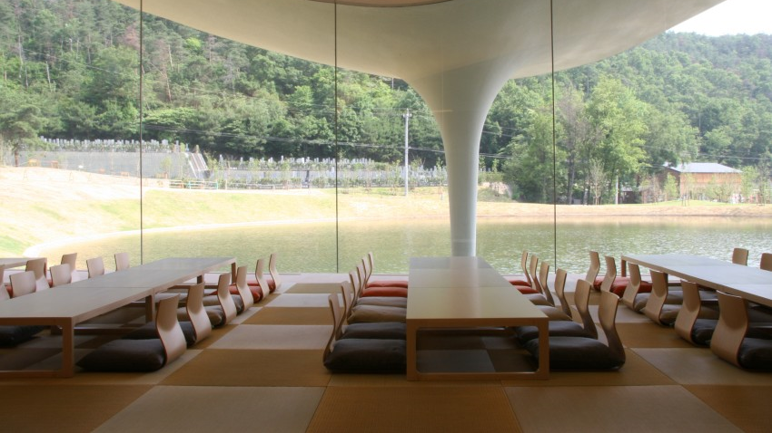
How can it be done?

Slide 14
How can it be done?
Algorithmic Design

Slide 15
How can it be done?
Algorithmic Design
Analysis

Slide 16
How can it be done?
Algorithmic Design
Analysis
Optimization

Slide 17
How can it be done?
Algorithmic Design
Analysis
Optimization

Slide 18
How can it be done?
Algorithmic Design
Analysis
Optimization

Slide 19
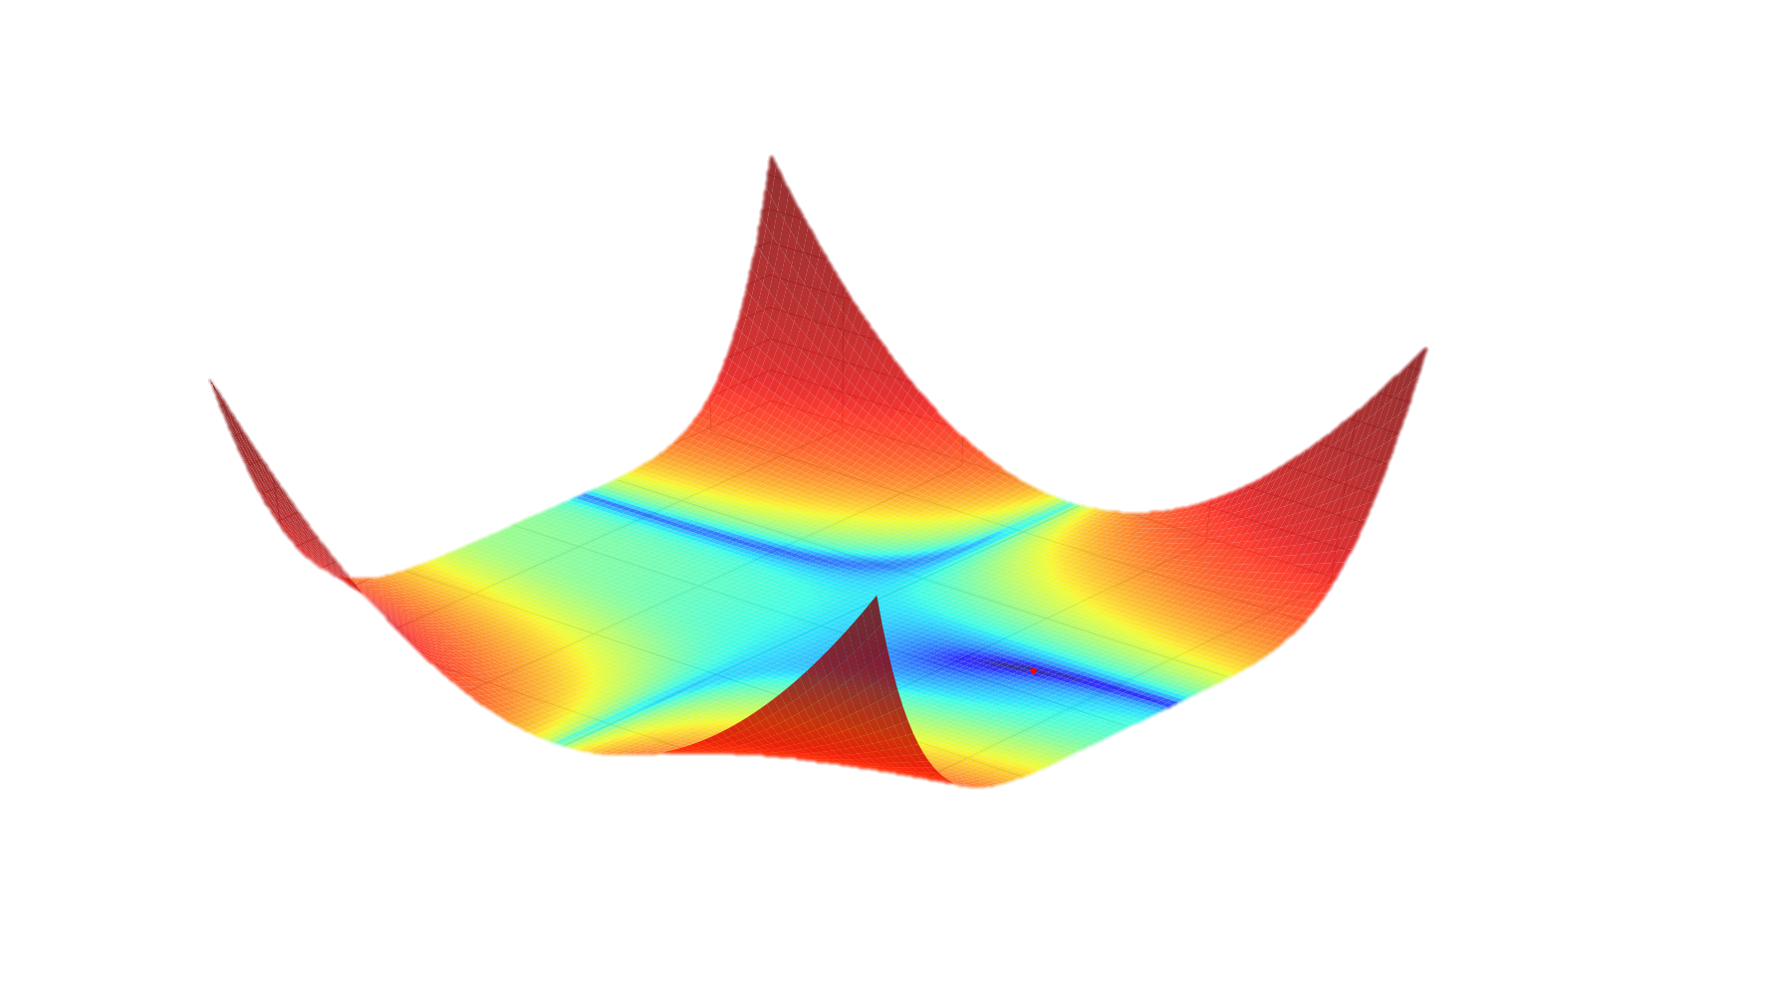
Optimization Algorithms

Slide 20
The Genetic Algorithm

Slide 21
The Genetic Algorithm
Create Population

Slide 22
The Genetic Algorithm
Create Population
Evaluate Population

Slide 23
The Genetic Algorithm
Create Population
Evaluate Population
Select Parents

Slide 24
The Genetic Algorithm
Create Population
Evaluate Population
Select Parents
Create Children

Slide 25
The Genetic Algorithm
Create Population
Evaluate Population
Select Parents
Create Children
Mutate Population

Slide 26
The Genetic Algorithm
Create Population
Evaluate Population
Select Parents
Create Children
Mutate Population

Slide 27
The Genetic Algorithm
Create Population
Evaluate Population
Select Parents
Create Children
Mutate Population
Size? Random? Gaussian? Uniform?

Slide 28
The Genetic Algorithm
Create Population
Evaluate Population
Select Parents
Create Children
Mutate Population
Probability? Random? Best? Tournament?

Slide 29
The Genetic Algorithm
Create Population
Evaluate Population
Select Parents
Create Children
Mutate Population
Probability? One Point? Two Point? Uniform?

Slide 30
The Genetic Algorithm
Create Population
Evaluate Population
Select Parents
Create Children
Mutate Population
Probability? Shuffle? Gaussian? Uniform?

Slide 31
The Genetic Algorithm
Create Population
Evaluate Population
Select Parents
Create Children
Mutate Population
Random? Gaussian? Uniform?
Random? Best? Tournament?
One Point? Two Point? Uniform?
Shuffle? Gaussian? Uniform?

Slide 32
Evolutionary Principles applied to Problem Solving
using
David Rutten

Slide 33
Evolutionary Principles applied to Problem Solving
using
David Rutten
Evolutionary Algorithms are slow. Dead slow.

Slide 34
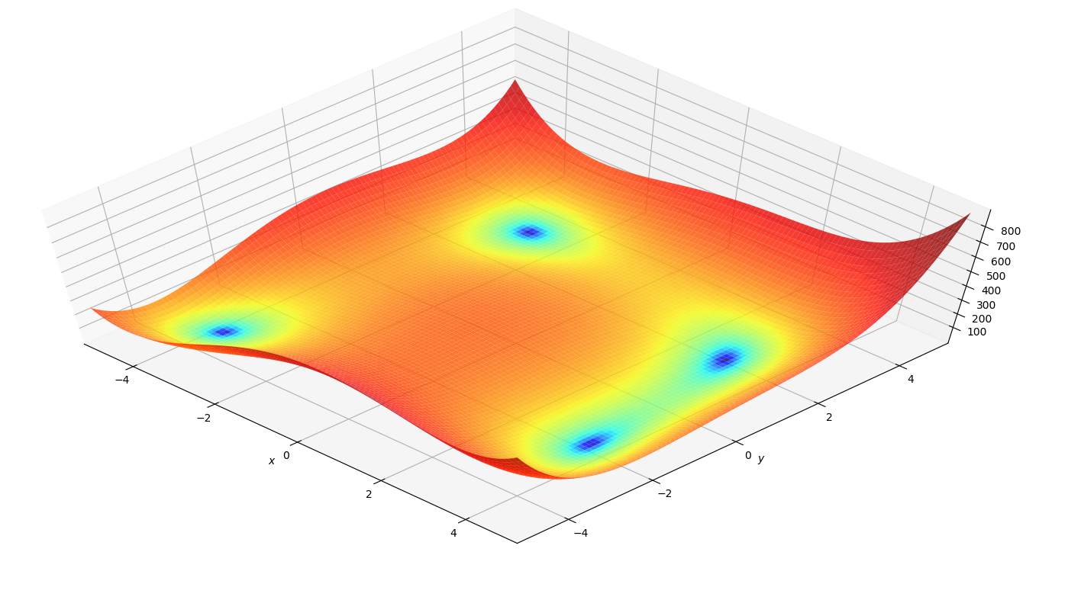
Alternatives

Slide 35
Alternatives
Direct-search

Slide 36
Alternatives
Direct-search
Model-based

Slide 37
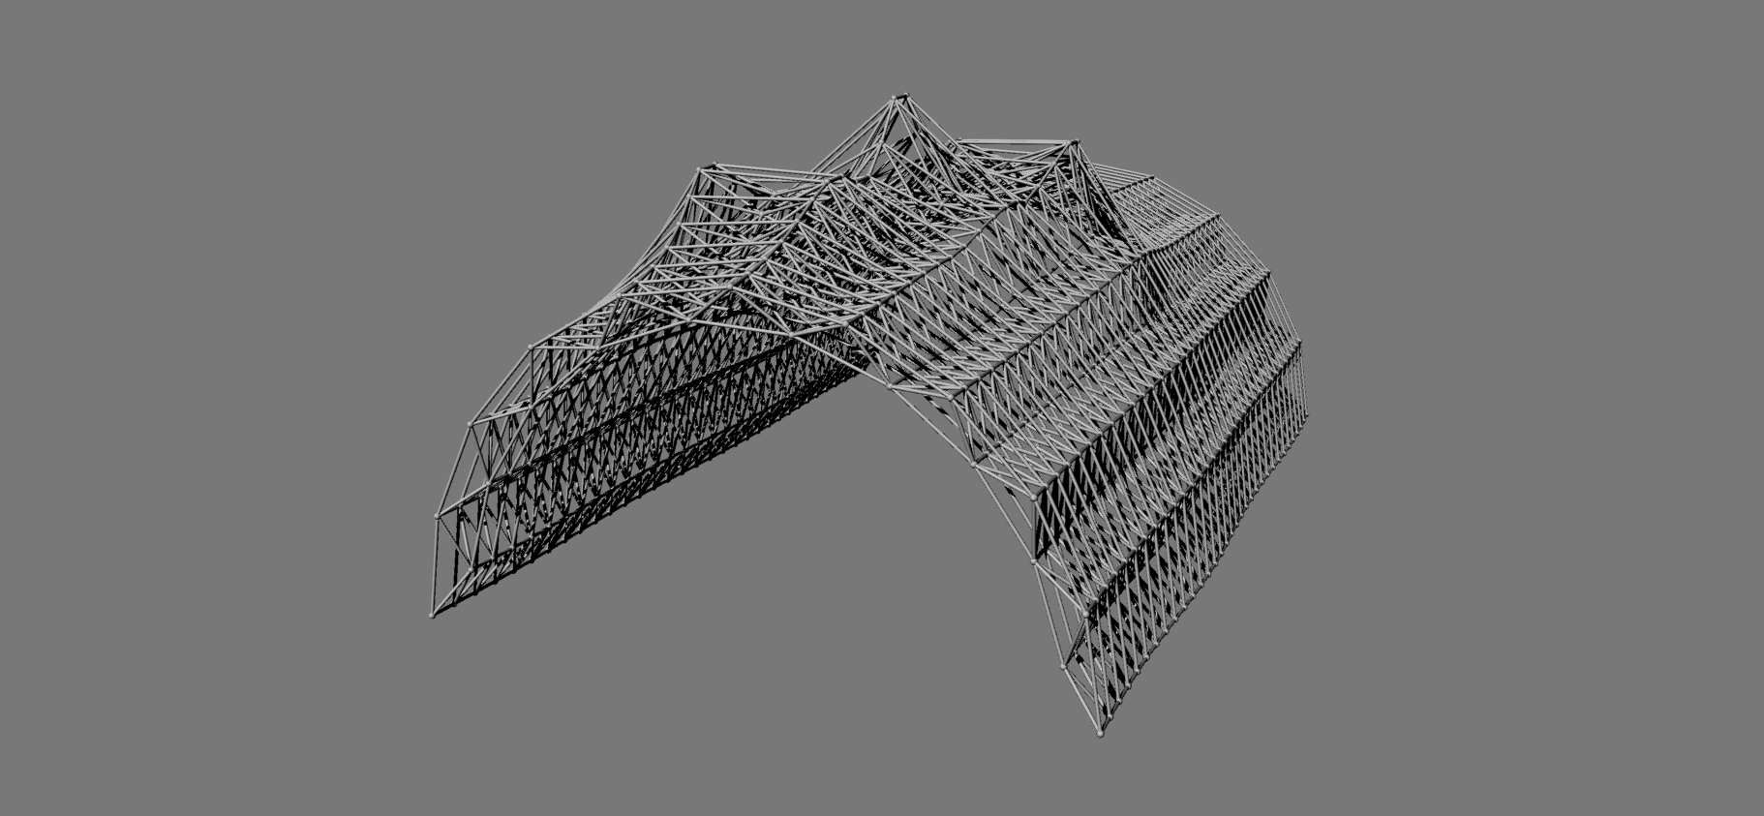
Case Study

Slide 38
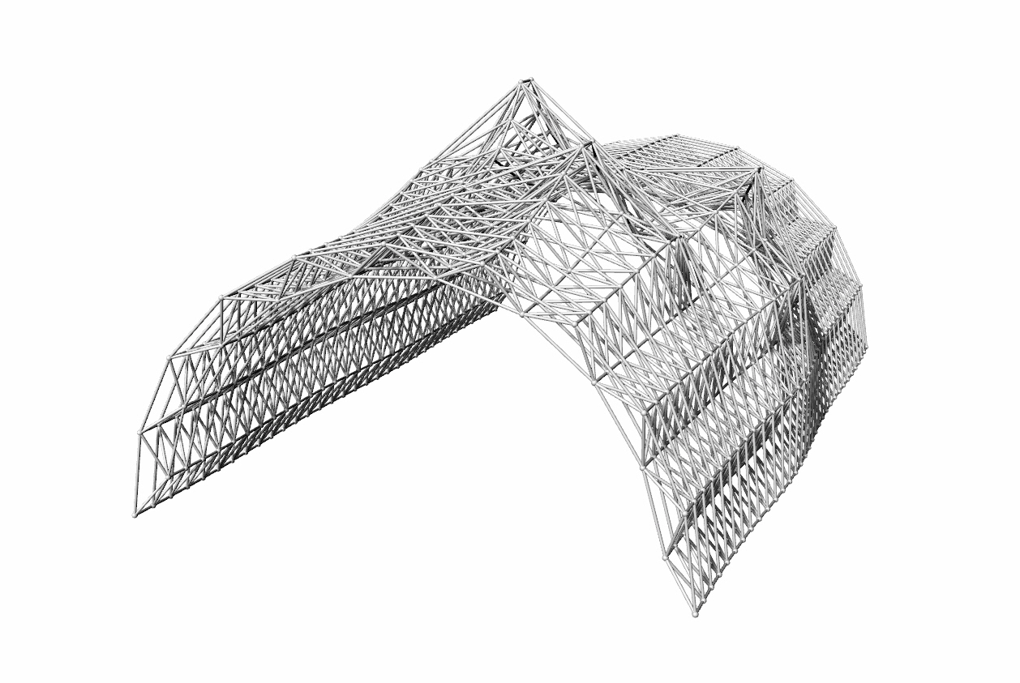
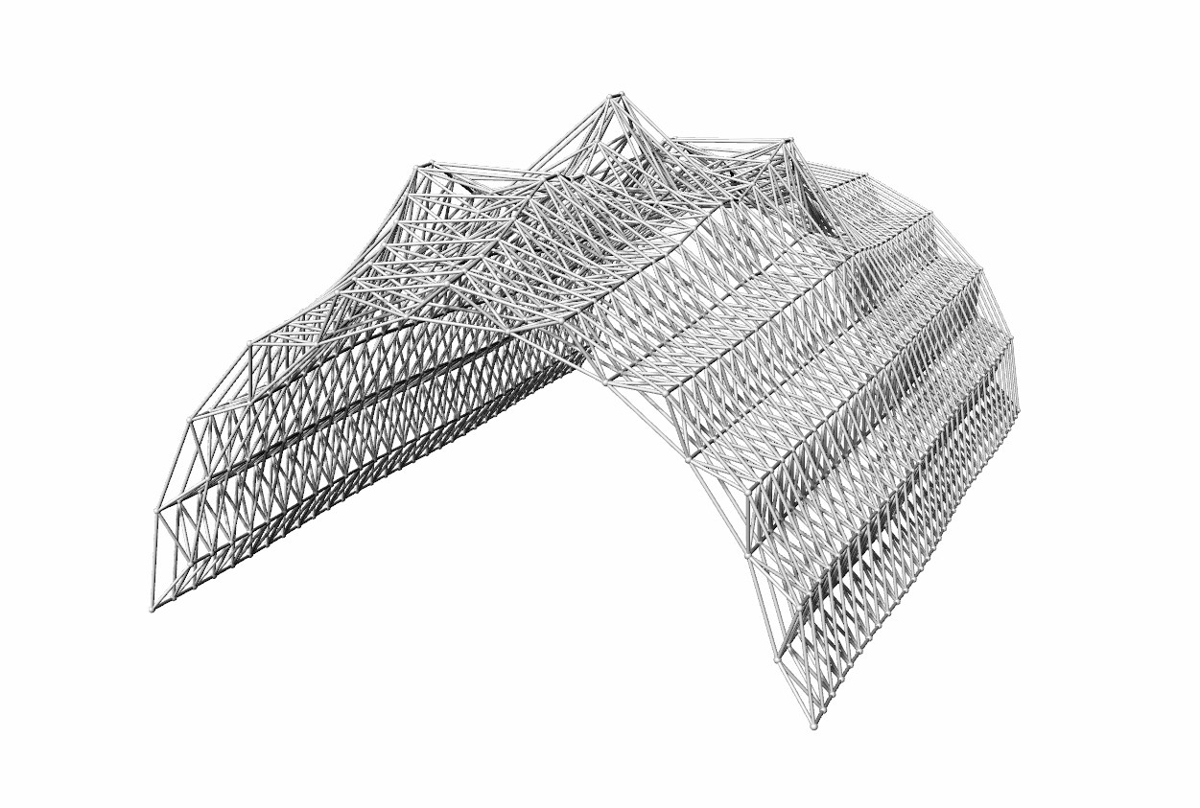
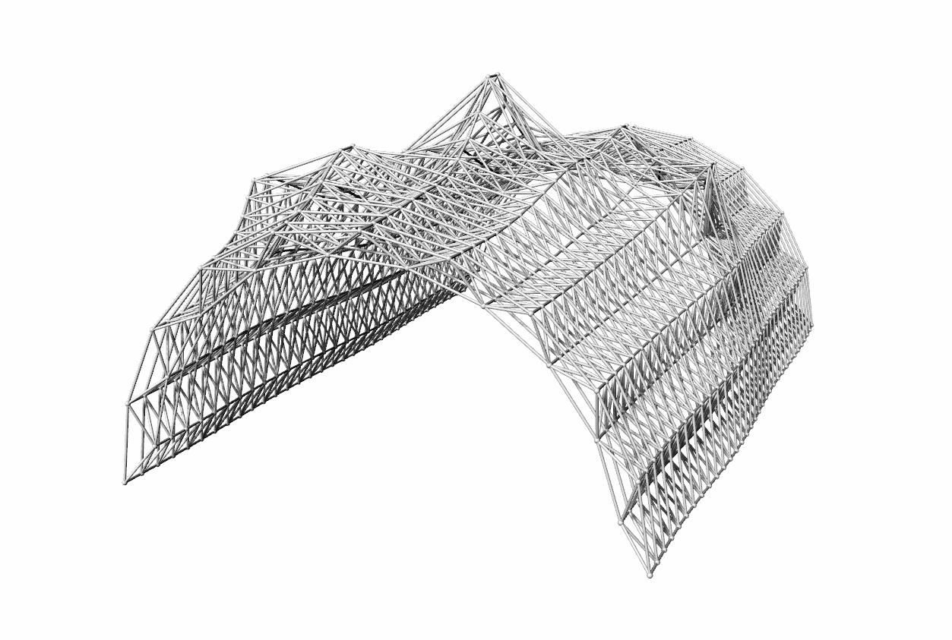
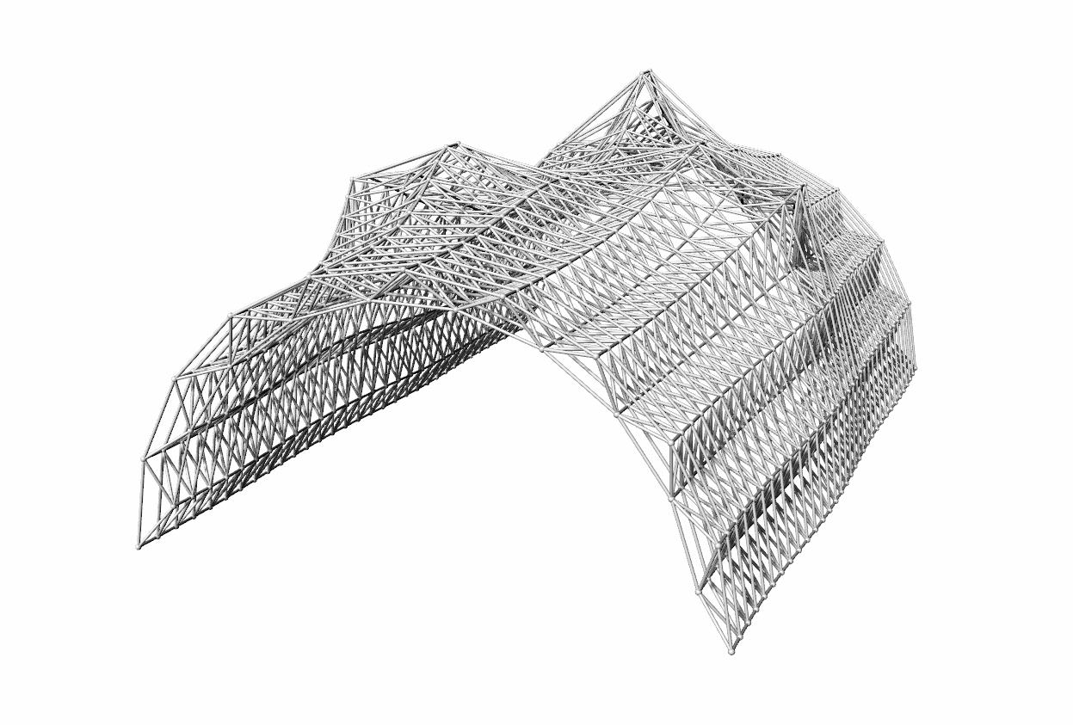
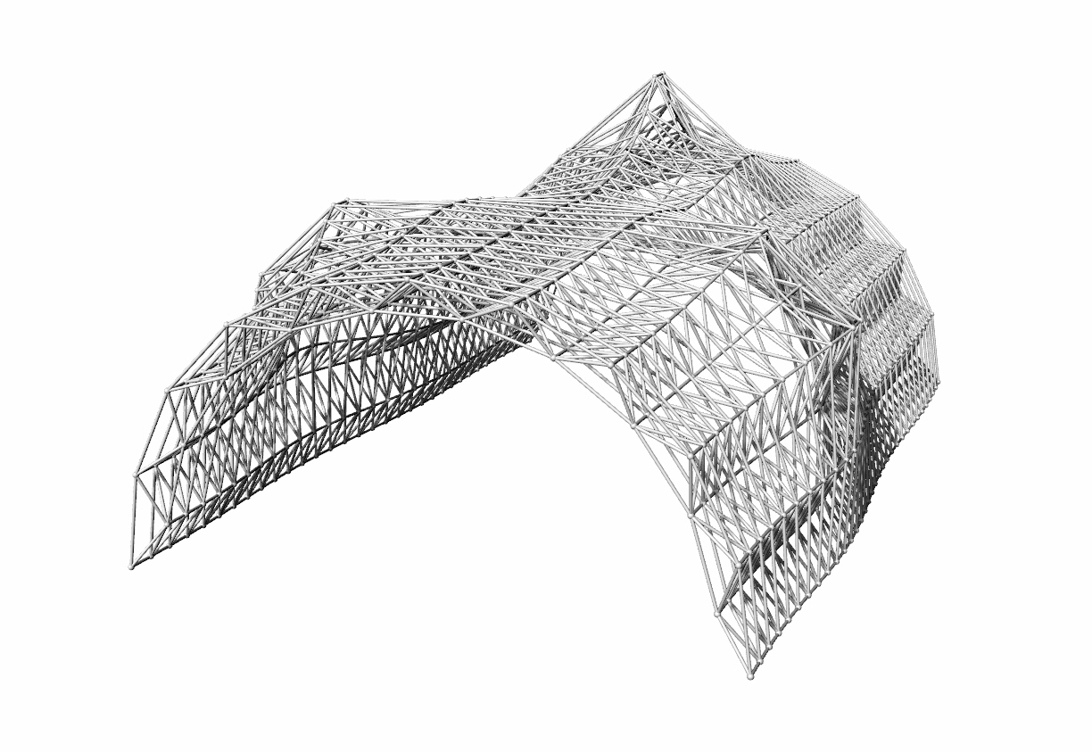
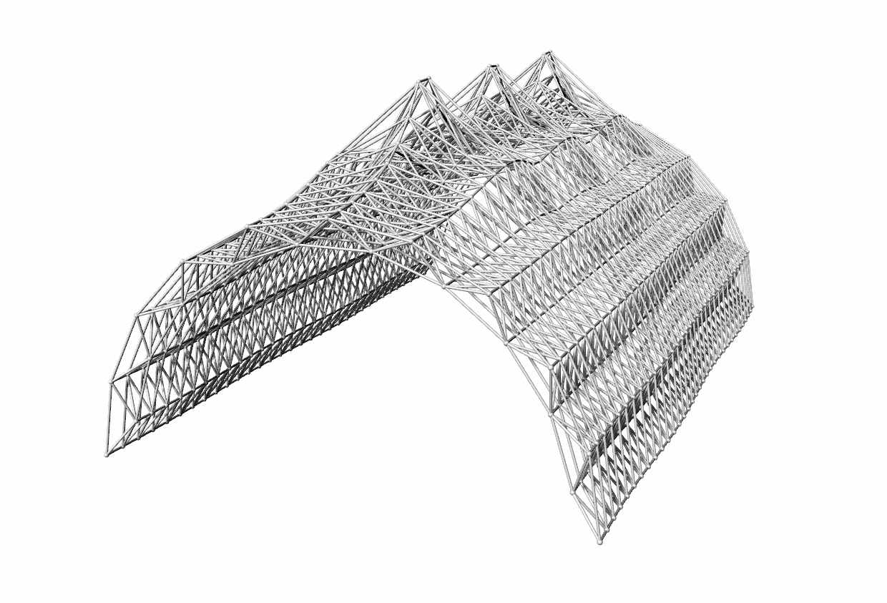
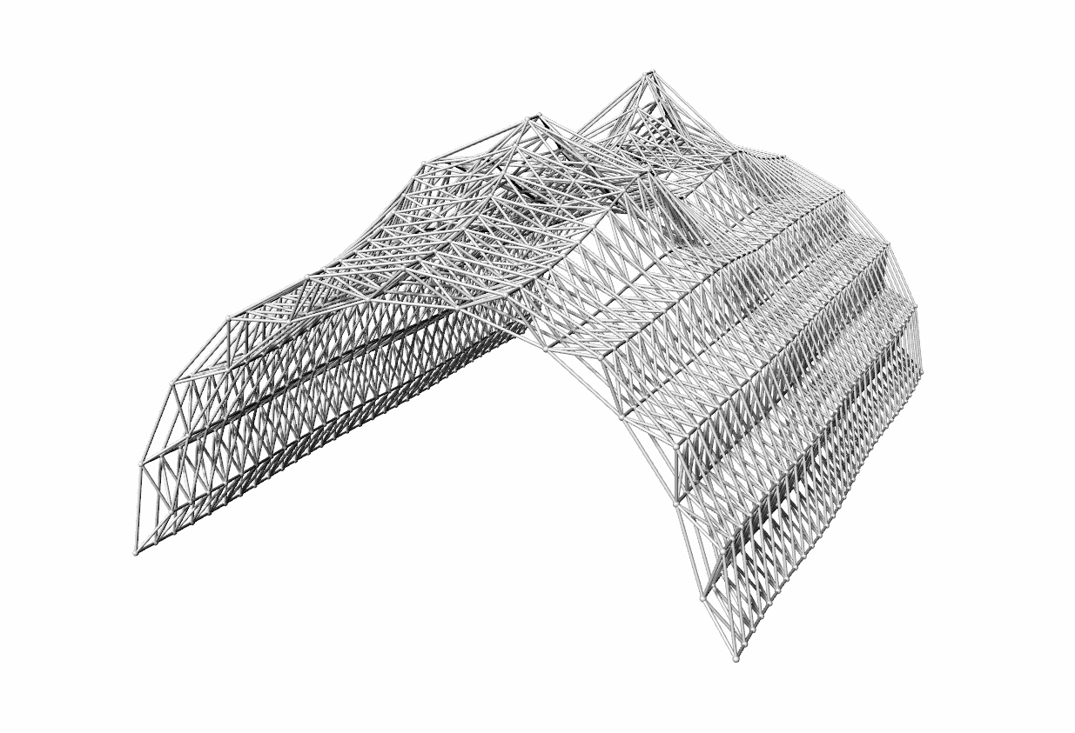
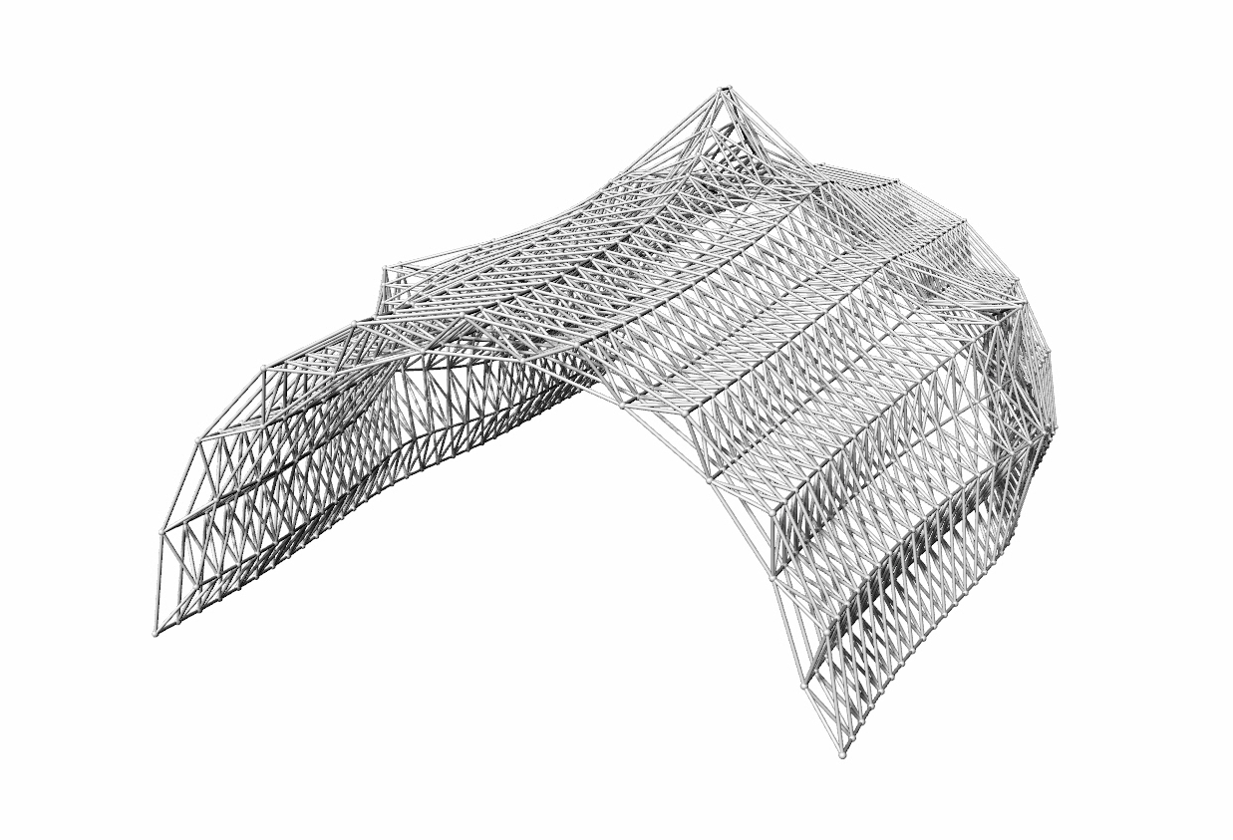
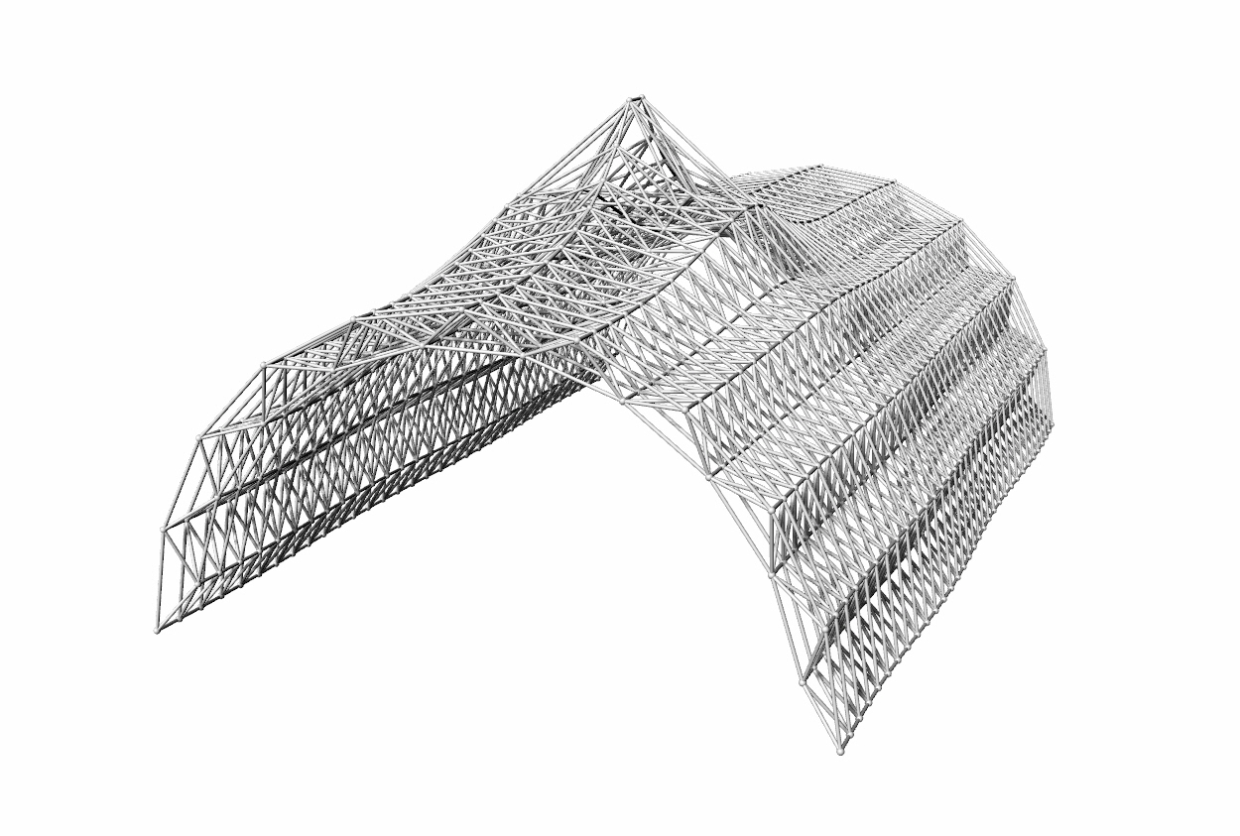
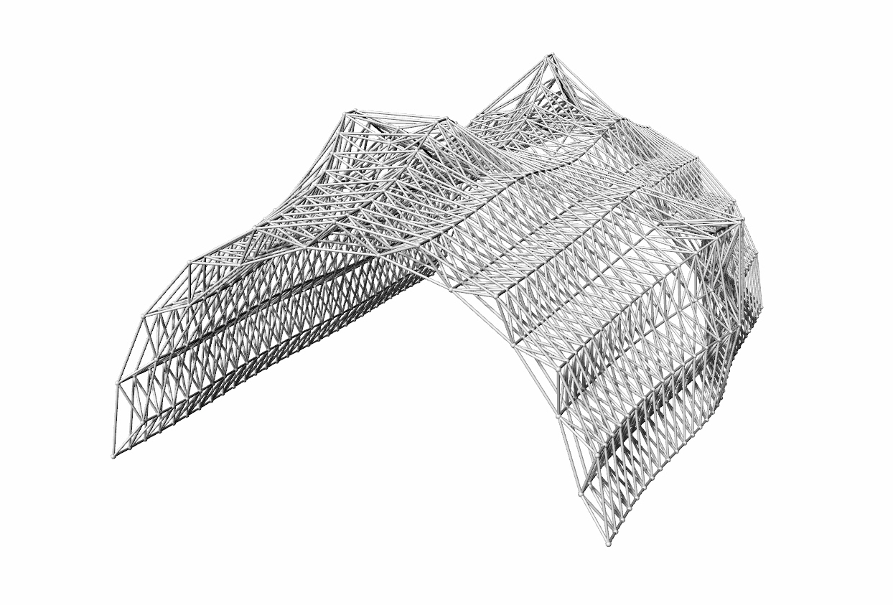
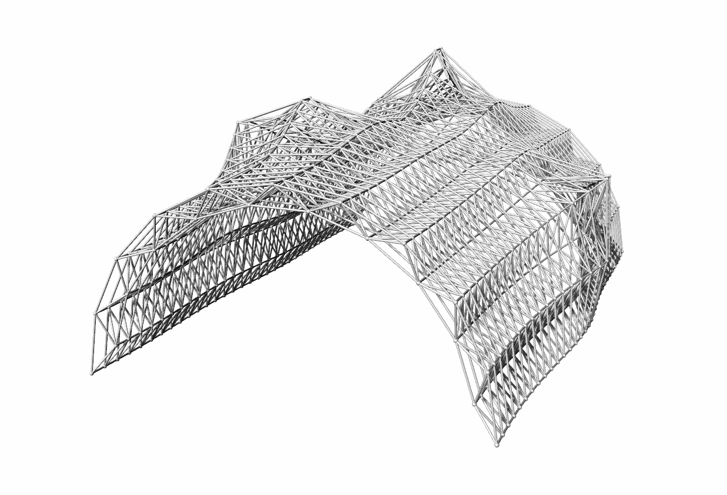
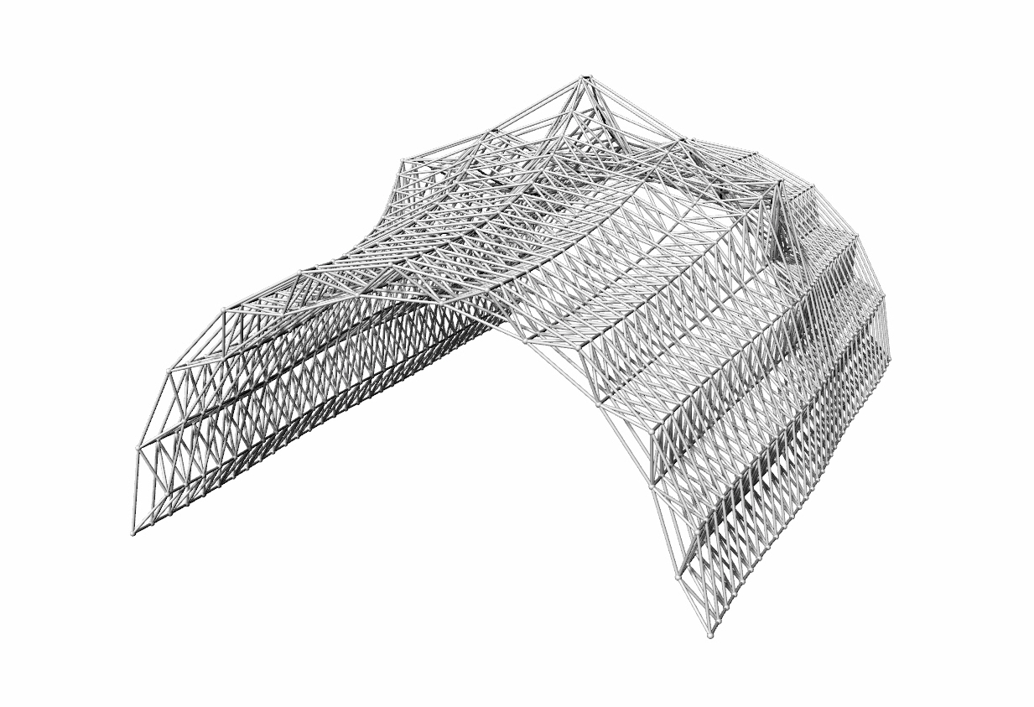

Slide 39
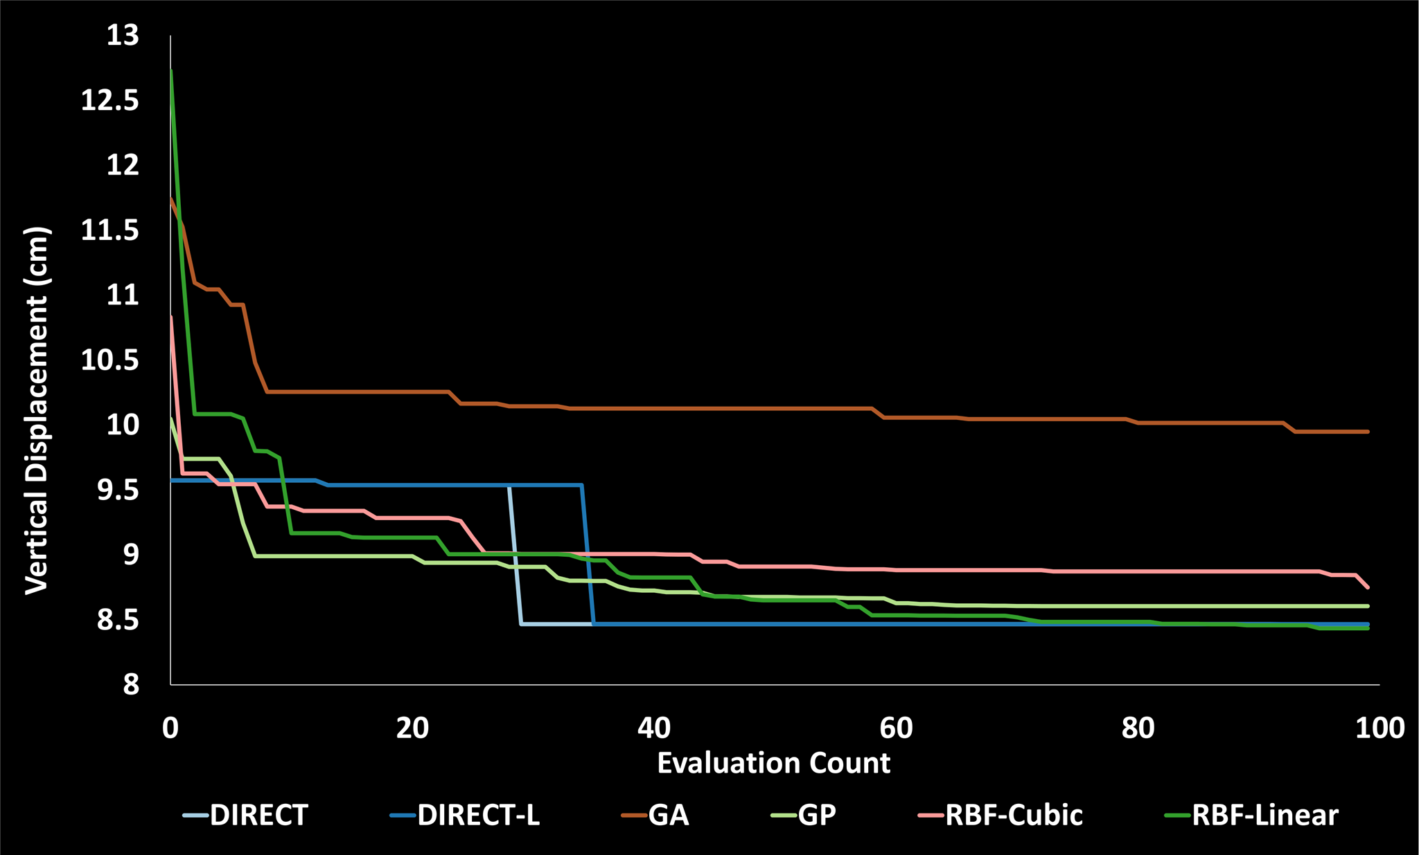
Results

Slide 43
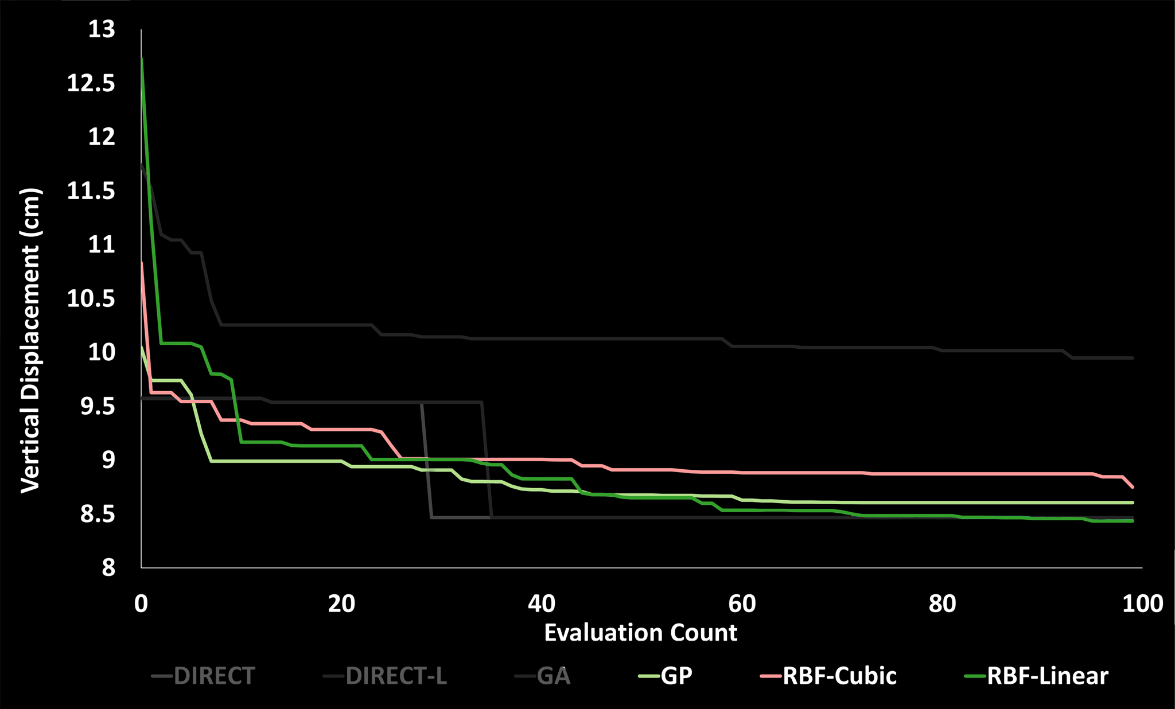

Slide 44
Conclusions

Slide 45
Conclusions
Using only Genetic Algorithms is not a good choice

Slide 46
Conclusions
Using only Genetic Algorithms is not a good choice
Direct-search and Model-based methods achieve better results

Slide 47
Conclusions
Using only Genetic Algorithms is not a good choice
Direct-search and Model-based methods achieve better results
Try to use several algorithms, instead of just one

Slide 48
Future Work

Slide 49
Future Work
Other optimization algorithms
Other case studies
Optimization framework
Optimization plugin

Slide 50
Thank You!
Questions?

