Slide 1
INTEGRATION OF ALGORITHMIC DESIGN PROCESSES IN THE BIM WORKFLOW
18th May 2018
Inês Caetano | Catarina Belém | Guilherme Ilunga | Sofia Feist | Francisco Bastos | António Leitão

Slide 2
ALGORITHMIC DESIGN
ARCHITECT
BIM MODEL

Slide 3
ALGORITHMIC DESIGN
ARCHITECT
ALGORITHM
BIM MODEL

Slide 4
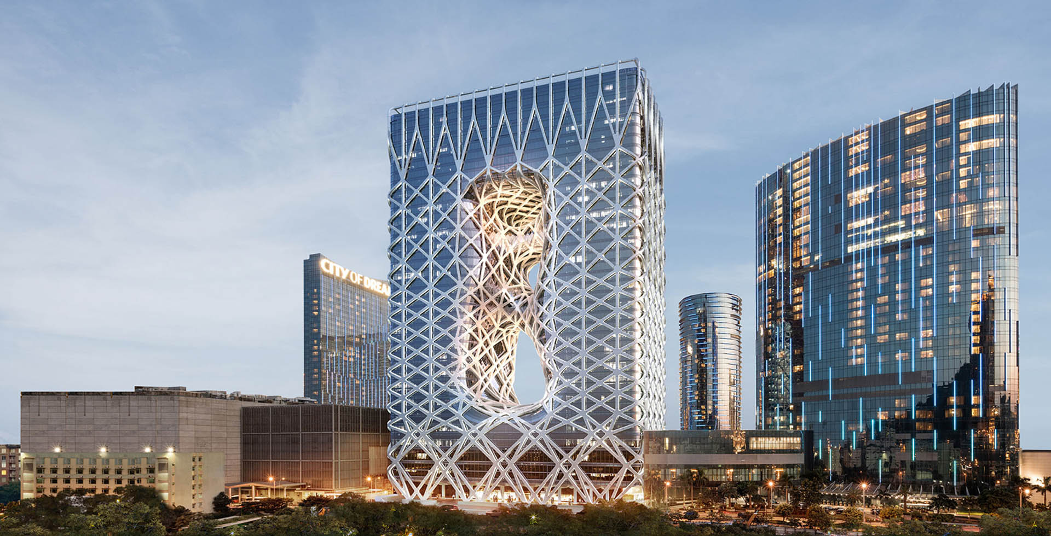
ALGORITHMIC DESIGN
Morpheus Hotel - Zaha Hadid Architects

Slide 5
RELATED WORK
Louvre Abu Dhabi – Ateliers Jean Nouvel

Slide 6
ALGORITHMIC DESIGN - CURRENT PRACTICES

Slide 7
ALGORITHMIC DESIGN - CURRENT PRACTICES
FOSTER AND PARTNERS
U
SPECIALIST MODELLING GROUP

Slide 8
ALGORITHMIC DESIGN - CURRENT PRACTICES
FOSTER AND PARTNERS
U
SPECIALIST MODELLING GROUP
U
ARUP
ADVANCED GEOMETRY UNIT

Slide 9
ALGORITHMIC DESIGN - CURRENT PRACTICES
+

Slide 10
ALGORITHMIC DESIGN - CURRENT PRACTICES
+
PROGRAMMING ARCHITECTURE

Slide 11
ALGORITHMIC DESIGN - CURRENT PRACTICES
+
PROGRAMMING ARCHITECTURE
SMARTGEOMETRY

Slide 12
ALGORITHMIC DESIGN - CURRENT PRACTICES
+
PROGRAMMING ARCHITECTURE
SMARTGEOMETRY
MARK BURRY

Slide 13
DESIGN TEAM
+
ATELIER DOS REMÉDIOS
ALGORITHMIC DESIGN FOR ARCHITECTURE

Slide 14
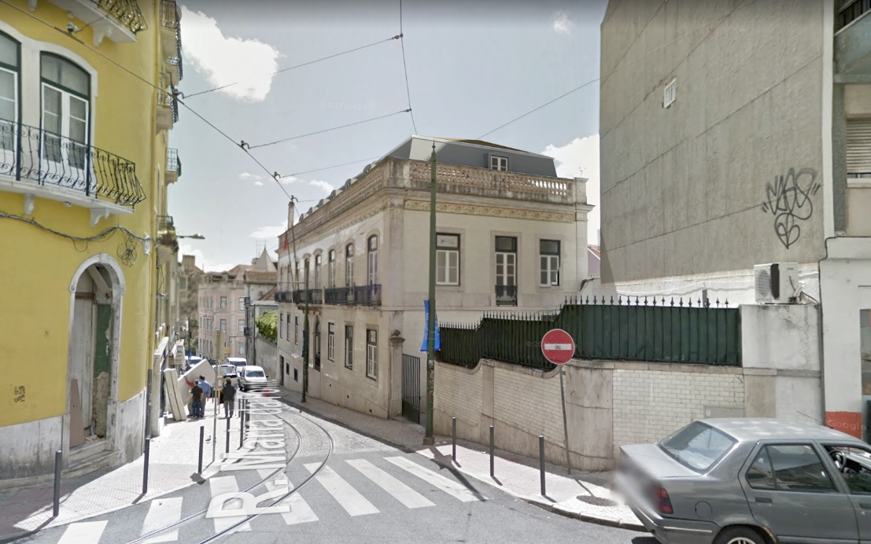
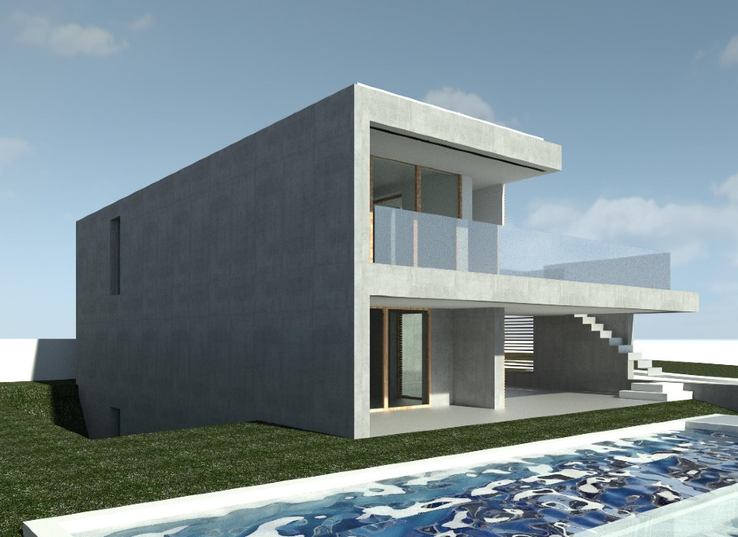
CASE STUDIES
CASE STUDY 1
CASE STUDY 2

Slide 15
WORKFLOW

Slide 16
WORKFLOW

Slide 17
WORKFLOW

Slide 18
WORKFLOW

Slide 19
WORKFLOW

Slide 20
CASE STUDY 1 – AUTOMATIC FURNITURE LAYOUT

Slide 21
CASE STUDY 1

Slide 22
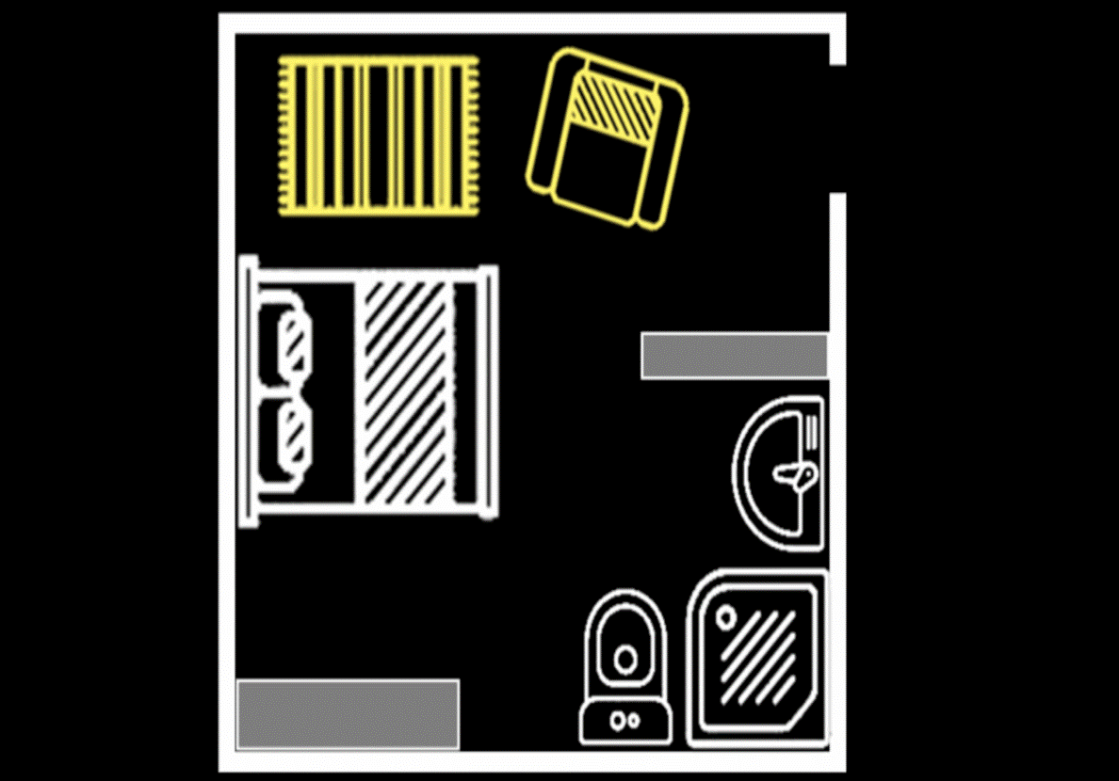
CASE STUDY 1

Slide 23
CASE STUDY 1

Slide 24
CASE STUDY 1

Slide 25
CASE STUDY 1
FIXED PARAMETERS:
Room Dimensions
HEIGHT
LENGTH
WIDTH

Slide 26
CASE STUDY 1
FIXED PARAMETERS:
Room Dimensions
Door

Slide 27
CASE STUDY 1
FIXED PARAMETERS:
Room Dimensions
Door
Window(s)

Slide 28
CASE STUDY 1
FIXED PARAMETERS:
Room Dimensions
Door
Window(s)
VARIABLE PARAMETERS:
Bed

Slide 29
CASE STUDY 1
FIXED PARAMETERS:
Room Dimensions
Door
Window(s)
VARIABLE PARAMETERS:
Bed
Wardrobe

Slide 30
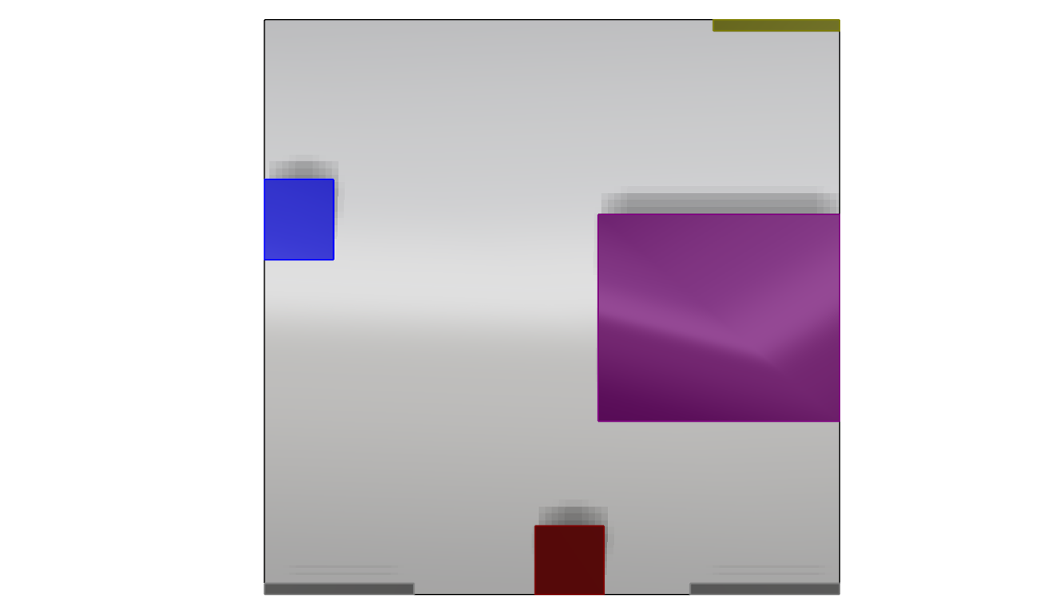
CASE STUDY 1
FIXED PARAMETERS:
Room Dimensions
Door
Window(s)
VARIABLE PARAMETERS:
Bed
Wardrobe
Sink

Slide 31
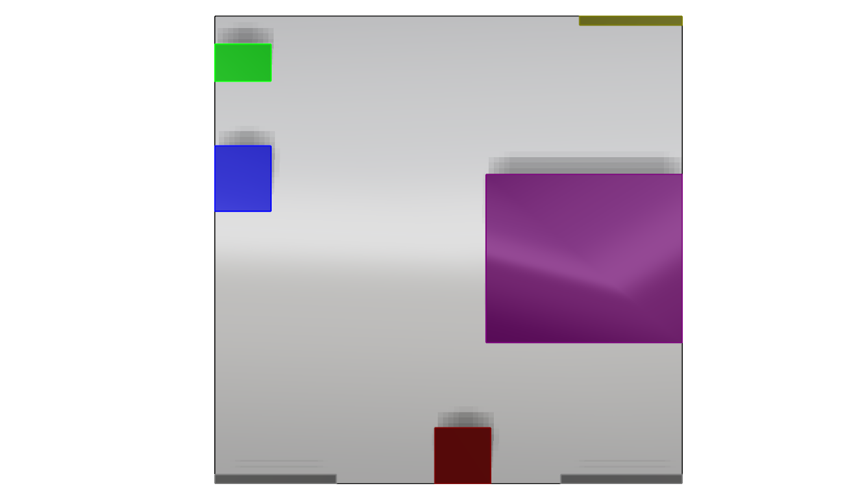
CASE STUDY 1
FIXED PARAMETERS:
Room Dimensions
Door
Window(s)
VARIABLE PARAMETERS:
Bed
Wardrobe
Sink
Toilet

Slide 32
CASE STUDY 1
FIXED PARAMETERS:
Room Dimensions
Door
Window(s)
VARIABLE PARAMETERS:
Bed
Wardrobe
Sink
Toilet
Shower

Slide 33
CASE STUDY 1
FIXED PARAMETERS:
Room Dimensions
Door
Window(s)
VARIABLE PARAMETERS:
Bed
Wardrobe
Sink
Toilet
Shower

Slide 34
CASE STUDY 1
FIXED PARAMETERS:
Room Dimensions
Door
Window(s)
VARIABLE PARAMETERS:
Bed
Wardrobe
Sink
Toilet
Shower

Slide 35
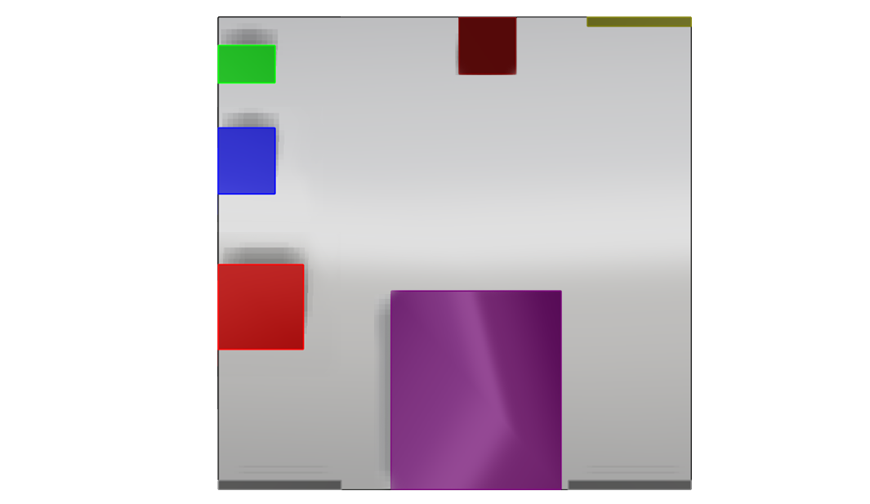
CASE STUDY 1
FIXED PARAMETERS:
Room Dimensions
Door
Window(s)
VARIABLE PARAMETERS:
Bed
Wardrobe
Sink
Toilet
Shower

Slide 36
CASE STUDY 1
FIXED PARAMETERS:
Room Dimensions
Door
Window(s)
VARIABLE PARAMETERS:
Bed
Wardrobe
Sink
Toilet
Shower

Slide 37
CASE STUDY 1
FIXED PARAMETERS:
Room Dimensions
Door
Window(s)
VARIABLE PARAMETERS:
Bed
Wardrobe
Sink
Toilet
Shower

Slide 38
CASE STUDY 1
CONSTRAINTS

Slide 39
CASE STUDY 1
CONSTRAINTS
CONSTRUCTIBILITY

Slide 40
CASE STUDY 1
CONSTRAINTS
CONSTRUCTIBILITY
PREFERENCES

Slide 41
CASE STUDY 1
CONSTRAINTS
CONSTRUCTIBILITY
PREFERENCES

Slide 42
CASE STUDY 1
CONSTRAINTS
CONSTRUCTIBILITY
No Overlap between Elements
PREFERENCES

Slide 43
CASE STUDY 1
CONSTRAINTS
CONSTRUCTIBILITY
No Overlap between Elements
Respect Circulation/Utility Spaces
PREFERENCES

Slide 44
CASE STUDY 1
CONSTRAINTS
CONSTRUCTIBILITY
No Overlap between Elements
Respect Circulation/Utility Spaces
Elements adjacent to walls
Element Orientation
Toilet right next to Sink
…
PREFERENCES

Slide 45
CASE STUDY 1
CONSTRAINTS
CONSTRUCTIBILITY
PREFERENCES

Slide 46
CASE STUDY 1
CONSTRAINTS
CONSTRUCTIBILITY
PREFERENCES
Sink or Shower next to window

Slide 47
CASE STUDY 1
CONSTRAINTS
CONSTRUCTIBILITY
PREFERENCES
Sink or Shower next to window
Bed facing the door

Slide 48
CASE STUDY 1
CONSTRAINTS
CONSTRUCTIBILITY
PREFERENCES
Sink or Shower next to window
Bed facing the door
Optimize Circulation Space
…

Slide 49
CASE STUDY 1
CONSTRUCTIBILITY
PREFERENCES

Slide 50
CASE STUDY 1
CONSTRUCTIBILITY
PREFERENCES

Slide 51
CASE STUDY 1
CONSTRUCTIBILITY
PREFERENCES
1.
2.
3.

Slide 52
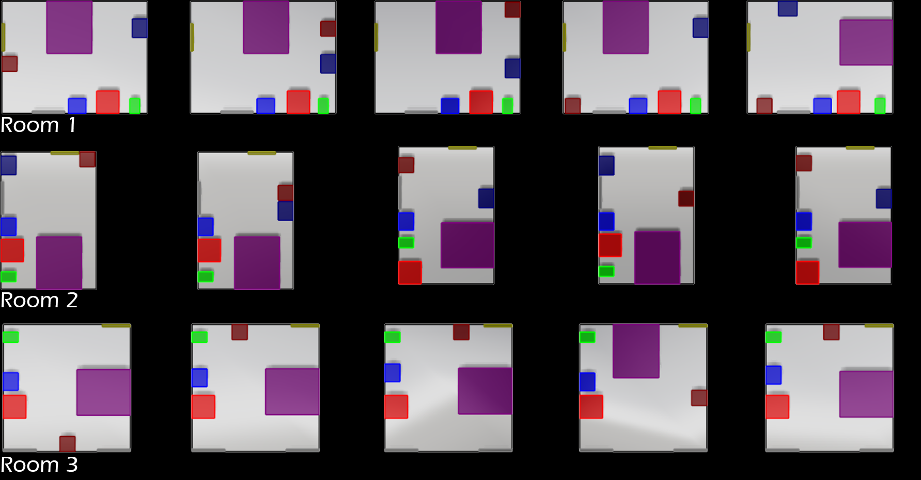
CASE STUDY 1 - RESULTS
Door
Window(s)
Bed
Wardrobe
Sink
Toilet
Shower

Slide 53
CASE STUDY 1 - RESULTS
Door
Window(s)
Bed
Wardrobe
Sink
Toilet
Shower

Slide 54
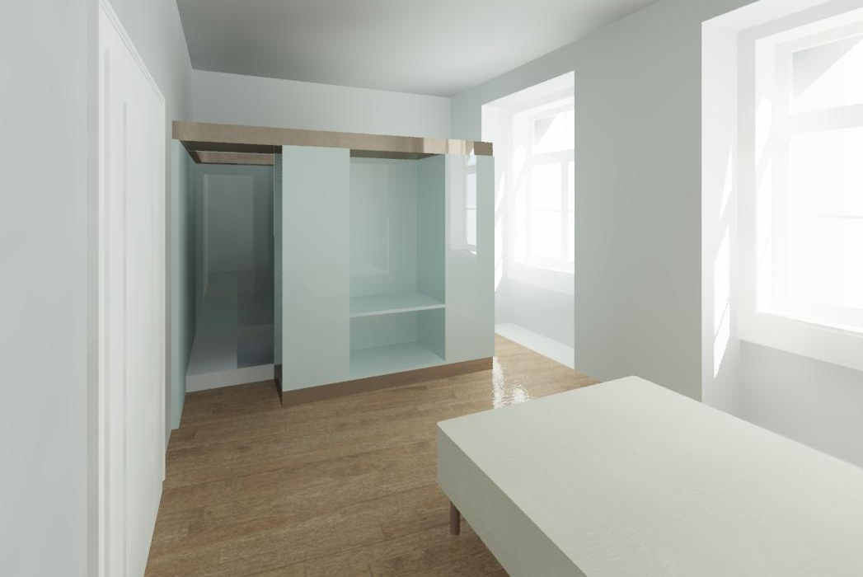
CASE STUDY 1 - RESULTS
Door
Window(s)
Bed
Wardrobe
Sink
Toilet
Shower

Slide 55
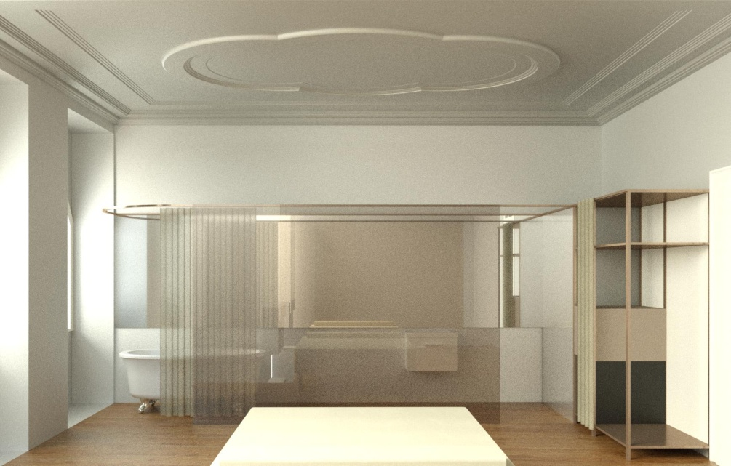
CASE STUDY 1 - RESULTS
Door
Window(s)
Bed
Wardrobe
Sink
Toilet
Shower

Slide 56
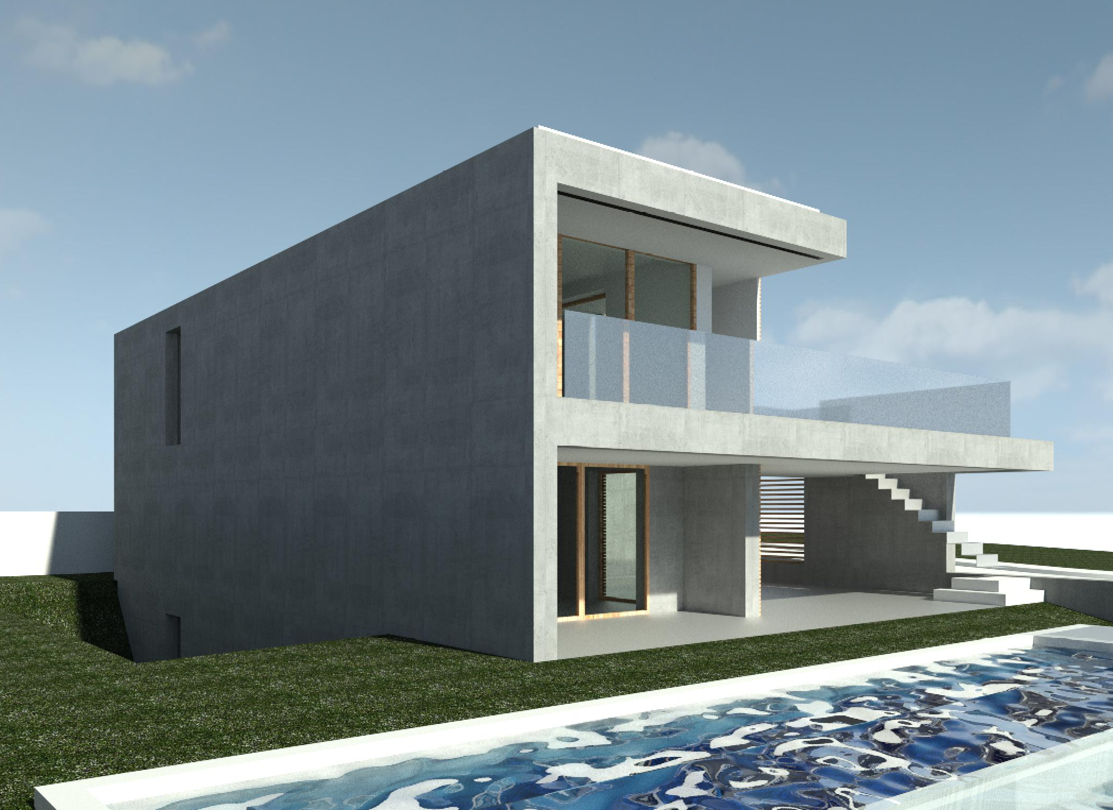
CASE STUDY 2 – LIGHTING OPTIMIZATION

Slide 57
CASE STUDY 2

Slide 58
CASE STUDY 2

Slide 59
CASE STUDY 2

Slide 60
CASE STUDY 2

Slide 61
CASE STUDY 2
Distance between bars

Slide 62
CASE STUDY 2
Distance between bars
Minimum size

Slide 63
CASE STUDY 2
Distance between bars
Minimum size
Maximum size

Slide 64
CASE STUDY 2
Distance between bars
Minimum size
Maximum size
Number of different bars

Slide 65
CASE STUDY 2

Slide 66
CASE STUDY 2

Slide 67
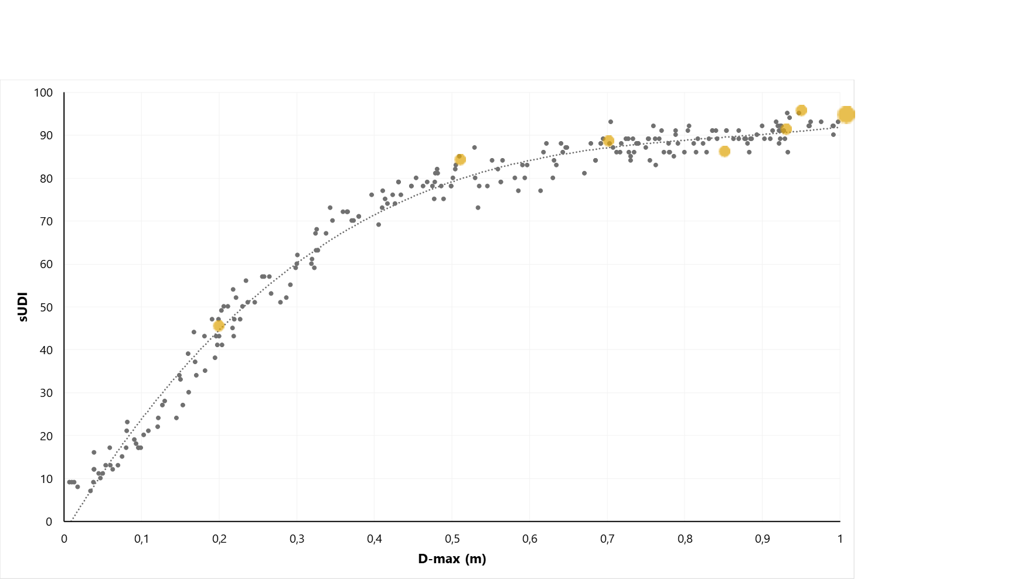
CASE STUDY 2

Slide 68
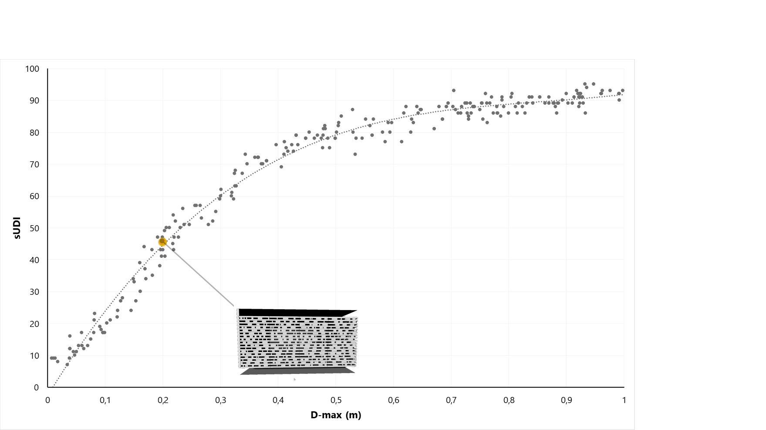
CASE STUDY 2

Slide 69
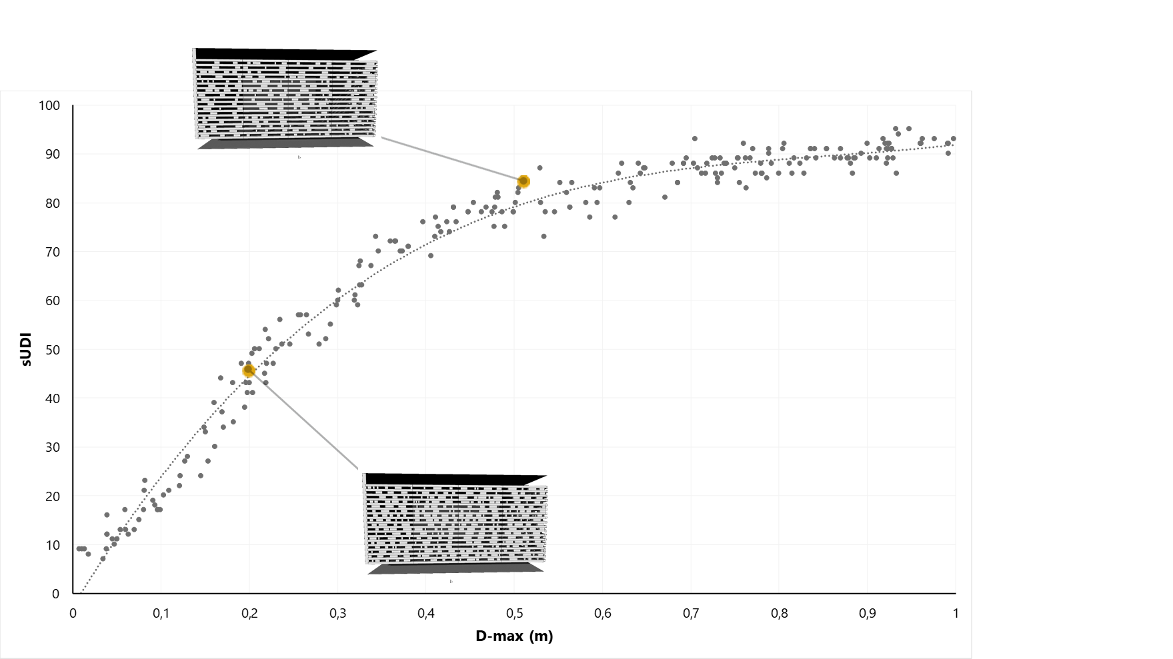
CASE STUDY 2

Slide 70
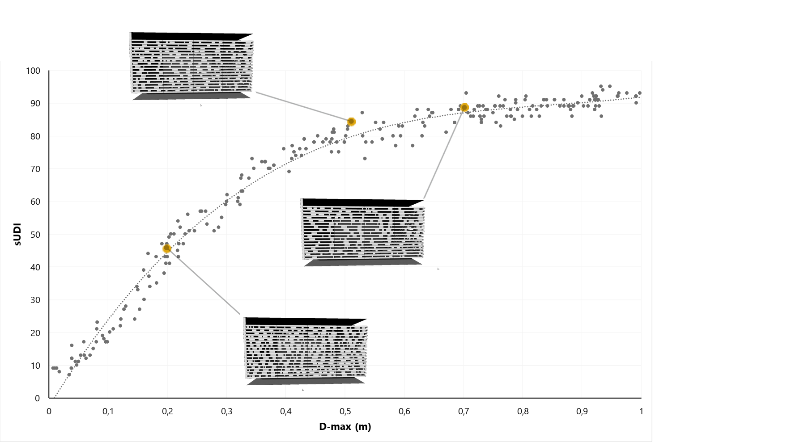
CASE STUDY 2

Slide 71
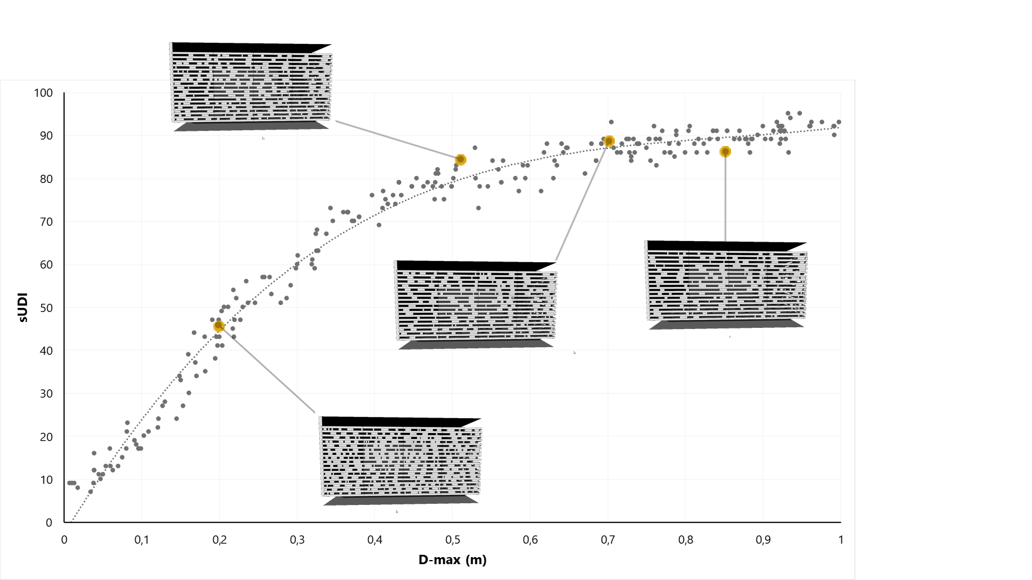
CASE STUDY 2

Slide 72
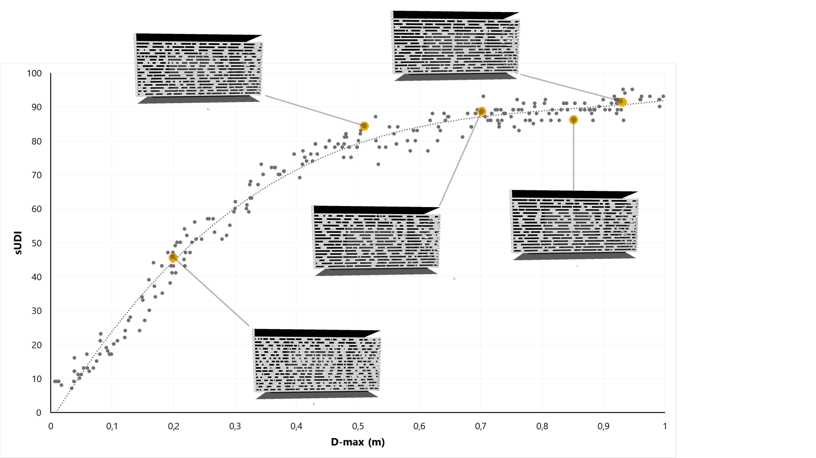
CASE STUDY 2

Slide 73
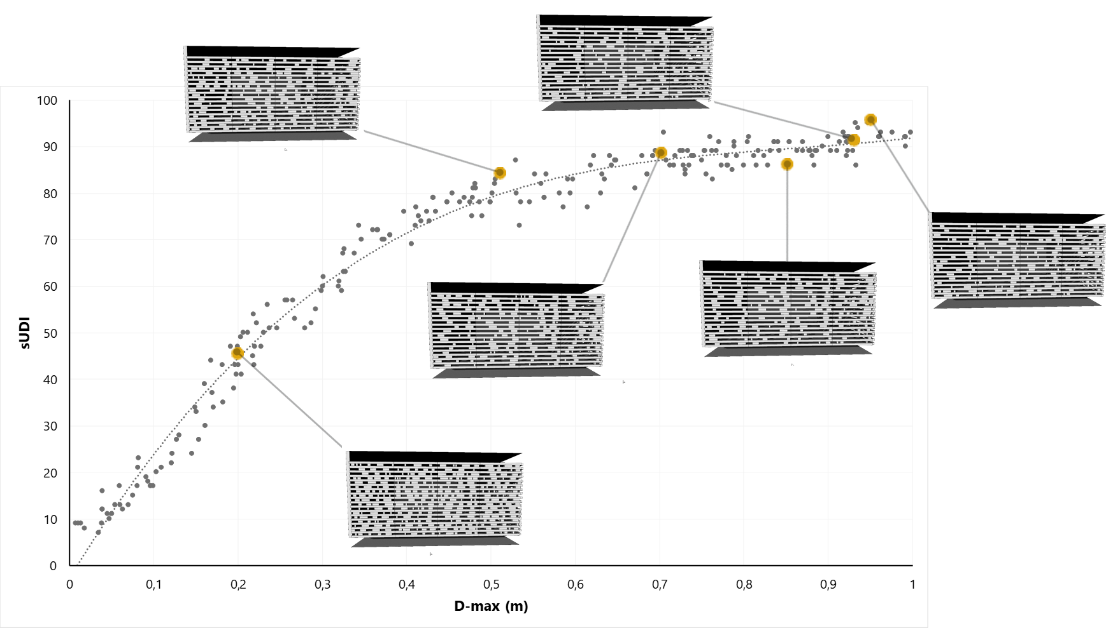
CASE STUDY 2

Slide 74
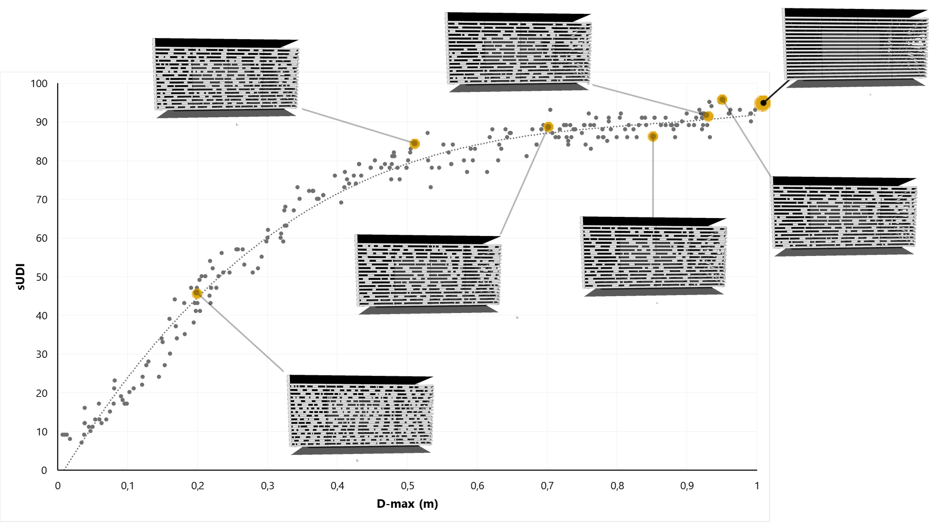
CASE STUDY 2

Slide 75
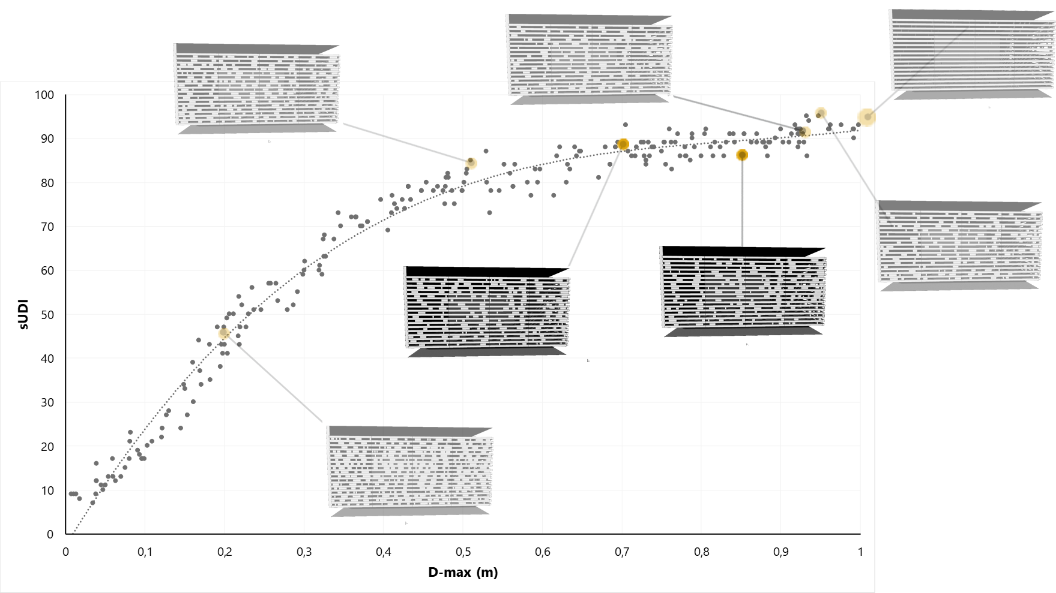
CASE STUDY 2

Slide 76
CASE STUDY 2

Slide 77
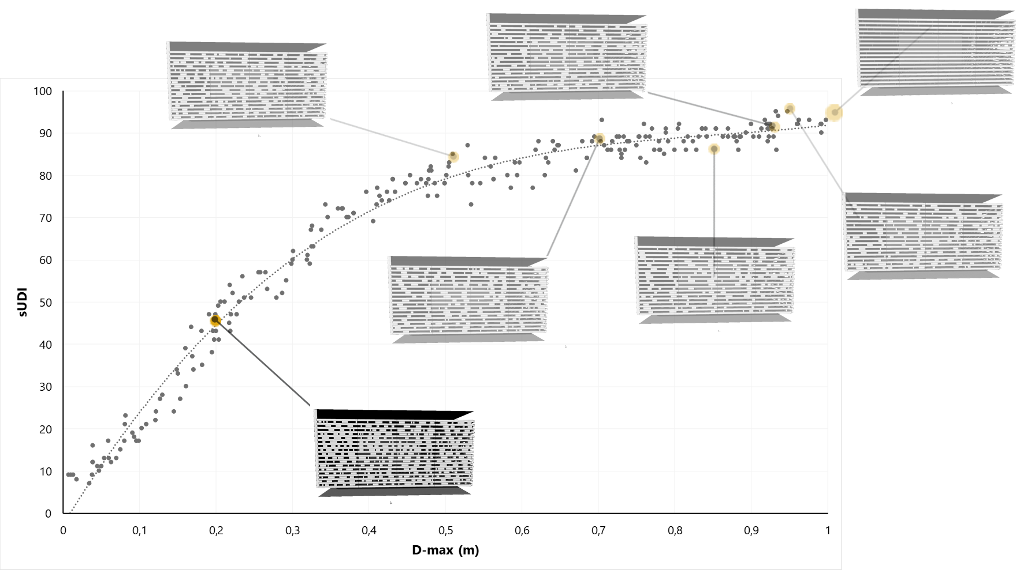
CASE STUDY 2

Slide 78
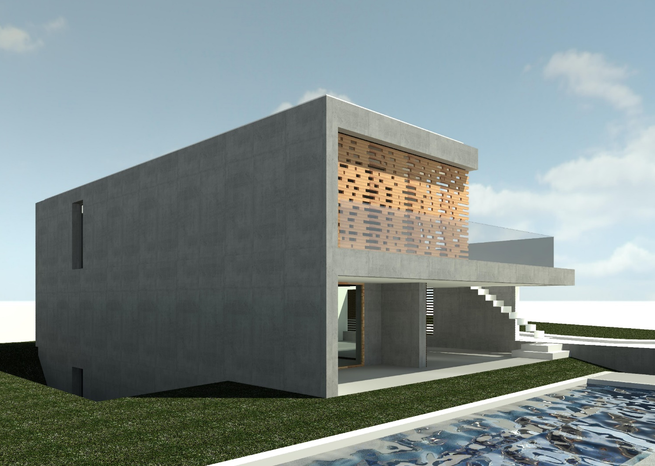
CASE STUDY 2 - RESULTS

Slide 79
CONCLUSIONS
More Exploration
Less Time
More informed designs
Easier optimization
Specialist-Architect interaction
Total Integration in the studio’s workflow

Slide 80
ALGORITHMIC DESIGN FOR ARCHITECTURE
ATELIER DOS REMÉDIOS
https://algorithmicdesign.github.io/
http://atrem.eu/
THANK YOU!
Inês CAETANO
Catarina BELÉM Guilherme ILUNGA
Sofia FEIST Francisco BASTOS
António LEITÃO
| ines.caetano@tecnico.ulisboa.pt
| catarina.belem@tecnico.ulisboa.pt | guilherme.ilunga@tecnico.ulisboa.pt | sofia.feist@tecnico.ulisboa.pt | francisco.bastos@tecnico.ulisboa.pt | antonio.menezes.leitao@tecnico.ulisboa.pt

