Slide 1
ALGORITHMIC PATTERNS FOR FAÇADE DESIGN
Merging Design Exploration, Optimization and Rationalization
Inês Caetano / INESC-ID, IST – University of Lisbon
António Leitão / INESC-ID, IST – University of Lisbon
Presenter: Luís Santos / UC Berkeley

Slide 2
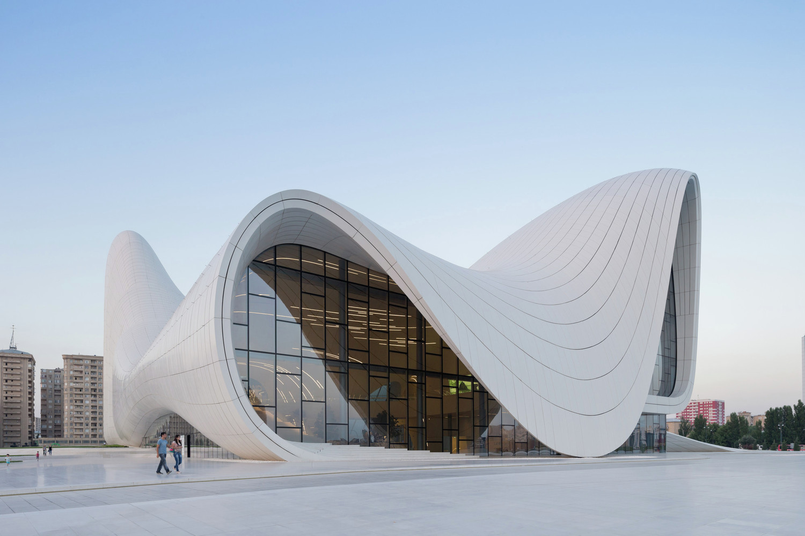
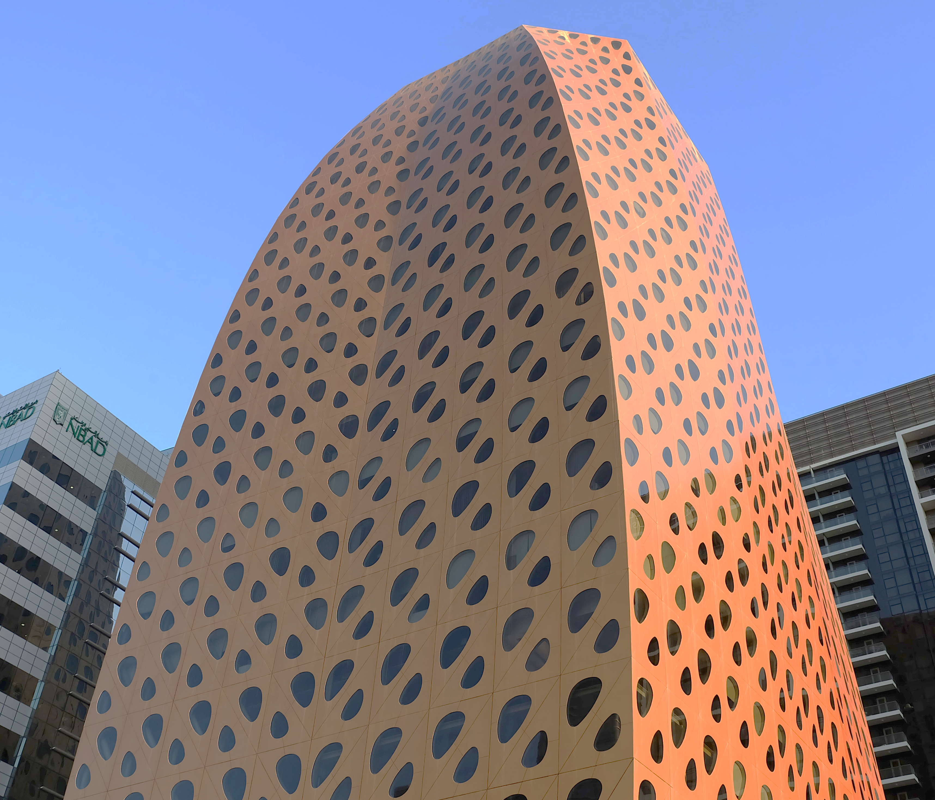
Computation-based Design
Heydar Aliyev Center © Zaha Hadid Architects
LIWA Tower © ONL / Kas Oosterhuis

Slide 3
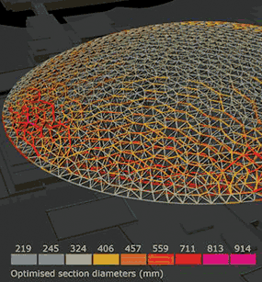
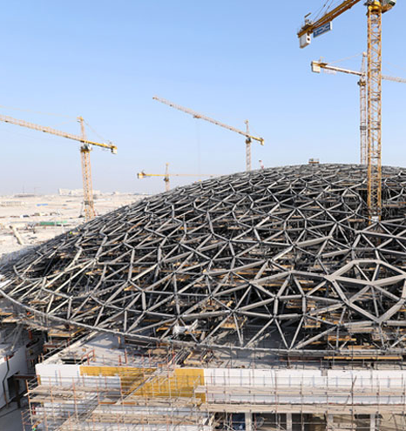
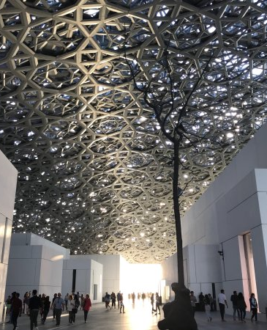
Computation-based Design
Louvre Abu Dhabi © Jean Nouvel

Slide 4
Algorithmic Design
ALGORITHMS
STUDY
HARDWORK
CODE
TIME
MATHS
PROGRAMMING
CODE
HARDWORK
ALGORITHMS
TIME
STUDY
PROGRAMMING
STUDY
MATHS
ALGORITHMS
TIME
CODE
MATHS
HARDWORK
PROGRAMMING

Slide 5
Algorithmic Patterns

Slide 6
Algorithmic Patterns

Slide 7
Algorithmic Patterns

Slide 8
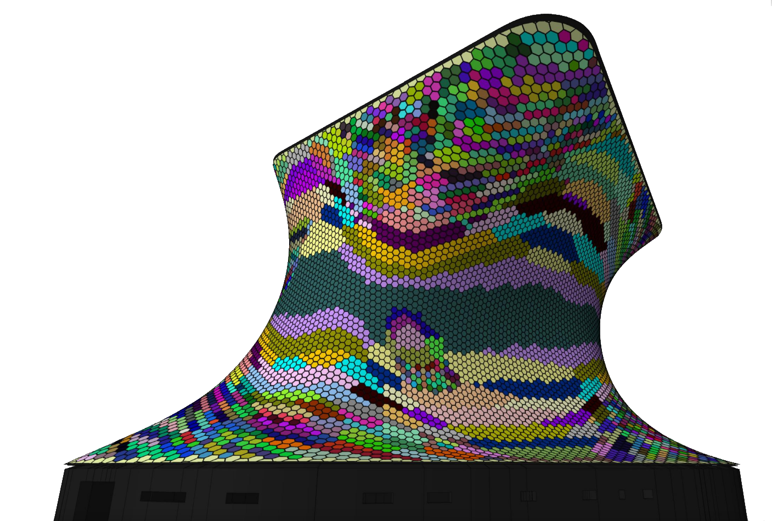
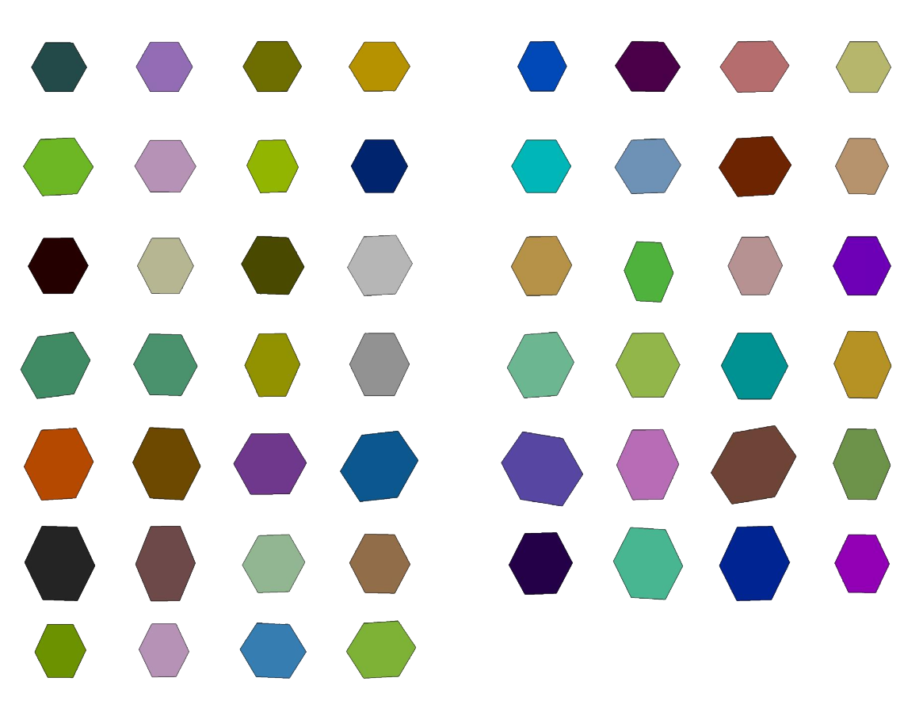
Surface Rationalization
Museo Soumaya © Fernando Romero Enterprise / Gehry Technologies

Slide 9
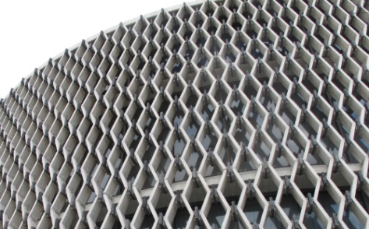
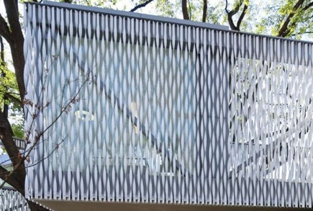
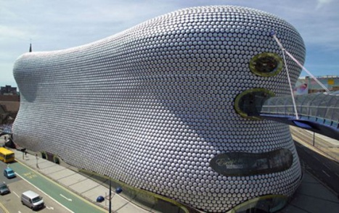
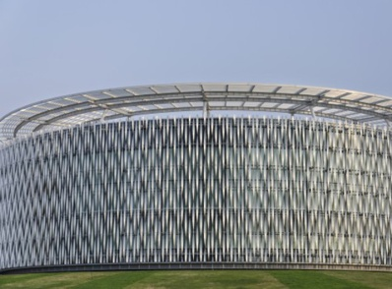
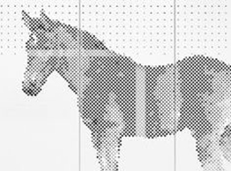
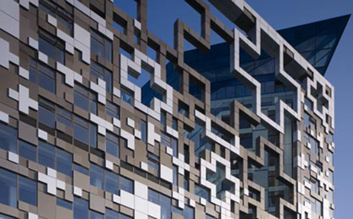
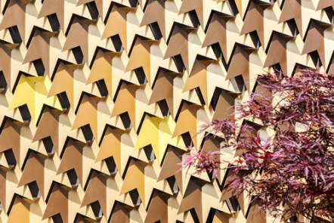
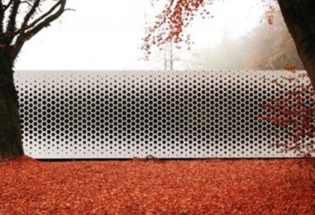
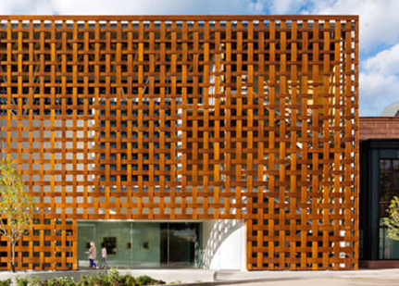
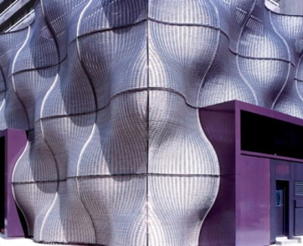
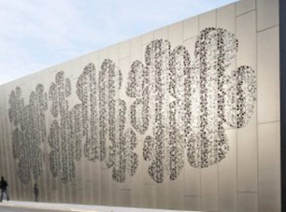
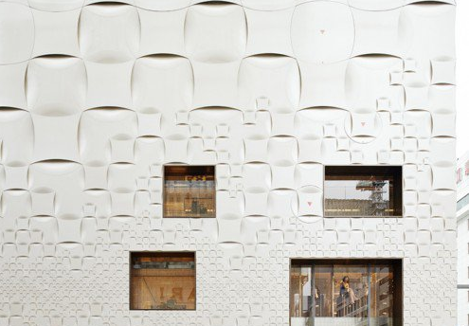
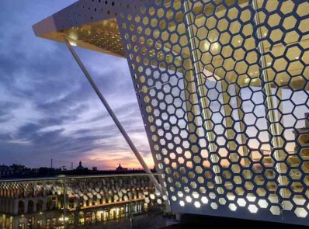
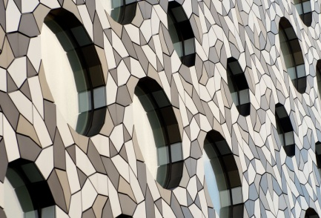
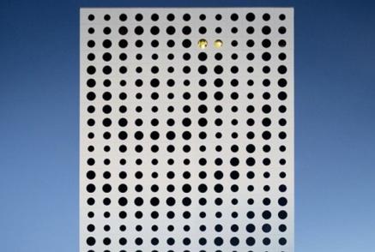
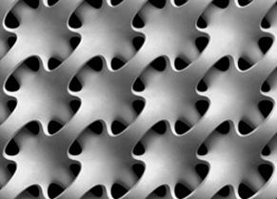

Slide 15
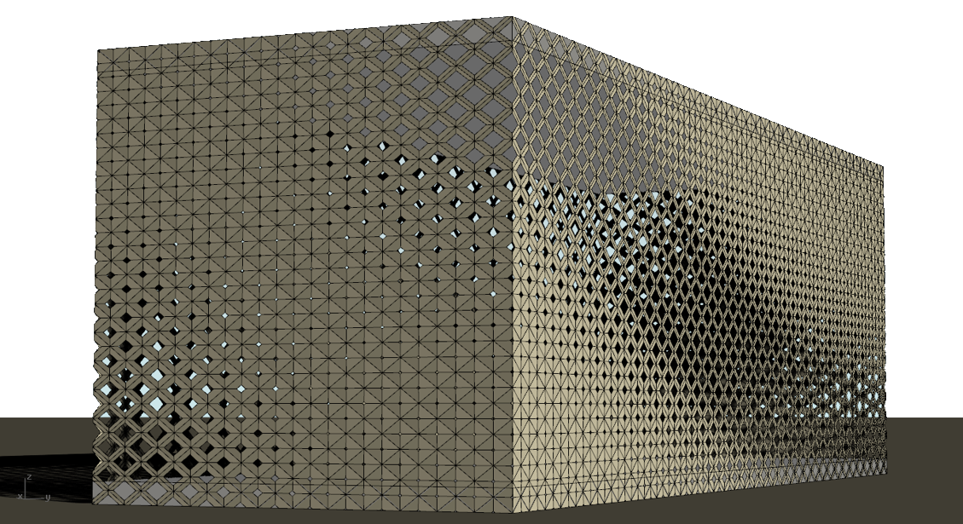
Case Study

Slide 16
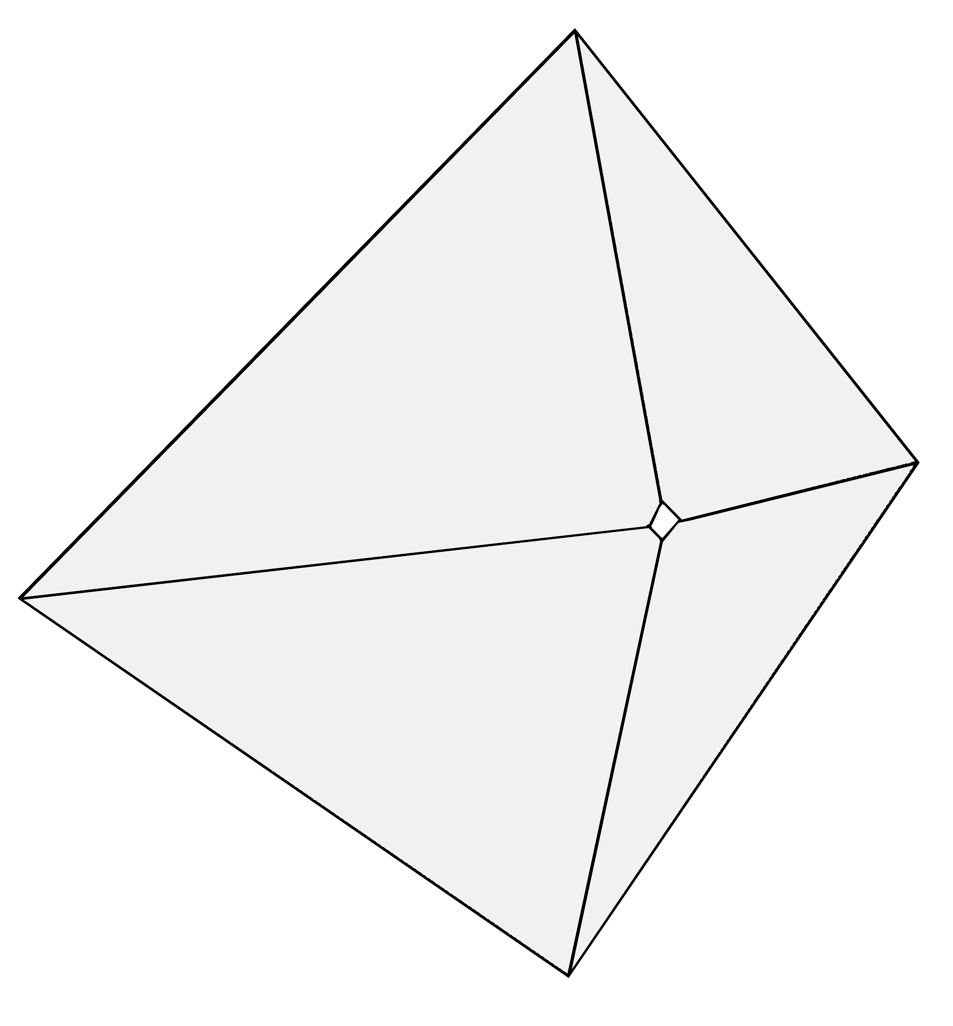
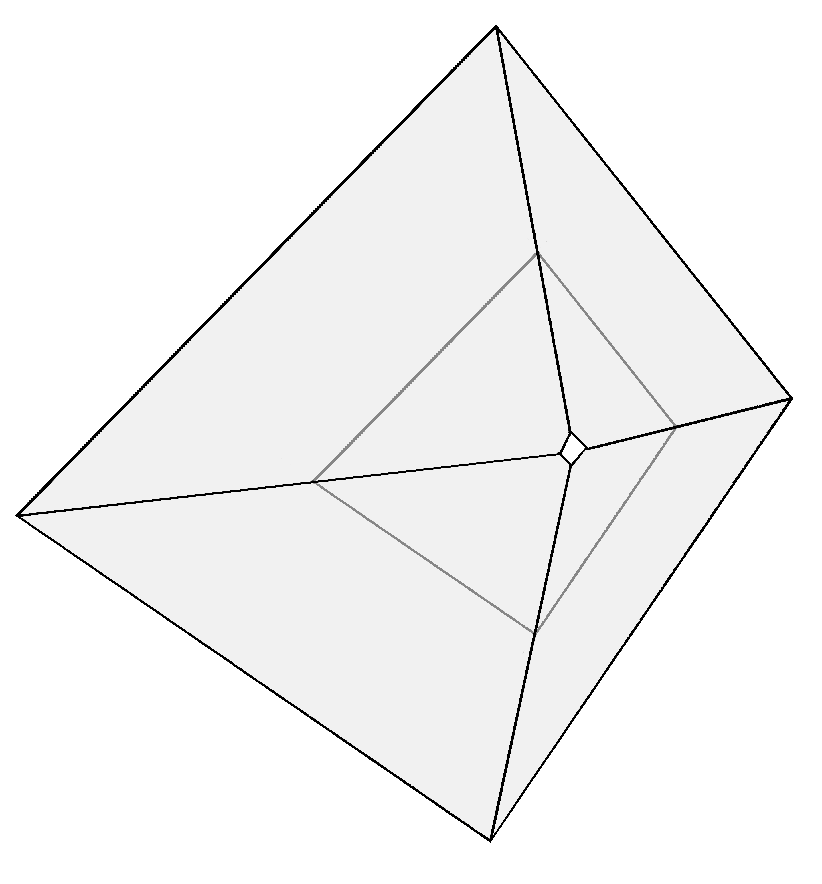
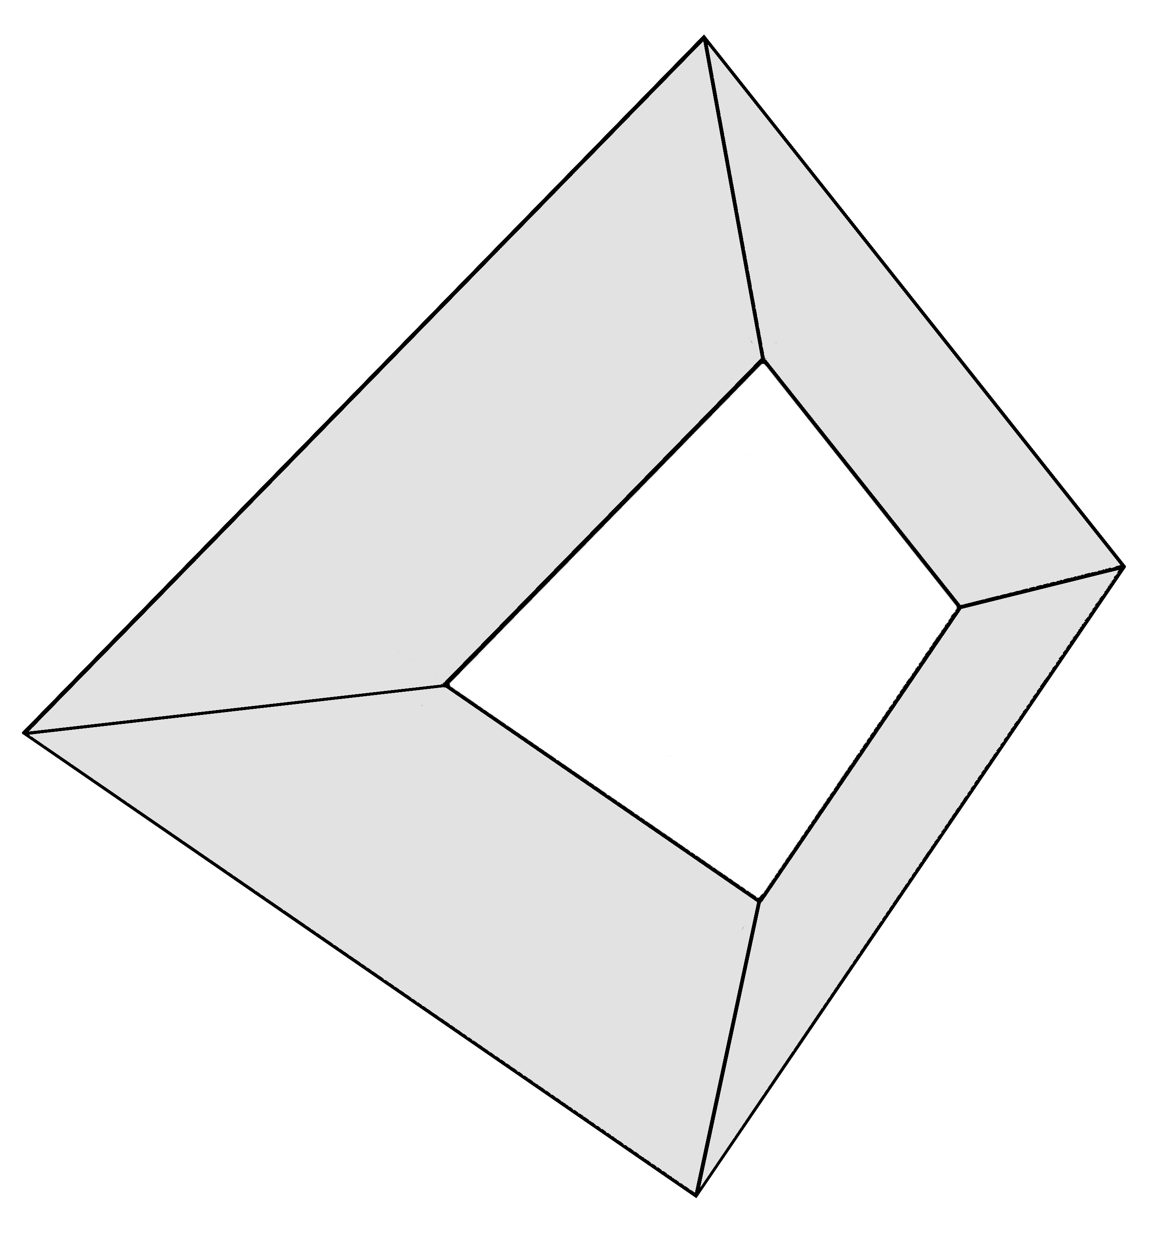
Design Development

Slide 17
Design Development

Slide 18
Design Development

Slide 19
Design Development

Slide 20
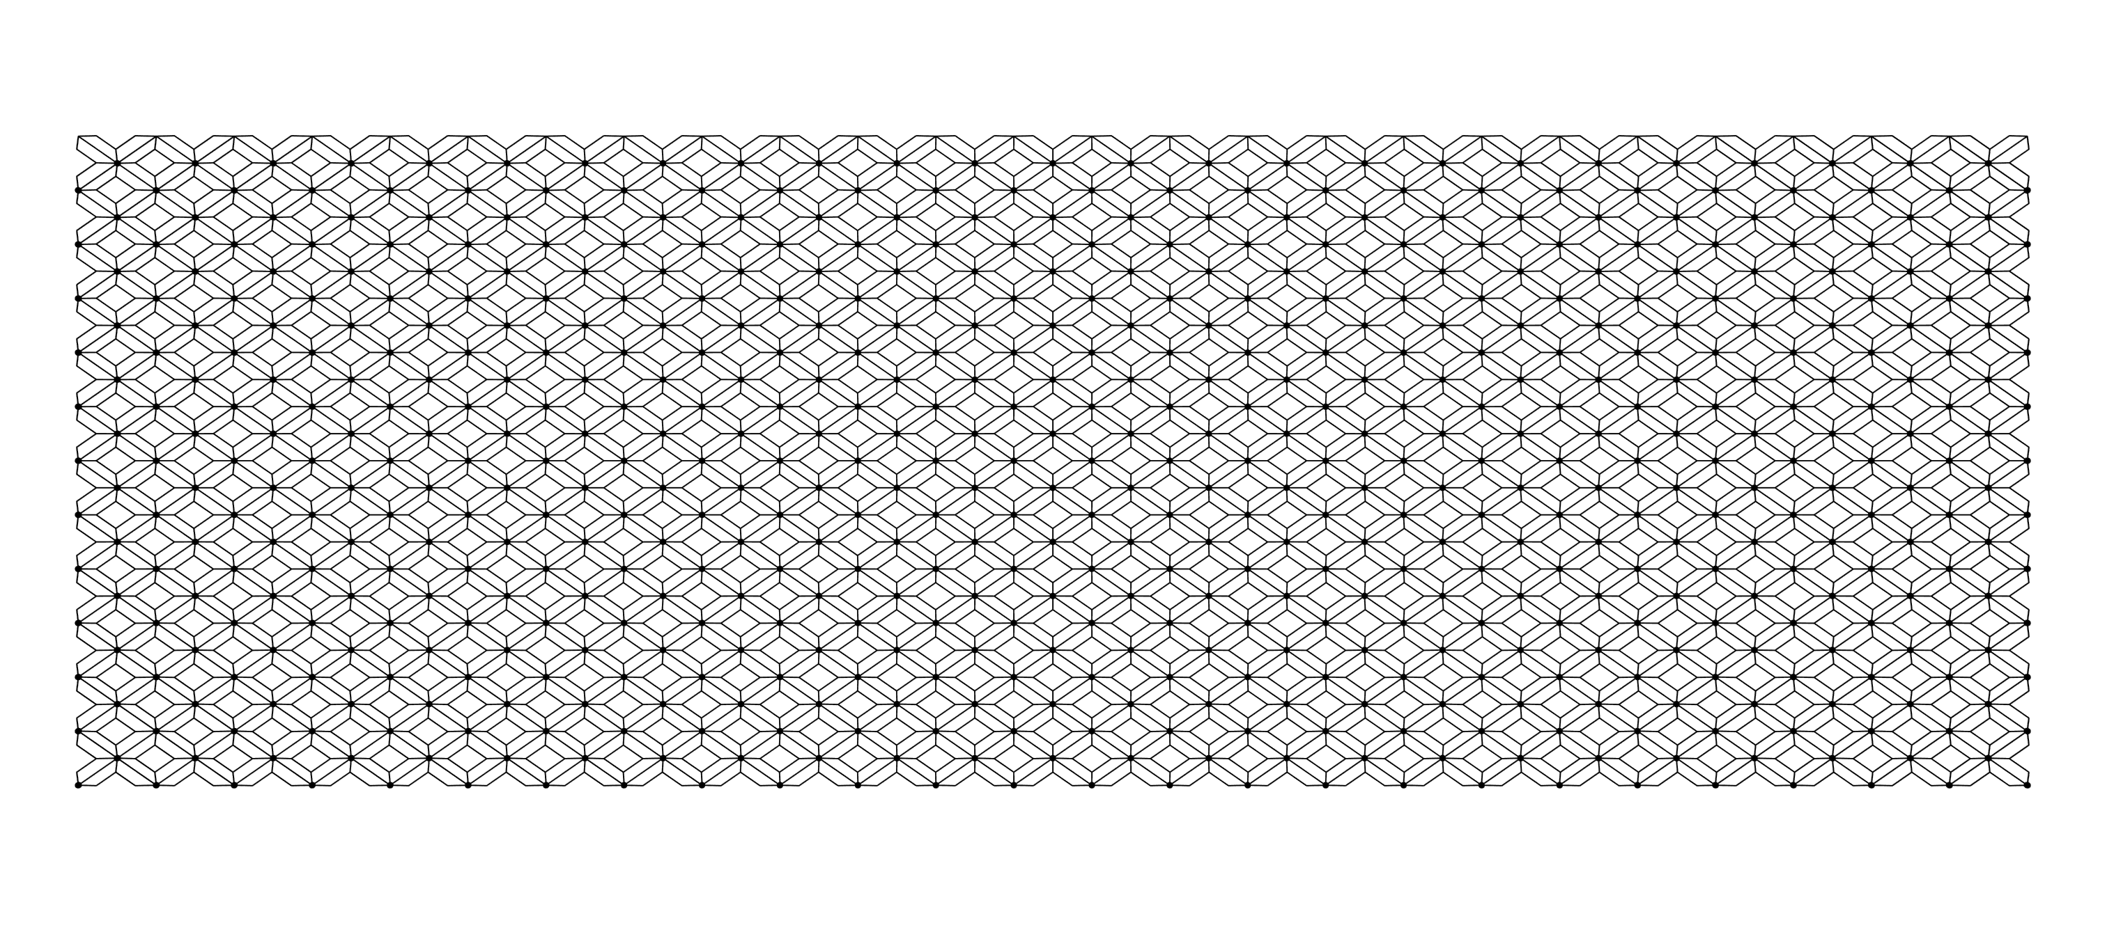
Design Development

Slide 21
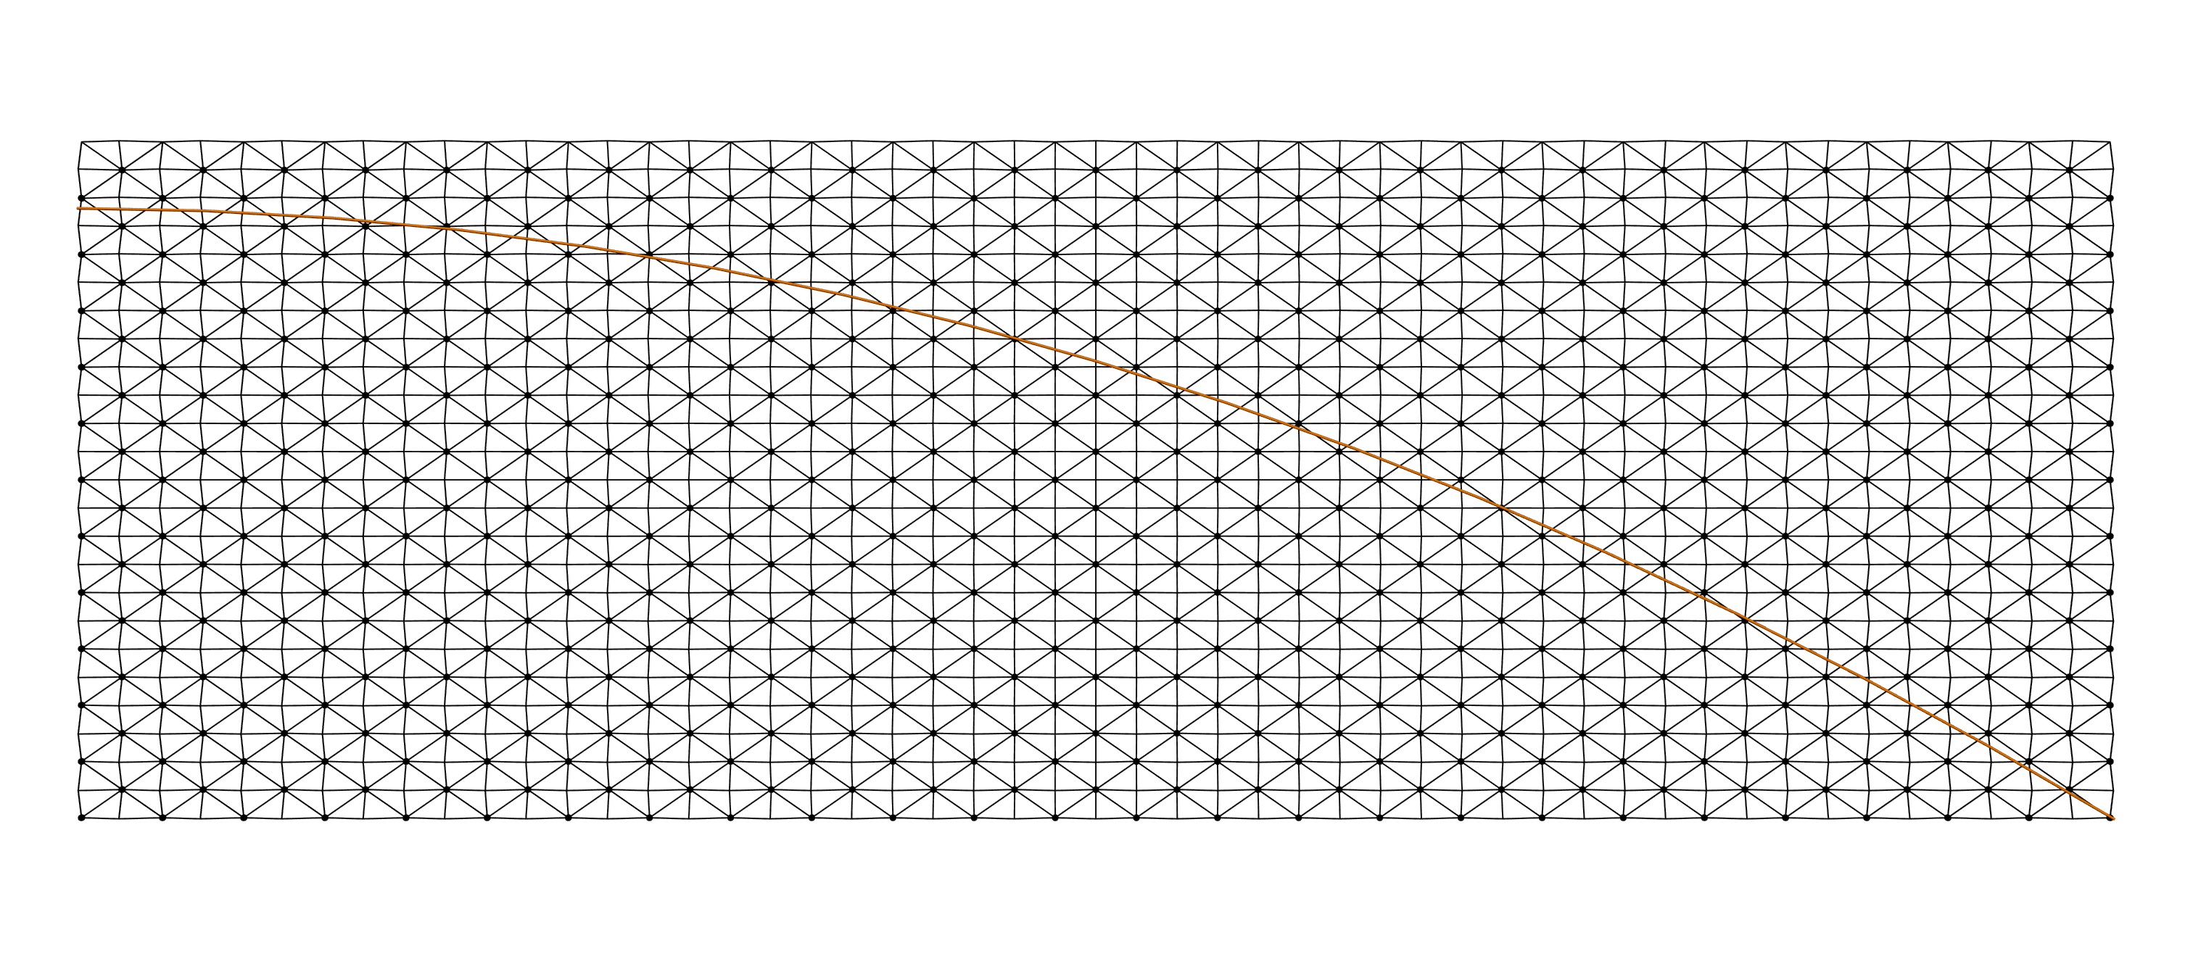
Design Development

Slide 22
Design Development

Slide 23
Design Optimization

Slide 24
Design Optimization

Slide 25
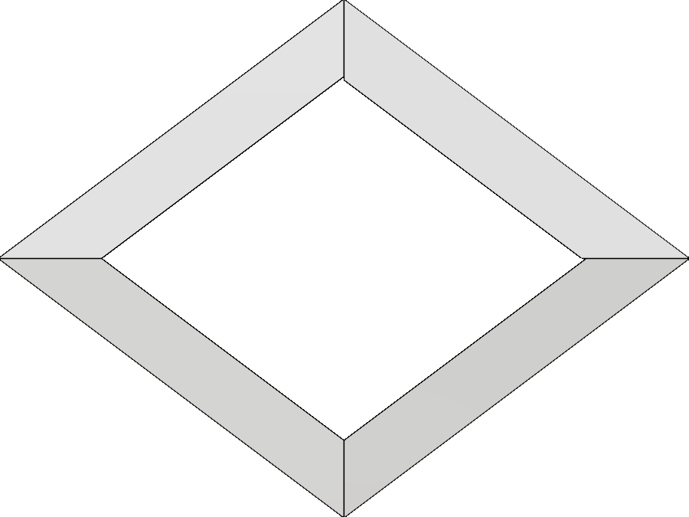
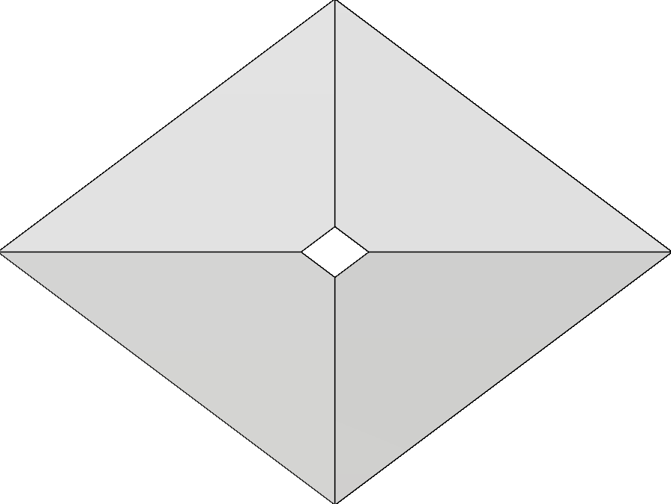
Design Optimization

Slide 26
Design Optimization
A
B
n

Slide 27
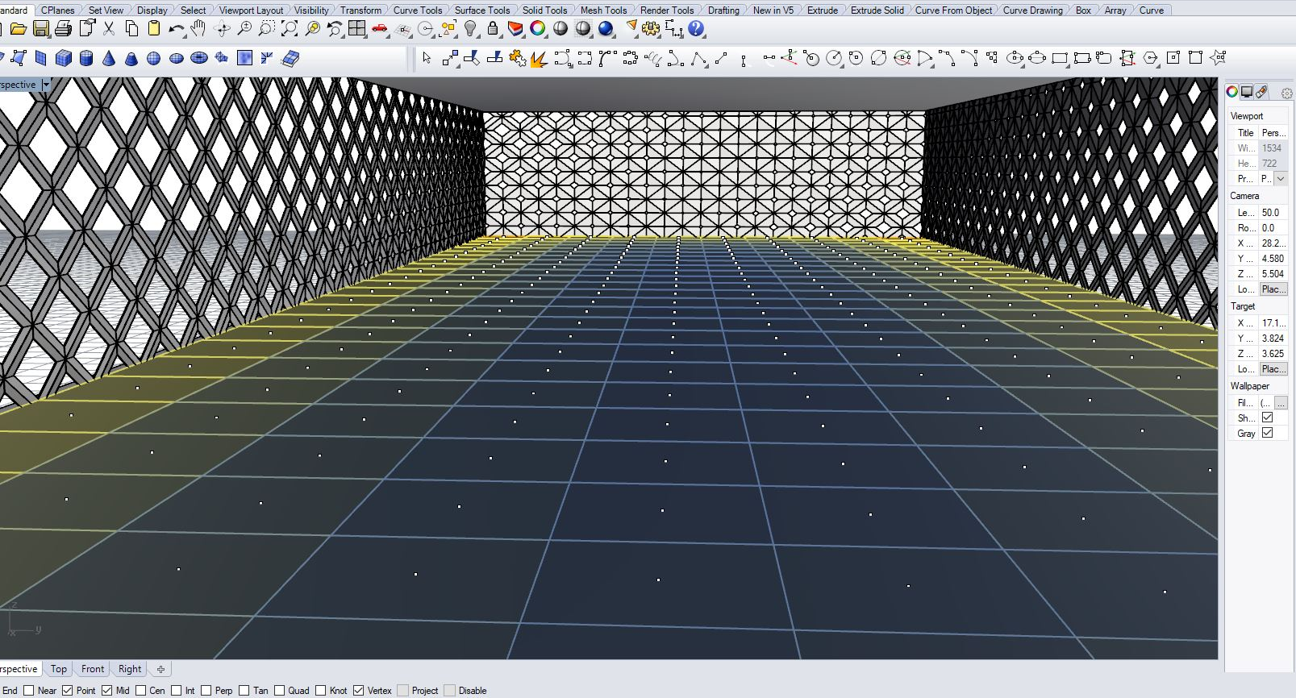
Design Optimization

Slide 28
Design Rationalization

Slide 29
Design Rationalization
2424
6144

Slide 30
Design Rationalization

Slide 31
Design Rationalization

Slide 32
Design Rationalization

Slide 33
Design Rationalization

Slide 34
Design Rationalization

Slide 35
Design Rationalization

Slide 36
Design Rationalization

Slide 37
Design Rationalization

Slide 38
Design Rationalization

Slide 39
Design Rationalization

Slide 40
Design Rationalization

Slide 41
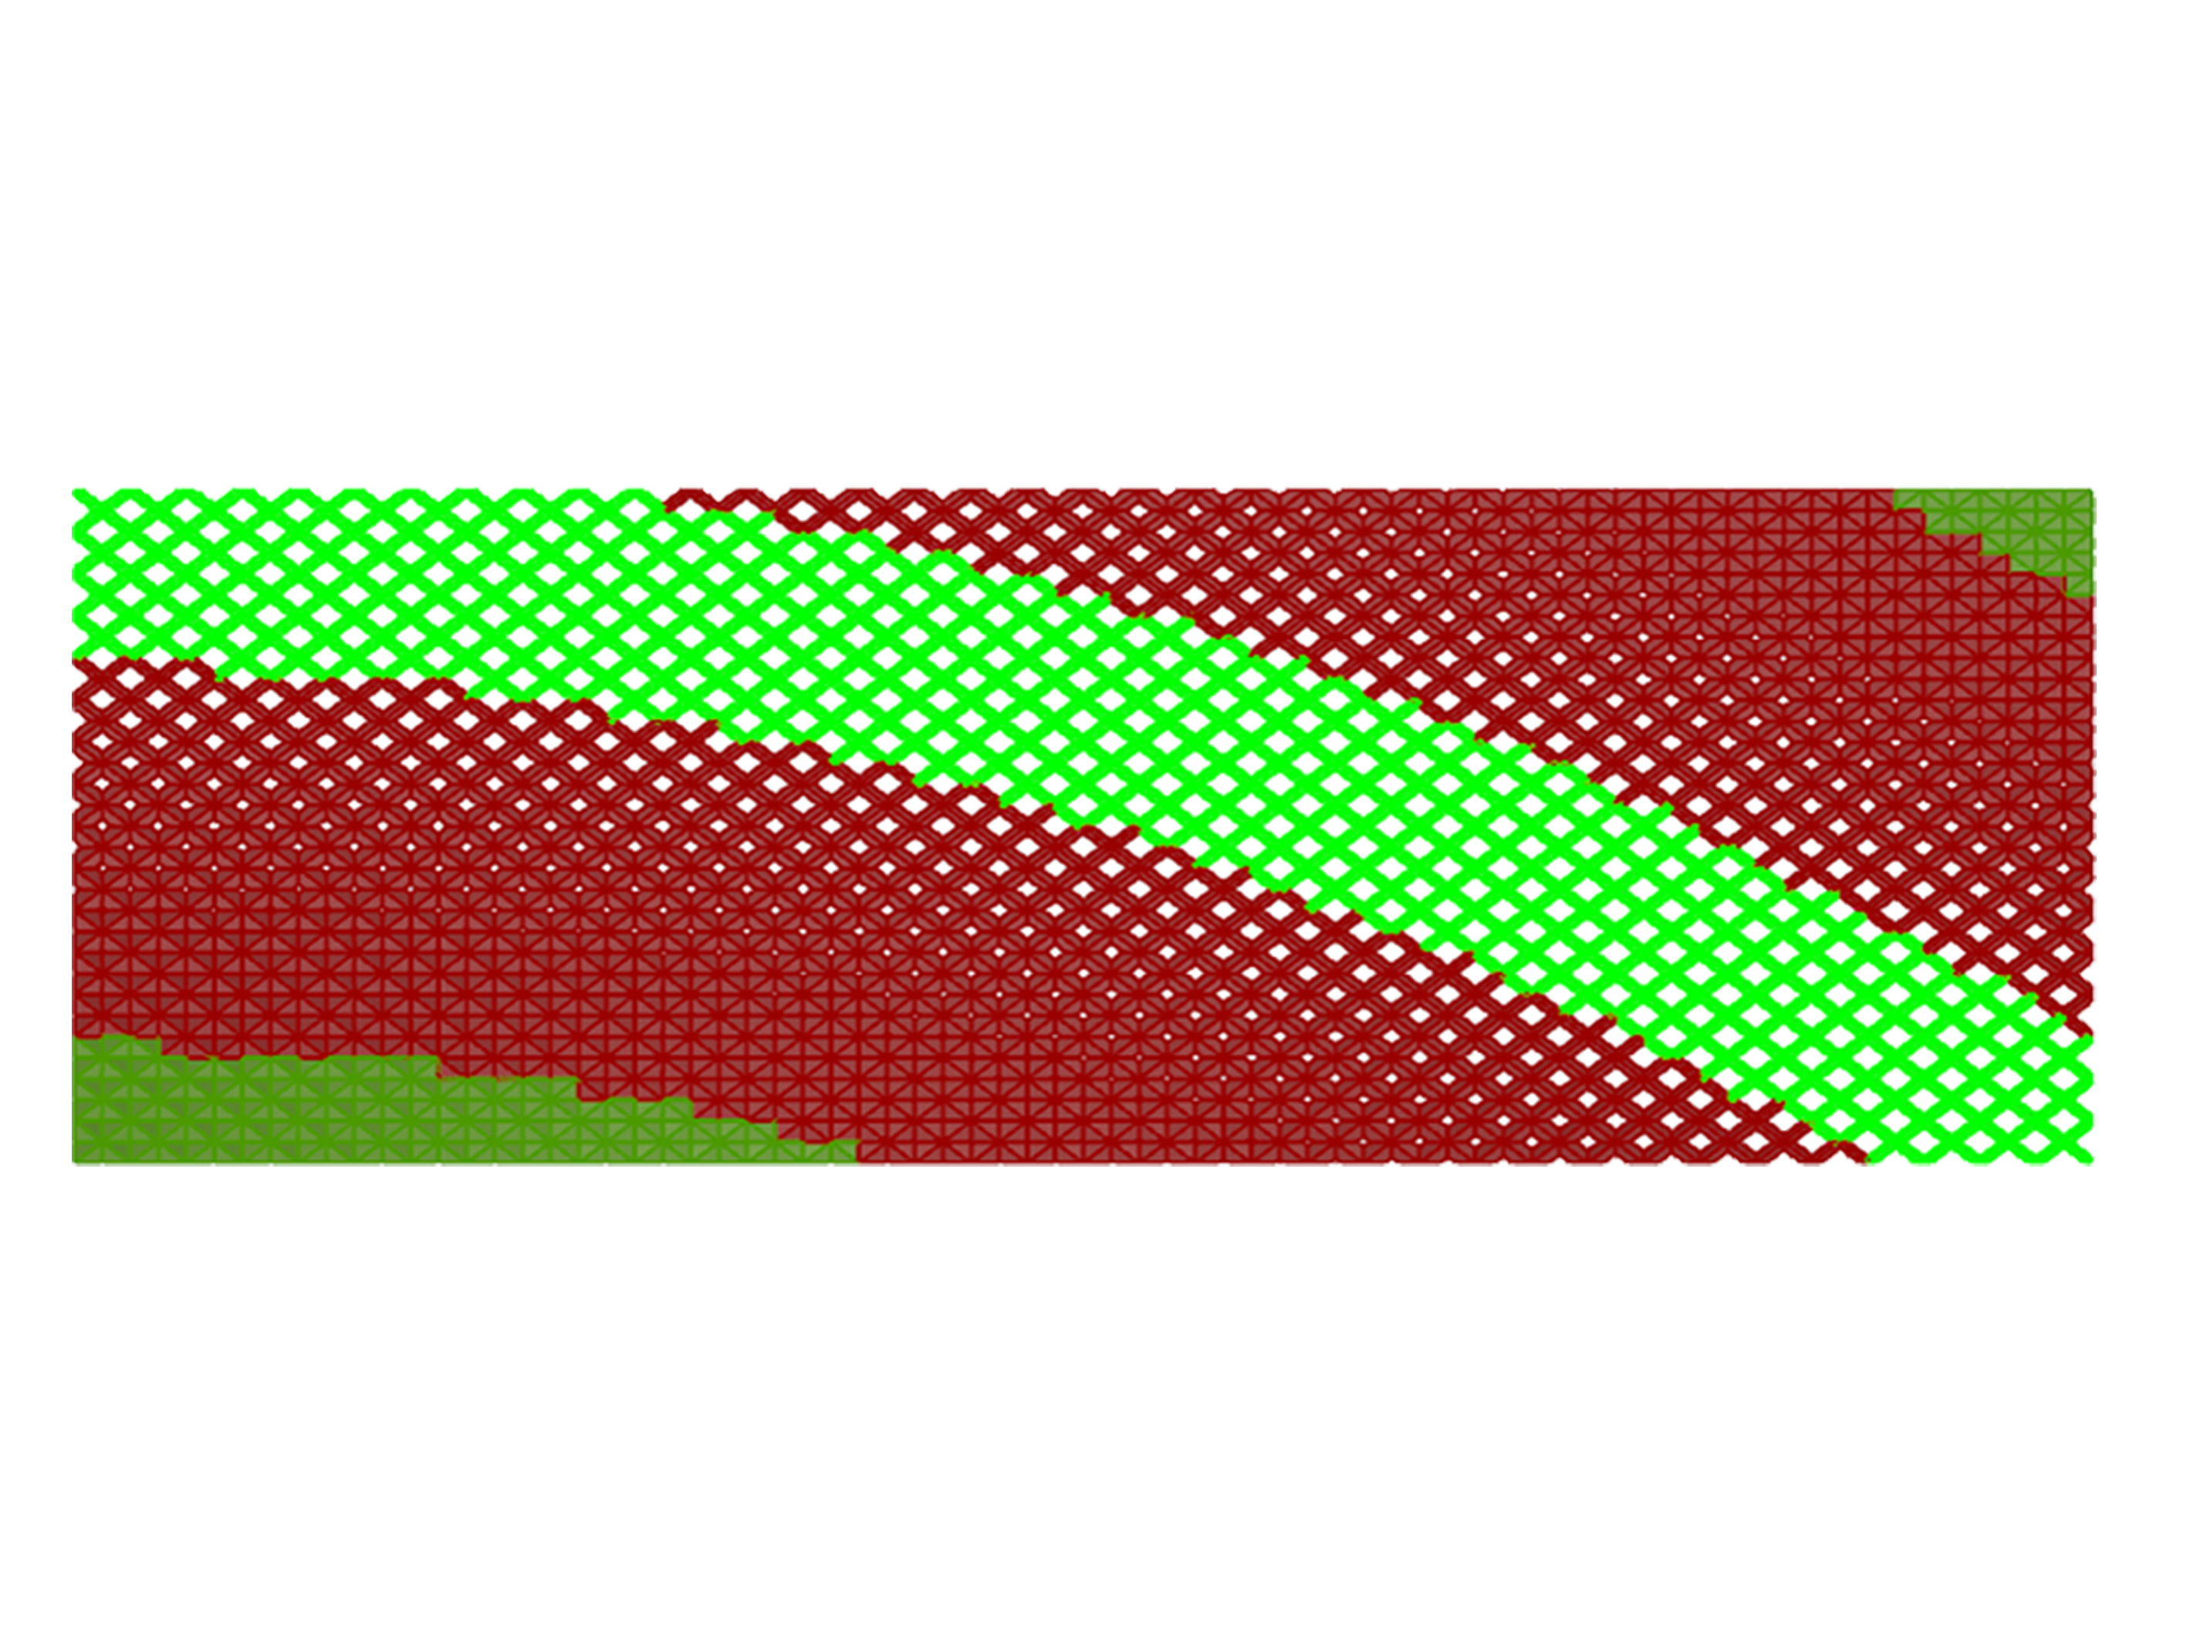
Design Rationalization

Slide 42
Design Rationalization

Slide 43
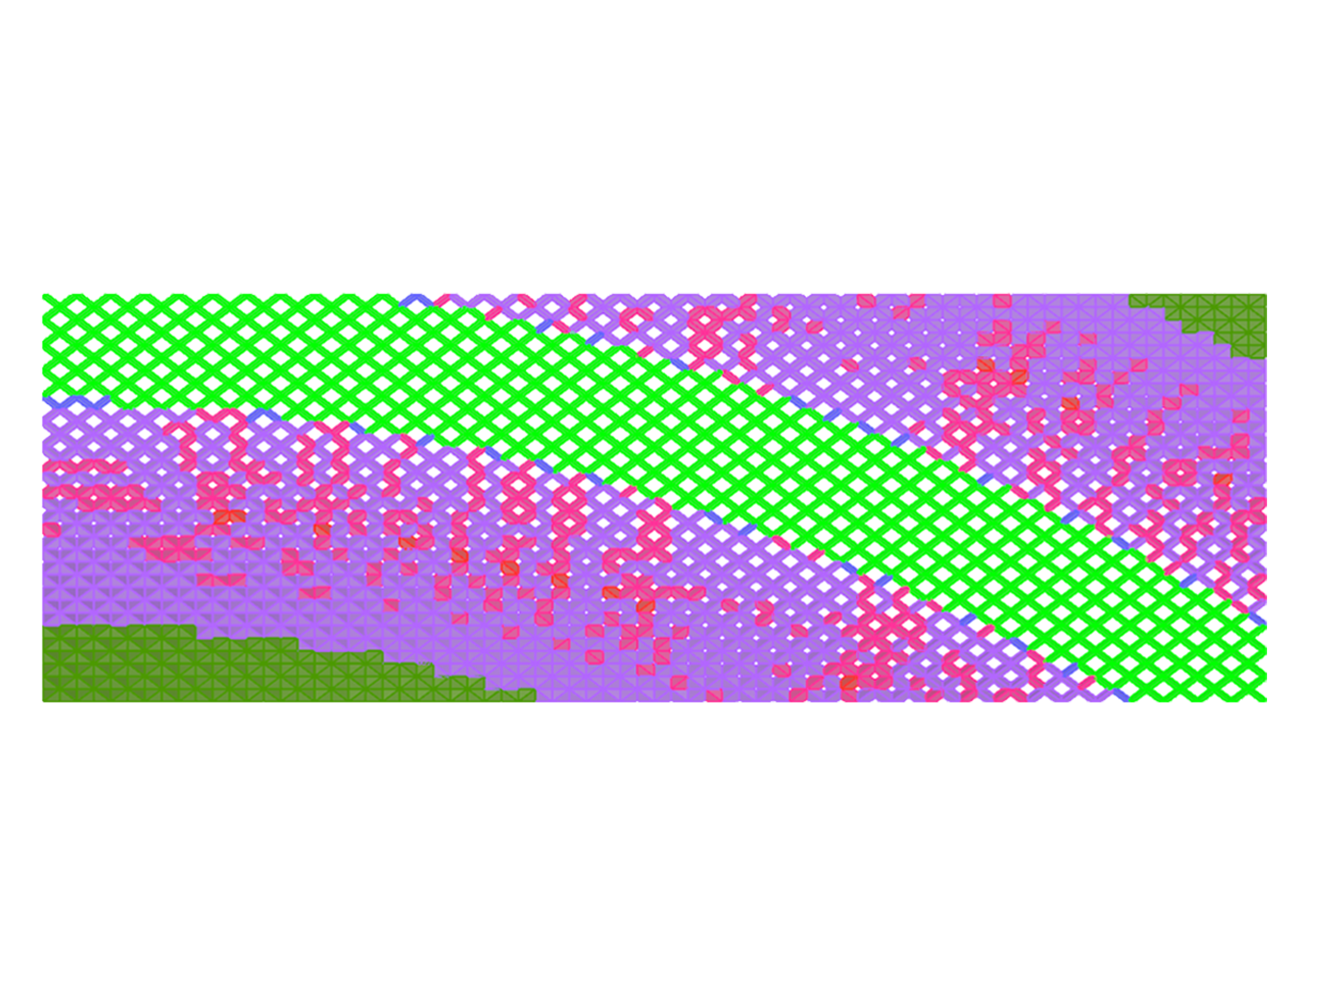
Design Rationalization

Slide 44
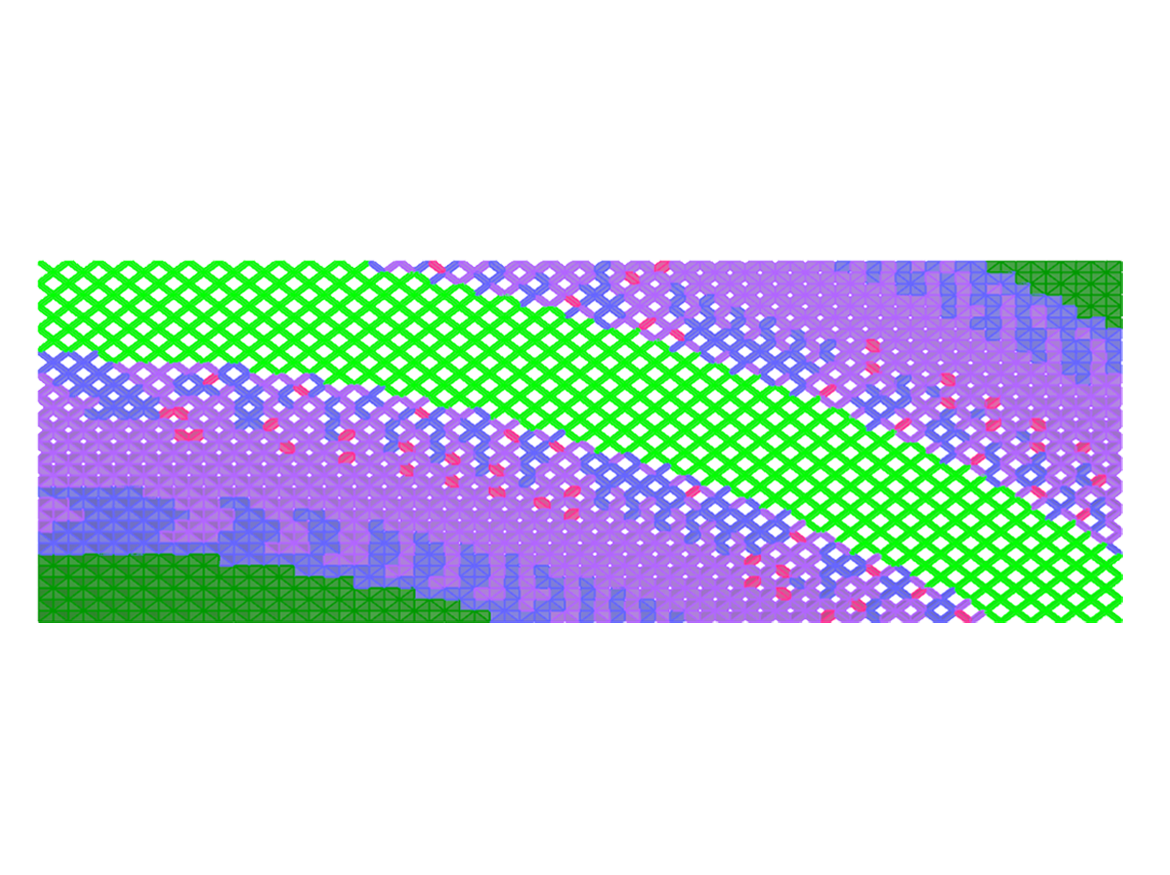
Design Rationalization

Slide 45
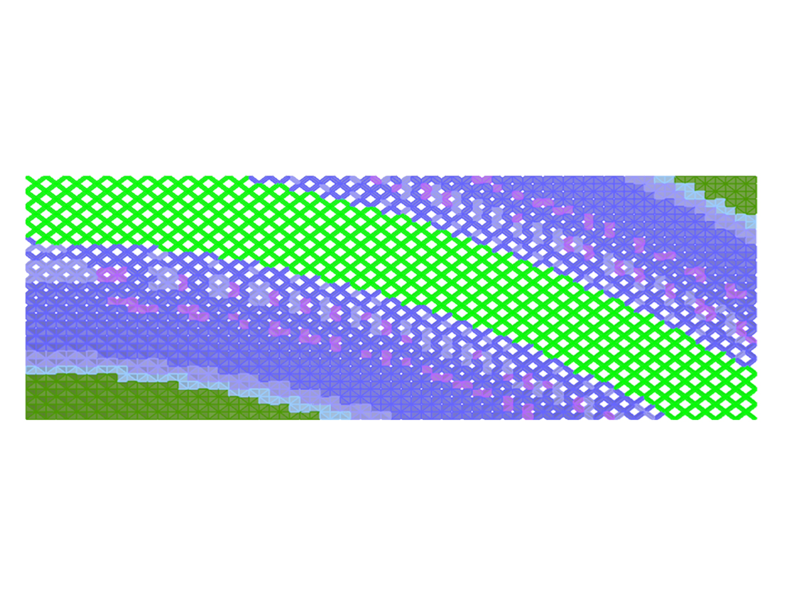
Design Rationalization

Slide 46
Design Rationalization

Slide 47
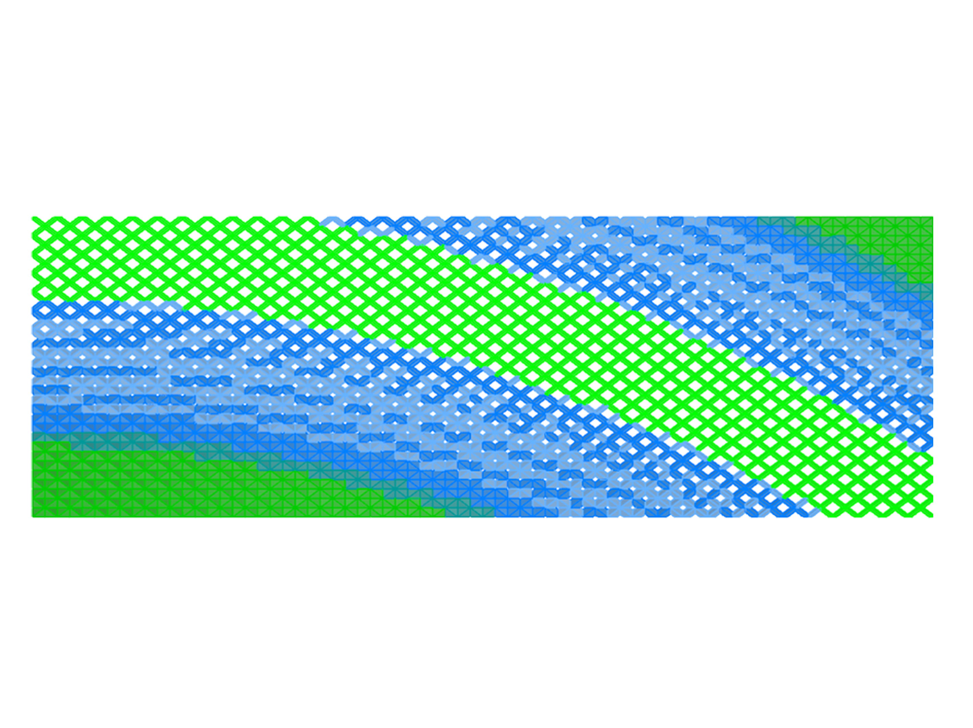
Design Rationalization

Slide 48
Design Rationalization

Slide 49
Design Rationalization

Slide 50
Design Rationalization

Slide 51
Design Rationalization

Slide 52
Evaluation

Slide 53
Evaluation

Slide 54
Evaluation
Design Exploration

Slide 55
Evaluation
Design Exploration

Slide 56
Evaluation
Design Exploration

Slide 57
Evaluation
Design Exploration

Slide 58
Evaluation
Design Exploration

Slide 59
Conclusions
Environmental concerns
Better performing solutions
Algorithmic design learning
Link between design stages
Selection of Optimization algorithms

Slide 60
Conclusions
Environmental concern
Better performing solutions
Algorithmic design learning
Link between design stages
Selection of Optimization algorithms

Slide 61
Inês Caetano / INESC-ID • IST, University of Lisbon
ines.caetano@tecnico.ulisboa.pt
António Leitão / INESC-ID • IST, University of Lisbon
antonio.menezes.leitao@tecnico.ulisboa.pt

