Slide 1
Luna Moth Supporting Creativity in the Cloud
Pedro Alfaiate Inês Caetano António Leitão
Notes:
Part of my master’s thesis

Slide 2
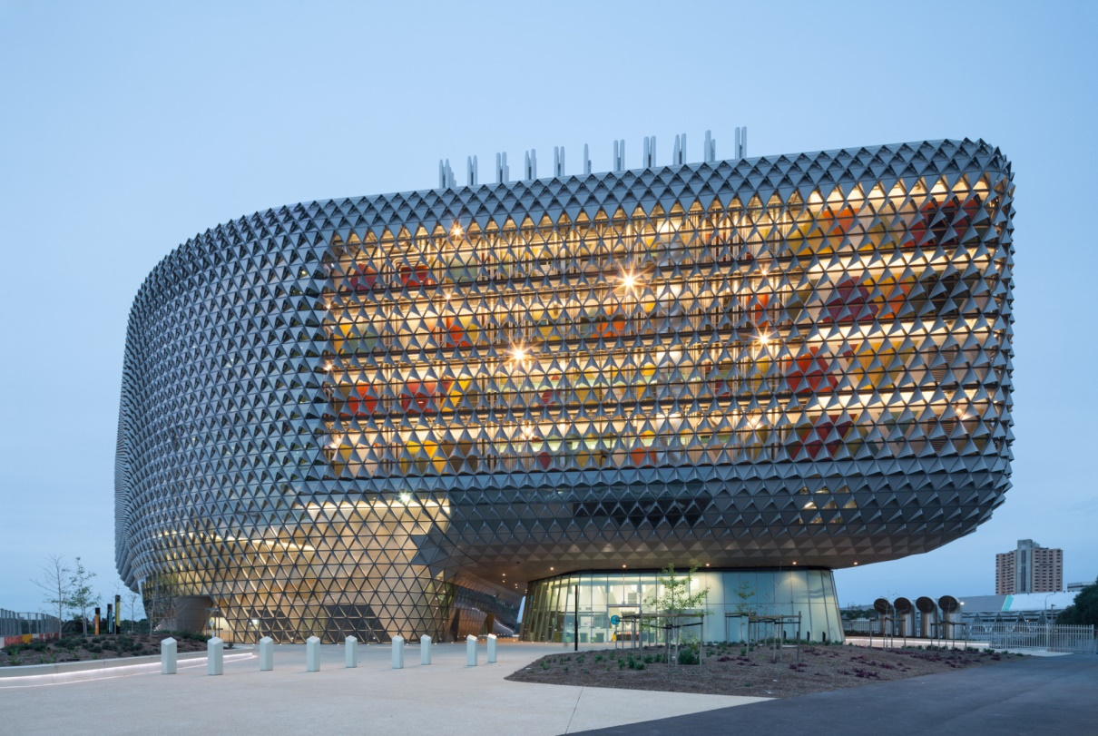
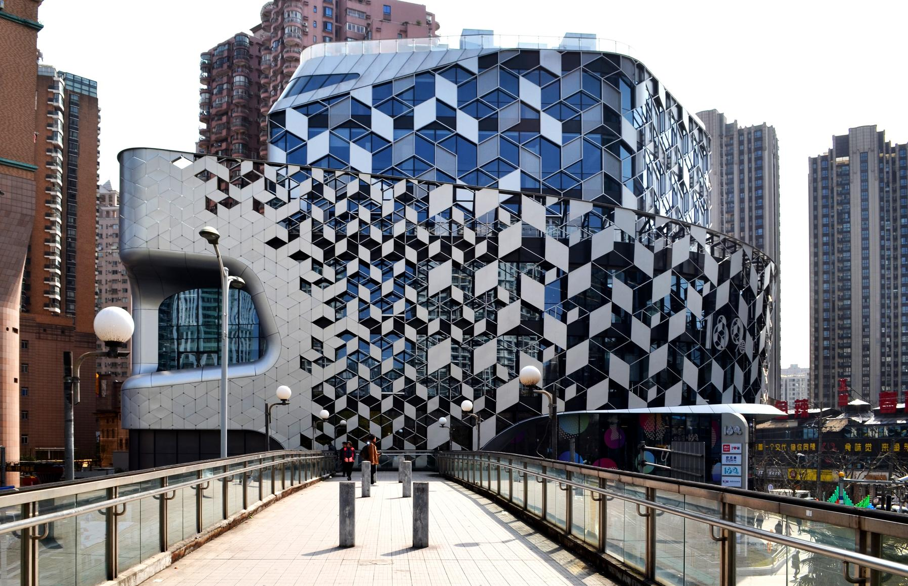
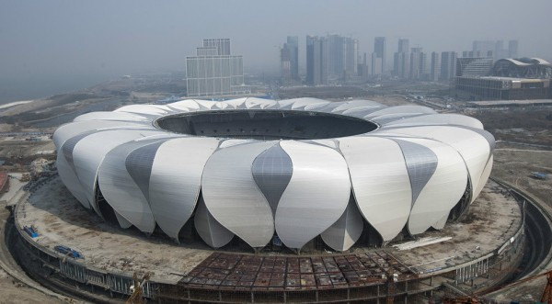
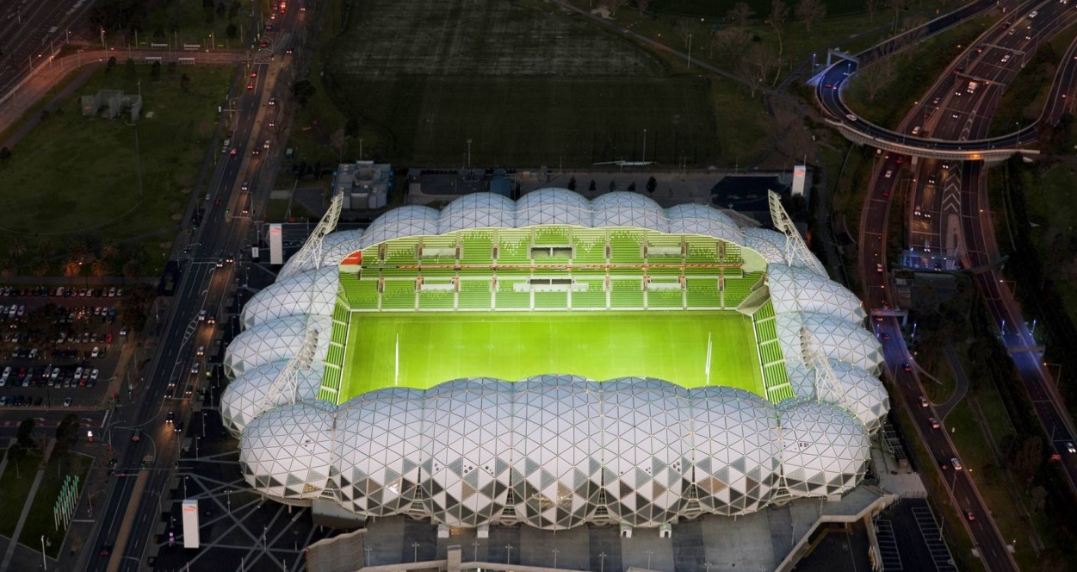
Generative Design
https://images.adsttc.com/media/images/53da/f4ec/c07a/80d9/7100/0407/large_jpg/5_50_1399_N75_screenhd.jpg?1406858458
https://www.unstudio.com/image/2017/6/22/s_unstudio_high_res_photoschina_shanghai_lane_189material_eric_jap_lane_189_eric.jpg%28mediaclass-background-xl.07f7adb8a95599dcb70557da25aa6351c3fd0c58%29.jpg
http://www.designmena.com/wp-content/uploads/2015/08/HangzhouTennisCenter-600x331.jpg
https://www.google.pt/search?q=AAMI+Park+Stadium,&source=lnms&tbm=isch&sa=X&ved=0ahUKEwiV8__449zWAhUECBoKHVrnCGcQ_AUICigB&biw=1229&bih=587#imgrc=CqmXqqWCWbtgOM:
Notes:
Generative design is a design process that creates shapes through algorithms, which allows us to automate repetitive tasks, create complex designs, and handle design changes more easily.
This in turn gives us more creative freedom to explore more of these designs.

Slide 3
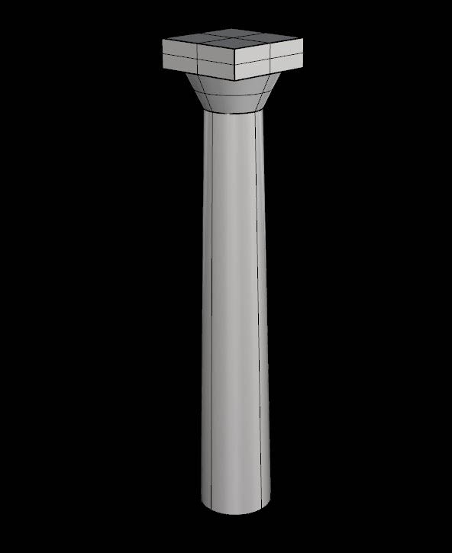
Problem
box(p, l, w, h)
cone_frustum(p, rb, h, rt)
cone_frustum(p, rb, h, rt)
Notes:
However, instead of interacting with the model directly, the architect interacts with the program that generates the model, which requires a higher level of abstraction than traditional 3D modeling.

Slide 4
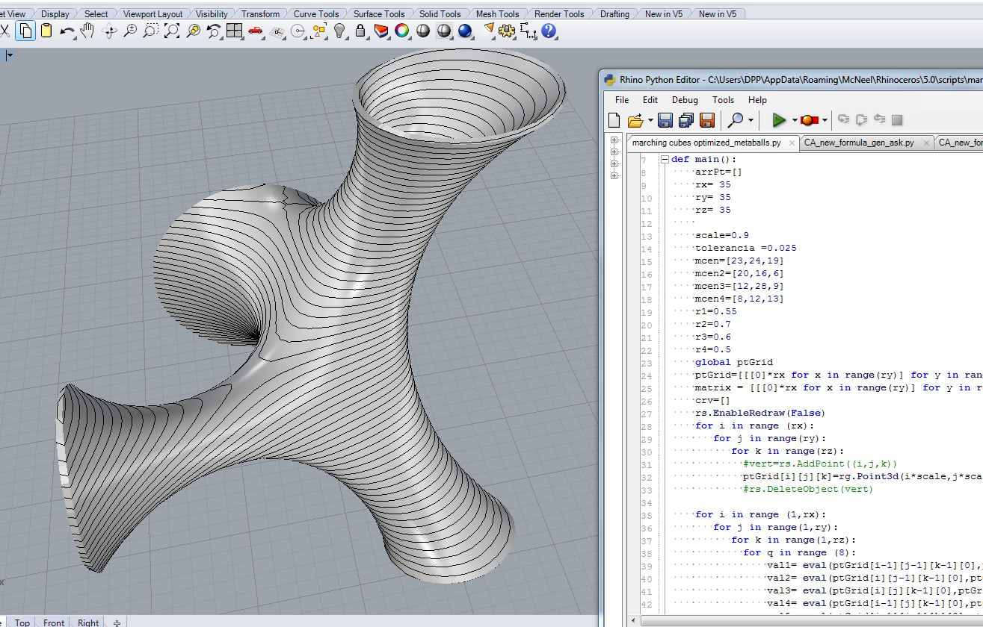
Programming Environments
https://escripto.files.wordpress.com/2012/07/metaball_relaxation1.jpg
Notes:
In order to overcome this, programming environments have been integrating features to help architects with the programming task.
Such as 1) simplifying how we edit programs, 2) how we run programs, and 3) the way we understand them.
The programming environment therefore doesn’t remove the abstraction, it simply makes it easier to use / understandable.

Slide 5
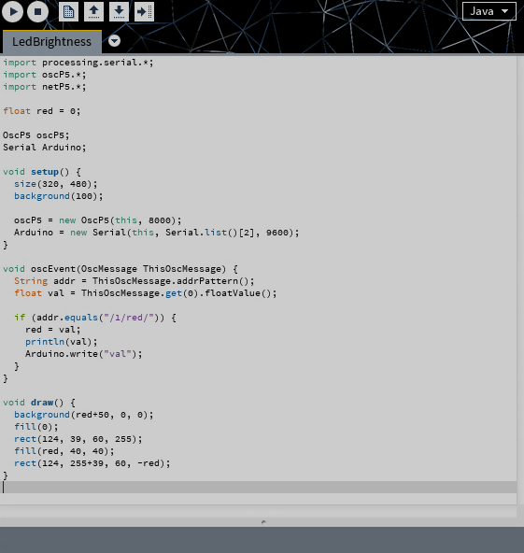
Textual vs Visual
https://aecuandme.files.wordpress.com/2013/12/main.png
http://i.imgur.com/cdfdKjO.png
Notes:
There are two main ways of programming in Generative Design:
Textual programming, and
Visual programming
Each has its own type of programming environment / advantages and disadvantages.

Slide 6
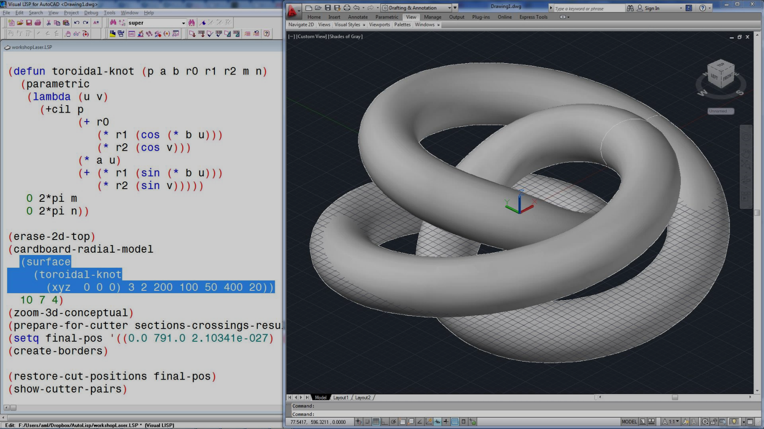
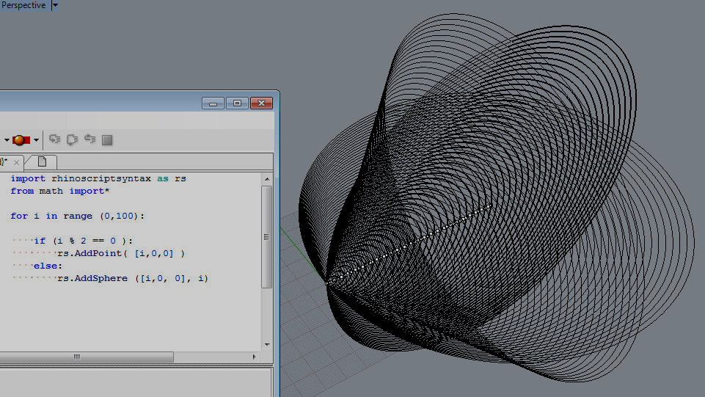
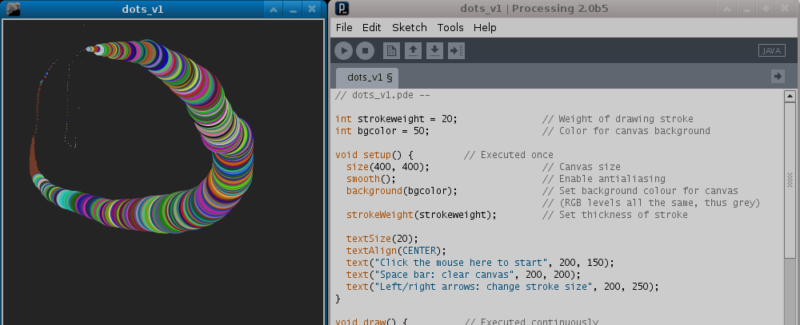
Textual Programming
Notes:
Textual programming environments require writing our programs.
Some examples include AutoLISP, RhinoPython, and Processing.
Textual programming has a certain level of abstraction which makes it possible to handle bigger and more complex designs.
However, they are less intuitive (not graphically attractive) and usually harder to see the connection between program and results.

Slide 7
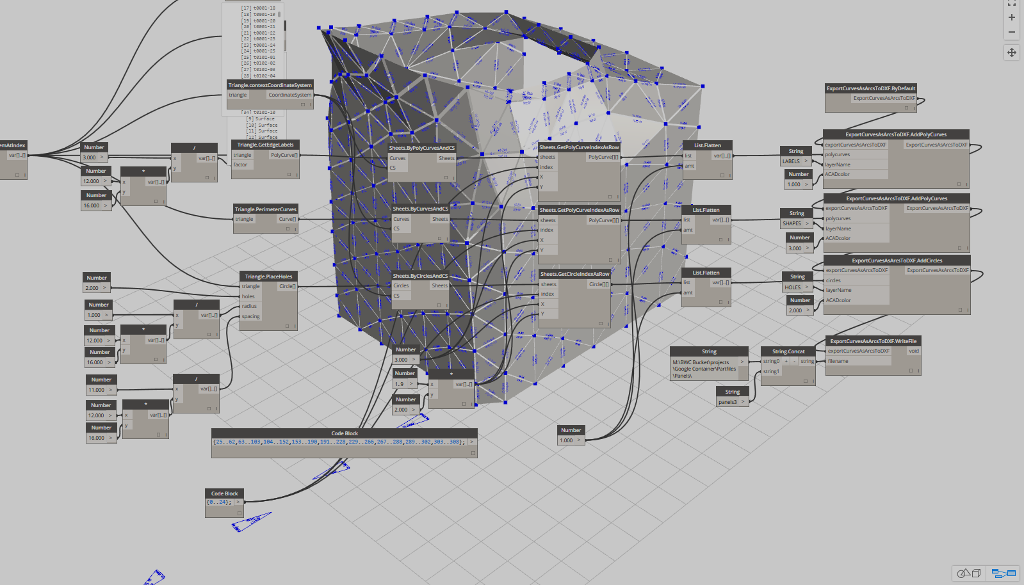
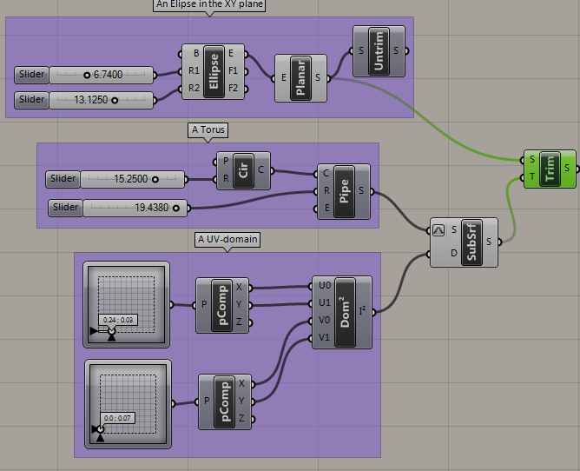
Visual Programming
http://quicksilver.be.washington.edu/courses/arch486x/5.Grasshopper/5.SubSurfaces/UV%20Crop%20&%20CopyTrim.png
http://becausewecan.org/sites/default/files/Capture0407.PNG
Notes:
On the other hand, we have visual programming, in which we build programs graphically.
Dynamo and Grasshopper are examples.
In these environments, the program is run every time we add a component, which makes it easier to build programs incrementally – when we add one component, we see its results immediately.
They also allow us to make adjustments to parameters intuitively by using sliders.

Slide 8
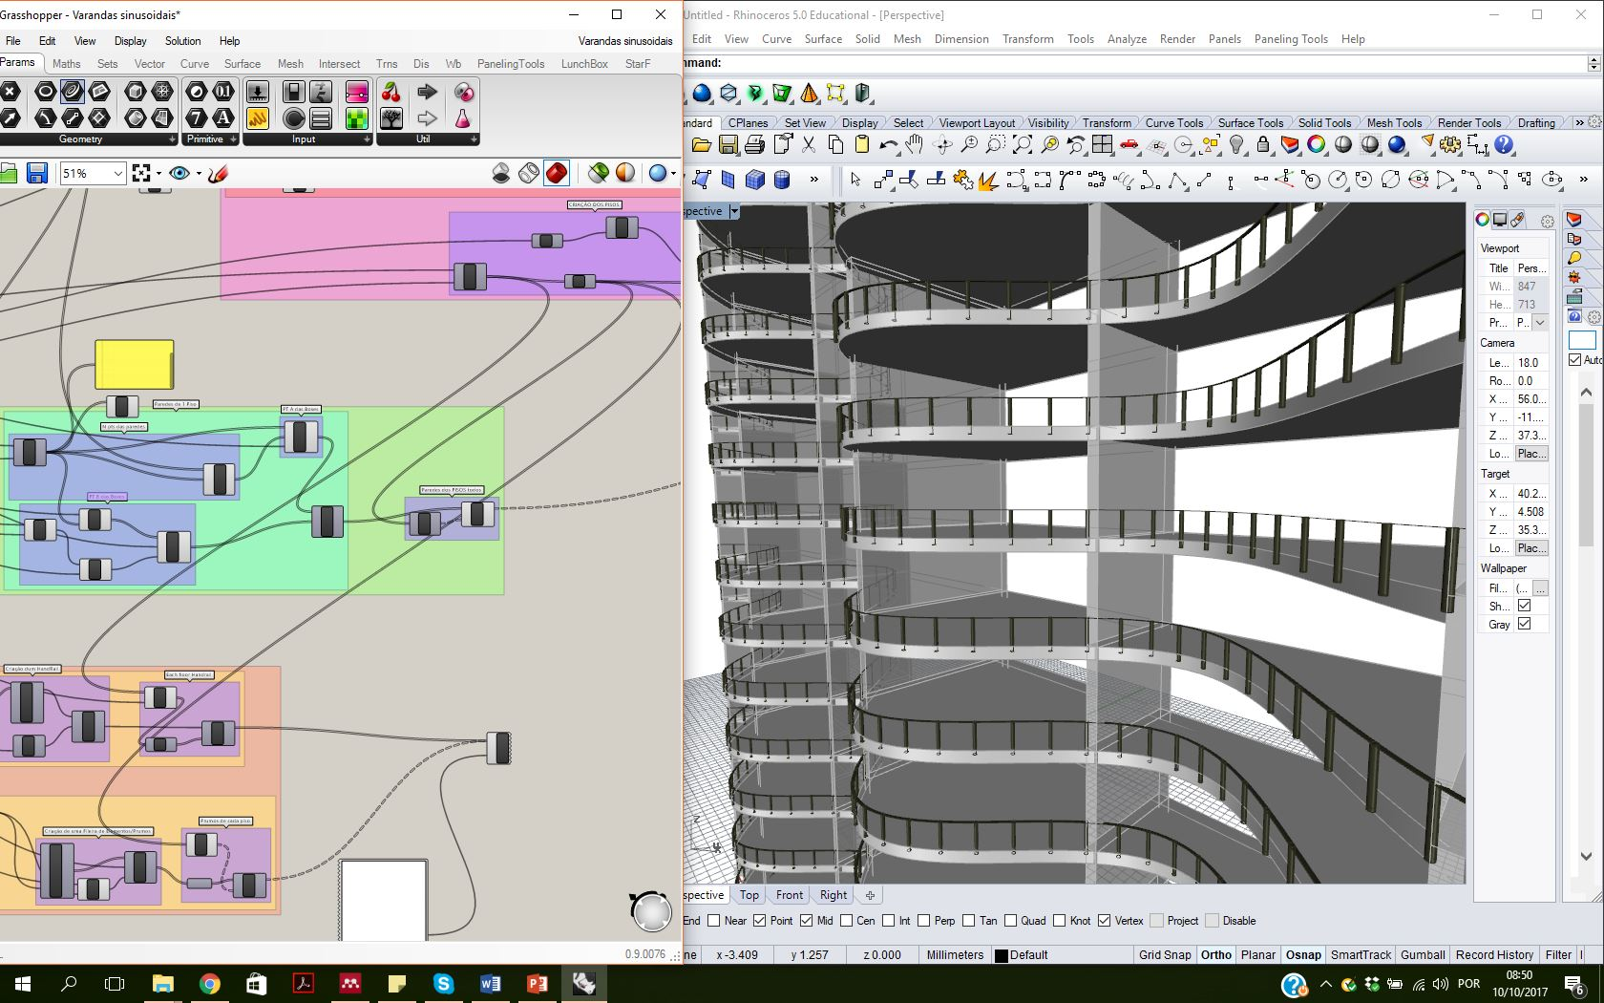
Traceability
Notes:
Apart from this, visual programming environments have traceability between the program and the model -> let us see the results of each component.
We can click on a component and the programming environment highlights the results that it produced.

Slide 9
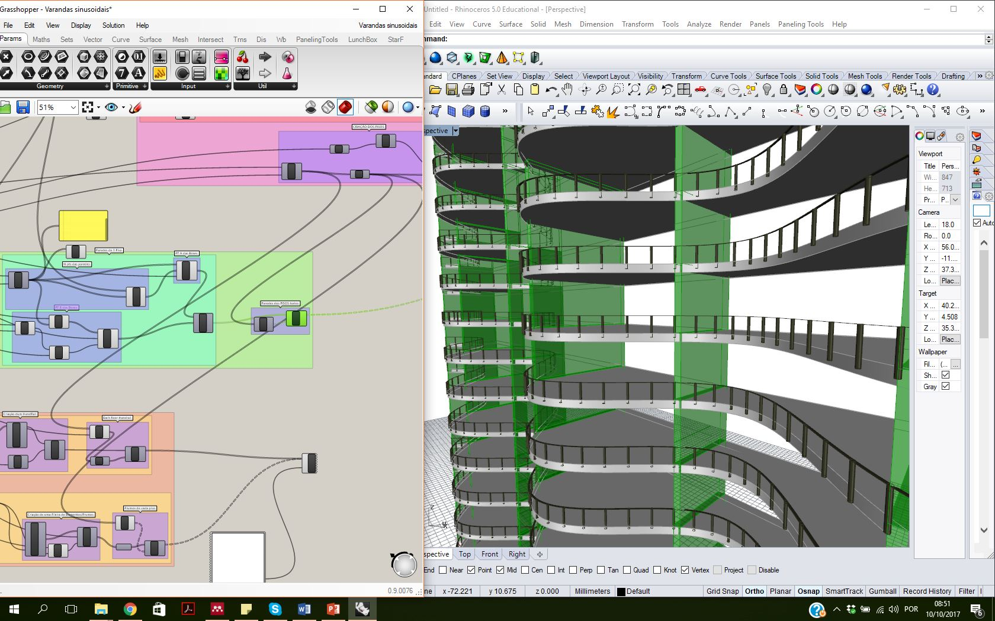
Traceability
Notes:
This can be useful if we want to find out what each part of the program does.
However, the other way around is not possible: Selecting a part of the results and seeing the components that created it.

Slide 10
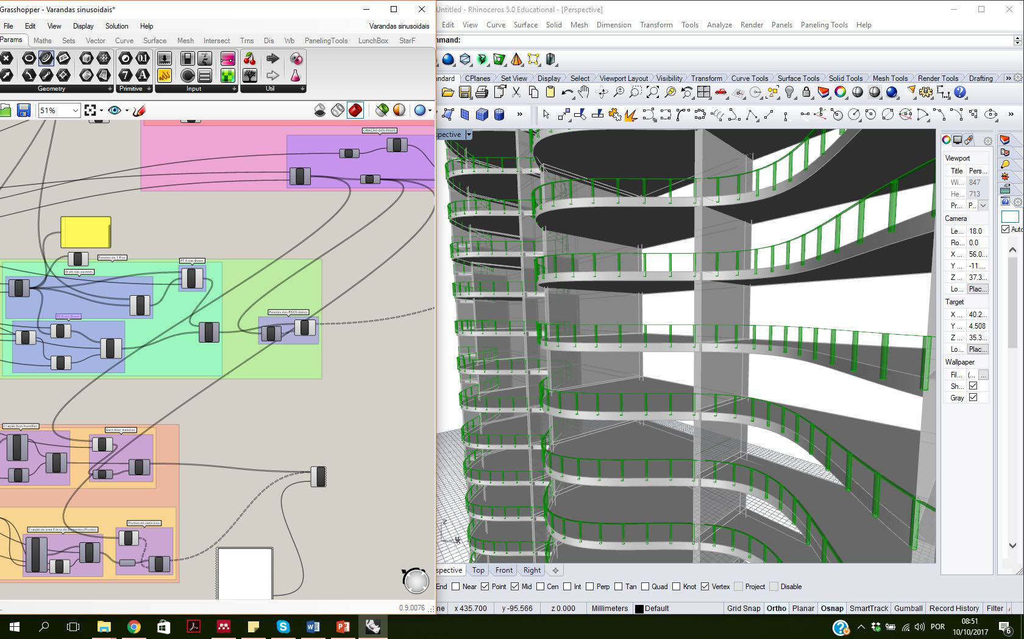
Traceability
?
?
Notes:
But currently this isn’t possible in these environments.
Lack of Scalability – difficult to understand and change

Slide 11
Traceable
Incremental
Scalable
Notes:
So architects require a programming environment in which they can 1) understand the connection between program and results, and the other way around; 2) build programs incrementally and 3) where programs grow slowly by using abstractions.
And this is where Luna Moth comes in.

Slide 12
Luna Moth
Traceable
Incremental
Scalable
Notes:
Luna Moth is a programming environment for Algorithmic Design that supports traceability and real-time feedback.

Slide 13
User Interface
Notes:
This is Luna Moth’s main editing interface.
It shows a program inspired by the Farnsworth house by Mies Van der Rohe.
We edit the program on the left side and the corrisponding results are displayed on the other.
Luna Moth uses textual programming due to its abstraction mechanisms and its conciseness.
LASER POINTER (existem parametros, neste caso podem ser ajustados com click n’drag)

Slide 14
Dom-ino demo
Immediate Feedback
Notes:
As in visual environments, we can manipulate parameters directly.
Clicking and then dragging any number will start changing it.
And the results are updated accordingly.

Slide 15
Traceability
Notes:
We can also try to find out what each function does by clicking on where it’s used.
Dom-ino, slabs, columns, stairs, …
And, as opposed to visual programming environments, we can go the other way.
Luna moth informs the user what part of the code is responsible for a certain part of the model, and this is very important for the understanding of the program, facilitating the application of design changes.
As an example, Clicking on a column will highlight the code that created that column.
And now change it to a cylinder.

Slide 16
Notes:
So, let’s create a program from scratch.
I want to create a tree inspired structure.
I start by creating a function, giving it a name and parameters.
I’ll leave it empty for now.
Now let’s call it so we can see something when we start adding stuff.
A tree has a trunk.
Define some additional information (the next point and radius).
And the actual trunk.
Next, the branches.
If its too small, end with a box.
Otherwise, add four smaller trees.
With different angles.
These four trees are almost duplicate.
I’ll remove the duplication by counting to four and using a formula for the angle.
Now, the program is smaller and I get the same result.
ONE MORE THING…

Slide 17
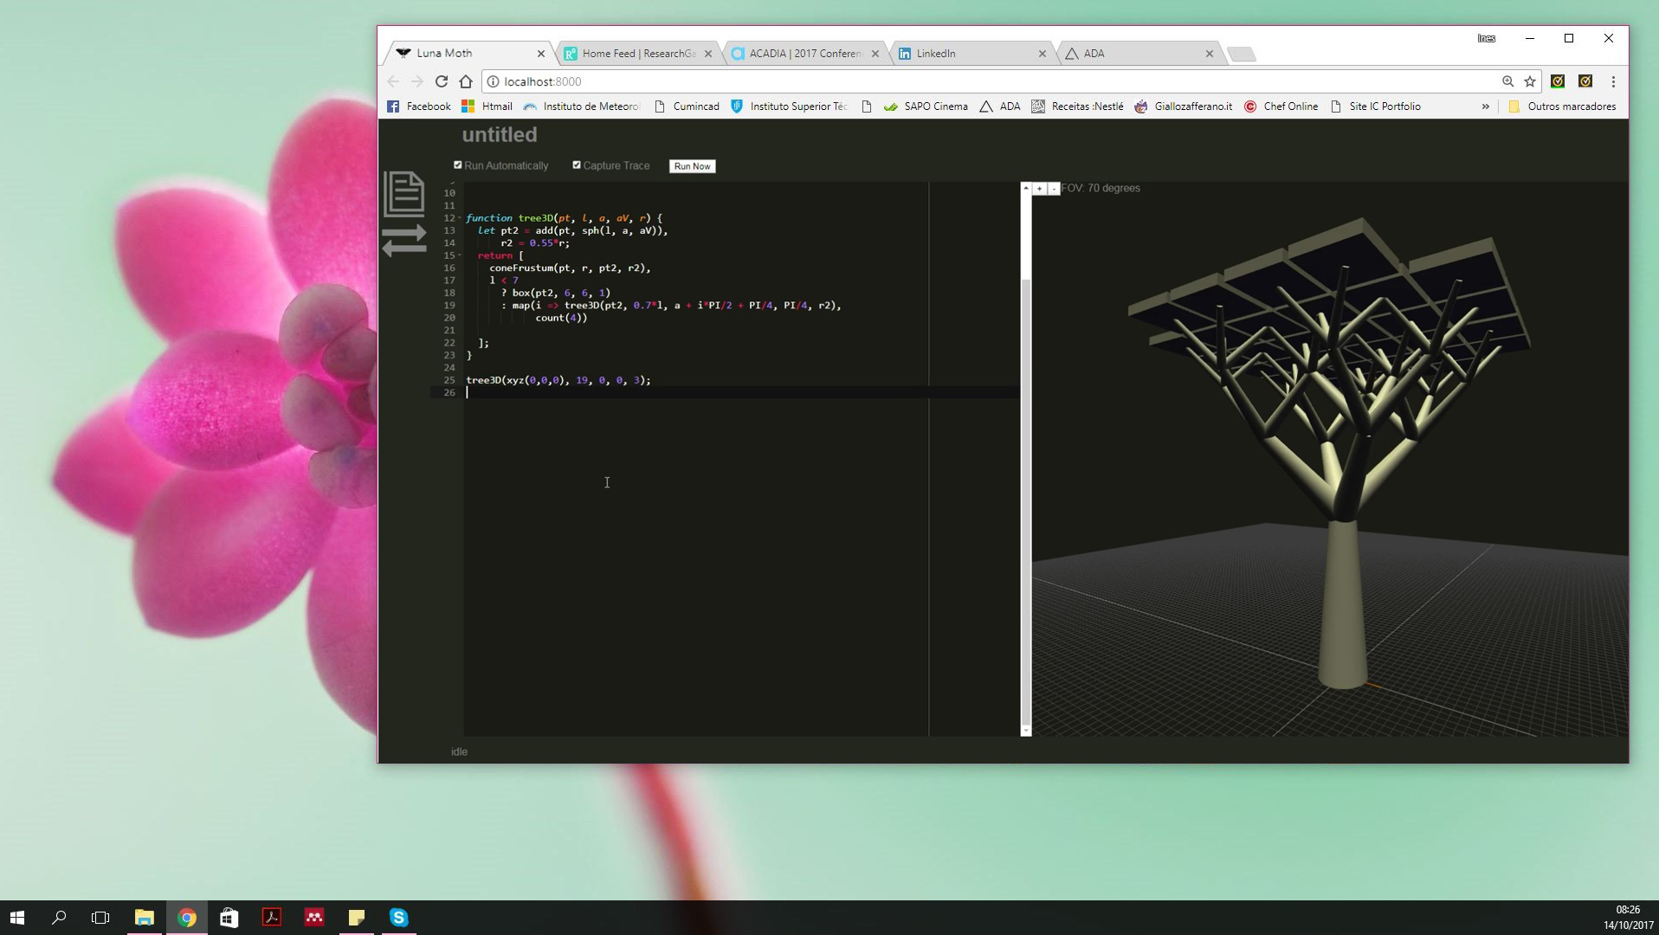
Notes:
Finally, Luna Moth runs in the web browser
Which means we don’t need to install it,
The only thing we need to do is go to its web page and use it.
Also, it is always updated and has remote storage, which promotes collaborative work.

Slide 18
Notes:
Running on the web browser does pose a problem:
How to integrate into the rest of the workflow?
How to get results onto other CAD tools on the computer?
Luna Moth uses a second application to allow it to communicate with the tools on our computer – It is able to interact with Rosetta, which is another programming environment, and here it is used as a remote service, allowing portability with different Computer-Aided Design, Building Information Modeling, and analysis applications.

Slide 19
Notes:
Generates an identical model from scratch

Slide 20
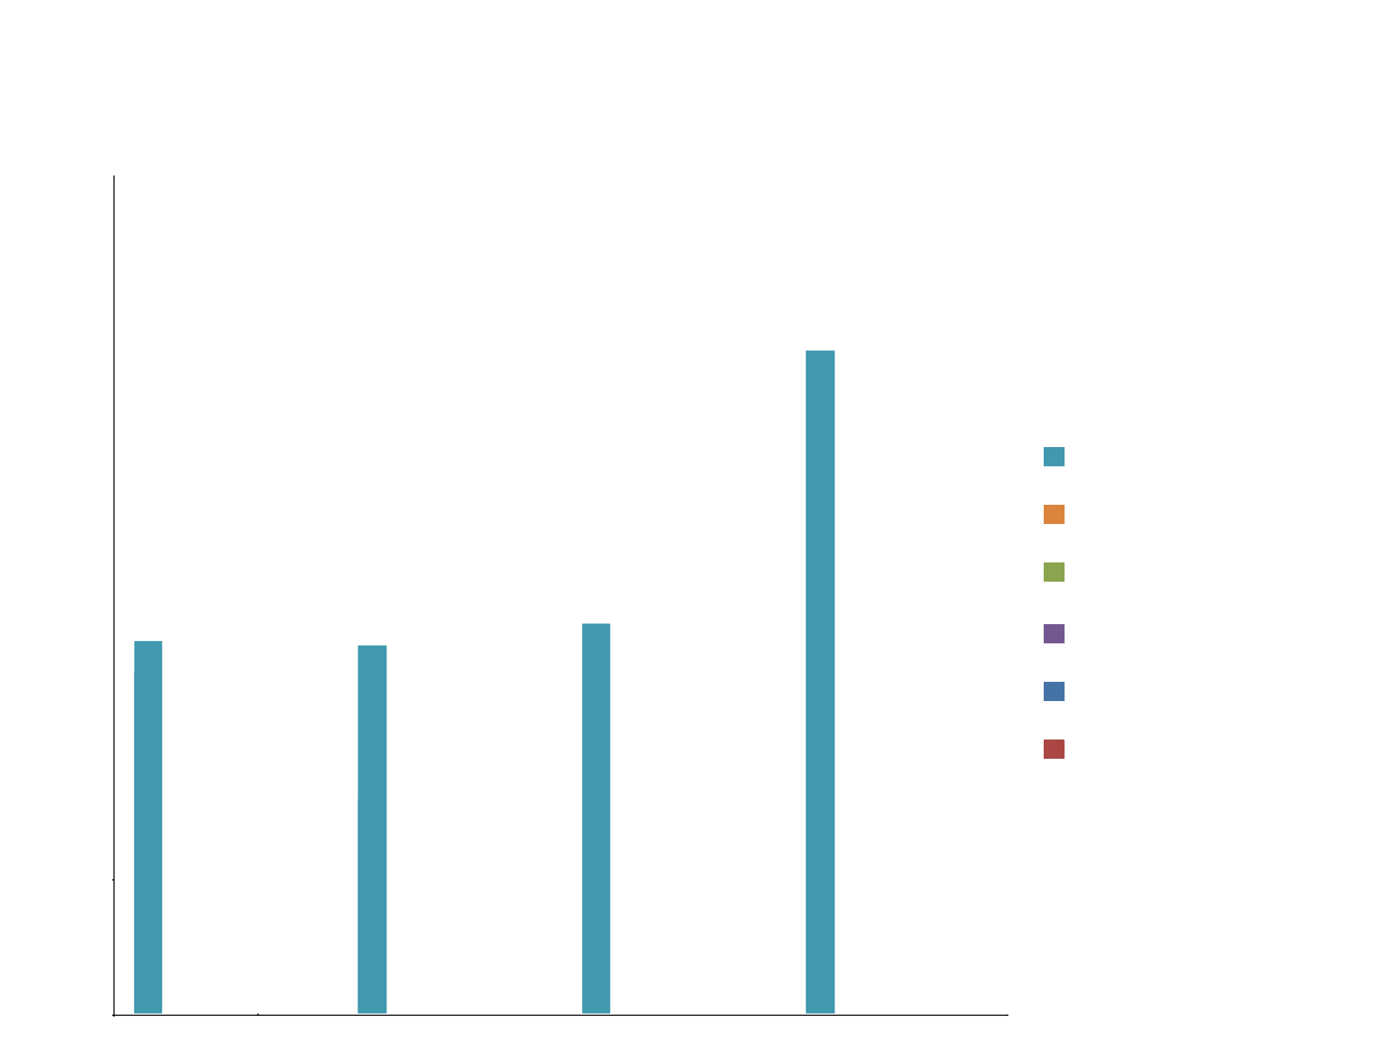
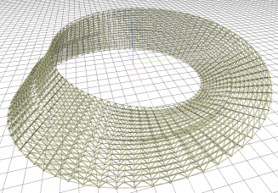
Performance
Notes:
To evaluate Luna Moth performance, we compared it with some similar tools. We used bench marks with several exemples, but for the presentation we selected 4. Identical models were produced using the set of tools selected, allowing to have a more accurate comparison.

Slide 21
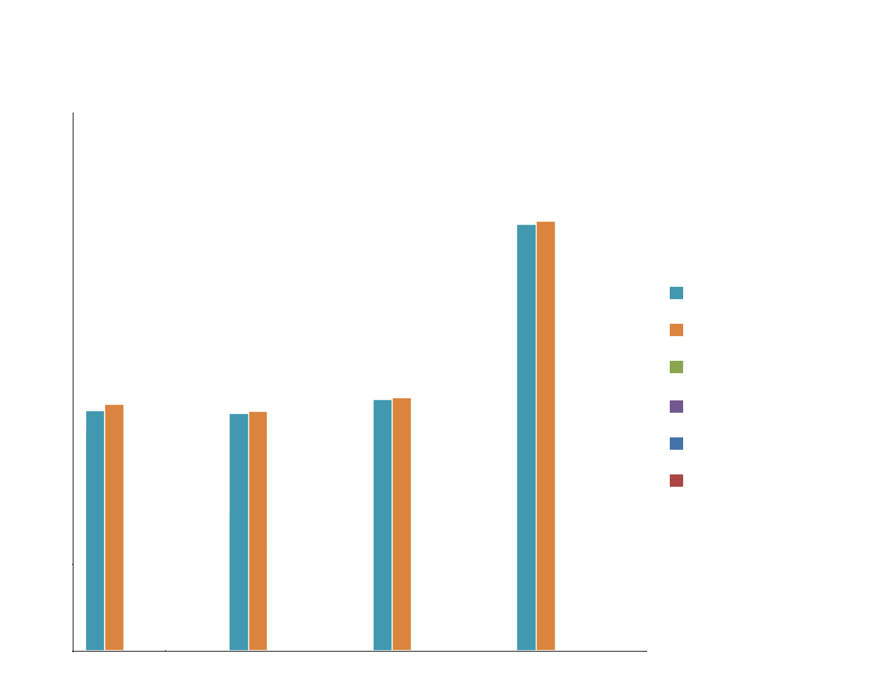
Performance
Notes:
Bake corrisponds to our second application Rosetta.

Slide 22
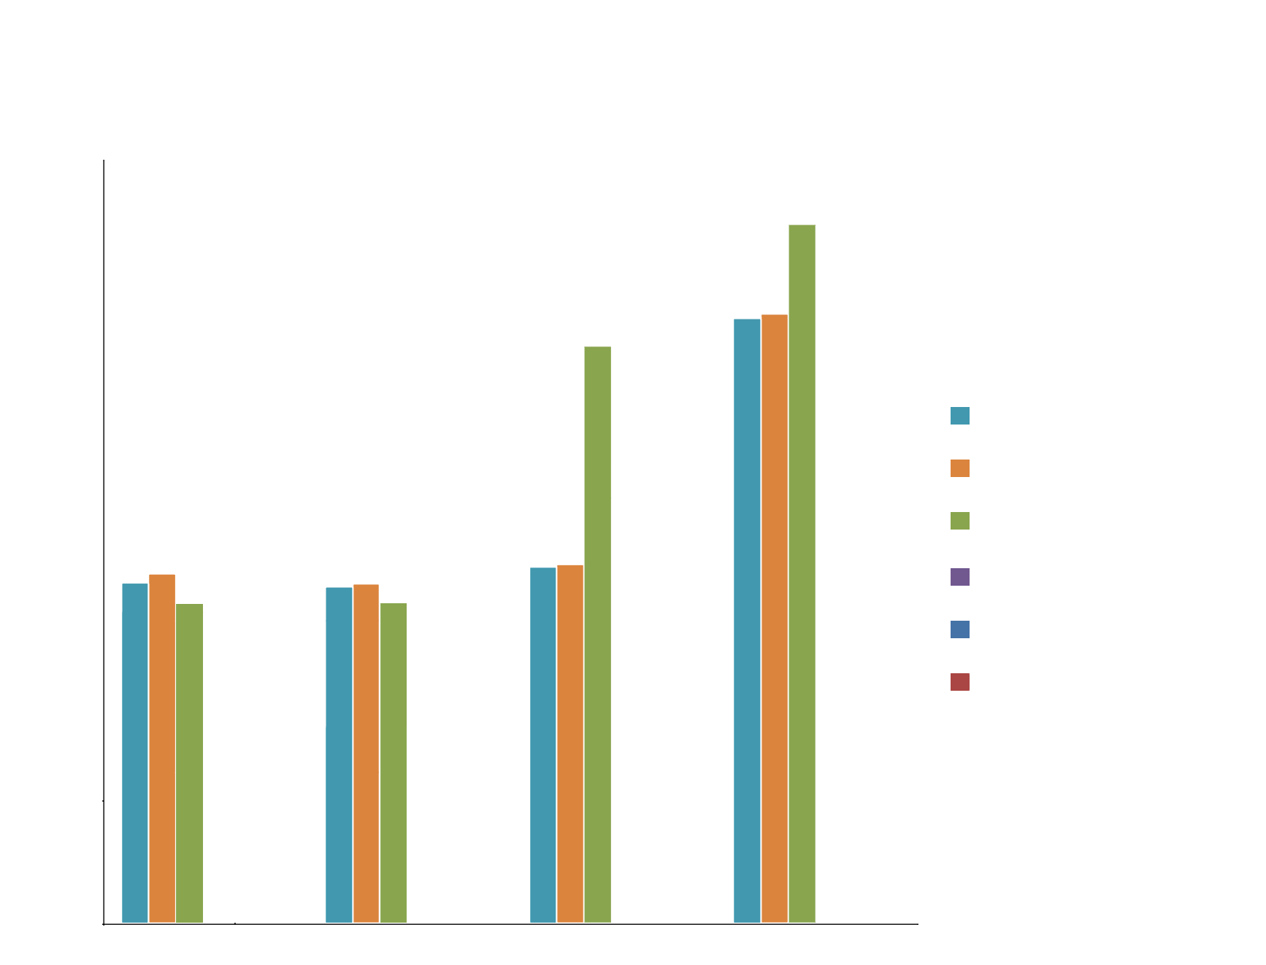
Performance

Slide 23
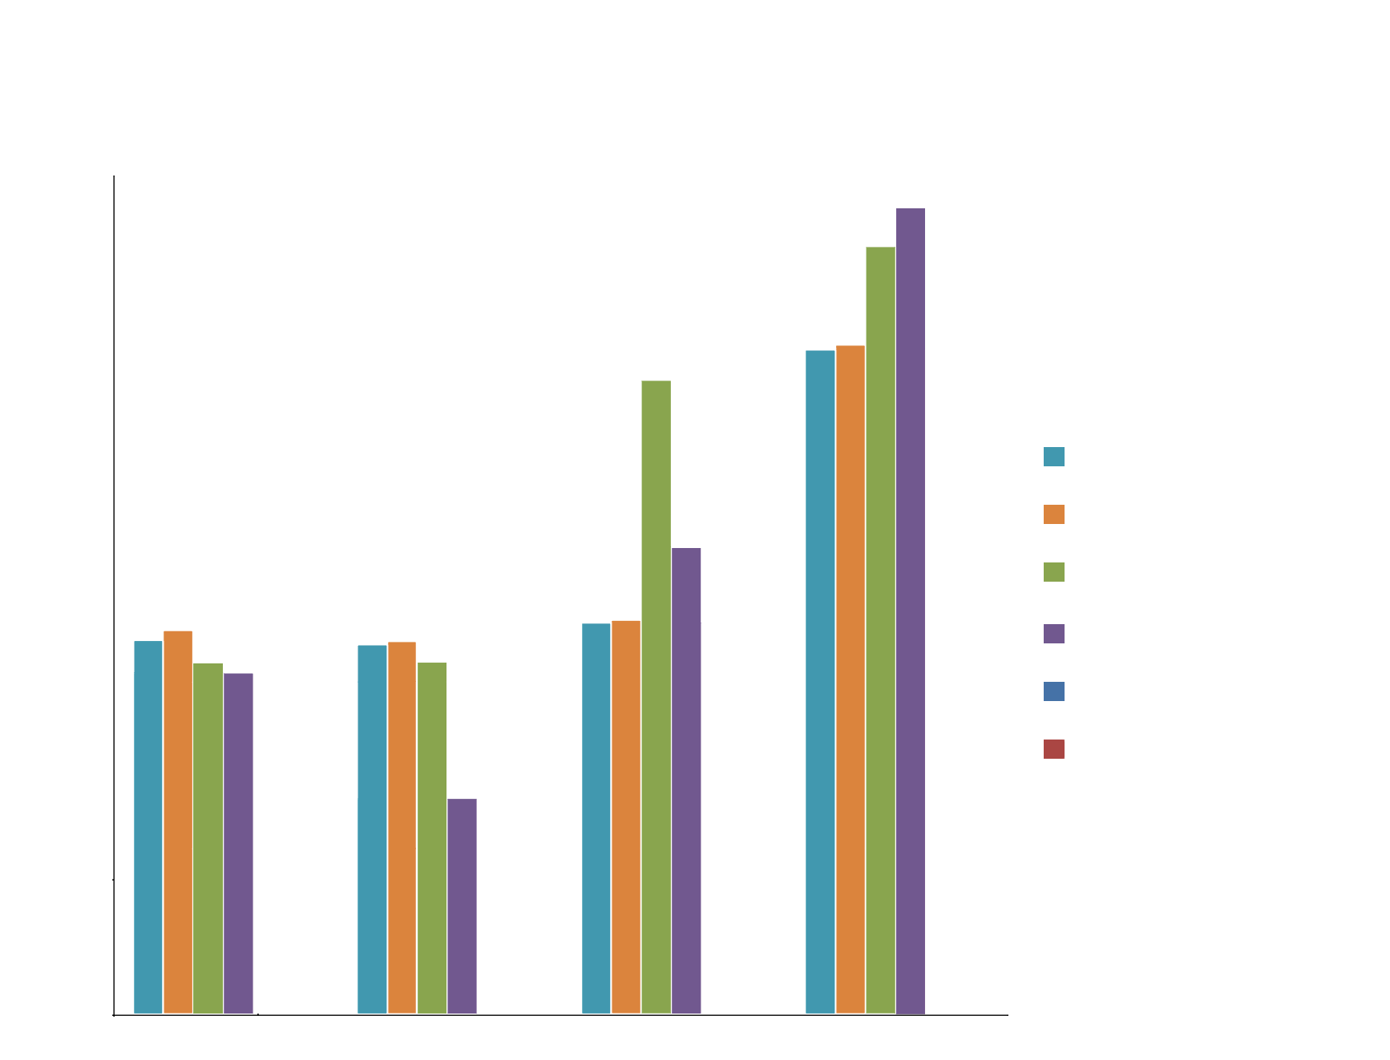
Performance
Notes:
Application similar to Lunamoth

Slide 24
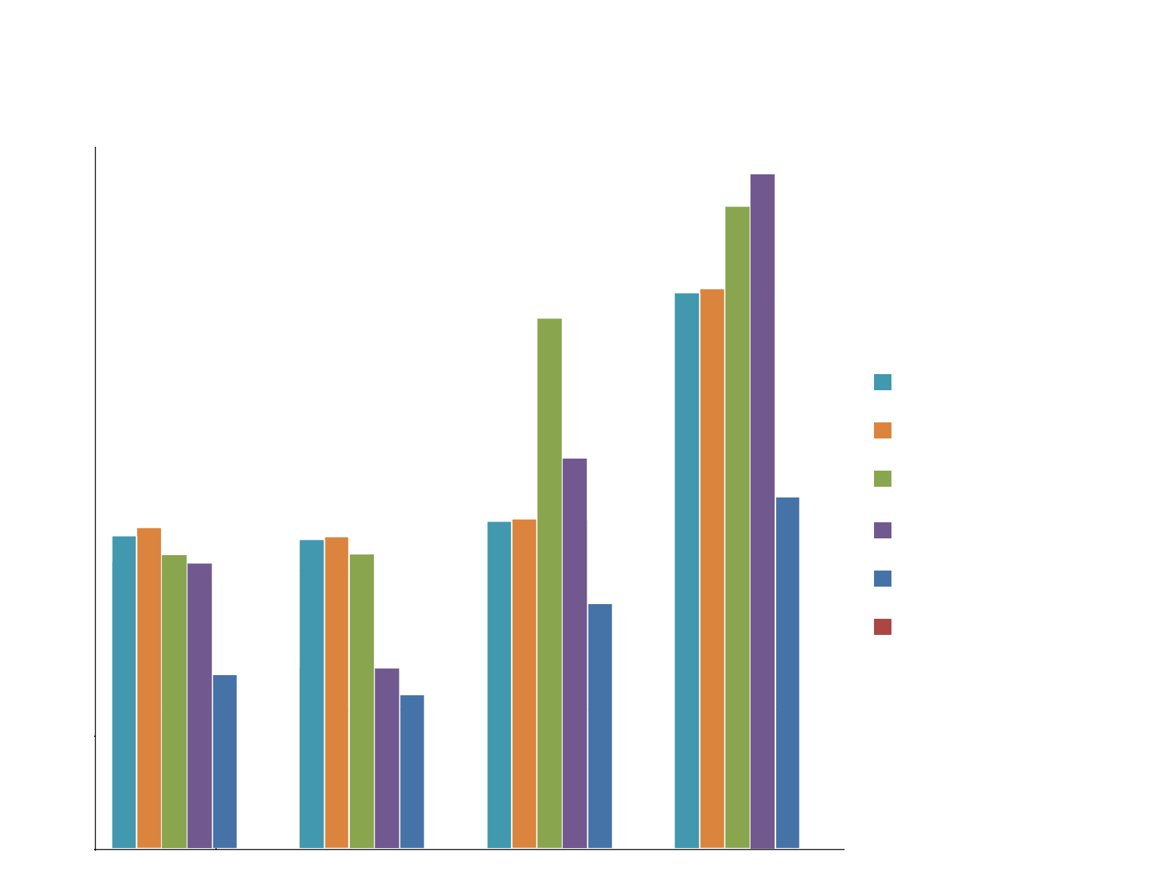
Performance
Notes:
Luna moth considerably faster in all examples.
Note the graphic is logarithmic → difference between times is not linear.
– Column example is 10x faster than grasshopper
- Mobious truss example is 100x faster than OpenJSCAD

Slide 25
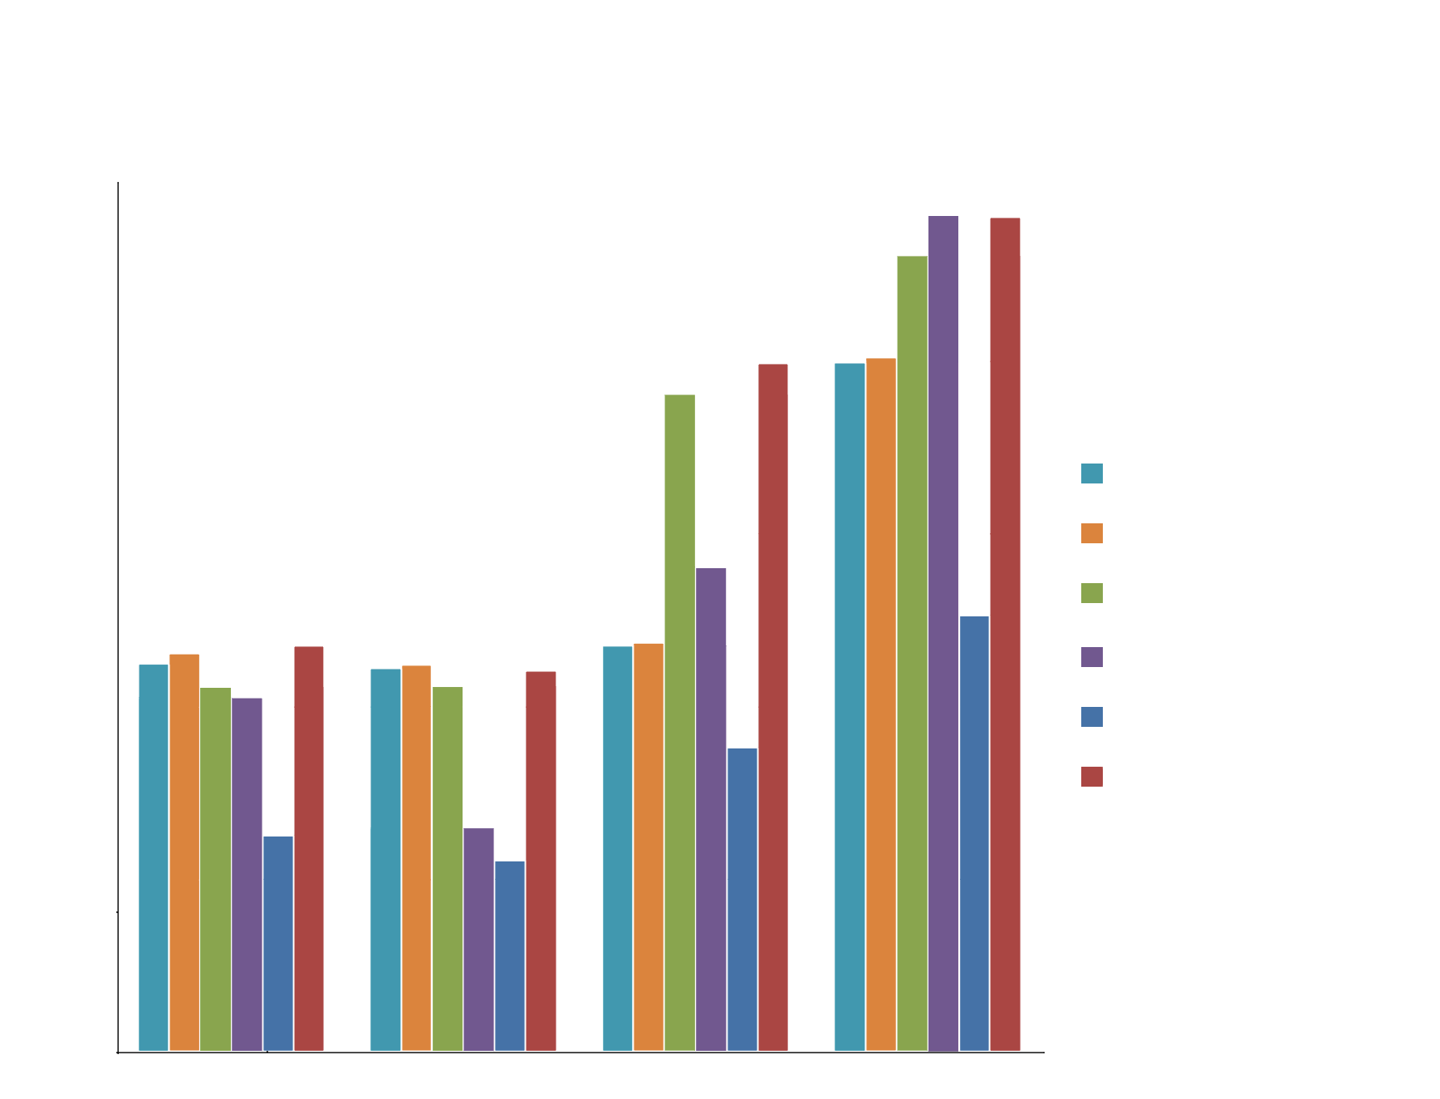
Performance
Notes:
Luna Moth+CAD → decrease of performance is influenced by Rosetta’s performance. Also, most of the time is lost in communication with CAD tool.
Nevertheless, this process is intended to be used only when the designer is satisfied with the result.
User can take full advantage of Luna Moth’s performance in the explorations of designs → uses rosetta once.
Therefore, this does not decrease so much the overall performance of Luna Moth.

Slide 26
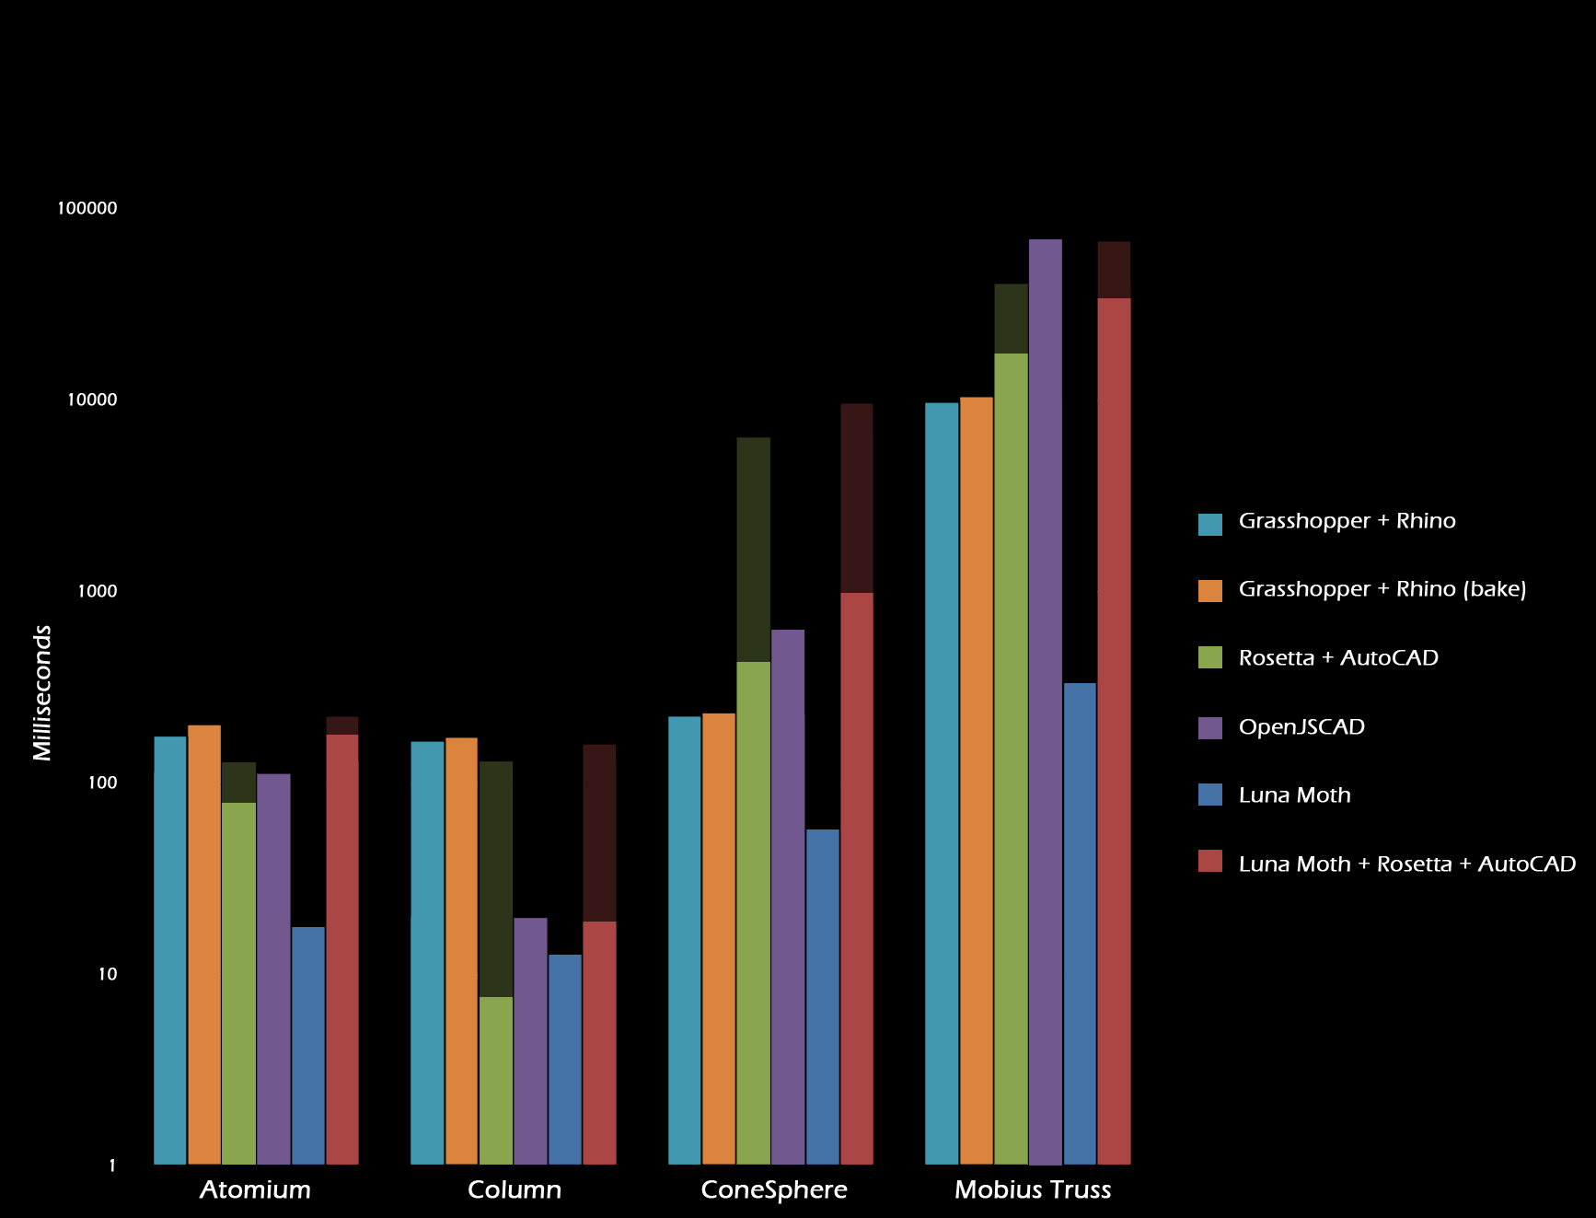
Performance
Notes:
Since the delivery of the paper, we have been improving the performance of Rosetta, and therefore it affected the performance of LunaMoth + Rosetta.
In some cases, we increased the performance 10x.

Slide 27
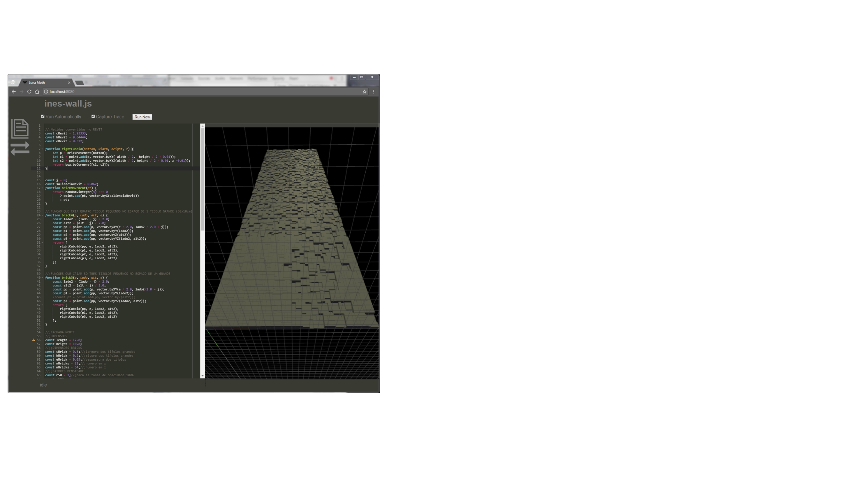
Workflow Integration

Slide 28
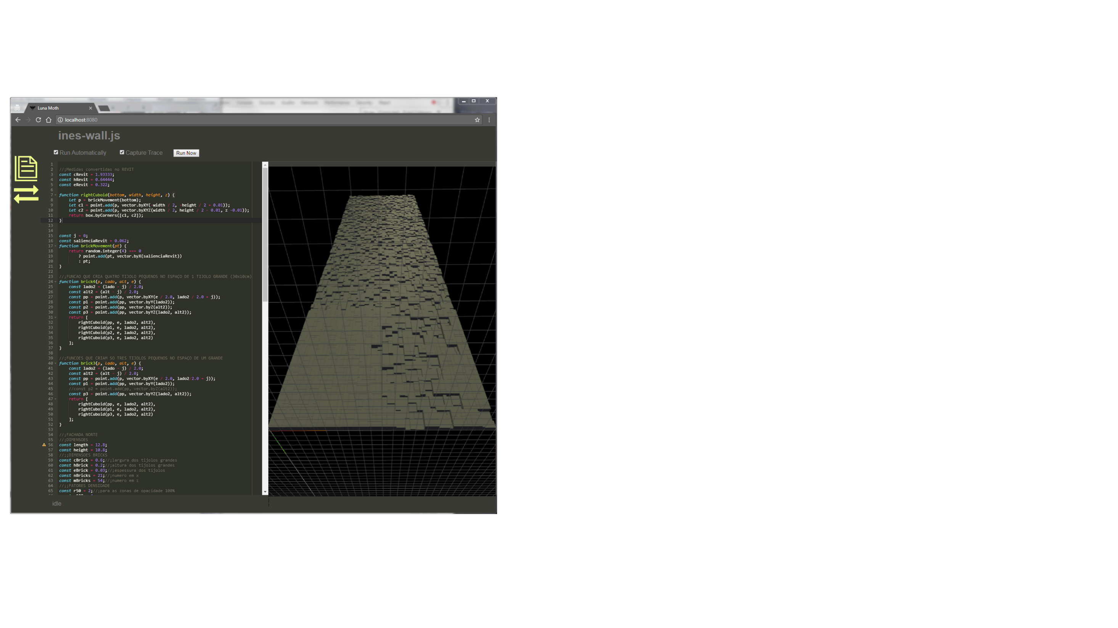
Workflow Integration

Slide 29
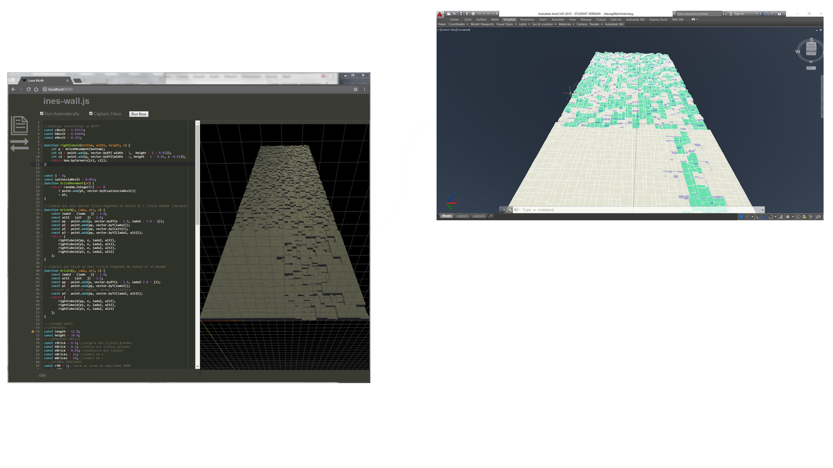
Workflow Integration

Slide 30
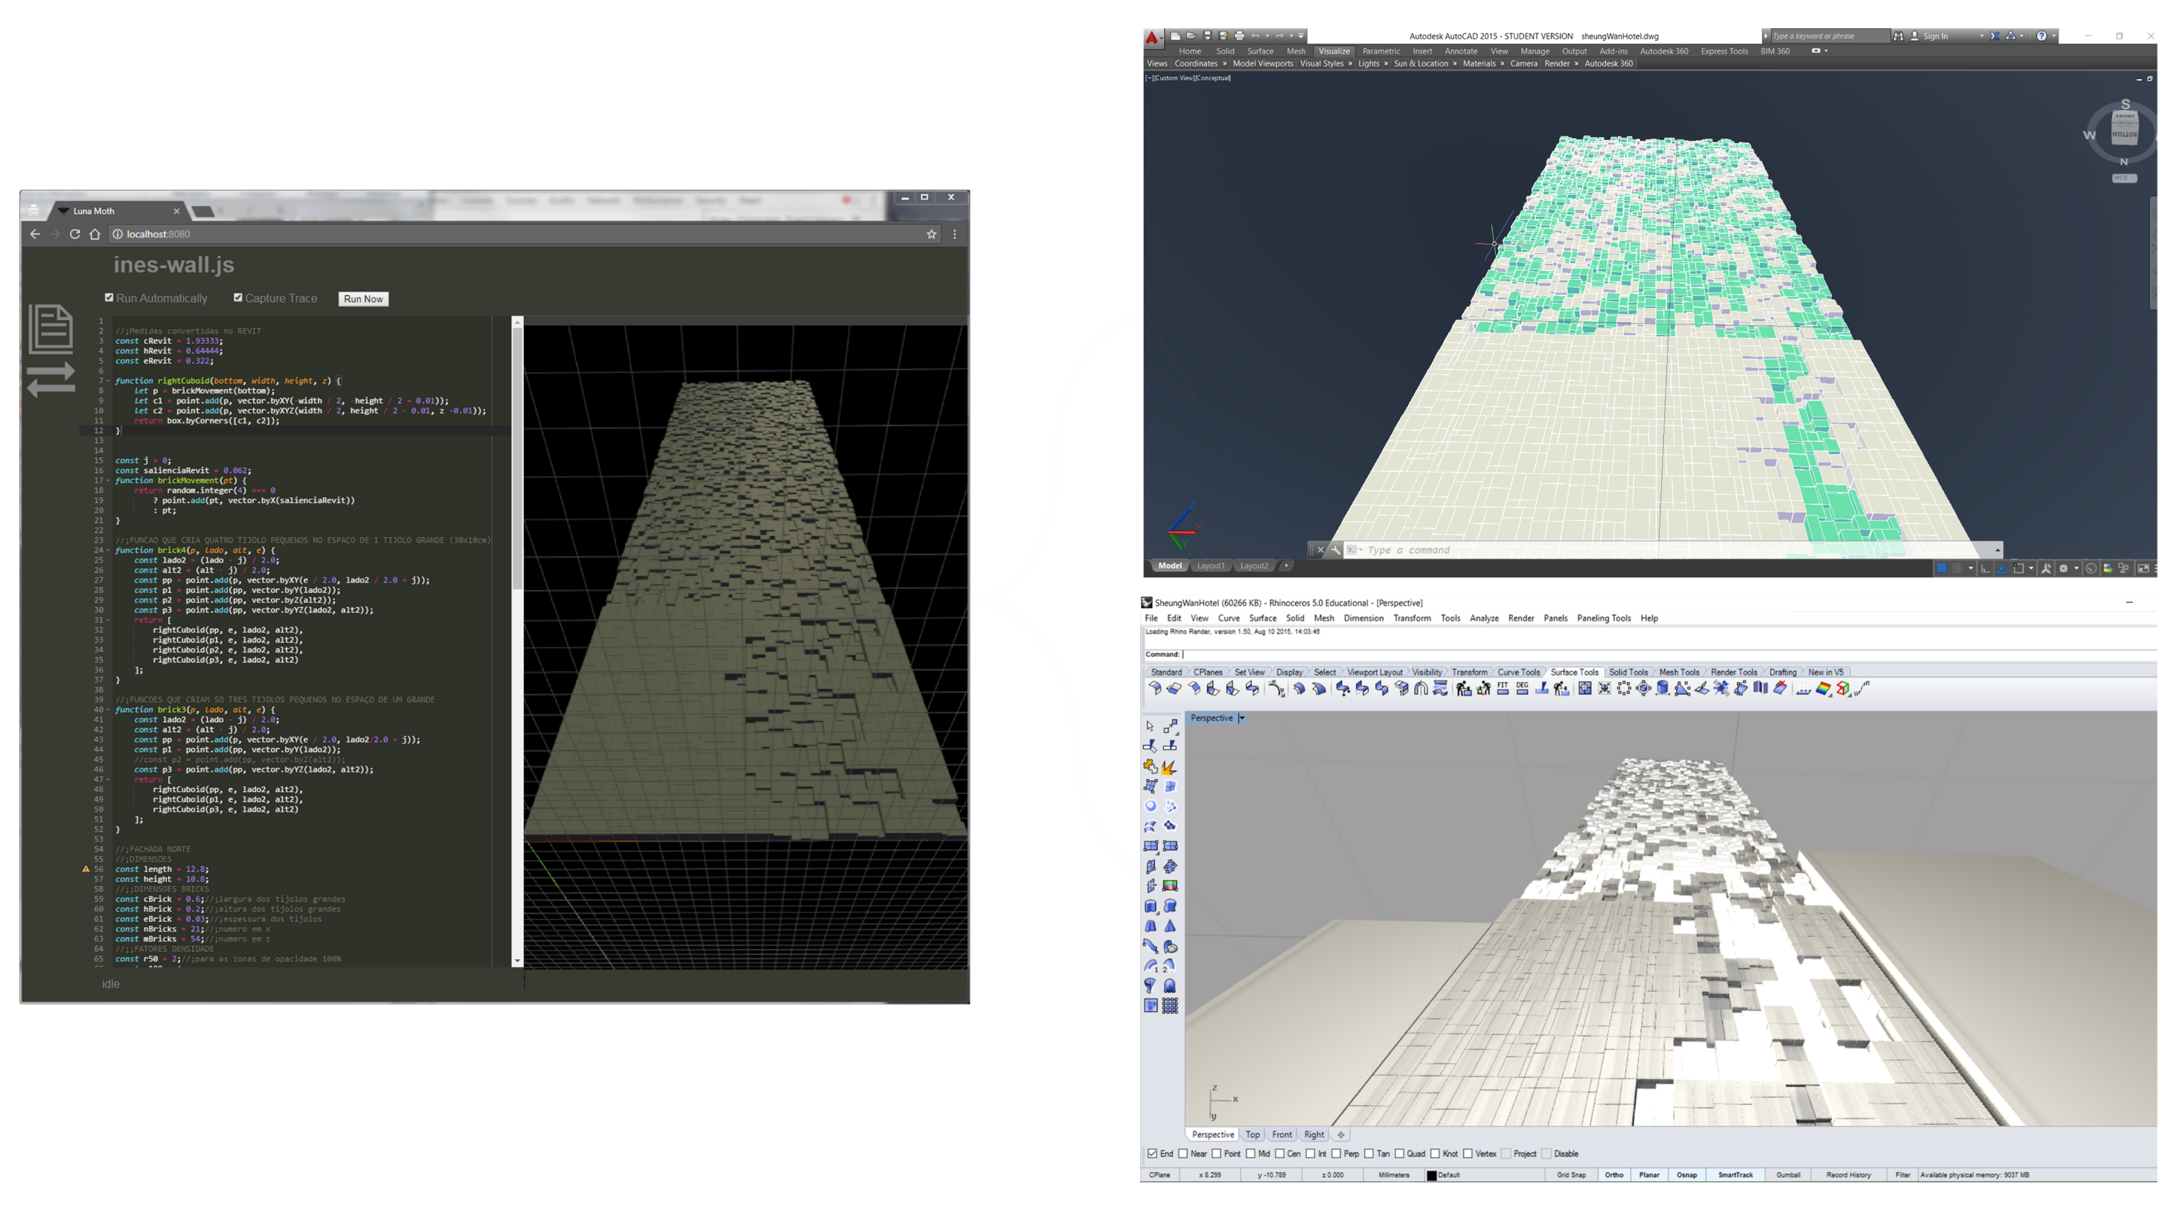
Workflow Integration

Slide 31
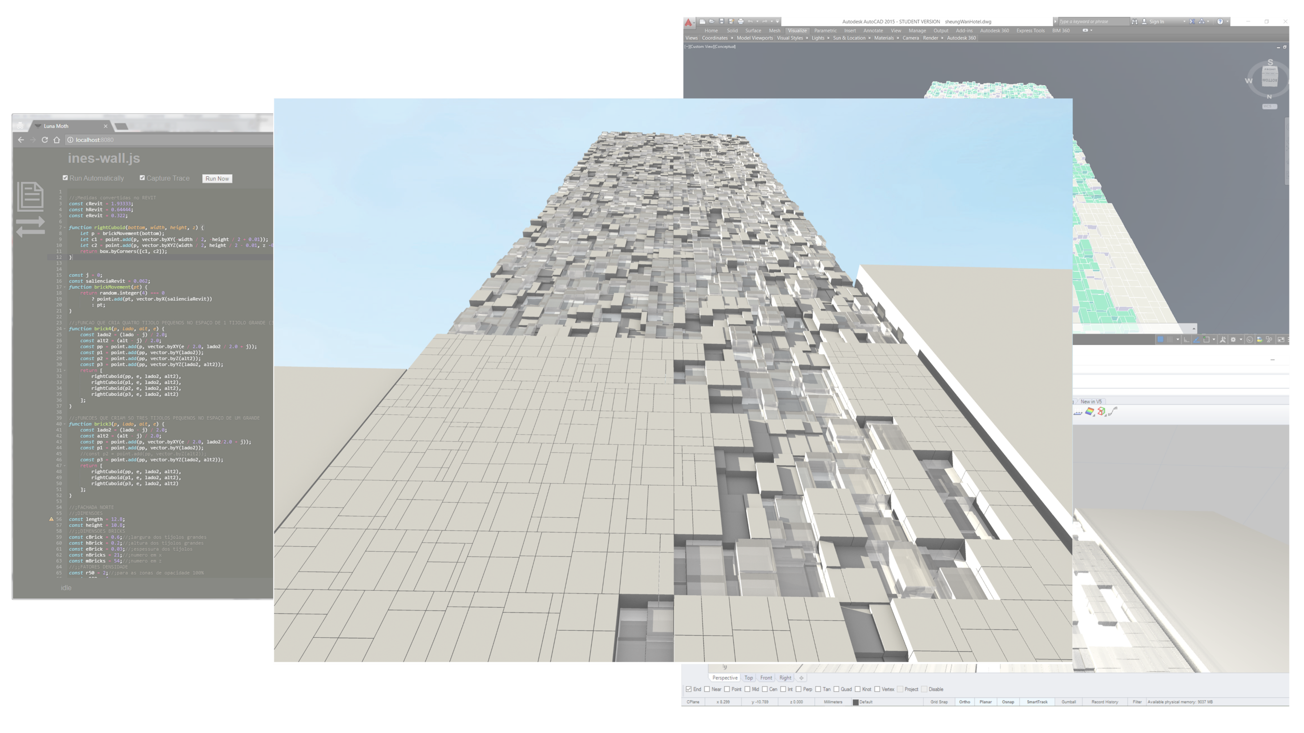

Slide 32
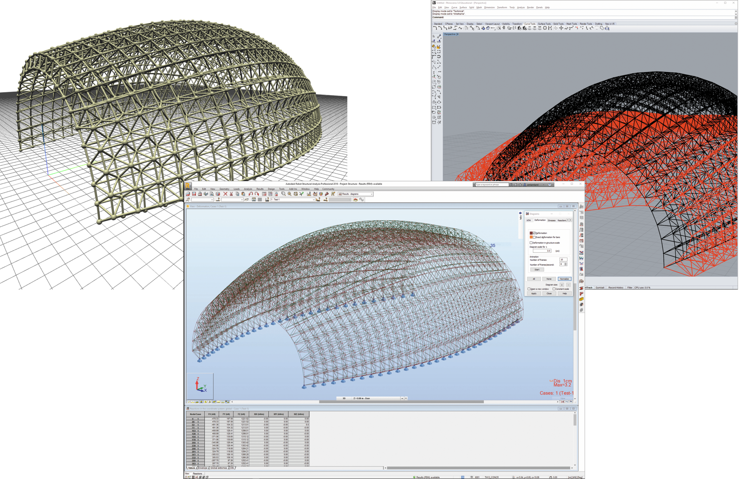
Workflow Integration
Notes:
As Luna Moth is connected with Rosetta, it is also possible to use the second application to generate na identical model inside other type of tools, such as the case of Robot – a structural analysis tool. see the picture. The model innitially produced in Luna Moth was then produced in Robot and the results were displayed in Rhino.

Slide 33
Future Work
Code completion
Improve error reporting
Illustrated programming
Execution visualization
Explore remote collaboration
Notes:
As for future work,
We plan on improving the programming experience with features such as:
Code completion
Better error reporting
Drawn documentation
Visualization of program execution…
In addition, given that Luna Moth is in the web browser, it also makes sense to explore remote collaboration.

Slide 34
Thank You
Questions?
Pedro Alfaiate
pedro.alfaiate@tecnico.ulisboa.pt
Inês Caetano
ines.caetano@tecnico.ulisboa.pt
António Leitão
antonio.menezes.leitao@tecnico.ulisboa.pt
https://github.com/pafalium/gd-web-env

Slide 35
Performance

Slide 36
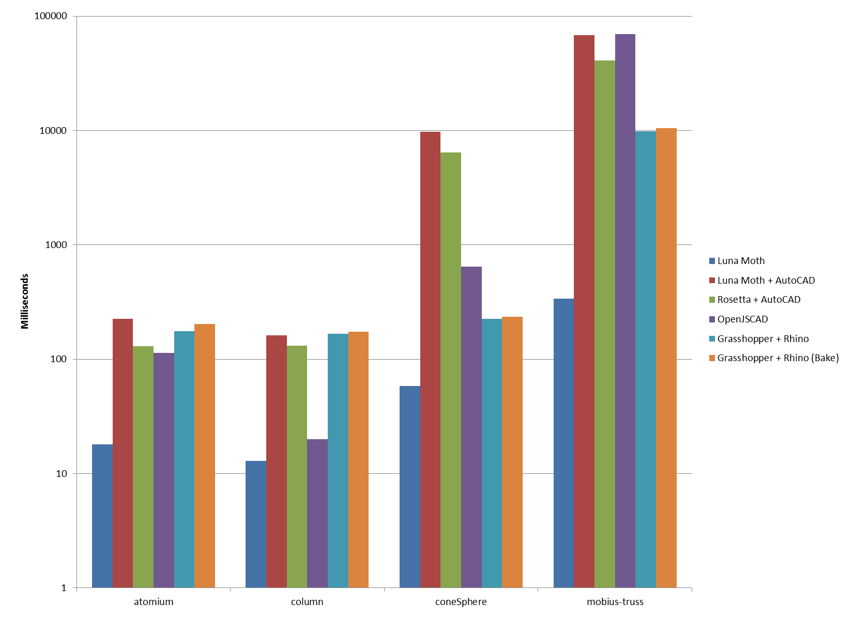

Slide 37
Future Work

Slide 38
Improve integration

Slide 39
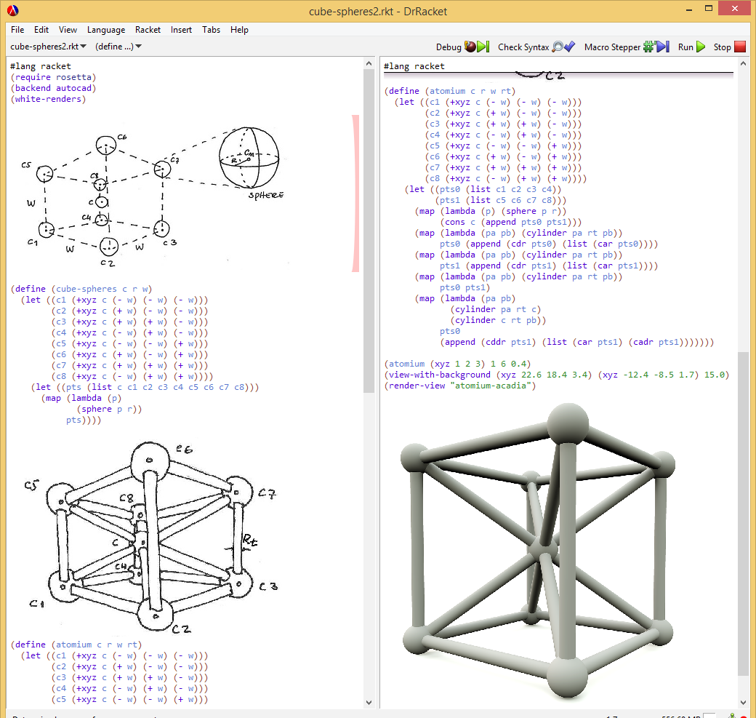
Improve programming experience
Code completion
Error reporting
Illustrated programming (Lopes and Leitão, 2014)
Timetable traceability
(as in Learnable Programming by Bret Victor)
(Lopes and Leitão, 2014)
Notes:
Illustrated programming
Timetable traceability
Code completion
Error reporting

Slide 40
Remote collaboration
Notes:
Collaboration, as emphasized by the web.
Sharing programs, editing programs collaboratively, showing program in a meeting,

Slide 41
CC BY-SA
https://www.flickr.com/photos/martinlatter/4732737190
https://commons.wikimedia.org/wiki/File:Beijing_national_stadium.jpg
https://commons.wikimedia.org/wiki/File:%E5%9B%BD%E5%AE%B6%E6%B8%B8%E6%B3%B3%E4%B8%AD%E5%BF%83%E5%A4%9C%E6%99%AF.jpg
https://commons.wikimedia.org/wiki/File:Espacio_Parasol_Sevilla.jpg
https://itp.nyu.edu/classes/sdieo-spring2013/files/2013/04/rhinopython6_loops.jpg
https://static.pexels.com/photos/247791/pexels-photo-247791.png
https://upload.wikimedia.org/wikipedia/commons/2/20/Grasshopper_MainWindow.png
http://www.grasshopper3d.com/group/geometrygym/forum/topics/grasshopper3d-geodesic-dome-structure-generator-ggdsg-geometry
https://www.flickr.com/photos/sjcockell/8425835703

