Slide 1
Luna Moth A Web-based Programming Environment for Generative Design
Pedro Alfaiate and António Leitão
Notes:
Part of my master’s thesis

Slide 2
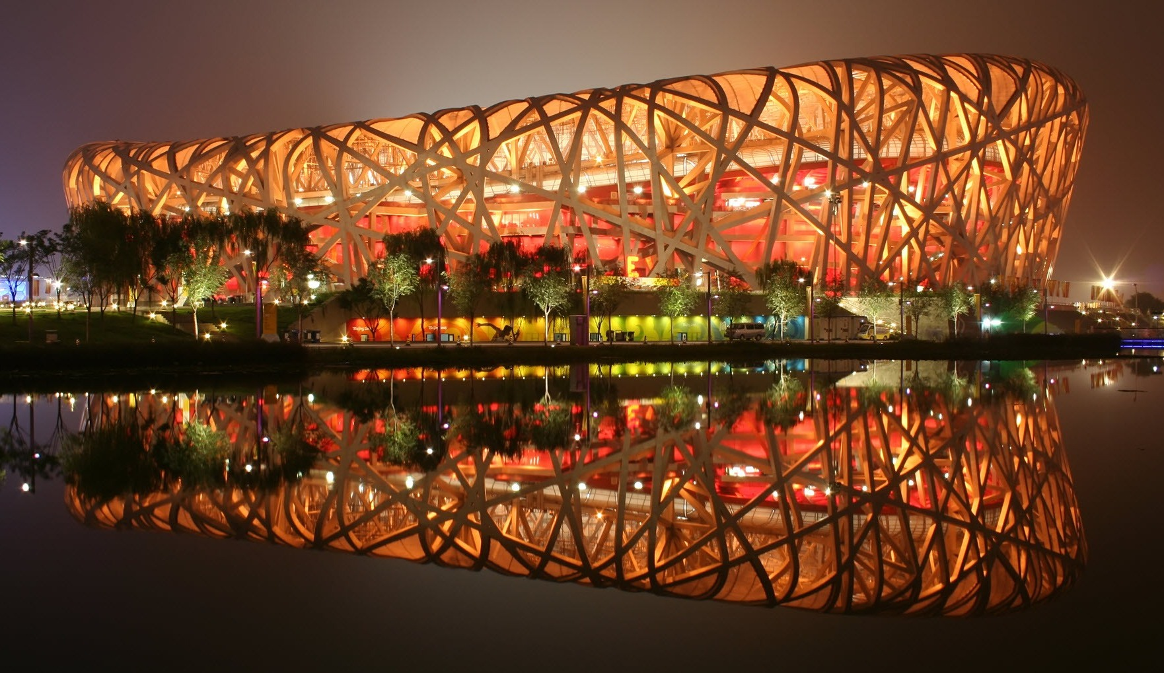
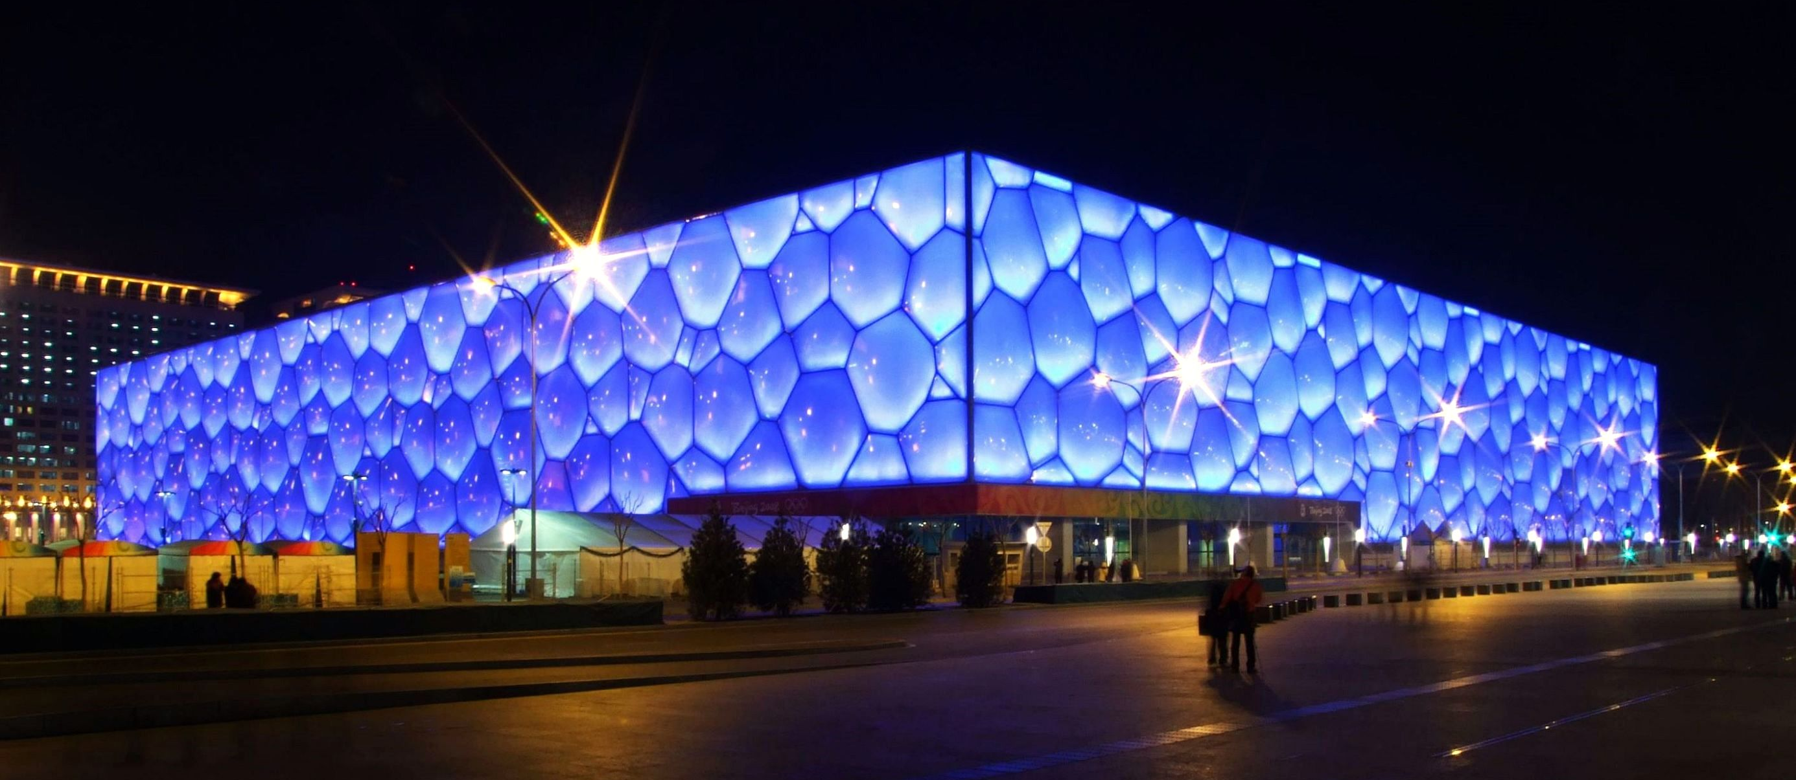
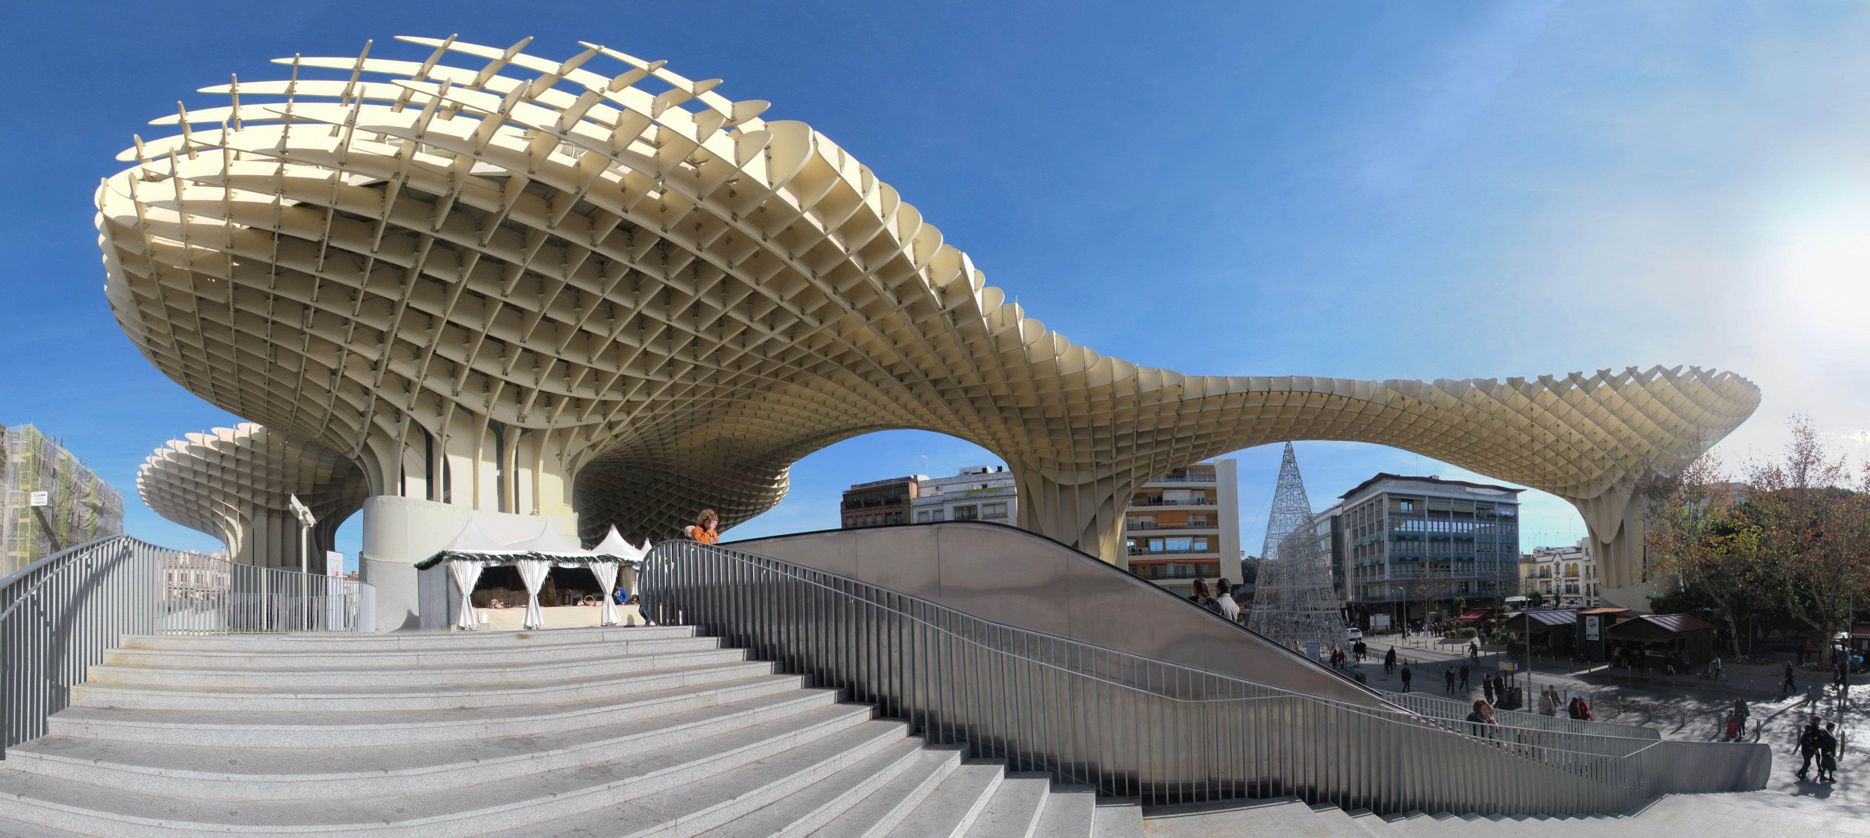
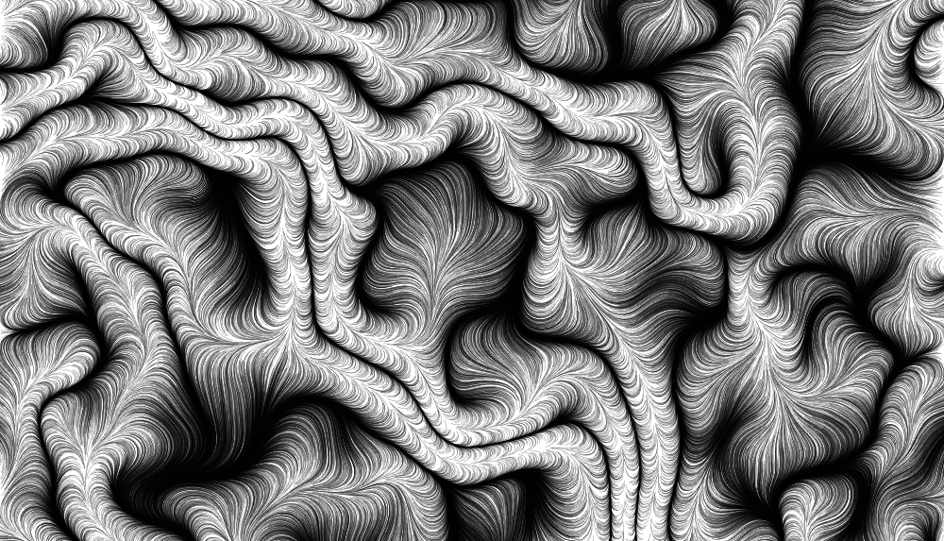
Generative Design
By Peter23 (Own work) [CC BY-SA 3.0 (http://creativecommons.org/licenses/by-sa/3.0)], via Wikimedia Commons
By Charlie fong (Own work) [Public domain, GFDL (http://www.gnu.org/copyleft/fdl.html) or CC BY-SA 4.0-3.0-2.5-2.0-1.0 (http://creativecommons.org/licenses/by-sa/4.0-3.0-2.5-2.0-1.0)], via Wikimedia Commons
By Rubendene (Own work) [CC BY-SA 3.0 (http://creativecommons.org/licenses/by-sa/3.0)], via Wikimedia Commons
By Martin Latter (Own work) CC BY-SA 2.0 (http://creativecommons.org/licenses/by-sa/2.0)
Notes:
As you know, we can use programming to automate many of the modeling tasks that we encounter.
That allows us to model repetitive, complex designs much more easily than if we did so by hand.
This in turn gives us more creative freedom to explore more of these designs.
For example, the 2D pattern on the bottom-right, or 2D models of buildings like the Bird’s Nest, the Water Cube, or the Setas de Sevilla.
All of these can be automated with computer programs.
Automate modelling
More creative freedom
Repetitive shapes
Mathematical/Complex shapes
Easier to adjust results
High initial effort compared to manual modelling

Slide 3
Problem
cylinder(r=1, h=5)
Notes:
However, there is a tradeoff.
We go from interacting with the model directly to interacting with the program that generates the model.
We work on a higher level of abstraction.
Problem: Programming is more abstract than modeling; and this implies that we can’t face programs the same way as traditional 3D modeling.
For one, we’re no longer doing the modeling ourselves; instead, we’re telling a machine how to do something.
For example, we refer to things by their name instead of selecting on the screen; there is more emphasis on creating than on modifying.

Slide 4
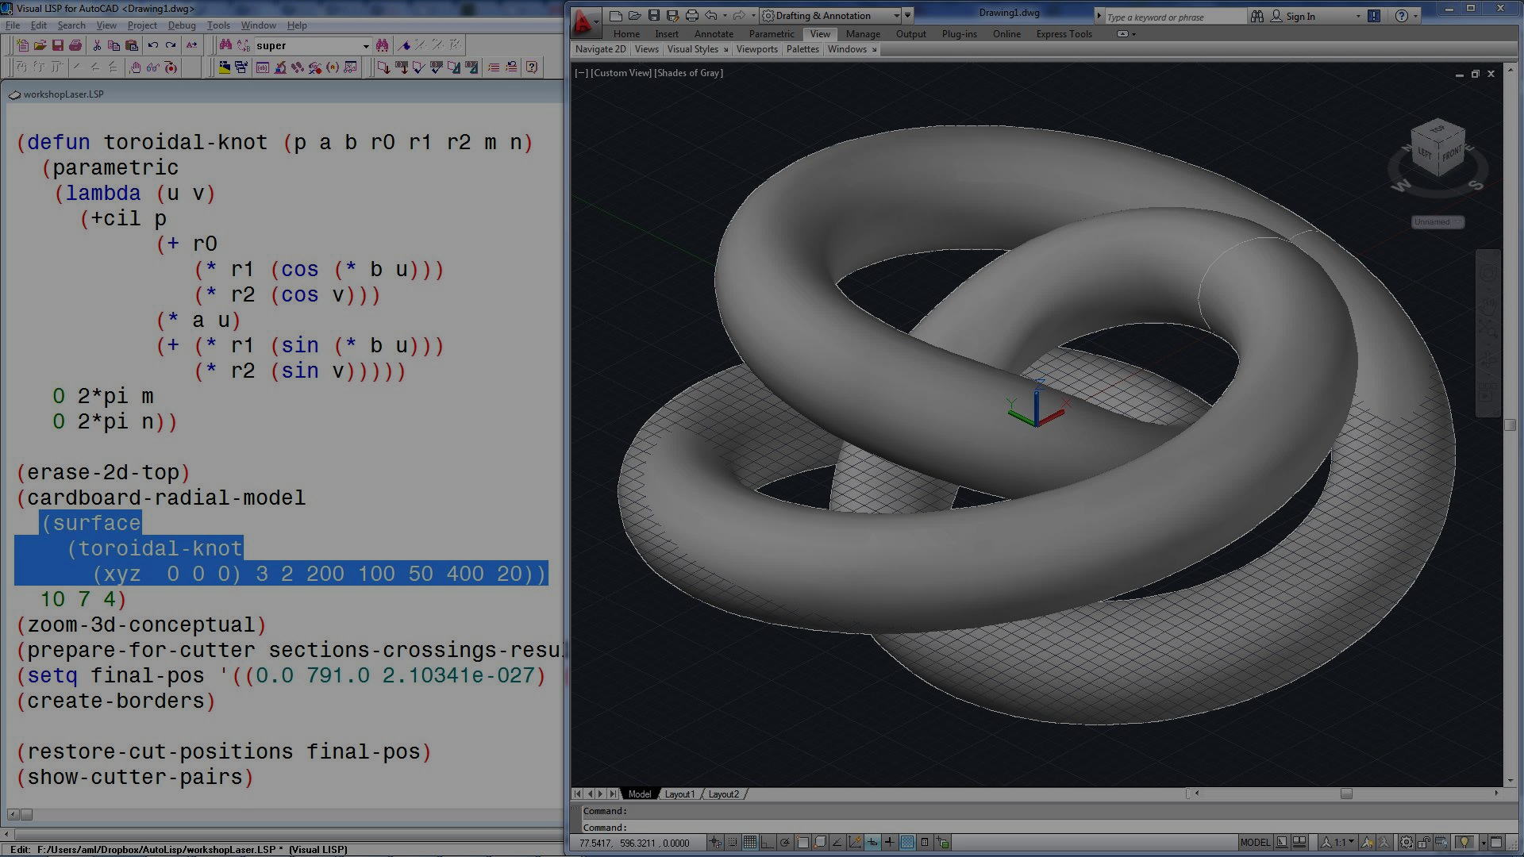
Programming Environments
Notes:
This is where programming environments can help.
Programming environments have features to help with the programming task.
They can help us by
simplifying how we edit programs,
simplifying how we run programs, and
simplifying how we understand them.
The programming environment doesn’t remove the abstraction; it makes it easier to use / understandable.
Describe IDEs Interactive Development Environment
Ferramenta para Ajudar a desenvolver…

Slide 5
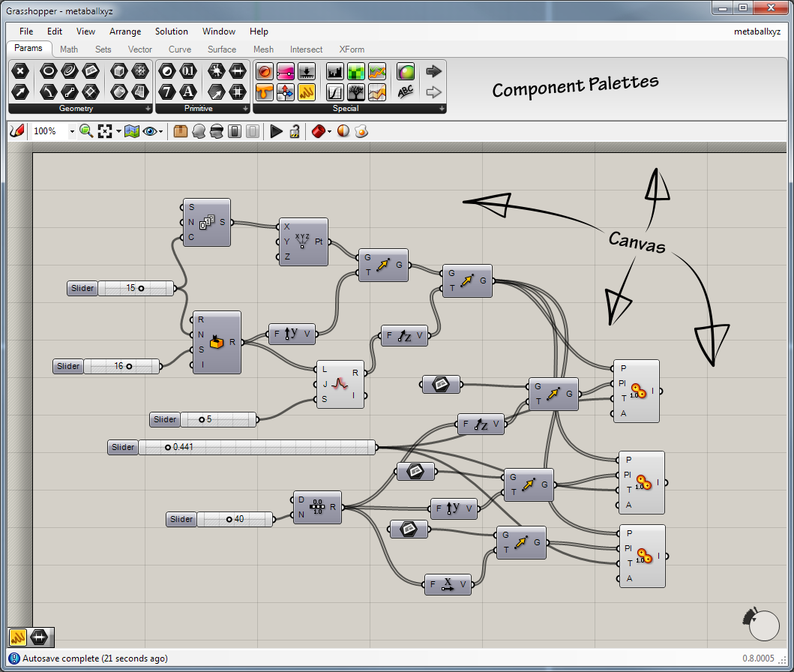
Textual vs Visual
Notes:
There are two main ways of programming in Generative Design:
Textual programming, and
Visual programming
Each has its own type of programming environment / advantages and disadvantages.

Slide 6
Textual Programming
Notes:
In textual programming, we literally write our programs.
Textual
AutoLisp (AutoCAD)
RhinoPython (Rhinoceros 3D)
Processing
Very abstract, terse. Fast to write.
Write, compile, run. Too slow…

Slide 7
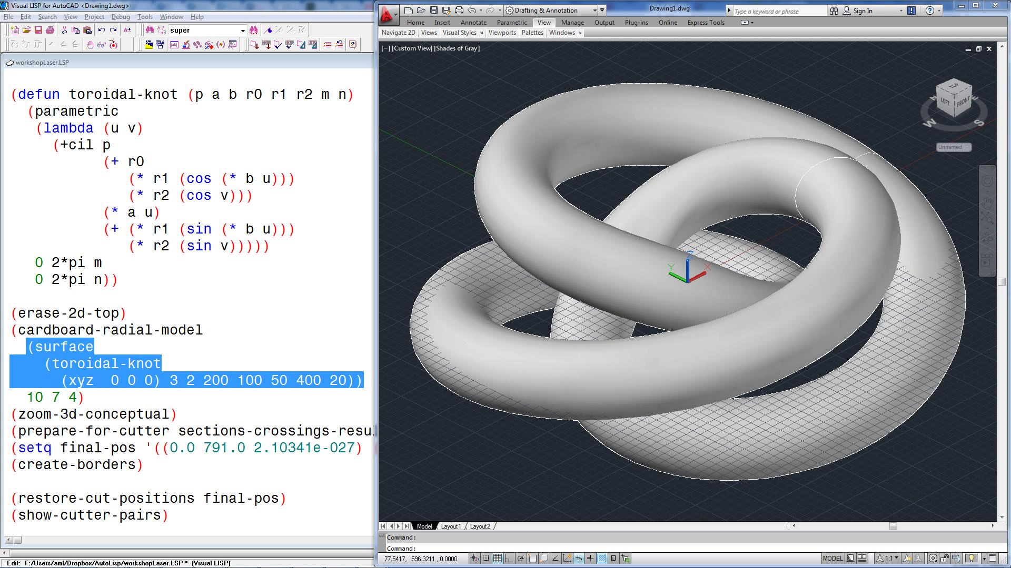
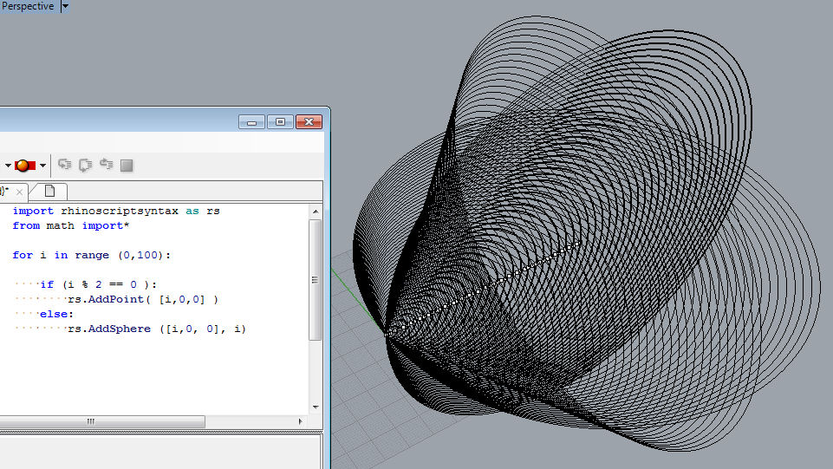
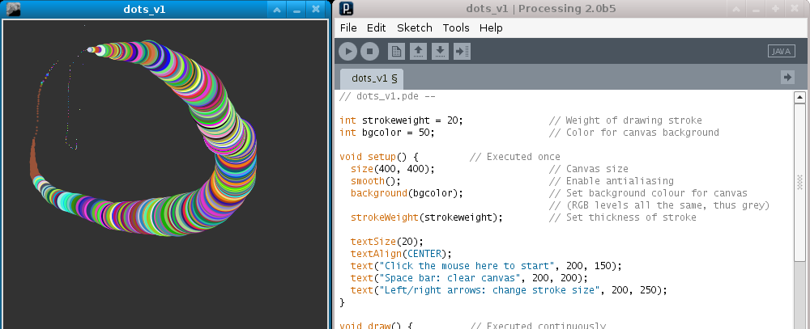
Notes:
Textual programming environments include AutoLISP, RhinoPython, and Processing.
Textual programming allows us to write programs using abstractions which makes it possible to handle bigger designs more easily.
And Programs end up more concise.
However, they are less intuitive (for visually oriented people) and usually harder to see the connection between program and results.

Slide 8
Visual Programming
Notes:
When it comes to visual programming, we build programs graphically.
Visual
Grasshopper (Rhinoceros 3D)
Dynamo (Revit)
Data-flow programming (typically)
Run on change
Intuitive parameter manipulation.
Trace from program to generated model

Slide 9
Notes:
Dynamo and Grasshopper are examples this kind of programming.
They run the program as we add more components,
which makes it easier to build programs incrementally.
So, if we add one component, we see its results immediately.
They also allow us to make adjustments to parameters intuitively by using sliders and other widgets.

Slide 10
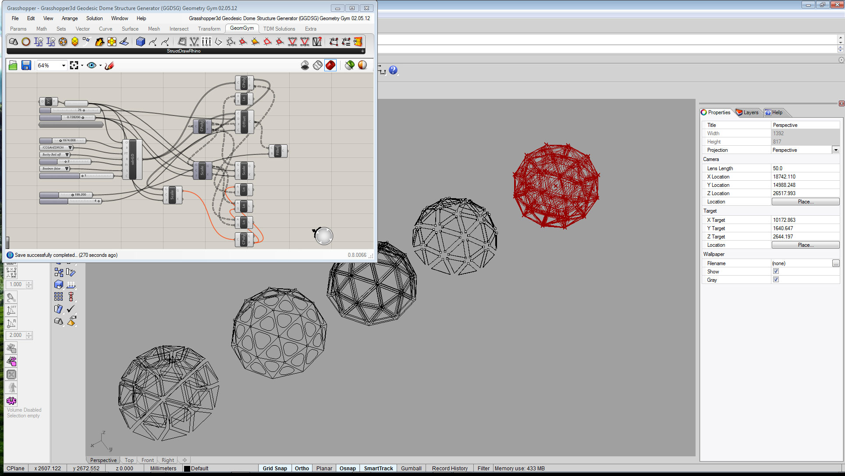
Notes:
Apart from this, visual programming environments also let us see the results of each component.
We can click on a component and the programming environment highlights the results that it produced.
Somewhat complex program
Can click on component to highlight results
What if we want to highlight components instead?
We can’t.

Slide 11
Notes:
This can be useful if we want to find out what each part of the program does.
However, when the program does something wrong, it would be better to go the other way:
Selecting a part of the results and seeing the components that created it.

Slide 12
?
Notes:
But this isn’t possible in these environments.

Slide 13
Luna Moth
Notes:
So we want to have a programming environment:
where we can build programs incrementally,
where we can understand the connection between program and results,
where programs grow slowly by using abstractions.
This is where Luna Moth comes in.

Slide 14
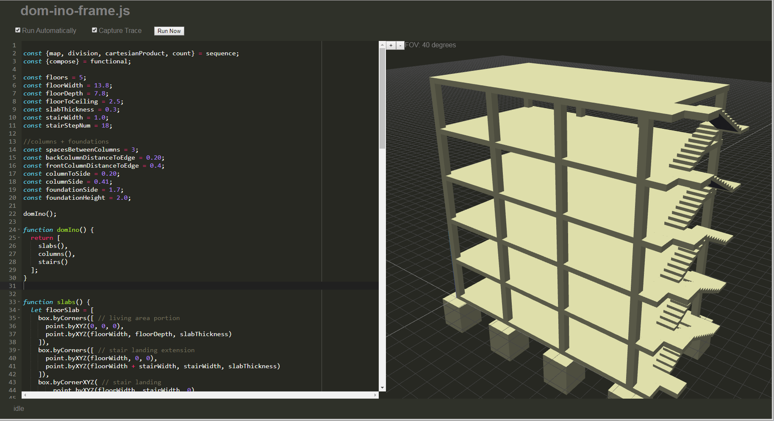
Notes:
This is Luna Moth’s main editing interface...
Showing a program inspired by the Dom-ino house by Le Corbusier.
We edit the program on one side and its results are displayed on the other.
Luna Moth uses textual programming because/for its abstraction mechanisms and for its conciseness.
LASER POINTER (existem parametros, neste caso podem ser ajustados com click n’drag)

Slide 15
Dom-ino demo
Notes:
As in visual environments, we can manipulate parameters directly.
Clicking and then dragging any number will start changing it.
And the results are updated accordingly.

Slide 16
Dom-ino demo
Notes:
We can also try to find out what each function does by clicking on where it’s used.
Dom-ino, slabs, columns, stairs, …
And, as opposed to visual programming environments, we can go the other way.
Clicking on a column will highlight the code that created that column.
And now change it to a cylinder.
(Can go on forever…)
ENFASE NA OUTRA DIREÇÃO

Slide 17
Tree structure demo
Notes:
So, let’s create a program from scratch.
I want to create a tree inspired structure.
I start by creating a function, giving it a name and parameters.
I’ll leave it empty for now.
Now let’s call it so we can see something when we start adding stuff.
A tree has a trunk.
Define some additional information (the next point and radius).
And the actual trunk.
Next, the branches.
If its too small, end with a box.
Otherwise, add four smaller trees.
With different angles.
These four trees are almost duplicate.
I’ll remove the duplication by counting to four and using a formula for the angle.
Now, the program is smaller and I get the same result.
ONE MORE THING…

Slide 18
Notes:
Finally, Luna Moth runs in the web browser
Which means we don’t need to install it,
The only thing we need to do is go to its web page and use it.
Easier setup
No install
No updates
Remote storage
Collaboration
Computation

Slide 19
Dom-ino export demo
Notes:
Running on the web browser does pose a problem:
How to integrate into the rest of the workflow?
How to get results onto other CAD tools on the computer?
In Luna Moth, we write our program first and then use a second application to allow Luna Moth to communicate with the applications on our computer.
Generated and NOT Exported.
Luna Moth needs to communicate with other tools.
For this, it requires a secondary application to run programs locally.
With this application running, we can then export the Dom-ino model from earlier to AutoCAD, for instance.
And then use it there.

Slide 20
Future Work
Notes:
As for future work,
We plan on improving the programming experience with features such as:
Code completion
Better error reporting
Drawn documentation
Visualization of program execution…
In addition, given that Luna Moth is in the web browser, it also makes sense to explore remote collaboration.

Slide 21
Thank You
Questions?
Pedro Alfaiate
pedro.alfaiate@tecnico.ulisboa.pt
António Leitão
antonio.menezes.leitao@tecnico.ulisboa.pt
https://github.com/pafalium/gd-web-env

Slide 22
Performance

Slide 23
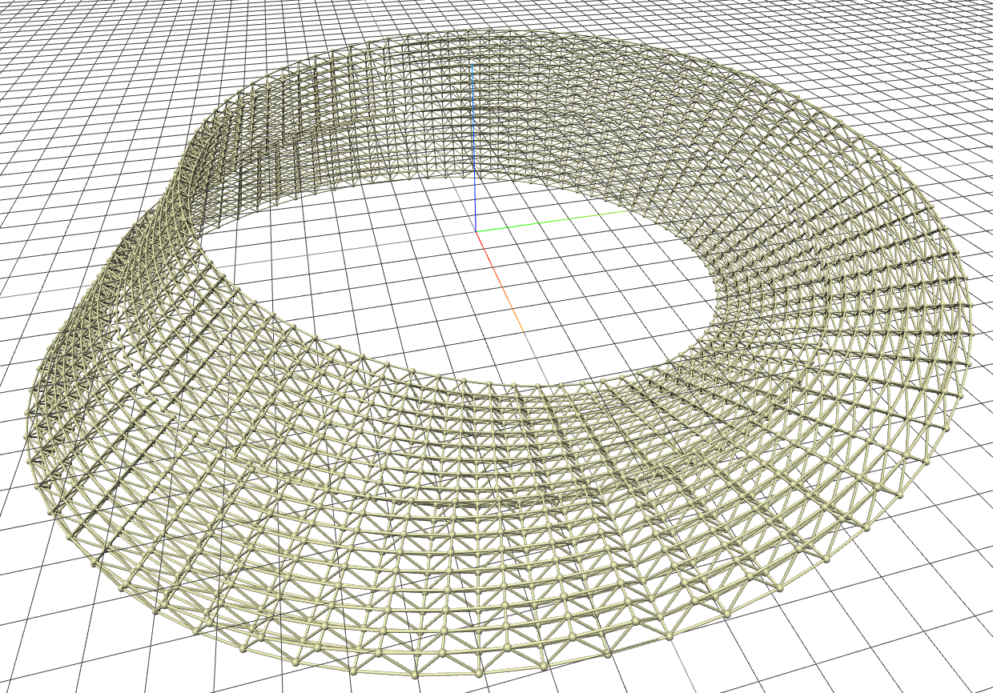
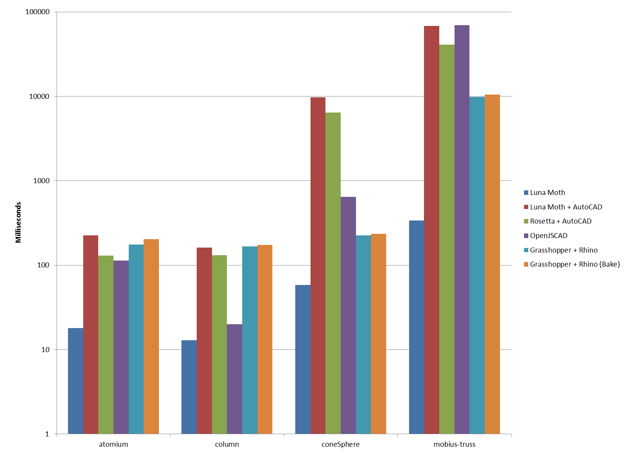

Slide 24
Future Work

Slide 25
Improve integration

Slide 26
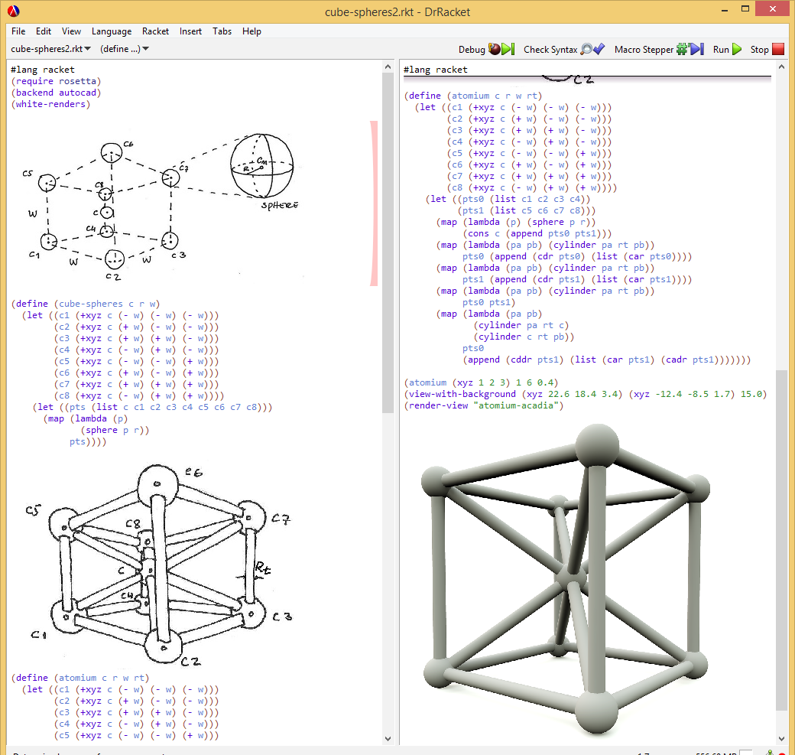
Improve programming experience
Code completion
Error reporting
Illustrated programming (Lopes and Leitão, 2014)
Timetable traceability
(as in Learnable Programming by Bret Victor)
(Lopes and Leitão, 2014)
Notes:
Illustrated programming
Timetable traceability
Code completion
Error reporting

Slide 27
Remote collaboration
Notes:
Collaboration, as emphasized by the web.
Sharing programs, editing programs collaboratively, showing program in a meeting,

Slide 28
CC BY-SA
https://www.flickr.com/photos/martinlatter/4732737190
https://commons.wikimedia.org/wiki/File:Beijing_national_stadium.jpg
https://commons.wikimedia.org/wiki/File:%E5%9B%BD%E5%AE%B6%E6%B8%B8%E6%B3%B3%E4%B8%AD%E5%BF%83%E5%A4%9C%E6%99%AF.jpg
https://commons.wikimedia.org/wiki/File:Espacio_Parasol_Sevilla.jpg
https://itp.nyu.edu/classes/sdieo-spring2013/files/2013/04/rhinopython6_loops.jpg
https://static.pexels.com/photos/247791/pexels-photo-247791.png
https://upload.wikimedia.org/wikipedia/commons/2/20/Grasshopper_MainWindow.png
http://www.grasshopper3d.com/group/geometrygym/forum/topics/grasshopper3d-geodesic-dome-structure-generator-ggdsg-geometry
https://www.flickr.com/photos/sjcockell/8425835703

