Slide 1
Algorithmic Design and Analysis
Fusing Disciplines
Rita Aguiar Carmo Cardoso António Leitão

Slide 2
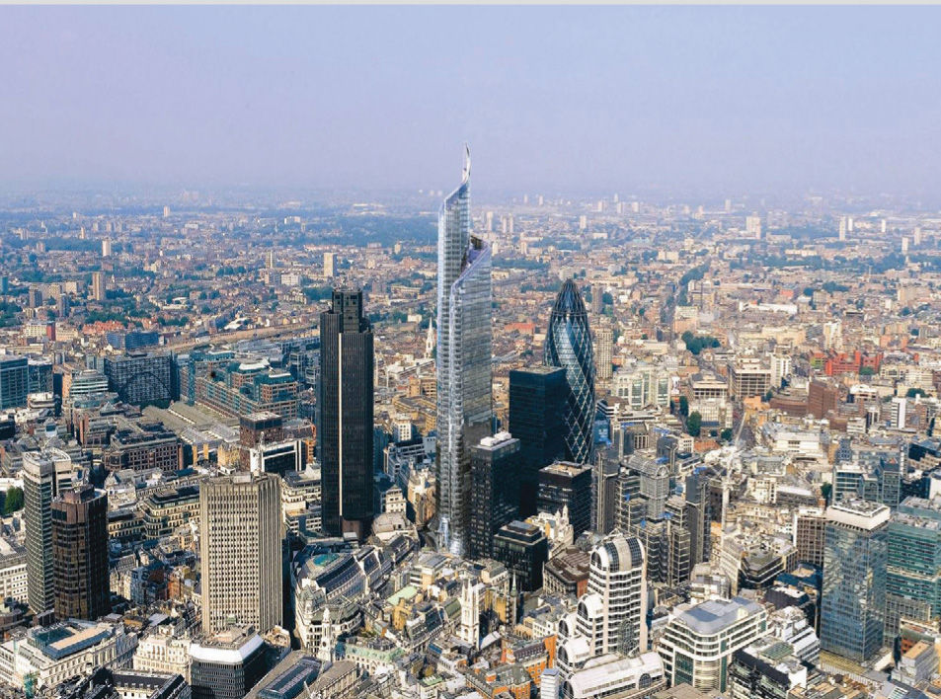
The Pinnacle, London, by KPF architects
Notes:
Today in the world of design and architectural project conception, the modeling tools available help the architect in the exploration and development of his designs. Furthermore, analysis tools have also emerged from a necessity of evaluating performance, and rapidly evolved to facilitate the analysis of buildings.

Slide 3
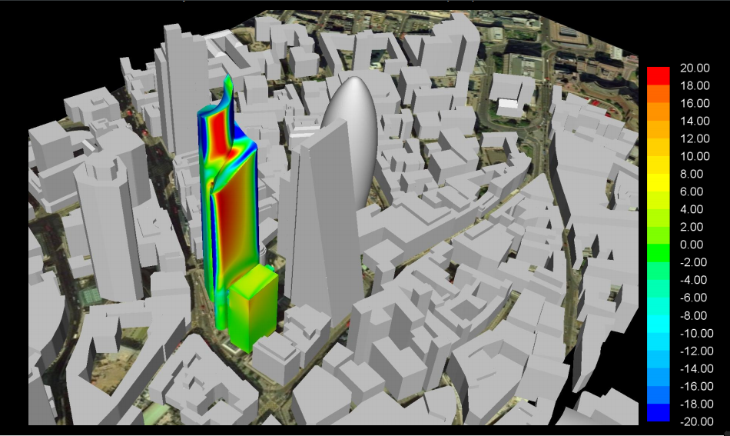
The Pinnacle, London, by KPF architects
Wind Pressure (Pa)
Notes:
The analysis tools require models adapted to the type of analysis to be performed, these models are called analytical models and can be distinguished from the geometric model created with modeling tools.

Slide 4
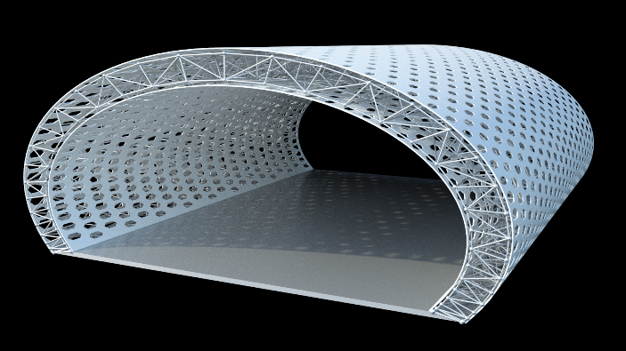
3D MODEL
of the geometry
Notes:
Here is an example of a geometrical model, which was obtained parametrically. However, when speaking of analysis, we require different models with different semantics for the same elements. (…)

Slide 5
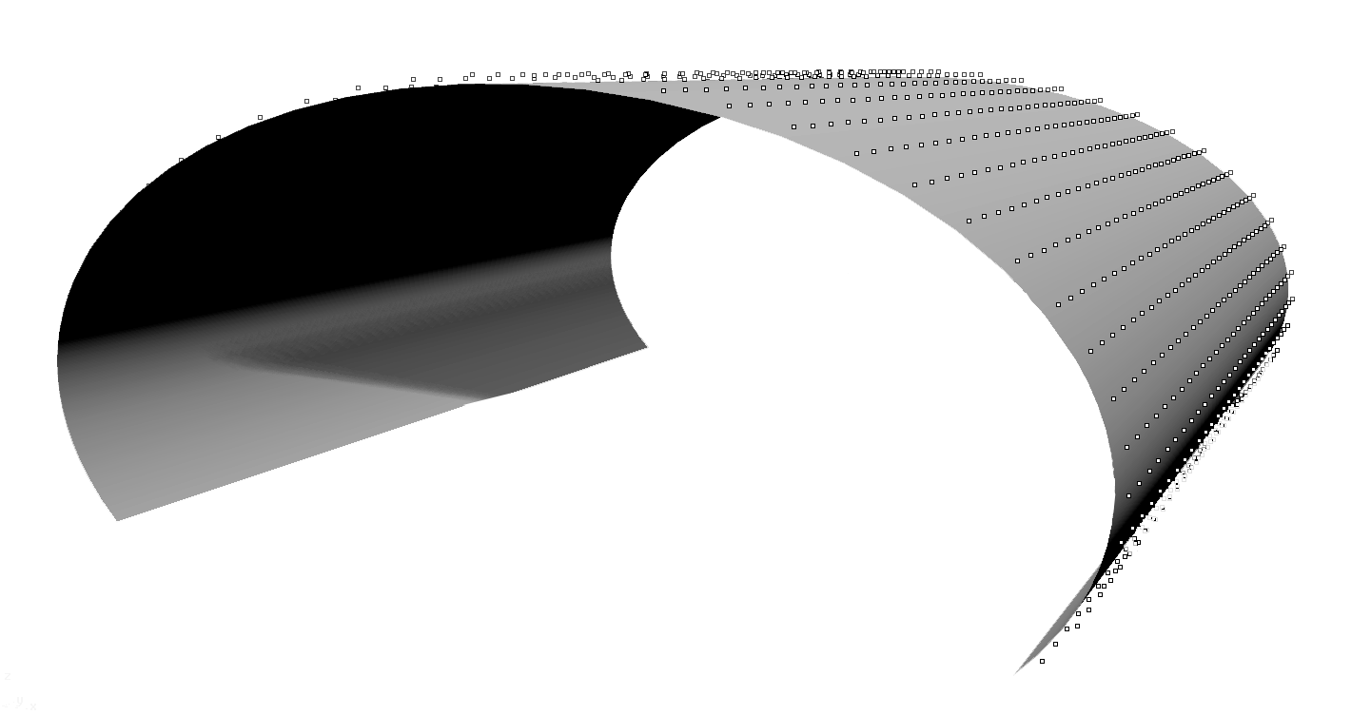
3D MODEL
of the geometry
Analytical Model for
Radiation Analysis
Notes:
If we intent to do a radiation analysis, the analytical model of the incident radiation requires information regarding materiality and the reflectivity of the building’s surfaces in contact with the exterior (instead of masses), as well as the sensor nodes to evaluate the incident radiation (…)

Slide 6
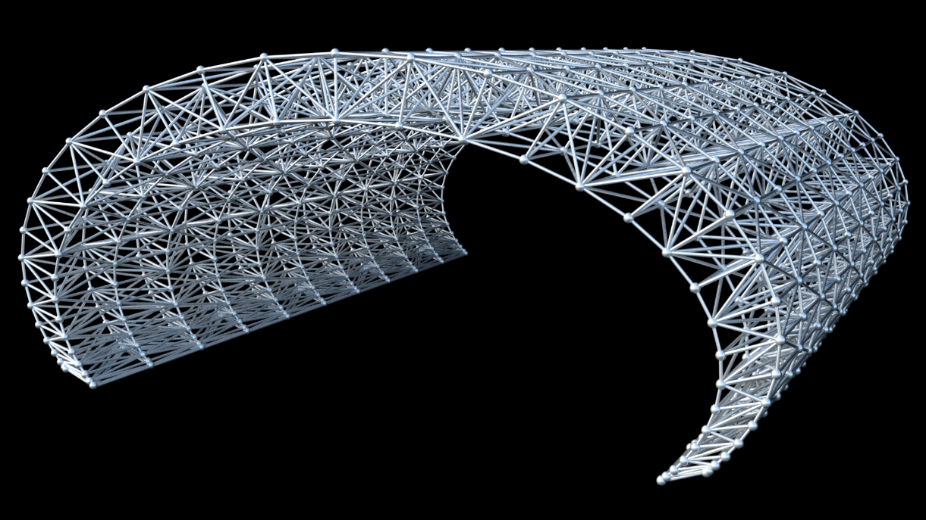
3D MODEL
of the geometry
Analytical Model for
Radiation Analysis
Analytical Model for
Structural Analysis
Notes:
If we intent to do a structural analysis we need to specify the geometry of the structural elements, represented by lines and nodes (instead of masses), as well as data on material properties, cross-sections, support and loads.

Slide 7
3D MODEL
of the geometry
Analytical Model for
Radiation Analysis
Analytical Model for
Structural Analysis
Notes:
Designers create the geometrical model to explore different options during the conceptual phase design phases, and spend spend a significant amount of time creating the geometrical model (…)

Slide 8
3D MODEL
of the geometry
Analytical Model for
Radiation Analysis
Analytical Model for
Structural Analysis
Notes:
(…) and if they wish to evaluate the performance of their designs, they have to dedicate additional time and effort to produce the analytical models for analysis. Analytical models have to include solely the specific information for the type of analysis in question and the elements must have the appropriate semantics. This discourages architects to perform an analysis of performance.

Slide 9
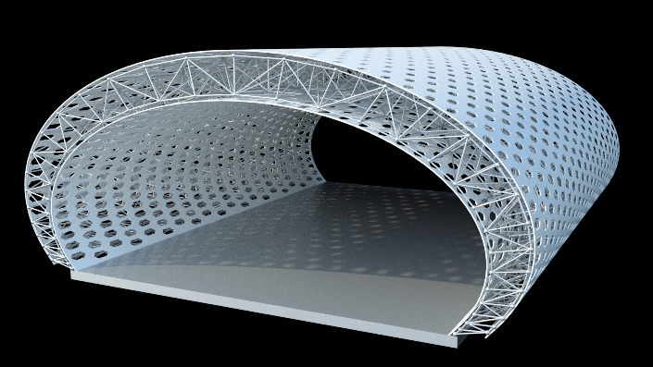
Parametric
Model
Design Process
Notes:
When taking advantage of Algorithmic-based approaches, architects can easily generate different variations of the same design by a script created with a parametric tool, to explore many design options.

Slide 10
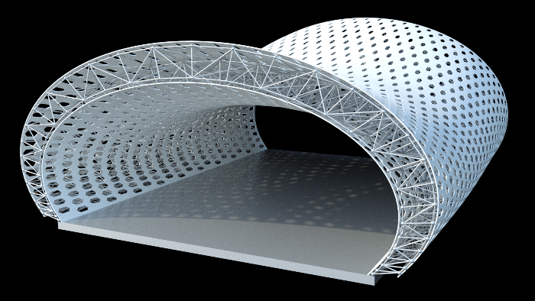
Parametric
Model
Design Process

Slide 11
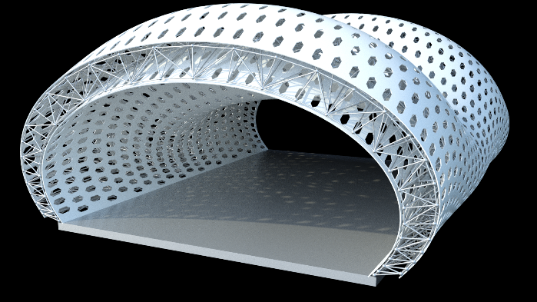
Parametric
Model
Design Process
Notes:
The architect puts all his effort into creating the script to generate the different parametric variations. (…)

Slide 12
Parametric
Model
Design Process
Notes:
(…) This exploration process could benefit from the analysis of all the relevant design variations considered by the architect. However, given the time and effort required to produce all the analytical models for the different variations, the analysis tools are frequently used only in later stages of a project (…)

Slide 13
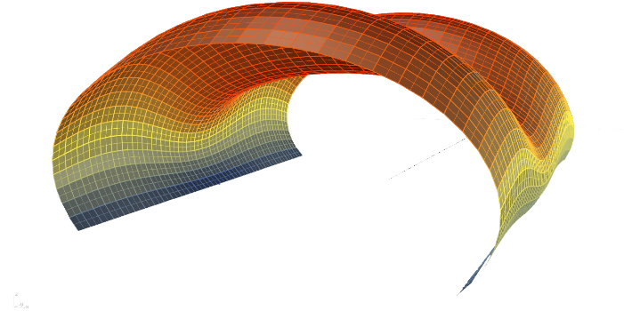
Parametric
Model
Design Process
Notes:
(…) so that that the chosen design can be validated in terms of performance, and so the architect makes some small adjustments according to the analysis results.

Slide 14
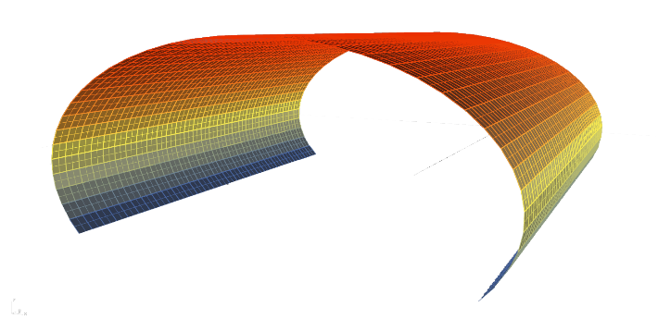
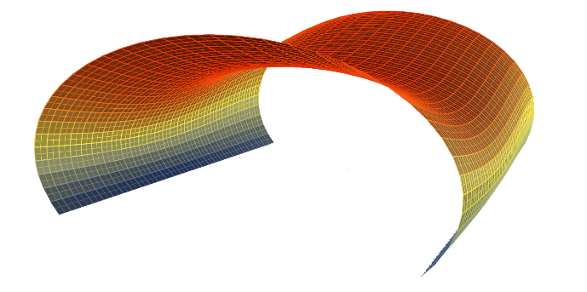
Parametric
Model
Design Process
Notes:
Considering that the analytical models take a lot of time and effort, designers will not be willing to evaluate several design variations. And so, the analysis process only takes place when the design is almost settled. But it is during the exploration of a design, that these tools could have a greater impact on the design choices and thus, improve performance. By doing analysis in the later phases of design we are probably not reaching the full performance potential.
So this led us to a question: What if we could integrate performance in the design process?

Slide 15
Parametric
Model
Design Process
Notes:
Architects have always considered aspects related to the functionality and use of their designs, to the environmental aspects such as solar radiation and winds, but not in a strict scientific manner, rather an intuitive one. Analysis tools provide us with rigorous results, that could work as a guiding principle to make informed design choices.
We want to achieve a situation where the same effort is implied to create both the geometrical models and the analytical models. But how does this integration differs from the current workflows?

Slide 16
Notes:
To solve this problem, we need to use a tool that supports parametric design.
First of all, we had to chose a parametric tool to work with. We used Rosetta which supports different programming languages and different CAD and BIM tools.

Slide 17
Notes:
We decided to test the structural analysis of the case study selected with the structural analysis software Robot, (...)

Slide 18
GG
Notes:
(…) using Karamba and GG plug-ins for Grasshopper. The analytical model is generated in Rhino, with solely the relevant information about the structural elements, and the structural analysis data (cross-sections, loads, etc) is input in Karamba’s components. The GG plug-in exports to Robot.
Even so, this workflow is extensive as it requires to input information on the Karamba components and to run Rosetta and GG. The analysis of the different variations is delayed since it is necessary to generate each variation at a time. Ideally, this task should be automated to facilitate the analysis of different variations (…)

Slide 19
Notes:
So we decided to connect Rosetta directly with the structural analysis tool Robot to automate the analysis of different variations. This workflow no longer depends on Karamba’s components to define material properties, loads and supports or GG to export to Robot and it does not depend on a modeling software.
The data information on structural analysis, such as loads and materiality, are described in the building’s script. Rosetta communicates directly with Robot to generate the analytical model and automate the analysis of the design variations. (…)

Slide 20
Notes:
We evaluated the structural performance of several variations of the case study here presented. This is the Shenzhen Bao’an International Airport located in Shenzhen in China.

Slide 21
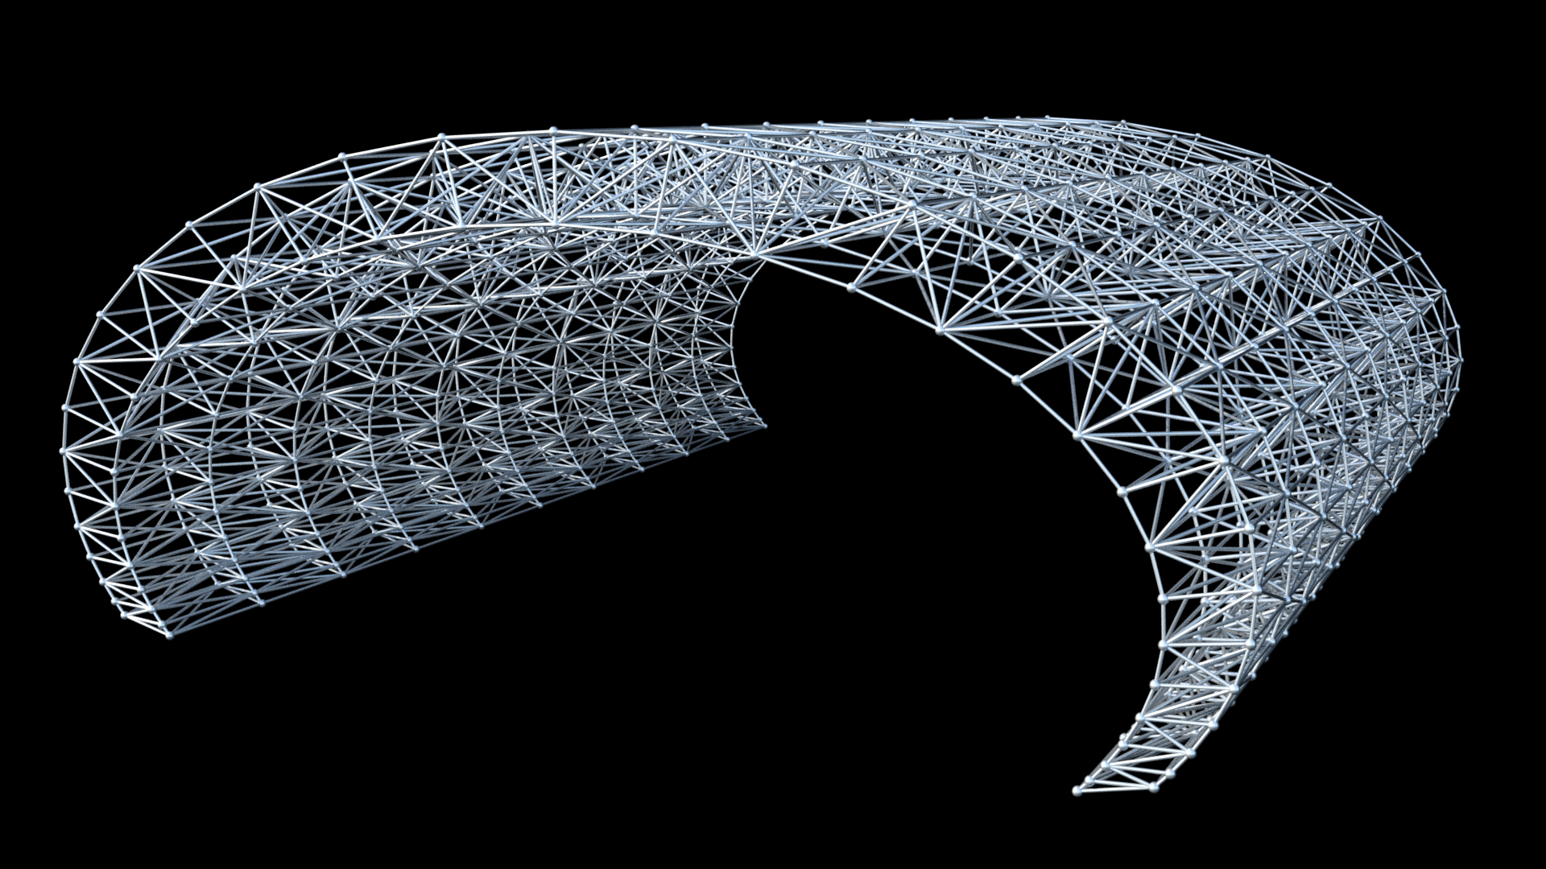
Notes:
This is the structural analytical model of the case study selected and we chose to evaluate 8 diferente truss type solutions for this structure to find the most suitable (…)

Slide 22
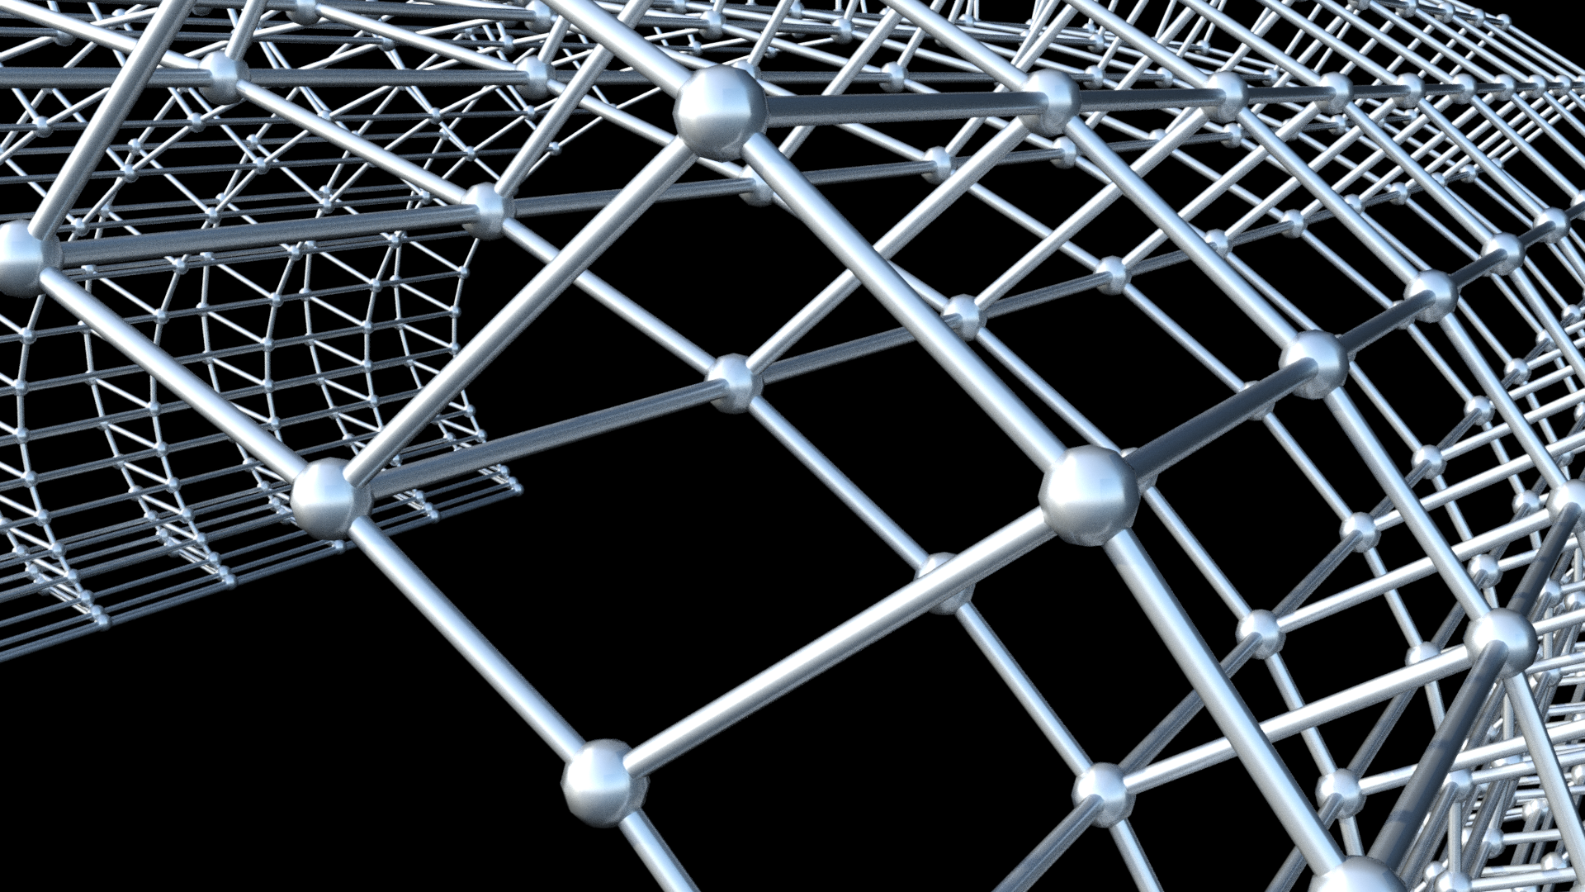
Vierendeel Beam
Notes:
These variations include the Vierendeel Beam, (…)

Slide 23
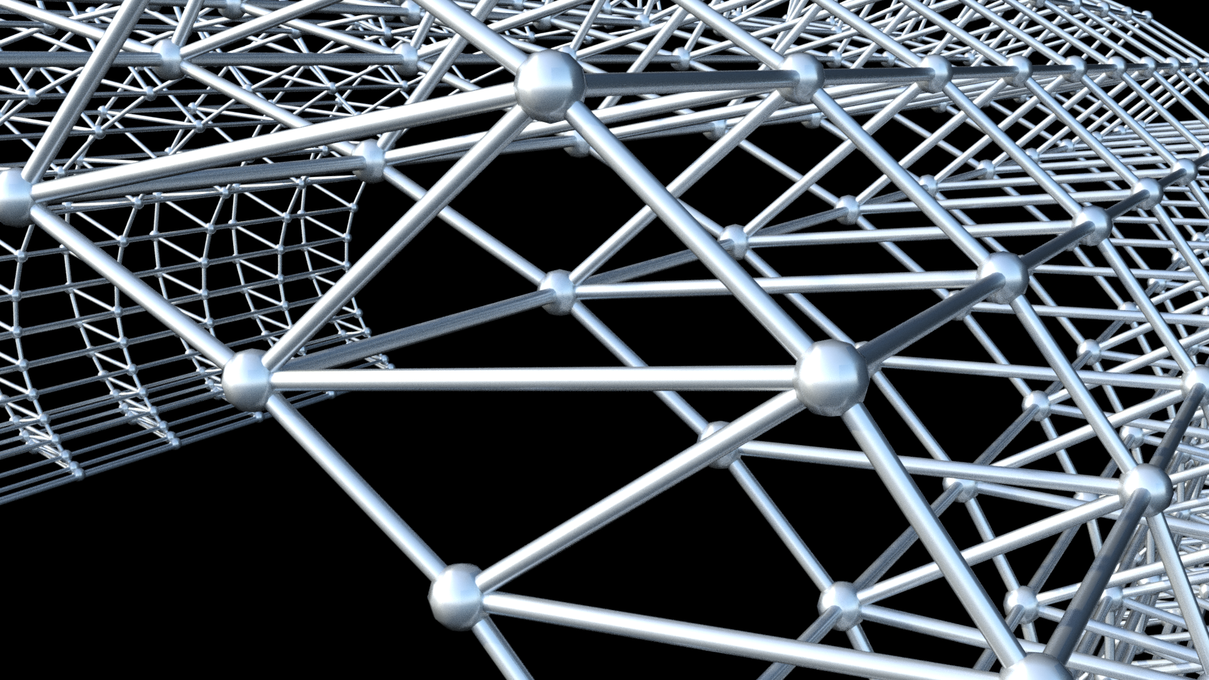
Planar Pratt
Notes:
(…), then by adding bracing we have Planar Pratt, (…)

Slide 24
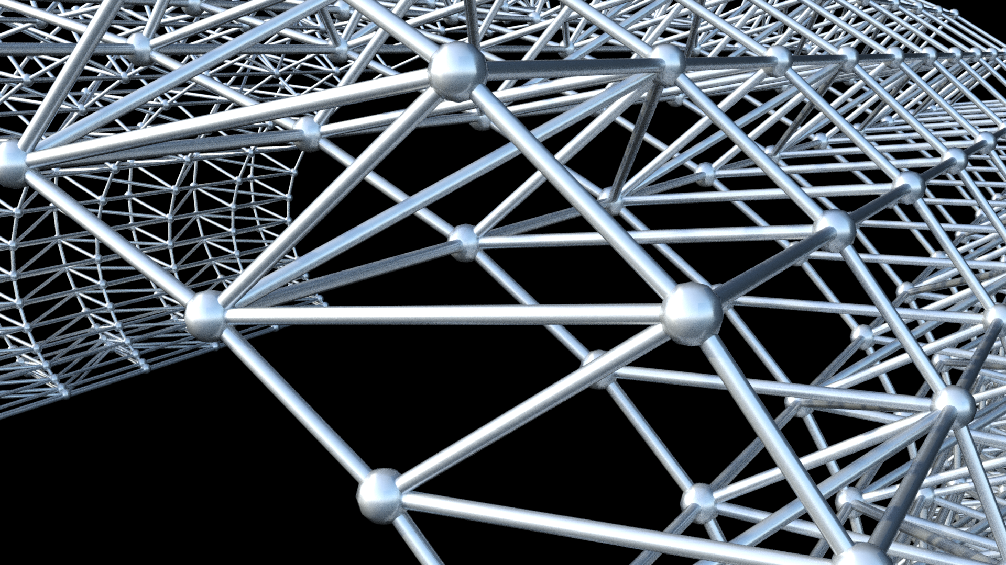
Planar Pratt + transversal bracing
Notes:
(…), transversal bracing, (…)

Slide 25
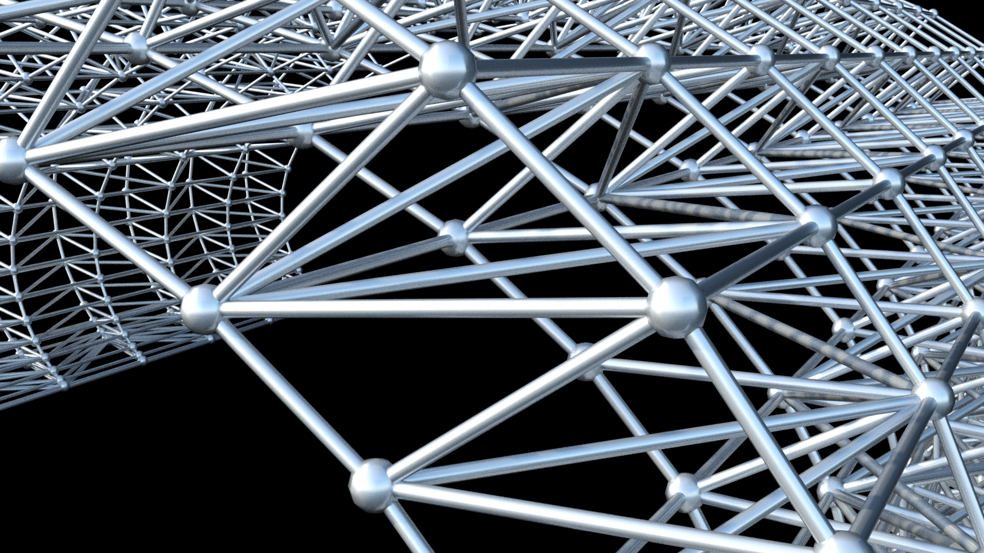
Planar Pratt + transversal bracing + spacial bracing
Notes:
(…), plus space bracing, (…)

Slide 26
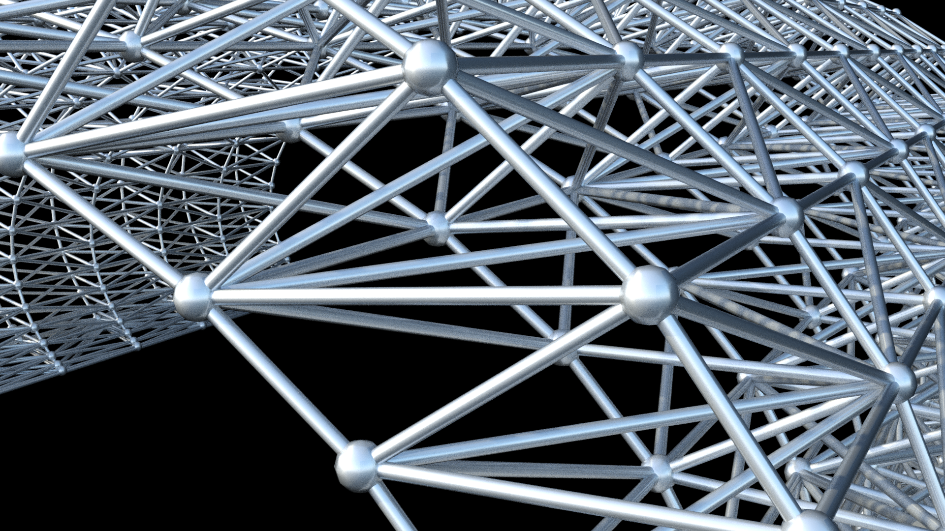
Pratt
Notes:
(…), top and bottom bracing, (…)

Slide 27
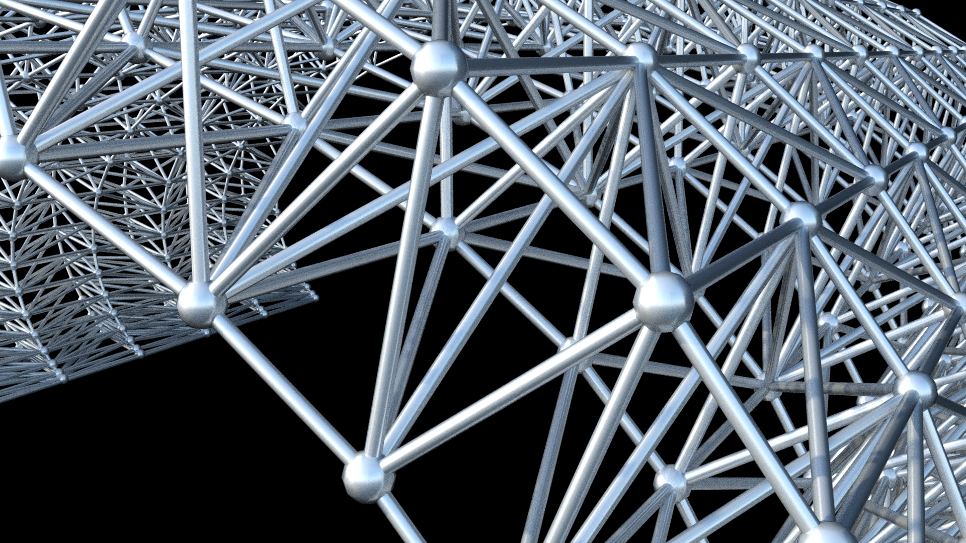
Howe

Slide 28
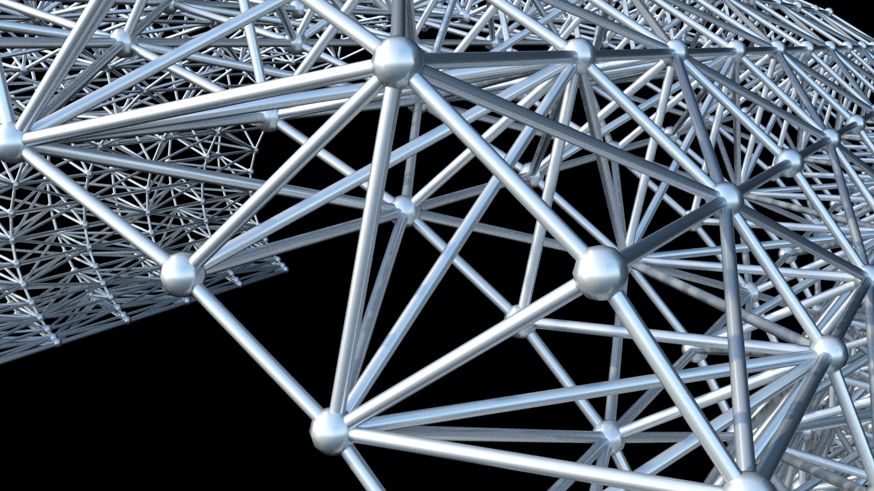
Warren with verticals

Slide 29
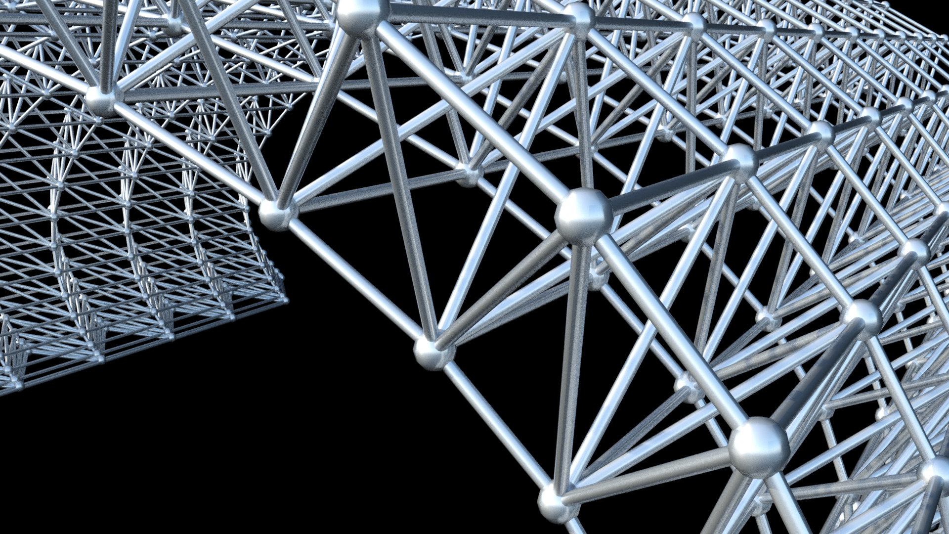
Warren

Slide 30
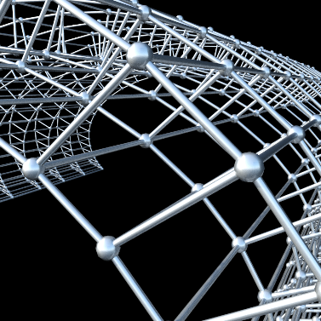
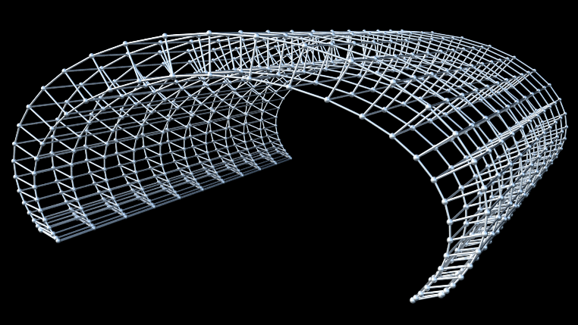
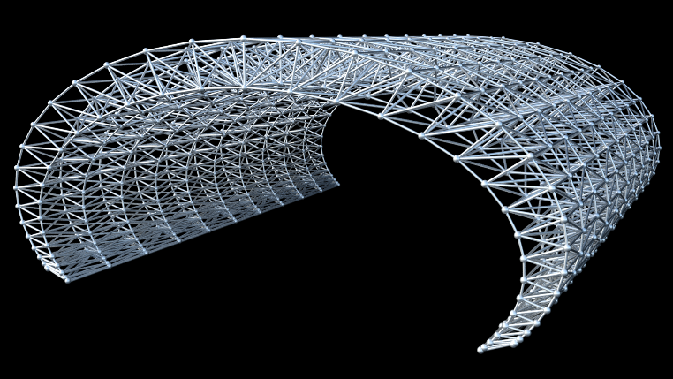
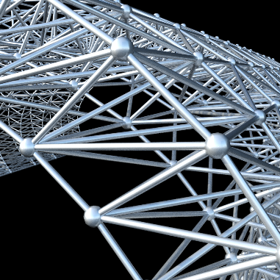
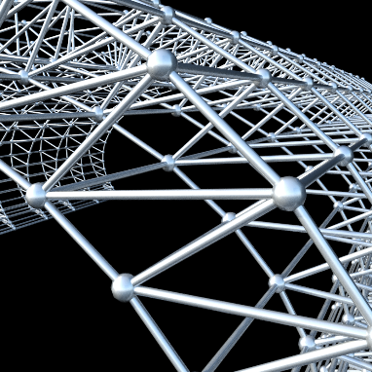
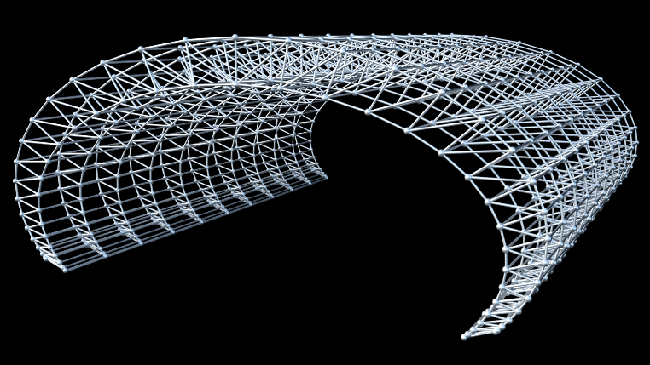
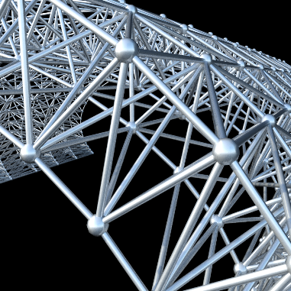
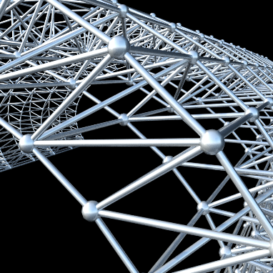
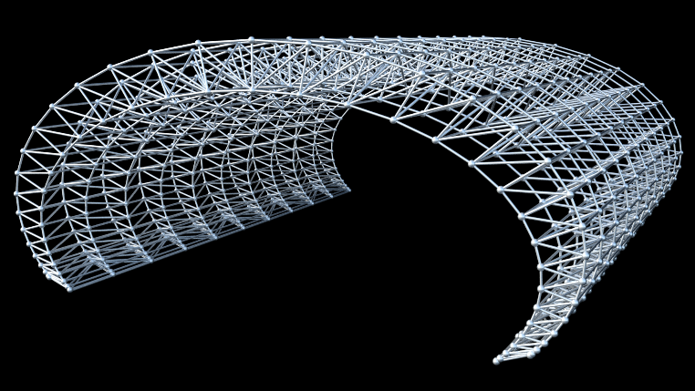
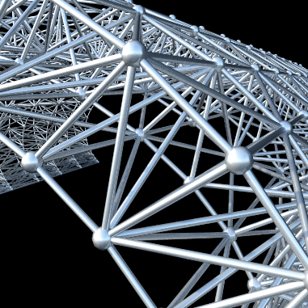
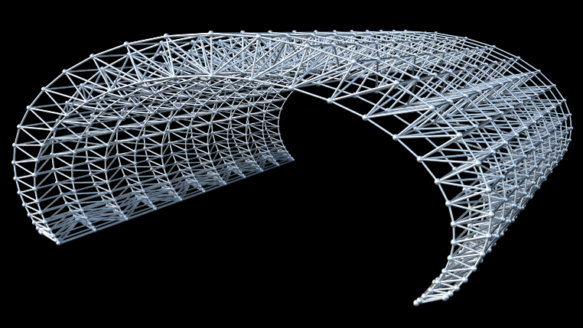
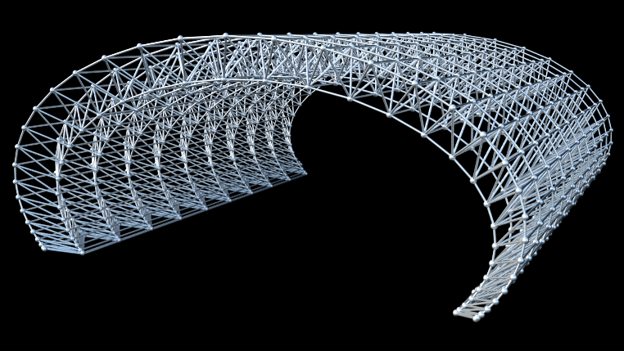
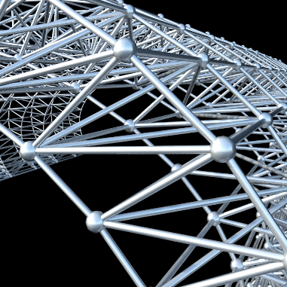
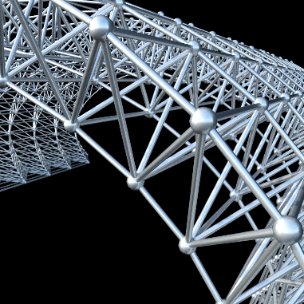
Vierendeel Beam
Pratt
Howe
Planar Pratt
Planar Pratt + transversal bracing
Warren w/verticals
Planar Pratt + transversal bracing + space bracing
Warren
Notes:
So here are summarized the eight case study variations which were evaluated. Using our approach we obtain the same results than using the previous workflow studied, but through a direct connection between the algorithmic-design tool Rosetta and the analysis software Robot. The 8 trusses were processed and analyzed one after the other automatically. All the connections between bars are welded.

Slide 31
Vierendeel Beam
Pratt
Planar Pratt
Howe
Planar Pratt + transversal bracing
Warren w/verticals
Planar Pratt + transversal bracing + space bracing
Warren
Notes:
We can obtain, for example, the deflection happening in the structure of each of the eight case studies and chose the truss type solution which is more suitable according to this criteria. In this case, Warren with verticals is the solution with the smallest displacement.

Slide 32
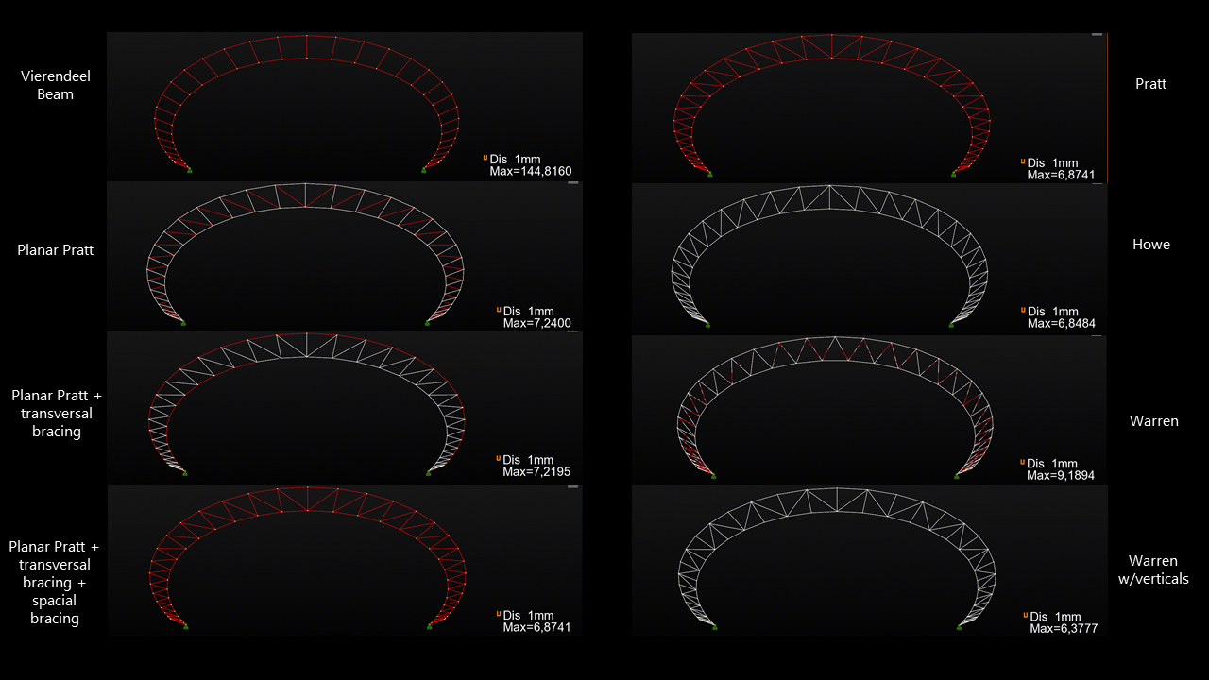
Vierendeel Beam
Pratt
Planar Pratt
Howe
Planar Pratt + transversal bracing
Warren w/verticals
Planar Pratt + transversal bracing + spacial bracing
Warren

Slide 33
Vierendeel Beam
Pratt
Planar Pratt
Howe
Planar Pratt + transversal bracing
Warren w/verticals
Planar Pratt + transversal bracing + spacial bracing
Warren
Notes:
We can obtain, for example, the deflection happening in the structure of each of the eight case studies.

Slide 34
Notes:
We then decided to test the radiation analysis of the case study using the analysis tool Radience.

Slide 35
Notes:
Using the DIVA plug-in for Grasshopper in Rhino, where we set-up data for the radiance analysis (reflectivity and materiality). Rosetta sends to Rhinoceros solely the information necessary to the analytical model of radiance analysis. However, this workflow is very extensive, information losses occur, it requires several steps to perform the analysis and it is difficult to automate the analysis of several variations.

Slide 36
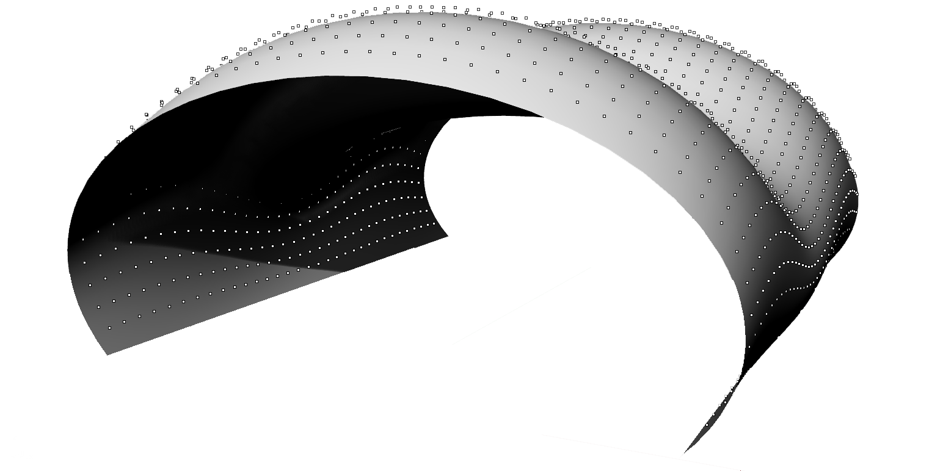
Notes:
And here is the analytical model containing the surface and the nodes. We evaluated the incident radiation on the building to obtain a radiation map. Rosetta sends to Rhinoceros solely the information necessary to the analytical model of lighting analysis, using DIVA we set-up the analysis information required to perform the analysis with Radience.

Slide 37
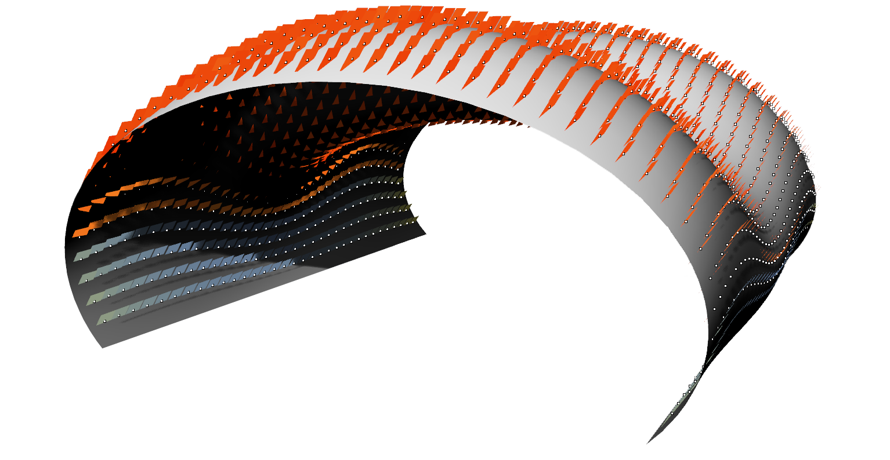
Notes:
However, the results obtained are unreliable. The results show that, due to incorrect computation of normal vectors for the curved surfaces of the case studies, the analysis radiation plans are incorrectly placed and thus the analysis is incorrect. DIVA causes information losses and has difficulties evaluating the radiation incident on curved surfaces since it computes a single normal vector for an entire surface.

Slide 38
Notes:
This lead us to change the workflow to avoid these issues, and we based our workflow on a direct connection between the algorithmic-design tool Rosetta and the analysis tool Radience.
This overrides any need for a 3d visualization modeling tool.

Slide 39
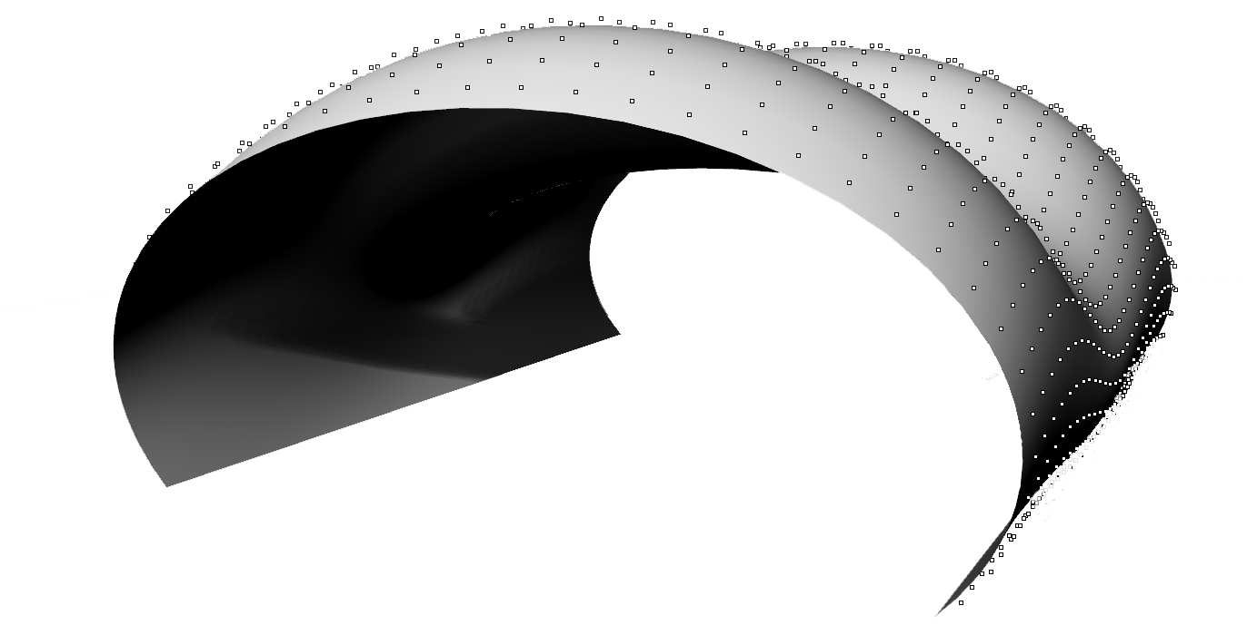
Notes:
And here is the analytical model containing the exterior surface of the case study and the sensor node to evaluate the incident radiation on and obtain a radiation map.

Slide 40
Notes:
Comparing the results of the previous workflow (…)

Slide 41
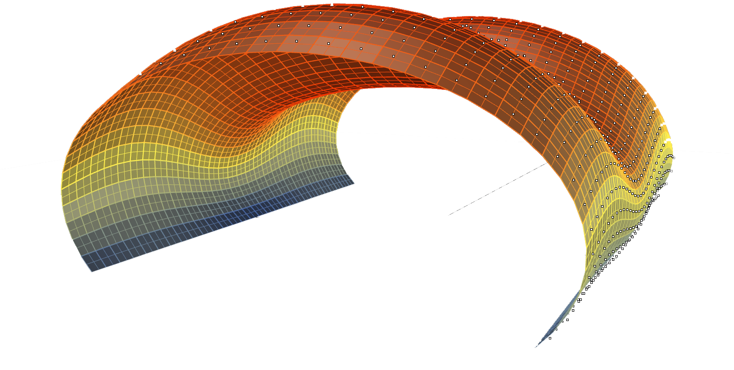
Notes:
We obtained the radiation map results with the direct connection between Rosetta and Radience, and decided to use them to produce hexagonal openings with different dimensions on the coverage of the building.

Slide 42
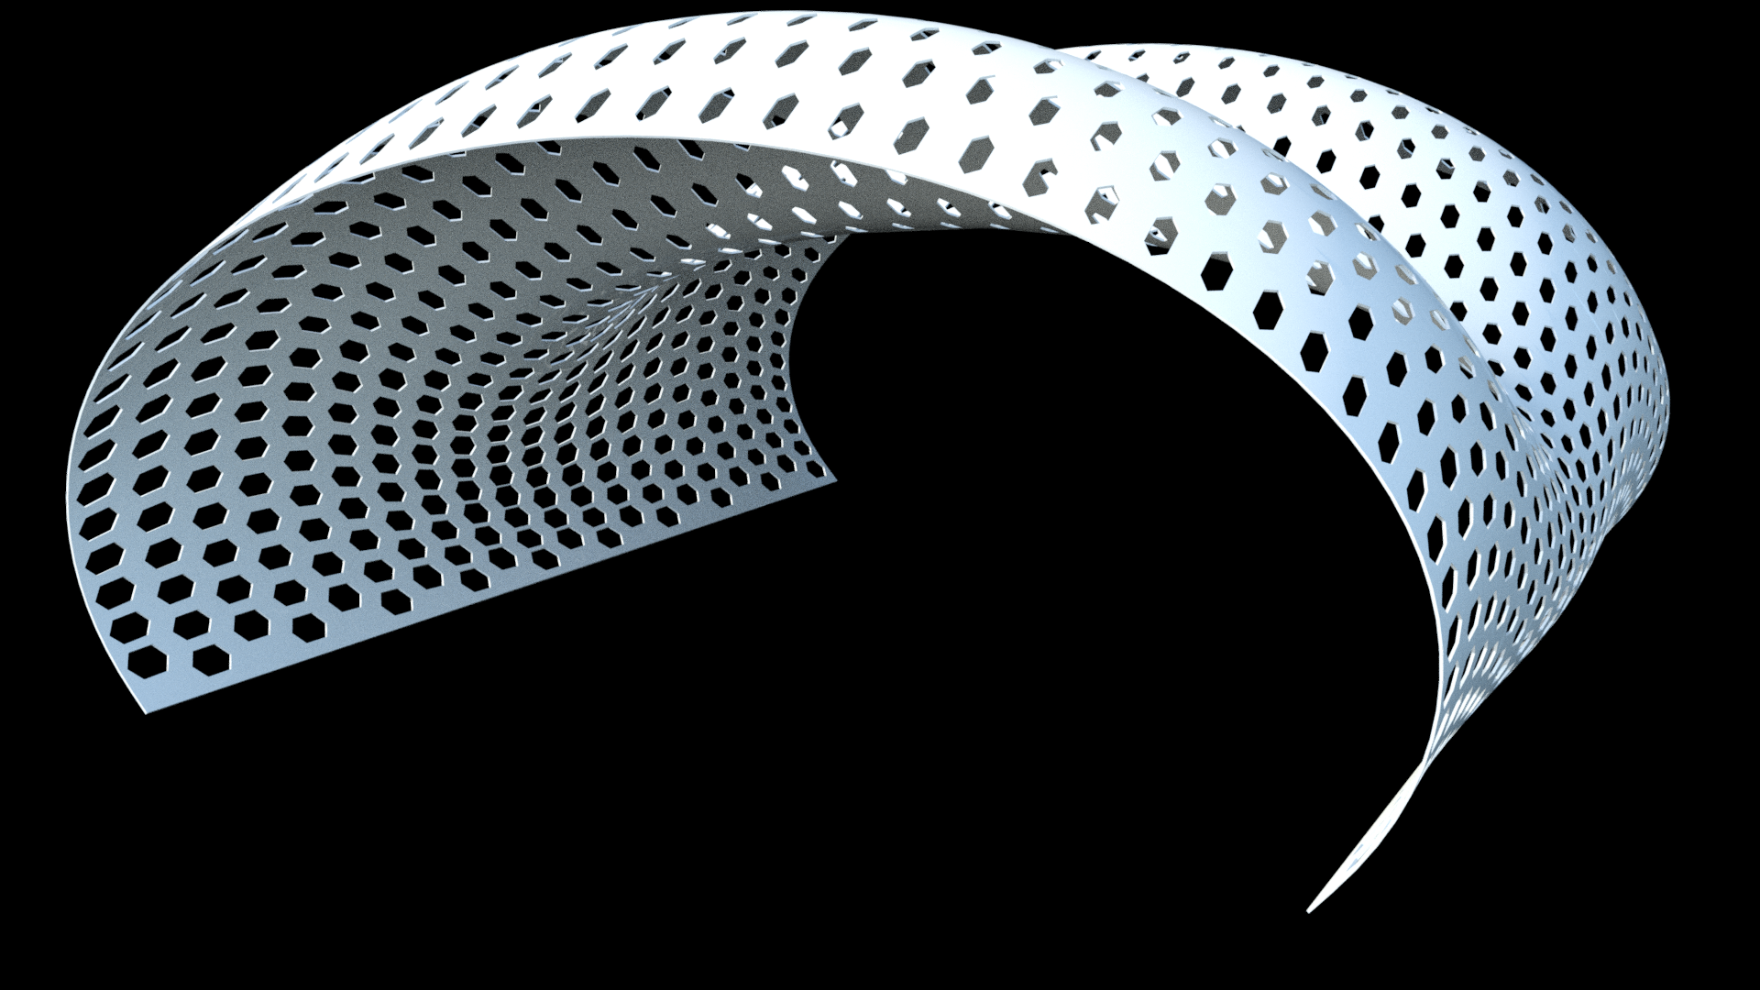
Notes:
This was the result, (…)

Slide 43
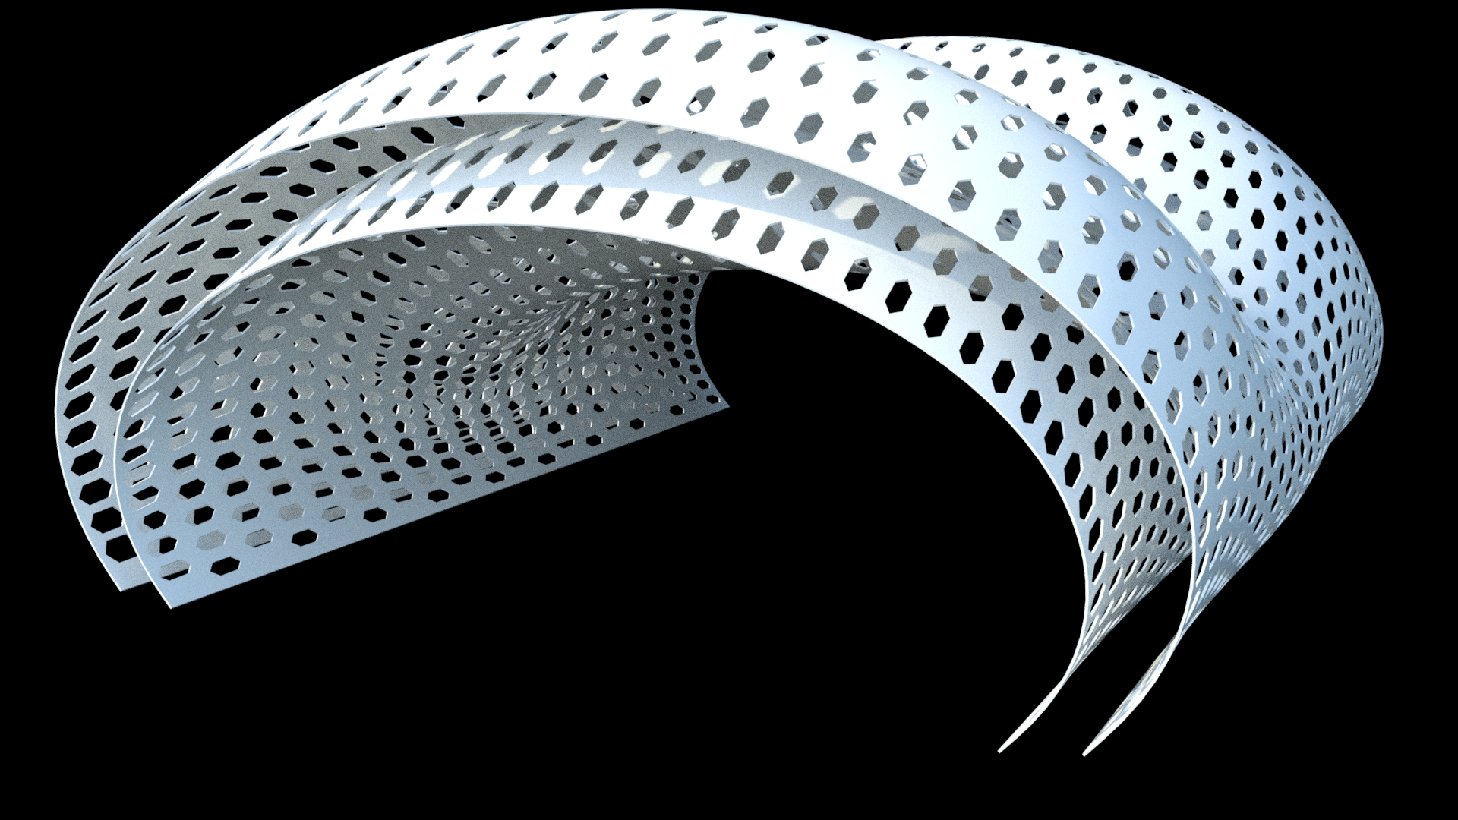
Notes:
(…), and we can now generate the geometrical model of the building with an interior layer of equal hexagonal openings, (…)

Slide 44
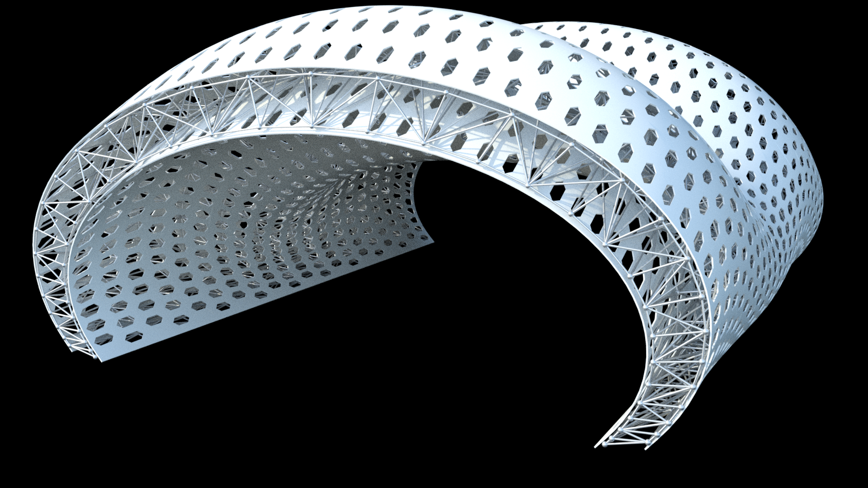
Notes:
(…), and the chosen truss type solution, (…)

Slide 45
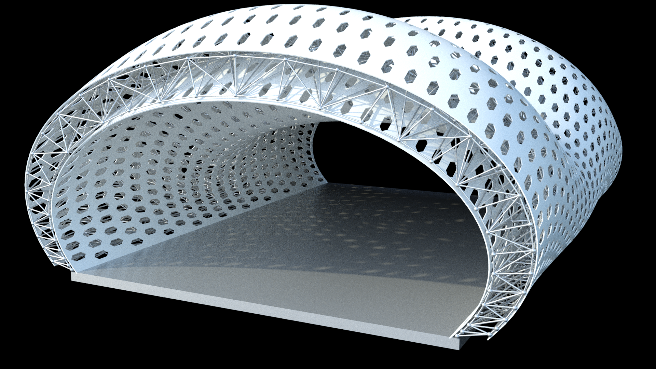
Notes:
(…).

Slide 46
Notes:
Using an algorithmic-design tool we were capable to directly connect with analysis software to generate analytical models to carry out performance analysis.

Slide 47
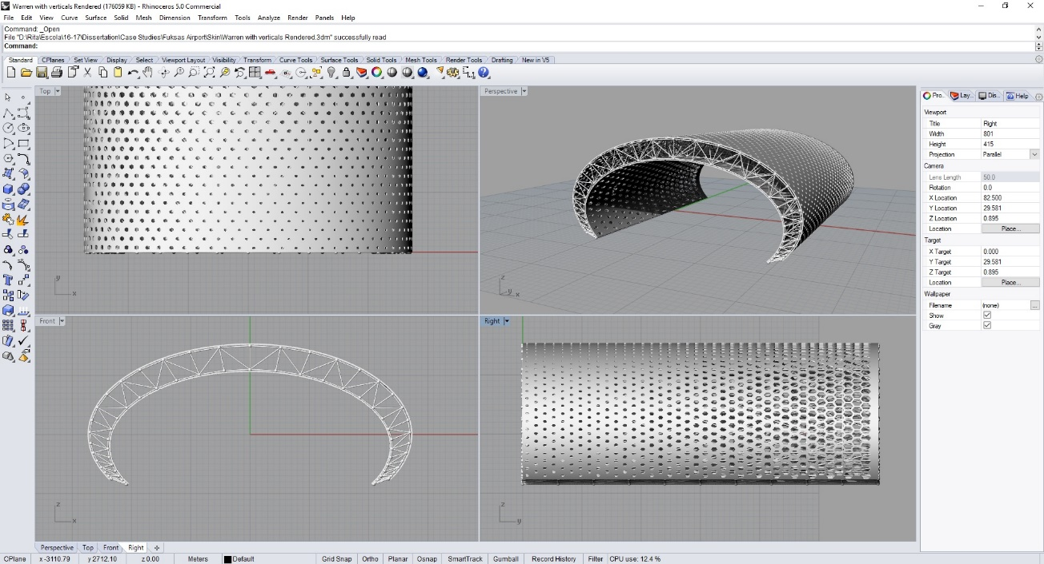
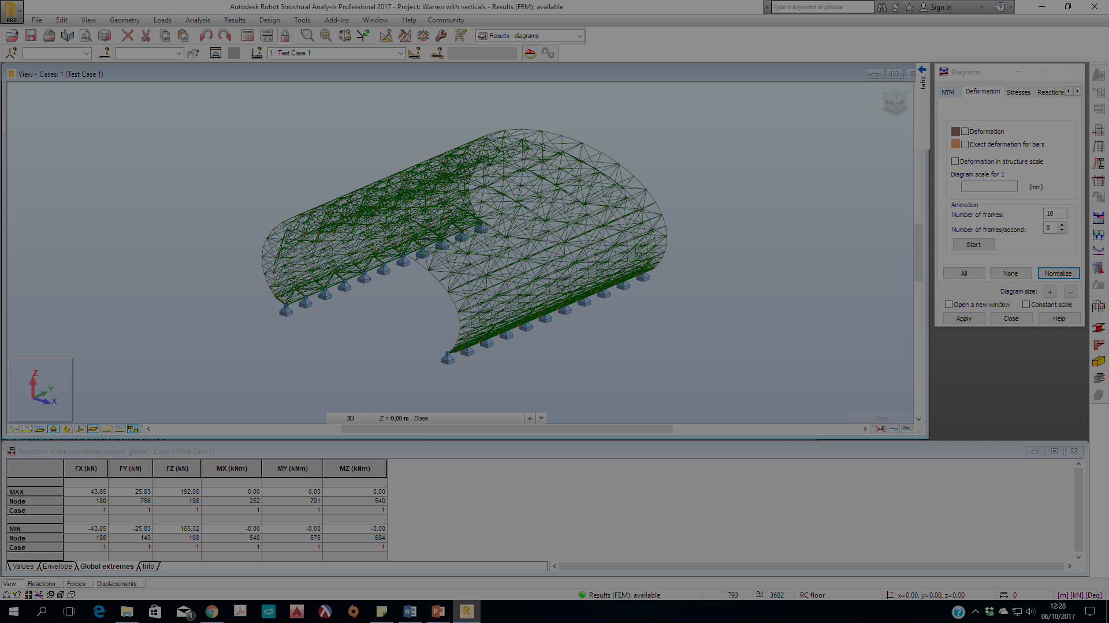
#lang racket
(require rosetta/rhino)
(define (superelipse p a b n t)
(+xz p
(* a (expt (expt (cos t) 2) (/ 1.0 n)) (sgn (cos t)))
(* b (expt (expt (sin t) 2) (/ 1.0 n)) (sgn (sin t)))))
(define (pontos-superelipse a b pts)
(λ(p)
(map-division (lambda (x)
(superelipse p a b n x))
psi0 psi1 pts
#t
(lambda (t) (/ (- 1 (cos (* t pi))) 2)))))
(define (truss-node-row row)
(if (null? row)
'()
(begin
(truss-node (car row))
(truss-node-row (cdr row)))))
(define (truss-nodes points-i points-s)
(if (null? points-i)
'()
(begin
(let ((a-i (car points-i))
(a-s (car points-s)))
(fixed-truss-node (car a-i))
(truss-node-row (cdr (drop-right a-i 1)))
(fixed-truss-node (last a-i))
(truss-nodes (cdr points-i) (cdr points-s))))))
(define fixed-truss-node-family (truss-node-family-element (default-truss-node-family)
#:support (create-node-support "SupportA" #:ux #t #:uy #t #:uz #t)))
(default-truss-bar-family (truss-bar-family-element (default-truss-bar-family)
#:material (list "ElasticIsotropic"
I_MT_STEEL
"Steel"
"I'm really steel"
210000000000.0
0.3
81000000000.0
77010.0
1.2E-05
0.04
235000000.0
360000000.0)
#:section (list "Tube"
"ElasticIsotropic"
#f
(list (list #t
0.1
0.01)))))
RHINO BACKEND
One script to rule them all
Notes:
This process is simple because the same script that produces the three-dimensional models is now capable of generating the analytical models according to the analysis tool used.

Slide 48
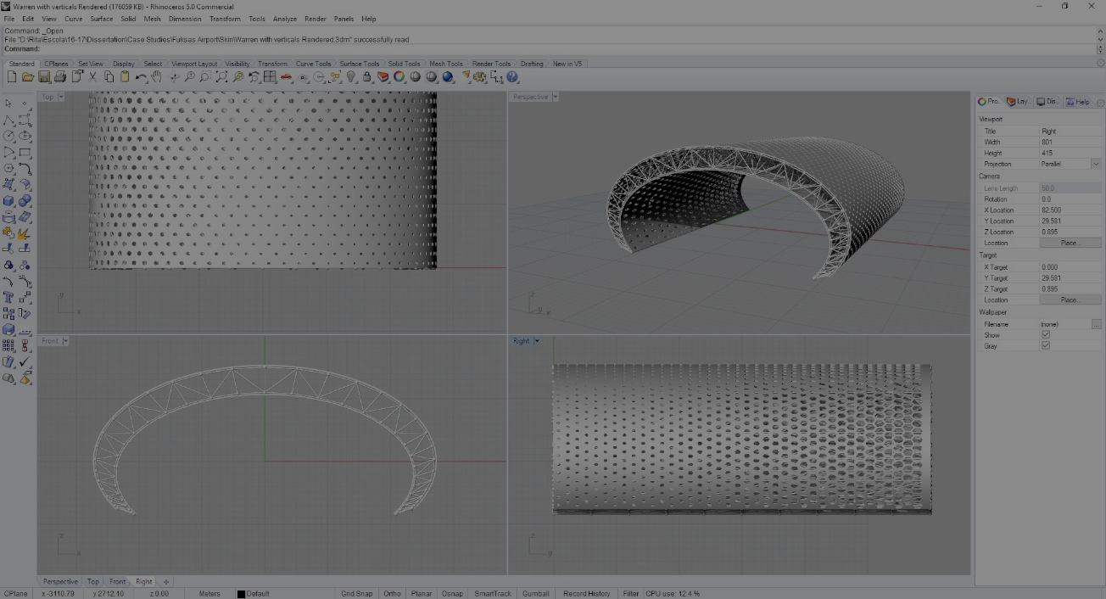
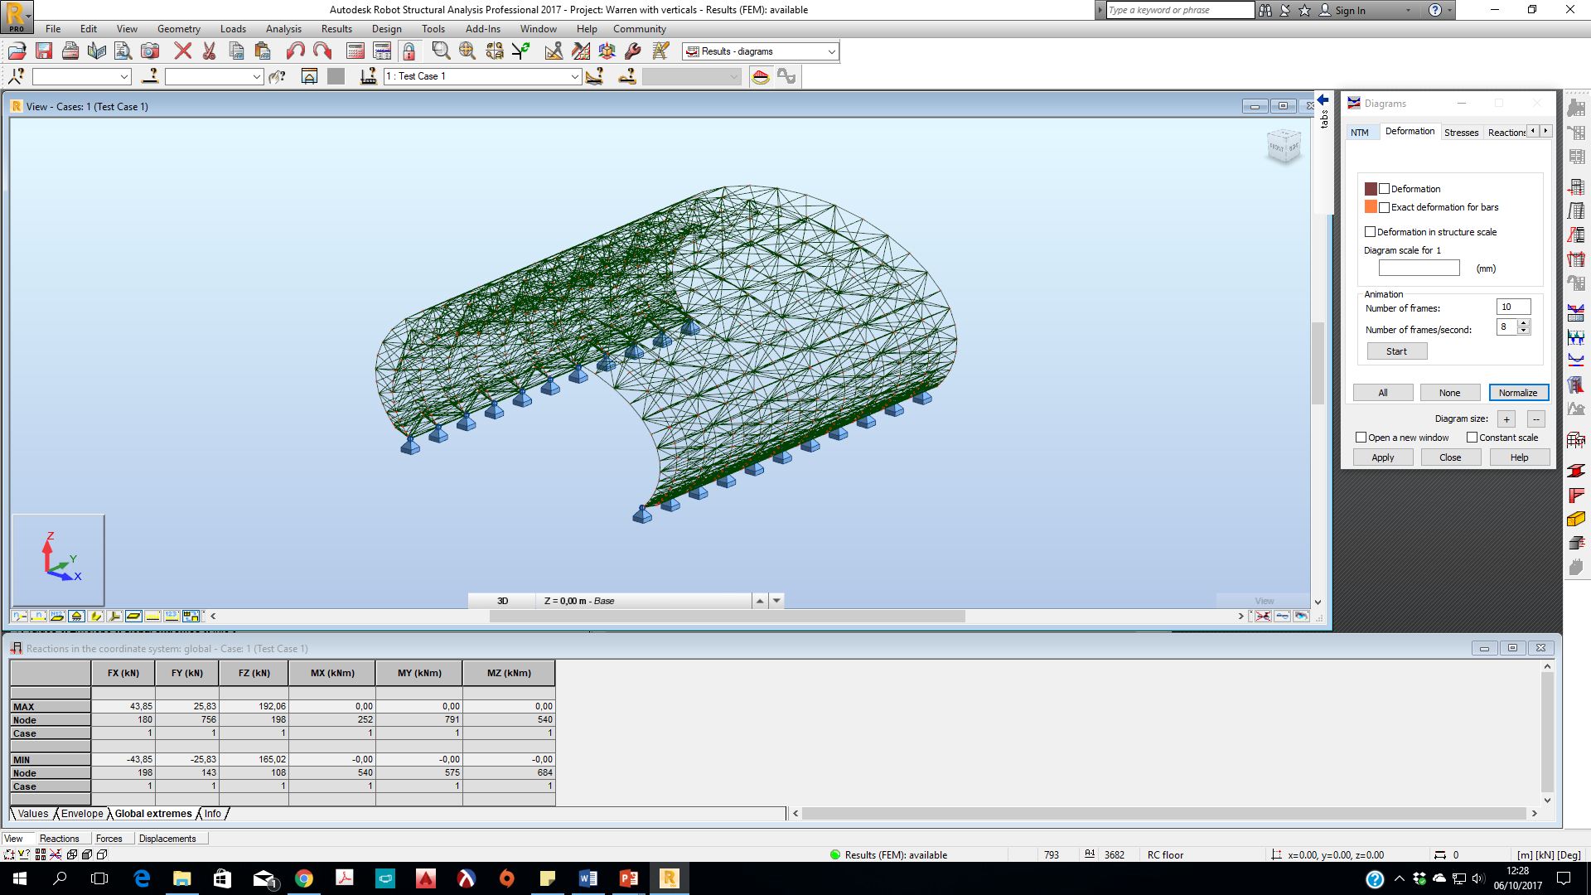
#lang racket
(require rosetta/robot)
(define (superelipse p a b n t)
(+xz p
(* a (expt (expt (cos t) 2) (/ 1.0 n)) (sgn (cos t)))
(* b (expt (expt (sin t) 2) (/ 1.0 n)) (sgn (sin t)))))
(define (pontos-superelipse a b pts)
(λ(p)
(map-division (lambda (x)
(superelipse p a b n x))
psi0 psi1 pts
#t
(lambda (t) (/ (- 1 (cos (* t pi))) 2)))))
(define (truss-node-row row)
(if (null? row)
'()
(begin
(truss-node (car row))
(truss-node-row (cdr row)))))
(define (truss-nodes points-i points-s)
(if (null? points-i)
'()
(begin
(let ((a-i (car points-i))
(a-s (car points-s)))
(fixed-truss-node (car a-i))
(truss-node-row (cdr (drop-right a-i 1)))
(fixed-truss-node (last a-i))
(truss-nodes (cdr points-i) (cdr points-s))))))
(define fixed-truss-node-family (truss-node-family-element (default-truss-node-family)
#:support (create-node-support "SupportA" #:ux #t #:uy #t #:uz #t)))
(default-truss-bar-family (truss-bar-family-element (default-truss-bar-family)
#:material (list "ElasticIsotropic"
I_MT_STEEL
"Steel"
"I'm really steel"
210000000000.0
0.3
81000000000.0
77010.0
1.2E-05
0.04
235000000.0
360000000.0)
#:section (list "Tube"
"ElasticIsotropic"
#f
(list (list #t
0.1
0.01)))))
ROBOT BACKEND
One script to rule them all
Notes:
It is not only capable of generating these analytical models without the need for any additional effort by the architect, it also allows the automation of numerous analyzes in a row, thus encouraging a wider performance-oriented design exploration.

Slide 49
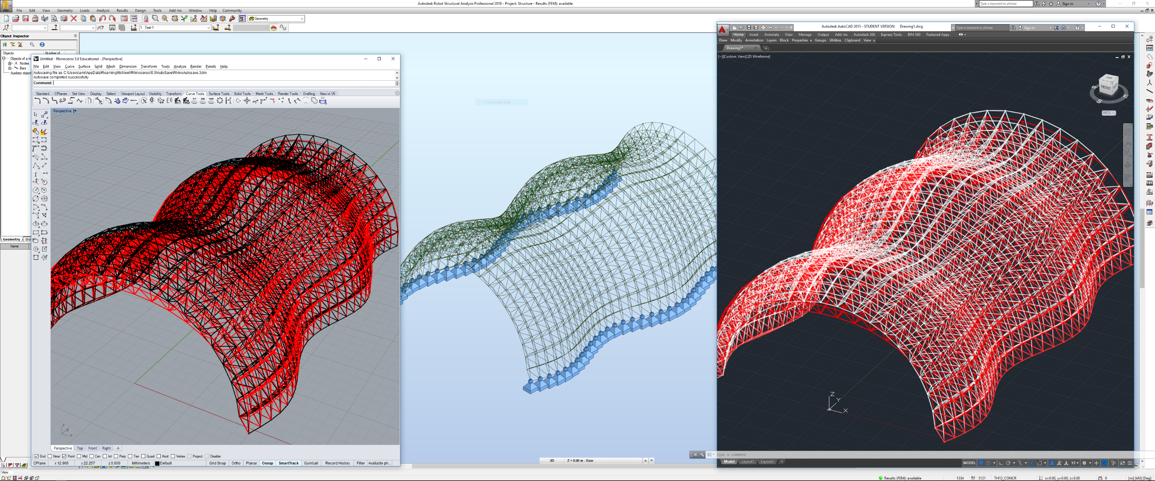
Notes:
We can also take advantage of Rosetta’s interoperability with CAD tools to generate models of the results obtained with the analysis tools. Here is an example of the deformed model of a truss seen in both AutoCAD and Rhino.

Slide 50
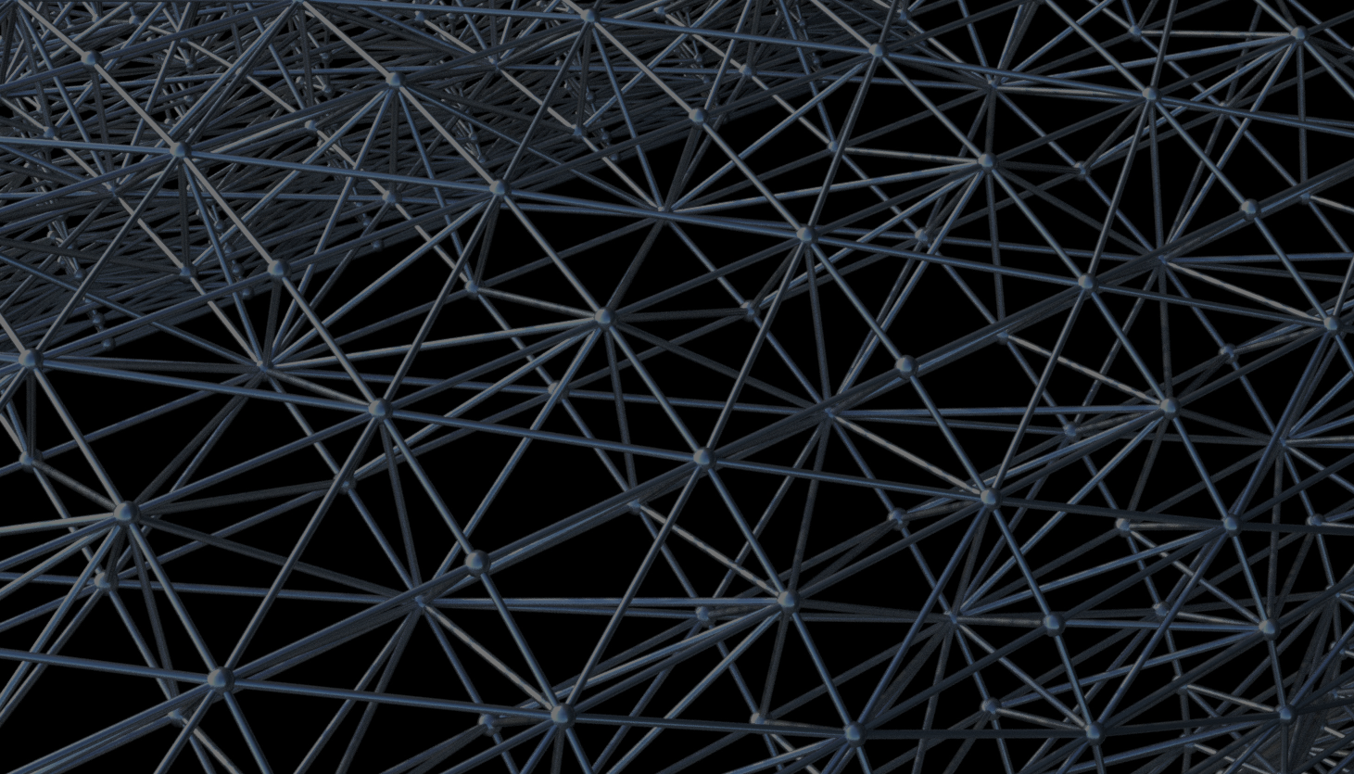
Thank you
Rita Aguiar
rita.aguiar@tecnico.ulisboa.pt
Carmo Machado Cardoso
ccardoso@soft-grid.com
António Menezes Leitão
antonio.menezes.leitao@tecnico.ulisboa.pt
https://algorithmicdesign.github.io/

