Slide 1
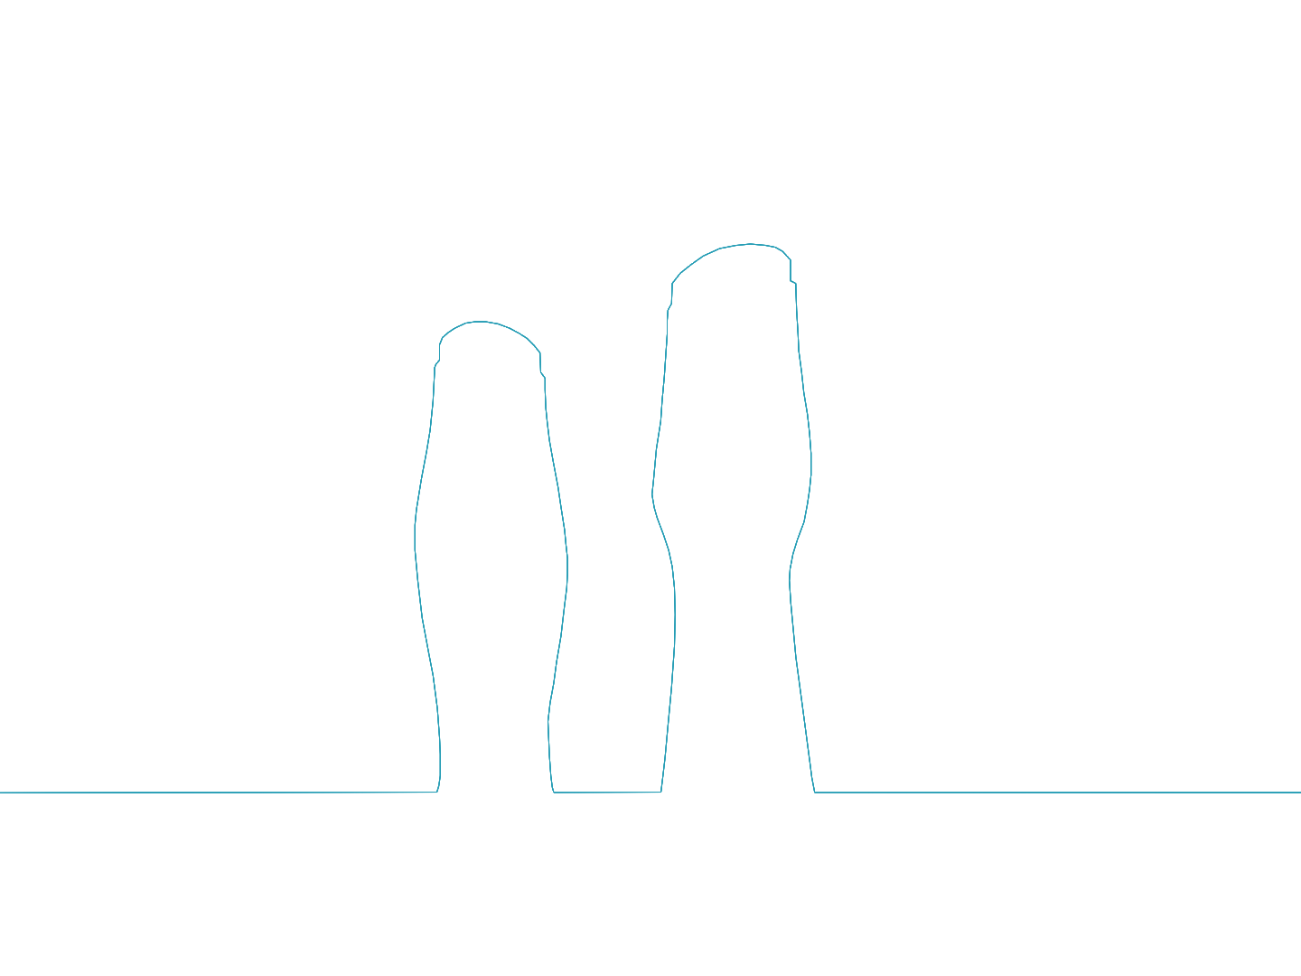
Portable Generative Design for Building Information Modelling
Sofia Feist
Bruno Ferreira
Guilherme Barreto
António Menezes Leitão
Notes:
Good morning. My name is Sofia Feist. The topic of my presentation is Portable Generative Design on Building Information Modelling.

Slide 2
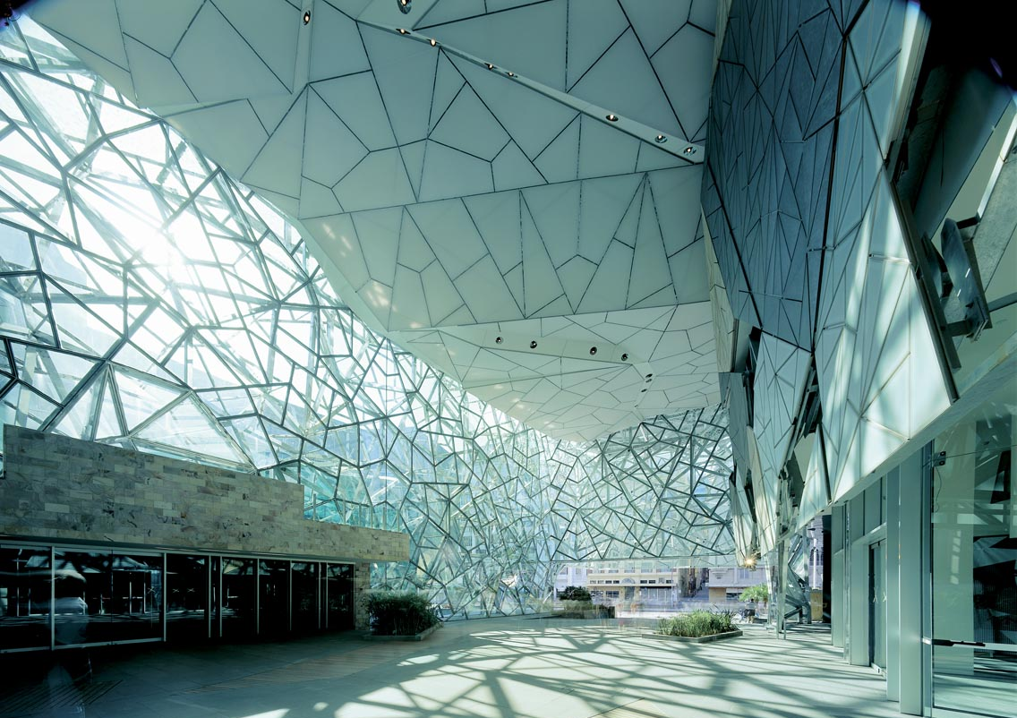
Federation Square
Lab Architecture Studio
Photo taken from: meinphoto.com/
Generative Design
Notes:
So first of all, what is Generative Design? Generative Design, or GD, is a programming approach to design which allows the generation of forms and shapes through algorithms. This approach introduced a whole new field of design exploration in architecture, allowing architects to efficiently explore and conceive complex forms. GD also allowed the automation of repetitive, time-consuming tasks that had to be manually executed before, thus relieving architects from tedious and error-prone work.

Slide 3
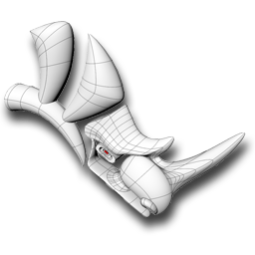
Rhinoceros
grasshopper
Rhinoscript
Visual LISP
Visual Basic
for Applications
GD Tools for CAD
Notes:
Realizing the advantages of GD, several tools and programming environments were introduced to CAD software, allowing architects with basic programming skills to explore Generative Design in CAD applications. Such is the case of Grasshopper and RhinoScript for Rhino 3D as well as Visual LISP and Visual Basic for AutoCAD.

Slide 4
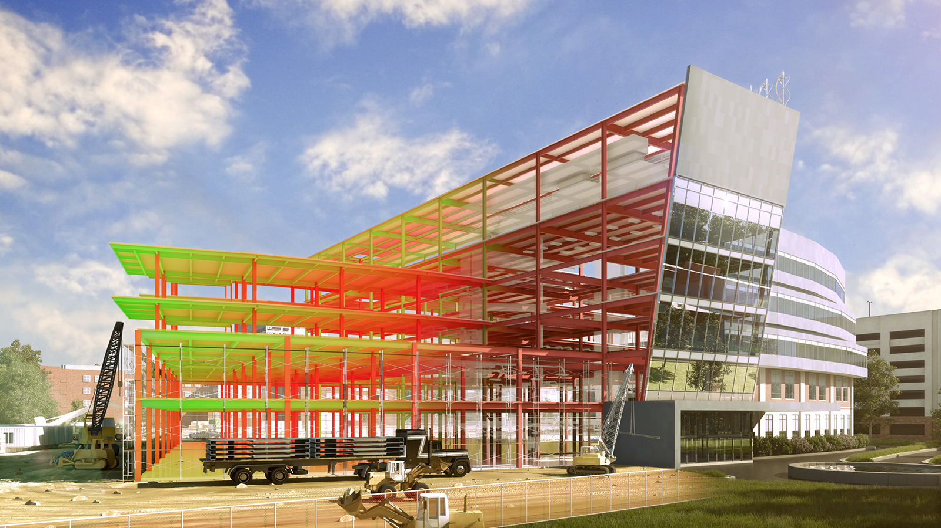
Image taken from: asiagreenbuildings.com
Building Information Modelling
Notes:
Recently, however, Building Information Modelling has been replacing CAD in architecture as a new design methodology based on the development of an intelligent, 3D model of a building, containing all relevant data for design and construction.
BIM can still benefit from the advantages of GD mentioned earlier and, for that reason, it is tempting to combine the two approaches.

Slide 5
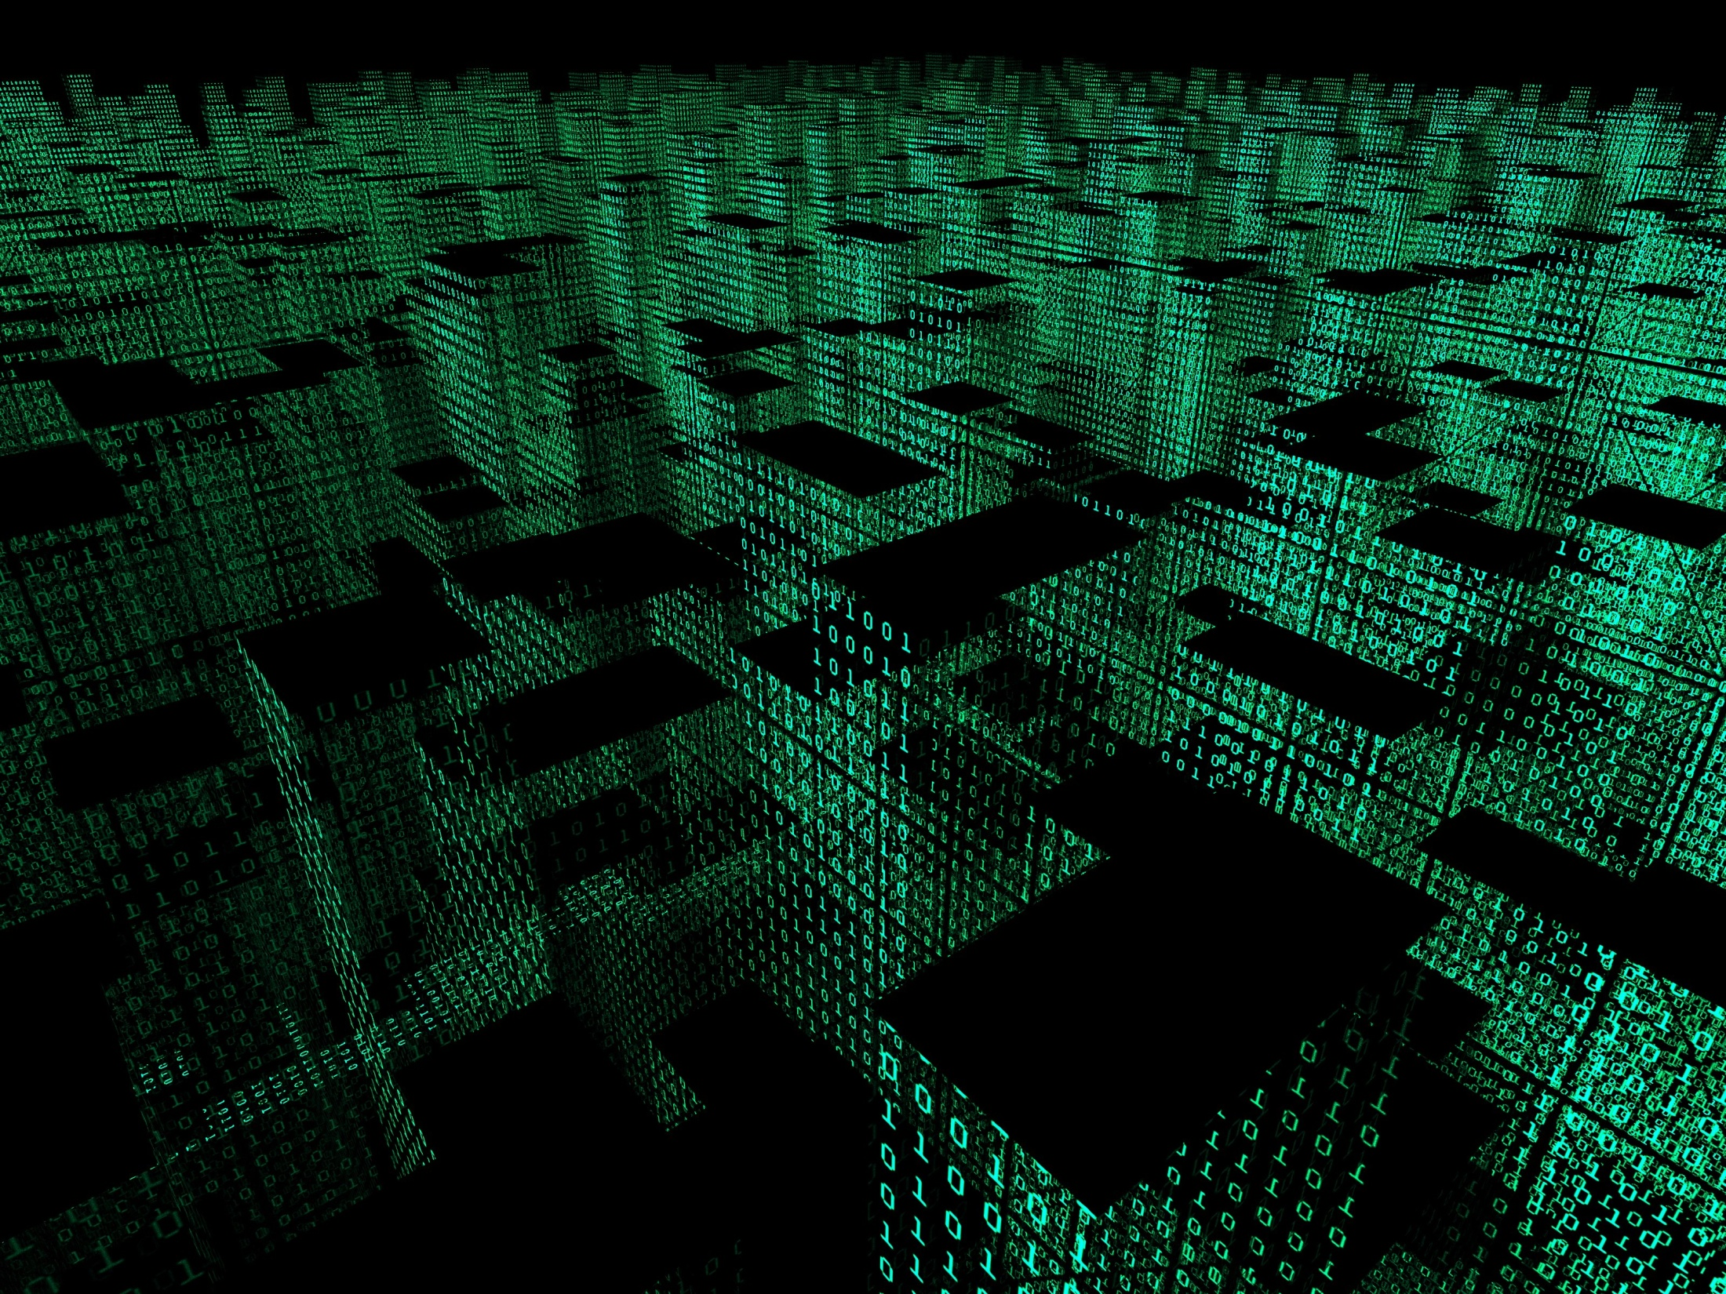
What exactly does programming for BIM entail?
Image taken from: ices.dk
Algorithmic-based Building Information Modelling – A-BIM
Notes:
To that effect, we propose Algorithmic-based Building Information Modelling, or A-BIM, a GD approach to BIM where we model and develop buildings through programming. A-BIM requires a different approach from the one needed for CAD since programming for BIM is not the same as programming for CAD. And that brings us to an important question: what exactly does programming for BIM entail and how is it different from CAD?

Slide 6
CAD
BIM
Box
Wall
Box
Slab
box(a, b, ...)
box(c, d, ...)
wall(a, b, ...)
slab(c, d, ...)
Semantics – A-BIM
Notes:
Well, first of all, one major difference between CAD and BIM is related to the fact that a BIM tool does not just create geometry; it creates building components containing all the semantic information related to that component. For example, when programming for CAD, a slab and a wall can both be created using a generic geometric operation, such as a box. When programming for BIM, on the other hand, they are two distinctly different BIM objects and require different operations with different semantics to be created: a wall operation to create a wall and a slab operation to create a slab.

Slide 7
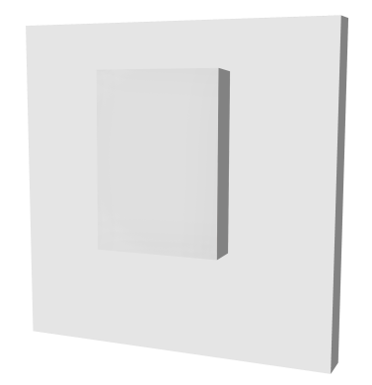
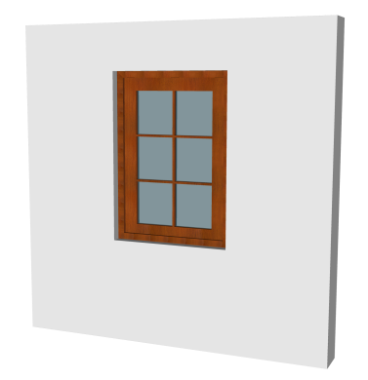
CAD
BIM
wall(...)
- box(...)
+ window(...)
wall(...)
window(wall(...), ...)
Associative Rules – A-BIM
Notes:
Another difference between CAD and BIM is that BIM objects have parametric and associative rules that dictate their behaviour in the model. For example, in CAD, a window in a wall can be created using a sequence of independent operations: first we create a wall, then we create the box corresponding the opening for the window which we subtract from the wall and, finally, we can place the window.
In BIM, a window can only exist hosted in a wall. This rule is reflected in the code where, in fact, a host wall is one of the parameters required to create the window. Moreover, when placing the window, the BIM application knows that an opening must be created in the wall for the window to exist and the necessary subtraction is done automatically.

Slide 8
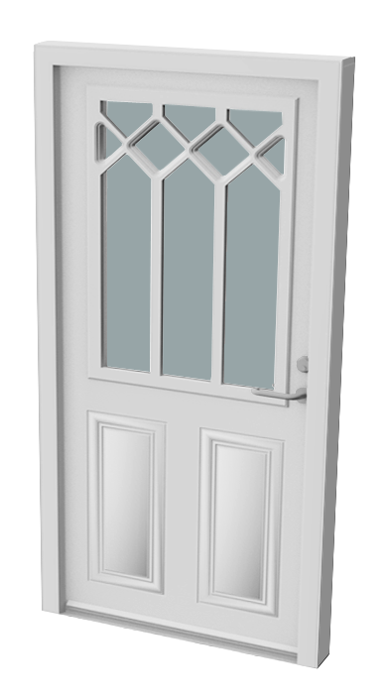
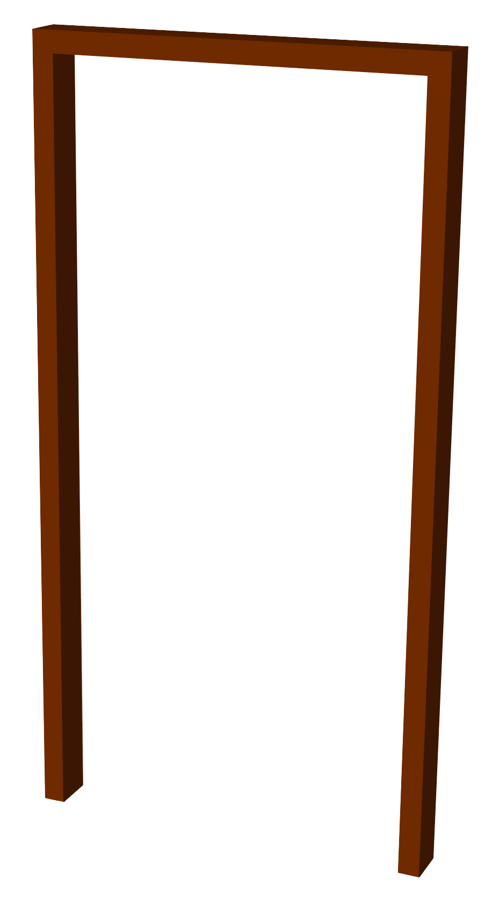
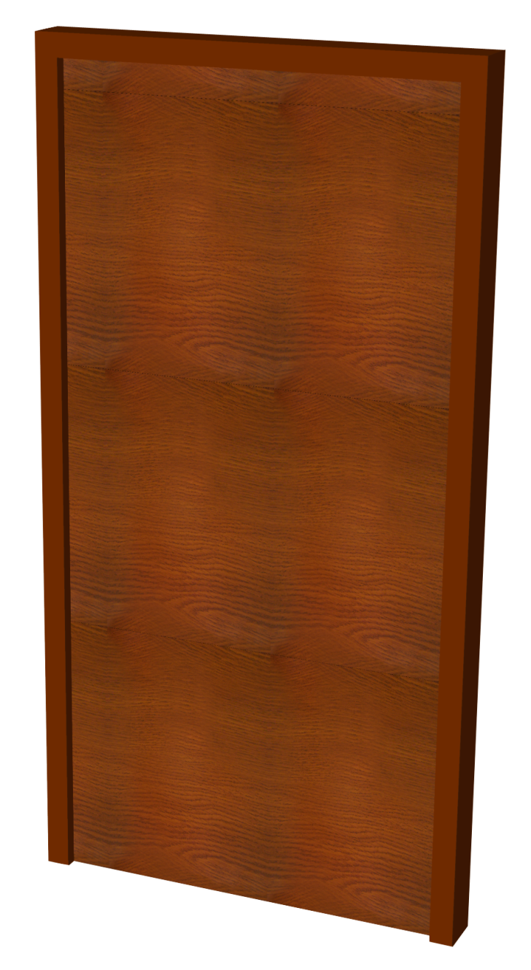
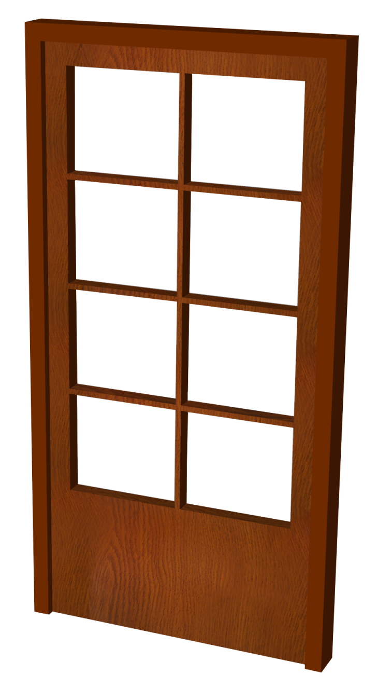
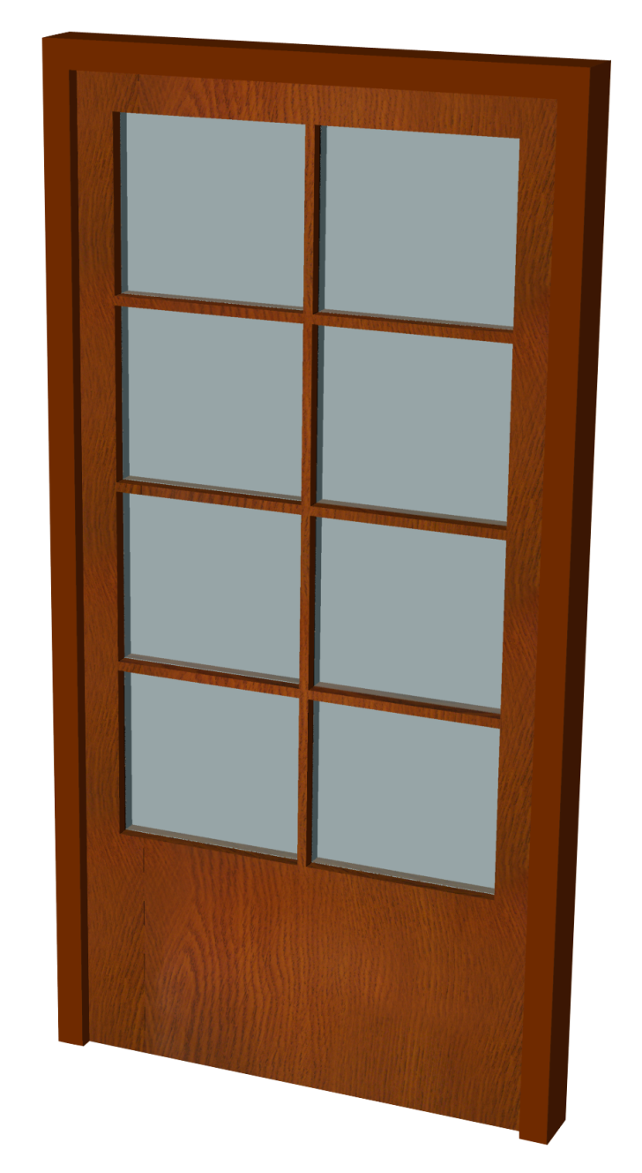
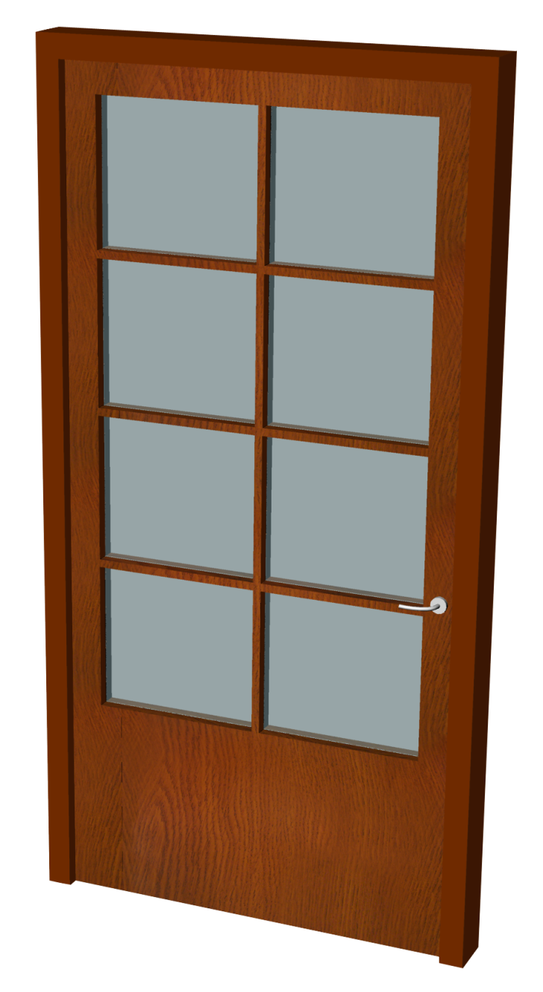
CAD
BIM
(define (casing p L l h)
(define casing-lenght 0.06)
(define casing-width 0.12)
(sweep (line (+x p (- (/ L -2) (/ casing-lenght 2)))
(+xz p (- (/ L -2) (/ casing-lenght 2))
(+ h (/ casing-lenght 2)))
(+xz p (+ (/ L +2) (/ casing-lenght 2))
(+ h (/ casing-lenght 2)))
(+x p (+ (/ L +2) (/ casing-lenght 2))))
(surface-rectangle p casing-lenght casing-width)))
(define (door p L l h)
(box (+xy p (/ L -2) (/ l -2)) L l h))
(define (glass p L l1 h)
(define door-margin 0.08)
(define door-margin-bottom 0.5)
(define door-middle 0.02)
(define n-glasses-horizontal 2)
(define n-glasses-vertical 4)
(define glass-area-length (- L (* door-margin 2) (* door-middle (- n-glasses-horizontal 1))))
(define glass-area-height (- h door-margin door-margin-bottom (* door-middle (- n-glasses-vertical 1))))
(define glass-length (/ glass-area-length n-glasses-horizontal))
(define glass-height (/ glass-area-height n-glasses-vertical))
(map-division (lambda (a b) (box (+xz p a b) glass-length l1 glass-height))
(+ (/ L -2) door-margin)
(+ (/ L -2) door-margin glass-area-length (* door-middle n-glasses-horizontal))
n-glasses-horizontal #f
door-margin-bottom
(+ door-margin-bottom glass-area-height (* door-middle n-glasses-vertical))
n-glasses-vertical #f))
(define (door-handle p)
(define handle-radius 0.005)
(cylinder p 0.02 (+y p (- 0.01)))
(sweep (spline p (+xy p (- 0.005) (- 0.03)) (+xy p (- 0.08) (- 0.05)))
(surface-circle p handle-radius)))
(define (complete-door p L l h)
(define glass-thickness 0.005)
(define door-margin 0.08)
(casing p L l h)
(subtraction (door p L l h)
(glass (+y p (- l)) L (* l 2) h))
(glass (+y p (/ glass-thickness -2)) L glass-thickness h)
(door-handle (+xyz p (- (/ L 2) (/ door-margin 2)) (/ l -2) 0.9)))
(complete-door (xyz 0 0 0) 1 0.06 2.1)
door(wall, location, door-family1)
door(wall, location, door-family2)
Pre-Modelled BIM objects – A-BIM
Notes:
Finally, BIM has pre-modelled building components which makes the creation of certain objects easier, since their geometry does not have to be created from scratch. When programming for CAD, for example, the modelling of a door might require the modelling of all of its subcomponents. The result is a lengthy code for just one door which can take some time to produce.
In BIM, doors can be chosen from a BIM library and edited to fit a project’s requirements. As such, we can simply change the type of door to obtain a different one. In CAD, this small change would have required the script that created the door to be completely adapted to accommodate this change.

Slide 9
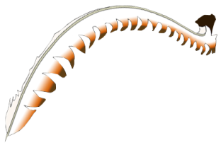
Lyrebird
Rhino-Grasshopper-ArchiCAD
Dynamo
GenerativeComponents
RevitPythonShell
GD Tools for BIM
Notes:
Now that we know what programming for BIM entails, we still need the tools to explore Generative Design for BIM. And, in fact, like with CAD, several tools were developed to allow the generation of models in BIM applications. Next, I’m going to talk briefly about a few of them.

Slide 10
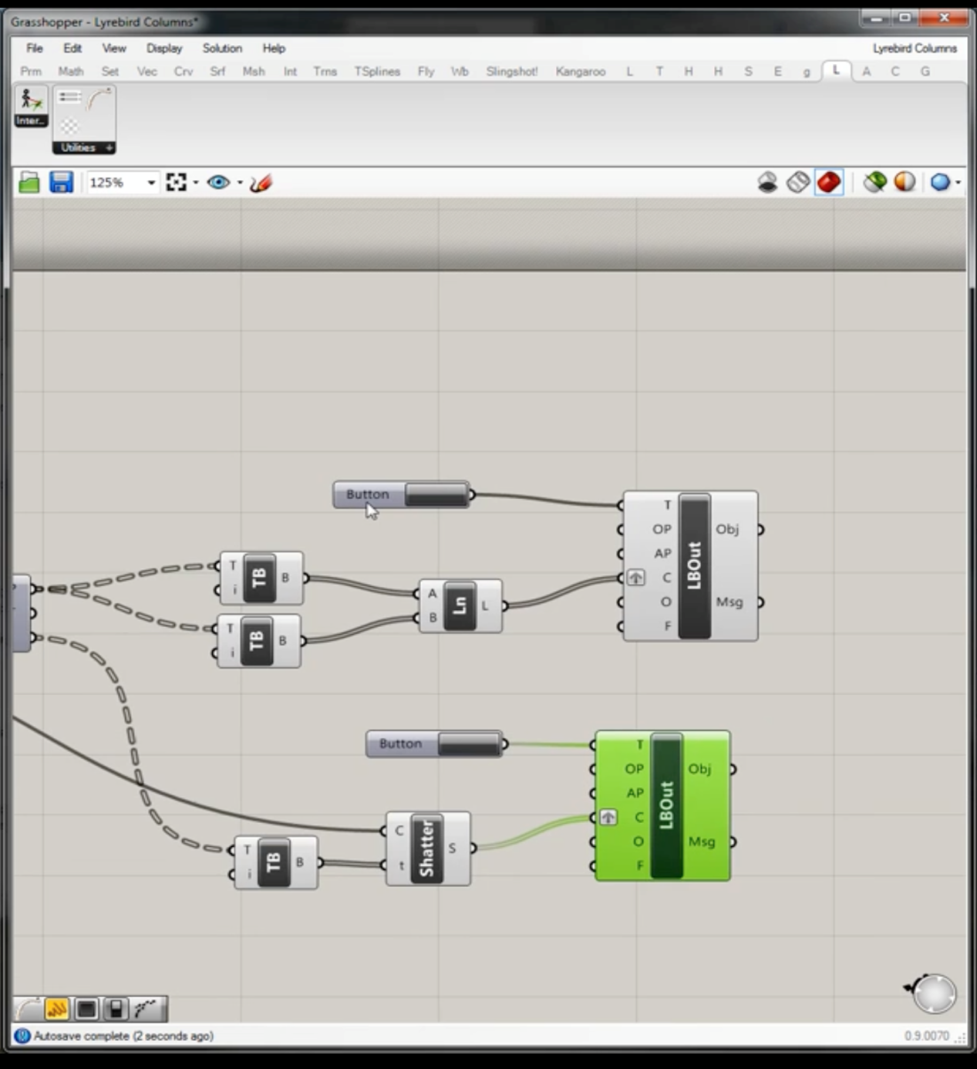
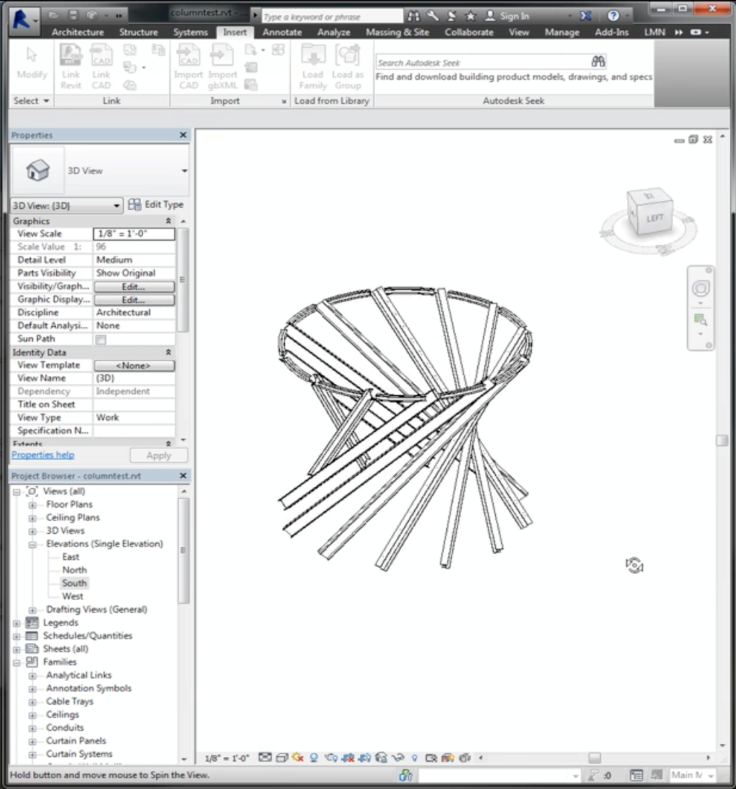
Image taken from: pinterest.com
Lyrebird – GD Tools for BIM
Notes:
First, we have Lyrebird which is a plug-in that enables the usage of Grasshopper to instantiate BIM objects in Revit.

Slide 11
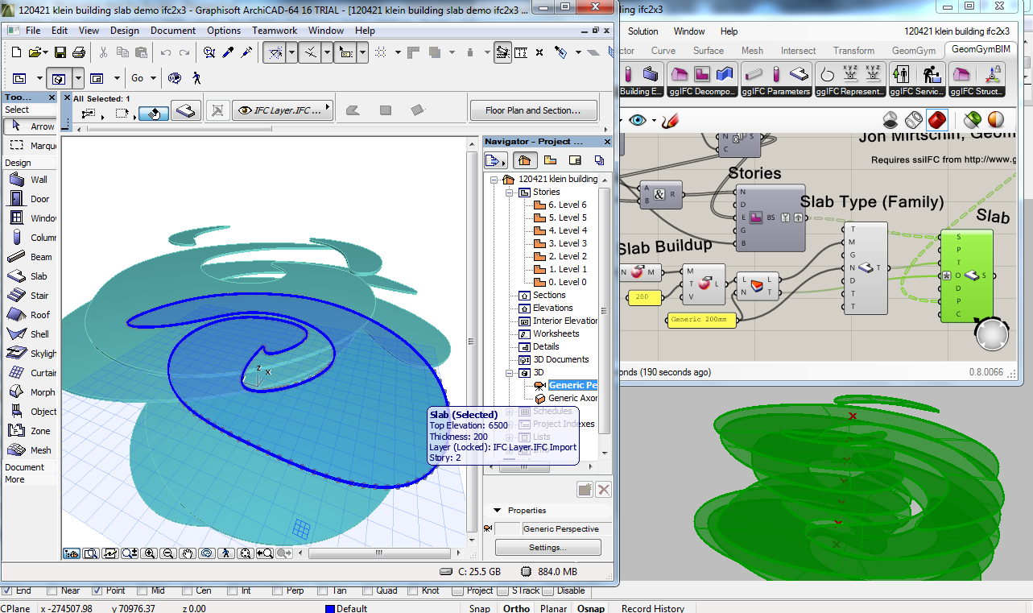
Image taken from: http://ssi.wdfiles.com/
Rhino-Grasshopper-ArchiCAD
– GD Tools for BIM
Notes:
We also have the Rhino-Grasshopper-ArchiCAD connection allows the creation of BIM objects in ArchiCAD using geometrical information created in Rhino with Grasshopper.

Slide 12
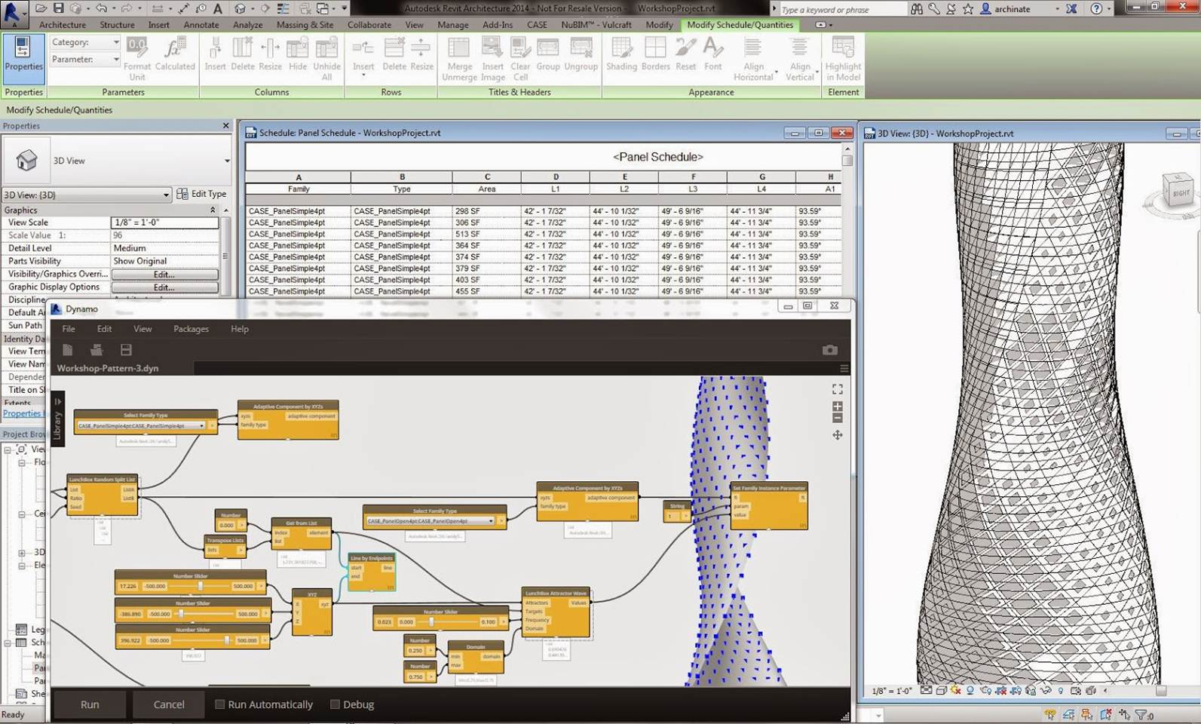
Image taken from: http://inthefold.autodesk.com/
Dynamo
– GD Tools for BIM
Notes:
We have Dynamo, a plug-in developed for Revit that uses a visual programming language similar to Grasshopper to generate BIM objects.

Slide 13
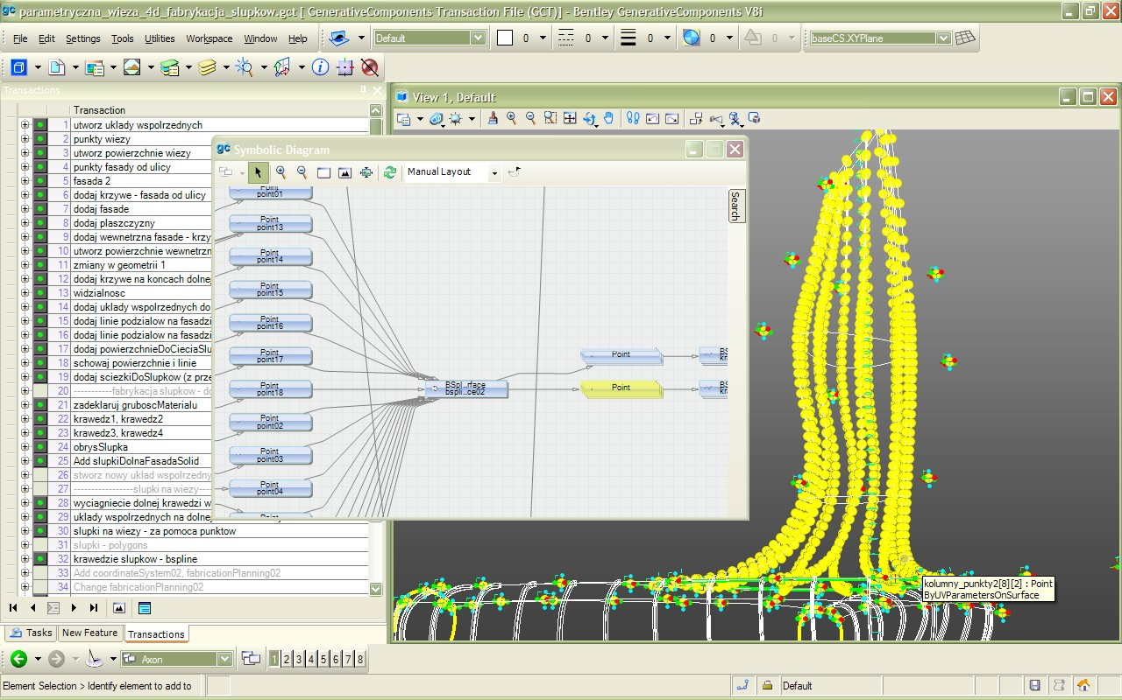
Image taken from: projektowanieparametryczne.pl/
GenerativeComponents – GD Tools for BIM
Notes:
GenerativeComponents is a parametric and associative system developed for Bentley's Microstation. It has three ways of programmatic interaction, all of which also allow the exploration of Generative Design for BIM.
(1) The first one is the one that you see here which is by creating a workflow of nodes and connections in the Symbolic Diagram, not unlike Grasshopper; (2) the second by defining relationships among objects with simple scripts in GCScript; and (3) by writing more complex programs in C#.

Slide 14
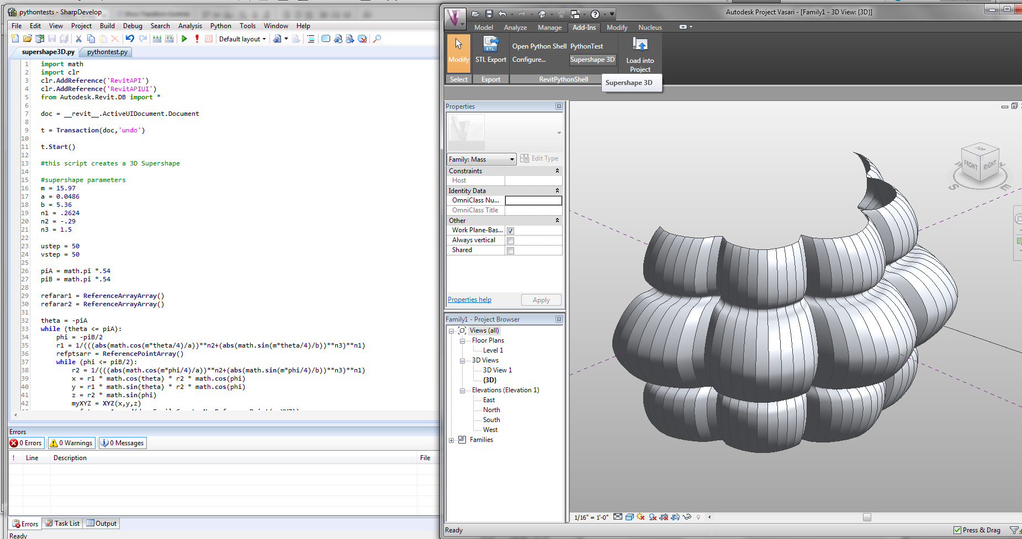
Image taken from: theprovingground.wdfiles.com/
RevitPythonShell – GD Tools for BIM
Notes:
Finally, we have RevitPythonShell is a plug-in developed for Revit that allows users to take advantage of the RevitAPI using Python.
(This tool was developed to simplify the workflow that is needed in order to use the RevitAPI.)

Slide 15
Portability
GD Tools for BIM
Notes:
These tools all have their advantages and disadvantages but one feature that they all lack is portability. This means that a program written with one of these tools will only work with one specific BIM application and will have to be written almost from scratch in order to work with a different one.

Slide 16
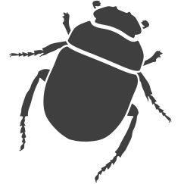
ROSETTA
ROSETTABIM
. . .
. . .
RosettaBIM
Notes:
As a possible solution to this problem we propose RosettaBIM, a tool for portable Generative Design. RosettaBIM is an extension of Rosetta, a tool originally developed to provide portable GD for CAD, which we extended to also supports BIM applications. With this tool, programs can be written in different programming languages and models can be generated in the different supported tools.

Slide 17
Slabs
Walls
Stairs
…
Architecture of RosettaBIM
Notes:
RosettaBIM is composed of two components : the first component is an abstraction layer that provides parameterized operations to create BIM objects, such as slabs or walls, among others, while the second component are the plug-ins that enables the production of the specified objects in the respective BIM tool. This architecture allows the creation of a common ground between the supported tools, which is what enables the portability of the GD programs.

Slide 18
Coordinate systems
Geometric operations
BIM operations
Implementation of RosettaBIM
Notes:
In order to implement RosettaBIM, we extended the abstraction layer of Rosetta, which already provided operations useful for the BIM paradigm, to also include BIM operations, namely to create and manipulate BIM objects. Then, we created a communication channel to exchange information between the abstraction layer of Rosetta and the new BIM back-ends. Currently, RosettaBIM only supports Revit and ArchiCAD as back-ends but can be extended to support other BIM tools.

Slide 19
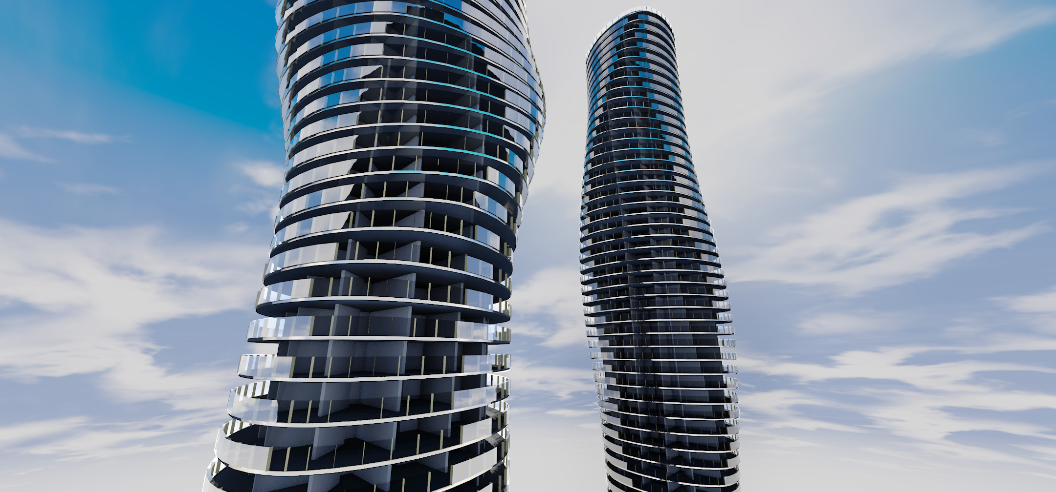
Evaluation of RosettaBIM
Notes:
Finally, we tested our implementation with the modelling of a few architectural examples and tested the portability of RosettaBIM.

Slide 20
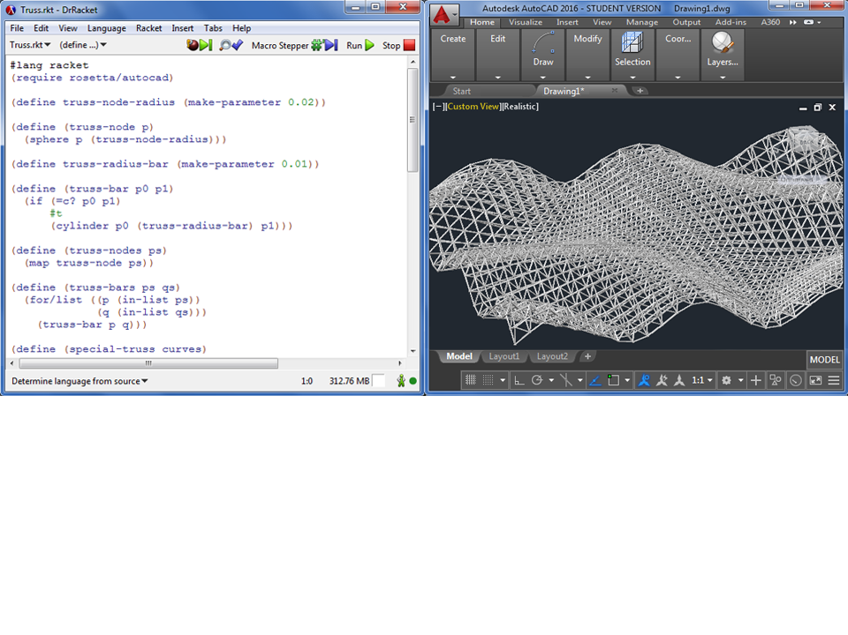
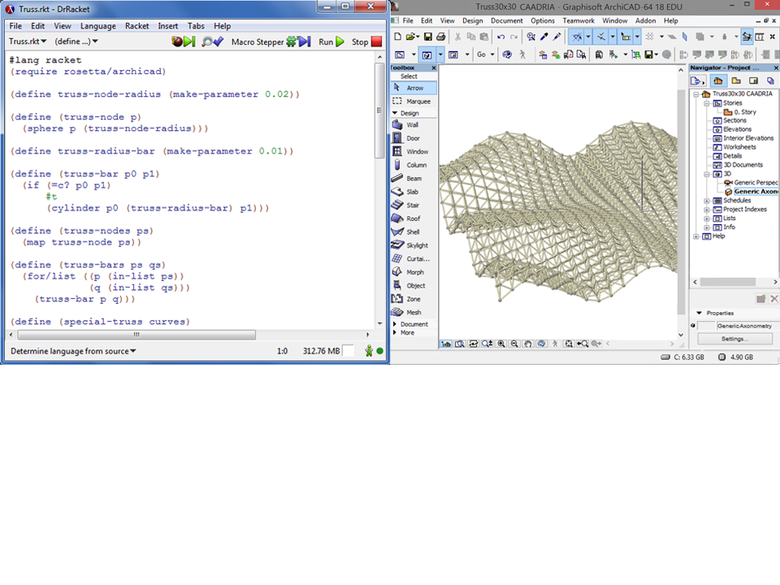
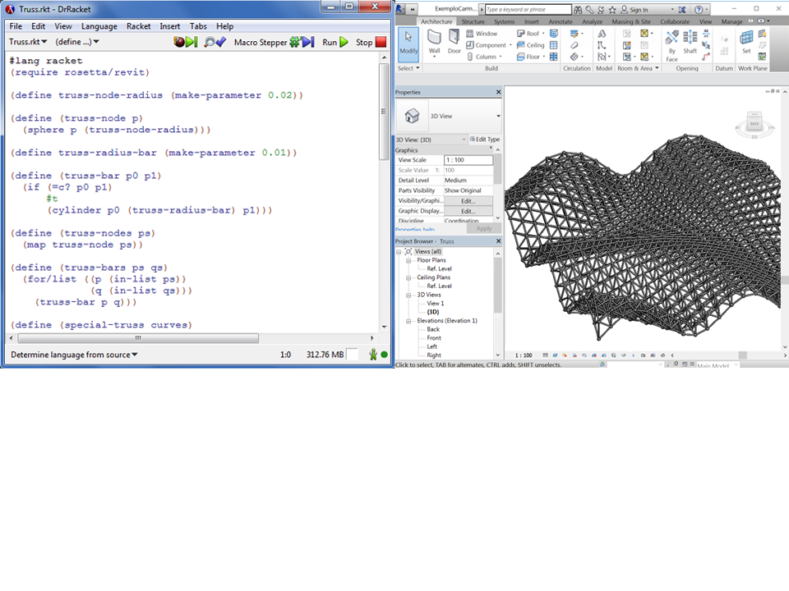
Truss – Evaluation
Notes:
So first of all, as an extension of Rosetta which already offered GD for CAD, RosettaBIM is still capable of producing geometric objects in BIM tools. In this example, we have a script which generates a truss in AutoCAD using simple geometric objects, namely spheres and cylinders. And note that by changing a single line of code, we can change the backend and use the exact same script to produce the truss in a different applications, in this case ArchiCAD. And with this, we can simply change the backend to any of the supported tools and the model will be produced in the corresponding application. So, as you can see, with RosettaBIM we can still produce geometry but we want more than that. We want to produce BIM objects.

Slide 21
Absolute Towers – Evaluation
Notes:
To that effect, we modelled an existing architectural building, more specifically one of the Absolute Towers. Like with the example of the truss, we used to same code to generate the model of the tower in both ArchiCAD and Revit but this time using the appropriate BIM objects for each building component. For that, we used the operations provided by our abstraction layer which are the same regardless of the chosen back-end. This means that, with the same operations and parameters, we were able to obtain equivalent BIM objects in both ArchiCAD and Revit.

Slide 22
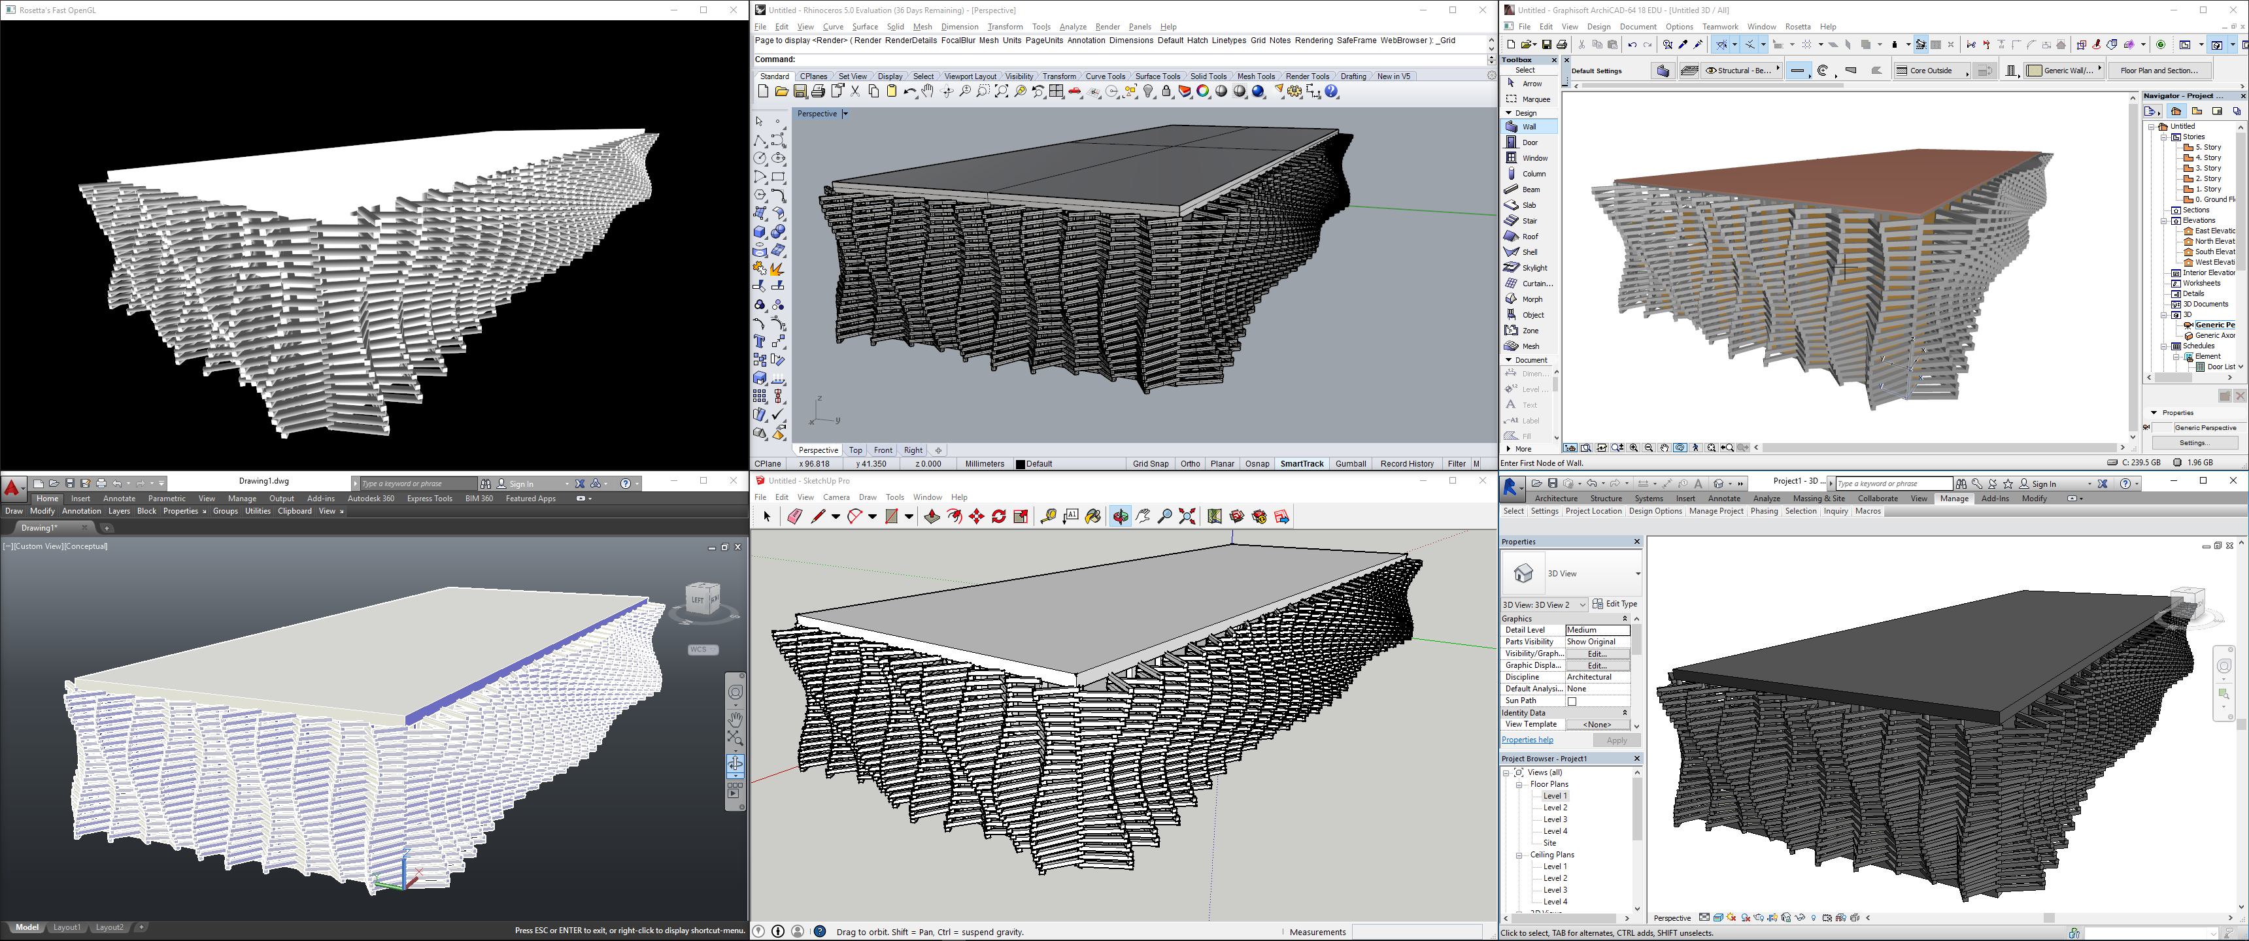
0,3s
43,6s
93,4s
4,6s
64,8s
397,6s
Portability CAD/BIM – Evaluation
Notes:
Finally, since Rosetta already offered portable GD for CAD and we extended it to BIM, we were able to achieve some portability between CAD and BIM using building components. We achieved by implementing some of the BIM operations needed for BIM in the supported CAD applications. Of course, CAD applications still don’t recognize these building components as such and neither do they store building information in them but we can still define their geometry. With this, we can achieve a more seamless transition between CAD and BIM, resulting in a more integrated workflow. For example, we can use a CAD application to quickly experiment with different design solutions before committing them to BIM.
One advantage of doing this is that we can save a lot of time in the generation of models. These are the times that this building took to be generated in the different applications we have here. First, we have a fast visualizer that we developed that generates the model almost instantaneously, then we have three frequently used CAD applications, namely SketchUp, Rhino and AutoCAD and finally we have ArchiCAD and Revit on the right. So, as you can see, if a model takes more than a minute to be generated in a BIM application each time a parameter is changed, then experimenting with different parameters becomes a chore.

Slide 23
Case Studies:
Complex Geometries
Automation
Optimization
Extending RosettaBIM:
BIM operations
BIM back-ends
BIM/CAD Portability
Future Work
Notes:
To conclude, I just want to add that RosettaBIM is still in development. In the future, we want to develop more case studies in order to further explore the capabilities of our tool, namely in the creation of more complex geometries, in the automation of repetitive tasks and in the integration of optimization processes to guide the design of buildings.
The feedback from these experiments will allow us to extend RosettaBIM’s capabilities. More specifically, we will be able to implement more BIM operations in order to generate more complete BIM models; we will expand RosettaBIM to support more BIM tools as back-ends and further explore this BIM/CAD portability that emerges by making CAD tools more BIM-like.

Slide 24
Thank You!
Questions?
Cover Image: @ Romain Trystram
sofia.feist@tecnico.ulisboa.pt
bruno.b.ferreira@tecnico.ulisboa.pt
guilherme.barreto@tecnico.ulisboa.pt
antonio.menezes.leitao@ist.utl.pt
Notes:
And that’s all folks. Thank you for your attention.

Slide 25
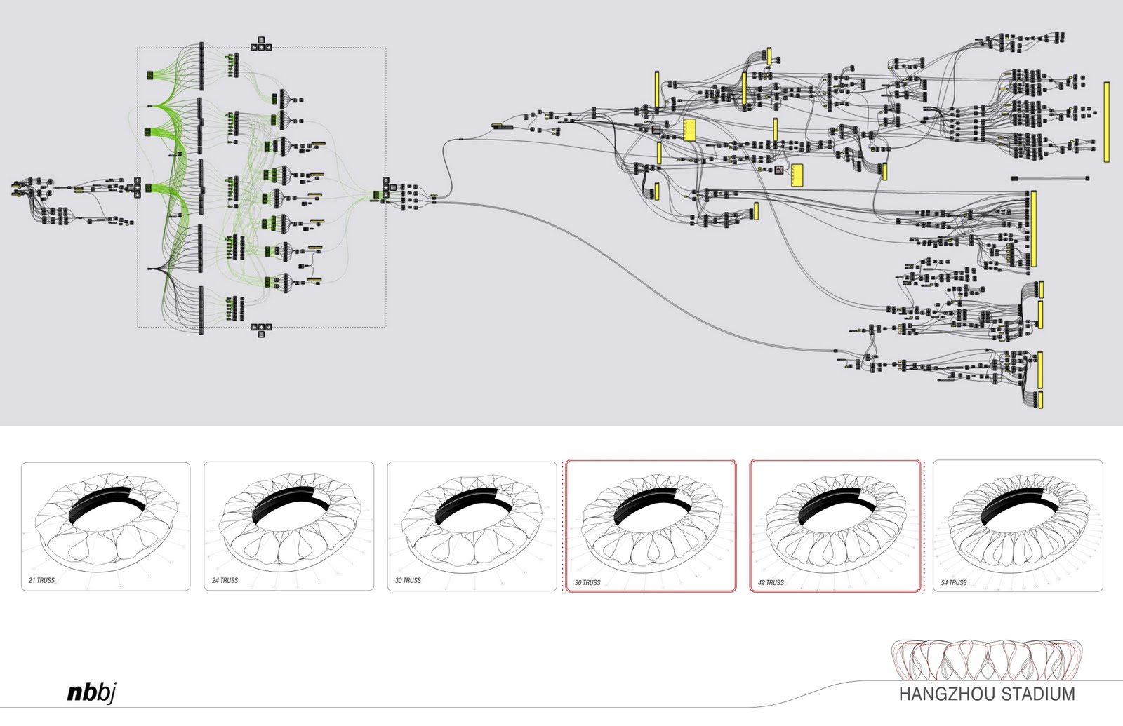
Image taken from: grasshopper3d.com
Visual Programming Languages
Notes:
In the approach we are considering here, we want to model and develop buildings through programming. For that reason, we chose to use textual programming languages as opposed to visual programming languages because they are more flexible in their capabilities. Visual programming languages, while easy to learn and use, tend to not perform well with more complex programs which become harder to read, change and reuse with a program’s complexity.

