Slide 1
Implementing Python for DrRacket
Pedro Palma Ramos
António Menezes Leitão

Slide 2
Contents
Motivation
Goals
Related Work
Solution
Benchmarks
Pedro Ramos & António Menezes Leitão | Implementing Python for DrRacket

Slide 3
Racket + DrRacket
Pedro Ramos & António Menezes Leitão | Implementing Python for DrRacket

Slide 4
Racket + DrRacket
Pedro Ramos & António Menezes Leitão | Implementing Python for DrRacket

Slide 5
Racket + DrRacket
Pedro Ramos & António Menezes Leitão | Implementing Python for DrRacket

Slide 6
Why Python?
Python is replacing Scheme in introductory programming courses
Pedro Ramos & António Menezes Leitão | Implementing Python for DrRacket
6

Slide 7
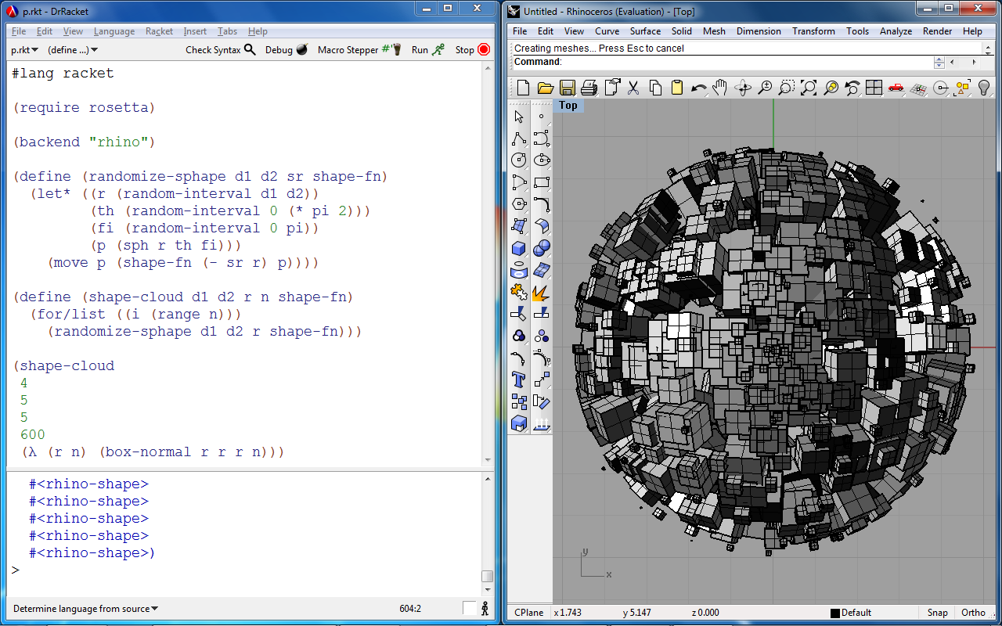
Rosetta IDE
Pedro Ramos & António Menezes Leitão | Implementing Python for DrRacket

Slide 8
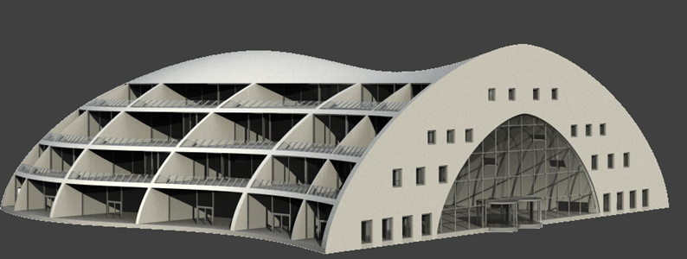
Generative Design
Pedro Ramos & António Menezes Leitão | Implementing Python for DrRacket

Slide 9
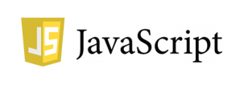
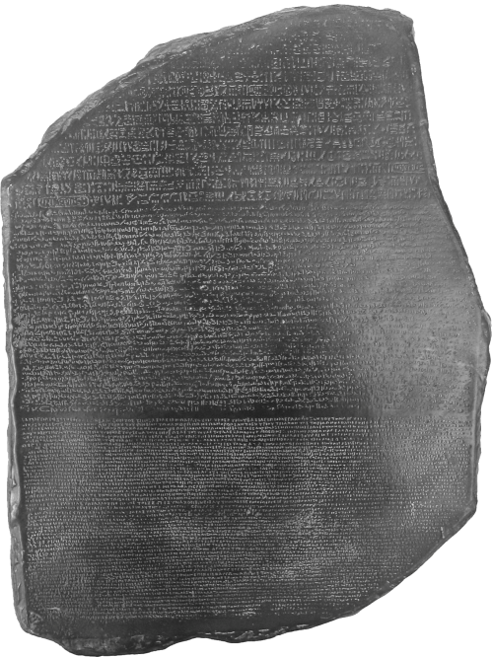
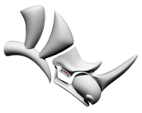
Rosetta IDE
Front ends:
Back ends:
Rosetta
(Racket)
AUTOLISP
Pedro Ramos & António Menezes Leitão | Implementing Python for DrRacket

Slide 10
High level, dynamically typed, GC’d
Focus on code readability
Multiple paradigms
Huge standard library + third-party libraries
Pedro Ramos & António Menezes Leitão | Implementing Python for DrRacket

Slide 11
Goals
Correctness + Completeness
Performance
DrRacket Integration
Interoperability with Racket
Pedro Ramos & António Menezes Leitão | Implementing Python for DrRacket

Slide 12
Related implementations
 | Language(s) written | Platform(s) targetted | Speedup (vs. CPython) | Std. library support
CPython | C | CPython’s VM | 1x | Full
Pedro Ramos & António Menezes Leitão | Implementing Python for DrRacket

Slide 13
Related implementations
 | Language(s) written | Platform(s) targetted | Speedup (vs. CPython) | Std. library support
CPython | C | CPython’s VM | 1x | Full
Jython | Java | JVM | ~1x | Most
IronPython | C# | CLI | ~1.8x | Most
Pedro Ramos & António Menezes Leitão | Implementing Python for DrRacket

Slide 14
Related implementations
 | Language(s) written | Platform(s) targetted | Speedup (vs. CPython) | Std. library support
CPython | C | CPython’s VM | 1x | Full
Jython | Java | JVM | ~1x | Most
IronPython | C# | CLI | ~1.8x | Most
PyPy | RPython | C, JVM, CLI | ~6x | Most
Pedro Ramos & António Menezes Leitão | Implementing Python for DrRacket

Slide 15
Related implementations
 | Language(s) written | Platform(s) targetted | Speedup (vs. CPython) | Std. library support
CPython | C | CPython’s VM | 1x | Full
Jython | Java | JVM | ~1x | Most
IronPython | C# | CLI | ~1.8x | Most
PyPy | RPython | C, JVM, CLI | ~6x | Most
PLT Spy | Scheme, C | Scheme | ~0.001x | Full
Pedro Ramos & António Menezes Leitão | Implementing Python for DrRacket

Slide 16
Our solution...
Pedro Ramos & António Menezes Leitão | Implementing Python for DrRacket

Slide 17
Pipeline
.py
.rkt
Python → Racket
(source-to-source compiler)
Racket → Bytecode
(Racket compiler + JIT)
Pedro Ramos & António Menezes Leitão | Implementing Python for DrRacket

Slide 18
Architecture
Pedro Ramos & António Menezes Leitão | Implementing Python for DrRacket

Slide 19
Racket Modules
reader module (for compilation)
read: input-port → (listof s-expression)
read-syntax: input-port → (listof syntax-object)
python module (for runtime behaviour)
Provides functions/macros used in compiled code
?
Pedro Ramos & António Menezes Leitão | Implementing Python for DrRacket

Slide 20
Syntax-objects
S-expression (Lisp code)
Source location information
File, line number, column number, span
Lexical-binding information
Pedro Ramos & António Menezes Leitão | Implementing Python for DrRacket

Slide 21
Architecture
Pedro Ramos & António Menezes Leitão | Implementing Python for DrRacket

Slide 22
Compilation Modules
lex+yacc module
Tokenization (Lex) and grammar (Yacc) specifications
ast-node module
Defines how each AST node is compiled
parse and compile modules
Interfaces for the above
Pedro Ramos & António Menezes Leitão | Implementing Python for DrRacket

Slide 23
Example
tokenization
PRINT
line: 3
start-col: 0
end-col: 5
NAME "arr"
line: 3
start-col: 6
end-col: 9
OPEN-BRACKET
line: 3
start-col: 9
end-col: 10
INT 6
line: 3
start-col: 10
end-col: 11
CLOSE-BRACKET
line: 3
start-col: 11
end-col: 12
Pedro Ramos & António Menezes Leitão | Implementing Python for DrRacket

Slide 24
Example
parsing
line: 3, cols: 0-12
print-node
expression
line: 3, cols: 6-12
indexing-node
line: 3, cols: 6-9
primary
sub
line: 3, cols: 10-11
identifier-node
literal-node
name
value
“arr”
6
Pedro Ramos & António Menezes Leitão | Implementing Python for DrRacket

Slide 25
Example
compiling
(py-print (py-get-index arr 6))
line: 3, cols: 0-12
py-print
(py-get-index arr 6)
line: 3, cols: 6-12
py-get-index
arr
line: 3, cols: 6-9
6
line: 3, cols: 10-11
Pedro Ramos & António Menezes Leitão | Implementing Python for DrRacket

Slide 26
DrRacket + Python
Pedro Ramos & António Menezes Leitão | Implementing Python for DrRacket

Slide 27
DrRacket + Python
Pedro Ramos & António Menezes Leitão | Implementing Python for DrRacket

Slide 28
DrRacket + Python
Pedro Ramos & António Menezes Leitão | Implementing Python for DrRacket

Slide 29
DrRacket + Python
Pedro Ramos & António Menezes Leitão | Implementing Python for DrRacket

Slide 30
DrRacket + Python
Pedro Ramos & António Menezes Leitão | Implementing Python for DrRacket

Slide 31
DrRacket + Python
Pedro Ramos & António Menezes Leitão | Implementing Python for DrRacket

Slide 32
DrRacket + Python
Pedro Ramos & António Menezes Leitão | Implementing Python for DrRacket

Slide 33
Architecture
Pedro Ramos & António Menezes Leitão | Implementing Python for DrRacket

Slide 34
Runtime Modules
runtime module
Defines Python functionality in Racket
py-print, py-get-index, etc.
libpython module
Foreign function interface (FFI) to CPython’s library
Pedro Ramos & António Menezes Leitão | Implementing Python for DrRacket

Slide 35
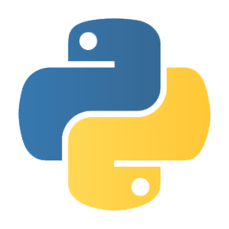
FFI Approach
libpython module
Racket
CPython VM
foreign calls
on C pointers
Racket FFI
(Foreign Function Interface)
Python/C API
Pedro Ramos & António Menezes Leitão | Implementing Python for DrRacket

Slide 36
FFI Runtime - Example
x + y
(define (py-add x y)
(PyObject_CallObject (PyObject_GetAttrString x "__add__")
(make-py-tuple y)))
(define (make-py-tuple . elems)
(let ([py-tuple (PyTuple_New (length elems))])
(for ([i (range (length elems))]
[elem elems])
(PyTuple_SetItem py-tuple i elem))
py-tuple))
Pedro Ramos & António Menezes Leitão | Implementing Python for DrRacket

Slide 37
FFI Runtime - Disadvantages
Bad Performance
Expensive type conversions + FFI calls
Finalizers for GC
Clumsy Interoperability with Racket
Wrappers/Unwrappers
Pedro Ramos & António Menezes Leitão | Implementing Python for DrRacket

Slide 38
What about implementing it over Racket data types?
Pedro Ramos & António Menezes Leitão | Implementing Python for DrRacket

Slide 39
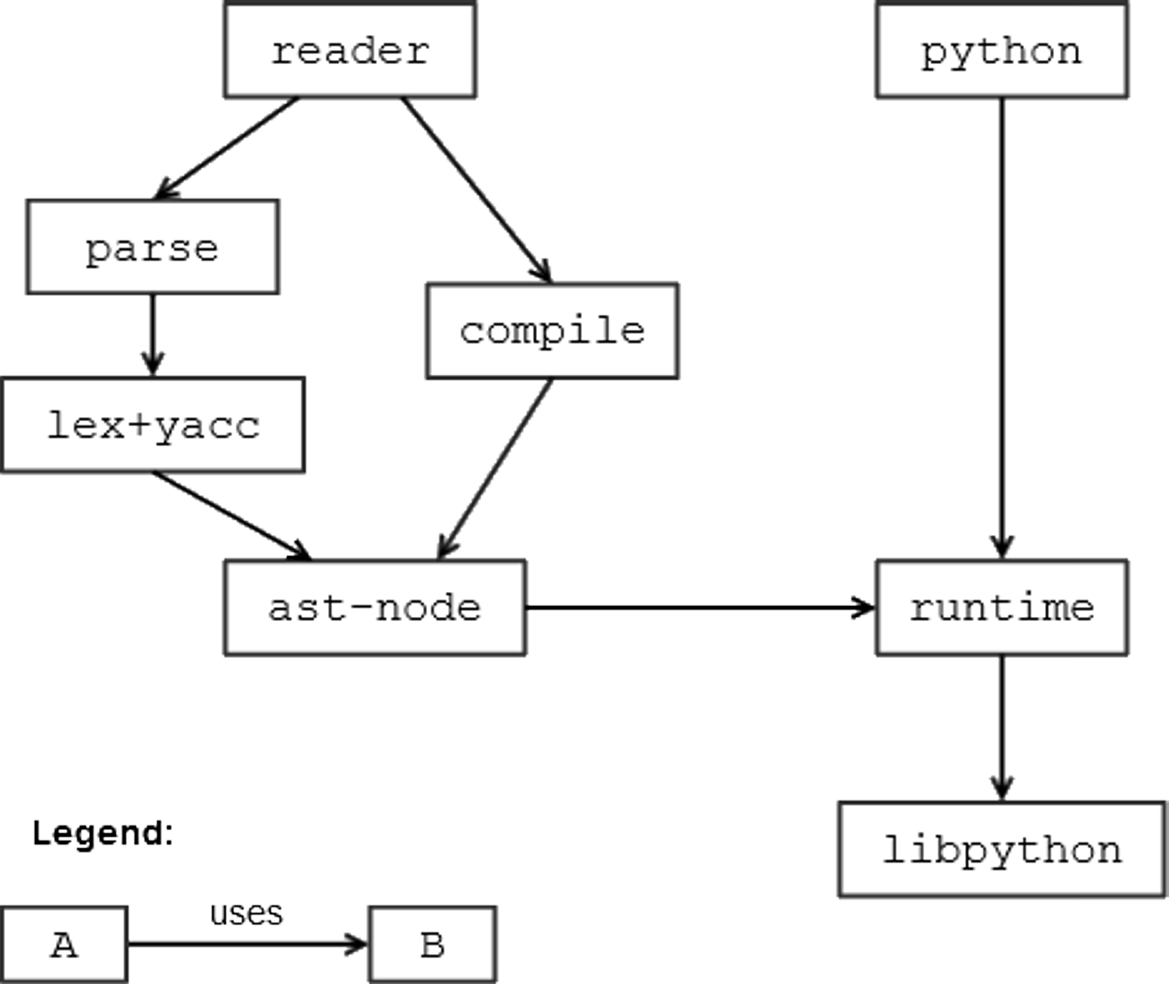
Architecture
Pedro Ramos & António Menezes Leitão | Implementing Python for DrRacket

Slide 40
Python’s Data Model
Every value is an object
Every object has a reference to its type-object
Type-objects hold hash-table for method dispatching
Maps method names to function objects
Operator behaviour is mapped to methods
Pedro Ramos & António Menezes Leitão | Implementing Python for DrRacket

Slide 41
Optimizations
Basic types mapped to Racket types
int, long, float, complex, string, dict
Avoids wrapping/unwrapping
Early method dispatching for operators
Avoids expensive method dispatching for common uses
Pedro Ramos & António Menezes Leitão | Implementing Python for DrRacket

Slide 42
Racket Runtime - Example
x + y
(define (py-add x y)
(py-method-call x "__add__" y))
(define (py-add x y)
(cond
[(and (number? x) (number? y)) (+ x y)]
[(and (string? x) (string? y)) (string-append x y)]
[else (py-method-call x "__add__" y)]))
Pedro Ramos & António Menezes Leitão | Implementing Python for DrRacket

Slide 43
Benchmarks
Fibonacci (tree recursion)
naive implementation of the Fibonacci sequence
Sieve of Eratosthenes (list iteration)
computing the number of primes below a given number
Pedro Ramos & António Menezes Leitão | Implementing Python for DrRacket

Slide 44
Fibonacci
(define (fib n)
(cond
[(= n 0) 0]
[(= n 1) 1]
[else (+ (fib (- n 1))
(fib (- n 2)))]))
(fib 30)
def fib(n):
if n == 0: return 0
elif n == 1: return 1
else: return fib(n-1) + fib(n-2)
print fib(30)
Pedro Ramos & António Menezes Leitão | Implementing Python for DrRacket

Slide 45
Sieve of Eratosthenes
(define (sieve n)
(let ([primes (make-vector (add1 n) #t)]
[counter 0])
(for ([i (in-range 2 n)])
(when (vector-ref primes i)
(set! counter (add1 counter))
(for ([j (in-range (* i i) n i)])
(vector-set! primes j #f))))
counter))
(sieve 10000000)
def sieve(n):
primes = [True] * (n+1)
counter = 0
for i in range(2,n):
if primes[i]:
counter = counter + 1
for j in range(i*i, n, i):
primes[j] = False
return counter
print sieve(10000000)
Pedro Ramos & António Menezes Leitão | Implementing Python for DrRacket

Slide 46
Fibonacci - Results
■ (a) Racket on Racket
■ (b) Python on CPython
■ (c) Python on Racket (FFI)
■ (d) Python on Racket (native)
(a)
(b)
(c)
(d)
Pedro Ramos & António Menezes Leitão | Implementing Python for DrRacket

Slide 47
Sieve of Eratosthenes - Results
■ (a) Racket on Racket
■ (b) Python on CPython
■ (c) Python on Racket (FFI)
■ (d) Python on Racket (native)
(a)
(b)
(c)
(d)
Pedro Ramos & António Menezes Leitão | Implementing Python for DrRacket

Slide 48
Thank you! Questions? Comments?
Pedro Ramos & António Menezes Leitão | Implementing Python for DrRacket

Slide 49
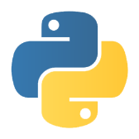
(1)
(2)
(3)
lexical
analysis
TOKENS
syntactic
analysis
AST
code generation
(4)
(5)
(6)
macro expansion
Racket bytecode
compiler
Racket VM
Pedro Ramos & António Menezes Leitão | Implementing Python for DrRacket

