Slide 1
Illustrated Programming
António Leitão
INESC – IST - UL
José Lopes
IST-Ul
Luís Santos
UC Berkeley - CBE
Notes:
Hi.
My name is António Leitão and I want to present you Illustrated Programming.

Slide 2
>illustrated programming
Notes:
But first, let me show you the problem that motivated this work.

Slide 3
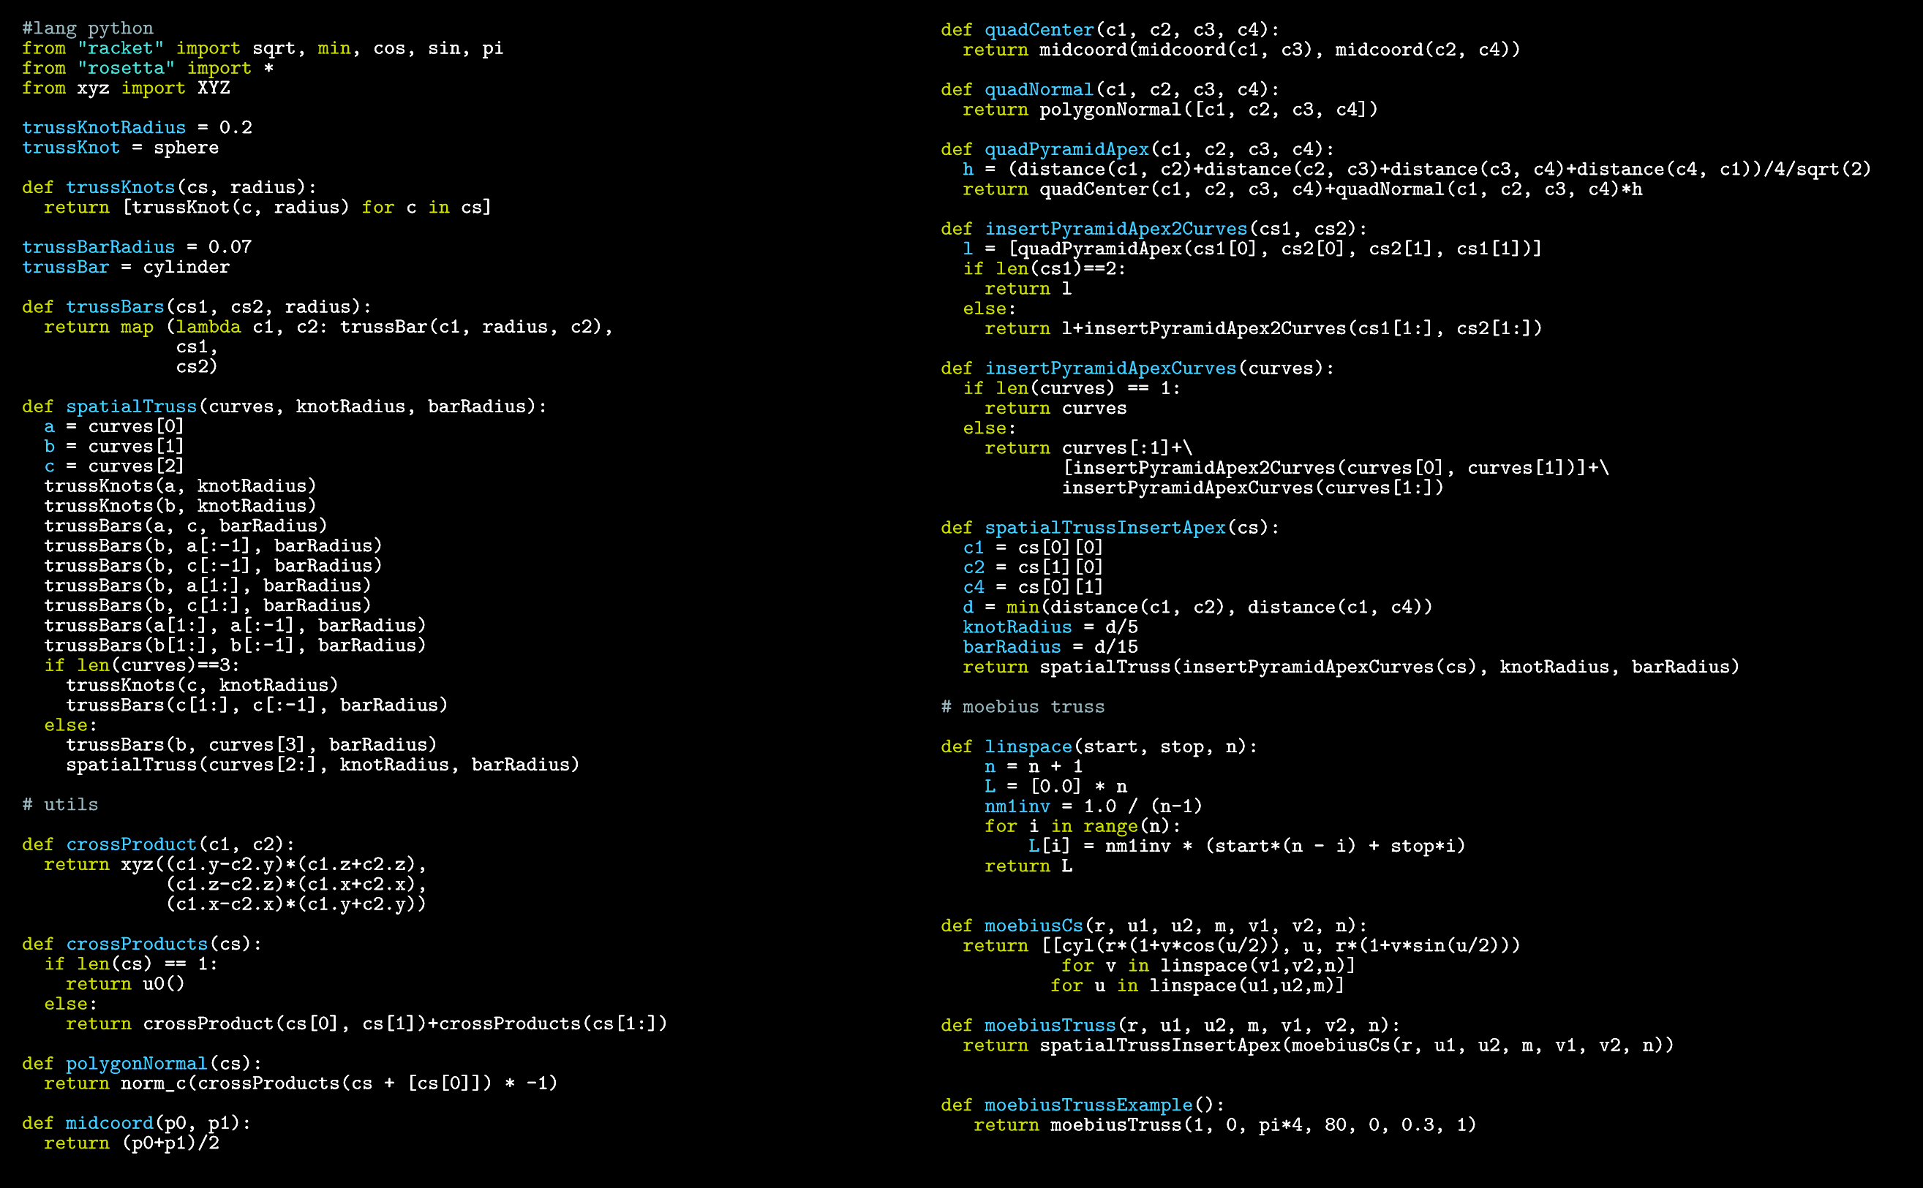
>What is this program doing?
Notes:
This is the problem.
This is a program that generates a design. But which design? It’s very hard to know.
And the problem is not related to fact that we are using a textual programming language here.

Slide 4
>How can I change this program?
© Nathan Miller
Notes:
In this program, it is also very hard to know what it does, and it is also very hard to know where and how to change it to make it generate something sligthly different.
In fact, in both cases, it is very hard to understand what the programs do, and what design problem are they trying to solve.
How did we get into this situation?

Slide 5
>Workflow
Sketches
CONCEPT
SCRIPT
DESIGN
Diagrams
Notes:
When we look into the typical workflow of people that create generative design programs, they usually start by making sketches and diagrams, which will then be the basis for writing the program.

Slide 6
>Workflow
Sketches
CONCEPT
SCRIPT
DESIGN
Diagrams
(define (skin-open-srf srf panel panel-f panel-h att)
(sphere att 0.03)
(iterate-quads
(lambda (h0 h1 h2 h3)
(panel (list-ref h0 4)
(list-ref h0 3)
(list-ref h1 4)
(list-ref h2 1)
(list-ref h2 0)
(list-ref h3 1)
panel-f panel-h att))
(iterate-quads
(lambda (p0 p1 p2 p3)
(let* ((a (ptf p0 p3 0.17))
(b (ptf p0 p1 1/2))
(f (ptf p0 p3 1/2))
(j (ptf p3 p2 1/2))
(e (ptf b j 2/3))
(k p1)
(l p2)
(c (ptf k l 0.17))
(d (ptf k l 1/2))
(w (ptf k l 2/3))
(g (ptf (ptf p0 p3 2/3) (ptf p1 p2 2/3) 3/2))
(h (ptf p3 p2 3/2))
(i (ptf k l 1.17)))
(panel a b c d e f panel-f panel-h att)
(list a b c d e f)))
(transpose-matrix srf))))
(define (hex-panel-1 p0 p1 p2 p3 p4 p5 f h att)
(let* ((c (quad-center p0 p1 p2 p3))
(n (quad-normal p0 p1 p2 p3))
(d (* f (distance att c))))
(loft (list
(closed-line p0 p1 p2 p3 p4 p5)
(move
(scale (closed-line p0 p1 p2 p3 p4 p5) d c)
(*c n (- h)))))))
(define (hex-panel-2 p0 p1 p2 p3 p4 p5 f h att)
(let* ((c (quad-center p0 p1 p2 p3))
(n (quad-normal p0 p1 p2 p3))
(d (* f (distance att c))))
(loft (list
(closed-line p0 p1 p2 p3 p4 p5)
(move
(scale (closed-line p0 p1 p2 p3 p4 p5) (/ d 1.3) c)
(*c n (/ (- h) 2.0)))
(move
(scale (closed-line p0 p1 p2 p3 p4 p5) d c)
(*c n (- h)))))))
Notes:
The problem is that after they write the program, we no longer have those sketches and diagrams available, so it becomes difficult to relate the program with the original concepts.

Slide 7
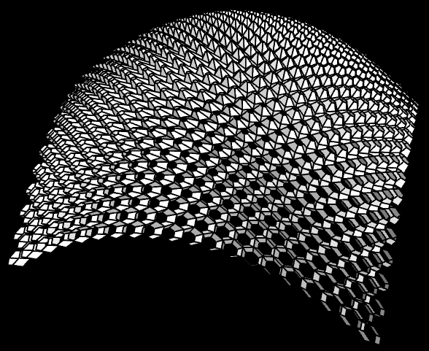
>Workflow
Sketches
CONCEPT
SCRIPT
DESIGN
Diagrams
(define (skin-open-srf srf panel panel-f panel-h att)
(sphere att 0.03)
(iterate-quads
(lambda (h0 h1 h2 h3)
(panel (list-ref h0 4)
(list-ref h0 3)
(list-ref h1 4)
(list-ref h2 1)
(list-ref h2 0)
(list-ref h3 1)
panel-f panel-h att))
(iterate-quads
(lambda (p0 p1 p2 p3)
(let* ((a (ptf p0 p3 0.17))
(b (ptf p0 p1 1/2))
(f (ptf p0 p3 1/2))
(j (ptf p3 p2 1/2))
(e (ptf b j 2/3))
(k p1)
(l p2)
(c (ptf k l 0.17))
(d (ptf k l 1/2))
(w (ptf k l 2/3))
(g (ptf (ptf p0 p3 2/3) (ptf p1 p2 2/3) 3/2))
(h (ptf p3 p2 3/2))
(i (ptf k l 1.17)))
(panel a b c d e f panel-f panel-h att)
(list a b c d e f)))
(transpose-matrix srf))))
(define (hex-panel-1 p0 p1 p2 p3 p4 p5 f h att)
(let* ((c (quad-center p0 p1 p2 p3))
(n (quad-normal p0 p1 p2 p3))
(d (* f (distance att c))))
(loft (list
(closed-line p0 p1 p2 p3 p4 p5)
(move
(scale (closed-line p0 p1 p2 p3 p4 p5) d c)
(*c n (- h)))))))
(define (hex-panel-2 p0 p1 p2 p3 p4 p5 f h att)
(let* ((c (quad-center p0 p1 p2 p3))
(n (quad-normal p0 p1 p2 p3))
(d (* f (distance att c))))
(loft (list
(closed-line p0 p1 p2 p3 p4 p5)
(move
(scale (closed-line p0 p1 p2 p3 p4 p5) (/ d 1.3) c)
(*c n (/ (- h) 2.0)))
(move
(scale (closed-line p0 p1 p2 p3 p4 p5) d c)
(*c n (- h)))))))
Notes:
And it also becomes difficult to relate the program with the generated design.
So, how can we solve these problems.
One possible solution, named Literate Programming, was proposed many years ago by Donald Knuth. He suggested that we should write our programs as if we were writing a book.

Slide 8
>Literate Programming
Documentation
Program
Documentation
Notes:
And this is what it looked like.
We would have text, formulas, and whatever would be necessary to explain the program in the middle of the program itself.
The human reader would use all this information to understand the program, while the computer would simply ignore it.
Unfortunately, Literate programming was a failure, simply because it was too hard to write programs like if they were books. It is already hard enough to write books.
However, in the area of generative design, we usually have most of the documentation available even before we have the program.
The only difference is that the documentation is in the form of sketches.

Slide 9
>Illustrated Programming
Documentation
def cubeSpheres(c, r, w):
c1 = c+xyz(-w,-w,-w)
c2 = c+xyz(+w,-w,-w)
c3 = c+xyz(+w,+w,-w)
c4 = c+xyz(-w,+w,-w)
c5 = c+xyz(-w,-w,+w)
c6 = c+xyz(+w,-w,+w)
c7 = c+xyz(+w,+w,+w)
c8 = c+xyz(-w,+w,+w)
for p in [c1,c2,c3,c4,c5,c6,c7,c8]:
sphere(p, r)
Program
Notes:
And this is the first step of what we call Illustrated Programming.
But it is more than this.

Slide 10
>Solution
Illustrated Programming
Sketch-Program
Correlation
Program-Model
Correlation
Immediate
Feedback
Traceability
Notes:
The idea of Illustrated Programming is that we should have, on one hand, a correlation between the sketches that document a design and the program that implements it, and, on the other hand, a correlation between the program and the model it generates.
For the first correlation, we propose that, like in Literate Programming, programs should include whatever helps its comprehension, particularly, sketches, as these are usually already available.
For the second correlation, we propose two different techniques: traceability and immediate feedback. Traceability establishes a bi-directional relation between the program and generated model, while immediate feedback allows us to see the impact of the program parameters in the generated model.

Slide 11
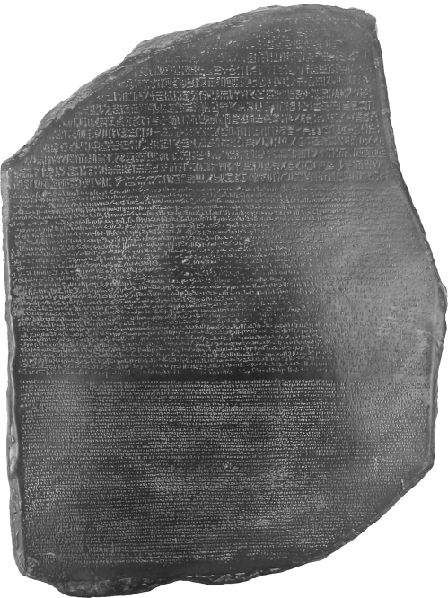
>Implementation
Javascript
Racket
Rosetta
AutoLISP
Python
SketchUp
Processing
Notes:
Naturaly, we want everybody to start using Illustrated Programming.
The problem is that different people prefer different programming languages and different CAD applications.
To solve this problem, in the last few years, we have been developing a programming environment for generative design, named Rosetta, which allows you to write your programs in different programming languages and generate your models in different CAD applications. We already support several programming languages and CAD applications, and we are working to support even more. Our current targets are Processing, SketchUp and Revit.
The good news is that we implemented Illustrated Programming for Rosetta, meaning that you can use it with all combinations of programming language and CAD application.

Slide 12
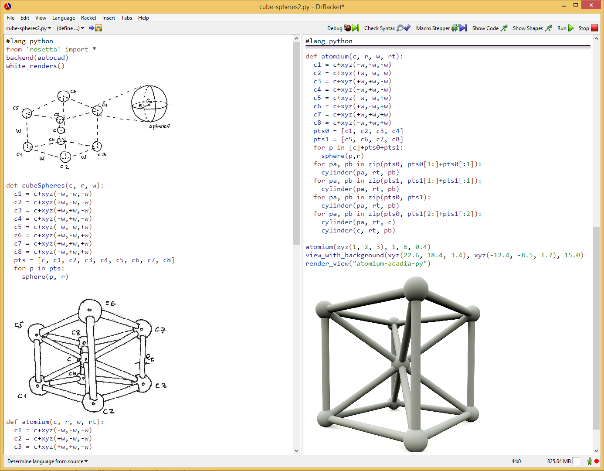
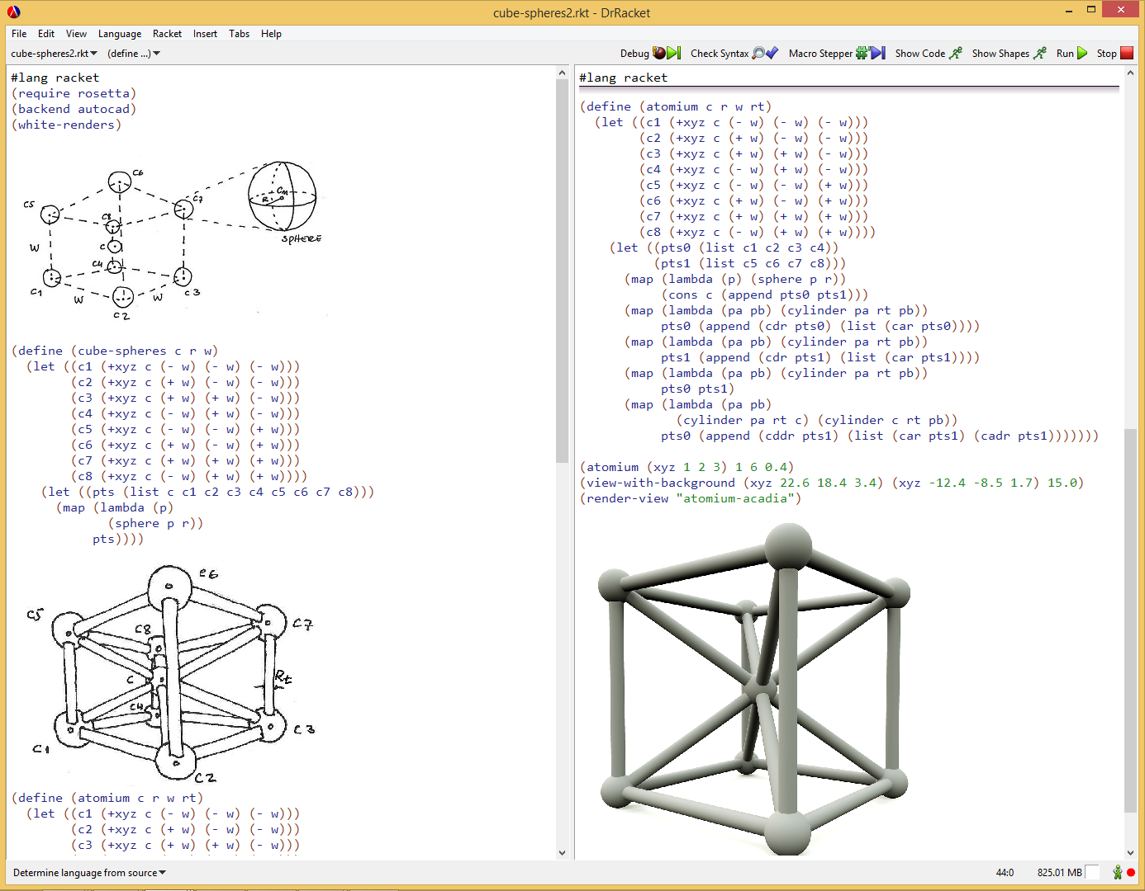
>Sketch-Program correlation
Notes:
And this is what it looks to have the Sketch-Program correlation.
Rosetta allows you to paste your sketches in the middle of your code. Naturaly, the sketches are labeled and it is a good practice to have the code use the same labels in the parameters and local variables, so that you can easily understand what each name means simply by looking at the sketch. And to make it clear what the program is supposed to do, you can execute the program, generate a model, render it, and then include the render in the program. Obviously, you can also include textual documentation if you want.

Slide 13
>Program-Model correlation: traceability
Notes:
In what regards, the Traceability, it is preferable to show you an example. The idea is that traceability helps you understand the structure of your program by relating parts of the program with the corresponding parts in the model. So, if I click in the program, it shows me which elements in the model were produced by that part of the code. Naturaly, if I click in more top-level parts of the program, it shows that they were responsible for a larger number of elements.
But it goes in the other direction, too. You can click on some element in your model, and it shows you the control flow that was used to generate that element, and also the other elements that were generated by that control flow.

Slide 14
>Program-Model correlation: immediate feedback
Notes:
Immediate feedback is a different tool that allows you to better understand the dynamics of your program. Just like you can do with, for example, Grasshopper, it is possible in Rosetta to specify a set of sliders that allow you to quickly cover the space of possibilities of your model. The problem is that typical CAD applications cannot cope with the responsiveness that is required for proper use of the sliders. And that’s what we see here, first for AutoCAD, and then for Rhino. We all know that, after a certain level of complexity, Grasshopper sliders become painfull to use because the model is not updated quickly enough.
Fortunately, in Rosetta, we can select different CAD applications, and we have implemented an opengl backend that is used just for visualization, but has the advantage that it is much more responsive than a complete CAD application. This means that we can use sliders for more complex models, and still get the immediate feedback we expect.
And when we are satisfied, we can generate the code that reproduces a particular model, we can insert it in our program, and we can revert to whatever CAD application we were using.

Slide 15
>Conclusion
Tools for program comprehension
Strong correlation between design, program, and model
Illustrated Programming concepts
Sketch-Program correlation
Program-Model correlation
Traceability
Immediate Feedback
Illustrated Programming in Rosetta
>Thank you!
>Questions?
Notes:
So, to conclude.
We discussed the need for program comprehension tools that establish a strong correlation between a design, the corresponding program, and the generated model.
And we propose Illustrated Programming as a solution to this problem.
Illustrated Programming is based, on one hand, on establishing a correlation between the original sketches and the program that was created from them and, on the other hand, on techniques that allow you to understand the relation between the program and the generated model, namely, traceability, and immediate feedback.
The main advantage of Illustrated Programming is that it improves the quality of generative design programs by offering a visual explanation of their structure and behavior, thus facilitating their development, understanding, and maintenance.
Finally, we showed you the implementation of Illustrated Programming in the Rosetta Programming Environment.

