Slide 1
An Implementation of Python for Racket
Pedro Palma Ramos
António Menezes Leitão

Slide 2
Contents
Motivation
Goals
Related Work
Solution
Performance Benchmarks
Future Work
Pedro Ramos & António Menezes Leitão | An Implementation of Python for Racket

Slide 3
Racket + DrRacket
Pedro Ramos & António Menezes Leitão | An Implementation of Python for Racket

Slide 4
Racket + DrRacket
Pedro Ramos & António Menezes Leitão | An Implementation of Python for Racket

Slide 5
Racket + DrRacket
Pedro Ramos & António Menezes Leitão | An Implementation of Python for Racket

Slide 6
Our goal...
Pedro Ramos & António Menezes Leitão | An Implementation of Python for Racket

Slide 7
Our goal...
Pedro Ramos & António Menezes Leitão | An Implementation of Python for Racket

Slide 8
Why Python?
Python is replacing Scheme in introductory programming courses
Pedro Ramos & António Menezes Leitão | An Implementation of Python for Racket
8

Slide 9
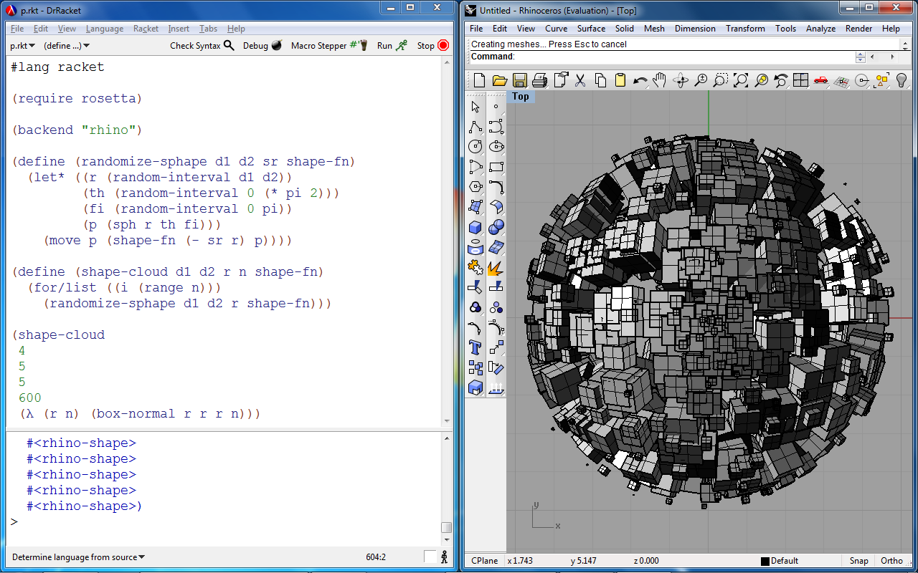
Rosetta IDE
Pedro Ramos & António Menezes Leitão | An Implementation of Python for Racket

Slide 10
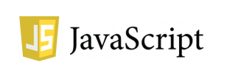
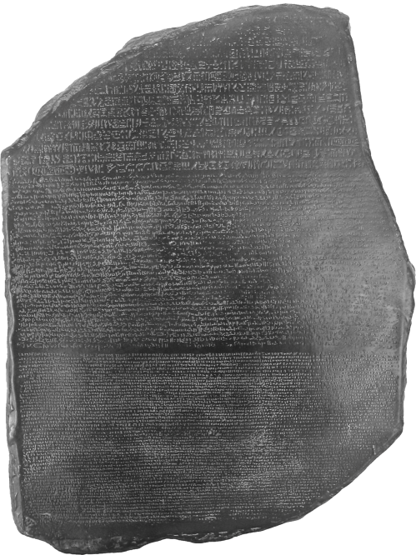
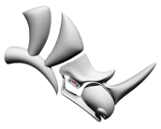
Rosetta IDE
Front ends:
Back ends:
Rosetta
(Racket)
AUTOLISP
Pedro Ramos & António Menezes Leitão | An Implementation of Python for Racket

Slide 11
Borrows influences from Lisp
High level, dynamically typed, GC’d
Multiple paradigms
Huge standard library + third-party libraries
Pedro Ramos & António Menezes Leitão | An Implementation of Python for Racket

Slide 12
Goals
Correctness + Completeness
Performance
DrRacket Integration
Interoperability with Racket
Pedro Ramos & António Menezes Leitão | An Implementation of Python for Racket

Slide 13
Related implementations
 | Language(s) written | Platform(s) targetted | Speedup (vs. CPython) | Std. library support
CPython | C | CPython’s VM | 1x | Full
Pedro Ramos & António Menezes Leitão | An Implementation of Python for Racket

Slide 14
Related implementations
 | Language(s) written | Platform(s) targetted | Speedup (vs. CPython) | Std. library support
CPython | C | CPython’s VM | 1x | Full
Jython | Java | JVM | ~1x | Most
IronPython | C# | CLI | ~1.8x | Most
CLPython | Common Lisp | Common Lisp | ~0.5x | Most
Pedro Ramos & António Menezes Leitão | An Implementation of Python for Racket

Slide 15
Related implementations
 | Language(s) written | Platform(s) targetted | Speedup (vs. CPython) | Std. library support
CPython | C | CPython’s VM | 1x | Full
Jython | Java | JVM | ~1x | Most
IronPython | C# | CLI | ~1.8x | Most
CLPython | Common Lisp | Common Lisp | ~0.5x | Most
PLT Spy | Scheme, C | Scheme | ~0.001x | Full
Pedro Ramos & António Menezes Leitão | An Implementation of Python for Racket

Slide 16
Our solution...
Pedro Ramos & António Menezes Leitão | An Implementation of Python for Racket

Slide 17
Pipeline
.py
.rkt
Python → Racket
(source-to-source compiler)
Racket → Bytecode
(Racket compiler + JIT)
Pedro Ramos & António Menezes Leitão | An Implementation of Python for Racket

Slide 18
Architecture
Pedro Ramos & António Menezes Leitão | An Implementation of Python for Racket

Slide 19
Racket Modules
reader module (for compilation)
read: input-port → (listof s-expression)
read-syntax: input-port → (listof syntax-object)
python module (for runtime behaviour)
Provides functions/macros used in compiled code
?
Pedro Ramos & António Menezes Leitão | An Implementation of Python for Racket

Slide 20
Syntax-objects
S-expression
Source location information
File, line number, column number, span
Lexical-binding information
Pedro Ramos & António Menezes Leitão | An Implementation of Python for Racket

Slide 21
Syntax-objects
(py-print (py-get-index arr 6))
line: 3, cols: 0-12
py-print
(py-get-index arr 6)
line: 3, cols: 6-12
py-get-index
arr
line: 3, cols: 6-9
6
line: 3, cols: 10-11
Pedro Ramos & António Menezes Leitão | An Implementation of Python for Racket

Slide 22
Architecture
Pedro Ramos & António Menezes Leitão | An Implementation of Python for Racket

Slide 23
How to implement Python’s behaviour?
Pedro Ramos & António Menezes Leitão | An Implementation of Python for Racket

Slide 24
Runtime implementation
Mapping to Python/C API
(via Racket Foreign Function Interface)
Racket reimplementation
Two alternatives:
Pedro Ramos & António Menezes Leitão | An Implementation of Python for Racket

Slide 25
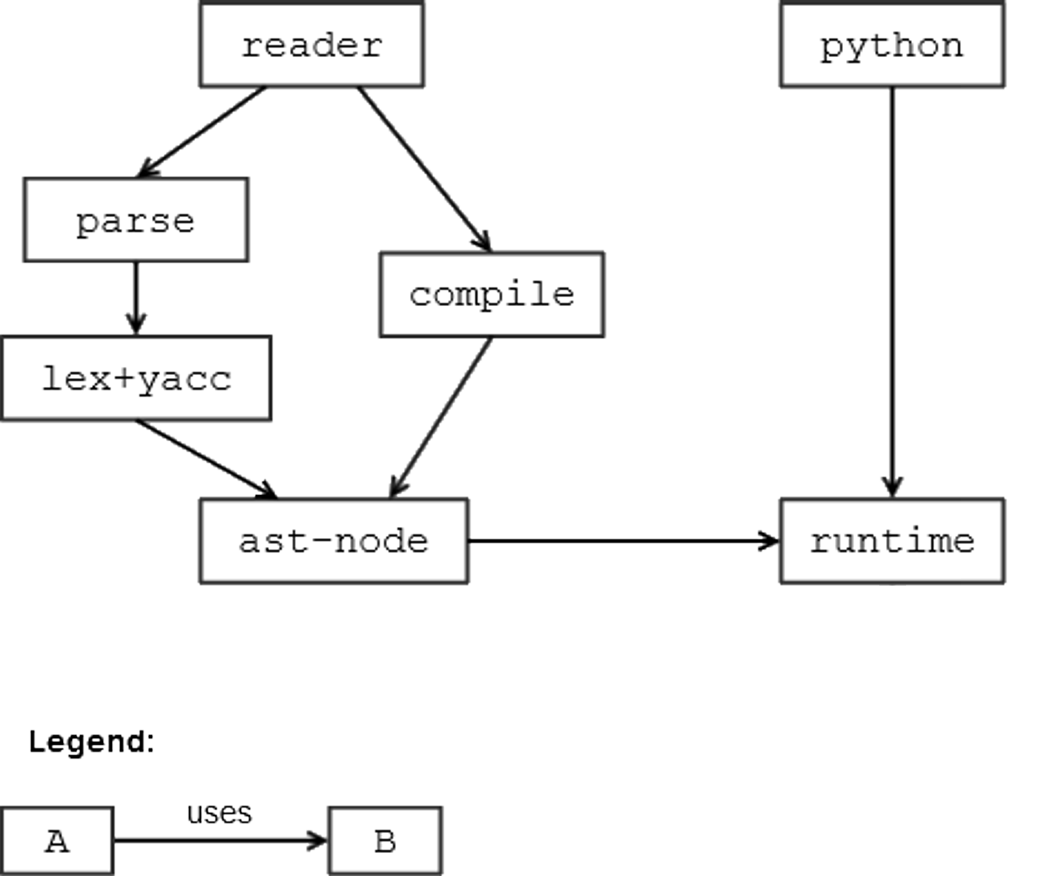
Architecture
Pedro Ramos & António Menezes Leitão | An Implementation of Python for Racket

Slide 26
FFI Approach
libpython module
Racket
CPython VM
foreign calls
on C pointers
Racket FFI
(Foreign Function Interface)
Python/C API
Pedro Ramos & António Menezes Leitão | An Implementation of Python for Racket

Slide 27
FFI Runtime - Example
x + y
(define (py-add x y)
(PyObject_CallObject (PyObject_GetAttrString x "__add__")
(make-py-tuple y)))
(define (make-py-tuple . elems)
(let ([py-tuple (PyTuple_New (length elems))])
(for ([i (range (length elems))]
[elem elems])
(PyTuple_SetItem py-tuple i elem))
py-tuple))
Pedro Ramos & António Menezes Leitão | An Implementation of Python for Racket

Slide 28
FFI Runtime - Disadvantages
Bad Performance
Expensive type conversions + FFI calls
Finalizers for GC
Clumsy Interoperability with Racket
Wrappers/Unwrappers
Pedro Ramos & António Menezes Leitão | An Implementation of Python for Racket

Slide 29
What about implementing it over Racket data types?
We must first understand
Python’s data model
Pedro Ramos & António Menezes Leitão | An Implementation of Python for Racket

Slide 30
Python’s Data Model
Every value is an object
Every object has a reference to its type-object
Type-objects hold hash-table for method dispatching
Maps method names to function objects
Operator behaviour is mapped to methods
Pedro Ramos & António Menezes Leitão | An Implementation of Python for Racket

Slide 31
Optimizations
Basic types mapped to Racket types
int, long, float, complex, string, dict
Avoids wrapping/unwrapping
Early method dispatching for operators
Avoids expensive method dispatching for common uses
Pedro Ramos & António Menezes Leitão | An Implementation of Python for Racket

Slide 32
Racket Runtime - Example
x + y
(define (py-add x y)
(py-method-call x "__add__" y))
(define (py-add x y)
(cond
[(and (number? x) (number? y)) (+ x y)]
[(and (string? x) (string? y)) (string-append x y)]
[else (py-method-call x "__add__" y)]))
Pedro Ramos & António Menezes Leitão | An Implementation of Python for Racket

Slide 33
How are modules imported?
Pedro Ramos & António Menezes Leitão | An Implementation of Python for Racket

Slide 34
Python import system
import <module>
<module> is imported as a module object
from <module> import <id>
<id> is imported as a new binding
from <module> import *
All bindings from <module> are imported
module->exports
+
dynamic-require
require
Special syntax for Racket imports
Pedro Ramos & António Menezes Leitão | An Implementation of Python for Racket

Slide 35
Import - Example
#lang python
import "racket" as rkt
def add_cons(c):
return rkt.car(c) + rkt.cdr(c)
c1 = rkt.cons(2, 3)
c2 = rkt.cons("abc", "def")
> add_cons(c1)
5
> add_cons(c2)
"abcdef"
Pedro Ramos & António Menezes Leitão | An Implementation of Python for Racket

Slide 36
Import - Example
#lang python
from "racket" import cons, car, cdr
def add_cons(c):
return car(c) + cdr(c)
c1 = cons(2, 3)
c2 = cons("abc", "def")
> add_cons(c1)
5
> add_cons(c2)
"abcdef"
Pedro Ramos & António Menezes Leitão | An Implementation of Python for Racket

Slide 37
Import - Example (Macros)
#lang python
from "racket/trace" import trace
def factorial(n):
if n == 0: return 1
else: return n * factorial(n-1)
trace(factorial)
> factorial(5)
>(factorial 5)
> (factorial 4)
> >(factorial 3)
> > (factorial 2)
> > >(factorial 1)
> > > (factorial 0)
< < < 1
< < <1
< < 2
< <6
< 24
<120
120
Pedro Ramos & António Menezes Leitão | An Implementation of Python for Racket

Slide 38
Other Features
Class definitions
class statement → new type object
Exception handling
raise, try...except statements → raise, with-handlers forms
Flow control statements
return, break, continue, yield → escape continuations
Pedro Ramos & António Menezes Leitão | An Implementation of Python for Racket

Slide 39
Benchmarks
Ackermann
computing the Ackermann function
Mandelbrot
computing if a complex sequence diverges after a limited number of iterations
Pedro Ramos & António Menezes Leitão | An Implementation of Python for Racket

Slide 40
Ackermann
(define (ackermann m n)
(cond
[(= m 0) (+ n 1)]
[(and (> m 0) (= n 0)) (ackermann (- m 1) 1)]
[else (ackermann (- m 1) (ackermann m (- n 1)))]))
(ackermann 3 9)
def ackermann(m,n):
if m == 0: return n+1
elif m > 0 and n == 0: return ackermann(m-1,1)
else: return ackermann(m-1, ackermann(m,n-1))
print ackermann(3,9)
Pedro Ramos & António Menezes Leitão | An Implementation of Python for Racket

Slide 41
Mandelbrot
(define (mandelbrot limit c)
(let loop ([i 0] [z 0+0i])
(cond
[(> i limit) i]
[(> (magnitude z) 2) i]
[else (loop (add1 i)
(+ (* z z) c))])))
(mandelbrot 1000000 .2+.3i)
def mandelbrot(limit, c):
z = 0+0j
for i in range(limit+1):
if abs(z) > 2: return i
z = z*z + c
return i+1
print mandelbrot(1000000, .2+.3j)
Pedro Ramos & António Menezes Leitão | An Implementation of Python for Racket

Slide 42
Ackermann - Results
■ (a) Racket on Racket
■ (b) Python on CPython
■ (c.1) Python on Racket (FFI)
■ (c.2) Python on Racket
(FFI + finalizers)
■ (d.1) Python on Racket (native)
■ (d.2) Python on Racket
(native + early dispatch)
Pedro Ramos & António Menezes Leitão | An Implementation of Python for Racket

Slide 43
Mandelbrot - Results
■ (a) Racket on Racket
■ (b) Python on CPython
■ (c.1) Python on Racket (FFI)
■ (c.2) Python on Racket
(FFI + finalizers)
■ (d.1) Python on Racket (native)
■ (d.2) Python on Racket
(native + early dispatch)
Pedro Ramos & António Menezes Leitão | An Implementation of Python for Racket

Slide 44
Future Work
Fully implement compilation process
Implement behaviour for built-in types
Integrate FFI calls with current data model
Formal testing for correctness
Pedro Ramos & António Menezes Leitão | An Implementation of Python for Racket

Slide 45
Thank you for listening! Questions? Comments?
Pedro Ramos & António Menezes Leitão | An Implementation of Python for Racket

Slide 46
Thank you for listening! Questions? Comments?
Pedro Ramos & António Menezes Leitão | An Implementation of Python for Racket

Slide 47
Pedro Ramos & António Menezes Leitão | An Implementation of Python for Racket

Slide 48
Ackermann
CLPython (SBCL): 2106 ms
Python on Racket: 811 ms
Mandelbrot
CLPython (SBCL): 943 ms
Python on Racket: 765 ms
Pedro Ramos & António Menezes Leitão | An Implementation of Python for Racket

