Slide 1
Programming Languages for Generative design:
Visual or Textual?
António Leitão
antonio.menezes.leitao@ist.utl.pt
Luís Santos
luis.sds82@gmail.com
2011 – Respecting Fragile Spaces

Slide 2
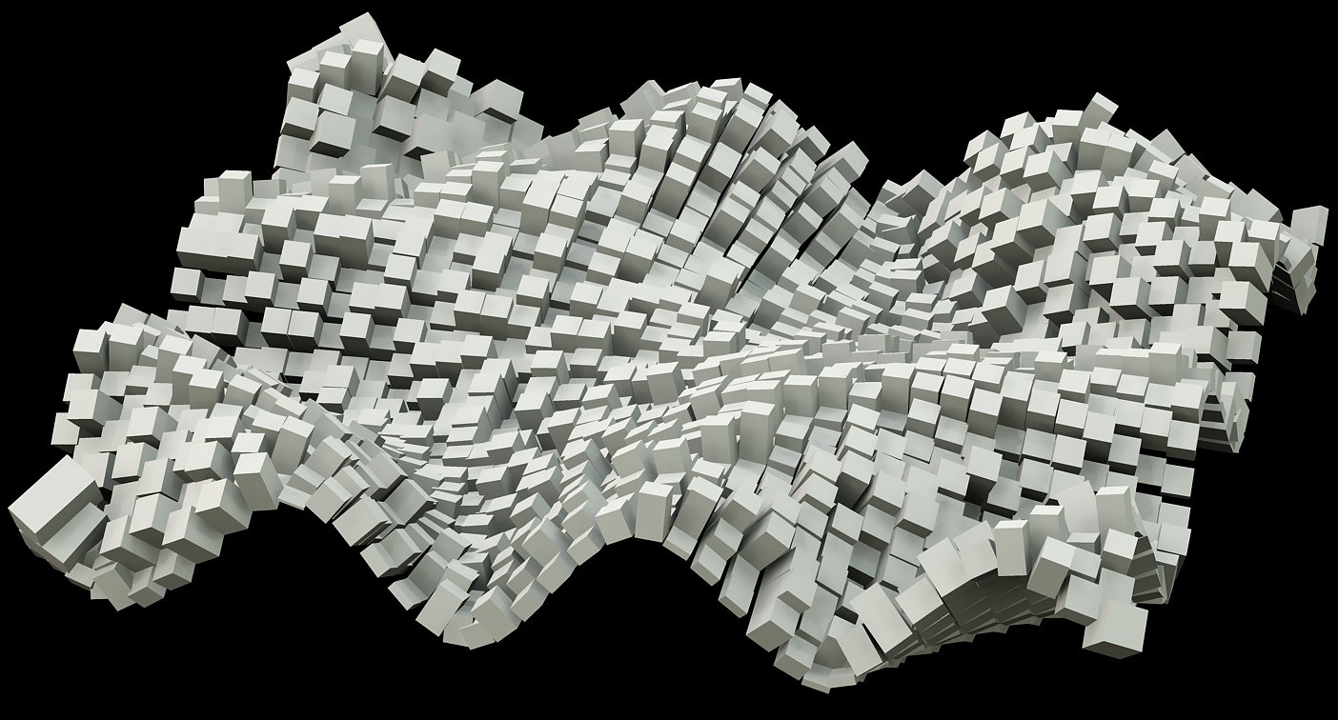
2011
Programming Languages for Generative design:
Visual or Textual?
“Geometry may still serve as the output of the design, but the design representation shifts, at least partially, into the realm of programming.”
(Kilian 2006)

Slide 3
2011
Programming Languages for Generative design:
Visual or Textual?
Visual Programming Languages (VPL):
Bidimensional arrangement of icons
Textual Programming Languages (TPL):
Unidimensional Sequence of Characters
Function ConicSpiral(Length,N)
Dim points()
ReDim points(N-1)
Dim t, i
For i=0 To N-1
t=i*Length/N
points(i)=Pt(t*Cos(5*t),
t*Sin(5*t),
t)
Next
ConicSpiralPoints=points
End Function

Slide 4
2011
Programming Languages for Generative design:
Visual or Textual?
… and the winner is …
No conclusive evidence (Menzies, 2002)
VPL: more motivating for beginners
TPL: more productive for complex problems

Slide 5
2011
Programming Languages for Generative design:
Visual or Textual?
Experiment 01

Slide 6
2011
Programming Languages for Generative design:
Visual or Textual?
Grasshopper
Expression
Function
Points
Parameters
Range
0, 0.2, 0.4, …, 20
Data Flow

Slide 7
2011
Programming Languages for Generative design:
Visual or Textual?
Mandatory Declaration
Function
RhinoScript
Parameters
Last index
Option Explicit
Function ConicSpiralPoints(Length,N)
Dim points()
ReDim points(N-1)
Dim t, i
For i=0 To N-1
t=i*Length/N
points(i)=Rhino.Addpoint(Array(t*Cos(5*t),t*Sin(5*t),t))
Next
ConicSpiralPoints=points
End Function
Sub Main ()
Call ConicSpiralPoints(20,100)
ConicSpiralPoints 25, 150
End Sub
Array Declaration
Array
Redimension
Range ?
Expression
Variable declaration
Points
Assignment
First index
Subroutine
Returned Value
For Loop
Array creation?
Function Call
Function Call??
Function Call?

Slide 8
2011
Programming Languages for Generative design:
Visual or Textual?
Fair: adj. free from self-interest, prejudice, or favoritism
Grasshopper (2007-2011): State-of-the-art, domain-specific VPL
RhinoScript (VbScript for Rhino): descendent of VisualBASIC (1988)

Slide 9
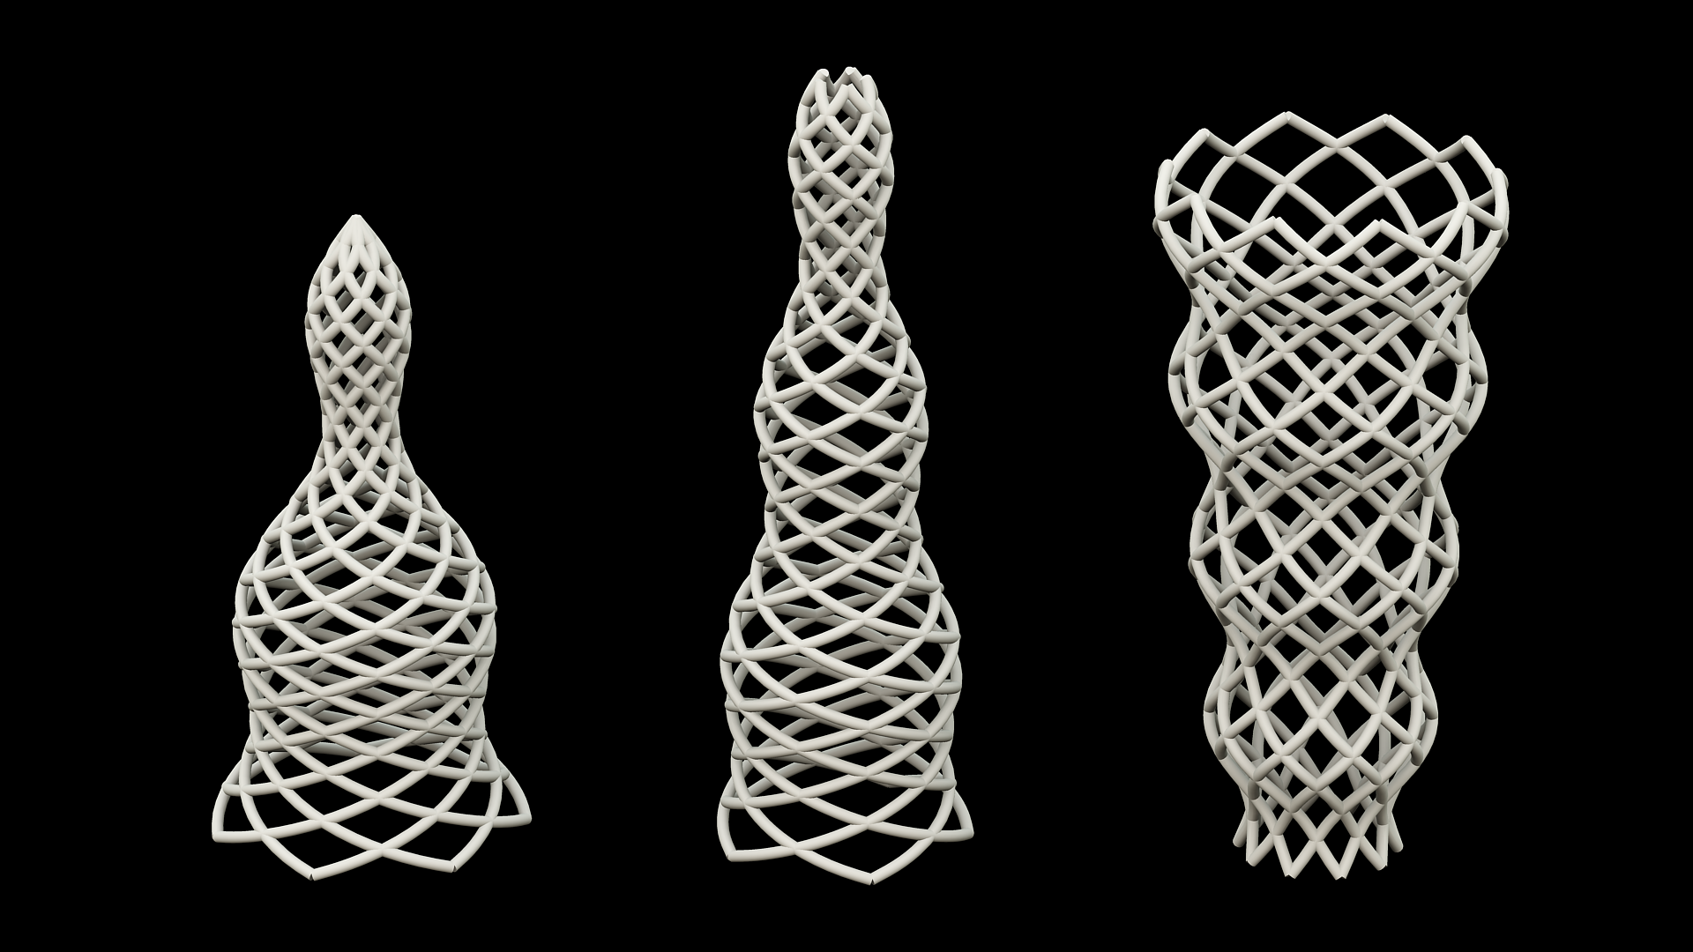
2011
Programming Languages for Generative design:
Visual or Textual?
Experiment 02

Slide 10
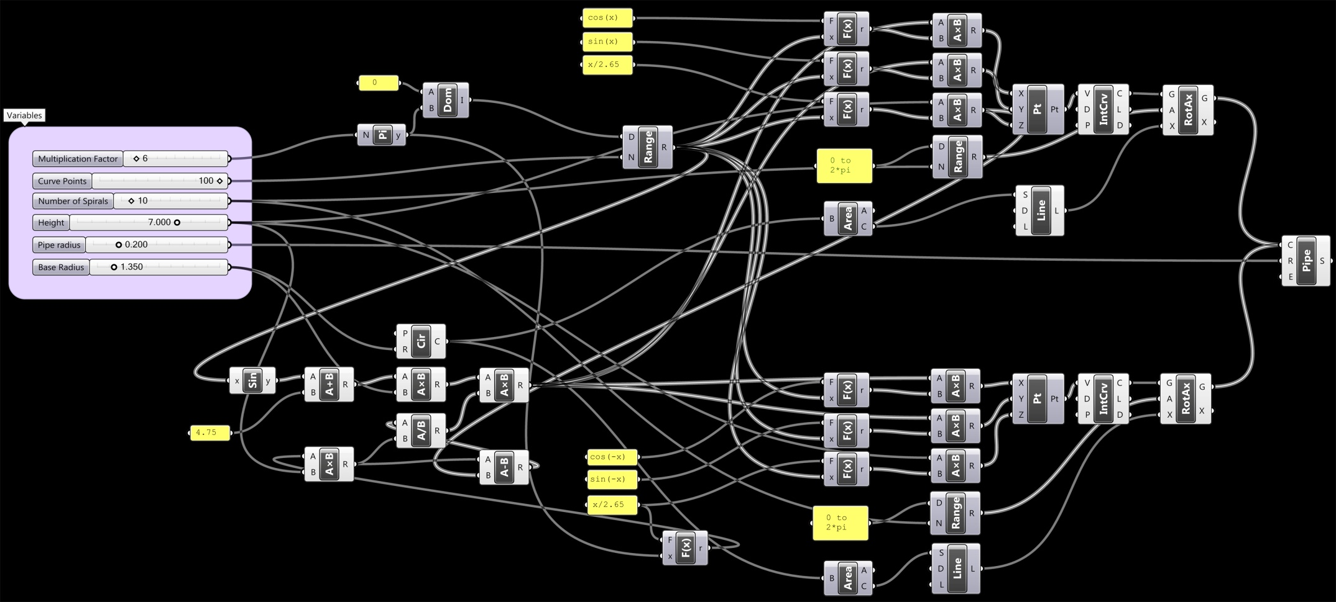
2011
Programming Languages for Generative design:
Visual or Textual?
Grasshopper
Copy & Paste?
Data Flow?
Parameters
(sin(a)+b)×c× …???
Copy & Paste?

Slide 11
2011
Programming Languages for Generative design:
Visual or Textual?
VisualScheme
(define (variation f n)
(map f (range 1 n)))
(define (linear a b)
(λ (t)
(+ a (* t (- b a)))))
(define (sinusoidal amp freq)
(λ (t)
(* amp (sin (* freq 2 pi t)))))

Slide 12
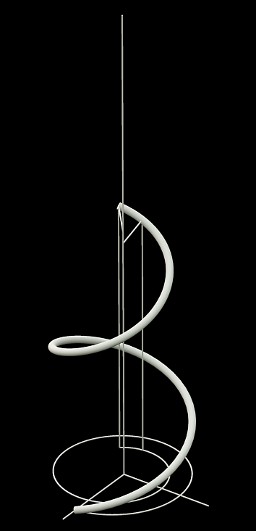
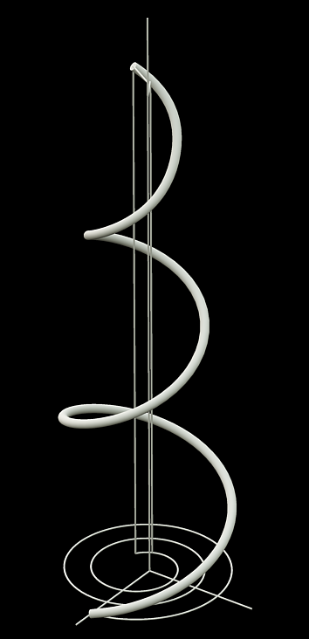
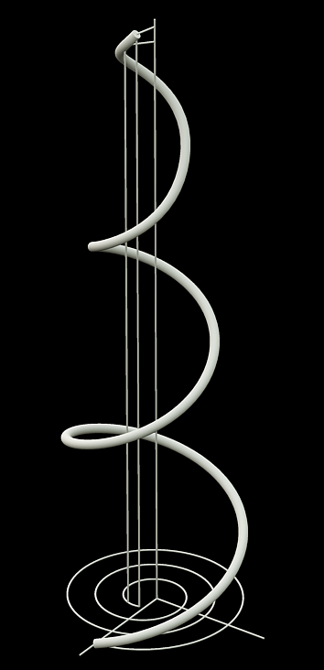
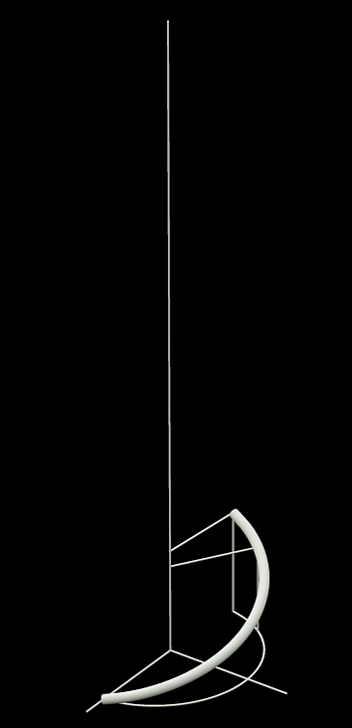
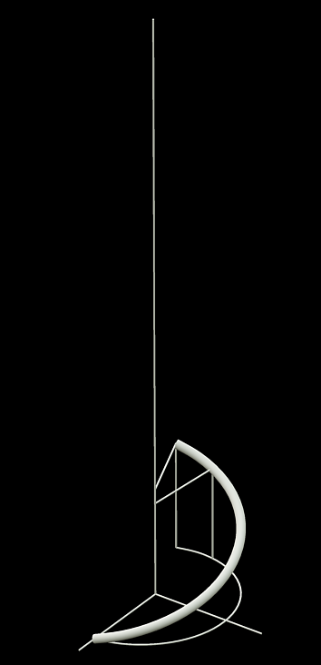
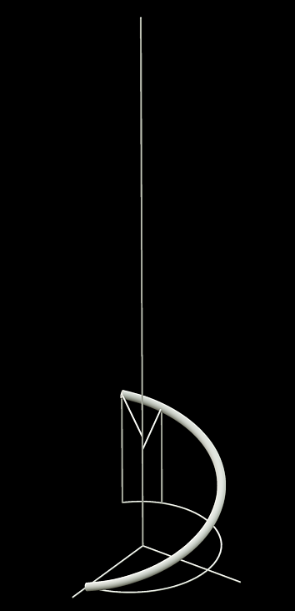
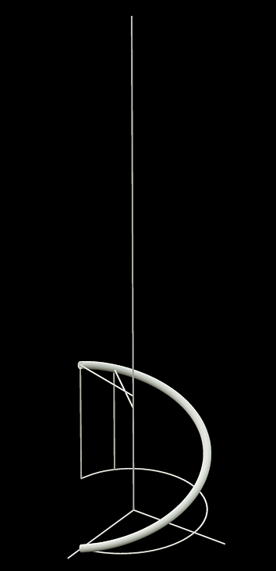
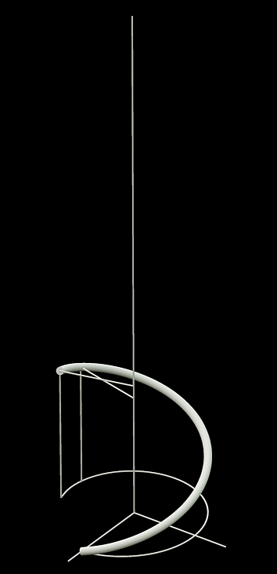
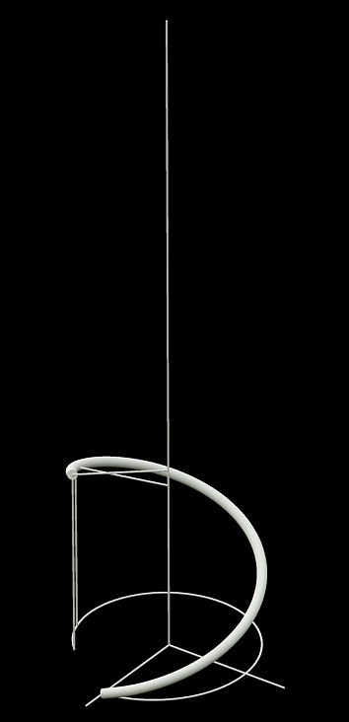
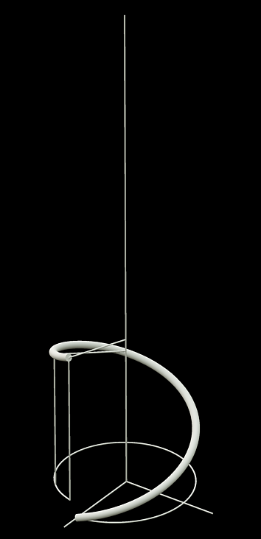
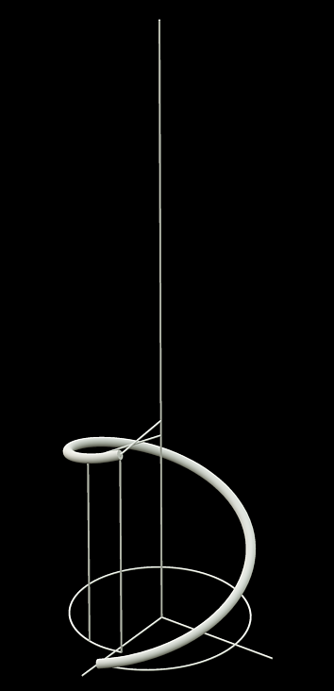
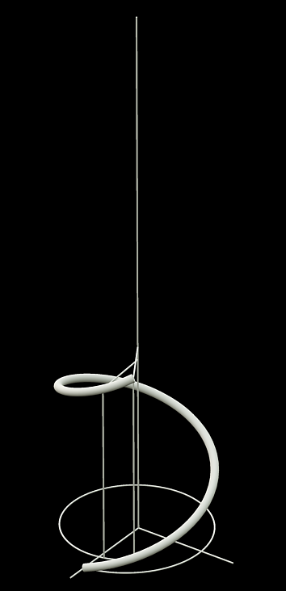
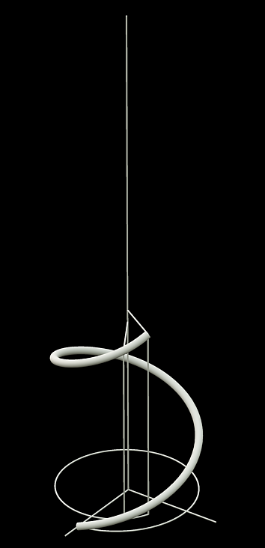
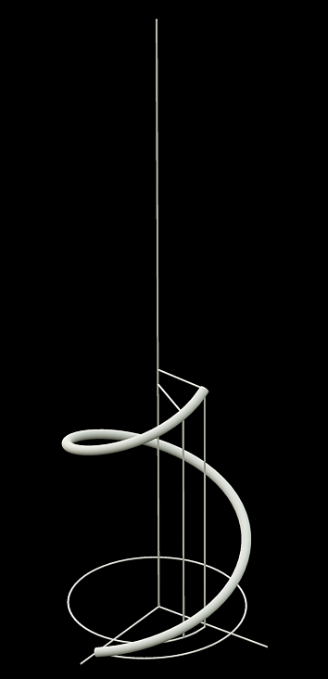
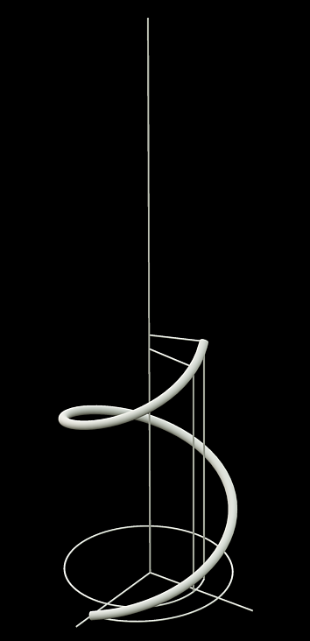
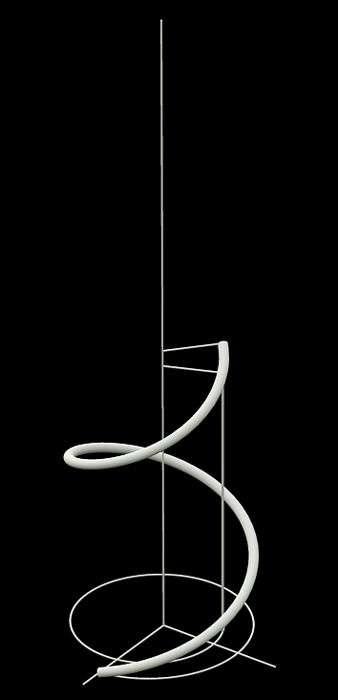
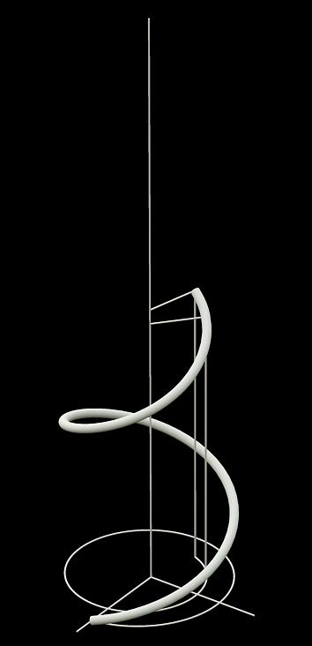
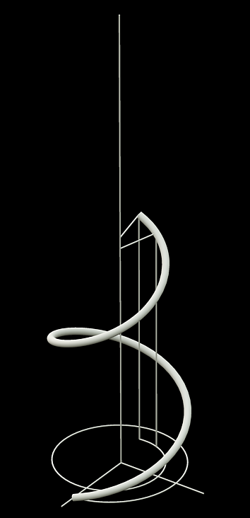
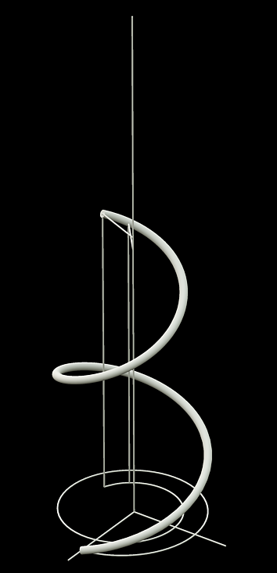
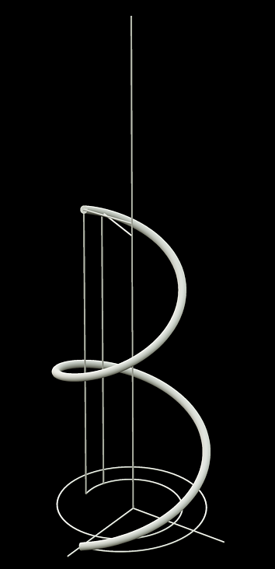
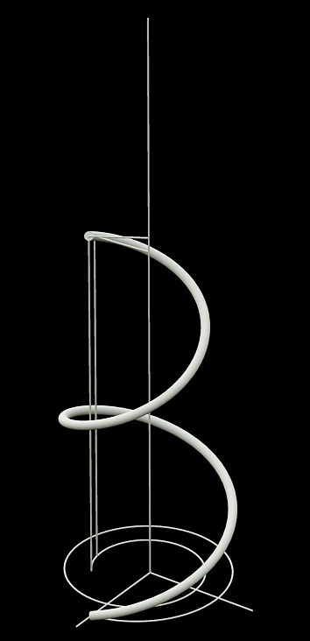
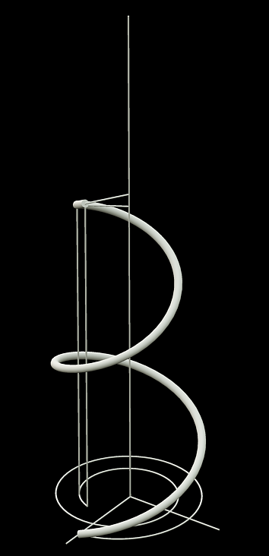
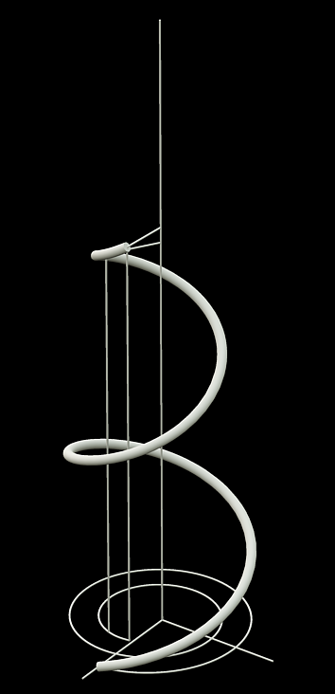
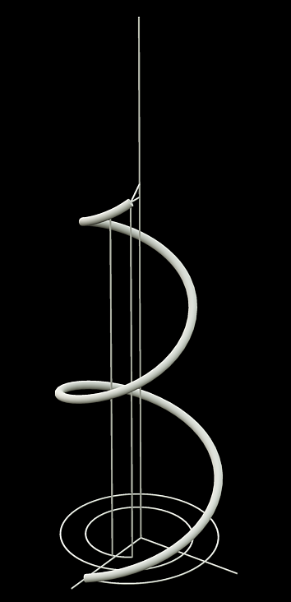
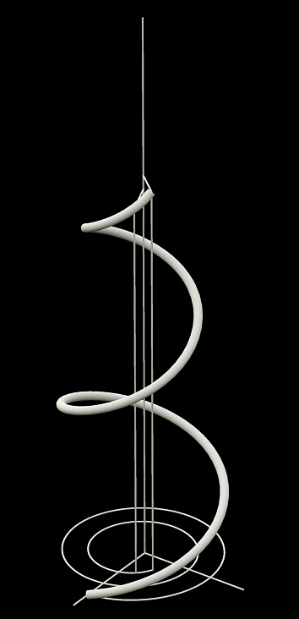
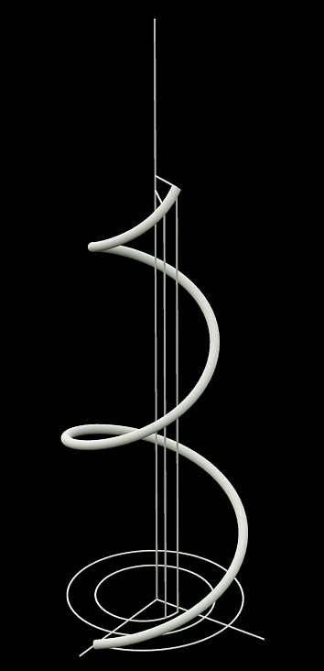
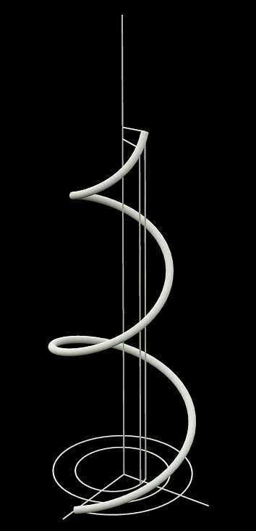
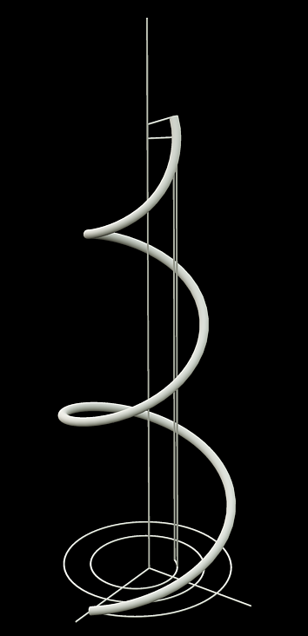
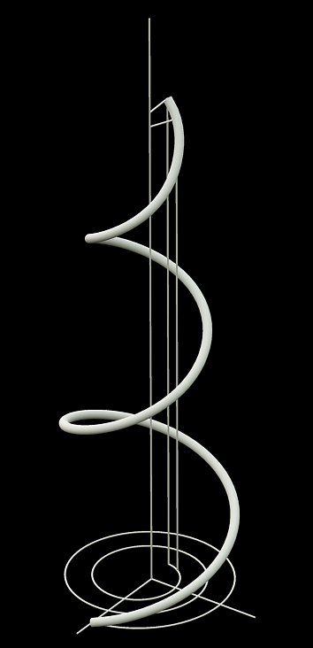
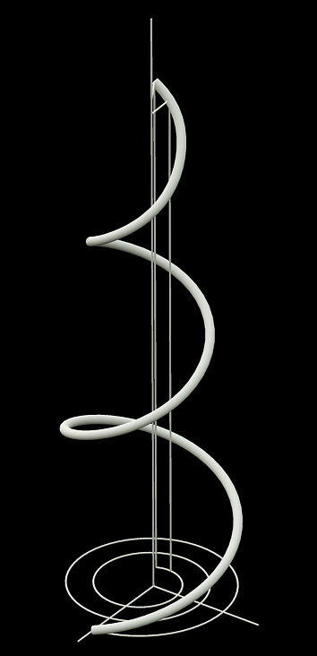
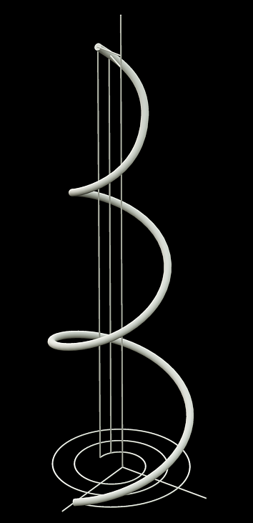
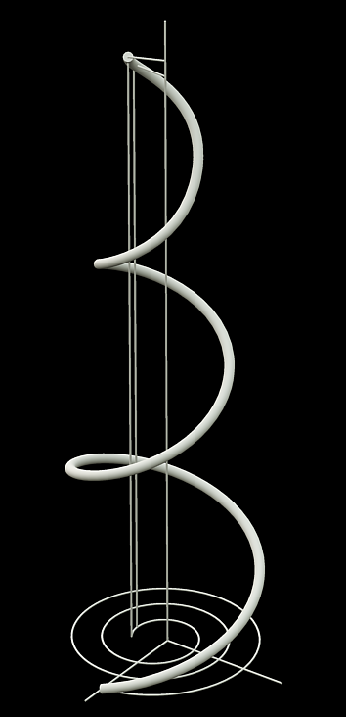
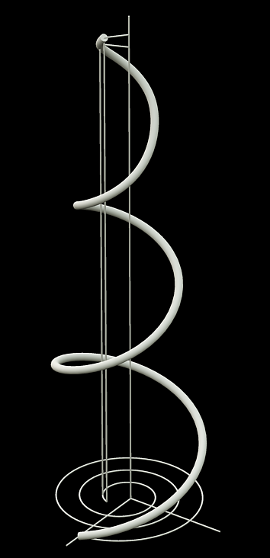
2011
Programming Languages for Generative design:
Visual or Textual?
VisualScheme
(define (spiral-points r0 r1 φ0 φ1 h amp freq n)
(map cyl
(variation (+fx (linear r0 r1)
(sinusoidal amp freq) n)
(variation (linear φ0 φ1) n)
(variation (linear 0 h) n)))

Slide 13
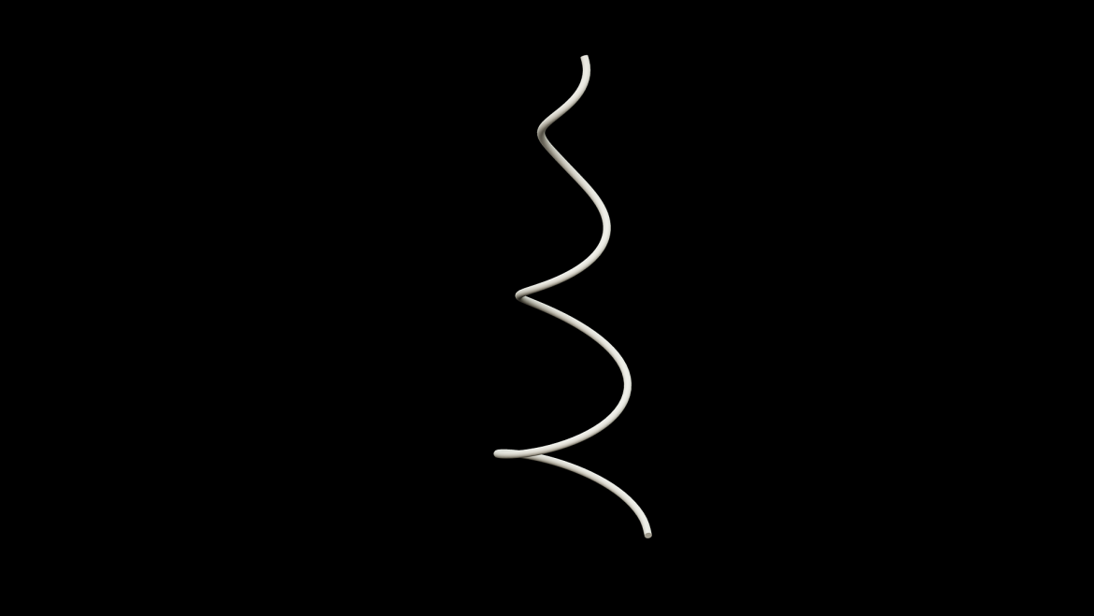
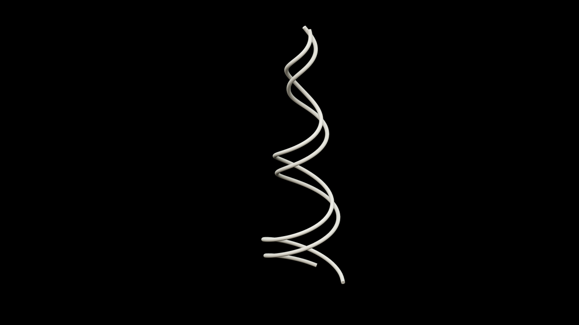
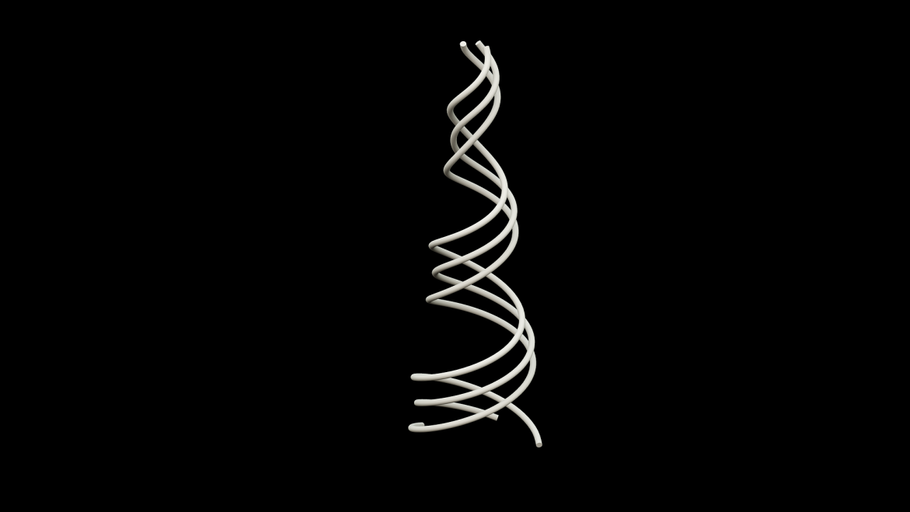
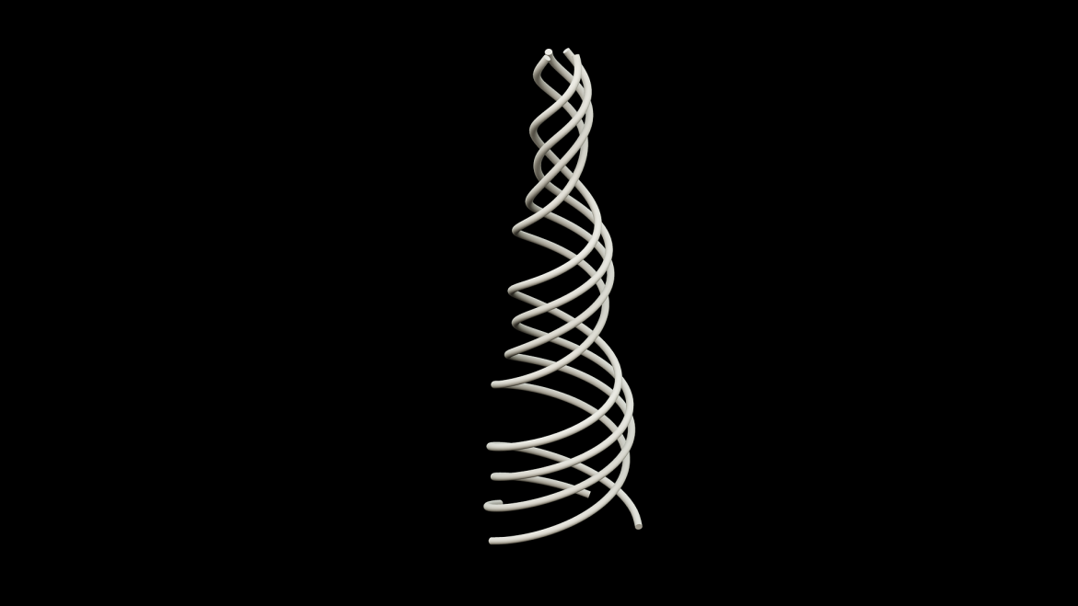
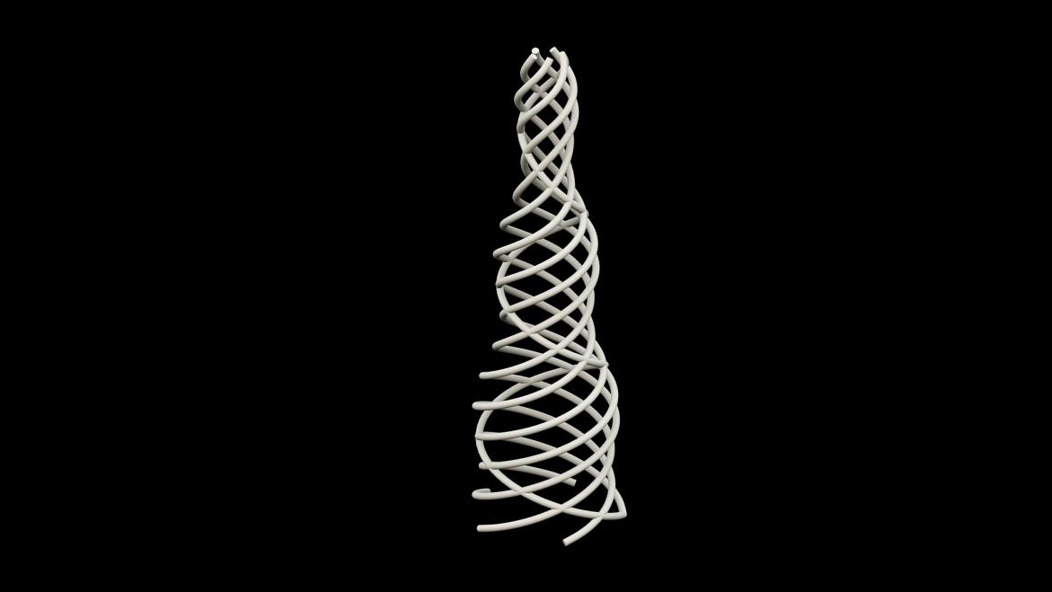
2011
Programming Languages for Generative design:
Visual or Textual?
VisualScheme
(define (spirals r0 r1 h amp freq nspiral turns n)
(map (λ (φ)
(spiral-points r0 r1 φ (+ φ (* 2 pi turns))
h amp freq n))
(variation (linear 0 (* 2 pi)) nspiral)))
(define (spirals-mesh r0 r1 h amp freq nspiral turns n)
(append (spirals r0 r1 h amp freq nspiral turns n)
(spirals r0 r1 h amp freq nspiral (- turns) n)))

Slide 14
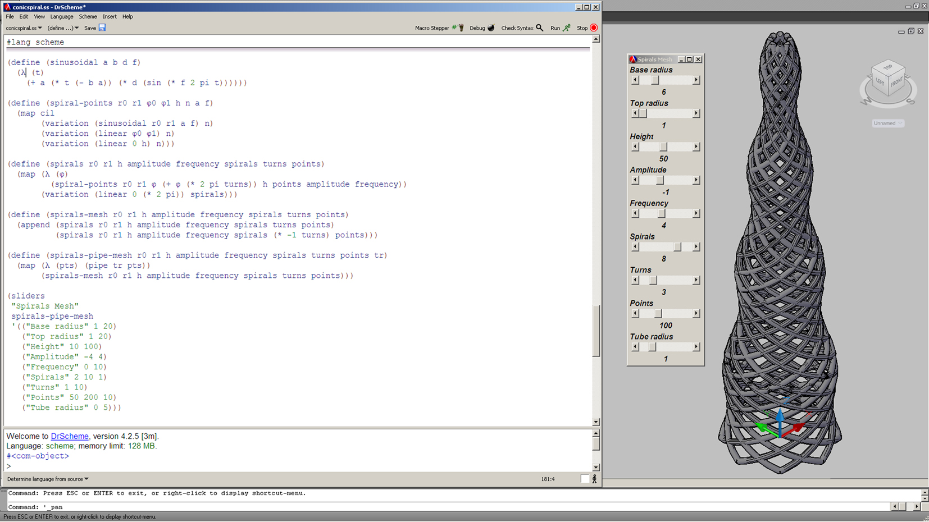
2011
Programming Languages for Generative design:
Visual or Textual?
VisualScheme

Slide 15
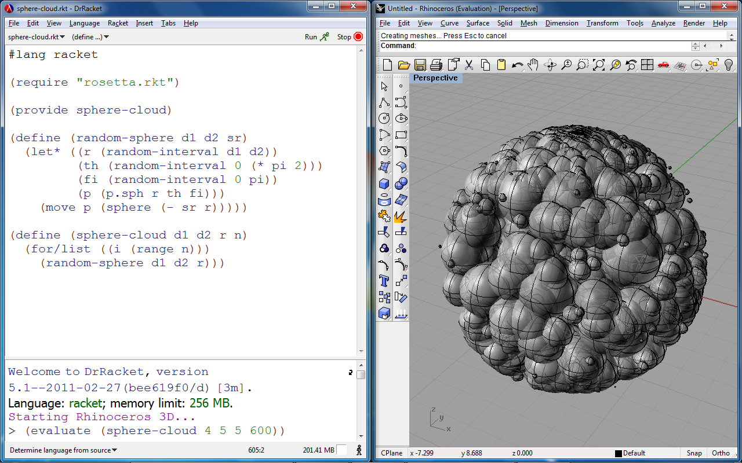
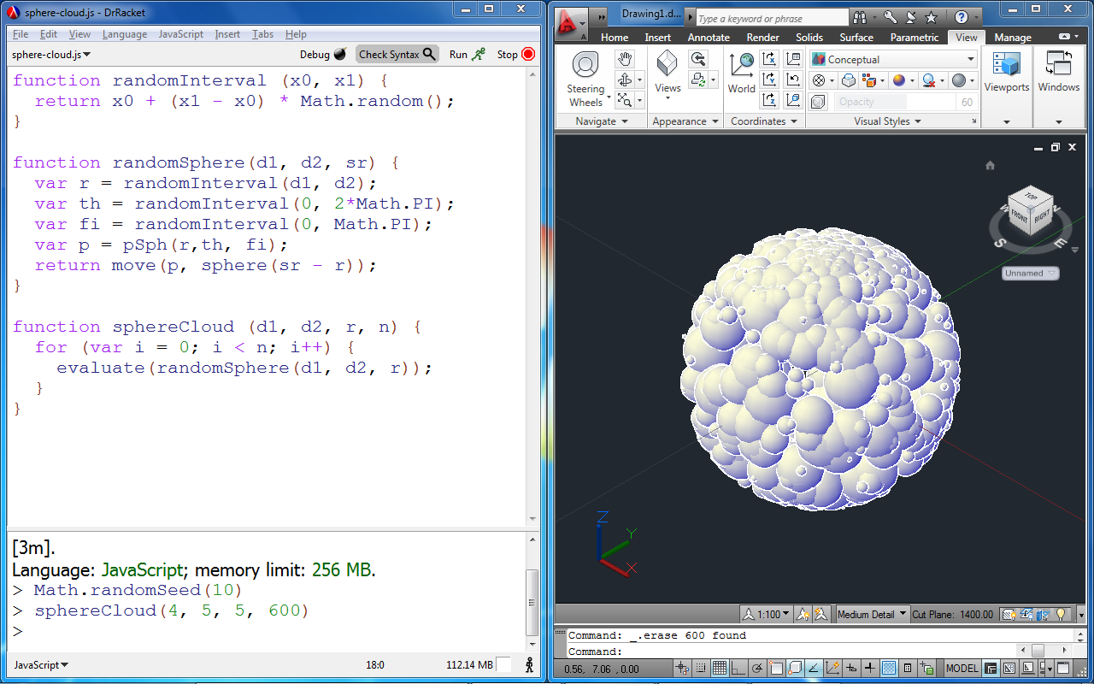
2011
Programming Languages for Generative design:
Visual or Textual?
Future Work: Rosetta

Slide 16
2011
Programming Languages for Generative design:
Visual or Textual?
Thank You
Questions?

