Slide 1
Portable Generative Design
for CAD Applications
José Lopes
jose.lopes@ist.utl.pt
António Leitão
antonio.menezes.leitao@ist.utl.pt
2011
- INTEGRATION THROUGH COMPUTATION

Slide 2
2011
Generative Design
- Different CAD Applications
- Different Programming Languages
- Different Modelling Primitives

Slide 3
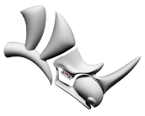
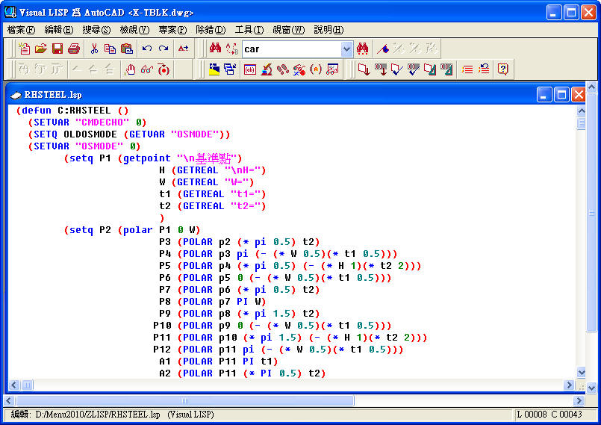
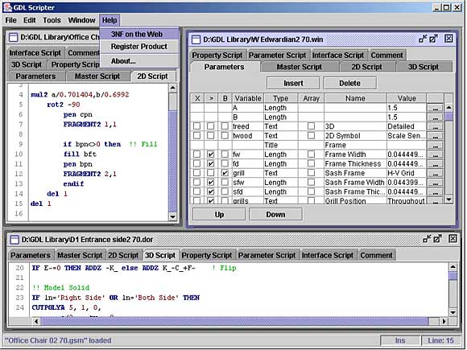
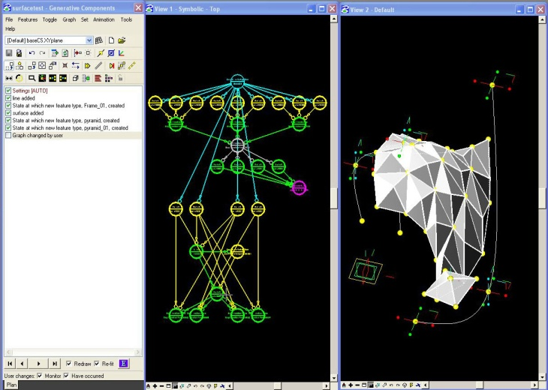
2011
INCOMPATIBLE
INCOMPATIBLE
INCOMPATIBLE
COMPATIBLE?
INCOMPATIBLE
INCOMPATIBLE
INCOMPATIBLE
INCOMPATIBLE

Slide 4
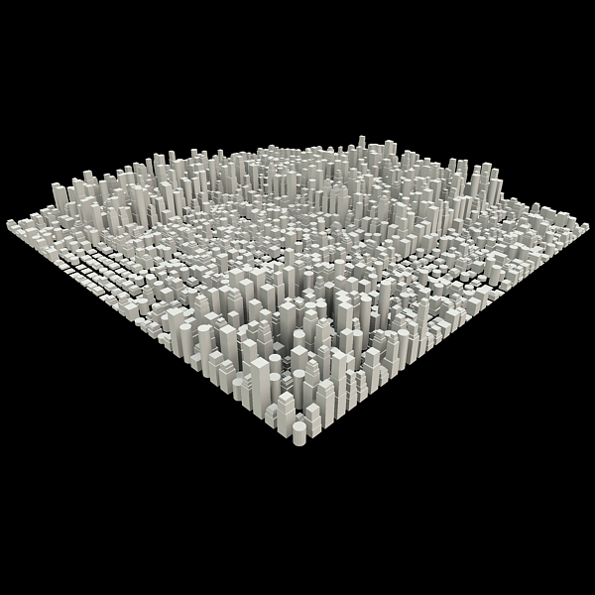
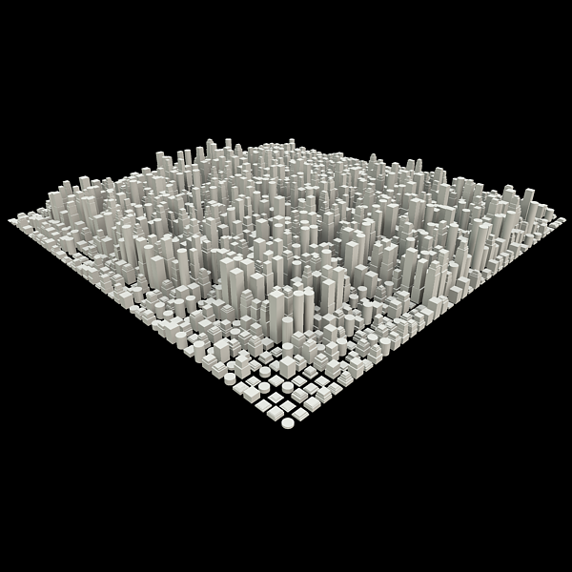
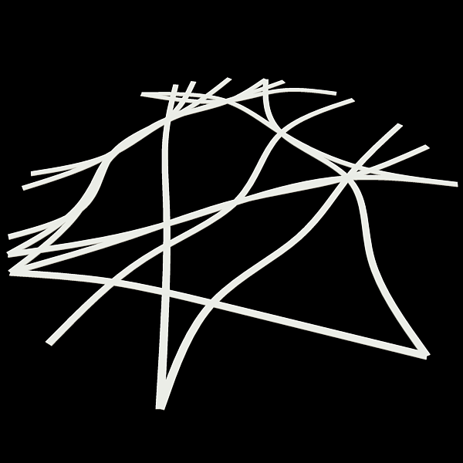
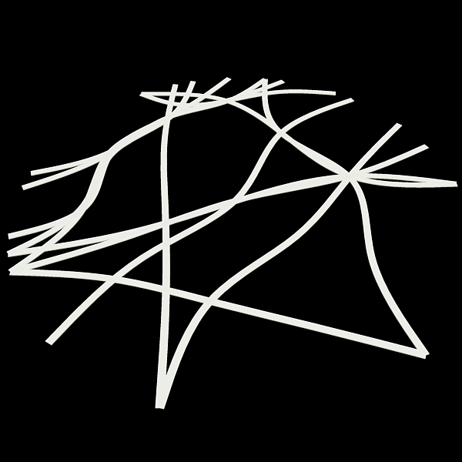
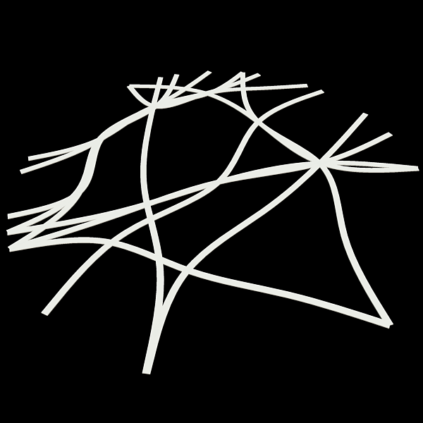
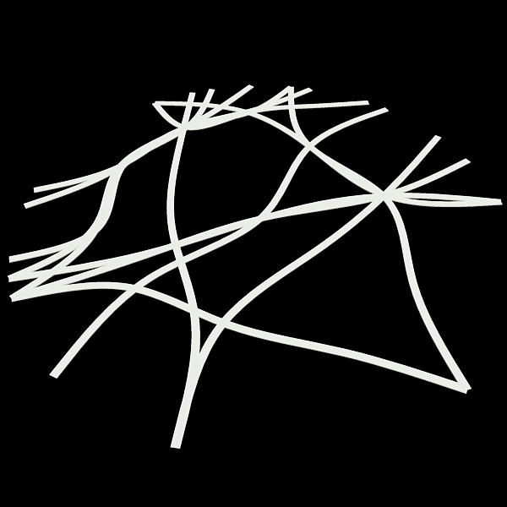
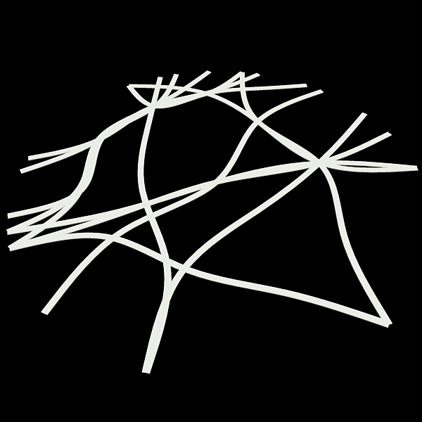
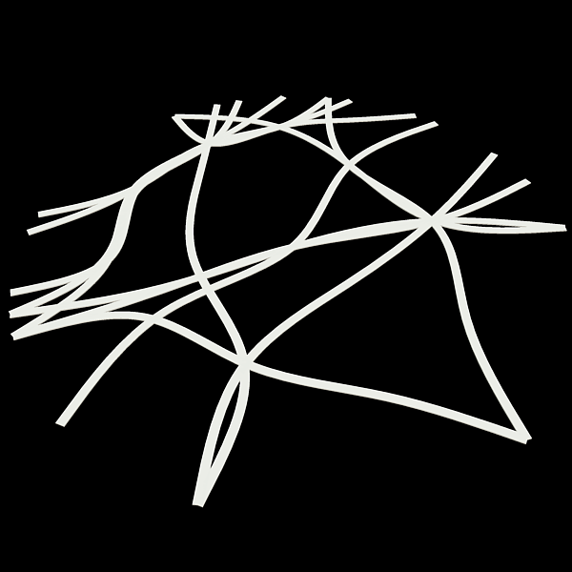
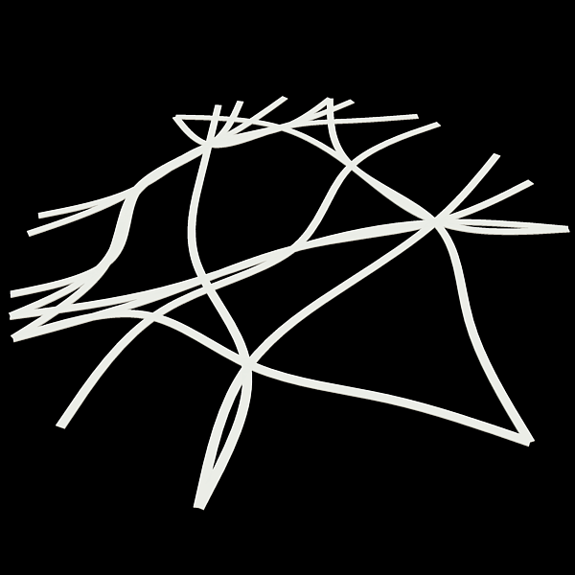
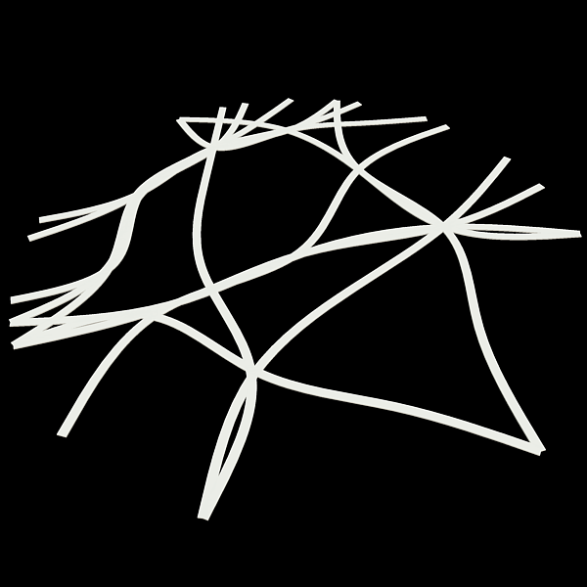
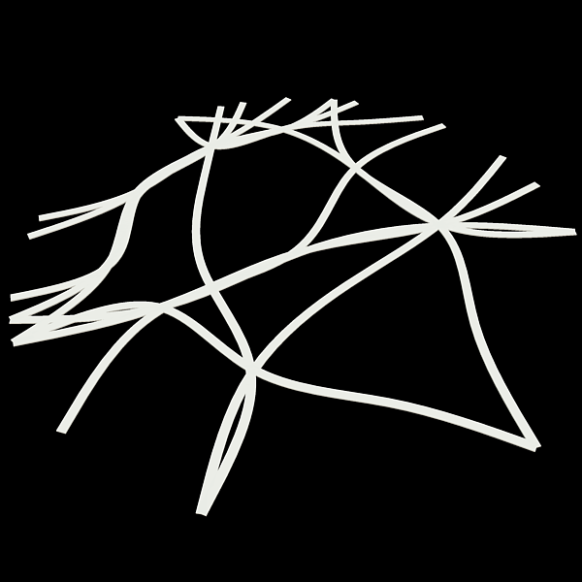
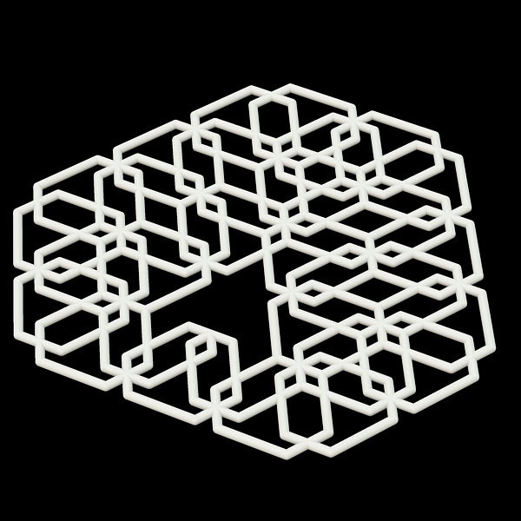
2011
Rosetta
- Teaching
- Researching
- Sharing

Slide 5
2011
CAD Applications
- Difficult to change CAD / Language
- Programs thrown away or rewritten
=
LOCK-IN

Slide 6
2011
Rosetta
One Program,
Many CAD Applications

Slide 7
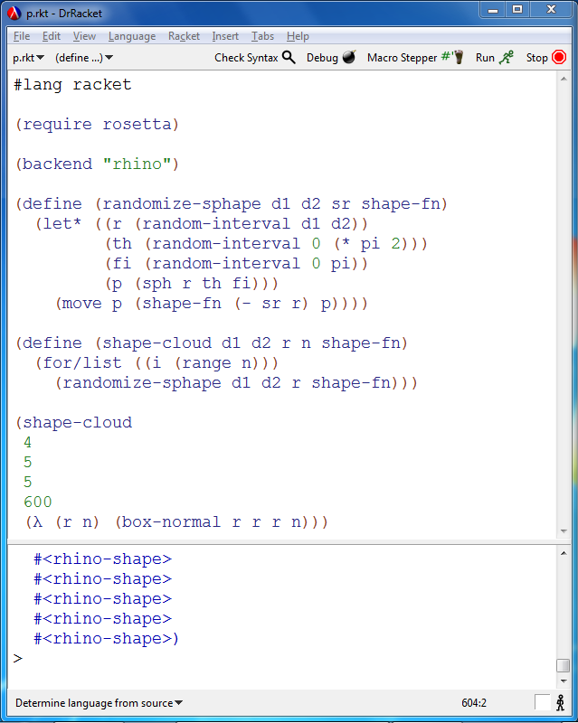
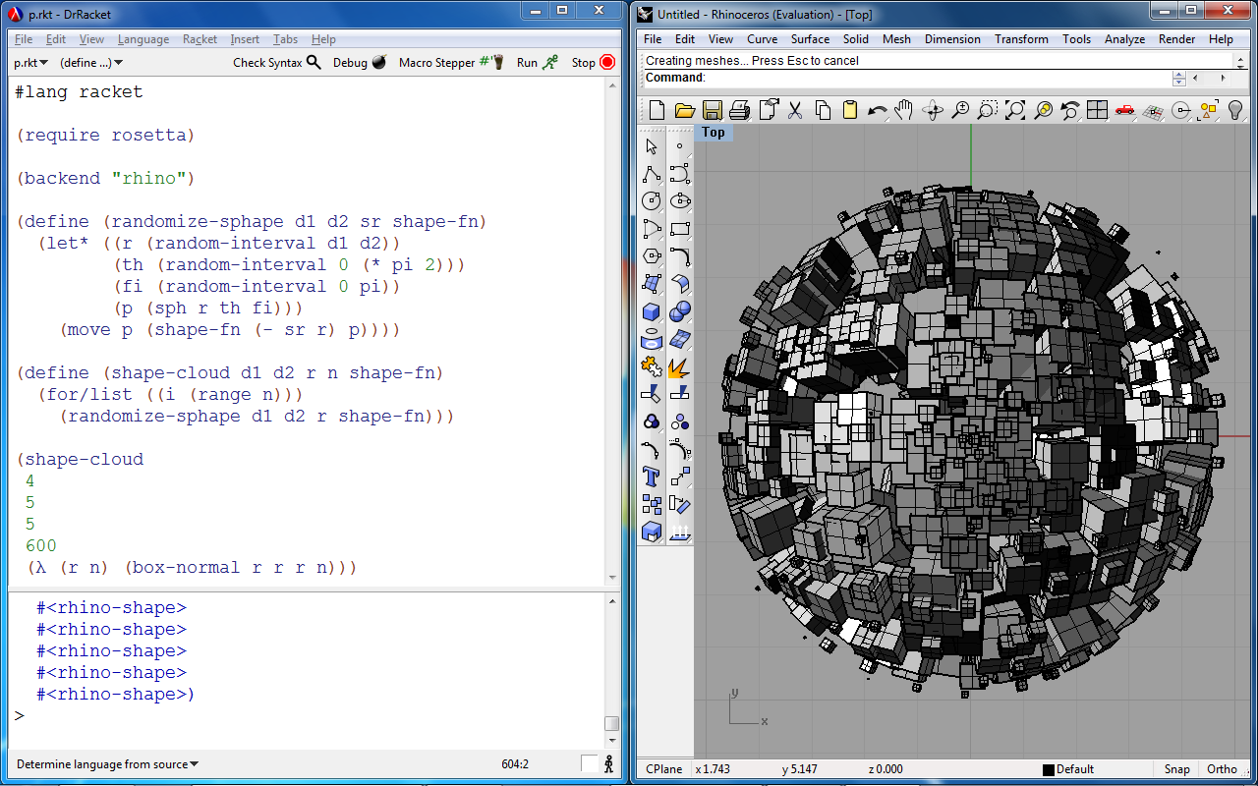
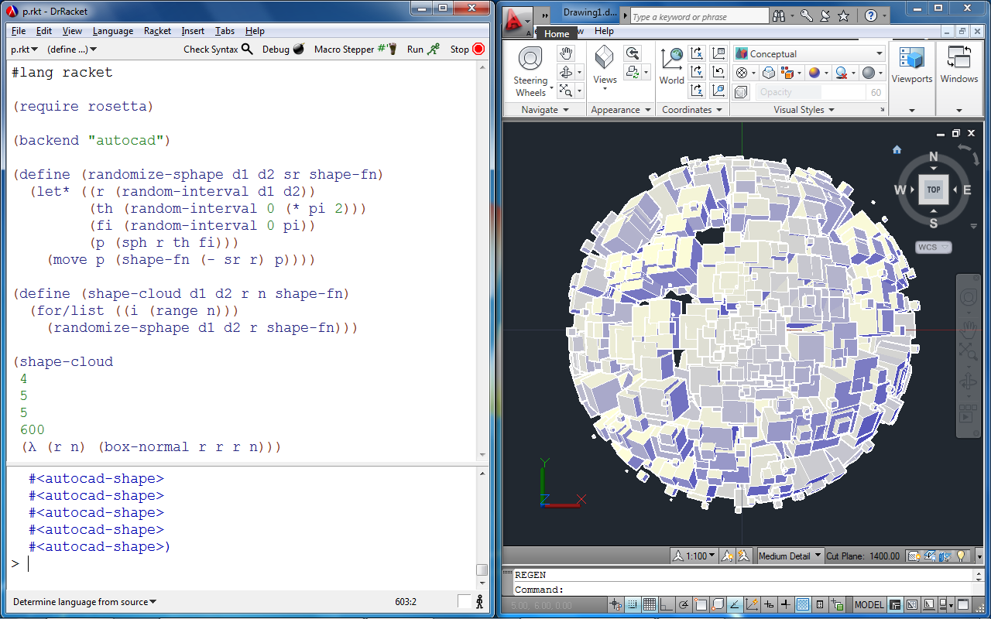
2011
Rosetta
Portability across CAD Applications
- Pedagogic environment
- Editor
- Debugger
- Listener

Slide 8
2011
Rosetta
One Program,
Many CAD Applications
One Program,
Many CAD Applications
and Languages

Slide 9
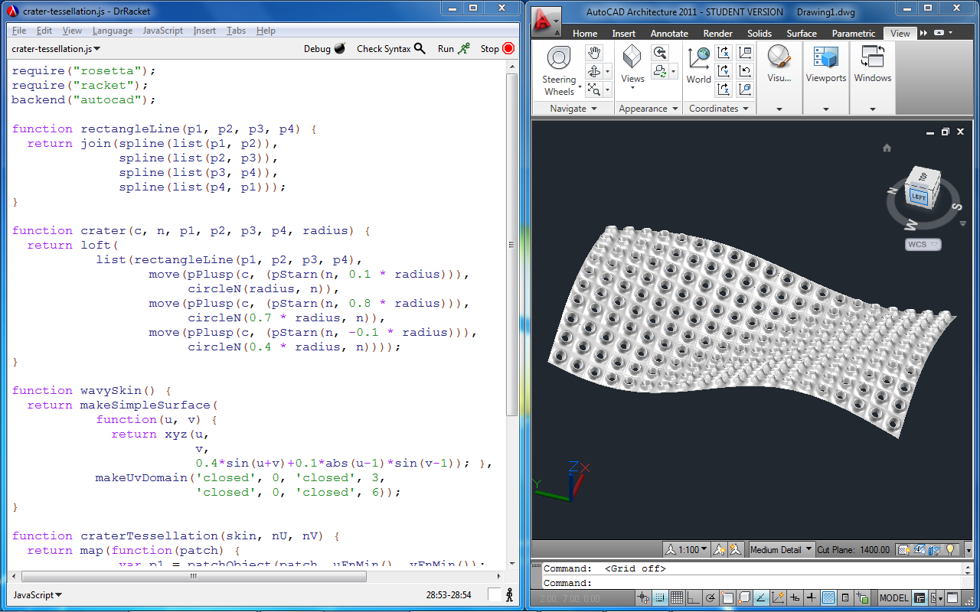
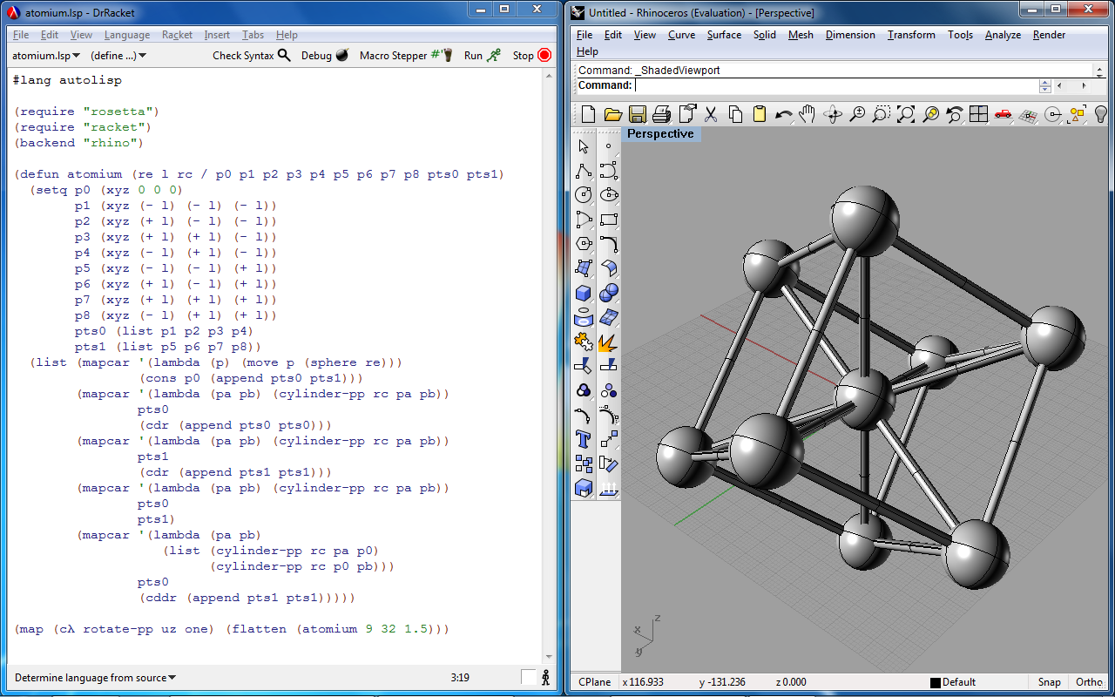
2011
Rosetta
Portability across Languages

Slide 10
2011
Rosetta
One Program,
Many CAD Applications
One Program,
Many CAD Applications
and Languages
Many Programs
, Many CAD Applications and Languages

Slide 11
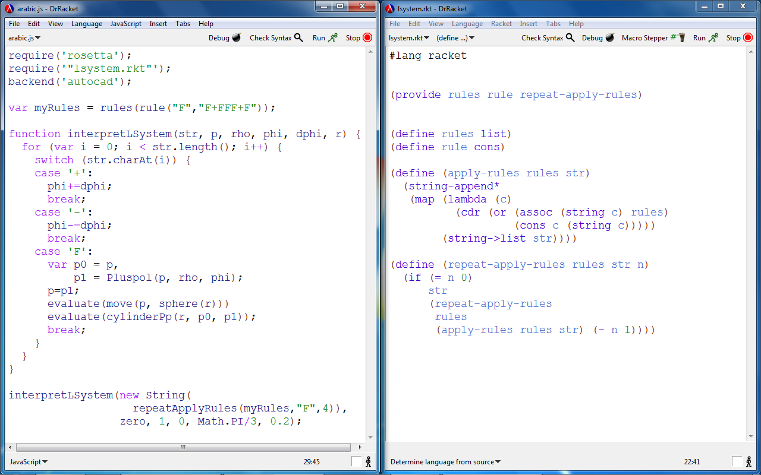
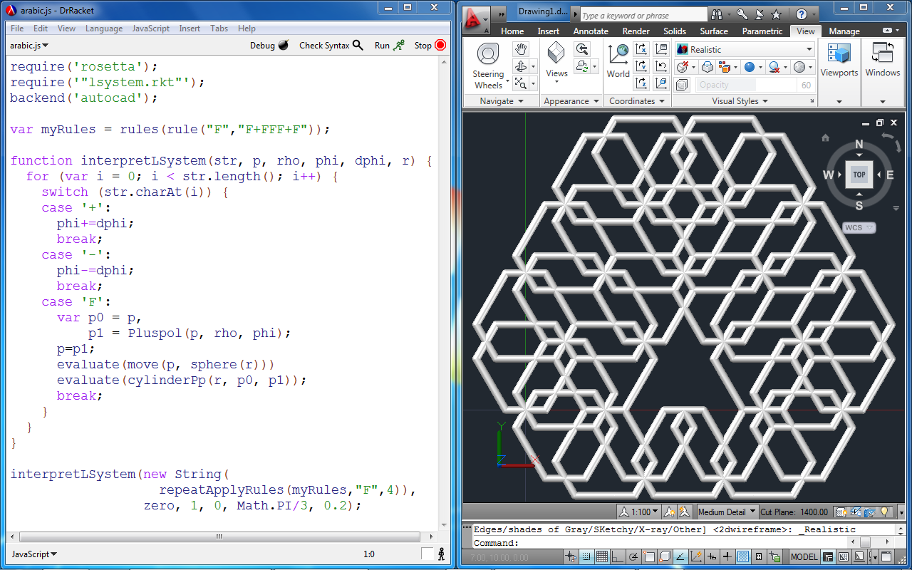
2011
Rosetta
Portability across Programs

Slide 12
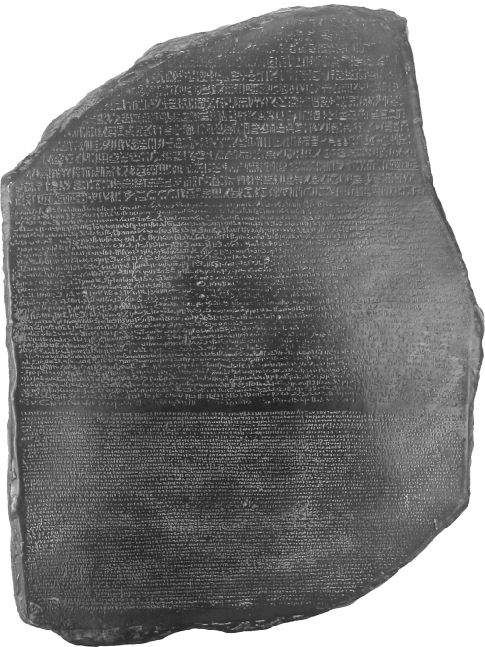
2011
Rosetta
Summary
Javascript
Racket
Rosetta
AutoLISP
…
…

Slide 13
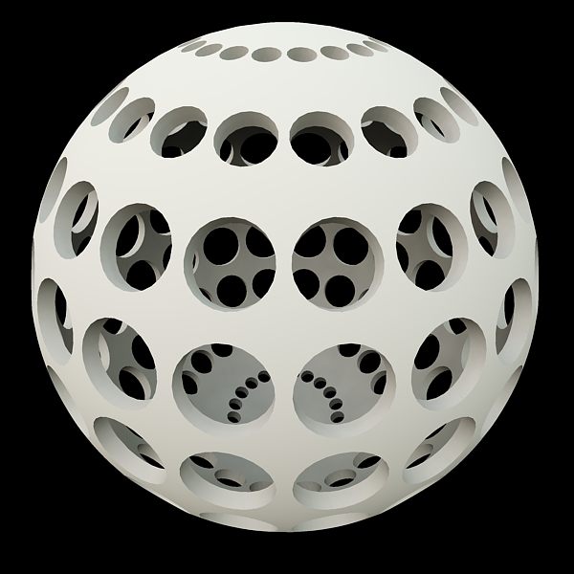
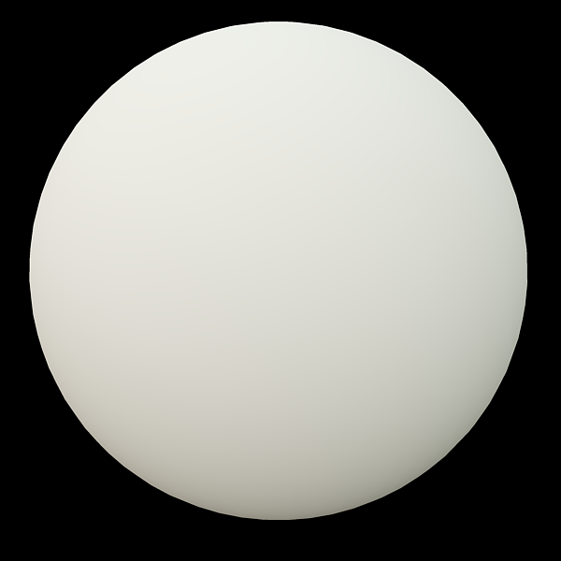
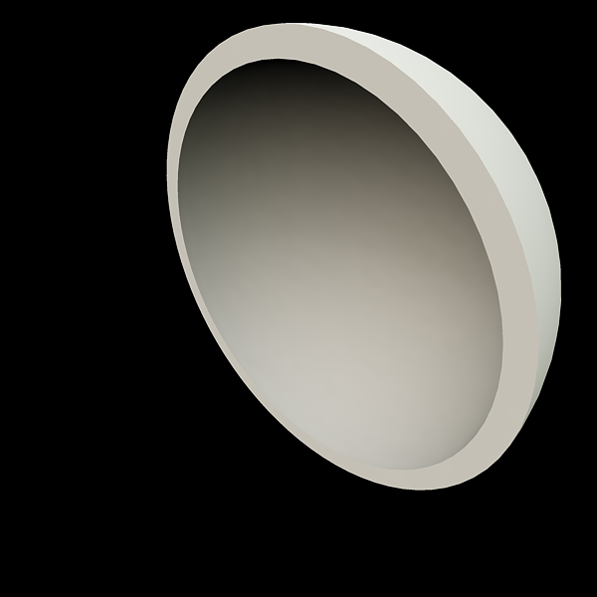
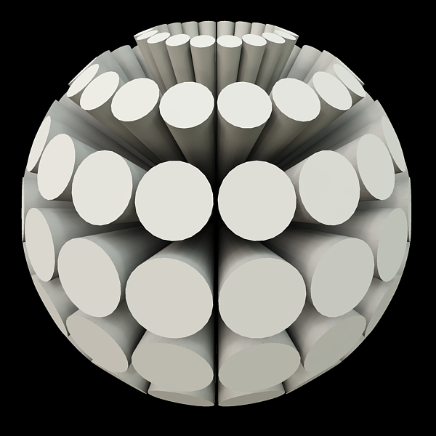
2011
Rosetta
Semantic differences in CAD Applications
var hollow-sphere =
subtract(sphere(10),
sphere(9));
var spherical-cones = ...
var pierced-sphere =
subtract(hollow-sphere,
spherical-cones);

Slide 14
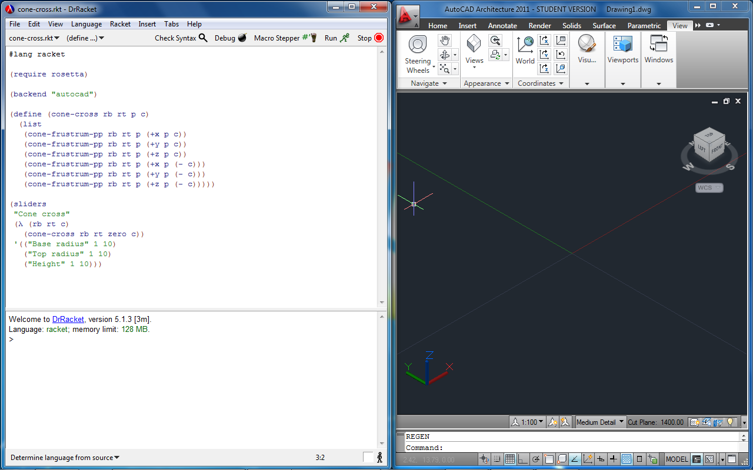
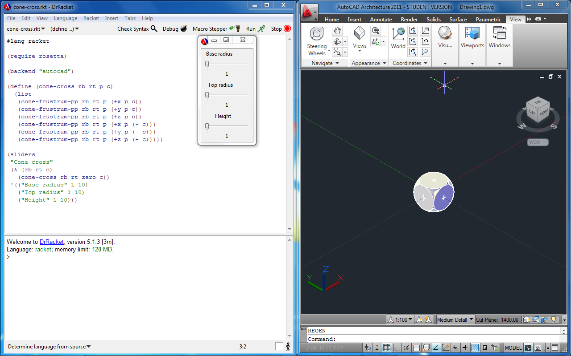
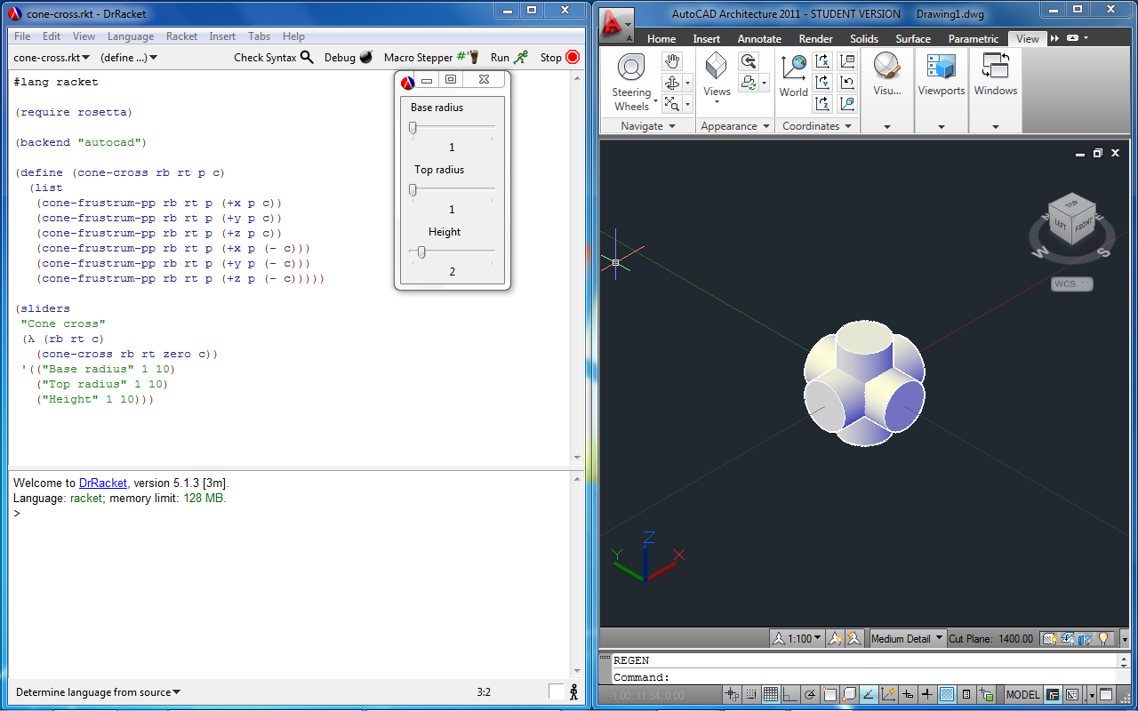
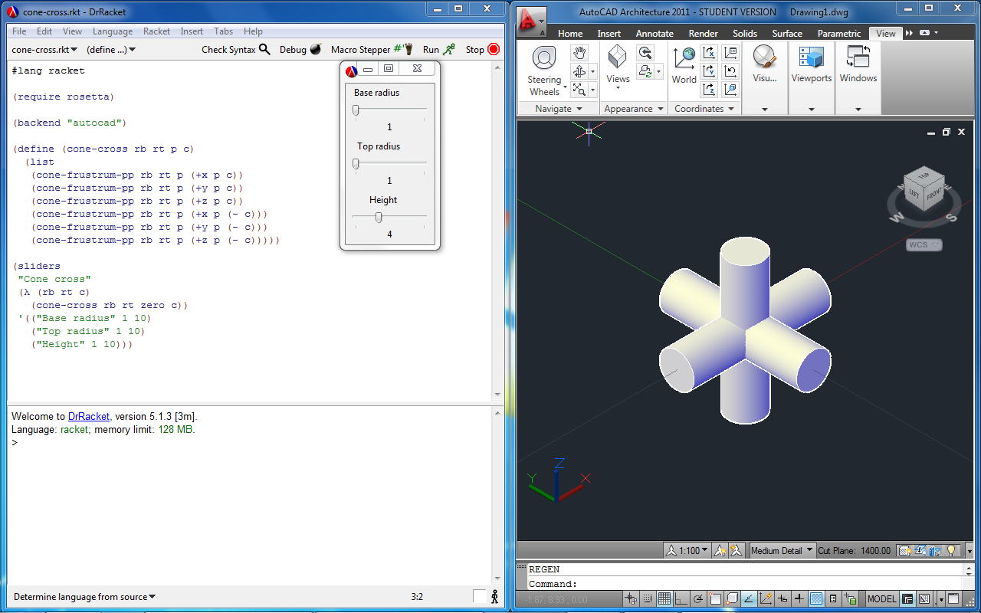
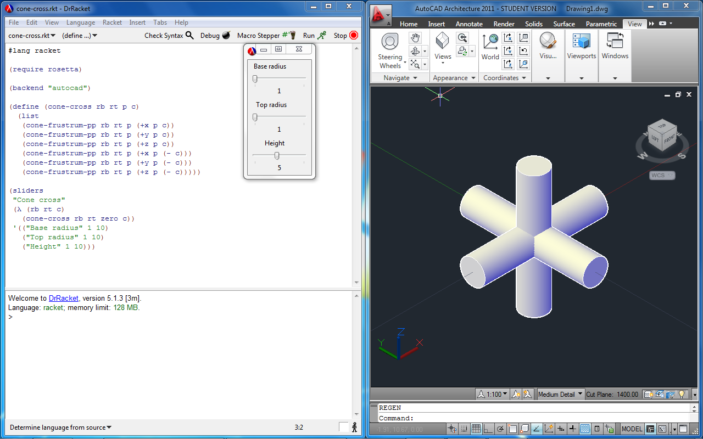
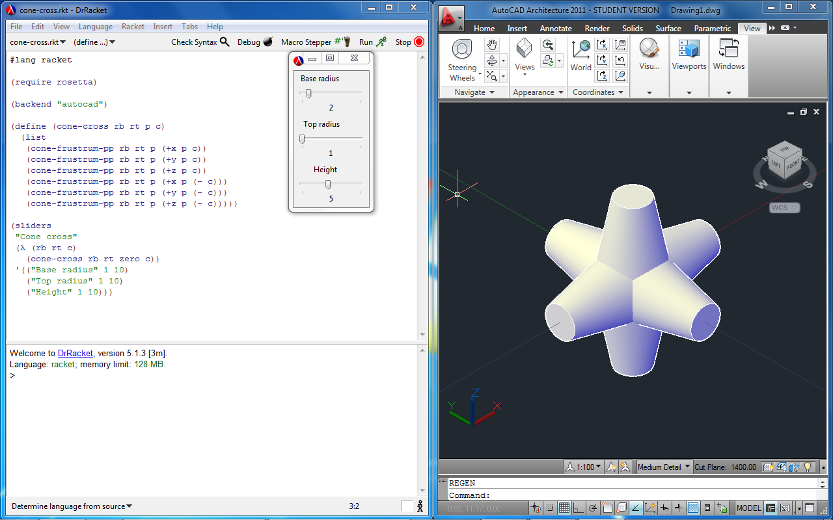
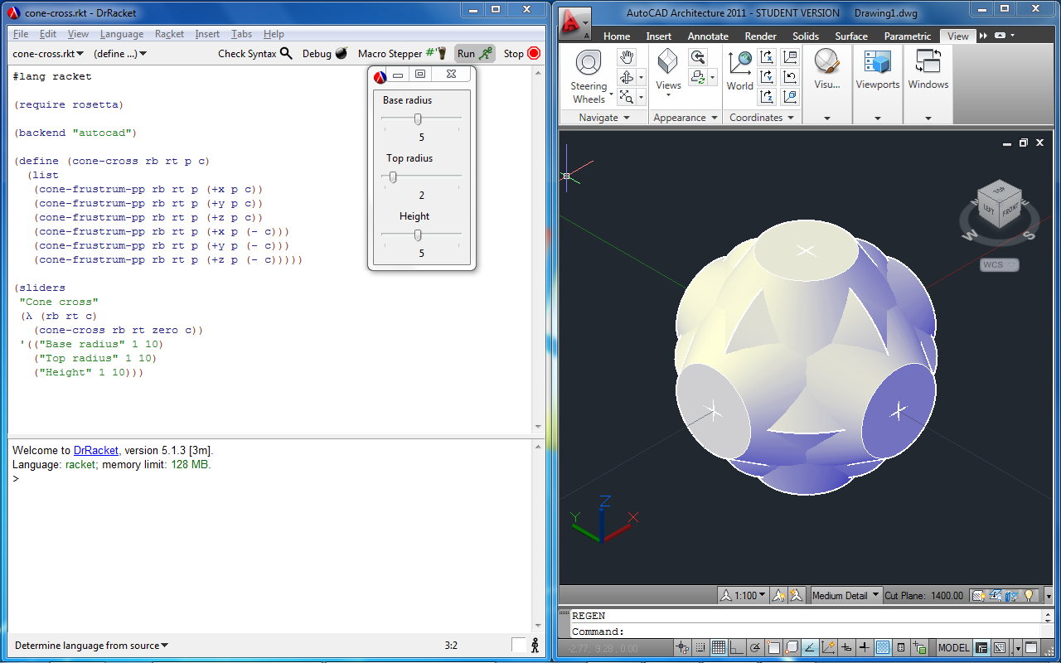
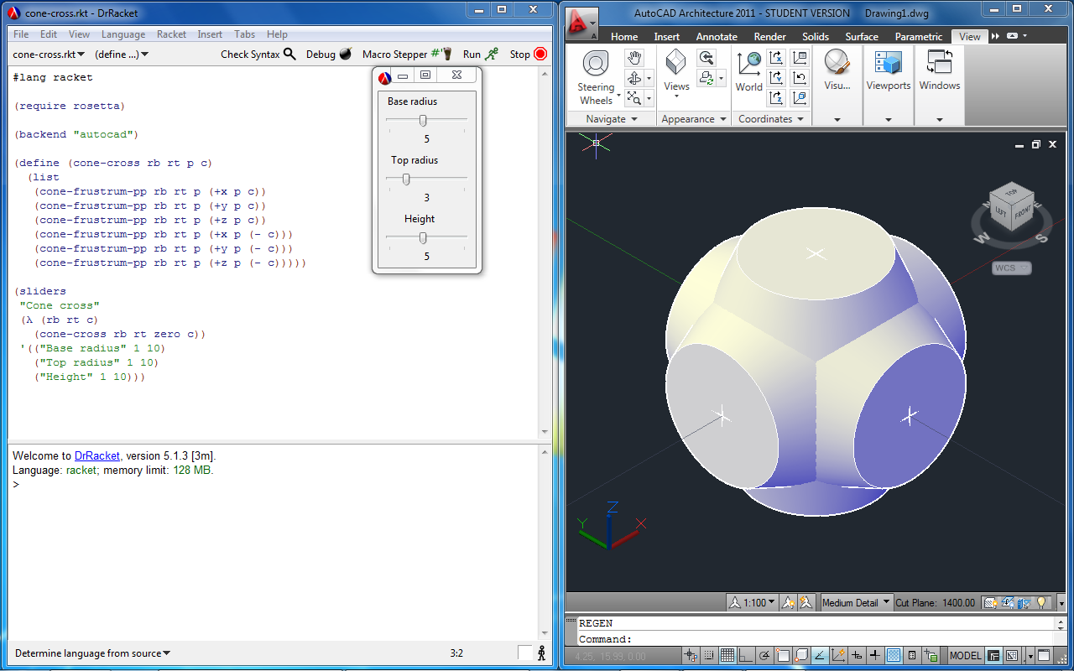
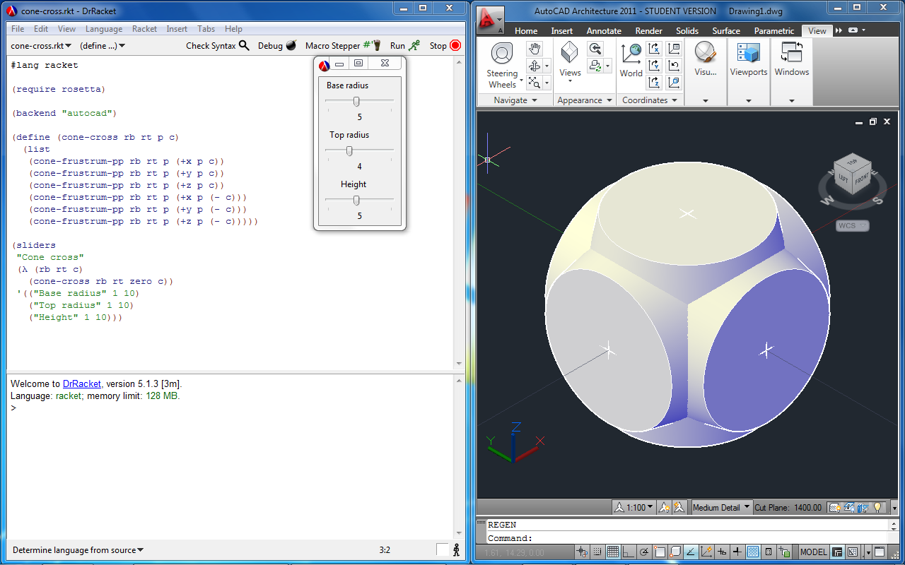
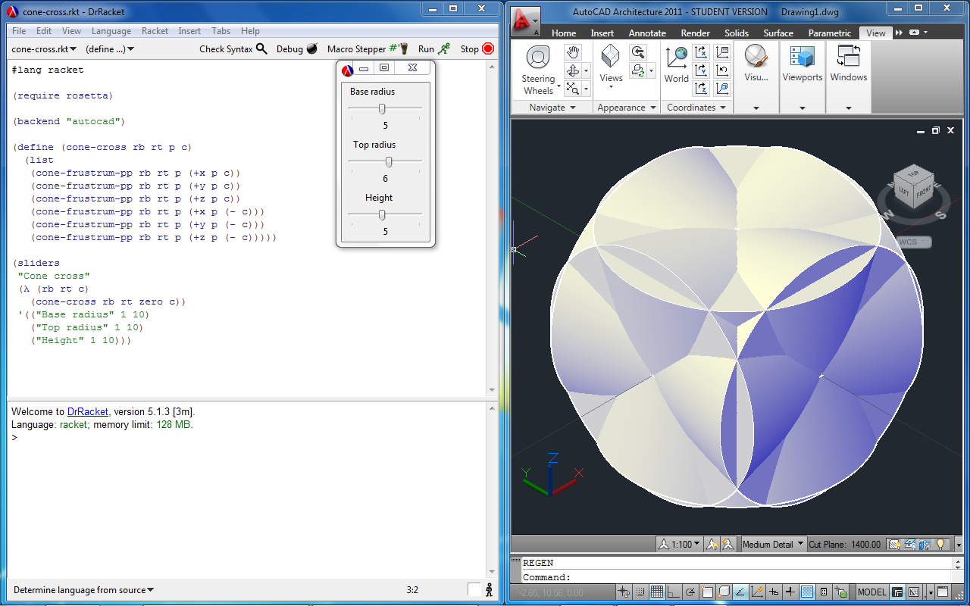
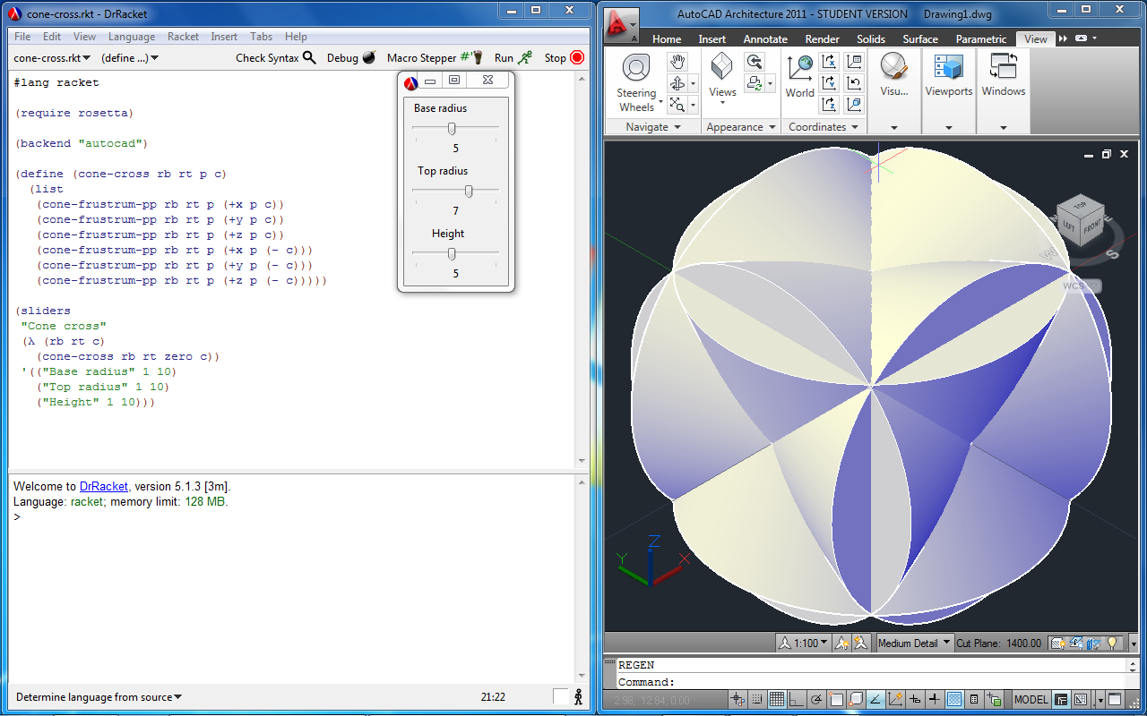
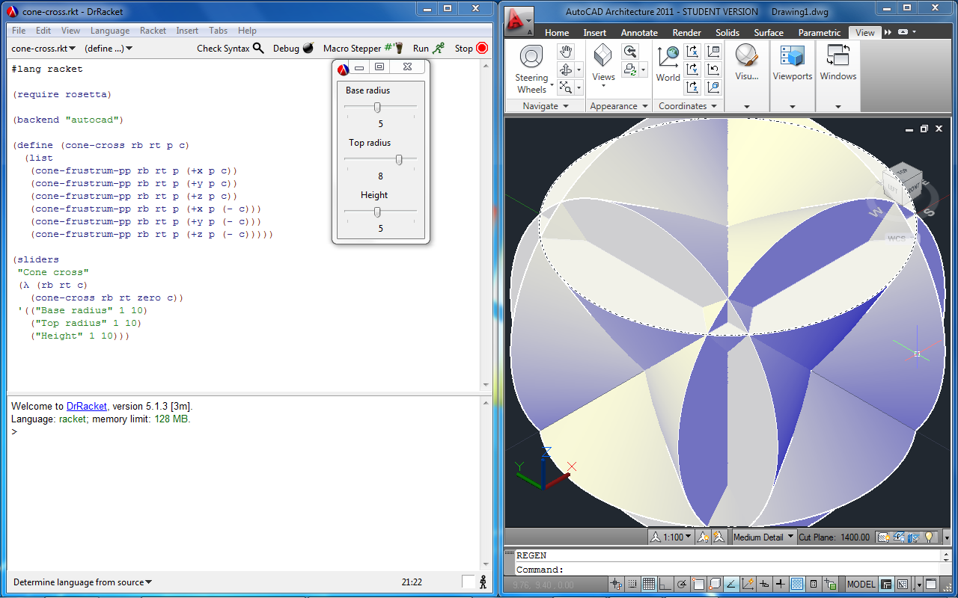
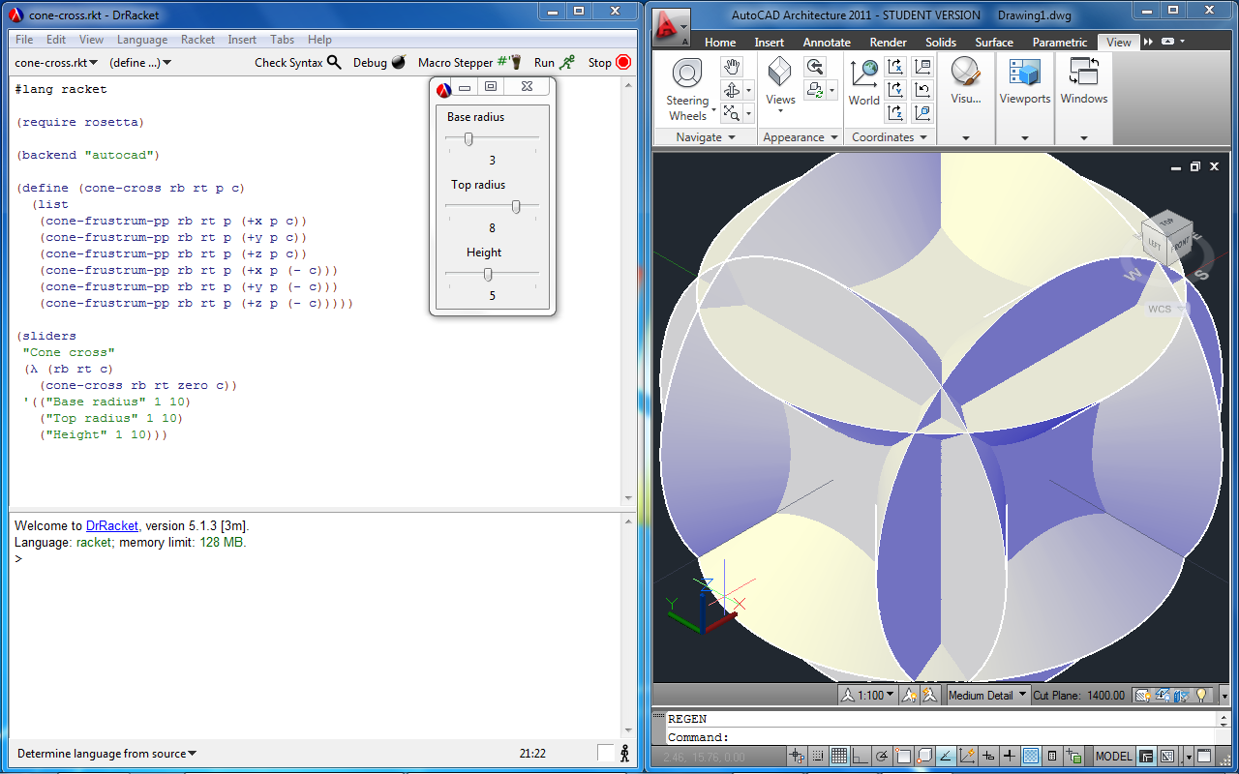
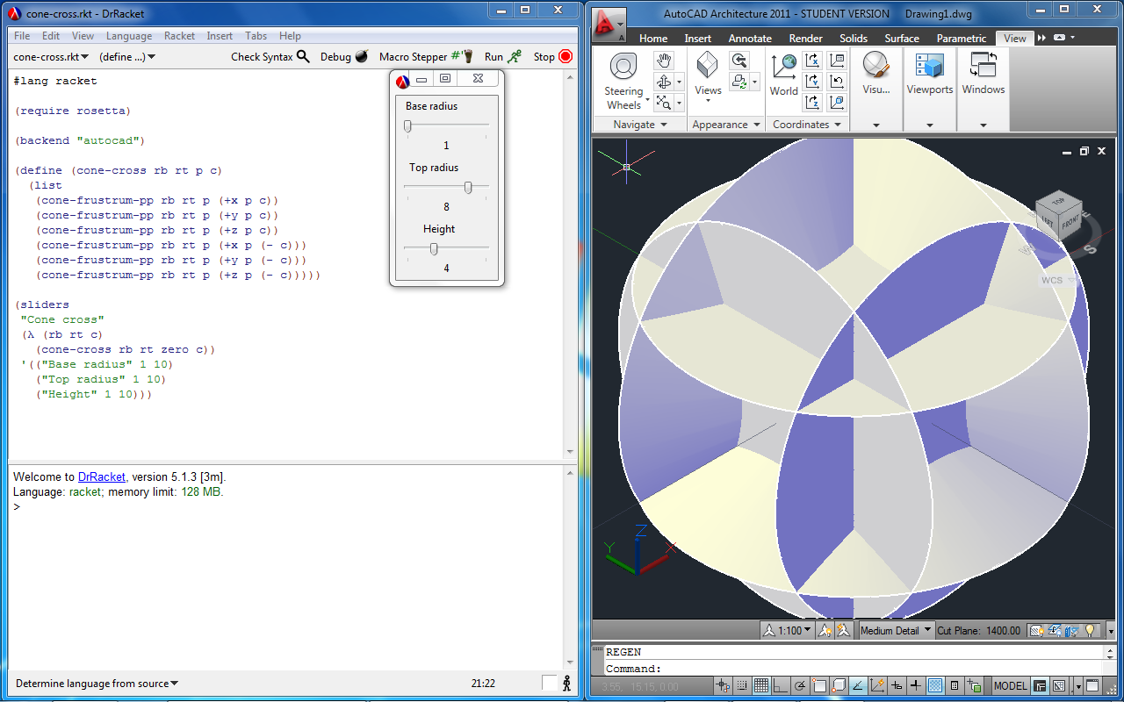
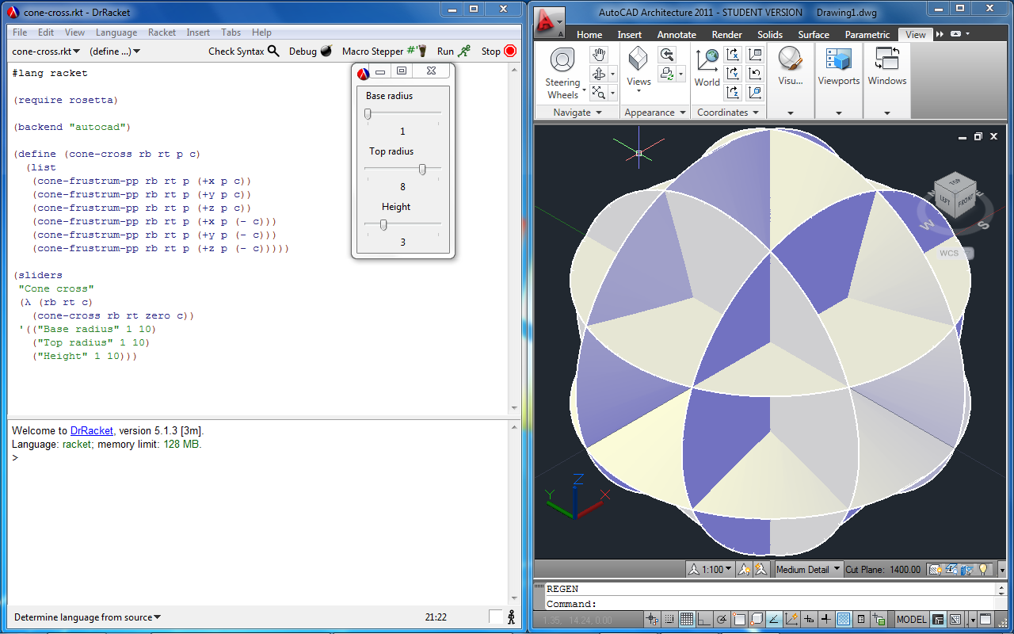
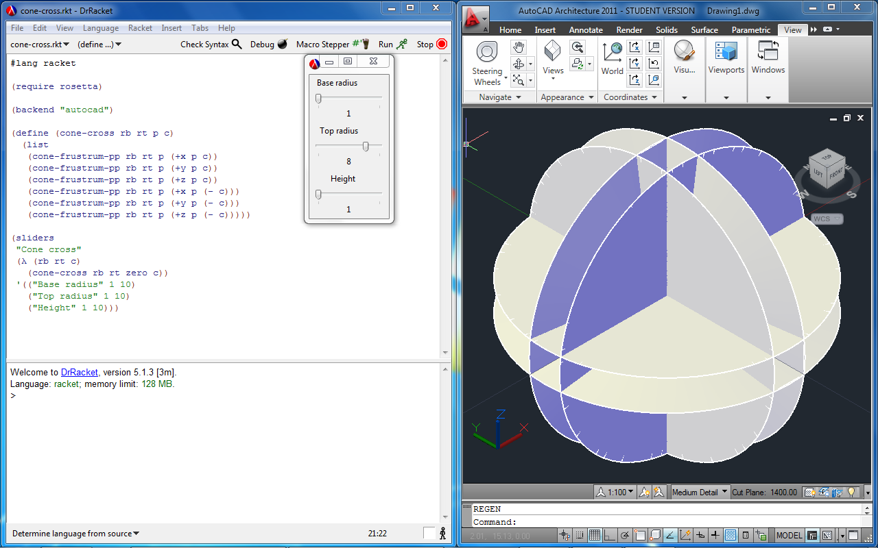
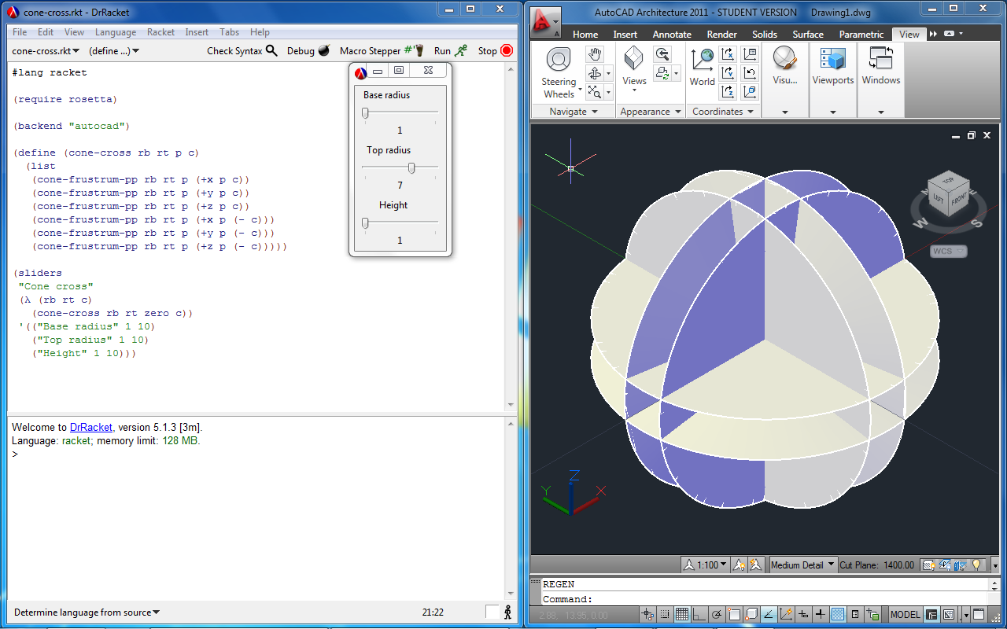
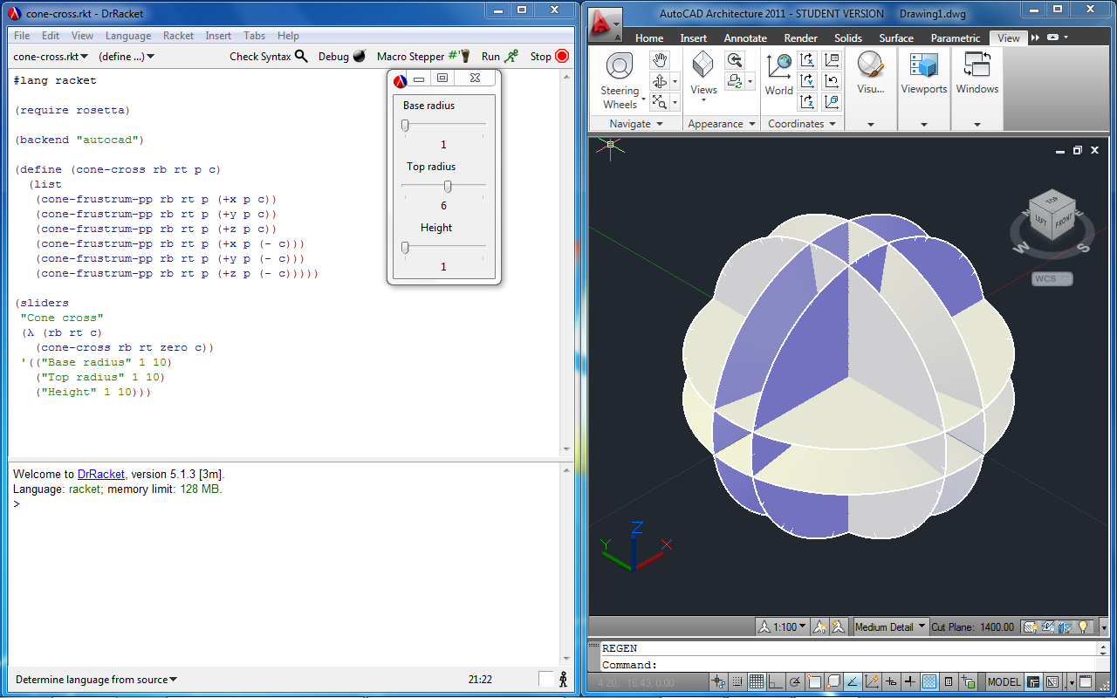
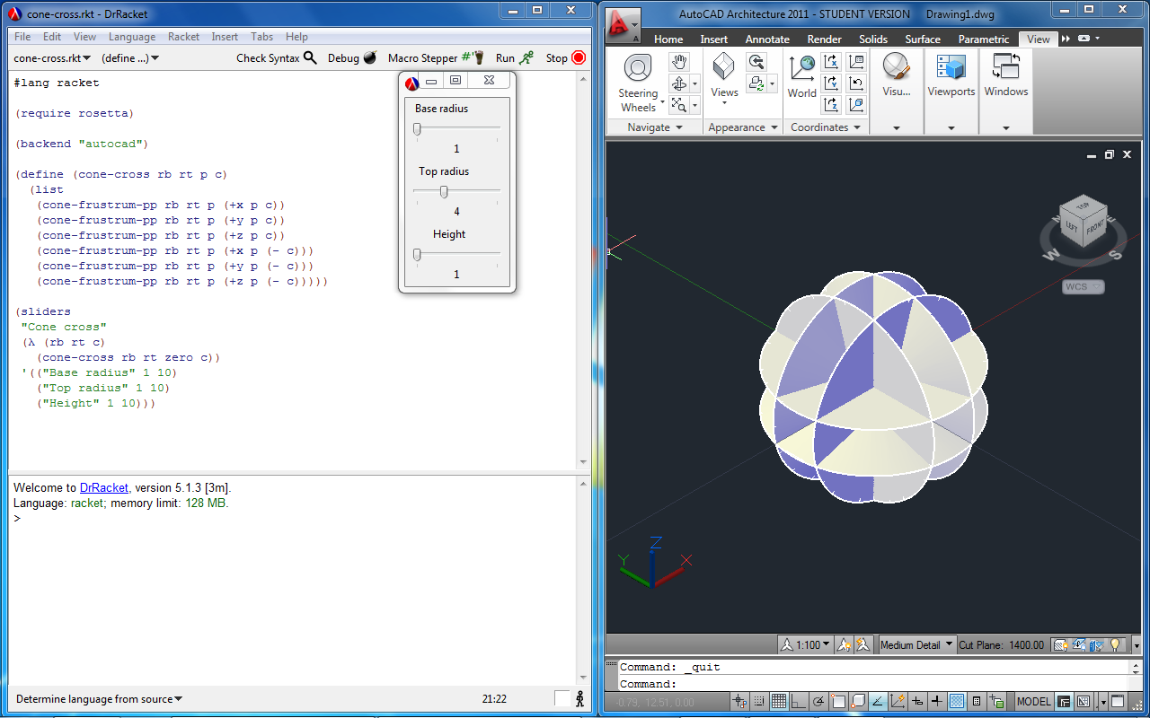
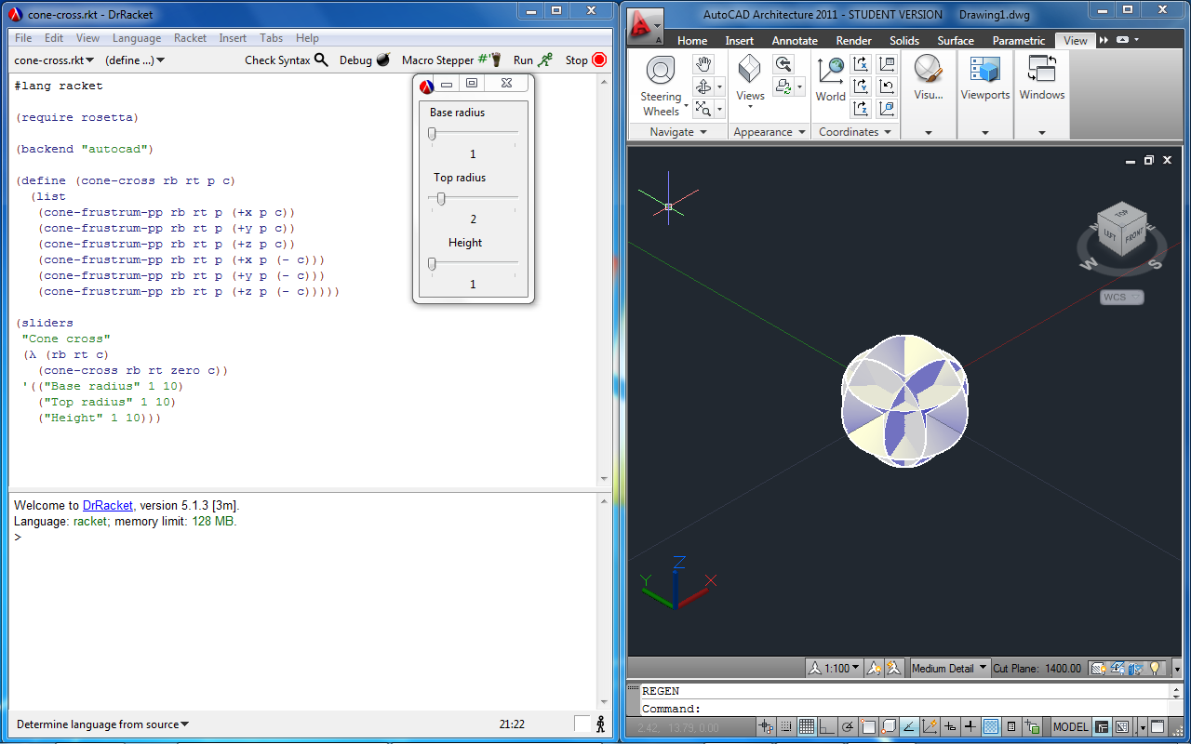
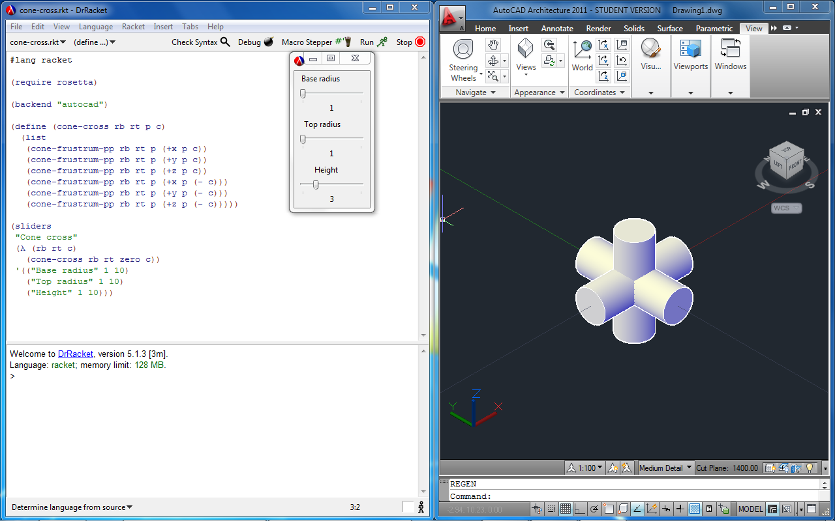
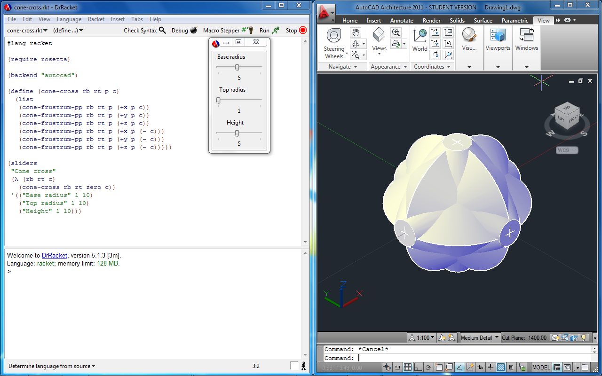
2011
Rosetta
Sliders

Slide 15
2011
RosettaFlow
Visual Programming Language Prototype

Slide 16
2011
Rosetta
Architectural example

Slide 17
2011
Rosetta
Architectural example

Slide 18
2011
Rosetta
Architectural example

Slide 19
2011
Rosetta
Architectural example

Slide 20
2011
Rosetta
Architectural example

Slide 21
2011
Rosetta
Architectural example

Slide 22
2011
Rosetta
Architectural example

Slide 23
2011
Rosetta
Architectural example

Slide 24
2011
Rosetta
Cross CAD Application example
(backend "rhino")
(define obj (get-object))
(backend "autocad")
(transform-obj obj ...)

Slide 25
2011
Community
Rosetta Lang

Slide 26
2011
Rosetta
- Teaching, Researching, Sharing
- Explore Language and CAD Applications
- Multiple combinations

Slide 27
2011
Thank You!
Questions?

