Slide 1

Technical University of Lisbon
UTL
AN UNIVERSITY IN THE WORLD
www.utl.pt
UTL
A UNIQUE EXPERIENCE

Slide 2
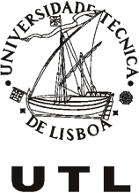
Technical University of Lisbon
- Origin in 1930
- 2nd biggest Portuguese University
- Leading Portuguese Research University
- Teaching and Research Areas
www.utl.pt
Agriculture
Architecture
Science and Technology
Social and Political Science
Economics and Management
Engineering
Natural Resources
Health and Human Development
Veterinary
7 Schools
1 931 Professors
1 193 Staff
24 330 Students
433 Courses (including Posgraduated Courses)

Slide 3







Technical University of Lisbon
The Schools
FMV | Faculty of Veterinary Medicine
ISA | School of Agriculture
ISEG | School of Economics and Management
IST | School of Engineering
ISCSP | School of Social and Political Sciences
FMH | Faculty of Human Kinetics
FA | Faculty of Architecture
www.utl.pt

Slide 4

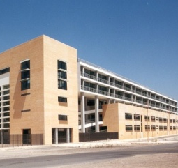
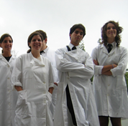
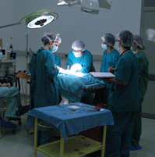
Technical University of Lisbon
FMV | Faculty of Veterinary Medicine
www.utl.pt
63 Professors
43 Staff
789 Students
4 Departments

Slide 5

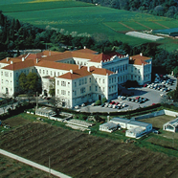
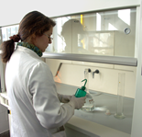
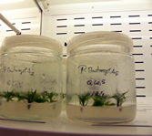
Technical University of Lisbon
ISA | School of Agriculture
www.utl.pt
130 Professors
137 Staff
1 820 Students
2 Departments

Slide 6
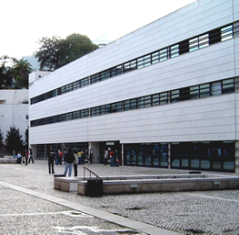
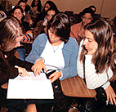
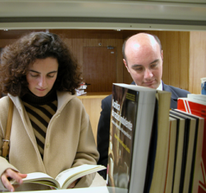
Technical University of Lisbon
ISEG | School of Economics and
Management
www.utl.pt
260 Professors
85 Staff
4 156 Students
4 Departments

Slide 7

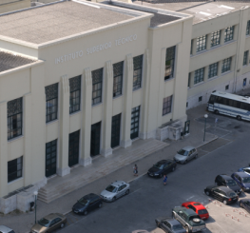
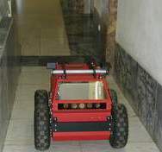
Technical University of Lisbon
IST | School of Engineering
www.utl.pt
848 Professors
585 Staff
11 296 Students
8 Departments

Slide 8

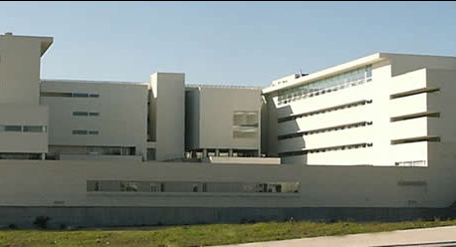
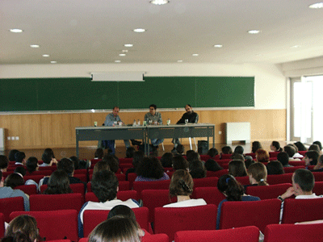
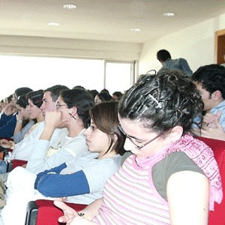
Technical University of Lisbon
ISCSP | School of Social
and Political Sciences
www.utl.pt
175 Professors
45 Staff
2 893 Students

Slide 9

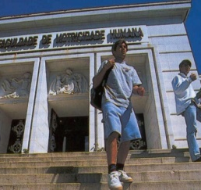
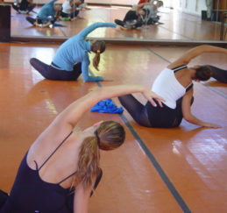
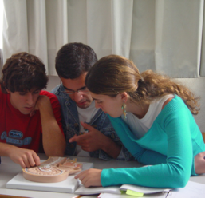
Technical University of Lisbon
FMH | Faculty of Human Kinetics
www.utl.pt
133 Professors
52 Staff
1 745 Students
8 Departments

Slide 10
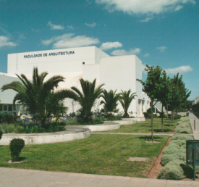
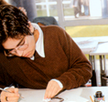
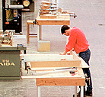
Technical University of Lisbon
FA | Faculty of Architecture
www.utl.pt
252 Professors
63 Staff
2 557 Students
6 Departments

Slide 11
Technical University of Lisbon
Facts and Figures 2010/2011
Enrolment Students 24 330
1st and 2nd Cycle (BsC + integrated Master) 18 094
2nd Cycle (MsC) 3 910
3rd Cycle (PhD) 1 881
Life Long Learning Programmes 445
Graduated Students 1st, 2nd, 3rd Cycles 4 313
Professors and Researchers 1 931
International Student from 80 countries 2 534
Research Areas available 18
• Research Units and Institutes 52
50% of the Research Units were classified as Excellent or Very Good by
an External International Evaluation Institution
• Centres of Excellence 4
• Associated Research Labs are available 7
• Patents requested 15
• Patents 27
Books 516 880
Periodicals 28 226
International Bilateral Agreements 564
www.utl.pt

Slide 12
Technical University of Lisbon
Higher Education System at UTL
1st Cycle –BSc – 3 years course -the degree of “licenciado” is conferred to those that finished the curricular units that integrate the study programme of the course.
1st and 2nd cycles Integrated Master Degree – 5 Years course in cases for which the access to the practice of a certain professional activity depends on that length of time established by legal European Union (EU) standards or resulting from a stable practice consolidated in the EU.
2nd Cycle – MSc – 2 Years course
3rd Cycle – PhD – 3 Years course
www.utl.pt

Slide 13
Technical University of Lisbon
52 Certified Research Units
www.utl.pt

Slide 14
Technical University of Lisbon
R&TD
Patents
UTL
www.utl.pt

Slide 15
Technical University of Lisbon
Internacional Cooperation
Europe (415 Erasmus Bilateral Agreements)
Asia (East Timor, India, Japan, Macau, China, South Korea, Russia,
Thailand, Indonesia)
Africa (Angola, Mozambique, Cape Verde, S. Tome, South Africa)
North America (Canada, USA)
South America (Brazil, Cuba, Peru, Chile, Mexico)
www.utl.pt

Slide 16
Technical University of Lisbon
About Internacional Cooperation
Mobility Programmes
Exchange Professors
Exchange Students
Exchange information in teaching methods
Cooperation in different research areas
Conferences
Seminars
Joint Programmes
www.utl.pt

Slide 17
Technical University of Lisbon
International Certification
Technical University of Lisbon
ECTS Label – European Commission
Faculty of Veterinary Medicine
EAEVE – European Association of Establishments for Veterinary Medicine
School of Economics and Management
- Master in Business Administration – AMBA – Association of MBAs
- Master Real Estate Management and Valuation - RICS - Royal Institution Chartered Surveyors
School of Engineering
MSci Biological Engineering – EUR-ACE Label - ENAEE – European Network for Accreditation of Engineering
www.utl.pt

Slide 18
Technical University of Lisbon
Some Distinguished Students of UTL
Aníbal Cavaco Silva, President of Portugal (since 2006),
Prime-Minister of Portugal (1985-1995)
António Guterres, United Nations High Commissioner for Refugees (since 2005), Prime-Minister of Portugal (1995–2002)
Maria Lourdes Pintassilgo, Prime-Minister of Portugal (1979–1980)
Alfredo Nobre da Costa, Prime-Minister of Portugal (1978)
João de Deus Pinheiro, European Commissioner (1993-2000)
José Mourinho, Coach of Real Madrid, former coach of FC Internazionale Milano (2007-2009) and of Chelsea Football Club (2004-2007)
www.utl.pt
All Governaments of Portugal have a large number of Ministers that were former students of UTL
The Board of the largest portuguese entreprises are also composed by former graduates of UTL

Slide 19

Technical University of Lisbon
Thank You for your attention !
www.utl.pt
www.utl.pt
Thank You for your attention !

