Slide 1

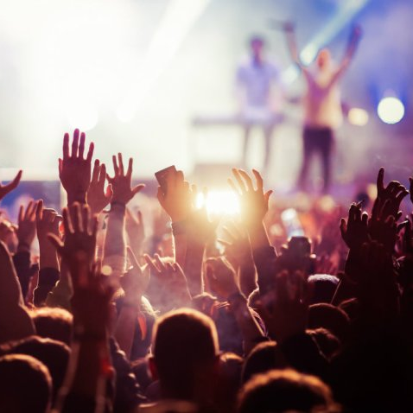
Low - Functionality prototype
Group 1 – 100 Limites

Slide 2




Our idea
Streaming app that allows people to watch music events live online.

Slide 3

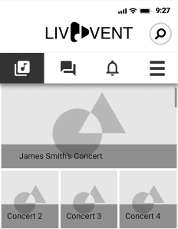
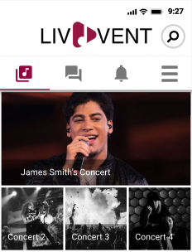
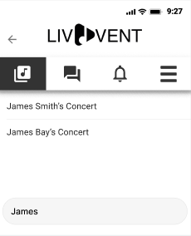
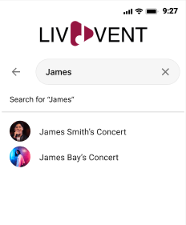
This week
  Added color and images to the low-fi prototype
  Changed elements according to user tests
  Added some new screens
  Cleaned and changed a few screens’ UI and structure
  Fixed some inconsistencies.

Slide 4
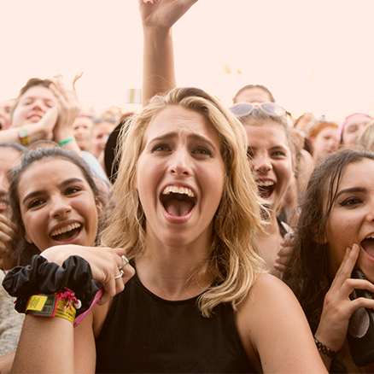
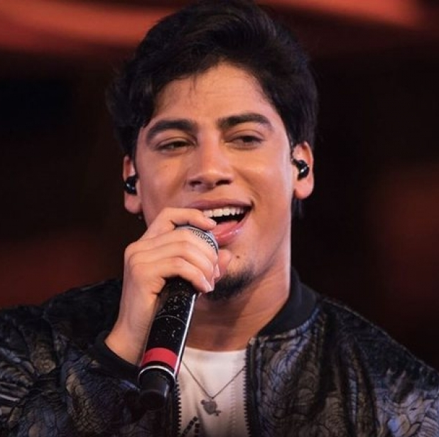
Personas
Music Events Fan
Music Artist

Slide 5



Critical tasks
Streaming
Communication
Notification

Slide 6
Feedback incorporation
Persona | Problem | Solution
Fan | Receiving confirmation after following an artist | Change the button’s text to “unfollow” when clicked
Fan | Understanding how to go to a voice call | Fan receives a notification when voice call starts that leads to it
Artist | Receiving confirmation after starting a concert | Transition to the live stream
Artist | Cannot specify date and time of the concert | Added new input fields for date and time
Artist | Couldn’t complete the profile information right after creating an account | New screen on sign up operation to complete the profile

Slide 7
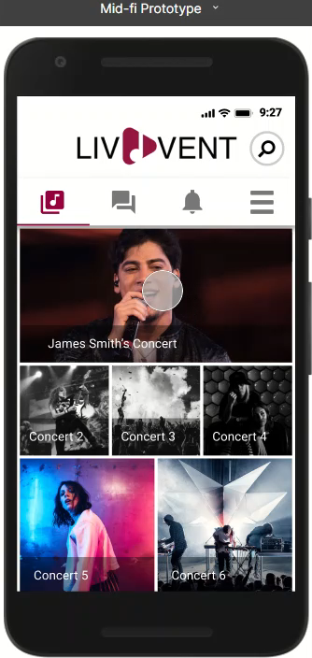


Fan side
Choose the
concert they want
Favorite artists will show up first
Go to stream
streaming
Buy ticket for concert

Slide 8
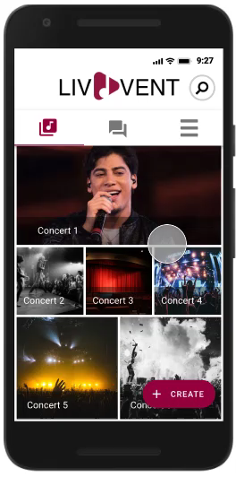
Artist side
Create concert
End stream
streaming
Start a stream

Slide 9
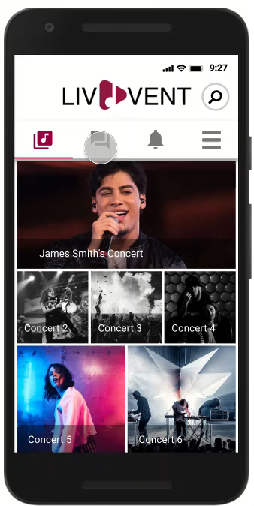
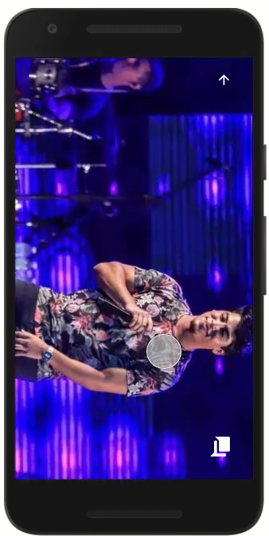
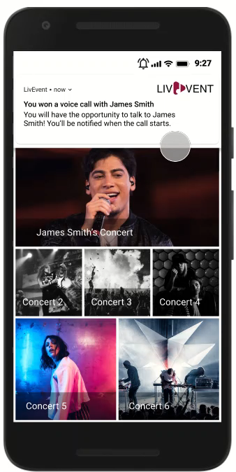
Fan side
Communication
Talk to other fans before the concert
Win a voice call with the artist after the concert
Talk to other fans during the concert

Slide 10
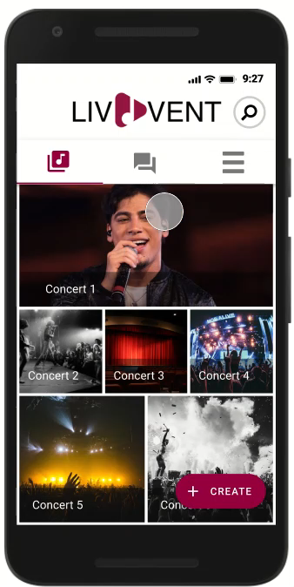
Artist side
Can mute each fan at will
Do voice call with 3 fans
Communication

Slide 11
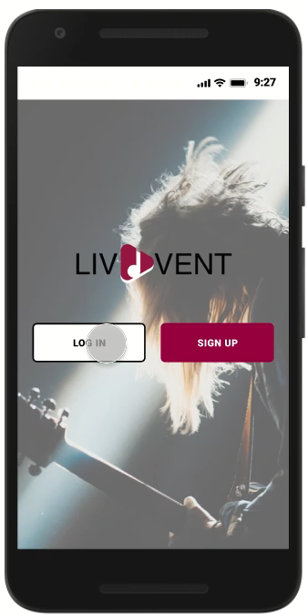
There are other notifications shown before
Receive notification when a new concert of a favorite artist
is available
Fan side
Check notification history
notification
Delete notification

Slide 12

Next steps
  Become more familiarized with flutter.
  Perform some minor adjustments to the low-fi prototype if needed.
  Start development of the high-fidelity prototype.

