Slide 1

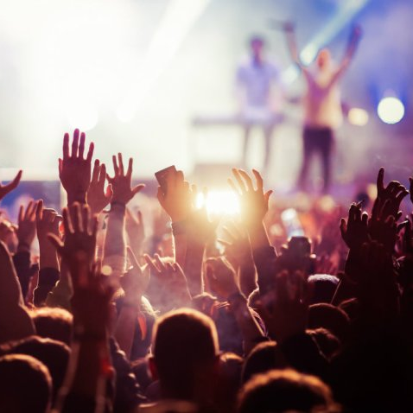
Final presentation
Group 1 – 100 Limites

Slide 2


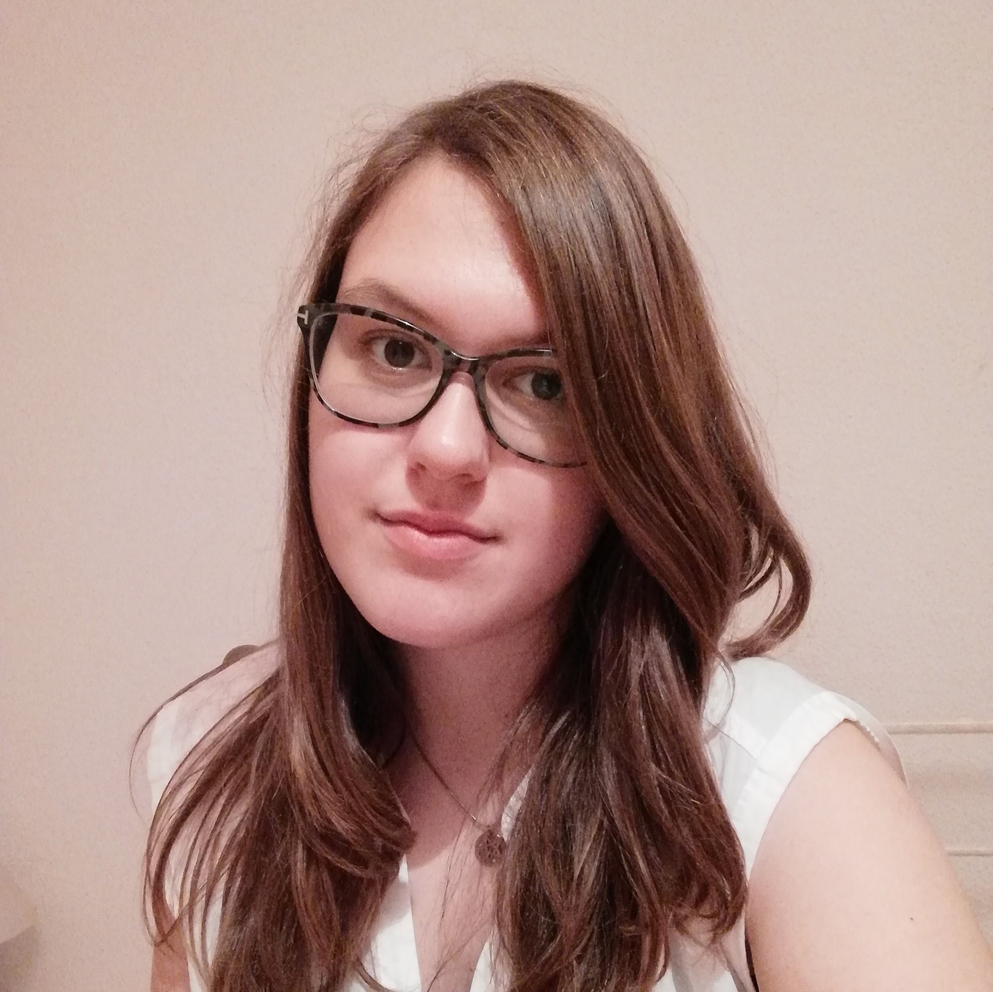
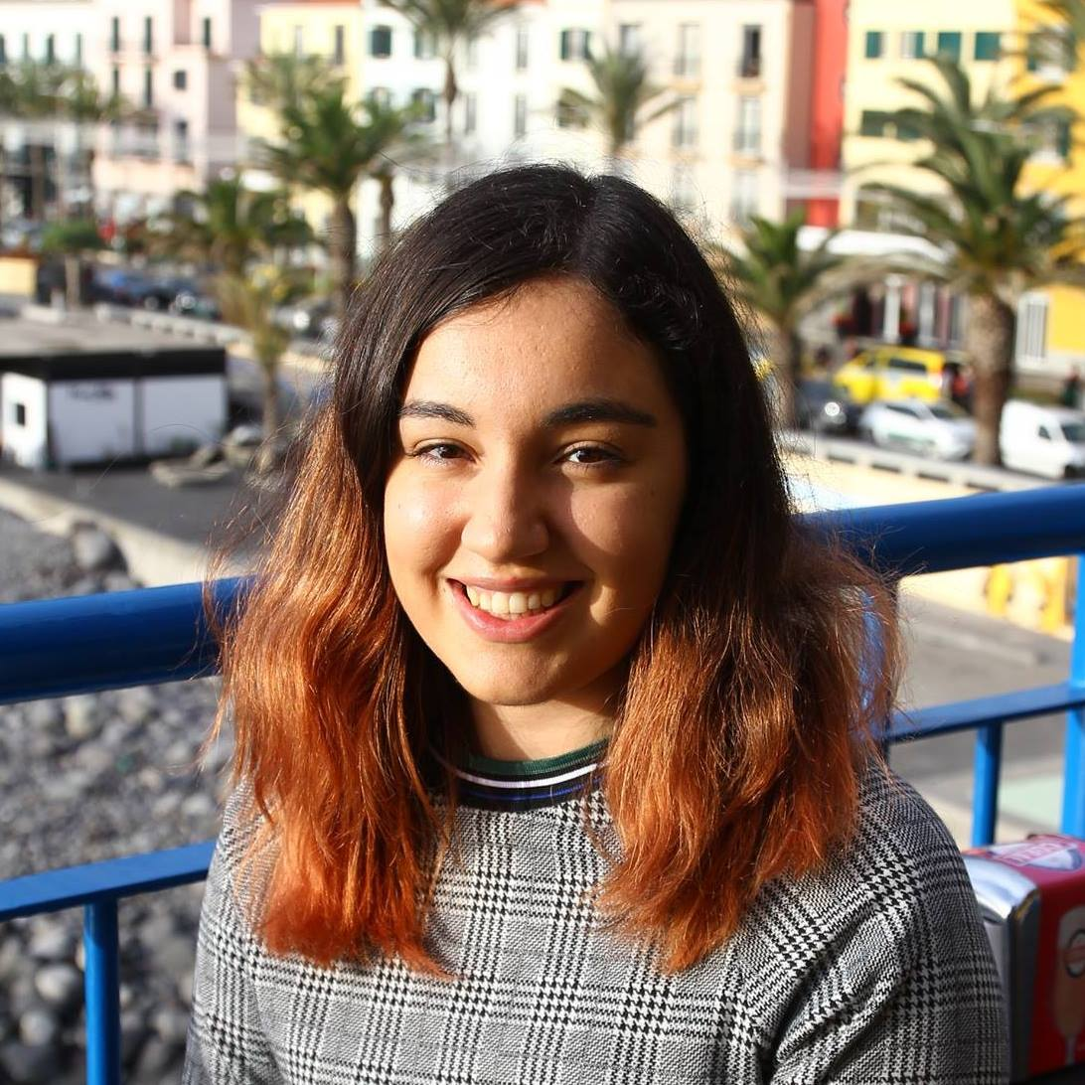
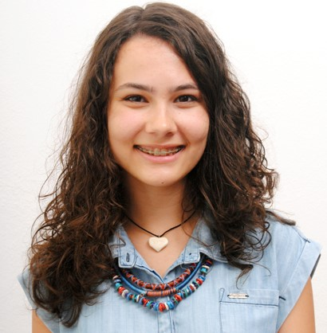
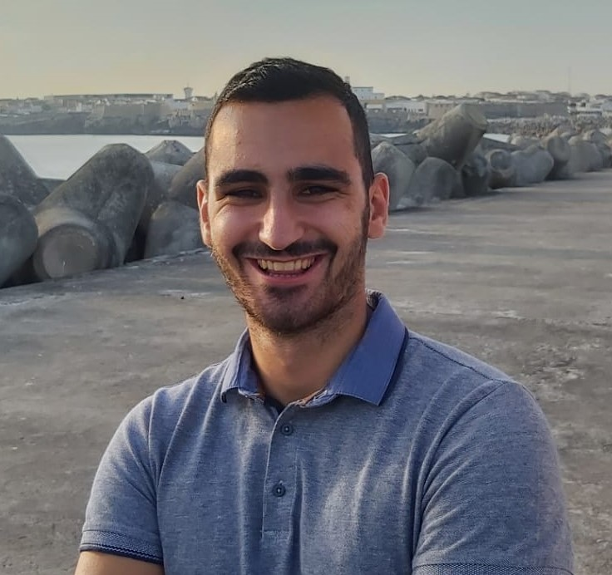
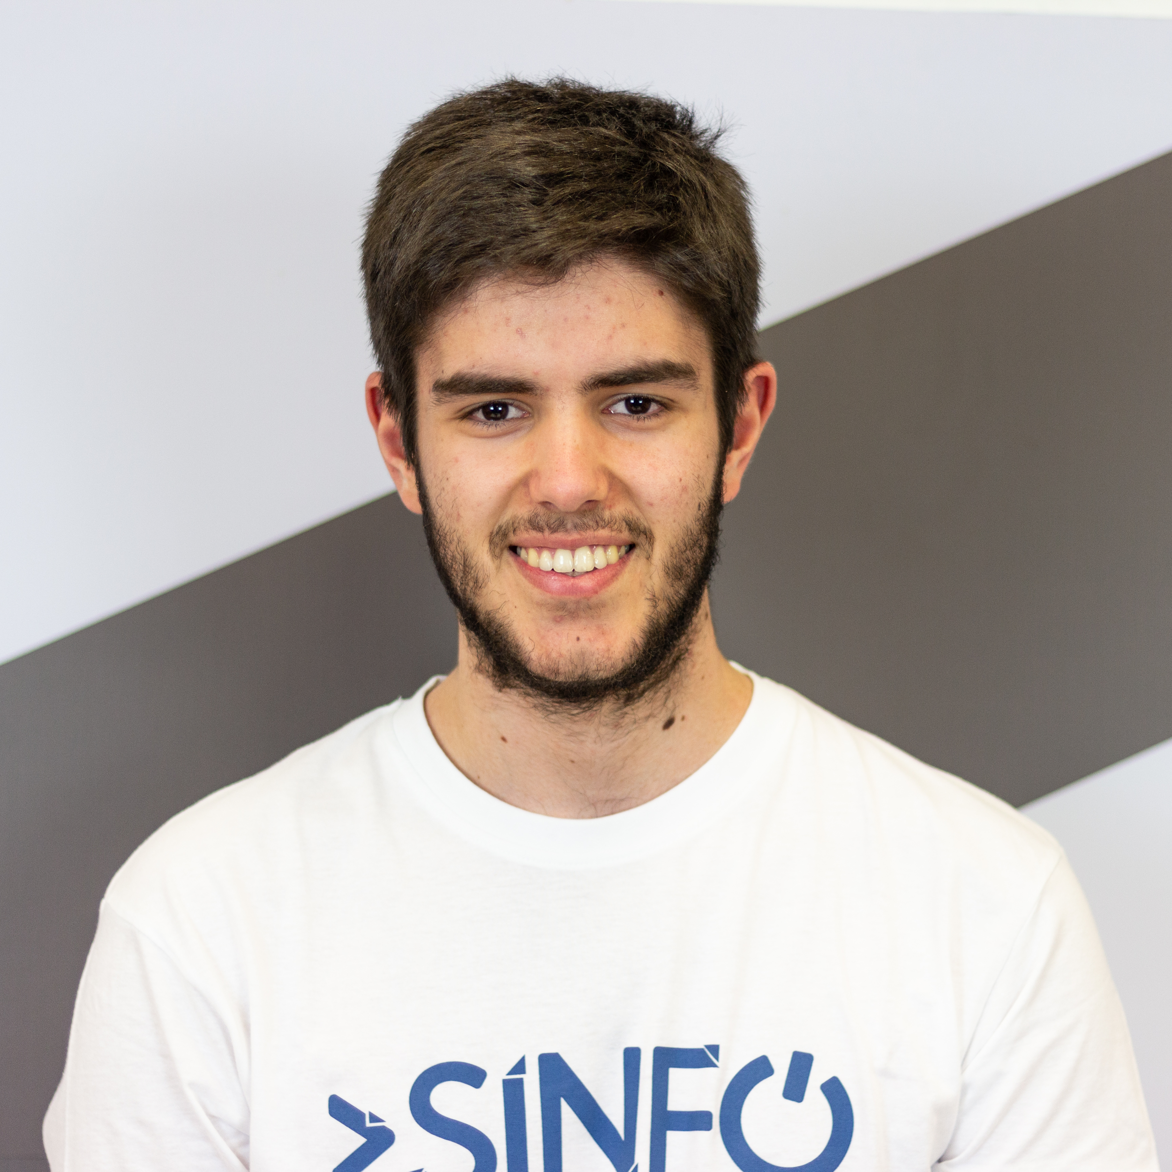
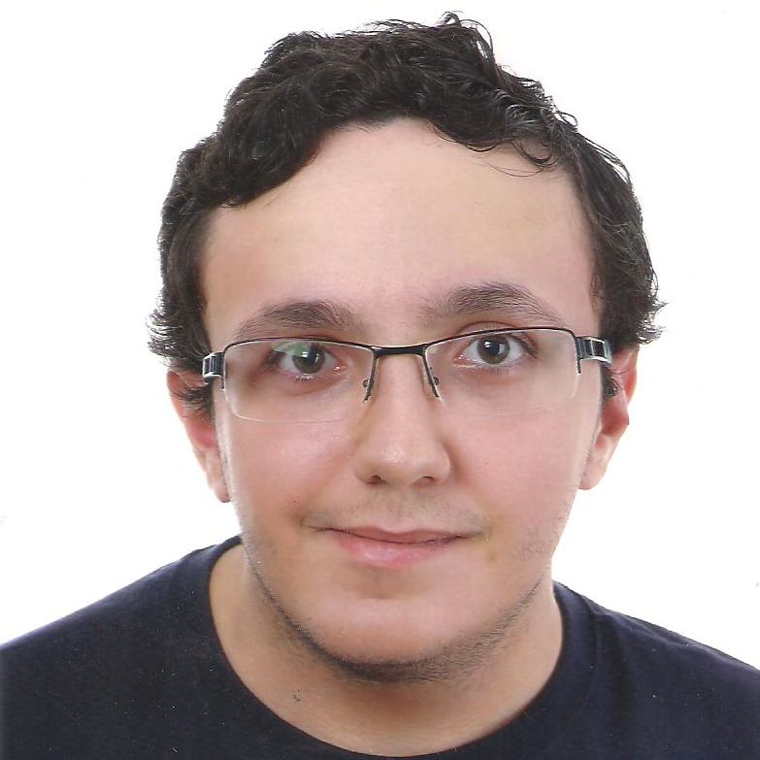
Our team
Ana Sofia Silva
Documentation Lead
Inês Alves
Front-end Developer
Beatriz Feliciano
Design Lead
Guilherme Nunes
User Research Lead
Pedro Maximino
Back-end Developer
João Fonseca
Project Manager

Slide 3

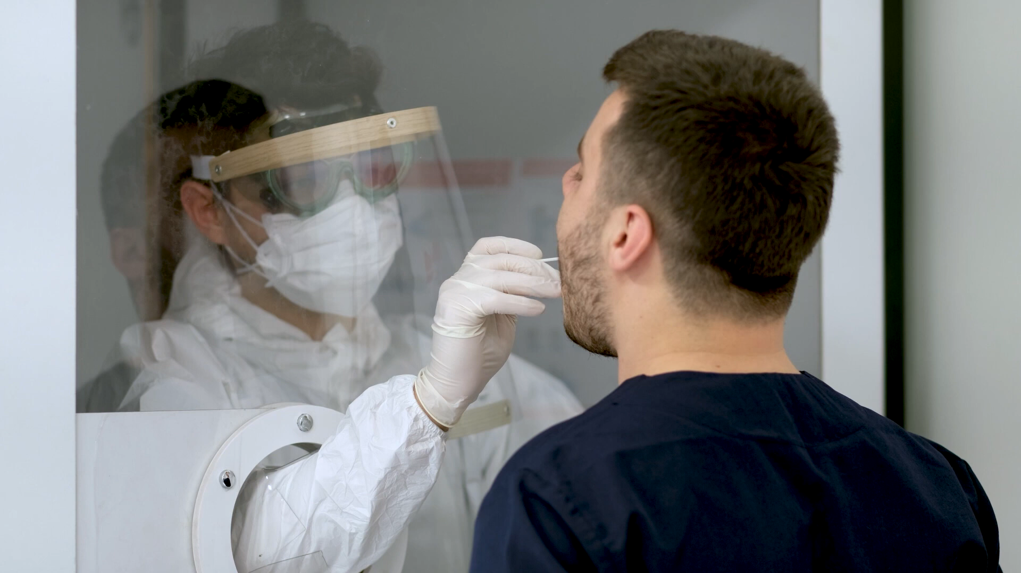
Promo

Slide 4

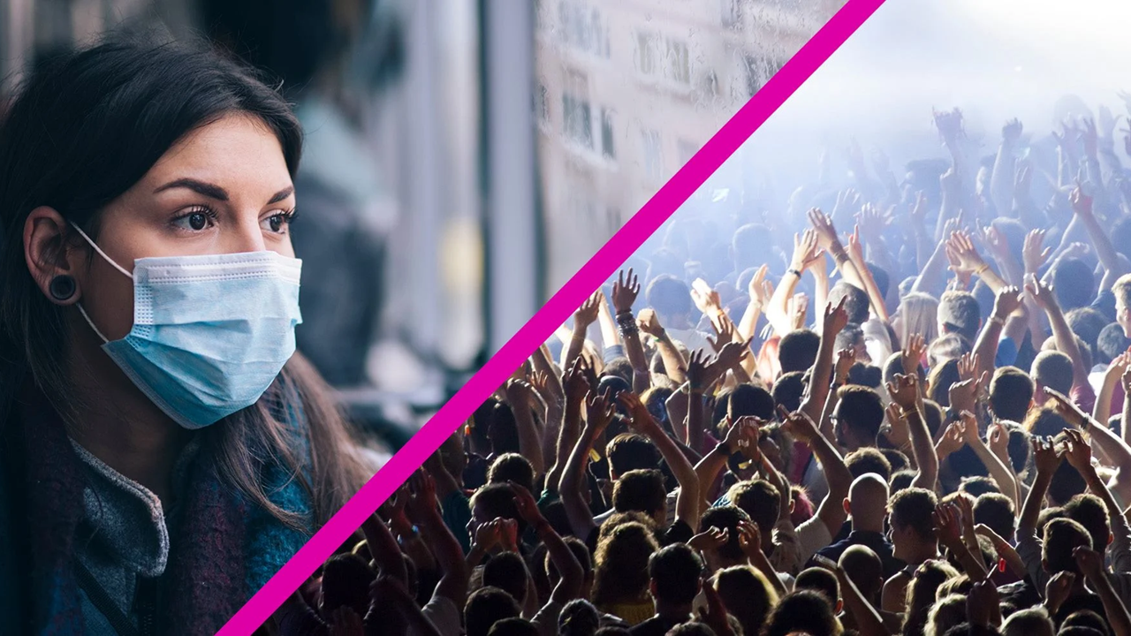
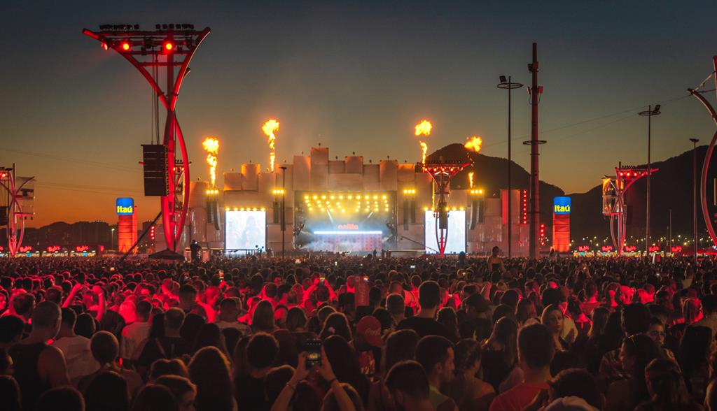

The problem

Slide 5







Our idea
Streaming of music events
Live chats with artists and fans
Purchase tickets online
Easy to use and safe

Slide 6

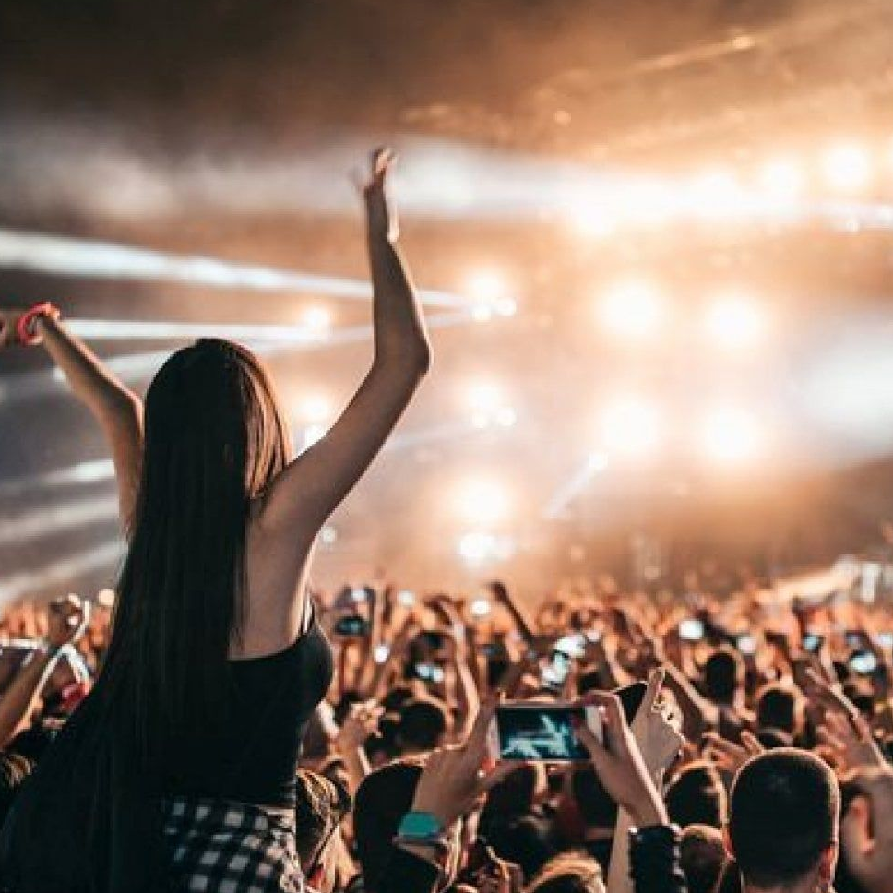
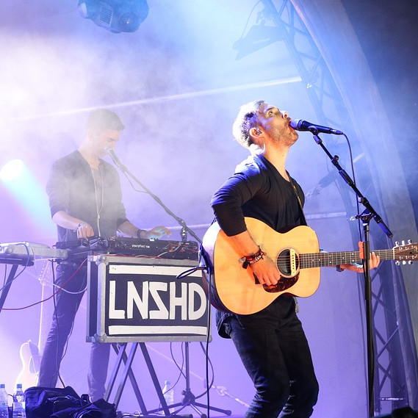
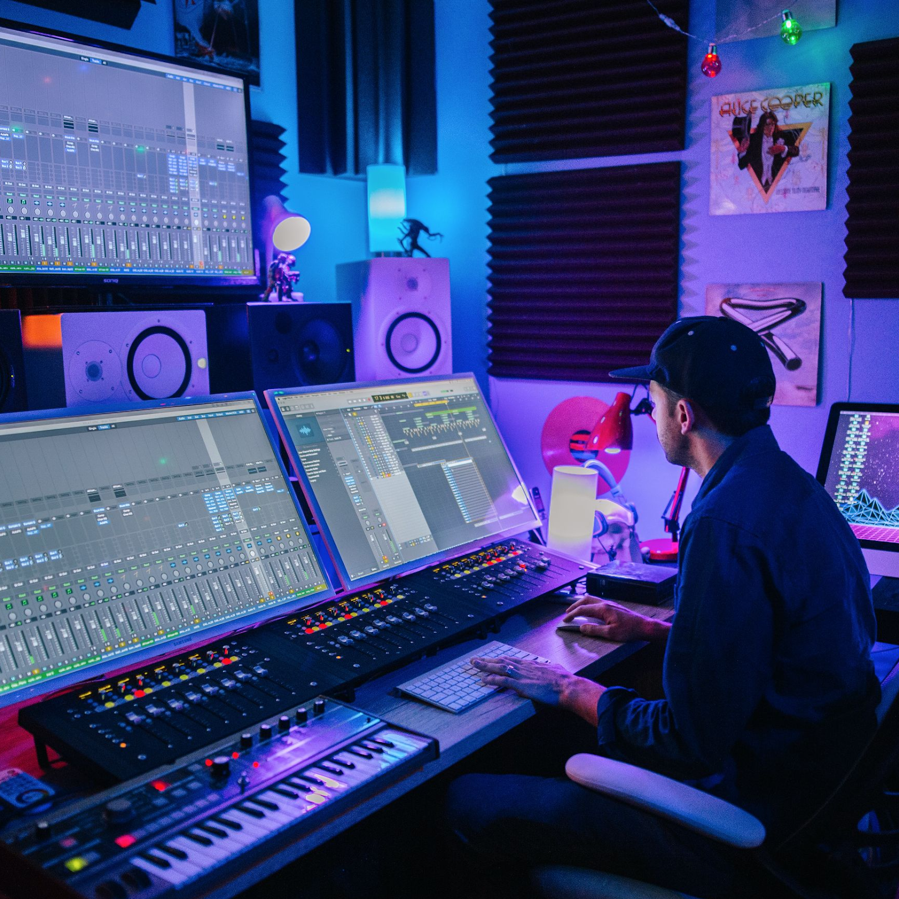
Target audience
Music Event Fans
Music Artists
Crew Members

Slide 7

What we gathered
  Artists
  It’s difficult to find a safe and easy way to perform their shows in the current situation.
  They aren’t able to monetize their shows.
  Lack of interaction and communication between them and their fans.
  Fans
  They need an alternative so they can watch their shows.
  They don’t want to be limited by room capacity or transportation.

Slide 8


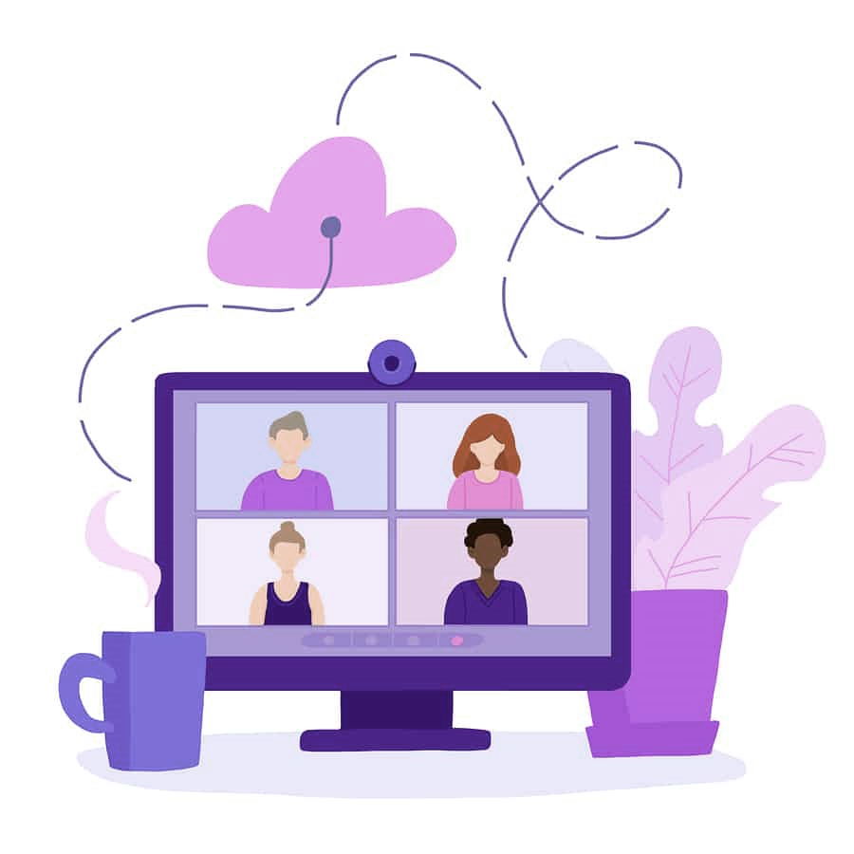
Our approach
Remote Questionnaires
Remote Interviews
23 music fans
1 artist
5 music fans
5 artists
1 crew member

Slide 9

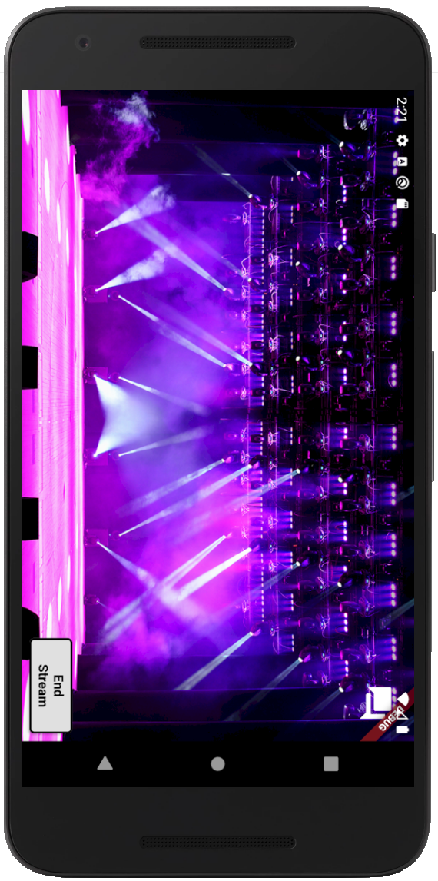



Feature #1
  Streaming: Stream music events live
  Communication: Allow interaction between fans and artists
  Notification: Notify fans whenever a new concert is created or when a concert/voice call starts

Slide 10
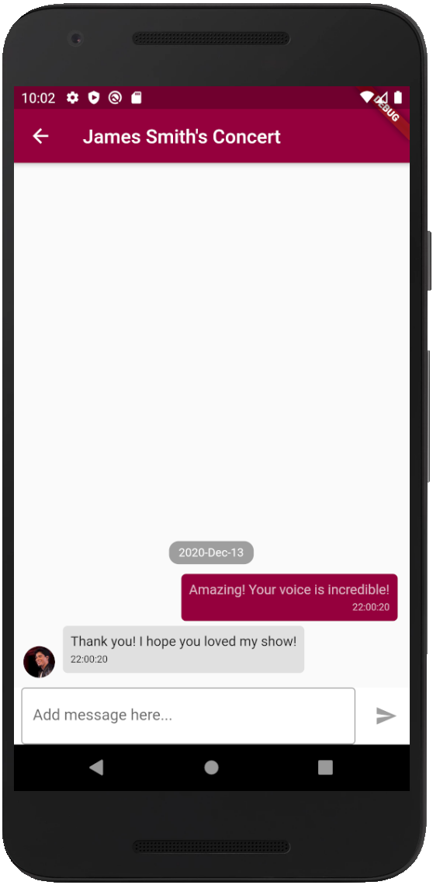


Feature #2
  Streaming: Stream music events live
  Communication: Allow interaction between fans and artists
  Notification: Notify fans whenever a new concert is created or when a concert/voice call starts

Slide 11
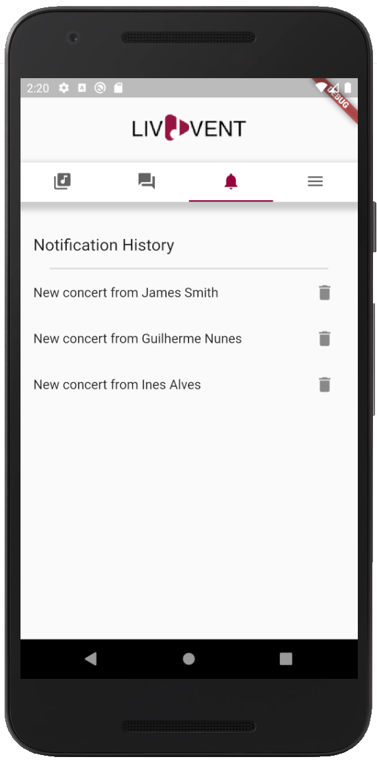

Feature #3
  Streaming: Stream music events live
  Communication: Allow interaction between fans and artists
  Notification: Notify fans whenever a new concert is created or when a concert/voice call starts

Slide 12
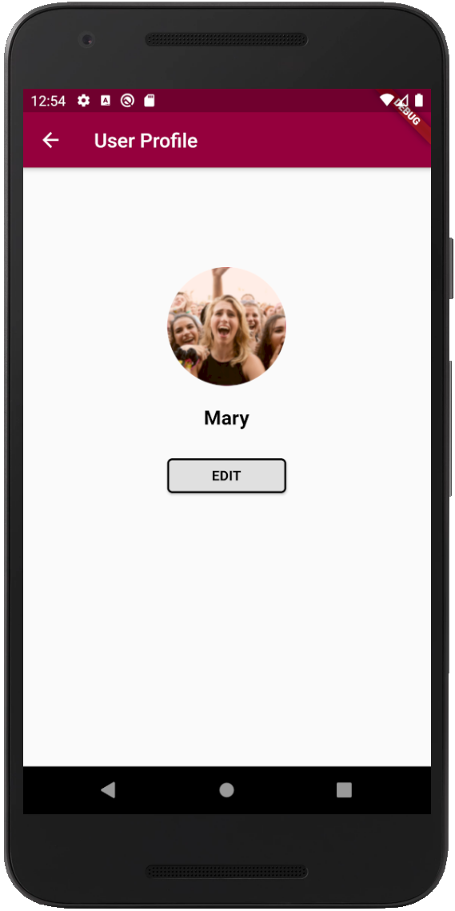
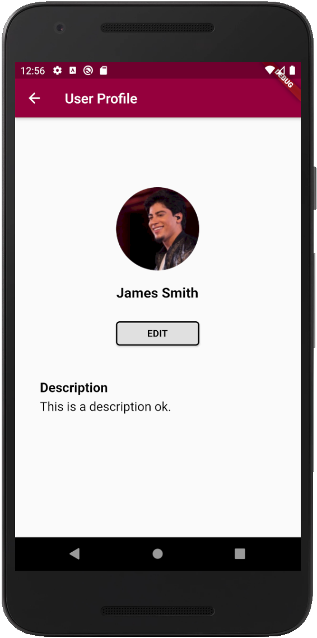



Additional feature #1
  Profile: Allow artists and fans to have a profile and edit it at will
  Payment: Allow fans to buy tickets for available concerts
  Favorite artists: Allow fans to follow and unfollow artists

Slide 13
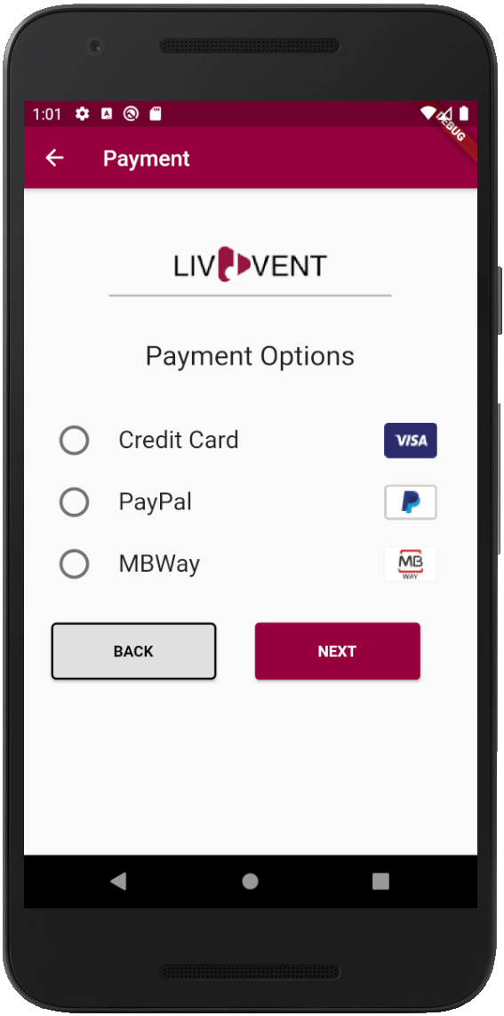
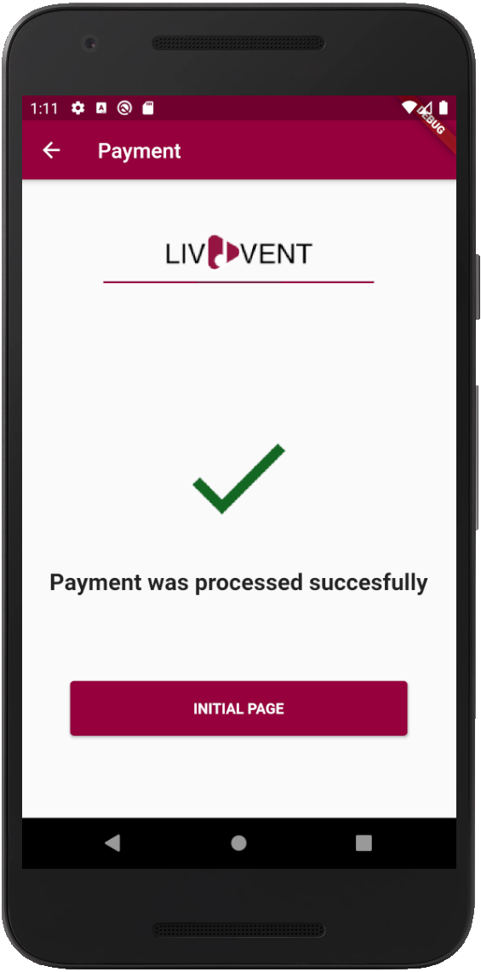


Additional feature #2
  Profile: Allow artists and fans to have a profile and edit it at will
  Payment: Allow fans to buy tickets for available concerts
  Favorite artists: Allow fans to follow and unfollow artists

Slide 14
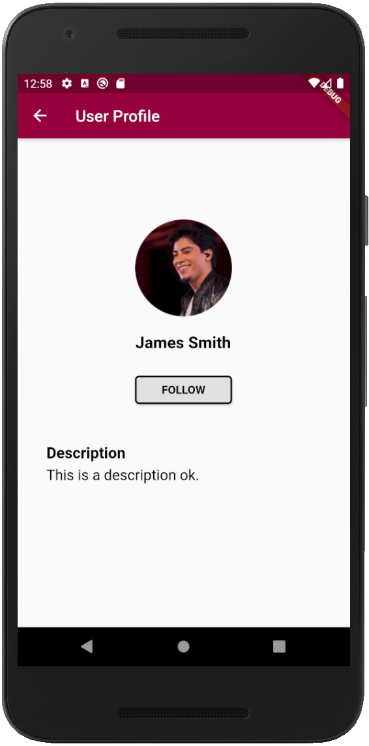
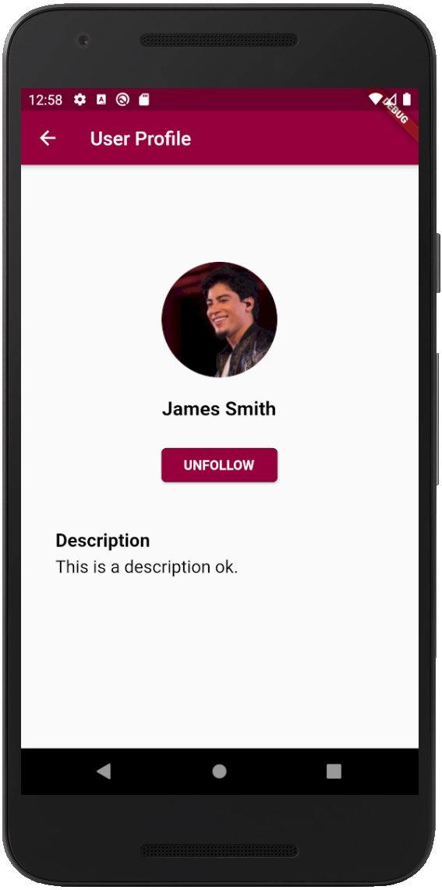

Additional feature #3
  Profile: Allow artists and fans to have a profile and edit it at will
  Payment: Allow fans to buy tickets for available concerts
  Favorite artists: Allow fans to follow and unfollow artists

Slide 15




Technology
LivEvent API
LivEvent Frontend
LivEvent APP

Slide 16

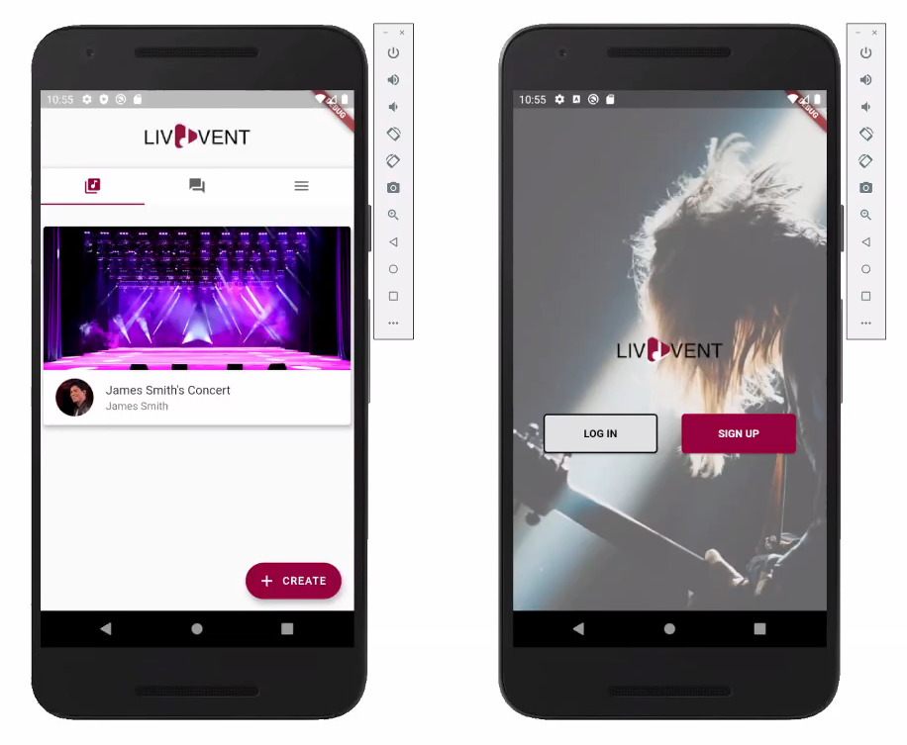

Demo
Artist
Fan

Slide 17


Thank you

