Slide 1

Vibrational Spectroscopy:
Absorption
(Diatomic Molecules)
Powerpoint Templates

Slide 2
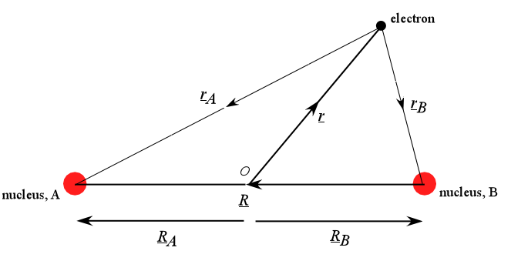
Born Oppenheimer

Slide 3
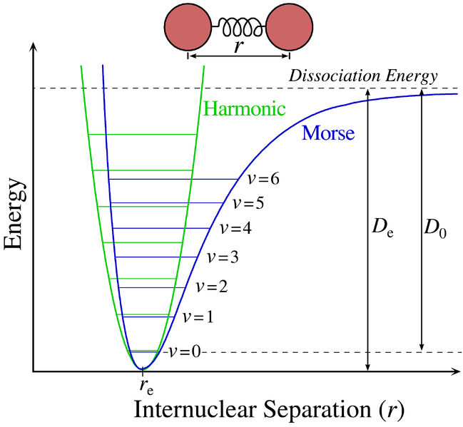
Morse Potential

Slide 4
Δv=±1

Slide 5
Rotational Spectroscopy:
Absorption

Slide 6
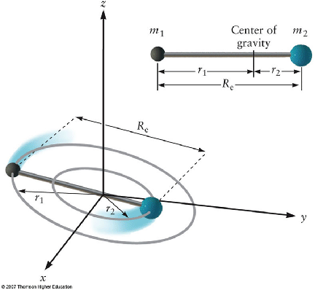

Slide 7
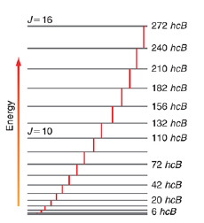
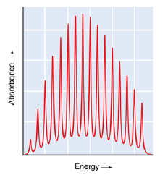

Slide 8
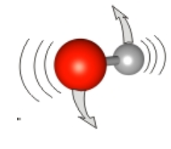
Centrifugal Distortion

Slide 9
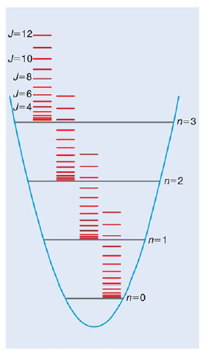
Roto-Vibrational Coupling

Slide 10
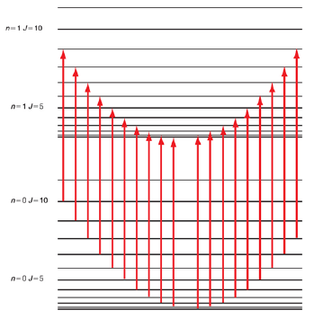

Slide 11
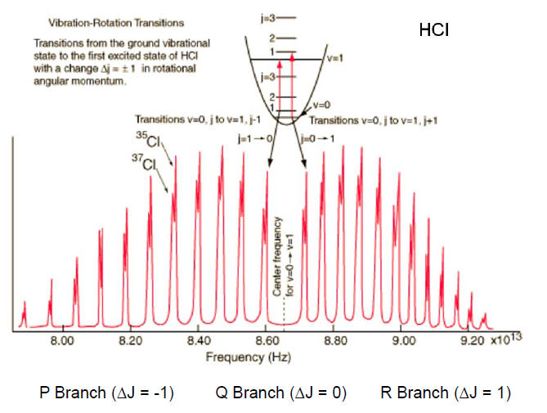

Slide 12

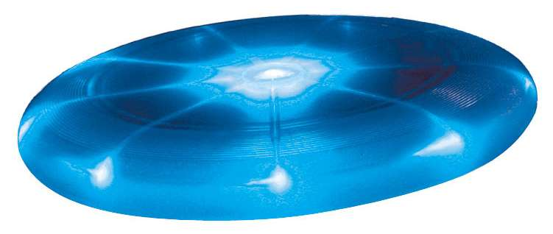
Prolate A>B=C
(cigar shaped)
Oblate A<B=C
(frisbee shaped)

