Slide 1

Atomic Spectroscopy:
(part B)
Emission, Absorption & Fluorescence
Powerpoint Templates

Slide 2
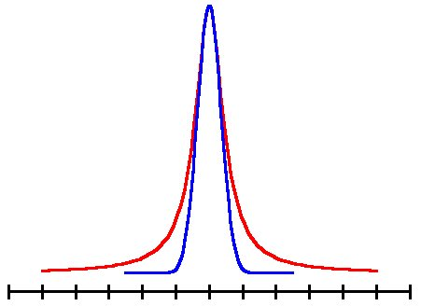
Spectral Line Broadening
Pressure Broadening
α_{L}=Full Width at Half Maximum
(Lorentzian shape - red)

Slide 3
Doppler Broadening
(Gaussian shape - blue)

Slide 4
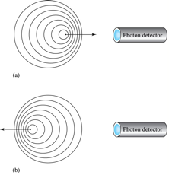

Slide 5
Natural Broadening
(Lorentzian shape )

Slide 6
Voigt Shape

Slide 7
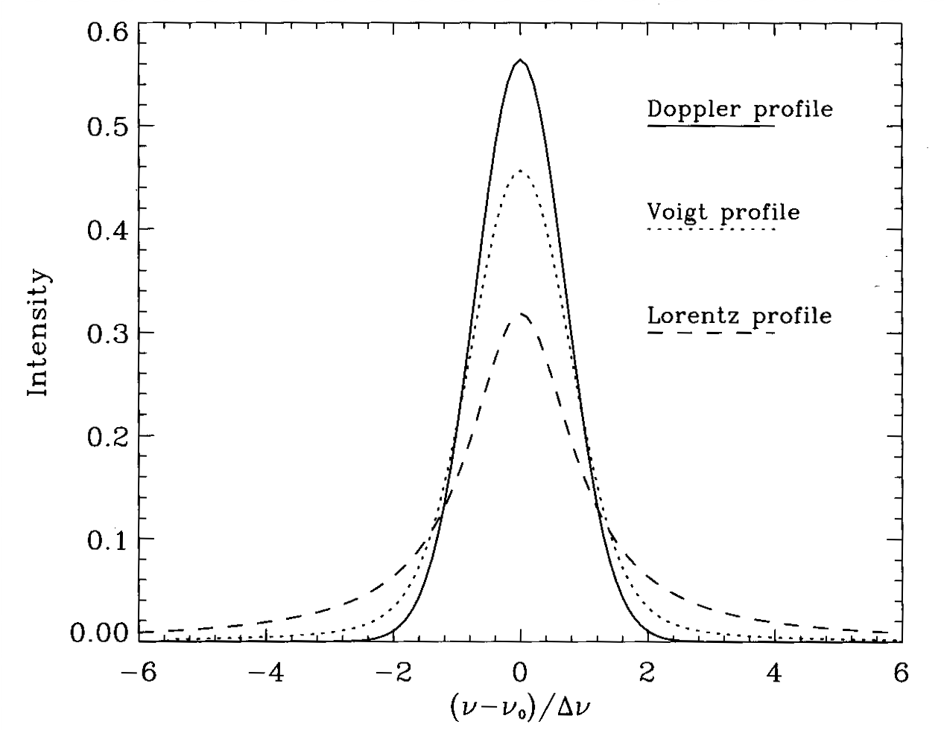

Slide 8
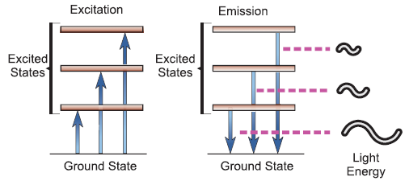
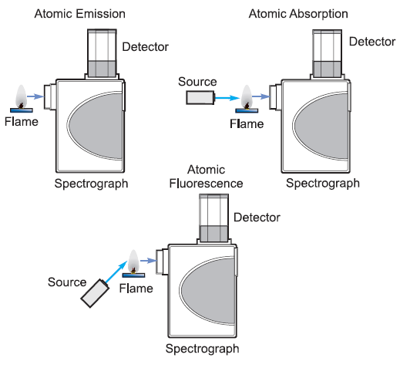

Slide 9
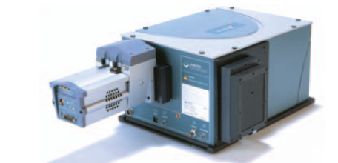

Slide 10
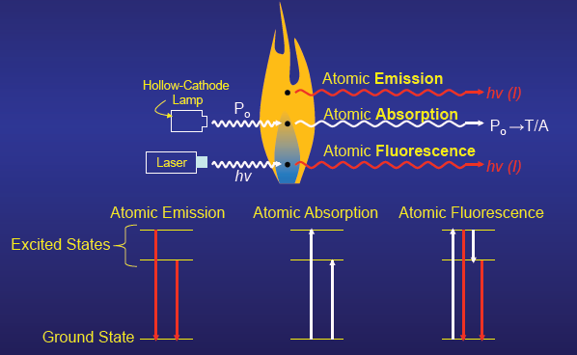

Slide 11
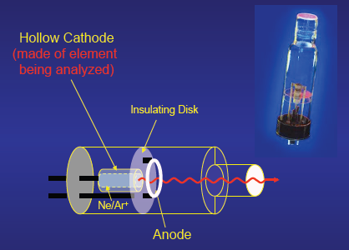
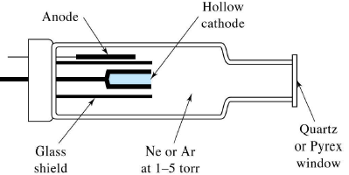

Slide 12
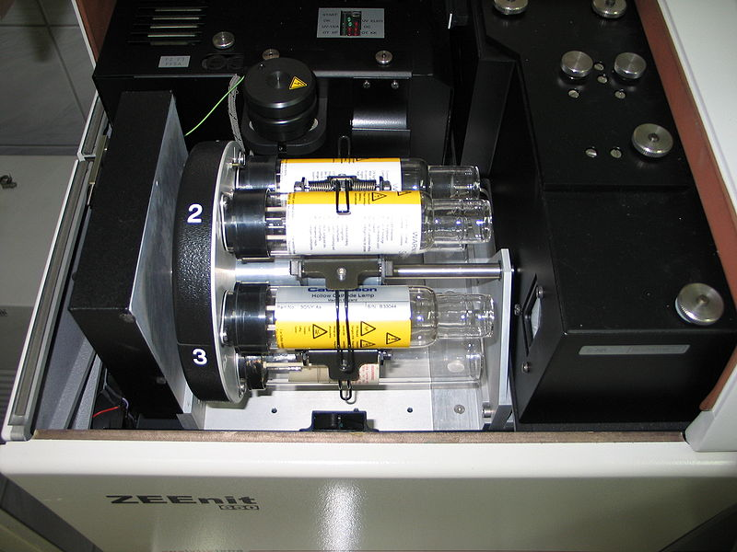

Slide 13
Element | Symbol | Gas | Price
Aluminum | Al | Ne | 129.00
Antimony | Sb | Ne | 129.00
Arsenic | As | Ne | 155.00
Barium | Ba | Ne | 129.00
Beryllium | Be | Ne | 178.00
Bismuth | Bi | Ne | 129.00
Boron | B | Ne | 138.00
Cadmium | Cd | Ne | 138.00
Calcium | Ca | Ne | 123.00
Cerium | Ce | Ne | 162.00
Cesium | Cs | Ne | 189.00
Chromium | Cr | Ne | 129.00
Cobalt | Co | Ne | 138.00
Copper | Cu | Ne | 123.00
Dysprosium | Dy | Ne | 166.00
Erbium | Er | Ne | 166.00
Europium | Eu | Ne | 138.00
Gadolinium | Gd | Ne | 133.00
Gallium | Ga | Ne | 138.00
Germanium | Ge | Ne | 138.00
Gold | Au | Ar | 178.00
Hafnium | Hf | Ne | 181.00
Holmium | Ho | Ne | 165.00
Indium | In | Ne | 129.00
Iron | Fe | Ne | 129.00
Iridium | Ir | Ne | 188.00
Lanthanum | La | Ne | 138.00
Lead | Pb | Ne | 129.00
Lithium | Li | Ar | 129.00
Lutetium | Lu | Ne | 178.00
Magnesium | Mg | Ne | 123.00
Manganese | Mn | Ne | 129.00
Mercury | Hg | Ne | 138.00
Molybdenum | Mo | Ne | 129.00
Element | Symbol | Gas | Price
Neodymium | Nd | Ne | 159.00
Nickel | Ni | Ne | 123.00
Niobium | Nb | Ne | 138.00
Osmium | Os | Ne | 212.00
Palladium | Pd | Ne | 138.00
Phosphorus | P | Ne | 229.00
Platinum | Pt | Ne | 229.00
Potassium | K | Ne | 129.00
Praseodymium | Pr | Ne | 138.00
Rhenium | Re | Ne | 178.00
Rhodium | Rh | Ne | 328.00
Rubidium | Rb | Ne | 189.00
Ruthenium | Ru | Ne | 231.00
Samarium | Sm | Ne | 129.00
Scandium | Sc | Ne | 198.00
Selenium | Se | Ne | 189.00
Silicon | Si | Ne | 138.00
Silver | Ag | Ne | 138.00
Sodium | Na | Ne | 129.00
Strontium | Sr | Ne | 178.00
Tantalum | Ta | Ne | 138.00
Tellurium | Te | Ne | 178.00
Terbium | Tb | Ne | 178.00
Thallium | Tl | Ne | 289.00
Thulium | Tm | Ne | 178.00
Tin | Sn | Ne | 129.00
Titanium | Ti | Ne | 129.00
Tungsten | W | Ne | 129.00
Vanadium | V | Ne | 138.00
Ytterbium | Yb | Ne | 178.00
Yttrium | Y | Ne | 178.00
Zinc | Zn | Ne | 123.00
Zirconium | Zr | Ne | 138.00

Slide 14
Atomization
- Flame
- Furnace
- Plasma

Slide 15
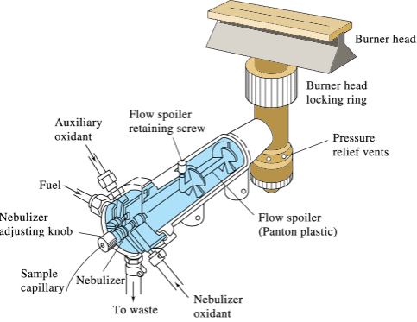
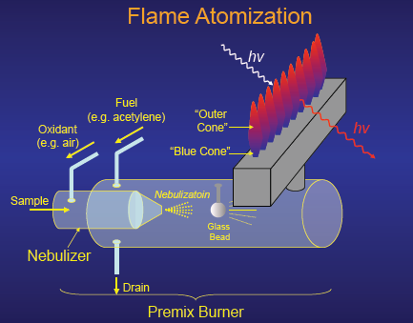

Slide 16
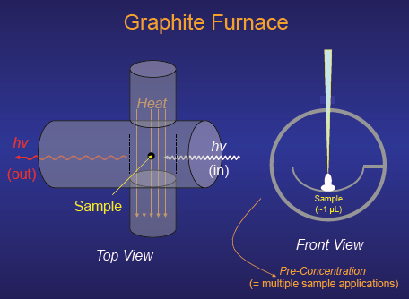
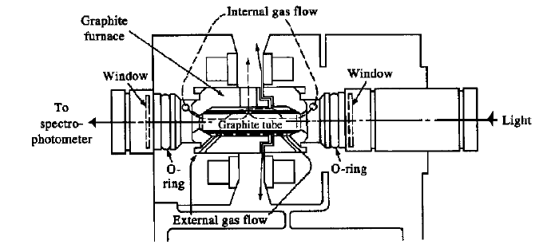

Slide 17
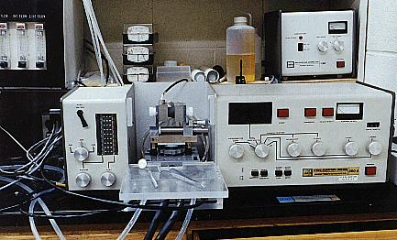
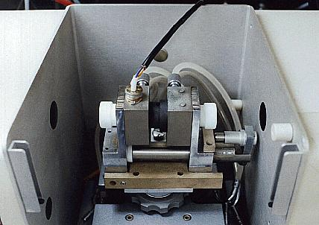

Slide 18
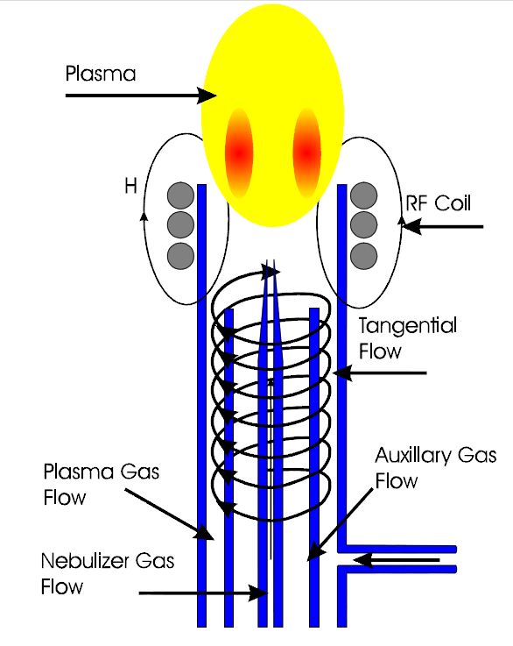
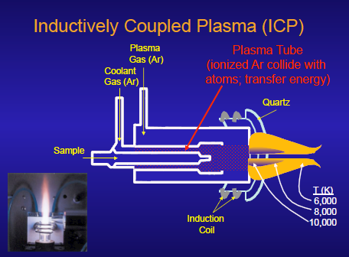

Slide 19
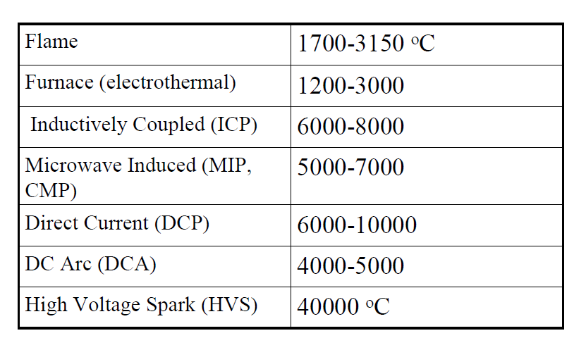

Slide 20
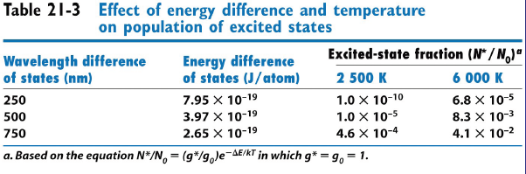
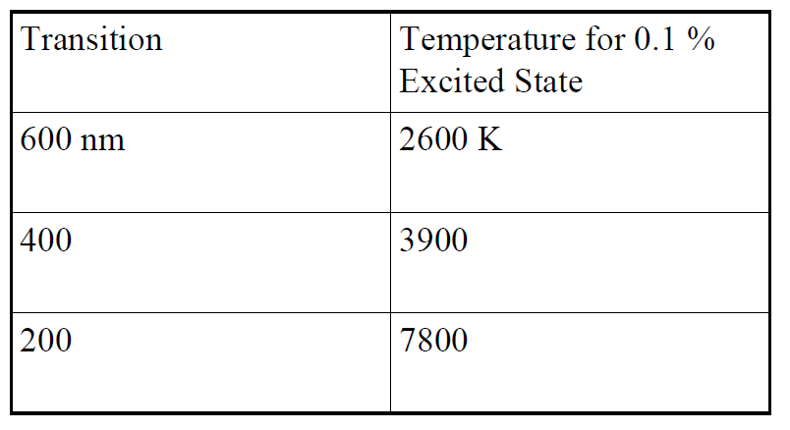

Slide 21
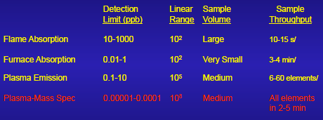

Slide 22
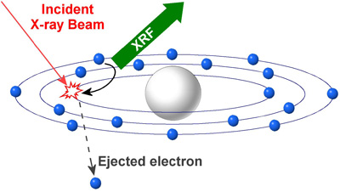
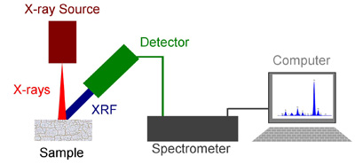
XRF X-ray Fluorescence

Slide 23
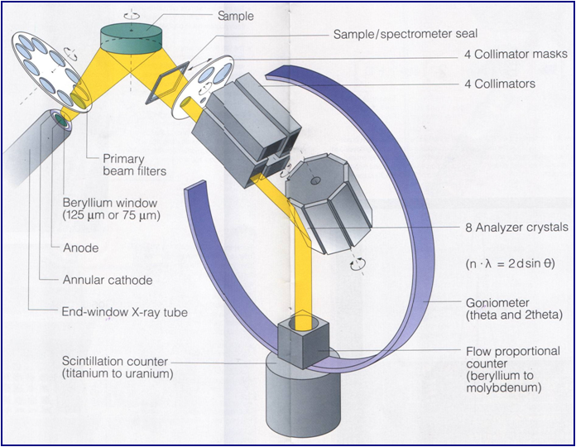

Slide 24
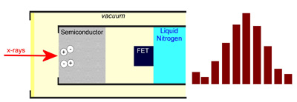
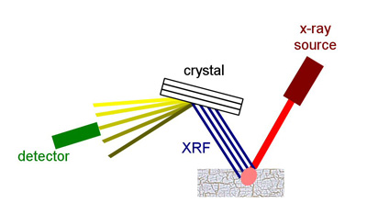
XRF Energy Dispersive
XRF Wavelenght Dispersive

Slide 25
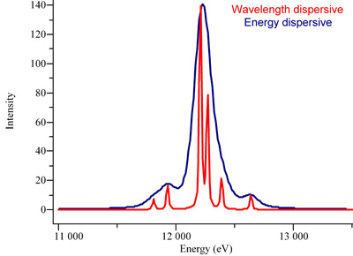

Slide 26
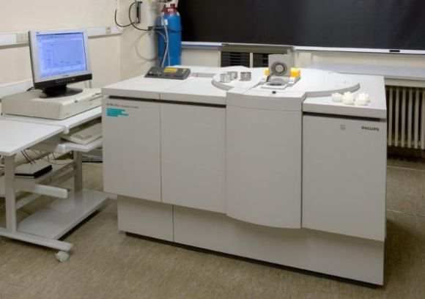

Slide 27
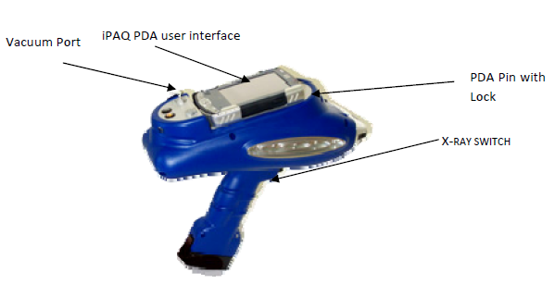
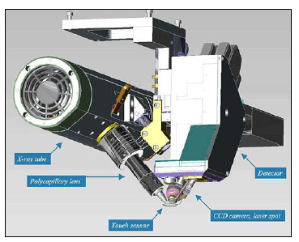

Slide 28
