Slide 1

Atomic Spectroscopy:
Emission, Absorption & Fluorescence
Powerpoint Templates

Slide 2
Term Symbols
L = 0, 1, 2, ...
S, P, D
J = L + S

Slide 3
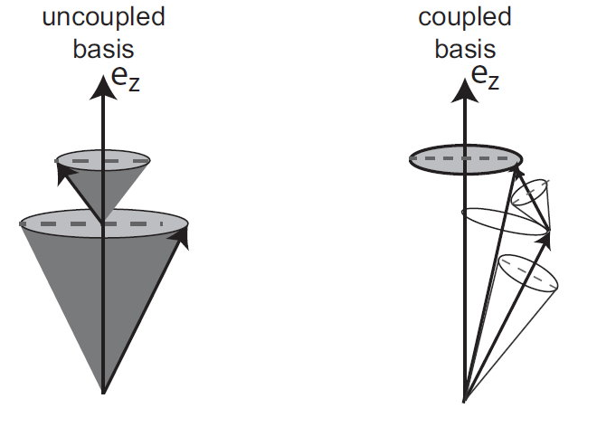
L = | l₁ + l₂ |, | l₁ + l₂ - 1 |, ..., | l₁ - l₂ |
S = | s₁ + s₂ |, | s₁ + s₂ - 1 |, ..., | s₁ - s₂ |

Slide 4
J = L + S
| L + S |, | L + S - 1 |, ..., | L - S |
Russell-Saunders Coupling
jj – Coupling
j_{i} = l_{i} + s_{i}
| j₁ + j₂ |, | j₁ + j₂ - 1 |, ..., | j₁ - j₂ |

Slide 5
Hund’s Rules
The lowest energy term is that which has the greatest spin multiplicity.
For terms that have the same spin multiplicity, the term with the highest orbital angular momentum lies lowest in energy.
spin-orbit coupling (more pronounced for heavier nuclei) splits terms into levels.
{ If the unfilled subshell is exactly or more than half full, the level with the highest J value has the lowest energy.
{ If the unfilled subshell is less than half full, the level with the lowest J value has the lowest energy.

Slide 7
Selection Rules
Helicity of a photon σ = ± 1
(Physically analogous to the angular momentum along the axis of propagation)
Upon absorption or emission of a photon the atom must change the momentum along the zz axis (considered collinear with the axis of propagation) in ± 1
ΔJ = 0; ± 1 (but J ≠ 0 if ΔJ = 0)
ΔM_{J} = 0; ± 1 (but ΔM_{J} ≠ 0 if J = 0)

Slide 8
Electric dipole Transition moment
Spin wave functions are differentially zero (αβ) or one (αα).
ΔS = 0 allowed
ΔS ≠ 0 forbidden

Slide 9
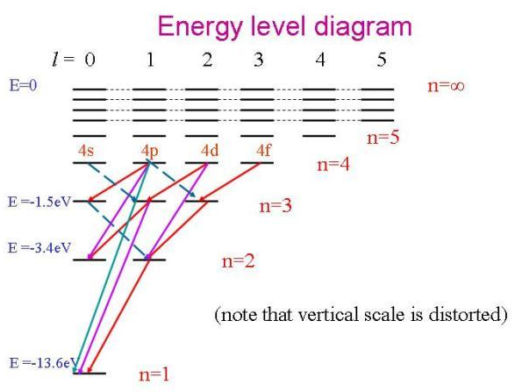
Grotrian Diagrams
Hydrogen

Slide 10
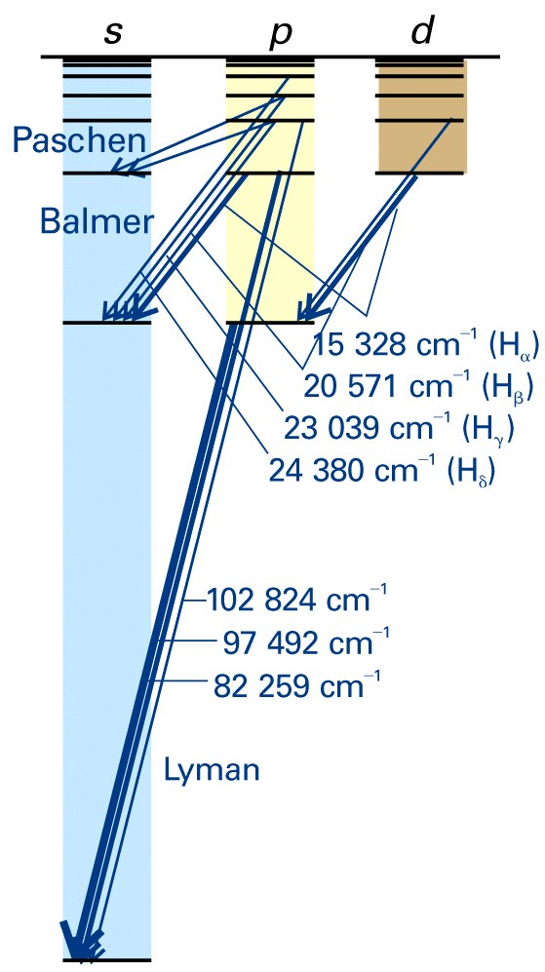

Slide 11
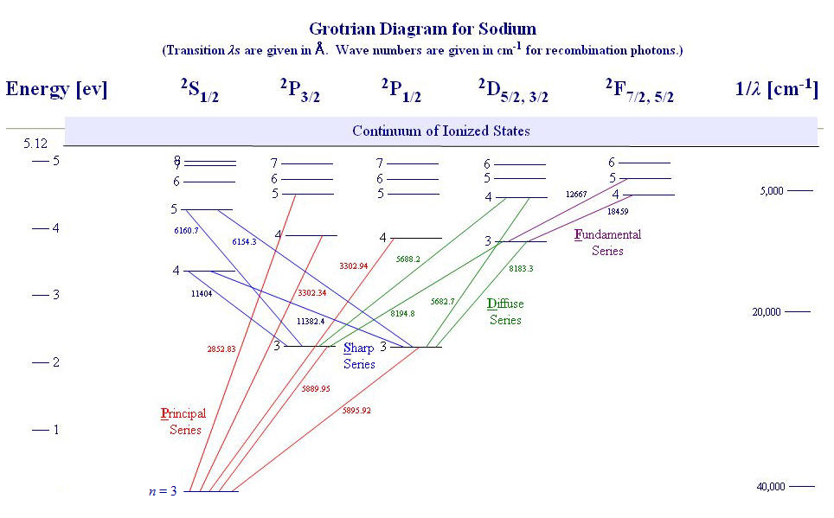

Slide 12
