Slide 1

Quantum Chemistry
Examples
Powerpoint Templates

Slide 2
Particle in a box
V=cte

Slide 3
Ψ(x) = A exp(ikx) + B exp(-ikx)
Ψ(0) = 0 → A = - B
Ψ(L) = 0 → kL = n π (n=1,2,…)

Slide 4
Ψ(x) = A sin(n π x/L)

Slide 5
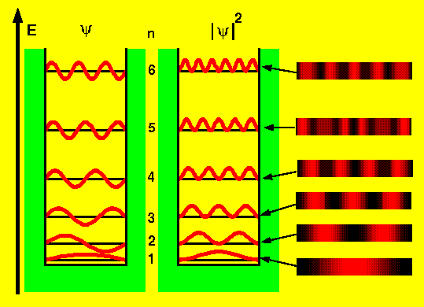

Slide 6
Harmonic oscillator
V=½kx²
k=mω²
E=(n + ½)hν

Slide 7
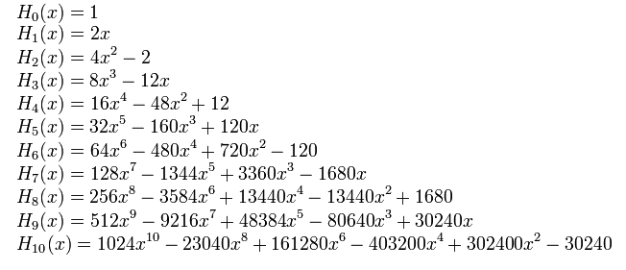

Slide 8
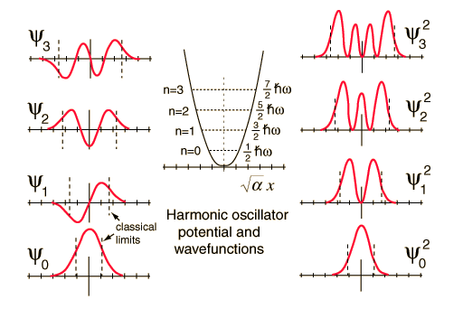

Slide 9
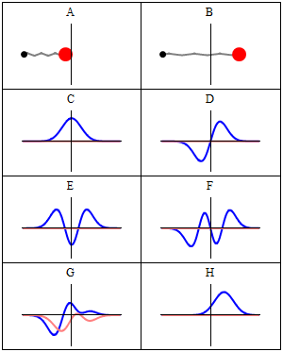

Slide 10
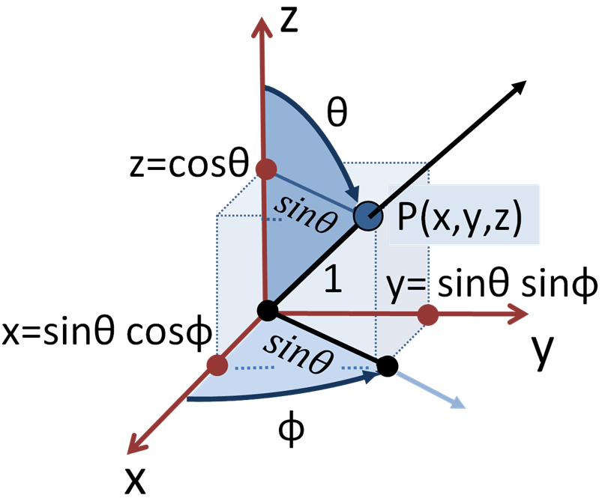
Hydrogen atom
V=cte/r

Slide 12
m=…,-2,-1,0,1,2,…

Slide 16
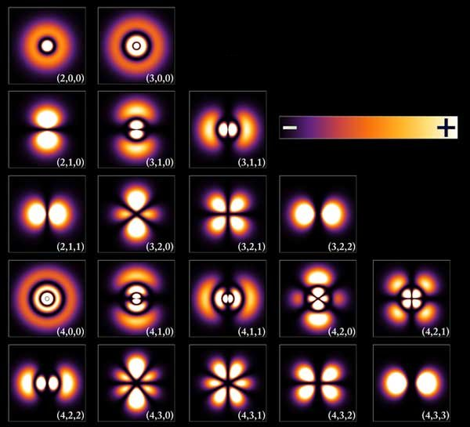

Slide 17
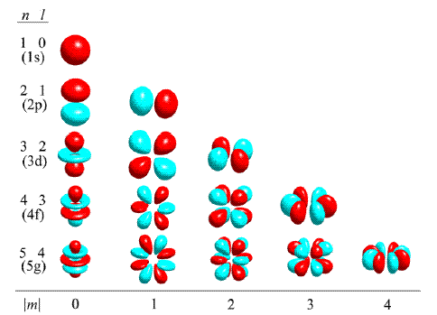

Slide 18
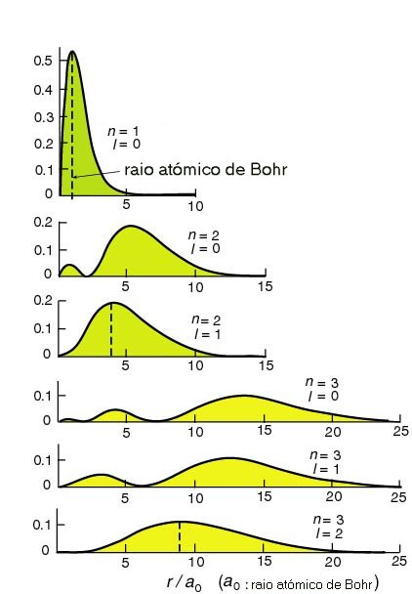

Slide 19
