Slide 1

Electromagnetic
Radiation
Powerpoint Templates

Slide 2
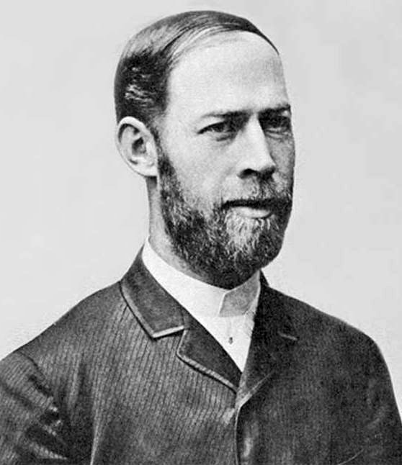
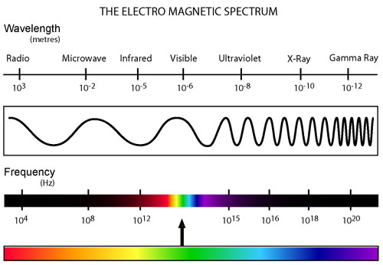
Hertz
(1857-1894)
1887 (22 years after Maxwell equations) discovered radio waves

Slide 3
Maxwell Equations

Slide 4
Constitutive Equations
Vacuum
D = ε_{o} E
B = μ_{o} H
Conductors
J = σ E
Linear media
D = ε E
B = μ H

Slide 5
Non linear media
P = χ⁽¹⁾E + χ⁽²⁾E² + χ⁽³⁾E³ + …
D = ε_{o}(E + χ⁽¹⁾E + χ⁽²⁾E² + χ⁽³⁾E³ + …)
D = ε_{o}(E + P)

Slide 6
Example SHG

Slide 7
Gauss Theorem
Isotropic media => Spherical field

Slide 8
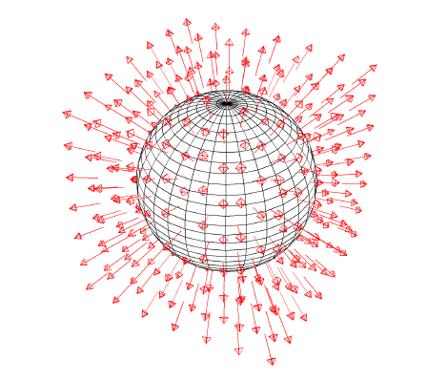
Nº of field lines entering a volume must be equal to the nº of lines living the volume (no magnetic charge accumulation allowed). => Field lines are closed loops.

Slide 9
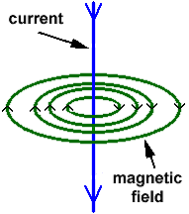
Stokes Theorem
DC current

Slide 10
Free Space

Slide 11
Possible solution: Plane waves

Slide 13
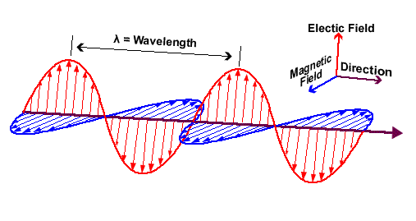
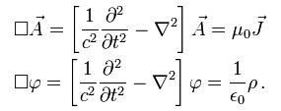
Potentials

Slide 14
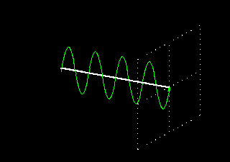
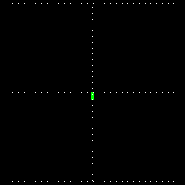
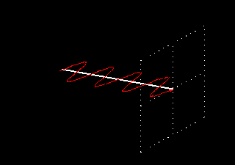
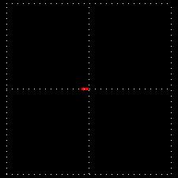
Polarization

Slide 15
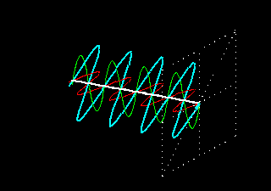
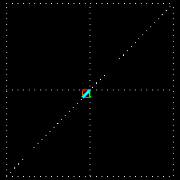
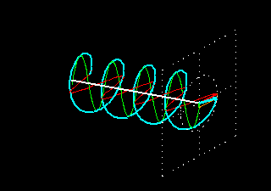
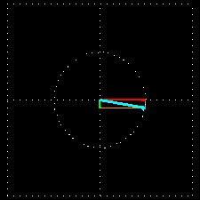

Slide 16
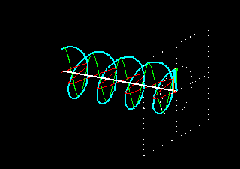
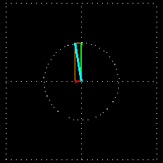

Slide 17
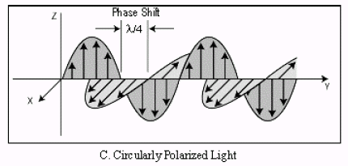
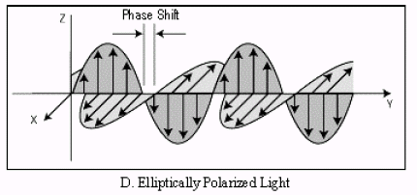

Slide 18
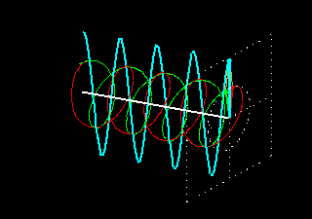
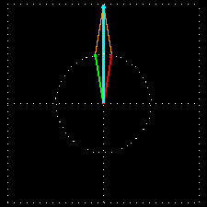

Slide 19
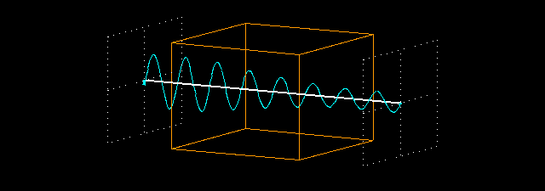
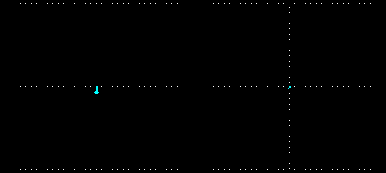

Slide 20
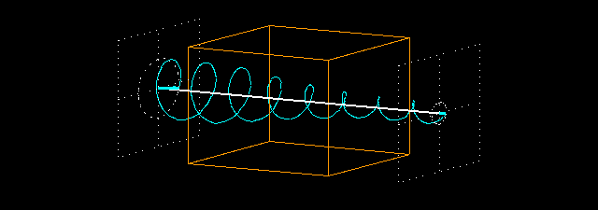
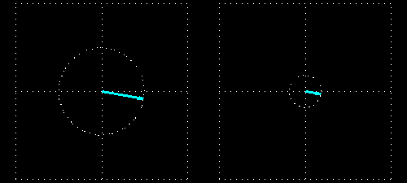

Slide 21
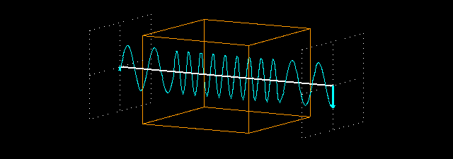
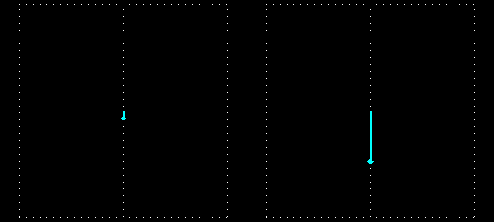

Slide 22
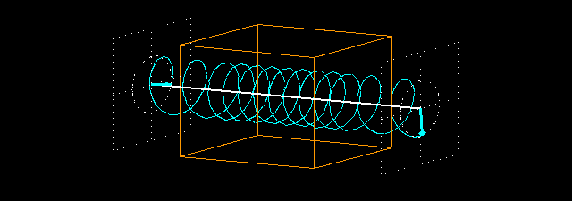
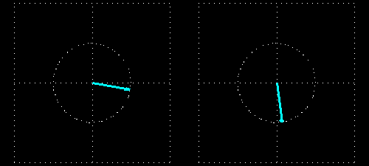

Slide 23
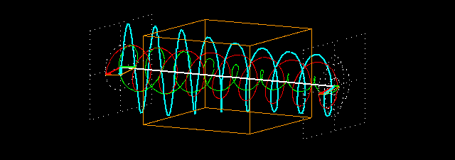
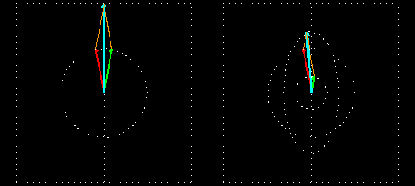

Slide 24
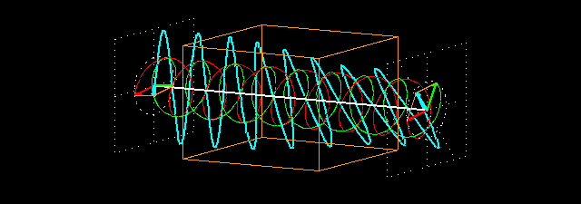
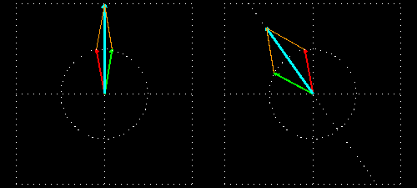

Slide 25
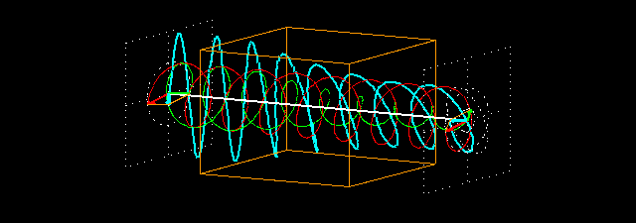
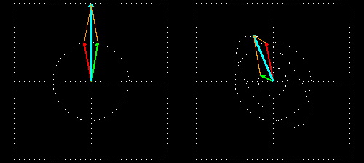

Slide 26
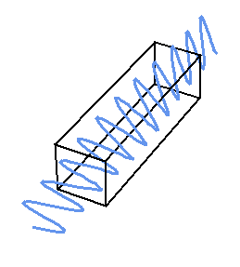

Slide 27
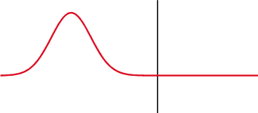
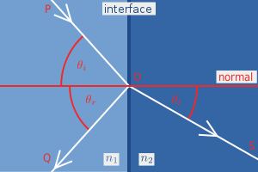
Refraction & Reflection

Slide 28
Law of reflection: θ_{i} = θ_{r}
Snell’s law: n₁ sin θ_{i} = n₂ sin θ_{t}

Slide 29
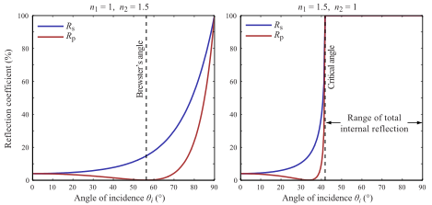
Brewster's angle: 56.4º
Total reflection: 42º

Slide 30
