Slide 1

Electronic Spectroscopy
EPR/ESR
Powerpoint Templates

Slide 2

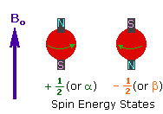
μ = g S
_{Landé factor}
E = - μ.B₀

Slide 3
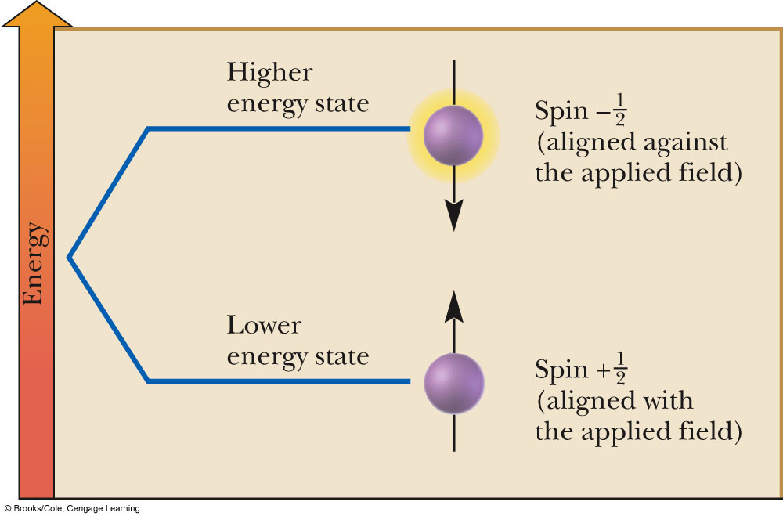
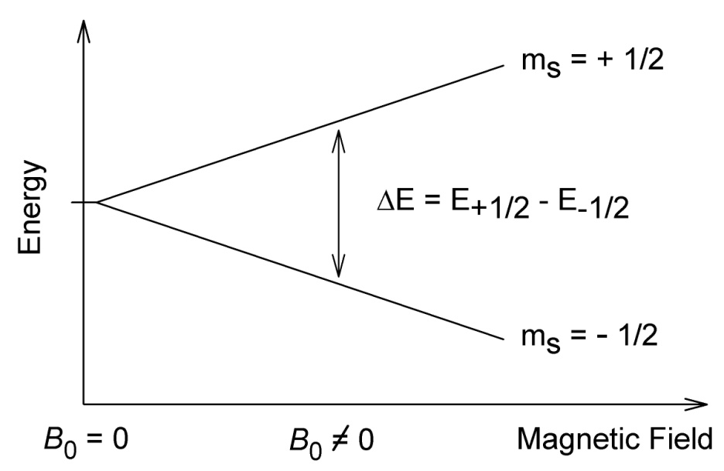
Electron Spins in B₀
ΔE = gB₀h/2π

Slide 4

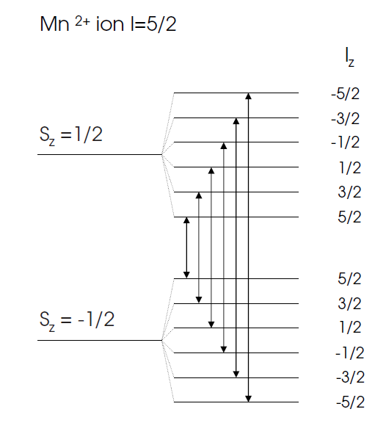

Slide 5
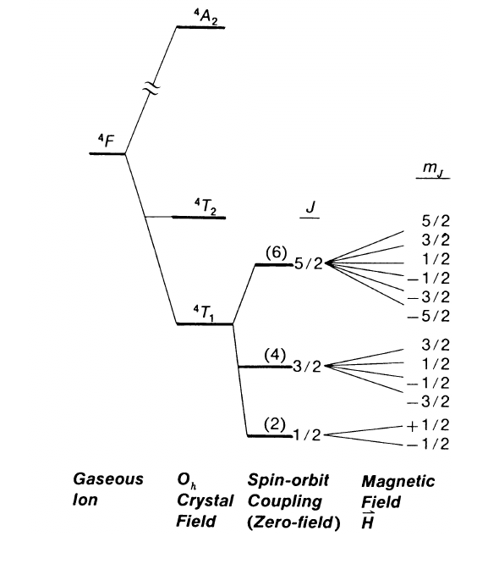
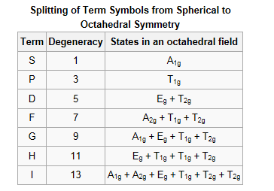

Slide 6
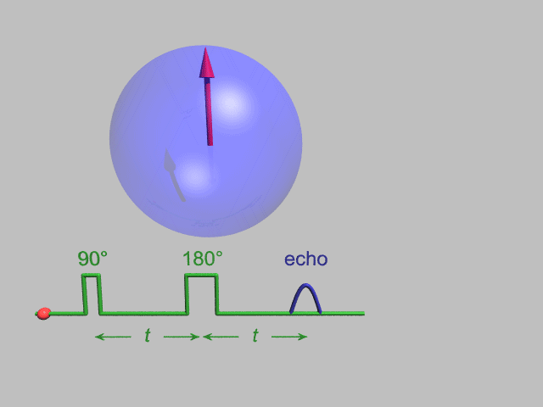

Slide 7
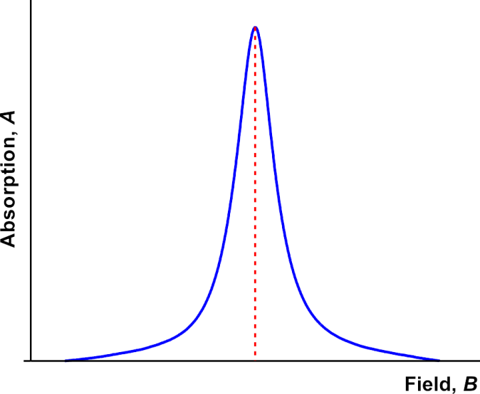
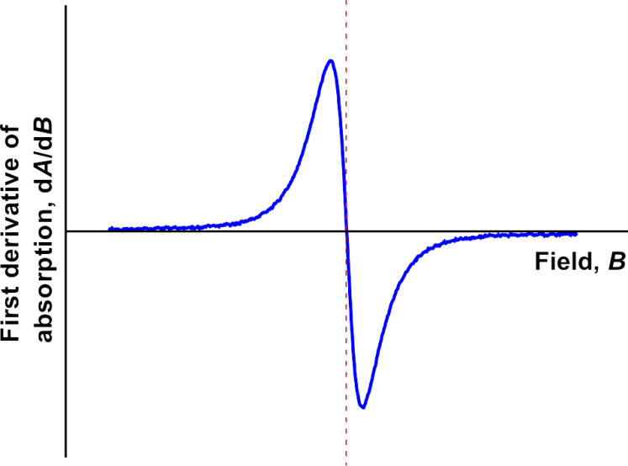
When phase-sensitive detection is used, the signal is the first derivative of the absorption intensity

Slide 8
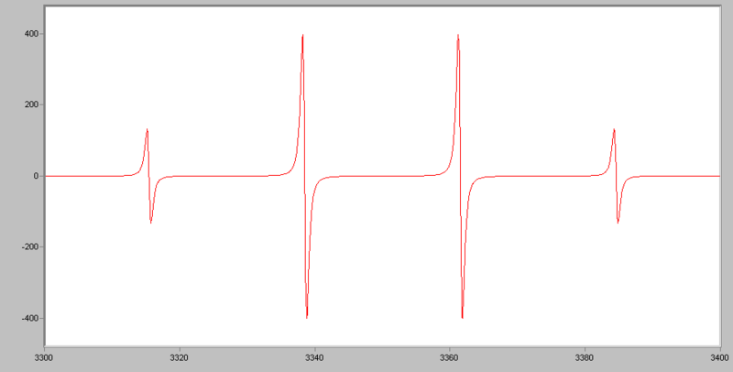
CH₃

Slide 9
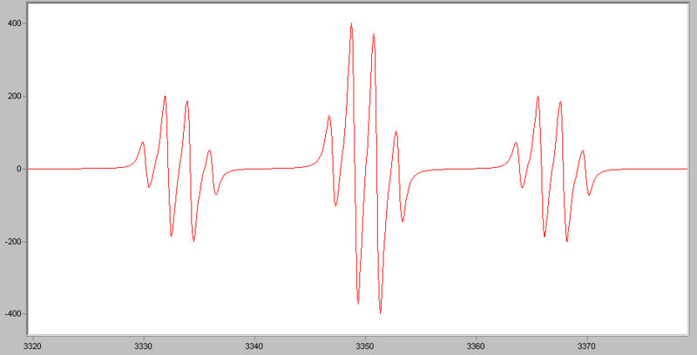
H₂COCH₃

Slide 10
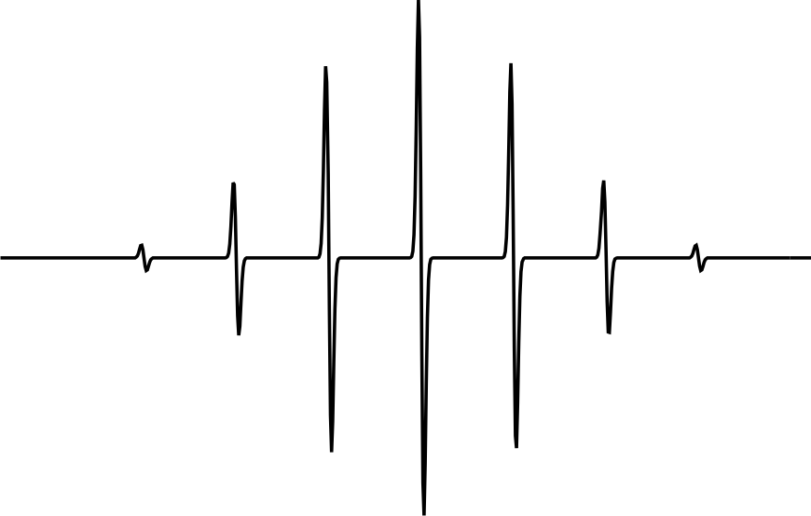
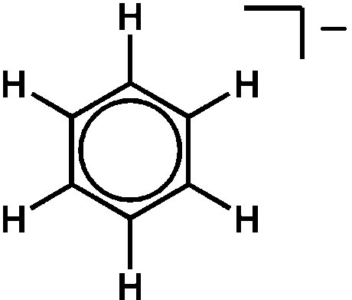
EPR spectrum of benzene radical anion

Slide 11
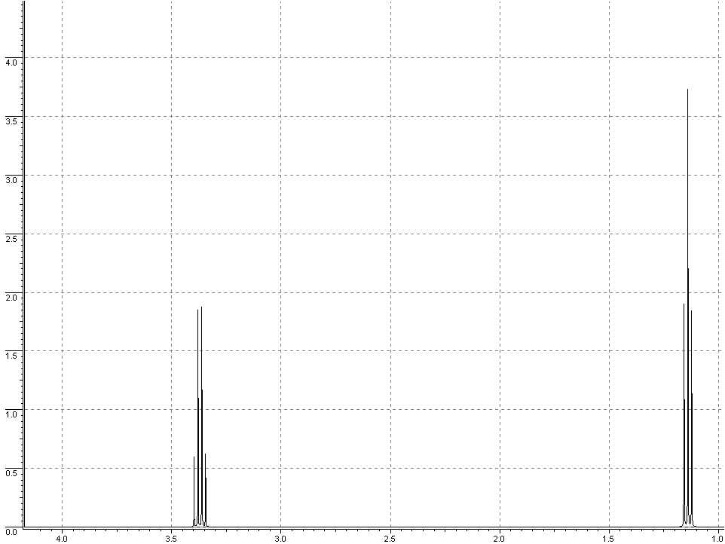
OC₄H₁₀

Slide 12
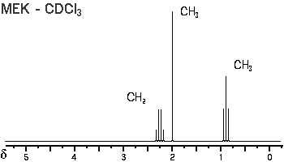
OC₄H₈

