Slide 1

Electronic Spectroscopy
NMR
Powerpoint Templates

Slide 2

μ = γ I
Isotope | Natural % Abundance | Spin (I) | Magnetic Moment (μ)* | Magnetogyric Ratio (γ)†
¹H | 99.9844 | 1/2 | 2.7927 | 26.753
²H | 0.0156 | 1 | 0.8574 | 4,107
¹¹B | 81.17 | 3/2 | 2.6880 | 8,5847
¹³C | 1.108 | 1/2 | 0.7022 | 6,728
¹⁵N | 0.37 | 1/2 | -0.2832 | -2,713
¹⁷O | 0.037 | 5/2 | -1.8930 | -3,628
¹⁹F | 100.0 | 1/2 | 2.6273 | 25,179
²⁹Si | 4.700 | 1/2 | -0.5555 | -5,319
³¹P | 100.0 | 1/2 | 1.1305 | 10,840
* μ in units of nuclear magnetons = 5.05078•10⁻²⁷ JT⁻¹ † γ in units of 10⁷rad T⁻¹ sec⁻¹

Slide 3
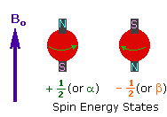
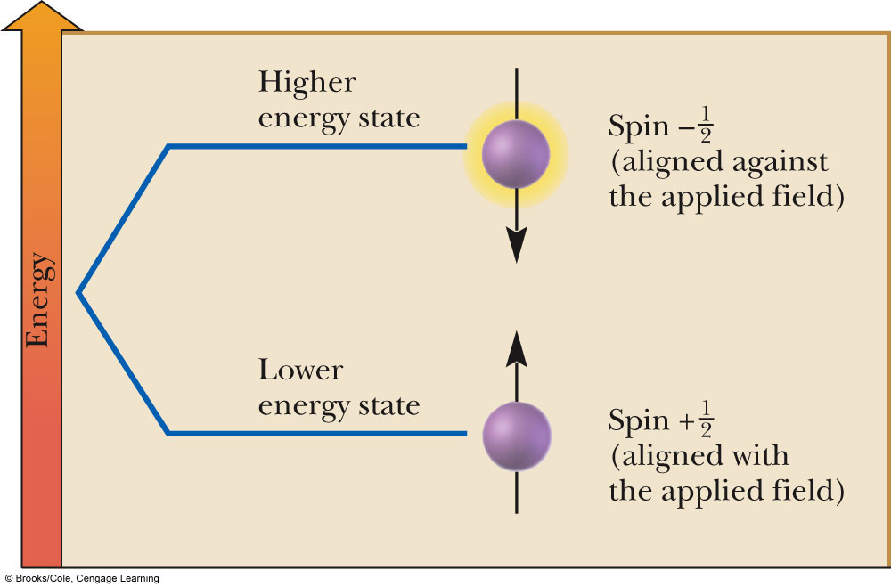
E = - μ.B₀
Nuclear Spins in B₀
ΔE = γB₀h/2π

Slide 4
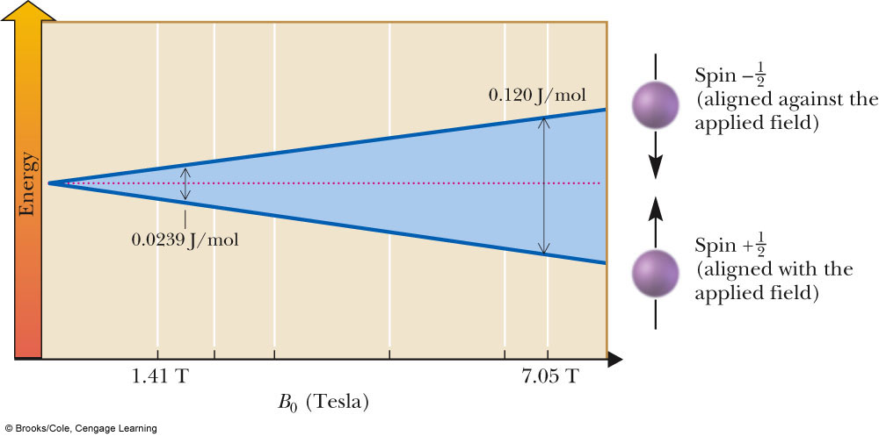
Values for H atom
Applied field strength of 7.05T
¹H is approximately 0.120 J/mol, which corresponds to a frequency of 300 MHz
¹³C is approximately 0.030 J/mol, which corresponds to a frequency of 75MHz

Slide 5
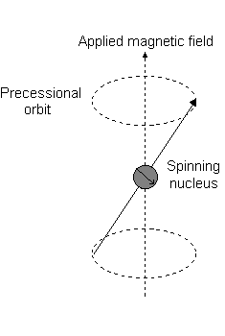
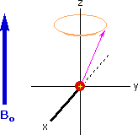

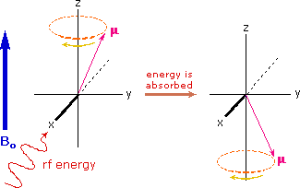
ω = γB₀
_{Larmour frequency}

Slide 6
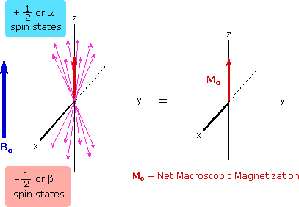
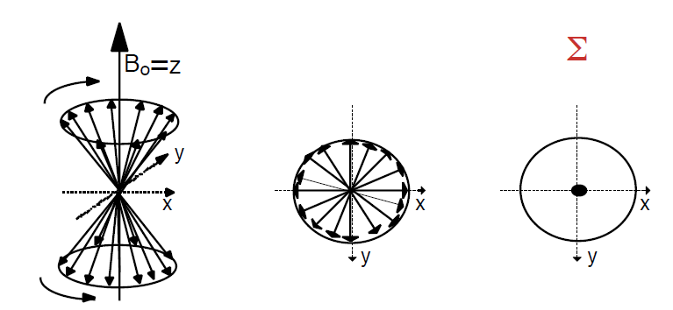

Slide 7

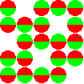
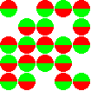


For 2.35 T (= 100 MHz) and 300 K one gets for 1H a population difference N(α) - N(β) of ca. 8.10⁻⁶

Slide 8
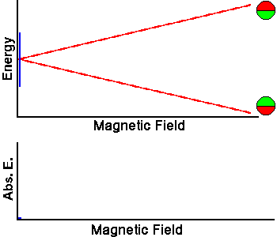
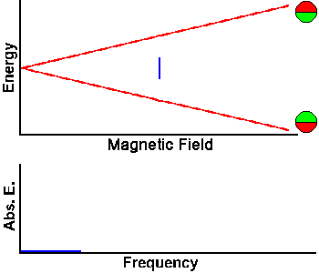

Slide 9
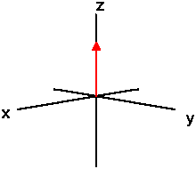
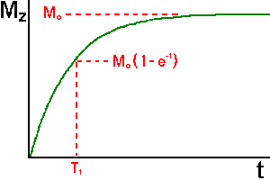

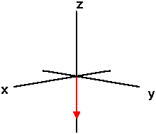
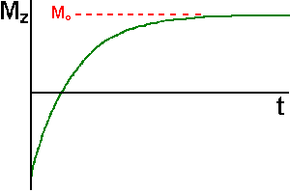

Spin Lattice Relaxation

Slide 10
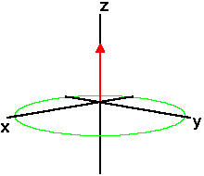
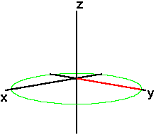
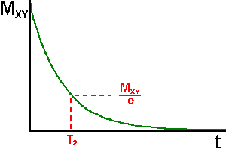


Slide 11

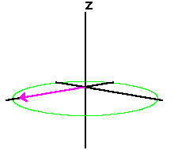
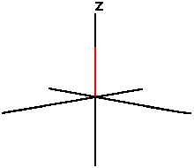


Slide 12
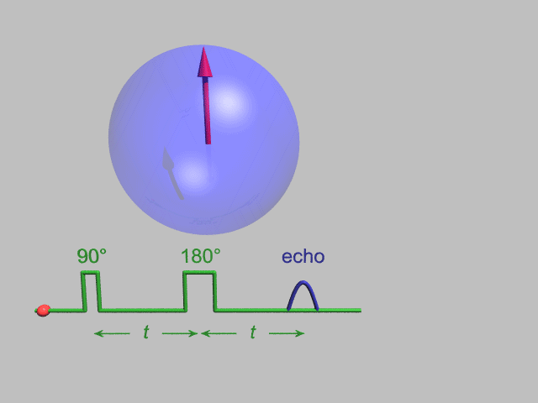

Slide 13
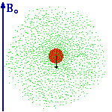

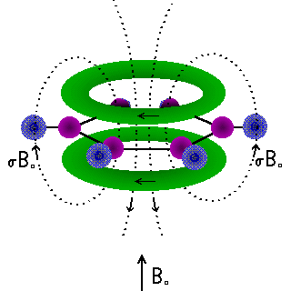
Chemical shift

Slide 14

Chemical shift (δ): The shift in ppm of an NMR signal from the signal of TMS

Slide 15
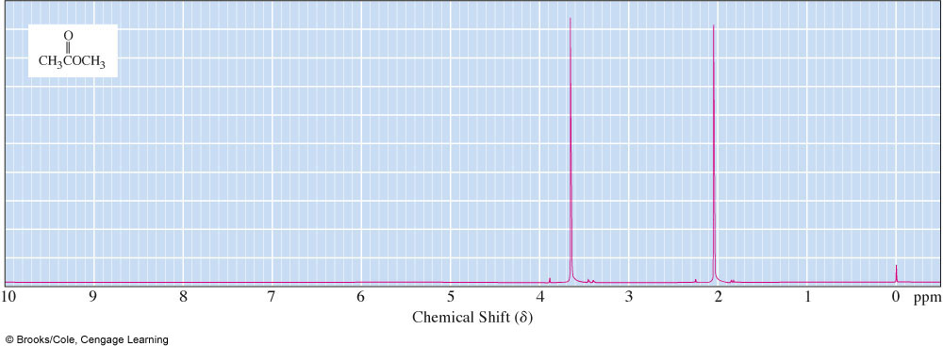
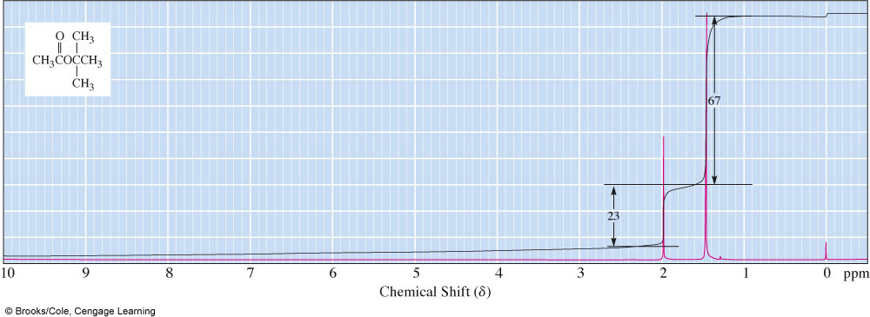

Slide 16
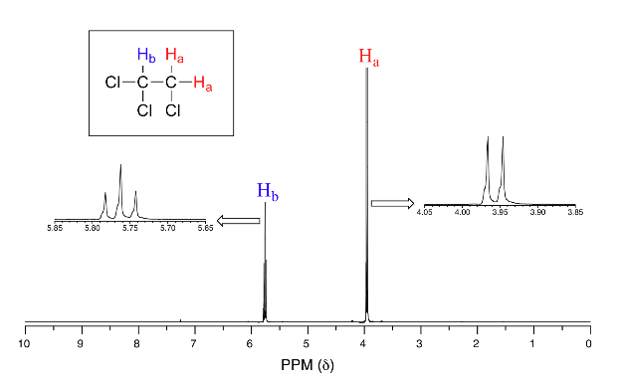

Slide 17
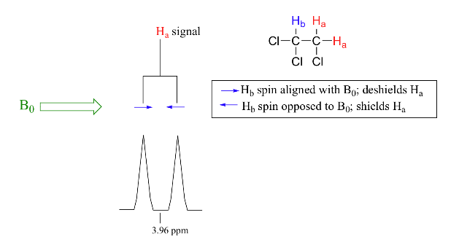

Slide 18
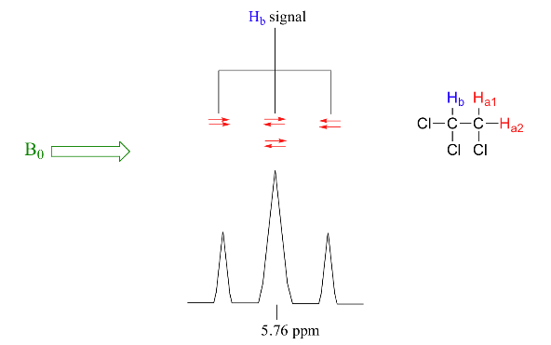

Slide 19
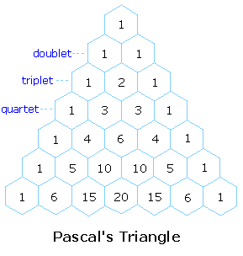
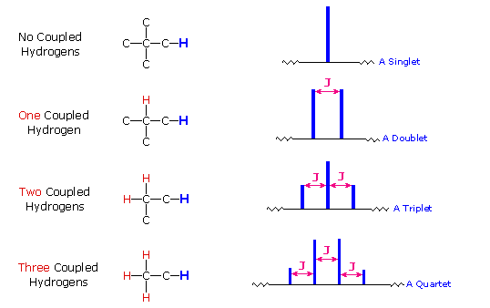

Slide 20
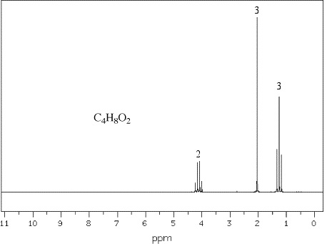

Slide 21
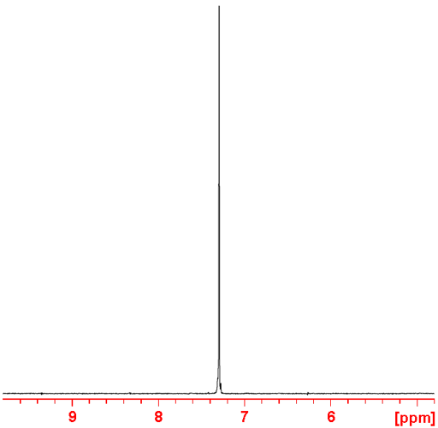
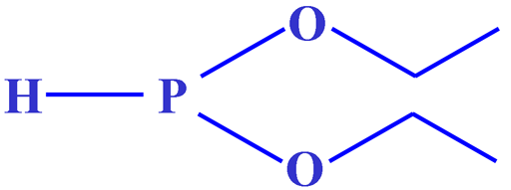
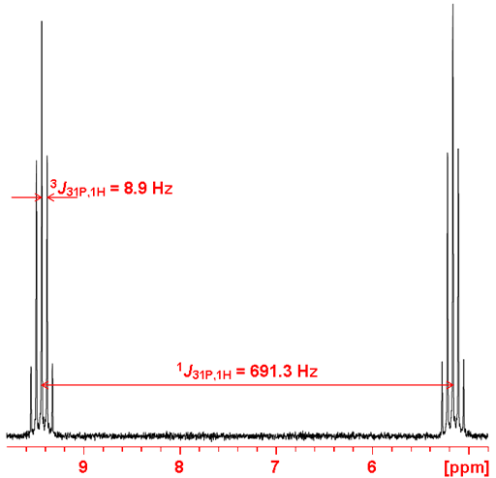
Direct Coupling ¹J

Slide 22
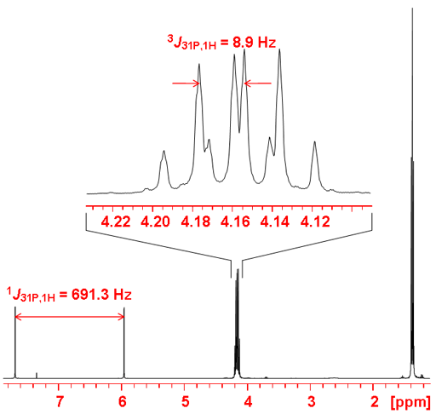

Slide 23
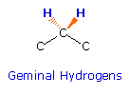

Geminal Coupling ²J
diastereotopic

Slide 24
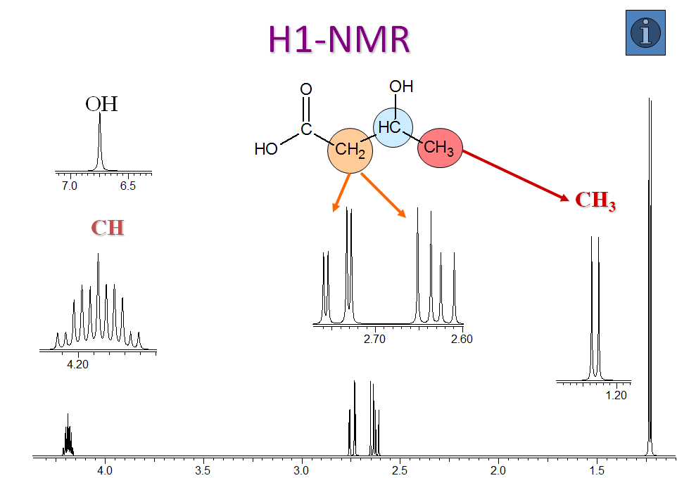

Slide 25
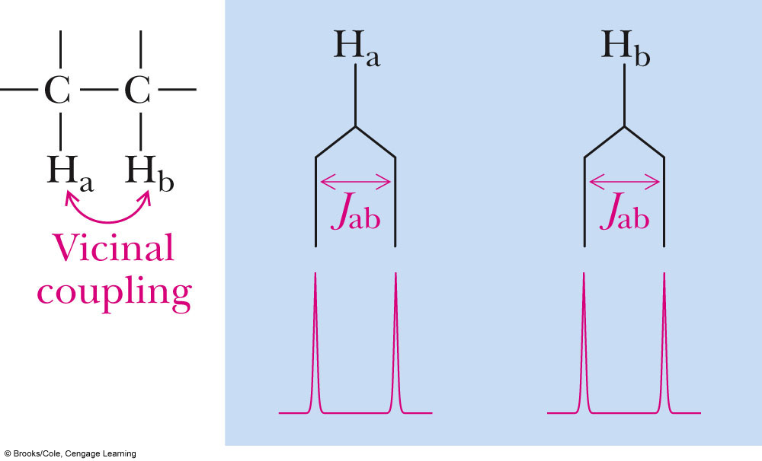
Vicinal Coupling ³J
Atoms three bonds apart, the coupling is called vicinal coupling

