Slide 1

Electronic Spectroscopy
Time Resolved Fluorescence
Powerpoint Templates

Slide 2
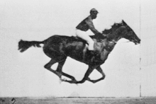
Eadweard Muybridge

Slide 3
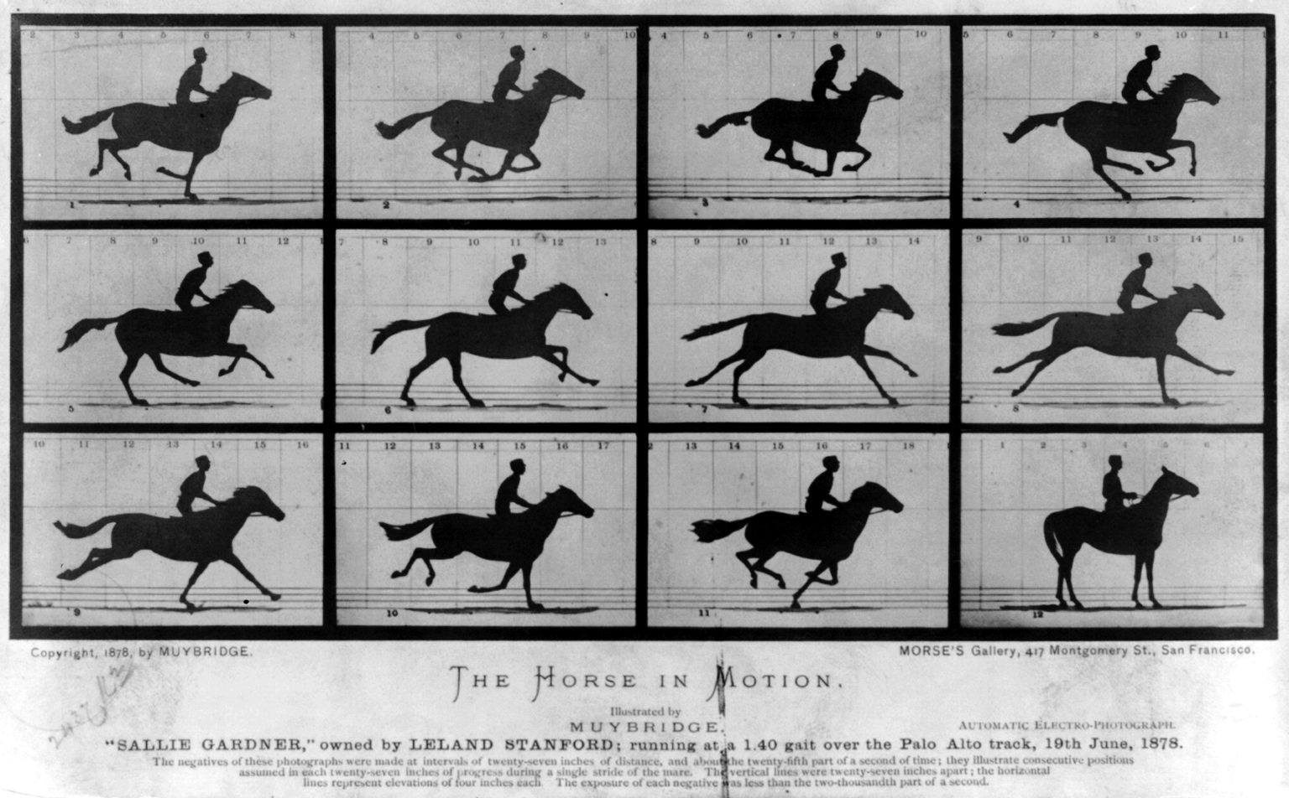

Slide 4
Direct Methods (τF > 200 ps)
Dependent on Ultrafast Electronics
Microchannel Plate
(expensive ones can be as fast as 20 ps)
Avalanche Photo Diode (200 ps)

Slide 5
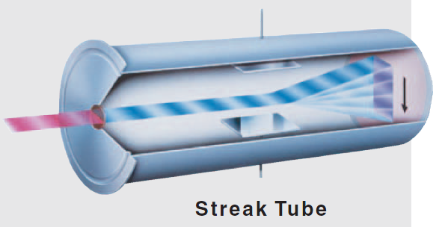
Streak-camera
Single picosecond pulses for excitation
streak-camera for detection
Time resolution down to about 2 ps.

Slide 6
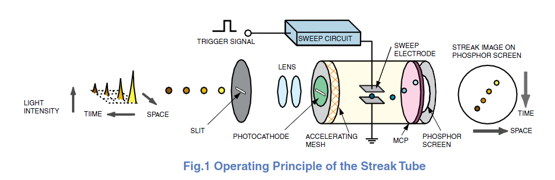
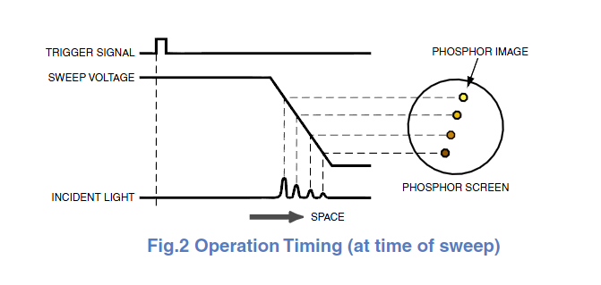

Slide 7
Indirect Methods (τF > 150 fs)
Optical Gating
TCSPC (τF > 20 ps)
Up Conversion (τF > 150 fs)

Slide 8
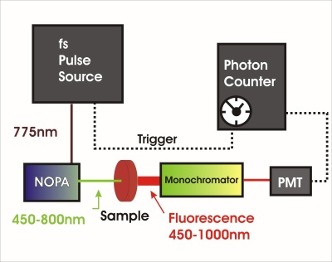
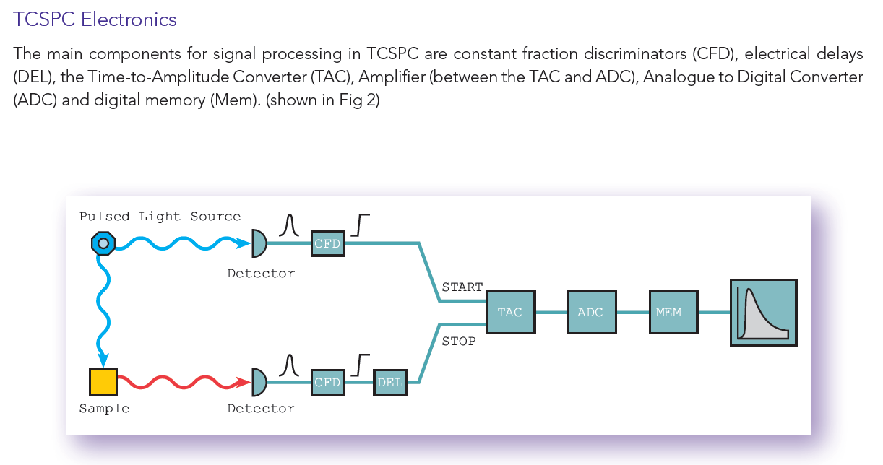

Slide 9
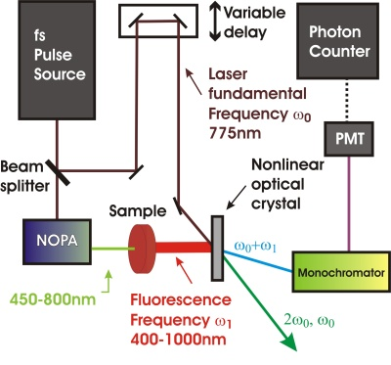

Slide 10
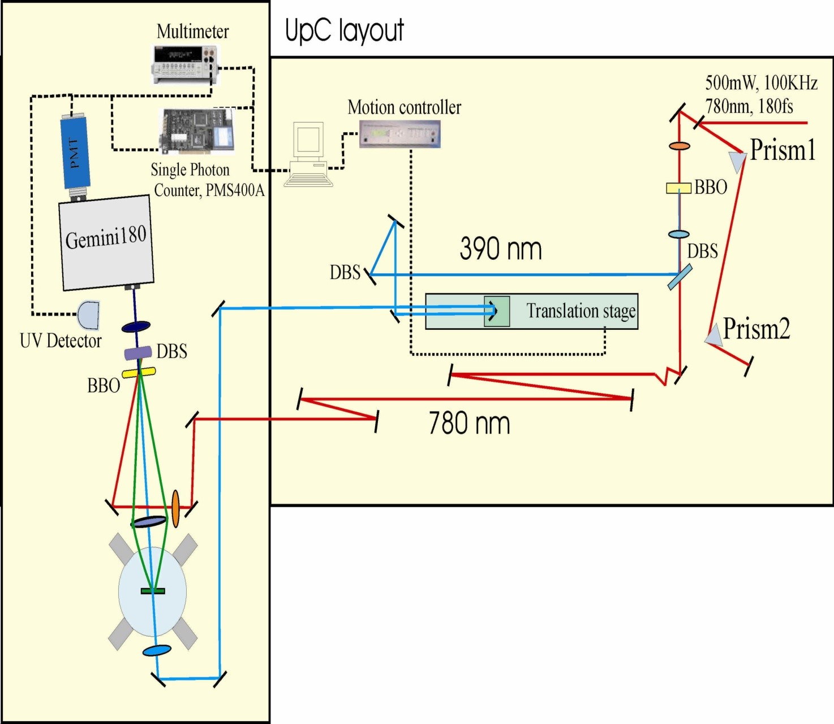

Slide 11
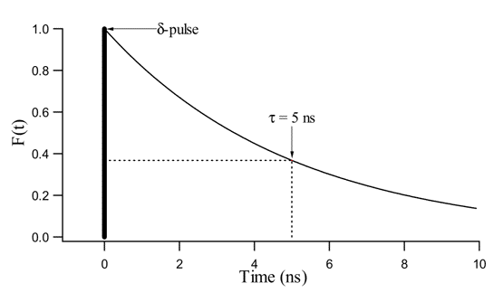

Slide 12
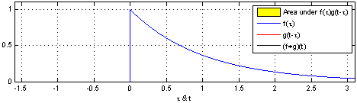

Slide 13
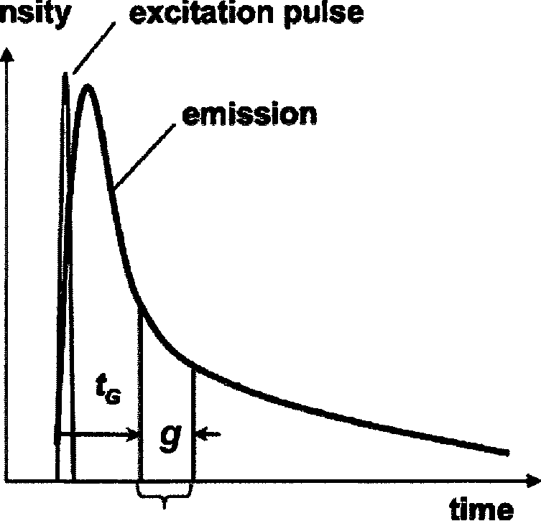

Slide 15
Not discussed methods
• Phase-fluorimetry
• Fluorescence lifetime imaging
fluorescence lifetime imaging microscopy
time-resolved confocal microscopy
time-resolved two-photon fluorescence microscopy
time-resolved near-field fluorescence microscopy
• Fluorescence correlation spectroscopy
• Single-molecule fluorescence spectroscopy

