Slide 1

Electronic
Spectroscopy
Powerpoint Templates

Slide 2
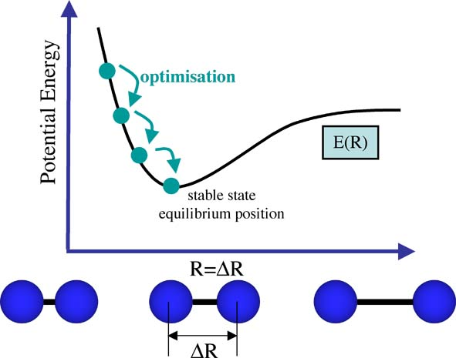

Slide 3
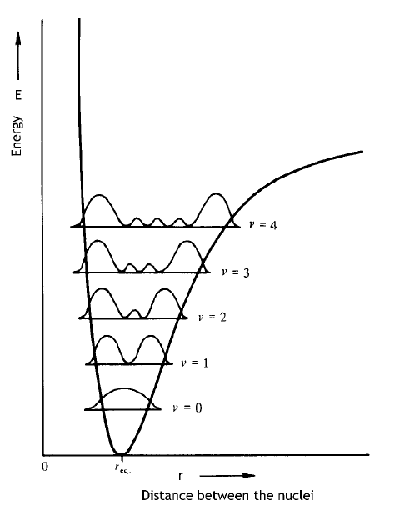

Slide 4
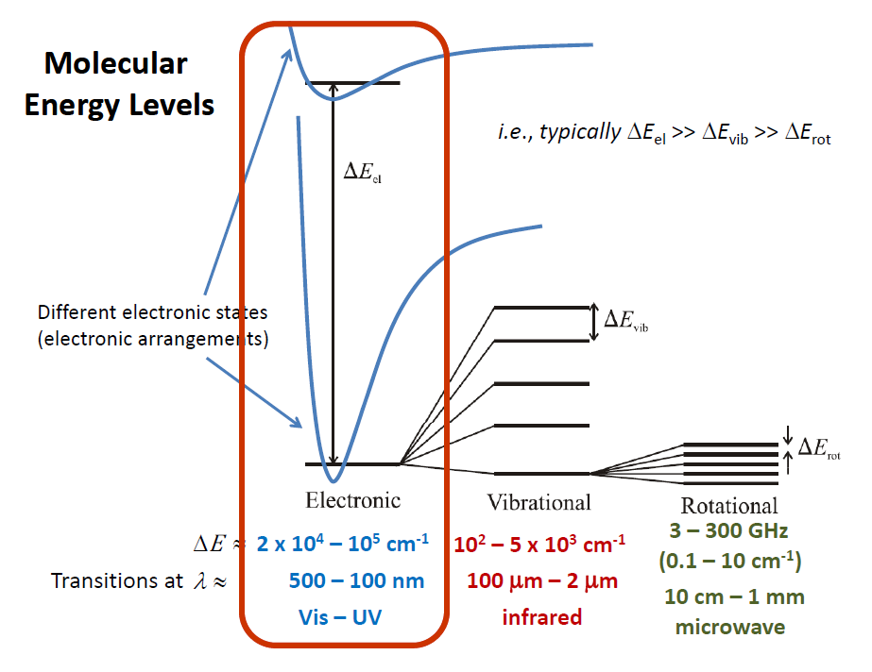

Slide 5
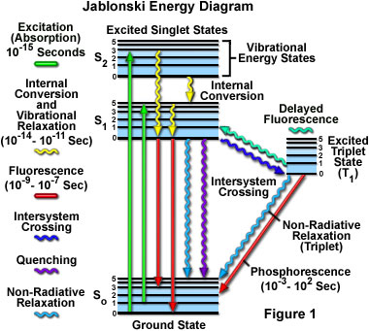

Slide 6
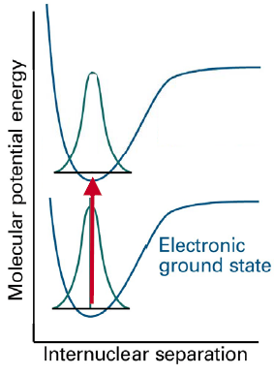
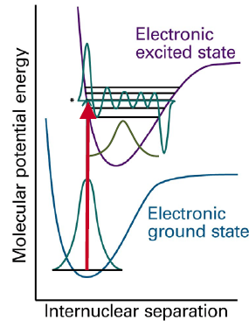

Slide 7
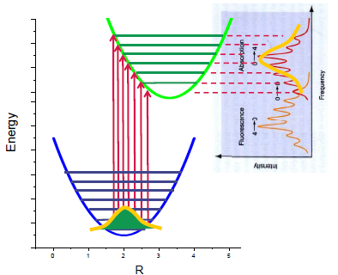

Slide 8
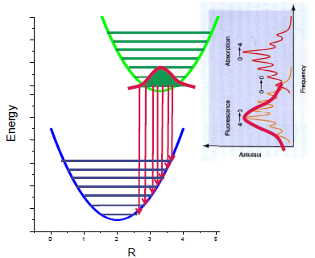

Slide 9
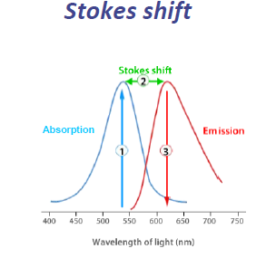

Slide 10
UV-Vis Terminology
Chromophore: a UV-Visible absorbing functional group
Bathochromic shift (red shift): to longer wavelengths
Auxochrome: a substituent on a chromophore that causes a red shift
Hypsochromic shift (blue shift): to shorter wavelengths
Hyperchromic shift: to greater absorbance
Hypochromic shift: to lesser absorbance

Slide 11
Classes of Electron transitions
(1) σ, π and n electrons (mostly organics)
(2) d and f electrons (inorganics/organometallics)
(3) charge-transfer (CT) electrons

Slide 12
σ → σ* and σ → π* transitions: high-energy, accessible in vacuum UV (λ_{max} <150 nm). Not usually observed in molecular UV-Vis.
n → σ* and π → σ* transitions: non-bonding electrons (lone pairs), wavelength (λ_{max}) in the 150-250 nm region.
n → π* and π → π* transitions: most common transitions observed in organic molecular UV-Vis, observed in compounds with lone pairs and multiple bonds with λ_{max} = 200-600 nm.
Charge transfer (CT)
MLCT (metal-to-ligand charge transfer)
LMCT (ligand-to-metal charge transfer)

Slide 13
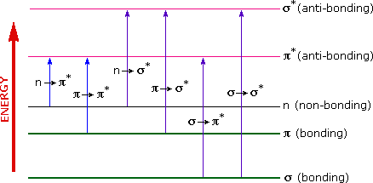

Slide 14
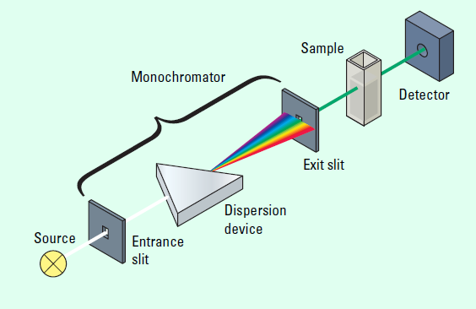

Slide 15
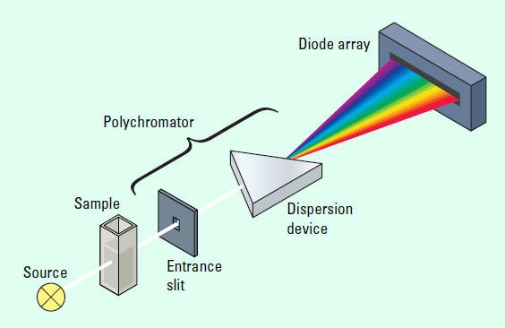

Slide 16
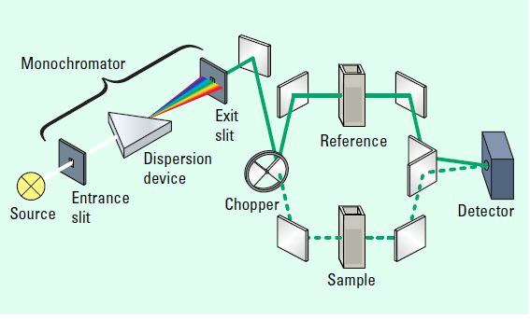

Slide 17
