Slide 1

Interaction radiation
Matter
Powerpoint Templates

Slide 2
Time Dependent
Perturbation Theory
Q: If a system is perturbed does the charge density responds instantaneously?
A: No. It takes time to adapt to the new situation
Example: Particle in a box perturbed by a constant field.

Slide 3
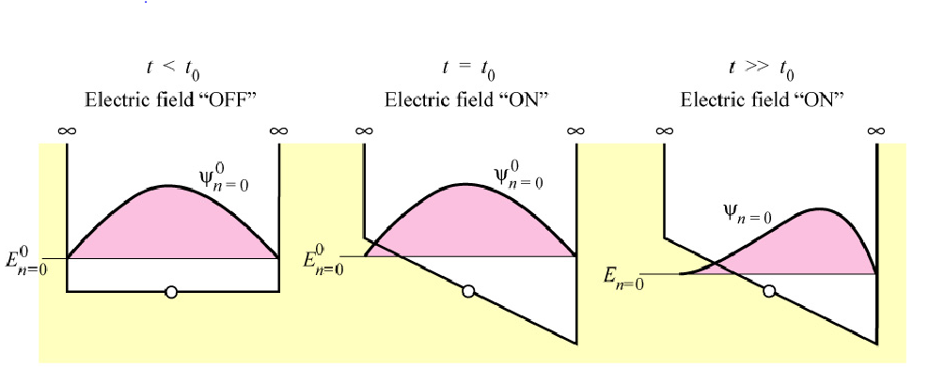

Slide 6
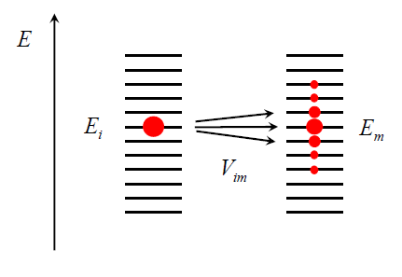
Week Perturbation

Slide 7
Constant Perturbation

Slide 8
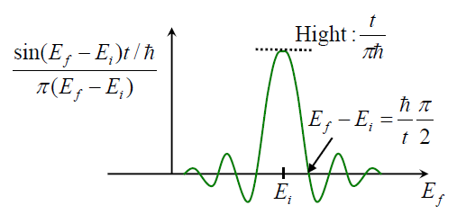
Transition Probability

Slide 9
Harmonic Perturbation
V_{mi}=2Wcos(ωt)

Slide 10
Transition Probability
Fermi Golden Rule

Slide 11
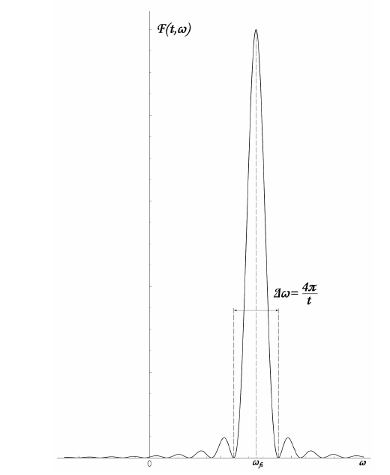

Slide 12
