Slide 1

Tutorial
3
Powerpoint Templates

Slide 2
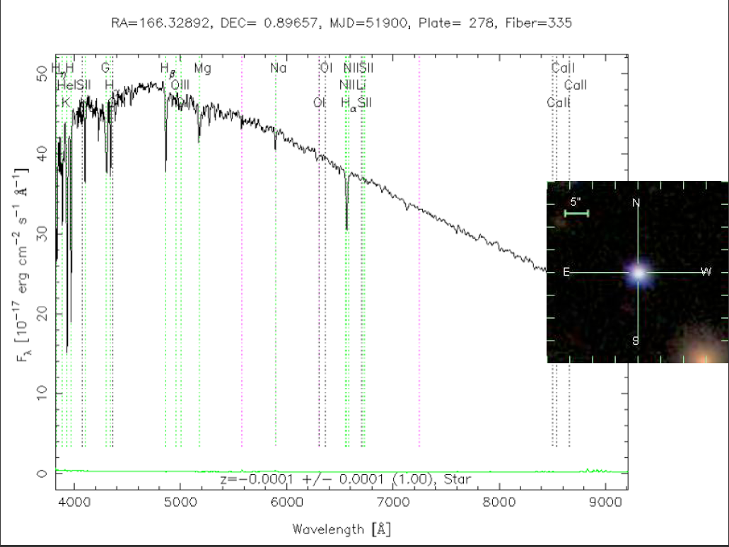
Star Spectra

Slide 3
